Slide 1
Bisaya post-class speech and self-reported affect
Can one spoken word, said right after class, tell us how a student feels?
CS412 mini-project · Group 3 · second-year Computer Science students · results of 2026-10-12
Notes:
Good day. We are Group 3. Our project asks one simple question: can a single spoken word, said right after class, tell us how a student feels?
We studied second-year Computer Science students. We will show what we collected, how we analysed it, what we found, and what we could not show.

Slide 2
What we asked
One word, two ratings, and a strict test
Right after class, each participant said one Bisaya word that matched their reaction
Suggested words: Salamat, Ambot, Grabe, Lisod, Sayon, Lingaw, Kapoy
Then they rated their feeling on two scales from 1 to 5
Valence: how pleasant the feeling is
Arousal: how much energy the feeling has
Our question: can the sound of the word tell us those ratings?
The test is strict: the computer is always tested on people it has never heard
1
word per participant
2
ratings from 1 to 5
108
voice measurements per recording
Group 3 · CS412 mini-project · every number comes from the analysis output files
2
Notes:
Right after class, each participant said one Bisaya word that matched their reaction, for example Kapoy, Salamat or Lingaw. Then they rated how they felt on two scales from 1 to 5.
Valence is how pleasant the feeling is. Arousal is how much energy it has: calm or tired at the low end, excited or tense at the high end.
Our question: can the sound of the word, not its meaning, tell us those ratings? From each recording the computer took 108 voice measurements.
And we made the test strict. The computer is always tested on people it has never heard, because a real system would meet new students.

Slide 3
The data we had
What went into the analysis
40
40
40
40
participants in the sheet
with a recording
analysed
required by the protocol
Audio: one short 16 kHz WAV file per participant, converted by the group from the phone recordings
31 files match an original recording. 9 could not be checked, and 3 are edited or clipped
We ran the models again without those files
Every participant has a spoken word in the sheet. No word was guessed from the feeling text
The group completed the sheet on 12 October: 9 blank words filled in and the ratings of 3 participants corrected. The earlier sheet and its results are kept
Noise: background voices in 16 of 40 recordings
Consent: the sheet says Yes for everyone, but the log of signed forms is not complete yet
Group 3 · CS412 mini-project · every number comes from the analysis output files
3
Notes:
The sheet lists 40 participants and we analysed all 40, which meets the protocol minimum of 40.
We want to be open about the audio. We recorded phone videos, and a group member converted them to short 16 kHz WAV files. Those files are what we analysed. We checked every file against the original recordings. 31 match an original. 9 could not be checked, and 3 of those show signs of editing, such as stretches of exact silence. We kept them, marked them, and ran the models again without them. You will see that result later.
Every participant has a spoken word in the sheet. No word was guessed from the feeling text.
The group completed the sheet on 12 October: 9 blank words were filled in by a group member who listened to each recording, and the ratings of 3 participants were corrected from the participants' answer forms, because the first sheet had typing mistakes. The results we show use the completed sheet. The earlier sheet and its results are kept, so the two can be compared.
The recordings were made in a hallway right after class, so they are noisy: we detected background voices in 16 of 40.
And consent: the sheet says Yes for everyone, but the log of the signed forms still has to be completed.

Slide 4
How we analysed it
One command runs eight steps. Each step writes its own report
1. Check
2. Clean
3. Find the word
4. Measure
every file and every sheet cell is checked; nothing is changed
fixes by fixed rules only; every fix is logged
the computer finds the spoken word in each clip, without seeing the ratings
108 numbers per voice: pitch, loudness, sound shape
5. Explore
6. Train
7. Test
8. Word check
charts, and simple links between voice and ratings
three models learn from some participants and are tested on the others, 10 times
is the score better than luck? 500 shuffles of the ratings, then a correction
does the model hear the feeling, or only the word?
Three rules keep the test fair: no participant is in both the training and the test data · the model's settings are learned from the training data only · the ratings are never used to cut or choose audio
Group 3 · CS412 mini-project · every number comes from the analysis output files
4
Notes:
Everything runs with one command, in eight steps.
Check: every file and every sheet cell is checked, and nothing is changed. Clean: fixes are made by fixed rules only, and each fix is logged. Find the word: the computer finds the spoken word inside each clip without ever seeing the ratings. Measure: 108 numbers for each voice.
Then we explore the data, train the models, test whether the scores are better than luck, and run the word check, which asks whether the model hears the feeling or only the word.
The three rules at the bottom keep the test fair. No participant is in both the training and the test data. The model's settings are learned from the training data only. And the ratings are never used to cut or choose audio.

Slide 5
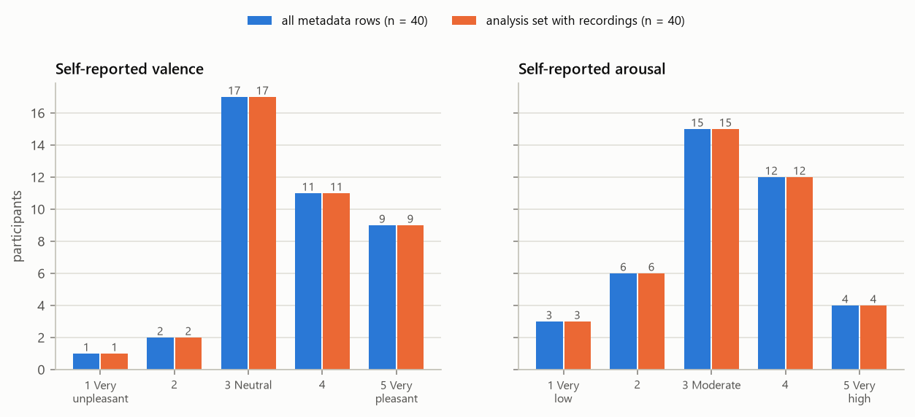
What the participants reported
Pleasant feelings came with higher energy (Spearman correlation 0.72, n = 40)
Most participants felt neutral to pleasant, with moderate to high energy
Some scores were chosen by very few people, so we grouped the scores before modelling:
Arousal: low (1–2), moderate (3), high (4–5)
Valence: not pleasant (1–3), pleasant (4–5)
Arousal: not high (1–3), high (4–5)
Rule: every group needs at least 5 people. Not modelled: valence with all five scores; arousal with all five scores; valence in three groups
Blue = everyone in the sheet · orange = the participants we analysed (here they are the same people)
Group 3 · CS412 mini-project · every number comes from the analysis output files
5
Notes:
Most participants reported neutral to pleasant feelings and moderate to high energy. The two ratings rise together: the correlation is 0.72.
Some scores were chosen by very few people, so we cannot model all five scores. We grouped them, and we fixed the groups before modelling: arousal into low, moderate and high; valence into pleasant and not pleasant; and arousal into high and not high.
We modelled a grouping only if every group has at least five people.

Slide 6
Voice measures and the ratings
Six voice features chosen in advance, out of 108 measured
Voice feature | Link with arousal (ρ) | p | Link with valence (ρ) | p
Pitch level | +0.08 | 0.621 | +0.16 | 0.333
Pitch range | +0.12 | 0.466 | +0.03 | 0.849
Loudness | +0.25 | 0.120 | +0.37 | 0.017
Word duration | +0.15 | 0.356 | +0.03 | 0.843
Brightness of the sound | +0.35 | 0.027 | +0.27 | 0.094
Share of voiced sound | +0.02 | 0.911 | +0.13 | 0.436
ρ is a correlation: 0 means no link, +1 or −1 means a perfect link
The strongest link among the six is +0.37
None of the six is significant after the correction for testing many features
All 108 features: 0 significant for arousal, 1 for valence
rms_db_iqr (ρ = −0.54)
Those were not chosen in advance, and their meaning is unclear
With 40 participants, only links of about 0.44 or stronger can be found reliably
Group 3 · CS412 mini-project · every number comes from the analysis output files
6
Notes:
Before any machine learning, we checked simple links. We chose six well-known voice features in advance: pitch level, pitch range, loudness, duration, brightness and the share of voiced sound.
None of them is significantly linked to the ratings. The strongest are brightness (spectral centroid) with arousal at +0.35 and loudness (RMS) with valence at +0.37. Those are weak.
Across all 108 features, 0 pass the correction for testing many features at once for arousal, and 1 for valence.
With 40 people, only links of about 0.44 or stronger can be found reliably. A moderate link of 0.3 would need about 90 participants.

Slide 7
How to read our results
Five ideas you need for the next slides
Idea | What it means | In our study
Chance | The score you get by pure guessing | 0.33 with 3 groups · 0.50 with 2 groups
Balanced accuracy | The average of the scores for each group, so always giving the most common answer does not help | From 0 to 1. Higher is better
95% interval | The range where the true score probably lies | Wide, because 40 participants are few
p-value | How often shuffled ratings, which mean nothing, score as high as the real ratings | Below 0.05 means it is unlikely to be luck
Correction (Holm) | With many tests, some look good by luck. The correction raises the p-values to account for that | 9 tests. A result counts only if p stays below 0.05
Group 3 · CS412 mini-project · every number comes from the analysis output files
7
Notes:
Before the results, five ideas.
Chance is the score you get by pure guessing: 0.33 with 3 groups, 0.50 with 2 groups.
Balanced accuracy is the average of the scores for each group. A model cannot look good by always giving the most common answer.
The 95% interval is the range where the true score probably lies. Ours are wide, because 40 people is few.
The p-value tells us how often shuffled ratings, which mean nothing, score as high as the real ones. A small p-value means the score is unlikely to be luck.
And the correction. We ran 9 tests, and with 9 tries a lucky result is expected. The Holm correction accounts for that.

Slide 8
No model beats chance after correction
The best of three models for each target, always tested on people the model never heard
Target | Best model | Balanced accuracy [95% interval] | Chance | p-value | p after correction
Arousal: low / moderate / high | Random forest | 0.41 [0.29, 0.54] | 0.33 | 0.134 | 0.802
Valence: not pleasant / pleasant | Random forest | 0.70 [0.58, 0.82] | 0.50 | 0.006 | 0.054
Arousal: not high / high | Random forest | 0.55 [0.43, 0.68] | 0.50 | 0.271 | 1.000
No model stays below 0.05 after the correction for 9 tests
1 of 9 p-values is below 0.05 before the correction. With 9 tests, about 0.45 lucky results are expected, so that is not evidence
The intervals are wide: 6 of the 9 model intervals include the chance level
Group 3 · CS412 mini-project · every number comes from the analysis output files
8
Notes:
Now the main test. For each target we show the best of three models.
The random forest was best for every target: 0.41 for three-level arousal (low, moderate, high), where chance is 0.33; 0.70 for valence (pleasant vs not pleasant), where chance is 0.50; 0.55 for two-level arousal (high vs not high), where chance is 0.50.
Is that better than luck? We shuffled the ratings 500 times and ran the whole procedure again each time. 1 of 9 tests has a p-value below 0.05: the smallest is 0.006, for the random forest on valence (pleasant vs not pleasant).
But we ran 9 tests. With 9 tries, about 0.45 lucky results are expected. After the Holm correction that p-value becomes 0.054, which is not significant. So no model stays significant after the correction.
That is close to 0.05, and we say so. But the limit was fixed before we looked at the results, and this score rests on files we could not check: without them it is 0.63.

Slide 9
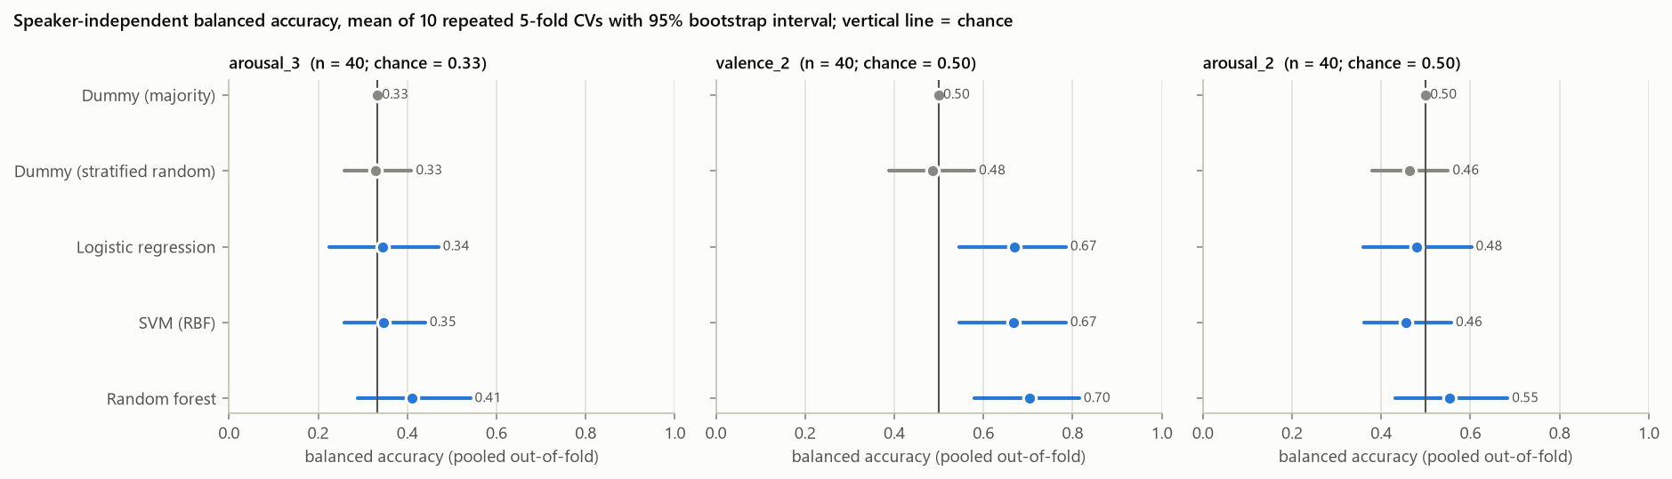
The same result as a picture
Dot = score · bar = 95% interval · line = chance · grey = baselines that ignore the audio · blue = our models
Names in the figure: arousal_3 = arousal in three groups · valence_2 = valence in two groups · arousal_2 = arousal in two groups
“Dummy” rows are the baselines: they answer without listening to the audio
6 of the 9 blue bars cross the chance line
Group 3 · CS412 mini-project · every number comes from the analysis output files
9
Notes:
This figure shows the same result as a picture, with one panel for each target. Each dot is a model's balanced accuracy. The horizontal bar is its 95% interval. The vertical line is chance.
The grey rows are baselines that never listen to the audio. The blue rows are our models.
The bars are wide. 6 of the 9 blue bars cross the chance line. 3 bars clear it, but none of those results passes the correction. This is what an inconclusive result looks like.

Slide 10
Is it the voice, or just the word?
The chosen word is linked to the feeling. This is called a lexical confound
By sound alone the computer tells “Kapoy” from the other words only weakly: balanced accuracy 0.69 (chance 0.50, p = 0.072, not significant)
Not pleasant: 13 of 15 Kapoy speakers, against 7 of 25 speakers of other words (Fisher test, p = 0.001)
The word and the feeling go together, so a model that picks up the word even partly could score above chance. With this data we cannot separate the two
Among Kapoy speakers alone, 0 of 12 links between voice and rating are significant after correction
Number of participants, by word and feeling
Word | Not pleasant (1–3) | Pleasant (4–5)
Kapoy | 13 | 2
other words | 7 | 18
Group 3 · CS412 mini-project · every number comes from the analysis output files
10
Notes:
This is our most important finding. Is the model hearing the feeling, or only recognising the word?
First test: can the computer tell Kapoy from the other words by sound alone? Only weakly. Balanced accuracy 0.69, with p = 0.072, which is not significant.
Second test: is the word linked to the feeling? Yes. Of 15 Kapoy speakers, 13 felt not pleasant. Of 25 speakers of other words, 7 did.
So the word and the feeling go together. A model that picks up the word even partly could score above chance without hearing the feeling, and with this data we cannot separate the two.
When we look at Kapoy speakers alone, the same word with different feelings, 0 of 12 links between voice and rating are significant.

Slide 11
Limits of this study
Why we call the results preliminary
Small sample: 40 participants
Only strong links (about 0.44 or more) can be found reliably. A moderate link of 0.3 needs about 90 participants
Audio: converted copies, not the original recordings. 9 could not be checked and 3 are edited or clipped
Noise: background voices in 16 of 40 recordings, made in a hallway right after class
Recording setting: 5 files come from recordings made with a different audio setting. 18 of 108 features differ before the correction and none after it (closest p = 0.053)
One word per person: we cannot separate a person's normal voice from their feeling
One context: one year level, one class activity and one session, so contexts cannot be compared
We measured links, not causes
Group 3 · CS412 mini-project · every number comes from the analysis output files
11
Notes:
We want to be clear about the limits. The sample is small. With 40 people only strong links can be found.
The audio is converted copies, not the original recordings: 9 could not be checked and 3 show signs of editing.
The recordings are noisy: we detected background voices in 16 of 40, in a hallway right after class. And 5 files come from recordings made with a different audio setting. Some features look different for those files, but with so few files the difference does not pass the correction. We also ran the models without them.
Each person said only one word, so we cannot separate a person's normal voice from their feeling at that moment.
Everyone came from the same year level, class activity and session, so we cannot compare contexts. And we measured links, not causes.

Slide 12
Conclusion
Our data do not show that post-class feelings can be recognised from the voice.
The pipeline is complete, tested and repeatable: new data can be analysed with one command
The chosen word is linked to the feeling, so a future study must control the word
The sample is too small: a real study needs about 90 participants
The closest result is valence in two groups: 0.70 against 0.50, p = 0.054 after correction. Without the 9 files we could not check, it is 0.63
Group 3 · CS412 mini-project · every number comes from the analysis output files
12
Notes:
Our conclusion: our data do not show that post-class feelings can be recognised from the voice.
That is a real result, not a failure. A careful analysis that finds no reliable signal is more useful than an impressive number that would not hold up.
We contribute three things. A complete, tested pipeline that repeats the whole analysis with one command. The finding that the chosen word is linked to the feeling and must be controlled. And a clear statement of how much data a real study needs: about 90 participants.

Slide 13
Next steps
Complete the consent log from the signed forms
Two group members listen to every clip, without seeing the ratings, to check the words and where they start and end
Find the original recordings for the 9 files we could not check
Record more participants: one device, one setting, a quiet place, one take
Follow the analysis plan we wrote before seeing new data
Confirm the open protocol questions with our instructor
Group 3 · CS412 mini-project · every number comes from the analysis output files
13
Notes:
Our next steps are concrete. Complete the consent log from the signed forms. Have two group members listen to every clip without seeing the ratings. Find the original recordings for the files we could not check. Record more participants with one device, one setting and one take. Follow the analysis plan we wrote before seeing new data. And confirm the open protocol questions with our instructor.
Thank you. We are happy to take your questions.

