Slide 1

Hospital Management System

Slide 2
Submitted By Mayur Tambe Sumit Tekam Shrikant Gobre Shyam Sundar Tiwari
Under the Guidance of Mrs. Savita A. Kumbhare Department of Computer Engineering, Pimpri Chinchwad College of Engineering, Pimpri, Pune-411044

Slide 3
About the Project
This project “Hospital Management System” is complete, and is made of totally error free, organized and clean code.
A user can add, view, search and delete patient records, present within the system.
Each user of the application has a username and password, and it has functions related to user management as well.
“Aditya Birla Memorial Hospital” has been used as hospital name.
Primarily, the program uses concept of structures in C and File Handling.

Slide 4
Problem Statement
Hospital is associated with the lives of common people
and their day-to-day routines.
The manual handling of the record is time consuming
and highly prone to error.
To make the complicated process Hospital Management System as simple as possible using Structured & Modular technique & Menu oriented interface.

Slide 5
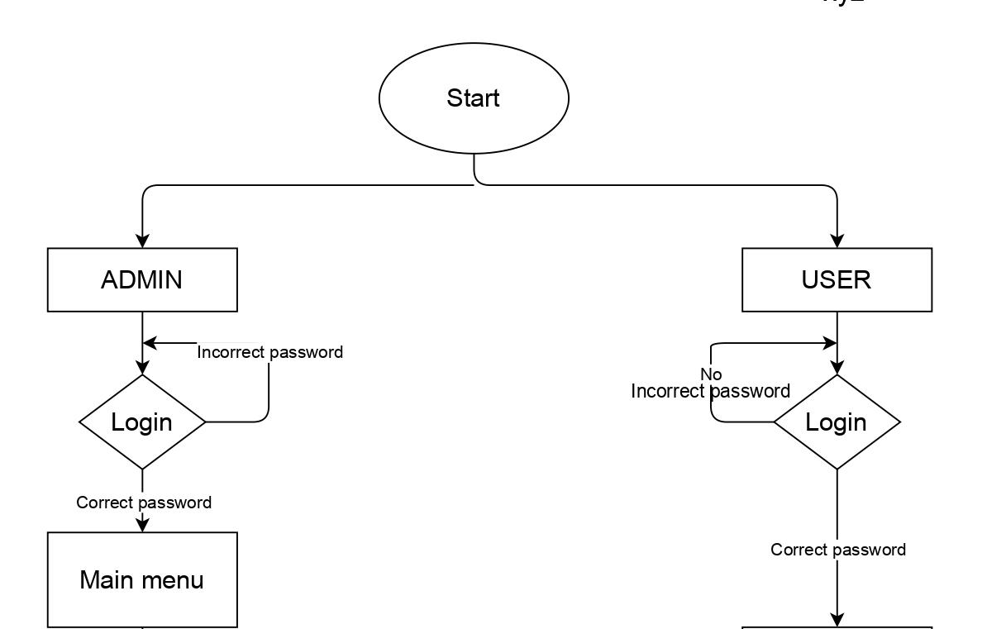
Flowchart

Slide 6
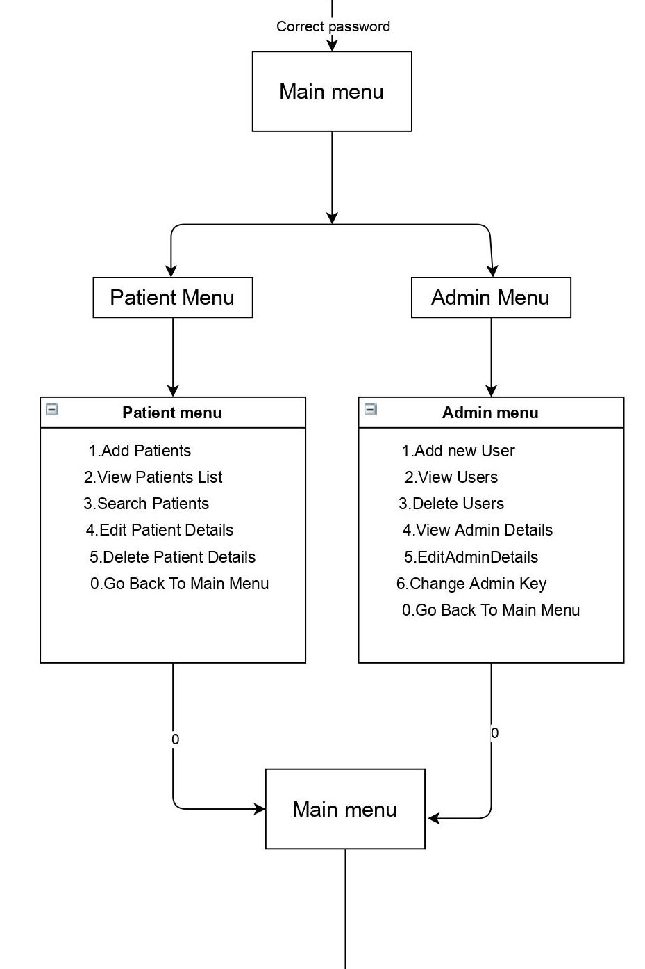
Admin Menu

Slide 7
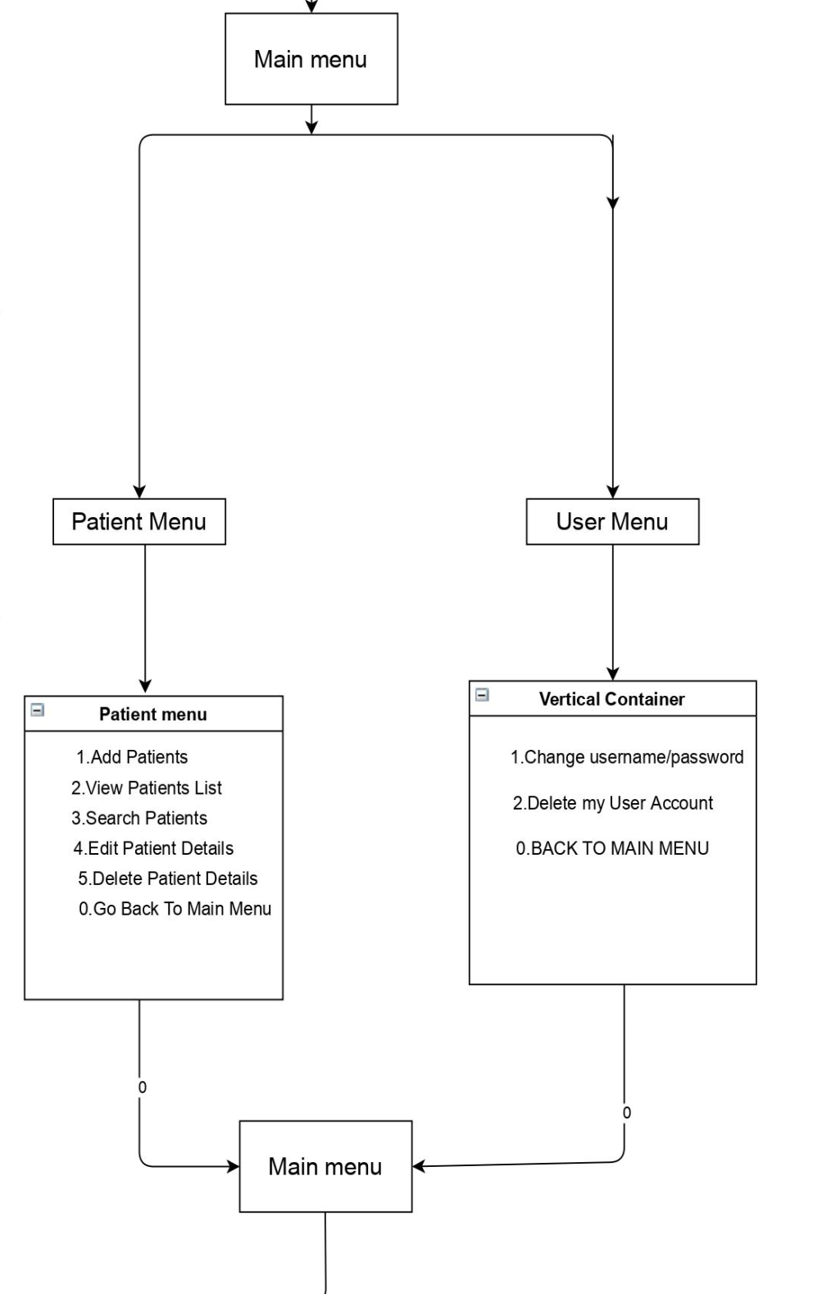
User Menu

Slide 8
PROPOSAL SOLUTION
The system is very simple in design and to implement. The system requires very low system resources and the system will work in almost all configurations.
Security of data.
Ensure data accuracy.
Administrator controls the entire system.
Reduce the damages of the machines.
Minimize manual data entry.
Greater efficiency.
User friendly and interactive.
Minimum time required.

Slide 9
Functions
void add()
void view()
void search()
void edit()
void del()
void editSelf();
void removeSelf();
void addUser();
void viewUsers();
void delUsers();
void addAdmin();
void editAdmin();
void changeKey();
void viewAdmin();
void removeUser();

Slide 10
Functions
void encrypt(char*)
void decrypt(char*)
int encryptInt(int)
int decryptInt(int)
void import()
void backup()
void wait(int)
void screenReset()

Slide 11
Structure
struct Patient
{
char name[30];
char disease[30],address[30],phone[15];
int cabin,age;
} x[100];
struct User
{
char password[30];
char userName[30];
} y[5];
struct Admin
{
char hospName[30];
char hospAdrs[30];
char hospContact[15];
char adminKey[6];
} admin0[1];

Slide 12
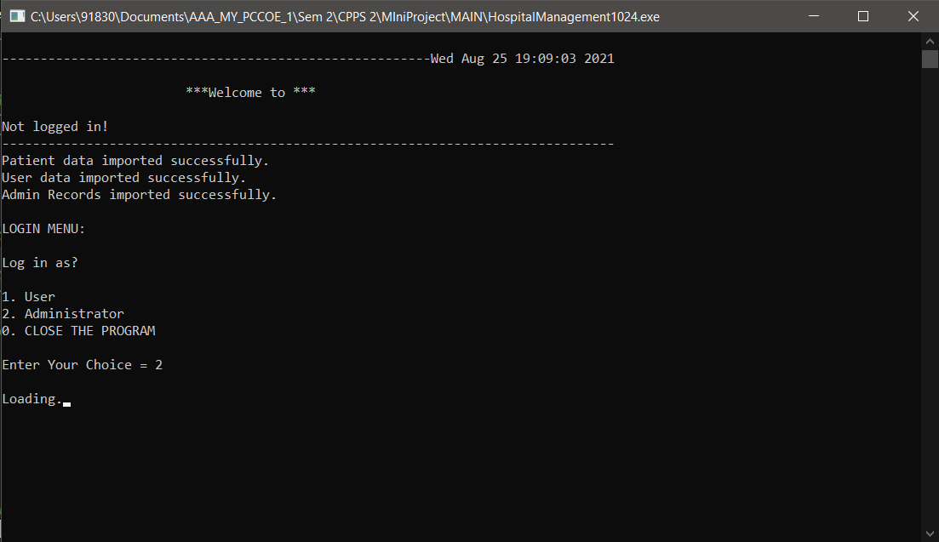
Output
Login Page

Slide 13
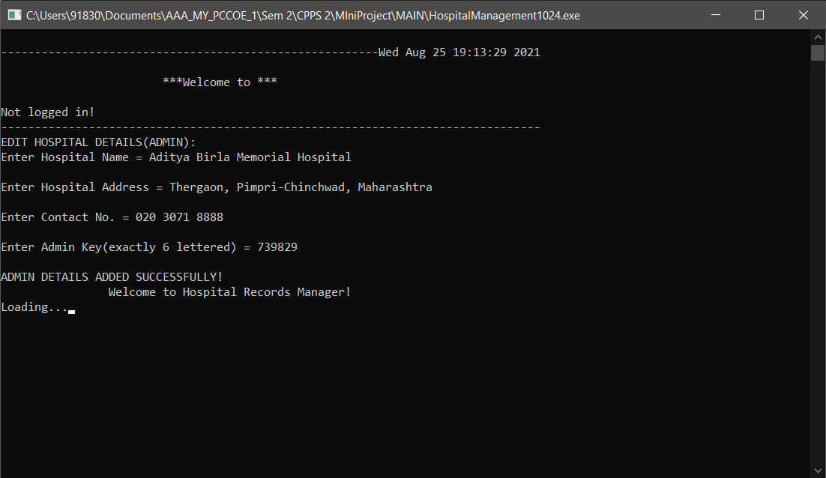
Hospital details

Slide 14
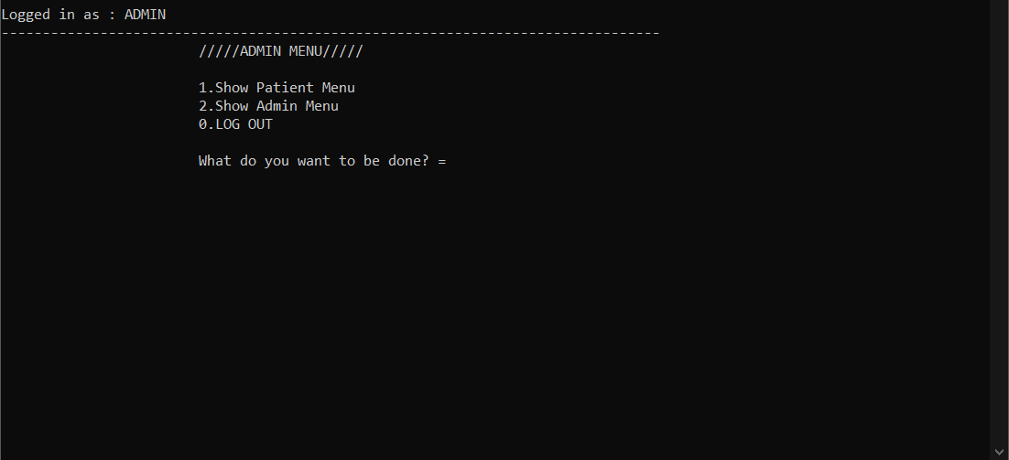
Admin Menu

Slide 15
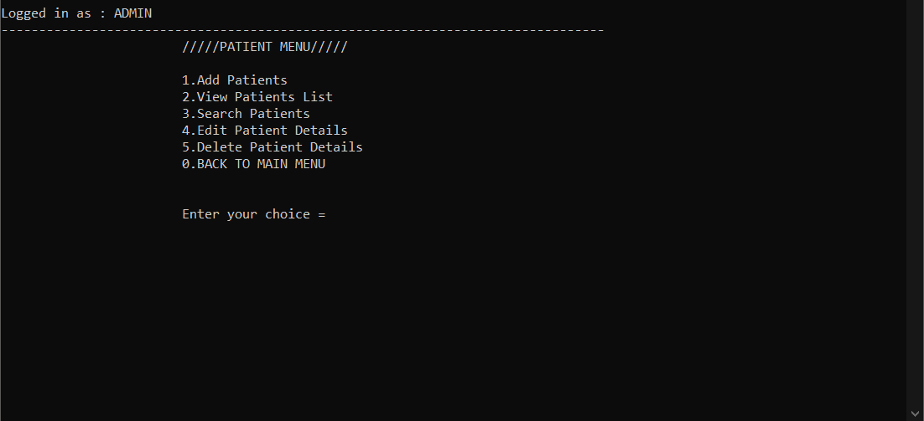
Patient menu

Slide 16
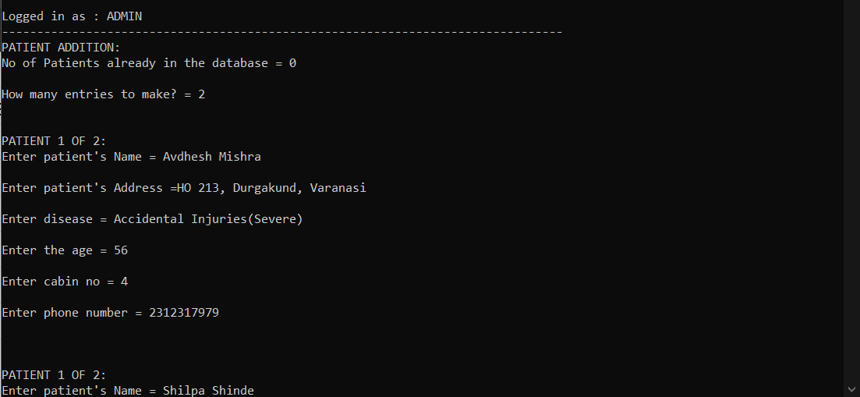
Adding Patient Details

Slide 17
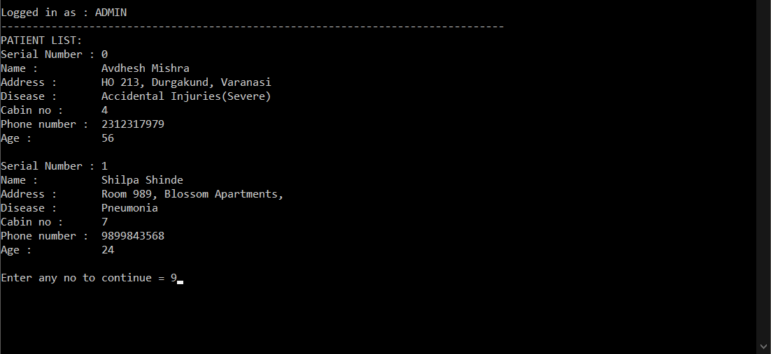
Patient List

Slide 18
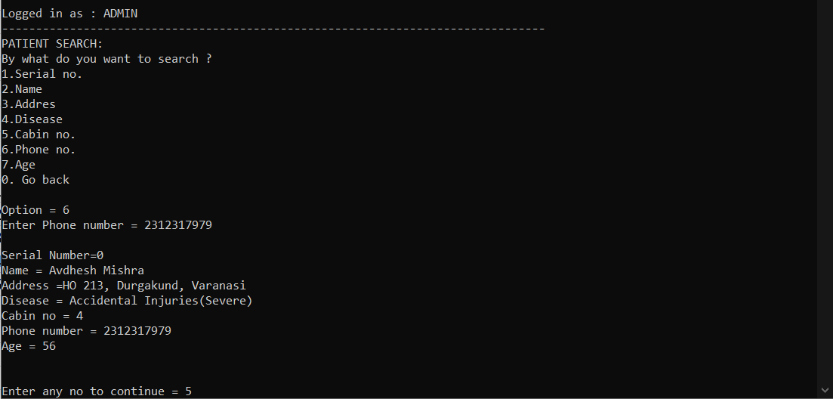
Search Patient Details

Slide 19
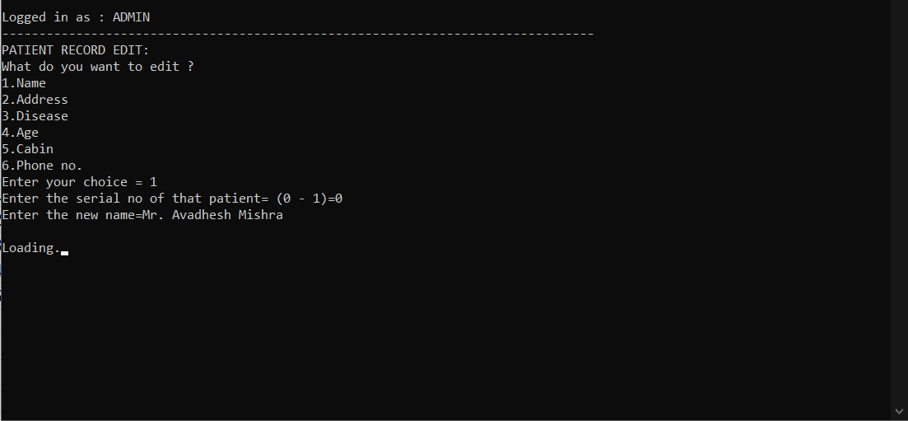
Patient Record Edit

Slide 20
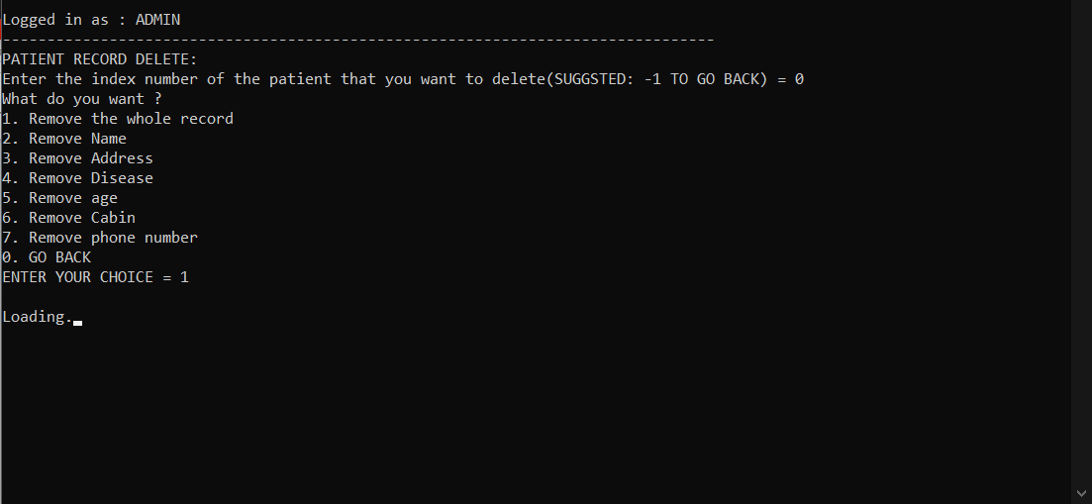
Patient Record Delete

Slide 21
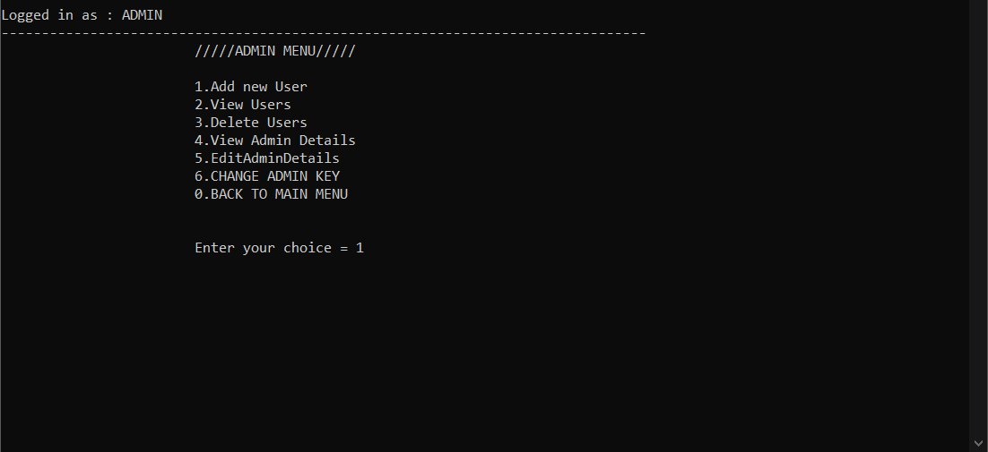
Admin Menu

Slide 22
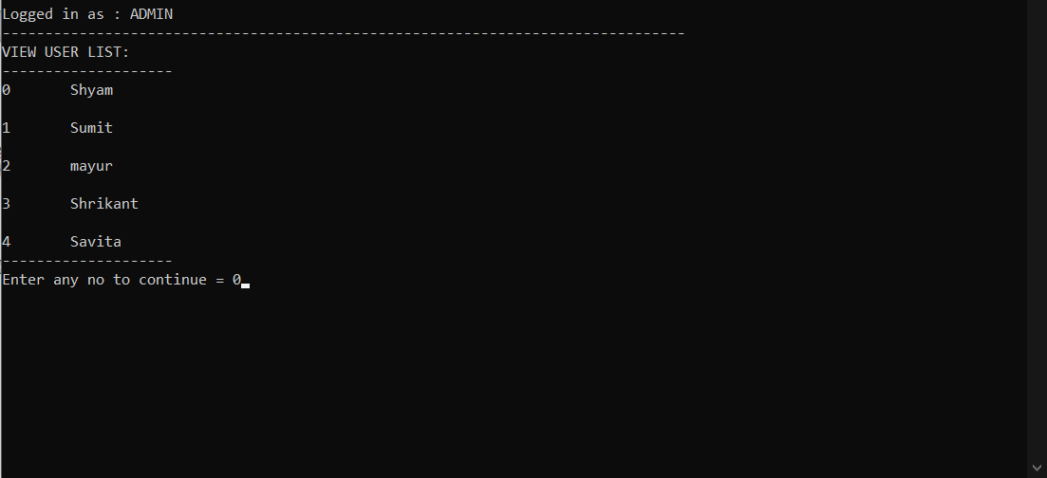
Users List

Slide 23
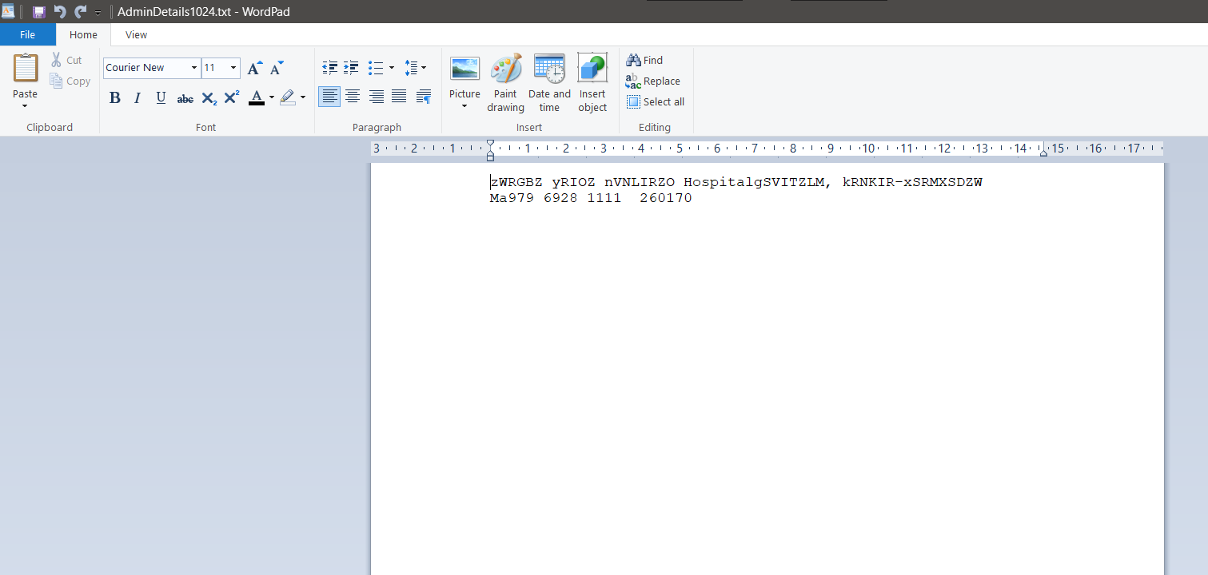
Encrypt Admin detail

Slide 24
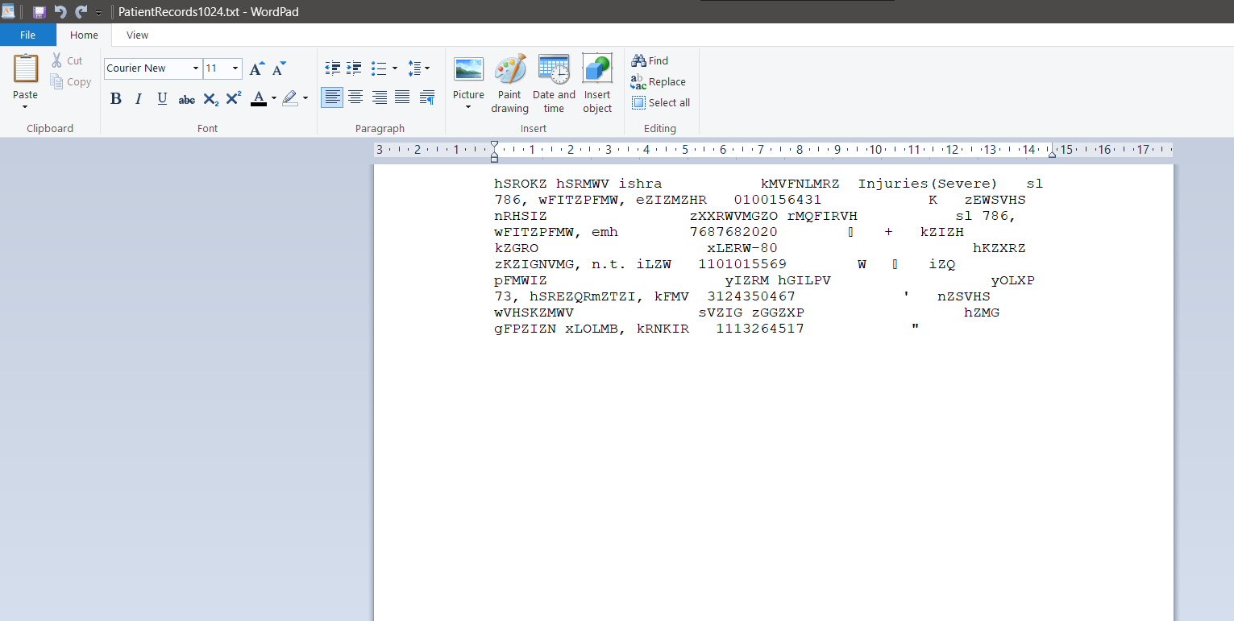
Encrypt Patient record

Slide 25
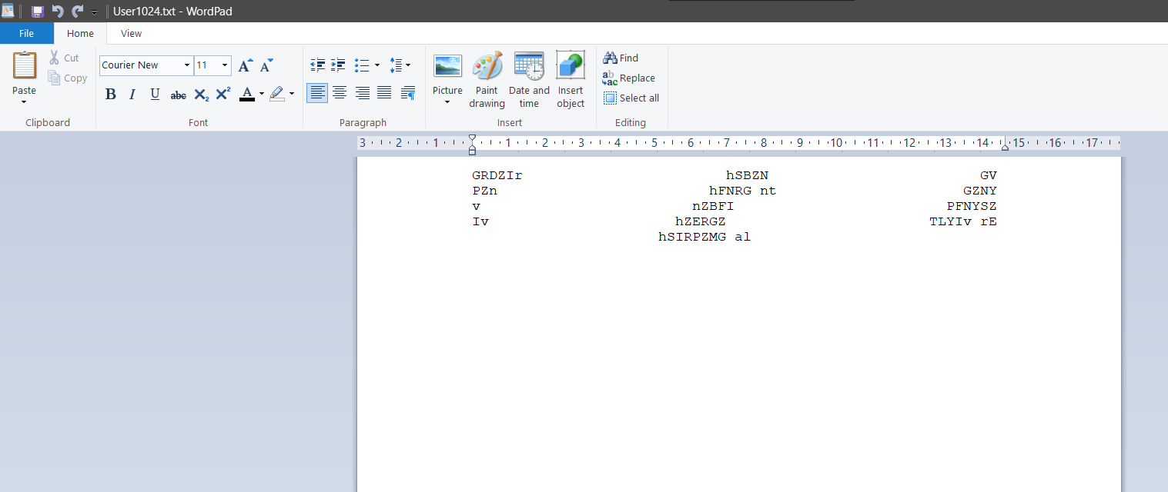
Encrypt User Detail

Slide 26
Thank You

