Slide 1
Comparing Diversity, Novelty, and Quality
of AI vs Human Research Proposals
Embedding-Based Comparison Using BioLinkBERT
February 2026

Slide 2
Study Design
Research Question
Approach
How do AI-generated research proposals compare to human-written proposals in diversity, novelty, quality, and thematic content when responding to the same funding call?
All models received the same funding call and evaluation criteria. All analyses use BioLinkBERT embeddings with non-parametric statistical tests.
We compare 23 human proposals and 69 AI proposals (from three frontier models) for the NSF NCEMS call, using embedding-based analyses across three dimensions: internal diversity, novelty relative to published literature, and thematic/cluster composition.
Analysis spans four parts:
(1) Diversity via pairwise, centroid, and nearest-neighbor metrics;
(2) Novelty via distance to a PubMed literature corpus;
(3) Thematic separation via topic modeling and cluster analysis.
(4) Stylistic comparison and regularization
Data
23
AI Models Tested
Human proposals (written by top scientists in MCB domain)
Claude Opus 4.5
69
Gemini 3 Pro Preview
GPT-5.2
AI proposals (23 per model)

Slide 3
Methodology
Embedding Pipeline
BioLinkBERT-large
340M-param biomedical model pretrained on PubMed with citation links. Encodes each proposal as a 1024-dim vector (400-word overlapping chunks, averaged).
Cosine distance in 1024-dim space for all metrics. Proposal-level inference: Mann-Whitney U, Cliff’s delta, permutation tests (10K), bootstrap 95% CIs, and Holm correction for model-wise comparisons.
Key Metric Definitions
Diversity
Novelty
Thematic & Stylistic Separation
Quality
How different are proposals from each other within the same group and between groups?
Measured by cosine distances between proposal embeddings. Three complementary lenses:
pairwise distances (all pairs)
centroid dispersion (distance to group center)
nearest-neighbor analysis (closest proposal in the combined space of all groups).
How far are proposals from what already exists in the scientific literature?
Measured as mean cosine distance from each proposal to its 10 nearest neighbors in a corpus of 350 PubMed articles. Higher = more novel.
Crucially different from diversity: a group can be internally diverse but still close to published work, or internally homogeneous but exploring genuinely new territory.
Do human and AI proposals occupy the same conceptual regions (based on topics and styles)?
LDA topic modeling identifies latent themes;
Gaussian Mixture Model clustering groups proposals by embedding similarity. Tests whether sources are segregated or intermingled.
Stylistic feature separation between groups
Do human and AI proposals exhibit same level of quality?
Human domain experts reviewed all human proposals and provided qualitative reviews;
AI reviewed all proposals with same criteria and requirements;
Compared similarity between AI and human reviews to check whether AI reviews are valid proxy

Slide 4
Methodology
Analysis Overview
Why these separate analyses?
Diversity asks: “Are the ideas varied?” Novelty asks: “Are they new relative to the field?” Thematic analysis asks: “Are they about the same things?” Quality asks: “Are they ‘good’ based on defined metrics?” A model can score high on one and low on another — these dimensions are complementary, not redundant.
Diversity (Slides 4-7)
Novelty (Slides 9-11)
Thematic & Style-Controlled (Slides 12-17)
Quality (Slide 19-31)
• Pairwise diversity (descriptive): all n(n−1)/2 within-group pairs
• Centroid dispersion — distance from each proposal to group mean
• Nearest-neighbor — closest proposal in combined 92-proposal space
• Embedding visualization — UMAP 2D projection
• Literature corpus: 350 PubMed articles from 7 search queries
• Novelty score: mean distance to k=10 nearest neighbors in literature
• Compares title+abstract embeddings (fair comparison with abstracts)
• Inference framework: proposal-level tests + permutation + bootstrap CI + Holm correction
• LDA topic modeling (k=5, strong priors, stability-validated)
• Topic distribution: Fisher’s exact tests with FDR correction
• GMM clustering (k=3, selected by BIC)
• Segregation metrics: NMI, ARI, between/within distance ratio
• Compare similarity between AI reviews against human experts reviews (on year 1)
• Compare scores of each proposal group by each AI evaluator (gemini, claude, gpt)
• Check if there are self-preference bias in AI evaluators
• Re-score proposals by removing those self-preference bias and compare the scores again

Slide 5
Research Questions, Main Findings, and Next Steps
One-sentence answers to each RQ from the integrated evidence
RQ1 (Diversity): Do AI and human proposals differ in internal diversity?
RQ2 (Novelty): Are AI proposals more novel than humans relative to literature?
Yes. Diversity is model-specific: Claude is most diverse, GPT-5.2 is most homogeneous, and Gemini is intermediate
No. Humans are more novel than pooled AI, and model-level tests show Claude and Gemini remain significantly less novel than humans.
RQ3 (Thematic/Stylistic): Are AI and human proposals similar in topic and style?
RQ4 (Quality): Are AI and human proposals similar in quality?
No. Topic, nearest-neighbor, and cluster analyses all show source (human vs each different AI model)-linked separation, and style adjustment reduces but does not eliminate it.
AI reviews generally align with human expert feedback, but AI judges are less diverse in perspective than human panels. Quality is evaluator-sensitive: GPT remains robustly higher than human proposals under controls, Gemini attenuates after self-removal, and Claude is not superior under stricter evaluator settings.
Main takeaway: AI can optimize proposal scores without matching human novelty; model choice creates clear tradeoffs across diversity, novelty, and scored quality.
Next Steps: Add blinded human scoring of AI proposals, fix reviewer-calibration reliability (ICC/rank agreement)

Slide 6
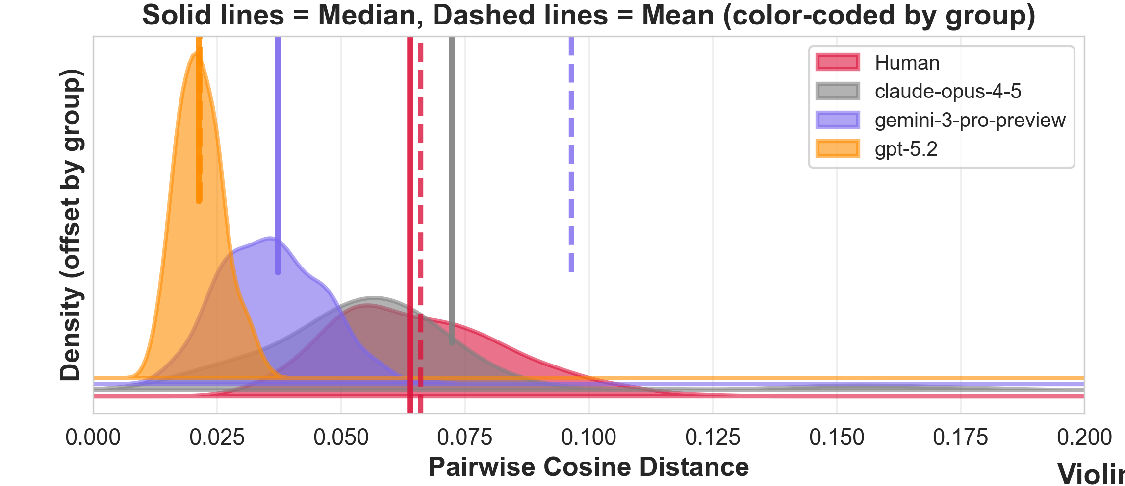
Analysis 1: Within-Group Pairwise Diversity
Results
Key Findings
Human baseline: mean 0.066; median 0.064; Std 0.018;
Claude Opus 4.5 is the strongest AI source of diversity
Mean diff vs Human: +0.274 (95% CI [0.209, 0.344]); Cliff’s δ = +1.00, p < 1e-8.
GPT-5.2 shows extreme homogeneity
Mean diff vs Human: -0.0445 (95% CI [-0.0486, -0.0408]); Cliff’s δ = -1.00, p < 1e-8.
Gemini 3 Pro is not significantly different from Human at proposal level
Mean diff: +0.0304 (95% CI [-0.0014, 0.0907]); Cliff’s δ = +0.30; MW p = 0.083.
All AI combined shows higher proposal-level diversity than Human
Cliff’s δ = +1.00; mean diff +0.107 (95% CI [0.068, 0.150]); Holm-adjusted permutation p = 0.015.
Proposal-level pairwise diversity vs Human baseline (one value per proposal).Positive = AI more diverse.

Slide 7
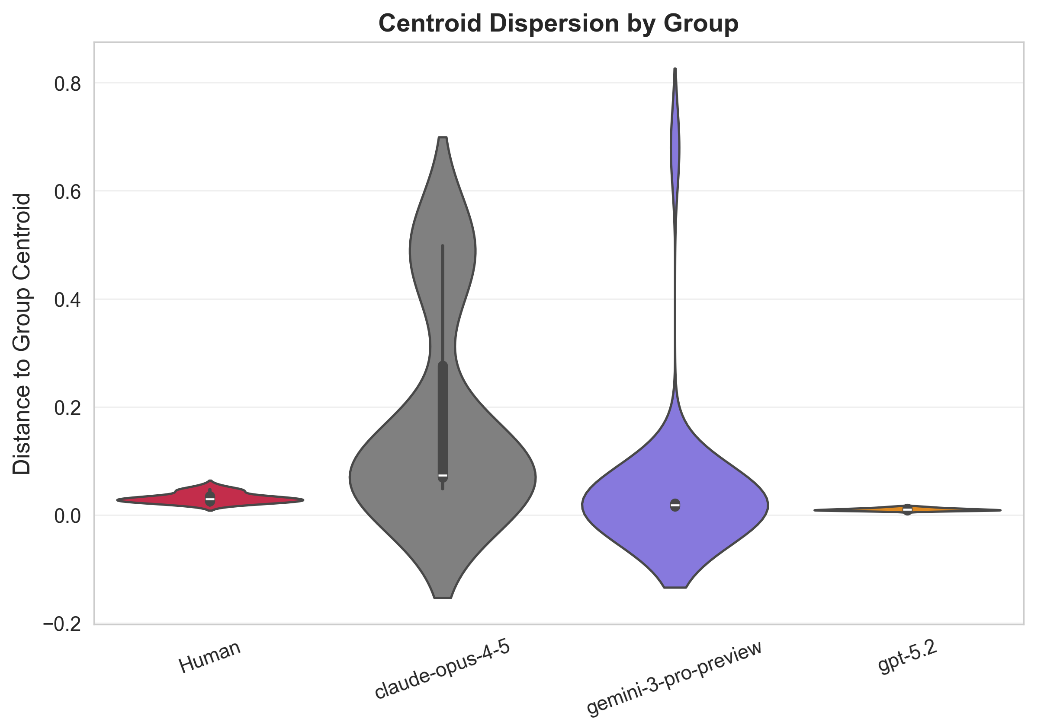
Analysis 2: Centroid Dispersion
Results
Key Findings
Human baseline: Mean 0.032; Median 0.029; Std 0.009;
Claude shows massive dispersion from its centroid
Mean dist: 0.179 vs Human 0.032. Cliff's Delta = +0.99 (near-maximum large effect, p < 0.001). Proposals spread widely around center.
GPT-5.2 is tightly clustered around its centroid
Mean dist: 0.010. Cliff's Delta = -1.00 (p < 0.001). Variance: 0.000005 vs Human 0.00008. Near-zero spread: all proposals essentially the same point in embedding space.
Gemini is less dispersed than humans
Mean dist: 0.047; Median 0.0178; SD 0.1348; Cliff's Delta = -0.82 (large effect, p < 0.001). Moderate clustering, though has some high-distance outlier proposals that skewed mean and sd.
All AI combined vs Human: not significant
Cliff's Delta = -0.17, p = 0.22. Claude's high dispersion offsets GPT-5.2's low dispersion, producing a misleading null result when aggregated.
Mean distance from each proposal to its group centroid. Larger = more spread out from center.
Consistency: Centroid pattern remains heterogeneous: Claude >> Human ≈ Gemini > GPT-5.2.

Slide 8
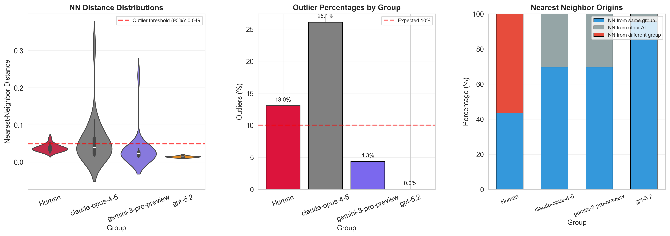
Analysis 3: Nearest-Neighbor Outlier Detection
Outliers = top 10% largest NN distances across all 92 proposals.
Outlier Rates (top 10% NN distance)
Key Findings
13.0%
26.1%
Claude: high dispersion and high outlier rate are consistent
Human
Claude
26.1% outliers aligns with Slide 6: Claude has the largest centroid dispersion, so many proposals fall far from nearest neighbors in global space.
4.3%
0 %
GPT-5.2: near-zero NN distances and zero outliers
Gemini
GPT-5.2
0% outliers and the smallest NN distances (mean 0.0139). GPT-5.2 proposals are near-identical, so each point has an extremely close same-model neighbor.
Human proposals produce genuine outliers
13% outliers. 43.5% have NN from own group; 56.5% NN from AI. Humans occupy shared territory but also produce truly unique ideas.
100% of AI proposals' nearest neighbors are other AI
No AI proposal is closest to a human proposal. 95.7% of GPT-5.2 nearest neighbors are within GPT-5.2. This indicates strong source-specific framing differences.

Slide 9
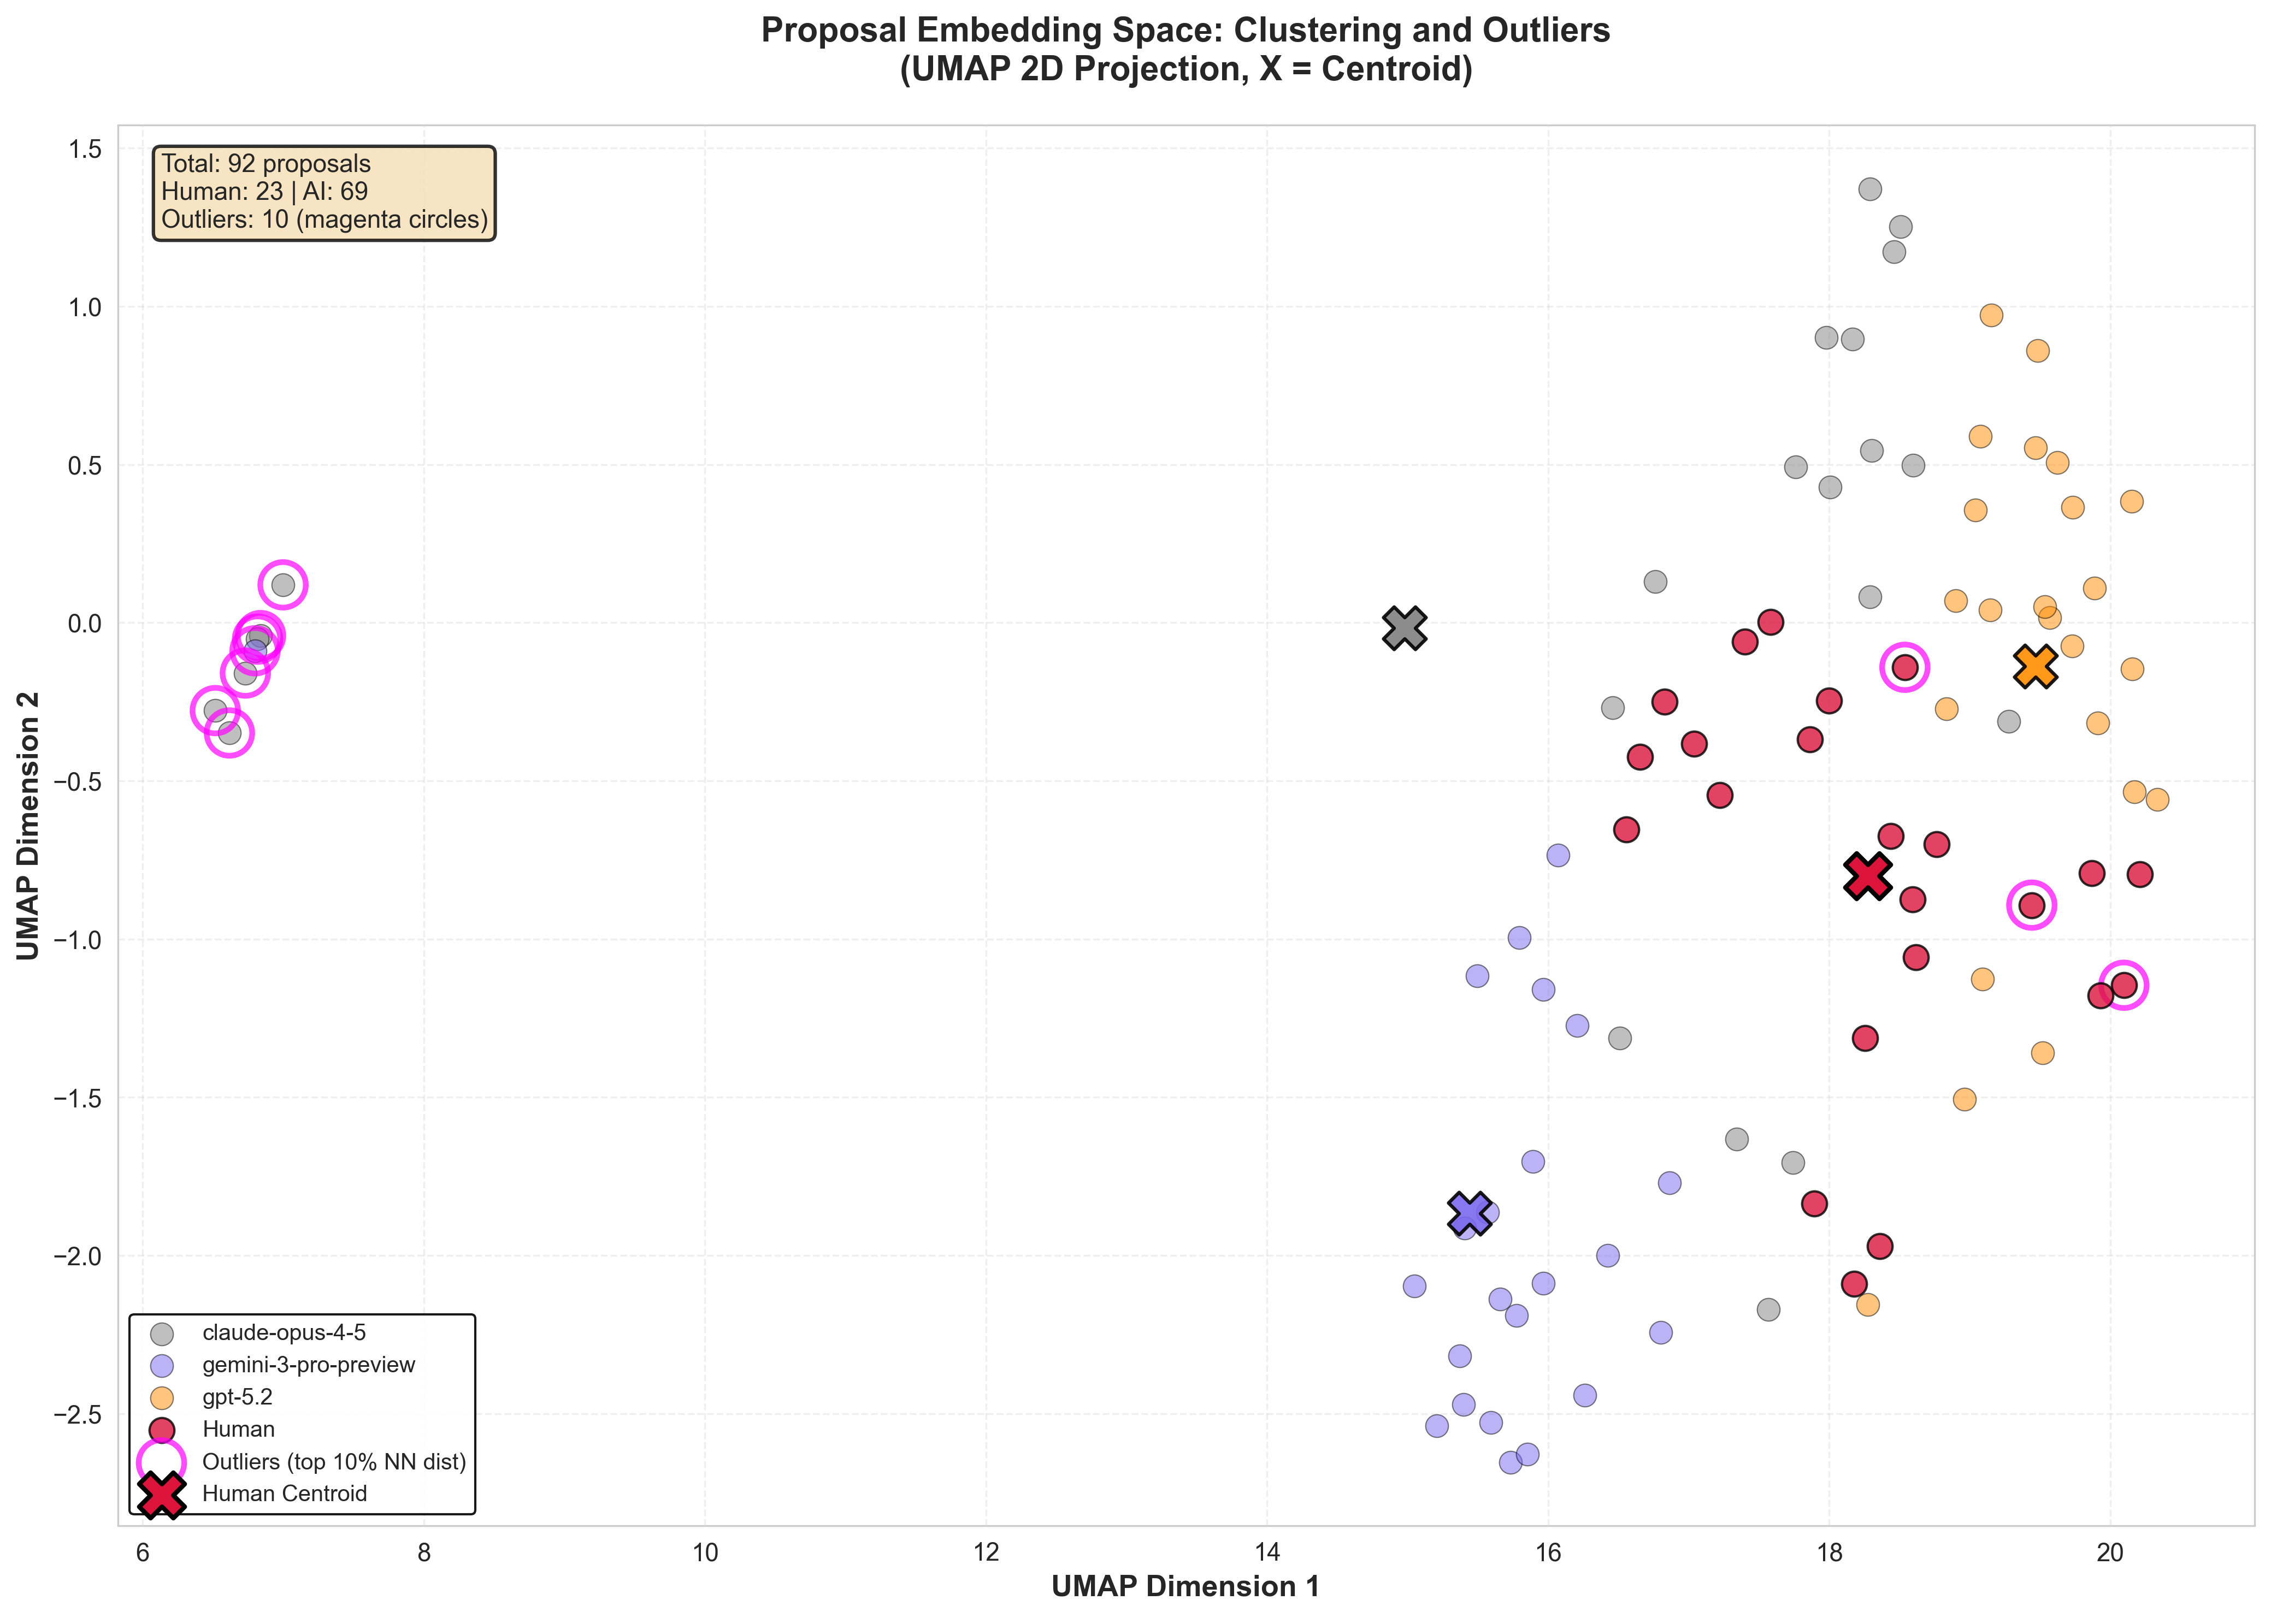
Embedding Space Visualization
UMAP 2D Projection
92 proposals projected from 1024-dim to 2D. X markers = group centroids. Magenta circles = outliers.
GPT-5.2 forms a tight, compact micro-cluster, consistent with very low within-model diversity.
Claude proposals occupy multiple regions, including the far-left periphery, and account for many highlighted outliers.
Gemini shows moderate clustering with some spread.
Human proposals are distributed throughout the center-right, overlapping with Claude and Gemini.
Outliers (magenta) are primarily Claude and Human proposals at the space periphery; GPT-5.2 remains compact with few/no outliers in this view.

Slide 10
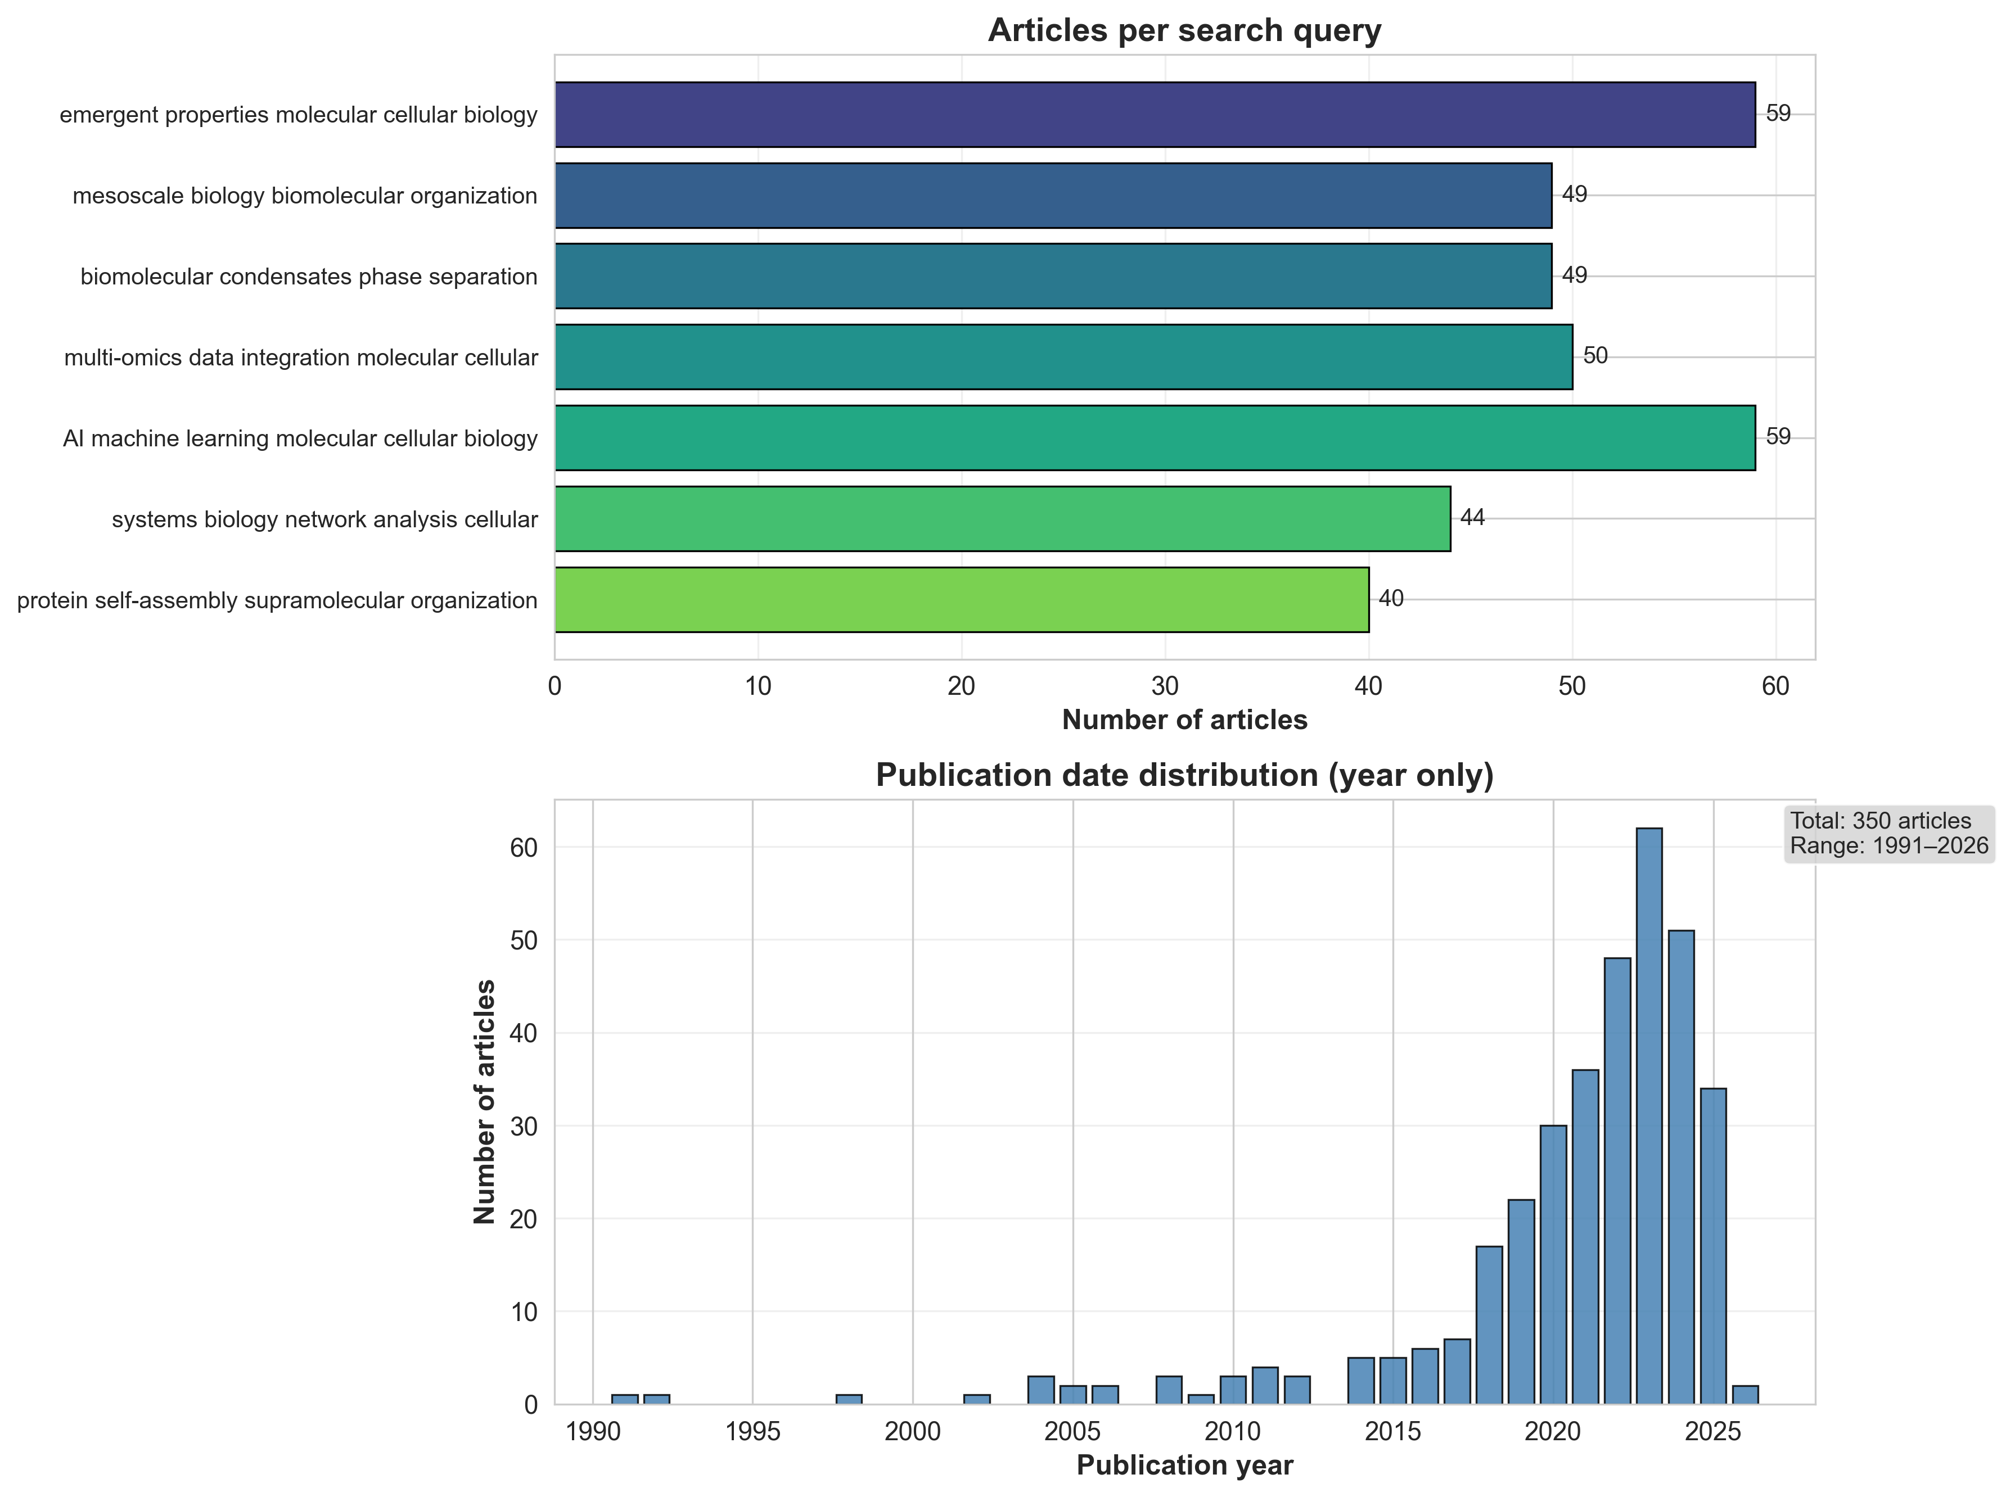
Defining Novelty & the Literature Corpus
How is novelty measured?
Reference Literature Corpus
For each proposal, we find its k=10 nearest neighbors in a reference corpus of published PubMed articles and compute the mean cosine distance. A higher score means the proposal is further from anything previously published — it explores territory that the existing literature does not cover. We embed only the title + abstract of each proposal (not the full text) to ensure a fair comparison with the PubMed abstracts.
How does novelty differ from diversity?
Diversity
Novelty
Compares proposals to each other within a group. A diverse group produces varied ideas, but those ideas may all be well-known in the literature. Reference: internal (proposals vs. proposals).
Compares proposals to published literature. A novel proposal explores territory that no published paper covers, regardless of how similar it is to other proposals. Reference: external (proposals vs. PubMed).
350 PubMed articles from 7 targeted queries
• Emergent properties in molecular/cellular biology (59 articles) • Mesoscale biology & biomolecular organization (49) • Biomolecular condensates & phase separation (49) • Multi-omics data integration (50) • AI/ML in molecular & cellular biology (59) • Systems biology & network analysis (44) • Protein self-assembly & supramolecular organization (40) Mean abstract length: 1,351 characters. Embedded with BioLinkBERT using same pipeline as proposals.
Implication: A model can be highly diverse (varied output) but low novelty (ideas the field already knows), or low diversity (repetitive) but high novelty (repetitively novel). These are independent dimensions.

Slide 11
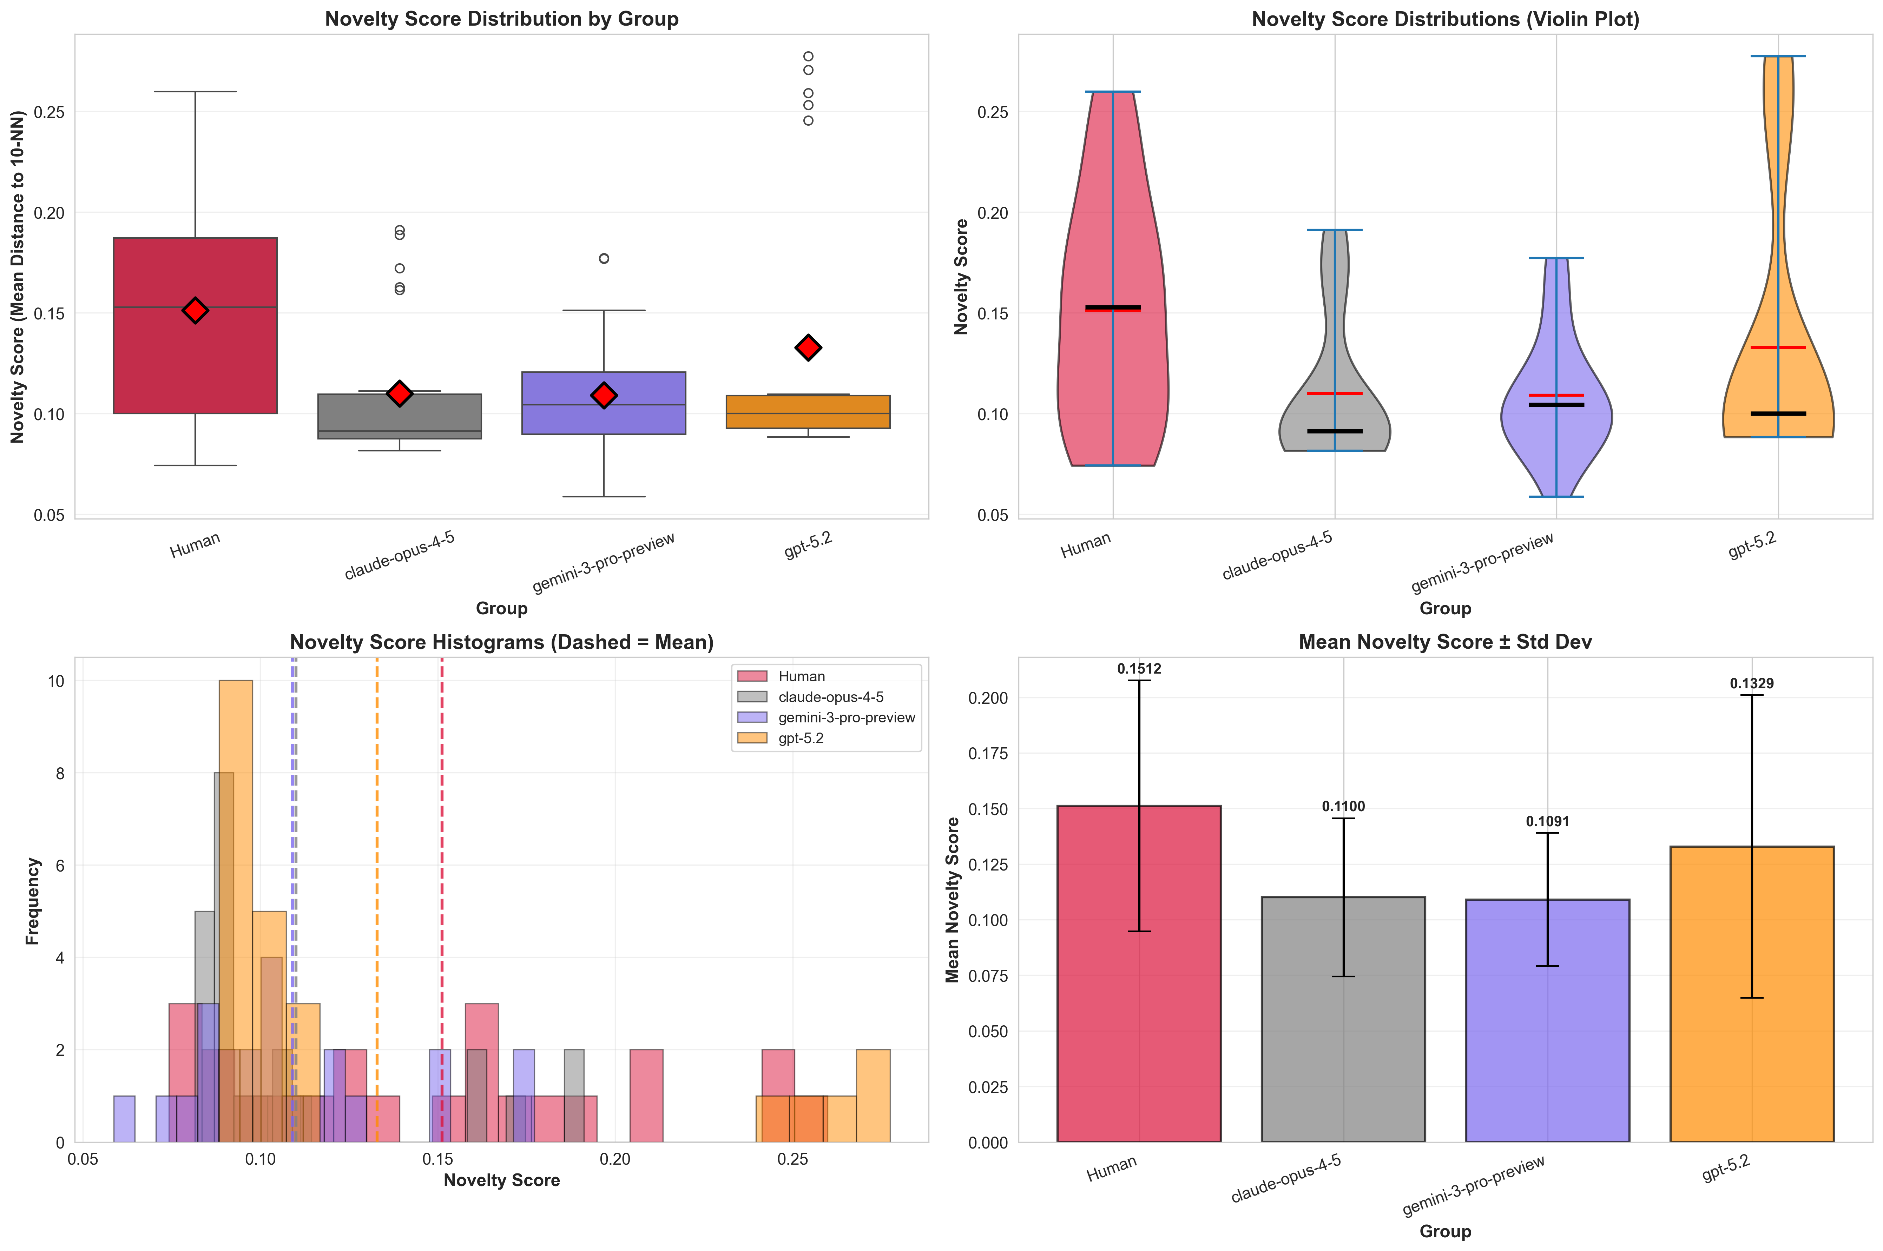
Novelty Analysis: Distance from Existing Literature
Novelty = Mean cosine distance to 10 nearest neighbors in a corpus of 350 PubMed articles
Human proposals are more novel than AI
Human mean novelty: 0.151 vs AI combined: 0.117 (Cliff’s d = −0.34, medium effect, p = 0.014). Human proposals sit further from published literature, suggesting they draw on less well-trodden ideas.
Model-level novelty gaps after corrected model mapping
Claude: d = −0.40 (p = 0.020), Gemini: d = −0.42 (p = 0.016), GPT-5.2: d = −0.21 (p = 0.219, ns). Pooled AI remains significantly less novel than Human.
Most vs. least novel proposals
Most novel human: “Cytokinetic Bottlenecks of Heat Waves” (0.260). Least novel AI: a Gemini antibiotic resistance proposal (0.059), nearly overlapping published work. AI’s lower novelty may reflect reliance on training-data-dominant framings.

Slide 12
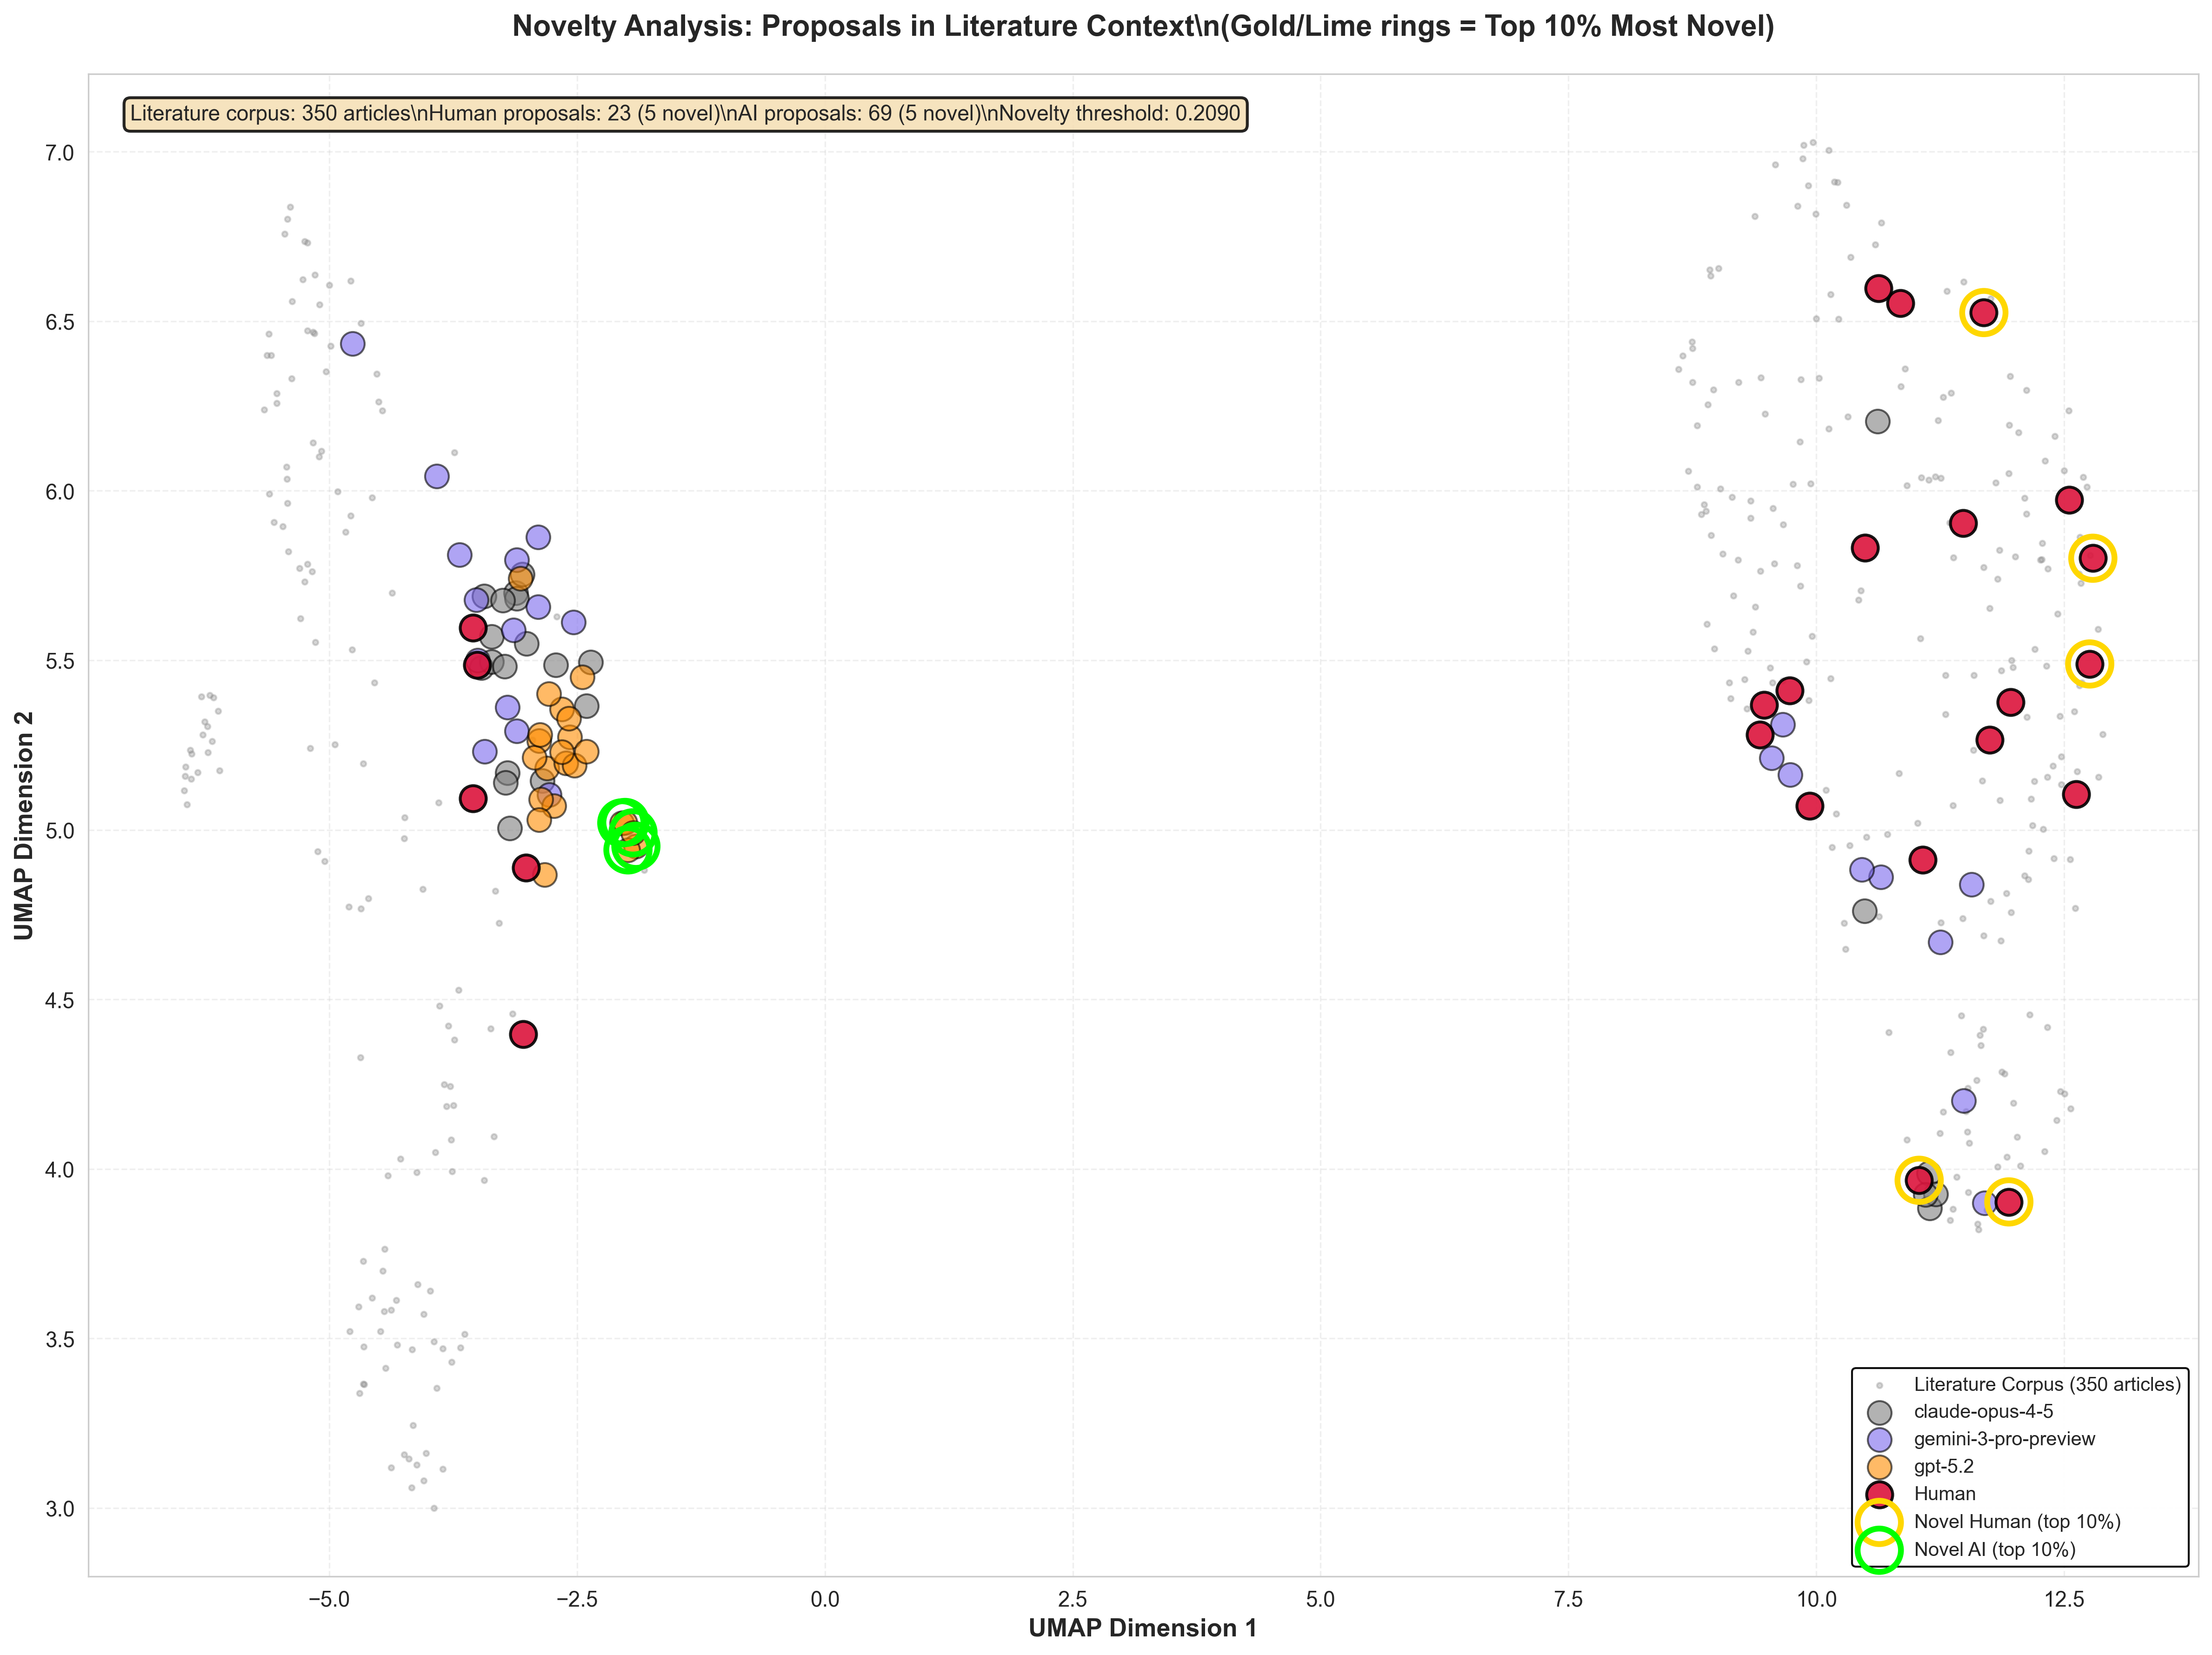
Novelty in Embedding Space
Proposals (colored) projected alongside 350 PubMed articles (gray) via UMAP
Key observations
Human proposals sit at the periphery of the literature cluster, occupying regions where fewer published articles exist. This aligns with the higher human novelty scores.
AI proposals tend to concentrate closer to dense literature regions. Claude and Gemini still show clear novelty gaps vs Human, while GPT-5.2 is closer to Human and not significant in model-level testing.
Interpretation caveat: UMAP projections can distort distances. The quantitative novelty scores (slide 10) are the primary evidence; this visualization serves as a qualitative consistency check. Proposals near literature ≠ low quality, and distance from literature could also indicate incoherence.
Linking diversity and novelty: GPT-5.2’s tight internal cluster maps onto well-published territory.
High internal similarity + low novelty = AI re-deriving the same ideas from training data.
Claude’s spread extends into less-charted space, but model-level novelty remains below Human.

Slide 13
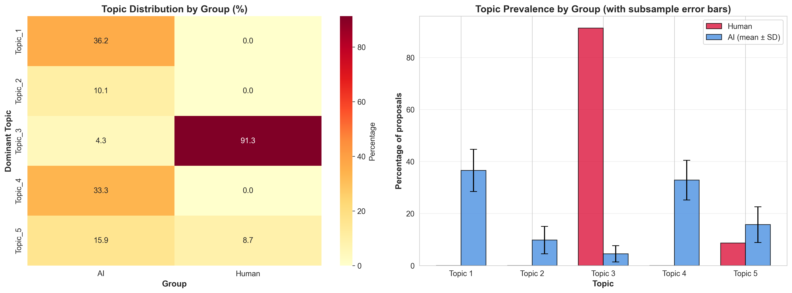
Thematic Analysis: Topic Distribution
LDA topic modeling (k=5, strong priors) with Fisher’s exact tests and FDR correction
Critical caveat
Separation is substantial but no longer perfect after content-only normalization. Human entropy is no longer zero (H=0.448), while AI remains much higher (subsampled H≈1.99). Results are exploratory and should be validated with expert coding.
Strong but not complete thematic separation
Per-topic Fisher’s exact tests (FDR-corrected)
Dominant-topic table now shows overlap: Topic 3 contains Human=21 and AI=3, and Topic 5 contains Human=2 and AI=11. Overall distribution difference remains significant (chi-square permutation p < 0.0001).
FDR-corrected per-topic tests: Topic 3 is Human-overrepresented (OR=231, q<0.001), Topics 1 and 4 are AI-overrepresented (q<0.01), while Topics 2 and 5 are not significant. Subsample validation: Topics 1, 3, and 4 are robust.

Slide 14
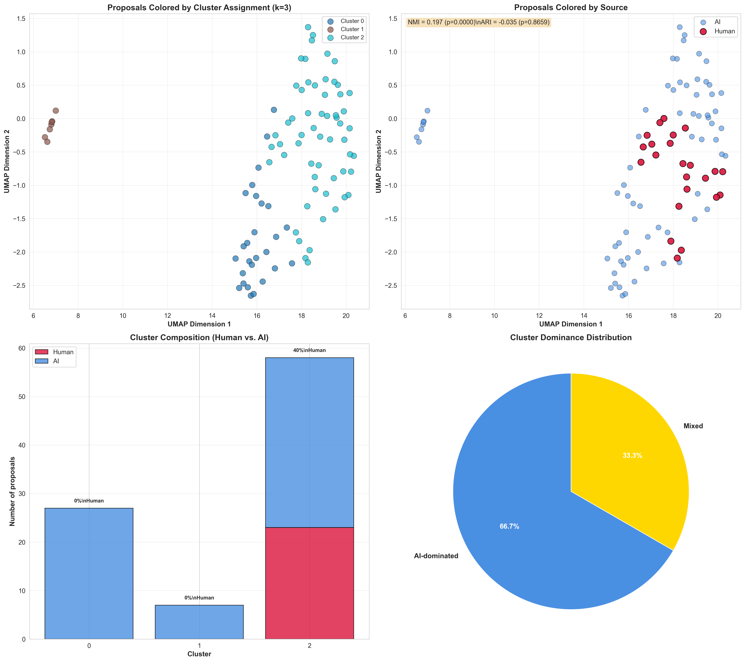
Cluster Segregation Analysis
Gaussian Mixture Model clustering (k=3, selected by BIC) with segregation metrics
Cluster composition reveals asymmetric segregation
Cluster 0 (n=27): 100% AI. Cluster 1 (n=7): 100% AI. Cluster 2 (n=58): 40% human, 60% AI. Two clusters are entirely AI-dominated. All 23 human proposals land in a single mixed cluster, while AI proposals spread across all three, suggesting AI occupies distinct conceptual regions that humans do not enter.
Segregation metrics
NMI = 0.197 (p < 0.0001): clusters predict human/AI source better than chance. ARI = −0.035 (p = 0.86): no agreement beyond chance (expected given unbalanced groups). Between/within distance ratio = 1.085 (p = 0.004): human and AI proposals are measurably more distant from each other than from their own group.
Connecting the evidence
Cluster segregation corroborates the nearest-neighbor finding (100% AI-AI nearest neighbors) and the topic separation. Across three independent methods — NN analysis, LDA topic modeling, and GMM clustering — humans and AI occupy different semantic territories.

Slide 15
Integrated Findings Across All Analyses
Convergent evidence from diversity, novelty, thematic, and cluster analyses
Diversity ranking is consistent
Novelty tracks a different dimension
Proposal-level pairwise, centroid, and NN analyses all show strong model heterogeneity: Claude is broad, GPT-5.2 shows mode collapse, and Gemini is intermediate.
Novelty adds a second lens: humans are furthest from the literature, while AI variation is often within known regions. This explains why high internal diversity (Claude) does not automatically imply high external novelty.
Semantic segregation confirmed 3 ways
Aggregation masks real differences
NN, LDA, and GMM all point to source-linked semantic segregation. Style-adjusted NN still shows strong asymmetry (AI same-group NN 94.2%), so the separation is reduced but not eliminated by style control.
Aggregation can hide or invert model-level effects depending on metric; report model-specific estimates with CIs and adjusted p-values.
Coherent story: AI model choice controls within-AI diversity; humans remain more novel vs literature; topic/cluster analyses show source-linked semantic separation; style-adjusted tests confirm the gap is not purely stylistic.

Slide 16
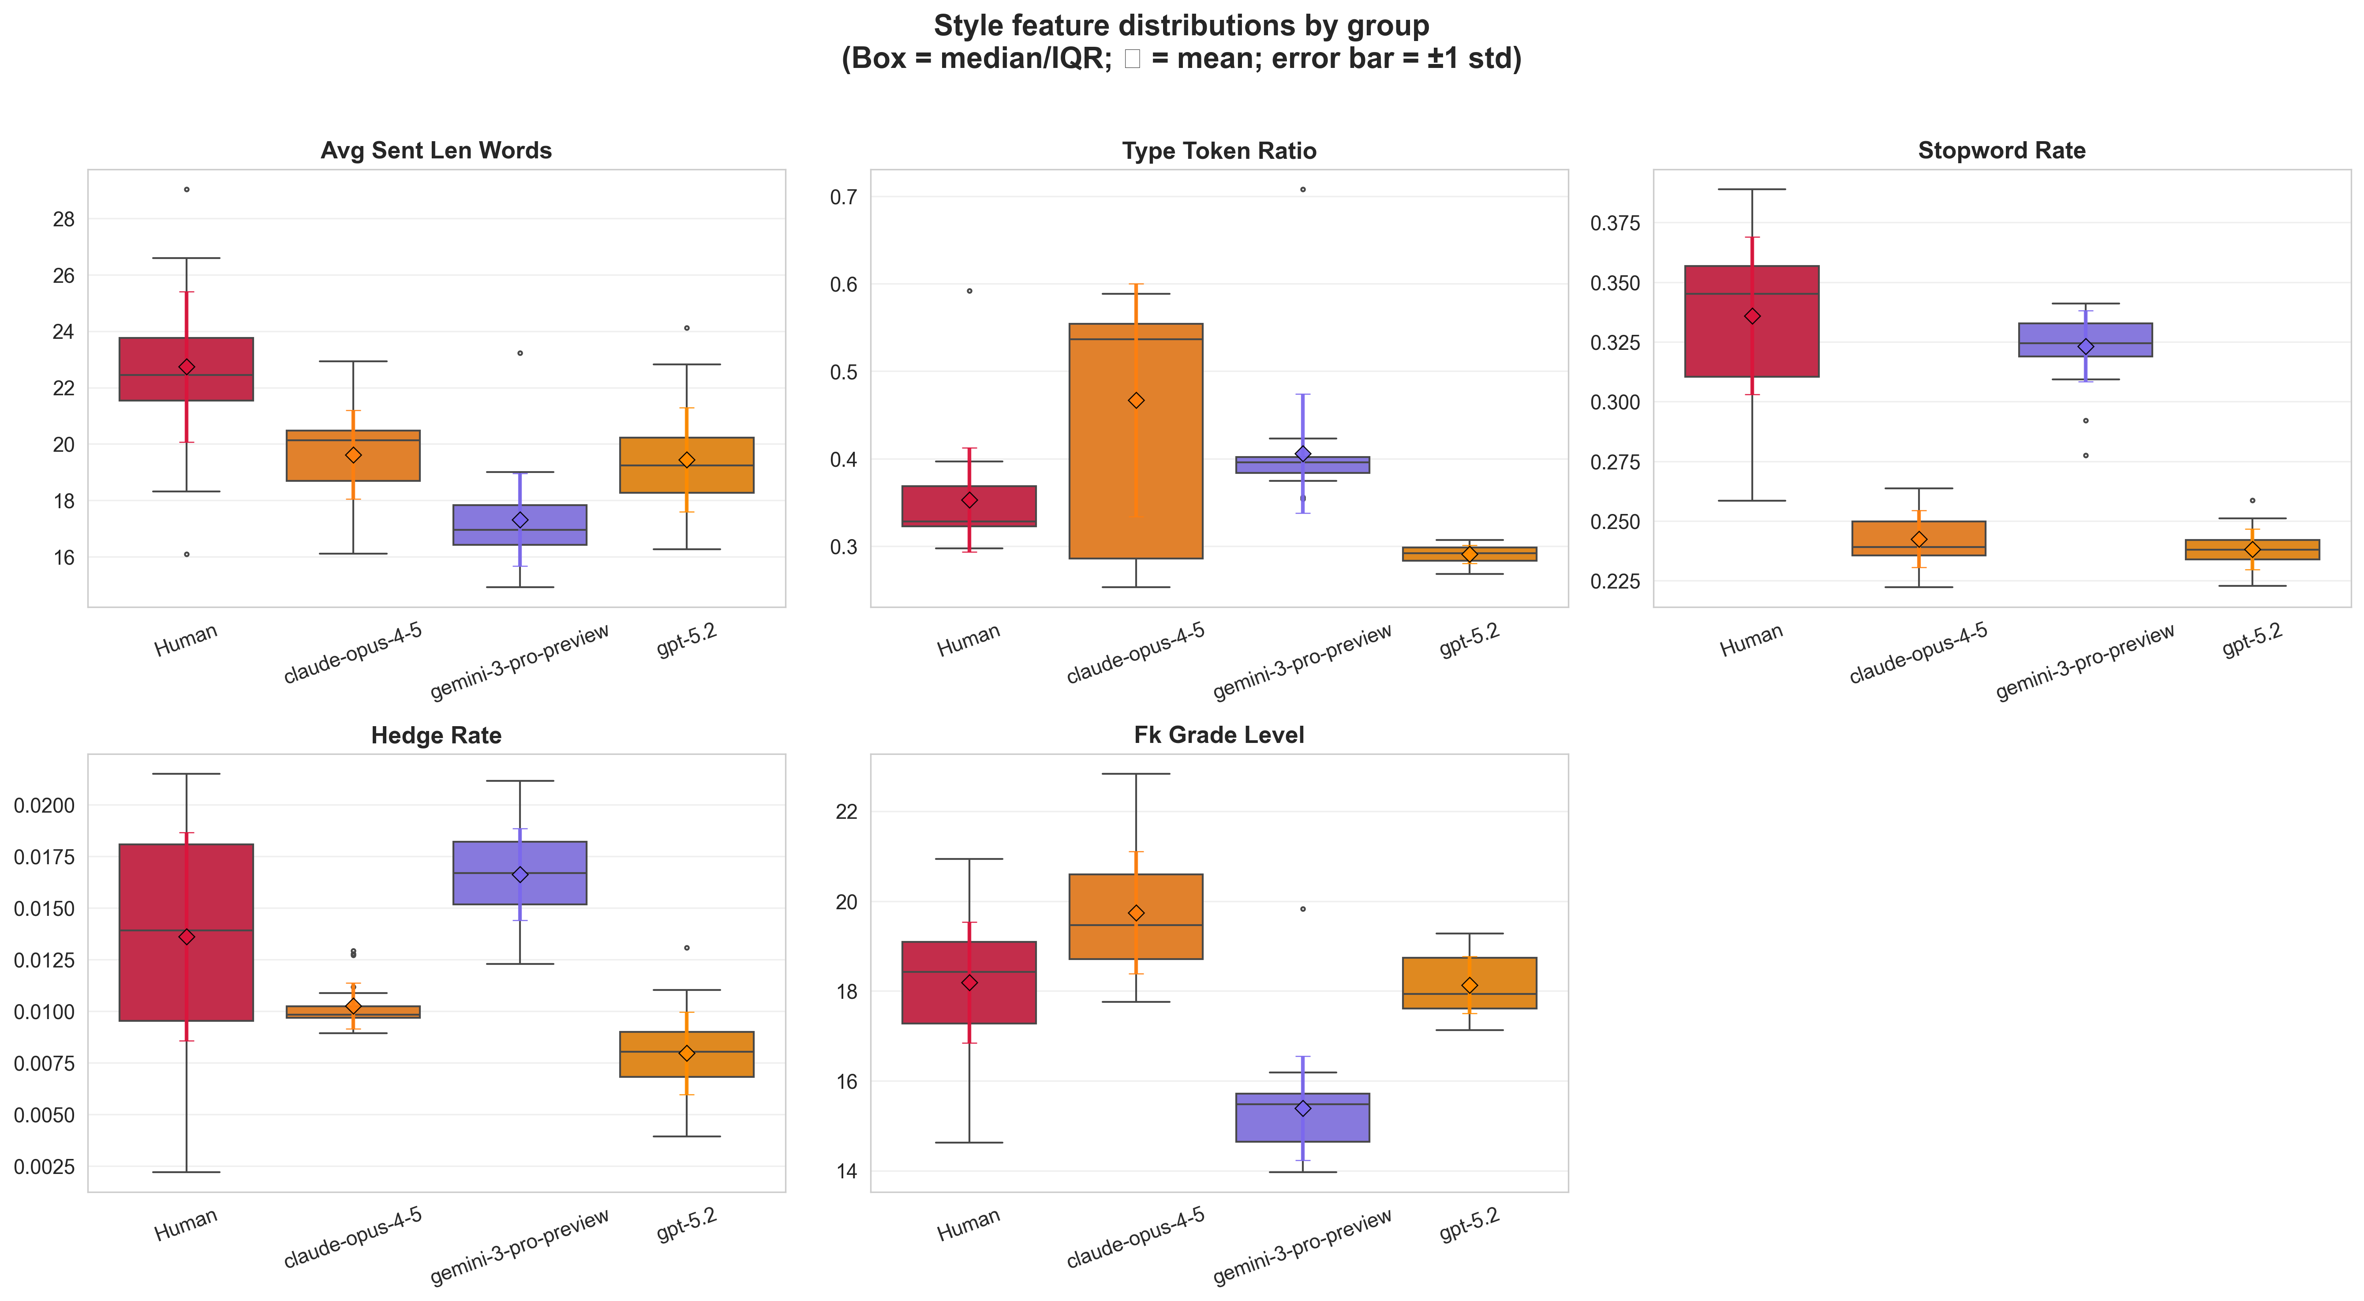
Strong Stylistic Differences Between Human and AI Proposals
Style-only baseline strongly separates Human vs AI (AUROC 1.000 ± 0.000; balanced accuracy 1.000 ± 0.000)
Are there stylistic differences between human and AI proposals?
We created style-only features that quantify how a proposal is written (structure, lexical variety, stopword usage, hedging/stance, sectioning, readability, and punctuation/formatting patterns) to build a style baseline.
Using logistic regression on style features, we found that style alone can separate human vs AI proposals.
Permutation test (AUROC, 1,000 label shuffles):
Observed AUROC: 1.000
Null mean AUROC: 0.505 ± 0.098
p-value: 0.0010

Slide 17
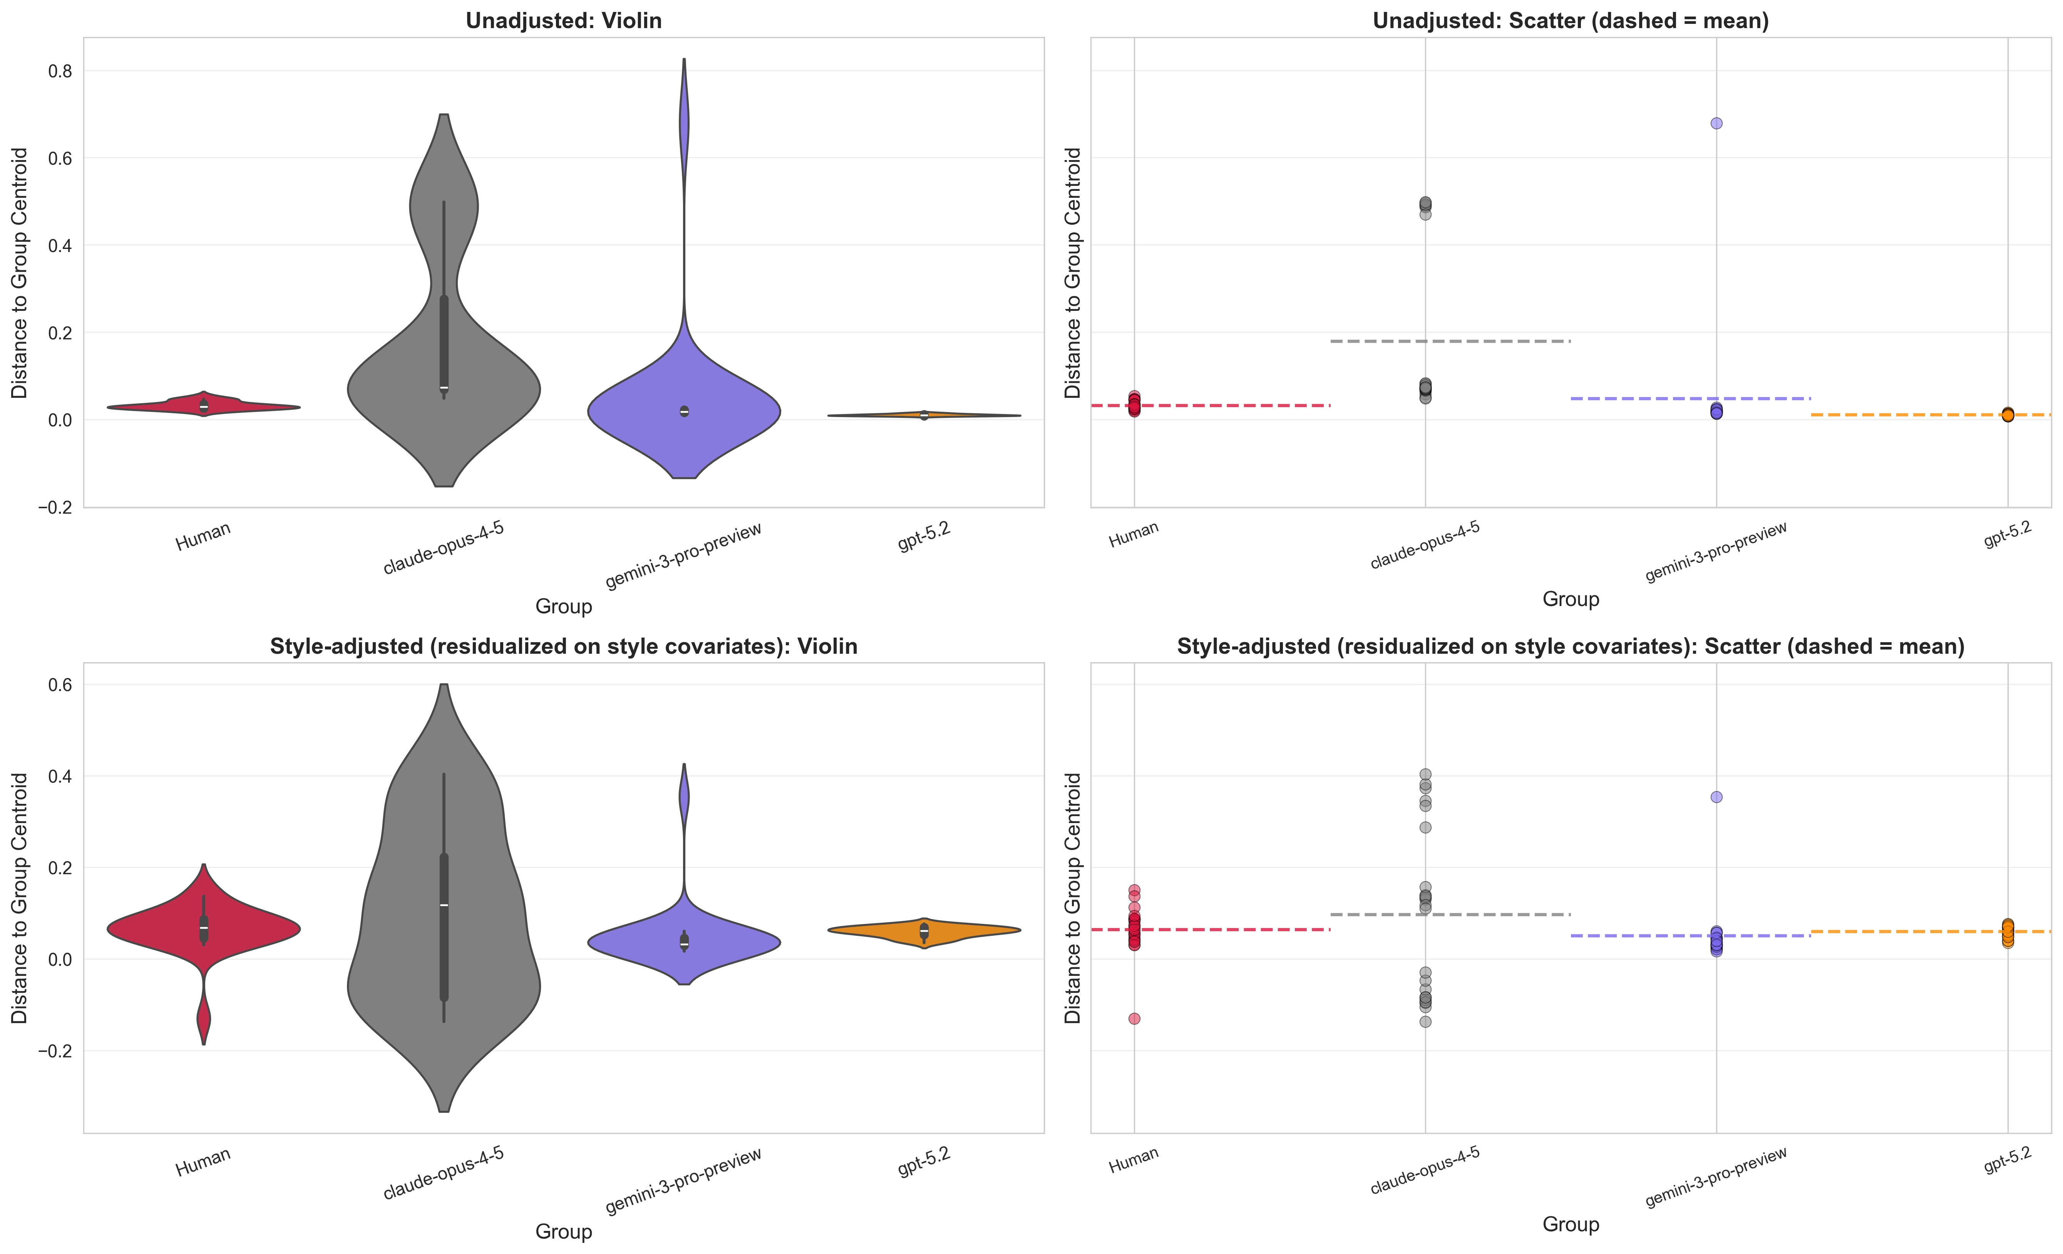
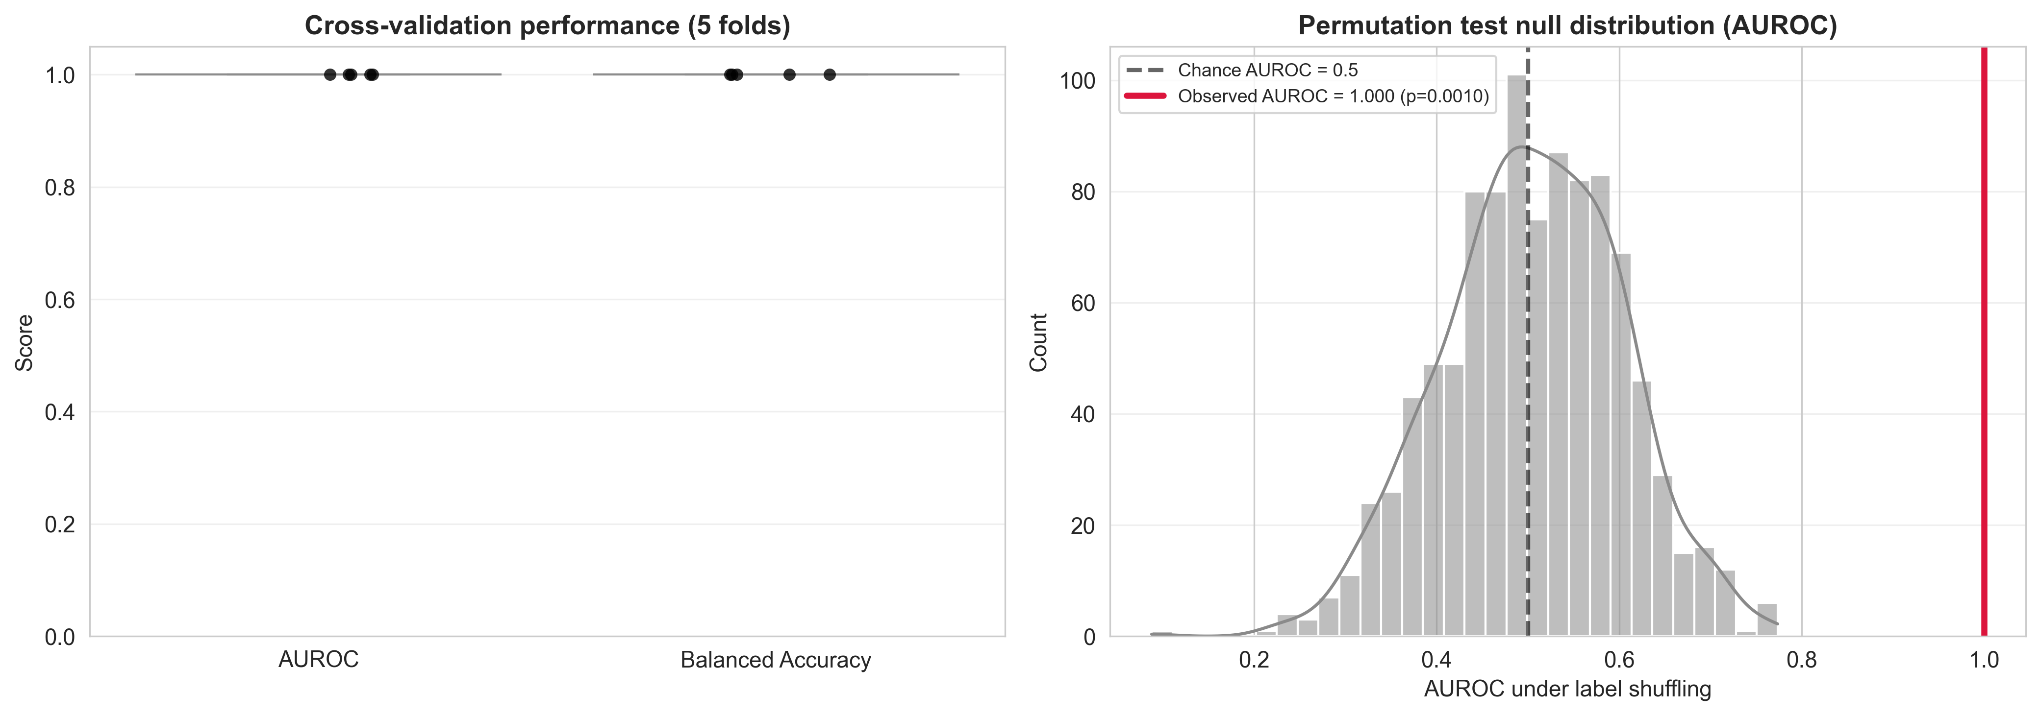
Style-adjusted centroid dispersion analysis
After removing embedding components predictable from style features, does semantic separation remain?
Style-adjusted centroid dispersion
Residualization workflow: fit y_raw ~ style features, subtract predicted style component, and analyze adjusted distances in residual space.
Style-only signal is maximal (AUROC 1.000), so this adjustment isolates style-independent embedding structure.
Adjusted results: AI-vs-human coefficient remains positive (+0.0486 for own-group centroid distance; permutation p=0.0002). Per-model effects: Claude δ=+0.123 (ns), Gemini δ=-0.611 (p=4.0e-4), GPT-5.2 δ=-0.172 (ns).

Slide 18
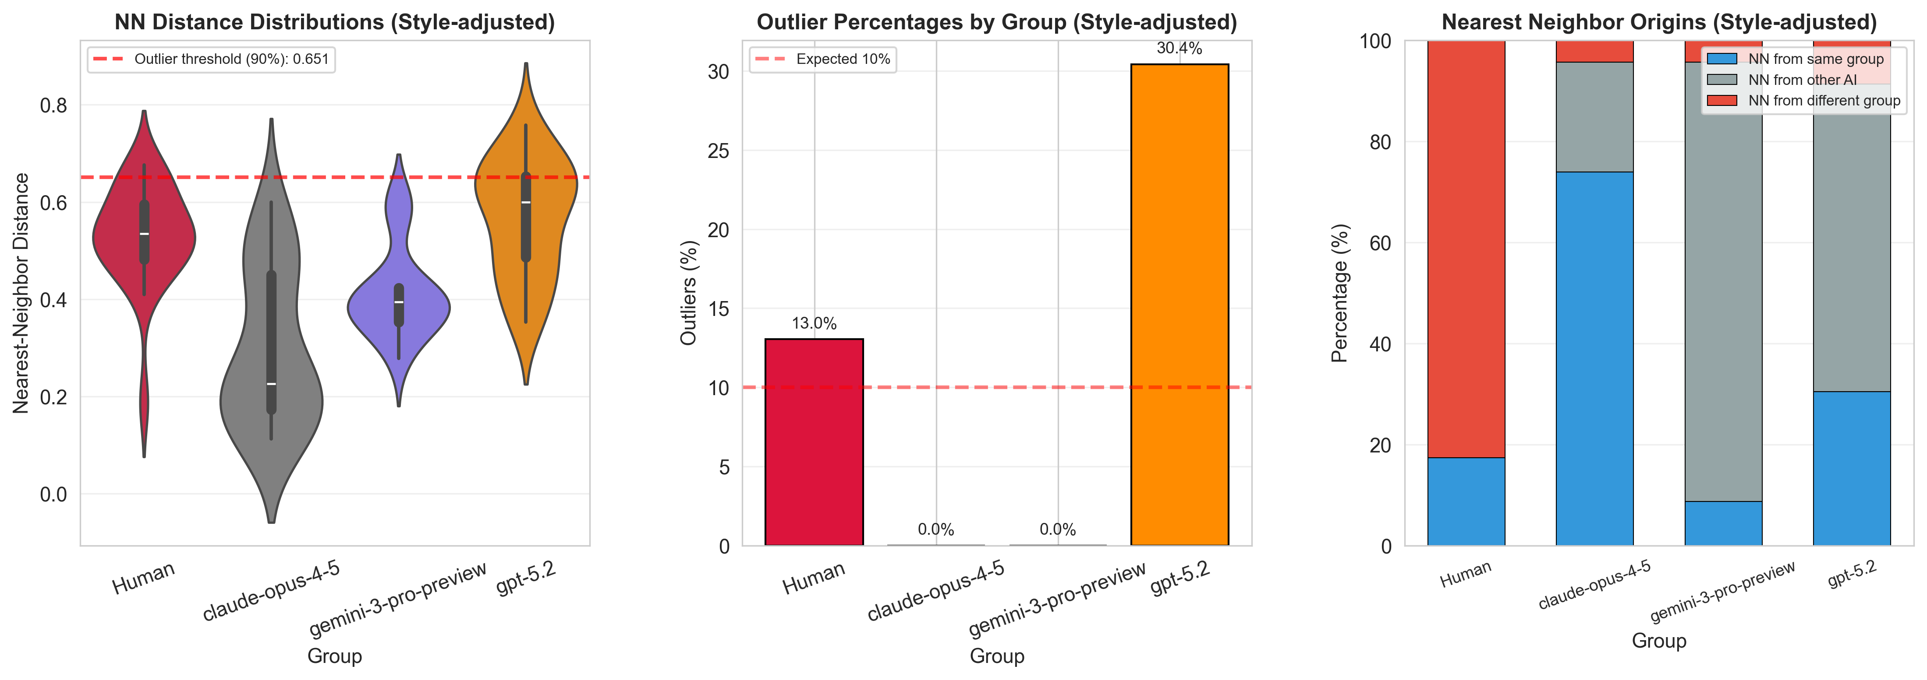
Style-adjusted NN and embedding-space diagnostics
Outlier Rates (top 10% NN distance)
What changes after removing style-related embedding variance?
13.0%
26.1% -> 0.0%
Nearest-neighbor and UMAP checks in residual space test whether human/AI separation persists beyond writing style.
Human
Claude
After adjustment, GPT-5.2 is most isolated (mean NN 0.5667; 30.4% outliers) while Claude is least isolated (mean NN 0.2973; 0% outliers).
Style-adjustment reduces style leakage (mean |corr(style, PC)|: 0.2036 → 0.0405), yet human/AI neighborhood asymmetry remains (AI same-group NN: 94.2%).
4.3% -> 0.0%
0.0% -> 30.4%
Gemini
GPT-5.2

Slide 19
Part IV Quality: Why Three Linked Analyses?
Motivation, analytical logic, and how R1, R2, and R3 connect
Motivation:
Diversity and novelty analyses (Parts I–III) tell us whether AI proposals explore different intellectual territory.
They do not tell us whether those proposals are high-quality, rigorous, or fundable. That requires explicit quality scoring.
But quality scoring with AI evaluators introduces new risks: evaluator leniency differences and self-preference bias.
Three linked sub-analyses:
R1 Proxy Validity: Are AI reviews textually and judgmentally similar to expert human reviews?
Without this, AI-judged quality scores have no established relationship to expert opinion.
R2 Proposal Quality: Do AI-generated proposals score higher than human-authored proposals under AI evaluation?
This is the core substantive question—but only interpretable after R1 and R3 are addressed.
R3 Evaluator Bias: Do AI evaluators show systematic leniency differences or self-preference?
If yes, R2 conclusions are confounded and must be re-run with bias controls.
Analytical sequence: R1 validates the instrument → R3 diagnoses bias → bias-controlled R2 enables valid inference.

Slide 20
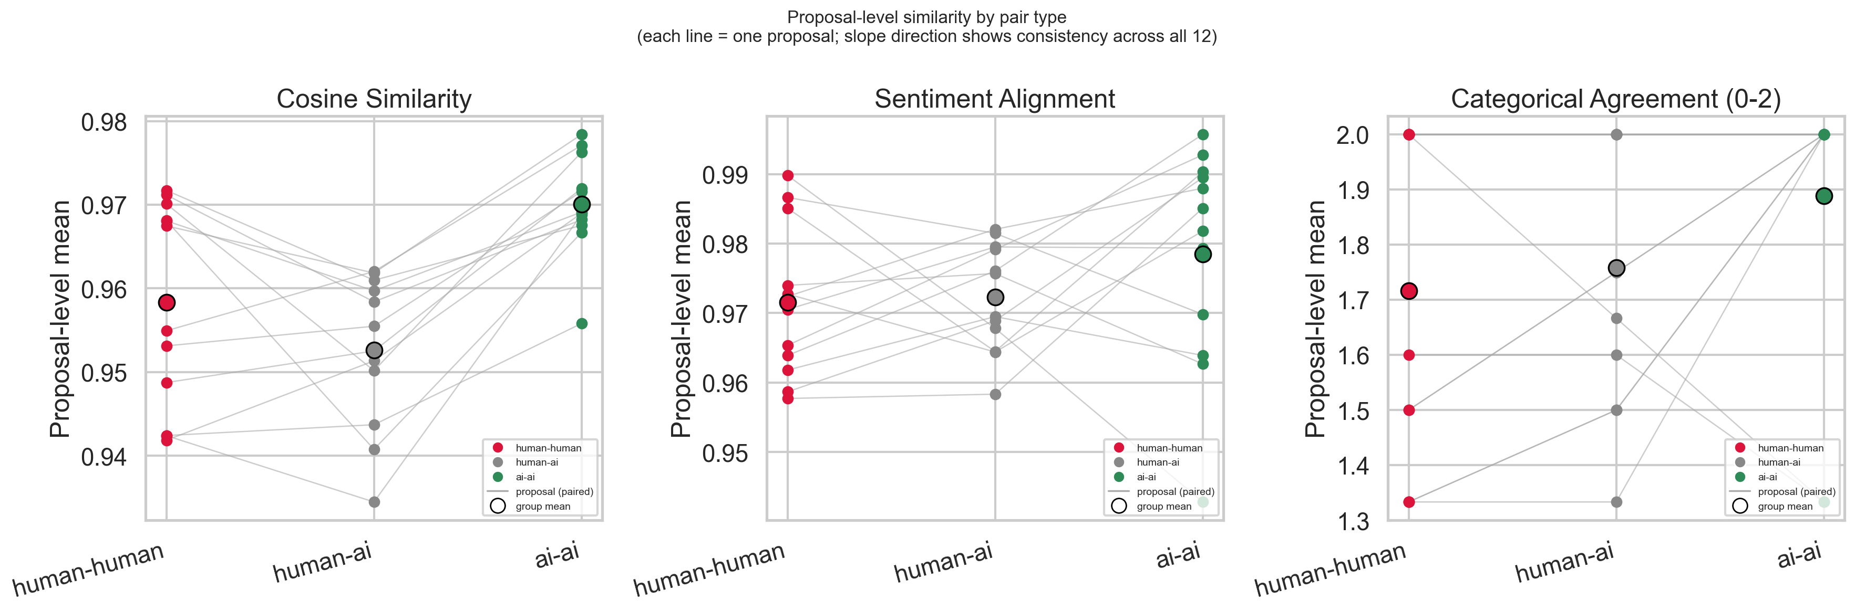
R1 Proxy Validity: Are AI reviews textually and judgmentally similar to expert human reviews?
Cosine similarity, sentiment alignment, and categorical agreement across review pair types
Why this analysis: If AI reviewers produce fundamentally different assessments than human experts, using them as a quality proxy is methodologically indefensible.
Design: 12 Y1 proposals were reviewed by both expert human panels and all 3 AI models, enabling direct pair comparison.
Three pair types: Human–Human (HH), Human–AI (HAI), AI–AI (AIAI). Paired Wilcoxon signed-rank is the primary test (same 12 proposals in both groups)
Metrics: (1) cosine similarity (sentence-BERT embeddings, do the reviews talk about similar things),
(2) sentiment polarity alignment: How close the two reviewers' tone/warmth is in a graded, continuous way (0-1)
(3) categorical agreement: Whether the two reviewers are pointing in the same direction — thumbs up, down, or mixed — regardless of how far apart they are. It treats neutral as a middle ground rather than full disagreement.

Slide 21
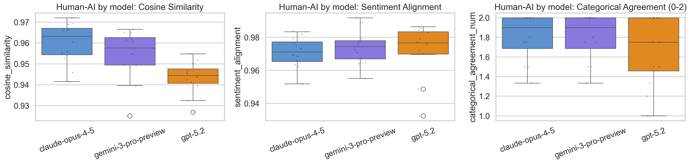
R1 Results: AI Reviews Are Aligned With Humans—But AI Judges Cluster Tightly
Human–AI similarity is not significantly lower than human–human; AI–AI similarity is dramatically higher
Human–AI vs Human–Human cosine: q=0.237, δ=-0.29 (small, not significant)
→ AI reviews are not detectably more dissimilar to each other than human reviews are to each other.
AI–AI vs Human–Human cosine: Wilcoxon p=0.016, q=0.025, δ=0.58 (large, significant)
AI–AI vs Human–AI cosine: Wilcoxon p=0.00049, q=<0.001, δ=0.93 (large, highly significant)
→ AI models converge on far more similar review language than humans do, and more than when reviewing the same human-written proposal.
Interpretation: AI reviews are not foreign to human expert assessments in textual content (R1 passes the basic validity bar).
However, the AI judge panel lacks the heterogeneity of human expert panels, which may compress the diversity of critical perspectives.

Slide 22
R2 Setup: Verifying Human Baseline Differences (Year 1 vs Year 2)
Before pooling two human cohorts as "human-all," we test whether they are statistically equivalent
Why this matters:
Two human cohorts exist: Year 1 (n=12 proposals, evaluated by both human experts and AI) and Year 2 (n=11 proposals, AI-evaluated only).
If the cohorts differ substantially in quality, pooling them inflates within-group variance and biases comparisons to AI.
Method: Mann–Whitney U + Cliff’s delta + BH-FDR, applied to all 8 scored dimensions.
Results across 8 criteria (BH-FDR corrected):
Overall score: Y1 mean=3.51, Y2 mean=3.81, q=0.090 — NOT significant (δ=-0.42 medium)
Relevance, Novelty, Rigor, Scope/Timeline, Synthesis, Open Science: all non-significant (q > 0.05)
EXCEPTION — Data Identification: Y1=3.36, Y2=4.06, q=0.005, δ=-0.69 (large, significant)
Y2 proposals include stronger data identification plans, possibly reflecting evolved grant writing norms.
Conclusion: the two cohorts are equivalent on 7 of 8 dimensions. Pooling as "human-all" is justified for overall quality comparisons, with the caveat that Data Identification scores in human-all reflect a year-of-submission effect.

Slide 23
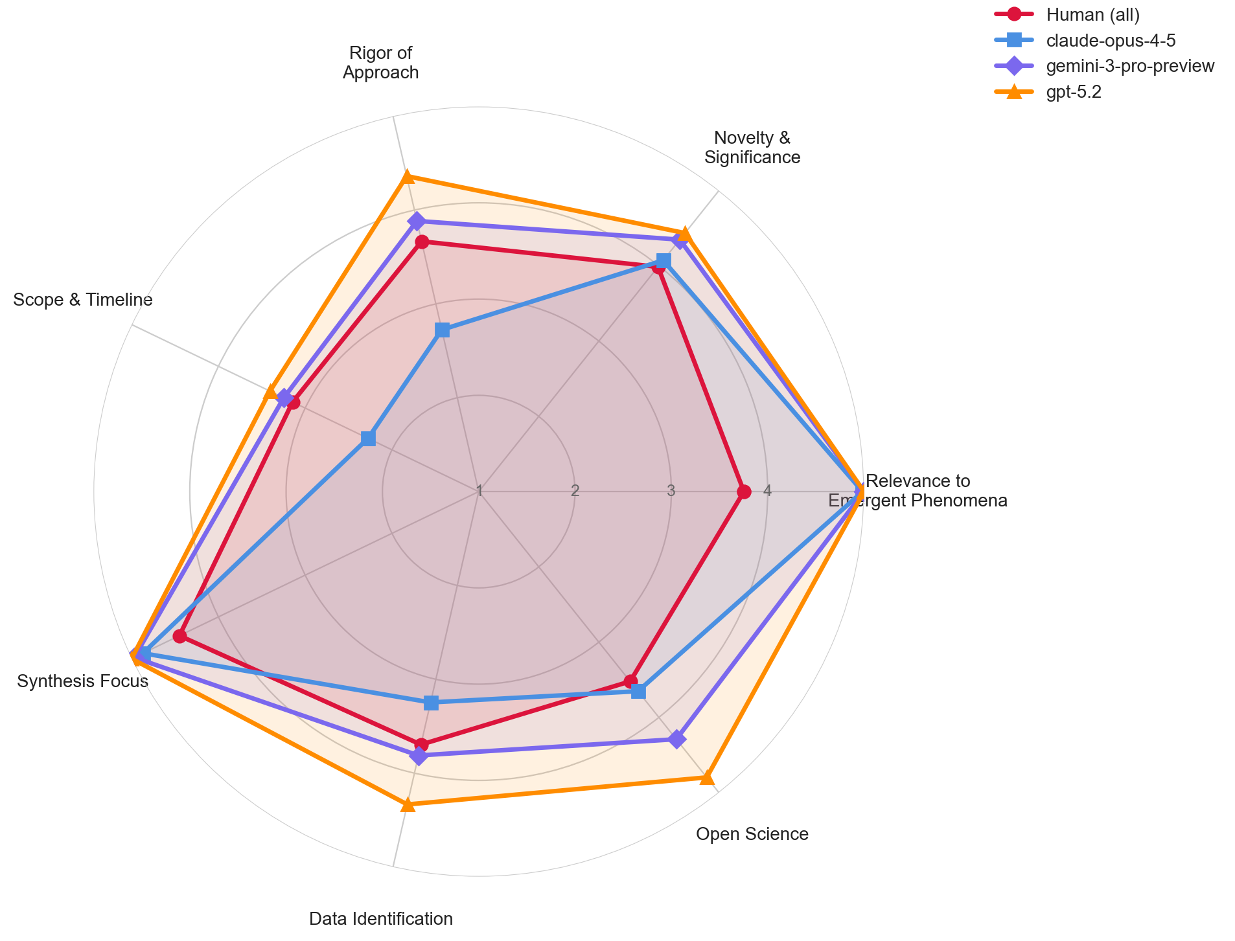
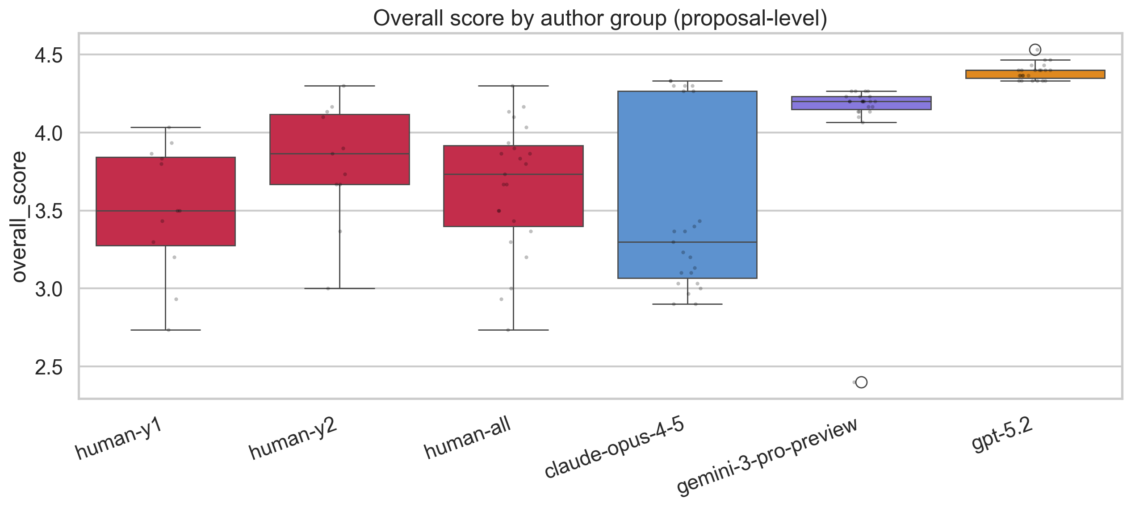
R2 Baseline: AI-Generated Proposals Score Higher Under AI Evaluation
All evaluators (gemini, claude, gpt) pooled; 23 AI proposals vs 23 human proposals per group
Method: proposal-level means (averaged across all AI evaluators), Mann–Whitney + Cliff’s δ + BH-FDR + bootstrap CI.
Human-all: mean=3.65 │ Claude: 3.50 (q=0.358, ns) │ Gemini: 4.12 (q=<0.001***) │ GPT-5.2: 4.39 (q=<0.001***)
Robust bootstrap (human−AI): Claude +0.15 [95% CI: −0.11, +0.43] ns │ Gemini −0.47 [−0.68, −0.23] sig │ GPT −0.74 [−0.91, −0.57] sig
Interpretation: Gemini and GPT proposals receive substantially higher scores than human proposals under pooled AI evaluation.
Claude proposals are statistically indistinguishable from human proposals (both on the 1–5 scale near 3.5).
IMPORTANT CAVEAT: these pooled scores include self-evaluations (AI evaluating its own proposals). R3 quantifies this bias.
Left: overall score distributions by author group. Right: radar chart of 7 criteria reveals pattern heterogeneity.

Slide 24
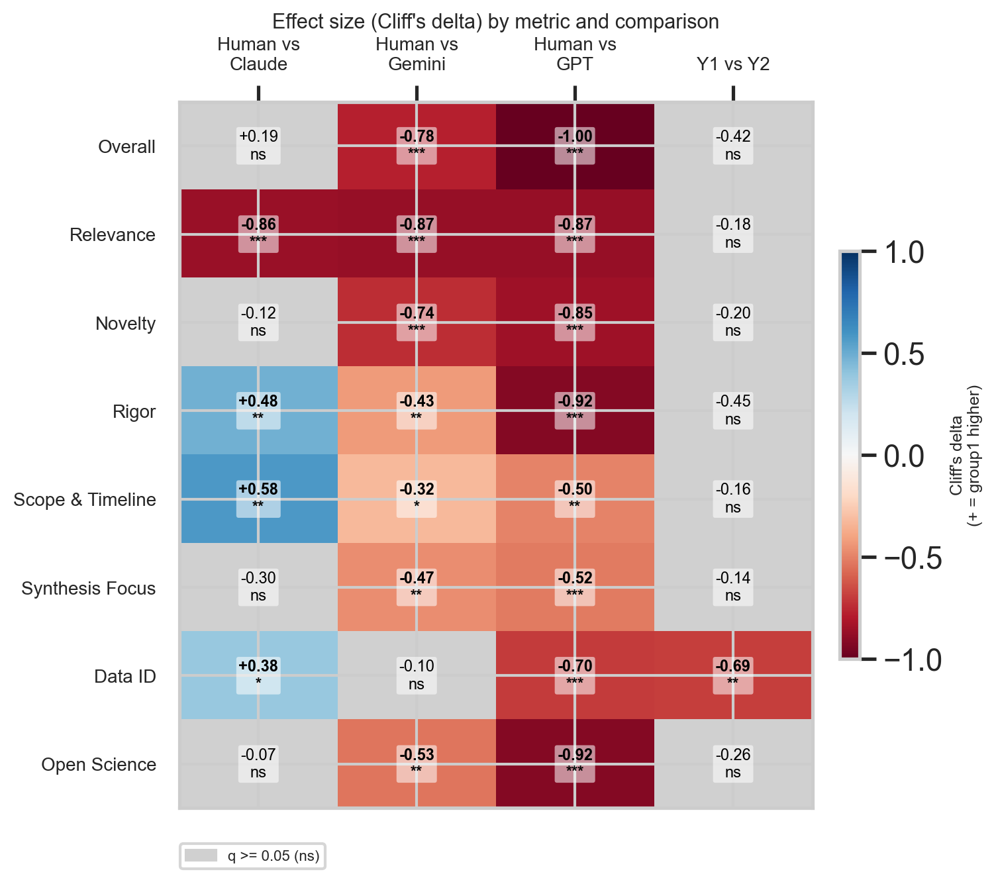
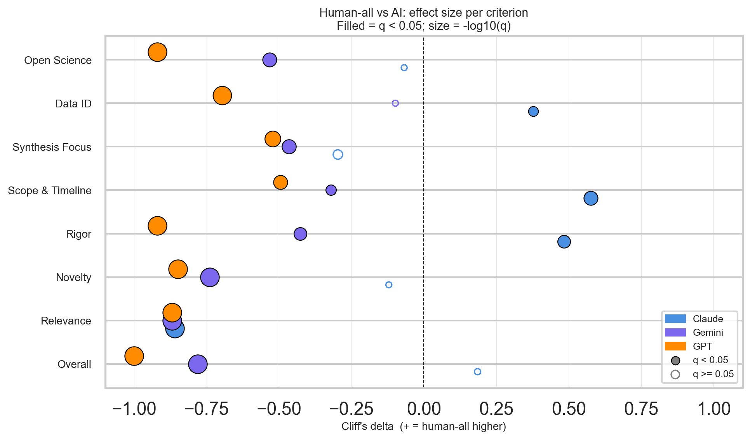
R2 Criterion Decomposition: The AI Advantage Is Model- and Dimension-Specific
Effect-size heatmap and dot plot across 7 rubric criteria
Key patterns (human-all vs each AI author group):
Relevance: all three AI models score near ceiling (5.0) vs human mean ≈3.75 — δ ≈ −0.87 large for all models.
Interpretation: "AI proposals score higher" is not uniform—models and criteria show opposite patterns.
Claude underperforms humans on Rigor and Scope/Timeline while exceeding them on Relevance alone.
Heatmap: blue=human higher, red=AI higher; gray=non-significant. Dot plot: filled=significant, hollow=ns.

Slide 25
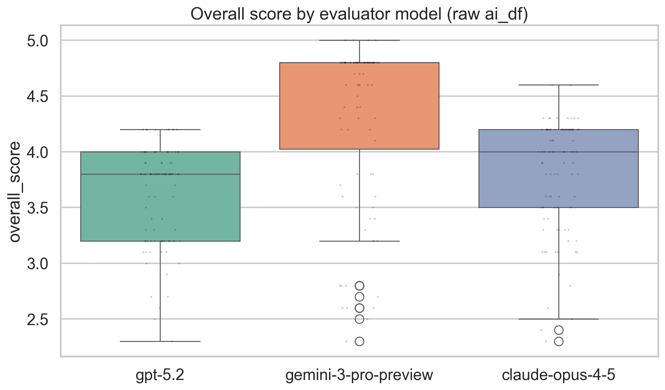
R3 Evaluator leniency: AI Evaluators Differ Substantially in Scoring Leniency
Kruskal–Wallis test across all 276 AI reviews; evaluator identity predicts score independently of proposal quality
Why diagnose evaluator leniency first:
If one evaluator systematically assigns higher scores, comparing author groups across a pooled panel
confounds proposal quality with evaluator severity—an evaluator effect, not a quality effect.
Result:
Kruskal–Wallis H = 70.034, p = 6.2 × 10⁻¹⁶ — evaluator identity is a highly significant predictor of score.
Gemini evaluator: mean = 4.32 (most lenient) │ Claude: 3.80 │ GPT: 3.62 (most strict)
The 0.71-point spread between Gemini and GPT evaluator means is larger than the human–GPT author group difference.
Consequence:
Pooled-evaluator R2 results are a mixture of proposal quality and evaluator severity.
Before accepting the R2 baseline, we must check (a) self-preference bias (R3 Step 2) and
(b) whether findings replicate with evaluator configuration controlled (sensitivity analyses).

Slide 26
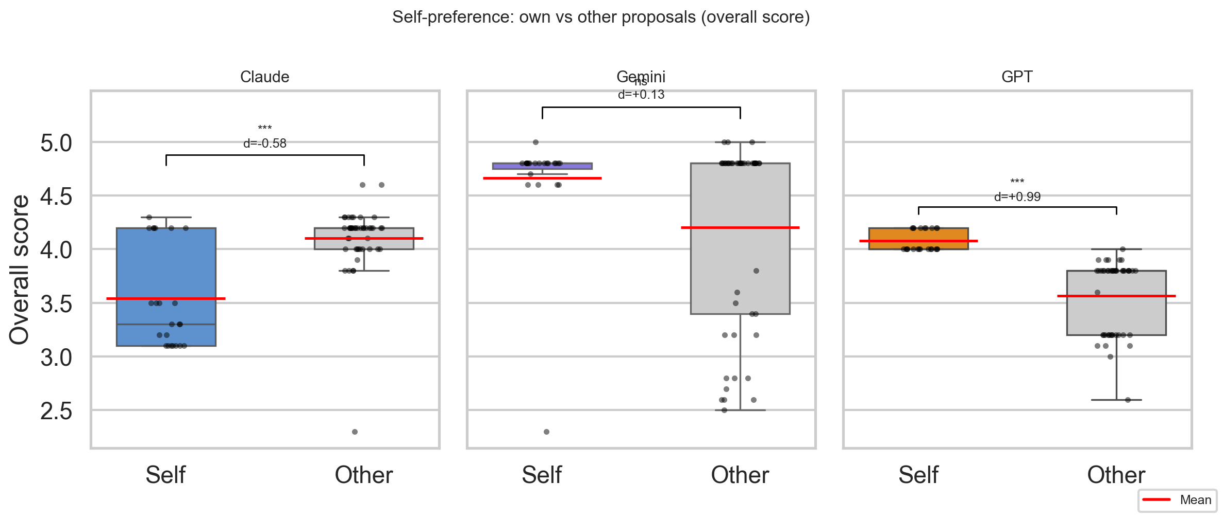
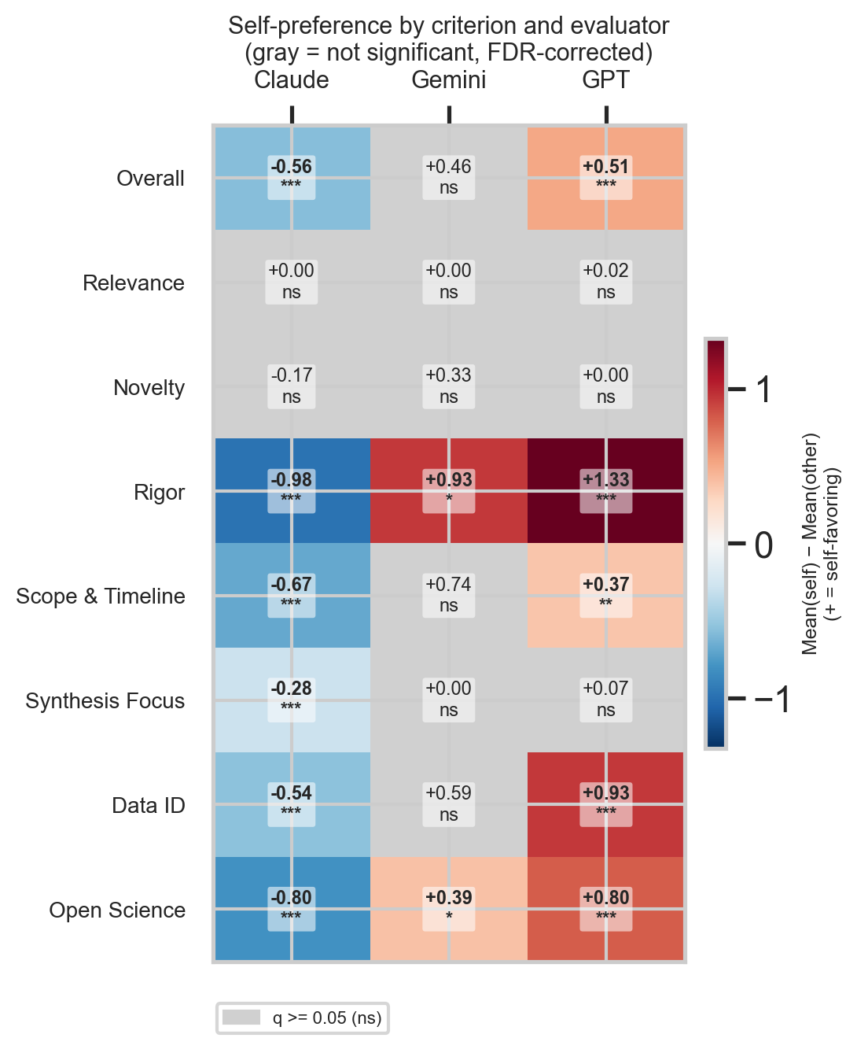
R3 Self-preference bias: Large in Magnitude and Model-Divergent
GPT strongly self-inflates; Claude self-deprecates; Gemini is neutral—all three effects are large or negligible
Method: for each AI evaluator, compare scores assigned to its own proposals (self) vs other models' proposals (other).
Mann–Whitney U + Cliff’s δ + BH-FDR, then criterion-level decomposition.
Results:
(1) GPT evaluator → strong self-INFLATION: δ=+0.987 large (q=<0.001); own mean=4.08 vs others mean=3.57
(2) Claude evaluator → strong self-DEPRECATION: δ=−0.581 large (q=<0.001); own mean=3.54 vs others mean=4.10
(3) Gemini evaluator → NO significant self-preference: δ=+0.128 negligible (q=0.327)
Implication: GPT baseline R2 advantage is at least partly a self-evaluation artifact, not objective quality difference.
Left: strip/box plot of self vs other by evaluator. Right: criterion-level heatmap of self−other mean differences.

Slide 27
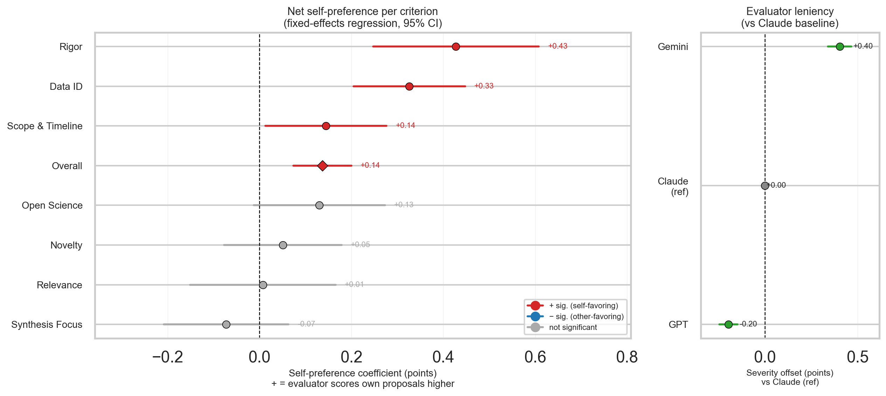
R3 Step 3: Self-Preference Survives Proposal-Quality Controls
Fixed-effects regression isolates self-preference net of proposal identity, evaluator severity, and author group
Why a regression?
The self vs other comparison conflates two mechanisms: (1) genuine self-preference bias and (2) AI models may simply produce higher-quality proposals that any evaluator would rate higher.
The regression removes the second explanation by adding proposal fixed effects.
Model: score ~ is_self * criterion + evaluator + author + proposal_uid (HC3-robust SEs)
Proposal fixed effects absorb all between-proposal quality variation.
Key findings:
Net self-preference (Data_ID reference criterion): +0.33 points persists after all controls.
Evaluator effects confirmed: Gemini +0.40 above Claude baseline; GPT −0.20 below.
GPT-authored proposals receive ~+1.25 more points than the baseline, net of evaluator severity.
Conclusion: self-preference is a real evaluator bias, not a proxy for objective quality differences.
Forest plot shows per-criterion self-preference coefficients (β ± 95% CI) and evaluator severity panel.

Slide 28
Re-run R2: Why Bias-Controlled Reruns Are Necessary Before Drawing Conclusions
Two sources of confound identified; two sensitivity analyses designed to address them
Summary of R3 findings and their implications for R2:
Confound 1 — Evaluator self-preference:
GPT evaluator strongly inflates own proposals (+0.99δ large). Including GPT self-evaluations in the pooled baseline
artificially elevates GPT-authored proposal scores.
Fix: Sensitivity 1 removes self-evaluations for AI authors (cross-evaluator-only).
Confound 2 — Evaluator leniency heterogeneity:
Gemini evaluator is 0.71 points more lenient than GPT evaluator. Pooling evaluators weights
proposal group comparisons by the leniency of whichever evaluator happened to review more of one group.
Fix: Sensitivity 2 uses Gemini-only as a single, uniform evaluator for all proposals.
Interpretation framework for the two reruns:
• Findings that hold under both controls are robust and interpretable.
• Findings that disappear or reverse under one control are evaluator-configuration sensitive.
• GPT’s elevated scores must survive cross-evaluator removal to be credible.

Slide 29
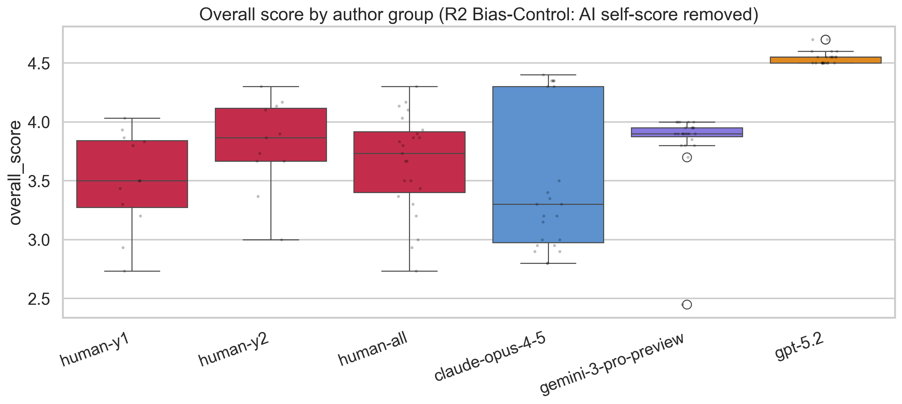
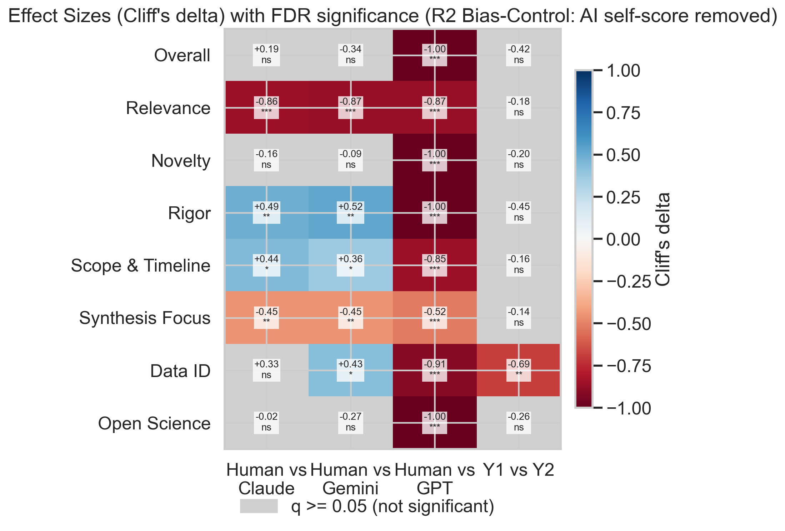
Sensitivity 1 — Cross-Evaluator Only: GPT Advantage Is Robust; Gemini Attenuates
Removing self-evaluations: each AI proposal scored only by the 2 models that did not write it
Design: for Claude-, Gemini-, and GPT-authored proposals, remove the 69 rows where evaluator==author (23 per model).
Human proposals are unaffected (all 3 AI models review them). This controls for self-preference without losing proposals.
Means (cross-eval only): Human 3.65 │ Claude 3.48 (q=0.262, ns) │ Gemini 3.84 (q=0.070, marginal) │ GPT 4.55 (q=<0.001***)
Key changes from baseline:
Gemini advantage: baseline q=1.4×10⁻⁵ (large sig) → q=0.070 (marginal, non-significant after self-removal)
→ Gemini’s elevated baseline score was substantially driven by self-evaluation inflation.
GPT advantage: remains highly significant (q=1.5×10⁻⁸, δ=−1.00 large); robust to self-removal.
→ GPT proposals are rated higher even by models that did not write them—a more credible quality signal.
Claude: unchanged (never significant), confirming Claude proposals are similar to human quality under fair evaluation.

Slide 30
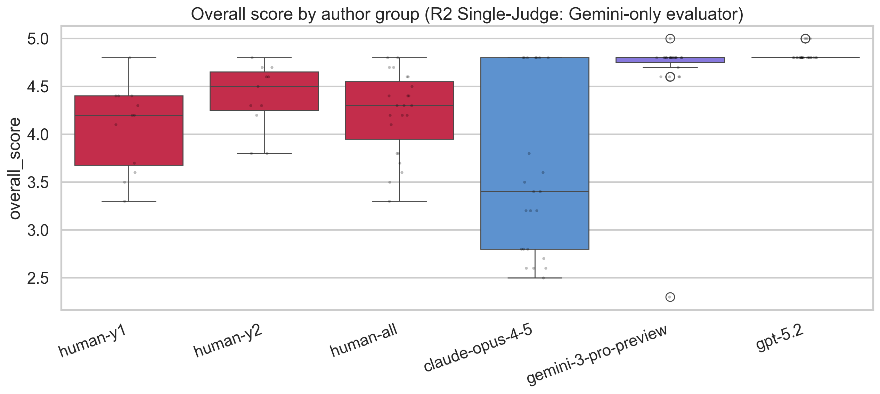
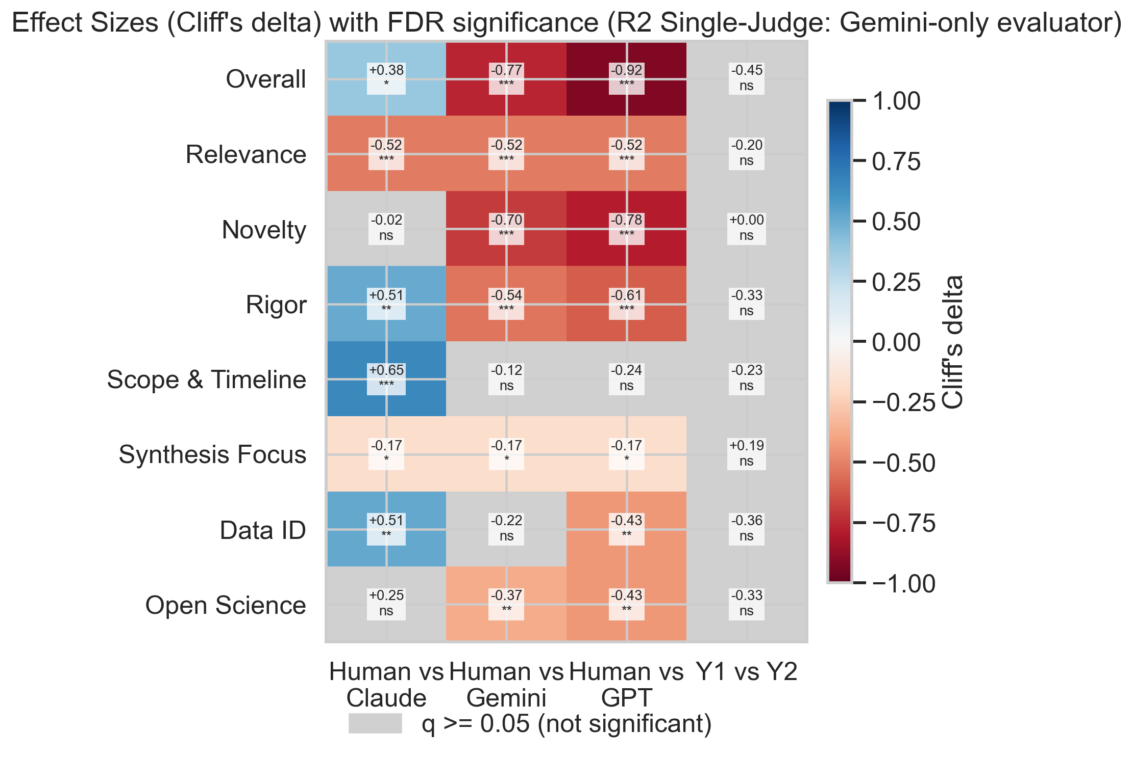
Sensitivity 2 — Gemini-Only Evaluator: Claude Falls Below Human Baseline
Single-evaluator control: all proposals evaluated by Gemini, eliminating leniency-mix confound
Design: restrict to Gemini-only reviews (92 rows). All 5 author groups evaluated by the same single evaluator.
This eliminates leniency-mix bias, at the cost of reduced power (n=23 per group, single evaluator).
Note: Gemini evaluates its own proposals (self-preference not removed here), making Gemini results still potentially inflated.
Means (Gemini-only): Human 4.23 │ Claude 3.58 (q=0.029***) │ Gemini 4.66 (q=<0.001***) │ GPT 4.83 (q=<0.001***)
Key changes from baseline:
Claude reversal: baseline q=0.358 (ns, Claude ≈ human) → Gemini-only q=0.029 (humans score significantly HIGHER than Claude).
→ Under a strict single evaluator, Claude proposals fall below human quality. The baseline equivalence was partly an artifact of mixed leniency.
GPT: still elevated above humans, robust across evaluator configurations.
Gemini: elevated above humans (but Gemini evaluates own proposals—self-preference likely inflating this result).

Slide 31
Summary: Key Findings, Big Picture, and Next Steps
Integrating R1–R3 and the sensitivity analyses into actionable conclusions
What we found:
R1: AI reviews are not detectably dissimilar to human expert reviews in text content (proxy validity holds at the bar tested).
However, AI reviewers converge far more tightly with each other than human experts do—homogeneous critique is a limitation.
R2 (baseline): AI proposals—especially GPT and Gemini—score substantially higher than human proposals under pooled AI evaluation.
R3: Self-preference biases are large (GPT: +0.99δ; Claude: −0.58δ) and evaluator leniency varies by 0.71 points across models.
After controls: GPT advantage is robust (δ=−1.00, sig across both sensitivity analyses). Gemini advantage disappears after self-removal.
Claude equivalence to humans flips to deficit under strict single-evaluator assessment.
Big picture:
AI language models—particularly GPT-5.2—generate grant proposals that are consistently rated more highly than human proposals
even by other AI models that did not write them. This is not merely an artifact of self-preference.
The pattern varies by model: Claude does not outperform humans; Gemini only does so under conditions that inflate its own score.
AI evaluators can serve as a scalable screening proxy, but they systematically compress critique diversity compared to human panels.
Limitations to address next:
1. Proxy validity beyond text similarity: ICC and rank-correlation with human panel are NaN—harmonization must be fixed.
2. Small n for human expert reviews (n=12 proposals, 47 reviews)—statistical power for human-AI calibration is limited.
3. Blinded external re-review: human raters have not scored AI proposals; the inverse direction (human rates AI) is untested.
4. GPT-5.2 near-zero variance in quality scores (SD=0.05) warrants investigation—are prompts saturating the rubric?
Recommended next steps: (a) repair proxy-validity harmonization; (b) recruit blinded human reviewers to rate AI proposals;
(c) test whether AI–AI homogeneity in reviews leads to worse ranking discrimination than human review panels.

Slide 32
Research Questions, Main Findings, and Next Steps
One-sentence answers to each RQ from the integrated evidence
RQ1 (Diversity): Do AI and human proposals differ in internal diversity?
RQ2 (Novelty): Are AI proposals more novel than humans relative to literature?
Yes. Diversity is model-specific: Claude is most diverse, GPT-5.2 is most homogeneous, and Gemini is intermediate
No. Humans are more novel than pooled AI, and model-level tests show Claude and Gemini remain significantly less novel than humans.
RQ3 (Thematic/Stylistic): Are AI and human proposals similar in topic and style?
RQ4 (Quality): Are AI and human proposals similar in quality?
No. Topic, nearest-neighbor, and cluster analyses all show source (human vs each different AI model)-linked separation, and style adjustment reduces but does not eliminate it.
AI reviews generally align with human expert feedback, but AI judges are less diverse in perspective than human panels. Quality is evaluator-sensitive: GPT remains robustly higher than human proposals under controls, Gemini attenuates after self-removal, and Claude is not superior under stricter evaluator settings.
Main takeaway: AI can optimize proposal scores without matching human novelty; model choice creates clear tradeoffs across diversity, novelty, and scored quality.
Next Steps: Add blinded human scoring of AI proposals, fix reviewer-calibration reliability (ICC/rank agreement)

