Slide 1
Diverse but Not Novel
Embedding-Based Analysis Reveals Systematic Differences
Between AI-Generated and Human-Written Research Proposals
IC2S2 Submission — Compiled Figures

Slide 2
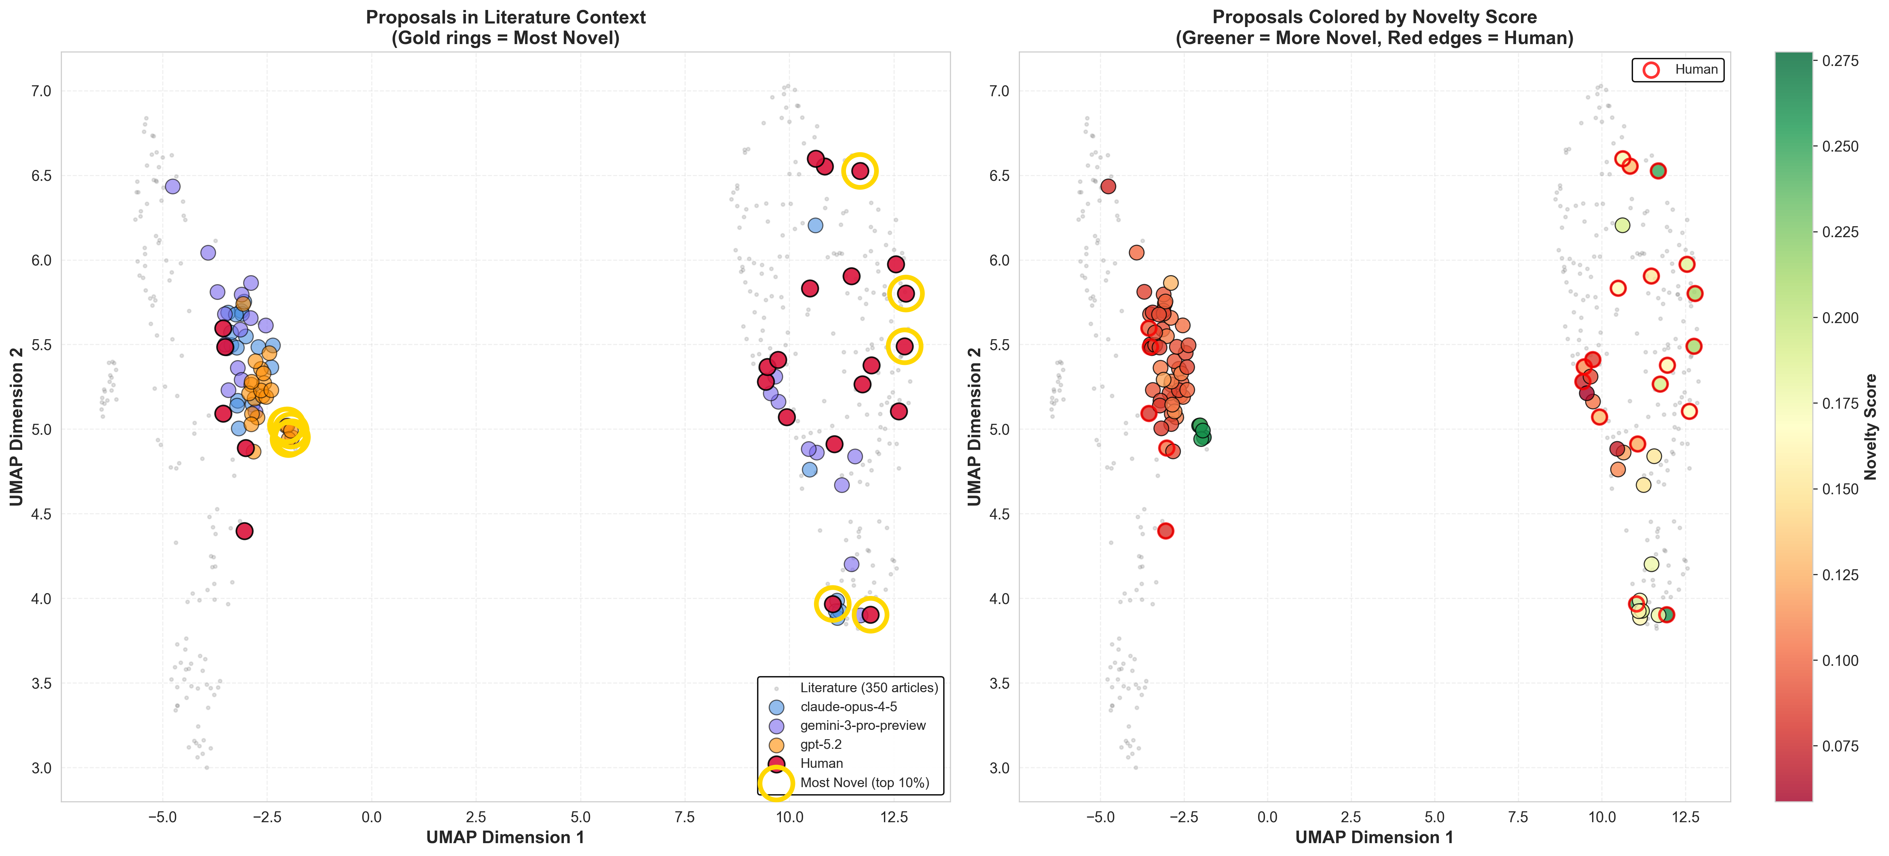
Figure 1 — UMAP: Proposals + PubMed Articles by Source and Model

Slide 3
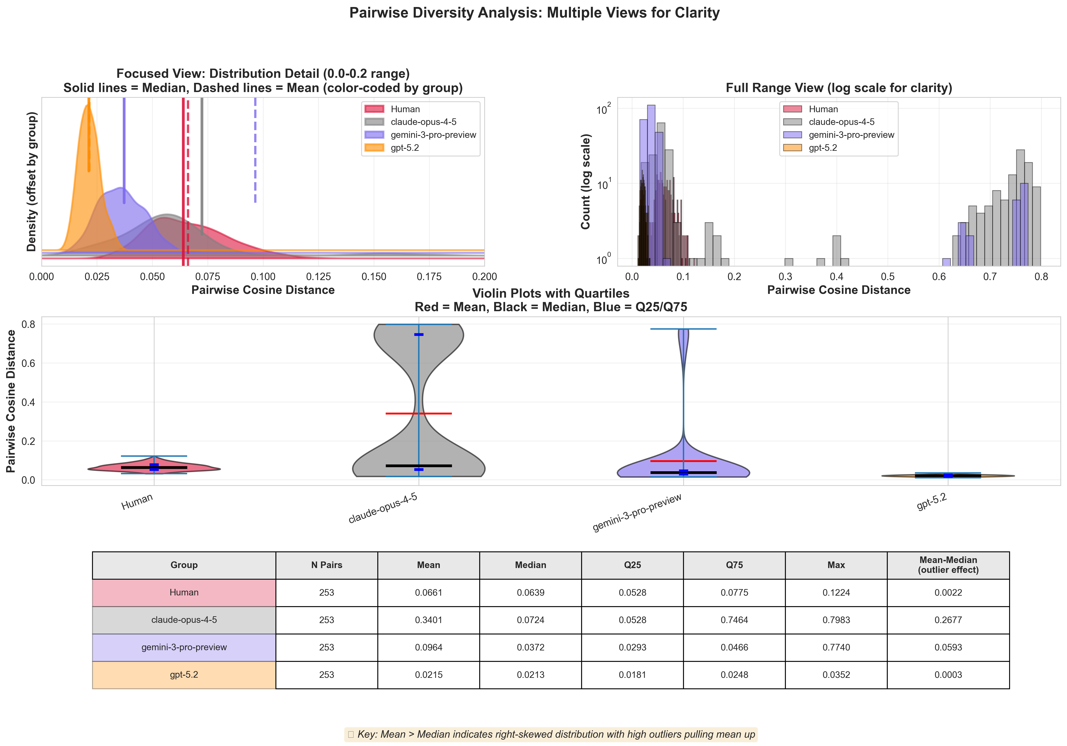
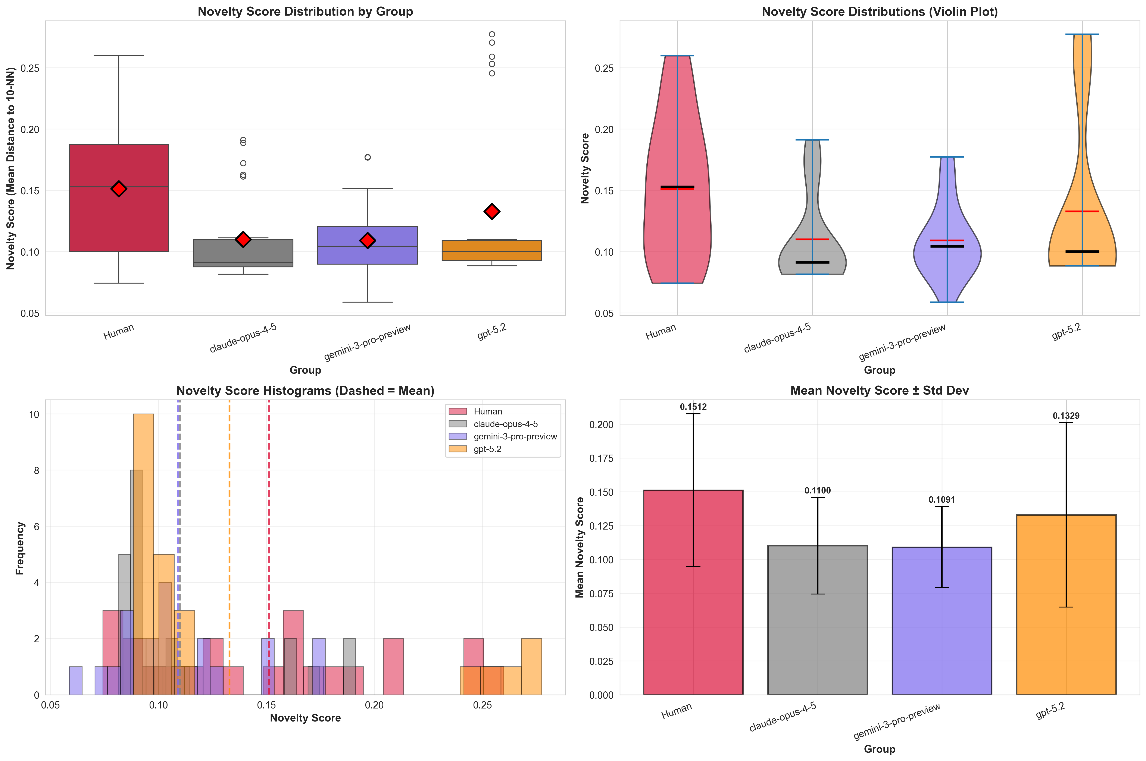
Figure 2 — Within-Group Diversity and Novelty by Model (Cliff's δ)

Slide 4
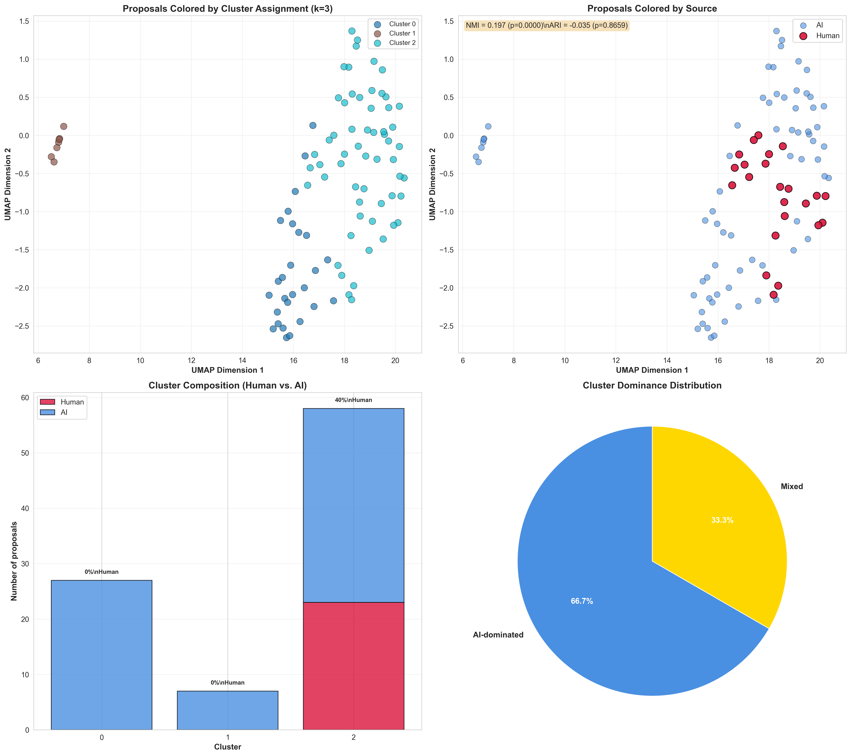
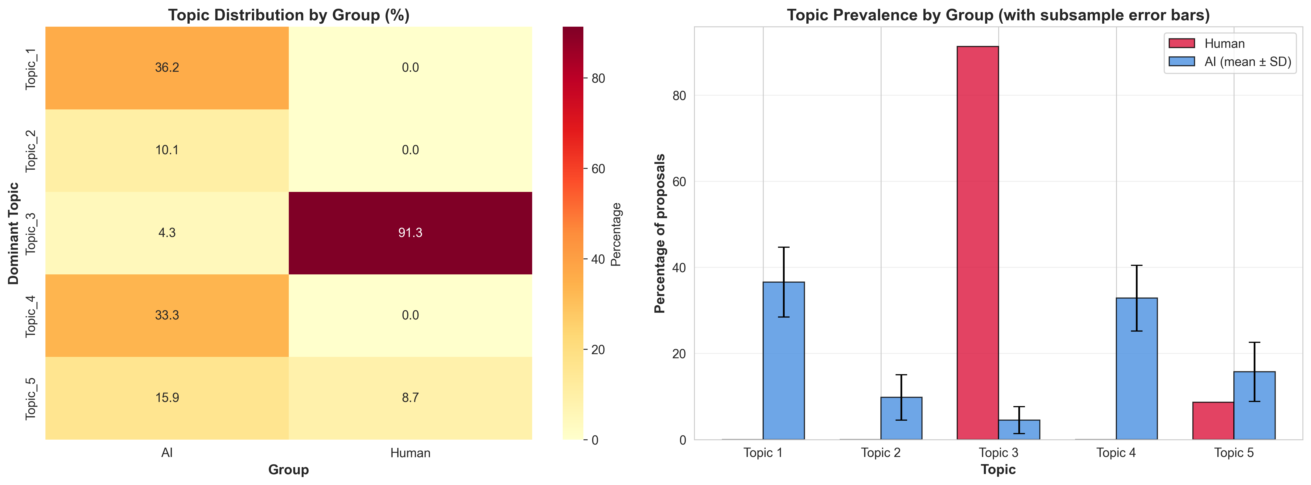
Figure 3 — Semantic Segregation: GMM Clusters and Topic Prevalence by Source

Slide 5
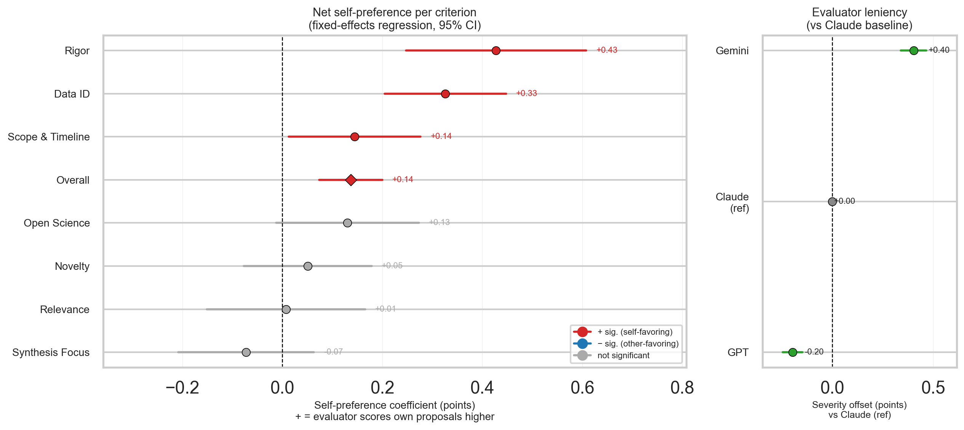
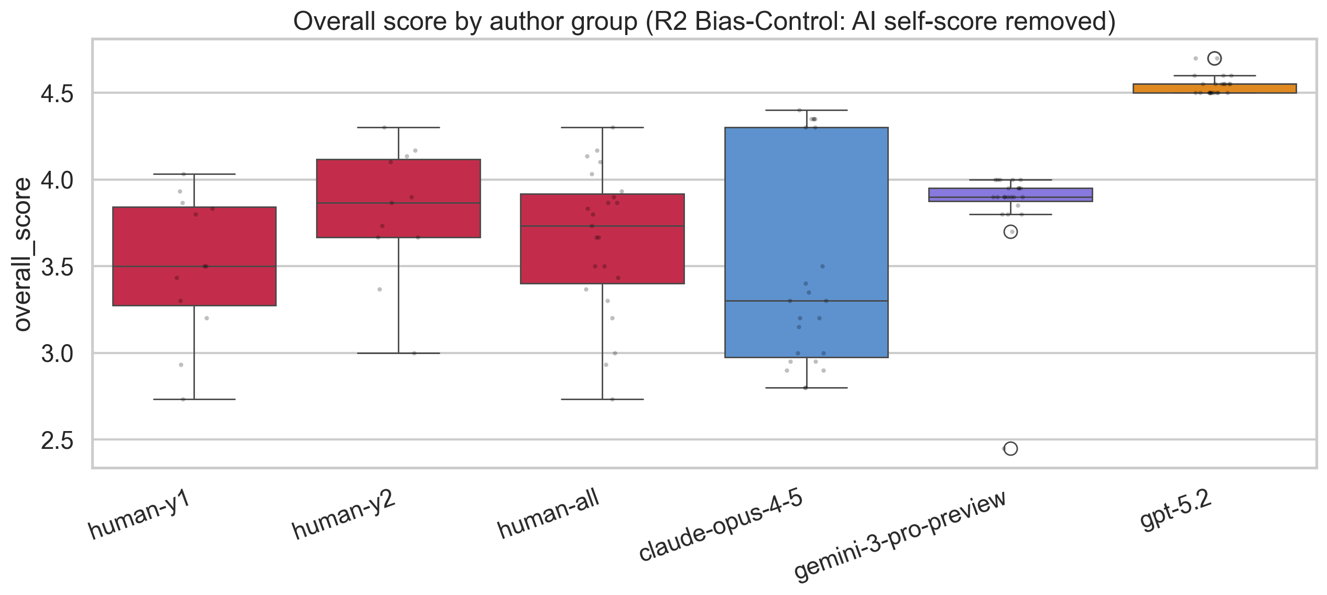
Figure 4 — AI Evaluation Quality: Self-Preference Bias and Cross-Evaluator Scores

