Slide 1
Comparing Diversity, Novelty, and Quality
of AI vs Human Research Proposals
Embedding-Based Comparison Using BioLinkBERT
February 2026

Slide 2
Study Design
Research Question
Approach
How do AI-generated research proposals compare to human-written proposals in diversity, novelty, quality, and thematic content when responding to the same funding call?
All models received the same funding call and evaluation criteria. All analyses use BioLinkBERT embeddings with non-parametric statistical tests.
We compare 23 human proposals and 69 AI proposals (from three frontier models) for the NSF NCEMS call, using embedding-based analyses across three dimensions: internal diversity, novelty relative to published literature, and thematic/cluster composition.
Analysis spans four parts:
(1) Diversity via pairwise, centroid, and nearest-neighbor metrics;
(2) Novelty via distance to a PubMed literature corpus;
(3) Thematic separation via topic modeling and cluster analysis.
(4) Stylistic comparison and regularization
Data
23
AI Models Tested
Human proposals (written by top scientists in MCB domain)
Claude Opus 4.5
69
Gemini 3 Pro Preview
GPT-5.2
AI proposals (23 per model)

Slide 3
Methodology
Embedding Pipeline
BioLinkBERT-large
340M-param biomedical model pretrained on PubMed with citation links. Encodes each proposal as a 1024-dim vector (400-word overlapping chunks, averaged).
Cosine distance in 1024-dim space for all metrics. Mann-Whitney U tests, Cliff’s delta, and permutation tests (10K iterations) for all comparisons.
Key Metric Definitions
Diversity
Novelty
Thematic & Stylistic Separation
Quality
How different are proposals from each other within the same group and between groups?
Measured by cosine distances between proposal embeddings. Three complementary lenses:
pairwise distances (all pairs)
centroid dispersion (distance to group center)
nearest-neighbor analysis (closest proposal in the combined space of all groups).
How far are proposals from what already exists in the scientific literature?
Measured as mean cosine distance from each proposal to its 10 nearest neighbors in a corpus of 350 PubMed articles. Higher = more novel.
Crucially different from diversity: a group can be internally diverse but still close to published work, or internally homogeneous but exploring genuinely new territory.
Do human and AI proposals occupy the same conceptual regions (based on topics and styles)?
LDA topic modeling identifies latent themes;
Gaussian Mixture Model clustering groups proposals by embedding similarity. Tests whether sources are segregated or intermingled.
Stylistic features seperation between groups
Do human and AI proposals exhibit same level of quality?
Human domain experts reviewed all human proposals and provided qualitative reviews;
AI reviewed all proposals with same criteria and requirements;
Compared similarity between AI and human reviews to check whether AI reviews are valid proxy

Slide 4
Methodology
Analysis Overview
Why these separate analyses?
Diversity asks: “Are the ideas varied?” Novelty asks: “Are they new relative to the field?” Thematic analysis asks: “Are they about the same things?” Quality asks: “Are they ‘good’ based on defined metrics?” A model can score high on one and low on another — these dimensions are complementary, not redundant.
Diversity (Slides 4-7)
Novelty (Slides 8-9)
Thematic & Stylistic (10-11)
Quality
• Pairwise distances — all n(n−1)/2 pairs within each group
• Centroid dispersion — distance from each proposal to group mean
• Nearest-neighbor — closest proposal in combined 92-proposal space
• Embedding visualization — UMAP 2D projection
• Literature corpus: 350 PubMed articles from 7 search queries
• Novelty score: mean distance to k=10 nearest neighbors in literature
• Compares title+abstract embeddings (fair comparison with abstracts)
• Statistical tests: same non-parametric framework as Part I
• LDA topic modeling (k=5, strong priors, stability-validated)
• Topic distribution: Fisher’s exact tests with FDR correction
• GMM clustering (k=3, selected by BIC)
• Segregation metrics: NMI, ARI, between/within distance ratio

Slide 5
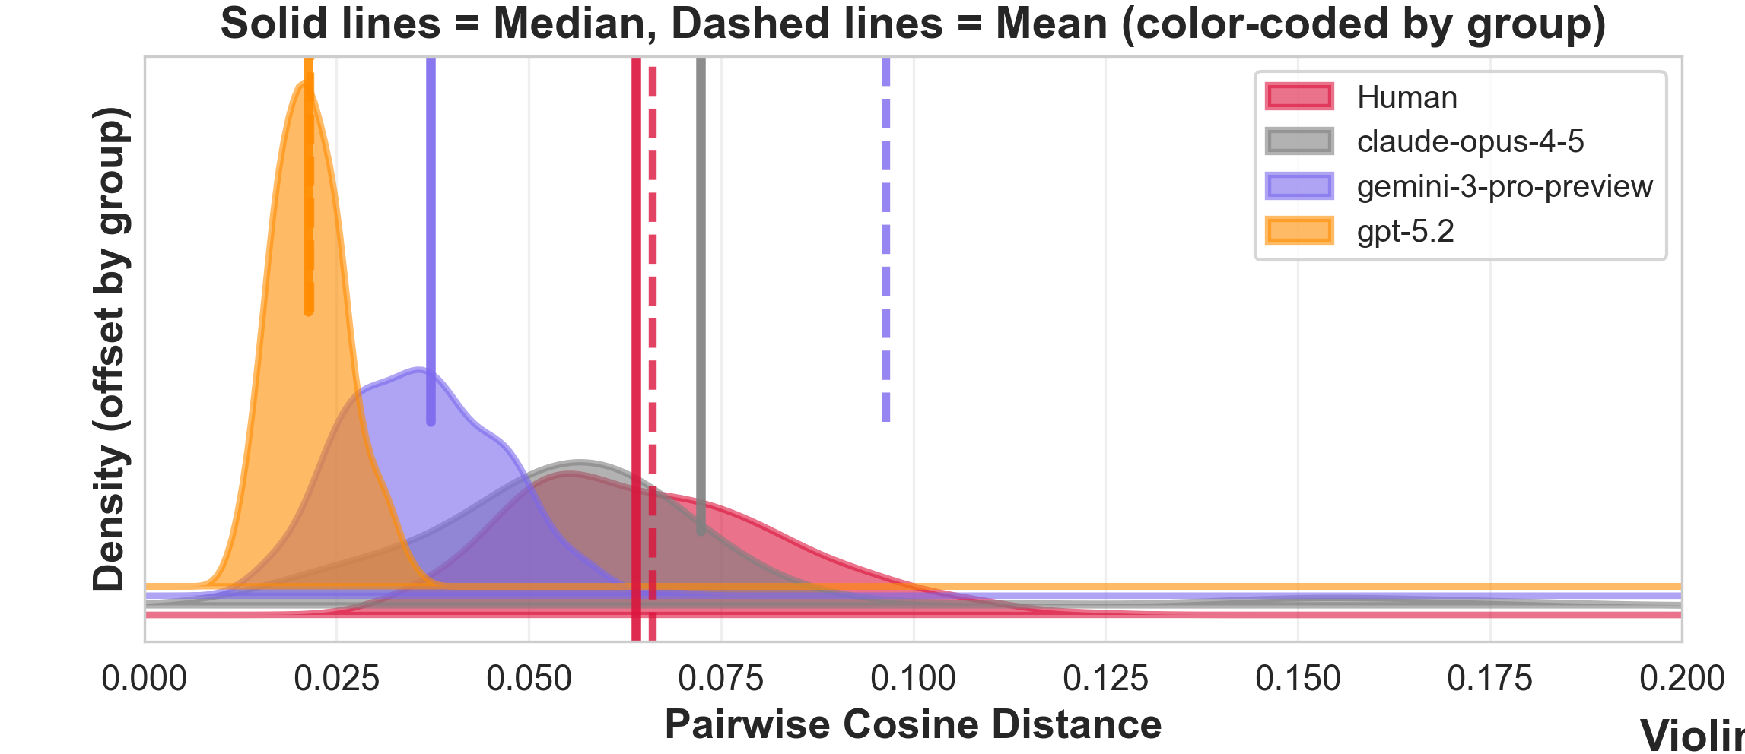
Analysis 1: Within-Group Pairwise Diversity
Results
Key Findings
Human baseline: mean 0.066; median 0.064; Std 0.018;
Claude Opus 4.5 is the only model MORE diverse than humans
Mean pairwise distance: 0.340 vs Human 0.066 (small effect, p < 0.001). However, highly skewed distribution: median 0.072 with long tail to 0.8.
GPT-5.2 shows extreme homogeneity
Mean pairwise distance: 0.022 (3x lower than humans). Cliff's Delta = -1.00 (maximum possible effect). Proposals are near-identical.
Gemini 3 Pro is moderately less diverse than humans
Mean: 0.096. Cliff's Delta = -0.73 (large effect, p < 0.001). More varied than GPT-5.2 but still significantly less than human.
All AI combined shows a small negative effect
Cliff's Delta = -0.29 (small). Aggregating masks dramatic between-model differences.
Cliff's Delta effect sizes vs Human baseline. Positive = AI more diverse.

Slide 6
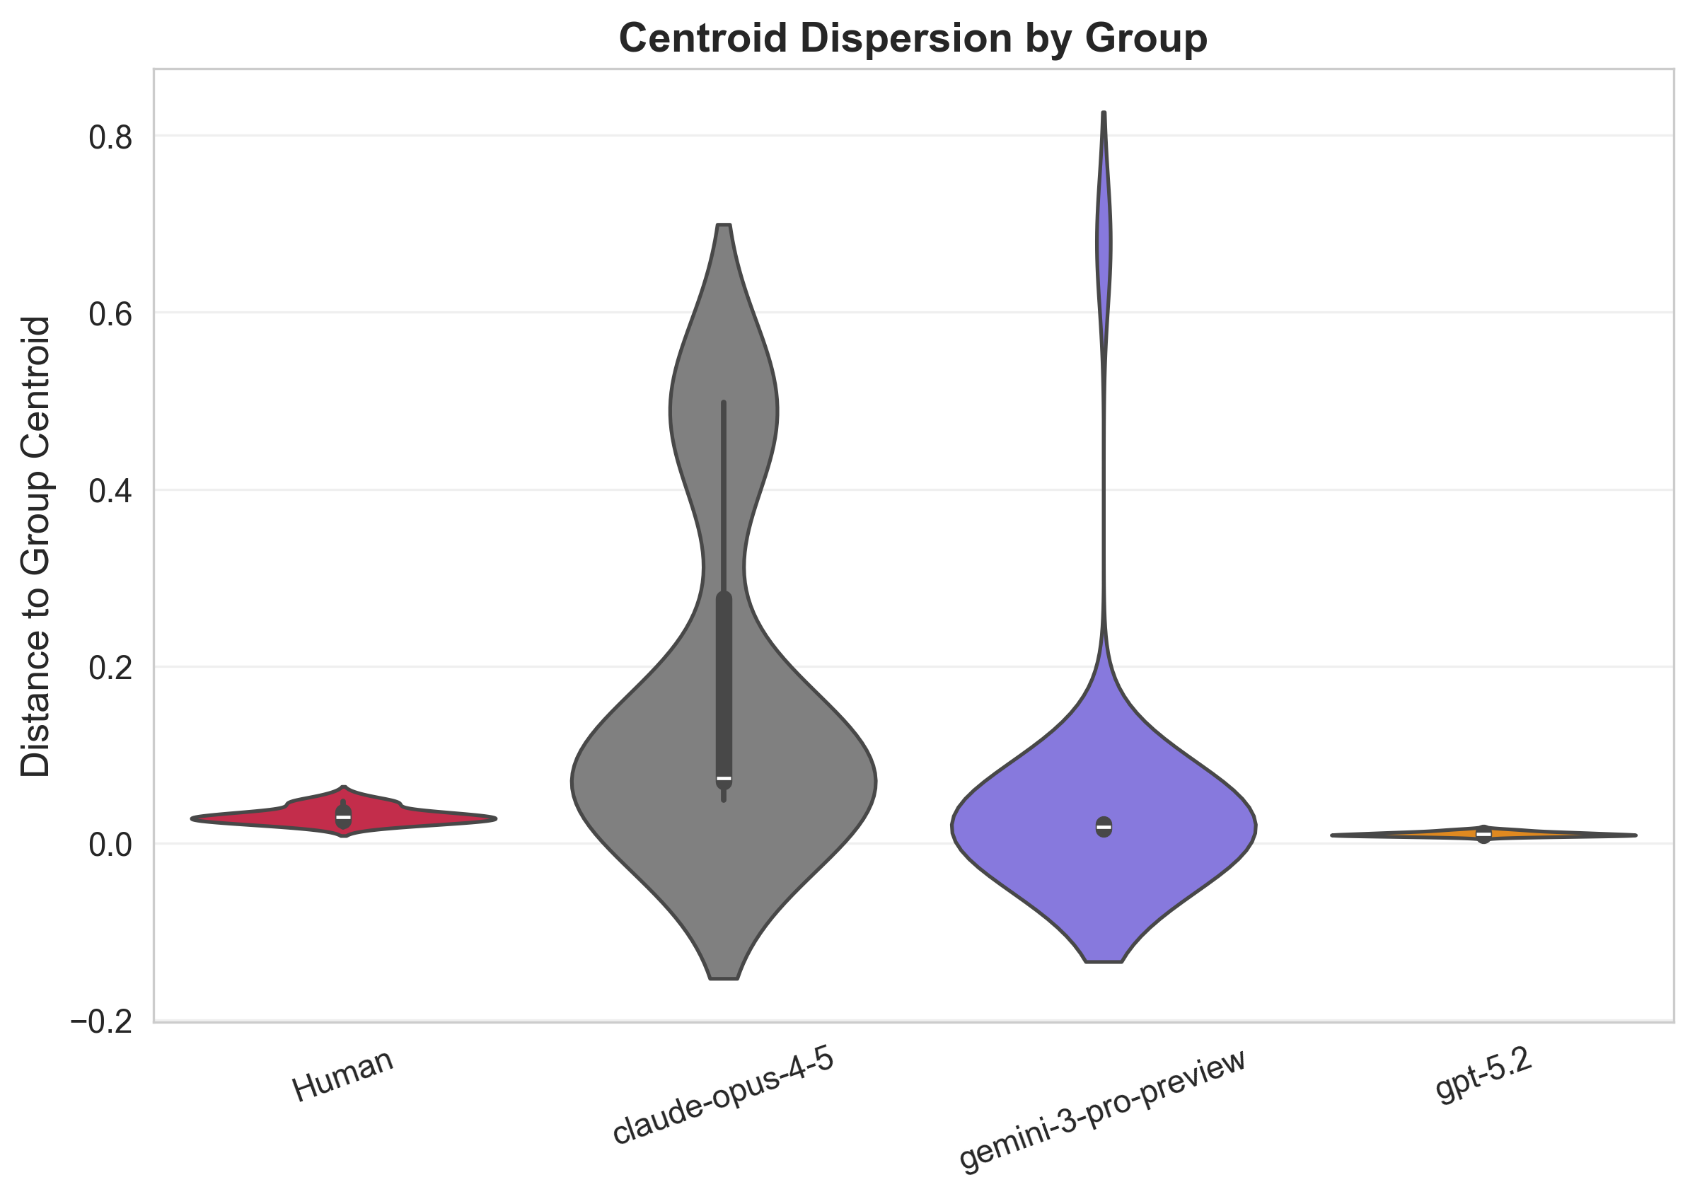
Analysis 2: Centroid Dispersion
Results
Key Findings
Human baseline: Mean 0.032; Median 0.029; Std 0.009;
Claude shows massive dispersion from its centroid
Mean dist: 0.179 vs Human 0.032. Cliff's Delta = +0.99 (near-maximum large effect, p < 0.001). Proposals spread widely around center.
GPT-5.2 is tightly clustered around its centroid
Mean dist: 0.010. Cliff's Delta = -1.00 (p < 0.001). Variance: 0.000005 vs Human 0.00008. Near-zero spread: all proposals essentially the same point in embedding space.
Gemini is less dispersed than humans
Mean dist: 0.047; Median 0.0178; SD 0.1348; Cliff's Delta = -0.82 (large effect, p < 0.001). Moderate clustering, though has some high-distance outlier proposals that skewed mean and sd.
All AI combined vs Human: not significant
Cliff's Delta = -0.17, p = 0.22. Claude's high dispersion offsets GPT-5.2's low dispersion, producing a misleading null result when aggregated.
Mean distance from each proposal to its group centroid. Larger = more spread out from center.
Consistency: Confirms pairwise analysis ranking: Claude > Human > Gemini > GPT-5.2

Slide 7
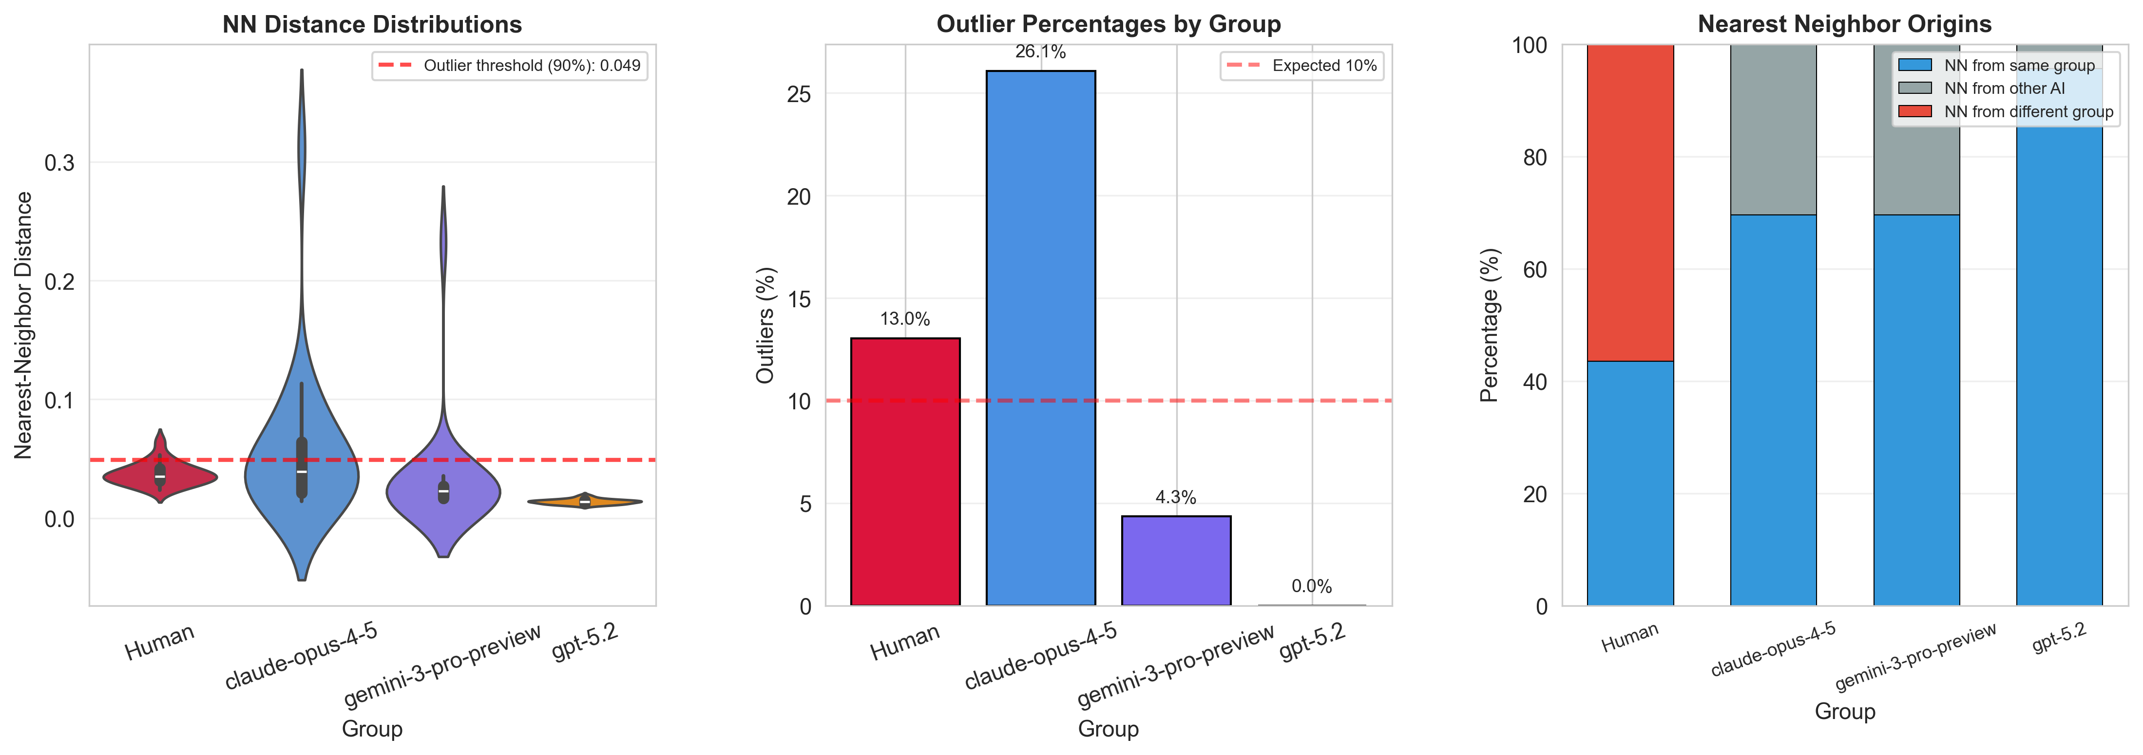
Analysis 3: Nearest-Neighbor Outlier Detection
Outliers = top 10% largest NN distances across all 92 proposals.
Outlier Rates (top 10% NN distance)
Key Findings
13.0%
26.1%
GPT-5.2 paradox: most outliers despite least diverse
Human
Claude
26.1% outliers. Its extreme internal similarity creates a tight, isolated cluster far from everyone else. Individual proposals appear as outliers in the global space.
4.3%
0 %
Claude: zero outliers despite highest diversity
Gemini
GPT-5.2
0% outliers, smallest NN distances (mean 0.014). Claude forms subclusters that are individually tight but spread across the space. Each proposal has a close neighbor.
Human proposals produce genuine outliers
13% outliers. 43.5% have NN from own group; 56.5% NN from AI. Humans occupy shared territory but also produce truly unique ideas.
100% of AI proposals' nearest neighbors are other AI
No AI proposal is closest to a human proposal. 95.7% of Claude's NN are from Claude itself. Suggests systematic framing differences between AI and human approaches.

Slide 8
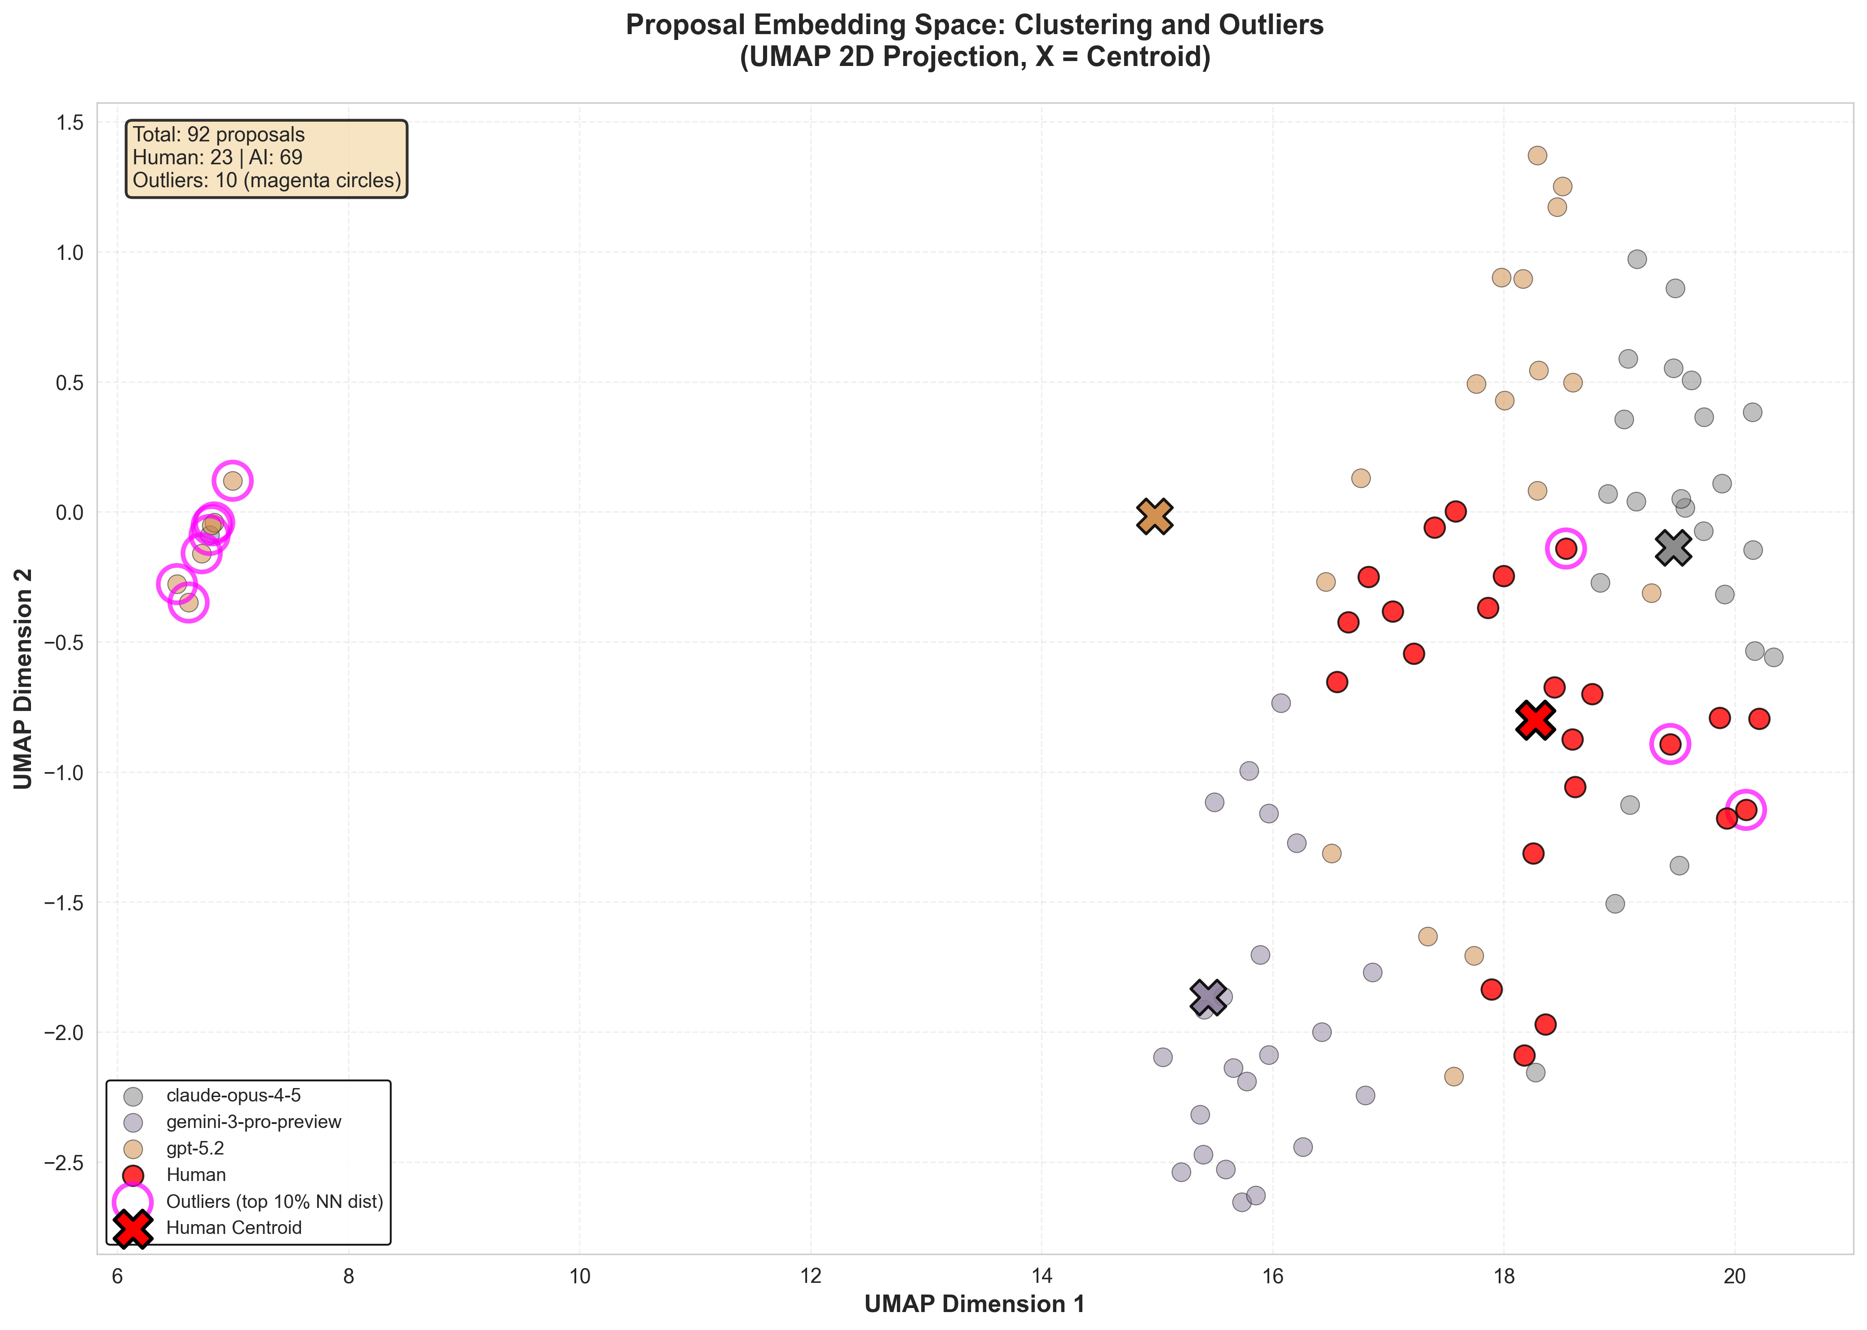
Embedding Space Visualization
UMAP 2D Projection
92 proposals projected from 1024-dim to 2D. X markers = group centroids. Magenta circles = outliers.
GPT-5.2 forms a tight, isolated cluster on the far left, visually confirming near-identical output.
Claude proposals are spread across multiple regions, forming distinct subclusters.
Gemini shows moderate clustering with some spread.
Human proposals are distributed throughout the center-right, overlapping with Claude and Gemini.
Outliers (magenta) are predominantly human and GPT-5.2 proposals at the space periphery.

Slide 9
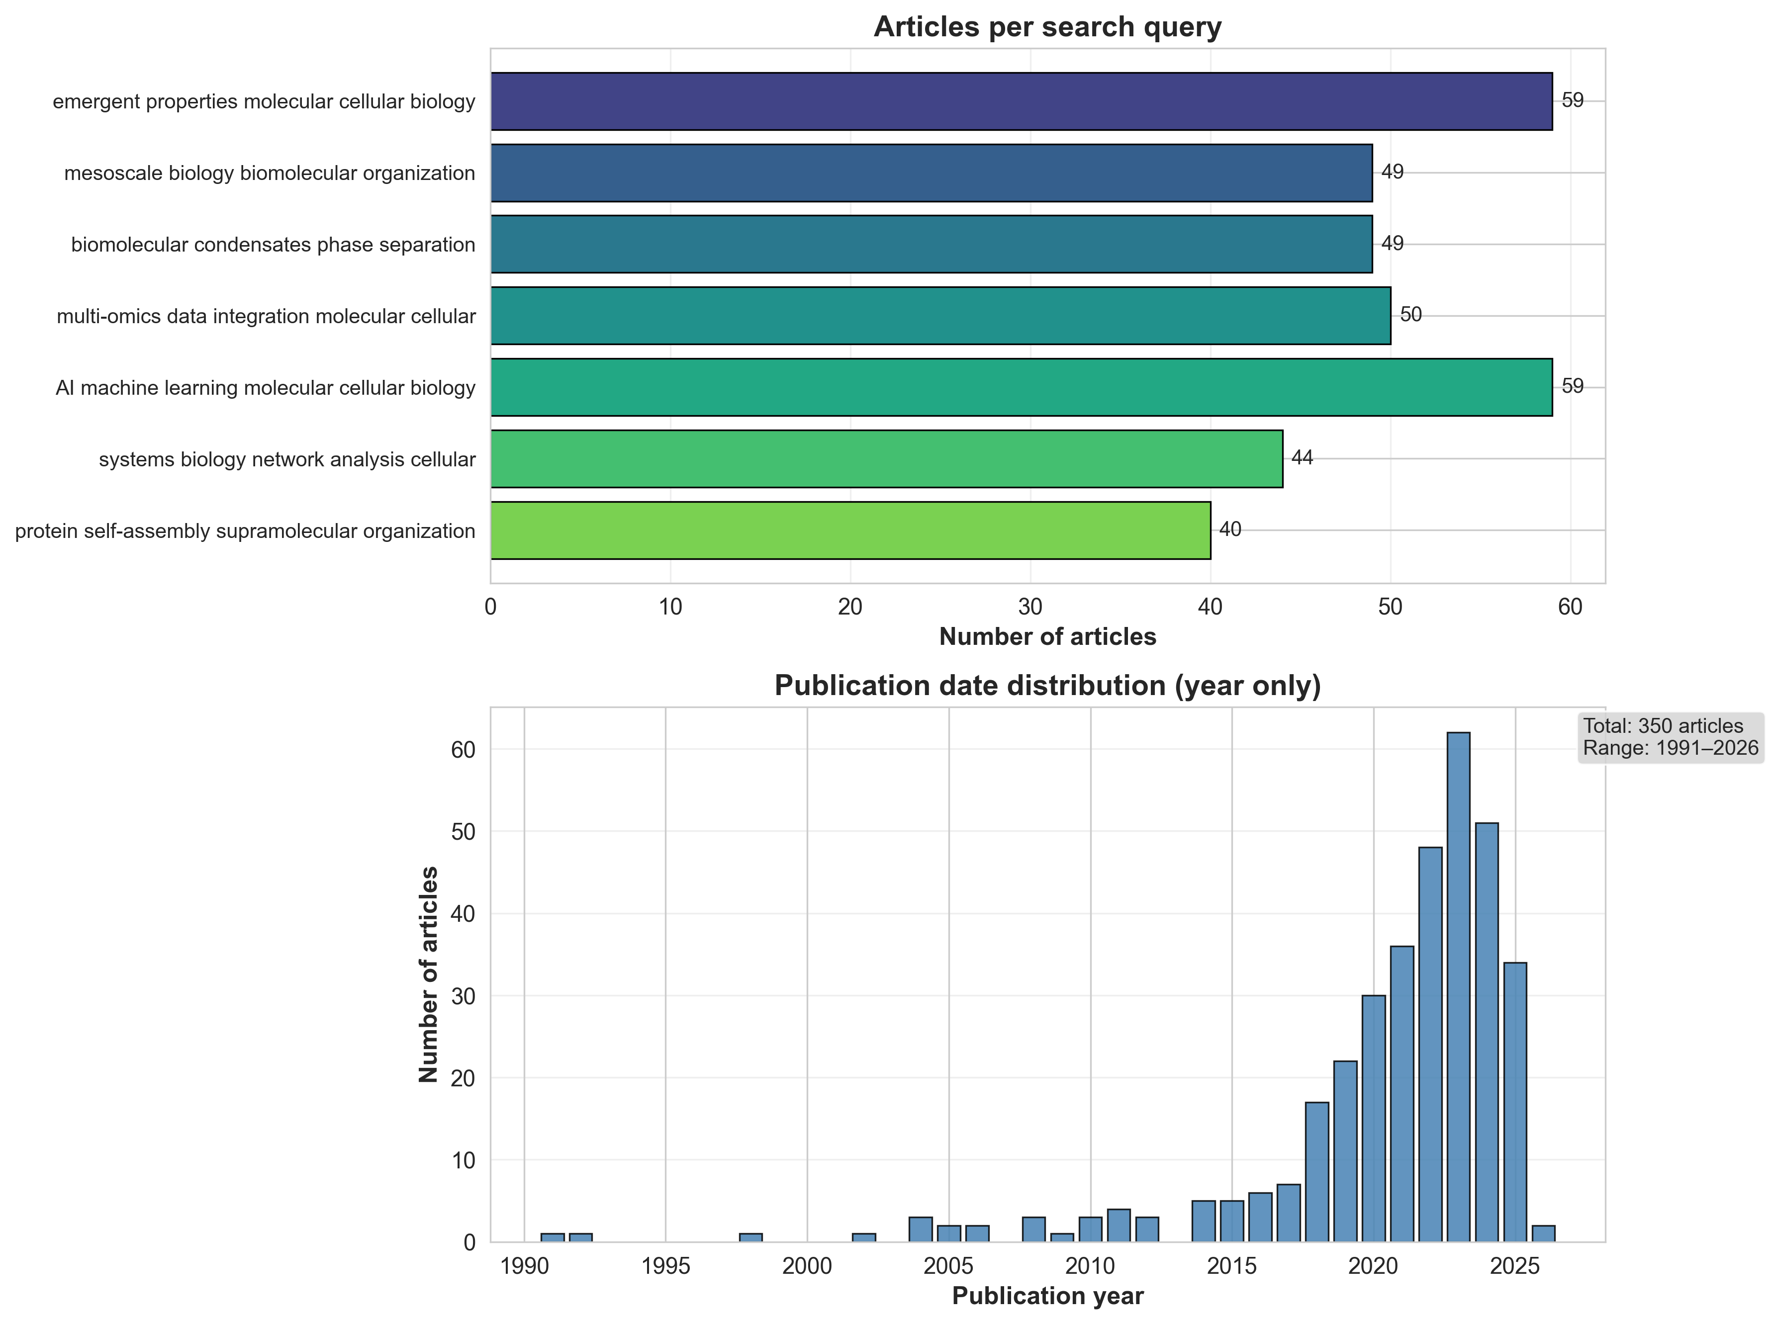
Defining Novelty & the Literature Corpus
How is novelty measured?
Reference Literature Corpus
For each proposal, we find its k=10 nearest neighbors in a reference corpus of published PubMed articles and compute the mean cosine distance. A higher score means the proposal is further from anything previously published — it explores territory that the existing literature does not cover. We embed only the title + abstract of each proposal (not the full text) to ensure a fair comparison with the PubMed abstracts.
How does novelty differ from diversity?
Diversity
Novelty
Compares proposals to each other within a group. A diverse group produces varied ideas, but those ideas may all be well-known in the literature. Reference: internal (proposals vs. proposals).
Compares proposals to published literature. A novel proposal explores territory that no published paper covers, regardless of how similar it is to other proposals. Reference: external (proposals vs. PubMed).
350 PubMed articles from 7 targeted queries
• Emergent properties in molecular/cellular biology (59 articles) • Mesoscale biology & biomolecular organization (49) • Biomolecular condensates & phase separation (49) • Multi-omics data integration (50) • AI/ML in molecular & cellular biology (59) • Systems biology & network analysis (44) • Protein self-assembly & supramolecular organization (40) Mean abstract length: 1,351 characters. Embedded with BioLinkBERT using same pipeline as proposals.
Implication: A model can be highly diverse (varied output) but low novelty (ideas the field already knows), or low diversity (repetitive) but high novelty (repetitively novel). These are independent dimensions.

Slide 10
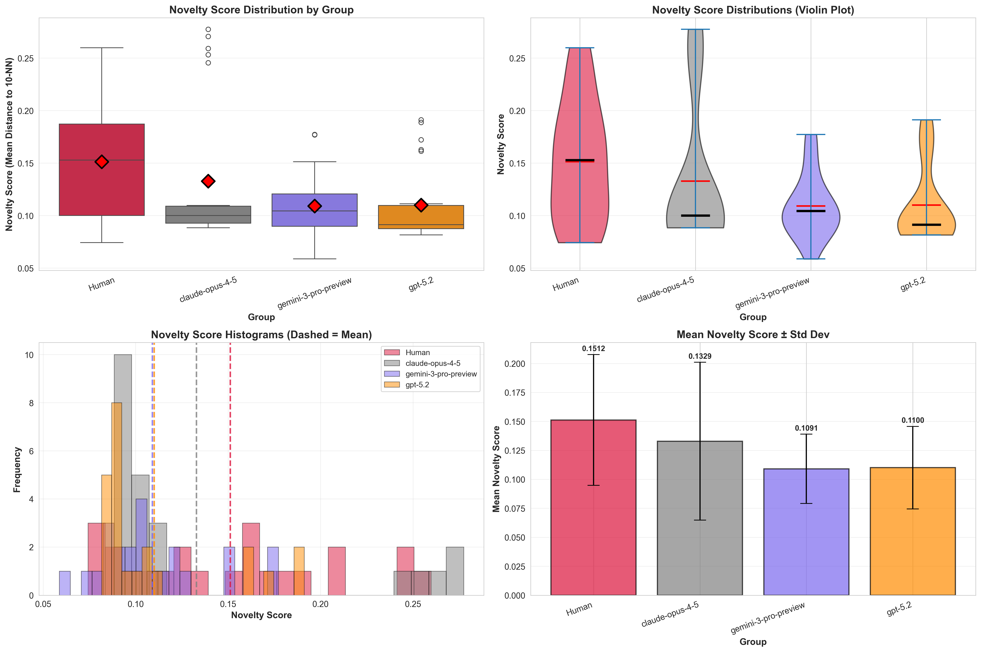
Novelty Analysis: Distance from Existing Literature
Novelty = Mean cosine distance to 10 nearest neighbors in a corpus of 350 PubMed articles
Human proposals are more novel than AI
Human mean novelty: 0.151 vs AI combined: 0.117 (Cliff’s d = −0.34, medium effect, p = 0.014). Human proposals sit further from published literature, suggesting they draw on less well-trodden ideas.
Claude is closest to human novelty
Claude: d = −0.21 (small, p = 0.22, not significant). Gemini: d = −0.42 (medium, p = 0.016). GPT-5.2: d = −0.40 (medium, p = 0.020). The same model that shows greatest internal diversity also produces the most novel output.
Most vs. least novel proposals
Most novel human: “Cytokinetic Bottlenecks of Heat Waves” (0.260). Least novel AI: a Gemini antibiotic resistance proposal (0.059), nearly overlapping published work. AI’s lower novelty may reflect reliance on training-data-dominant framings.

Slide 11
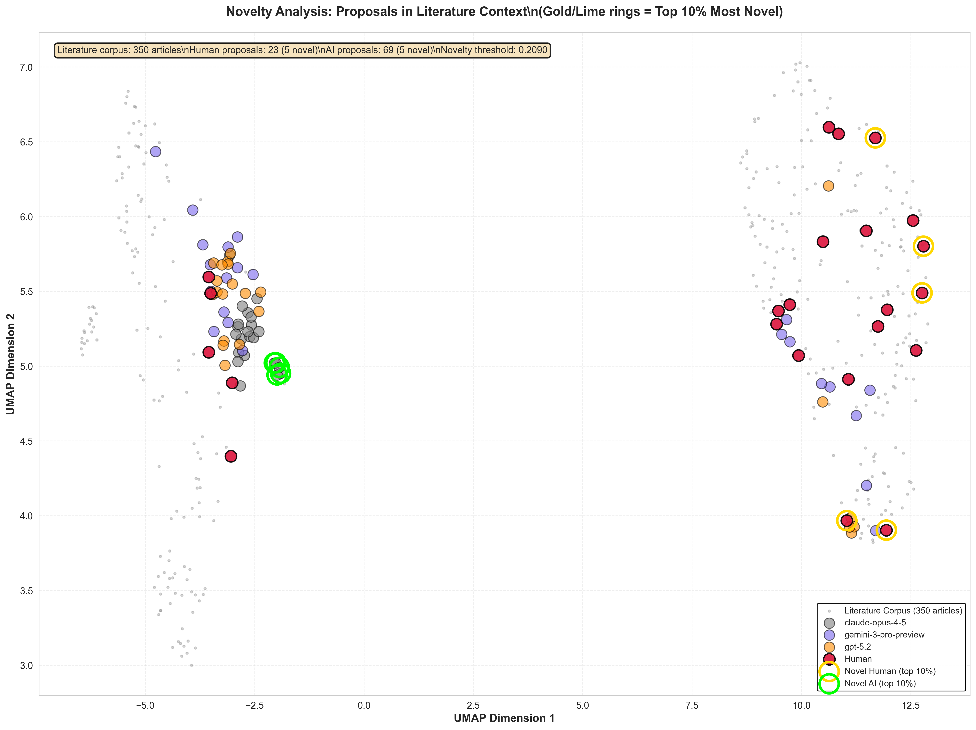
Novelty in Embedding Space
Proposals (colored) projected alongside 350 PubMed articles (gray) via UMAP
Key observations
Human proposals (red markers) sit at the periphery of the literature cluster, occupying regions where fewer published articles exist. This is consistent with the novelty scores: humans venture further from the established literature.
AI proposals (colored markers) tend to concentrate closer to dense literature regions, particularly GPT-5.2 and Gemini. Claude proposals show more scatter, with some overlapping human territory, consistent with its non-significant novelty difference.
Interpretation caveat: UMAP projections can distort distances. The quantitative novelty scores (slide 8) are the primary evidence; this visualization serves as a qualitative consistency check. Proposals near literature ≠ low quality, and distance from literature could also indicate incoherence.
Linking diversity and novelty: GPT-5.2’s tight internal cluster maps onto well-published territory.
High internal similarity + low novelty = AI re-deriving the same ideas from training data.
Claude’s spread extends into less-charted space, mirroring its higher novelty scores.

Slide 12
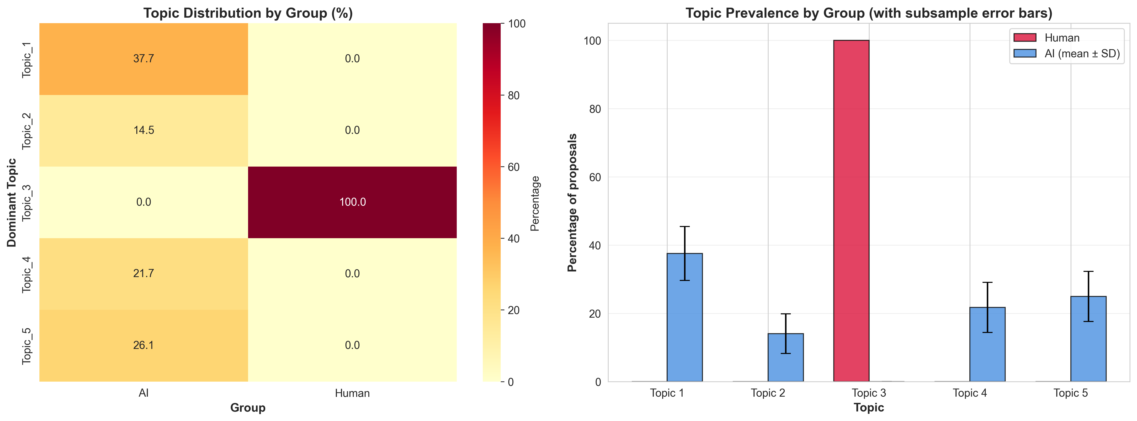
Thematic Analysis: Topic Distribution
LDA topic modeling (k=5, strong priors) with Fisher’s exact tests and FDR correction
Critical caveat
Perfect separation is a red flag: LDA may be capturing systematic stylistic or templating artifacts rather than genuine scientific themes. Human entropy = 0 (all in one topic) is suspicious. These results are exploratory and require validation with expert coding.
Complete thematic separation
Per-topic Fisher’s exact tests (FDR-corrected)
All 23 human proposals map to a single dominant topic (Topic 3: evolutionary/species-level biology). All 69 AI proposals distribute across the other 4 topics (mechanical/structural, transport/diffusion, imaging/perturbation, splicing/allosteric). Overall chi-square permutation test: p < 0.0001.
Topic 3 (human-exclusive): p < 0.0001. Topics 1, 4, 5 (AI-overrepresented): p < 0.05. Topic 2 (AI-leaning): p = 0.061 (marginal). Subsample validation (n=23 each, 1000 iter): Topics 1 and 3 robust (>98%); Topic 2 weak (18.5%).

Slide 13
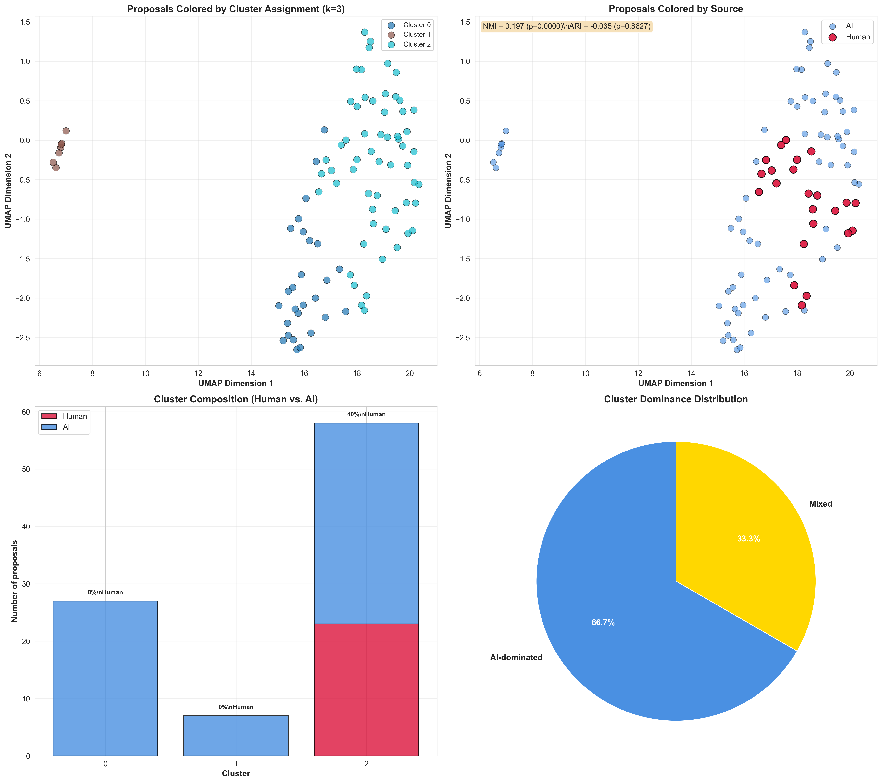
Cluster Segregation Analysis
Gaussian Mixture Model clustering (k=3, selected by BIC) with segregation metrics
Cluster composition reveals asymmetric segregation
Cluster 0 (n=27): 100% AI. Cluster 1 (n=7): 100% AI. Cluster 2 (n=58): 40% human, 60% AI. Two clusters are entirely AI-dominated. All 23 human proposals land in a single mixed cluster, while AI proposals spread across all three, suggesting AI occupies distinct conceptual regions that humans do not enter.
Segregation metrics
NMI = 0.197 (p < 0.0001): clusters predict human/AI source better than chance. ARI = −0.035 (p = 0.86): no agreement beyond chance (expected given unbalanced groups). Between/within distance ratio = 1.085 (p = 0.004): human and AI proposals are measurably more distant from each other than from their own group.
Connecting the evidence
Cluster segregation corroborates the nearest-neighbor finding (100% AI-AI nearest neighbors) and the topic separation. Across three independent methods — NN analysis, LDA topic modeling, and GMM clustering — humans and AI occupy different semantic territories.

Slide 14
Integrated Findings Across All Analyses
Convergent evidence from diversity, novelty, thematic, and cluster analyses
Diversity ranking is consistent
Novelty tracks a different dimension
Claude > Human > Gemini > GPT-5.2, confirmed by pairwise, centroid, and NN analyses. All three metrics agree: same ranking, consistent effect sizes, robust under permutation.
Human > Claude > GPT-5.2 ≈ Gemini for novelty. Humans are both moderately diverse AND more novel. Claude is most diverse but only moderately novel, suggesting its spread is within AI-typical territory. Diversity ≠ novelty.
Semantic segregation confirmed 3 ways
Aggregation masks real differences
100% AI-AI nearest neighbors (NN analysis). Complete topic separation (LDA). Two AI-only clusters (GMM, NMI p < 0.0001). Human and AI proposals occupy different semantic regions, even when AI shows high internal diversity.
“AI vs Human” centroid dispersion: non-significant (p = 0.22). But per-model: Claude d = +0.99, GPT-5.2 d = −1.00. Similarly, topic entropy (AI = 1.94, Human = 0.00) hides that humans produce truly distinctive ideas rather than a single narrow theme.
Bottom line: AI models generate systematically different kinds of ideas than humans, and they differ dramatically from each other. Human proposals are more novel relative to existing literature and occupy unique conceptual territory that no AI model fully reaches.

Slide 15
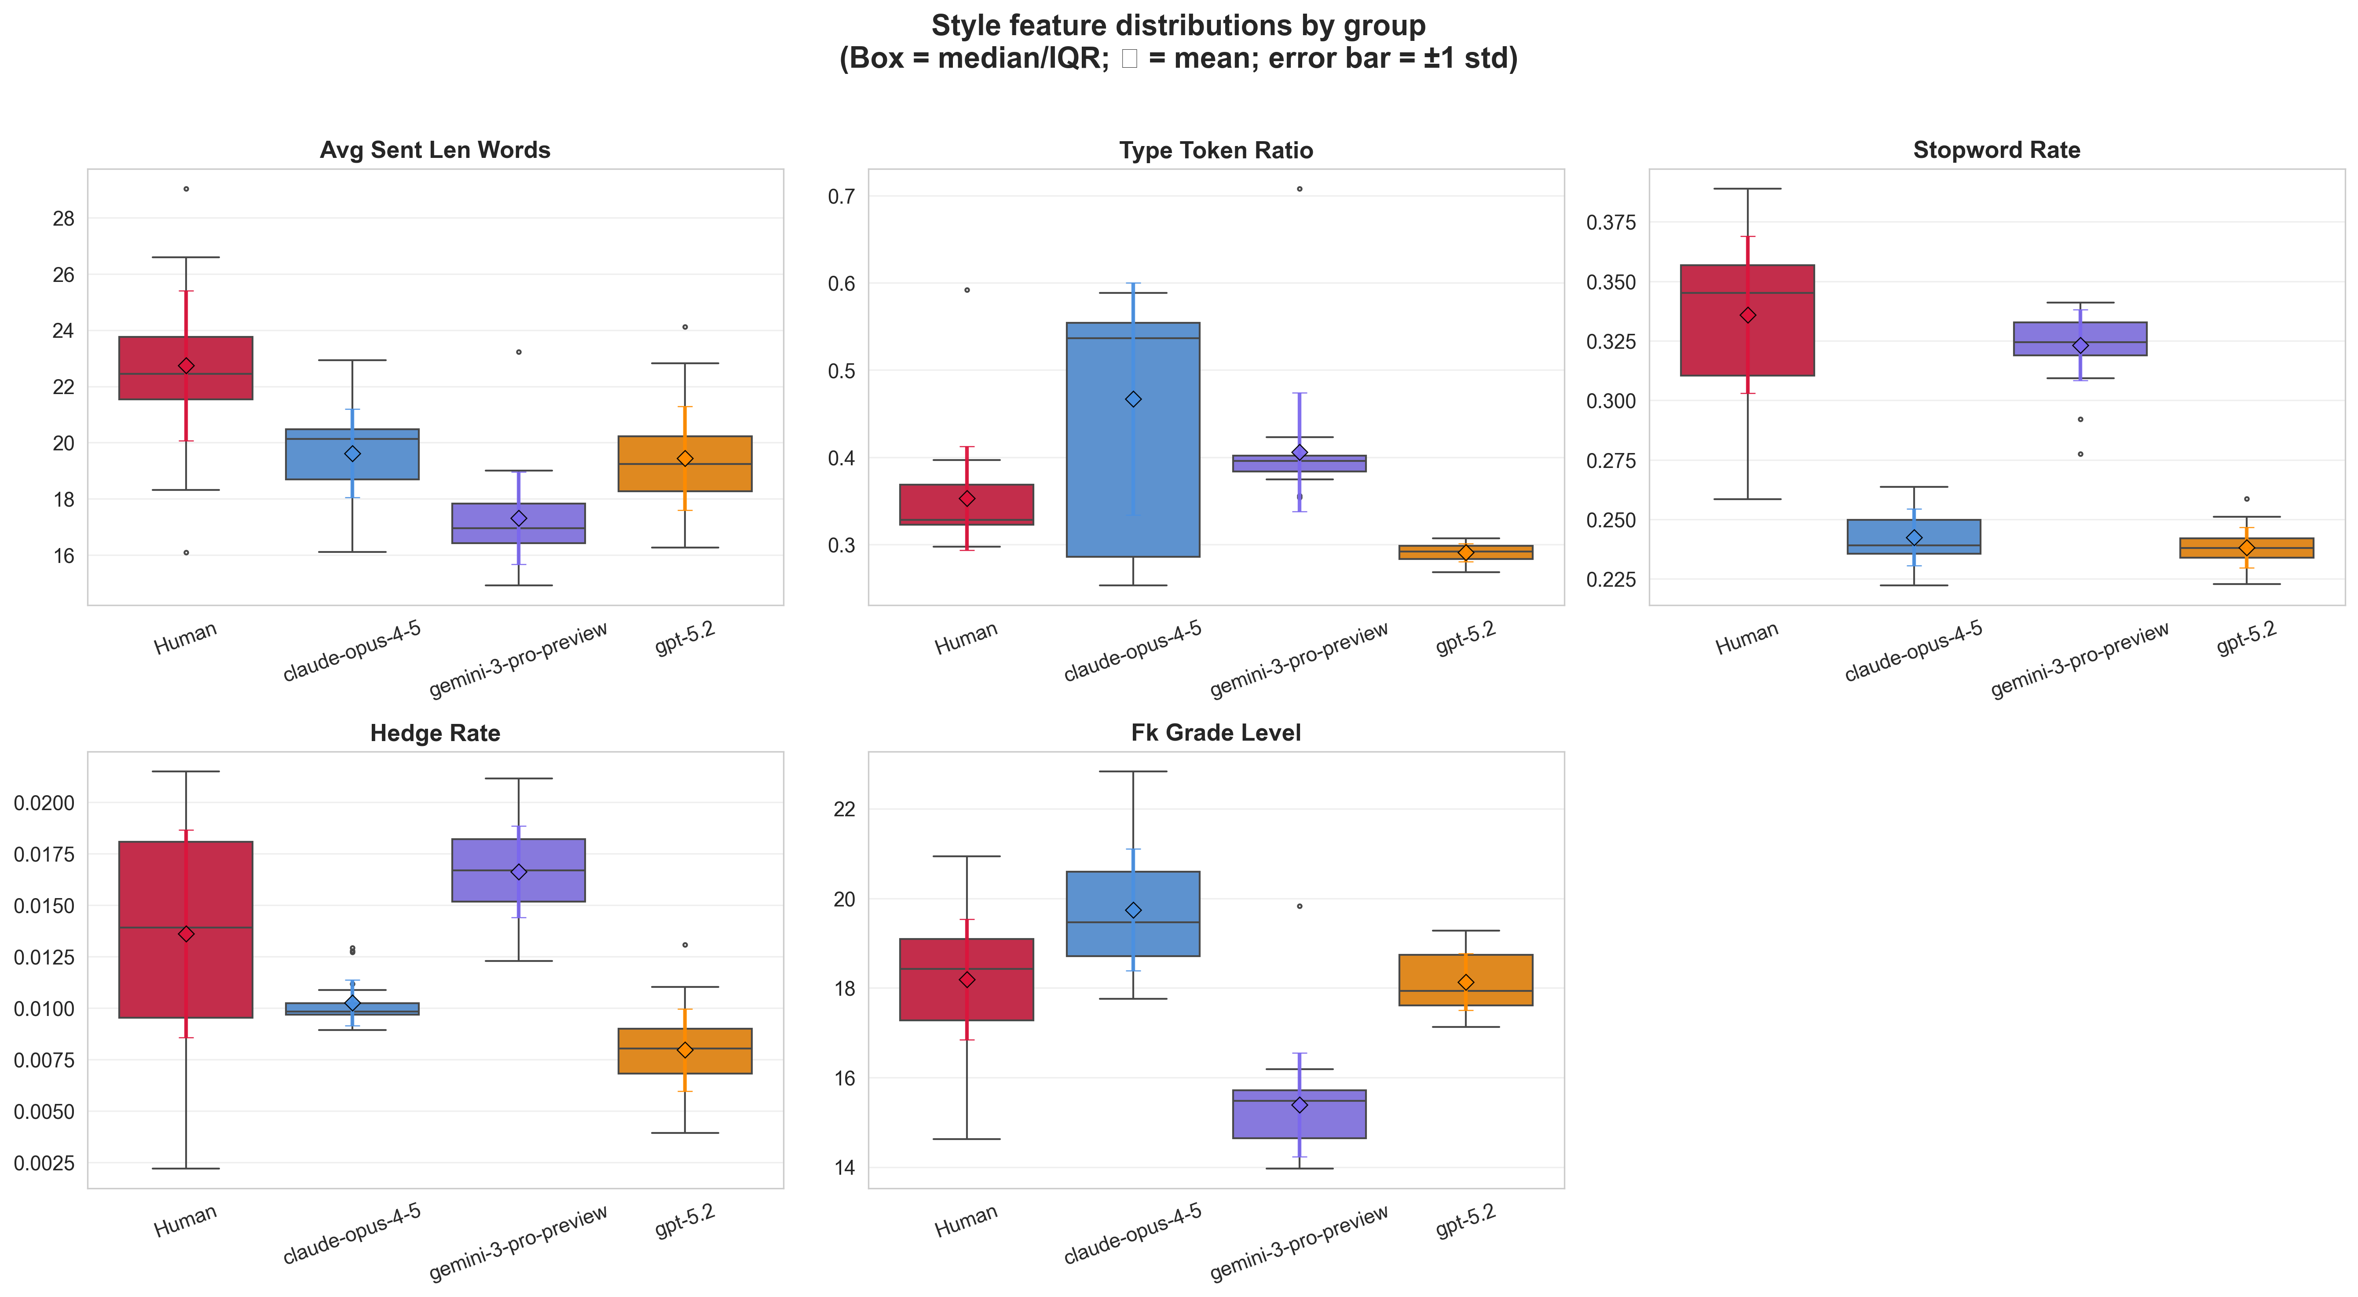
Strong Stylstic Differences Between Human and AI Proposals
Stylistic differences can predict authorship (AI vs Human) with 90% accuracy
Are there stylistic differences beteween human/AI propsoals?
We created style-only features that quantify how a proposal is written (structure, lexical variety, stopword usage, hedging/stance, sectioning, readability, and punctuation/formatting patterns) to build a style baseline.
With logistic regression, we found that style alone can seperate human vs AI proposals
Permutation test (AUROC, 1,000 label shuffles):
Observed AUROC: 0.980
Null mean AUROC: 0.509 ± 0.099
p-value: 0.0010

Slide 16
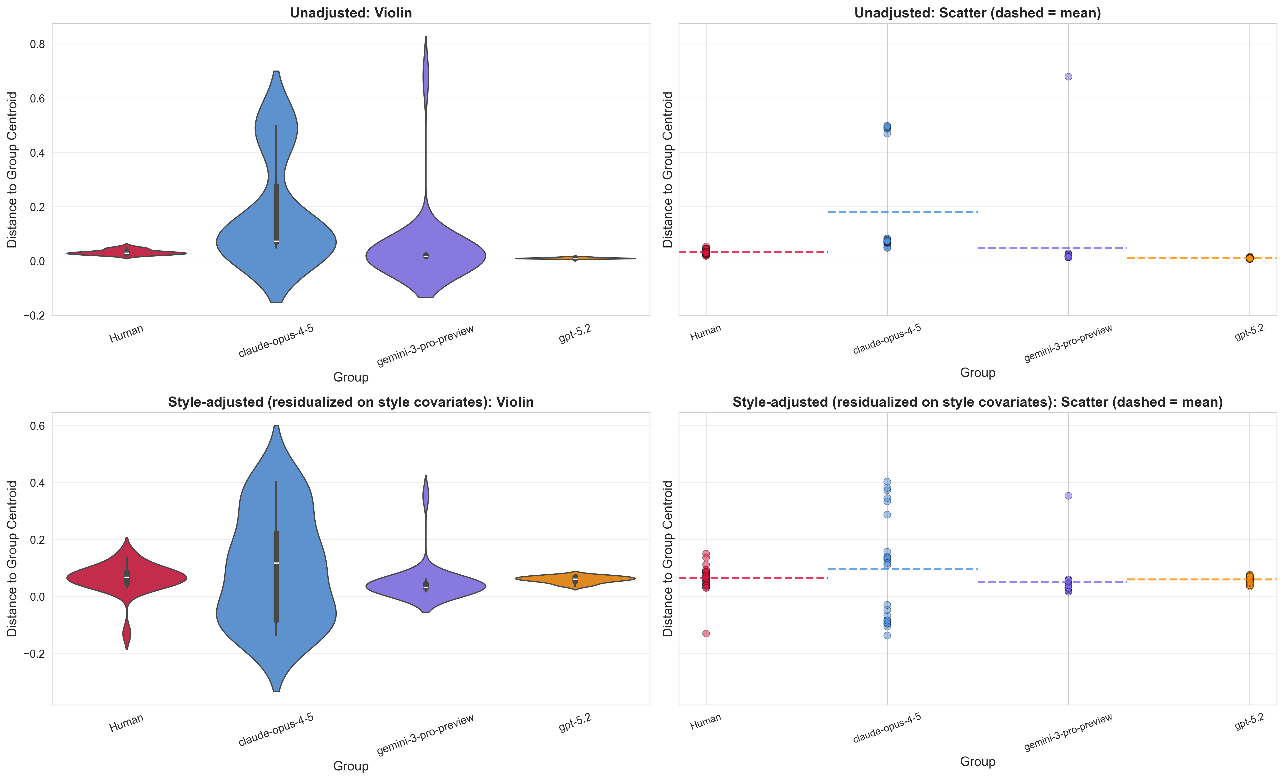
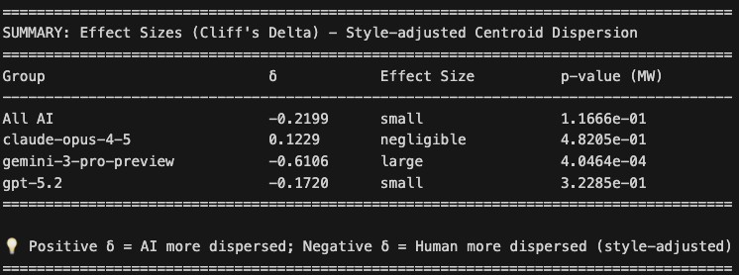
Style-adjusted centroid dispersion analysis
After removing the embedding components predictable from style features, do we still see separation?
Style-adjusted centroid dispersion
We compute each proposal’s distance-to-its-group-centroid (y_raw). Fit a simple linear model: y_raw ~ (style features). Subtract the model’s prediction from y_raw to get a residual. Add back the overall mean (just to keep numbers on a similar scale).
Result: y_adj = “dispersion after removing what style can explain”.
A meaningful chunk of the unadjusted centroid-dispersion differences was driven by style, but not all of it: after controlling for measured style, Claude still looks genuinely more variable, thoufh effect size is negligible

Slide 17
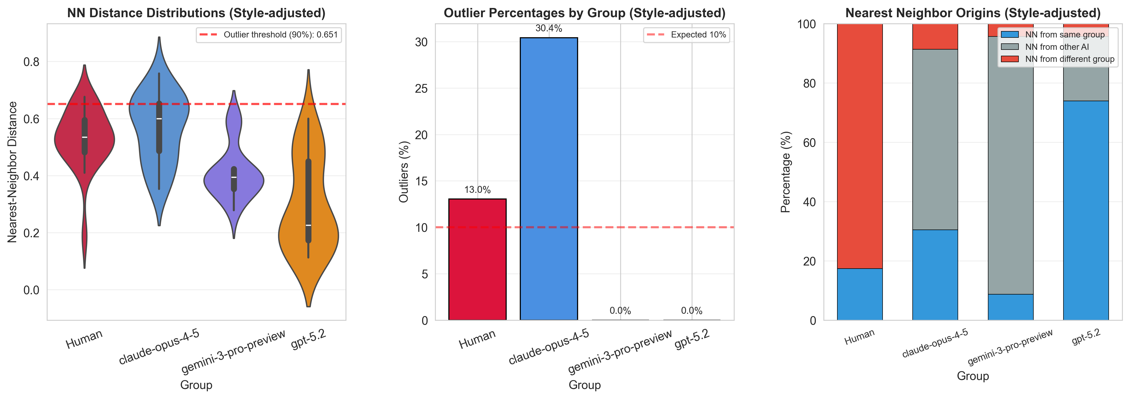
Style-adjusted NN and outlier analysis
Outlier Rates (top 10% NN distance)
Style-adjusted NN and outlier
If we remove the parts of embeddings that can be predicted from writing style, who is still most isolated from their nearest neighbor?
13.0%
0.0% -> 30.4%
Human
Claude
Claude proposals become more isolated in the residual space → they look more “content-different” from their nearest neighbors (or at least less similar under the residual embedding geometry).
GPT‑5.2 becomes less isolated after style is removed → its previous “outlier-ness” in the raw embedding space was partly driven by stylistic embedding components.
4.3% -> 0%
26.1% -> 0%
Gemini
GPT-5.2

Slide 18
Key Findings
1
2
Model-specific diversity varies dramatically
Human proposals are more novel than AI
Claude is more diverse than humans (d = +0.25, pairwise). GPT-5.2 shows mode collapse (d = −1.00). Gemini is intermediate (d = −0.73). There is no single “AI diversity” story.
Human mean novelty 0.151 vs AI 0.117 (d = −0.34, medium). Claude’s novelty is closest to human (not significant), while GPT-5.2 and Gemini are significantly less novel — their output stays close to published literature.
3
4
Human and AI occupy different semantic territory
Diversity does not equal novelty
100% of AI nearest neighbors are other AI proposals. GMM clustering: 2 of 3 clusters are AI-only (NMI = 0.20, p < 0.0001). LDA: complete topic separation. Humans and AI generate fundamentally different kinds of ideas.
Claude produces the most diverse proposals, but they are only moderately novel. Human proposals are moderately diverse but most novel. High diversity within AI space may reflect variation among training-data-typical framings, not genuinely new ideas.
Overarching narrative
AI models can produce diverse proposals on paper, but that diversity operates within a different conceptual space than humans. Human scientists bring genuinely novel perspectives — ideas further from published literature and outside the semantic territory AI models inhabit. This suggests AI is better positioned as an ideation complement to, rather than replacement for, human researchers.

Slide 19
Implications & Limitations
What This Means
AI models are not interchangeable for scientific ideation
Limitations
GPT-5.2’s mode collapse vs Claude’s subcluster diversity means model choice drastically affects the space of ideas. Researchers should test multiple models and evaluate outputs comparatively, not assume one model represents “AI.”
• Single funding call (NCEMS) — generalizability is unknown.
• Small, unbalanced sample (23 human vs. 69 AI). Power is limited for subtle effects.
• Embedding distance ≠ conceptual diversity. BioLinkBERT may conflate stylistic with semantic differences. Expert validation is needed.
Human novelty advantage suggests complementary roles
Human proposals venture further from published literature, indicating that human scientists bring perspectives not derivable from training data alone. AI may be most valuable for extending existing lines of inquiry, while humans contribute genuinely novel framings.
• Novelty score conflates novelty with incoherence. High distance from literature could mean a genuinely new idea OR a poorly formulated one.
• Topic separation may be an artifact of writing style or prompt templating, not genuine thematic differences. LDA results are exploratory.
• Population mismatch: humans wrote under real funding stakes; AI under zero stakes. This confounds any comparison of quality or effort.
Semantic segregation raises questions about AI’s “idea space”
• No quality evaluation yet — diversity and novelty do not imply good science. Human expert review (planned) is the critical missing piece.
The consistent finding that AI and human proposals occupy distinct territories — confirmed by NN, LDA, and GMM analyses — suggests systematic differences in how AI frames research. This may limit AI’s ability to surface truly unconventional ideas.
Next steps: (1) Human expert evaluation of proposal quality; (2) Augmented conditions (literature-enriched, persona-based prompts); (3) Construct validation of embedding metrics; (4) Larger sample sizes across multiple funding calls.

