Slide 1
STYLE-CONTROLLED
Style-Controlled Comparison of AI vs. Human Research Proposals
Study
NSF NCEMS Proposals
Proposals
Rephrased-Proposal Analysis: Diversity, Novelty, Thematic Content, and Quality
23 Human + 69 AI
Models Tested
Embedding-Based Analysis Using BioLinkBERT · Rephrased via Gemini Flash
Claude Opus 4.5
Gemini 3 Pro
GPT-5.2
Date
March 2026

Slide 2
Why a Style-Controlled Analysis?
MOTIVATION
The style confound problem and how rephrasing addresses it
The Problem:
AI and human proposals differ dramatically in writing style — sentence length, vocabulary, hedging, formatting, punctuation. BioLinkBERT embeddings capture both semantic content and stylistic signals. Observed diversity, novelty, and clustering differences in the baseline analysis could be partly or fully stylistic artifacts rather than genuine conceptual differences.
The Solution: Standardized Rephrasing
What This Enables
Each proposal is rewritten into a fixed 5-section template using a two-step AI pipeline (Gemini Flash), neutralizing stylistic fingerprints while preserving scientific content. All 92 proposals emerge with identical structure, register, and formatting.
Comparing embedding distances on rephrased proposals tests whether Human vs. AI differences persist after style equalization. Residual differences are semantic — in what ideas are proposed — rather than how they are written.
Key Change in Findings
Analyses Preserved
Baseline style-only AUROC = 1.000 (perfect separation). Rephrased style AUROC = 0.684. Raw novelty gap persists but attenuates (δ=−0.294, p<0.001); local-density normalized gap disappears (p=0.22). Diversity pattern reverses: humans become more diverse than pooled AI; Claude-Opus-4.5 shows semantic mode collapse.
All four analysis types (Diversity, Novelty, Thematic/Cluster, Quality) are run identically on rephrased proposals, enabling direct comparison with the baseline. Statistical framework is unchanged: BioLinkBERT + non-parametric tests + bootstrap CIs.

Slide 3
Proposal Rephrasing: Two-Step AI Pipeline
REPHRASE PIPELINE
Gemini Flash extracts semantic facts then fills a fixed template, aiming to remove all stylistic fingerprints
INPUT
STEP 1: SUMMARIZE
STEP 2: FILL
OUTPUT
Original Proposal
Extract Semantic Facts
Generate Fixed Template
Standardized Proposal
Full text (AI: 6 fields; Human: abstract + full draft). Variable length, structure, and style per author group.
15 structured fact categories extracted as plain declarative statements. Strips sentence rhythms, punctuation habits, vocabulary, hedging, and rhetorical framing. Output is style-free numbered fact list.
→
→
Template prose written from facts only — output style is governed by strict formatting rules, not source patterns. Third-person neutral, declarative, controlled sentence count per section.
→
~2,200 chars (uniform across all 92 proposals). Identical structure, register, and format.
Section 1 · Background (3 sentences)
Section 2 · Methods (3 sentences)
Section 3 · Data Sources (3 sentences)
Section 4 · Feasibility (2 sentences)
Section 5 · Open Science (2 sentences)
Domain, gap, research question
Study design, tools, validation
Datasets, integration, limitations
Timeline, collaboration rationale
Data sharing, team composition
Style rules enforced: Third-person neutral · Declarative-only (no hedging unless fact states uncertainty) · 18–22 word avg sentences · No bullet points · No serial commas · Acronym definitions on first use · Title rephrased to 8–15 words in noun-phrase format

Slide 4
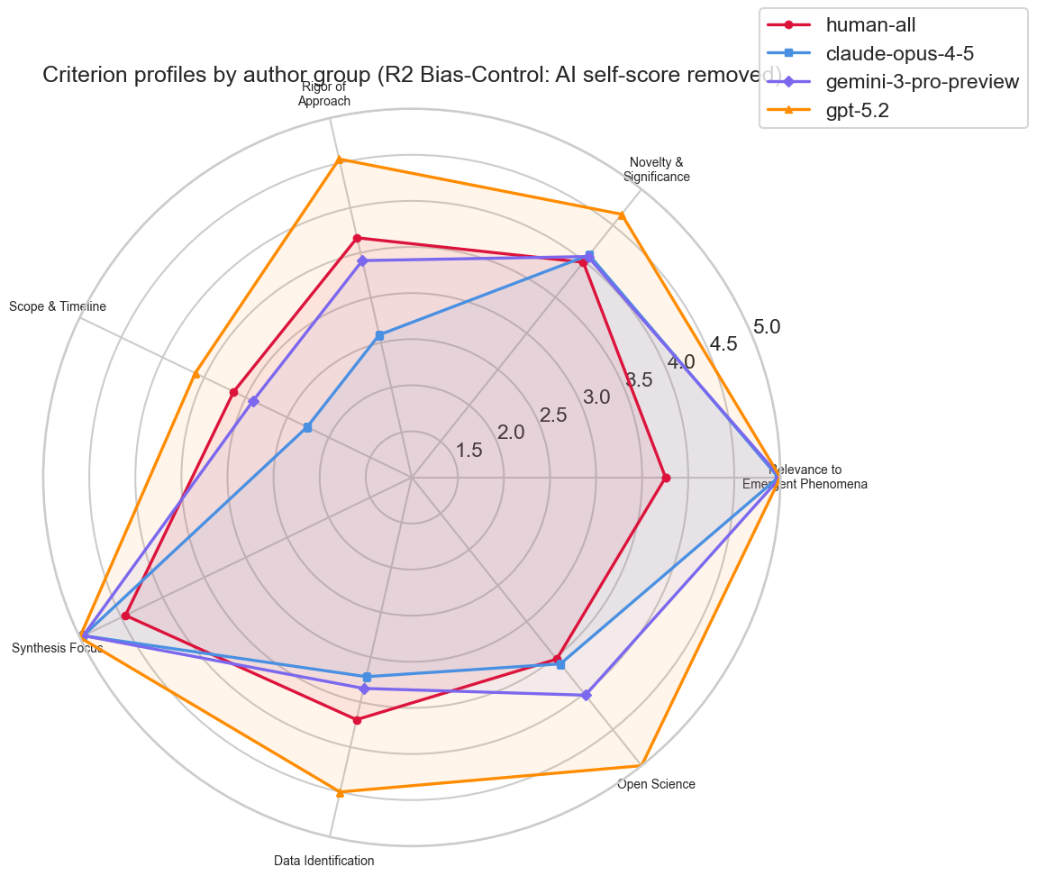
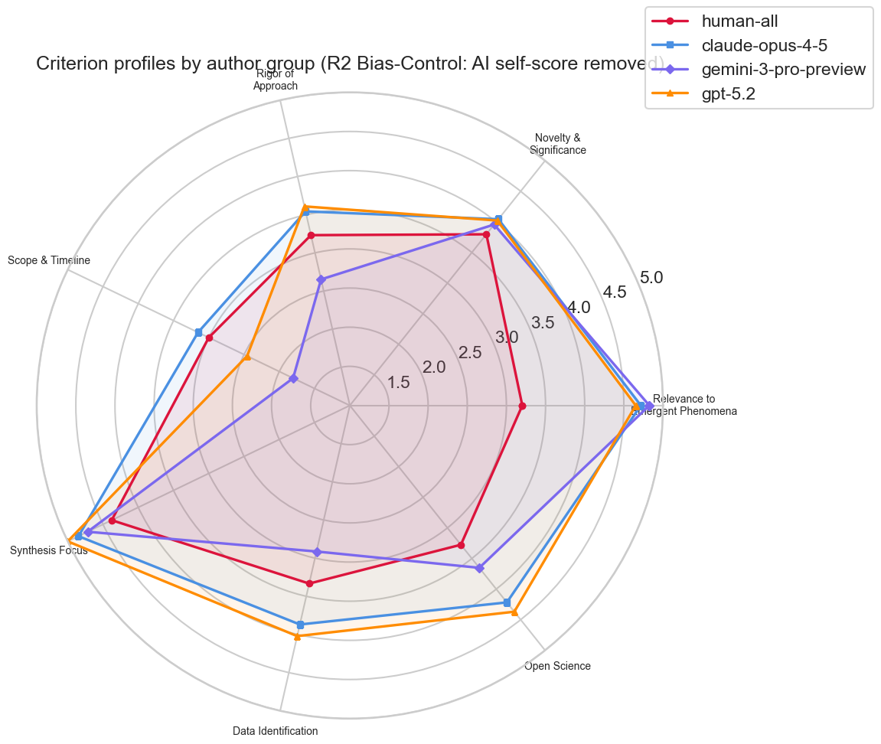
BASELINE (NO style control)
AFTER rephrase (with style control)
both cross-eval only to remove AI self-preference bias

Slide 5
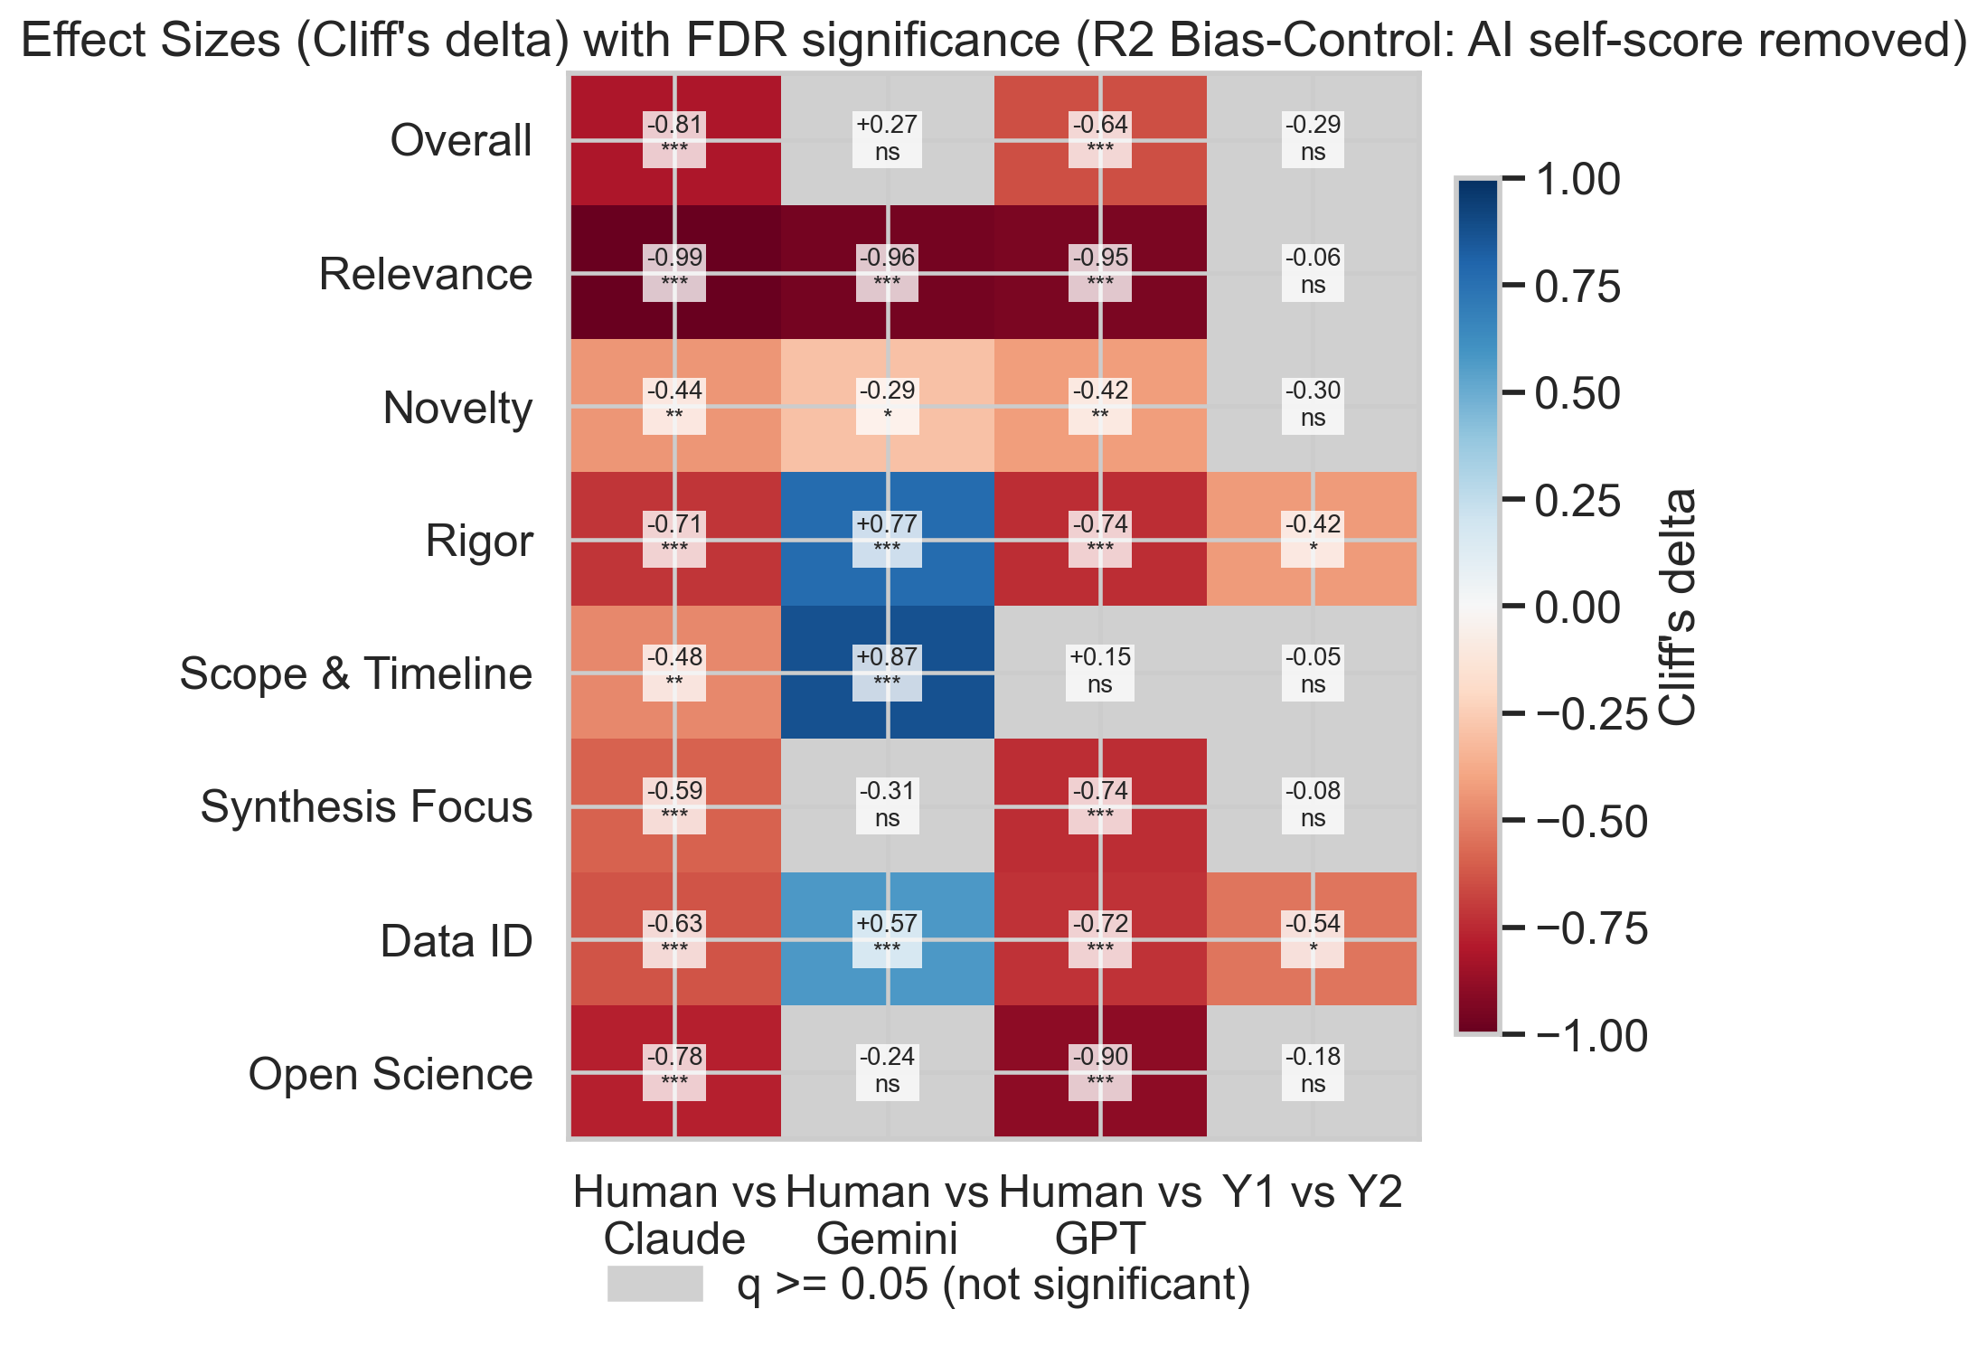

Slide 6
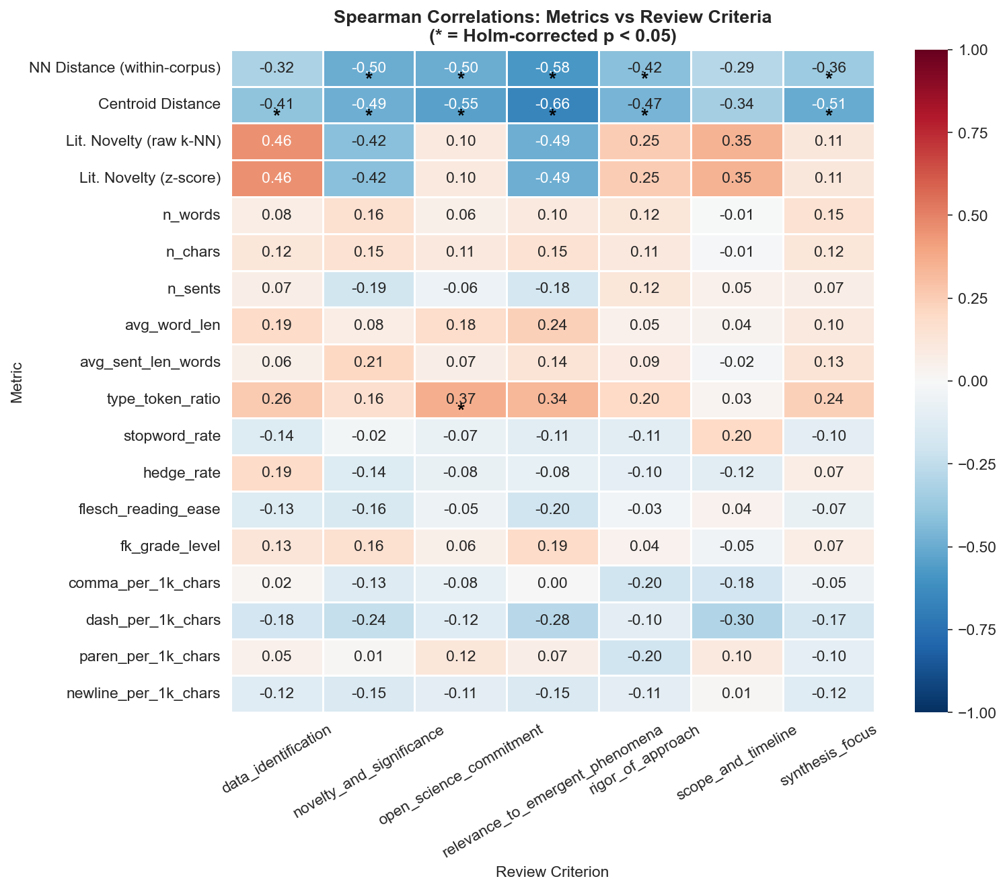
ALL proposals: NN distance negatively correlated with novelty score
Spearman r = −0.576 (p = 0.004) for humans; much weaker for AI models. Human outliers explore unique territory but are not rewarded by AI reviewers for it.

Slide 7
Analysis Overview
OVERVIEW
Data, methodology, and analysis structure for the style-controlled comparison
Data (Rephrased)
Part I: Diversity (Slides 6–8)
Part II: Novelty (Slides 9–10)
Pairwise diversity (proposal-level means)
Centroid dispersion (distance to group center)
Nearest-neighbor outlier detection
UMAP 2D embedding visualization
k=10 NN distance to 1,030 PubMed articles
Literature-normalized z-scores
Section-1 only embeddings (fair comparison)
Proposals visualized in literature space
23
69
Human proposals (Y1+Y2)
AI proposals (3 models)
Human (Y1: 12, Y2: 11)
Claude Opus 4.5 (n=23)
Part III: Thematic & Style (Slides 11–13)
Part IV: Quality (Slides 14–16)
Gemini 3 Pro Preview (n=23)
LDA topic modeling (k=5, strong priors)
GMM clustering (k=3, BIC selection)
Style baseline: AUROC after rephrasing
Residualized centroid + NN sensitivity tests
R1: AI review proxy validity vs. human experts
R2: Proposal scores under AI evaluation
R3: Evaluator bias + self-preference
Sensitivity: cross-evaluator + Gemini-only reruns
GPT-5.2 (n=23)
Embedding Pipeline (Unchanged)
BioLinkBERT-large (333M params, 1024-dim)
400-word chunks, 50-word overlap, averaged
Cosine distance for all metrics
Mann-Whitney U + Cliff's δ + bootstrap CIs

Slide 8
Key Findings — Style-Controlled Analysis
KEY FINDINGS
One-sentence answers from the rephrased-proposal analyses
RQ1 — DIVERSITY
RQ2 — NOVELTY
RQ3 — THEMATIC SEPARATION
RQ4 — QUALITY
Are AI proposals more or less diverse than human proposals after style control?
Are AI proposals less novel than human proposals relative to literature?
Do human and AI proposals still cluster differently after style removal?
Do AI proposals score higher under AI evaluation on rephrased proposals?
Reversed vs. baseline: Humans are significantly more diverse than pooled AI (δ=−0.768, p<0.001). Claude-Opus-4.5 is maximally homogeneous (mode collapse); GPT-5.2 and Gemini are intermediate.
Partially attenuated: Raw novelty gap persists after rephrasing (δ=−0.294, p<0.001) but is smaller than baseline (δ=−0.34). Local-density normalized gap disappears (δ=+0.016, p=0.22) — humans target sparser literature regions.
Yes, but reduced: Significant cluster segregation remains (NMI=0.089, p=0.003). Style-reduced AUROC = 0.684 vs. 1.000 baseline.
Yes, pattern holds: GPT (4.32) and Claude (4.01) score above human (3.59). GPT self-inflates (δ=+0.933). Cross-evaluator reruns confirm GPT and Claude advantage; Gemini is not significant. Gemini strongly self-deprecates (δ=−0.732).
Main Takeaway
Rephrasing reveals that the baseline novelty gap was largely stylistic, while diversity and thematic separation reflect genuine semantic differences. Human proposals are semantically more varied; Claude-Opus-4.5 shows near-zero diversity (mode collapse). Raw novelty gap persists. Evaluator biases diverge: GPT self-inflates (δ=+0.933) while Gemini self-deprecates (δ=−0.732).

Slide 9
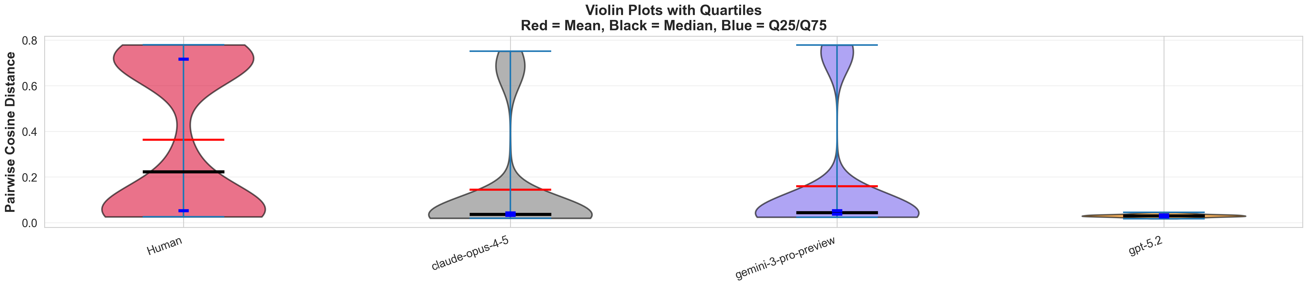
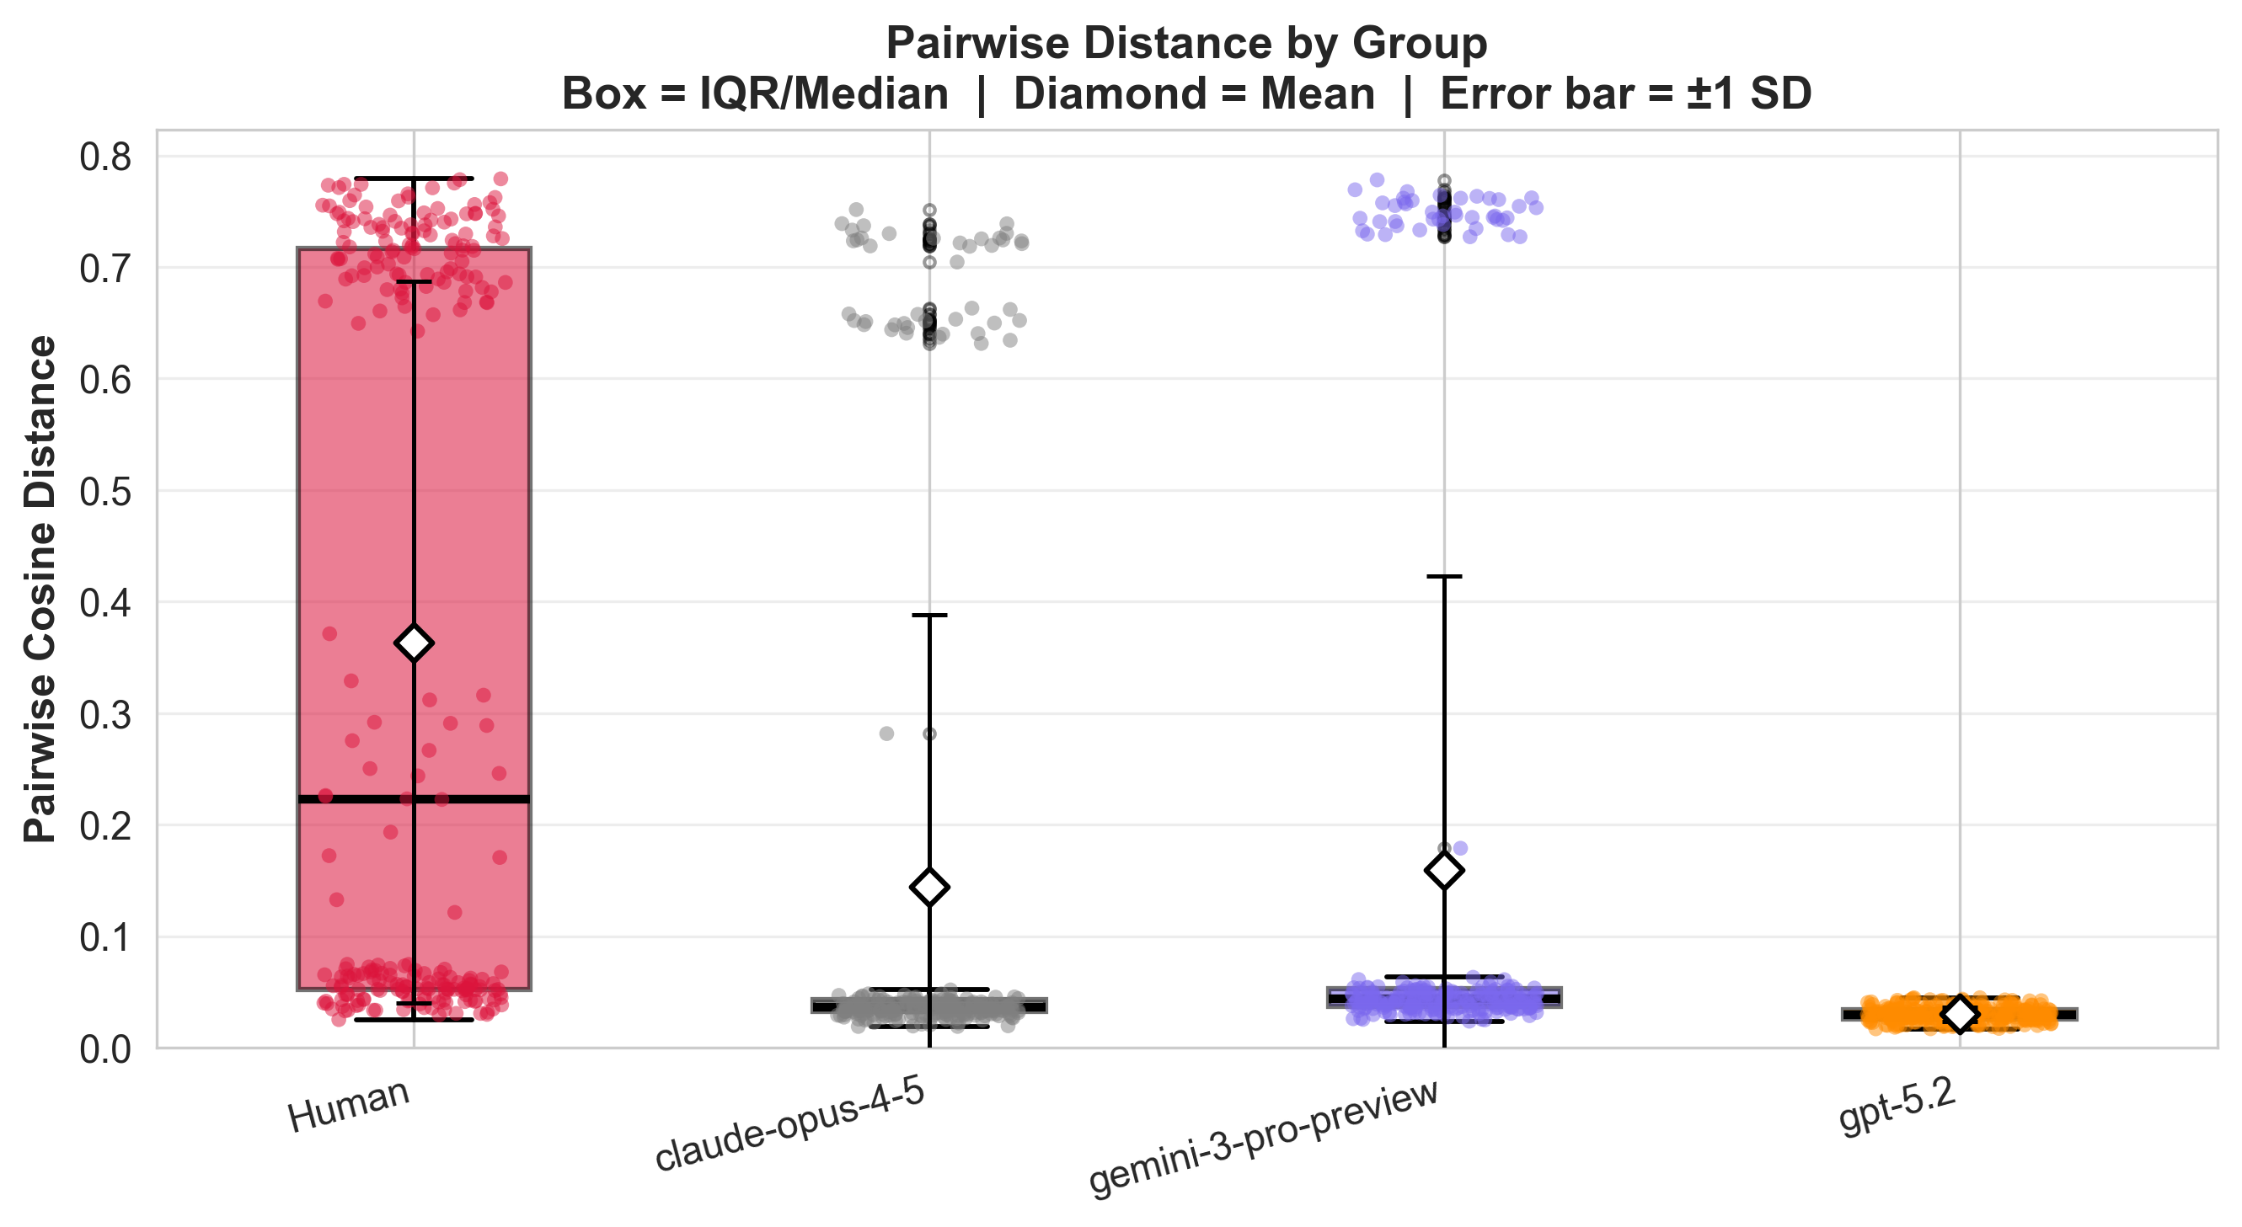
Analysis 1.1
PART I · DIVERSITY
Within-Group Pairwise Diversity
Proposal-level mean pairwise cosine distance; Mann-Whitney U + Cliff's δ + permutation tests
GPT-5.2 and Gemini intermediate
GPT-5.2 mean = 0.315 (Std = 0.159); Gemini mean = 0.151 (Std = 0.173). Both significantly less diverse than humans. Claude (mean = 0.034) shows the sharpest collapse.
Key difference from baseline: Baseline showed Claude > Human in pairwise diversity (Cliff's δ = +1.00) and All AI > Human. After rephrasing: Human > GPT-5.2 > Gemini >> Claude (near-zero). Style was entirely masking Claude's semantic homogeneity — Claude collapses to mode collapse after rephrasing.
Humans most diverse — reversal from baseline
Claude-Opus-4.5 is maximally homogeneous (mode collapse)
Human mean pairwise distance = 0.443; All AI combined = 0.183. Cliff's δ = −0.768 (large effect), permutation p < 0.001. Bootstrap 95% CI for mean diff: [−0.303, −0.211].
Mean = 0.034; near-zero variance (Std = 0.007). Cliff's δ = −1.00, p < 0.001. All Claude proposals occupy essentially the same point in embedding space.

Slide 10
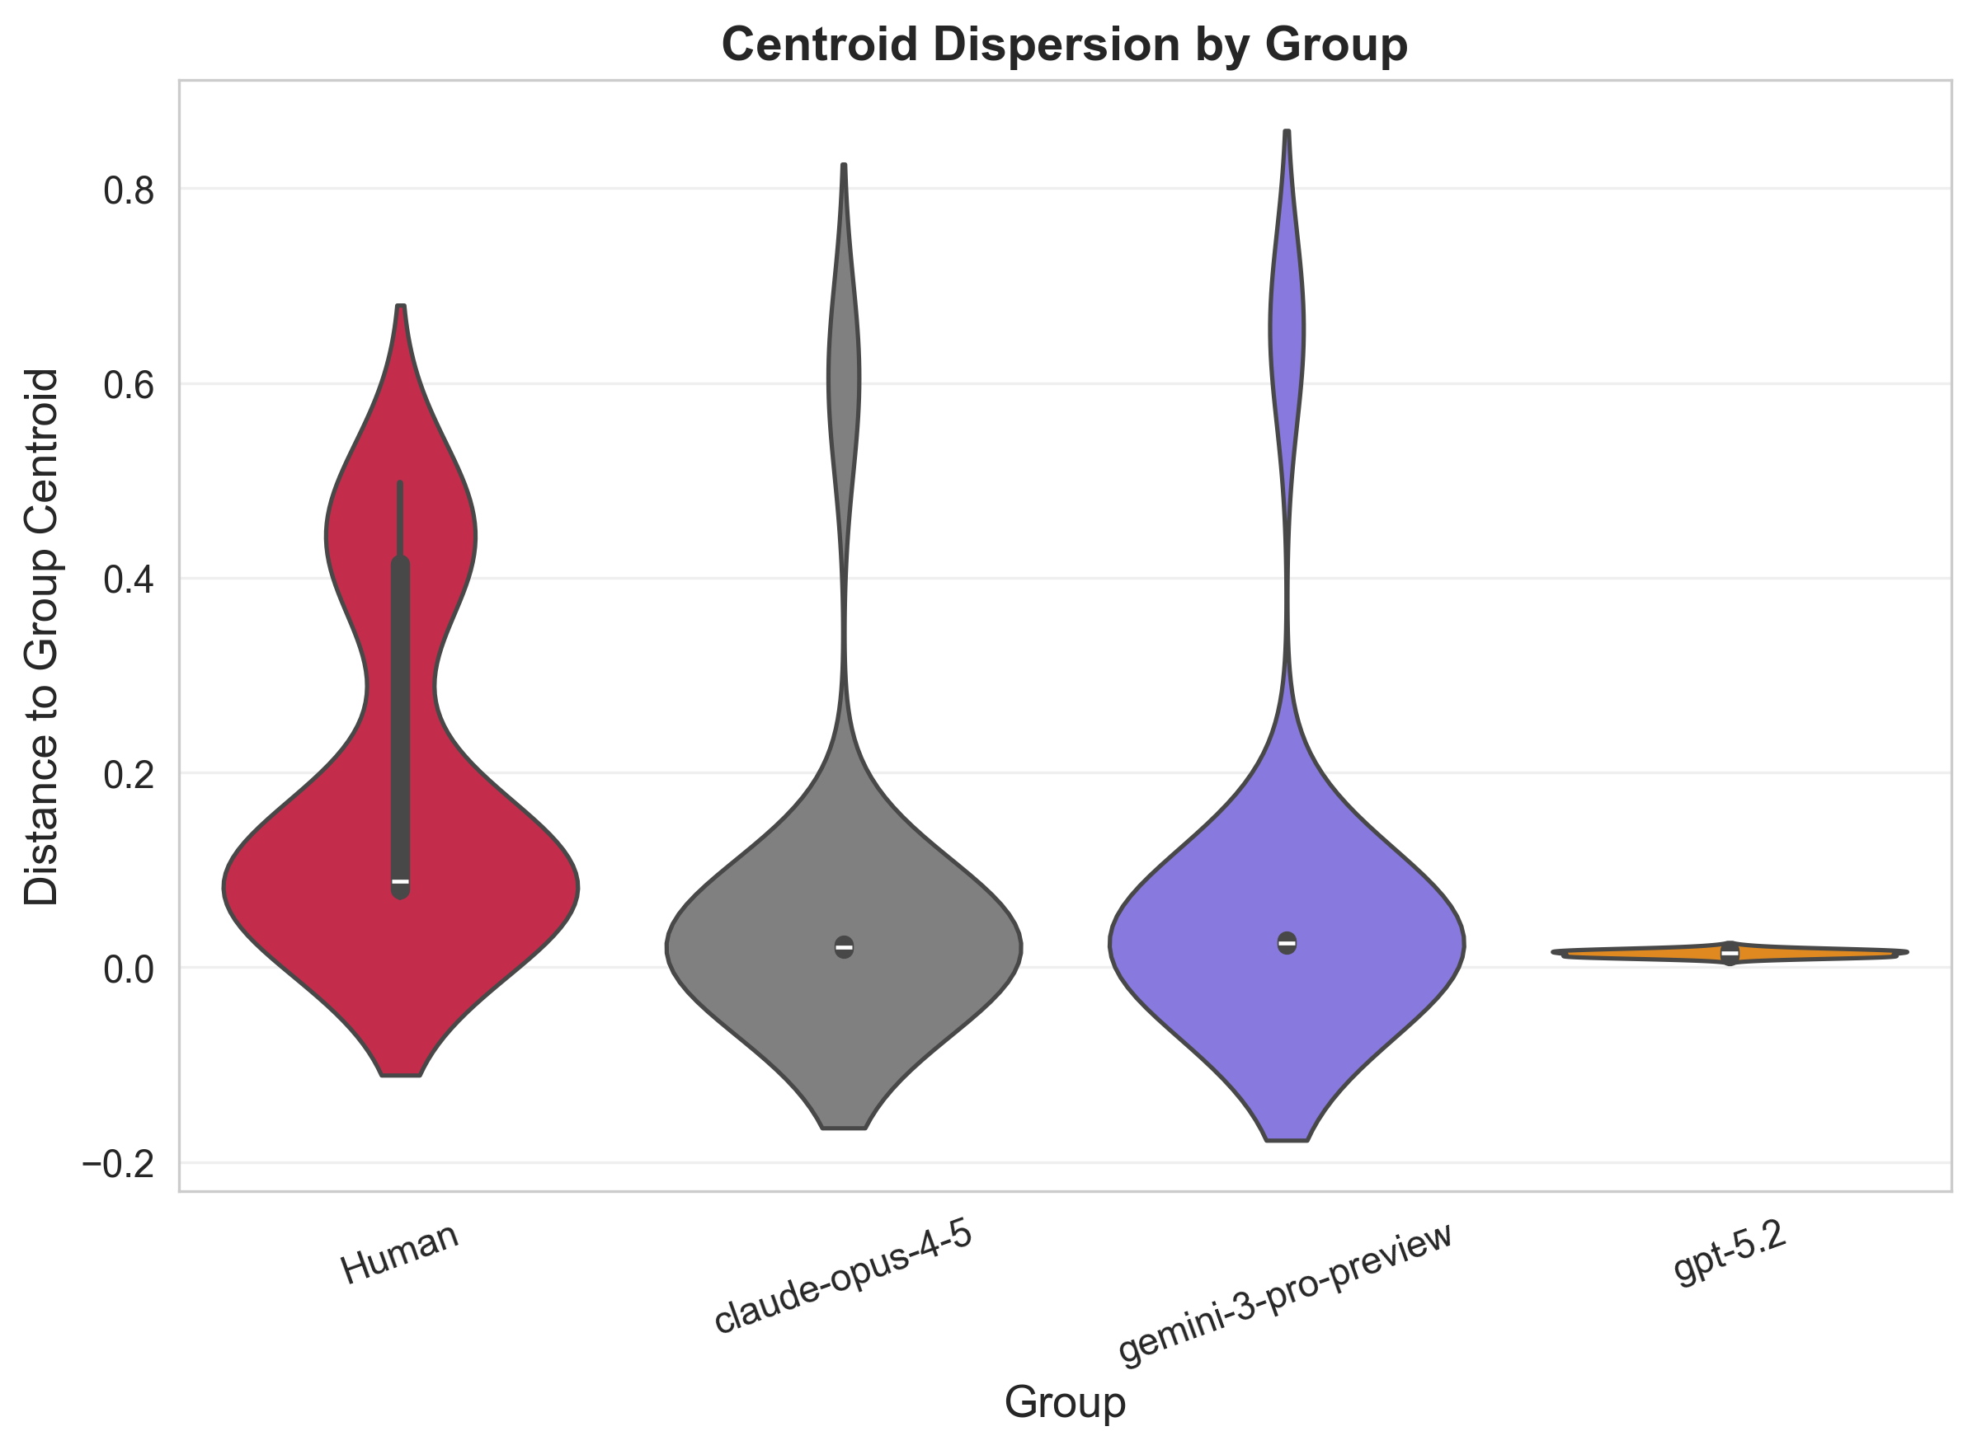
Analyses 1.2 & 1.3
PART I · DIVERSITY
Centroid Dispersion & Nearest-Neighbor Analysis
Distance to group centroid and outlier detection across 92 proposals in combined space
Key Findings — Centroid Dispersion
Human proposals are the most dispersed from their centroid (Mean = 0.241), consistent with pairwise results.
All AI models are significantly less dispersed than humans (large effects, p < 0.001).
Claude-Opus-4.5 is essentially a single point (Mean = 0.016, Std = 0.004) — consistent mode collapse across pairwise, centroid, and NN analyses.
Key Findings — Nearest-Neighbor
Human proposals have highest mean NN distance (0.074) and highest outlier rate (30.4%; 7 of 23 proposals).
87.0% of AI proposals have their nearest neighbor from within the AI group — semantic source-segregation persists after rephrasing.
Claude-Opus-4.5 = 0 outliers; 82.6% of its NNs are other Claude proposals — highest same-model NN rate of any group.
Vs. baseline: Pattern is consistent with centroid analysis: Human > GPT-5.2 > Gemini >> Claude-Opus-4.5. AI same-group NN rate (87.0%) suggests conceptual, not just stylistic, source clustering.
Centroid dispersion by model. Larger = more spread from center.

Slide 11
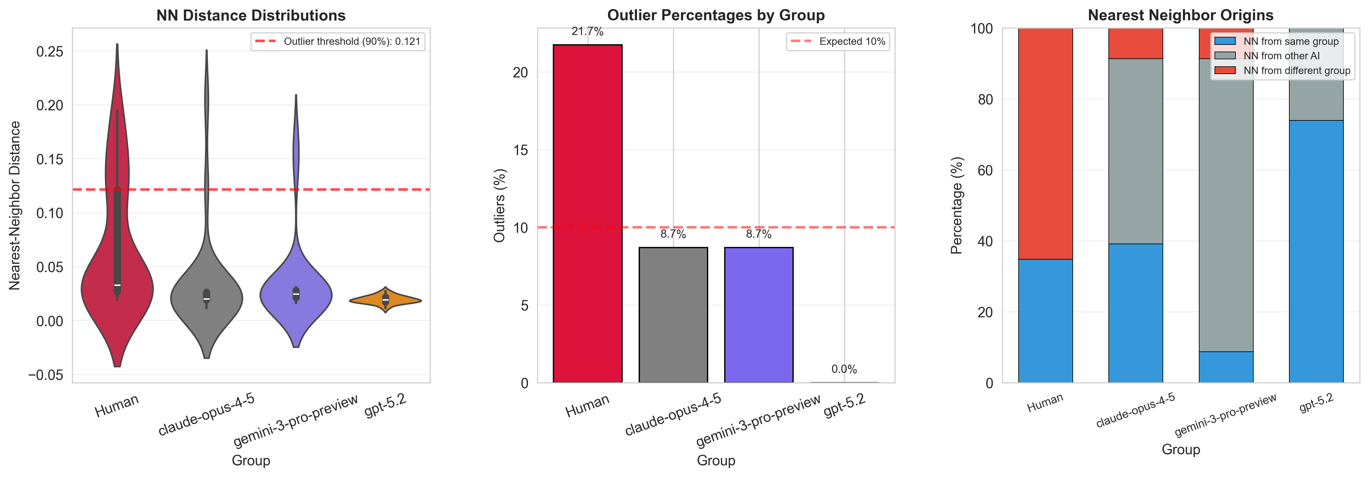
Analyses 1.2 & 1.3
PART I · DIVERSITY
PART I · DIVERSITY
Nearest-Neighbor Analysis
Distance to group centroid and outlier detection across 92 proposals in combined space
Nearest-neighbor distances by model group.
NN Group Membership
Human
Claude
30.4% outliers
0% outliers
69.6% NN from AI
82.6% NN same model
Gemini
GPT-5.2
4.3% outliers
8.7% outliers
39.1% NN other AI
47.8% NN same model

Slide 12
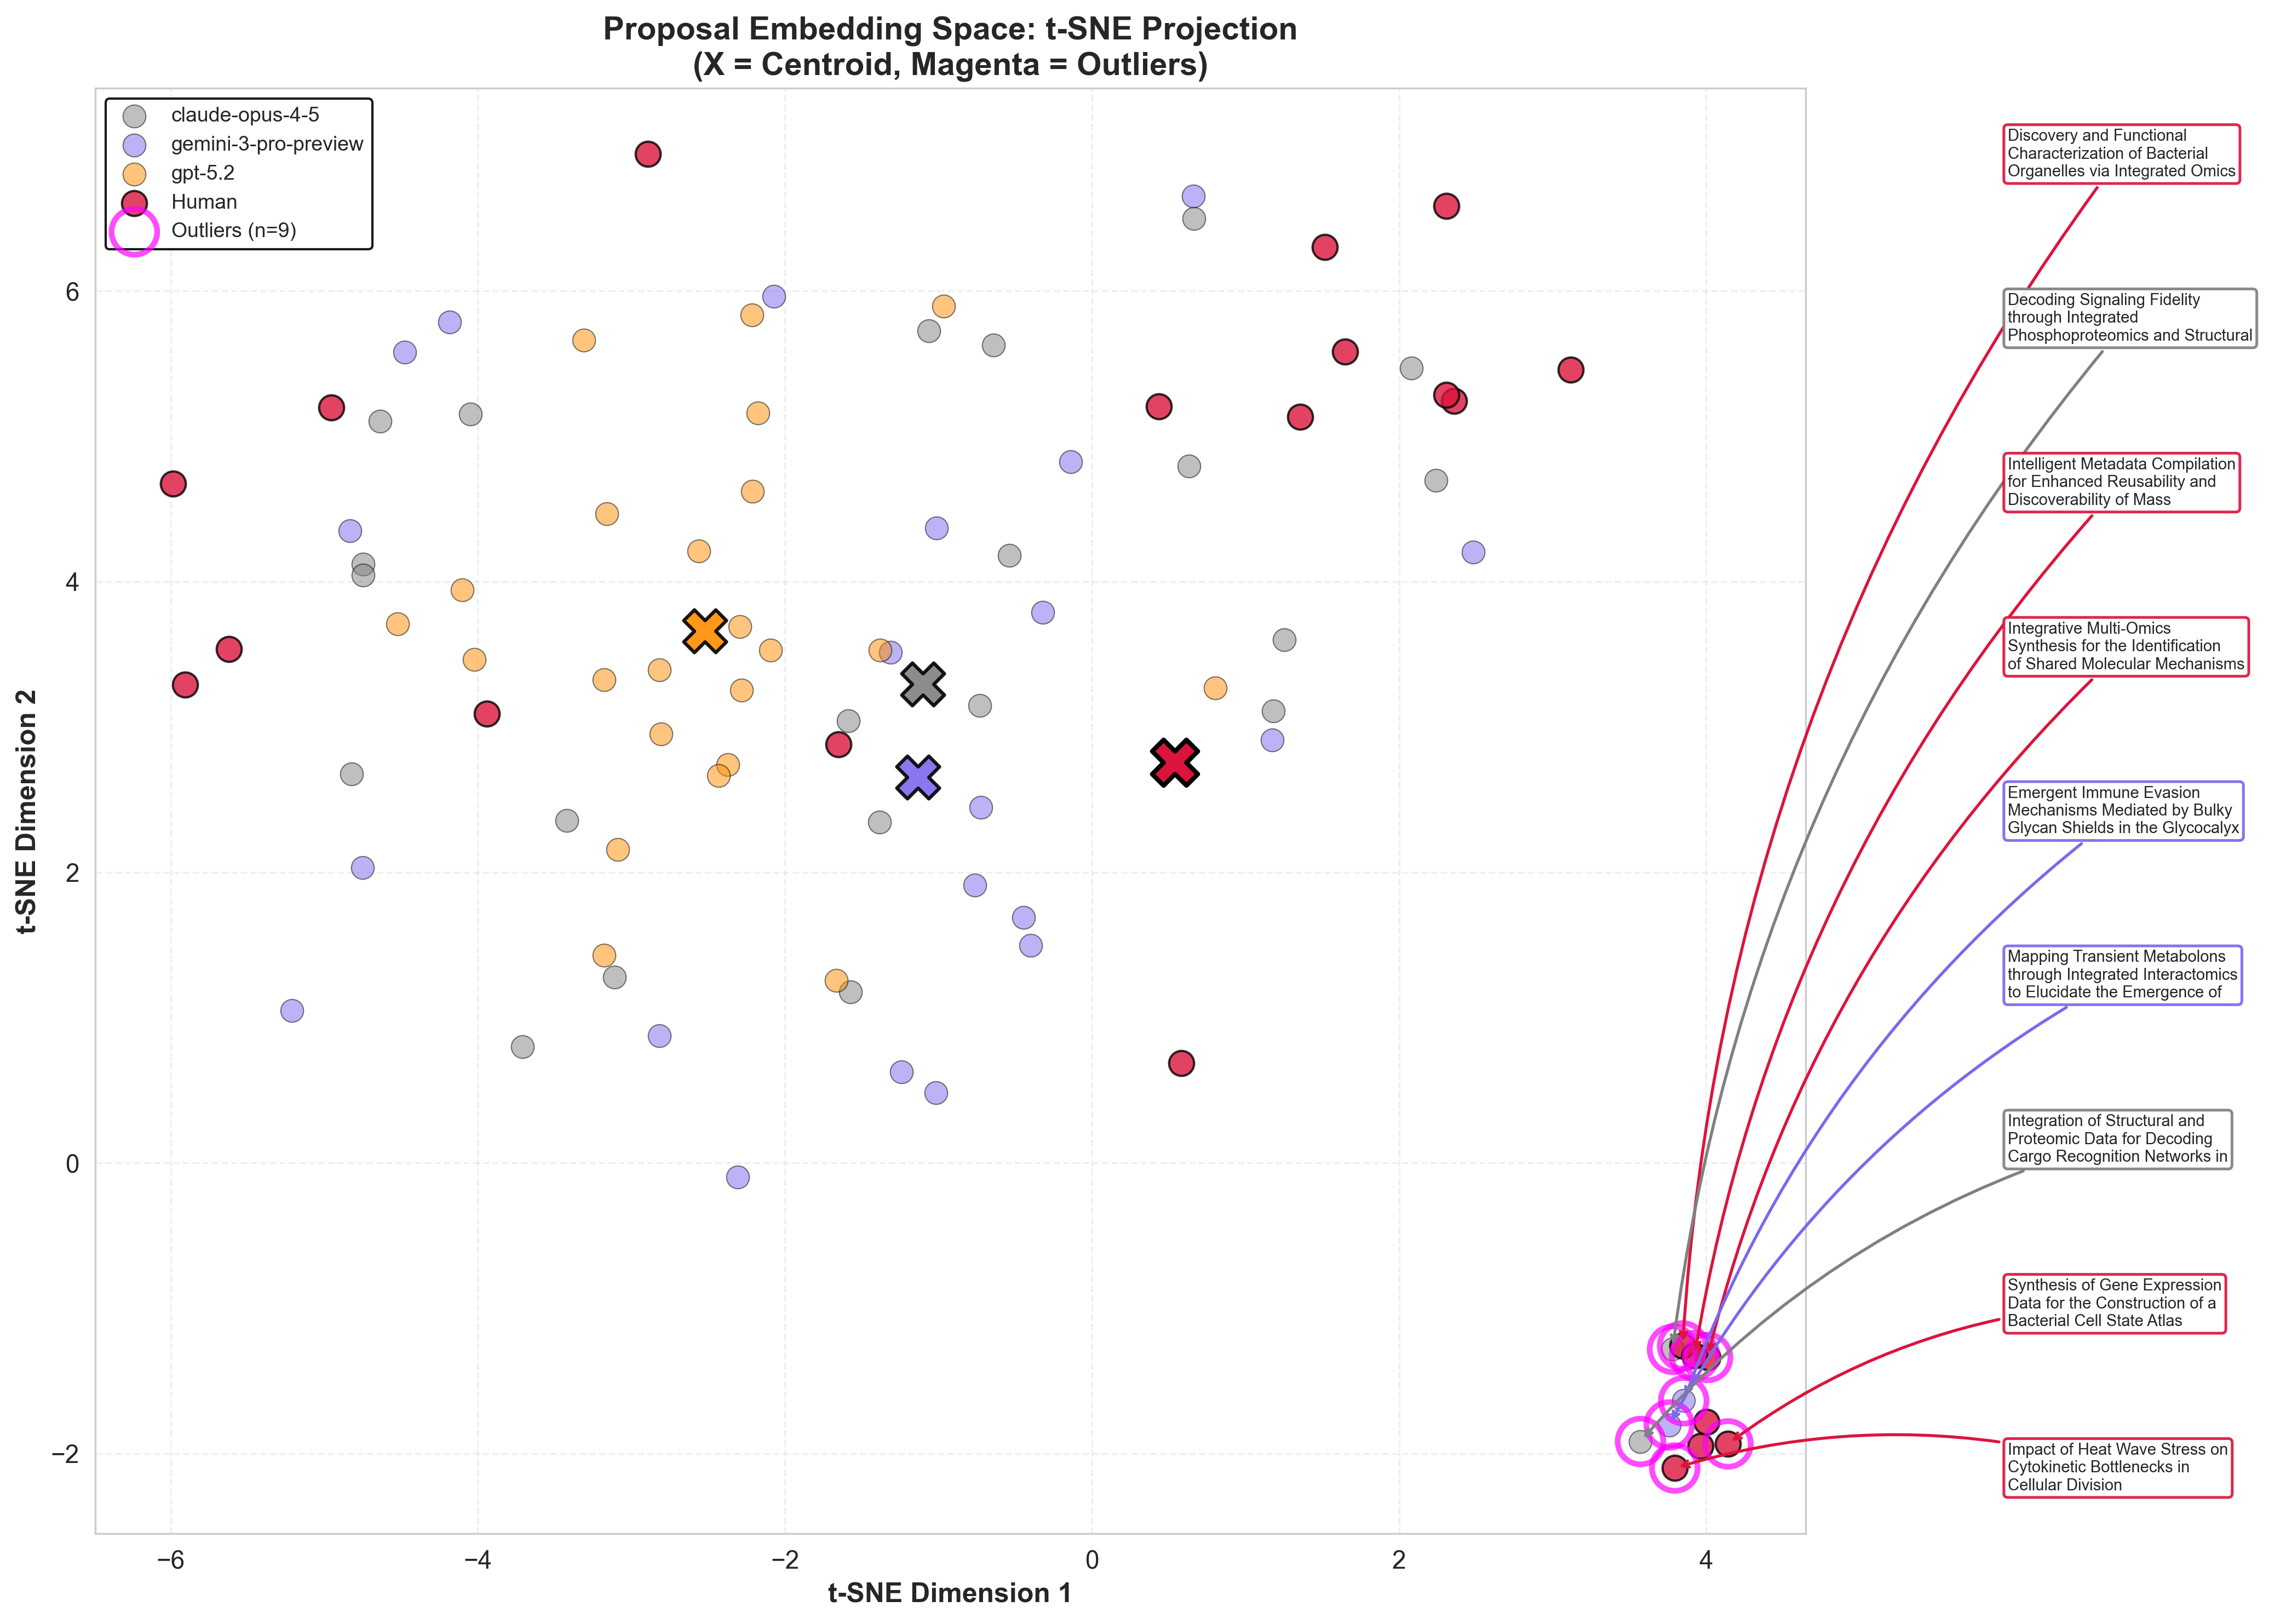
Embedding Space Visualization
PART I · DIVERSITY
TSNE 2D projection of 92 rephrased proposals; X = group centroids; magenta circles = outliers (top 10% NN distance)
Human (red)
Distributed broadly across the embedding space. Account for 7 of 10 total outliers (30.4% outlier rate). Overlap with Claude and Gemini but extend to periphery.
Claude (grey)
Near-zero spread; 0 outlier proposals. Claude collapses to a tight cluster after rephrasing — baseline Claude diversity was entirely stylistic (semantic mode collapse).
Gemini (purple)
Intermediate spread. 1 outlier proposal at periphery. Overlaps with human and Claude regions.
GPT-5.2 (orange)
Intermediate spread; 2 outlier proposals. GPT-5.2 shows moderate within-group variance (mean pairwise dist = 0.315), distinct from Claude mode collapse.
Caveat: UMAP projections distort distances in high-dimensional space. The quantitative analyses (pairwise, centroid, NN) are primary evidence; this visualization serves as a qualitative consistency check.

Slide 13
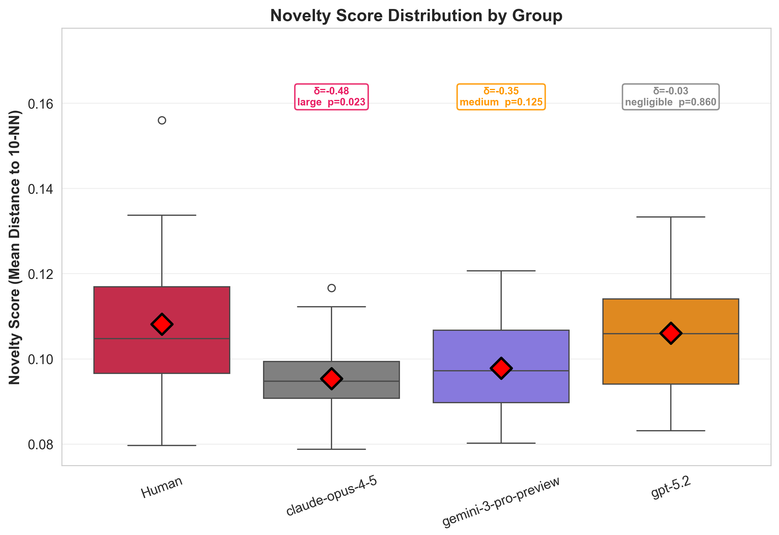
Analysis 2
PART II · NOVELTY
Novelty Analysis: Distance from Existing Literature
Novelty = mean cosine distance to k=10 nearest neighbors in 1,030 PubMed articles; Section 1 embeddings only
Raw Novelty Gap Persists but Attenuates; Local-Density Gap Disappears
All AI vs. Human: δ = −0.132 (negligible), permutation p = 0.171. Not significant. Baseline showed δ = −0.34, p = 0.014 (significant human advantage). The gap was largely stylistic.
+0.016
−0.030
Local-density δ (All AI vs Human)
negligible (local-density), p=0.22
Raw mean diff (AI − Human)
95% CI 95% CI [−0.051, −0.010]
Most novel proposal (rephrased)
Human: "MaiTool — LLM-powered bioinformatics tools for microbiome analysis" — novelty score 0.240. Followed by "Searching the crosslinking mass spectrometry universe" (0.230).
Literature-normalized z-scores
All groups have local-density z > 0 (proposals farther from literature than local neighbors). Human z = 1.82 is highest; Gemini = 1.93, GPT = 1.47, Claude = 1.32, meaning proposals are closer to existing work than articles are to each other. Human z-score marginally higher but not significant.
Overlap with novelty top-10%
6 of 10 most literature-novel proposals are Human; 2 Gemini, 1 GPT-5.2. Top NN-outliers also skew human: 7 of 10 total are human. Most novel by raw score: Human "MaiTool" (score=0.240).

Slide 14
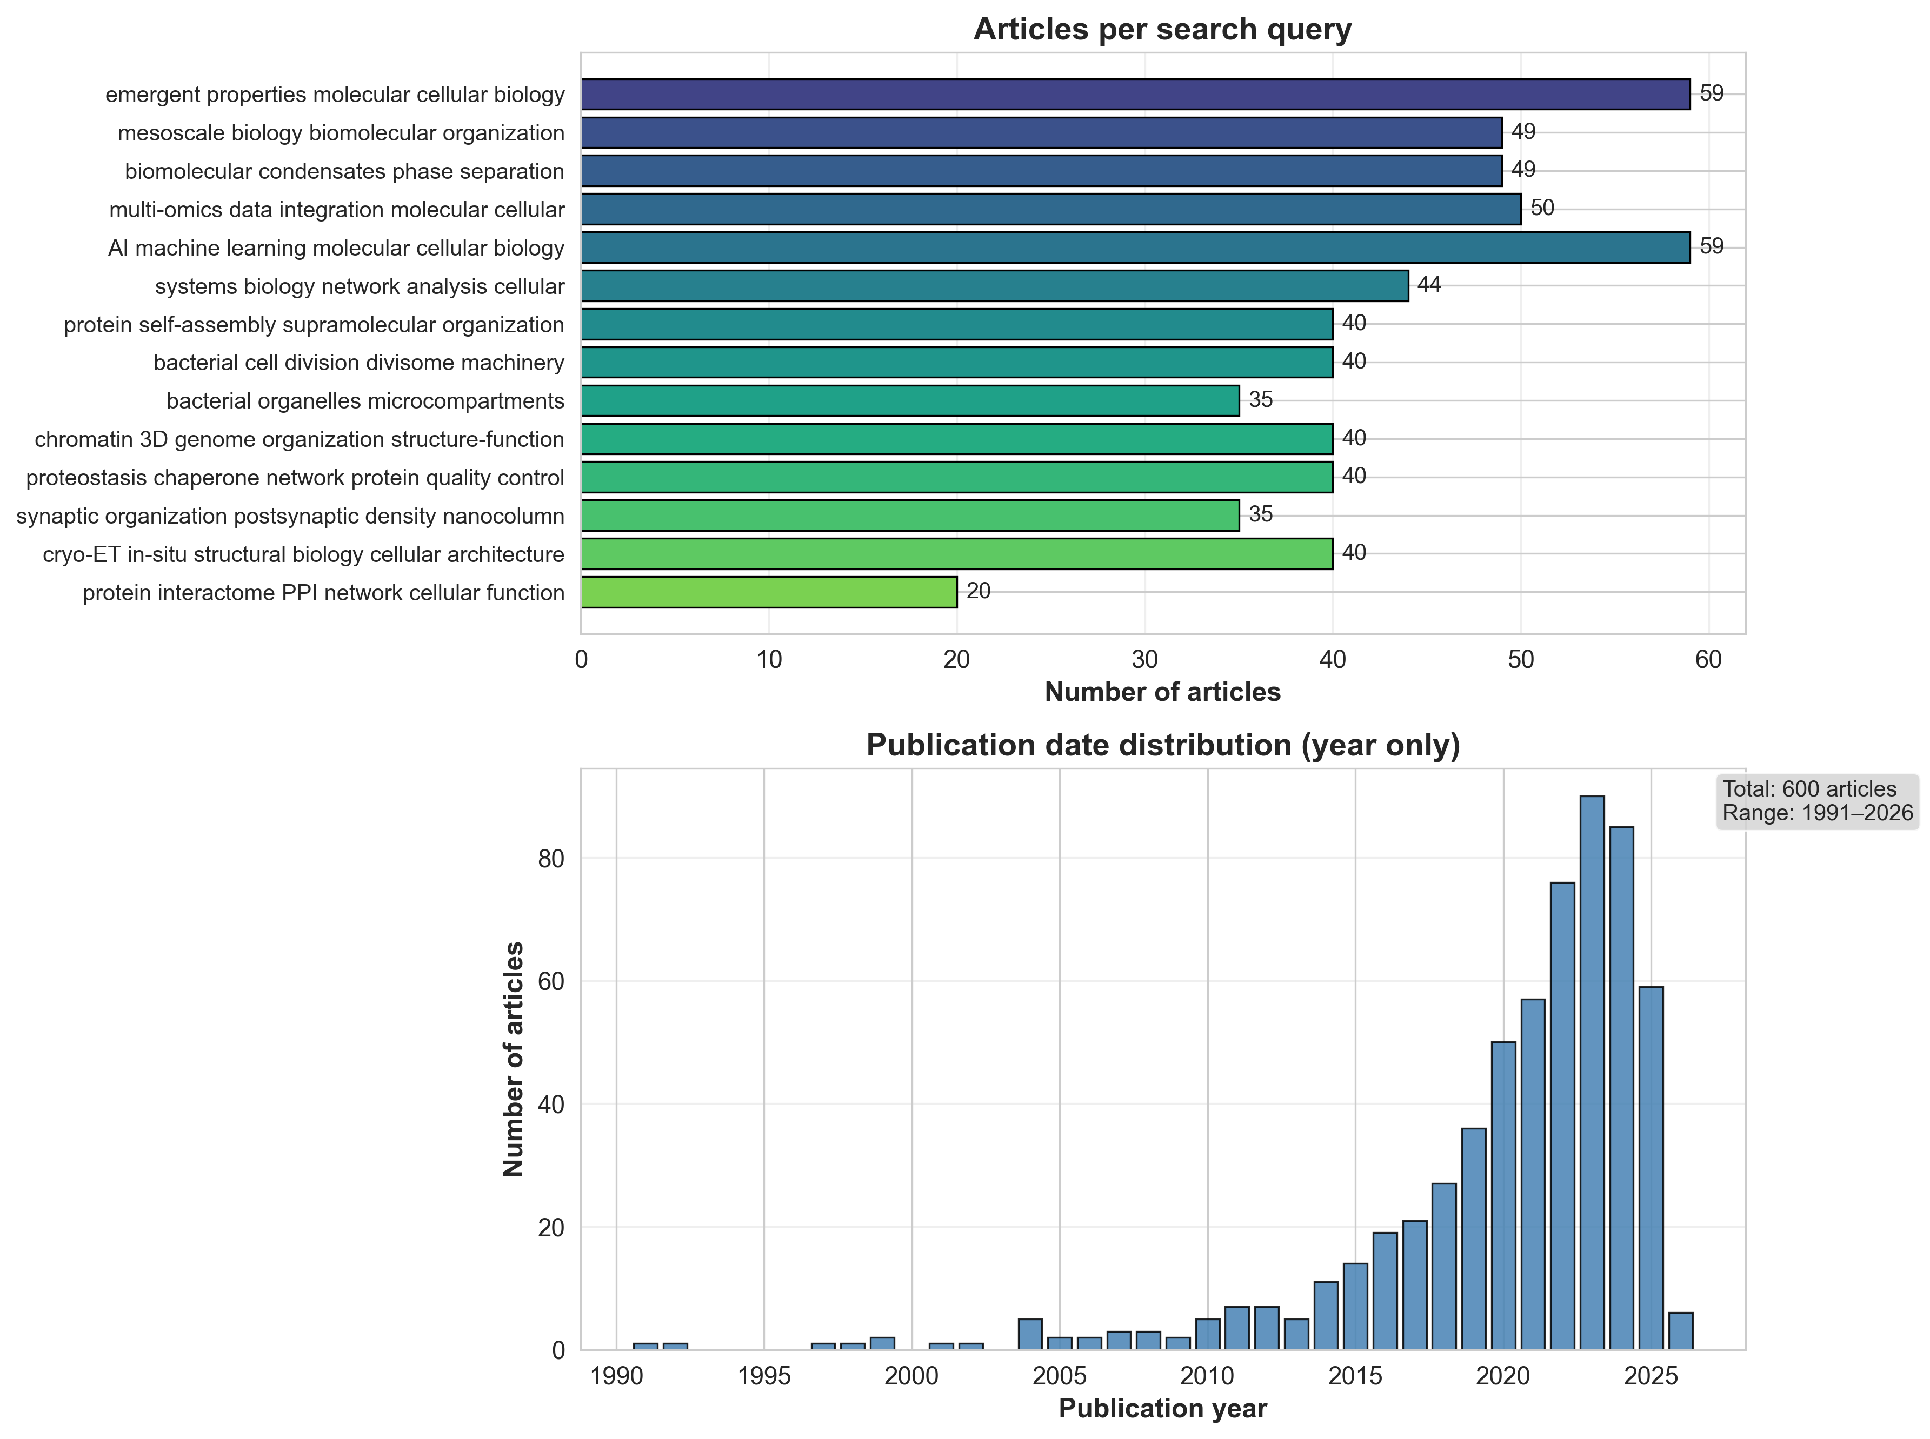
Literature Corpus (Expanded: 350 → 1,030 articles via 35 targeted queries)
1,030 PubMed articles, 35 targeted queries
Topics: emergent phenomena, condensates, omics, AI/ML, systems biology
Within-corpus mean NN dist: 0.110 ± 0.058
Proposals embedded using Section 1 only (fair comparison with abstracts)

Slide 15
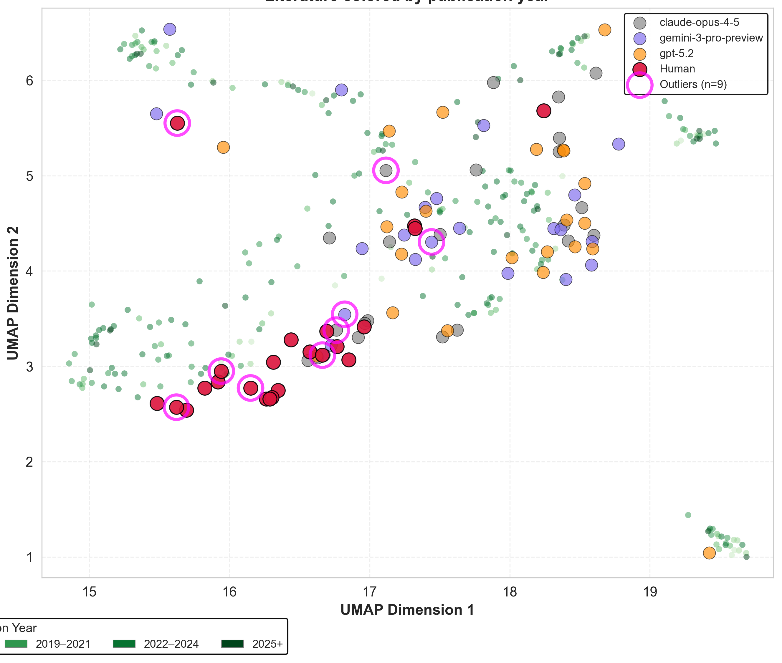
Proposals in Literature Embedding Space
PART II · NOVELTY
UMAP fit on 1,030 PubMed articles (gray); proposals projected into literature coordinate system
Mixed peripheral positioning
Human proposals are no longer clearly more peripheral than AI proposals after rephrasing. All groups sit at the edges of dense literature regions, consistent with the non-significant novelty test.
Claude-Opus-4.5 compact cluster
Claude proposals remain tightly clustered in one region of literature space, consistent with mode collapse in diversity analyses. GPT-5.2 shows more spread across literature regions.

Slide 16
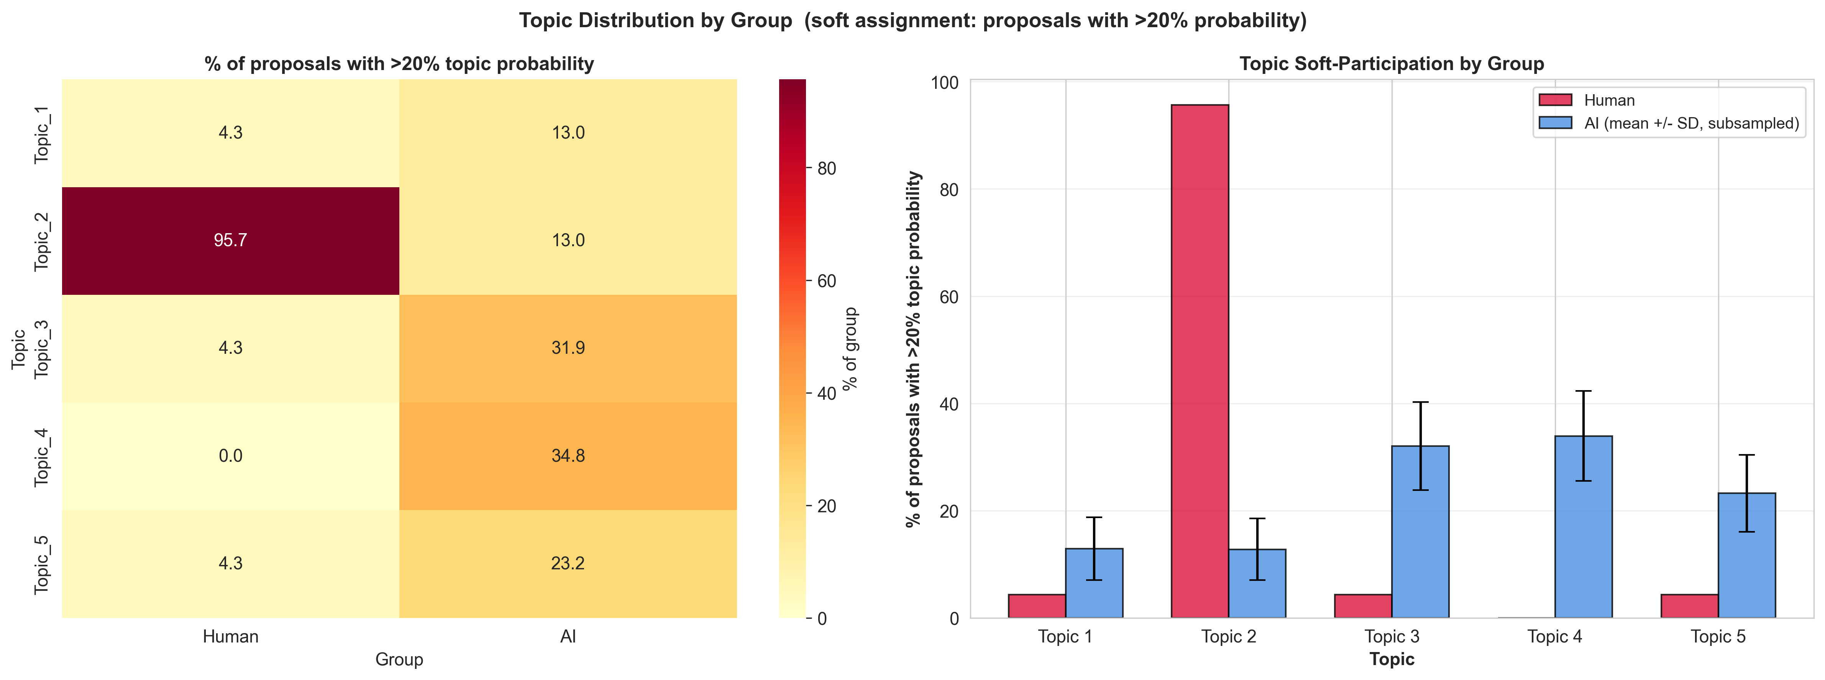
Analyses 3.1–3.4
PART III · THEMATIC
Thematic & Cluster Analysis
LDA topic modeling (k=5) and GMM clustering (k=3, BIC) on rephrased proposals
Strong thematic separation persists
Overall distribution difference: chi-square permutation p < 0.0001. Topic_2 is Human-dominated (100% of humans participate; Fisher p<0.001); Topic_3 is AI-dominated (4.3% human, Fisher q=0.008). Subsample validation (1,000 resamples): Topic_2 robust (100%), Topic_3 moderate (73%) are robust.
Cluster 0 (n=24)
Cluster 1 (n=19)
Cluster 2 (n=49)
Mixed (AI-leaning): 20.8% Human, 79.2% AI
Mixed (Human-leaning): 57.9% Human, 42.1% AI
AI-dominated: 14.3% Human, 85.7% AI
Segregation metrics (k=3 GMM, BIC selection)
NMI = 0.089, p = 0.003 — clusters predict source better than chance
ARI = 0.125, p = 0.001 — significant cluster-source agreement
Topic distribution (soft assignment, >20% probability threshold)
Between/within distance ratio = 1.241, p = 0.002 — Human and AI more distant from each other than from own group
Weaker but still significant segregation vs. baseline
Baseline NMI = 0.197; rephrased NMI = 0.089. Style was amplifying thematic separation — cluster segregation weakens after rephrasing. ARI improves from −0.035 to +0.125 and the between/within ratio reaches 1.241 (p=0.002), confirming semantic separation persists but is less extreme than baseline.

Slide 17
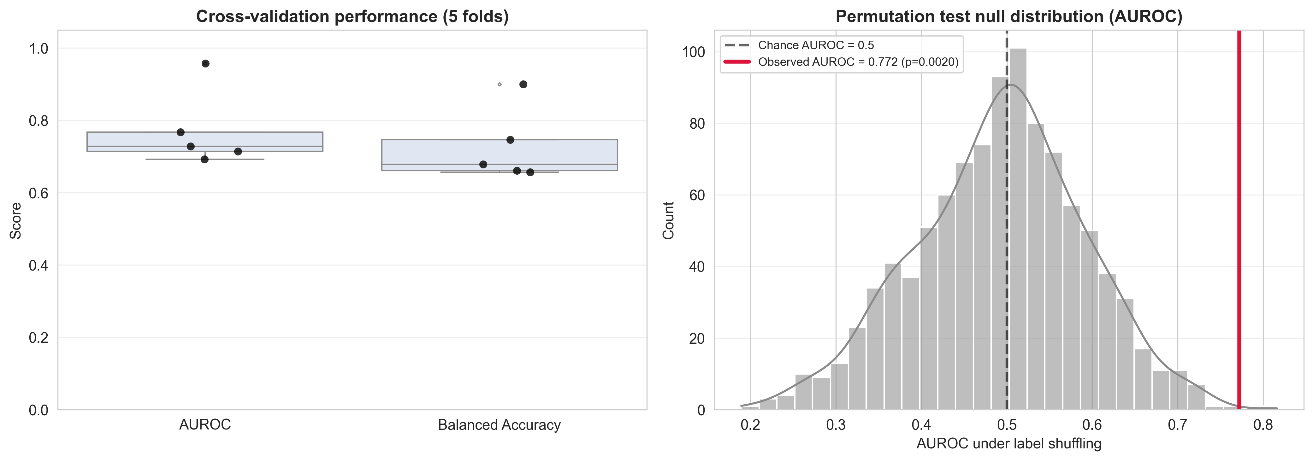
Style Baseline: How Much Style Remains After Rephrasing?
PART III · STYLE
Logistic regression on 18 stylistic features; 5-fold CV with permutation test (1,000 shuffles)
Rephrasing substantially reduces stylistic separability
AUROC drops from 1.000 (perfect) to 0.684 (±0.102). Permutation p = 0.023 — still significantly above chance but far less extreme than baseline. The template enforces near-uniform structure.
Residual style is not random
Permutation null AUROC = 0.506 ± 0.096. The observed 0.684 is well above chance — some stylistic trace remains despite standardization, likely from section-level content density variation.
Top predictive features (after rephrasing)
Type-token ratio (coef = +0.795) is the strongest AI predictor. Number of sentences (coef = −0.536) and hedging rate (−0.369) predict Human. Comma rate (+0.415) and stopword rate (+0.375) also push toward AI. Content-driven variation, not formatting.
Style Feature Means After Rephrasing
1.000
0.684
Avg sentence length:
AI = 18.3w, Human = 18.4w
→
Baseline AUROC
(original proposals)
Rephrased AUROC
(style-controlled)
Flesch reading ease:
AI ≈ Human (template enforces similar readability)
Stopword rate:
AI = 0.296, Human = 0.293

Slide 18
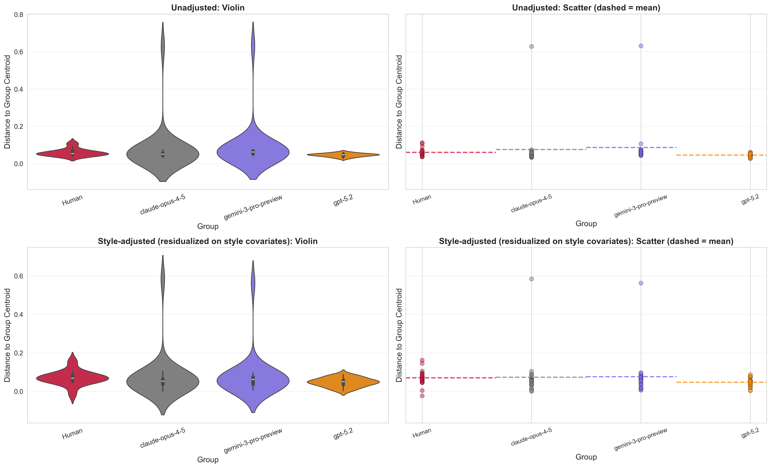
Style-Adjusted Centroid Dispersion & Nearest-Neighbor Analysis
PART III · STYLE CONTROL
Residualization: fit embedding distance ~ style features; test on residual. Removes linear style contribution.
Style-adjusted centroid dispersion: Human still more spread
After residualization: AI indicator coef = −0.151, permutation p = 0.0002. Human proposals remain significantly more dispersed from centroid even after removing style-predictable variance. MW δ = −0.76413 (small-medium effect).
Style-adjusted NN outlier rates
Outlier threshold (90th pct): 0.521. Human = 2 outliers (8.7%), Claude = 2 (8.7%), GPT-5.2 = 2 (8.7%), Gemini = 4 (17.4%). Pattern shifts: Gemini gains outliers in residual space (1→4) while Human loses them (7→2) — Gemini is conceptually isolated; Human's peripheral isolation was partly stylistic.
Style-Adjusted NN Outlier Rates
Residualization diagnostic
8.7%
8.7%
17.4%
8.7%
Mean |corr(style covariate, PC score)| drops from 0.105 (raw) to 0.064 (residualized), confirming effective style removal. Human/AI neighborhood asymmetry persists: AI same-group NN = 78.3% in residual space.
Human
Claude
Gemini
GPT-5.2
Semantic separation confirmed
Even after double style-control (rephrasing + residualization), Human/AI semantic segregation persists. 78.3% of AI proposals have their nearest neighbor from within the AI group — a conceptual, not stylistic, signal.

Slide 19
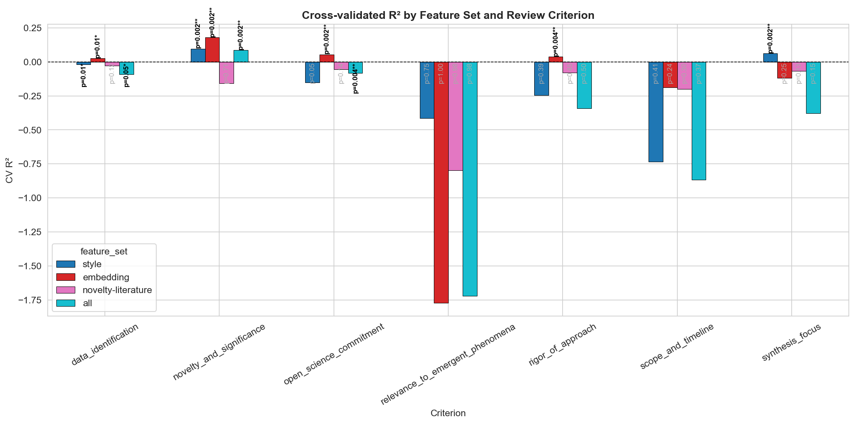
Analysis 3.1–3.5
PART V · REVIEW SCORES
Metric–Score Correlation & Predictive Validation
Do diversity/novelty metrics predict AI-assigned review scores? Ridge regression R² by criterion.
Semantic isolation predicts lower scores
Embedding features predict Novelty & Significance scores
NN distance (within-corpus) shows strong negative correlations with review criteria — most notably Relevance (centroid_dist r = −0.548) and Novelty & Significance (nn_dist r = −0.498). Main-idea NN distance shows strongest correlations: Relevance r = −0.554, Novelty r = −0.485. Open Science shows weak correlation (r = −0.079).498). Semantically isolated proposals score lower.
Ridge regression: embedding-only R² = 0.18 for Novelty & Significance (p = 0.002), outperforming style-only R² = 0.096. This validates embedding metrics as proxies for the Novelty criterion specifically.

Slide 20
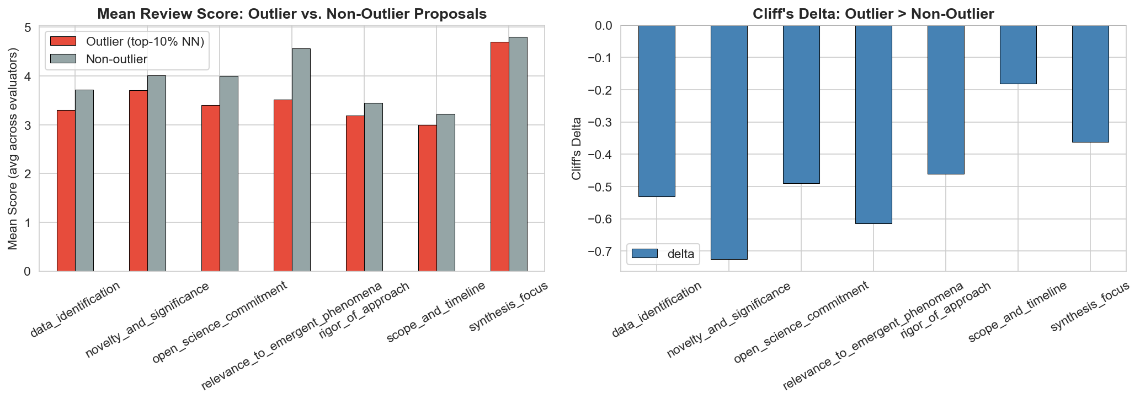
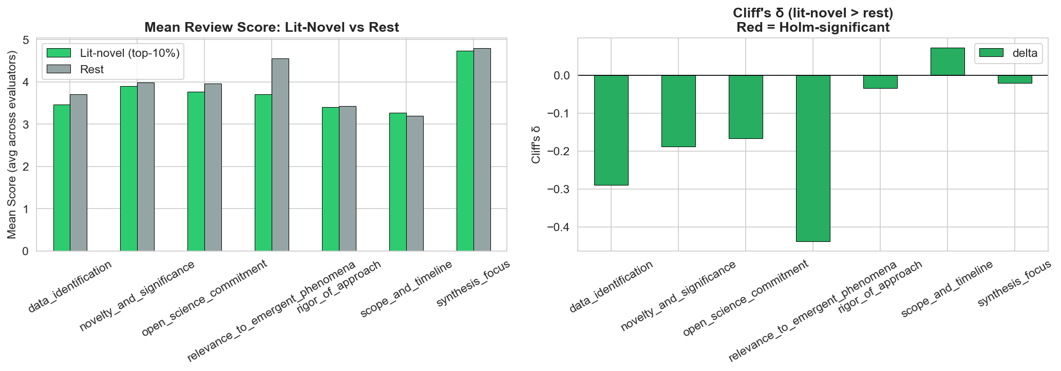
NN outliers vs. literature-novel proposals do not align with high scores (by AI evaluator)
Outlier proposals (top-10% NN distance) score lower on all criteria (Cliff's δ < 0, all p ≈ 1.0 for one-sided "outlier scores higher" test). Literature-novel proposals similarly show no score advantage. AI evaluators reward relevance, not peripherality.

Slide 21
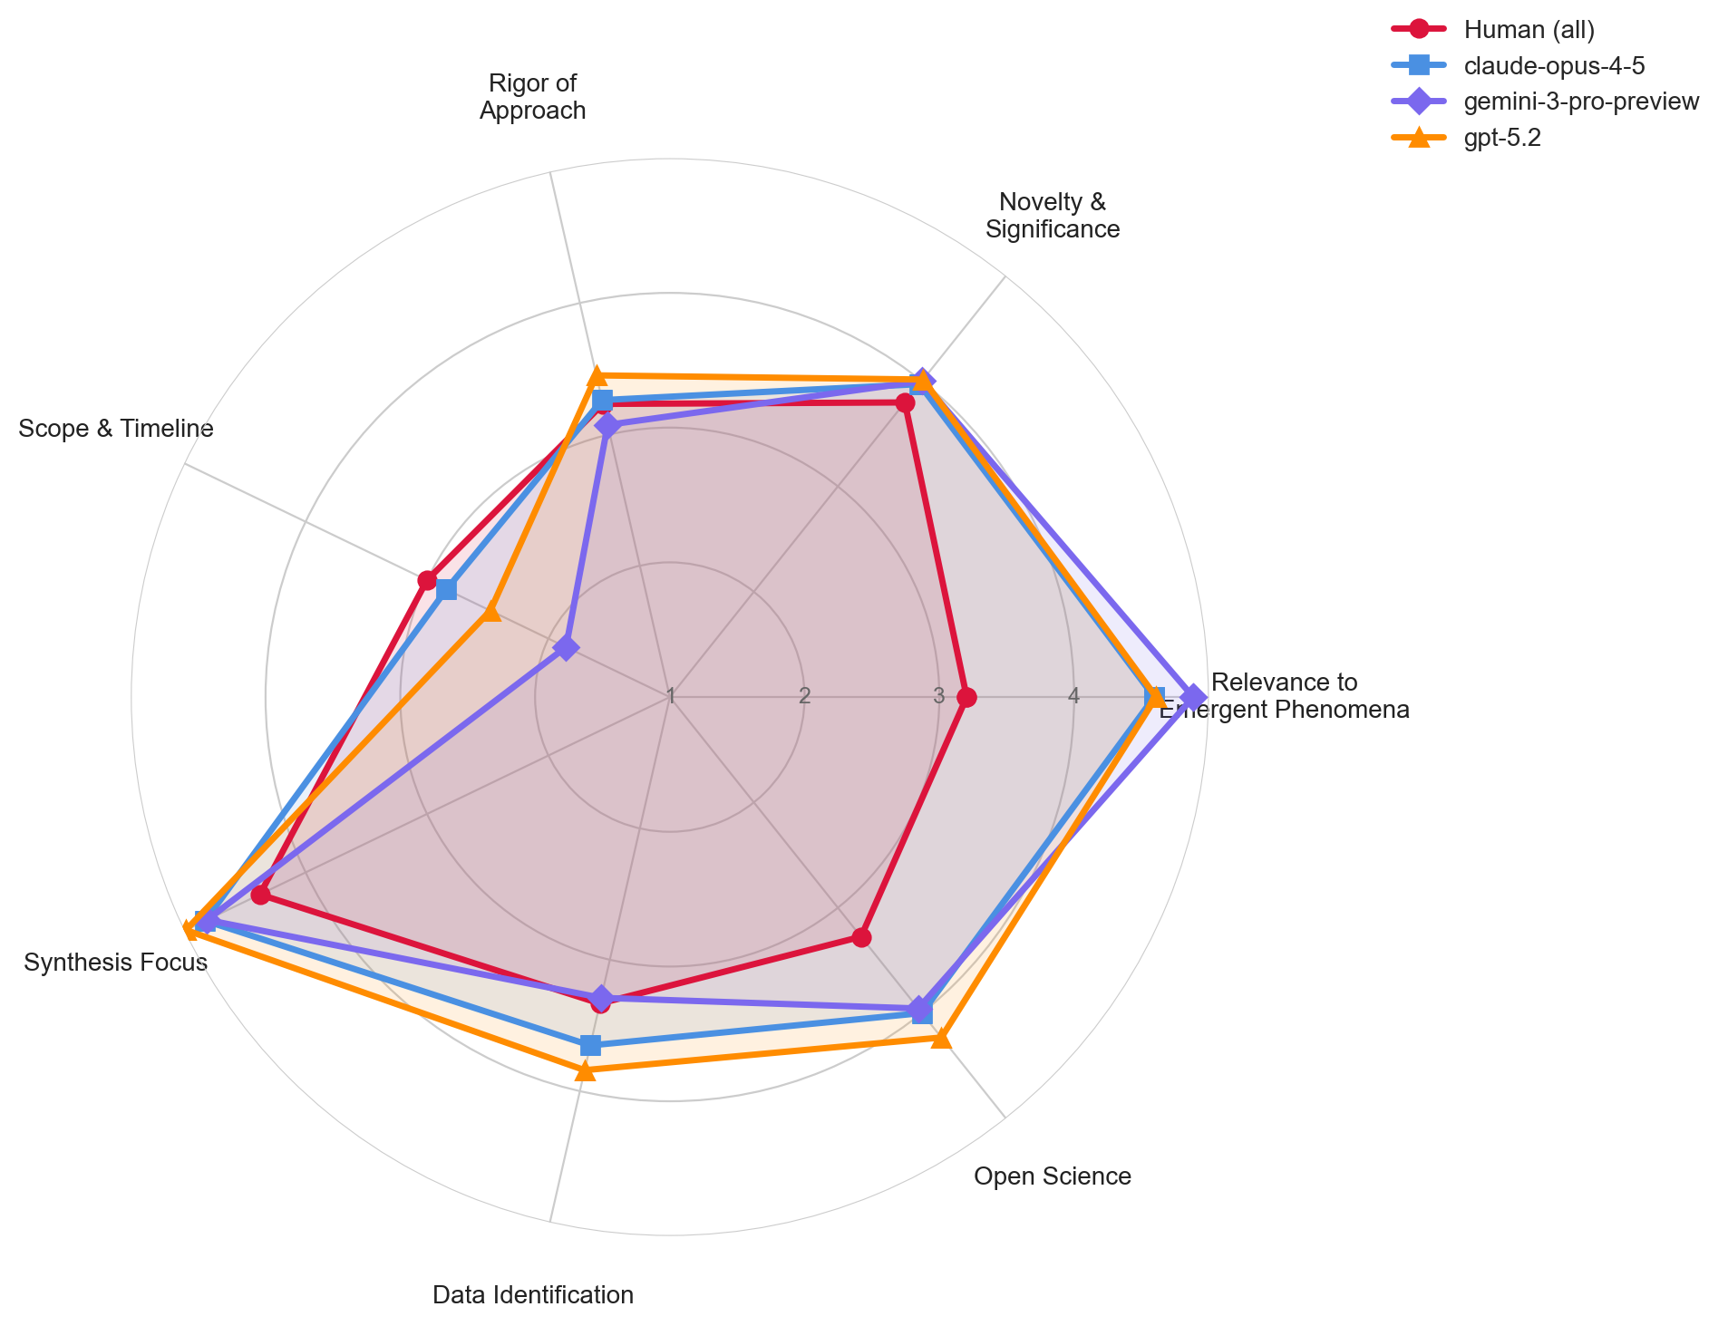
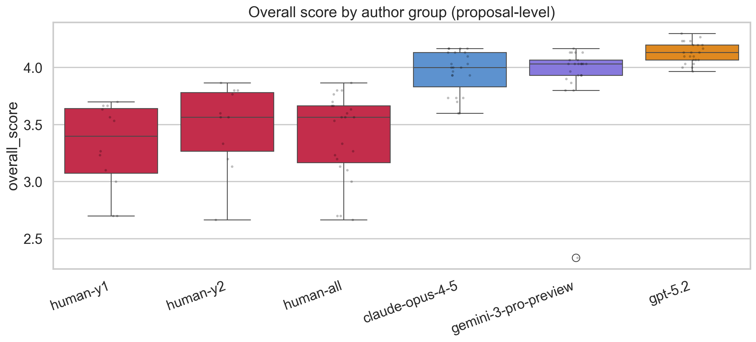
Proposal Quality
PART IV · QUALITY R2
R2: Proposal Quality Under AI Evaluation (Rephrased)
All AI evaluators pooled; 23 proposals per group; Mann-Whitney + Cliff's δ + bootstrap CI; BH-FDR correction
GPT-5.2 and Claude score substantially higher than humans
GPT-5.2 mean = 4.32 vs. Human 3.59 (δ = −0.72, q < 0.001). Claude = 4.01 (δ = −0.65, q < 0.001). Gemini = 3.83 (not significant vs. human, cross-eval q = 0.68). Bootstrap CI (human − GPT, cross-eval): −0.888 [−1.069, −0.706].
Evaluator leniency differs substantially
Kruskal-Wallis H = 98.02, p < 5.2×10⁻²². Gemini evaluator: mean = 4.30 (most lenient); GPT evaluator: mean = 3.72; Claude = 3.78. The 0.58-point spread (Gemini−GPT) is larger than the human-GPT author group difference.
Cross-Evaluator Only (Self-removed)
GPT advantage remains (q < 0.001, δ = −0.992). Gemini is NOT significant (q = 0.682). Claude advantage confirmed (q < 0.001, δ = −0.652). Human Y1 (3.44) ≈ Y2 (3.74).

Slide 22
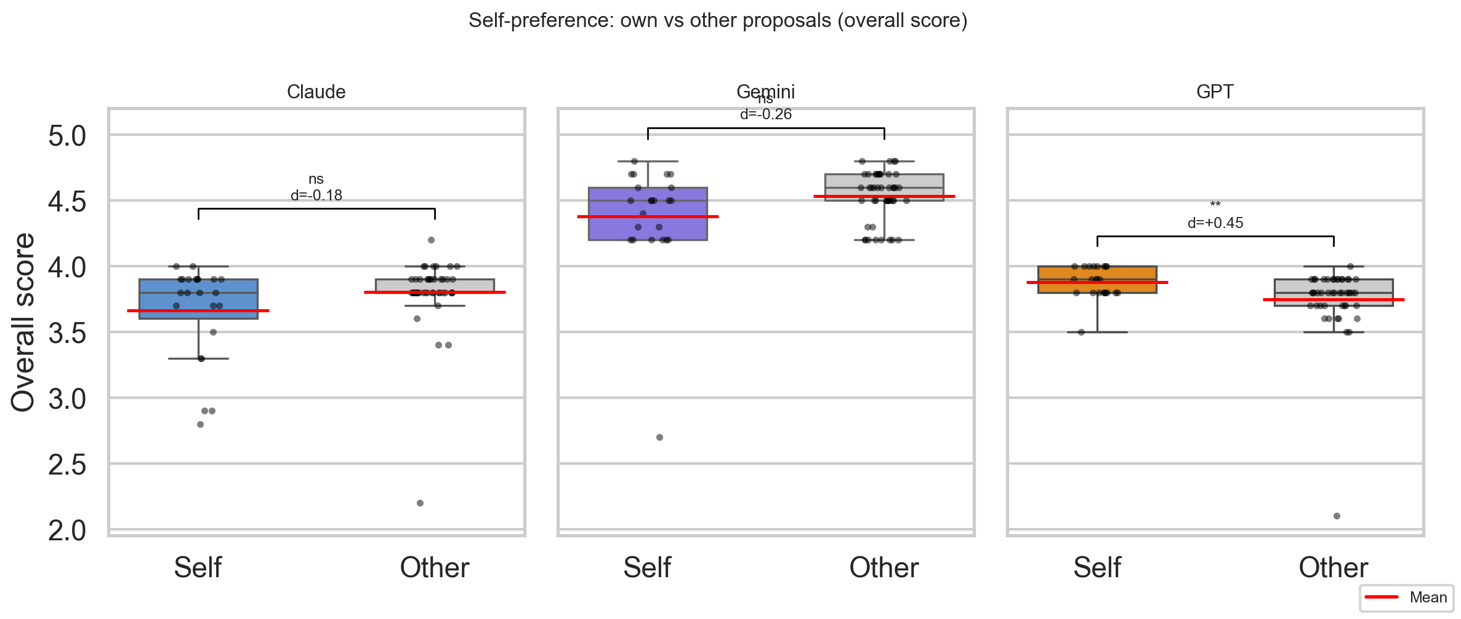
Evaluator Bias
PART IV · QUALITY R3
R3: Self-Preference Bias in AI Evaluators
Comparing self vs. other scores; fixed-effects regression isolates bias net of proposal quality
GPT self-inflates, especially on Relevance and Novelty
Criterion-level tests: GPT shows significant self-preference on Relevance to Emergent Phenomena (q < 0.001) and Novelty & Significance (q = 0.014). Fixed-effects regression confirms net GPT self-preference = +0.33 points. Gemini shows criterion-level self-deprecation on Relevance and Novelty (δ < −0.5, p < 0.001).
Self-preference is not explained by proposal quality
Fixed-effects model with proposal fixed effects absorbs all between-proposal quality variation. GPT bias persists: it is a real evaluator bias, not a proxy for GPT proposals being objectively better. Evaluator severity: Gemini +0.40 above Claude baseline; GPT −0.20 below.
R1: AI Review Proxy Validity
12 proposals matched. Human-AI cosine similarity: not significantly lower than human-human (p=0.26). AI-AI similarity significantly higher than human-human (δ=+0.514, p=0.035) — AI reviewers converge more tightly with each other than human experts do. Basic proxy validity holds; AI panels lack human critique diversity.
GPT-5.2
Gemini
Claude
+0.93
−0.73
~0
Strong self-inflation (δ=+0.933, q=3.3×10⁻¹²). Self: 4.00, Other: 3.81.
Strong self-DEPRECATION (δ=−0.732, q=7.7×10⁻⁷). Gemini rates its own proposals significantly lower than others' proposals.
Negligible self-preference (δ=−0.053, q=0.717, not significant).

Slide 23
Summary & Conclusions
CONCLUSIONS
What the style-controlled analysis adds and what remains for future work
DIVERSITY
NOVELTY
THEMATIC SEPARATION
QUALITY
Human proposals are more semantically diverse than pooled AI after style removal (δ=−0.768). Baseline Claude diversity advantage was stylistic — Claude-Opus-4.5 shows semantic mode collapse after rephrasing. GPT-5.2 and Gemini are intermediate.
Raw novelty gap persists after rephrasing (δ=−0.294, p<0.001) but is attenuated from baseline. Local-density normalized gap disappears (δ=+0.016, p=0.22). Style was partly responsible; humans also target sparser literature regions.
Semantic segregation weakens after rephrasing (NMI: 0.197→0.089) but remains significant (p=0.003). Style was amplifying apparent thematic separation. No human-dominated cluster; two mixed clusters and one AI-dominated cluster.
GPT-5.2 and Claude score higher than humans under cross-evaluator control; Gemini is not significant. GPT strongly self-inflates (δ=+0.933); Gemini strongly self-deprecates (δ=−0.732). AI reviews are valid but evaluator biases must be controlled.
Next Step 1
Next Step 2
Next Step 3
Next Step 4
Blinded human scoring of AI proposals to test the inverse direction (human rates AI)
Fix proxy-validity harmonization (ICC/rank agreement currently NaN for most criteria)
Investigate GPT near-zero variance in quality scores — prompts may saturate the rubric
Test whether AI review panel homogeneity leads to worse ranking discrimination than human panels
Big Picture
Rephrasing reveals that the Human/AI difference is primarily semantic (what ideas are proposed) rather than stylistic (how they are written). Human proposals explore more varied conceptual territory; Claude-Opus-4.5 shows near-zero semantic diversity (mode collapse) after style removal. GPT and Claude both achieve higher AI-assigned scores under cross-evaluator control. Large, divergent evaluator biases (GPT inflates, Gemini deflates) must be accounted for in any AI-review pipeline.

