Slide 1
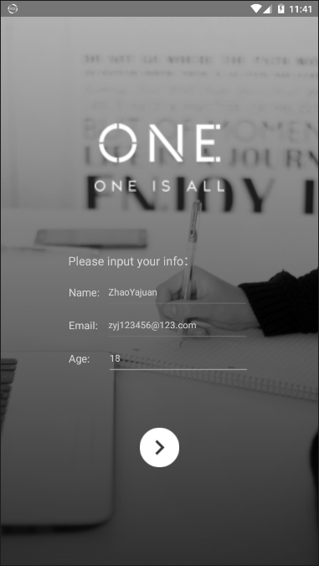
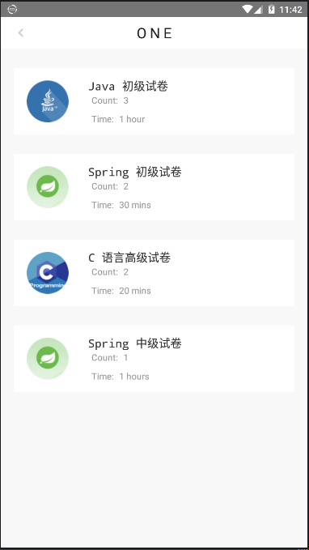
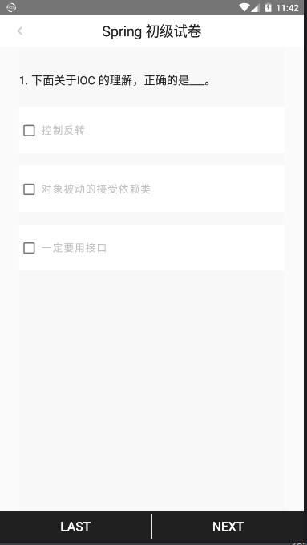
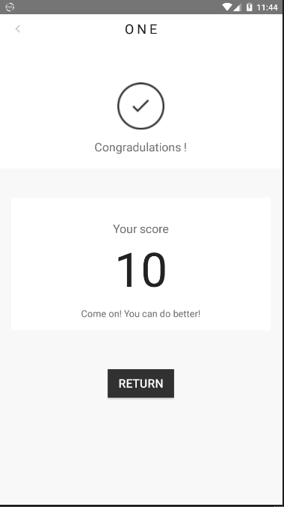
ONE
Summary The APP for interview. The interviewee answer all questions then calculate score. The interviewer compare every interviewee by the result recording.
Characteristic Concise, Easy to operate
Future Capture more and more questions from network. The interviewee answer question online, when score reach the standard send interview letter.

