Slide 1
L16: Libraries, OpenCL and OpenAcc

Slide 2
Administrative
Remaining Lectures
  Monday, April 15: CUDA 5 Features (small exercise)
  Wednesday, April 17: Parallel Architectures and Getting to Exascale
Final projects
  Poster session, April 24 (dry run April 22)
  Final report, May 1

Slide 3
Final Project Presentation
Dry run on April 22, Presentation on April 24
  Easels, tape and poster board provided
  Tape a set of Powerpoint slides to a standard 2’x3’ poster, or bring your own poster.
Final Report on Projects due May 1
  Submit code
  And written document, roughly 10 pages, based on earlier submission.
  In addition to original proposal, include
    Project Plan and How Decomposed (from DR)
    Description of CUDA implementation
    Performance Measurement
    Related Work (from DR)

Slide 4
Sources for Today’s Lecture
References:
OpenAcc Home page:
http://www.openacc-standard.org/
OpenCL Home page:
http://www.khronos.org/opencl/
Overview of OpenCL:
http://www.khronos.org/assets/uploads/developers/library/overview/opencl-overview.pdf
http://www1.coe.neu.edu/~pmistry/perhaad/Research_files/icpe-opencl-tutorial.pdf
2012 Tutorial
Additional Reference (new book):
Heterogeneous Computing with OpenCL, B. Gaster, L. Howes, D. Kaeli, P. Mistry, D. Schaa, Morgan Kaufmann, 2012.

Slide 5
Many Different Paths to Parallel Programming
In this course, we have focused on CUDA
But there are other programming technologies, some of which we will discuss today
Range of solutions:
  Libraries
  Higher Levels of Abstraction
    OpenACC (today)
    PyCUDA, Copperhead, etc.
  Non-proprietary, but similar solutions
    Specifically, OpenCL

Slide 6
A Few Words About Libraries
Take a look at what you find in /usr/local/cuda-5.0/lib
  CUBLAS: linear algebra
  CUSPARSE: sparse linear algebra
  CUFFT: signal processing (FFTs)
More in https://developer.nvidia.com/gpu-accelerated-libraries
Also, https://developer.nvidia.com/thrust
  Thrust:
    STL-like templated interfaces to several algorithms and data structures designed for high performance heterogeneous parallel computing

Slide 7
Advantages of Libraries
Some common algorithms can be encapsulated in a library
  Library is developed by performance expert
  Can be used by average developer
  Accelerates development process
Often programmer does not even need to think about parallelism
  Parallelism is embedded in the library
Disadvantages of libraries
  Difficult to customize to specific contexts
  Complex and difficult to understand

Slide 8
What is OpenAcc?
High-level directives can be added to C/C++ or Fortran programs
  Mark loops or blocks of statements to be offloaded to an attached accelerator
  Portable across host, OS and accelerator
  Similar in spirit to OpenMP
Example constructs
  #pragma acc parallel [clause[,]…] newline
  block of code or loop
  Example clauses:
  async[], copy_in(), private(), copy_out(), …
Announced at SC11, November 2011
A partnership between Nvidia, Cray, PGI, and CAPS

Slide 9
Why Openacc?
Advantages:
  Ability to add GPU code to existing program with very low effort, similar to OpenMP vs. Pthreads
  Compiler deals with complexity of index expressions, data movement, synchronization
  Has the potential to be portable and non-proprietary if adopted by other vendors
  Real gains are being achieved on real applications
Disadvantages:
  Performance may suffer, possibly a lot
  Cannot express everything that can be expressed in CUDA
  Still not widely adopted by the community, but it is new so this may change

Slide 10
What is OpenCL?
Open source standard specification for developing heterogeneous parallel applications
  i.e., parallel codes that use a mix of different functional units
  Goal is to unify how parallelism is expressed, how to offload computation to accelerators like GPUs, and port code from one platform to another
Advantages over CUDA
  Not proprietary
  Not specific to Nvidia GPUs
Disadvantages (my list)
  Portable, but not necessarily performance portable
  CUDA is customized to Nvidia hardware execution model, so can be made faster
  A bit low level in terms of programmer abstractions

Slide 11
OpenCL short presentation
Taken from
http://www.khronos.org/assets/uploads/developers/library/overview/opencl-overview.pdf
http://www1.coe.neu.edu/~pmistry/perhaad/Research_files/icpe-opencl-tutorial.pdf

Slide 12
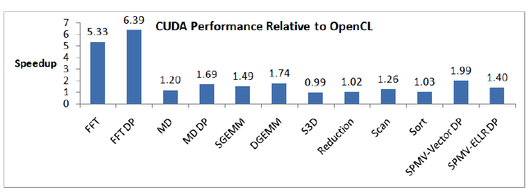
A recent comparison, from Vetter, “Programming Scalable Heterogeneous Systems Productively”, SOS15, March 2011.
See also: Anthony Danalis, Gabriel Marin, Collin McCurdy, Jeremy S. Meredith, Philip C. Roth, Kyle Spafford, Vinod Tipparaju, and Jeffrey S. Vetter. 2010. The Scalable Heterogeneous Computing (SHOC) benchmark suite. In Proceedings of the 3rd Workshop on General-Purpose Computation on Graphics Processing Units (GPGPU '10). ACM, New York, NY, USA, 63-74.

Slide 13
What are the differences
This is not scientific, but I have read the following:
  Startup is much higher in OpenCL because of its generality
  Data transfer may also be slower due to a more general protocol
  Computation is slightly slower due to generality of scheduling
Bottom line
  Generality slows down performance
  One can ask whether programmability is improved, or portability is achieved (unclear)

Slide 14
What will it take for OpenCL to Dethrone CUDA
For problems not on Nvidia GPUs, it may already have
  CUDA programs often do not run on other hardware
  But sometimes the CUDA support exists
But what happens for people who want the ultimate in performance
  Will continue to use CUDA until OpenCL codes run as fast or faster
  This may not be achievable due to reasons in previous slide
  CUDA is getting a larger and larger applications community
  CUDA codes are tuned at a low level for Nvidia architecture features
Alternatively, if portability across high-end platforms becomes important, then performance may be sacrified
Eventually CUDA will be replaced with something, if history is any guide

