Slide 1
Future of
Computer
Architecture
David A. Patterson
Pardee Professor of Computer Science, U.C. Berkeley
President, Association for Computing Machinery
February, 2006
Notes:
“How to Give a Bad Talk”
“How to Have a Bad Career”
Hence today’s title

Slide 2
High Level Message
Everything is changing; Old conventional wisdom is out
We DESPERATELY need a new architectural solution for microprocessors based on parallelism
Need to create a “watering hole” to bring everyone together to quickly find that solution
  architects, language designers, application experts, numerical analysts, algorithm designers, programmers, …

Slide 3
Outline
Part I: A New Agenda for Computer Architecture
  Old Conventional Wisdom vs. New Conventional Wisdom
Part II: A “Watering Hole” for Parallel Systems
  Research Accelerator for Multiple Processors
Conclusion
Notes:
Key Advice on a bad career
Send part alternatives
First point is selecting a problem. Those who know the university promotion system know that promotion committees ask the question:
Is this person the leading person in their field?
How do you do that? First piece of bad advice

Slide 4
Conventional Wisdom (CW) in Computer Architecture
Old CW: Chips reliable internally, errors at pins
New CW: ≤65 nm ⇒ high soft & hard error rates
Old CW: Demonstrate new ideas by building chips
New CW: Mask costs, ECAD costs, GHz clock rates ⇒ researchers can’t build believable prototypes
Old CW: Innovate via compiler optimizations + architecture
New: Takes > 10 years before new optimization at leading conference gets into production compilers
Old: Hardware is hard to change, SW is flexible
New: Hardware is flexible, SW is hard to change

Slide 5
Conventional Wisdom (CW) in Computer Architecture
Old CW: Power is free, Transistors expensive
New CW: “Power wall” Power expensive, Xtors free
(Can put more on chip than can afford to turn on)
Old: Multiplies are slow, Memory access is fast
New: “Memory wall” Memory slow, multiplies fast
(200 clocks to DRAM memory, 4 clocks for FP multiply)
Old : Increasing Instruction Level Parallelism via compilers, innovation (Out-of-order, speculation, VLIW, …)
New CW: “ILP wall” diminishing returns on more ILP
New: Power Wall + Memory Wall + ILP Wall = Brick Wall
  Old CW: Uniprocessor performance 2X / 1.5 yrs
  New CW: Uniprocessor performance only 2X / 5 yrs?

Slide 6
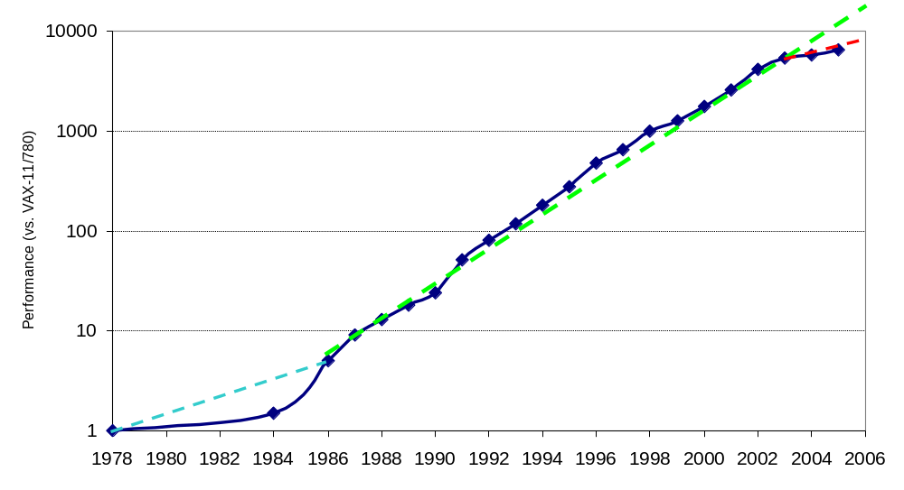
Uniprocessor Performance (SPECint)
3X
From Hennessy and Patterson, Computer Architecture: A Quantitative Approach, 4th edition, 2006
⇒ Sea change in chip design: multiple “cores” or processors per chip
VAX : 25%/year 1978 to 1986
RISC + x86: 52%/year 1986 to 2002
RISC + x86: ??%/year 2002 to present

Slide 7
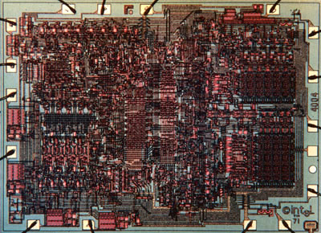
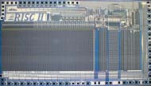
Sea Change in Chip Design
Intel 4004 (1971): 4-bit processor,
2312 transistors, 0.4 MHz,
10 micron PMOS, 11 mm² chip
RISC II (1983): 32-bit, 5 stage
pipeline, 40,760 transistors, 3 MHz,
3 micron NMOS, 60 mm² chip
125 mm² chip, 0.065 micron CMOS
= 2312 RISC II+FPU+Icache+Dcache
  RISC II shrinks to ≈ 0.02 mm² at 65 nm
  Caches via DRAM or 1 transistor SRAM (www.t-ram.com) ?
  Proximity Communication via capacitive coupling at > 1 TB/s ?
  (Ivan Sutherland @ Sun / Berkeley)
Processor is the new transistor?

Slide 8
Déjà vu all over again?
“… today’s processors … are nearing an impasse as technologies approach the speed of light..”
David Mitchell, The Transputer: The Time Is Now (1989)
Transputer had bad timing (Uniprocessor performance↑)
⇒ Procrastination rewarded: 2X seq. perf. / 1.5 years
“We are dedicating all of our future product development to multicore designs. … This is a sea change in computing”
Paul Otellini, President, Intel (2005)
All microprocessor companies switch to MP (2X CPUs / 2 yrs)
⇒ Procrastination penalized: 2X sequential perf. / 5 yrs
Manufacturer/Year | AMD/’05 | Intel/’06 | IBM/’04 | Sun/’05
Processors/chip | 2 | 2 | 2 | 8
Threads/Processor | 1 | 2 | 2 | 4
Threads/chip | 2 | 4 | 4 | 32

Slide 9
21st Century Computer Architecture
Old CW: Since cannot know future programs, find set of old programs to evaluate designs of computers for the future
  E.g., SPEC2006
What about parallel codes?
  Few available, tied to old models, languages, architectures, …
New approach: Design computers of future for numerical methods important in future
Claim: key methods for next decade are 7 dwarves (+ a few), so design for them!
  Representative codes may vary over time, but these numerical methods will be important for > 10 years

Slide 10
High-end simulation in the physical sciences = 7 numerical methods:
Phillip Colella’s “Seven dwarfs”
Structured Grids (including locally structured grids, e.g. Adaptive Mesh Refinement)
Unstructured Grids
Fast Fourier Transform
Dense Linear Algebra
Sparse Linear Algebra
Particles
Monte Carlo
If add 4 for embedded, covers all 41 EEMBC benchmarks
  8. Search/Sort
  9. Filter
  10. Combinational logic
  11. Finite State Machine
Note: Data sizes (8 bit to 32 bit) and types (integer, character) differ, but algorithms the same
Well-defined targets from algorithmic, software, and architecture standpoint
Slide from “Defining Software Requirements for Scientific Computing”, Phillip Colella, 2004

Slide 11
6/11 Dwarves Covers 24/30 SPEC
SPECfp
  8 Structured grid
    3 using Adaptive Mesh Refinement
  2 Sparse linear algebra
  2 Particle methods
  5 TBD: Ray tracer, Speech Recognition, Quantum Chemistry, Lattice Quantum Chromodynamics
  (many kernels inside each benchmark?)
SPECint
  8 Finite State Machine
  2 Sorting/Searching
  2 Dense linear algebra (data type differs from dwarf)
  1 TBD: 1 C compiler (many kernels?)

Slide 12
21st Century Code Generation
Old CW: Takes a decade for compilers to introduce an architecture innovation
New approach: “Auto-tuners” 1st run variations of program on computer to find best combinations of optimizations (blocking, padding, …) and algorithms, then produce C code to be compiled for that computer
  E.g., PHiPAC (BLAS), Atlas (BLAS),
  Sparsity (Sparse linear algebra), Spiral (DSP), FFT-W
  Can achieve 10X over conventional compiler
One Auto-tuner per dwarf?
  Exist for Dense Linear Algebra, Sparse Linear Algebra, Spectral
Notes:
Autotuners is fine. I had a slightly longer list I was working on before seeing Krste's mail. PHiPAC: Dense linear algebra (Krste, Jim, Jeff Bilmes and others at UCB) PHiPAC = Portable High Performance Ansi C FFTW: Fastest Fourier Transforms in the West (from Matteo Frigo and Steve Johnson at MIT; Matteo is now at IBM) Atlas: Dense linear algebra now the "standard" for many BLAS implementations; used in Matlab, for example. (Jack Dongarra, Clint Whaley et al) Sparsity: Sparse linear algebra (Eun-Jin Im and Kathy at UCB) Spiral: DSP algorithms including FFTs and other transforms (Markus Pueschel, José M. F. Moura et al) OSKI: Sparse linear algebra (Rich Vuduc, Jim and Kathy, From the Bebop project at UCB) In addition there are groups at Rice, USC, UIUC, Cornell, UT Austin, UCB (Titanium), LLNL and others working on compilers that include an auto-tuning (Search-based) optimization phase. Both the Bebop group and the Atlas group have done work on automatic tuning of collective communication routines for supercomputers/clusters, but this is ongoing. I'll send a slide with an autotuning example later. Kathy

Slide 13
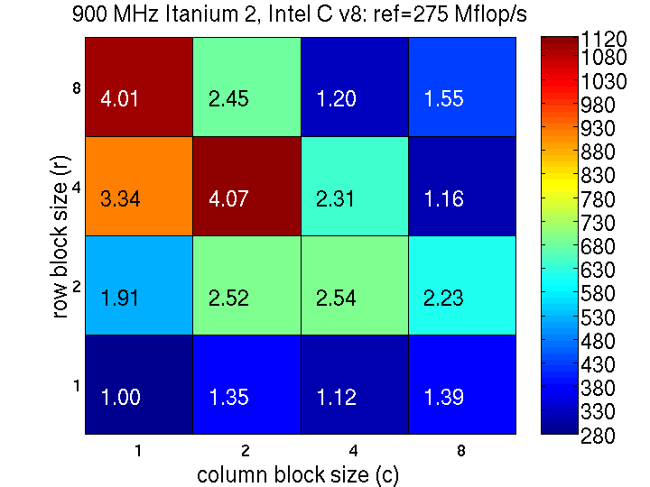
Sparse Matrix – Search for Blocking
for finite element problem [Im, Yelick, Vuduc, 2005]
Mflop/s
Best: 4x2
Reference
Mflop/s
Notes:
[NOTE: This slide has some animation in it.]
Consider the following experiment in which we implement SpMV using BCSR format for the matrix shown in the previous slide at all block sizes that divide 8x8—16 implementations in all. These implementations fully unroll the innermost loop and use scalar replacement for the source and destination vectors. You might reasonably expect performance to increase relatively smoothly as r and c increase, but this is clearly not the case!
Platform: 900 MHz Itanium-2, 3.6 Gflop/s peak speed. Intel v8.0 compiler.
Good speedups (4x) but at an unexpected block size (4x2).
Figure taken from Im, Yelick, Vuduc, IJHPCA 2005 paper.

Slide 14
Best Sparse Blocking for 8 Computers
 | Intel Pentium M |  | Sun Ultra 2, Sun Ultra 3, AMD Opteron
IBM Power 4, Intel/HP Itanium | Intel/HP Itanium 2 | IBM Power 3
8
4
row block size (r)
2
1
1
2
4
8
column block size (c)
All possible column block sizes selected for 8 computers; How could compiler know?

Slide 15
21st Century Measures of Success
Old CW: Don’t waste resources on accuracy, reliability
  Speed kills competition
  Blame Microsoft for crashes
New CW: SPUR is critical for future of IT
  Security
  Privacy
  Usability (cost of ownership)
  Reliability
Success not limited to performance/cost
“20th century vs. 21st century C&C: the SPUR manifesto,” Communications of the ACM , 48:3, 2005.

Slide 16
Style of Parallelism
Less HW Control,
Simpler Prog. model
Explicitly Parallel
More Flexible
Data Level Parallel
(≈ SIMD)
Thread Level Parallel
(≈ MIMD)
Streaming
(time is one
dimension)
General
DLP
No
Coupling
TLP
Barrier
Synch.
TLP
Tight
Coupling
TLP
  Programmer wants code to run on as many parallel architectures as possible so (if possible)
  Architect wants to run as many different types of parallel programs as possible so

Slide 17
Parallel Framework – Apps (so far)
Original 7 dwarves: 6 data parallel, 1 no coupling TLP
Bonus 4 dwarves: 2 data parallel, 2 no coupling TLP
EEMBC (Embedded): Stream 10, DLP 19, Barrier TLP 2
SPEC (Desktop): 14 DLP, 2 no coupling TLP
D
W
A
R
F
S
S
P
E
C
E
E
M
B
C
Most Important Apps?
Most New
Architectures
E
E
M
B
C
S
P
E
C
D
w
a
r
f
S
Streaming DLP DLP No coupling TLP
Barrier TLP Tight TLP

Slide 18
Outline
Part I: A New Agenda for Computer Architecture
  Old Conventional Wisdom vs. New Conventional Wisdom
Part II: A “Watering Hole” for Parallel Systems
  Research Accelerator for Multiple Processors
Conclusion
Notes:
Key Advice on a bad career
Send part alternatives
First point is selecting a problem. Those who know the university promotion system know that promotion committees ask the question:
Is this person the leading person in their field?
How do you do that? First piece of bad advice

Slide 19
Problems with Sea Change
Algorithms, Programming Languages, Compilers, Operating Systems, Architectures, Libraries, … not ready for 1000 CPUs / chip
Only companies can build HW, and it takes years
Software people don’t start working hard until hardware arrives
  3 months after HW arrives, SW people list everything that must be fixed, then we all wait 4 years for next iteration of HW/SW
How get 1000 CPU systems in hands of researchers to innovate in timely fashion on in algorithms, compilers, languages, OS, architectures, … ?
Avoid waiting years between HW/SW iterations?

Slide 20
Build Academic MPP from FPGAs
As ≈ 25 CPUs will fit in Field Programmable Gate Array (FPGA), 1000-CPU system from ≈ 40 FPGAs?
  16 32-bit simple “soft core” RISC at 150MHz in 2004 (Virtex-II)
  FPGA generations every 1.5 yrs; ≈ 2X CPUs, ≈ 1.2X clock rate
HW research community does logic design (“gate shareware”) to create out-of-the-box, MPP
  E.g., 1000 processor, standard ISA binary-compatible, 64-bit, cache-coherent supercomputer @ ≈ 100 MHz/CPU in 2007
  RAMPants: Arvind (MIT), Krste Asanovíc (MIT), Derek Chiou (Texas), James Hoe (CMU), Christos Kozyrakis (Stanford), Shih-Lien Lu (Intel), Mark Oskin (Washington), David Patterson (Berkeley, Co-PI), Jan Rabaey (Berkeley), and John Wawrzynek (Berkeley, PI)
“Research Accelerator for Multiple Processors”

Slide 21
Why RAMP Good for Research MPP?
 | SMP | Cluster | Simulate | RAMP
Scalability (1k CPUs) | C | A | A | A
Cost (1k CPUs) | F ($40M) | C ($2-3M) | A+ ($0M) | A ($0.1-0.2M)
Cost of ownership | A | D | A | A
Power/Space (kilowatts, racks) | D (120 kw, 12 racks) | D (120 kw, 12 racks) | A+ (.1 kw, 0.1 racks) | A (1.5 kw, 0.3 racks)
Community | D | A | A | A
Observability | D | C | A+ | A+
Reproducibility | B | D | A+ | A+
Reconfigurability | D | C | A+ | A+
Credibility | A+ | A+ | F | B+/A-
Perform. (clock) | A (2 GHz) | A (3 GHz) | F (0 GHz) | C (0.1-.2 GHz)
GPA | C | B- | B | A-

Slide 22
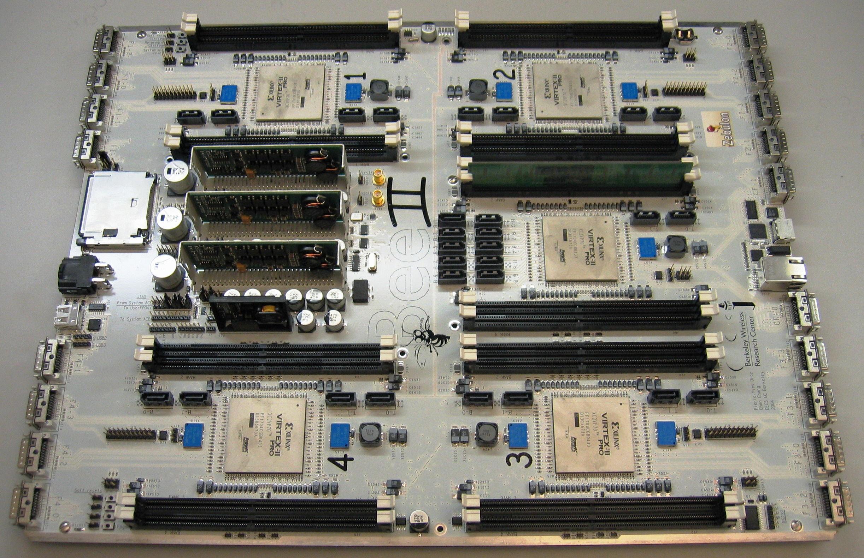
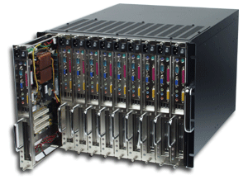
RAMP 1 Hardware
Completed Dec. 2004 (14x17 inch 22-layer PCB)
Board:
5 Virtex II FPGAs, 18 banks DDR2-400 memory,
20 10GigE conn.
1.5W / computer,
5 cu. in. /computer,
$100 / computer
Box:
8 compute modules in 8U rack mount chassis
1000 CPUs :
≈1.5 KW,
≈ ¼ rack,
≈ $100,000
  BEE2: Berkeley Emulation Engine 2
  By John Wawrzynek and Bob Brodersen with students Chen Chang and Pierre Droz

Slide 23
RAMP Milestones
Name | Goal | Target | CPUs | Details
Red (Stanford) | Get Started | 1H06 | 8 PowerPC 32b hard cores | Transactional memory SMP
Blue (Cal) | Scale | 2H06 | ≈1000 32b soft (Microblaze) | Cluster, MPI
White (All) | Full Features | 1H07? | 128? soft 64b, Multiple commercial ISAs | CC-NUMA, shared address, deterministic, debug/monitor
2.0 | 3rd party sells it | 2H07? | 4X CPUs of ‘04 FPGA | New ’06 FPGA, new board

Slide 24
Can RAMP keep up?
FGPA generations: 2X CPUs / 18 months
  2X CPUs / 24 months for desktop microprocessors
1.1X to 1.3X performance / 18 months
  1.2X? / year per CPU on desktop?
However, goal for RAMP is accurate system emulation, not to be the real system
  Goal is accurate target performance, parameterized reconfiguration, extensive monitoring, reproducibility, cheap (like a simulator) while being credible and fast enough to emulate 1000s of OS and apps in parallel
  (like hardware)

Slide 25


Multiprocessing Watering Hole
RAMP
Parallel file system
Dataflow language/computer
Data center in a box
Fault insertion to check dependability
Router design
Compile to FPGA
Flight Data Recorder
Security enhancements
Transactional Memory
Internet in a box
128-bit Floating Point Libraries
Parallel languages
Killer app: ≈ All CS Research, Advanced Development
RAMP attracts many communities to shared artifact
⇒ Cross-disciplinary interactions
⇒ Ramp up innovation in multiprocessing
RAMP as next Standard Research/AD Platform?
(e.g., VAX/BSD Unix in 1980s, Linux/x86 in 1990s)

Slide 26
Supporters and Participants
Gordon Bell (Microsoft)
Ivo Bolsens (Xilinx CTO)
Jan Gray (Microsoft)
Norm Jouppi (HP Labs)
Bill Kramer (NERSC/LBL)
Konrad Lai (Intel)
Craig Mundie (MS CTO)
Jaime Moreno (IBM)
G. Papadopoulos (Sun CTO)
Jim Peek (Sun)
Justin Rattner (Intel CTO)
Michael Rosenfield (IBM)
Tanaz Sowdagar (IBM)
Ivan Sutherland (Sun Fellow)
Chuck Thacker (Microsoft)
Kees Vissers (Xilinx)
Jeff Welser (IBM)
David Yen (Sun EVP)
Doug Burger (Texas)
Bill Dally (Stanford)
Susan Eggers (Washington)
Kathy Yelick (Berkeley)
RAMP Participants: Arvind (MIT), Krste Asanovíc (MIT),
Derek Chiou (Texas), James Hoe (CMU), Christos Kozyrakis (Stanford), Shih-Lien Lu (Intel), Mark Oskin (Washington), David Patterson (Berkeley, Co-PI), Jan Rabaey (Berkeley), and John Wawrzynek (Berkeley, PI)

Slide 27
Conclusion [1/2]
Parallel Revolution has occurred;
Long live the revolution!
Aim for Security, Privacy, Usability, Reliability as well as performance and cost of purchase
Use Applications of Future to design Computers, Languages, … of the Future
  7 + 5? Dwarves as candidates for programs of future
Although most architect’s focusing toward right, most dwarves are toward left
Streaming DLP DLP No coupling TLP
Barrier TLP Tight TLP

Slide 28
Conclusions [2 / 2]
Research Accelerator for Multiple Processors
Carpe Diem: Researchers need it ASAP
  FPGAs ready, and getting better
  Stand on shoulders vs. toes: standardize on Berkeley
  FPGA platforms (BEE, BEE2) by Wawrzynek et al
  Architects aid colleagues via gateware
RAMP accelerates HW/SW generations
  System emulation + good accounting vs. FPGA computer
  Emulate, Trace, Reproduce anything; Tape out every day
“Multiprocessor Research Watering Hole”
ramp up research in multiprocessing via common research platform ⇒ innovate across fields ⇒ hasten sea change from sequential to parallel computing

Slide 29
Acknowledgments
Material comes from discussions on new directions for architecture with:
  Professors Krste Asanovíc (MIT), Raz Bodik, Jim Demmel, Kurt Keutzer, John Wawrzynek, and Kathy Yelick
  LBNL:Parry Husbands, Bill Kramer, Lenny Oliker, John Shalf
  UCB Grad students Joe Gebis and Sam Williams
RAMP based on work of RAMP Developers:
  Arvind (MIT), Krste Asanovíc (MIT), Derek Chiou (Texas), James Hoe (CMU), Christos Kozyrakis (Stanford),
  Shih-Lien Lu (Intel), Mark Oskin (Washington),
  David Patterson (Berkeley, Co-PI), Jan Rabaey (Berkeley), and John Wawrzynek (Berkeley, PI)

Slide 30
Backup Slides

Slide 31
Operand Size and Type
Programmer should be able to specify data size, type independent of algorithm
1 bit (Boolean*)
8 bits (Integer, ASCII)
16 bits (Integer, DSP fixed pt, Unicode*)
32 bits (Integer, SP Fl. Pt., Unicode*)
64 bits (Integer, DP Fl. Pt.)
128 bits (Integer*, Quad Precision Fl. Pt.*)
1024 bits (Crypto*)
* Not supported well in most programming languages and optimizing compilers

Slide 32
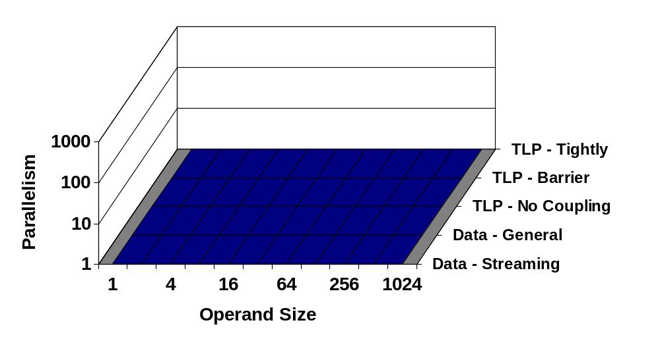
Amount of Explicit Parallelism
Given natural operand size and level of parallelism, how parallel is computer or how must parallelism available in application?
Proposed Parallel Framework
Boolean
Crypto

Slide 33
Parallel Framework - Architecture
Examples of good architectural matches to each style
C
M
5
C
L
U
S
T
E
R
T
C
C
I
M
A
G
I
N
E
Vec-
tor
MMX
Boolean
Crypto

Slide 34
Parallel Framework – Apps (so far)
Original 7: 6 data parallel, 1 no coupling TLP
Bonus 4: 2 data parallel, 2 no coupling TLP
EEMBC (Embedded): Stream 10, DLP 19, Barrier TLP 2
SPEC (Desktop): 14 DLP, 2 no coupling TLP
E
E
M
B
C
S
P
E
C
S
P
E
C
D
W
A
R
F
S
D
W
A
R
F
S
E
E
M
B
C
Boolean
Crypto

Slide 35
RAMP FAQ
Q: How can many researchers get RAMPs?
A1: RAMP 2.0 to be available for purchase at low margin from 3rd party vendor
A2: Single board RAMP 2.0 still interesting as FPGA 2X CPUs/18 months
  RAMP 2.0 FPGA two generations later than RAMP 1.0, so 256? simple CPUs per board vs. 64?

Slide 36
Parallel FAQ
Q: Won’t the circuit or processing guys solve CPU performance problem for us?
A1: No. More transistors, but can’t help with ILP wall, and power wall is close to fundamental problem
  Memory wall could be lowered some, but hasn’t happened yet commercially
A2: One time jump. IBM using “strained silicon” on Silicon On Insulator to increase electron mobility (Intel doesn’t have SOI)
⇒ clock rate↑ or leakage power↓
  Continue making rapid semiconductor investment?

Slide 37
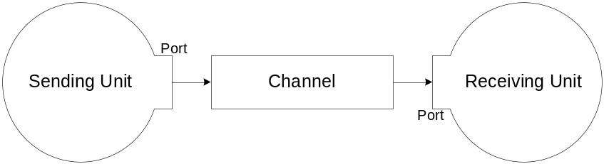
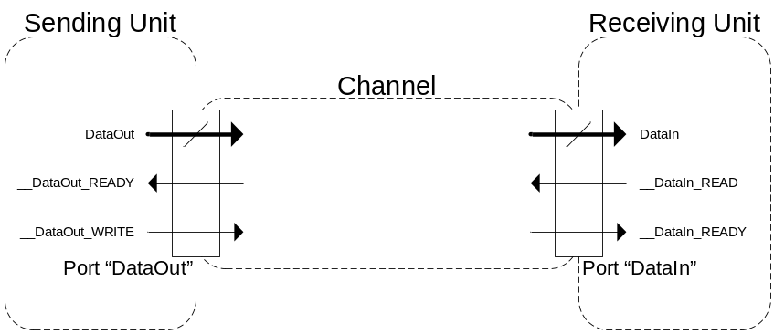
Gateware Design Framework
Design composed of units that send messages over channels via ports
Units (10,000 + gates)
  CPU + L1 cache, DRAM controller….
Channels (≈ FIFO)
  Lossless, point-to-point, unidirectional, in-order message delivery…

Slide 38
Quick Sanity Check
BEE2 uses old FPGAs (Virtex II), 4 banks DDR2-400/cpu
16 32-bit Microblazes per Virtex II FPGA,
0.75 MB memory for caches
  32 KB direct mapped Icache, 16 KB direct mapped Dcache
Assume 150 MHz, CPI is 1.5 (4-stage pipe)
  I$ Miss rate is 0.5% for SPECint2000
  D$ Miss rate is 2.8% for SPECint2000, 40% Loads/stores
BW need/CPU = 150/1.5*4B*(0.5% + 40%*2.8%)
= 6.4 MB/sec
BW need/FPGA = 16*6.4 = 100 MB/s
Memory BW/FPGA = 4*200 MHz*2*8B = 12,800 MB/s
Plenty of BW for tracing, …

Slide 39
Handicapping ISAs
Got it: Power 405 (32b), SPARC v8 (32b), Xilinx Microblaze (32b)
Very Likely: SPARC v9 (64b)
Likely: IBM Power 64b
Probably (haven’t asked): MIPS32, MIPS64
No: x86, x86-64
  But Derek Chiou of UT looking at x86 binary translation
We’ll sue: ARM
  But pretty simple ISA & MIT has good lawyers

Slide 40
Related Approaches (1)
Quickturn, Axis, IKOS, Thara:
  FPGA- or special-processor based gate-level hardware emulators
  Synthesizable HDL is mapped to array for cycle and bit-accurate netlist emulation
  RAMP’s emphasis is on emulating high-level architecture behaviors
    Hardware and supporting software provides architecture-level abstractions for modeling and analysis
    Targets architecture and software research
    Provides a spectrum of tradeoffs between speed and accuracy/precision of emulation
RPM at USC in early 1990’s:
  Up to only 8 processors
  Only the memory controller implemented with configurable logic

Slide 41
Related Approaches (2)
Software Simulators
Clusters (standard microprocessors)
PlanetLab (distributed environment)
Wisconsin Wind Tunnel (used CM-5 to simulate shared memory)
All suffer from some combination of:
  Slowness, inaccuracy, scalability, unbalanced computation/communication, target inflexibility

Slide 42
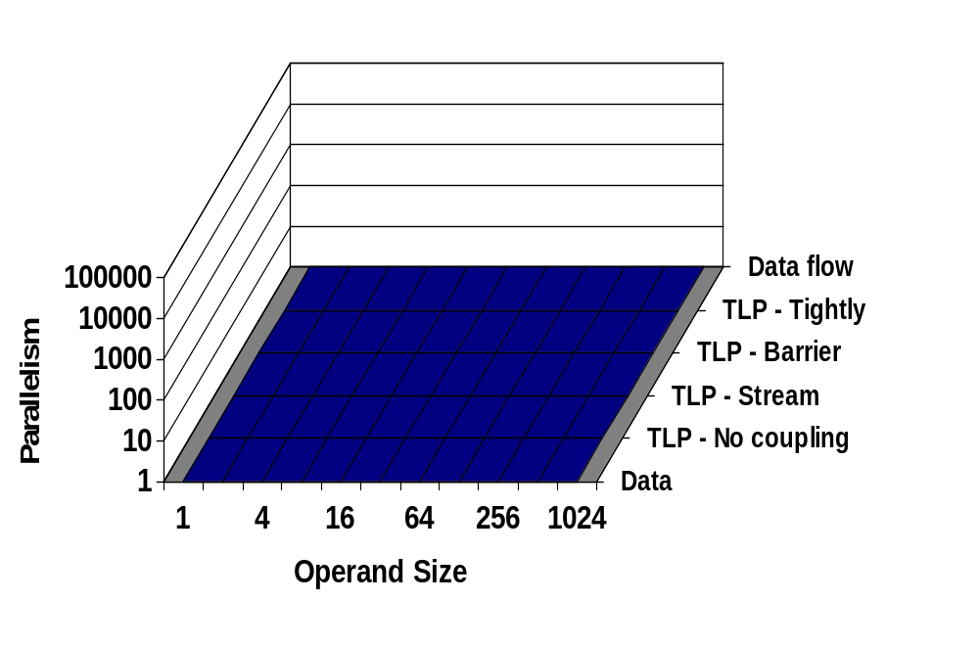
Parallel Framework - Benchmarks
7 Dwarfs: Use simplest parallel model that works
Monte Carlo
Dense
Structured
Unstructured
Sparse
FFT
Particle
Boolean
Crypto

Slide 43
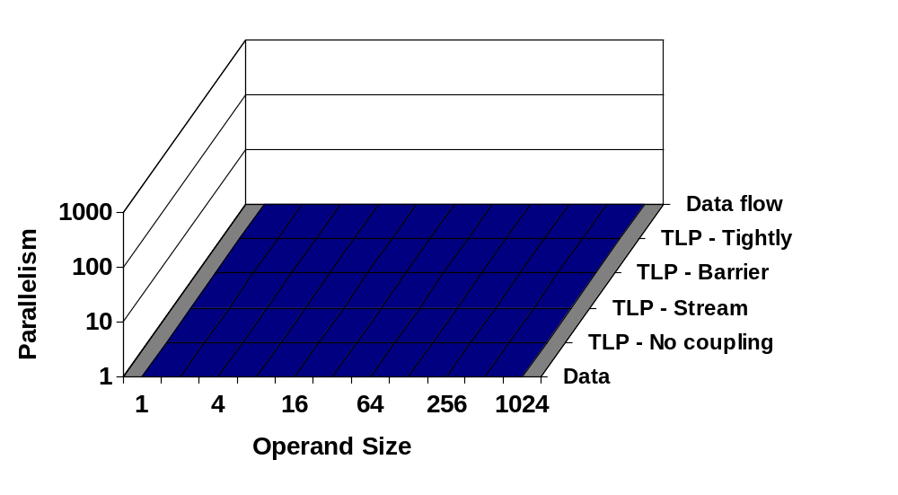
Parallel Framework - Benchmarks
Additional 4 Dwarfs (not including FSM, Ray tracing)
Comb.
Logic
Searching / Sorting
Filter
crypto
Boolean
Crypto

Slide 44
Parallel Framework – EEMBC Benchmarks
Number EEMBC kernels | Parallelism | Style | Operand
14 | 1000 | Data | 8 - 32 bit
5 | 100 | Data | 8 - 32 bit
10 | 10 | Stream | 8 - 32 bit
2 | 10 | Tightly Coupled | 8 - 32 bit
Bit
Manipulation
Cache Buster
Basic Int
Angle to Time
CAN Remote
Boolean
Crypto

Slide 45
SPECintCPU: 32-bit integer
FSM: perlbench, bzip2, minimum cost flow (MCF), Hidden Markov Models (hmm), video (h264avc), Network discrete event simulation, 2D path finding library (astar), XML Transformation (xalancbmk)
Sorting/Searching: go (gobmk), chess (sjeng),
Dense linear algebra: quantum computer (libquantum), video (h264avc)
TBD: compiler (gcc)

Slide 46
SPECfpCPU: 64-bit Fl. Pt.
Structured grid: Magnetohydrodynamics (zeusmp), General relativity (cactusADM), Finite element code (calculix), Maxwell's E&M eqns solver (GemsFDTD), Fluid dynamics (lbm; leslie3d-AMR), Finite element solver (dealII-AMR), Weather modeling (wrf-AMR)
Sparse linear algebra: Fluid dynamics (bwaves), Linear program solver (soplex),
Particle methods: Molecular dynamics (namd, 64-bit; gromacs, 32-bit),
TBD: Quantum chromodynamics (milc), Quantum chemistry (gamess), Ray tracer (povray), Quantum crystallography (tonto), Speech recognition (sphinx3)

