Slide 1
Preparations Exercise 3
Exercise Lesson TTK4165
Signal Processing in Medical Imaging

Slide 2
Introduction
Purpose:
  Simulate received signal from a simple 1D pulse echo system in Matlab, using a 1D tissue model defined by variation in acoustic impedance.
  See what happens at tissue transitions
“PulseEcho.m”
  You will need to modify the code, in order to solve the tasks
Theory
  Theoretical considerations (Mostly Angelsen ch. 1.3)

Slide 3

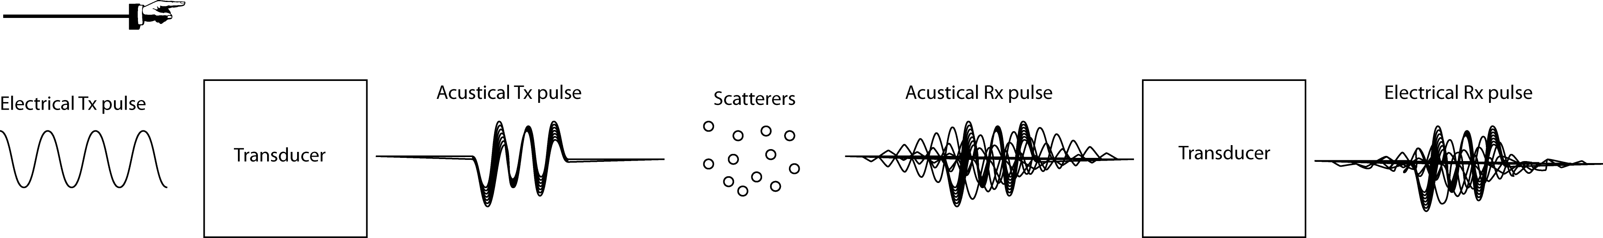
1 System Overview
Transmitted electrical signal: Sine function
Transducer impulse response: Bandpass filtered delta function
Transmitted acoustical pulse: Conv(electrical signal,probe response)
Received acoustical pulse: Conv(scatter-function,Tx acoustical pulse)
Received electrical signal: Conv(Rx acoustical pulse, probe response)

Slide 4
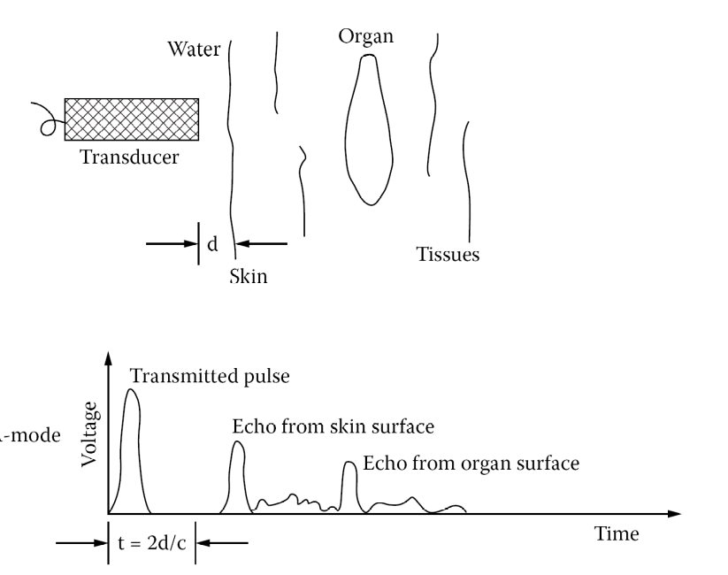
2 Frequency / Pulse length
Vary the pulse length and the center frequency of the pulse
Try to find the values that give the best result
Hint: Remember that the transducer has a center frequency and a bandwidth.

Slide 5

3 Vary the layer thickness
Vary the thickness, th, of the fat layer
Take a closer look at the values th = /2 and
th = /4, where is the wavelength of the signal
- Explain what happens
- Find a theoretical expression for how the backscattered amplitude varies with layer thickness
(See equations.pdf and Angelsen ch 1.3)

Slide 6
4 Muscle Tissue
Change the matlab code:
  Modify the acoustic impedance function Z
Use f0 = 2MHz and f0 = 4MHz and look at the differences at these two frequencies
- Explain what happens

Slide 7
5 Liver Tissue
Change the impedance function in the matlab code (Hint: randn()-function in matlab)
Vary the pulse length
Investigate the backscattered signal from several simulations
  Explain what happens
  Obs: Speckle = Variations in amplitude of the received signal

Slide 8
Good luck!
Prepare a brief report with figures, text and code snippets.

