Slide 1
Module 6
Planning and managing Exchange Online recipients and permissions
Notes:
Presentation: 60 minutes
Lab: 60 minutes
After completing this module, students will be able to:
Describe Microsoft Exchange Online in Microsoft Office 365.
Manage Exchange Online recipients.
Plan and configure delegated administration.
Required materials
To teach this module, you need the Microsoft PowerPoint file 20347A_06.pptx.
Preparation tasks
To prepare for this module, you should:
Read all of this module’s materials.
Practice performing the labs.
Work through the Module Review and Takeaways section to determine how you will use the information to reinforce student learning and promote knowledge transfer to on-the-job performance.
As you prepare for this class, it is imperative that you complete the labs yourself. This gives you an understanding of how the labs work, as well as the concepts that each lab covers. This enables you to provide meaningful hints to students who might have issues while working in the labs. Furthermore, it will help guide your lecture to ensure that you discuss the concepts that the labs cover.
20347A
6: Planning and managing Exchange Online recipients and permissions

Slide 2
Module Overview
Overview of Exchange Online Managing Exchange Online recipients Planning and configuring Exchange Online permissions
Notes:
Provide an overview of the module.
20347A
6: Planning and managing Exchange Online recipients and permissions

Slide 3
Lesson 1: Overview of Exchange Online
Exchange Online features Exchange Online subscription options Planning an Exchange Online implementation Connect to Exchange Online from Windows PowerShell
Notes:
Provide an overview of the lesson.
Question
How will your organization use Exchange Online?
Answer
Answers will vary based on students’ organizational needs.
20347A
6: Planning and managing Exchange Online recipients and permissions

Slide 4
Exchange Online features
Planning and deployment
Permissions
Message policy and compliance
Security features
Mail flow tools
Recipients
Reporting and troubleshooting tools
Sharing and collaboration
Clients and mobile devices
Voice messaging
High availability
Interoperability, connectivity, and compatibility
Notes:
20347A
6: Planning and managing Exchange Online recipients and permissions

Slide 5
Exchange Online subscription options
Exchange Online is available as part of the following Office 365 subscriptions:
Exchange Online feature | Office 365 Business Essentials Office 365 Business Premium | Office 365 Education | Office 365 Enterprise E1 Office 365 Government E1 | Office 365 Enterprise E3 Office 365 Government E3 | Office 365 Enterprise E5 | Office 365 Enterprise K1 Office 365 Government K1
Mailbox | 50 GB | 50 GB | 50 GB | Unlimited | Unlimited | 2 GB
Advanced email |  | Yes |  | Yes | Yes
Voicemail integration |  |  |  | Yes | Yes
Notes:
This topic has one additional slide.
Describe the features available in each plan. For current details, go to the TechNet topic “Exchange Online Service Description”:
http://aka.ms/esip1w
20347A
6: Planning and managing Exchange Online recipients and permissions

Slide 6
Exchange Online subscription options
Microsoft offers the following Exchange Online stand-alone plans:
Exchange Online Plan 1
Exchange Online Plan 2
Exchange Online Protection
Exchange Online Advanced Threat Protection
Exchange Online Archiving
Exchange Online Kiosk
Notes:
For current details, go to the TechNet website Exchange Online Service Description:
http://aka.ms/esip1w
20347A
6: Planning and managing Exchange Online recipients and permissions

Slide 7

Planning an Exchange Online implementation
Architecture
Current email system
Features
User requirements
Usability
Reliability
Security
Manageability
Regulatory
Notes:
This topic has one additional slide.
Discuss the planning considerations with your students.
20347A
6: Planning and managing Exchange Online recipients and permissions

Slide 8
Planning an Exchange Online implementation
Mailbox sizes
Bandwidth
Directory health
Mail delivery
DNS settings
Communications
Training
File types
Notes:
The point of this slide is not to provide detailed planning guidance, but to identify the common factors with all email migration or coexistence plans.
20347A
6: Planning and managing Exchange Online recipients and permissions

Slide 9
Connect to Exchange Online from Windows PowerShell
Before you can use Windows PowerShell to manage Exchange Online, you must connect to it:
Install the Azure AD module:
Microsoft Online Services Sign-In Assistant for IT Professionals
Azure Active Directory Module for Windows PowerShell
Run the following Windows PowerShell script:
$credential = Get-Credential
Import-Module MsOnline
connect-msolservice –credential $credential
$exchangeSession = New-PSSession -ConfigurationName Microsoft.Exchange -ConnectionUri "https://outlook.office365.com/powershell-liveid/" -Credential $credential -Authentication "Basic" -AllowRedirection
Import-PSSession $exchangeSession -DisableNameChecking
Notes:
Students will use these commands in the lab, so make sure they understand what they are doing before moving on. You can find more detailed guidance in the article “Administering your Azure AD directory”:
http://aka.ms/sswmwy
20347A
6: Planning and managing Exchange Online recipients and permissions

Slide 10
Lesson 2: Managing Exchange Online recipients
Managing Exchange Online mailboxes Configuring email addresses Configuring distribution groups Configuring resources Configuring shared mailboxes Configuring contacts Bulk importing contacts Configuring mail users
Notes:
Provide an overview of the lesson.
Question
A mail user is the same as a mailbox user.
( )False
( )True
Answer
(√)False
( )True
Feedback: A mail user combines some of the attributes of a full mailbox user with the characteristics of a contact. The main difference between a mail user and a mailbox user is that the mail user does not have a mailbox, although, unlike a contact, the mail user can sign in to your Office 365 tenant.
20347A
6: Planning and managing Exchange Online recipients and permissions

Slide 11
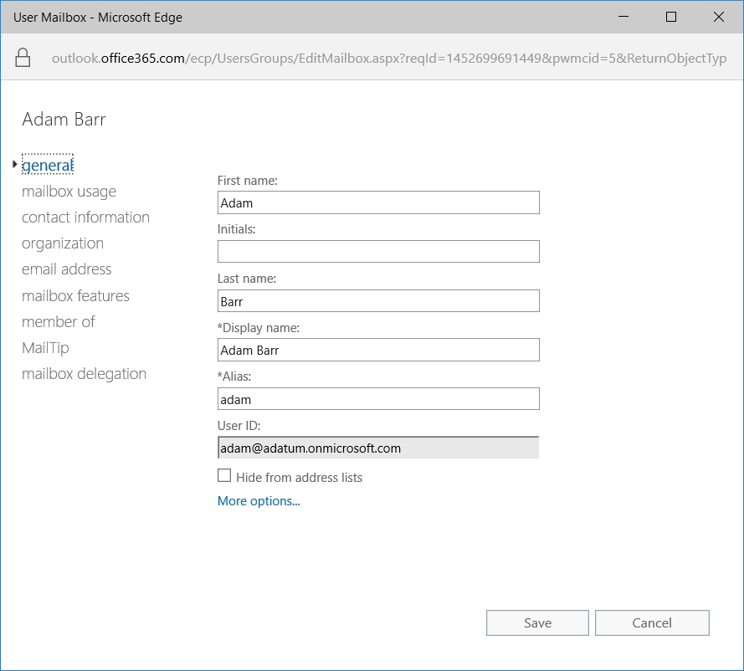
Managing Exchange Online mailboxes
Notes:
Consider demonstrating these features as you discuss this topic.
20347A
6: Planning and managing Exchange Online recipients and permissions

Slide 12
Configuring email addresses
Office 365 does not use email policies like Exchange on-premises
Default email addresses for new Office 365 accounts are @companyname.onmicrosoft.com
Additional domains can be registered, allowing you to create email addresses for those domains
Email addresses can be created or marked as primary (reply-to) in Exchange admin center or with Windows PowerShell
Notes:
This topic has two additional slides.
Consider demonstrating these features as you discuss this topic.
20347A
6: Planning and managing Exchange Online recipients and permissions

Slide 13
Configuring email addresses
Configure additional email addresses individually through Exchange admin center or in bulk by using Windows PowerShell
The Windows PowerShell command must evaluate all users and then change the email address
For example:
$users = Get-Mailbox
foreach ($a in $users) {$a.emailaddresses.Add("smtp:$($a.alias)@thenewdomainname")} $users | %{Set-Mailbox $_.Identity -EmailAddresses $_.EmailAddresses}
You must connect to the Exchange Online service first
Notes:
Consider demonstrating these features as you discuss this topic.
20347A
6: Planning and managing Exchange Online recipients and permissions

Slide 14
Configuring email addresses
With directory synchronization, you can populate email addresses in Office 365 by using attributes in Active Directory
Directory synchronization then pushes these addresses to Office 365 mailboxes
You can then edit the proxy email addresses in ADSI Edit or Active Directory Users and Computers
Primary email addresses start with SMTP:
Secondary email addresses start with smtp:
You can still add email addresses to Exchange Online for registered domains through Exchange admin center or Windows PowerShell
Notes:
Consider demonstrating these features as you discuss this topic.
20347A
6: Planning and managing Exchange Online recipients and permissions

Slide 15
Configuring distribution groups
 | Office 365 security group | Exchange Online security group | Exchange Online distribution group | Exchange Online dynamic distribution group
Visible in Office 365 Users and Groups | Yes | Yes | No | No
Visible in Exchange Online Groups | No | Yes | Yes | Yes
Can set permissions | Yes | Yes | No | No
Has email address | No | Yes | Yes | Yes
Has dynamic membership | No | No | No | Yes
Supports self-enroll | No | No | Yes | No
Notes:
Describe the various options and make sure the students understand the difference between the group types.
Consider demonstrating these features as you discuss this topic.
20347A
6: Planning and managing Exchange Online recipients and permissions

Slide 16
Configuring resources
Resource mailboxes can be for rooms or equipment
Their main purpose is to accept or reject booking requests
Booking requests can be automatically or manually accepted
Users can sign in to the resource mailbox through delegated access rights
Ensure that you label resources logically and consistently
Notes:
Consider demonstrating these features as you discuss this topic.
20347A
6: Planning and managing Exchange Online recipients and permissions

Slide 17
Configuring shared mailboxes
Shared mailboxes provide generic email addresses that multiple user accounts can access
Shared mailboxes can have three permission levels:
Full Access can act as mailbox owner
Send As can send mail as if from the mailbox
Send on Behalf Of can send mail on behalf of the mailbox
Only mailbox users and mail users can access shared mailboxes; contacts can’t
Notes:
Consider demonstrating these features as you discuss this topic.
20347A
6: Planning and managing Exchange Online recipients and permissions

Slide 18
Configuring contacts
Mail contacts in Office 365 are the equivalent of contacts in AD DS
Mail contacts enable you to add external contact details to the GAL
Mail contacts can be created through Exchange admin center or by using Windows PowerShell
Mail contacts require an alias and an external email address
Further fields are available after you create the contact
Notes:
Consider demonstrating these features as you discuss this topic.
20347A
6: Planning and managing Exchange Online recipients and permissions

Slide 19
Bulk importing contacts
Bulk import process
Create a CSV file containing the necessary information
Use Windows PowerShell to create the contacts
Customize the newly created contacts by using Windows PowerShell
Import file must provide:
FirstName
LastName
Name
ExternalEmailAddress
Use the Import-CSV command to create contacts with mandatory fields
Rerun the Import-CSV command to populate additional variables
Notes:
Consider demonstrating these features as you discuss this topic.
20347A
6: Planning and managing Exchange Online recipients and permissions

Slide 20
Configuring mail users
Mail users can sign in to Office 365
Mail users have an external address rather than a mailbox
Create in Exchange admin center or with Windows PowerShell
Unlike contacts, mail users can be added to shared mailboxes
Notes:
Consider demonstrating these features as you discuss this topic.
20347A
6: Planning and managing Exchange Online recipients and permissions

Slide 21
Lesson 3: Planning and configuring Exchange Online permissions
Plan for Exchange Online admin roles Manage delegated permissions with admin roles Overview of user roles
Notes:
Provide an overview of the lesson.
Question
What requirements does your organization have for assigning Exchange Online permissions? Does your organization use a centralized or decentralized administration model? What special permissions will you need to configure?
Answer
Answers will vary. In most organizations, a central team of Exchange administrators will likely maintain full control of the Exchange environment, while another team might need permissions to create mailboxes. Other organizations might have complicated administrative scenarios in which different groups need many different permission levels.
20347A
6: Planning and managing Exchange Online recipients and permissions

Slide 22
Plan for Exchange Online admin roles
To ensure that your Exchange Online administration is working:
Decide what you want Exchange Online to achieve
Create a change management framework
Set up a change log system to record changes
Identify administrative roles and tasks
Map roles and tasks to existing role groups
Define additional administrative role groups as required
Identify training requirements
Assign users to administrative role groups
Monitor the environment
Notes:
Make sure students are comfortable with each of the stages.
20347A
6: Planning and managing Exchange Online recipients and permissions

Slide 23
Manage delegated permissions with admin roles
Office 365 provides the following admin role groups:
Compliance Management
Discovery Management
Help Desk
Help Desk Administrators
Hygiene Management
Organization Management
Recipient Management
Records Management
Tenant Admins
UM Management
View-Only Organization Management
Notes:
Discuss the various admin roles. Consider demonstrating these features as you discuss this topic.
20347A
6: Planning and managing Exchange Online recipients and permissions

Slide 24
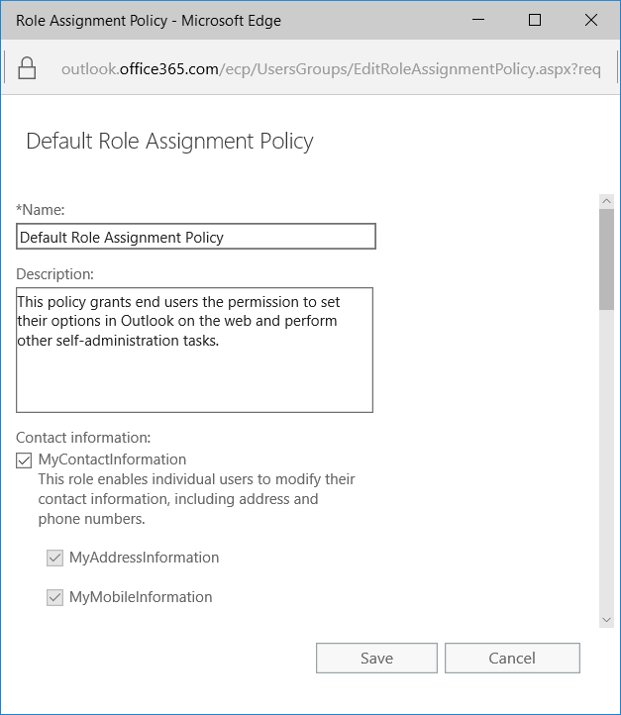
Overview of user roles
Notes:
Consider demonstrating these features as you discuss this topic.
20347A
6: Planning and managing Exchange Online recipients and permissions

Slide 25
Lab: Managing Exchange Online recipients and permissions
Exercise 1: Configuring Exchange Online recipients Exercise 2: Configuring delegated administration
Logon Information
Virtual machines: 20347A-LON-DC1
20347A-LON-DS1
20347A-LON-CL1
User names: Adatum\Administrator
Adatum\Holly
Password: Pa$$w0rd
Estimated Time: 60 minutes
Notes:
Exercise 1: Configuring Exchange Online recipients
In preparation for migrating more users to Office 365, you need to ensure that you can manage Exchange Online recipients by using the Exchange admin center and Windows PowerShell.
Exercise 2: Configuring delegated administration
A. Datum has delegated some administrative tasks in Exchange Server 2016 on-premises and would like to duplicate this configuration in Exchange Online.
20347A
6: Planning and managing Exchange Online recipients and permissions

Slide 26
Lab Scenario
A. Datum Corporation is ready to move a second group of pilot users to Office 365. Before completing the move, you must ensure that you can manage Exchange recipients in Exchange Online. You also must ensure that you can delegate permissions in Exchange Online.
Notes:
20347A
6: Planning and managing Exchange Online recipients and permissions

Slide 27
Lab Review
What Windows PowerShell cmdlet can you use to add a mail-enabled security group to your Exchange Online subscription? In the lab, you ran the Set-CalendarProcessing "Conference Room" -AutomateProcessing AutoAccept cmdlet. What do the -AutomateProcessing AutoAccept switches do?
Notes:
Question
What Windows PowerShell cmdlet can you use to add a mail-enabled security group to your Exchange Online subscription?
Answer
You can use the New-DistributionGroup cmdlet. For example:
New-DistributionGroup -Name "File Server Managers" -Alias fsadmin -Type security
Question
In the lab, you ran the Set-CalendarProcessing "Conference Room" -AutomateProcessing AutoAccept cmdlet. What do the -AutomateProcessing AutoAccept switches do?
Answer
The switches configure the room mailbox to process booking requests automatically.
20347A
6: Planning and managing Exchange Online recipients and permissions

Slide 28
Module Review and Takeaways
Review Questions
Notes:
Review Questions
Question
What do you need to do to manage your Exchange Online tenant by using Windows PowerShell?
Answer
Before you can use Windows PowerShell to manage Exchange Online, you must connect to it by following this procedure:
Install the Microsoft Azure Active Directory (Azure AD) module:
Microsoft Online Services Sign-In Assistant for IT Professionals
Azure Active Directory Module
Run the following Windows PowerShell script:
$credential = Get-Credential
Import-Module MsOnline
connect-msolservice –credential $credential
$exchangeSession = New-PSSession -ConfigurationName Microsoft.Exchange -ConnectionUri "https://outlook.office365.com/powershell-liveid/" -Credential $credential -Authentication "Basic" -AllowRedirection
Import-PSSession $exchangeSession -DisableNameChecking
20347A
6: Planning and managing Exchange Online recipients and permissions
(More notes on the next slide)

Slide 29
Notes:
Question
What types of groups can you use in Exchange Online?
Answer
Exchange Online provides additional group features, which enable the creation of the following group types:
Mail-enabled security groups
Mail-enabled distribution groups
Mail-enabled dynamic distribution groups
20347A
6: Planning and managing Exchange Online recipients and permissions

