Slide 1
Module 8
Planning and deploying Skype for Business Online
Notes:
Presentation: 60 minutes
Lab: 60 minutes
After completing this module, students will be able to:
Plan and configure Skype for Business Online service settings.
Configure Skype for Business Online user settings and clients.
Plan voice integration with Skype for Business Online.
Required materials
To teach this module, you need the Microsoft PowerPoint file 20347A_08.pptx.
Preparation tasks
To prepare for this module, you should:
Read all of this module’s materials.
Practice performing the demonstrations and labs.
Work through the Module Review and Takeaways section to determine how you will use the information to reinforce student learning and promote knowledge transfer to on-the-job performance.
As you prepare for this class, it is imperative that you complete the labs yourself. This gives you an understanding of how the labs work and the concepts that each covers, so that you can provide meaningful hints to students who might have issues. Furthermore, it will help guide your lecture to ensure that you discuss the concepts that the labs cover.
20347A
8: Planning and deploying Skype for Business Online

Slide 2
Module Overview
Planning and configuring Skype for Business Online service settings Configuring Skype for Business Online users and client connectivity Planning voice integration with Skype for Business Online
Notes:
20347A
8: Planning and deploying Skype for Business Online

Slide 3
Lesson 1: Planning and configuring Skype for Business Online service settings
Overview of Skype for Business Online Skype for Business Online subscription options Network requirements for Skype for Business Online Connecting to Skype for Business Online by using Windows PowerShell Configuring organization settings Configuring external communications Skype Meeting Broadcast Configuring Skype Meeting Broadcast
Notes:
Question
You are preparing your Windows 10 workstation to manage Skype for Business Online by using the Windows PowerShell command-line interface. What software do you need to install on the computer?
( ) Option 1: Windows PowerShell 3.0
( ) Option 2: Microsoft Online Services Sign-In Assistant
( ) Option 3: Skype for Business Online module for Windows PowerShell
( ) Option 4: Windows Azure Active Directory module for Windows PowerShell
Answer
(√ ) Option 3: Skype for Business Online module for Windows PowerShell
Feedback: Windows PowerShell is already installed on the Windows 10 operating system, and the Microsoft Online Services Sign-In Assistant is not required. The Microsoft Azure Active Directory module for Windows PowerShell is required to manage Office 365 accounts, but not to manage Skype for Business Online.
Question
You can invite users from outside of your organization to Skype Meeting Broadcast, but only as attendees, not as presenters.
( ) False
( ) True
Answer
( ) False
(√) True
Feedback: Event team members must be from your organization.
20347A
8: Planning and deploying Skype for Business Online

Slide 4
Overview of Skype for Business Online
Skype for Business Online features:
Presence information
Instant messaging
Voice calls
Web conferencing
Audio conferencing
Enhanced presentations
Support for federation
Notes:
As you begin this lesson, ask students about their experience with Skype for Business or Microsoft Lync Server, both online and on-premises. If students are familiar with both of these products, review the Skype for Business Online features quickly. If students are familiar only with the on-premises version of Skype for Business Server or Lync Server, then emphasize that the features and user experience of Skype for Business Online is almost identical to the on-premises version. Additionally, mention that the primary difference with Skype for Business Online is that administrators have fewer options to configure, and they do not need to manage any of the servers.
20347A
8: Planning and deploying Skype for Business Online

Slide 5
Skype for Business Online subscription options
Options | Online plan 1 | Online plan 2 | Skype for Business Server 2015
Presence and instant messaging | Yes | Yes | Yes
Audio and HD video calling to Skype for Business users | Yes | Yes | Yes
Group HD video calling | No | Yes | Yes
Schedule meetings in Microsoft Outlook | No | Yes | Yes
Join meetings from desktops and web browsers, including anonymously | No | Yes | Yes
Desktop sharing, application sharing, and remote control | No | Yes | Yes
Persistent Chat | No | No | Yes
Dial-in audio conferencing | No | No | Yes
Enterprise Voice | No | No | Yes
Notes:
Microsoft Office 365 and Skype for Business Online subscriptions change frequently, so go to http://aka.ms/trgzo4 to show students the current subscription options. You can also go to the Skype for Business Online Service Description website at http://aka.ms/eljskd to show detailed information about the different plan options.
20347A
8: Planning and deploying Skype for Business Online

Slide 6
Network requirements for Skype for Business Online
Ensure that you are not blocking client access to the Skype for Business environment based on URLs, domain names, IP addresses, or ports
Avoid granting access based on current IP addresses; use domain names or URLs instead
Optimize your network for conferencing
Plan for bandwidth requirements
Notes:
Ask students whether they are restricting outbound connections to the Internet in their organizations. If they are, then they will need to ensure that users can access a wide variety of URLs and IP addresses by using several ports. Consider showing the http://aka.ms/rploze website as a way of emphasizing the complexity of this task.
20347A
8: Planning and deploying Skype for Business Online

Slide 7
Connecting to Skype for Business Online by using Windows PowerShell
Requirements:
Windows PowerShell 3.0 or later
Windows PowerShell module for Skype for Business Online
To connect to Skype for Business Online by using Windows PowerShell, use the following commands:
$cred = Get-Credential
$SfBSession = New-CSOnlineSession –Credential $cred
Import-PSSession $SfBSession
Notes:
Make sure that you cover the steps that are required to connect to Skype for Business Online. These are different from connecting to other Office 365 services—they have to be performed before students can run any of the commands that are shown in other topics in this module.
20347A
8: Planning and deploying Skype for Business Online

Slide 8
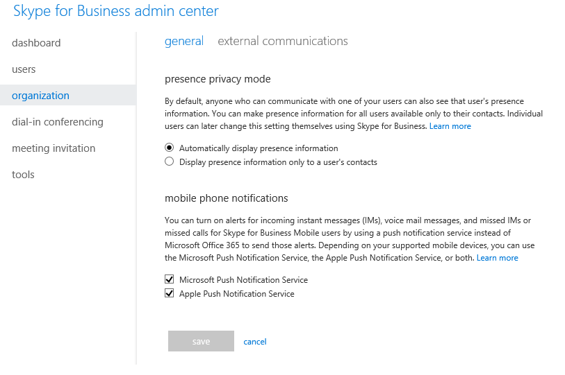
Configuring organization settings
Notes:
Note that this topic has one additional slide.
20347A
8: Planning and deploying Skype for Business Online

Slide 9
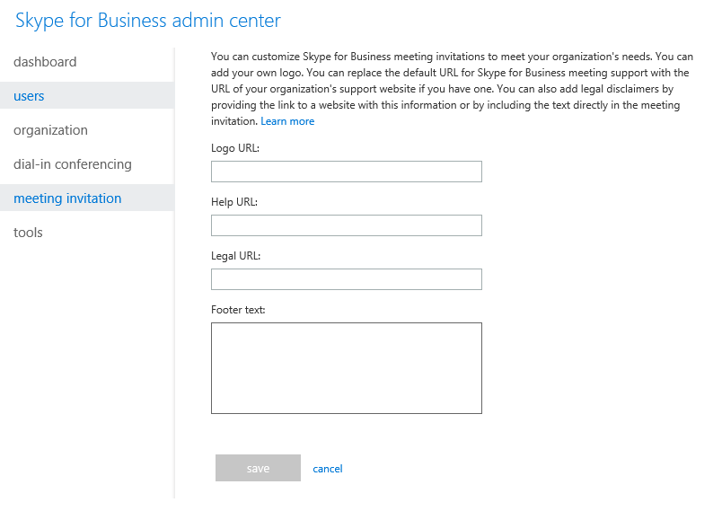
Configuring meeting invitation settings
Notes:
20347A
8: Planning and deploying Skype for Business Online

Slide 10
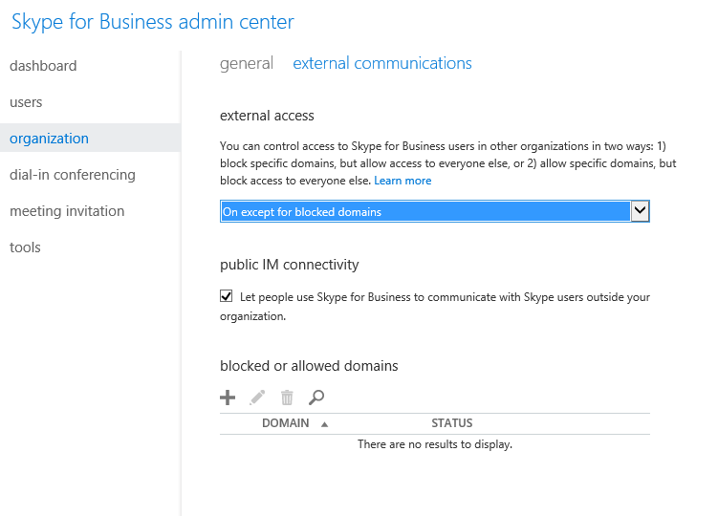
Configuring external communications
Notes:
Point out that external access is disabled by default for Office 365 tenants that were created before July 24, 2015. External access is enabled for all domains for Office 365 tenants that were created after this date.
20347A
8: Planning and deploying Skype for Business Online

Slide 11
Skype Meeting Broadcast
Enable online meetings that can be attended by up to 10,000 attendees
Requires an Office 365 Enterprise E1, Office 365 Enterprise E3, Office 365 Enterprise E5 or a stand-alone Skype for Business Online Plan 2 subscription
User roles:
Organizer
Producer
Event team member
Attendee
Book a Skype Meeting Broadcast by using https://broadcast.skype.com
Joining a Skype Meeting Broadcast is similar to joining other Skype for Business Online meetings
Notes:
Point out that Skype Meeting Broadcast is relatively new in Skype for Business Online. As you describe this feature, point out the benefits of using Skype for Business Online to provide this functionality. Very few organizations would have the capacity to host an online meeting for 10,000 people by using an on-premises solution.
20347A
8: Planning and deploying Skype for Business Online

Slide 12
Configuring Skype Meeting Broadcast
Verify the current Skype Meeting Broadcast configuration
Enable Skype Meeting Broadcast:
Set-CSBroadcastMeetingConfiguration –EnableBroadcastMeeting $True
Allow external access to required domains
Allow firewall access to required URLs
Create and manage meetings
Notes:
20347A
8: Planning and deploying Skype for Business Online

Slide 13
Lesson 2: Configuring Skype for Business Online users and client connectivity
Configuring audio and video settings for users Configuring external communications for users Skype for Business Online client options
Notes:
Question
You need to ensure that only specific users in your organization can communicate with users in other organizations who are using Skype for Business. However, all other users in your organization should be blocked. How would you configure Skype for Business Online to achieve this?
Answer
To configure this, you must first allow external access for the organization, and then you must disable external communication for the users who should be blocked from communicating with external users.
20347A
8: Planning and deploying Skype for Business Online

Slide 14
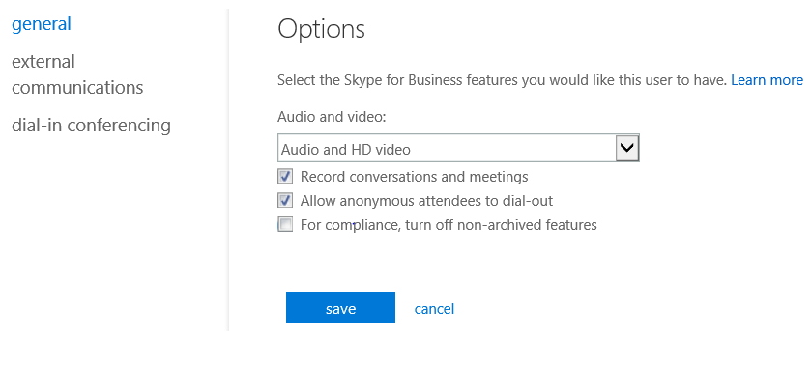
Configuring audio and video settings for users
Notes:
20347A
8: Planning and deploying Skype for Business Online

Slide 15
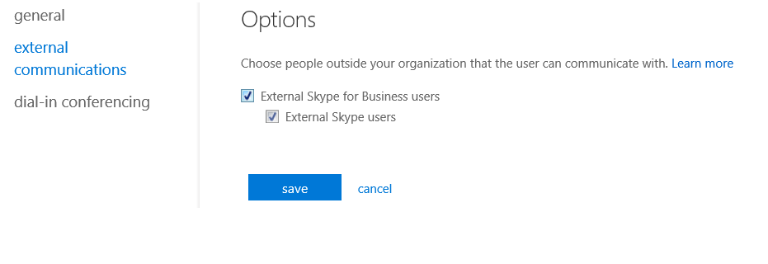
Configuring external communications for users
Notes:
20347A
8: Planning and deploying Skype for Business Online

Slide 16
Skype for Business Online client options
Skype for Business 2016 and Skype for Business 2015 clients
Microsoft Lync 2013
Lync 2013 Basic
Lync 2010
Lync Windows Store app
Skype for Business Web App
Skype for Business Mobile app clients
Lync for Mac 2011
Notes:
20347A
8: Planning and deploying Skype for Business Online

Slide 17
Lesson 3: Planning voice integration with Skype for Business Online
Overview of voice integration options Planning dial-in conferencing Configuring dial-in conferencing with an ACP Configuring dial-in conferencing with a Microsoft conferencing bridge Overview of Cloud PBX PSTN Calling service PSTN connectivity with an on-premises solution Planning a Cloud PBX solution
Notes:
Question
Cloud PBX is a relatively new offering in Skype for Business Online. Do you think that your organization will be interested in this feature? What changes would you need to make in your organization to start using Cloud PBX?
Answer
Answers will vary. Cloud PBX is likely to appeal to organizations that are based in the United States and that are looking at replacing a PBX system. Most organizations would need to plan carefully to ensure that their Internet connection has enough bandwidth and is reliable enough to support telephony.
20347A
8: Planning and deploying Skype for Business Online

Slide 18
Overview of voice integration options
Dial-in conferencing with a non-Microsoft provider enables users to join audio meetings
Cloud PBX provides full Private Branch Exchange (PBX) functionality in the cloud
Voice calling plans enables PSTN calls to and from Cloud PBX users
PSTN Conferencing enables users to join audio meetings by using the Cloud PBX solution
Notes:
Explain the options that are available in Skype for Business Online for providing Enterprise Voice features. As you start this topic, ask students if they have used Enterprise Voice with their on-premises Lync Server or Skype for Business Server deployments. If they have, ask them about the issues that they experienced in configuring Enterprise Voice.
Stress that all the voice integration options require the correct subscription, and they might also require additional add-in licenses. You can connect to http://aka.ms/tm4tg0 to provide students with the latest information.
20347A
8: Planning and deploying Skype for Business Online

Slide 19
Planning dial-in conferencing
Dial-in conferencing allows users to join audio meetings by phone
You can provide dial-in conferencing by using:
An ACP
A Microsoft conferencing bridge
Consider the features that you need to provide users when planning your dial-in conferencing solution
Notes:
The next two topics provide details on how to deploy dial-in conferencing with an audio conferencing provider (ACP) and with a Microsoft conference bridge, so do not spend too much time on specifics now. Discuss the list of features that organizations need to provide for dial-in conferencing.
20347A
8: Planning and deploying Skype for Business Online

Slide 20
Configuring dial-in conferencing with an ACP
Select a dial-in conferencing provider
Set up an account with that provider
Export users and import settings
Manually configure user settings
Notes:
Mention that the steps provided in this topic might vary depending on the ACP with which you are working.
20347A
8: Planning and deploying Skype for Business Online

Slide 21
Configuring dial-in conferencing with a Microsoft conferencing bridge
Assign a license to user accounts from a qualifying subscription
Assign the PSTN Conferencing add-in to user accounts
Configure dial-in user settings
Notes:
20347A
8: Planning and deploying Skype for Business Online

Slide 22
Overview of Cloud PBX
Cloud PBX is an online PBX solution that integrates with Skype for Business Online
Provides full PBX functionality
Calls between internal users do not require PSTN connectivity
Provides voice mail access from a Skype for Business client or through email
Provides PSTN integration:
Through PSTN Calling service
Through integration with an on-premises PSTN connection
Notes:
Ask students whether they have deployed Enterprise Voice with Skype for Business Server 2015. If they are familiar with this implementation, point out that Cloud PBX provides much of the same functionality as Enterprise Voice, including public switched telephone network (PSTN) integration.
20347A
8: Planning and deploying Skype for Business Online

Slide 23
PSTN Calling service
PSTN calling options:
Skype for Business PSTN Local Calling
Skype for Business PSTN Local and International Calling
To configure PSTN calling:
Purchase and assign appropriate licenses and calling plans
Obtain phone numbers
Configure emergency addresses and locations
Assign phone numbers to users
Notes:
20347A
8: Planning and deploying Skype for Business Online

Slide 24
PSTN connectivity with an on-premises solution
Configure Cloud PBX to use your existing Enterprise Voice with a PSTN connectivity solution:
Requires a full Enterprise Voice solution with Edge server and PSTN connectivity
Deploy Skype for Business Cloud Connector Edition:
Provides on-premises Skype for Business Server 2015 virtual machines that provide on-premises connectivity to Skype for Business Online and PSTN
Notes:
Point out that Skype for Business Cloud Connector is a very new product offering, and the features and configuration might change.
20347A
8: Planning and deploying Skype for Business Online

Slide 25
Planning a Cloud PBX solution
Consider your organization’s requirements
Consider your organization’s infrastructure
Consider ease of management
Consider geographic limitations
Notes:
20347A
8: Planning and deploying Skype for Business Online

Slide 26
Lab: Configuring Skype for Business Online
Exercise 1: Configuring Skype for Business Online organization settings Exercise 2: Configuring Skype for Business Online user settings Exercise 3: Configuring a Skype Meeting Broadcast
Logon Information
Virtual machines: 20347A-LON-DC1
20347A-LON-DS1 20347A-LON-CL1
20347A-LON-CL3 20347A-LON-CL4
User name: Adatum\Administrator
Password: Pa$$w0rd
Estimated Time: 60 minutes
Notes:
Exercise 1: Configuring Skype for Business Online organization settings
A. Datum needs to ensure that internal users can communicate with some external users, but the company also wants the option to block communication with some specified domains. A. Datum also wants to customize the default meeting page to provide company-specific information. You need to configure the required settings.
Exercise 2: Configuring Skype for Business Online user settings
You need to configure different Skype for Business Online user settings based on the department of which the user is a member. You will use Windows PowerShell to configure the settings.
Exercise 3: Configuring a Skype Meeting Broadcast
A. Datum is interested in exploring the option of hosting large company meetings and external meetings on Skype for Business. You need to configure a Skype Meeting Broadcast.
20347A
8: Planning and deploying Skype for Business Online

Slide 27
Lab Scenario
As part of an Office 365 implementation, A. Datum Corporation wants to use Skype for Business Online to provide IM and online conferencing. You need to configure the Skype for Business Online service settings and the user settings to meet A. Datum’s requirements.
Notes:
20347A
8: Planning and deploying Skype for Business Online

Slide 28
Lab Review
How will you change the Windows PowerShell steps that you ran in the lab if you want to block all communication with external domains except for litware.com? Do you think that your organization will use Skype Meeting Broadcast?
Notes:
Question
How will you change the Windows PowerShell steps that you ran in the lab if you want to block all communication with external domains except for litware.com?
Answer
Run the following commands if you want to block all communication with external domains except for litware.com:
$x = New-CsEdgeDomainPattern -Domain "litware.com"
$newAllowList = New-CsEdgeAllowList -AllowedDomain $x
Set-CsTenantFederationConfiguration -AllowedDomains $newAllowList
The key difference in these commands compared to the ones that you ran in the lab is the New-CsEdgeAllowList cmdlet in the second command. In the lab, you used the New-CsEdgeAllowAllKnownDomains cmdlet, which allows all domains except for blocked domains.
Question
Do you think that your organization will use Skype Meeting Broadcast?
Answer
Answers will vary. Very large organizations or organizations that frequently make online presentations to large numbers of users will likely use this feature. Smaller organizations are more likely to meet their requirements just by using normal Skype for Business meetings.
20347A
8: Planning and deploying Skype for Business Online

Slide 29
Module Review and Takeaways
Common Issues and Troubleshooting Tips
Tools
Notes:
Common Issues and Troubleshooting Tips
Common Issue: Users cannot authenticate to Skype for Business Online.
Troubleshooting Tip:
Depending on your deployment, you might have to check if the correct Domain Name System (DNS) resource records are configured and if directory synchronization is working. You might also have to check the firewall settings.
Use the Microsoft Remote Connectivity Analyzer (http://aka.ms/btyn1z) to test connectivity to Skype for Business Online. If connectivity fails, the analyzer can provide detailed information about what failed.
Note: Ensure that you cover the common issues and the corresponding troubleshooting tips listed in this section. Encourage students to share tips from their own work environments.
Tools
The following tools are covered in this module:
Skype for Business admin center. Accessible from the Office 365 admin center, use this tool to configure Skype for Business Online service settings and user settings.
Skype for Business Server Management Shell. Use this tool to configure Skype for Business Online settings.
The Skype for Business Online module for Windows PowerShell. This provides the Windows PowerShell commands that are required to configure Skype for Business Online when you use the Skype for Business Server Management Shell.
20347A
8: Planning and deploying Skype for Business Online

