Slide 1
Module 9
Planning for and configuring SharePoint Online
Notes:
Presentation: 70 minutes
Lab: 60 minutes
After completing this module, students will be able to:
Configure SharePoint Online services.
Plan and configure SharePoint site collections.
Plan and configure external user sharing.
Required materials
To teach this module, you need the Microsoft PowerPoint file 20347A_09.pptx.
Preparation tasks
To prepare for this module, you should:
Read all of this module’s materials.
Practice performing the demonstrations and labs.
Work through the Module Review and Takeaways section to determine how you will use the information to reinforce student learning and promote knowledge transfer to on-the-job performance.
As you prepare for this class, it is imperative that you complete the labs yourself. This gives you an understanding of how the labs work, as well as the concepts that each lab covers. This enables you to provide meaningful hints to students who might have issues while working in the labs. Furthermore, it will help guide your lecture to ensure that you discuss the concepts that the labs cover.
20347A
9: Planning for and configuring SharePoint Online

Slide 2
Module Overview
Configuring SharePoint Online services Planning and configuring SharePoint Online site collections Planning and configuring external user sharing
Notes:
Provide an overview of the module.
20347A
9: Planning for and configuring SharePoint Online

Slide 3
Lesson 1: Configuring SharePoint Online services
Overview of the SharePoint admin center Configuring SharePoint Online settings Configuring SharePoint Online user profiles Adding SharePoint Online apps Configuring Office 365 Video
Notes:
Provide an overview of the lesson.
Question
Discuss the advantages and possible disadvantages between SharePoint on-premises versus SharePoint Online.
Answer
Answers will vary. SharePoint Online is a standardized service. In SharePoint Online, no custom code solutions are available and for SharePoint on-premises, there is no need to size hardware.
Question
The maximum file size in SharePoint Online is 2 GB.
( ) False
( ) True
Answer
(√ ) False
( ) True
Feedback: The new attachment size limit in SharePoint Online is 10 GB, according to the service limits and boundaries.
20347A
9: Planning for and configuring SharePoint Online

Slide 4
Overview of the SharePoint admin center
You can use the SharePoint admin center to:
Create and manage site collections
Allocate and monitor site collection storage
Manage permissions and users, and help secure content on sites
Manage user profiles and configure personal sites
Enable and configure specific SharePoint Online features or global settings
Notes:
Provide an overview of the SharePoint admin center. Discuss the advantages of SharePoint Online and the limits and boundaries students need to consider when configuring public cloud solutions.
20347A
9: Planning for and configuring SharePoint Online

Slide 5
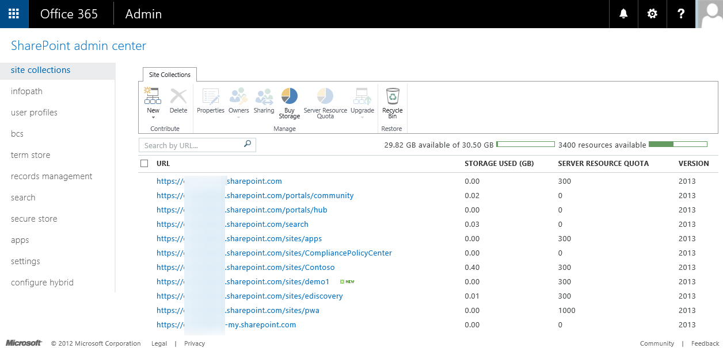
Overview of the SharePoint admin center
Notes:
20347A
9: Planning for and configuring SharePoint Online

Slide 6
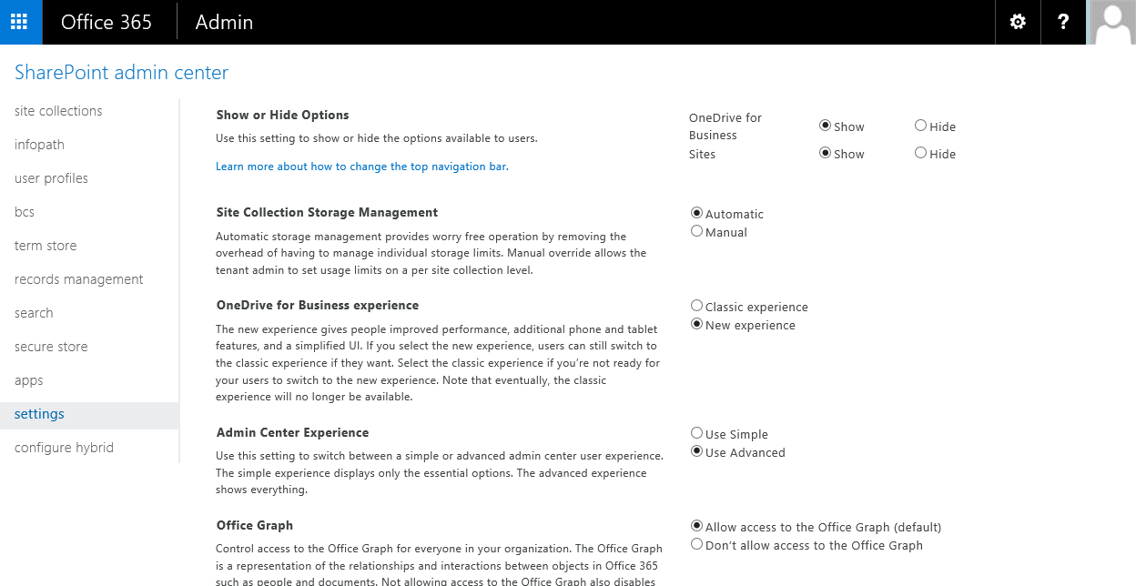
Configuring SharePoint Online settings
Notes:
Discuss the admin capabilities within SharePoint Online. Make it clear that these settings affect the entire SharePoint Online tenant and should be done first before activating user access to SharePoint Online. Give some advice on decision points that need to be done in the beginning when you start working with Office 365 and SharePoint Online.
20347A
9: Planning for and configuring SharePoint Online

Slide 7
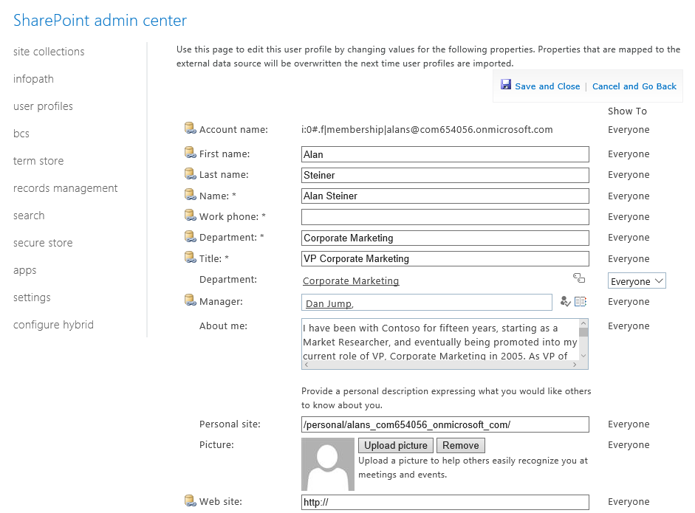
Configuring SharePoint Online user profiles
Notes:
Discuss the user profiles settings menu and make clear that the menu includes more settings than what the menu name signifies.
20347A
9: Planning for and configuring SharePoint Online

Slide 8
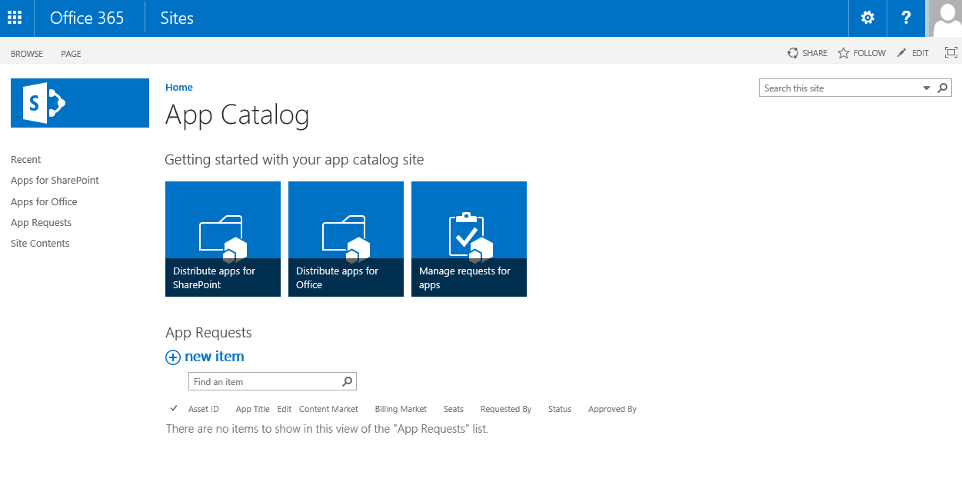
Adding SharePoint Online apps
Notes:
Discuss use cases for the App Catalog and how it helps enterprises to have control on apps.
20347A
9: Planning for and configuring SharePoint Online

Slide 9
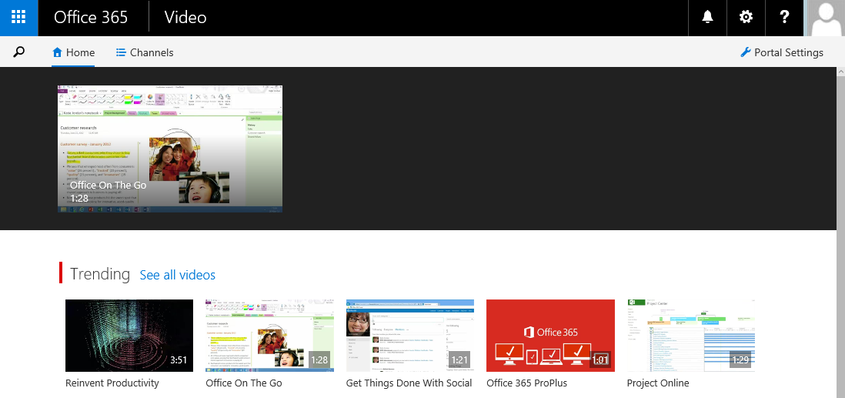
Configuring Office 365 Video
In the SharePoint admin center, under Settings, the only available option for an administrator is to enable or disable the video service
Notes:
Discuss the possible usage scenarios for the Office 365 Video portal.
20347A
9: Planning for and configuring SharePoint Online

Slide 10
Lesson 2: Planning and configuring SharePoint Online site collections
Overview of site collections Default site collections Planning site collections Creating site collections Configuring site collections Managing site collections by using Windows PowerShell Common errors and best practices
Notes:
Question
Which of the following sites do you find in the Enterprise section of the site collection templates in the SharePoint admin center? (Select all that apply.)
( ) Option 1: Document Center site
( ) Option 2: Community site
( ) Option 3: Enterprise Wiki
( ) Option 4: Search Center site
( ) Option 5: Records Center site
Answer
(√) Option 1: Document Center site
(√) Option 4: Search Center site
(√) Option 5: Records Center site
Feedback: Community site and Enterprise Wiki are not available in the Enterprise section of the site collection templates in the SharePoint admin center.
Question
If you delete a site collection, you can restore it from the Recycle Bin for 30 days.
( ) False
( ) True
Answer
( ) False
(√ ) True
20347A
9: Planning for and configuring SharePoint Online
(More notes on the next slide)

Slide 11
Notes:
Feedback: When you delete a site collection, it stays in the Recycle Bin for 30 days before it is permanently deleted; this gives you a 30-day window of opportunity to restore the entire site collection if it was deleted in error or your situation has changed and you want to retain it.
Question
Which of the following actions do you need to perform during the creation of a site collection? (Select all that apply.)
( )Option 1: Define an administrator
( )Option 2: Define the sharing settings
( )Option 3: Define a second administrator
( )Option 4: Set the language
( )Option 5: Set the storage quota
Answer
(√) Option 1: Define an administrator
(√) Option 4: Set the language
Feedback: You can define sharing settings, a second administrator, and the storage quota after the creation of a site collection.
20347A
9: Planning for and configuring SharePoint Online

Slide 12
Overview of site collections
The site collection root is a top-level site. Example: contoso.sharepoint.com
It can be a parent of many sites
Subsite 1
Example: contoso.sharepoint.com/markets
Subsite 2
Example: contoso.sharepoint.com/
technologies
Subsite 3
Example: contoso.sharepoint.com/
sales
Notes:
Discuss various site collection designs and the advantages and disadvantages. Consider rights managements and possible limitations.
20347A
9: Planning for and configuring SharePoint Online

Slide 13
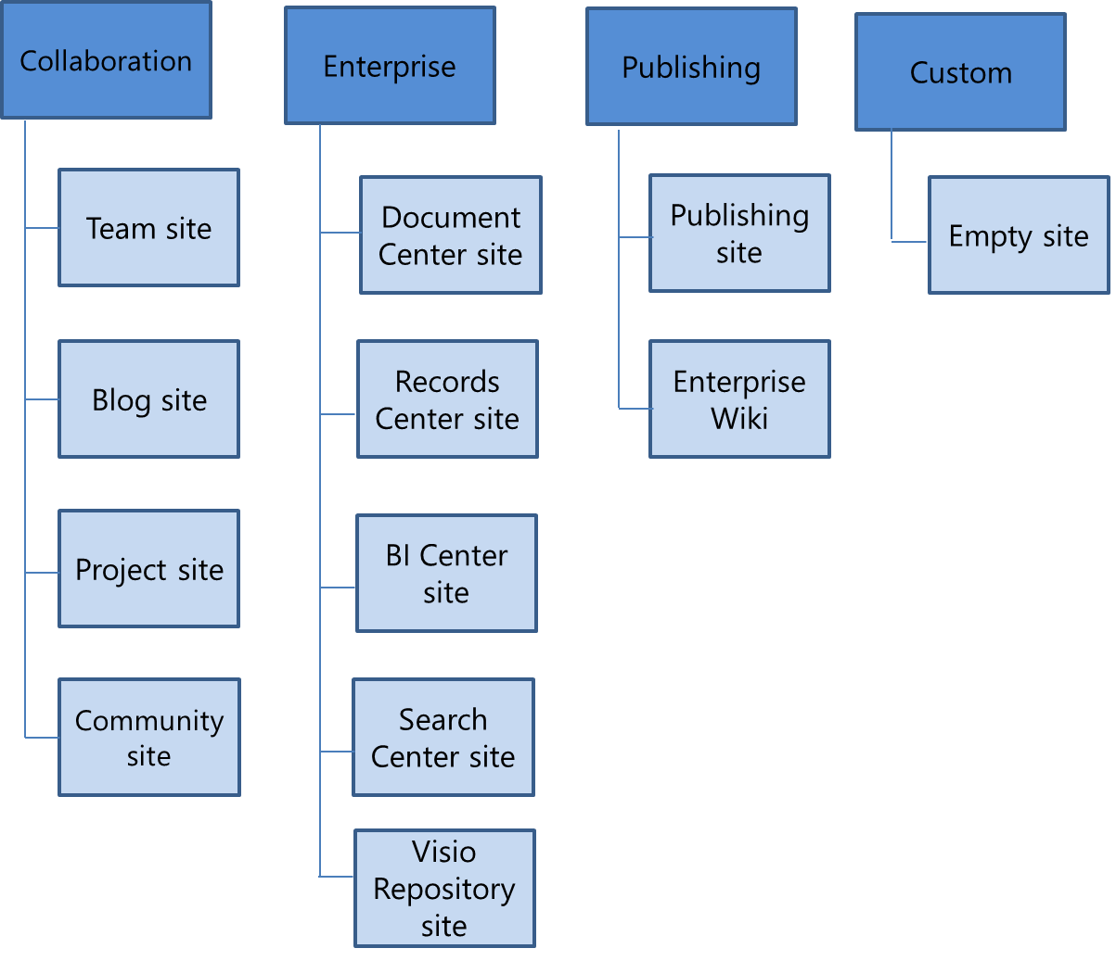
Default site collections
Types of sites you can create in SharePoint Online and Office 365:
Notes:
Discuss the different site collection templates.
20347A
9: Planning for and configuring SharePoint Online

Slide 14
Planning site collections
Ask yourself the following questions:
What site templates should you use?
How many site collections are required?
How much storage is needed?
Are multiple languages required?
Do you need to grant access to external users?
Who will manage your site collections?
What SharePoint Online limits exist?
How to plan for governance?
How to plan for the site collection lifecycle?
Notes:
Give an overview of the factors administrators should consider before they plan for a site collection in SharePoint Online.
20347A
9: Planning for and configuring SharePoint Online

Slide 15
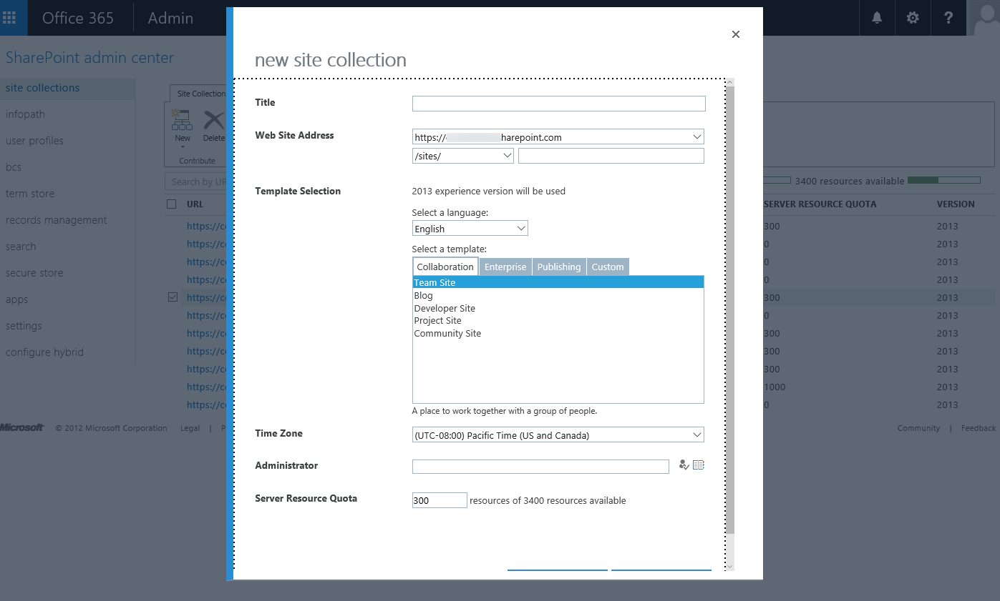
Creating site collections
Deleted site collections are in the Recycle Bin for 30 days, before which you can restore them
Notes:
Show how to create, update, and delete site collections. Let the students discuss the best way to efficiently manage thousands of site collections in a very large company.
20347A
9: Planning for and configuring SharePoint Online

Slide 16
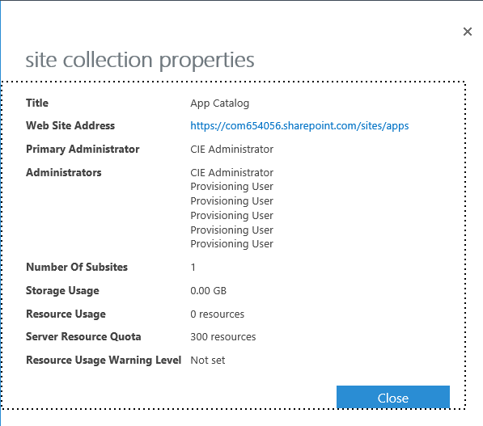
Configuring site collections
Viewing site collection properties
Adding or removing site collection administrators
Sharing site collections
Managing the server resource quote for a site collection
Upgrading site collections from a previous version
Notes:
Discuss the strategy behind proper site collection planning and about quotas or automatic storage assignment.
20347A
9: Planning for and configuring SharePoint Online

Slide 17
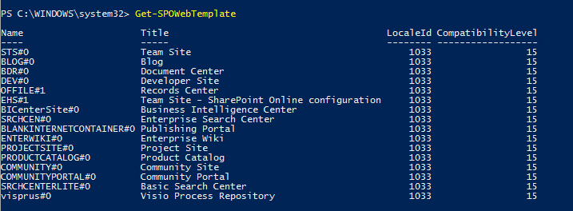
Managing site collections by using Windows PowerShell
Set up the SharePoint Online Management Shell
Connect the SharePoint Online service
Use Windows PowerShell to manage site collections:
Get-SPOSite
Get-SPOWebTemplate
New-SPOSite
Set-SPOSite
Notes:
Show what a good Windows PowerShell cmdlet to create multiple site collections might look like.
20347A
9: Planning for and configuring SharePoint Online

Slide 18
Common errors and best practices
The best practices are:
Follow the Keep it simple, stupid principle
Centralize your management of SharePoint Online
Maintain your site to keep it fresh and up-to-date
Plan your permission structure carefully
Consistently retain the look and feel of the SharePoint Online interface
Keep thorough and up-to-date documentation of site configuration
Notes:
Discuss the issues that can go wrong within site collection planning.
20347A
9: Planning for and configuring SharePoint Online

Slide 19
Lesson 3: Planning and configuring external user sharing
Overview of external user sharing Considerations for external user sharing Configuring external user sharing Sharing documents and auditing shared access Remove external user sharing Common errors and best practices Managing external user sharing by using Windows PowerShell
Notes:
Question
What is the correct definition for external users?
( ) Option 1: Users with a non-Microsoft account
( ) Option 2: Users with a Microsoft account
( ) Option 3: Users inside your organization’s Azure Active Directory
( ) Option 4: Users outside your organization’s Azure Active Directory
( ) Option 5: Users in any Azure Active Directory
Answer
(√) Option 4: Users outside your organization’s Azure Active Directory
Feedback: Users outside your organization’s Azure Active Directory are referred to as external users.
Question
From a user perspective, you can share content in SharePoint Online with internal users in the same way as with external users.
( ) False
( ) True
Answer
( ) False
(√ ) True
Feedback: With the appropriate settings, users can share content internally and externally with the same user experience.
20347A
9: Planning for and configuring SharePoint Online
(More notes on the next slide)

Slide 20
Notes:
Question
Where can administrators enable external sharing for the Office 365 tenant? (Select all that apply.)
( ) Option 1: In the Office 365 admin center, use the setup menu
( ) Option 2: In the Office 365 admin center, use the external sharing menu
( ) Option 3: In the SharePoint admin center, use the site collections menu
( ) Option 4: In the SharePoint admin center, use the apps menu
( ) Option 5: In the SharePoint admin center, use the settings menu
Answer
(√) Option 2: In the Office 365 admin center, use the external sharing menu
(√) Option 5: In the SharePoint admin center, use the settings menu
Feedback: There are two options where Office 365 administrators can configure external user sharing: with the external sharing menu of the Office 365 admin center and with the settings menu in the SharePoint admin center.
20347A
9: Planning for and configuring SharePoint Online

Slide 21
Overview of external user sharing
There are three methods for sharing site content with external users:
You can share your entire site with external users by inviting them to sign in with either a Microsoft account or an Office 365 user ID
You can share individual documents with external users by inviting them to sign in to your site with either a Microsoft account or an Office 365 user ID
You can share individual documents with external users by sending them an anonymous guest link to view or edit the document
Notes:
Discuss the different options for sharing external content and the advantages and disadvantages of each option.
20347A
9: Planning for and configuring SharePoint Online

Slide 22
Considerations for external user sharing
You must plan for the site structure before using external user sharing
When planning your sharing strategy, including how to share your site content with external users:
Who needs access to content on your site and any subsites?
Do they need access to an entire site or just a subsite?
Do they only need access to a few specific documents?
Do they only need to view the shared content, or do they also need to make changes to it?
Which users in your organization need to be able to share content with external users?
Which content on your site should never be shared with users external to your organization?
Is a governance policy in place?
Notes:
Go through the different sharing options and define a clear strategy for sharing.
20347A
9: Planning for and configuring SharePoint Online

Slide 23
Configuring external user sharing
You can enable or disable external user sharing at two levels within the SharePoint admin center:
At the global level for your entire SharePoint Online tenant. If you enable external sharing, you can also configure whether to allow sharing only with authenticated users, or to allow sharing with both authenticated users and anonymous users through guest links
At the individual site collection level. This enables you to secure content on specific site collections when you do not want all your content shared
Notes:
Discuss how to configure sharing with external users.
20347A
9: Planning for and configuring SharePoint Online

Slide 24
Sharing documents and auditing shared access
Three sharing settings are:
Not allowed
Share invitations
Share links and invitations
Auditing shared access to sites and documents:
On the site home page, view a list of users with whom a site is shared
On the Files tab, view a list of users with whom a specific document is shared
Notes:
Discuss how an administrator can handle all different user sharing options within SharePoint Online.
20347A
9: Planning for and configuring SharePoint Online

Slide 25
Remove external user sharing
Remove external user permissions
Revoke invitations
Disable anonymous guest links
Turn off external user sharing
Notes:
Discuss with students the methods to properly remove or revoke external user sharing and how to manage them.
20347A
9: Planning for and configuring SharePoint Online

Slide 26
Common errors and best practices
Plan what external users can see and access
Consider creating a site purely for the purposes of sharing content with external users
Exercise security awareness
Set appropriate permissions
Avoid using anonymous guest links for sensitive content
Ensure you know the identity of any external user
If you share team site content, consider creating a subsite for the shared content
External users sometimes do not receive the invitation email due to transportation errors or spam-filters; send a new invitation
Split your site collections for internal and external users to ease the management
Notes:
Discuss the best practices with your students and the best way to share content externally. Consider also public available sections.
20347A
9: Planning for and configuring SharePoint Online

Slide 27
Managing external user sharing by using Windows PowerShell
To get a list of all external users:
Open Windows PowerShell and connect to SharePoint Online.
To get a list of all external SharePoint Online users, run this command:
Get-SPOExternalUser -Position 0 -PageSize 30 | Select DisplayName,EMail | Format-Table
The SharePoint Online API delivers a list of users with their sign in name and shows the output in the Windows PowerShell window.
Close the Windows PowerShell window.
Notes:
Discuss the advantages of Windows PowerShell management compared to the SharePoint admin center.
20347A
9: Planning for and configuring SharePoint Online

Slide 28
Lab: Configuring SharePoint Online
Exercise 1: Configuring SharePoint Online settings Exercise 2: Creating and configuring SharePoint Online site collections Exercise 3: Configuring and verifying external user sharing
Logon Information
Virtual machines: 20347A-LON-DC1
20347A-LON-DS1
20347A-LON-CL1
User names: Adatum\administrator for LON-DC1
Adatum\administrator for LON-DS1
Adatum\Holly for LON-CL1
Password: Pa$$w0rd
Estimated Time: 60 minutes
Notes:
Exercise 1: Configure SharePoint Online settings
As a first step in the SharePoint Online deployment, you will configure using Yammer as the default enterprise social networking tool of the SharePoint Online service settings.
Exercise 2: Creating and configuring SharePoint Online site collections
As a first step in the SharePoint Online deployment, you will create two different site collections, one for the Accounts Project group, and one for the Marketing group.
Exercise 3: Configuring and verifying external user sharing
Now, you will create a new site collection and configure the SharePoint Online service settings. Then, you will share the site and documents with external users.
20347A
9: Planning for and configuring SharePoint Online

Slide 29
Lab Scenario
Now that the pilot group is getting comfortable with Exchange Online and Skype for Business Online, the next step is to start using SharePoint Online. You need to start the SharePoint Online deployment by configuring the service settings, creating and configuring site collections, and configuring external user sharing.
Notes:
20347A
9: Planning for and configuring SharePoint Online

Slide 30
Lab Review
What is the best way to verify access to external sites? What is the best way to configure user profile settings and where do you get all the data?
Notes:
Question
What is the best way to verify access to external sites?
Answer
The best ways can be to test access with external test users or to create external test users who test access later.
Question
What is the best way to configure user profile settings and where do you get all the data?
Answer
Check if Azure Active Directory (Azure AD) Connect is in place and configure synchronization of data from Active Directory to Azure AD. Azure AD fields will synchronize with the Profile Fields section.
20347A
9: Planning for and configuring SharePoint Online

Slide 31
Module Review and Takeaways
Review Question Best Practices
Notes:
Review Question
Question
Create a checklist for proper site collection planning.
Answer
While planning for site collections, you need to plan for the following:
Site collections side-by-side or top-down
Permissions inheritance
Branding
External user sharing permissions
Possible site quotas
Best Practices
SharePoint Online offers several configuration options; planning a collaboration solution and configuring SharePoint Online are tasks that you must do upfront to have a good SharePoint Online environment where your users can start working with.
The main points you should consider are:
Do proper planning before you start with user onboarding.
Create a sharing policy that is consistent throughout the service.
Automate site collection generation as much as possible.
20347A
9: Planning for and configuring SharePoint Online

