Slide 1
Module 10
Planning and configuring an Office 365 collaboration solution
Notes:
Presentation: 60 minutes
Lab: 60 minutes
After completing this module, students will be able to:
Enable and configure Yammer Enterprise.
Configure Microsoft OneDrive for Business.
Configure Microsoft Office 365 groups.
Required materials:
To teach this module, you need the Microsoft PowerPoint file 20347A_10.pptx.
Preparation tasks:
To prepare for this module, you should:
Read all of this module’s materials.
Practice performing the demonstrations and labs.
Work through the Module Review and Takeaways section to determine how you will use the information to reinforce student learning and promote knowledge transfer to on-the-job performance.
As you prepare for this class, it is imperative that you complete the labs yourself. This gives you an understanding of how the labs work and the concepts that each covers, so that you can provide meaningful hints to students who might have issues. Furthermore, it will help guide your lecture to ensure that you discuss the concepts that the labs cover.
20347A
10: Planning and configuring an Office 365 collaboration solution

Slide 2
Module Overview
Planning and managing Yammer Enterprise Planning and configuring OneDrive for Business Configuring Office 365 groups
Notes:
Provide an overview of the module.
20347A
10: Planning and configuring an Office 365 collaboration solution

Slide 3
Lesson 1: Planning and managing Yammer Enterprise
Overview of Yammer Enterprise Enabling Yammer Enterprise Configuring security settings Configuring user roles and administrators Configuring usage policy Configuring external networks Optimizing the user experience with Yammer
Notes:
Provide an overview of the lesson.
Question
Select the three Office 365 subscriptions with which Yammer Enterprise is available.
( ) Option 1: Basic Network with SharePoint Online
( ) Option 2: Enterprise Network and Office 365
( ) Option 3: Basic Network and Office 365
( ) Option 4: Enterprise Network
( ) Option 5: Enterprise Network and SharePoint Online
Answer
(√) Option -2: Enterprise Network and Office 365
(√) Option -4: Enterprise Network
(√) Option -5: Enterprise Network and SharePoint Online
Question
Which three features are available only in a Yammer Enterprise Network?
( ) Option 1: Secure Enterprise Social Networking
( ) Option 2: Enterprise Administrator
( ) Option 3: Group Administrator
( ) Option 4: Verified Administrator
( ) Option 5: Enterprise Integrations
20347A
10: Planning and configuring an Office 365 collaboration solution
(More notes on the next slide)

Slide 4
Notes:
Answer
(√) Option 2: Enterprise Administrator
(√) Option 4: Verified Administrator
(√) Option 5: Enterprise Integrations
Question
Which two things must be in place before you enable Yammer Enterprise within Office 365?
( ) Option 1: A verified custom domain
( ) Option 2: A paid Yammer Enterprise network
( ) Option 3: A Global Administrator in Office 365
( ) Option 4: A Global Administrator in Office 365 with the verified domain
( ) Option 5: A verified Administrator in Yammer
Answer
(√) Option 1: A verified custom domain
(√) Option 4: A Global Administrator in Office 365 with the verified domain
20347A
10: Planning and configuring an Office 365 collaboration solution

Slide 5
Overview of Yammer Enterprise
Yammer:
Is available within Office 365
Can work as stand-alone solution for an enterprise social network
Is managed and audited through Office 365
Allows you to create external networks
Is an easy to adopt collaboration tool
Integrates with Office 365
Allows easy mobile access
Notes:
Note: This topic has one additional slide.
Provide an overview of Yammer, and outline the differences between Yammer Enterprise and Yammer Basic. Discuss with your students the benefits of using Yammer, and how they can implement it in an organization.
20347A
10: Planning and configuring an Office 365 collaboration solution

Slide 6
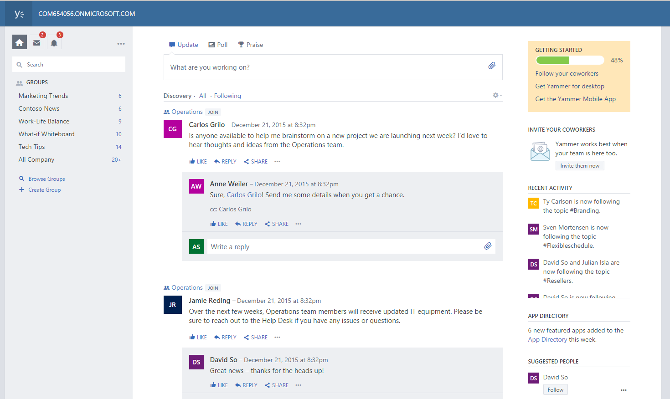
Overview of Yammer Enterprise
Notes:
20347A
10: Planning and configuring an Office 365 collaboration solution

Slide 7
Enabling Yammer Enterprise
Add a company domain
Assign global administrators
Activate Yammer Enterprise
Merge domains within Yammer Enterprise
Notes:
Outline why it is important to activate Yammer Enterprise within Office 365. Discuss the necessary steps in the correct order. Discuss why it is important to consolidate domains in one Yammer Network.
20347A
10: Planning and configuring an Office 365 collaboration solution

Slide 8
Configuring security settings
Configure security options:
IP range
Password policies
External messaging
Enforce Office 365 identity in Yammer
User experience with different identity options:
Office 365 identity enforced. The user is prompted to sign in with his/her Office 365 identity.
Office 365 identity not enforced. If the user has no corresponding Office 365 email account, the user is prompted to sign in with his/her Yammer identity.
Notes:
Discuss security settings for a Yammer Network. Go through the various options for Office 365 identities and discuss them in detail.
20347A
10: Planning and configuring an Office 365 collaboration solution

Slide 9
Configuring user roles and administrators
Yammer user roles and administrators:
Guest User
User
Group Admin
Network Admin
Verified Admin
Notes:
Note: This topic has one additional slide.
Discuss different user roles and their rights within a Yammer network. Clarify that Yammer is user centric.
20347A
10: Planning and configuring an Office 365 collaboration solution

Slide 10
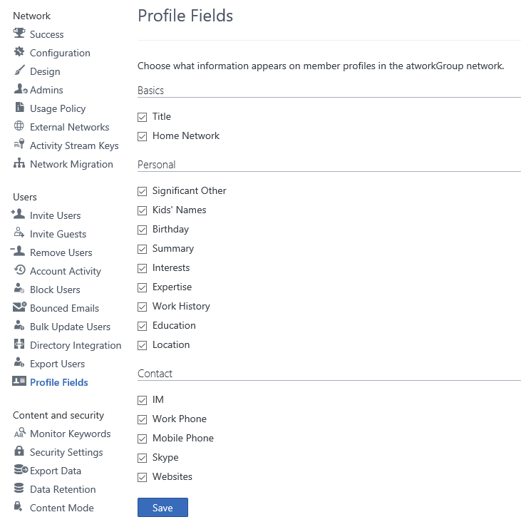
Configuring user roles and administrators
Notes:
20347A
10: Planning and configuring an Office 365 collaboration solution

Slide 11
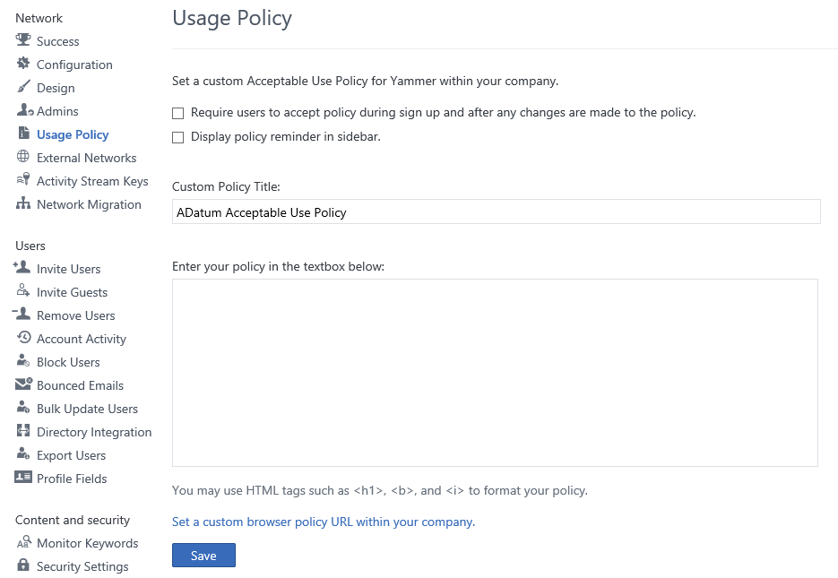
Configuring usage policy
Notes:
Discuss the advantages and disadvantages of usage policies. Explain how to create a good and engaging usage policy.
20347A
10: Planning and configuring an Office 365 collaboration solution

Slide 12
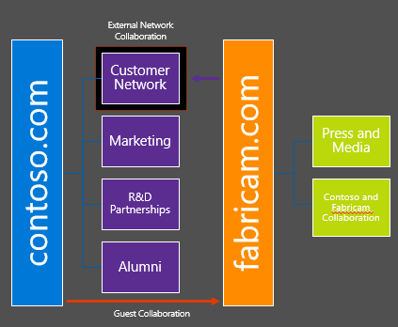
Configuring external networks
Networks are private and secure
Yammer networks are containers for users and groups
Only users with corporate email addresses can join a network
Networks operate independently of email domains
Notes:
Note: This topic has one additional slide.
Clarify the difference between Home Networks and External Networks.
20347A
10: Planning and configuring an Office 365 collaboration solution

Slide 13
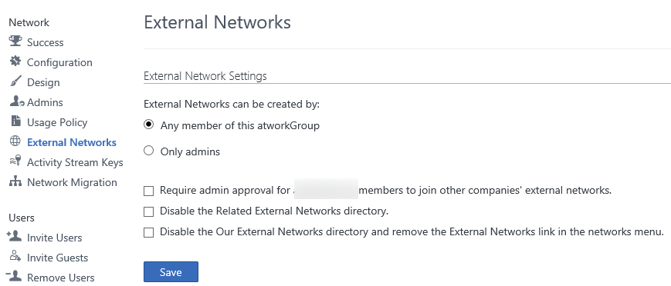
Configuring external networks
Notes:
Discuss external networks and how they work. Discuss some of the administration options, and their respective advantages and disadvantages.
20347A
10: Planning and configuring an Office 365 collaboration solution

Slide 14
Optimizing the user experience with Yammer
Optimize the user experience
Configure Yammer Embed
Add Yammer to SharePoint Online
Optimize Profile Settings
Set up notifications
Configure preferences
Notes:
Note: This topic has one additional slide.
20347A
10: Planning and configuring an Office 365 collaboration solution

Slide 15
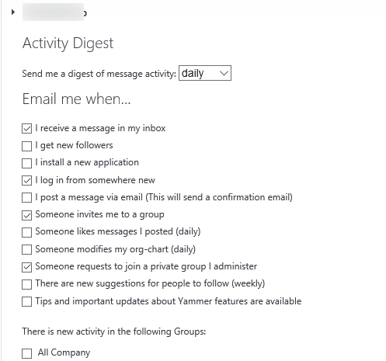
Optimizing the user experience with Yammer
Notes:
20347A
10: Planning and configuring an Office 365 collaboration solution

Slide 16
Lesson 2: Planning and configuring OneDrive for Business
Overview of OneDrive for Business OneDrive for Business collaboration features OneDrive for Business client configuration and synchronization Migrating files to OneDrive for Business Managing OneDrive for Business Planning a OneDrive for Business implementation
Notes:
Question
Select all the OneDrive for Business attributes.
( ) Option 1: Provides up to unlimited Storage
( ) Option 2: Provides free Online Storage for personal use
( ) Option 3: Available from any device
( ) Option 4: Included in Office 365 and SharePoint Online Plans
( ) Option 5: Allows uploading files up to 15 GB in size
Answer
(√) Option 1: Provides up to unlimited Storage
(√) Option 3: Available from any device
(√) Option 4: Included in Office 365 and SharePoint Online Plans
Question
With the OneDrive for Business next-generation sync client, selective sync is possible.
( ) False
( ) True
Answer
( ) False
(√) True
20347A
10: Planning and configuring an Office 365 collaboration solution
(More notes on the next slide)

Slide 17
Notes:
Question
Select three characters that are not supported in filenames that you store in OneDrive for Business and SharePoint Online.
( ) Option 1: #
( ) Option 2: {
( ) Option 3: &
( ) Option 4: %
( ) Option 5: ?
Answer
(√) Option 1: #
(√) Option 4: %
(√) Option 5: ?
20347A
10: Planning and configuring an Office 365 collaboration solution

Slide 18
Overview of OneDrive for Business
OneDrive for Business:
Enables users to store files on the cloud storage that comes with your office 365 subscription
Provides up to unlimited storage, depending on subscription type
Enables users to sync files
Provides mobile apps
Notes:
Discuss the different cloud storage providers and the advantages of OneDrive for Business.
20347A
10: Planning and configuring an Office 365 collaboration solution

Slide 19
OneDrive for Business collaboration features
Share documents
View which documents are shared with you
Stop sharing documents
Notes:
Discuss how sharing in OneDrive for Business works.
20347A
10: Planning and configuring an Office 365 collaboration solution

Slide 20
OneDrive for Business client configuration and synchronization
OneDrive for Business sync clients:
Old sync client = groove.exe:
Syncs SharePoint libraries as well
New sync client = onedrive.exe:
Supports selective sync
Integrates with OneDrive Client
Find and configure the correct version
Notes:
Discuss the two different sync clients and when to use which. Make it clear that all the above limitations are expected to be resolved in the near future.
20347A
10: Planning and configuring an Office 365 collaboration solution

Slide 21
Migrating files to OneDrive for Business
Migrating content to OneDrive for Business or SharePoint Online:
Analyze the data:
Data limits
Names
Characters
Migrate the data:
Online
Through Client
Troubleshoot migration issues
Notes:
Discuss best practices for a good migration strategy.
20347A
10: Planning and configuring an Office 365 collaboration solution

Slide 22
Managing OneDrive for Business
Manage security:
Permission settings
Orphaned permissions
Sharing principles:
Decide what to share
Decide what to stop sharing
Monitoring shares:
Check shares periodically
Notes:
Discuss how you can inform and advise users to share only the necessary things, and describe a good security policy for sharing.
20347A
10: Planning and configuring an Office 365 collaboration solution

Slide 23
Planning a OneDrive for Business implementation
Analyze existing content
Inform users of the change
Help users understand the difference between the two sync clients
Help users understand the difference between the consumer and the business version of OneDrive
Show users how the sync client works
Show users how sharing works
Notes:
Discuss what a successful OneDrive for Business strategy looks like, and how user awareness can help in an OneDrive implementation.
20347A
10: Planning and configuring an Office 365 collaboration solution

Slide 24
Lesson 3: Configuring Office 365 groups
Overview of Office 365 groups Office 365 group components Creating and configuring Office 365 groups How users experience Office 365 groups Removing Office 365 groups
Notes:
Question
Select two services with which Office 365 groups are already integrated.
( ) Option 1: OneDrive for Business
( ) Option 2: Yammer
( ) Option 3: Delve
( ) Option 4: OneNote
( ) Option 5: Skype for Business
Answer
(√) Option 1: OneDrive for Business
(√) Option 4: OneNote
Question
Office 365 groups provide polls.
( ) False
( ) True
Answer
(√) False
( ) True
20347A
10: Planning and configuring an Office 365 collaboration solution
(More notes on the next slide)

Slide 25
Notes:
Question
Which Windows PowerShell cmdlet do you use to disable groups?
( ) Option 1: Set-OwaMailboxPolicy -Identity test.com\OwaMailuserPolicy-Default -GroupCreationEnabled $true
( ) Option 2: Set-OwaMailboxPolicy -Identity test.com\OwaMailboxPolicy-Default -GroupCreationEnabled $false
( ) Option 3: Set-OwaMailuserPolicy -Identity test.com\OwaMailboxPolicy-Default -GroupCreationEnabled $false
( ) Option 4: Set-OwaMailuserPolicy -Identity test.com\OwaMailUserPolicy-Default -GroupCreationDisabled $true
( ) Option 5: Set-OwaMailuserPolicy -Identity test.com\OwaMailboxPolicy-Default -GroupCreationDisabled $true
Answer
(√) Option 2: Set-OwaMailboxPolicy -Identity test.com\OwaMailboxPolicy-Default -GroupCreationEnabled $false
20347A
10: Planning and configuring an Office 365 collaboration solution

Slide 26
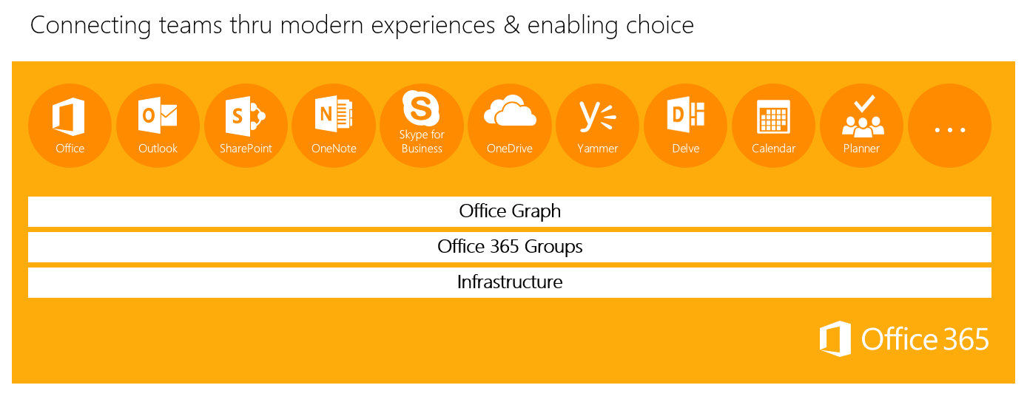
Overview of Office 365 groups
Groups span across Office 365
Groups are available across all the Office 365 services
Groups extend Office 365
Groups are based on Azure Active Directory
Notes:
Talk about how an Office 365 administrator can handle the user-centric approach by using Office 365 groups. Discuss common usage scenarios where Office 365 can bring additional value for users. Discuss how an administrator can handle Office 365 groups administration.
20347A
10: Planning and configuring an Office 365 collaboration solution

Slide 27
Office 365 group components
Office 365 groups creation:
The Azure Active Directory Group is created
A mailbox with calendar is created
A OneDrive for Business page is created
A OneNote Notebook is created
Notes:
Explain the difference between distribution groups, security groups, and Office 365 groups. Mention the components of Office 365 groups. If required, please read about distribution groups and security groups on TechNet.
20347A
10: Planning and configuring an Office 365 collaboration solution

Slide 28
Creating and configuring Office 365 groups
Managing Office 365 groups:
Create an Office 365 group with the Office 365 admin center
Edit and configure an Office 365 group
Manage groups with Windows PowerShell
Assign naming policies
Notes:
Note: This topic has one additional slide.
Discuss the best ways to manage Office 365 groups as an administrator.
20347A
10: Planning and configuring an Office 365 collaboration solution

Slide 29
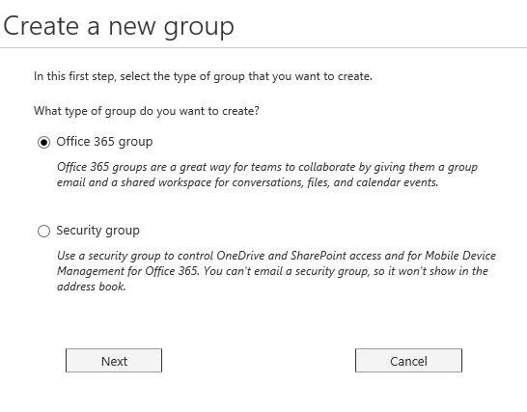
Creating and configuring Office 365 groups
Notes:
20347A
10: Planning and configuring an Office 365 collaboration solution

Slide 30
How users experience Office 365 groups
Conversations and email:
Users can access group conversations either through Outlook or the Outlook Web App.
Group calendar:
Every member of the group automatically sees meeting invites and other events.
Files, sharing, and OneDrive for Business:
A group’s One Drive for Business page is the primary place for group files.
Subscribing to a group:
Subscribing is not enabled by default. Each user can decide to subscribe or not subscribe to a group.
Notes:
Explain how users experience Office 365 groups.
20347A
10: Planning and configuring an Office 365 collaboration solution

Slide 31
Removing Office 365 groups
Disable group creation for all users
Disable group creation for a subset of users
Hide a group from the GAL
Notes:
Discuss the scenarios where it makes sense to disable Office 365 groups or enable it only for a subset of users.
20347A
10: Planning and configuring an Office 365 collaboration solution

Slide 32
Lab: Planning and configuring an Office 365 collaboration solution
Exercise 1: Configuring Yammer Enterprise Exercise 2: Configuring OneDrive for Business Exercise 3: Configuring Office 365 groups
Logon Information
Virtual machines: 20347A-LON-DC1
20347A-LON-DS1 20347A-LON-CL1 20347A-LON-CL3
User names: Adatum\administrator Adatum\Holly Adatum\Roman
Password: Pa$$w0rd
Estimated Time: 60 minutes
Notes:
Exercise 1: Configuring Yammer Enterprise
As a first step in exploring the collaboration options, you will configure Yammer Enterprise for A. Datum. Yammer Enterprise is enabled by default, so you need to configure the settings and explore the user experience with Yammer.
Exercise 2: Configuring OneDrive for Business
After you enable Yammer Enterprise, you are ready to configure OneDrive for Business for A. Datum. If you have Office 2013 or Office 2016 installed, you have the sync client on your computer, and you can start using OneDrive for Business.
Exercise 3: Configuring Office 365 groups
The final Office 365 collaboration solution that you need to explore is Office 365 groups. You need to configure Office 365 groups, including membership, privacy, and subscription options, and explore the user interaction with Office 365 groups.
20347A
10: Planning and configuring an Office 365 collaboration solution

Slide 33
Lab Scenario
With all of the core Office 365 components configured and working well, the next step for A. Datum administrators is to explore options for using Office 365 to enhance collaboration within the organization. To do this, you will enable and configure Yammer Enterprise, OneDrive for Business, and Office 365 groups.
Notes:
20347A
10: Planning and configuring an Office 365 collaboration solution

Slide 34
Lab Review
If you enforce Office 365 identities in Yammer, what is the impact for Yammer users with no Office 365 identities? Which Windows PowerShell cmdlets can you use to create an Office 365 group and to add the group owner?
Notes:
Question
If you enforce Office 365 identities in Yammer, what is the impact for Yammer users with no Office 365 identities?
Answer
If you implement federated identity model in Office 365, the user will log in by using SSO. A user with a Yammer identity cannot sign in any longer.
Question
Which Windows PowerShell cmdlets can you use to create an Office 365 group and to add the group owner?
Answer
First you need to connect to Exchange Remote PowerShell. Then, to create an Office 365 group, use the New-UnifiedGroup cmdlet, and to add an owner of the group, use the New-UnifiedGroupLinks cmdlet.
20347A
10: Planning and configuring an Office 365 collaboration solution

Slide 35
Module Review and Takeaways
Best Practices
Common Issues and Troubleshooting Tips
Review Question
Notes:
Best Practices
Always enable Yammer Enterprise as the primary Enterprise Social Network within Office 365.
Design a usage policy.
Familiarize yourself with the administration options within Yammer Enterprise.
Support users during their initial experience of using Yammer.
Familiarize yourself with the different OneDrive for Business sync clients and their limitations and features.
Create a consistent sharing policy across Office 365.
Decide if and when you should use Office 365 groups, because they are essential to some of the Office 365 components.
Decide if Office 365 groups will be user centric or centrally managed.
Common Issues and Troubleshooting Tips
Common Issue: Synchronization is not working in OneDrive for Business
Troubleshooting Tip:
Check the limitations of the sync client
Check the filenames
Check the file name length
Check the file size
20347A
10: Planning and configuring an Office 365 collaboration solution
(More notes on the next slide)

Slide 36
Notes:
Common Issue: Multiple Yammer Networks exist for different Office 365 domains
Troubleshooting Tip:
Define a consolidation plan
Inform users in both networks
Create a migration plan
Common Issue: Office 365 groups are enabled and used without administrative awareness
Troubleshooting Tip:
Familiarize yourself with the continuous changes within Office 365
Check groups and define a naming policy
Ensure that you cover the common issues and the corresponding troubleshooting tips listed in this section. Encourage students to share tips from their own work environments.
Note: Ensure that you cover the common issues and the corresponding troubleshooting tips listed in this section. Encourage students to share tips from their own work environments.
Review Question
Question
Discuss the differences between Office 365 groups and Yammer and possible use cases where you need one tool or the other.
Answer
Some of the differences between Yammer and Office 365 groups are:
External users can be invited to Yammer and participate there.
Office 365 planner needs Office 365 groups.
Yammer can also work as a stand-alone tool.
20347A
10: Planning and configuring an Office 365 collaboration solution

