Slide 1
Module 11
Planning and configuring Rights Management and compliance
Notes:
Presentation: 75 Minutes
Lab: 75 Minutes
After completing this module, students will be able to:
Describe the compliance features in Microsoft Office 365.
Configure Microsoft Azure Rights Management (Azure RMS) in Office 365.
Manage the compliance features in Office 365.
Required materials
To teach this module, you need the Microsoft PowerPoint file 20347A_11.pptx.
Preparation tasks
To prepare for this module, you should:
Read all of this module’s materials.
Practice performing the demonstrations and labs.
Work through the Module Review and Takeaways section to determine how you will use the information to reinforce student learning and promote knowledge transfer to on-the-job performance.
As you prepare for this class, it is imperative that you complete the labs yourself. This gives you an understanding of how the labs work, as well as the concepts that each lab covers. This enables you to provide meaningful hints to students who might have issues while working in the labs. Furthermore, it will help guide your lecture to ensure that you discuss the concepts that the labs cover.
20347A
11: Planning and configuring Rights Management and compliance

Slide 2
Module Overview
Overview of the compliance features in Office 365 Planning and configuring Azure Rights Management in Office 365 Managing the compliance features in Office 365
Notes:
Provide an overview of the module.
20347A
11: Planning and configuring Rights Management and compliance

Slide 3
Lesson 1: Overview of the compliance features in Office 365
Security considerations when planning an Office 365 implementation Compliance and security features in Office 365 Overview of the Protection Center for Office 365 Configuring permissions in the Protection Center Advanced security and compliance features in Office 365 Enterprise E5 subscriptions
Notes:
Provide an overview of the lesson.
Question
What are the customer compliance setting elements?
( ) Option 1: DLP
( ) Option 2: A data processing agreement
( ) Option 3: The Rights Management service for file-level access restrictions
( ) Option 4: ISO 27018
( ) Option 5: S/MIME for security-enhanced, certificate-based email access
Answer
(√) Option 1: DLP
(√) Option 3: The Rights Management service for file-level access restrictions
(√) Option 5: S/MIME for security-enhanced, certificate-based email access
Question
What are the role groups that exist in the Protection Center?
( ) Option 1: eDiscovery Manager
( ) Option 2: Legal Hold Manager
( ) Option 3: Service Assurance User
( ) Option 4: ComplianceUser
( ) Option 5: ComplianceReviewer
Answer
(√) Option 1: eDiscovery Manager
(√) Option 3: Service Assurance User
20347A
11: Planning and configuring Rights Management and compliance

Slide 4
Security considerations when planning an Office 365 implementation
Security considerations for an Office 365 implementation:
Service-level security
Security-related customer controls
Privacy by design
Privacy-related customer controls
Service compliance
Customer compliance
Notes:
Discuss security concerns related to cloud services. Discuss the different service-level security features that Office 365 offers.
20347A
11: Planning and configuring Rights Management and compliance

Slide 5
Compliance and security features in Office 365
Office 365 provides features to comply with the following compliance standards:
HIPAA
Data processing agreements
FISMA
ISO/IEC 27001:2013
EU Model Clauses
The U.S.‒EU Safe Harbor Framework
FERPA
SSAE 16
PIPEDA
GLBA
Notes:
Discuss the security features for Office 365 and the compliance standards that Office 365 helps deliver. Discuss with the students which features are important to them.
20347A
11: Planning and configuring Rights Management and compliance

Slide 6
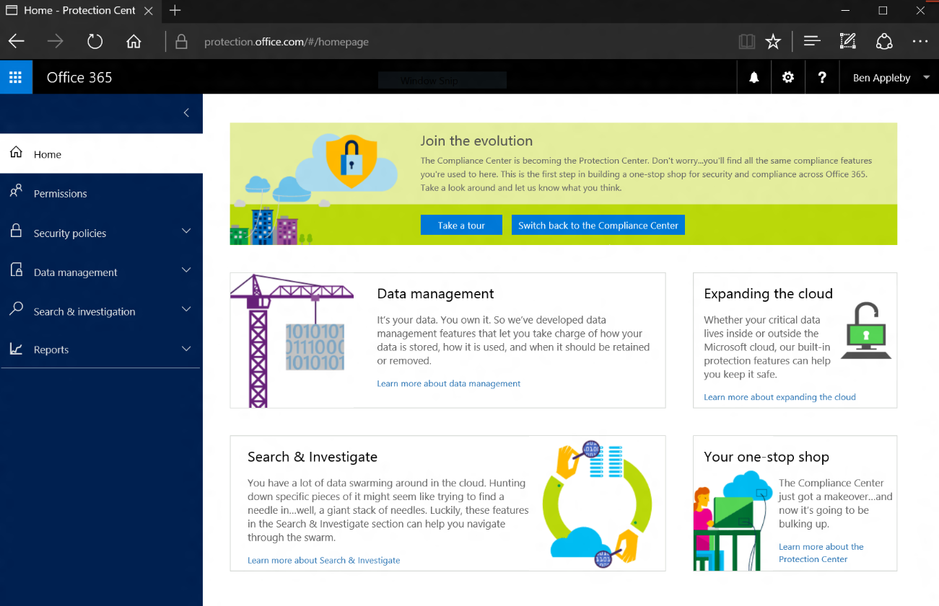
Overview of the Protection Center for Office 365
Notes:
Note: This topic has one additional slide.
Discuss the options available in the Protection Center.
20347A
11: Planning and configuring Rights Management and compliance

Slide 7
Overview of the Protection Center for Office 365
The Protection Center features:
Home
Permissions
Security policies
Data management
Search & Investigation
Reports
Service Assurance
Notes:
Discuss the differences between the Protection Center and the Compliance Center. Look at the capabilities you find in the Protection Center.
20347A
11: Planning and configuring Rights Management and compliance

Slide 8
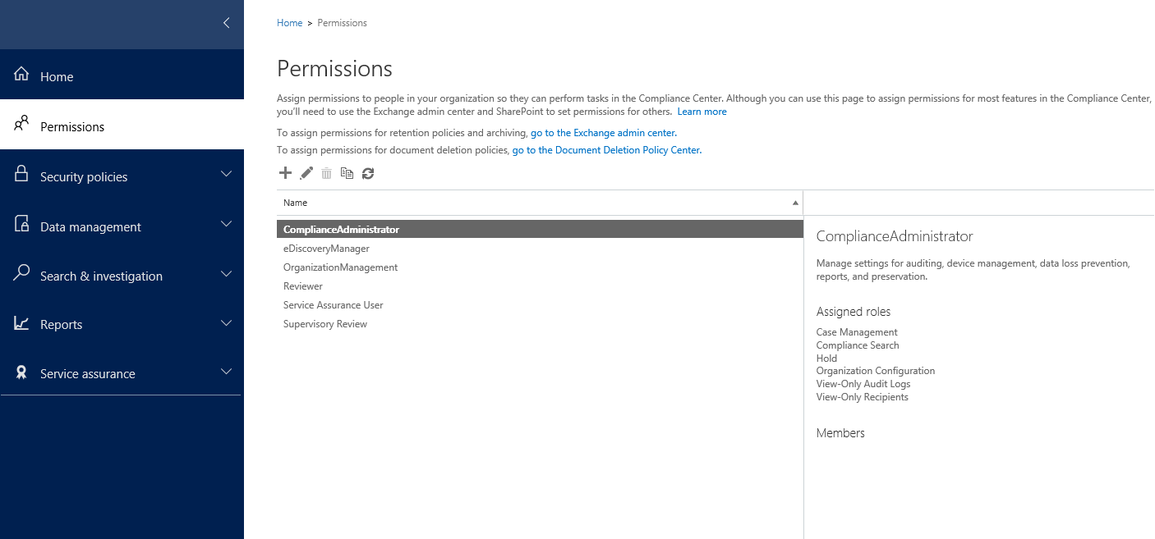
Configuring permissions in the Protection Center
Notes:
Discuss the permission levels in the Protection Center.
20347A
11: Planning and configuring Rights Management and compliance

Slide 9
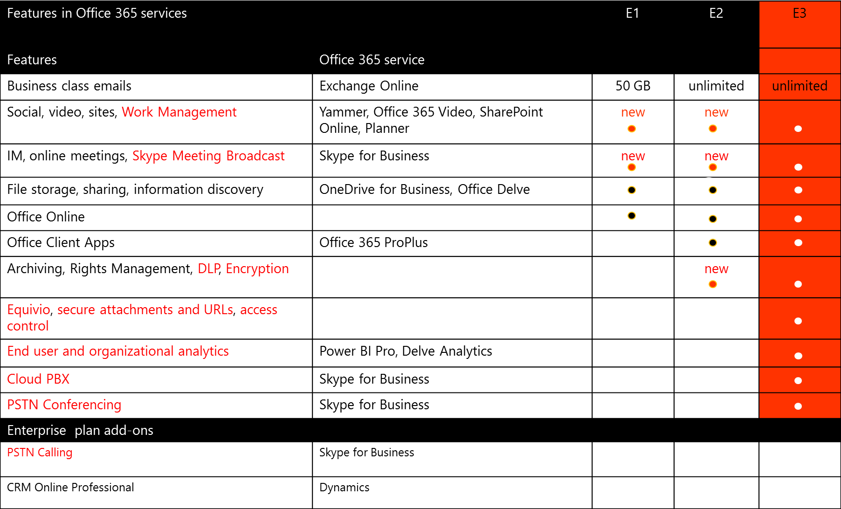
Advanced security and compliance features in Office 365 Enterprise E5 subscriptions
Notes:
Discuss the advanced security features in the Office 365 Enterprise E5 plan.
20347A
11: Planning and configuring Rights Management and compliance

Slide 10
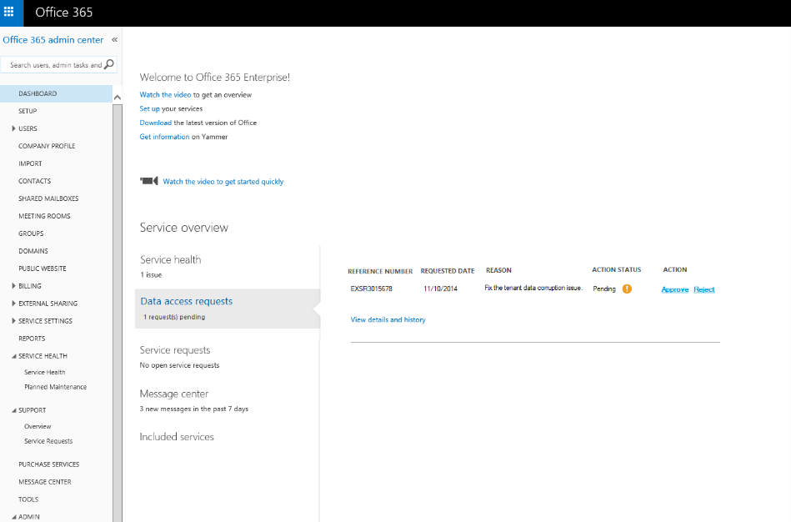
Advanced security and compliance features in Office 365 Enterprise E5 subscriptions
Notes:
Discuss the Customer Lockbox feature and how it integrates into the security standards of Office 365.
20347A
11: Planning and configuring Rights Management and compliance

Slide 11
Lesson 2: Planning and configuring Azure Rights Management in Office 365
Overview of Azure RMS in Office 365 How Azure RMS Works Comparing AD RMS and Azure RMS Planning Azure RMS integration with Office 365 Configuring Azure RMS integration
Notes:
Provide an overview of the lesson.
Question
Which groups are available for custom Azure RMS templates?
( ) Option 1: Viewer
( ) Option 2: Author
( ) Option 3: Reader
( ) Option 4: Blocker
( ) Option 5: Co-Author
Answer
(√) Option 1: Viewer
(√) Option 5: Co-Author
Question
To use Azure RMS between two organizations, a trust must be defined in a direct, point-to-point relationship.
( ) False
( ) True
Answer
(√) False
( ) True
20347A
11: Planning and configuring Rights Management and compliance

Slide 12











Overview of Azure RMS in Office 365
Azure RMS provides the Rights Management
properties for Office 365
Windows Server
file services
Popular platforms that are supported include:
Windows
Mac OS X
iOS
Android
Windows Phone
Connect to Windows Server file services to integrate with File Classification Infrastructure and Dynamic Access Control
Rights Management
Windows Server
Active Directory
Directory
synchronization
Use a common identity for on-premises
Active Directory and Azure AD
Connect to on-premises servers running
Exchange Server and SharePoint Server
Notes:
Discuss Azure Rights Management and how it works.
20347A
11: Planning and configuring Rights Management and compliance

Slide 13





How Azure RMS Works
Rights Management
The policy, which contains
usage rights and the
content key, is added to the document
Authentication and
authorization
Content key and rights
Policy
The document remains protected but decrypted with usage rights enforced for authenticated users
Protect
Document is unprotected
Content is protected by a symmetric key, which is encrypted with the organization’s root key
Notes:
Discuss how content is encrypted within Office 365.
20347A
11: Planning and configuring Rights Management and compliance

Slide 14
Comparing AD RMS and Azure RMS
Azure RMS
Supports Office 365
Supports on-premises server products
Does not require building explicit trust relationships
Makes default templates available
Makes sharing apps available
Supports mobile devices
Supports Multi-Factor Authentication
Supports Cryptographic Mode 2
Uses RSA-2048
Notes:
Discuss and compare the advantages and disadvantages of Azure RMS and Active Directory Rights Management Services (AD RMS).
20347A
11: Planning and configuring Rights Management and compliance

Slide 15
Planning Azure RMS integration with Office 365
To plan Azure RMS integration, you must:
Activate Azure RMS
Configure onboarding for a phased deployment
Notes:
Discuss how you can activate Azure RMS.
20347A
11: Planning and configuring Rights Management and compliance

Slide 16
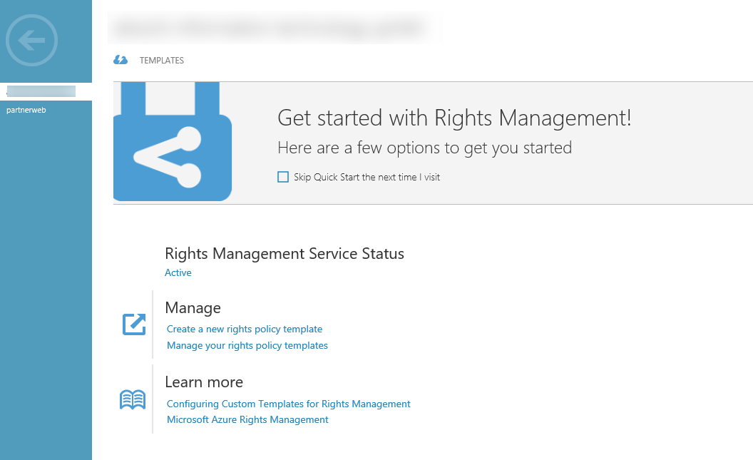
Configuring Azure RMS integration
Notes:
Discuss the super user functionality for Azure RMS and common usage scenarios.
20347A
11: Planning and configuring Rights Management and compliance

Slide 17
Lesson 3: Managing the compliance features in Office 365
Configuring archive mailboxes Configuring retention tags and policies Configuring document deletion policies in SharePoint Online and OneDrive for Business Configuring preservation policies Configuring DLP policies for email Creating DLP policies for SharePoint Online and OneDrive for Business Compliance search and Office 365 Advanced eDiscovery Configuring audit reports
Notes:
Provide an overview of the lesson.
Question
Select the types of possible retention tags actions.
( ) Option 1: A unique name
( ) Option 2: A delete action
( ) Option 3: An allow recovery action
( ) Option 4: A do not allow recovery action
( ) Option 5: A create action
Answer
(√) Option 1: A unique name
(√) Option 2: A delete action
(√) Option 3: An allow recovery action
Question
Preservation policies help to keep the content you need by preserving email and documents.
( ) False
( ) True
Answer
( ) False
(√) True
20347A
11: Planning and configuring Rights Management and compliance

Slide 18
Configuring archive mailboxes
Use Archive Management in the Protection Center to:
Enable an In-Place Archive
Disable an In-Place Archive
Notes:
Discuss scenarios in which you would use an In-Place Archive.
20347A
11: Planning and configuring Rights Management and compliance

Slide 19


Configuring retention tags and policies
Default Policy Tag
Retention Policy Tags
Personal Tags
Retention tags are linked to a retention policy
The retention policy is applied to user mailboxes
Notes:
Note: This topic has two additional slides.
Discuss retention policies and usage scenarios.
20347A
11: Planning and configuring Rights Management and compliance

Slide 20
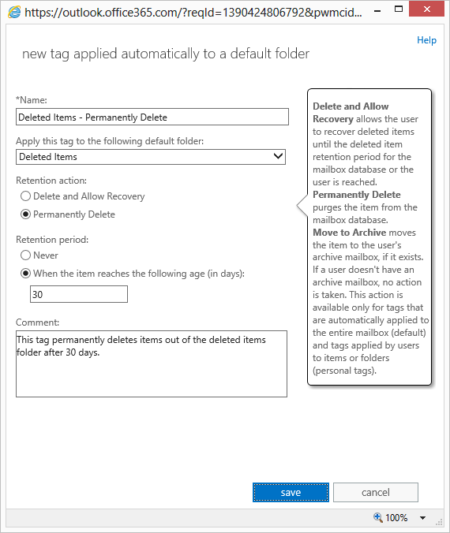
Configuring retention tags and policies
Notes:
20347A
11: Planning and configuring Rights Management and compliance

Slide 21
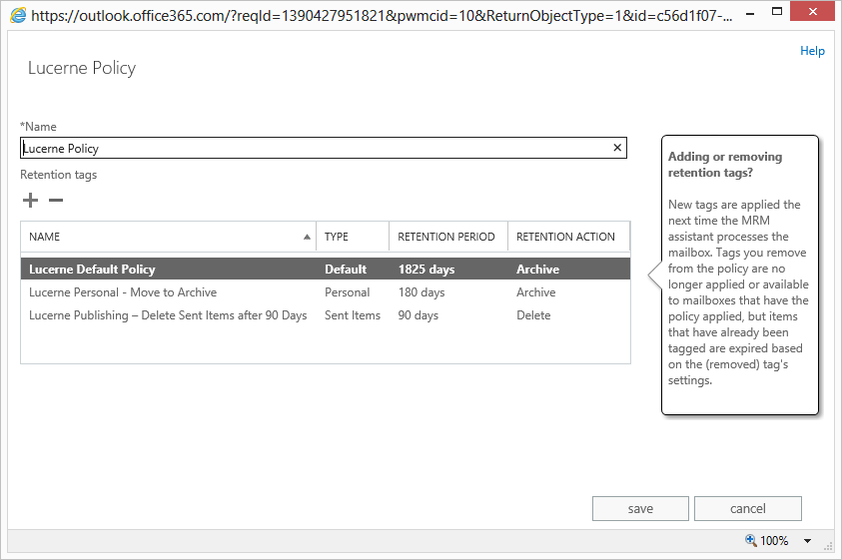
Configuring retention tags and policies
Notes:
20347A
11: Planning and configuring Rights Management and compliance

Slide 22
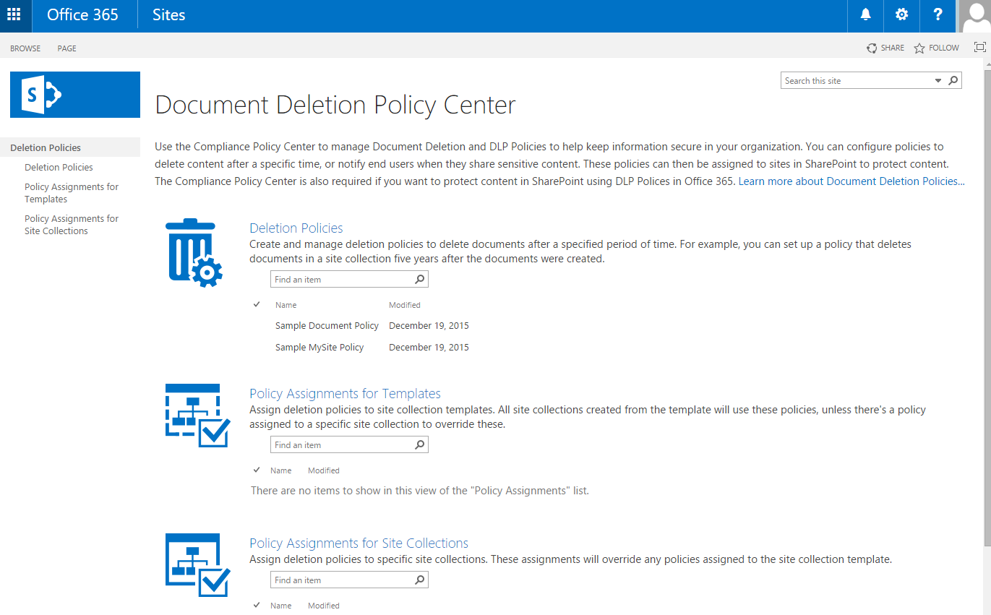
Configuring document deletion policies in SharePoint Online and OneDrive for Business
Notes:
Discuss usage scenarios for document deletion policies.
20347A
11: Planning and configuring Rights Management and compliance

Slide 23
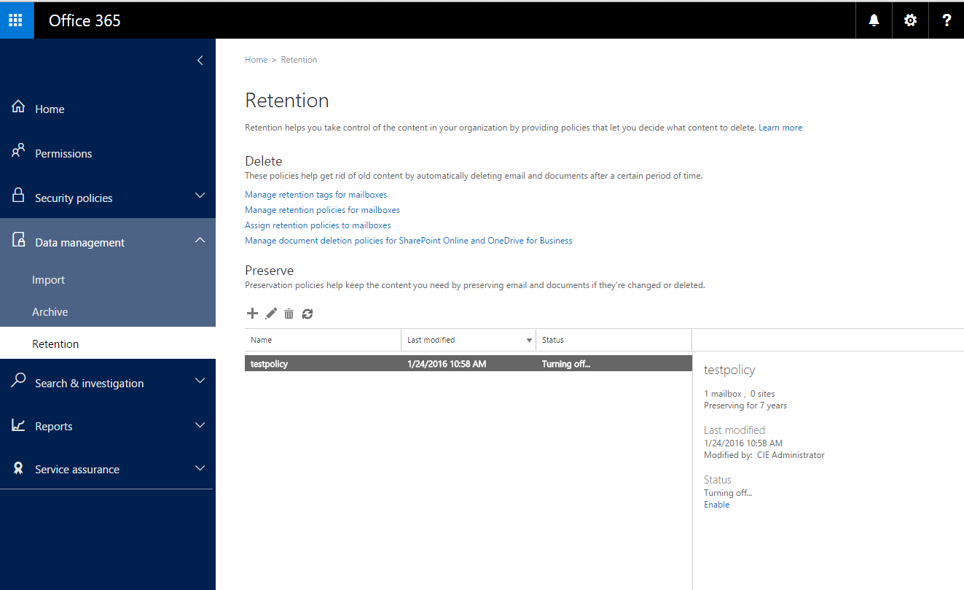
Configuring preservation policies
Notes:
Discuss usage scenarios for document preservation.
20347A
11: Planning and configuring Rights Management and compliance

Slide 24
Configuring DLP policies for email
To manage DLP policies:
Create a standard DLP policy
Create a custom DLP policy
View DLP policy detection reports
Notes:
Discuss scenarios for DLP policies and when to use them.
20347A
11: Planning and configuring Rights Management and compliance

Slide 25
Creating DLP policies for SharePoint Online and OneDrive for Business
You can help secure your content for SharePoint Online by:
Creating a DLP policy for SharePoint Online, OneDrive for Business or both
Editing or disabling a DLP policy
Notes:
Discuss scenarios in which students use data loss prevention (DLP) policies for Microsoft SharePoint and Microsoft OneDrive for Business.
20347A
11: Planning and configuring Rights Management and compliance

Slide 26
Compliance search and Office 365 Advanced eDiscovery
Prepare and manage eDiscovery
Compliance search and eDiscovery
Content search
Preparation of search results
Office 365 Advanced eDiscovery search
Preparation status
Search results added to a case
Notes:
Discuss usage scenarios for eDiscovery.
20347A
11: Planning and configuring Rights Management and compliance

Slide 27
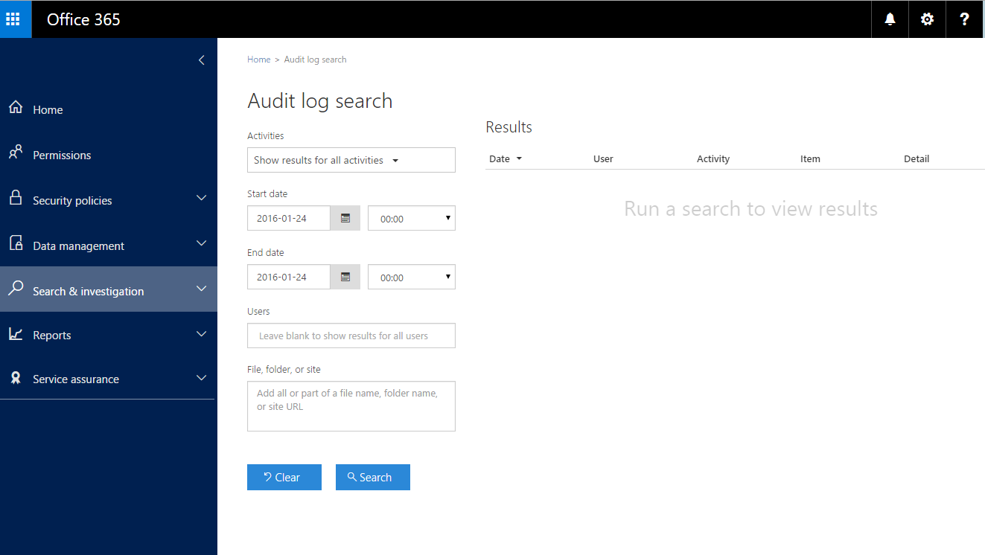
Configuring audit reports
Notes:
Explain how the audit log search works and discuss common scenarios.
20347A
11: Planning and configuring Rights Management and compliance

Slide 28
Lab: Configuring Rights Management and compliance
Exercise 1: Configuring Rights Management in Office 365 Exercise 2: Configuring compliance features
Logon Information
Virtual machines: 20347A-LON-DC1
20347A-LON-DS1
20347A-LON-CL1
User name: Adatum\Administrator
Password: Pa$$w0rd
Estimated Time: 75 Minutes
Notes:
Exercise 1: Configuring Rights Management in Office 365
You need to configure Rights Management in Exchange Online and SharePoint Online to help ensure that confidential information is not shared with unauthorized users.
Exercise 2: Configuring compliance features
You need to implement the compliance features required to address the security requirements.
20347A
11: Planning and configuring Rights Management and compliance

Slide 29
Lab Scenario
The compliance and security groups at A. Datum Corporation have concerns with the implications of moving internal services and content to a cloud-based solution, such as Office 365. To receive project approval, you need to show how you can use the Rights Management and compliance features to address these concerns.
Notes:
20347A
11: Planning and configuring Rights Management and compliance

Slide 30
Lab Review
What is the best approach to protecting organizational financial data? Retention policies are helpful for increasing available space in your mailbox.
Notes:
Question
What is the best approach to protect organizational financial data?
Answer
The best approach is to create a DLP rule and use Azure RMS to help protect all the files and emails containing that information.
Question
Retention policies are helpful for reducing space in your mailbox.
( ) False
( ) True
Answer
(√) False
( ) True
20347A
11: Planning and configuring Rights Management and compliance

Slide 31
Module Review and Takeaways
Best Practice Common Issue and Troubleshooting Tip
Notes:
Best Practice
Security enhancement is a continuous process. Good planning and tenant preparation helps to secure the environment for users.
Common issue and troubleshooting tip
Common Issue: Encrypted content is not accessible.
Troubleshooting Tip: Configure a super user account to get access to the content.
20347A
11: Planning and configuring Rights Management and compliance

