Slide 1
Module 12
Monitoring and troubleshooting Microsoft Office 365
Notes:
Presentation: 45 minutes
Lab: 30 minutes
After completing this module, students will be able to:
Troubleshoot Microsoft Office 365 connectivity and service issues.
Monitor Office 365 service health.
Required materials
To teach this module, you need the Microsoft PowerPoint file 20347A_12.pptx.
Preparation tasks
To prepare for this module, you should:
Read all of this module’s materials.
Practice performing the demonstrations and labs.
Work through the Module Review and Takeaways section to determine how you will use the information to reinforce student learning and promote knowledge transfer to on-the-job performance.
As you prepare for this class, it is imperative that you complete the labs yourself. This gives you an understanding of how the labs work and the concepts that each covers, so that you can provide meaningful hints to students who might have issues. Furthermore, it will help guide your lecture to ensure that you discuss the concepts that the labs cover.
20347A
12: Monitoring and troubleshooting Microsoft Office 365

Slide 2
Module Overview
Troubleshooting Office 365 Monitoring Office 365 service health
Notes:
Provide an overview of the module.
20347A
12: Monitoring and troubleshooting Microsoft Office 365

Slide 3
Lesson 1: Troubleshooting Office 365
Overview of Office 365 troubleshooting Microsoft Remote Connectivity Analyzer The Microsoft Office 365 Support and Recovery Assistant tool Message tracking tools Hybrid environment free/busy troubleshooter Do-it-yourself troubleshooter
Notes:
Provide an overview of the lesson.
Question
Which of the following are options or tools that you can use for monitoring and troubleshooting Office 365?
( ) Option 1: Service Health
( ) Option 2: Protection Center
( ) Option 3: Service Requests
( ) Option 4: Notification Center
( ) Option 5: Alert Center
Answer
(√) Option 1: Service Health
(√) Option 3: Service Requests
Question
The Microsoft Office 365 Support and Recovery Assistant is a new tool that users can run to fix common Outlook problems.
( ) False
( ) True
Answer
( ) False
(√) True
20347A
12: Monitoring and troubleshooting Microsoft Office 365

Slide 4
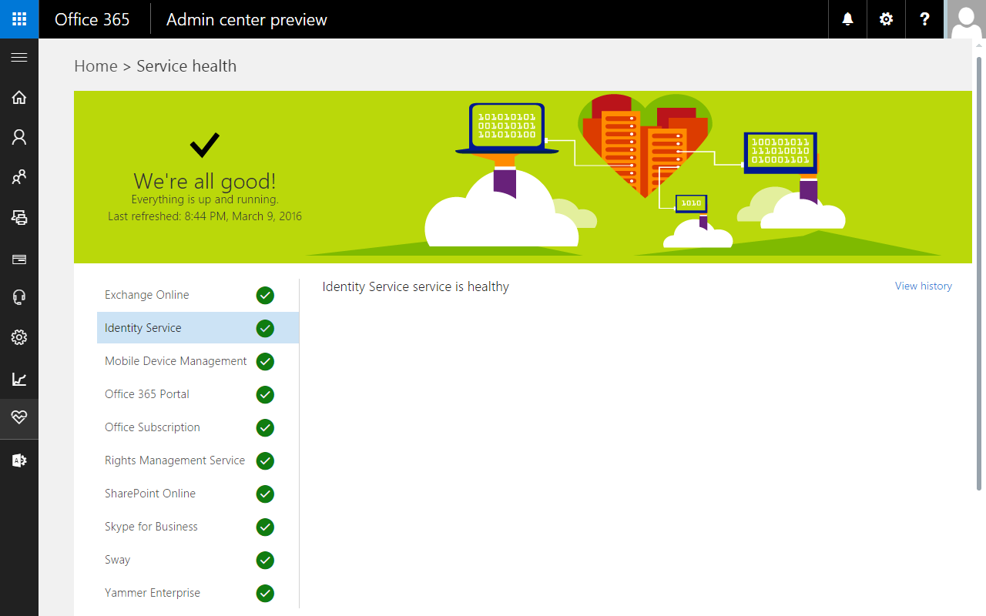
Overview of Office 365 troubleshooting
Notes:
Give an overview of the current troubleshooting options. Inform students that they can check the current health of their Office 365 environment by using the Office 365 admin center. Provide an overview of the differences between troubleshooting on-premises services and cloud services.
20347A
12: Monitoring and troubleshooting Microsoft Office 365

Slide 5
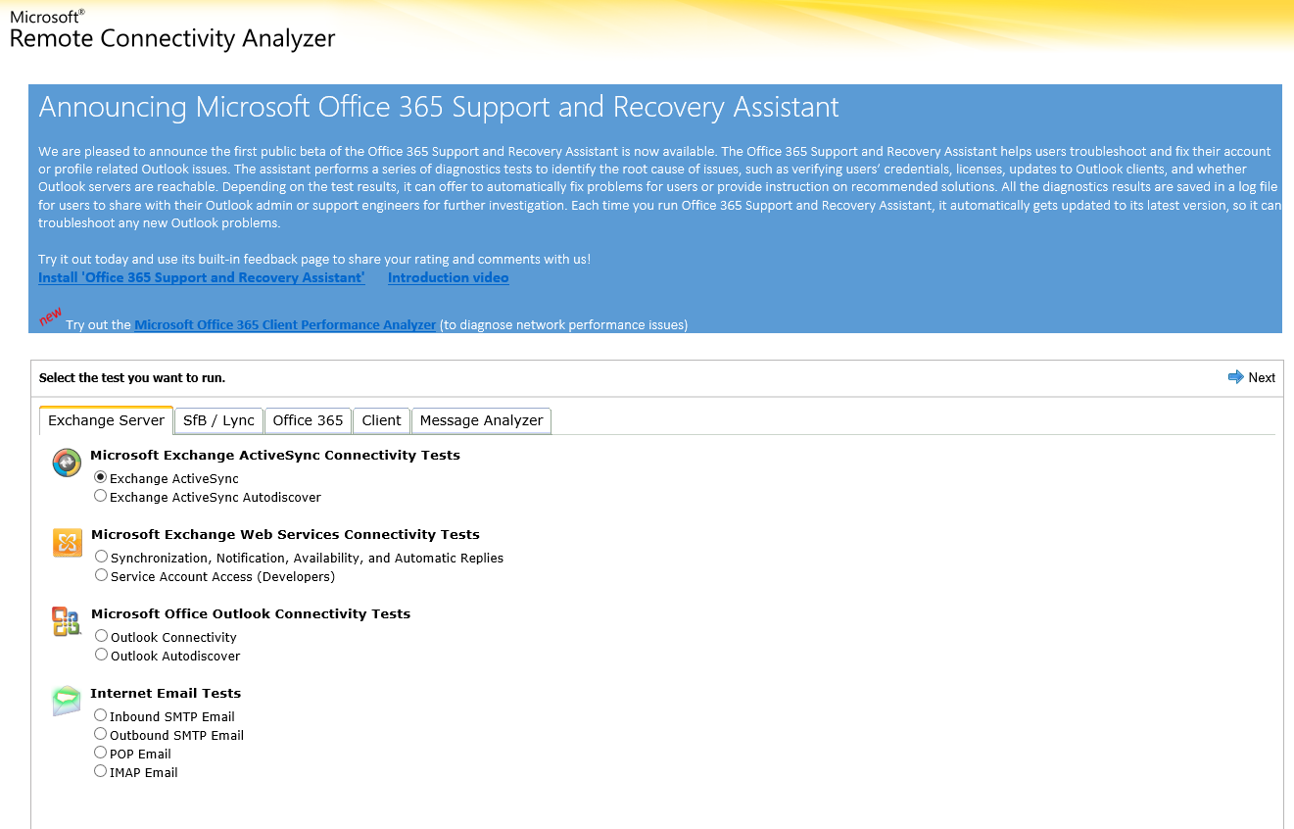
Microsoft Remote Connectivity Analyzer
Notes:
Provide an overview of the Microsoft Remote Connectivity Analyzer and go through the various tabs. Explain the tools and tests that are available for on-premises servers and for Office 365 services.
20347A
12: Monitoring and troubleshooting Microsoft Office 365

Slide 6
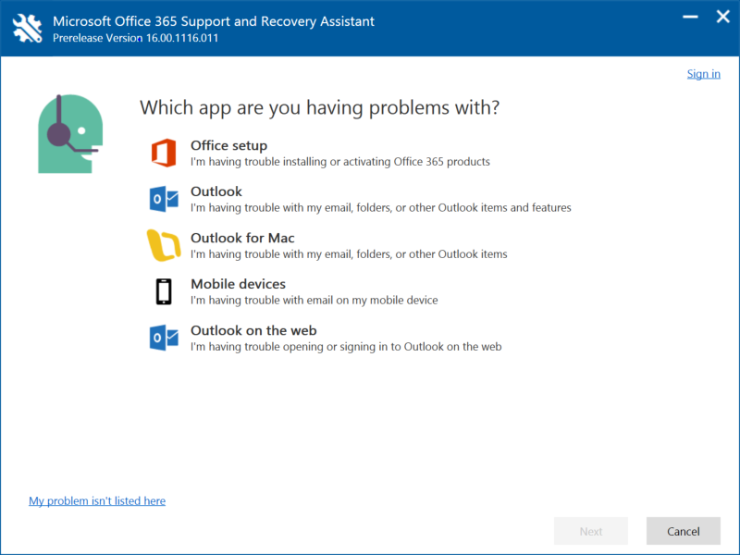
The Microsoft Office 365 Support and Recovery Assistant tool
Downloadable client program
Helps troubleshoot common problems
Allows you to perform connectivity diagnosis
Notes:
Discuss the troubleshooting options the Microsoft Office 365 Support and Recovery Assistant tool provides and describe where these can be helpful.
20347A
12: Monitoring and troubleshooting Microsoft Office 365

Slide 7
Message tracking tools
Microsoft Message Analyzer
Delivery reports:
The Microsoft Exchange Online message trace tool
Personal delivery reports
Notes:
Discuss the different options for tracking message delivery.
20347A
12: Monitoring and troubleshooting Microsoft Office 365

Slide 8
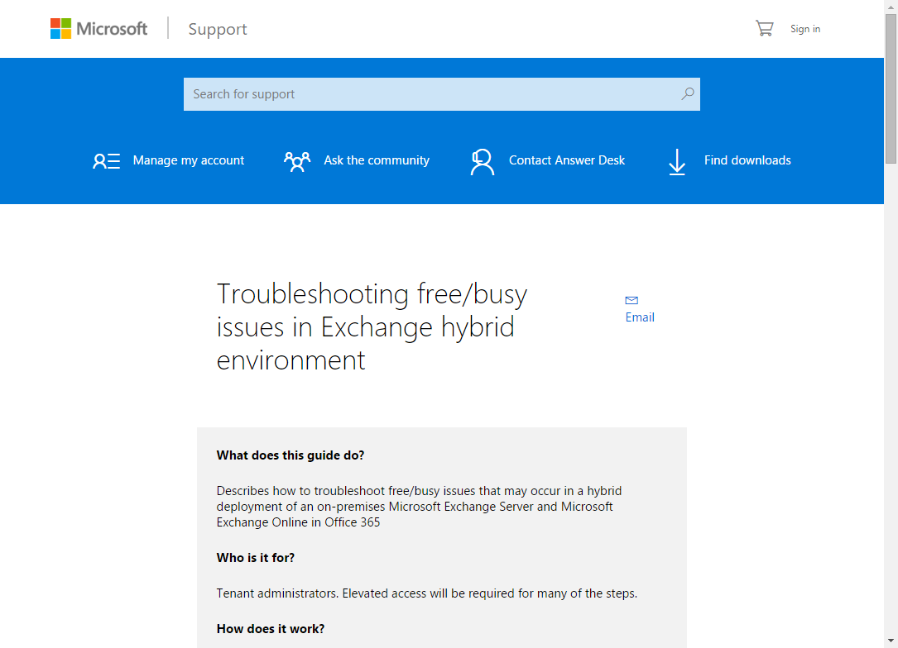
Hybrid environment free/busy troubleshooter
The hybrid environment free/busy troubleshooter:
Is an online tool
Helps resolve free/busy issues with a set of configuration questions
Points you to support articles or to the Remote Connectivity Analyzer tool
Notes:
Discuss the hybrid environment free/busy troubleshooter tool and the common issues that you can troubleshoot by using this tool.
20347A
12: Monitoring and troubleshooting Microsoft Office 365

Slide 9
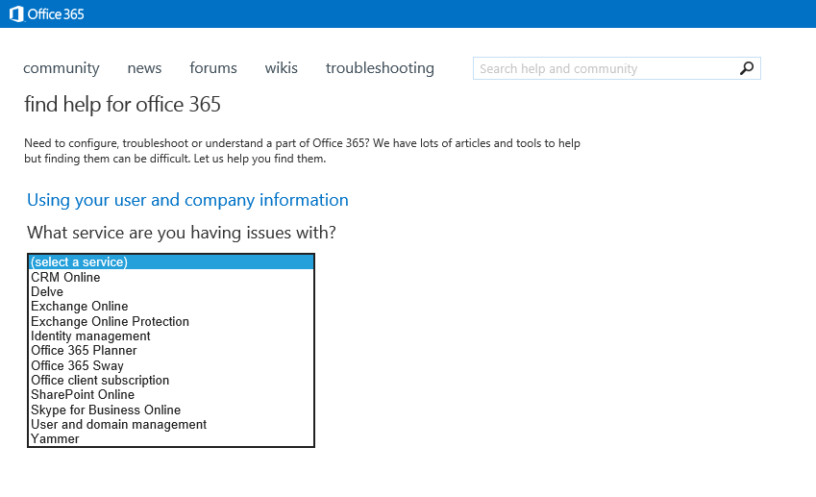
Do-it-yourself troubleshooter
Notes:
Discuss the do-it-yourself troubleshooter.
20347A
12: Monitoring and troubleshooting Microsoft Office 365

Slide 10
Lesson 2: Monitoring Office 365 service health
Service health information in the Office 365 dashboard Office 365 auditing reports Office 365 mail and protection reports Managing Exchange Online reports by using Windows PowerShell Office 365 service requests Monitoring Office 365 with Operations Manager
Notes:
Provide an overview of the lesson.
Question
A service in the Service Health dashboard can have which of following statuses?
( ) Option 1: Normal service
( ) Option 2: Service anomaly
( ) Option 3: Extended recovery
( ) Option 4: Investigating
( ) Option 5: Operations aborted
Answer
(√) Option 1: Normal service
(√) Option 3: Extended recovery
(√) Option 4: Investigating
Question
How can you open a service request in Office 365?
( ) Option 1: Via Skype for Business
( ) Option 2: Via email
( ) Option 3: Via phone
( ) Option 4: Via the Office 365 admin center
( ) Option 5: Via the Office 365 App launcher
Answer
(√) Option 3: Via phone
(√) Option 4: Via the Office 365 admin center
20347A
12: Monitoring and troubleshooting Microsoft Office 365

Slide 11
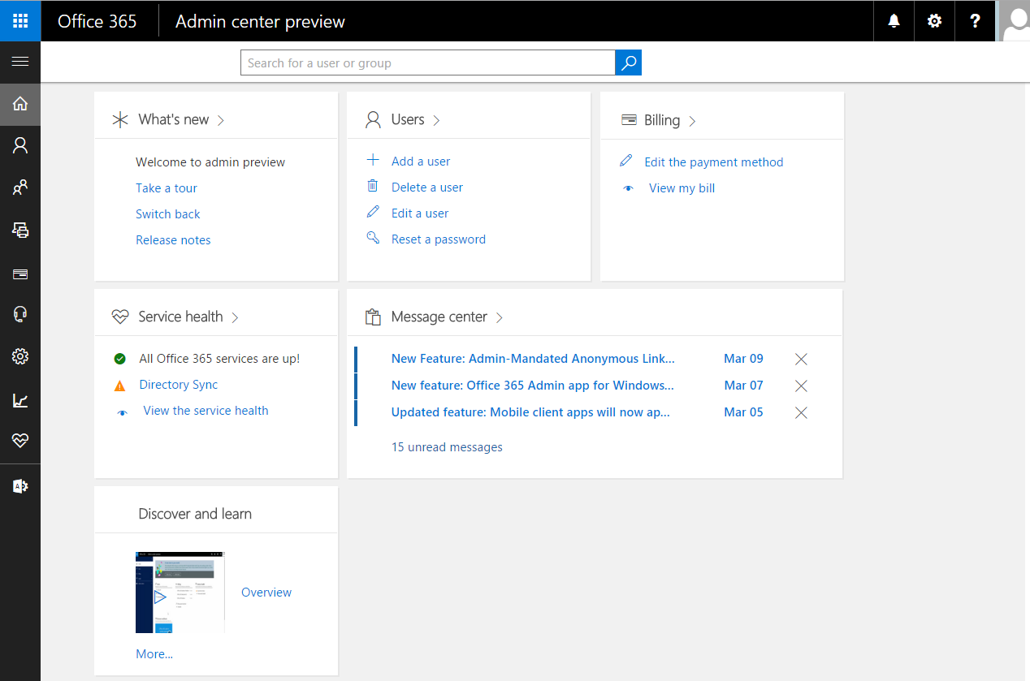
Service health information in the Office 365 dashboard
Notes:
Note: This topic has three additional slides.
Provide an overview of the Service Health dashboard.
20347A
12: Monitoring and troubleshooting Microsoft Office 365

Slide 12
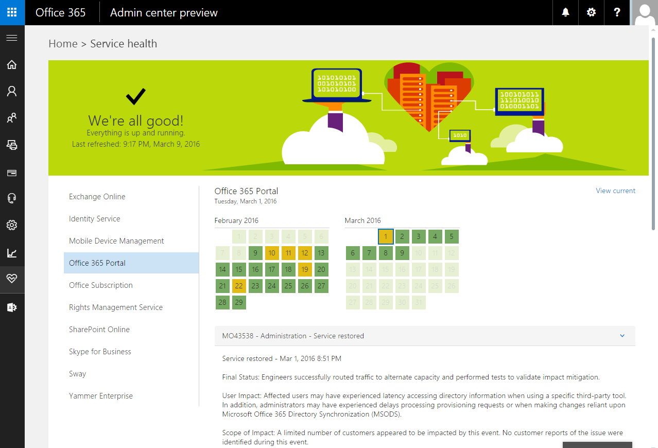
Service health information in the Office 365 dashboard
Notes:
Go through the different service status icons and discuss what they mean.
20347A
12: Monitoring and troubleshooting Microsoft Office 365

Slide 13
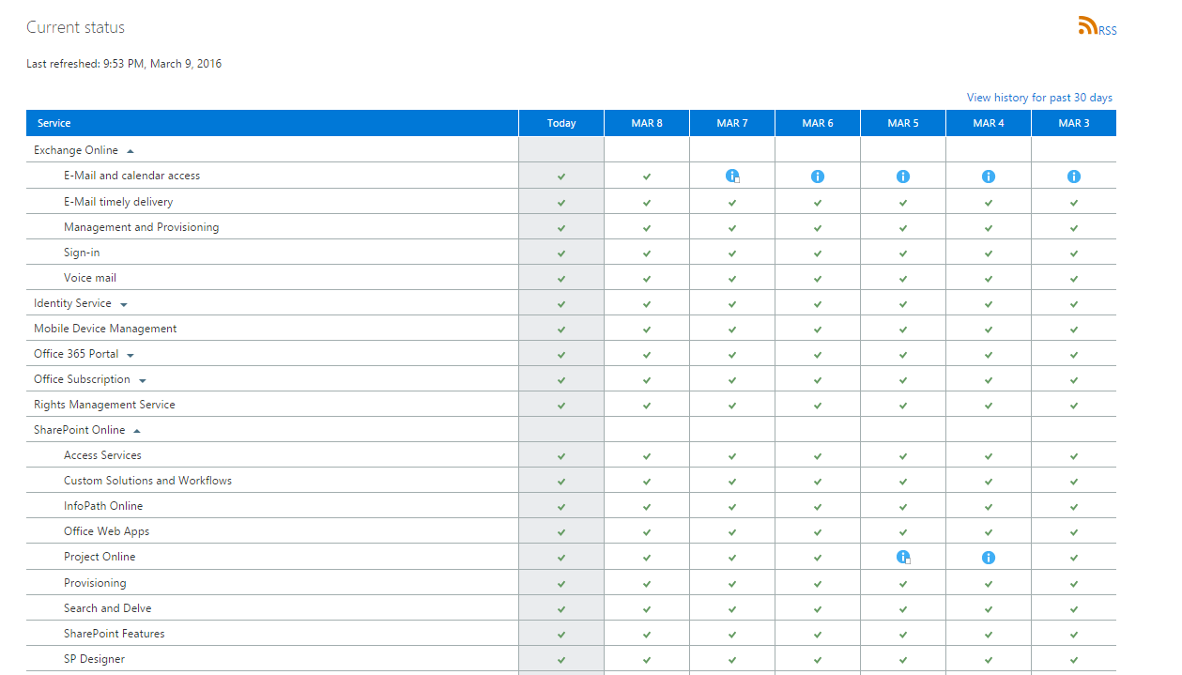
Service health information in the Office 365 dashboard
Notes:
Explain the 6-day history of service incidents.
20347A
12: Monitoring and troubleshooting Microsoft Office 365

Slide 14
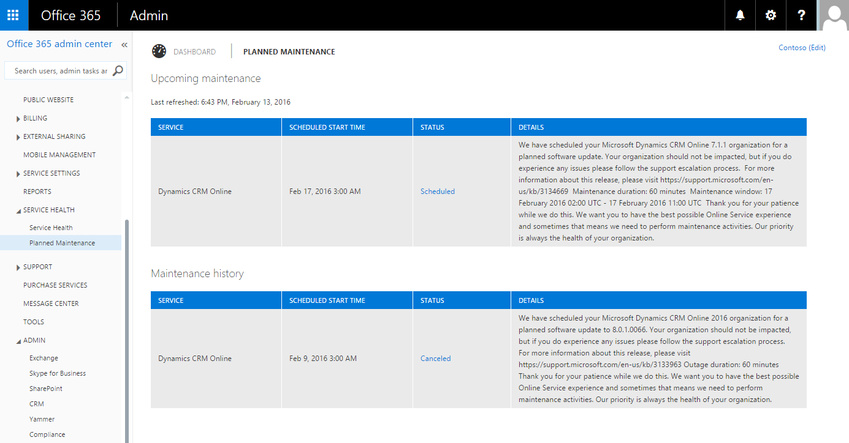
Service health information in the Office 365 dashboard
Notes:
Explain to students that they can learn in advance about upcoming maintenance to Office 365 by reviewing the information on the Upcoming maintenance page. This might help students to plan for outages or service changes in their environment. Note that the screenshot on the slide is of the previous Office 365 admin center. This was not replaced with the screenshot of the new admin center because the planned maintenance table was not available in the new admin center at the time of writing this course.
20347A
12: Monitoring and troubleshooting Microsoft Office 365

Slide 15
Office 365 auditing reports
Mailbox access by non-owners
Role group changes
Mailbox content search and hold
Mailbox litigation holds
Notes:
Explain the various auditing reports that are available in the Office 365 admin center. If possible, demonstrate how to generate a report.
20347A
12: Monitoring and troubleshooting Microsoft Office 365

Slide 16
Office 365 mail and protection reports
Mail reports:
Active and inactive mailboxes
New and deleted mailboxes
New and deleted groups
Mailbox usage
Types of mailbox connections
Protection reports:
Top senders and recipients
Top malware for mail
Malware detections
Spam detections
Sent and received mail
Notes:
Explain the various mail and protection reports that are available in the Office 365 admin center. If possible, demonstrate how to generate one of these reports.
20347A
12: Monitoring and troubleshooting Microsoft Office 365

Slide 17
Managing Exchange Online reports by using Windows PowerShell
The Windows PowerShell cmdlets that you can use for reporting purposes in Exchange Online are categorized into:
Auditing cmdlets
Message tracking cmdlets
General reporting cmdlets
Exchange Online Protection cmdlets
Notes:
20347A
12: Monitoring and troubleshooting Microsoft Office 365

Slide 18
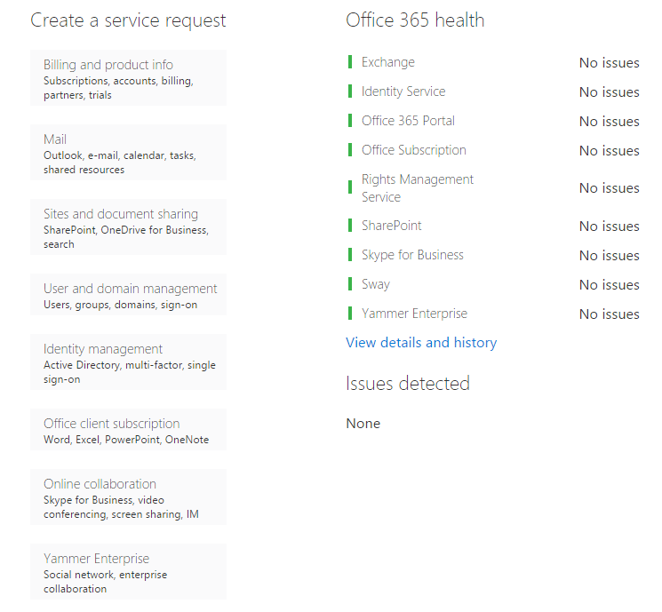
Office 365 service requests
You can submit service requests by using the portal or by phone
The support team provides assistance all of the time
Answer time depends on the severity of the issue
Elevated support is also available
Notes:
Discuss the different service request options.
20347A
12: Monitoring and troubleshooting Microsoft Office 365

Slide 19
Monitoring Office 365 with Operations Manager
System Center management pack for Office 365 allows you monitor:
Subscription health
Service status
Active and resolved incidents
Message Centre
Alerts
Notes:
20347A
12: Monitoring and troubleshooting Microsoft Office 365

Slide 20
Lab: Monitoring and troubleshooting Office 365
Exercise 1: Monitoring Office 365 Exercise 2: Monitoring service health and analyzing reports
Logon Information
Virtual machines: 20347A-LON-DC1
20347A-LON-DS1
20347A-LON-CL1
User names: Adatum\administrator
Adatum\Holly
Password: Pa$$w0rd
Estimated Time: 30 minutes
Notes:
Exercise 1: Monitoring Office 365
Some A. Datum users report that they cannot access their mailboxes through Outlook. You need to check whether the issue is with client connectivity or with mail flow.
Instructor Note: This exercise should take around 15 minutes to complete. In this exercise, students send an email to a nonexistent mail domain and then use message tracking tools and delivery reports to diagnose the issue.
Exercise 2: Monitoring service health and analyzing reports
You identified the reports that you need to provide to A. Datum’s management. Management is particularly interested in the number of malware and spam items that are reaching the organization. You need to familiarize yourself with the Office 365 reporting tools. Your next task is to produce reports on the numbers of messages that Exchange Online Protection is intercepting.
Instructor Note: This exercise should take around 15 minutes to complete. In this exercise, students use the Office 365 admin center to monitor service health. Students then generate, view, and interpret the various Office 365 reports.
20347A
12: Monitoring and troubleshooting Microsoft Office 365

Slide 21
Lab Scenario
A. Datum Corporation’s Office 365 deployment is almost complete. As the team enters the final phase of this project, you need to set up a suitable monitoring environment to track the status of Office 365 and to ensure that the help desk and IT management can respond to any reported issues. Additionally, you need to learn how to monitor and troubleshoot Office 365 issues so that you can train the support staff in these areas.
Notes:
20347A
12: Monitoring and troubleshooting Microsoft Office 365

Slide 22
Lab Review
How would you view all the failed messages for a group of users?
What is the first tool you will use to search for service incidents and failures?
Notes:
Question
How would you view all the failed messages for a group of users?
Answer
In the Exchange Online admin center, sign in as an administrator, click mail flow, click message trace, and then click Select Members.
Question
What is the first tool you will use to search for service incidents and failures?
Answer
The Service Health dashboard is the first tool that you will use.
20347A
12: Monitoring and troubleshooting Microsoft Office 365

Slide 23
Module Review and Takeaways
Best Practice
Common Issues and Troubleshooting Tips
Notes:
Best Practice
Many tools are available to help troubleshoot issues in Office 365. As a starting point, you can use the Office 365 do-it-yourself troubleshooter for an initial diagnosis.
Common Issue: Outlook client connectivity issues
Troubleshooting Tip: Look for Autodiscover issues in the Microsoft Remote Connectivity Analyzer.
Issue
Unable to connect to the Skype for Business client
Troubleshooting Tip
Use the Microsoft Office 365 Support and Recovery Assistant tool.
20347A
12: Monitoring and troubleshooting Microsoft Office 365

