Slide 1
ELEMENTARY COMBINATORICS & PROBABILITY
Review week 1

Slide 2
TODAY
Problem set 5
Review permutations & combinations
Interim exam

Slide 3
Graded assignment 2 is out
Deadline: TODAY, March 22, 23:59 Barcelona time
See Google classroom

Slide 4
Problem set 5
https://docs.google.com/document/d/1Kf4NYeMPyABbbiWnm5sYKGgZOr3oK3XDznbb1Sf0oyY/edit?usp=sharing

Slide 5

THE PIGEONHOLE PRINCIPLE
If $n$ or more pigeons are distributed among $k$ pigeonholes and $n>k$, then at least one pigeonhole contains two or more pigeons.
Example:
If $n=12$ people sit on $k=10$ chairs, then two or more people are sitting on at least one of the chairs.

Slide 6
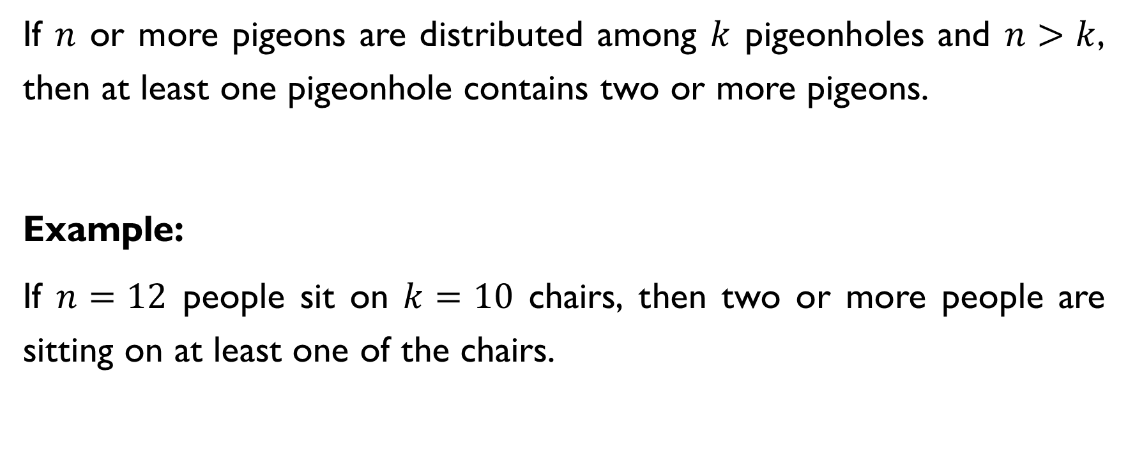
THE PIGEONHOLE PRINCIPLE
If $n$ or more pigeons are distributed among $k$ pigeonholes and $n>k$, then at least one pigeonhole contains two or more pigeons.
Example:
If $n=12$ people sit on $k=10$ chairs, then two or more people are sitting on at least one of the chairs.

Slide 7
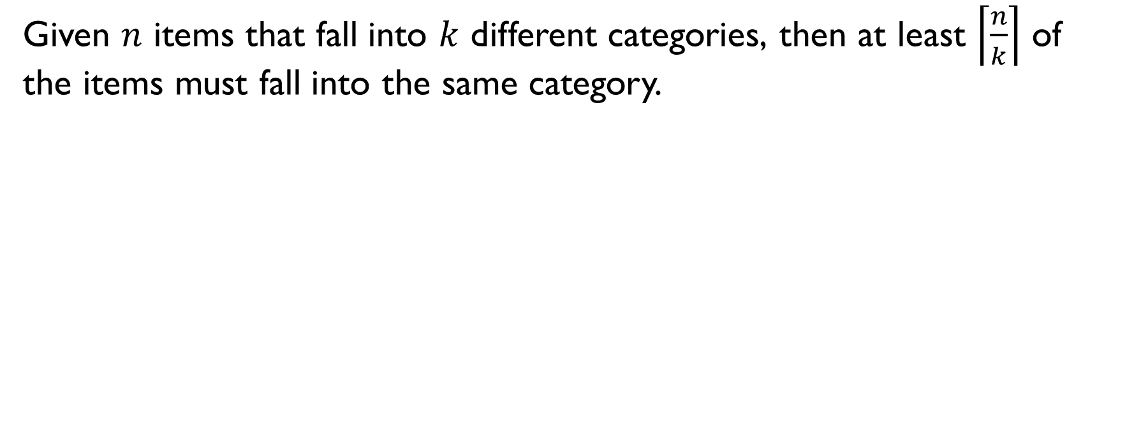
Generalized pigeonhole principle
Given $n$ items that fall into $k$ different categories, then at least $\left\lceil \frac{n}{k}\right\rceil$ of the items must fall into the same category.
Example:
If $n=22$ people sit on $k=10$ chairs, then at least $\left\lceil \frac{33}{10}\right\rceil =4$people are sitting on at least one of the chairs.

Slide 8
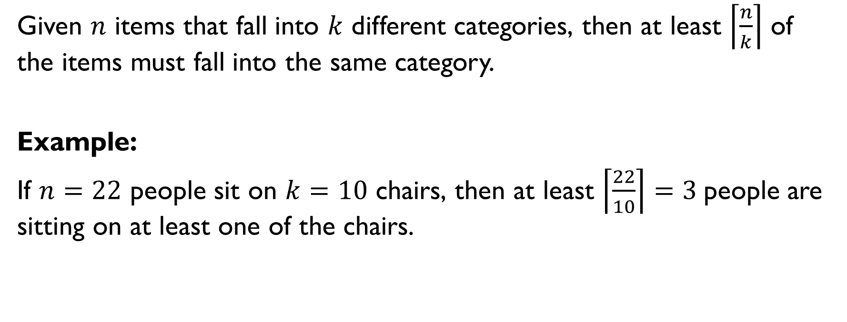
Generalized pigeonhole principle
Given $n$ items that fall into $k$ different categories, then at least $\left\lceil \frac{n}{k}\right\rceil$ of the items must fall into the same category.
Example:
If $n=22$ people sit on $k=10$ chairs, then at least $\left\lceil \frac{22}{10}\right\rceil =3$people are sitting on at least one of the chairs.

Slide 9

remainders
In a set of 7 integers, what is the largest number of integers that must have the same remainder when divided by 5? Pigeons: $n=7$ integers Holes: $k=5$ possible remainders (0, 1, 2, 3, 4) Generalized pigeonhole principle: At least $\left\lceil 7/5\right\rceil =2$ numbers have the same remainder when divided by 5.

Slide 10

remainders
In a set of 7 integers, what is the largest number of integers that must have the same remainder when divided by 5? Pigeons: $n=7$ integers Holes: $k=5$ possible remainders (0, 1, 2, 3, 4) Generalized pigeonhole principle: At least $\left\lceil 7/5\right\rceil =2$ numbers have the same remainder when divided by 5.

Slide 11

remainders
In a set of 7 integers, what is the largest number of integers that must have the same remainder when divided by 5? Pigeons: $n=7$ integers Holes: $k=5$ possible remainders (0, 1, 2, 3, 4) Generalized pigeonhole principle: At least $\left\lceil 7/5\right\rceil =2$ numbers have the same remainder when divided by 5.

Slide 12
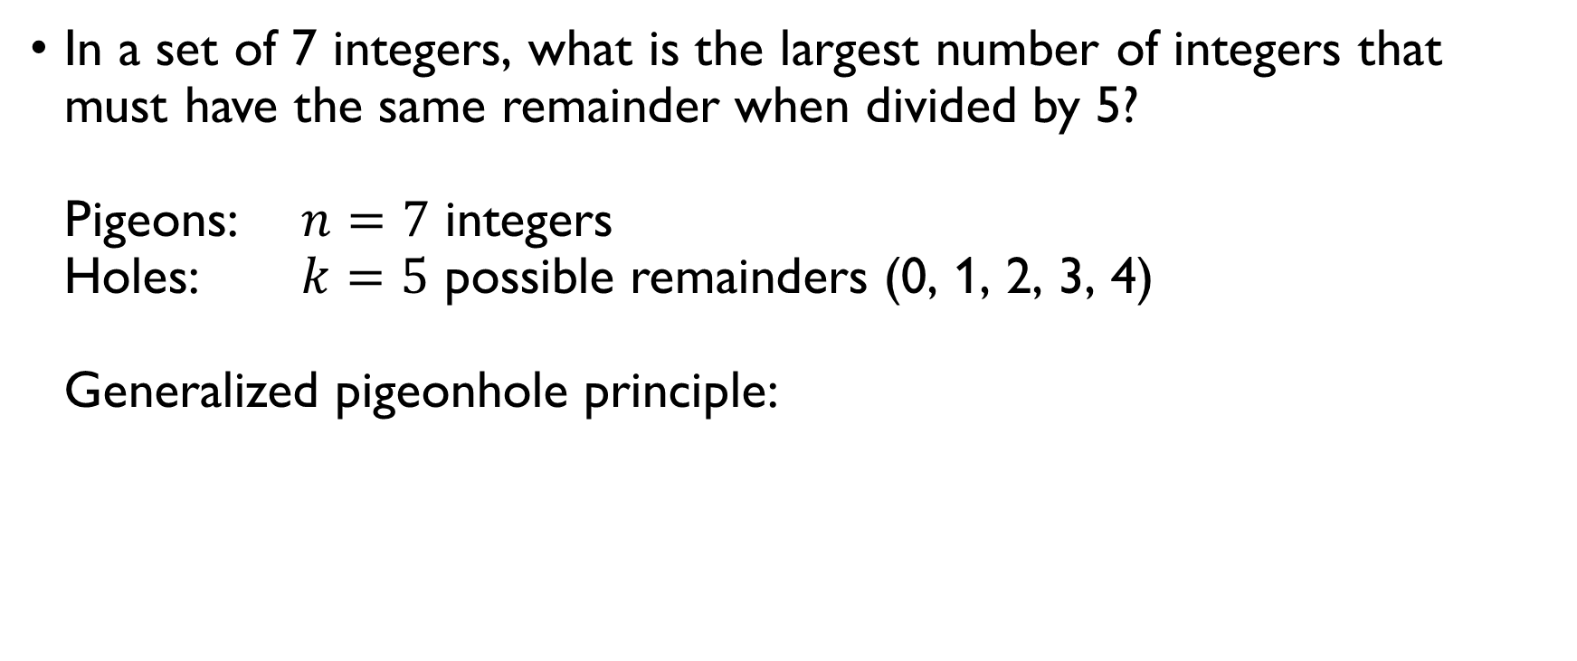
remainders
In a set of 7 integers, what is the largest number of integers that must have the same remainder when divided by 5? Pigeons: $n=7$ integers Holes: $k=5$ possible remainders (0, 1, 2, 3, 4) Generalized pigeonhole principle: At least $\left\lceil 7/5\right\rceil =2$ numbers have the same remainder when divided by 5.

Slide 13
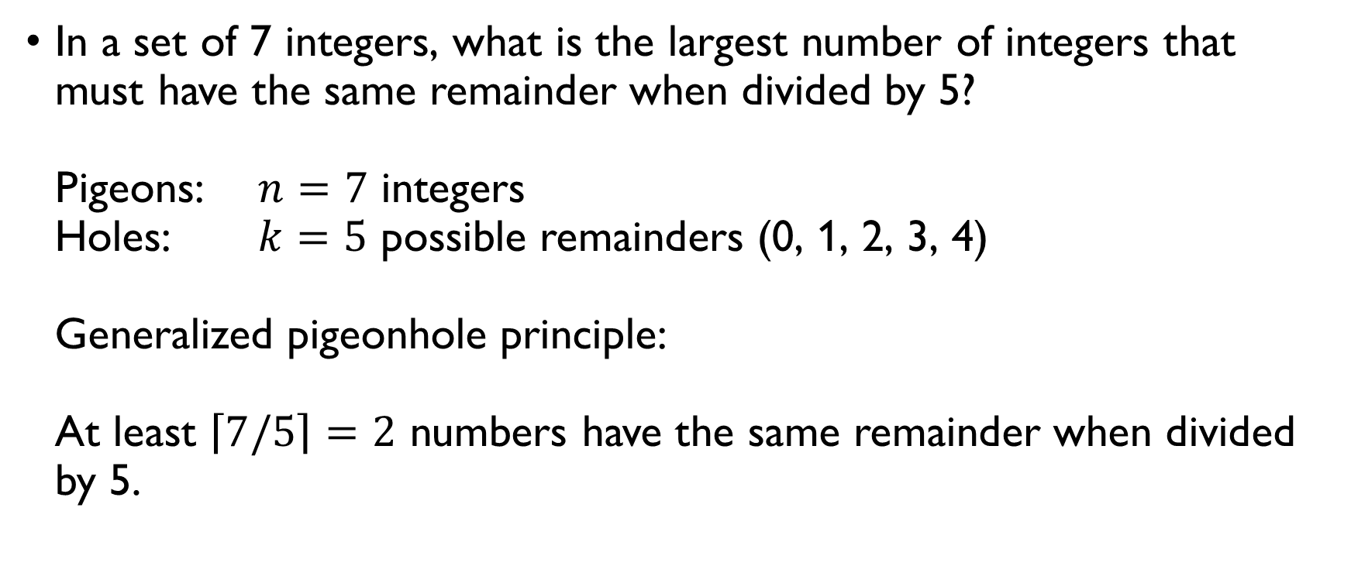
remainders
In a set of 7 integers, what is the largest number of integers that must have the same remainder when divided by 5? Pigeons: $n=7$ integers Holes: $k=5$ possible remainders (0, 1, 2, 3, 4) Generalized pigeonhole principle: At least $\left\lceil 7/5\right\rceil =2$ numbers have the same remainder when divided by 5.

Slide 14

grades
In a discrete mathematics class of 32 students, what is the largest number of students who must receive the same grade if there are only 5 possible grades? Pigeons: $n=32$ students Holes: $k=5$ possible grades Generalized pigeonhole principle: At least $\left\lceil 32/5\right\rceil =7$ students must have received the same grade.

Slide 15
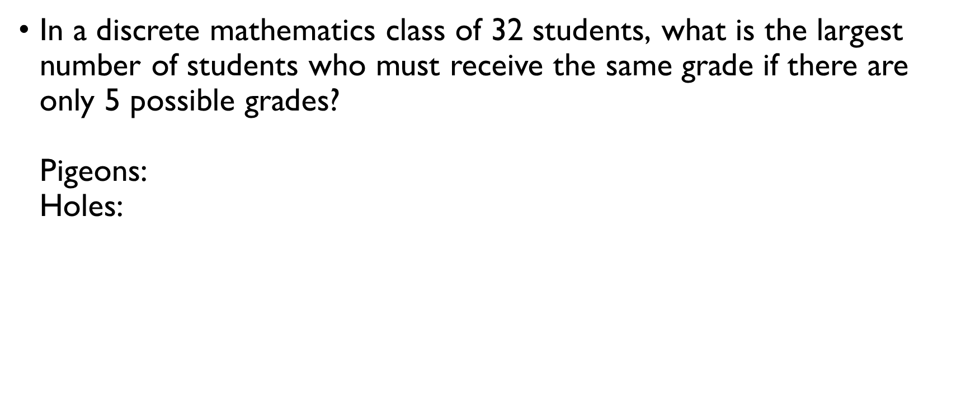
grades
In a discrete mathematics class of 32 students, what is the largest number of students who must receive the same grade if there are only 5 possible grades? Pigeons: $n=32$ students Holes: $k=5$ possible grades Generalized pigeonhole principle: At least $\left\lceil 32/5\right\rceil =7$ students must have received the same grade.

Slide 16
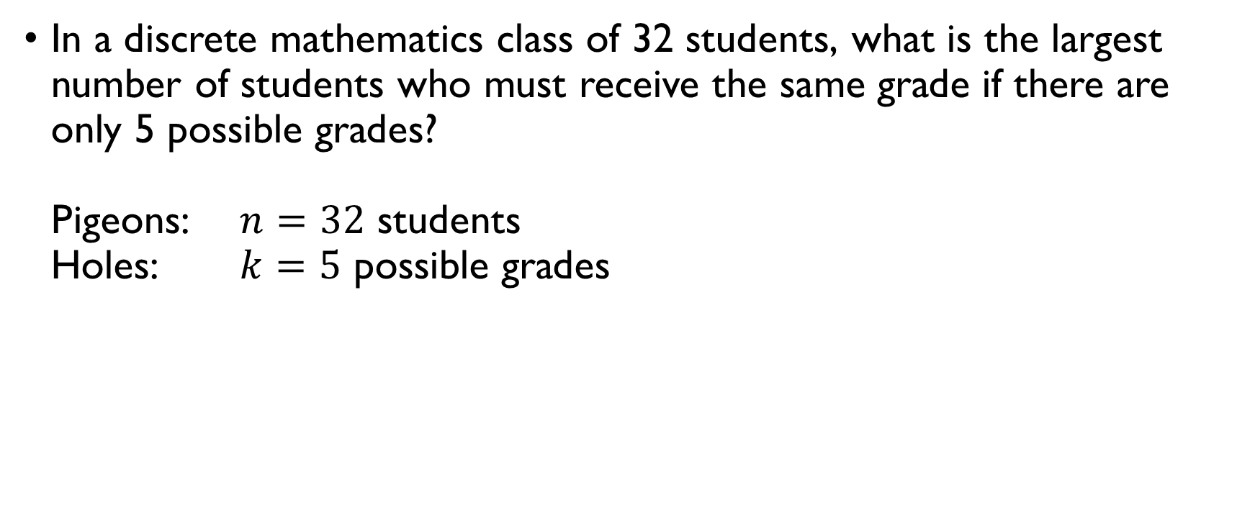
grades
In a discrete mathematics class of 32 students, what is the largest number of students who must receive the same grade if there are only 5 possible grades? Pigeons: $n=32$ students Holes: $k=5$ possible grades Generalized pigeonhole principle: At least $\left\lceil 32/5\right\rceil =7$ students must have received the same grade.

Slide 17
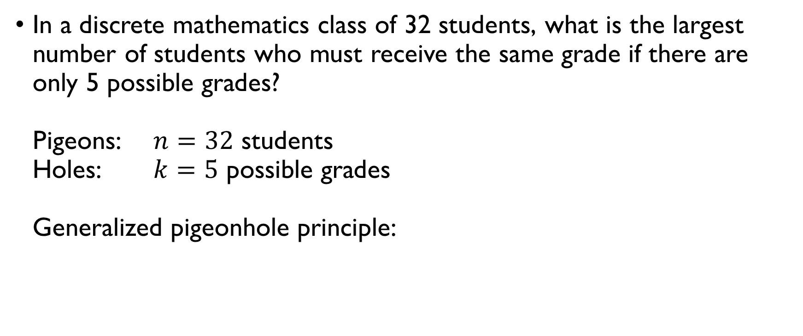
grades
In a discrete mathematics class of 32 students, what is the largest number of students who must receive the same grade if there are only 5 possible grades? Pigeons: $n=32$ students Holes: $k=5$ possible grades Generalized pigeonhole principle: At least $\left\lceil 32/5\right\rceil =7$ students must have received the same grade.

Slide 18
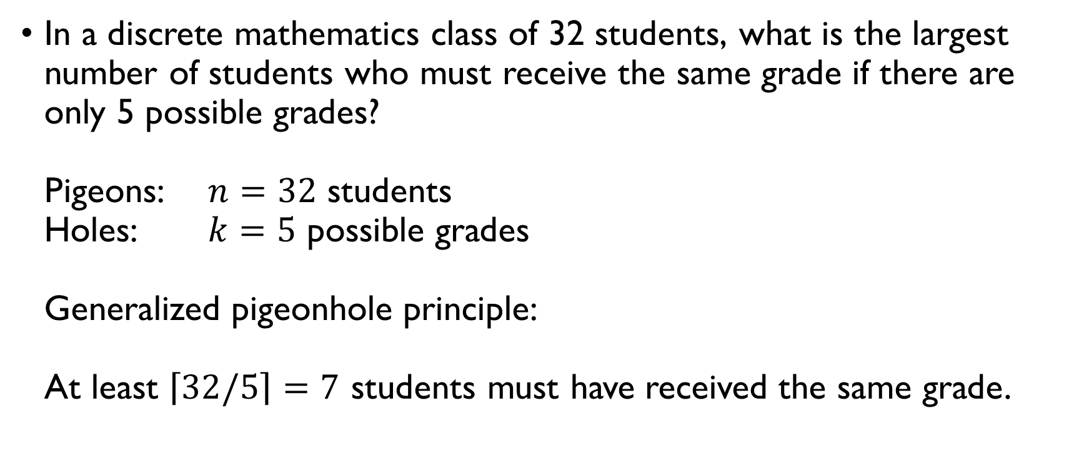
grades
In a discrete mathematics class of 32 students, what is the largest number of students who must receive the same grade if there are only 5 possible grades? Pigeons: $n=32$ students Holes: $k=5$ possible grades Generalized pigeonhole principle: At least $\left\lceil 32/5\right\rceil =7$ students must have received the same grade.

Slide 19

Odd or even
Prove that in any set of 3 integer numbers, it is always possible to choose 2 numbers such that their sum is even. Pigeons: $n=3$ numbers Holes: $k=2$ odd / even At least two of the numbers belong to the same “hole” $↔$
At least two of the numbers are odd $→$ the sum is even
At least two of the numbers are even $→$ the sum is even
Thus, it is always possible numbers such that their sum is even.

Slide 20

Odd or even
Prove that in any set of 3 integer numbers, it is always possible to choose 2 numbers such that their sum is even. Pigeons: $n=3$ numbers Holes: $k=2$ odd / even At least two of the numbers belong to the same “hole” $↔$
At least two of the numbers are odd $→$ the sum is even
At least two of the numbers are even $→$ the sum is even
Thus, it is always possible numbers such that their sum is even.

Slide 21

Odd or even
Prove that in any set of 3 integer numbers, it is always possible to choose 2 numbers such that their sum is even. Pigeons: $n=3$ numbers Holes: $k=2$ odd / even At least two of the numbers belong to the same “hole” $↔$
At least two of the numbers are odd $→$ the sum is even
At least two of the numbers are even $→$ the sum is even
Thus, it is always possible numbers such that their sum is even.

Slide 22
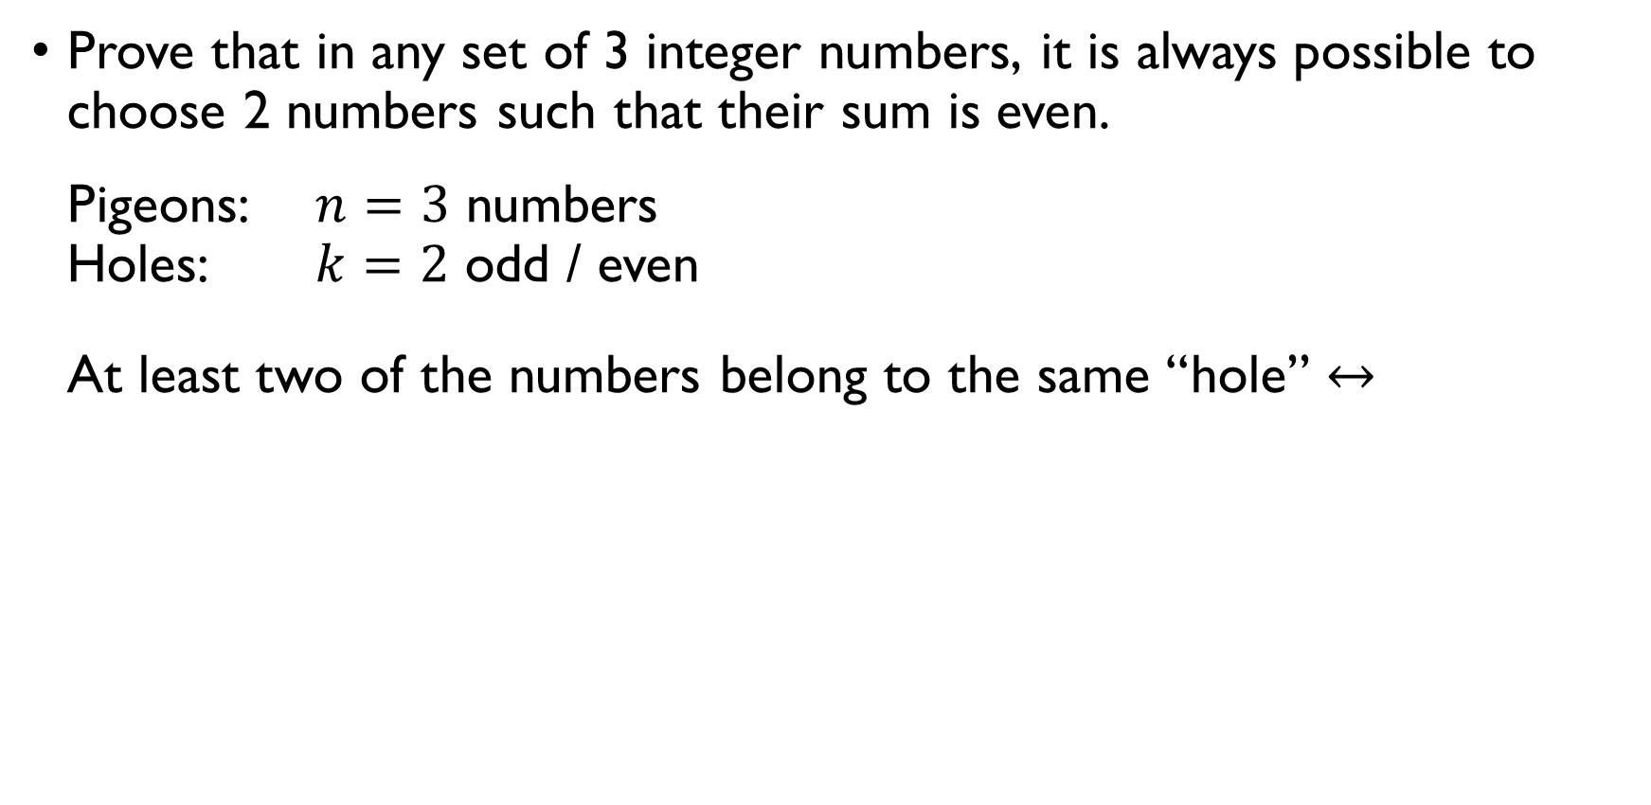
Odd or even
Prove that in any set of 3 integer numbers, it is always possible to choose 2 numbers such that their sum is even. Pigeons: $n=3$ numbers Holes: $k=2$ odd / even At least two of the numbers belong to the same “hole” $↔$
At least two of the numbers are odd $→$ the sum is even
At least two of the numbers are even $→$ the sum is even
Thus, it is always possible numbers such that their sum is even.

Slide 23
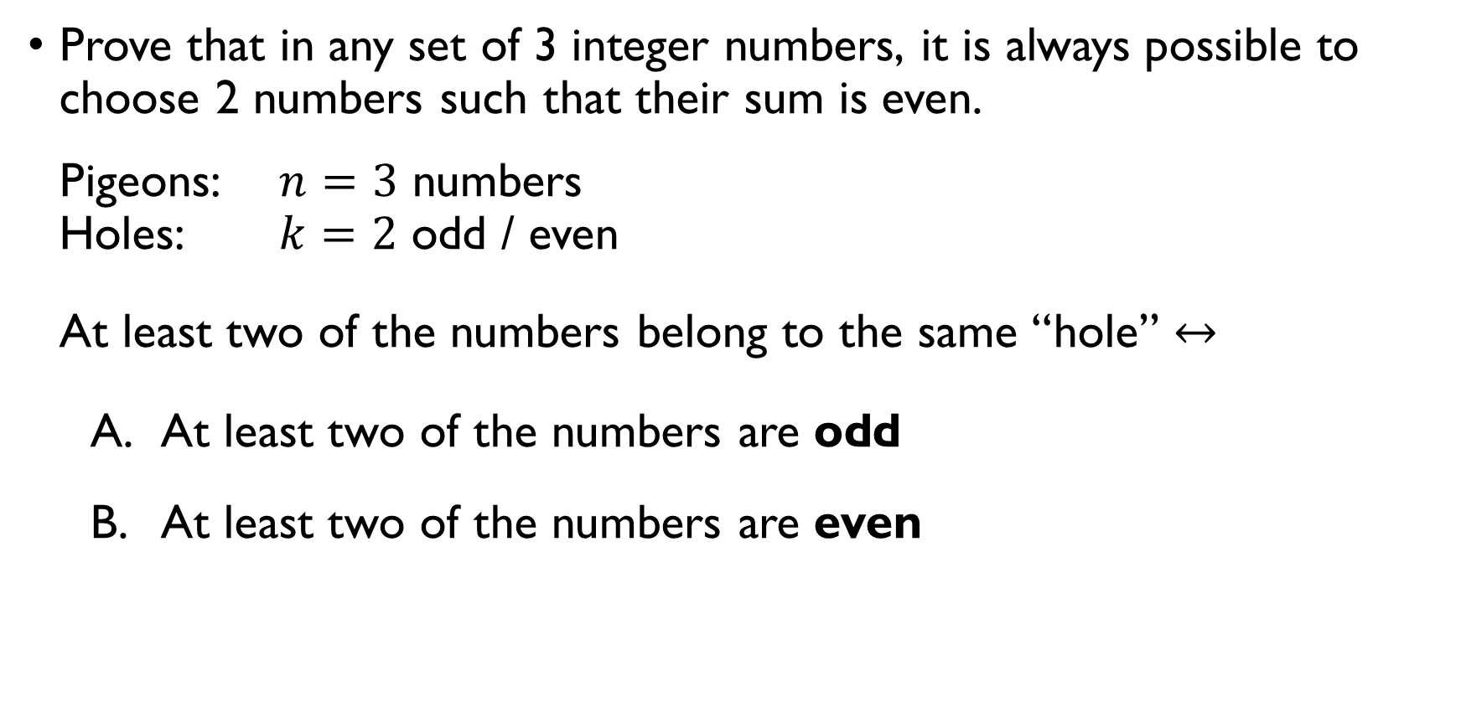
Odd or even
Prove that in any set of 3 integer numbers, it is always possible to choose 2 numbers such that their sum is even. Pigeons: $n=3$ numbers Holes: $k=2$ odd / even At least two of the numbers belong to the same “hole” $↔$
At least two of the numbers are odd $→$ the sum is even
At least two of the numbers are even $→$ the sum is even
Thus, it is always possible numbers such that their sum is even.

Slide 24
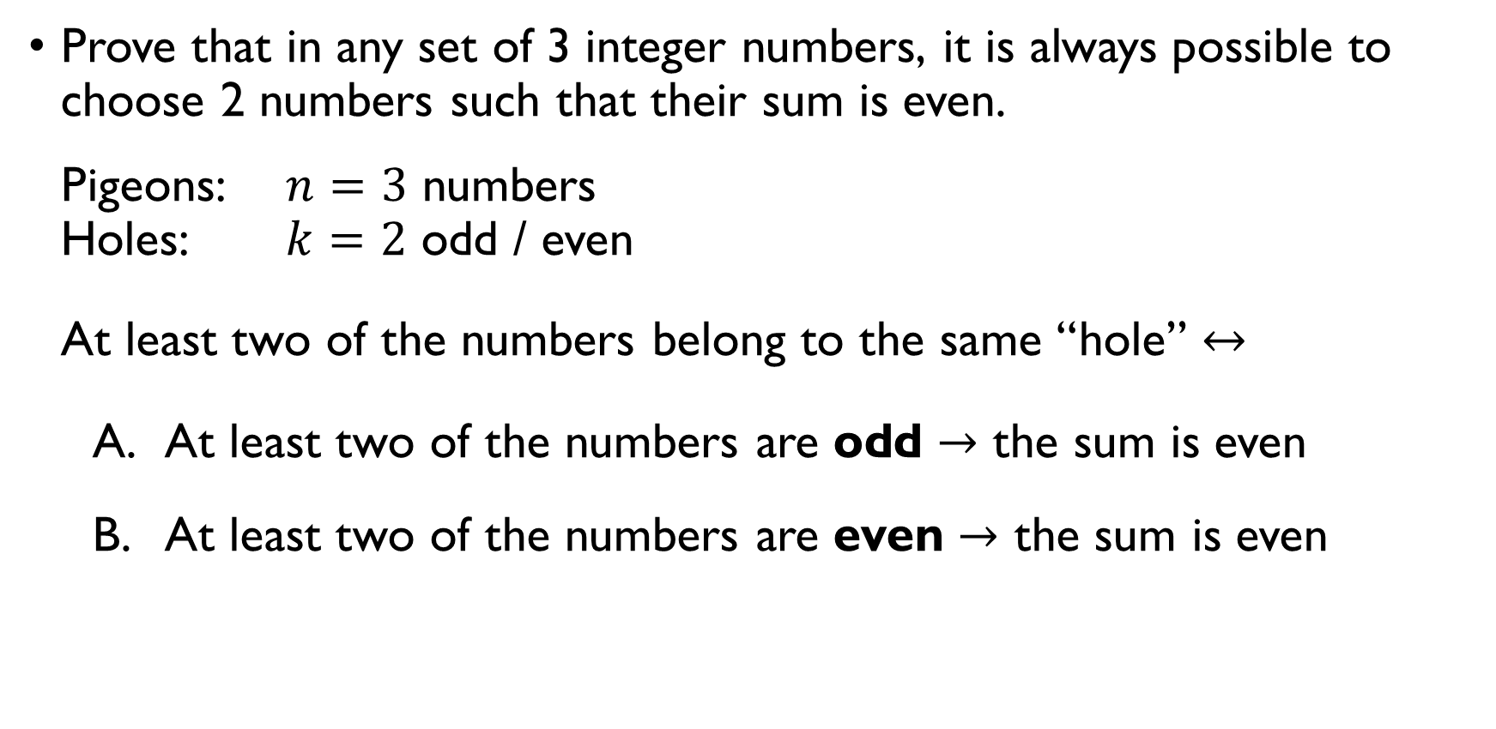
Odd or even
Prove that in any set of 3 integer numbers, it is always possible to choose 2 numbers such that their sum is even. Pigeons: $n=3$ numbers Holes: $k=2$ odd / even At least two of the numbers belong to the same “hole” $↔$
At least two of the numbers are odd $→$ the sum is even
At least two of the numbers are even $→$ the sum is even
Thus, it is always possible numbers such that their sum is even.

Slide 25
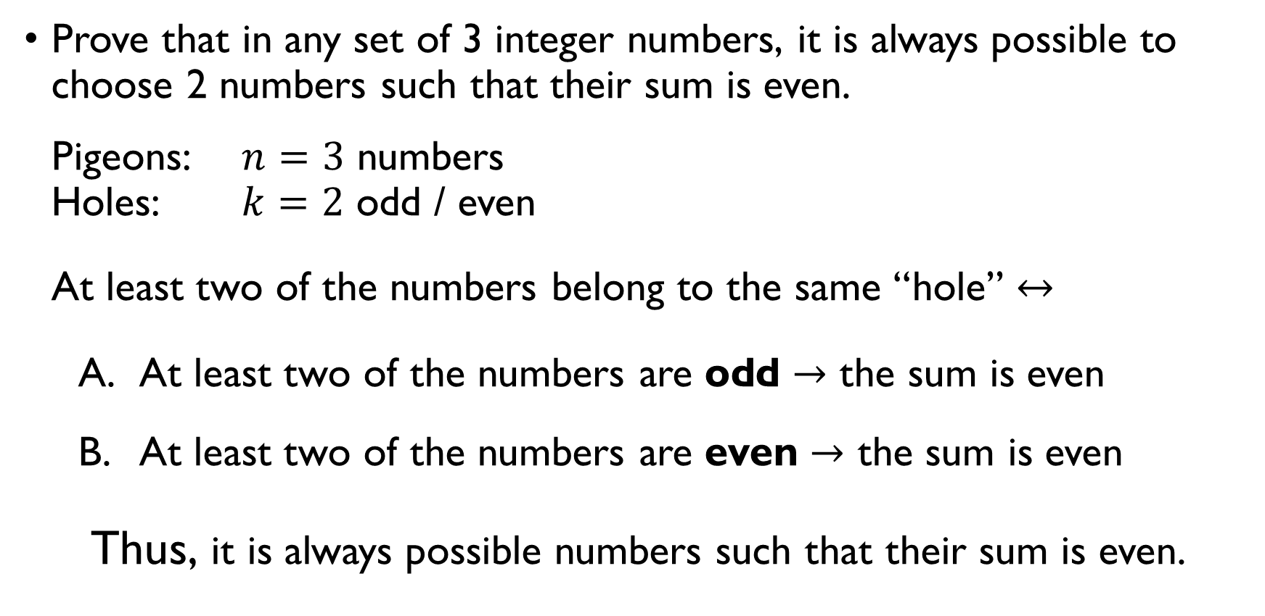
Odd or even
Prove that in any set of 3 integer numbers, it is always possible to choose 2 numbers such that their sum is even. Pigeons: $n=3$ numbers Holes: $k=2$ odd / even At least two of the numbers belong to the same “hole” $↔$
At least two of the numbers are odd $→$ the sum is even
At least two of the numbers are even $→$ the sum is even
Thus, it is always possible numbers such that their sum is even.

Slide 26

Odd or even
Show that in any finite set of $n$ numbers, at least half of the numbers are odd or at least half of them are even. There are $k=2$ “holes”: even and odd numbers. If $n$ numbers are distributed between $k=2$ holes, at least $\left\lceil \frac{n}{2}\right\rceil$ of them belong to the same hole $⟺$ At least $\left\lceil \frac{n}{2}\right\rceil$ are odd or $\left\lceil \frac{n}{2}\right\rceil$ are even.

Slide 27

Odd or even
Show that in any finite set of $n$ numbers, at least half of the numbers are odd or at least half of them are even. There are $k=2$ “holes”: even and odd numbers. If $n$ numbers are distributed between $k=2$ holes, at least $\left\lceil \frac{n}{2}\right\rceil$ of them belong to the same hole $⟺$ At least $\left\lceil \frac{n}{2}\right\rceil$ are odd or $\left\lceil \frac{n}{2}\right\rceil$ are even.

Slide 28
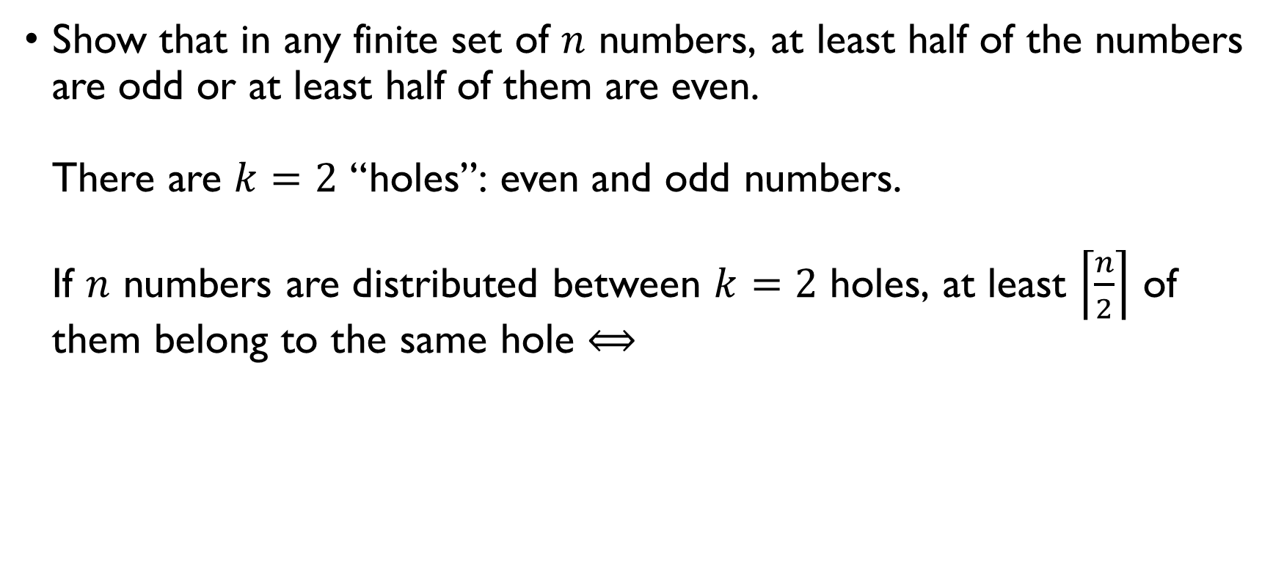
Odd or even
Show that in any finite set of $n$ numbers, at least half of the numbers are odd or at least half of them are even. There are $k=2$ “holes”: even and odd numbers. If $n$ numbers are distributed between $k=2$ holes, at least $\left\lceil \frac{n}{2}\right\rceil$ of them belong to the same hole $⟺$ At least $\left\lceil \frac{n}{2}\right\rceil$ are odd or $\left\lceil \frac{n}{2}\right\rceil$ are even.

Slide 29
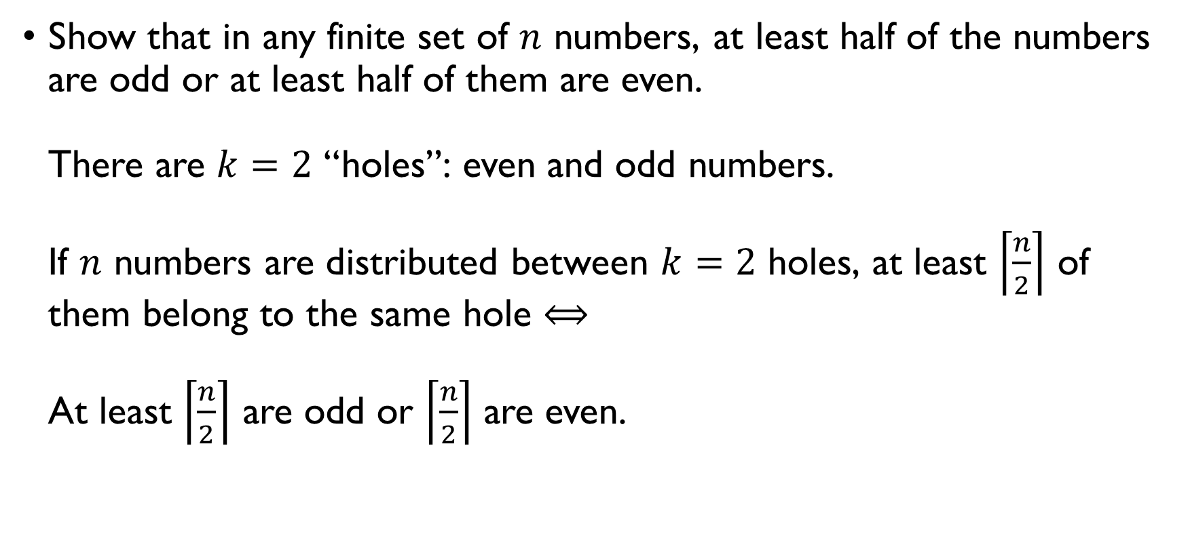
Odd or even
Show that in any finite set of $n$ numbers, at least half of the numbers are odd or at least half of them are even. There are $k=2$ “holes”: even and odd numbers. If $n$ numbers are distributed between $k=2$ holes, at least $\left\lceil \frac{n}{2}\right\rceil$ of them belong to the same hole $⟺$ At least $\left\lceil \frac{n}{2}\right\rceil$ are odd or $\left\lceil \frac{n}{2}\right\rceil$ are even.

Slide 30
review

Slide 31
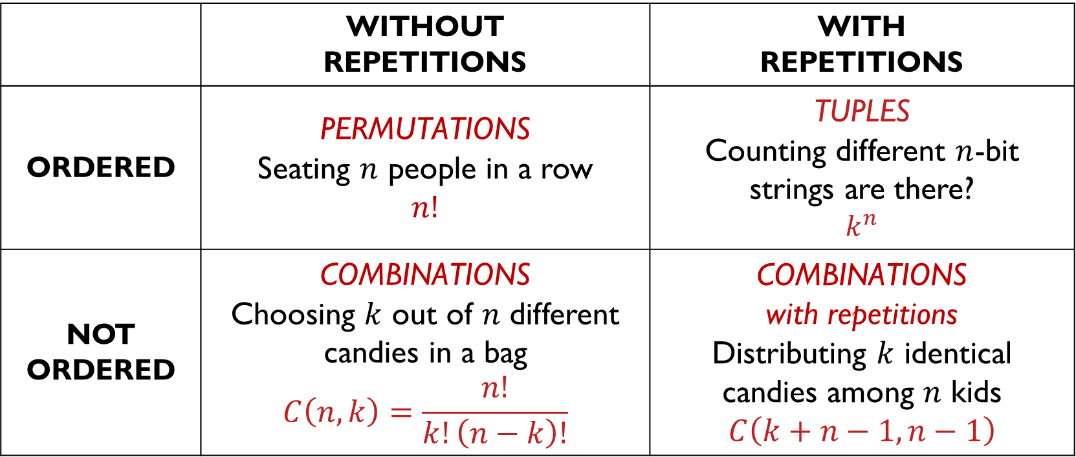

Different arrangements
Imagine you have $n$ objects. How can you arrange them?
 | WITHOUT REPETITIONS | WITH REPETITIONS
ORDERED | PERMUTATIONS Seating $n$ people in a row $$n!$$ | TUPLES Counting different $n$-bit strings are there? $$k^{n}$$
NOT ORDERED | COMBINATIONS Choosing $k$ out of $n$ different candies in a bag $$C\left(n,k\right)=\frac{n!}{k!\left(n−k\right)!}$$ | COMBINATIONS with repetitions Distributing $k$ identical candies among $n$ kids $$C\left(k+n−1, n−1\right)$$

Slide 32

permutations
How many ways are there to order 10 books on a shelf?
$$10⋅9⋅…⋅\dot{2}⋅1=10!$$
How many ways are there to order the letters of the word CORONA?
$$\frac{6!}{2!}=6⋅5⋅4⋅3$$
How many ways are there to appoint a president, a vice-president and a secretary from 10 candidates?
$$10⋅9⋅8$$

Slide 33

permutations
How many ways are there to order 10 books on a shelf?
$$10⋅9⋅…⋅\dot{2}⋅1=10!$$
How many ways are there to order the letters of the word CORONA?
$$\frac{6!}{2!}=6⋅5⋅4⋅3$$
How many ways are there to appoint a president, a vice-president and a secretary from 10 candidates?
$$10⋅9⋅8$$

Slide 34

permutations
How many ways are there to order 10 books on a shelf?
$$10⋅9⋅…⋅\dot{2}⋅1=10!$$
How many ways are there to order the letters of the word CORONA?
$$\frac{6!}{2!}=6⋅5⋅4⋅3$$
How many ways are there to appoint a president, a vice-president and a secretary from 10 candidates?
$$10⋅9⋅8$$

Slide 35

permutations
How many ways are there to order 10 books on a shelf?
$$10⋅9⋅…⋅\dot{2}⋅1=10!$$
How many ways are there to order the letters of the word CORONA?
$$\frac{6!}{2!}=6⋅5⋅4⋅3$$
How many ways are there to appoint a president, a vice-president and a secretary from 10 candidates?
$$10⋅9⋅8$$

Slide 36
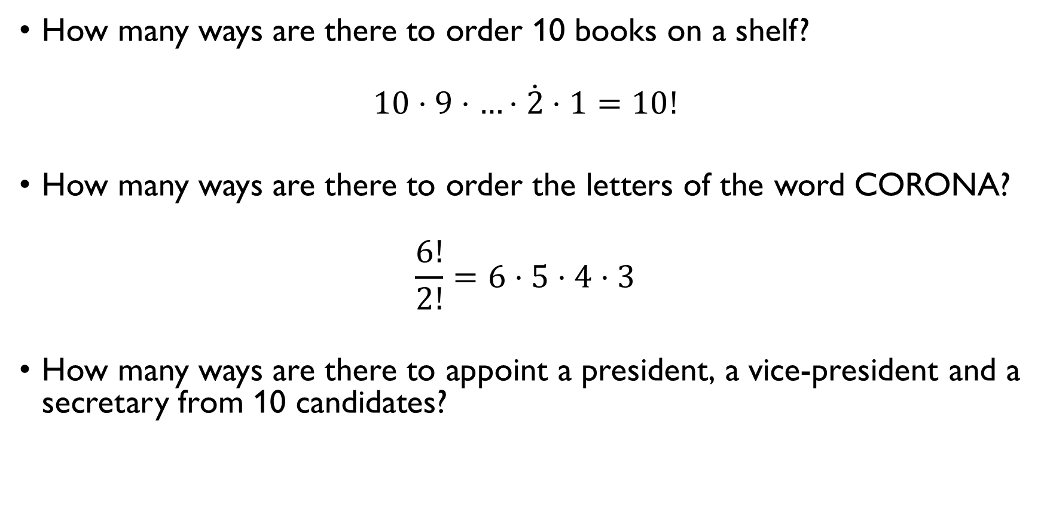
permutations
How many ways are there to order 10 books on a shelf?
$$10⋅9⋅…⋅\dot{2}⋅1=10!$$
How many ways are there to order the letters of the word CORONA?
$$\frac{6!}{2!}=6⋅5⋅4⋅3$$
How many ways are there to appoint a president, a vice-president and a secretary from 10 candidates?
$$10⋅9⋅8$$

Slide 37
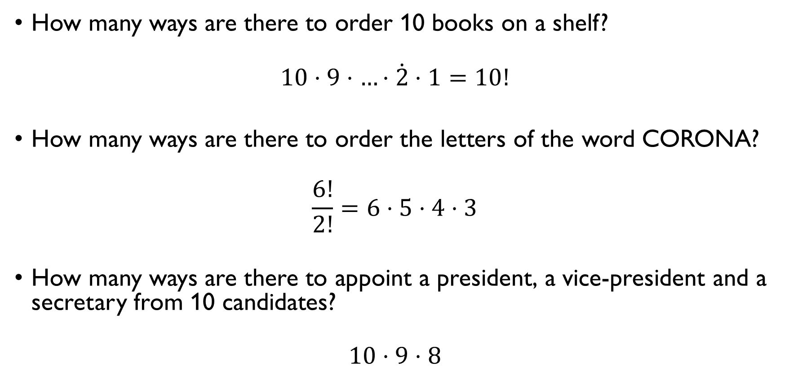
permutations
How many ways are there to order 10 books on a shelf?
$$10⋅9⋅…⋅\dot{2}⋅1=10!$$
How many ways are there to order the letters of the word CORONA?
$$\frac{6!}{2!}=6⋅5⋅4⋅3$$
How many ways are there to appoint a president, a vice-president and a secretary from 10 candidates?
$$10⋅9⋅8$$

Slide 38

tuples
How many 8-bit strings are there?
$$2⋅2⋅2⋅2⋅2⋅2⋅2⋅2=2^{8}$$
How many 10-character strings are there such that each symbol is 1, 2 or 3?
$$3^{10}$$
How many 6-character license plates are there, if each character can be a number or a digit?
$$36⋅36⋅36⋅36⋅36⋅36={36}^{6}$$

Slide 39

tuples
How many 8-bit strings are there?
$$2⋅2⋅2⋅2⋅2⋅2⋅2⋅2=2^{8}$$
How many 10-character strings are there such that each symbol is 1, 2 or 3?
$$3^{10}$$
How many 6-character license plates are there, if each character can be a number or a digit?
$$36⋅36⋅36⋅36⋅36⋅36={36}^{6}$$

Slide 40

tuples
How many 8-bit strings are there?
$$2⋅2⋅2⋅2⋅2⋅2⋅2⋅2=2^{8}$$
How many 10-character strings are there such that each symbol is 1, 2 or 3?
$$3^{10}$$
How many 6-character license plates are there, if each character can be a number or a digit?
$$36⋅36⋅36⋅36⋅36⋅36={36}^{6}$$

Slide 41

tuples
How many 8-bit strings are there?
$$2⋅2⋅2⋅2⋅2⋅2⋅2⋅2=2^{8}$$
How many 10-character strings are there such that each symbol is 1, 2 or 3?
$$3^{10}$$
How many 6-character license plates are there, if each character can be a number or a digit?
$$36⋅36⋅36⋅36⋅36⋅36={36}^{6}$$

Slide 42
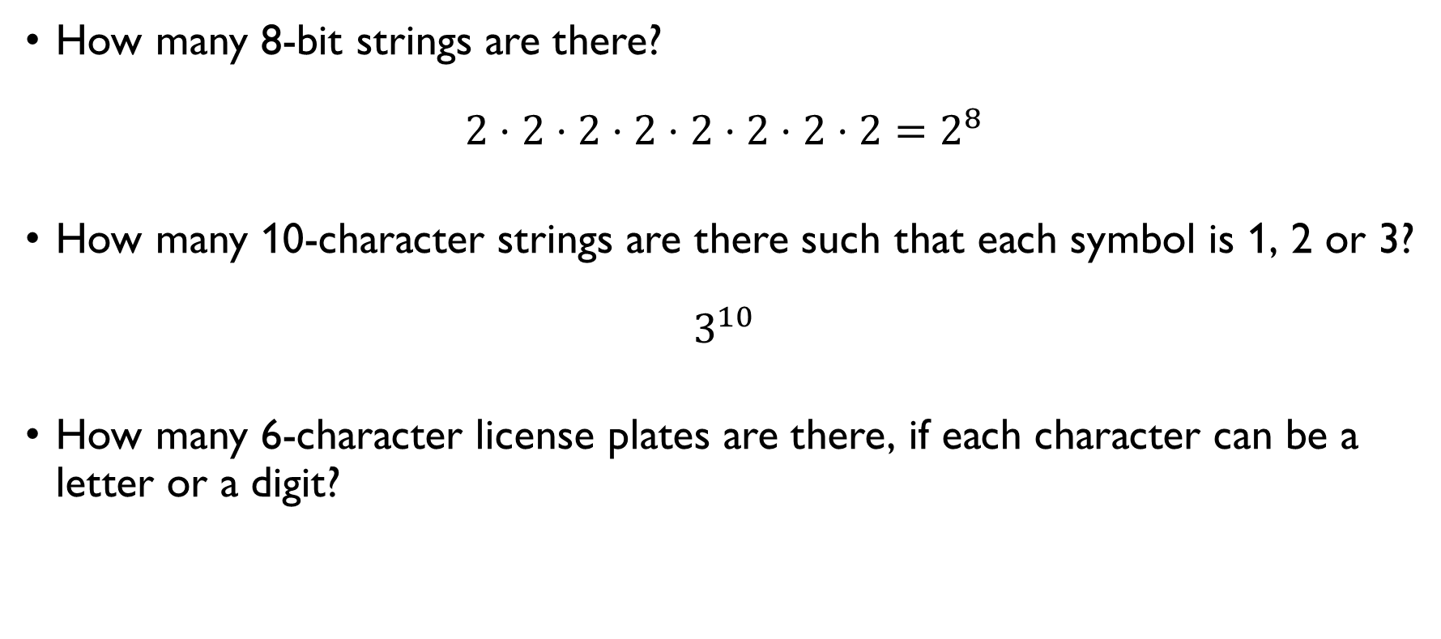
tuples
How many 8-bit strings are there?
$$2⋅2⋅2⋅2⋅2⋅2⋅2⋅2=2^{8}$$
How many 10-character strings are there such that each symbol is 1, 2 or 3?
$$3^{10}$$
How many 6-character license plates are there, if each character can be a letter or a digit?
$$36⋅36⋅36⋅36⋅36⋅36={36}^{6}$$

Slide 43
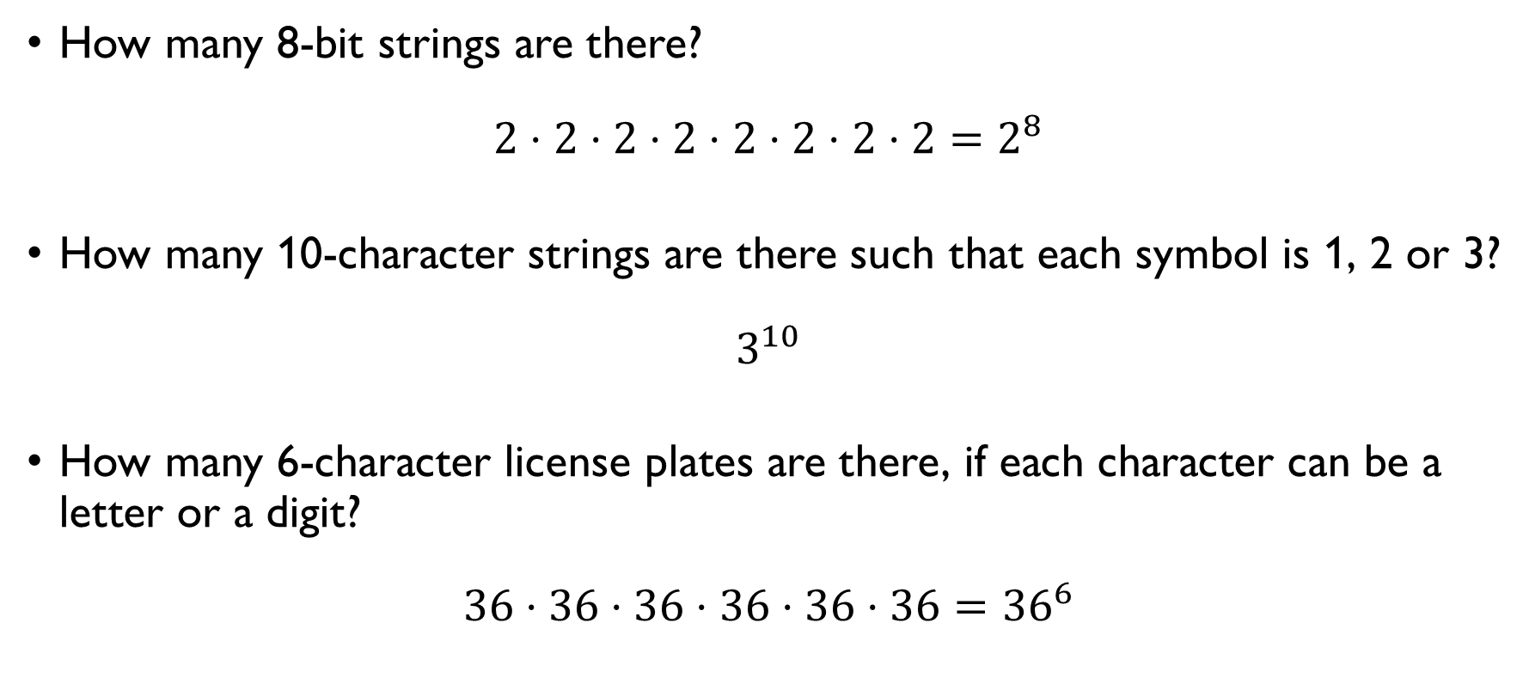
tuples
How many 8-bit strings are there?
$$2⋅2⋅2⋅2⋅2⋅2⋅2⋅2=2^{8}$$
How many 10-character strings are there such that each symbol is 1, 2 or 3?
$$3^{10}$$
How many 6-character license plates are there, if each character can be a letter or a digit?
$$36⋅36⋅36⋅36⋅36⋅36={36}^{6}$$

Slide 44

Combinations with(out) repetitions
How many ways are there to choose 4 books out of 10 (all of them different)?
$$C\left(10, 4\right)=\frac{10!}{4!6!}$$
How many ways are there to make a 4-ingredient salad if there are 10 ingredients available, and each of them can be used any number of times?
$$C\left(4+10−1, 10−1\right)=\frac{13!}{9!4!}$$

Slide 45

Combinations with(out) repetitions
How many ways are there to choose 4 books out of 10 (all of them different)?
$$C\left(10, 4\right)=\frac{10!}{4!6!}$$
How many ways are there to make a 4-ingredient salad if there are 10 ingredients available, and each of them can be used any number of times?
$$C\left(4+10−1, 10−1\right)=\frac{13!}{9!4!}$$

Slide 46
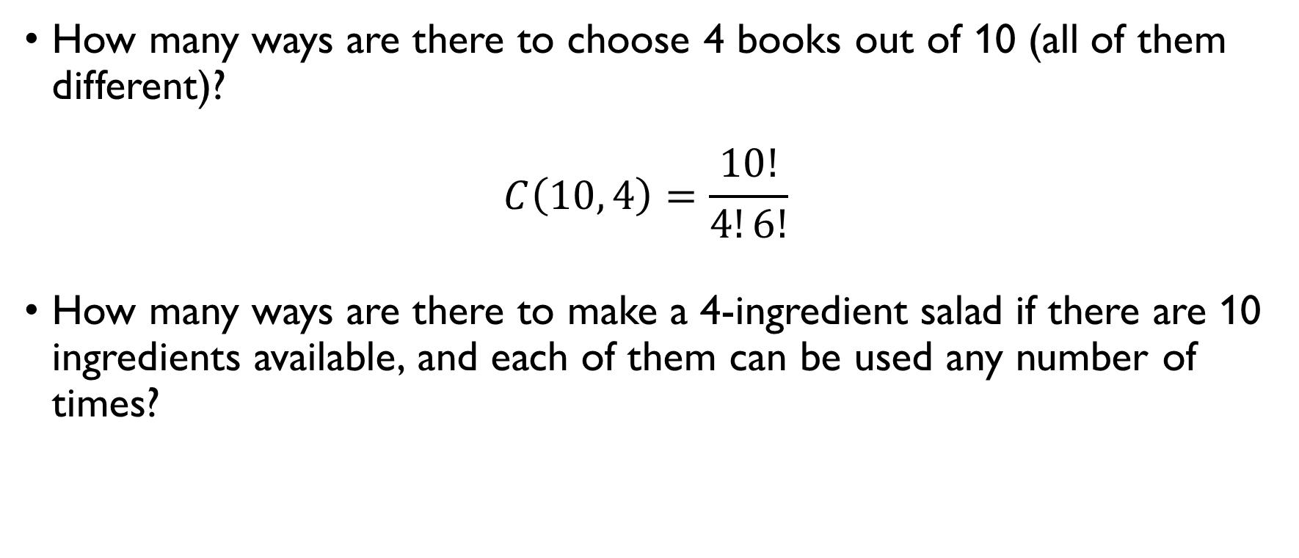
Combinations with(out) repetitions
How many ways are there to choose 4 books out of 10 (all of them different)?
$$C\left(10, 4\right)=\frac{10!}{4!6!}$$
How many ways are there to make a 4-ingredient salad if there are 10 ingredients available, and each of them can be used any number of times?
$$C\left(4+10−1, 10−1\right)=\frac{13!}{9!4!}$$

Slide 47
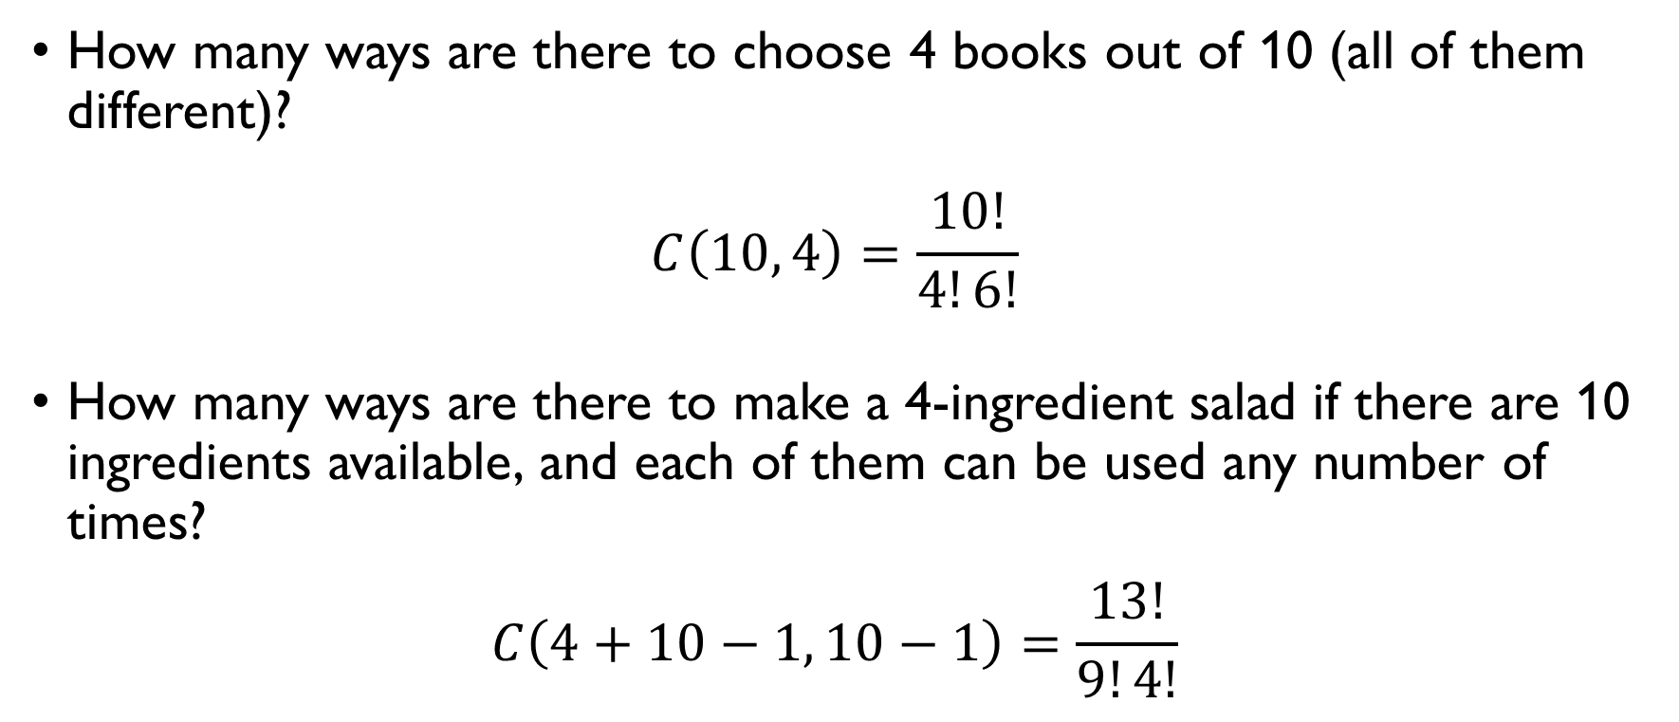
Combinations with(out) repetitions
How many ways are there to choose 4 books out of 10 (all of them different)?
$$C\left(10, 4\right)=\frac{10!}{4!6!}$$
How many ways are there to make a 4-ingredient salad if there are 10 ingredients available, and each of them can be used any number of times?
$$C\left(4+10−1, 10−1\right)=\frac{13!}{9!4!}$$

Slide 48

Sum rule
A password can consist of either two different low-case letters or two different lower-case letters and a digit. How many passwords are there? $26⋅25$ passwords consisting of two unique letters $26⋅25⋅10$ passwords consisting of two unique letters and a digit
$→26⋅25+26⋅25⋅10$
passwords that consist of either two different low-case letters or two different lower-case letters and a digit.

Slide 49

Sum rule
A password can consist of either two different low-case letters or two different lower-case letters and a digit. How many passwords are there? $26⋅25$ passwords consisting of two unique letters $26⋅25⋅10$ passwords consisting of two unique letters and a digit
$→26⋅25+26⋅25⋅10$
passwords that consist of either two different low-case letters or two different lower-case letters and a digit.

Slide 50
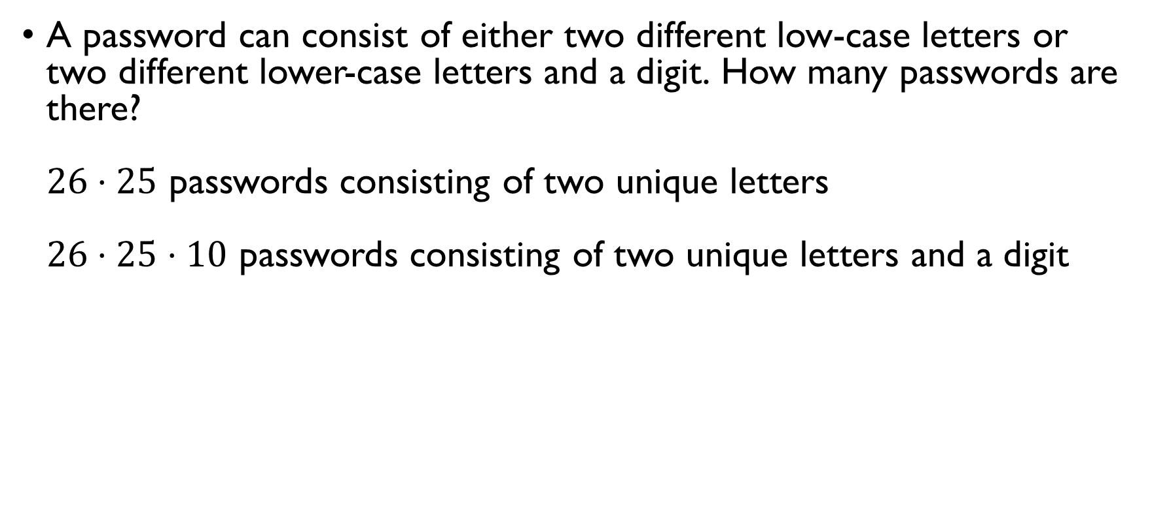
Sum rule
A password can consist of either two different low-case letters or two different lower-case letters and a digit. How many passwords are there? $26⋅25$ passwords consisting of two unique letters $26⋅25⋅10$ passwords consisting of two unique letters and a digit
$→26⋅25+26⋅25⋅10$
passwords that consist of either two different low-case letters or two different lower-case letters and a digit.

Slide 51
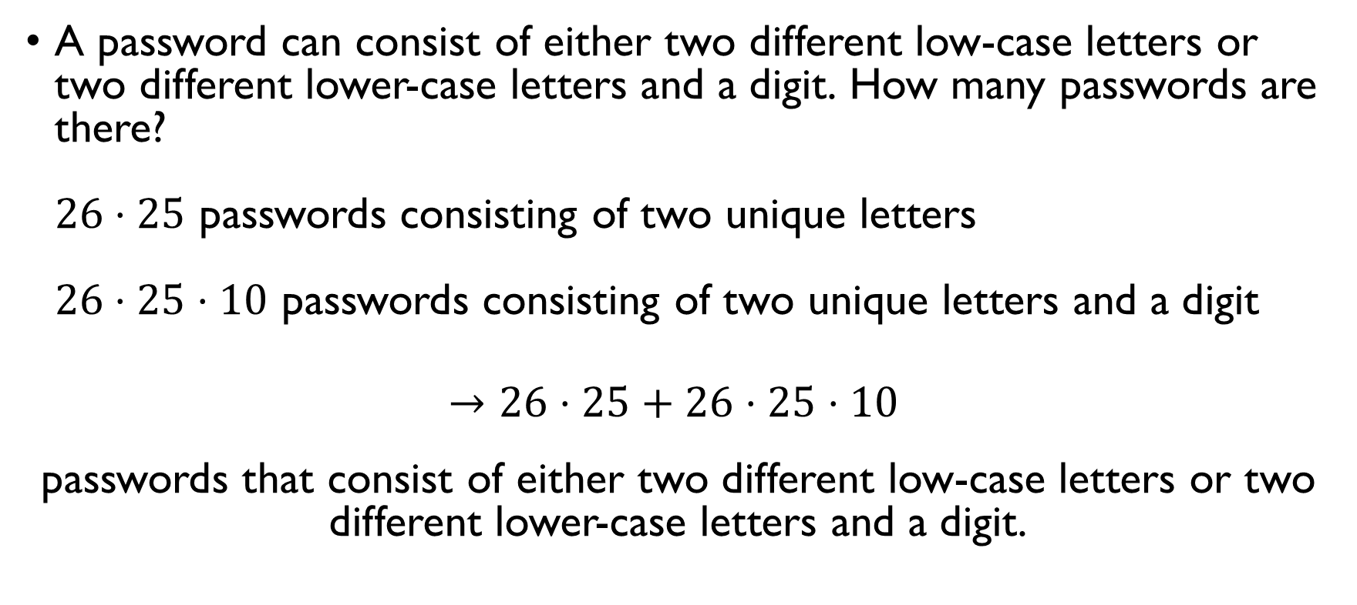
Sum rule
A password can consist of either two different low-case letters or two different lower-case letters and a digit. How many passwords are there? $26⋅25$ passwords consisting of two unique letters $26⋅25⋅10$ passwords consisting of two unique letters and a digit
$→26⋅25+26⋅25⋅10$
passwords that consist of either two different low-case letters or two different lower-case letters and a digit.

Slide 52

Inclusion-exclusion
Each entry of a string is an element of the set S = {0, 1, 2}. How many such strings of length 6 are there that begin with 022 or end with 01? Begin with 022: $3^{3}$ End with 01: $3^{4}$ Begin with 022 and end with 01: $3$ Begin with 022 or end with 01: $3^{3}+3^{4}−3$

Slide 53
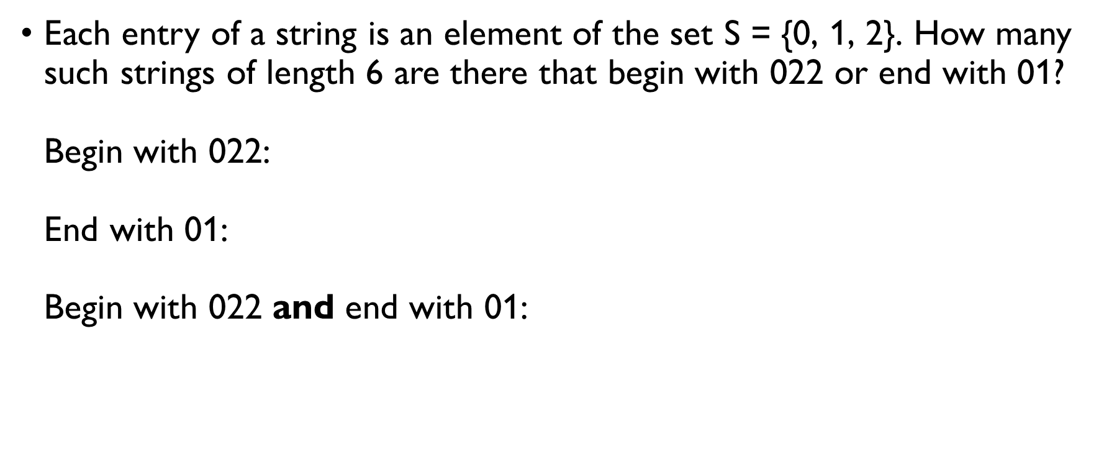
Inclusion-exclusion
Each entry of a string is an element of the set S = {0, 1, 2}. How many such strings of length 6 are there that begin with 022 or end with 01? Begin with 022: $3^{3}$ End with 01: $3^{4}$ Begin with 022 and end with 01: $3$ Begin with 022 or end with 01: $3^{3}+3^{4}−3$

Slide 54
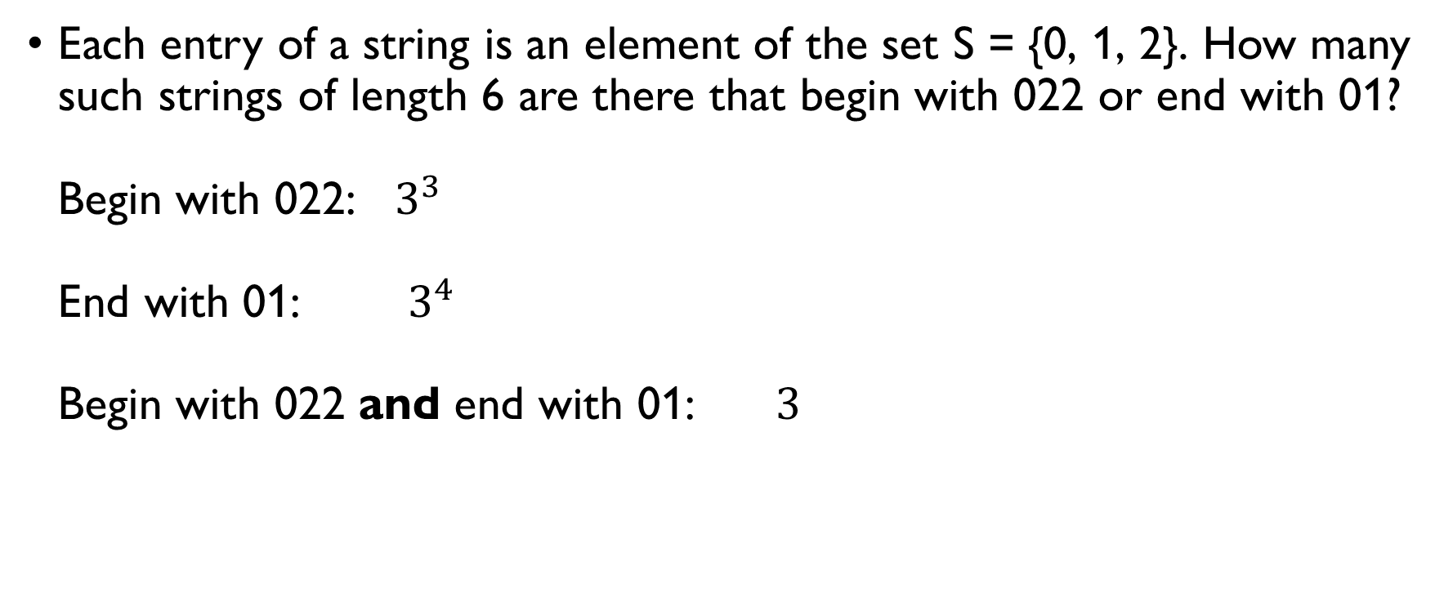
Inclusion-exclusion
Each entry of a string is an element of the set S = {0, 1, 2}. How many such strings of length 6 are there that begin with 022 or end with 01? Begin with 022: $3^{3}$ End with 01: $3^{4}$ Begin with 022 and end with 01: $3$ Begin with 022 or end with 01: $3^{3}+3^{4}−3$

Slide 55

Inclusion-exclusion
Each entry of a string is an element of the set S = {0, 1, 2}. How many such strings of length 6 are there that begin with 022 or end with 01? Begin with 022: $3^{3}$ End with 01: $3^{4}$ Begin with 022 and end with 01: $3$ Begin with 022 or end with 01: $3^{3}+3^{4}−3$

Slide 56

Product rule
A restaurant offers a food sharing menu of 5 cold and 5 warm starters. There are 15 cold and 10 warm starters on the menu to choose from. How many different sets of food are there if you want to order all different things? $C\left(15, 5\right)=\frac{15!}{5!10!}$ ways of choosing cold starters $C\left(10, 5\right)=\frac{10!}{5!5!}$ ways of choosing cold starters
$→C\left(15, 5\right)⋅C\left(10, 5\right)=\frac{15!}{5!10!}⋅\frac{10!}{5!5!}=\frac{15!}{{\left(5!\right)}^{3}}$ different sharing menus

Slide 57

Product rule
A restaurant offers a food sharing menu of 5 cold and 5 warm starters. There are 15 cold and 10 warm starters on the menu to choose from. How many different sets of food are there if you want to order all different things? $C\left(15, 5\right)=\frac{15!}{5!10!}$ ways of choosing cold starters $C\left(10, 5\right)=\frac{10!}{5!5!}$ ways of choosing cold starters
$→C\left(15, 5\right)⋅C\left(10, 5\right)=\frac{15!}{5!10!}⋅\frac{10!}{5!5!}=\frac{15!}{{\left(5!\right)}^{3}}$ different sharing menus

Slide 58

Product rule
A restaurant offers a food sharing menu of 5 cold and 5 warm starters. There are 15 cold and 10 warm starters on the menu to choose from. How many different sets of food are there if you want to order all different things? $C\left(15, 5\right)=\frac{15!}{5!10!}$ ways of choosing cold starters $C\left(10, 5\right)=\frac{10!}{5!5!}$ ways of choosing cold starters
$→C\left(15, 5\right)⋅C\left(10, 5\right)=\frac{15!}{5!10!}⋅\frac{10!}{5!5!}=\frac{15!}{{\left(5!\right)}^{3}}$ different sharing menus

Slide 59

Product rule
A restaurant offers a food sharing menu of 5 cold and 5 warm starters. There are 15 cold and 10 warm starters on the menu to choose from. How many different sets of food are there if you want to order all different things? $C\left(15, 5\right)=\frac{15!}{5!10!}$ ways of choosing cold starters $C\left(10, 5\right)=\frac{10!}{5!5!}$ ways of choosing cold starters
$→C\left(15, 5\right)⋅C\left(10, 5\right)=\frac{15!}{5!10!}⋅\frac{10!}{5!5!}=\frac{15!}{{\left(5!\right)}^{3}}$ different sharing menus

Slide 60

Product rule
A restaurant offers a food sharing menu of 5 cold and 5 warm starters. There are 15 cold and 10 warm starters on the menu to choose from. How many different sets of food are there if you want to order all different things? $C\left(15, 5\right)=\frac{15!}{5!10!}$ ways of choosing cold starters $C\left(10, 5\right)=\frac{10!}{5!5!}$ ways of choosing cold starters
$→C\left(15, 5\right)⋅C\left(10, 5\right)=\frac{15!}{5!10!}⋅\frac{10!}{5!5!}=\frac{15!}{{\left(5!\right)}^{3}}$ different sharing menus

Slide 61

Product rule
A restaurant offers a food sharing menu of 5 cold and 5 warm starters. There are 15 cold and 10 warm starters on the menu to choose from. How many different sets of food are there if you can include any dish several times? $C\left(15+5−1, 15−1\right)=\frac{19!}{14!5!}$ ways of choosing cold starters $C\left(10+5−1 , 10−1\right)=\frac{14!}{9!5!}$ ways of choosing cold starters
$→C\left(19, 14\right)⋅C\left(14, 9\right)=\frac{19!}{14!5!}⋅\frac{14!}{9!5!}=\frac{19!}{{9!⋅\left(5!\right)}^{2}}$ different sharing menus

Slide 62

Product rule
A restaurant offers a food sharing menu of 5 cold and 5 warm starters. There are 15 cold and 10 warm starters on the menu to choose from. How many different sets of food are there if you can include any dish several times? $C\left(15+5−1, 15−1\right)=\frac{19!}{14!5!}$ ways of choosing cold starters $C\left(10+5−1 , 10−1\right)=\frac{14!}{9!5!}$ ways of choosing cold starters
$→C\left(19, 14\right)⋅C\left(14, 9\right)=\frac{19!}{14!5!}⋅\frac{14!}{9!5!}=\frac{19!}{{9!⋅\left(5!\right)}^{2}}$ different sharing menus

Slide 63

Product rule
A restaurant offers a food sharing menu of 5 cold and 5 warm starters. There are 15 cold and 10 warm starters on the menu to choose from. How many different sets of food are there if you can include any dish several times? $C\left(15+5−1, 15−1\right)=\frac{19!}{14!5!}$ ways of choosing cold starters $C\left(10+5−1 , 10−1\right)=\frac{14!}{9!5!}$ ways of choosing cold starters
$→C\left(19, 14\right)⋅C\left(14, 9\right)=\frac{19!}{14!5!}⋅\frac{14!}{9!5!}=\frac{19!}{{9!⋅\left(5!\right)}^{2}}$ different sharing menus

Slide 64

Product rule
A restaurant offers a food sharing menu of 5 cold and 5 warm starters. There are 15 cold and 10 warm starters on the menu to choose from. How many different sets of food are there if you can include any dish several times? $C\left(15+5−1, 15−1\right)=\frac{19!}{14!5!}$ ways of choosing cold starters $C\left(10+5−1 , 10−1\right)=\frac{14!}{9!5!}$ ways of choosing cold starters
$→C\left(19, 14\right)⋅C\left(14, 9\right)=\frac{19!}{14!5!}⋅\frac{14!}{9!5!}=\frac{19!}{{9!⋅\left(5!\right)}^{2}}$ different sharing menus

Slide 65

Product rule
A restaurant offers a food sharing menu of 5 cold and 5 warm starters. There are 15 cold and 10 warm starters on the menu to choose from. How many different sets of food are there if you can include any dish several times? $C\left(15+5−1, 15−1\right)=\frac{19!}{14!5!}$ ways of choosing cold starters $C\left(10+5−1 , 10−1\right)=\frac{14!}{9!5!}$ ways of choosing cold starters
$→C\left(19, 14\right)⋅C\left(14, 9\right)=\frac{19!}{14!5!}⋅\frac{14!}{9!5!}=\frac{19!}{{9!⋅\left(5!\right)}^{2}}$ different sharing menus

Slide 66
Interim exam
Exam available on Google classroom as of 10:20
Open book
15 questions
5 one-point questions;
10 two-point questions.
Solutions must be written in the file
typed or pictures;
should contain explanations.
Deadline: 12:30 Barcelona time
GOOD LUCK!

