Slide 1
ELEMENTARY COMBINATORICS & PROBABILITY
Lecture 11
Random variables

Slide 2
Last time
Random variables
Probability mass function
Cumulative distribution function

Slide 3
today
Review PMFs and CDFs
Special distributions

Slide 4

PMF and CDF
For a discrete random variable $X$ with range $R_{X}=\left\{x_{1},x_{2},…\right\}$ probability mass function (PMF) is defined as
$$P_{X}\left(x\right)=\left\{\begin{aligned}P\left(X=x\right), x∈R_{X} \\ 0, x∉R_{X}\end{aligned}\right.$$ Example:
Cumulative distribution function (CDF) of a random variable $X$ is defined as follows:
$$F_{X}\left(x\right)=P\left(X≤x\right) ∀x∈ℝ$$

Slide 5
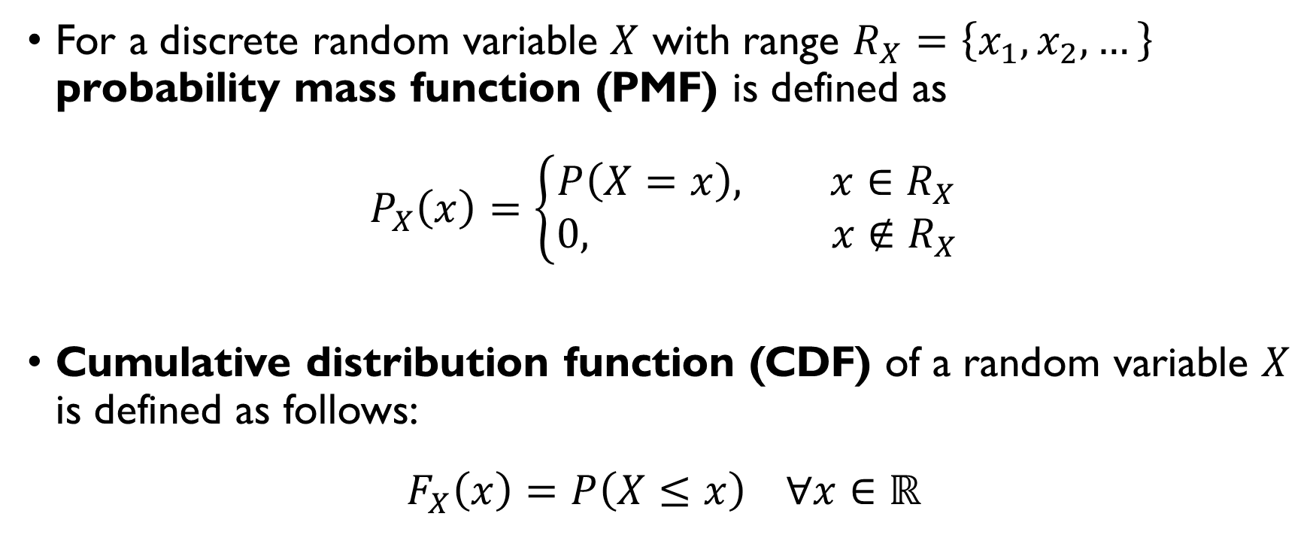
PMF and CDF
For a discrete random variable $X$ with range $R_{X}=\left\{x_{1},x_{2},…\right\}$ probability mass function (PMF) is defined as
$$P_{X}\left(x\right)=\left\{\begin{aligned}P\left(X=x\right), x∈R_{X} \\ 0, x∉R_{X}\end{aligned}\right.$$ Example:
Cumulative distribution function (CDF) of a random variable $X$ is defined as follows:
$$F_{X}\left(x\right)=P\left(X≤x\right) ∀x∈ℝ$$

Slide 6
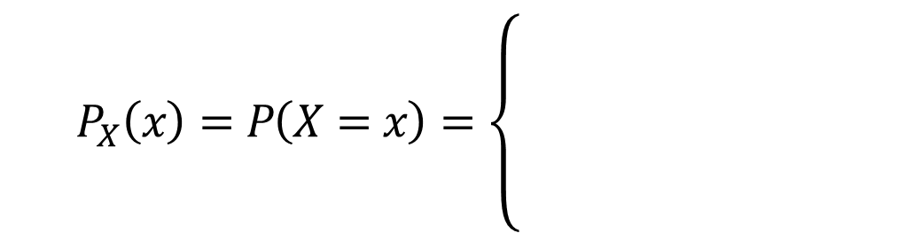


PMF and cdf: example
$X$ – total number of heads after two tosses of a coin.
$$P_{X}\left(x\right)=P\left(X=x\right)=\left\{\begin{aligned}0.25, x=0 \\ 0.5, x=1 \\ 0.25, x=3 \\ 0, otherwise\end{aligned}\right.$$
$$F_{X}\left(x\right)=P\left(X≤x\right)=\left\{\begin{aligned}0, x<0 \\ 0.25, 0≤x<1 \\ 0.75, 1≤x<2 \\ 1, x≥2\end{aligned}\right.$$

Slide 7
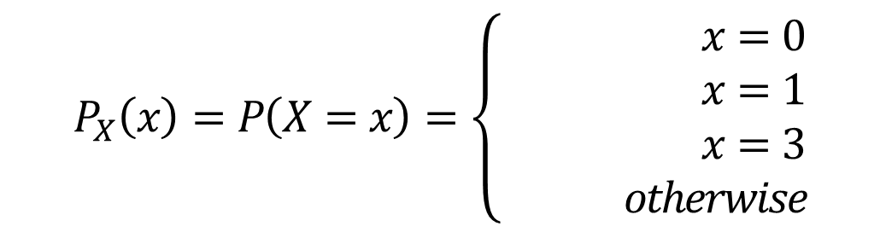
PMF and cdf: example
$X$ – total number of heads after two tosses of a coin.
$$P_{X}\left(x\right)=P\left(X=x\right)=\left\{\begin{aligned}0.25, x=0 \\ 0.5, x=1 \\ 0.25, x=3 \\ 0, otherwise\end{aligned}\right.$$
$$F_{X}\left(x\right)=P\left(X≤x\right)=\left\{\begin{aligned}0, x<0 \\ 0.25, 0≤x<1 \\ 0.75, 1≤x<2 \\ 1, x≥2\end{aligned}\right.$$

Slide 8
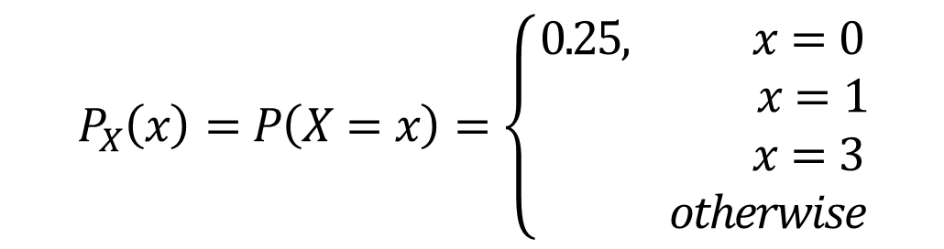
PMF and cdf: example
$X$ – total number of heads after two tosses of a coin.
$$P_{X}\left(x\right)=P\left(X=x\right)=\left\{\begin{aligned}0.25, x=0 \\ 0.5, x=1 \\ 0.25, x=3 \\ 0, otherwise\end{aligned}\right.$$
$$F_{X}\left(x\right)=P\left(X≤x\right)=\left\{\begin{aligned}0, x<0 \\ 0.25, 0≤x<1 \\ 0.75, 1≤x<2 \\ 1, x≥2\end{aligned}\right.$$

Slide 9
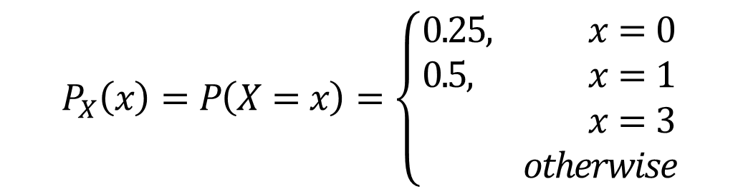
PMF and cdf: example
$X$ – total number of heads after two tosses of a coin.
$$P_{X}\left(x\right)=P\left(X=x\right)=\left\{\begin{aligned}0.25, x=0 \\ 0.5, x=1 \\ 0.25, x=3 \\ 0, otherwise\end{aligned}\right.$$
$$F_{X}\left(x\right)=P\left(X≤x\right)=\left\{\begin{aligned}0, x<0 \\ 0.25, 0≤x<1 \\ 0.75, 1≤x<2 \\ 1, x≥2\end{aligned}\right.$$

Slide 10
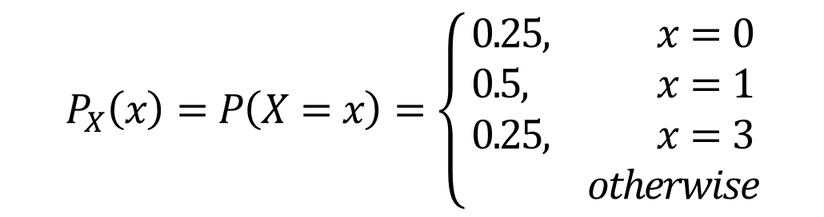
PMF and cdf: example
$X$ – total number of heads after two tosses of a coin.
$$P_{X}\left(x\right)=P\left(X=x\right)=\left\{\begin{aligned}0.25, x=0 \\ 0.5, x=1 \\ 0.25, x=3 \\ 0, otherwise\end{aligned}\right.$$
$$F_{X}\left(x\right)=P\left(X≤x\right)=\left\{\begin{aligned}0, x<0 \\ 0.25, 0≤x<1 \\ 0.75, 1≤x<2 \\ 1, x≥2\end{aligned}\right.$$

Slide 11
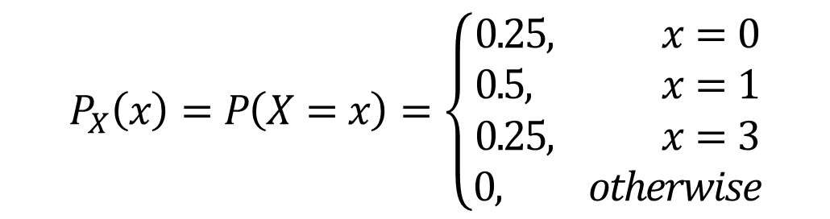
PMF and cdf: example
$X$ – total number of heads after two tosses of a coin.
$$P_{X}\left(x\right)=P\left(X=x\right)=\left\{\begin{aligned}0.25, x=0 \\ 0.5, x=1 \\ 0.25, x=3 \\ 0, otherwise\end{aligned}\right.$$
$$F_{X}\left(x\right)=P\left(X≤x\right)=\left\{\begin{aligned}0, x<0 \\ 0.25, 0≤x<1 \\ 0.75, 1≤x<2 \\ 1, x≥2\end{aligned}\right.$$

Slide 12
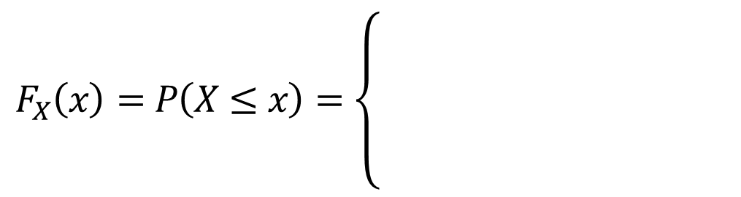
PMF and cdf: example
$X$ – total number of heads after two tosses of a coin.
$$P_{X}\left(x\right)=P\left(X=x\right)=\left\{\begin{aligned}0.25, x=0 \\ 0.5, x=1 \\ 0.25, x=3 \\ 0, otherwise\end{aligned}\right.$$
$$F_{X}\left(x\right)=P\left(X≤x\right)=\left\{\begin{aligned}0, x<0 \\ 0.25, 0≤x<1 \\ 0.75, 1≤x<2 \\ 1, x≥2\end{aligned}\right.$$

Slide 13
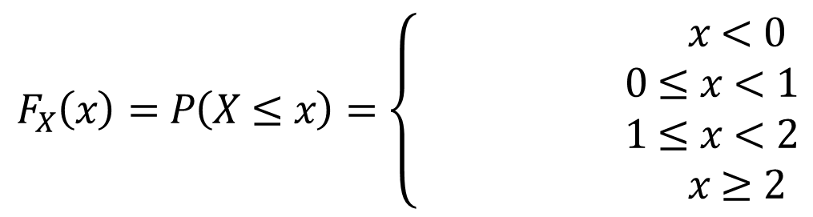
PMF and cdf: example
$X$ – total number of heads after two tosses of a coin.
$$P_{X}\left(x\right)=P\left(X=x\right)=\left\{\begin{aligned}0.25, x=0 \\ 0.5, x=1 \\ 0.25, x=3 \\ 0, otherwise\end{aligned}\right.$$
$$F_{X}\left(x\right)=P\left(X≤x\right)=\left\{\begin{aligned}0, x<0 \\ 0.25, 0≤x<1 \\ 0.75, 1≤x<2 \\ 1, x≥2\end{aligned}\right.$$

Slide 14
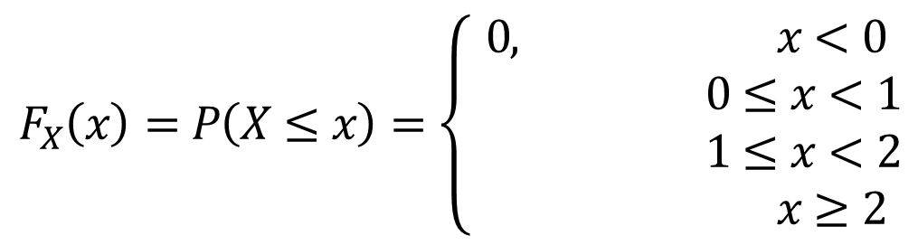
PMF and cdf: example
$X$ – total number of heads after two tosses of a coin.
$$P_{X}\left(x\right)=P\left(X=x\right)=\left\{\begin{aligned}0.25, x=0 \\ 0.5, x=1 \\ 0.25, x=3 \\ 0, otherwise\end{aligned}\right.$$
$$F_{X}\left(x\right)=P\left(X≤x\right)=\left\{\begin{aligned}0, x<0 \\ 0.25, 0≤x<1 \\ 0.75, 1≤x<2 \\ 1, x≥2\end{aligned}\right.$$

Slide 15
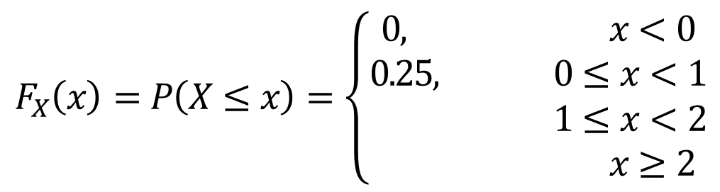
PMF and cdf: example
$X$ – total number of heads after two tosses of a coin.
$$P_{X}\left(x\right)=P\left(X=x\right)=\left\{\begin{aligned}0.25, x=0 \\ 0.5, x=1 \\ 0.25, x=3 \\ 0, otherwise\end{aligned}\right.$$
$$F_{X}\left(x\right)=P\left(X≤x\right)=\left\{\begin{aligned}0, x<0 \\ 0.25, 0≤x<1 \\ 0.75, 1≤x<2 \\ 1, x≥2\end{aligned}\right.$$

Slide 16
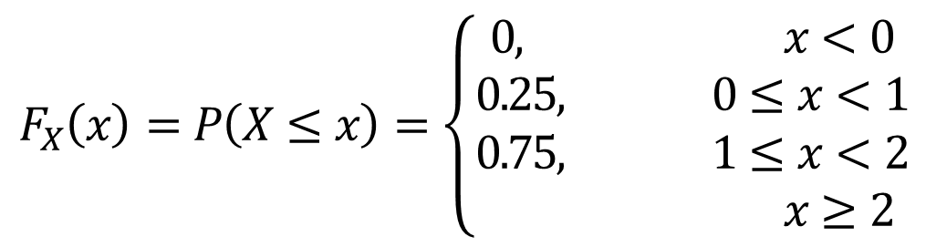
PMF and cdf: example
$X$ – total number of heads after two tosses of a coin.
$$P_{X}\left(x\right)=P\left(X=x\right)=\left\{\begin{aligned}0.25, x=0 \\ 0.5, x=1 \\ 0.25, x=3 \\ 0, otherwise\end{aligned}\right.$$
$$F_{X}\left(x\right)=P\left(X≤x\right)=\left\{\begin{aligned}0, x<0 \\ 0.25, 0≤x<1 \\ 0.75, 1≤x<2 \\ 1, x≥2\end{aligned}\right.$$

Slide 17
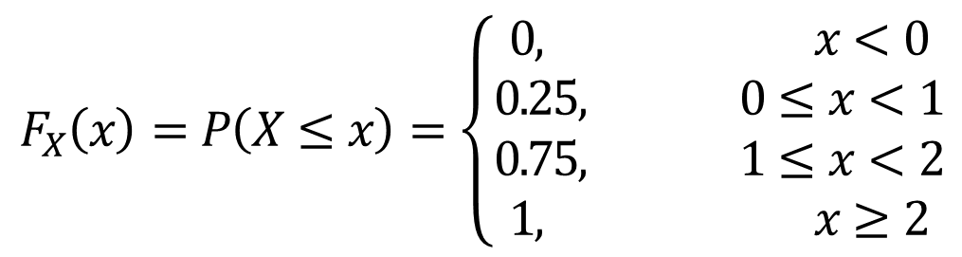
PMF and cdf: example
$X$ – total number of heads after two tosses of a coin.
$$P_{X}\left(x\right)=P\left(X=x\right)=\left\{\begin{aligned}0.25, x=0 \\ 0.5, x=1 \\ 0.25, x=3 \\ 0, otherwise\end{aligned}\right.$$
$$F_{X}\left(x\right)=P\left(X≤x\right)=\left\{\begin{aligned}0, x<0 \\ 0.25, 0≤x<1 \\ 0.75, 1≤x<2 \\ 1, x≥2\end{aligned}\right.$$

Slide 18

Balls in a bowl
A bowl contains two red balls and three blue balls. Three balls are selected at random from the bowl. Let random variable $X$ denote the number of red balls among them. $R_{X}=\left\{0, 1, 2\right\}$

Slide 19

Balls in a bowl
A bowl contains two red balls and three blue balls. Three balls are selected at random from the bowl. Let random variable $X$ denote the number of red balls among them. $R_{X}=\left\{0, 1, 2\right\}$

Slide 20

Balls in a bowl
A bowl contains two red balls and three blue balls. Three balls are selected at random from the bowl. Let random variable $X$ denote the number of red balls among them. $R_{X}=\left\{0, 1, 2\right\}$

Slide 21
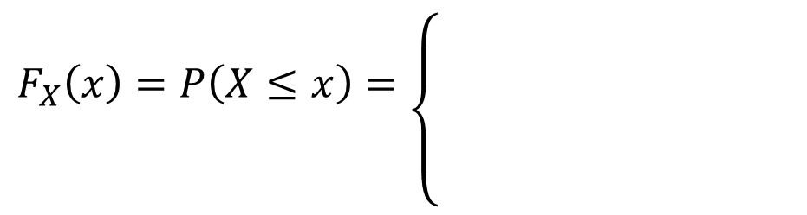
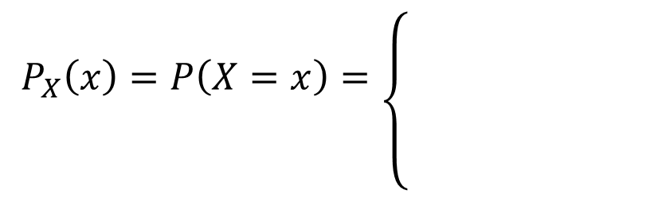
Balls in a bowl
A bowl contains two red balls and three blue balls. Three balls are selected at random from the bowl. Let random variable $X$ denote the number of red balls among them. $R_{X}=\left\{0, 1, 2\right\}$
$$P_{X}\left(x\right)=P\left(X=x\right)=\left\{{0.1, x=0 \atop \begin{aligned}0.6, x=1 \\ 0.3, x=2 \\ 0, otherwise\end{aligned}}\right.$$
$$F_{X}\left(x\right)=P\left(X≤x\right)=\left\{{0, x<0 \atop \begin{aligned}0.1 0≤x<1 \\ 0.7, 1≤x<2 \\ 1, x≥2 \end{aligned}}\right.$$

Slide 22
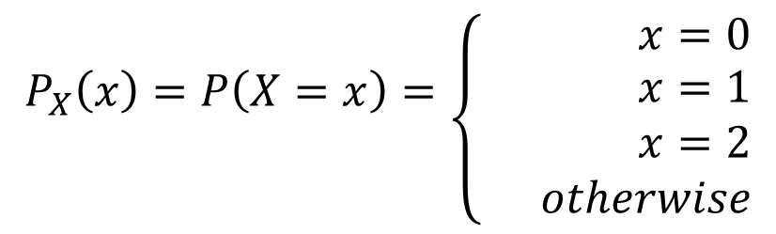
Balls in a bowl
A bowl contains two red balls and three blue balls. Three balls are selected at random from the bowl. Let random variable $X$ denote the number of red balls among them. $R_{X}=\left\{0, 1, 2\right\}$
$$P_{X}\left(x\right)=P\left(X=x\right)=\left\{{0.1, x=0 \atop \begin{aligned}0.6, x=1 \\ 0.3, x=2 \\ 0, otherwise\end{aligned}}\right.$$
$$F_{X}\left(x\right)=P\left(X≤x\right)=\left\{{0, x<0 \atop \begin{aligned}0.1 0≤x<1 \\ 0.7, 1≤x<2 \\ 1, x≥2 \end{aligned}}\right.$$

Slide 23
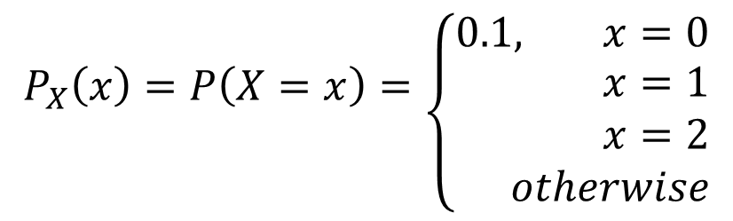
Balls in a bowl
A bowl contains two red balls and three blue balls. Three balls are selected at random from the bowl. Let random variable $X$ denote the number of red balls among them. $R_{X}=\left\{0, 1, 2\right\}$
$$P_{X}\left(x\right)=P\left(X=x\right)=\left\{{0.1, x=0 \atop \begin{aligned}0.6, x=1 \\ 0.3, x=2 \\ 0, otherwise\end{aligned}}\right.$$
$$F_{X}\left(x\right)=P\left(X≤x\right)=\left\{{0, x<0 \atop \begin{aligned}0.1 0≤x<1 \\ 0.7, 1≤x<2 \\ 1, x≥2 \end{aligned}}\right.$$

Slide 24
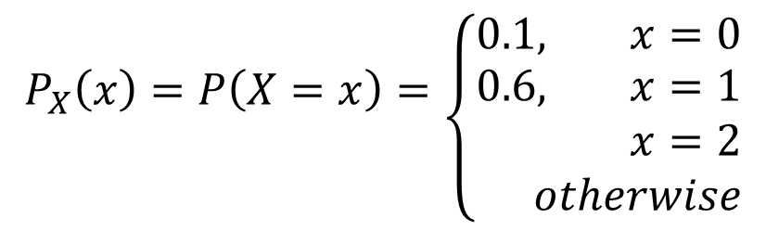
Balls in a bowl
A bowl contains two red balls and three blue balls. Three balls are selected at random from the bowl. Let random variable $X$ denote the number of red balls among them. $R_{X}=\left\{0, 1, 2\right\}$
$$P_{X}\left(x\right)=P\left(X=x\right)=\left\{{0.1, x=0 \atop \begin{aligned}0.6, x=1 \\ 0.3, x=2 \\ 0, otherwise\end{aligned}}\right.$$
$$F_{X}\left(x\right)=P\left(X≤x\right)=\left\{{0, x<0 \atop \begin{aligned}0.1 0≤x<1 \\ 0.7, 1≤x<2 \\ 1, x≥2 \end{aligned}}\right.$$

Slide 25
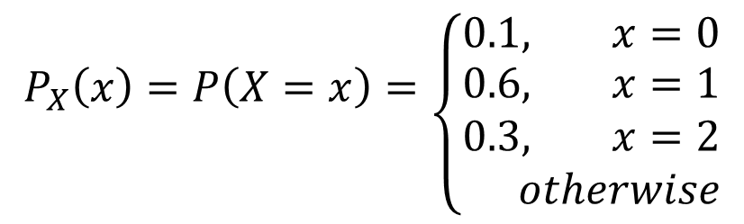
Balls in a bowl
A bowl contains two red balls and three blue balls. Three balls are selected at random from the bowl. Let random variable $X$ denote the number of red balls among them. $R_{X}=\left\{0, 1, 2\right\}$
$$P_{X}\left(x\right)=P\left(X=x\right)=\left\{{0.1, x=0 \atop \begin{aligned}0.6, x=1 \\ 0.3, x=2 \\ 0, otherwise\end{aligned}}\right.$$
$$F_{X}\left(x\right)=P\left(X≤x\right)=\left\{{0, x<0 \atop \begin{aligned}0.1 0≤x<1 \\ 0.7, 1≤x<2 \\ 1, x≥2 \end{aligned}}\right.$$

Slide 26
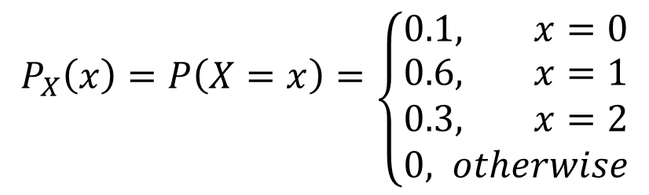
Balls in a bowl
A bowl contains two red balls and three blue balls. Three balls are selected at random from the bowl. Let random variable $X$ denote the number of red balls among them. $R_{X}=\left\{0, 1, 2\right\}$
$$P_{X}\left(x\right)=P\left(X=x\right)=\left\{{0.1, x=0 \atop \begin{aligned}0.6, x=1 \\ 0.3, x=2 \\ 0, otherwise\end{aligned}}\right.$$
$$F_{X}\left(x\right)=P\left(X≤x\right)=\left\{{0, x<0 \atop \begin{aligned}0.1 0≤x<1 \\ 0.7, 1≤x<2 \\ 1, x≥2 \end{aligned}}\right.$$

Slide 27
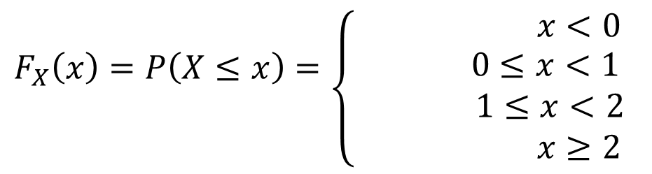
Balls in a bowl
A bowl contains two red balls and three blue balls. Three balls are selected at random from the bowl. Let random variable $X$ denote the number of red balls among them. $R_{X}=\left\{0, 1, 2\right\}$
$$P_{X}\left(x\right)=P\left(X=x\right)=\left\{{0.1, x=0 \atop \begin{aligned}0.6, x=1 \\ 0.3, x=2 \\ 0, otherwise\end{aligned}}\right.$$
$$F_{X}\left(x\right)=P\left(X≤x\right)=\left\{{0, x<0 \atop \begin{aligned}0.1 0≤x<1 \\ 0.7, 1≤x<2 \\ 1, x≥2 \end{aligned}}\right.$$

Slide 28
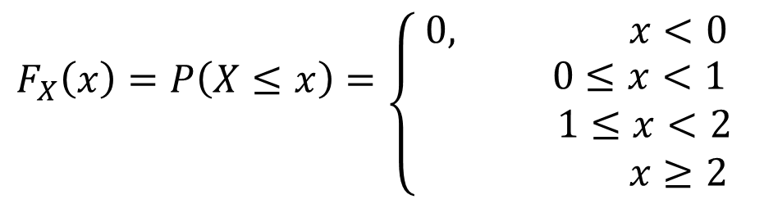
Balls in a bowl
A bowl contains two red balls and three blue balls. Three balls are selected at random from the bowl. Let random variable $X$ denote the number of red balls among them. $R_{X}=\left\{0, 1, 2\right\}$
$$P_{X}\left(x\right)=P\left(X=x\right)=\left\{{0.1, x=0 \atop \begin{aligned}0.6, x=1 \\ 0.3, x=2 \\ 0, otherwise\end{aligned}}\right.$$
$$F_{X}\left(x\right)=P\left(X≤x\right)=\left\{{0, x<0 \atop \begin{aligned}0.1 0≤x<1 \\ 0.7, 1≤x<2 \\ 1, x≥2 \end{aligned}}\right.$$

Slide 29
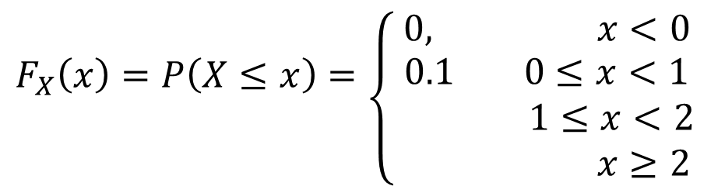
Balls in a bowl
A bowl contains two red balls and three blue balls. Three balls are selected at random from the bowl. Let random variable $X$ denote the number of red balls among them. $R_{X}=\left\{0, 1, 2\right\}$
$$P_{X}\left(x\right)=P\left(X=x\right)=\left\{{0.1, x=0 \atop \begin{aligned}0.6, x=1 \\ 0.3, x=2 \\ 0, otherwise\end{aligned}}\right.$$
$$F_{X}\left(x\right)=P\left(X≤x\right)=\left\{{0, x<0 \atop \begin{aligned}0.1 0≤x<1 \\ 0.7, 1≤x<2 \\ 1, x≥2 \end{aligned}}\right.$$

Slide 30
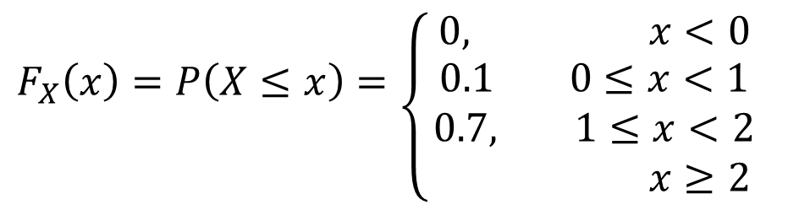
Balls in a bowl
A bowl contains two red balls and three blue balls. Three balls are selected at random from the bowl. Let random variable $X$ denote the number of red balls among them. $R_{X}=\left\{0, 1, 2\right\}$
$$P_{X}\left(x\right)=P\left(X=x\right)=\left\{{0.1, x=0 \atop \begin{aligned}0.6, x=1 \\ 0.3, x=2 \\ 0, otherwise\end{aligned}}\right.$$
$$F_{X}\left(x\right)=P\left(X≤x\right)=\left\{{0, x<0 \atop \begin{aligned}0.1 0≤x<1 \\ 0.7, 1≤x<2 \\ 1, x≥2 \end{aligned}}\right.$$

Slide 31
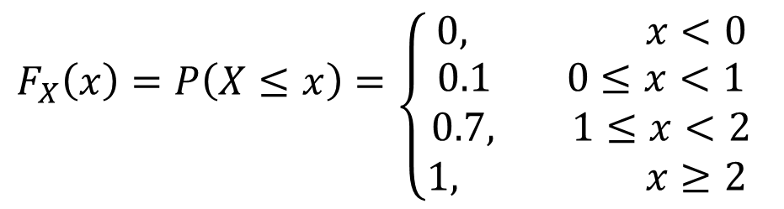
Balls in a bowl
A bowl contains two red balls and three blue balls. Three balls are selected at random from the bowl. Let random variable $X$ denote the number of red balls among them. $R_{X}=\left\{0, 1, 2\right\}$
$$P_{X}\left(x\right)=P\left(X=x\right)=\left\{{0.1, x=0 \atop \begin{aligned}0.6, x=1 \\ 0.3, x=2 \\ 0, otherwise\end{aligned}}\right.$$
$$F_{X}\left(x\right)=P\left(X≤x\right)=\left\{{0, x<0 \atop \begin{aligned}0.1 0≤x<1 \\ 0.7, 1≤x<2 \\ 1, x≥2 \end{aligned}}\right.$$

Slide 32

ROLLING DICE
You are rolling a pair of dice. Let random variable $X$ denote the maximum of the two numbers you got. $R_{X}=\left\{1, 2, 3, 4, 5, 6\right\}$
Distribution of $X$:

Slide 33

ROLLING DICE
You are rolling a pair of dice. Let random variable $X$ denote the maximum of the two numbers you got. $R_{X}=\left\{1, 2, 3, 4, 5, 6\right\}$
Distribution of $X$:

Slide 34

ROLLING DICE
You are rolling a pair of dice. Let random variable $X$ denote the maximum of the two numbers you got. $R_{X}=\left\{1, 2, 3, 4, 5, 6\right\}$
Distribution of $X$:

Slide 35
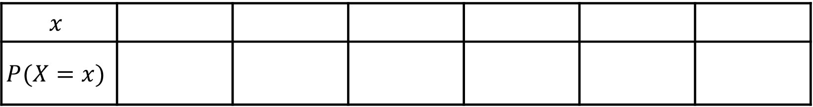

ROLLING DICE
You are rolling a pair of dice. Let random variable $X$ denote the maximum of the two numbers you got. $R_{X}=\left\{1, 2, 3, 4, 5, 6\right\}$
Distribution of $X$:
$$x$$ | 1 | 2 | 3 | 4 | 5 | 6
$$P(X=x)$$ | $$\frac{1}{36}$$ | $$\frac{1+2}{36}$$ | $$\frac{1+2⋅2}{36}$$ | $$\frac{1+2⋅3}{36}$$ | $$\frac{1+2⋅4}{36}$$ | $$\frac{1+2⋅5}{36}$$

Slide 36
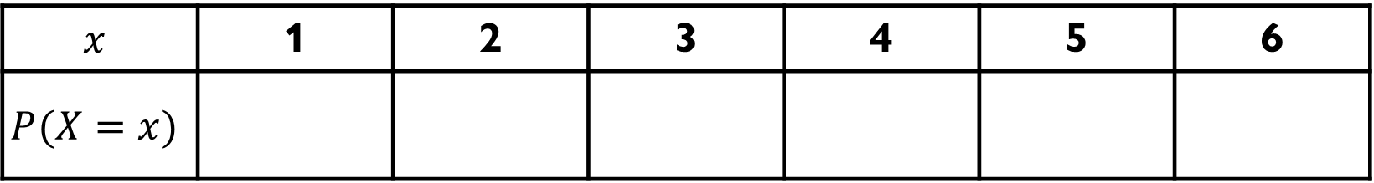
ROLLING DICE
You are rolling a pair of dice. Let random variable $X$ denote the maximum of the two numbers you got. $R_{X}=\left\{1, 2, 3, 4, 5, 6\right\}$
Distribution of $X$:
$$x$$ | 1 | 2 | 3 | 4 | 5 | 6
$$P(X=x)$$ | $$\frac{1}{36}$$ | $$\frac{1+2}{36}$$ | $$\frac{1+2⋅2}{36}$$ | $$\frac{1+2⋅3}{36}$$ | $$\frac{1+2⋅4}{36}$$ | $$\frac{1+2⋅5}{36}$$

Slide 37
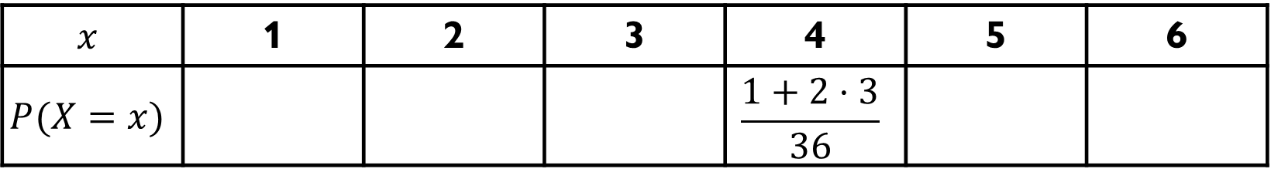
ROLLING DICE
You are rolling a pair of dice. Let random variable $X$ denote the maximum of the two numbers you got. $R_{X}=\left\{1, 2, 3, 4, 5, 6\right\}$
Distribution of $X$:
$$x$$ | 1 | 2 | 3 | 4 | 5 | 6
$$P(X=x)$$ | $$\frac{1}{36}$$ | $$\frac{1+2}{36}$$ | $$\frac{1+2⋅2}{36}$$ | $$\frac{1+2⋅3}{36}$$ | $$\frac{1+2⋅4}{36}$$ | $$\frac{1+2⋅5}{36}$$

Slide 38
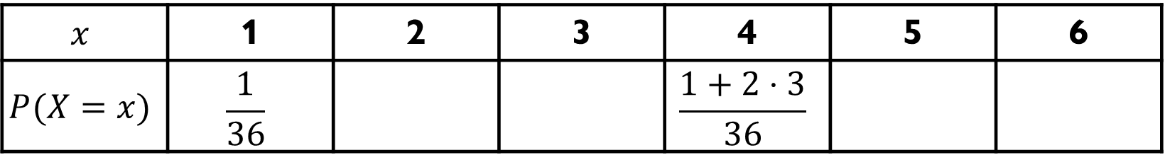
ROLLING DICE
You are rolling a pair of dice. Let random variable $X$ denote the maximum of the two numbers you got. $R_{X}=\left\{1, 2, 3, 4, 5, 6\right\}$
Distribution of $X$:
$$x$$ | 1 | 2 | 3 | 4 | 5 | 6
$$P(X=x)$$ | $$\frac{1}{36}$$ | $$\frac{1+2}{36}$$ | $$\frac{1+2⋅2}{36}$$ | $$\frac{1+2⋅3}{36}$$ | $$\frac{1+2⋅4}{36}$$ | $$\frac{1+2⋅5}{36}$$

Slide 39
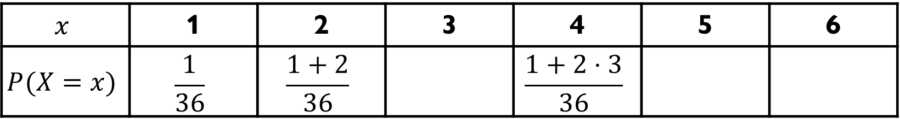
ROLLING DICE
You are rolling a pair of dice. Let random variable $X$ denote the maximum of the two numbers you got. $R_{X}=\left\{1, 2, 3, 4, 5, 6\right\}$
Distribution of $X$:
$$x$$ | 1 | 2 | 3 | 4 | 5 | 6
$$P(X=x)$$ | $$\frac{1}{36}$$ | $$\frac{1+2}{36}$$ | $$\frac{1+2⋅2}{36}$$ | $$\frac{1+2⋅3}{36}$$ | $$\frac{1+2⋅4}{36}$$ | $$\frac{1+2⋅5}{36}$$

Slide 40
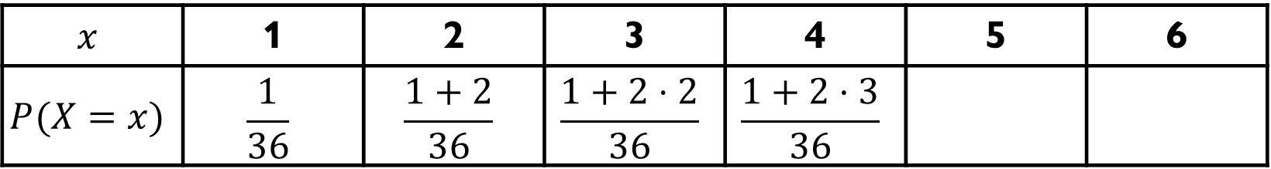
ROLLING DICE
You are rolling a pair of dice. Let random variable $X$ denote the maximum of the two numbers you got. $R_{X}=\left\{1, 2, 3, 4, 5, 6\right\}$
Distribution of $X$:
$$x$$ | 1 | 2 | 3 | 4 | 5 | 6
$$P(X=x)$$ | $$\frac{1}{36}$$ | $$\frac{1+2}{36}$$ | $$\frac{1+2⋅2}{36}$$ | $$\frac{1+2⋅3}{36}$$ | $$\frac{1+2⋅4}{36}$$ | $$\frac{1+2⋅5}{36}$$

Slide 41
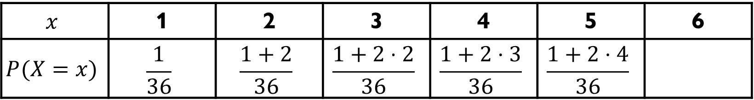
ROLLING DICE
You are rolling a pair of dice. Let random variable $X$ denote the maximum of the two numbers you got. $R_{X}=\left\{1, 2, 3, 4, 5, 6\right\}$
Distribution of $X$:
$$x$$ | 1 | 2 | 3 | 4 | 5 | 6
$$P(X=x)$$ | $$\frac{1}{36}$$ | $$\frac{1+2}{36}$$ | $$\frac{1+2⋅2}{36}$$ | $$\frac{1+2⋅3}{36}$$ | $$\frac{1+2⋅4}{36}$$ | $$\frac{1+2⋅5}{36}$$

Slide 42
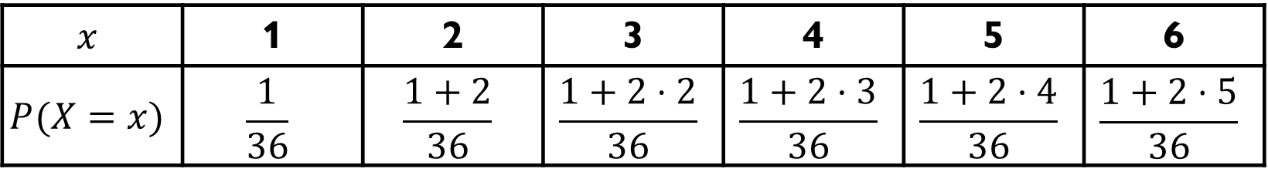
ROLLING DICE
You are rolling a pair of dice. Let random variable $X$ denote the maximum of the two numbers you got. $R_{X}=\left\{1, 2, 3, 4, 5, 6\right\}$
Distribution of $X$:
$$x$$ | 1 | 2 | 3 | 4 | 5 | 6
$$P(X=x)$$ | $$\frac{1}{36}$$ | $$\frac{1+2}{36}$$ | $$\frac{1+2⋅2}{36}$$ | $$\frac{1+2⋅3}{36}$$ | $$\frac{1+2⋅4}{36}$$ | $$\frac{1+2⋅5}{36}$$

Slide 43
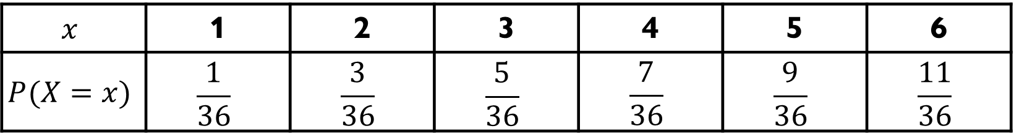
ROLLING DICE
You are rolling a pair of dice. Let random variable $X$ denote the maximum of the two numbers you got. $R_{X}=\left\{1, 2, 3, 4, 5, 6\right\}$
Distribution of $X$:
$$x$$ | 1 | 2 | 3 | 4 | 5 | 6
$$P(X=x)$$ | $$\frac{1}{36}$$ | $$\frac{3}{36}$$ | $$\frac{5}{36}$$ | $$\frac{7}{36}$$ | $$\frac{9}{36}$$ | $$\frac{11}{36}$$

Slide 44
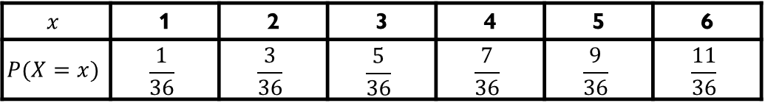

ROLLING DICE
$$x$$ | 1 | 2 | 3 | 4 | 5 | 6
$$P(X=x)$$ | $$\frac{1}{36}$$ | $$\frac{3}{36}$$ | $$\frac{5}{36}$$ | $$\frac{7}{36}$$ | $$\frac{9}{36}$$ | $$\frac{11}{36}$$
You are rolling a pair of dice. Let random variable $X$ denote the maximum of the two numbers you got. $R_{X}=\left\{1, 2, 3, 4, 5, 6\right\}$
CDF of $X$:
$$F_{X}\left(x\right)=\left\{\begin{aligned}0, x<1 \\ 1/36, 1≤x<2 \\ 4/36, 2≤x<3 \\ 9/36, 3≤x<4 \\ 16/36, 4≤x<5 \\ 25/36, 5≤x<6 \\ 1, x≥6\end{aligned}\right.$$

Slide 45
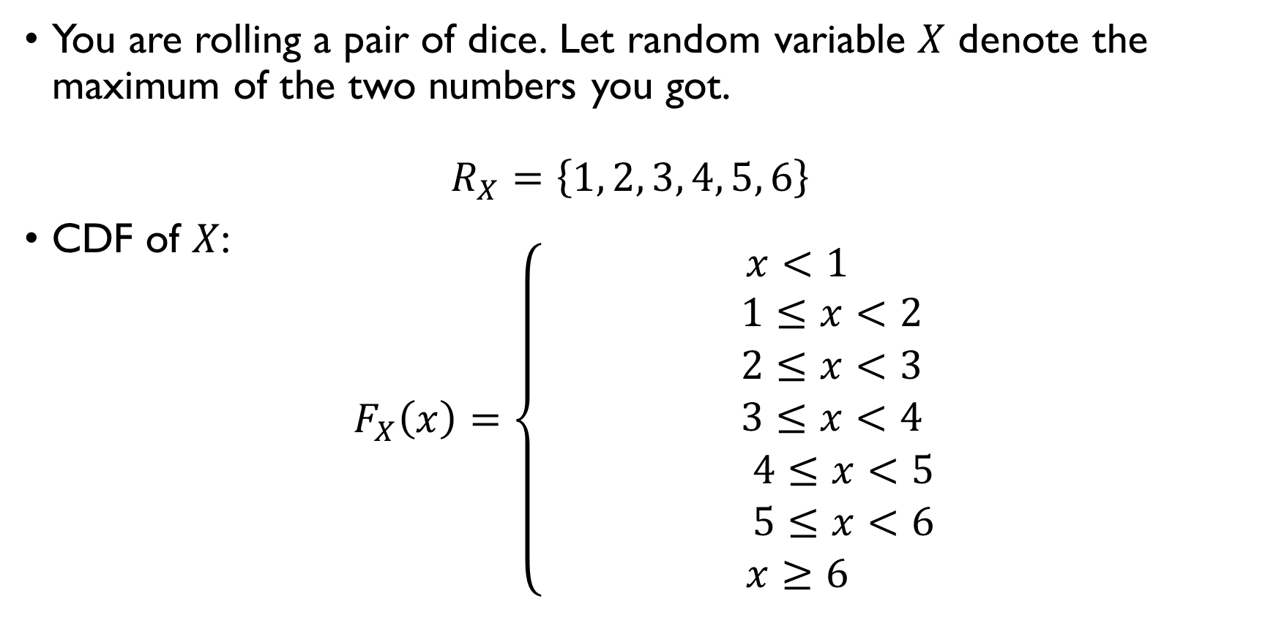
ROLLING DICE
$$x$$ | 1 | 2 | 3 | 4 | 5 | 6
$$P(X=x)$$ | $$\frac{1}{36}$$ | $$\frac{3}{36}$$ | $$\frac{5}{36}$$ | $$\frac{7}{36}$$ | $$\frac{9}{36}$$ | $$\frac{11}{36}$$
You are rolling a pair of dice. Let random variable $X$ denote the maximum of the two numbers you got. $R_{X}=\left\{1, 2, 3, 4, 5, 6\right\}$
CDF of $X$:
$$F_{X}\left(x\right)=\left\{\begin{aligned}0, x<1 \\ 1/36, 1≤x<2 \\ 4/36, 2≤x<3 \\ 9/36, 3≤x<4 \\ 16/36, 4≤x<5 \\ 25/36, 5≤x<6 \\ 1, x≥6\end{aligned}\right.$$

Slide 46

ROLLING DICE
$$x$$ | 1 | 2 | 3 | 4 | 5 | 6
$$P(X=x)$$ | $$\frac{1}{36}$$ | $$\frac{3}{36}$$ | $$\frac{5}{36}$$ | $$\frac{7}{36}$$ | $$\frac{9}{36}$$ | $$\frac{11}{36}$$
You are rolling a pair of dice. Let random variable $X$ denote the maximum of the two numbers you got. $R_{X}=\left\{1, 2, 3, 4, 5, 6\right\}$
CDF of $X$:
$$F_{X}\left(x\right)=\left\{\begin{aligned}0, x<1 \\ 1/36, 1≤x<2 \\ 4/36, 2≤x<3 \\ 9/36, 3≤x<4 \\ 16/36, 4≤x<5 \\ 25/36, 5≤x<6 \\ 1, x≥6\end{aligned}\right.$$

Slide 47

ROLLING DICE
$$x$$ | 1 | 2 | 3 | 4 | 5 | 6
$$P(X=x)$$ | $$\frac{1}{36}$$ | $$\frac{3}{36}$$ | $$\frac{5}{36}$$ | $$\frac{7}{36}$$ | $$\frac{9}{36}$$ | $$\frac{11}{36}$$
You are rolling a pair of dice. Let random variable $X$ denote the maximum of the two numbers you got. $R_{X}=\left\{1, 2, 3, 4, 5, 6\right\}$
CDF of $X$:
$$F_{X}\left(x\right)=\left\{\begin{aligned}0, x<1 \\ 1/36, 1≤x<2 \\ 4/36, 2≤x<3 \\ 9/36, 3≤x<4 \\ 16/36, 4≤x<5 \\ 25/36, 5≤x<6 \\ 1, x≥6\end{aligned}\right.$$

Slide 48
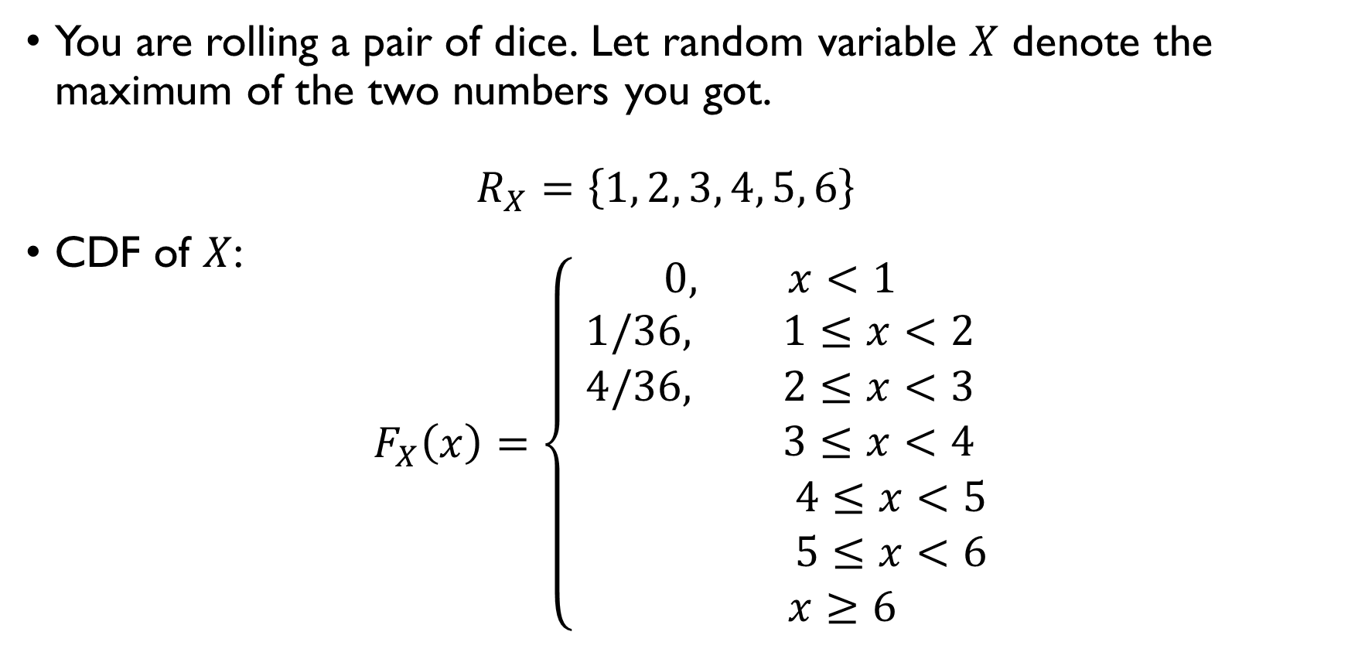
ROLLING DICE
$$x$$ | 1 | 2 | 3 | 4 | 5 | 6
$$P(X=x)$$ | $$\frac{1}{36}$$ | $$\frac{3}{36}$$ | $$\frac{5}{36}$$ | $$\frac{7}{36}$$ | $$\frac{9}{36}$$ | $$\frac{11}{36}$$
You are rolling a pair of dice. Let random variable $X$ denote the maximum of the two numbers you got. $R_{X}=\left\{1, 2, 3, 4, 5, 6\right\}$
CDF of $X$:
$$F_{X}\left(x\right)=\left\{\begin{aligned}0, x<1 \\ 1/36, 1≤x<2 \\ 4/36, 2≤x<3 \\ 9/36, 3≤x<4 \\ 16/36, 4≤x<5 \\ 25/36, 5≤x<6 \\ 1, x≥6\end{aligned}\right.$$

Slide 49
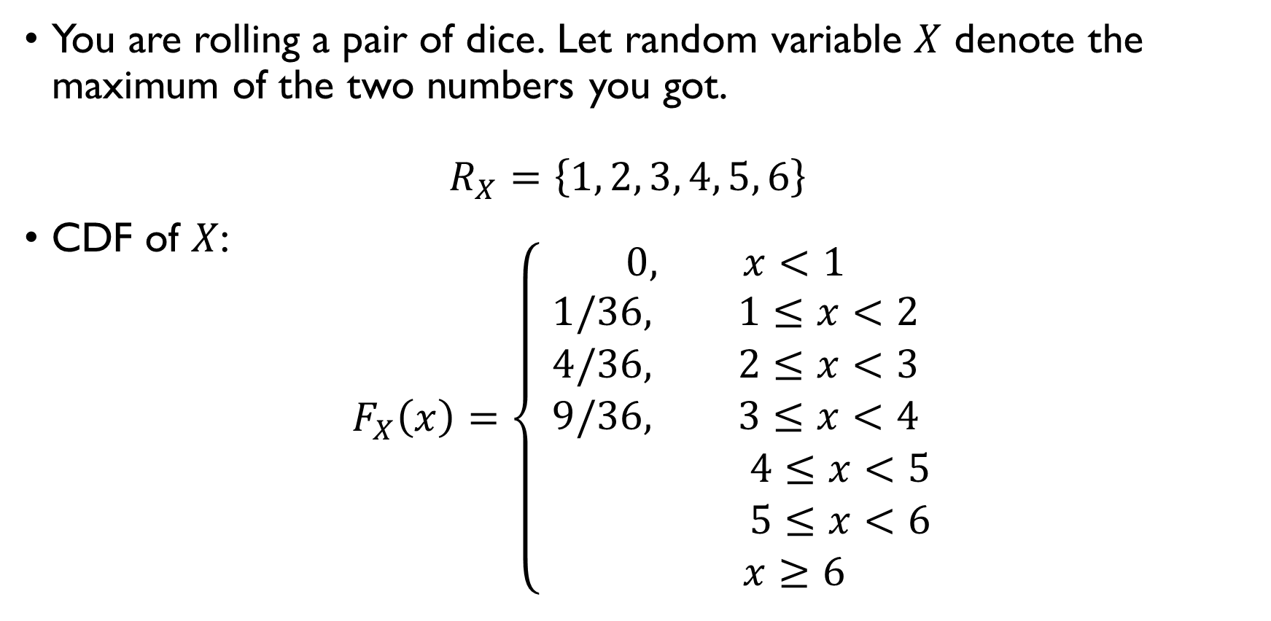
ROLLING DICE
$$x$$ | 1 | 2 | 3 | 4 | 5 | 6
$$P(X=x)$$ | $$\frac{1}{36}$$ | $$\frac{3}{36}$$ | $$\frac{5}{36}$$ | $$\frac{7}{36}$$ | $$\frac{9}{36}$$ | $$\frac{11}{36}$$
You are rolling a pair of dice. Let random variable $X$ denote the maximum of the two numbers you got. $R_{X}=\left\{1, 2, 3, 4, 5, 6\right\}$
CDF of $X$:
$$F_{X}\left(x\right)=\left\{\begin{aligned}0, x<1 \\ 1/36, 1≤x<2 \\ 4/36, 2≤x<3 \\ 9/36, 3≤x<4 \\ 16/36, 4≤x<5 \\ 25/36, 5≤x<6 \\ 1, x≥6\end{aligned}\right.$$

Slide 50
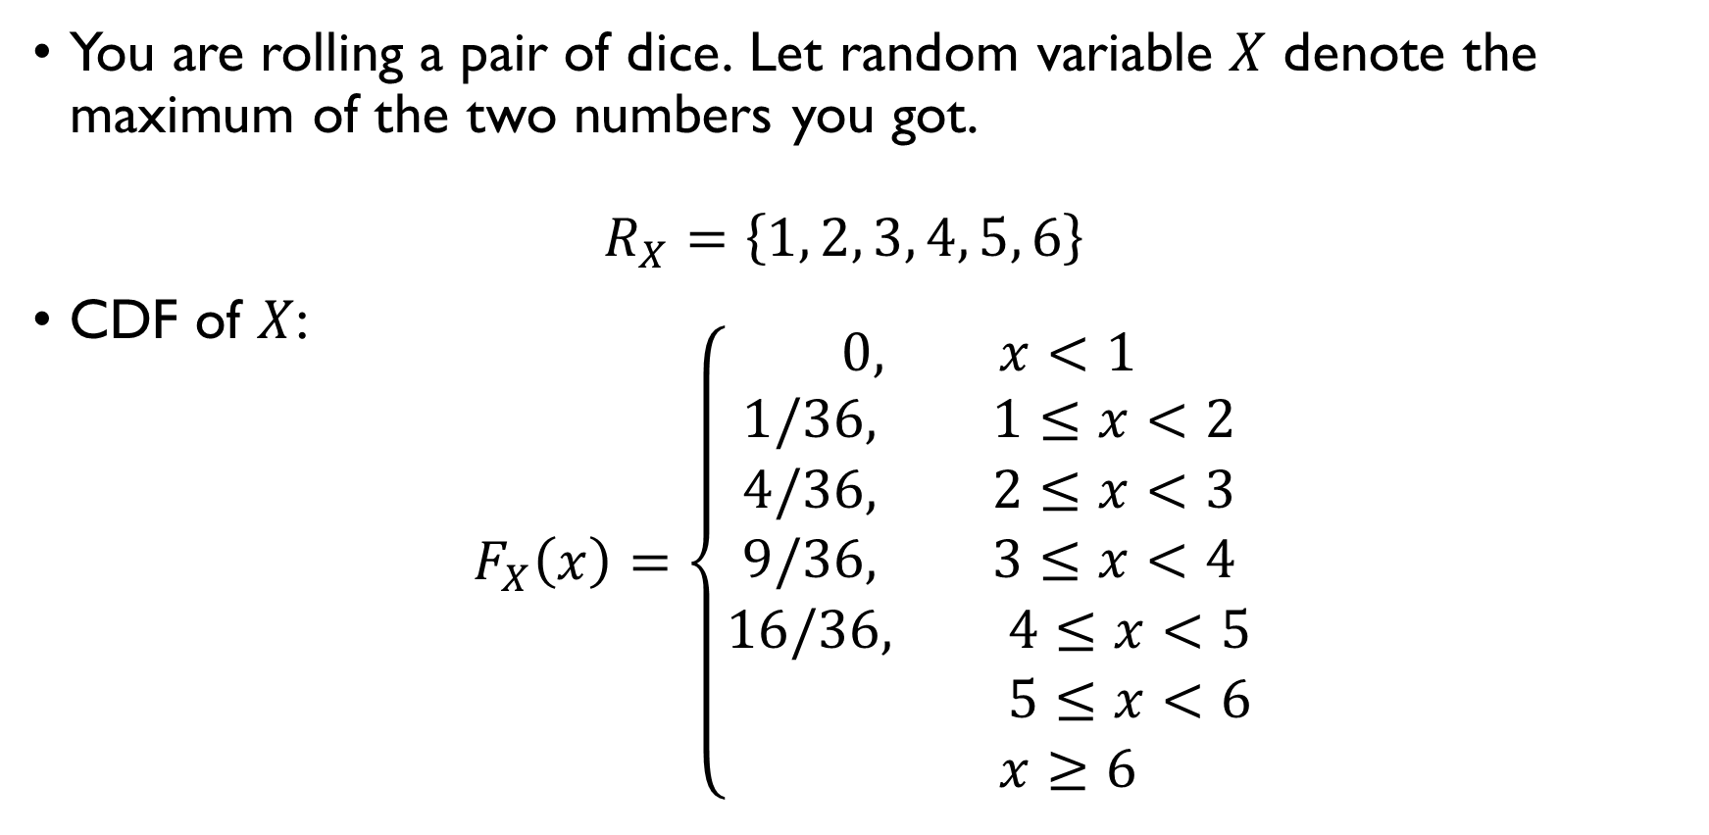
ROLLING DICE
$$x$$ | 1 | 2 | 3 | 4 | 5 | 6
$$P(X=x)$$ | $$\frac{1}{36}$$ | $$\frac{3}{36}$$ | $$\frac{5}{36}$$ | $$\frac{7}{36}$$ | $$\frac{9}{36}$$ | $$\frac{11}{36}$$
You are rolling a pair of dice. Let random variable $X$ denote the maximum of the two numbers you got. $R_{X}=\left\{1, 2, 3, 4, 5, 6\right\}$
CDF of $X$:
$$F_{X}\left(x\right)=\left\{\begin{aligned}0, x<1 \\ 1/36, 1≤x<2 \\ 4/36, 2≤x<3 \\ 9/36, 3≤x<4 \\ 16/36, 4≤x<5 \\ 25/36, 5≤x<6 \\ 1, x≥6\end{aligned}\right.$$

Slide 51
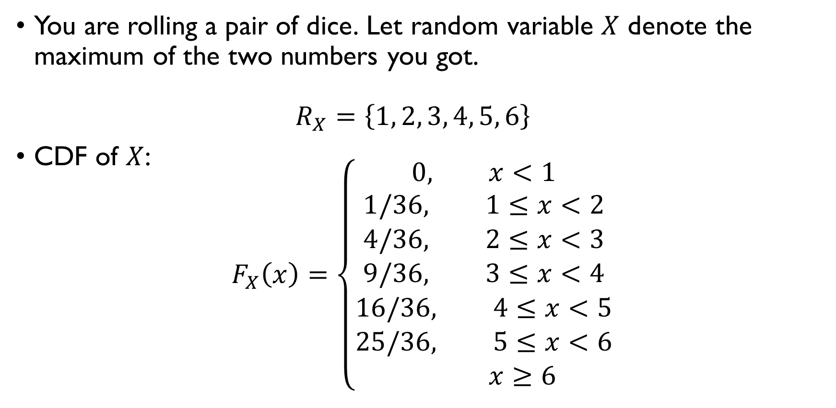
ROLLING DICE
$$x$$ | 1 | 2 | 3 | 4 | 5 | 6
$$P(X=x)$$ | $$\frac{1}{36}$$ | $$\frac{3}{36}$$ | $$\frac{5}{36}$$ | $$\frac{7}{36}$$ | $$\frac{9}{36}$$ | $$\frac{11}{36}$$
You are rolling a pair of dice. Let random variable $X$ denote the maximum of the two numbers you got. $R_{X}=\left\{1, 2, 3, 4, 5, 6\right\}$
CDF of $X$:
$$F_{X}\left(x\right)=\left\{\begin{aligned}0, x<1 \\ 1/36, 1≤x<2 \\ 4/36, 2≤x<3 \\ 9/36, 3≤x<4 \\ 16/36, 4≤x<5 \\ 25/36, 5≤x<6 \\ 1, x≥6\end{aligned}\right.$$

Slide 52

ROLLING DICE
$$x$$ | 1 | 2 | 3 | 4 | 5 | 6
$$P(X=x)$$ | $$\frac{1}{36}$$ | $$\frac{3}{36}$$ | $$\frac{5}{36}$$ | $$\frac{7}{36}$$ | $$\frac{9}{36}$$ | $$\frac{11}{36}$$
You are rolling a pair of dice. Let random variable $X$ denote the maximum of the two numbers you got. $R_{X}=\left\{1, 2, 3, 4, 5, 6\right\}$
CDF of $X$:
$$F_{X}\left(x\right)=\left\{\begin{aligned}0, x<1 \\ 1/36, 1≤x<2 \\ 4/36, 2≤x<3 \\ 9/36, 3≤x<4 \\ 16/36, 4≤x<5 \\ 25/36, 5≤x<6 \\ 1, x≥6\end{aligned}\right.$$

Slide 53


Cdf of a discrete random variable
$$F_{X}\left(x\right)=\left\{\begin{aligned}0, x<1 \\ 1/36, 1≤x<2 \\ 4/36, 2≤x<3 \\ 9/36, 3≤x<4 \\ 16/36, 4≤x<5 \\ 25/36, 5≤x<6 \\ 1, x≥6\end{aligned}\right.$$

Slide 54

PMF and CDF: basic properties
Which basic properties does a PMF function have?
0 $≤$ P(x) $≤$ 1
All non-zero values sum up to one
Which basic properties does a CDF function have?
0 $≤$ F(x) $≤$ 1
F(x) is non-decreasing

Slide 55

PMF and CDF: basic properties
Which basic properties does a PMF function have?
0 $≤$ P(x) $≤$ 1
All non-zero values sum up to one
Which basic properties does a CDF function have?
0 $≤$ F(x) $≤$ 1
F(x) is non-decreasing

Slide 56
Rolling dice: pmf and cdf
Google Classroom -> Programming exercise

Slide 57
Special distributions

Slide 58

Bernoulli distribution
Consider a random experiment with two possible outcomes: “success” (with probability $p$) or “failure” (with probability $1−p$)
tossing a coin: H or T;
a new child: a boy r a girl;
you take an exam: pass or fail.
Consider a random variable $X\sim Bernoulli\left(p\right)$

Slide 59


Bernoulli distribution
Consider a random experiment with two possible outcomes: “success” (with probability $p$) or “failure” (with probability $1−p$)
tossing a coin: H or T;
a new child: a boy r a girl;
you take an exam: pass or fail.
Consider a random variable $X\sim Bernoulli\left(p\right)$
$$x$$ | $$0$$ | $$1$$
$$P\left(X=x\right)$$ | $$1−p$$ | $$p$$

Slide 60

Bernoulli distribution
Consider a random experiment with two possible outcomes: “success” (with probability $p$) or “failure” (with probability $1−p$)
tossing a coin: H or T;
a new child: a boy r a girl;
you take an exam: pass or fail.
Consider a random variable $X\sim Bernoulli\left(p\right)$
$$x$$ | $$0$$ | $$1$$
$$P\left(X=x\right)$$ | $$1−p$$ | $$p$$

Slide 61

Bernoulli distribution
Consider a random experiment with two possible outcomes: “success” (with probability $p$) or “failure” (with probability $1−p$)
tossing a coin: H or T;
a new child: a boy r a girl;
you take an exam: pass or fail.
Consider a random variable $X\sim Bernoulli\left(p\right)$
$$x$$ | $$0$$ | $$1$$
$$P\left(X=x\right)$$ | $$1−p$$ | $$p$$

Slide 62

Bernoulli distribution
A random variable $X$ is said to be a Bernoulli random variable with parameter $p$ if its PMF is given by
$$P_{X}\left(x\right)=P\left(X=x\right)=\left\{\begin{aligned}p, x=1 \\ 1−p, x=0 \\ 0, otherwise\end{aligned}\right.$$

Slide 63

Example: passing an exam
You need to answer a multiple-choice question (4 options, only 1 is correct).
You don’t know the answer, so you are randomly guessing.
$X$- a random variable: $X=1$ if guessed correctly and $X=0$ otherwise.
$$X\sim Bernoulli\left(0.25\right)$$
$$P_{X}\left(x\right)=P\left(X=x\right)=\left\{\begin{aligned}0.75, x=0 \\ 0.25, x=1 \\ 0, otherwise\end{aligned}\right.$$

Slide 64

Example: passing an exam
You need to answer a multiple-choice question (4 options, only 1 is correct).
You don’t know the answer, so you are randomly guessing.
$X$- a random variable: $X=1$ if guessed correctly and $X=0$ otherwise.
$$X\sim Bernoulli\left(0.25\right)$$
$$P_{X}\left(x\right)=P\left(X=x\right)=\left\{\begin{aligned}0.75, x=0 \\ 0.25, x=1 \\ 0, otherwise\end{aligned}\right.$$

Slide 65

Example: passing an exam
You need to answer a multiple-choice question (4 options, only 1 is correct).
You don’t know the answer, so you are randomly guessing.
$X$- a random variable: $X=1$ if guessed correctly and $X=0$ otherwise.
$$X\sim Bernoulli\left(0.25\right)$$
$$P_{X}\left(x\right)=P\left(X=x\right)=\left\{\begin{aligned}0.75, x=0 \\ 0.25, x=1 \\ 0, otherwise\end{aligned}\right.$$

Slide 66

Example: passing an exam
You need to answer a multiple-choice question (4 options, only 1 is correct).
You don’t know the answer, so you are randomly guessing.
$X$- a random variable: $X=1$ if guessed correctly and $X=0$ otherwise.
$$X\sim Bernoulli\left(0.25\right)$$
$$P_{X}\left(x\right)=P\left(X=x\right)=\left\{\begin{aligned}0.75, x=0 \\ 0.25, x=1 \\ 0, otherwise\end{aligned}\right.$$

Slide 67

Example: passing an exam
You need to answer a multiple-choice question (4 options, only 1 is correct).
You don’t know the answer, so you are randomly guessing.
$X$- a random variable: $X=1$ if guessed correctly and $X=0$ otherwise.
$$X\sim Bernoulli\left(0.25\right)$$
$$P_{X}\left(x\right)=P\left(X=x\right)=\left\{\begin{aligned}0.75, x=0 \\ 0.25, x=1 \\ 0, otherwise\end{aligned}\right.$$

Slide 68

Example: passing an exam
You need to answer a multiple-choice question (4 options, only 1 is correct).
You don’t know the answer, so you are randomly guessing.
$X$- a random variable: $X=1$ if guessed correctly and $X=0$ otherwise.
$$X\sim Bernoulli\left(0.25\right)$$
$$P_{X}\left(x\right)=P\left(X=x\right)=\left\{\begin{aligned}0.75, x=0 \\ 0.25, x=1 \\ 0, otherwise\end{aligned}\right.$$

Slide 69

Binomial distribution
You toss a coin once. Random variable $X\sim Bernoulli\left(p\right)$ denotes if you get heads:
$$R_{X}=\left\{0,1\right\}, P\left(X=0\right)=P\left(T\right)=1−p, P\left(X=1\right)=P\left(H\right)=p$$
Imagine now that you toss a coin $n$ times. Random variable $Y$ is the total number of heads you get:
$$R_{Y}=\left\{0, 1, 2, …, n\right\}$$
$$P\left(Y=k\right)=P\left(kH, \left(n−k\right)T\right)=C\left(n,k\right)⋅p^{k}{\left(1−p\right)}^{n−k}$$
$$Y\sim Binomial\left(n,p\right)$$

Slide 70

Binomial distribution
You toss a coin once. Random variable $X\sim Bernoulli\left(p\right)$ denotes if you get heads:
$$R_{X}=\left\{0,1\right\}, P\left(X=0\right)=P\left(T\right)=1−p, P\left(X=1\right)=P\left(H\right)=p$$
Imagine now that you toss a coin $n$ times. Random variable $Y$ is the total number of heads you get:
$$R_{Y}=\left\{0, 1, 2, …, n\right\}$$
$$P\left(Y=k\right)=P\left(kH, \left(n−k\right)T\right)=C\left(n,k\right)⋅p^{k}{\left(1−p\right)}^{n−k}$$
$$Y\sim Binomial\left(n,p\right)$$

Slide 71

Binomial distribution
You toss a coin once. Random variable $X\sim Bernoulli\left(p\right)$ denotes if you get heads:
$$R_{X}=\left\{0,1\right\}, P\left(X=0\right)=P\left(T\right)=1−p, P\left(X=1\right)=P\left(H\right)=p$$
Imagine now that you toss a coin $n$ times. Random variable $Y$ is the total number of heads you get:
$$R_{Y}=\left\{0, 1, 2, …, n\right\}$$
$$P\left(Y=k\right)=P\left(kH, \left(n−k\right)T\right)=C\left(n,k\right)⋅p^{k}{\left(1−p\right)}^{n−k}$$
$$Y\sim Binomial\left(n,p\right)$$

Slide 72

Binomial distribution
You toss a coin once. Random variable $X\sim Bernoulli\left(p\right)$ denotes if you get heads:
$$R_{X}=\left\{0,1\right\}, P\left(X=0\right)=P\left(T\right)=1−p, P\left(X=1\right)=P\left(H\right)=p$$
Imagine now that you toss a coin $n$ times. Random variable $Y$ is the total number of heads you get:
$$R_{Y}=\left\{0, 1, 2, …, n\right\}$$
$$P\left(Y=k\right)=P\left(kH, \left(n−k\right)T\right)=C\left(n,k\right)⋅p^{k}{\left(1−p\right)}^{n−k}$$
$$Y\sim Binomial\left(n,p\right)$$

Slide 73

Binomial distribution
You toss a coin once. Random variable $X\sim Bernoulli\left(p\right)$ denotes if you get heads:
$$R_{X}=\left\{0,1\right\}, P\left(X=0\right)=P\left(T\right)=1−p, P\left(X=1\right)=P\left(H\right)=p$$
Imagine now that you toss a coin $n$ times. Random variable $Y$ is the total number of heads you get:
$$R_{Y}=\left\{0, 1, 2, …, n\right\}$$
$$P\left(Y=k\right)=P\left(kH, \left(n−k\right)T\right)=C\left(n,k\right)⋅p^{k}{\left(1−p\right)}^{n−k}$$
$$Y\sim Binomial\left(n,p\right)$$

Slide 74

Binomial distribution
You toss a coin once. Random variable $X\sim Bernoulli\left(p\right)$ denotes if you get heads:
$$R_{X}=\left\{0,1\right\}, P\left(X=0\right)=P\left(T\right)=1−p, P\left(X=1\right)=P\left(H\right)=p$$
Imagine now that you toss a coin $n$ times. Random variable $Y$ is the total number of heads you get:
$$R_{Y}=\left\{0, 1, 2, …, n\right\}$$
$$P\left(Y=k\right)=P\left(kH, \left(n−k\right)T\right)=C\left(n,k\right)⋅p^{k}{\left(1−p\right)}^{n−k}$$
$$Y\sim Binomial\left(n,p\right)$$

Slide 75

Binomial distribution
You toss a coin once. Random variable $X\sim Bernoulli\left(p\right)$ denotes if you get heads:
$$R_{X}=\left\{0,1\right\}, P\left(X=0\right)=P\left(T\right)=1−p, P\left(X=1\right)=P\left(H\right)=p$$
Imagine now that you toss a coin $n$ times. Random variable $Y$ is the total number of heads you get:
$$R_{Y}=\left\{0, 1, 2, …, n\right\}$$
$$P\left(Y=k\right)=P\left(kH, \left(n−k\right)T\right)=C\left(n,k\right)⋅p^{k}{\left(1−p\right)}^{n−k}$$
$$Y\sim Binomial\left(n,p\right)$$

Slide 76

Binomial distribution
You toss a coin once. Random variable $X\sim Bernoulli\left(p\right)$ denotes if you get heads:
$$R_{X}=\left\{0,1\right\}, P\left(X=0\right)=P\left(T\right)=1−p, P\left(X=1\right)=P\left(H\right)=p$$
Imagine now that you toss a coin $n$ times. Random variable $Y$ is the total number of heads you get:
$$R_{Y}=\left\{0, 1, 2, …, n\right\}$$
$$P\left(Y=k\right)=P\left(kH, \left(n−k\right)T\right)=C\left(n,k\right)⋅p^{k}{\left(1−p\right)}^{n−k}$$
$$Y\sim Binomial\left(n,p\right)$$

Slide 77

Binomial distribution
A random variable $Y$ is said to follow Binomial distribution with parameters $n$ and $p$ if its PMF is given by
$$P_{Y}\left(k\right)=P\left(Y=k\right)=\left\{\begin{aligned}C\left(n,k\right)⋅p^{k}{\left(1−p\right)}^{n−k}, k=0, 1,…,n \\ 0, otherwise\end{aligned}\right.$$
Represents a number of successes in a series of $n$ independent Bernoulli trials, each of which results in success with probability $p$.

Slide 78

Binomial distribution
A random variable $Y$ is said to follow Binomial distribution with parameters $n$ and $p$ if its PMF is given by
$$P_{Y}\left(k\right)=P\left(Y=k\right)=\left\{\begin{aligned}C\left(n,k\right)⋅p^{k}{\left(1−p\right)}^{n−k}, k=0, 1,…,n \\ 0, otherwise\end{aligned}\right.$$
Represents the number of successes in a series of $n$ independent Bernoulli trials, each of which results in success with probability $p$.

Slide 79

Example: exam
You are randomly guessing the answers to 5 multiple choice questions (4 options, 1 correct in each).
$Y\sim Binomial\left(5, 0.25\right)$ – number of correctly guessed answers.
$$P_{Y}\left(k\right)=C\left(n,k\right)p^{k}{\left(1−p\right)}^{n−k}=\left\{\begin{aligned}{0.75}^{5}, k=0 \\ C\left(5, 1\right)⋅0.25⋅{0.75}^{5}, k=1 \\ C\left(5, 2\right)⋅{0.25}^{2}⋅{0.75}^{3}, k=2 \\ C\left(5, 3\right)⋅{0.25}^{3}⋅{0.75}^{2}, k=3 \\ C\left(5, 4\right)⋅0. {25}^{4}⋅0.75, k=4 \\ {0.25}^{5}, k=5 \\ 0, k=0\end{aligned}\right.$$

Slide 80

Example: exam
You are randomly guessing the answers to 5 multiple choice questions (4 options, 1 correct in each).
$Y\sim Binomial\left(5, 0.25\right)$ – number of correctly guessed answers.
$$P_{Y}\left(k\right)=C\left(n,k\right)p^{k}{\left(1−p\right)}^{n−k}=\left\{\begin{aligned}{0.75}^{5}, k=0 \\ 5⋅0.25⋅{0.75}^{5}, k=1 \\ 10⋅{0.25}^{2}⋅{0.75}^{3}, k=2 \\ 10⋅{0.25}^{3}⋅{0.75}^{2}, k=3 \\ 5⋅0. {25}^{4}⋅0.75, k=4 \\ {0.25}^{5}, k=5 \\ 0, otherwise\end{aligned}\right.$$

Slide 81

Example: exam
$Y\sim Binomial\left(5, 0.25\right)$ – number of correctly guessed answers.
$$P_{Y}\left(k\right)=C\left(n,k\right)p^{k}{\left(1−p\right)}^{n−k}=\left\{\begin{aligned}{0.75}^{5}, k=0 \\ 5⋅0.25⋅{0.75}^{5}, k=1 \\ 10⋅{0.25}^{2}⋅{0.75}^{3}, k=2 \\ 10⋅{0.25}^{3}⋅{0.75}^{2}, k=3 \\ 5⋅0. {25}^{4}⋅0.75, k=4 \\ {0.25}^{5}, k=5 \\ 0, otherwise\end{aligned}\right.$$
What are the chances of passing the test (= guessing 3 or more)?
$$P\left(Y≥3\right)=P_{Y}\left(3\right)+P_{Y}\left(4\right)+P_{Y}\left(5\right) \sim 0.1035$$

Slide 82

Example: exam
$Y\sim Binomial\left(5, 0.25\right)$ – number of correctly guessed answers.
$$P_{Y}\left(k\right)=C\left(n,k\right)p^{k}{\left(1−p\right)}^{n−k}=\left\{\begin{aligned}{0.75}^{5}, k=0 \\ 5⋅0.25⋅{0.75}^{5}, k=1 \\ 10⋅{0.25}^{2}⋅{0.75}^{3}, k=2 \\ 10⋅{0.25}^{3}⋅{0.75}^{2}, k=3 \\ 5⋅0. {25}^{4}⋅0.75, k=4 \\ {0.25}^{5}, k=5 \\ 0, otherwise\end{aligned}\right.$$
What are the chances of passing the test (= guessing 3 or more)?
$$P\left(Y≥3\right)=P_{Y}\left(3\right)+P_{Y}\left(4\right)+P_{Y}\left(5\right) \sim 0.1035$$

