Slide 1
ELEMENTARY COMBINATORICS & PROBABILITY
Lecture 2
Principle of Inclusion-Exclusion

Slide 2
Last time
The basics of set theory
Basic counting principles
Rule of sum
Rule of product
Other useful tricks
Applying those to solve problems

Slide 3
today
Basic counting principles: review
Finish Problem Set 1
Principle of exclusion-inclusion
How to apply rule of sum when the sets are not disjoint?
Problem Set 2.

Slide 4
PROBLEM SET 1

Slide 5
Complement of a complement
(A^{C})^{C} = ?

Slide 6
Complement of a complement
(A^{C})^{C} = ?
A^{C}
A = (A^{C})^{C}

Slide 7
Complement of a complement
(A^{C})^{C} = A
A^{C}
A = (A^{C})^{C}

Slide 8
Absorption law 2
A ∪ (A ∩ B) = ?

Slide 9
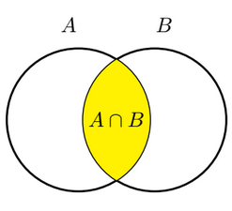
Absorption law 2
A ∪ (A ∩ B) = ?

Slide 10
Absorption law 2
A ∪ (A ∩ B) = A

Slide 11
shopping
A woman has decided to shop at one store today, either in the north part of town or the south part of town.
North: shop at either a mall, a furniture store, or a jewelry store.
South: shop at either a clothing store or a shoe store.
How many stores can the woman choose from?
Sum rule:
3 options in the north part + 2 options in the south part = = 2 + 3 = 5 different stores to visit

Slide 12
shopping
A woman has decided to shop at one store today, either in the north part of town or the south part of town.
North: shop at either a mall, a furniture store, or a jewelry store.
South: shop at either a clothing store or a shoe store.
How many stores can the woman choose from?
Sum rule:
3 options in the north part + 2 options in the south part = = 2 + 3 = 5 different stores to visit

Slide 13
workouts
You want to design a 30-minute workout.
First 15 minutes: running, rowing, kickboxing or skipping.
Second 15 minutes: squats, pull-ups or core routine.
How many such workouts are possible?
Product rule:
4 options for the first part x 3 options for the second part = = 4 x 3 = 12 options for the

Slide 14
workouts
You want to design a 30-minute workout.
First 15 minutes: running, rowing, kickboxing or skipping.
Second 15 minutes: squats, pull-ups or core routine.
How many such workouts are possible?
Product rule:
4 options for the first part x 3 options for the second part = = 4 x 3 = 12 options for the

Slide 15
numbers
How many integer numbers from 1 to 999 don’t contain digit 7?
1 – 9:
8 numbers (everything but 7)
10 – 99:
8 x 9 numbers (1st digit: anything but 0 or 7, 2nd digit: anything but 7)
100 – 999:
8 x 9 x 9 (1st digit: anything but 0 or 7, 2nd and 3rd digits: anything but 7)
Sum rule:
8 + 8 x 9 + 8 x 9 x 9 numbers from 1 to 999 don’t contain digit 7

Slide 16
numbers
How many integer numbers from 1 to 999 don’t contain digit 7?
1 – 9:
8 numbers (everything but 7)
10 – 99:
8 x 9 numbers (1st digit: anything but 0 or 7, 2nd digit: anything but 7)
100 – 999:
8 x 9 x 9 (1st digit: anything but 0 or 7, 2nd and 3rd digits: anything but 7)
Sum rule:
8 + 8 x 9 + 8 x 9 x 9 numbers from 1 to 999 don’t contain digit 7

Slide 17
numbers
How many integer numbers from 1 to 999 don’t contain digit 7?
1 – 9:
8 numbers (everything but 7)
10 – 99:
8 x 9 numbers (1st digit: anything but 0 or 7, 2nd digit: anything but 7)
100 – 999:
8 x 9 x 9 (1st digit: anything but 0 or 7, 2nd and 3rd digits: anything but 7)
Sum rule:
8 + 8 x 9 + 8 x 9 x 9 numbers from 1 to 999 don’t contain digit 7

Slide 18
numbers
How many integer numbers from 1 to 999 don’t contain digit 7?
1 – 9:
8 numbers (everything but 7)
10 – 99:
8 x 9 numbers (1st digit: anything but 0 or 7, 2nd digit: anything but 7)
100 – 999:
8 x 9 x 9 (1st digit: anything but 0 or 7, 2nd and 3rd digits: anything but 7)
Sum rule:
8 + 8 x 9 + 8 x 9 x 9 numbers from 1 to 999 don’t contain digit 7

Slide 19
numbers
How many integer numbers from 1 to 999 don’t contain digit 7?
1 – 9:
8 numbers (everything but 7)
10 – 99:
8 x 9 numbers (1st digit: anything but 0 or 7, 2nd digit: anything but 7)
100 – 999:
8 x 9 x 9 (1st digit: anything but 0 or 7, 2nd and 3rd digits: anything but 7)
Sum rule:
8 + 8 x 9 + 8 x 9 x 9 numbers from 1 to 999 don’t contain digit 7

Slide 20
numbers
How many integer numbers from 1 to 999 don’t contain digit 7?
1 – 9:
8 numbers (everything but 7)
10 – 99:
8 x 9 numbers (1st digit: anything but 0 or 7, 2nd digit: anything but 7)
100 – 999:
8 x 9 x 9 (1st digit: anything but 0 or 7, 2nd and 3rd digits: anything but 7)
Sum rule:
8 + 8 x 9 + 8 x 9 x 9 numbers from 1 to 999 don’t contain digit 7

Slide 21
numbers
How many integer numbers from 1 to 999 don’t contain digit 7?
Other solution:
Number between 1 and 999:
* * *
(6 is represented as 006, 45 is represented as 045)
Every digit * can be anything but 7, therefore:
9 x 9 x 9 – 1
(000 should not be considered, because we’re interested numbers from 1 to 999)

Slide 22
numbers
How many integer numbers from 1 to 999 don’t contain digit 7?
Other solution:
Number between 1 and 999:
* * *
(6 is represented as 006, 45 is represented as 045)
Every digit * can be anything but 7, therefore:
9 x 9 x 9 – 1
(000 should not be considered, because we’re interested numbers from 1 to 999)

Slide 23
numbers
How many integer numbers from 1 to 999 don’t contain digit 7?
Other solution:
Number between 1 and 999:
* * *
(6 is represented as 006, 45 is represented as 045)
Every digit * can be anything but 7, therefore:
9 x 9 x 9 – 1
(000 should not be considered, because we’re interested numbers from 1 to 999)

Slide 24
numbers
How many integer numbers from 1 to 999 don’t contain digit 7?
Other solution:
Number between 1 and 999:
* * *
(6 is represented as 006, 45 is represented as 045)
Every digit * can be anything but 7, therefore:
9 x 9 x 9 – 1
(000 should not be considered, because we’re interested numbers from 1 to 999)

Slide 25
numbers
How many integer numbers from 1 to 999 don’t contain digit 7?
Other solution:
Number between 1 and 999:
* * *
(6 is represented as 006, 45 is represented as 045)
Every digit * can be anything but 7, therefore:
9 x 9 x 9 – 1
(000 should not be considered, because we’re interested numbers from 1 to 999)

Slide 26
numbers
How many integer numbers from 1 to 999 contain digit 7?
There are 999 numbers between 1 and 999.
728 don’t contain digit 7 (previous step).
Therefore, 999 – 728 – 271 numbers contain digit 7.

Slide 27
numbers
How many integer numbers from 1 to 999 contain digit 7?
There are 999 numbers between 1 and 999.
728 don’t contain digit 7 (previous step).
Therefore, 999 – 728 – 271 numbers contain digit 7.

Slide 28
numbers
How many integer numbers from 1 to 999 contain digit 7?
There are 999 numbers between 1 and 999.
728 don’t contain digit 7 (previous step).
Therefore, 999 – 728 – 271 numbers contain digit 7.

Slide 29
numbers
How many integer numbers from 1 to 999 contain digit 7 exactly once?
Numbers from 1 to 999: * * *
Contain 7 exactly once ⬄ three possibility:
7 * * 9 x 9 options
* 7 * 9 x 9 options
* * 7 9 x 9 options
Sum rule:
9 x 9 + 9 x 9 + 9 x 9 = 243 numbers from 1 to 999 contain digit 7 exactly once

Slide 30
numbers
How many integer numbers from 1 to 999 contain digit 7 exactly once?
Numbers from 1 to 999: * * *
Contain 7 exactly once ⬄ three possibility:
7 * * 9 x 9 options
* 7 * 9 x 9 options
* * 7 9 x 9 options
Sum rule:
9 x 9 + 9 x 9 + 9 x 9 = 243 numbers from 1 to 999 contain digit 7 exactly once

Slide 31
numbers
How many integer numbers from 1 to 999 contain digit 7 exactly once?
Numbers from 1 to 999: * * *
Contain 7 exactly once ⬄ three possibility:
7 * * 9 x 9 options
* 7 * 9 x 9 options
* * 7 9 x 9 options
Sum rule:
9 x 9 + 9 x 9 + 9 x 9 = 243 numbers from 1 to 999 contain digit 7 exactly once

Slide 32
numbers
How many integer numbers from 1 to 999 contain digit 7 exactly once?
Numbers from 1 to 999: * * *
Contain 7 exactly once ⬄ three possibility:
7 * * 9 x 9 options
* 7 * 9 x 9 options
* * 7 9 x 9 options
Sum rule:
9 x 9 + 9 x 9 + 9 x 9 = 243 numbers from 1 to 999 contain digit 7 exactly once

Slide 33
numbers
How many integer numbers from 1 to 999 contain digit 7 exactly once?
Numbers from 1 to 999: * * *
Contain 7 exactly once ⬄ three possibility:
7 * * 9 x 9 options
* 7 * 9 x 9 options
* * 7 9 x 9 options
Sum rule:
9 x 9 + 9 x 9 + 9 x 9 = 243 numbers from 1 to 999 contain digit 7 exactly once

Slide 34
numbers
How many integer numbers from 1 to 999 contain digit 7 exactly once?
Numbers from 1 to 999: * * *
Contain 7 exactly once ⬄ three possibility:
7 * * 9 x 9 options
* 7 * 9 x 9 options
* * 7 9 x 9 options
Sum rule:
9 x 9 + 9 x 9 + 9 x 9 = 243 numbers from 1 to 999 contain digit 7 exactly once

Slide 35
numbers
How many integer numbers from 1 to 999 contain digit 7 exactly once?
Numbers from 1 to 999: * * *
Contain 7 exactly once ⬄ three possibility:
7 * * 9 x 9 options
* 7 * 9 x 9 options
* * 7 9 x 9 options
Sum rule:
9 x 9 + 9 x 9 + 9 x 9 = 243 numbers from 1 to 999 contain digit 7 exactly once

Slide 36
numbers
How many integer numbers from 1 to 999 contain digit 7 exactly once?
Numbers from 1 to 999: * * *
Contain 7 exactly once ⬄ three possibility:
7 * * 9 x 9 options
* 7 * 9 x 9 options
* * 7 9 x 9 options
Sum rule:
9 x 9 + 9 x 9 + 9 x 9 = 243 numbers from 1 to 999 contain digit 7 exactly once

Slide 37
numbers
How many integer numbers from 1 to 999 contain digit 7 exactly once?
Other solution:
1 – 9:
1 option (number 7)
10 – 99:
7* (9 options) *7 (8 options)
100 – 999:
7** (9 x 9 options) *7* (8 x 9 options) **7 (8 x 9 options)
Sum rule: 1 + 9 + 8 + 9 x 9 + 8 x 9 + 8 x 9 = 243 numbers from 1 to 999 contain digit 7 exactly once

Slide 38
numbers
How many integer numbers from 1 to 999 contain digit 7 exactly once?
Other solution:
1 – 9:
1 option (number 7)
10 – 99:
7* (9 options) *7 (8 options)
100 – 999:
7** (9 x 9 options) *7* (8 x 9 options) **7 (8 x 9 options)
Sum rule: 1 + 9 + 8 + 9 x 9 + 8 x 9 + 8 x 9 = 243 numbers from 1 to 999 contain digit 7 exactly once

Slide 39
numbers
How many integer numbers from 1 to 999 contain digit 7 exactly once?
Other solution:
1 – 9:
1 option (number 7)
10 – 99:
7* (9 options) *7 (8 options)
100 – 999:
7** (9 x 9 options) *7* (8 x 9 options) **7 (8 x 9 options)
Sum rule: 1 + 9 + 8 + 9 x 9 + 8 x 9 + 8 x 9 = 243 numbers from 1 to 999 contain digit 7 exactly once

Slide 40
numbers
How many integer numbers from 1 to 999 contain digit 7 exactly once?
Other solution:
1 – 9:
1 option (number 7)
10 – 99:
7* (9 options) *7 (8 options)
100 – 999:
7** (9 x 9 options) *7* (8 x 9 options) **7 (8 x 9 options)
Sum rule: 1 + 9 + 8 + 9 x 9 + 8 x 9 + 8 x 9 = 243 numbers from 1 to 999 contain digit 7 exactly once

Slide 41
numbers
How many integer numbers from 1 to 999 contain digit 7 exactly once?
Other solution:
1 – 9:
1 option (number 7)
10 – 99:
7* (9 options) *7 (8 options)
100 – 999:
7** (9 x 9 options) *7* (8 x 9 options) **7 (8 x 9 options)
Sum rule: 1 + 9 + 8 + 9 x 9 + 8 x 9 + 8 x 9 = 243 numbers from 1 to 999 contain digit 7 exactly once

Slide 42
numbers
How many integer numbers from 1 to 999 contain digit 7 exactly once?
Other solution:
1 – 9:
1 option (number 7)
10 – 99:
7* (9 options) *7 (8 options)
100 – 999:
7** (9 x 9 options) *7* (8 x 9 options) **7 (8 x 9 options)
Sum rule: 1 + 9 + 8 + 9 x 9 + 8 x 9 + 8 x 9 = 243 numbers from 1 to 999 contain digit 7 exactly once

Slide 43
numbers
How many integer numbers from 1 to 999 contain digit 7 exactly once?
Other solution:
1 – 9:
1 option (number 7)
10 – 99:
7* (9 options) *7 (8 options)
100 – 999:
7** (9 x 9 options) *7* (8 x 9 options) **7 (8 x 9 options)
Sum rule: 1 + 9 + 8 + 9 x 9 + 8 x 9 + 8 x 9 = 243 numbers from 1 to 999 contain digit 7 exactly once

Slide 44
numbers
How many integer numbers from 1 to 999 contain digit 7 exactly once?
Other solution:
1 – 9:
1 option (number 7)
10 – 99:
7* (9 options) *7 (8 options)
100 – 999:
7** (9 x 9 options) *7* (8 x 9 options) **7 (8 x 9 options)
Sum rule: 1 + 9 + 8 + 9 x 9 + 8 x 9 + 8 x 9 = 243 numbers from 1 to 999 contain digit 7 exactly once

Slide 45
numbers
How many integer numbers from 1 to 999 contain digit 7 exactly once?
Other solution:
1 – 9:
1 option (number 7)
10 – 99:
7* (9 options) *7 (8 options)
100 – 999:
7** (9 x 9 options) *7* (8 x 9 options) **7 (8 x 9 options)
Sum rule: 1 + 9 + 8 + 9 x 9 + 8 x 9 + 8 x 9 = 243 numbers from 1 to 999 contain digit 7 exactly once

Slide 46
numbers
How many integer numbers from 1 to 999 contain digit 7 more than once?
There are 999 numbers from 1 to 999.
728 don’t contain digit 7 (previous steps).
243 of them contain digit 7 exactly once (previous step).
Therefore,
999 – 728 – 243 = 28 numbers from 1 to 999 contain digit 7 more than once

Slide 47
numbers
How many integer numbers from 1 to 999 contain digit 7 more than once?
There are 999 numbers from 1 to 999.
728 don’t contain digit 7 (previous steps).
243 of them contain digit 7 exactly once (previous step).
Therefore,
999 – 728 – 243 = 28 numbers from 1 to 999 contain digit 7 more than once

Slide 48
numbers
How many integer numbers from 1 to 999 contain digit 7 more than once?
There are 999 numbers from 1 to 999.
728 don’t contain digit 7 (previous steps).
243 of them contain digit 7 exactly once (previous step).
Therefore,
999 – 728 – 243 = 28 numbers from 1 to 999 contain digit 7 more than once

Slide 49
numbers
How many integer numbers from 1 to 999 contain digit 7 more than once?
There are 999 numbers from 1 to 999.
728 don’t contain digit 7 (previous steps).
243 of them contain digit 7 exactly once (previous step).
Therefore,
999 – 728 – 243 = 28 numbers from 1 to 999 contain digit 7 more than once

Slide 50
numbers
How many integer numbers from 1 to 999 contain digit 7 more than once?
There are 999 numbers from 1 to 999.
728 don’t contain digit 7 (previous steps).
243 of them contain digit 7 exactly once (previous step).
Therefore,
999 – 728 – 243 = 28 numbers from 1 to 999 contain digit 7 more than once

Slide 51
numbers
How many integer numbers from 1 to 999 contain digit 7 more than once?
There are 999 numbers from 1 to 999.
728 don’t contain digit 7 (previous steps).
243 of them contain digit 7 exactly once (previous step).
Therefore,
999 – 728 – 243 = 28 numbers from 1 to 999 contain digit 7 more than once

Slide 52
Numbers 2
How many numbers between 0 and 9999 contain digit 3 less than 3 times?
How many numbers between 0 and 9999 contain digit 3 three times?
333 1
3*** 9 x 9 x 9
*3** 8 x 9 x 9
**3* 8 x 9 x 9
***3 8 x 9 x 9
=> 2674 numbers

Slide 53
Numbers 2
How many numbers between 0 and 9999 contain digit 3 less than 3 times?
How many numbers between 0 and 9999 contain digit 3 three times?
333 1
333* 9
33*3 9
3*33 9
*333 8
=> 1 + 9 + 9 + 9 + 8 = 36 numbers

Slide 54
Numbers 2
How many numbers between 0 and 9999 contain digit 3 less than 3 times?
How many numbers between 0 and 9999 contain digit 3 three times?
333 1
333* 9
33*3 9
3*33 9
*333 8
=> 1 + 9 + 9 + 9 + 8 = 36 numbers

Slide 55
Numbers 2
How many numbers between 0 and 9999 contain digit 3 less than 3 times?
How many numbers between 0 and 9999 contain digit 3 four times?
Just one: 3333

Slide 56
Numbers 2
How many numbers between 0 and 9999 contain digit 3 less than 3 times?
How many numbers between 0 and 9999 contain digit 3 four times?
Just one: 3333

Slide 57
Numbers 2
How many numbers between 0 and 9999 contain digit 3 less than 3 times?
There are 10000 numbers between 0 and 9999.
1 contains digit 3 four times (previous step).
2674 contain digit 3 three times (previous step).
Therefore, 10000 – 1 – 2674 = 7325 numbers between 0 and 9999 contain digit 3 less that three times.

Slide 58
Numbers 2
How many numbers between 0 and 9999 contain digit 3 less than 3 times?
There are 10000 numbers between 0 and 9999.
1 contains digit 3 four times (previous step).
2674 contain digit 3 three times (previous step).
Therefore, 10000 – 1 – 2674 = 7325 numbers between 0 and 9999 contain digit 3 less that three times.

Slide 59
Numbers 2
How many numbers between 0 and 9999 contain digit 3 less than 3 times?
There are 10000 numbers between 0 and 9999.
1 contains digit 3 four times (previous step).
2674 contain digit 3 three times (previous step).
Therefore, 10000 – 1 – 2674 = 7325 numbers between 0 and 9999 contain digit 3 less that three times.

Slide 60
Numbers 2
How many numbers between 0 and 9999 contain digit 3 less than 3 times?
There are 10000 numbers between 0 and 9999.
1 contains digit 3 four times (previous step).
36 contain digit 3 three times (previous step).
Therefore, 10000 – 1 – 2674 = 7325 numbers between 0 and 9999 contain digit 3 less that three times.

Slide 61
Numbers 2
How many numbers between 0 and 9999 contain digit 3 less than 3 times?
There are 10000 numbers between 0 and 9999.
1 contains digit 3 four times (previous step).
36 contain digit 3 three times (previous step).
Therefore, 10000 – 1 – 36 = 9963 numbers between 0 and 9999 contain digit 3 less that three times.

Slide 62
PASSWORDS
A password should be 6 characters long. Each character can be an uppercase letter or a digit. At least one character must be a digit. How many such passwords are there?
At least one digit = 1, 2, 3, 4, 5 or 6 digits
Too difficult.
At least one digit = any number of digits but 0
Easier!

Slide 63
PASSWORDS
A password should be 6 characters long. Each character can be an uppercase letter or a digit. At least one character must be a digit. How many such passwords are there?
At least one digit = 1, 2, 3, 4, 5 or 6 digits
Too difficult.
At least one digit = any number of digits but 0
Easier!

Slide 64
PASSWORDS
A password should be 6 characters long. Each character can be an uppercase letter or a digit. At least one character must be a digit. How many such passwords are there?
At least one digit = 1, 2, 3, 4, 5 or 6 digits
Too difficult.
At least one digit = any number of digits but 0
Easier!

Slide 65
PASSWORDS
A password should be 6 characters long. Each character can be an uppercase letter or a digit. At least one character must be a digit. How many such passwords are there?
At least one digit = 1, 2, 3, 4, 5 or 6 digits
Too difficult.
At least one digit = any number of digits but 0
Easier!

Slide 66
PASSWORDS
A password should be 6 characters long. Each character can be an uppercase letter or a digit. At least one character must be a digit. How many such passwords are there?
At least one digit = 1, 2, 3, 4, 5 or 6 digits
Too difficult.
At least one digit = any number of digits but 0
Easier!

Slide 67
PASSWORDS
A password should be 6 characters long. Each character can be an uppercase letter or a digit. At least one character must be a digit. How many such passwords are there?
36 x 36 x 36 x 36 x 36 x 36 = 36⁶ 6-character passwords with any number of digits
26 x 26 x 26 x 26 x 26 x 26 = 26⁶ 6-character passwords with no digits
36⁶ – 26⁶ passwords with at least one digit

Slide 68
PASSWORDS
A password should be 6 characters long. Each character can be an uppercase letter or a digit. At least one character must be a digit. How many such passwords are there?
36 x 36 x 36 x 36 x 36 x 36 = 36⁶ 6-character passwords with any number of digits
26 x 26 x 26 x 26 x 26 x 26 = 26⁶ 6-character passwords with no digits
36⁶ – 26⁶ passwords with at least one digit

Slide 69
PASSWORDS
A password should be 6 characters long. Each character can be an uppercase letter or a digit. At least one character must be a digit. How many such passwords are there?
36 x 36 x 36 x 36 x 36 x 36 = 36⁶ 6-character passwords with any number of digits
26 x 26 x 26 x 26 x 26 x 26 = 26⁶ 6-character passwords with no digits
36⁶ – 26⁶ passwords with at least one digit

Slide 70
PASSWORDS
A password should be 6 characters long. Each character can be an uppercase letter or a digit. At least one character must be a digit. How many such passwords are there?
36 x 36 x 36 x 36 x 36 x 36 = 36⁶ 6-character passwords with any number of digits
26 x 26 x 26 x 26 x 26 x 26 = 26⁶ 6-character passwords with no digits
36⁶ – 26⁶ passwords with at least one digit

Slide 71
PASSWORDS
A password should be 6 characters long. Each character can be an uppercase letter or a digit. At least one character must be a digit. How many such passwords are there?
36 x 36 x 36 x 36 x 36 x 36 = 36⁶ 6-character passwords with any number of digits
26 x 26 x 26 x 26 x 26 x 26 = 26⁶ 6-character passwords with no digits
36⁶ – 26⁶ passwords with at least one digit

Slide 72
PASSWORDS
A password should be 6 characters long. Each character can be an uppercase letter or a digit. At least one character must be a digit. How many such passwords are there?
36 x 36 x 36 x 36 x 36 x 36 = 36⁶ 6-character passwords with any number of digits
26 x 26 x 26 x 26 x 26 x 26 = 26⁶ 6-character passwords with no digits
36⁶ – 26⁶ passwords with at least one digit

Slide 73
Numbers with similar digits
How many numbers between 0 and 999999 don’t have two similar digits next to each other?
0 – 9:
10 numbers (anything)
10 – 99:
9 x 9 (1st digit anything but 0; 2nd digit anything but the previous one)
100 – 999:
9 x 9 x 9 (1st digit anything but 0; 2nd and 3rd digits anything but the previous one)
… and so on (do for 4-, 5- and 6-digit numbers, then sum up)

Slide 74
Numbers with similar digits
How many numbers between 0 and 999999 don’t have two similar digits next to each other?
0 – 9:
10 numbers (anything)
10 – 99:
9 x 9 (1st digit anything but 0; 2nd digit anything but the previous one)
100 – 999:
9 x 9 x 9 (1st digit anything but 0; 2nd and 3rd digits anything but the previous one)
… and so on (do for 4-, 5- and 6-digit numbers, then sum up)

Slide 75
Numbers with similar digits
How many numbers between 0 and 999999 don’t have two similar digits next to each other?
0 – 9:
10 numbers (anything)
10 – 99:
9 x 9 (1st digit anything but 0; 2nd digit anything but the previous one)
100 – 999:
9 x 9 x 9 (1st digit anything but 0; 2nd and 3rd digits anything but the previous one)
… and so on (do for 4-, 5- and 6-digit numbers, then sum up)

Slide 76
Numbers with similar digits
How many numbers between 0 and 999999 don’t have two similar digits next to each other?
0 – 9:
10 numbers (anything)
10 – 99:
9 x 9 (1st digit anything but 0; 2nd digit anything but the previous one)
100 – 999:
9 x 9 x 9 (1st digit anything but 0; 2nd and 3rd digits anything but the previous one)
… and so on (do for 4-, 5- and 6-digit numbers, then sum up)

Slide 77
Numbers with similar digits
How many numbers between 0 and 999999 don’t have two similar digits next to each other?
0 – 9:
10 numbers (anything)
10 – 99:
9 x 9 (1st digit anything but 0; 2nd digit anything but the previous one)
100 – 999:
9 x 9 x 9 (1st digit anything but 0; 2nd and 3rd digits anything but the previous one)
… and so on (do for 4-, 5- and 6-digit numbers, then sum up)

Slide 78
SET OPERATIONS: REVISION

Slide 79

SET OPERATIONS: REVISION
Let $C$, $M$ and $I$ be the sets of people who like Chinese, Mexican and Italian food respectively.
People who like Chinese or Mexican cuisine: $C∪M$
People who like Mexican and Italian cuisine: $M∩I$
People who like at least one of the cuisine: $C∪M∪I$
People who like all three cuisines: $C∩M∩I$

Slide 80
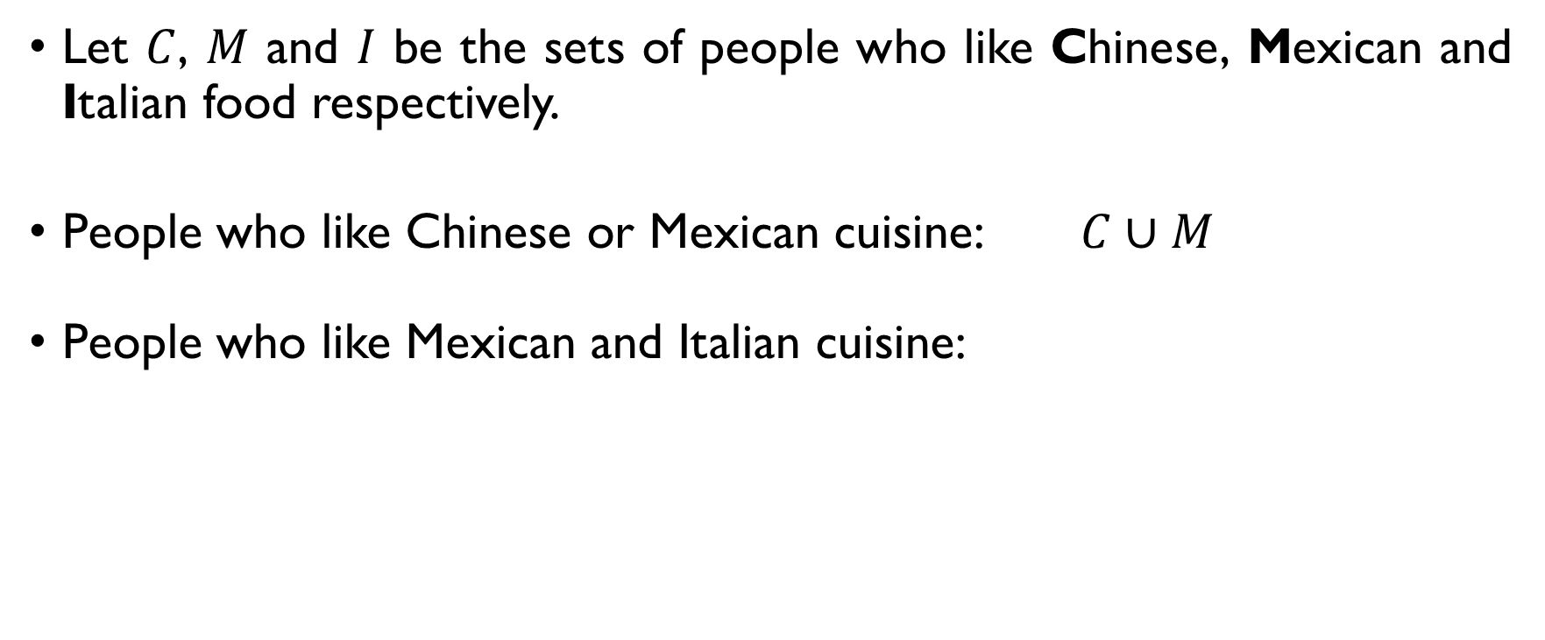
SET OPERATIONS: REVISION
Let $C$, $M$ and $I$ be the sets of people who like Chinese, Mexican and Italian food respectively.
People who like Chinese or Mexican cuisine: $C∪M$
People who like Mexican and Italian cuisine: $M∩I$
People who like at least one of the cuisine: $C∪M∪I$
People who like all three cuisines: $C∩M∩I$

Slide 81
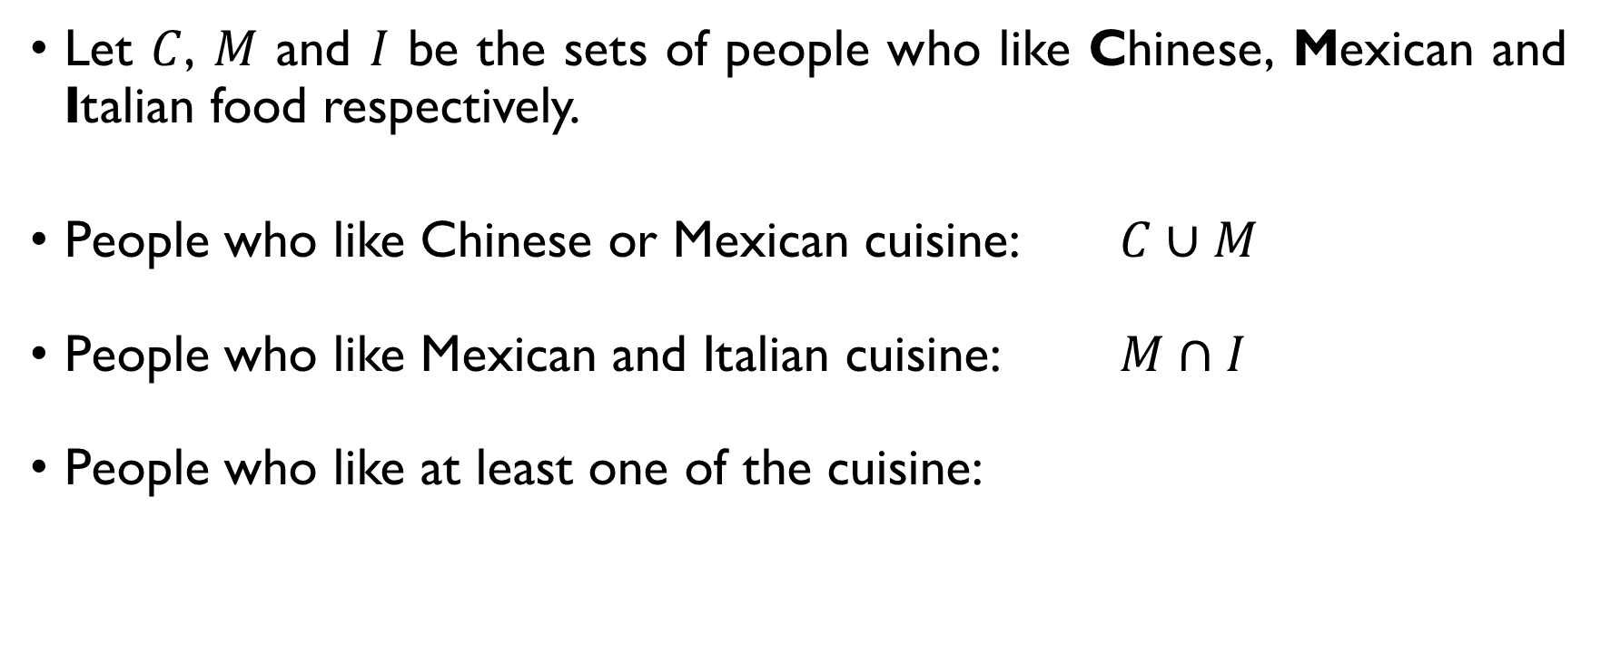
SET OPERATIONS: REVISION
Let $C$, $M$ and $I$ be the sets of people who like Chinese, Mexican and Italian food respectively.
People who like Chinese or Mexican cuisine: $C∪M$
People who like Mexican and Italian cuisine: $M∩I$
People who like at least one of the cuisine: $C∪M∪I$
People who like all three cuisines: $C∩M∩I$

Slide 82
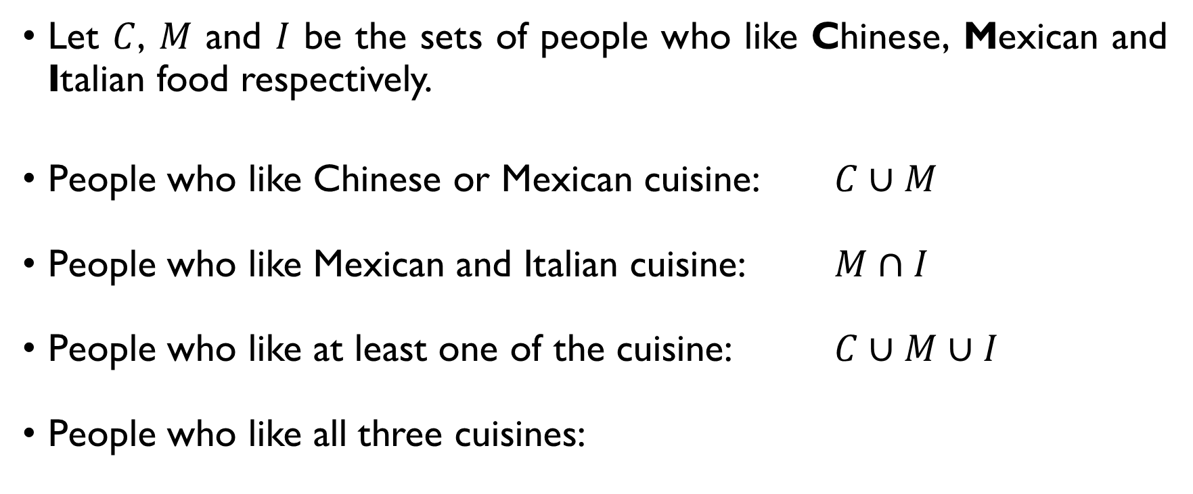
SET OPERATIONS: REVISION
Let $C$, $M$ and $I$ be the sets of people who like Chinese, Mexican and Italian food respectively.
People who like Chinese or Mexican cuisine: $C∪M$
People who like Mexican and Italian cuisine: $M∩I$
People who like at least one of the cuisine: $C∪M∪I$
People who like all three cuisines: $C∩M∩I$

Slide 83
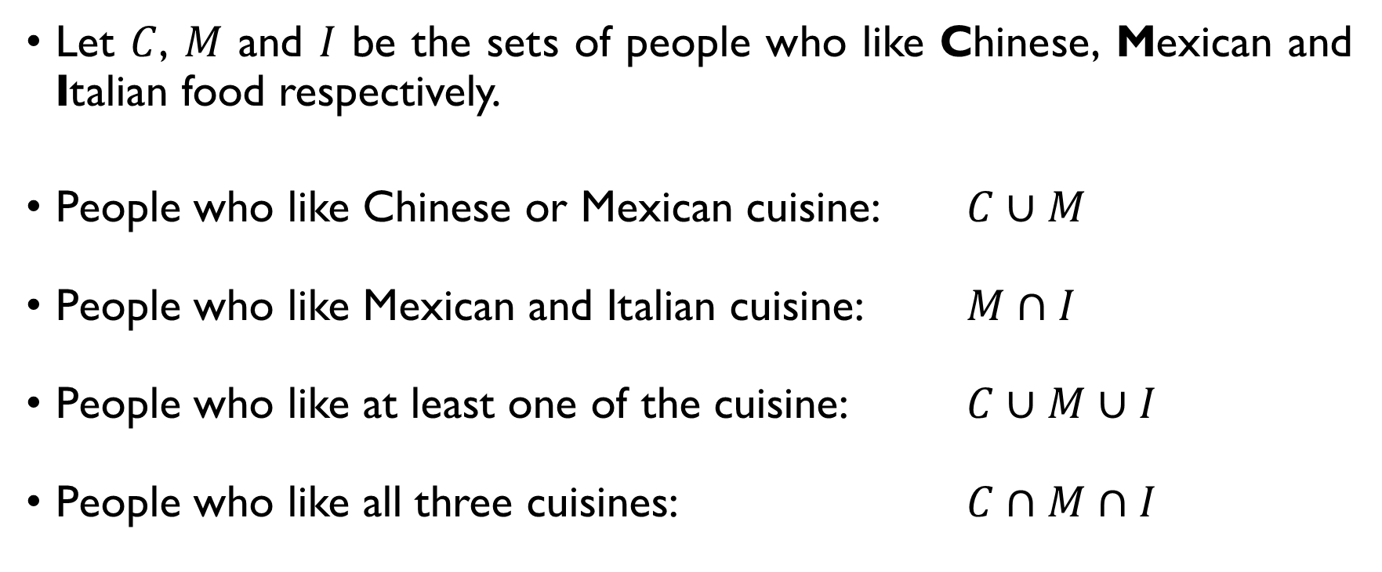
SET OPERATIONS: REVISION
Let $C$, $M$ and $I$ be the sets of people who like Chinese, Mexican and Italian food respectively.
People who like Chinese or Mexican cuisine: $C∪M$
People who like Mexican and Italian cuisine: $M∩I$
People who like at least one of the cuisine: $C∪M∪I$
People who like all three cuisines: $C∩M∩I$

Slide 84
THE PRINCIPLE OF INCLUSION-EXCLUSION

Slide 85
COUNT NUMBERS DIVISIBLE BY 3
How many numbers between 1 and 100 are divisible by 3? Every 3rd number is divisible by 3: 3, 6, 9, …, 93, 96, 99. Thus, there are [100 / 3] = 33 of them.

Slide 86
COUNT NUMBERS DIVISIBLE BY 3
How many numbers between 1 and 100 are divisible by 3? Every 3rd number is divisible by 3: 3, 6, 9, …, 93, 96, 99. Thus, there are [100 / 3] = 33 of them.

Slide 87
COUNT NUMBERS DIVISIBLE BY 3
How many numbers between 1 and 100 are divisible by 3? Every 3rd number is divisible by 3: 3, 6, 9, …, 93, 96, 99. Thus, there are [100 / 3] = 33 of them.

Slide 88
COUNT NUMBERS DIVISIBLE BY 5
How many numbers between 1 and 100 are divisible by 5? Every 5th number is divisible by 5: 5, 10, 15, …, 95, 95, 100. Thus, there are [100 / 5] = 20 of them.

Slide 89
COUNT NUMBERS DIVISIBLE BY 5
How many numbers between 1 and 100 are divisible by 5? Every 5th number is divisible by 5: 5, 10, 15, …, 95, 95, 100. Thus, there are [100 / 5] = 20 of them.

Slide 90
COUNT NUMBERS DIVISIBLE BY 5
How many numbers between 1 and 100 are divisible by 5? Every 5th number is divisible by 5: 5, 10, 15, …, 95, 95, 100. Thus, there are [100 / 5] = 20 of them.

Slide 91
COUNT NUMBERS DIVISIBLE BY 3 & 5
How many numbers between 1 and 100 are divisible by 3? 33
How many numbers between 1 and 100 are divisible by 5? 20
How many numbers between 1 and 100 are divisible by 3 or 5? Sum rule:
33 numbers divisible by 3 + 20 numbers divisible by 5 = = 55 numbers divisible by 3 or 5.

Slide 92
COUNT NUMBERS DIVISIBLE BY 3 & 5
How many numbers between 1 and 100 are divisible by 3? 33
How many numbers between 1 and 100 are divisible by 5? 20
How many numbers between 1 and 100 are divisible by 3 or 5? Sum rule:
33 numbers divisible by 3 + 20 numbers divisible by 5 = = 53 numbers divisible by 3 or 5.

Slide 93

COUNT NUMBERS DIVISIBLE BY 3 & 5
How many numbers between 1 and 100 are divisible by 3? 33
How many numbers between 1 and 100 are divisible by 5? 20
How many numbers between 1 and 100 are divisible by 3 or 5? Sum rule:
33 numbers divisible by 3 + 20 numbers divisible by 5 = = 53 numbers divisible by 3 or 5.

Slide 94

ADDITION PRINCIPLE
If A and B are disjoint sets (A ∩ B = $∅$), then
|A ∪ B | = |A| + |B|

Slide 95

ADDITION PRINCIPLE
If A and B are disjoint sets (A ∩ B = $∅$), then
|A ∪ B | = |A| + |B|
A
B

Slide 96
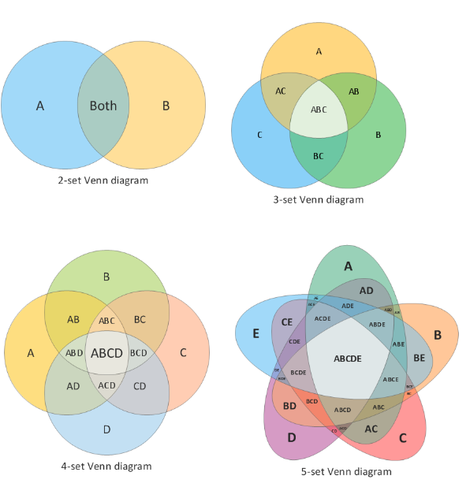

Inclusion-exclusion (2 sets)
If A and B are not disjoint (A ∩ B = $∅$), then
|A ∪ B | = |A| + |B| – |A ∩ B|

Slide 97

Inclusion-exclusion (2 sets)
If A and B are not disjoint (A ∩ B = $∅$), then
|A ∪ B | = |A| + |B| – |A ∩ B|

Slide 98
Inclusion-exclusion (2 sets)
If A and B are not disjoint (A ∩ B = $∅$), then
|A ∪ B | = |A| + |B| – |A ∩ B|
Problem: counting this area twice

Slide 99

Inclusion-exclusion (2 sets)
If A and B are not disjoint (A ∩ B = $∅$), then
|A ∪ B | = |A| + |B| – |A ∩ B|
Problem: counting this area twice

Slide 100
Back to our example
Sum rule:
33 numbers divisible by 3 + 20 numbers divisible by 5 = = 53 numbers divisible by 3 or 5.
Problem: there are numbers which are divisible both by 3 and 5 (e.g., 15, 30, 45, …).

Slide 101
Back to our example
Sum rule:
33 numbers divisible by 3 + 20 numbers divisible by 5 = = 53 numbers divisible by 3 or 5.
Problem: there are numbers which are divisible both by 3 and 5 (e.g., 15, 30, 45, …).

Slide 102
Back to our example
Sum rule:
33 numbers divisible by 3 + 20 numbers divisible by 5 = = 53 numbers divisible by 3 or 5.
Problem: there are numbers which are divisible both by 3 and 5 (e.g., 15, 30, 45, …).
Numbers divisible by 3
Numbers divisible by 5

Slide 103
Back to our example
Sum rule:
33 numbers divisible by 3 + 20 numbers divisible by 5 = = 53 numbers divisible by 3 or 5.
Problem: there are numbers which are divisible both by 3 and 5 (e.g., 15, 30, 45, …).
Numbers divisible by 3
Numbers divisible by 15
Numbers divisible by 5

Slide 104

Back to our example
How many numbers between 1 and 100 are divisible by 3 or 5?
$$\left|D_{3}∪D_{5}\right|=\left|D_{3}\right|+\left|D_{5}\right|−\left|D_{15}\right|= \\ =33+20−6=47$$
Numbers divisible by 3
Numbers divisible by 15
Numbers divisible by 5

Slide 105

Back to our example
How many numbers between 1 and 100 are divisible by 3 or 5?
$$\left|D_{3}∪D_{5}\right|=\left|D_{3}\right|+\left|D_{5}\right|−\left|D_{15}\right|= \\ =33+20−6=47$$
Numbers divisible by 3
Numbers divisible by 15
Numbers divisible by 5

Slide 106

Back to our example
How many numbers between 1 and 100 are divisible by 3 or 5?
$$\left|D_{3}∪D_{5}\right|=\left|D_{3}\right|+\left|D_{5}\right|−\left|D_{15}\right|= \\ =33+20−6=47.$$
Numbers divisible by 3
Numbers divisible by 15
Numbers divisible by 5

Slide 107
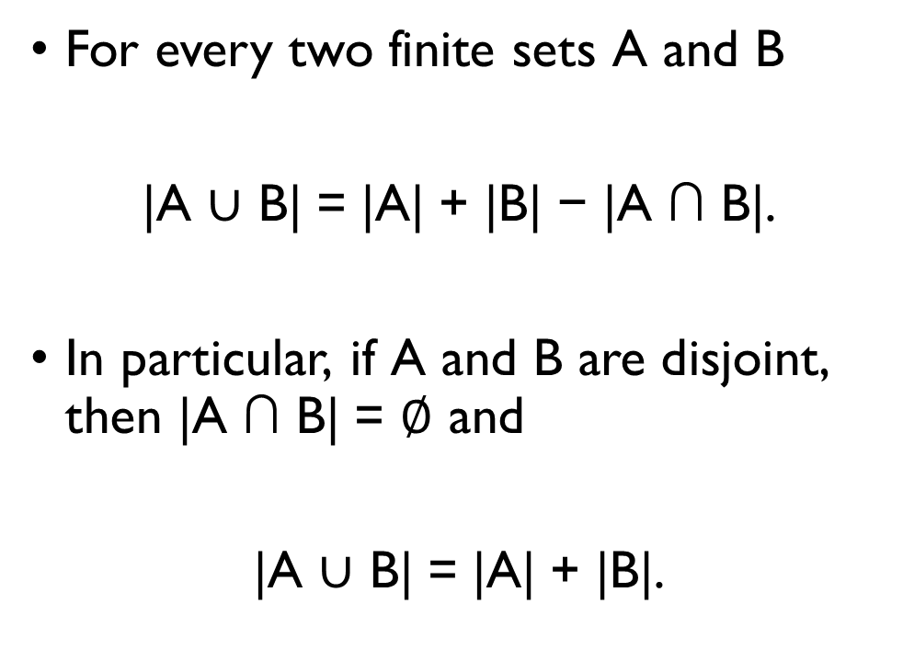
PRINCIPLE OF INCLUSION-EXCLUSION for two sets
For every two finite sets A and B
|A ∪ B| = |A| + |B| − |A ∩ B|.
In particular, if A and B are disjoint, then |A ∩ B| = $∅$ and
|A ∪ B| = |A| + |B|.
A
B

Slide 108
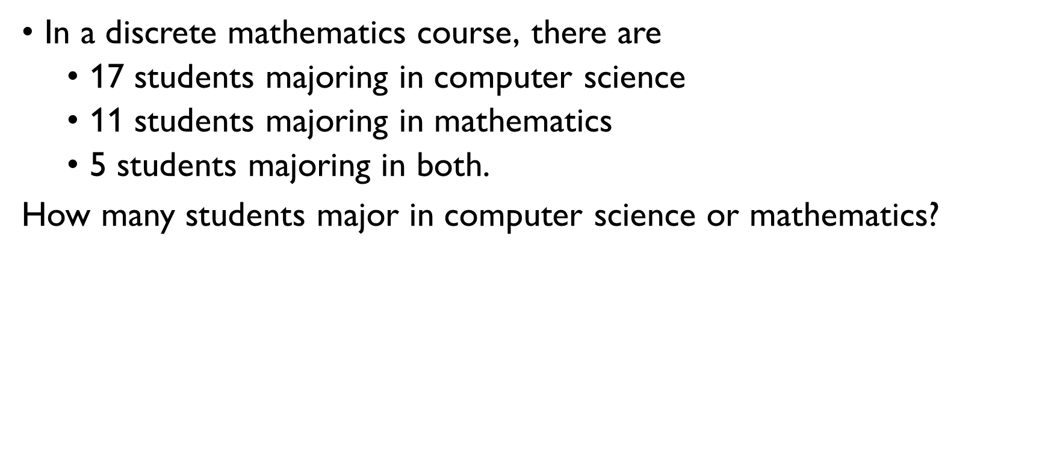
EXAMPLE: STUDENTS
In a discrete mathematics course, there are
17 students majoring in computer science set C
11 students majoring in mathematics set M
5 students majoring in both.
How many students major in computer science or mathematics?
Students majoring in CS or Math: $C∪M$
$$\left|C∪M\right|=\left|C\right|+\left|M\right|−\left|C∩M\right|=$$ $=17+11−5=23$ students majoring in CS of Math

Slide 109
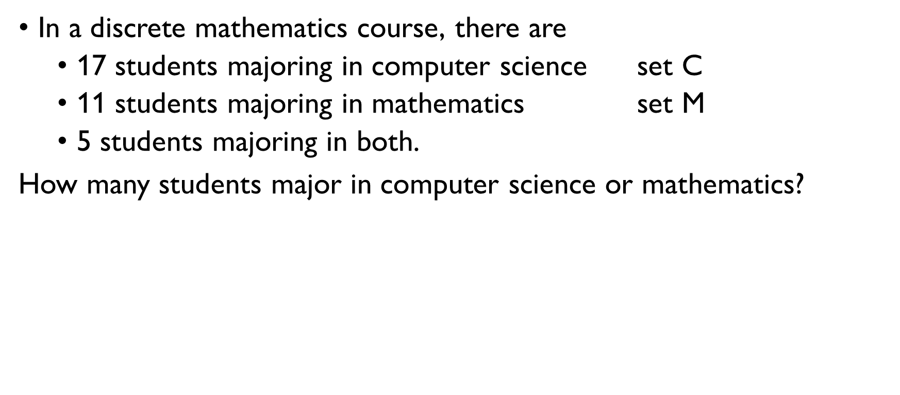
EXAMPLE: STUDENTS
In a discrete mathematics course, there are
17 students majoring in computer science set C
11 students majoring in mathematics set M
5 students majoring in both.
How many students major in computer science or mathematics?
Students majoring in CS or Math: $C∪M$
$$\left|C∪M\right|=\left|C\right|+\left|M\right|−\left|C∩M\right|=$$ $=17+11−5=23$ students majoring in CS of Math

Slide 110
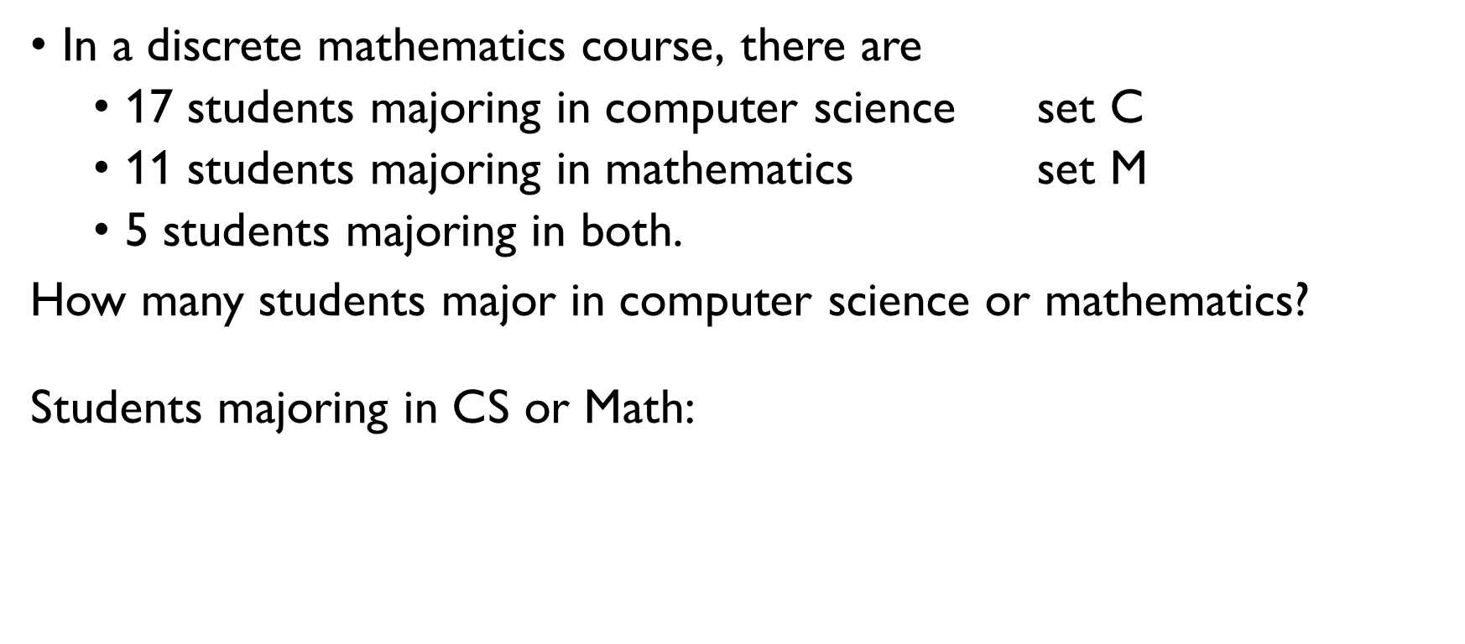
EXAMPLE: STUDENTS
In a discrete mathematics course, there are
17 students majoring in computer science set C
11 students majoring in mathematics set M
5 students majoring in both.
How many students major in computer science or mathematics?
Students majoring in CS or Math: $C∪M$
$$\left|C∪M\right|=\left|C\right|+\left|M\right|−\left|C∩M\right|=$$ $=17+11−5=23$ students majoring in CS of Math

Slide 111
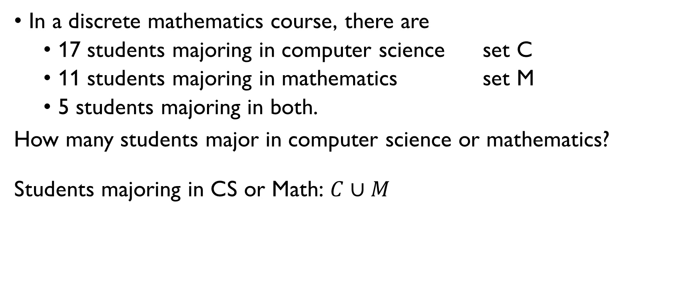
EXAMPLE: STUDENTS
In a discrete mathematics course, there are
17 students majoring in computer science set C
11 students majoring in mathematics set M
5 students majoring in both.
How many students major in computer science or mathematics?
Students majoring in CS or Math: $C∪M$
$$\left|C∪M\right|=\left|C\right|+\left|M\right|−\left|C∩M\right|=$$ $=17+11−5=23$ students majoring in CS of Math

Slide 112
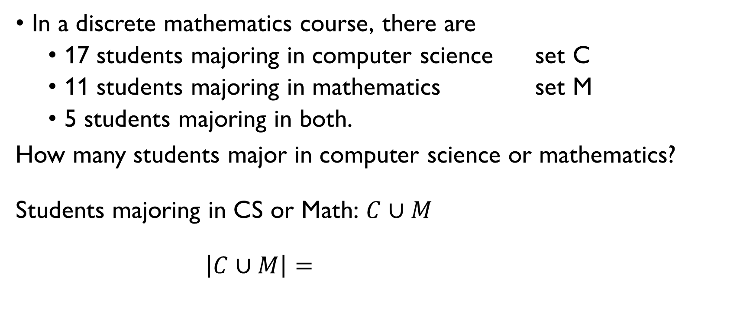
EXAMPLE: STUDENTS
In a discrete mathematics course, there are
17 students majoring in computer science set C
11 students majoring in mathematics set M
5 students majoring in both.
How many students major in computer science or mathematics?
Students majoring in CS or Math: $C∪M$
$$\left|C∪M\right|=\left|C\right|+\left|M\right|−\left|C∩M\right|=$$ $=17+11−5=23$ students majoring in CS of Math

Slide 113
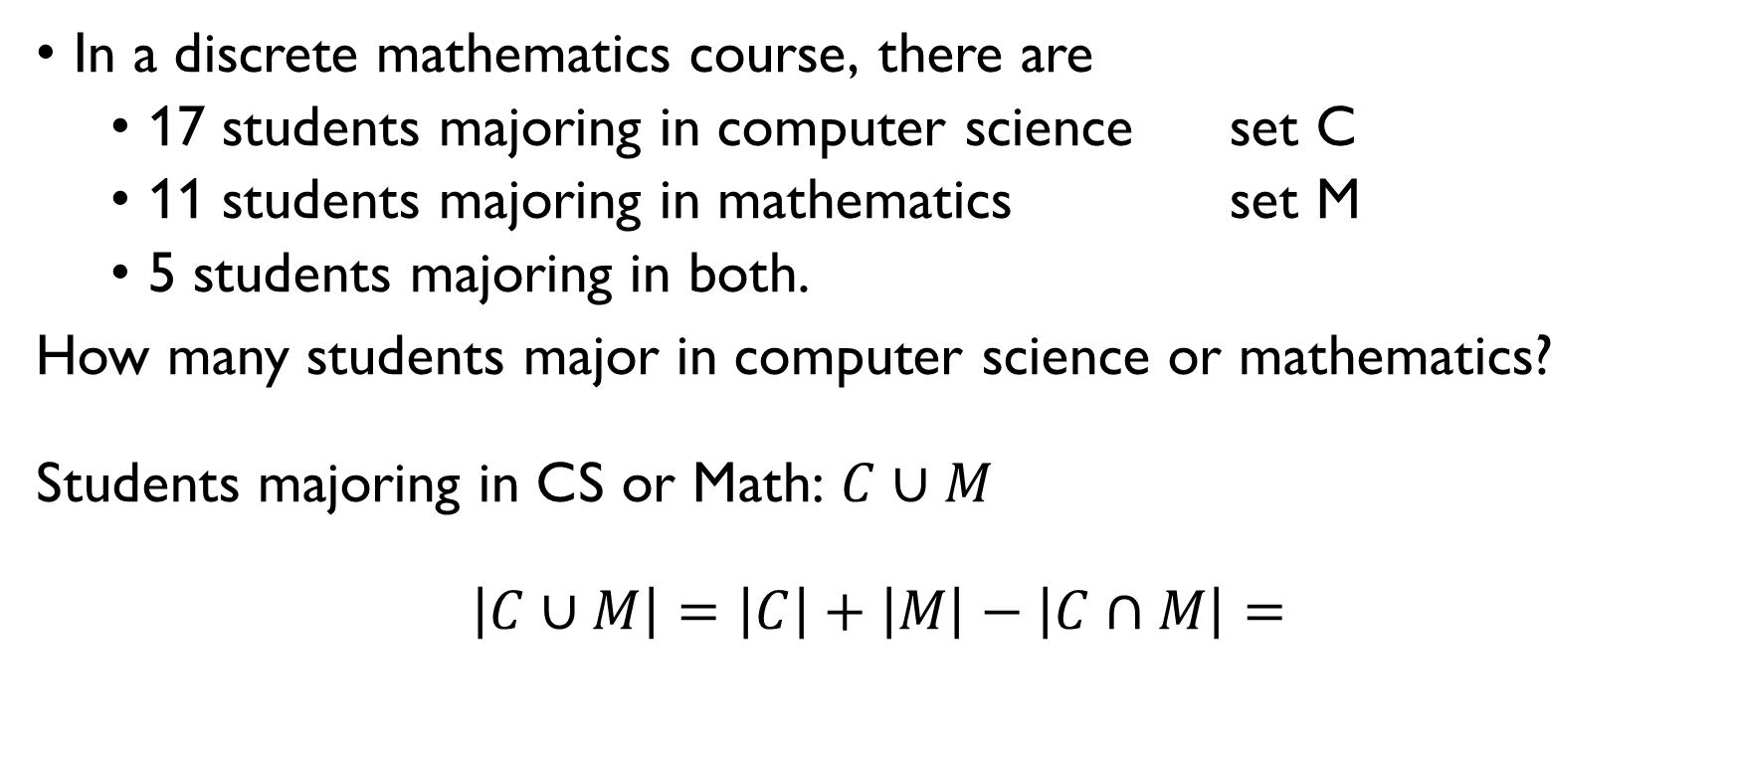
EXAMPLE: STUDENTS
In a discrete mathematics course, there are
17 students majoring in computer science set C
11 students majoring in mathematics set M
5 students majoring in both.
How many students major in computer science or mathematics?
Students majoring in CS or Math: $C∪M$
$$\left|C∪M\right|=\left|C\right|+\left|M\right|−\left|C∩M\right|=$$ $=17+11−5=23$ students majoring in CS of Math

Slide 114
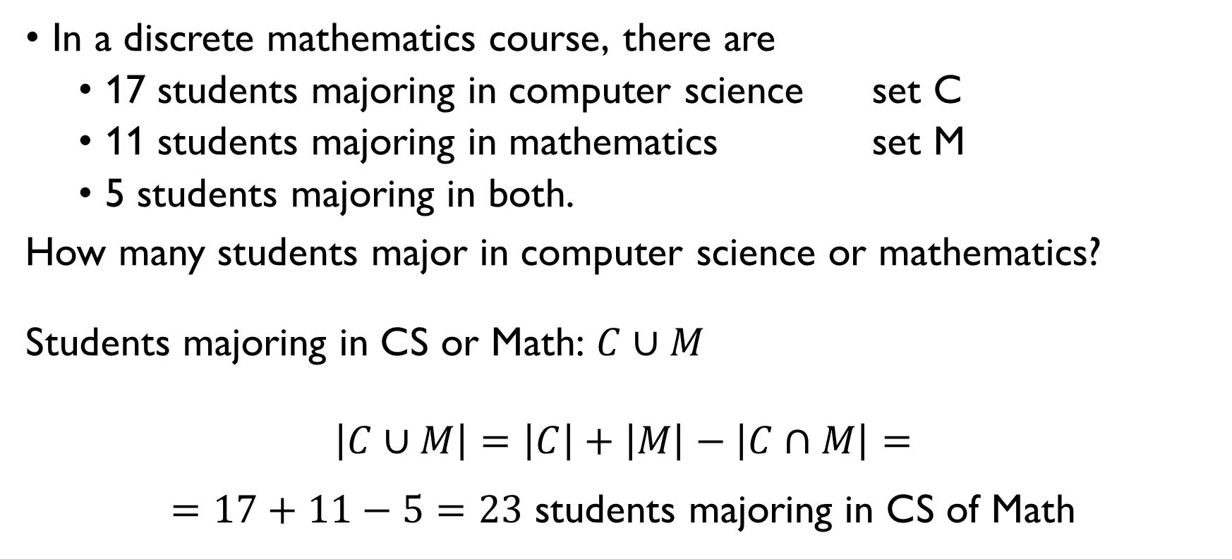
EXAMPLE: STUDENTS
In a discrete mathematics course, there are
17 students majoring in computer science set C
11 students majoring in mathematics set M
5 students majoring in both.
How many students major in computer science or mathematics?
Students majoring in CS or Math: $C∪M$
$$\left|C∪M\right|=\left|C\right|+\left|M\right|−\left|C∩M\right|=$$ $=17+11−5=23$ students majoring in CS of Math

Slide 115
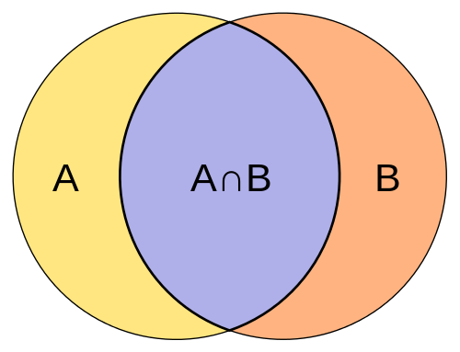
EXAMPLE: STUDENTS
|CS| = 17
|Math| = 11
In a discrete mathematics course, there are
17 students majoring in computer science
11 students majoring in mathematics
5 students majoring in both.
CS only
CS and Math
5
Math only

Slide 116
EXAMPLE: STUDENTS
|CS| = 17
|Math| = 11
In a discrete mathematics course, there are
17 students majoring in computer science
11 students majoring in mathematics
5 students majoring in both.
CS only
?
CS and Math
5
Math only

Slide 117
EXAMPLE: STUDENTS
|CS| = 17
|Math| = 11
In a discrete mathematics course, there are
17 students majoring in computer science
11 students majoring in mathematics
5 students majoring in both.
CS only
17 – 5 =
= 12
CS and Math
5
Math only
?

Slide 118
EXAMPLE: STUDENTS
|CS| = 17
|Math| = 11
In a discrete mathematics course, there are
17 students majoring in computer science
11 students majoring in mathematics
5 students majoring in both.
CS only
17 – 5 =
= 12
CS and Math
5
Math only
11 – 5 = 6

Slide 119

Example: 8-bit strings
How many 8-bit sequences begin with 110 or end with 1100? # begin with 110: $N_{110} =2⋅2⋅2⋅2⋅2=2^{5}=32$ # end with 1100: $N_{1100} =2⋅2⋅2⋅2=2^{4}=16$ # begin with 110 and end with 1100: $N_{110, 1100}=2$
$$N=N_{110}+N_{1100}−N_{110, 1100}=32+16−2=46$$

Slide 120

Example: 8-bit strings
How many 8-bit sequences begin with 110 or end with 1100?
$$N=N_{begin with 110}+N_{end with 1100}−N_{begin with 110 and end with 1100}$$

Slide 121

Example: 8-bit strings
How many 8-bit sequences begin with 110 or end with 1100? # begin with 110: $N_{110} =2⋅2⋅2⋅2⋅2=2^{5}=32$ # end with 1100: $N_{1100} =2⋅2⋅2⋅2=2^{4}=16$ # begin with 110 and end with 1100: $N_{110, 1100}=2$
$$N=N_{110}+N_{1100}−N_{110, 1100}=32+16−2=46$$

Slide 122
Example: 8-bit strings
How many 8-bit sequences begin with 110 or end with 1100? # begin with 110: $N_{110} =2⋅2⋅2⋅2⋅2=2^{5}=32$ # end with 1100: $N_{1100} =2⋅2⋅2⋅2=2^{4}=16$ # begin with 110 and end with 1100: $N_{110, 1100}=2$
$$N=N_{110}+N_{1100}−N_{110, 1100}=32+16−2=46$$
1 | 1 | 0 | * | * | * | * | *

Slide 123
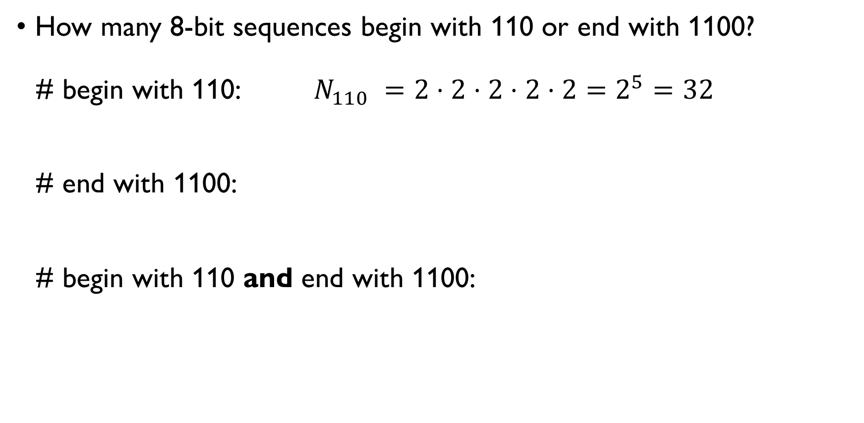
Example: 8-bit strings
How many 8-bit sequences begin with 110 or end with 1100? # begin with 110: $N_{110} =2⋅2⋅2⋅2⋅2=2^{5}=32$ # end with 1100: $N_{1100} =2⋅2⋅2⋅2=2^{4}=16$ # begin with 110 and end with 1100: $N_{110, 1100}=2$
$$N=N_{110}+N_{1100}−N_{110, 1100}=32+16−2=46$$
1 | 1 | 0 | * | * | * | * | *

Slide 124
Example: 8-bit strings
How many 8-bit sequences begin with 110 or end with 1100? # begin with 110: $N_{110} =2⋅2⋅2⋅2⋅2=2^{5}=32$ # end with 1100: $N_{1100} =2⋅2⋅2⋅2=2^{4}=16$ # begin with 110 and end with 1100: $N_{110, 1100}=2$
$$N=N_{110}+N_{1100}−N_{110, 1100}=32+16−2=46$$
1 | 1 | 0 | * | * | * | * | *
* | * | * | * | 1 | 1 | 0 | 0

Slide 125
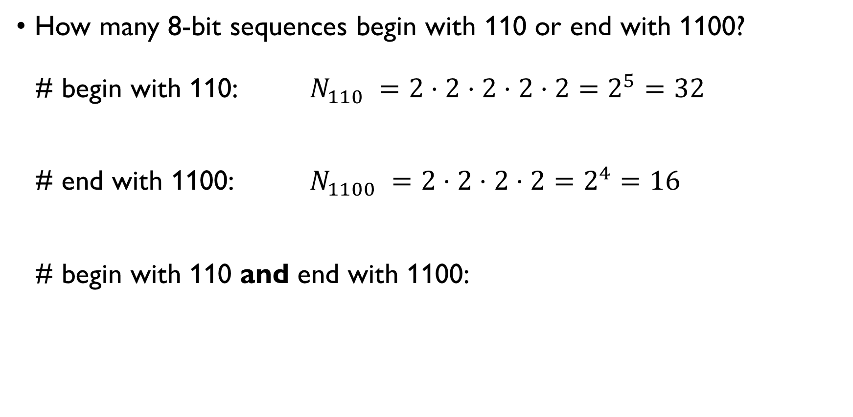
Example: 8-bit strings
How many 8-bit sequences begin with 110 or end with 1100? # begin with 110: $N_{110} =2⋅2⋅2⋅2⋅2=2^{5}=32$ # end with 1100: $N_{1100} =2⋅2⋅2⋅2=2^{4}=16$ # begin with 110 and end with 1100: $N_{110, 1100}=2$
$$N=N_{110}+N_{1100}−N_{110, 1100}=32+16−2=46$$
1 | 1 | 0 | * | * | * | * | *
* | * | * | * | 1 | 1 | 0 | 0

Slide 126
Example: 8-bit strings
How many 8-bit sequences begin with 110 or end with 1100? # begin with 110: $N_{110} =2⋅2⋅2⋅2⋅2=2^{5}=32$ # end with 1100: $N_{1100} =2⋅2⋅2⋅2=2^{4}=16$ # begin with 110 and end with 1100: $N_{110, 1100}=2$
$$N=N_{110}+N_{1100}−N_{110, 1100}=32+16−2=46$$
1 | 1 | 0 | * | * | * | * | *
* | * | * | * | 1 | 1 | 0 | 0
1 | 1 | 0 | * | 1 | 1 | 0 | 0

Slide 127
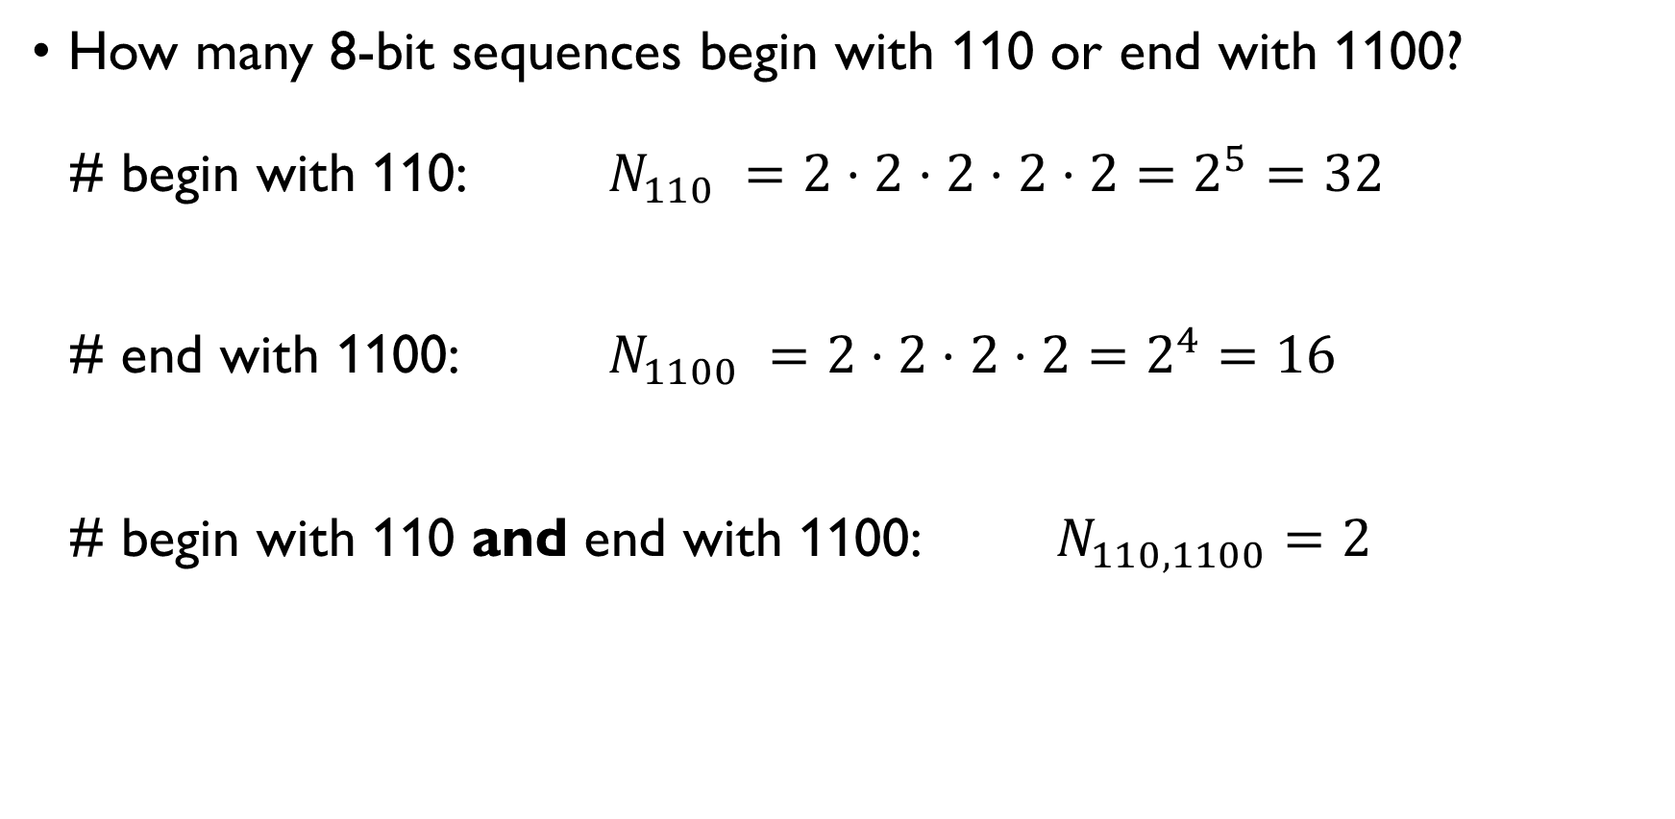
Example: 8-bit strings
How many 8-bit sequences begin with 110 or end with 1100? # begin with 110: $N_{110} =2⋅2⋅2⋅2⋅2=2^{5}=32$ # end with 1100: $N_{1100} =2⋅2⋅2⋅2=2^{4}=16$ # begin with 110 and end with 1100: $N_{110, 1100}=2$
$$N=N_{110}+N_{1100}−N_{110, 1100}=32+16−2=46$$
1 | 1 | 0 | * | * | * | * | *
* | * | * | * | 1 | 1 | 0 | 0
1 | 1 | 0 | * | 1 | 1 | 0 | 0

Slide 128
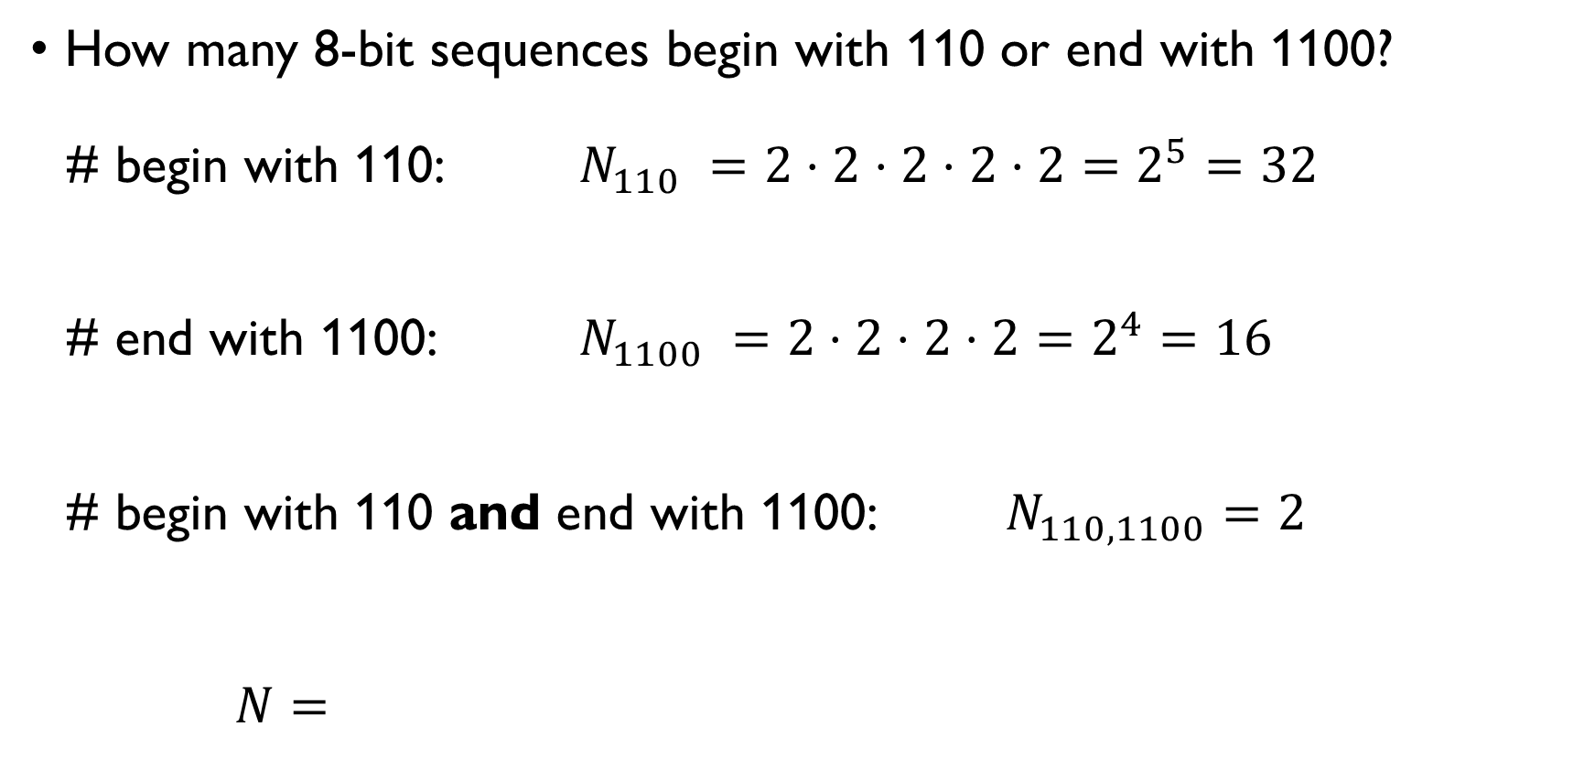
Example: 8-bit strings
How many 8-bit sequences begin with 110 or end with 1100? # begin with 110: $N_{110} =2⋅2⋅2⋅2⋅2=2^{5}=32$ # end with 1100: $N_{1100} =2⋅2⋅2⋅2=2^{4}=16$ # begin with 110 and end with 1100: $N_{110, 1100}=2$
$$N=N_{110}+N_{1100}−N_{110, 1100}=32+16−2=46$$
1 | 1 | 0 | * | * | * | * | *
* | * | * | * | 1 | 1 | 0 | 0
1 | 1 | 0 | * | 1 | 1 | 0 | 0

Slide 129
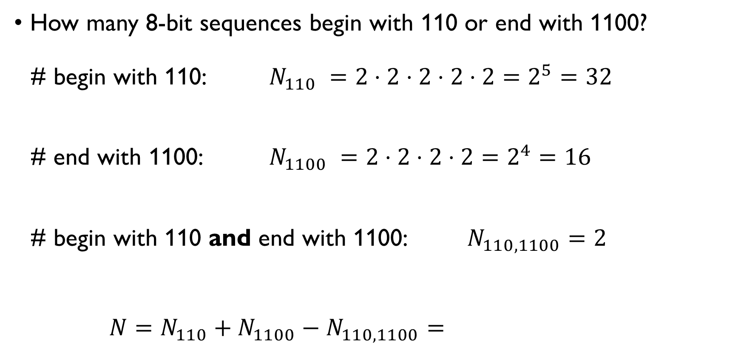
Example: 8-bit strings
How many 8-bit sequences begin with 110 or end with 1100? # begin with 110: $N_{110} =2⋅2⋅2⋅2⋅2=2^{5}=32$ # end with 1100: $N_{1100} =2⋅2⋅2⋅2=2^{4}=16$ # begin with 110 and end with 1100: $N_{110, 1100}=2$
$$N=N_{110}+N_{1100}−N_{110, 1100}=32+16−2=46$$
1 | 1 | 0 | * | * | * | * | *
* | * | * | * | 1 | 1 | 0 | 0
1 | 1 | 0 | * | 1 | 1 | 0 | 0

Slide 130
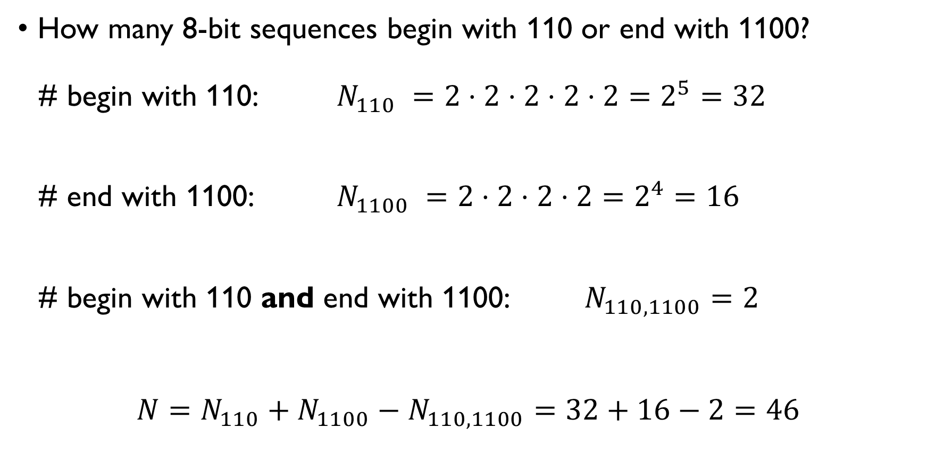
Example: 8-bit strings
How many 8-bit sequences begin with 110 or end with 1100? # begin with 110: $N_{110} =2⋅2⋅2⋅2⋅2=2^{5}=32$ # end with 1100: $N_{1100} =2⋅2⋅2⋅2=2^{4}=16$ # begin with 110 and end with 1100: $N_{110, 1100}=2$
$$N=N_{110}+N_{1100}−N_{110, 1100}=32+16−2=46$$
1 | 1 | 0 | * | * | * | * | *
* | * | * | * | 1 | 1 | 0 | 0
1 | 1 | 0 | * | 1 | 1 | 0 | 0

Slide 131

An Inequality application
In a group of 50 people, 30 own a dog and 25 own a cat. What can we say about the number of people who own both a dog and a cat?
$$\left|D∪C\right|=\left|D\right|+\left|C\right|−\left|D∩C\right|$$
$$\left|D\right|+\left|C\right|=30+25=55$$
$\left|D∪C\right|≤50$
$$50≥55−\left|D∩C\right|$$
$$\left|D∩C\right|≥5$$
At least 5 people must own both a dog and a cat.

Slide 132
An Inequality application
In a group of 50 people, 30 own a dog and 25 own a cat. What can we say about the number of people who own both a dog and a cat?
$$\left|D∪C\right|=\left|D\right|+\left|C\right|−\left|D∩C\right|$$
$$\left|D\right|+\left|C\right|=30+25=55$$
$\left|D∪C\right|≤50$
$$50≥55−\left|D∩C\right|$$
$$\left|D∩C\right|≥5$$
At least 5 people must own both a dog and a cat.
Dog owners
Cat owners

Slide 133
An Inequality application
In a group of 50 people, 30 own a dog and 25 own a cat. What can we say about the number of people who own both a dog and a cat?
$$\left|D∪C\right|=\left|D\right|+\left|C\right|−\left|D∩C\right|$$
$$\left|D\right|+\left|C\right|=30+25=55$$
$\left|D∪C\right|≤50$
$$50≥55−\left|D∩C\right|$$
$$\left|D∩C\right|≥5$$
At least 5 people must own both a dog and a cat.
All respondents
Cat owners
?
Dog owners

Slide 134

An Inequality application
In a group of 50 people, 30 own a dog and 25 own a cat. What can we say about the number of people who own both a dog and a cat?
$$\left|D∪C\right|=\left|D\right|+\left|C\right|−\left|D∩C\right|$$
$$\left|D\right|+\left|C\right|=30+25=55$$
$\left|D∪C\right|≤50$
$$50≥55−\left|D∩C\right|$$
$$\left|D∩C\right|≥5$$
At least 5 people must own both a dog and a cat.
All respondents
Cat owners
?
Dog owners

Slide 135

An Inequality application
In a group of 50 people, 30 own a dog and 25 own a cat. What can we say about the number of people who own both a dog and a cat?
$$\left|D∪C\right|=\left|D\right|+\left|C\right|−\left|D∩C\right|$$
$$\left|D\right|+\left|C\right|=30+25=55$$
$\left|D∪C\right|≤50$
$$50≥55−\left|D∩C\right|$$
$$\left|D∩C\right|≥5$$
At least 5 people must own both a dog and a cat.
All respondents
Cat owners
?
Dog owners

Slide 136

An Inequality application
In a group of 50 people, 30 own a dog and 25 own a cat. What can we say about the number of people who own both a dog and a cat?
$$\left|D∪C\right|=\left|D\right|+\left|C\right|−\left|D∩C\right|$$
$$\left|D\right|+\left|C\right|=30+25=55$$
$\left|D∪C\right|≤50$
$$50≥55−\left|D∩C\right|$$
$$\left|D∩C\right|≥5$$
At least 5 people must own both a dog and a cat.
All respondents
Cat owners
?
Dog owners

Slide 137

An Inequality application
In a group of 50 people, 30 own a dog and 25 own a cat. What can we say about the number of people who own both a dog and a cat?
$$\left|D∪C\right|=\left|D\right|+\left|C\right|−\left|D∩C\right|$$
$$\left|D\right|+\left|C\right|=30+25=55$$
$\left|D∪C\right|≤50$
$$50≥55−\left|D∩C\right|$$
$$\left|D∩C\right|≥5$$
At least 5 people must own both a dog and a cat.
All respondents
Cat owners
?
Dog owners

Slide 138

An Inequality application
In a group of 50 people, 30 own a dog and 25 own a cat. What can we say about the number of people who own both a dog and a cat?
$$\left|D∪C\right|=\left|D\right|+\left|C\right|−\left|D∩C\right|$$
$$\left|D\right|+\left|C\right|=30+25=55$$
$\left|D∪C\right|≤50$
$$50≥55−\left|D∩C\right|$$
$$\left|D∩C\right|≥5$$
At least 5 people must own both a dog and a cat.
All respondents
Cat owners
?
Dog owners

Slide 139

An Inequality application
In a group of 50 people, 30 own a dog and 25 own a cat. What can we say about the number of people who own both a dog and a cat?
$$\left|D∪C\right|=\left|D\right|+\left|C\right|−\left|D∩C\right|$$
$$\left|D\right|+\left|C\right|=30+25=55$$
$\left|D∪C\right|≤50$
$$50≥55−\left|D∩C\right|$$
$$\left|D∩C\right|≥5$$
At least 5 people must own both a dog and a cat.
All respondents
Cat owners
?
Dog owners

Slide 140

An Inequality application
In a group of 50 people, 30 own a dog and 25 own a cat. What can we say about the number of people who own both a dog and a cat?
$$\left|D∪C\right|=\left|D\right|+\left|C\right|−\left|D∩C\right|$$
$$\left|D\right|+\left|C\right|=30+25=55$$
$\left|D∪C\right|≤50$
$$50≥55−\left|D∩C\right|$$
$$\left|D∩C\right|≥5$$
At least 5 people must own both a dog and a cat.
All respondents
Dog owners
Cat owners

Slide 141
LET’S PRACTICE!
https://docs.google.com/document/d/1VIDmtgY9qrhqisifcF6R_E37QSOH7-g0Ib25bX4vxiw/edit?usp=sharing
PART I

Slide 142
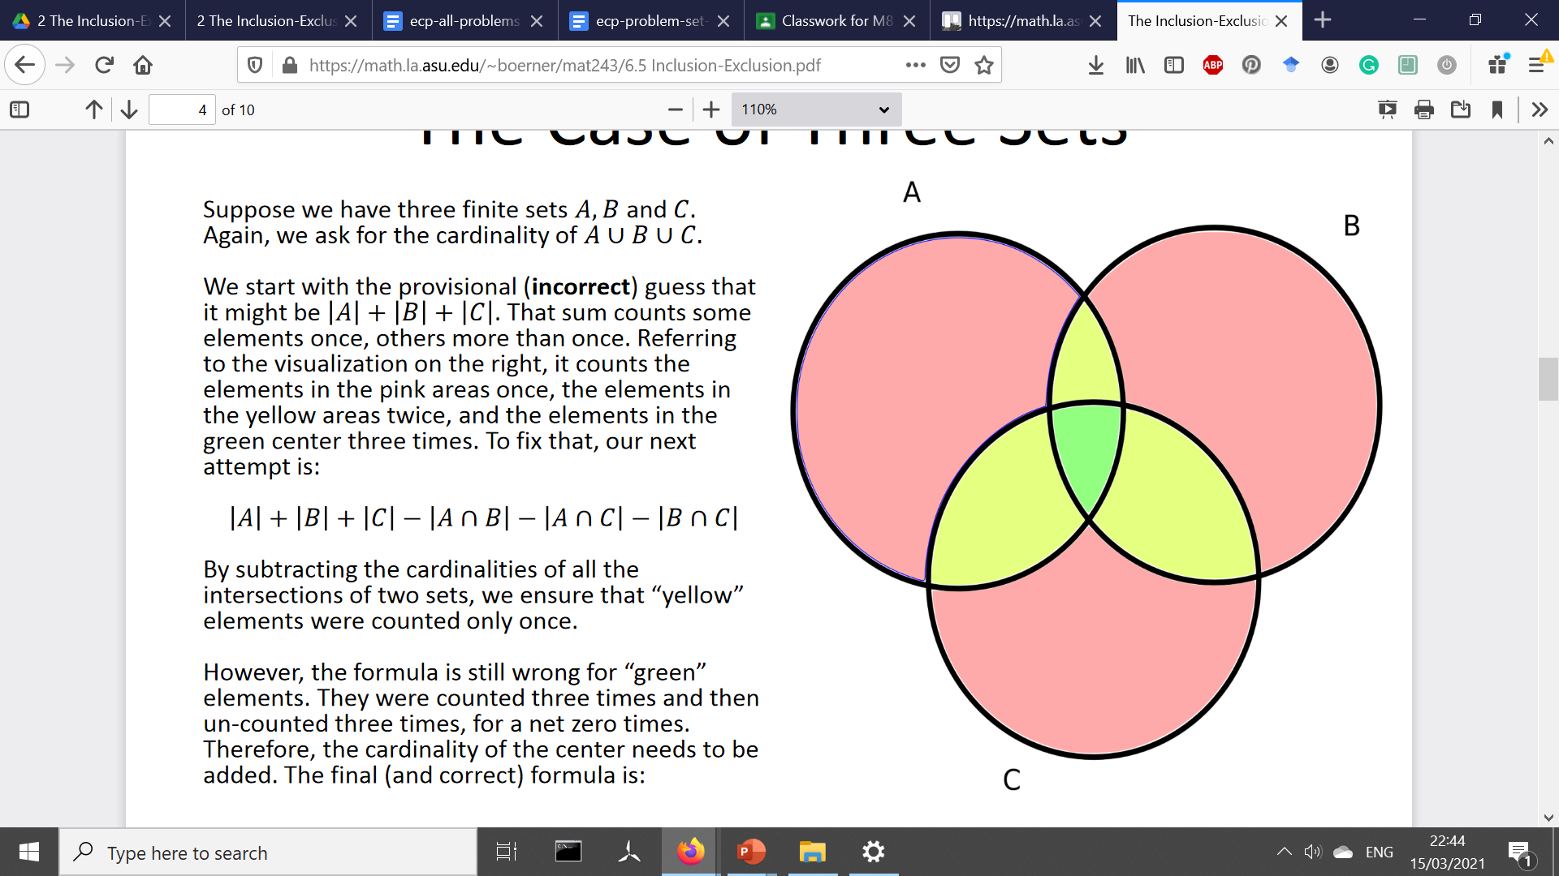
PRINCIPLE OF INCLUSION-EXCLUSION for three sets
For any finite sets A, B and C
|A ∪ B ∪ C| =
= |A| + |B| + |C| − − |A ∩ B| − |A ∩ C| − |B ∩ C| + + |A ∩ B ∩ C|

Slide 143
PRINCIPLE OF INCLUSION-EXCLUSION for three sets
For any finite sets A, B and C
|A ∪ B ∪ C| =
= |A| + |B| + |C| − − |A ∩ B| − |A ∩ C| − |B ∩ C| + + |A ∩ B ∩ C|

Slide 144
PRINCIPLE OF INCLUSION-EXCLUSION for three sets
For any finite sets A, B and C
|A ∪ B ∪ C| =
= |A| + |B| + |C| − − |A ∩ B| − |A ∩ C| − |B ∩ C| + + |A ∩ B ∩ C|

Slide 145
PRINCIPLE OF INCLUSION-EXCLUSION for three sets
For any finite sets A, B and C
|A ∪ B ∪ C| =
= |A| + |B| + |C| − − |A ∩ B| − |A ∩ C| − |B ∩ C| + + |A ∩ B ∩ C|

Slide 146

TRAVELLERS
Travelers are surveyed about the city they want to visit:
Las Vegas: 26
NY: 31
Orlando: 36
Las Vegas and NY: 12
Las Vegas and Orlando: 11
NY and Orlando: 13
all three: 5
How many of these travelers want to visit at least one of the cities?
$$\left|L∪N∪O\right|= \\ =\left|L\right|+\left|N\right|+\left|O\right|− \\ −\left|L∩N\right|−\left|L∩O\right|−\left|N∩O\right|+ \\ +\left|L∩N∩O\right|= \\ =26+31+36− \\ −12−11−13+ \\ + 3=60$$

Slide 147

TRAVELLERS
Travelers are surveyed about the city they want to visit:
Las Vegas: 26
NY: 31
Orlando: 36
Las Vegas and NY: 12
Las Vegas and Orlando: 11
NY and Orlando: 13
all three: 5
How many of these travelers want to visit at least one of the cities?
$$\left|L∪N∪O\right|= \\ =\left|L\right|+\left|N\right|+\left|O\right|− \\ −\left|L∩N\right|−\left|L∩O\right|−\left|N∩O\right|+ \\ +\left|L∩N∩O\right|= \\ =26+31+36− \\ −12−11−13+ \\ + 3=60$$

Slide 148

TRAVELLERS
Travelers are surveyed about the city they want to visit:
Las Vegas: 26
NY: 31
Orlando: 36
Las Vegas and NY: 12
Las Vegas and Orlando: 11
NY and Orlando: 13
all three: 5
How many of these travelers want to visit at least one of the cities?
$$\left|L∪N∪O\right|= \\ =\left|L\right|+\left|N\right|+\left|O\right|− \\ −\left|L∩N\right|−\left|L∩O\right|−\left|N∩O\right|+ \\ +\left|L∩N∩O\right|= \\ =26+31+36− \\ −12−11−13+ \\ + 3=60$$

Slide 149
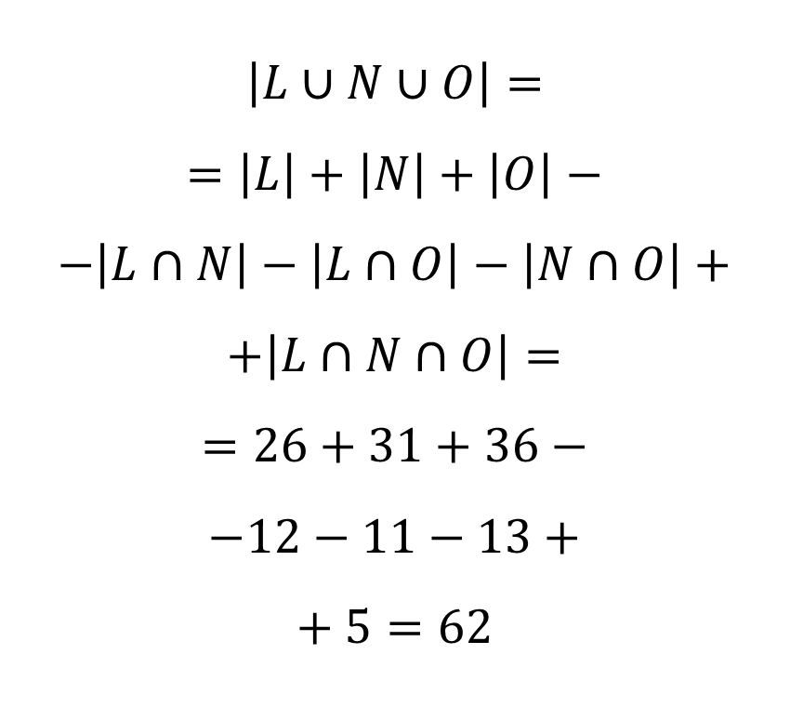
TRAVELLERS
Travelers are surveyed about the city they want to visit:
Las Vegas: 26
NY: 31
Orlando: 36
Las Vegas and NY: 12
Las Vegas and Orlando: 11
NY and Orlando: 13
all three: 5
How many of these travelers want to visit at least one of the cities?
$$\left|L∪N∪O\right|= \\ =\left|L\right|+\left|N\right|+\left|O\right|− \\ −\left|L∩N\right|−\left|L∩O\right|−\left|N∩O\right|+ \\ +\left|L∩N∩O\right|= \\ =26+31+36− \\ −12−11−13+ \\ + 5=62$$

Slide 150
TRAVELLERS 2
Travelers are surveyed about the city they want to visit:
Las Vegas: 26
NY: 31
Orlando: 36
Las Vegas and NY: 12
Las Vegas and Orlando: 11
NY and Orlando: 13
all three: 5
How many of these travelers want to visit at least two of the cities?
5 + 6 + 7 + 8 = 26

Slide 151
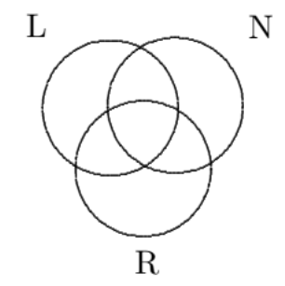
TRAVELLERS 2
Travelers are surveyed about the city they want to visit:
Las Vegas: 26
NY: 31
Orlando: 36
Las Vegas and NY: 12
Las Vegas and Orlando: 11
NY and Orlando: 13
all three: 5
How many of these travelers want to visit at least two of the cities?
O
5 + 6 + 7 + 8 = 26

Slide 152
TRAVELLERS 2
Travelers are surveyed about the city they want to visit:
Las Vegas: 26
NY: 31
Orlando: 36
Las Vegas and NY: 12
Las Vegas and Orlando: 11
NY and Orlando: 13
all three: 5
How many of these travelers want to visit at least two of the cities?
“at least two cities” =
all three cities
NY and L but not O NY and O but not L
L and O but not NY
O
5 + 6 + 7 + 8 = 26

Slide 153
TRAVELLERS 2
Travelers are surveyed about the city they want to visit:
Las Vegas: 26
NY: 31
Orlando: 36
Las Vegas and NY: 12
Las Vegas and Orlando: 11
NY and Orlando: 13
all three: 5
How many of these travelers want to visit at least two of the cities?
“at least two cities” =
all three cities
NY and L but not O NY and O but not L
L and O but not NY
5
O
5 + 6 + 7 + 8 = 26

Slide 154
TRAVELLERS 2
Travelers are surveyed about the city they want to visit:
Las Vegas: 26
NY: 31
Orlando: 36
Las Vegas and NY: 12
Las Vegas and Orlando: 11
NY and Orlando: 13
all three: 5
How many of these travelers want to visit at least two of the cities?
“at least two cities” =
all three cities
NY and L but not O NY and O but not L
L and O but not NY
5
O
5 + 6 + 7 + 8 = 26

Slide 155
TRAVELLERS 2
Travelers are surveyed about the city they want to visit:
Las Vegas: 26
NY: 31
Orlando: 36
Las Vegas and NY: 12
Las Vegas and Orlando: 11
NY and Orlando: 13
all three: 5
How many of these travelers want to visit at least two of the cities?
“at least two cities” =
all three cities
NY and L but not O NY and O but not L
L and O but not NY
7
5
O
5 + 6 + 7 + 8 = 26

Slide 156
TRAVELLERS 2
Travelers are surveyed about the city they want to visit:
Las Vegas: 26
NY: 31
Orlando: 36
Las Vegas and NY: 12
Las Vegas and Orlando: 11
NY and Orlando: 13
all three: 5
How many of these travelers want to visit at least two of the cities?
“at least two cities” =
all three cities
NY and L but not O NY and O but not L
L and O but not NY
7
5
O
5 + 6 + 7 + 8 = 26

Slide 157
TRAVELLERS 2
Travelers are surveyed about the city they want to visit:
Las Vegas: 26
NY: 31
Orlando: 36
Las Vegas and NY: 12
Las Vegas and Orlando: 11
NY and Orlando: 13
all three: 5
How many of these travelers want to visit at least two of the cities?
“at least two cities” =
all three cities
NY and L but not O NY and O but not L
L and O but not NY
7
5
O
5 + 6 + 7 + 8 = 26

Slide 158
TRAVELLERS 2
Travelers are surveyed about the city they want to visit:
Las Vegas: 26
NY: 31
Orlando: 36
Las Vegas and NY: 12
Las Vegas and Orlando: 11
NY and Orlando: 13
all three: 5
How many of these travelers want to visit at least two of the cities?
“at least two cities” =
all three cities
NY and L but not O NY and O but not L
L and O but not NY
7
5
O
5 + 6 + 7 + 8 = 26

Slide 159
TRAVELLERS 2
Travelers are surveyed about the city they want to visit:
Las Vegas: 26
NY: 31
Orlando: 36
Las Vegas and NY: 12
Las Vegas and Orlando: 11
NY and Orlando: 13
all three: 5
How many of these travelers want to visit at least two of the cities?
“at least two cities” =
all three cities
NY and L but not O NY and O but not L
L and O but not NY
7
5
8
O
5 + 6 + 7 + 8 = 26

Slide 160
TRAVELLERS 2
Travelers are surveyed about the city they want to visit:
Las Vegas: 26
NY: 31
Orlando: 36
Las Vegas and NY: 12
Las Vegas and Orlando: 11
NY and Orlando: 13
all three: 5
How many of these travelers want to visit at least two of the cities?
“at least two cities” =
all three cities
NY and L but not O NY and O but not L
L and O but not NY
7
5
8
O
5 + 6 + 7 + 8 = 26

Slide 161
TRAVELLERS 2
Travelers are surveyed about the city they want to visit:
Las Vegas: 26
NY: 31
Orlando: 36
Las Vegas and NY: 12
Las Vegas and Orlando: 11
NY and Orlando: 13
all three: 5
How many of these travelers want to visit at least two of the cities?
“at least two cities” =
all three cities
NY and L but not O NY and O but not L
L and O but not NY
7
5
6
8
O
5 + 6 + 7 + 8 = 26

Slide 162
TRAVELLERS 2
Travelers are surveyed about the city they want to visit:
Las Vegas: 26
NY: 31
Orlando: 36
Las Vegas and NY: 12
Las Vegas and Orlando: 11
NY and Orlando: 13
all three: 5
How many of these travelers want to visit at least two of the cities?
“at least two cities” =
all three cities
NY and L but not O NY and O but not L
L and O but not NY
7
5
6
8
O
5 + 6 + 7 + 8 = 26
5 + 6 + 8 + 7 = 26 people

Slide 163

EXAMPLE: STUDENT CANTEEN
60 students:
31 students like beef;
32 students like chicken;
31 students like fish;
15 students like beef and chicken;
12 students like beef and fish;
19 students like chicken and fish;
8 students like all three.
How many like none of these?
Students who like b, c or f: $B∪C∪F$
$$\left|B∪C∪F\right|=$$
$$=\left|B\right|+\left|C\right|+\left|F\right|−$$
$$−\left|B∩C\right|−\left|B∩F\right|−\left|C∩F\right|$$
$$+\left|B∩C∩F\right|=31+32+31−15−$$ $−12−19+8=56$
Students who don’t like either:
$${\left(B∪C∪F \right)}^{c}$$
$$\left|{\left(B∪C∪F \right)}^{c}\right|=\left|U\right|−\left|B∪C∪F\right|=60−56=4$$

Slide 164

EXAMPLE: STUDENT CANTEEN
60 students:
31 students like beef;
32 students like chicken;
31 students like fish;
15 students like beef and chicken;
12 students like beef and fish;
19 students like chicken and fish;
8 students like all three.
How many like none of these?
Students who like b, c or f: $B∪C∪F$
$$\left|B∪C∪F\right|=$$
$$=\left|B\right|+\left|C\right|+\left|F\right|−$$
$$−\left|B∩C\right|−\left|B∩F\right|−\left|C∩F\right|$$
$$+\left|B∩C∩F\right|=31+32+31−15−$$ $−12−19+8=56$
Students who don’t like either:
$${\left(B∪C∪F \right)}^{c}$$
$$\left|{\left(B∪C∪F \right)}^{c}\right|=\left|U\right|−\left|B∪C∪F\right|=60−56=4$$

Slide 165

EXAMPLE: STUDENT CANTEEN
60 students:
31 students like beef;
32 students like chicken;
31 students like fish;
15 students like beef and chicken;
12 students like beef and fish;
19 students like chicken and fish;
8 students like all three.
How many like none of these?
Students who like b, c or f: $B∪C∪F$
$$\left|B∪C∪F\right|=$$
$$=\left|B\right|+\left|C\right|+\left|F\right|−$$
$$−\left|B∩C\right|−\left|B∩F\right|−\left|C∩F\right|$$
$$+\left|B∩C∩F\right|=31+32+31−15−$$ $−12−19+8=56$
Students who don’t like either:
$${\left(B∪C∪F \right)}^{c}$$
$$\left|{\left(B∪C∪F \right)}^{c}\right|=\left|U\right|−\left|B∪C∪F\right|=60−56=4$$

Slide 166
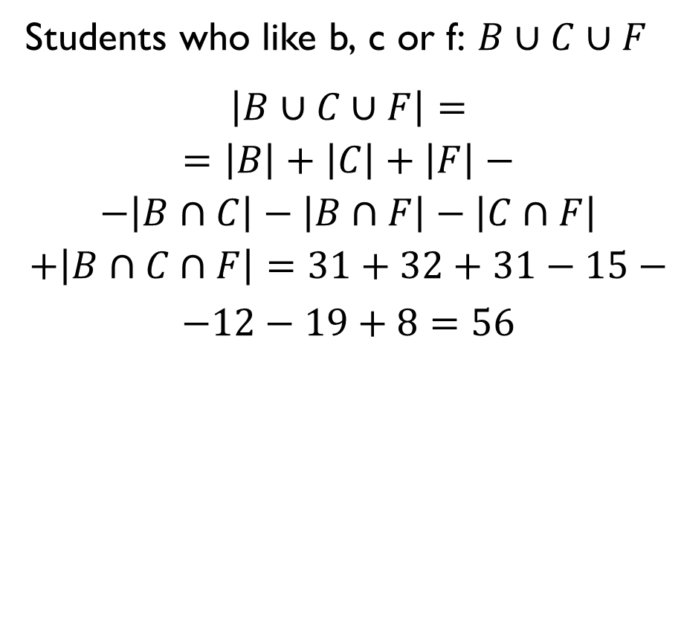
EXAMPLE: STUDENT CANTEEN
60 students:
31 students like beef;
32 students like chicken;
31 students like fish;
15 students like beef and chicken;
12 students like beef and fish;
19 students like chicken and fish;
8 students like all three.
How many like none of these?
Students who like b, c or f: $B∪C∪F$
$$\left|B∪C∪F\right|=$$
$$=\left|B\right|+\left|C\right|+\left|F\right|−$$
$$−\left|B∩C\right|−\left|B∩F\right|−\left|C∩F\right|$$
$$+\left|B∩C∩F\right|=31+32+31−15−$$ $−12−19+8=56$
Students who don’t like either:
$${\left(B∪C∪F \right)}^{c}$$
$$\left|{\left(B∪C∪F \right)}^{c}\right|=\left|U\right|−\left|B∪C∪F\right|=60−56=4$$

Slide 167
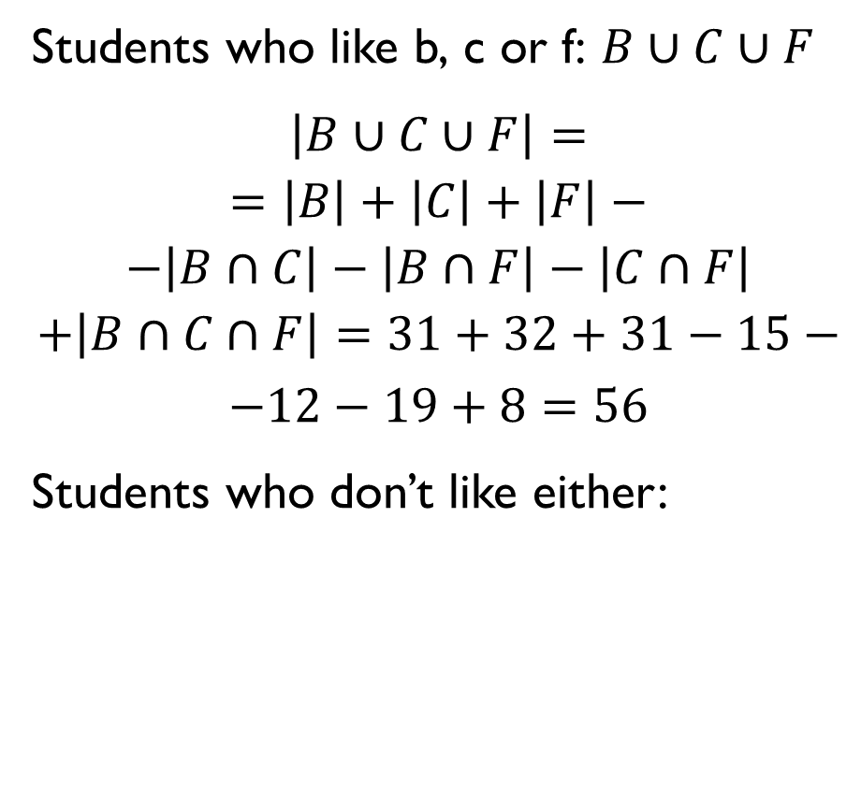
EXAMPLE: STUDENT CANTEEN
60 students:
31 students like beef;
32 students like chicken;
31 students like fish;
15 students like beef and chicken;
12 students like beef and fish;
19 students like chicken and fish;
8 students like all three.
How many like none of these?
Students who like b, c or f: $B∪C∪F$
$$\left|B∪C∪F\right|=$$
$$=\left|B\right|+\left|C\right|+\left|F\right|−$$
$$−\left|B∩C\right|−\left|B∩F\right|−\left|C∩F\right|$$
$$+\left|B∩C∩F\right|=31+32+31−15−$$ $−12−19+8=56$
Students who don’t like either:
$${\left(B∪C∪F \right)}^{c}$$
$$\left|{\left(B∪C∪F \right)}^{c}\right|=\left|U\right|−\left|B∪C∪F\right|=60−56=4$$

Slide 168
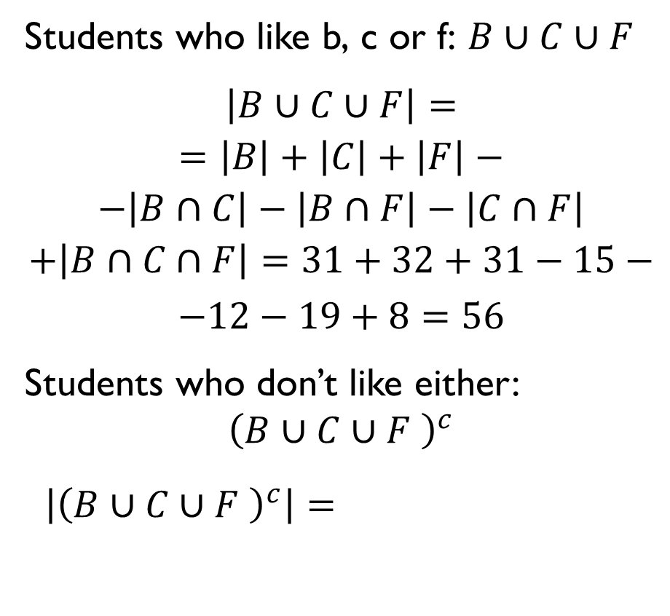
EXAMPLE: STUDENT CANTEEN
60 students:
31 students like beef;
32 students like chicken;
31 students like fish;
15 students like beef and chicken;
12 students like beef and fish;
19 students like chicken and fish;
8 students like all three.
How many like none of these?
Students who like b, c or f: $B∪C∪F$
$$\left|B∪C∪F\right|=$$
$$=\left|B\right|+\left|C\right|+\left|F\right|−$$
$$−\left|B∩C\right|−\left|B∩F\right|−\left|C∩F\right|$$
$$+\left|B∩C∩F\right|=31+32+31−15−$$ $−12−19+8=56$
Students who don’t like either:
$${\left(B∪C∪F \right)}^{c}$$
$$\left|{\left(B∪C∪F \right)}^{c}\right|=\left|U\right|−\left|B∪C∪F\right|=60−56=4$$

Slide 169

EXAMPLE: STUDENT CANTEEN
60 students:
31 students like beef;
32 students like chicken;
31 students like fish;
15 students like beef and chicken;
12 students like beef and fish;
19 students like chicken and fish;
8 students like all three.
How many like none of these?
Students who like b, c or f: $B∪C∪F$
$$\left|B∪C∪F\right|=$$
$$=\left|B\right|+\left|C\right|+\left|F\right|−$$
$$−\left|B∩C\right|−\left|B∩F\right|−\left|C∩F\right|$$
$$+\left|B∩C∩F\right|=31+32+31−15−$$ $−12−19+8=56$
Students who don’t like either:
$${\left(B∪C∪F \right)}^{c}$$
$$\left|{\left(B∪C∪F \right)}^{c}\right|=\left|U\right|−\left|B∪C∪F\right|=60−56=4$$

Slide 170

EXAMPLE: STUDENT CANTEEN
60 students:
31 students like beef;
32 students like chicken;
31 students like fish;
15 students like beef and chicken;
12 students like beef and fish;
19 students like chicken and fish;
8 students like all three.
How many like none of these?
Students who like b, c or f: $B∪C∪F$
$$\left|B∪C∪F\right|=$$
$$=\left|B\right|+\left|C\right|+\left|F\right|−$$
$$−\left|B∩C\right|−\left|B∩F\right|−\left|C∩F\right|$$
$$+\left|B∩C∩F\right|=31+32+31−15−$$ $−12−19+8=56$
Students who don’t like either:
$${\left(B∪C∪F \right)}^{c}$$
$$\left|{\left(B∪C∪F \right)}^{c}\right|=\left|U\right|−\left|B∪C∪F\right|=60−56=4$$

Slide 171

PRINCIPLE OF INCLUSION-EXCLUSION FOR FOUR SETS
For any finite sets A, B, C and D
$$\left|A∪B∪C∪D\right|=$$
$$=\left|A\right|+\left|B\right|+\left|C\right|+\left|D\right|−$$
$$−\left|A∩B\right|−\left|A∩C\right|−\left|A∩D\right|−$$
$$−\left|B∩C\right|−\left|B∩D\right|−\left|C∩D\right|+$$
$$+\left|A∩B∩C\right|+\left|B∩C∩D\right|+$$
$$+\left|A∩B∩D\right|+\left|A∩C∩D\right|−$$
$$−\left|A∩B∩C∩D\right|$$

Slide 172

PRINCIPLE OF INCLUSION-EXCLUSION FOR FOUR SETS
For any finite sets A, B, C and D
$$\left|A∪B∪C∪D\right|=$$
$$=\left|A\right|+\left|B\right|+\left|C\right|+\left|D\right|−$$
$$−\left|A∩B\right|−\left|A∩C\right|−\left|A∩D\right|−$$
$$−\left|B∩C\right|−\left|B∩D\right|−\left|C∩D\right|+$$
$$+\left|A∩B∩C\right|+\left|B∩C∩D\right|+$$
$$+\left|A∩B∩D\right|+\left|A∩C∩D\right|−$$
$$−\left|A∩B∩C∩D\right|$$

Slide 173

PRINCIPLE OF INCLUSION-EXCLUSION FOR FOUR SETS
For any finite sets A, B, C and D
$$\left|A∪B∪C∪D\right|=$$
$$=\left|A\right|+\left|B\right|+\left|C\right|+\left|D\right|−$$
$$−\left|A∩B\right|−\left|A∩C\right|−\left|A∩D\right|−$$
$$−\left|B∩C\right|−\left|B∩D\right|−\left|C∩D\right|+$$
$$+\left|A∩B∩C\right|+\left|B∩C∩D\right|+$$
$$+\left|A∩B∩D\right|+\left|A∩C∩D\right|−$$
$$−\left|A∩B∩C∩D\right|$$

Slide 174

PRINCIPLE OF INCLUSION-EXCLUSION FOR FOUR SETS
For any finite sets A, B, C and D
$$\left|A∪B∪C∪D\right|=$$
$$=\left|A\right|+\left|B\right|+\left|C\right|+\left|D\right|−$$
$$−\left|A∩B\right|−\left|A∩C\right|−\left|A∩D\right|−$$
$$−\left|B∩C\right|−\left|B∩D\right|−\left|C∩D\right|+$$
$$+\left|A∩B∩C\right|+\left|B∩C∩D\right|+$$
$$+\left|A∩B∩D\right|+\left|A∩C∩D\right|−$$
$$−\left|A∩B∩C∩D\right|$$

Slide 175

PRINCIPLE OF INCLUSION-EXCLUSION FOR FOUR SETS
For any finite sets A, B, C and D
$$\left|A∪B∪C∪D\right|=$$
$$=\left|A\right|+\left|B\right|+\left|C\right|+\left|D\right|−$$
$$−\left|A∩B\right|−\left|A∩C\right|−\left|A∩D\right|−$$
$$−\left|B∩C\right|−\left|B∩D\right|−\left|C∩D\right|+$$
$$+\left|A∩B∩C\right|+\left|B∩C∩D\right|+$$
$$+\left|A∩B∩D\right|+\left|A∩C∩D\right|−$$
$$−\left|A∩B∩C∩D\right|.$$

Slide 176
LET’S PRACTICE!
https://docs.google.com/document/d/1VIDmtgY9qrhqisifcF6R_E37QSOH7-g0Ib25bX4vxiw/edit?usp=sharing
PART II

