Slide 1
ELEMENTARY COMBINATORICS & PROBABILITY
Probability of an event

Slide 2
TODAY
Probability of an event

Slide 3
motivation
Some things in the world are random
flipping a coin;
roll of a die;
picking a random card from a shuffled deck of cards.
Probability theory: predict the unpredictable.
Started to evolve in the 17th century
gambling games.

Slide 4
motivation
Some things in the world are random
flipping a coin;
roll of a die;
picking a random card from a shuffled deck of cards.
Probability theory: predict the unpredictable.
Started to evolve in the 17th century
gambling games.

Slide 5
motivation
Some things in the world are random
flipping a coin;
roll of a die;
picking a random card from a shuffled deck of cards.
Probability theory: predict the unpredictable.
Started to evolve in the 17th century
gambling games.

Slide 6

There are some regularities…
(Mid’17th century) Frenchman Chevalier de Méré observed the following:
If a die is rolled four times, it’s more likely than not that $6$ would occur at least once.
He also tried to check the following idea:
If a pair of dice is rolled $24$ times, a sum of $12$ would occur at least once.
de Méré discussed this with Pascal, who in turn started the discussion with Fermat. The Probability theory was born.
(1933) Kolmogorov developed the first rigorous approach to probability.

Slide 7

There are some regularities…
(Mid’17th century) Frenchman Chevalier de Méré observed the following:
If a die is rolled four times, it’s more likely than not that $6$ would occur at least once.
He also tried to check the following idea:
If a pair of dice is rolled $24$ times, a sum of $12$ would occur at least once.
de Méré discussed this with Pascal, who in turn started the discussion with Fermat. The Probability theory was born.
(1933) Kolmogorov developed the first rigorous approach to probability.

Slide 8
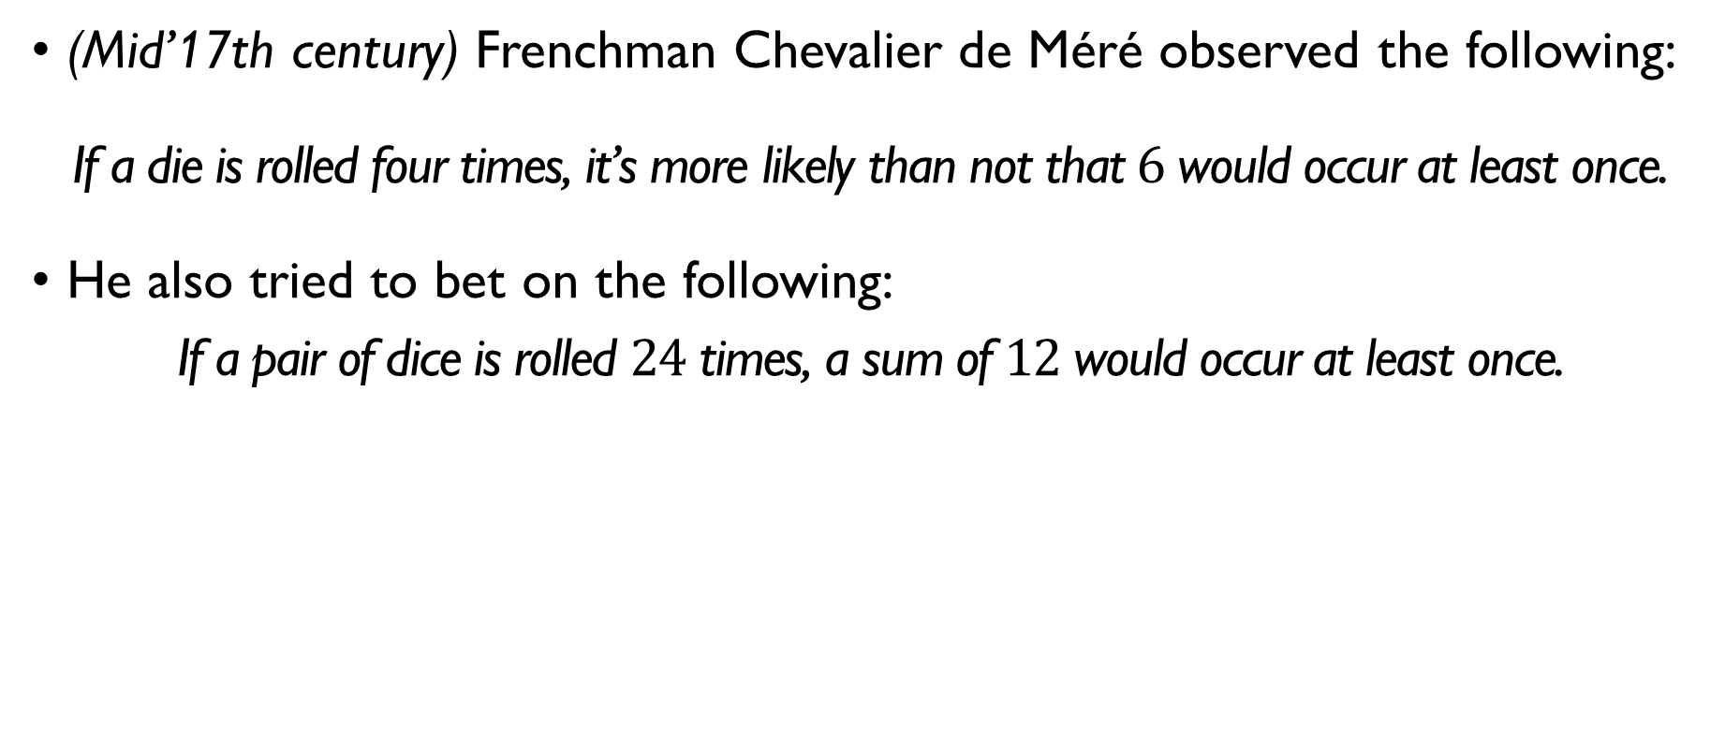
There are some regularities…
(Mid’17th century) Frenchman Chevalier de Méré observed the following:
If a die is rolled four times, it’s more likely than not that $6$ would occur at least once.
He also tried to bet on the following:
If a pair of dice is rolled $24$ times, a sum of $12$ would occur at least once.
de Méré discussed this with Pascal, who in turn started the discussion with Fermat. The Probability theory was born.
(1933) Kolmogorov developed the first rigorous approach to probability.

Slide 9
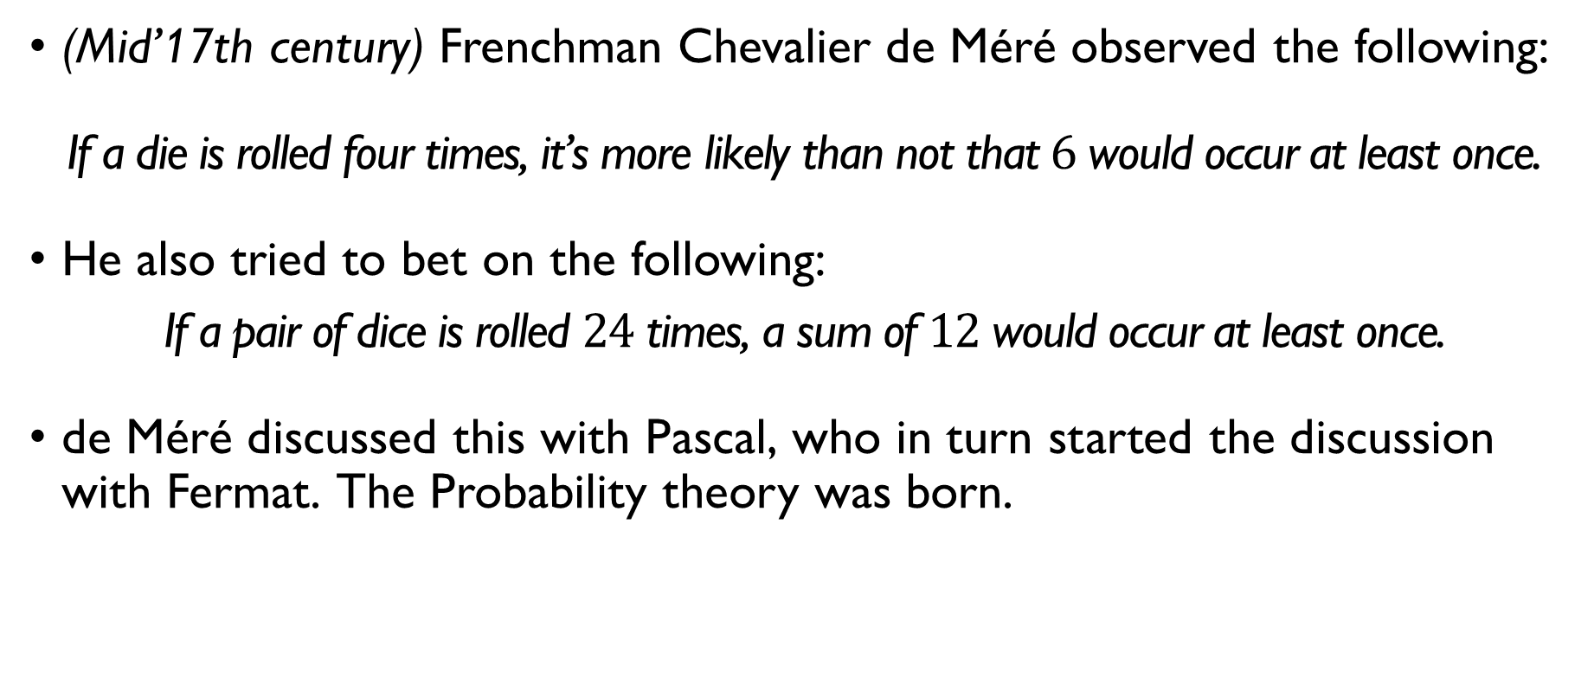
There are some regularities…
(Mid’17th century) Frenchman Chevalier de Méré observed the following:
If a die is rolled four times, it’s more likely than not that $6$ would occur at least once.
He also tried to bet on the following:
If a pair of dice is rolled $24$ times, a sum of $12$ would occur at least once.
de Méré discussed this with Pascal, who in turn started the discussion with Fermat. The Probability theory was born.
(1933) Kolmogorov developed the first rigorous approach to probability.

Slide 10
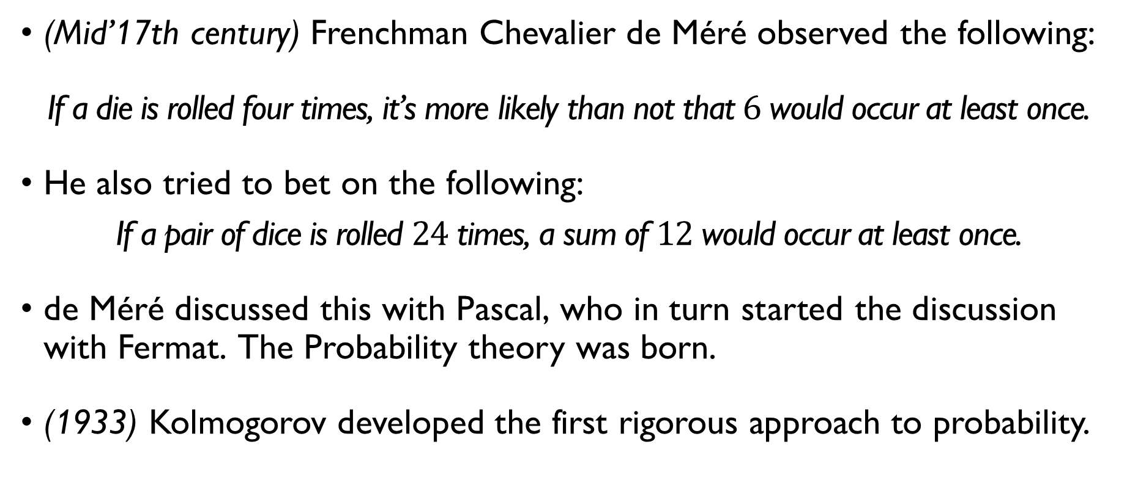
There are some regularities…
(Mid’17th century) Frenchman Chevalier de Méré observed the following:
If a die is rolled four times, it’s more likely than not that $6$ would occur at least once.
He also tried to bet on the following:
If a pair of dice is rolled $24$ times, a sum of $12$ would occur at least once.
de Méré discussed this with Pascal, who in turn started the discussion with Fermat. The Probability theory was born.
(1933) Kolmogorov developed the first rigorous approach to probability.

Slide 11
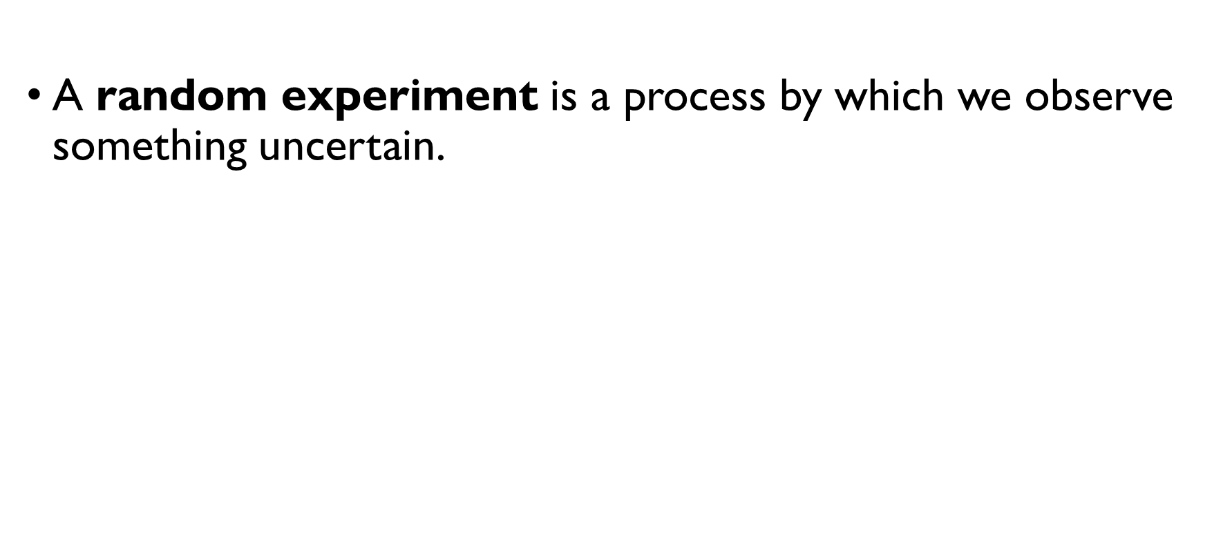
Let’s formalize it
A random experiment is a process by which we observe something uncertain.
The result of a random experiment is called the outcome.
The set of all possible outcomes is called the sample space (denoted by $S$).

Slide 12
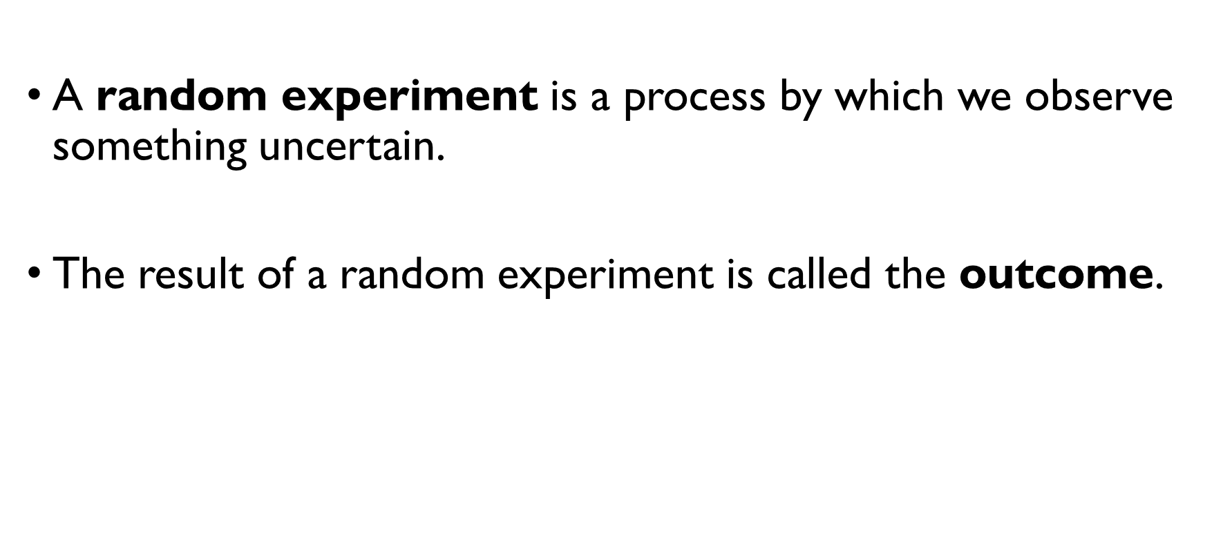
Let’s formalize it
A random experiment is a process by which we observe something uncertain.
The result of a random experiment is called the outcome.
The set of all possible outcomes is called the sample space (denoted by $S$).

Slide 13
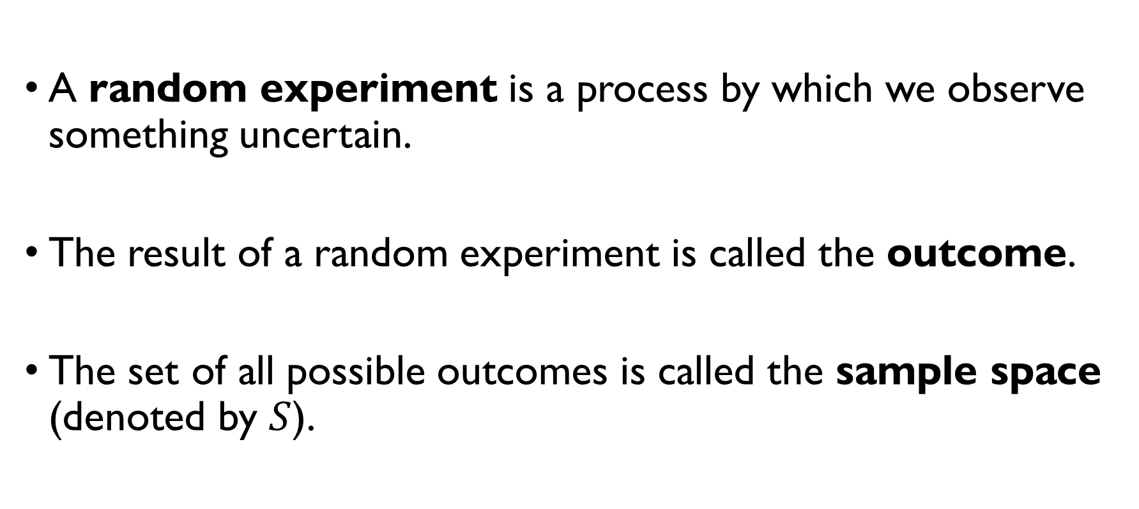
Let’s formalize it
A random experiment is a process by which we observe something uncertain.
The result of a random experiment is called the outcome.
The set of all possible outcomes is called the sample space (denoted by $S$).

Slide 14
Random experiments: examples
Random experiment: flipping a coin once Sample space: {H, T} Outcome: H (we’ve got heads)
Random experiment: flipping a coin twice. Sample space: {HH, HT, TH, TT} Outcome: HT (we’ve got heads and tails)
Random experiment: rolling a die Sample space: {1, 2, 3, 4, 5, 6} Outcome: 5

Slide 15
Random experiments: examples
Random experiment: flipping a coin once Sample space: {H, T} Outcome: H (we’ve got heads)
Random experiment: flipping a coin twice. Sample space: {HH, HT, TH, TT} Outcome: HT (we’ve got heads and tails)
Random experiment: rolling a die Sample space: {1, 2, 3, 4, 5, 6} Outcome: 5

Slide 16
Random experiments: examples
Random experiment: flipping a coin once Sample space: {H, T} Outcome: H (we’ve got heads)
Random experiment: flipping a coin twice. Sample space: {HH, HT, TH, TT} Outcome: HT (we’ve got heads and tails)
Random experiment: rolling a die Sample space: {1, 2, 3, 4, 5, 6} Outcome: 5

Slide 17
Random experiments: examples
Random experiment: flipping a coin once Sample space: {H, T} Outcome: H (we’ve got heads)
Random experiment: flipping a coin twice. Sample space: {HH, HT, TH, TT} Outcome: HT (we’ve got heads and tails)
Random experiment: rolling a die Sample space: {1, 2, 3, 4, 5, 6} Outcome: 5

Slide 18
Random experiments: examples
Random experiment: flipping a coin once Sample space: {H, T} Outcome: H (we’ve got heads)
Random experiment: flipping a coin twice. Sample space: {HH, HT, TH, TT} Outcome: HT (we’ve got heads and tails)
Random experiment: rolling a die Sample space: {1, 2, 3, 4, 5, 6} Outcome: 5

Slide 19
Random experiments: examples
Random experiment: flipping a coin once Sample space: {H, T} Outcome: H (we’ve got heads)
Random experiment: flipping a coin twice. Sample space: {HH, HT, TH, TT} Outcome: HT (we’ve got heads and tails)
Random experiment: rolling a die Sample space: {1, 2, 3, 4, 5, 6} Outcome: 5

Slide 20
Random experiments: examples
Random experiment: flipping a coin once Sample space: {H, T} Outcome: H (we’ve got heads)
Random experiment: flipping a coin twice. Sample space: {HH, HT, TH, TT} Outcome: HT (we’ve got heads and tails)
Random experiment: rolling a die Sample space: {1, 2, 3, 4, 5, 6} Outcome: 5

Slide 21
Random experiments: examples
Random experiment: flipping a coin once Sample space: {H, T} Outcome: H (we’ve got heads)
Random experiment: flipping a coin twice. Sample space: {HH, HT, TH, TT} Outcome: HT (we’ve got heads and tails)
Random experiment: rolling a die Sample space: {1, 2, 3, 4, 5, 6} Outcome: 5

Slide 22
Random experiments: examples
Random experiment: flipping a coin once Sample space: {H, T} Outcome: H (we’ve got heads)
Random experiment: flipping a coin twice. Sample space: {HH, HT, TH, TT} Outcome: HT (we’ve got heads and tails)
Random experiment: rolling a die Sample space: {1, 2, 3, 4, 5, 6} Outcome: 5

Slide 23

event
Each subset of a sampling space is called an event (denoted by $E$). Example: rolling a die $S = \left\{1, 2, 3, 4, 5, 6\right\}$ $E_{1}=\left\{1\right\}−$ we’ve got number 1. $E_{2}=\left\{2, 4, 6\right\}−$ we’ve got an even number. $E_{3}=\left\{3, 5\right\}−$ we’ve got $3$ or $5$.

Slide 24

event
Each subset of a sampling space is called an event (denoted by $E$). Example: rolling a die $S = \left\{1, 2, 3, 4, 5, 6\right\}$ $E_{1}=\left\{1\right\}−$ we’ve got number 1. $E_{2}=\left\{2, 4, 6\right\}−$ we’ve got an even number. $E_{3}=\left\{3, 5\right\}−$ we’ve got $3$ or $5$.

Slide 25
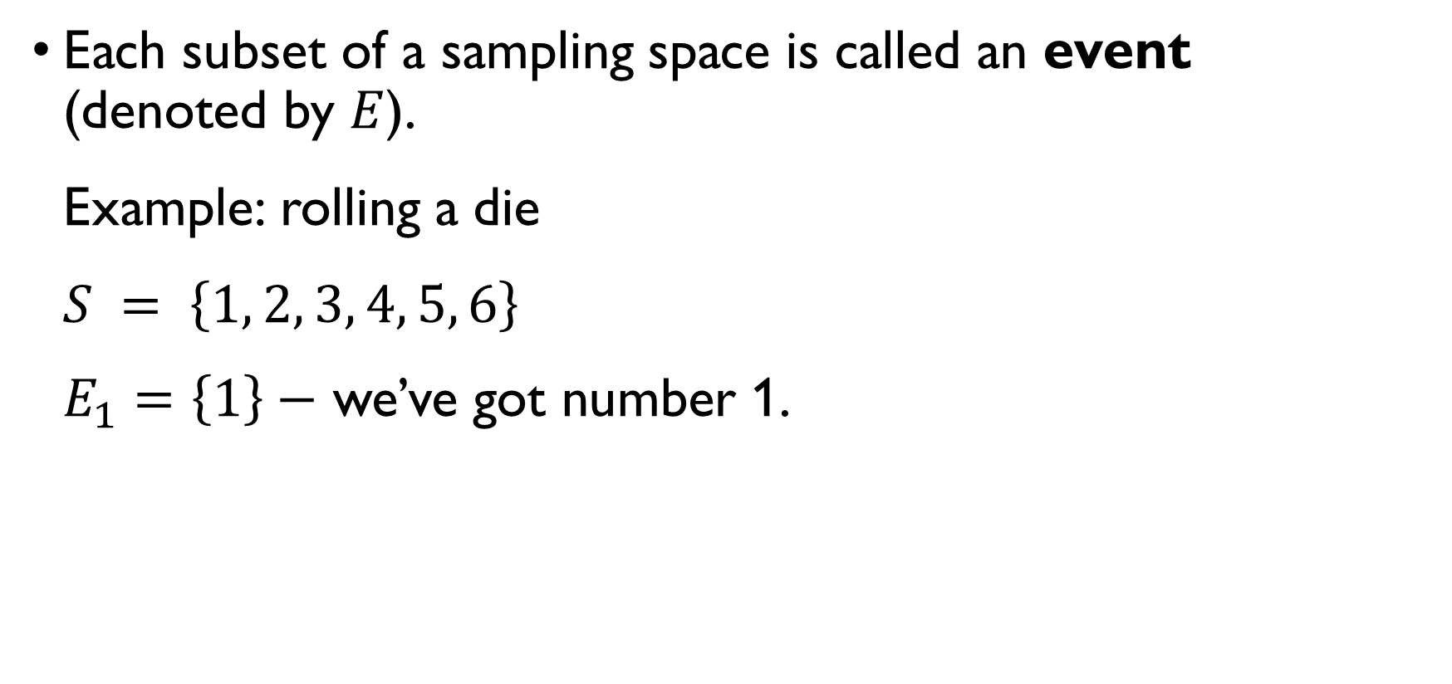
event
Each subset of a sampling space is called an event (denoted by $E$). Example: rolling a die $S = \left\{1, 2, 3, 4, 5, 6\right\}$ $E_{1}=\left\{1\right\}−$ we’ve got number 1. $E_{2}=\left\{2, 4, 6\right\}−$ we’ve got an even number. $E_{3}=\left\{3, 5\right\}−$ we’ve got $3$ or $5$.

Slide 26
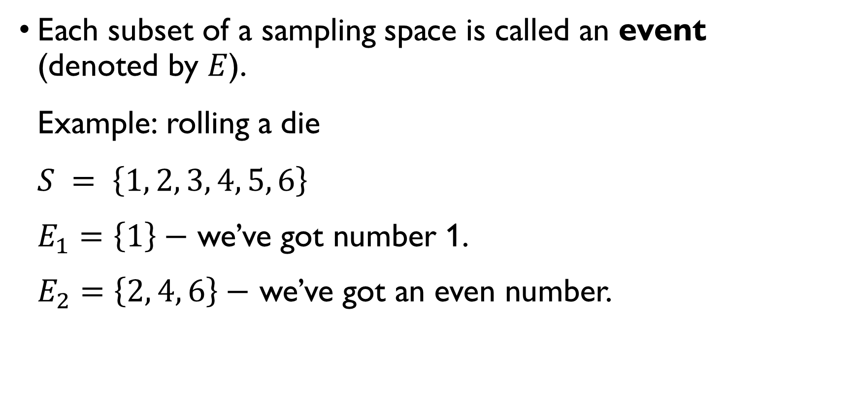
event
Each subset of a sampling space is called an event (denoted by $E$). Example: rolling a die $S = \left\{1, 2, 3, 4, 5, 6\right\}$ $E_{1}=\left\{1\right\}−$ we’ve got number 1. $E_{2}=\left\{2, 4, 6\right\}−$ we’ve got an even number. $E_{3}=\left\{3, 5\right\}−$ we’ve got $3$ or $5$.

Slide 27
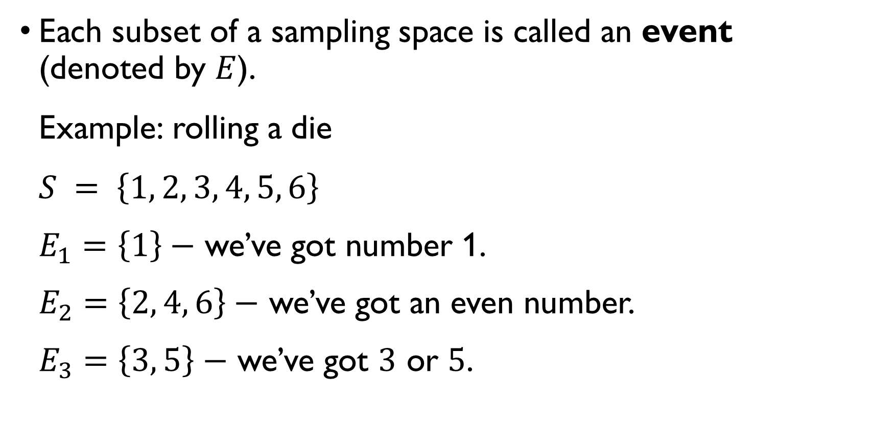
event
Each subset of a sampling space is called an event (denoted by $E$). Example: rolling a die $S = \left\{1, 2, 3, 4, 5, 6\right\}$ $E_{1}=\left\{1\right\}−$ we’ve got number 1. $E_{2}=\left\{2, 4, 6\right\}−$ we’ve got an even number. $E_{3}=\left\{3, 5\right\}−$ we’ve got $3$ or $5$.

Slide 28

events
Events are sets $→$ set operations applicable. Example: $S =\left\{1, 3, 5, 6, 10\right\}$ $E_{1}=\left\{1, 5\right\}, E_{2}=\left\{5, 6, 10\right\},$ $E_{1}∪E_{2}=\left\{1, 5, 6, 10\right\}, E_{1}∩E_{2}=\left\{5\right\}$
Two events $E$ and $F$ in a sample space $S$ are mutually exclusive if the sets $E$ and $F$ are disjoint. Example: rolling a die $E_{1}=\left\{1, 3, 5\right\}, E_{2}=\left\{2, 4, 6\right\}, E_{1}∩E_{2}=∅$

Slide 29

events
Events are sets $→$ set operations applicable. Example: $S =\left\{1, 3, 5, 6, 10\right\}$ $E_{1}=\left\{1, 5\right\}, E_{2}=\left\{5, 6, 10\right\},$ $E_{1}∪E_{2}=\left\{1, 5, 6, 10\right\}, E_{1}∩E_{2}=\left\{5\right\}$
Two events $E$ and $F$ in a sample space $S$ are mutually exclusive if the sets $E$ and $F$ are disjoint. Example: rolling a die $E_{1}=\left\{1, 3, 5\right\}, E_{2}=\left\{2, 4, 6\right\}, E_{1}∩E_{2}=∅$

Slide 30

events
Events are sets $→$ set operations applicable. Example: $S =\left\{1, 3, 5, 6, 10\right\}$ $E_{1}=\left\{1, 5\right\}, E_{2}=\left\{5, 6, 10\right\},$ $E_{1}∪E_{2}=\left\{1, 5, 6, 10\right\}, E_{1}∩E_{2}=\left\{5\right\}$
Two events $E$ and $F$ in a sample space $S$ are mutually exclusive if the sets $E$ and $F$ are disjoint. Example: rolling a die $E_{1}=\left\{1, 3, 5\right\}, E_{2}=\left\{2, 4, 6\right\}, E_{1}∩E_{2}=∅$

Slide 31

events
Events are sets $→$ set operations applicable. Example: $S =\left\{1, 3, 5, 6, 10\right\}$ $E_{1}=\left\{1, 5\right\}, E_{2}=\left\{5, 6, 10\right\},$ $E_{1}∪E_{2}=\left\{1, 5, 6, 10\right\}, E_{1}∩E_{2}=\left\{5\right\}$
Two events $E$ and $F$ in a sample space $S$ are mutually exclusive if the sets $E$ and $F$ are disjoint. Example: rolling a die $E_{1}=\left\{1, 3, 5\right\}, E_{2}=\left\{2, 4, 6\right\}, E_{1}∩E_{2}=∅$

Slide 32
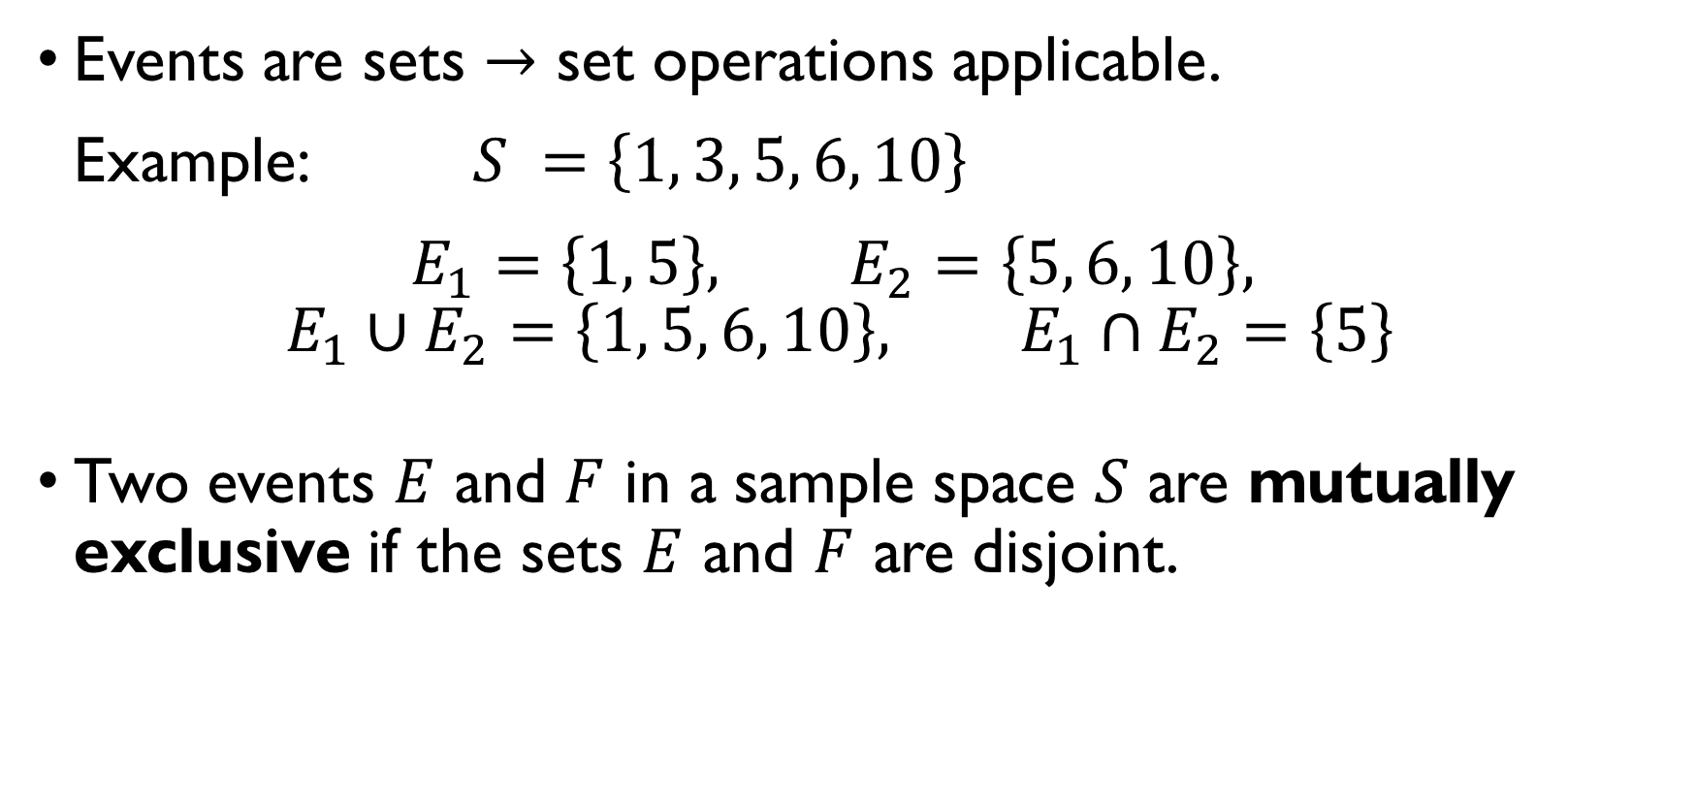
events
Events are sets $→$ set operations applicable. Example: $S =\left\{1, 3, 5, 6, 10\right\}$ $E_{1}=\left\{1, 5\right\}, E_{2}=\left\{5, 6, 10\right\},$ $E_{1}∪E_{2}=\left\{1, 5, 6, 10\right\}, E_{1}∩E_{2}=\left\{5\right\}$
Two events $E$ and $F$ in a sample space $S$ are mutually exclusive if the sets $E$ and $F$ are disjoint. Example: rolling a die $E_{1}=\left\{1, 3, 5\right\}, E_{2}=\left\{2, 4, 6\right\}, E_{1}∩E_{2}=∅$

Slide 33
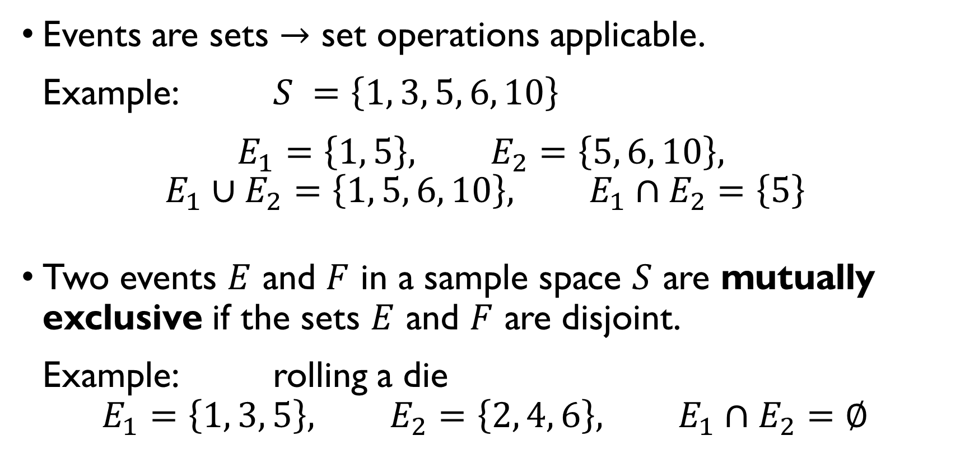
events
Events are sets $→$ set operations applicable. Example: $S =\left\{1, 3, 5, 6, 10\right\}$ $E_{1}=\left\{1, 5\right\}, E_{2}=\left\{5, 6, 10\right\},$ $E_{1}∪E_{2}=\left\{1, 5, 6, 10\right\}, E_{1}∩E_{2}=\left\{5\right\}$
Two events $E$ and $F$ in a sample space $S$ are mutually exclusive if the sets $E$ and $F$ are disjoint. Example: rolling a die $E_{1}=\left\{1, 3, 5\right\}, E_{2}=\left\{2, 4, 6\right\}, E_{1}∩E_{2}=∅$

Slide 34
What is probability

Slide 35
Relative frequency
Pascal and Fermat defined probability when a game is repeated a large number of times under the same conditions.
Probability of an event is defined by the limiting frequency with which this event appears in a long series of similar events.
Example: If we flip a fair coin infinitely many times, it will come up heads half of the times.

Slide 36
Relative frequency
Pascal and Fermat defined probability when a game is repeated a large number of times under the same conditions.
Probability of an event is defined by the limiting frequency with which this event appears in a long series of similar events.
Example: If we flip a fair coin infinitely many times, it will come up heads half of the times.

Slide 37
Relative frequency
Pascal and Fermat defined probability when a game is repeated a large number of times under the same conditions.
Probability of an event is defined by the limiting frequency with which this event appears in a long series of similar events.
Example: If we flip a fair coin infinitely many times, it will come up heads half of the times.

Slide 38

Computing probability
If a sample space $S$ is finite, and each outcome is equally likely, than probability of an event $E$ can be computed as
$$P\left(E\right)=\frac{\# ways E can occur}{\# possible outcomes}=\frac{\left|E\right|}{\left|S\right|}$$
Example: rolling a die $S=\left\{1, 2, 3, 4, 5, 6\right\}, \left|S\right|=6$ $E_{1}=\left\{1\right\}, \left|E_{1}\right|=1, P\left(E_{1}\right)=1/6$ $E_{2}=\left\{1, 3, 5\right\}, \left|E_{2}\right|=3, P\left(E_{2}\right)=1/2$

Slide 39
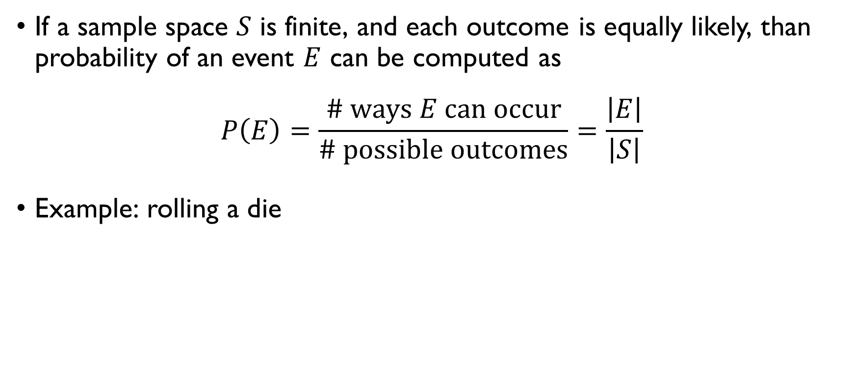
Computing probability
If a sample space $S$ is finite, and each outcome is equally likely, than probability of an event $E$ can be computed as
$$P\left(E\right)=\frac{\# ways E can occur}{\# possible outcomes}=\frac{\left|E\right|}{\left|S\right|}$$
Example: rolling a die $S=\left\{1, 2, 3, 4, 5, 6\right\}, \left|S\right|=6$ $E_{1}=\left\{1\right\}, \left|E_{1}\right|=1, P\left(E_{1}\right)=1/6$ $E_{2}=\left\{1, 3, 5\right\}, \left|E_{2}\right|=3, P\left(E_{2}\right)=1/2$

Slide 40
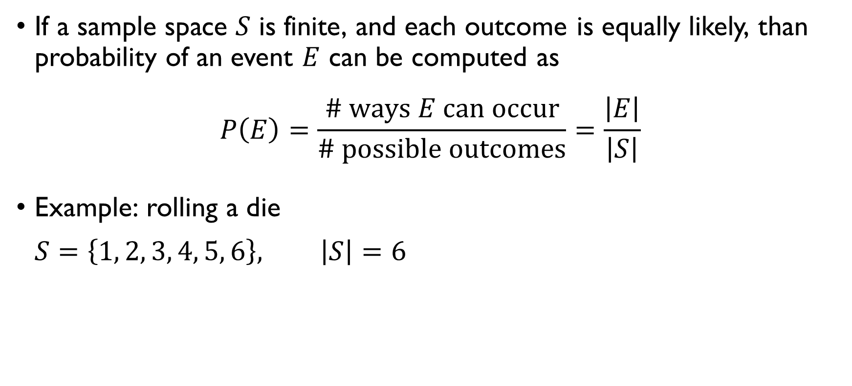
Computing probability
If a sample space $S$ is finite, and each outcome is equally likely, than probability of an event $E$ can be computed as
$$P\left(E\right)=\frac{\# ways E can occur}{\# possible outcomes}=\frac{\left|E\right|}{\left|S\right|}$$
Example: rolling a die $S=\left\{1, 2, 3, 4, 5, 6\right\}, \left|S\right|=6$ $E_{1}=\left\{1\right\}, \left|E_{1}\right|=1, P\left(E_{1}\right)=1/6$ $E_{2}=\left\{1, 3, 5\right\}, \left|E_{2}\right|=3, P\left(E_{2}\right)=1/2$

Slide 41
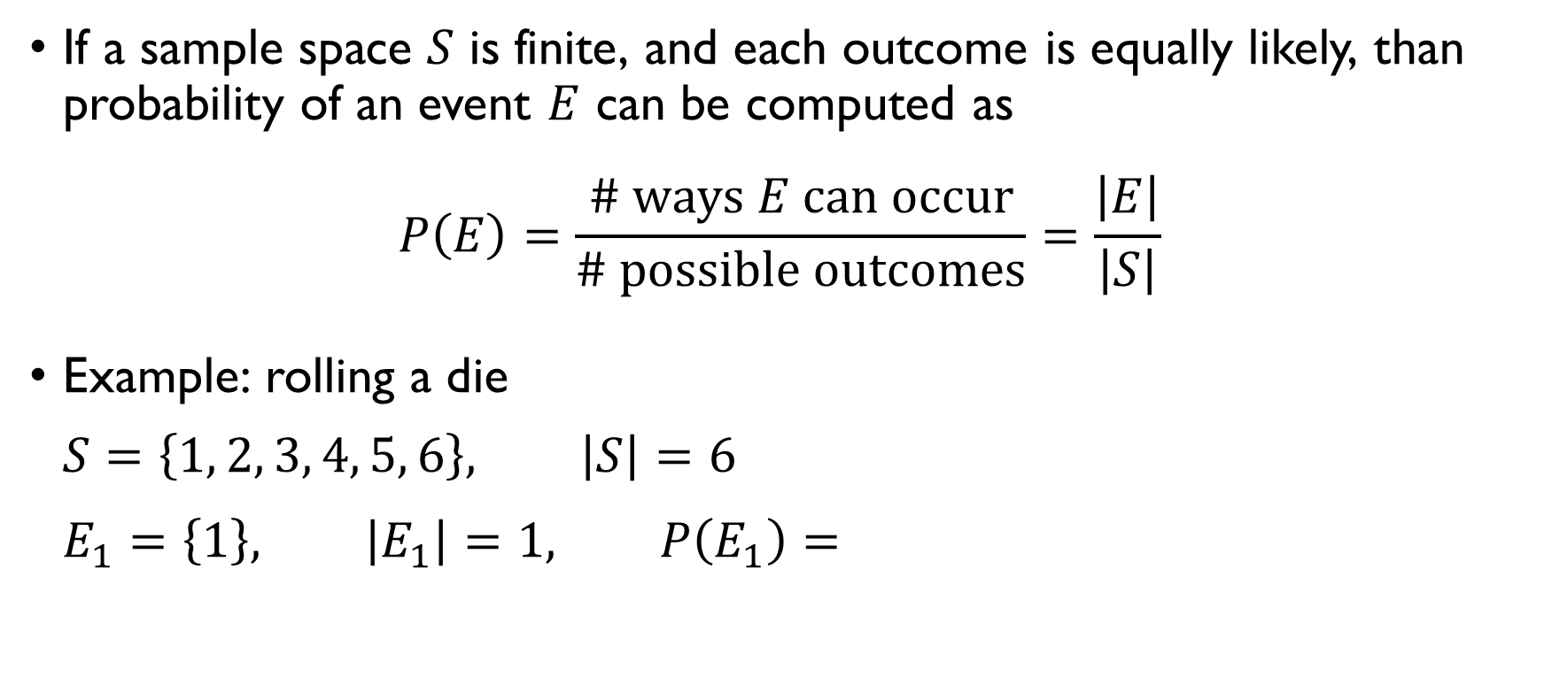
Computing probability
If a sample space $S$ is finite, and each outcome is equally likely, than probability of an event $E$ can be computed as
$$P\left(E\right)=\frac{\# ways E can occur}{\# possible outcomes}=\frac{\left|E\right|}{\left|S\right|}$$
Example: rolling a die $S=\left\{1, 2, 3, 4, 5, 6\right\}, \left|S\right|=6$ $E_{1}=\left\{1\right\}, \left|E_{1}\right|=1, P\left(E_{1}\right)=1/6$ $E_{2}=\left\{1, 3, 5\right\}, \left|E_{2}\right|=3, P\left(E_{2}\right)=1/2$

Slide 42
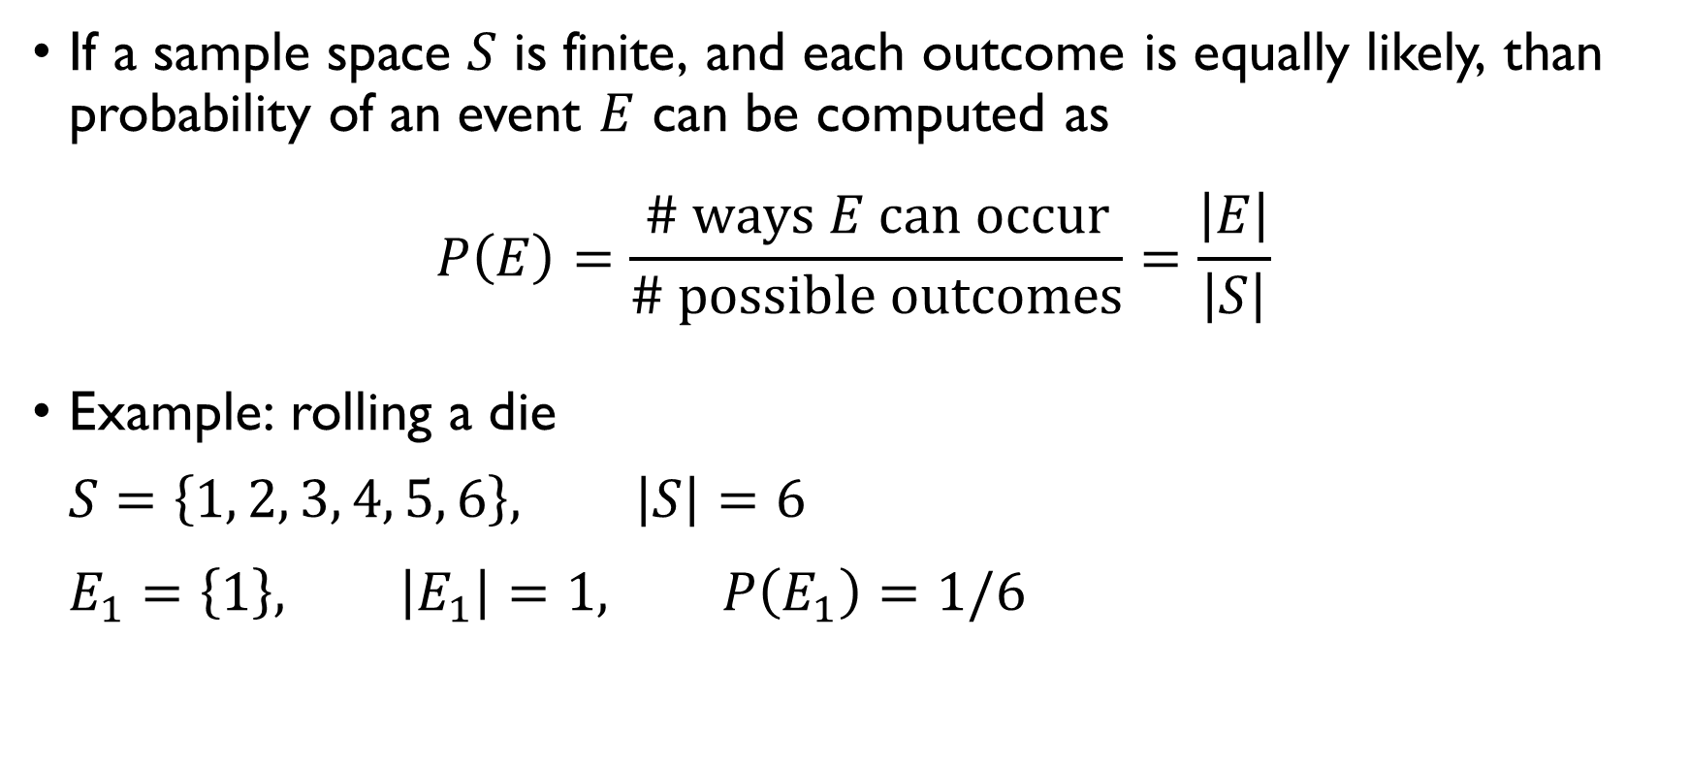
Computing probability
If a sample space $S$ is finite, and each outcome is equally likely, than probability of an event $E$ can be computed as
$$P\left(E\right)=\frac{\# ways E can occur}{\# possible outcomes}=\frac{\left|E\right|}{\left|S\right|}$$
Example: rolling a die $S=\left\{1, 2, 3, 4, 5, 6\right\}, \left|S\right|=6$ $E_{1}=\left\{1\right\}, \left|E_{1}\right|=1, P\left(E_{1}\right)=1/6$ $E_{2}=\left\{1, 3, 5\right\}, \left|E_{2}\right|=3, P\left(E_{2}\right)=1/2$

Slide 43
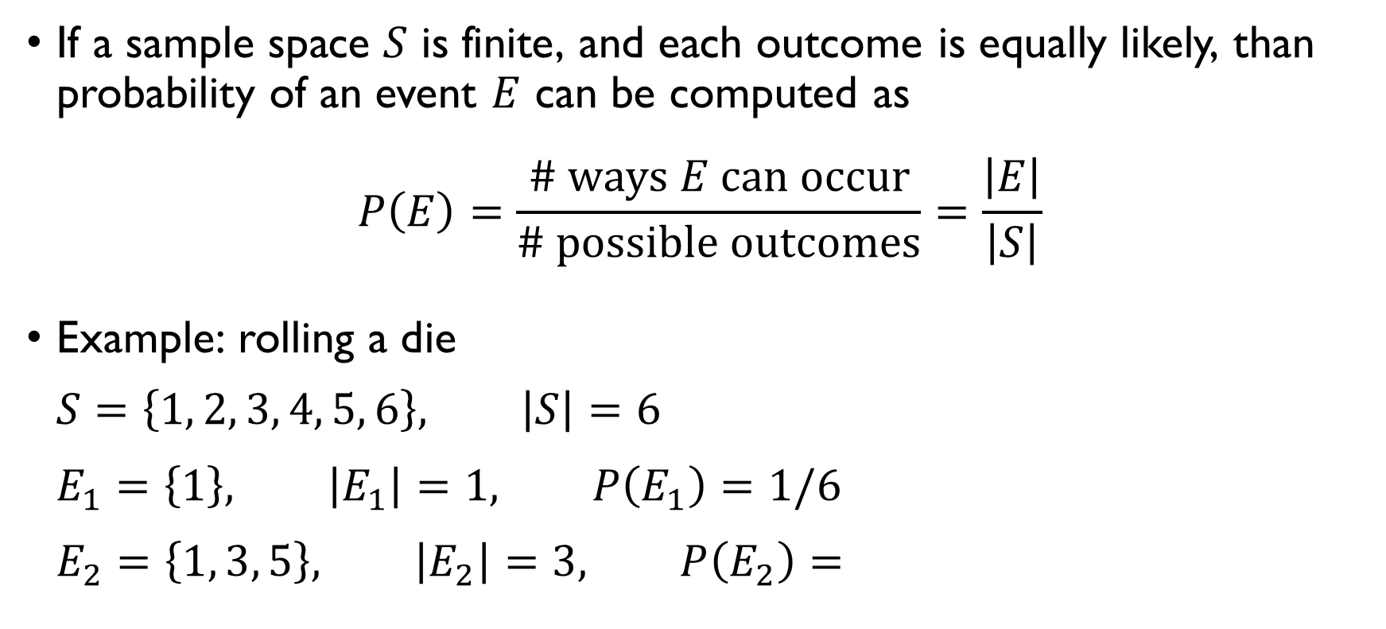
Computing probability
If a sample space $S$ is finite, and each outcome is equally likely, than probability of an event $E$ can be computed as
$$P\left(E\right)=\frac{\# ways E can occur}{\# possible outcomes}=\frac{\left|E\right|}{\left|S\right|}$$
Example: rolling a die $S=\left\{1, 2, 3, 4, 5, 6\right\}, \left|S\right|=6$ $E_{1}=\left\{1\right\}, \left|E_{1}\right|=1, P\left(E_{1}\right)=1/6$ $E_{2}=\left\{1, 3, 5\right\}, \left|E_{2}\right|=3, P\left(E_{2}\right)=1/2$

Slide 44
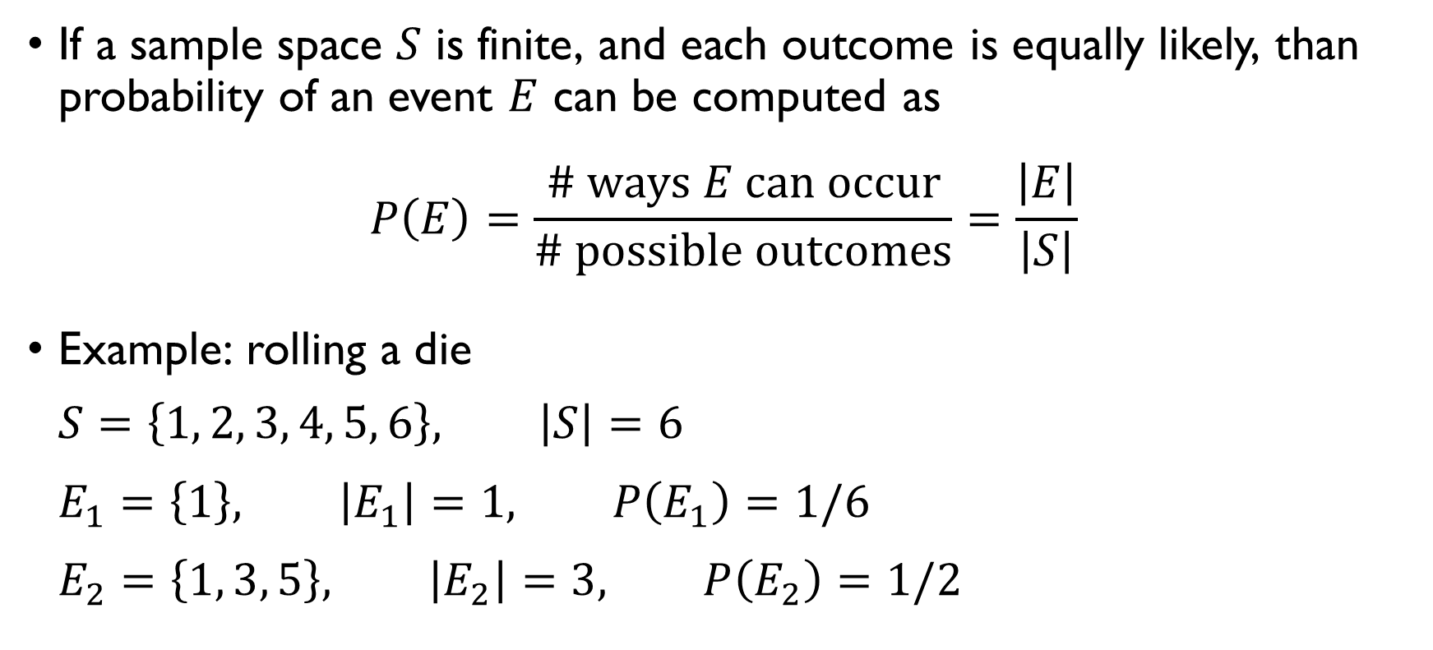
Computing probability
If a sample space $S$ is finite, and each outcome is equally likely, than probability of an event $E$ can be computed as
$$P\left(E\right)=\frac{\# ways E can occur}{\# possible outcomes}=\frac{\left|E\right|}{\left|S\right|}$$
Example: rolling a die $S=\left\{1, 2, 3, 4, 5, 6\right\}, \left|S\right|=6$ $E_{1}=\left\{1\right\}, \left|E_{1}\right|=1, P\left(E_{1}\right)=1/6$ $E_{2}=\left\{1, 3, 5\right\}, \left|E_{2}\right|=3, P\left(E_{2}\right)=1/2$

Slide 45
Alternative interpretation: Degree of belief
Limiting frequency interpretation of probability isn’t always applicable.
What’s the probability that you country’s football team will win the next world cup?
What’s the probability that you’ll become the next US president?
Another interpretation of probability: quantification of our degree of subjective personal belief that something will happen.
Good news: interpretation doesn’t matter, same principles hold.

Slide 46
Alternative interpretation: Degree of belief
Limiting frequency interpretation of probability isn’t always applicable.
What’s the probability that you country’s football team will win the next world cup?
What’s the probability that you’ll become the next US president?
Another interpretation of probability: quantification of our degree of subjective personal belief that something will happen.
Good news: interpretation doesn’t matter, same principles hold.

Slide 47
Alternative interpretation: Degree of belief
Limiting frequency interpretation of probability isn’t always applicable.
What’s the probability that you country’s football team will win the next world cup?
What’s the probability that you’ll become the next US president?
Another interpretation of probability: quantification of our degree of subjective personal belief that something will happen.
Good news: interpretation doesn’t matter, same principles hold.

Slide 48
Alternative interpretation: Degree of belief
Limiting frequency interpretation of probability isn’t always applicable.
What’s the probability that you country’s football team will win the next world cup?
What’s the probability that you’ll become the next US president?
Another interpretation of probability: quantification of our degree of subjective personal belief that something will happen.
Good news: interpretation doesn’t matter, same principles hold.

Slide 49
Alternative interpretation: Degree of belief
Limiting frequency interpretation of probability isn’t always applicable.
What’s the probability that you country’s football team will win the next world cup?
What’s the probability that you’ll become the next US president?
Another interpretation of probability: quantification of our degree of subjective personal belief that something will happen.
Good news: interpretation doesn’t matter, same principles hold.

Slide 50
MORE EXAMPLES

Slide 51
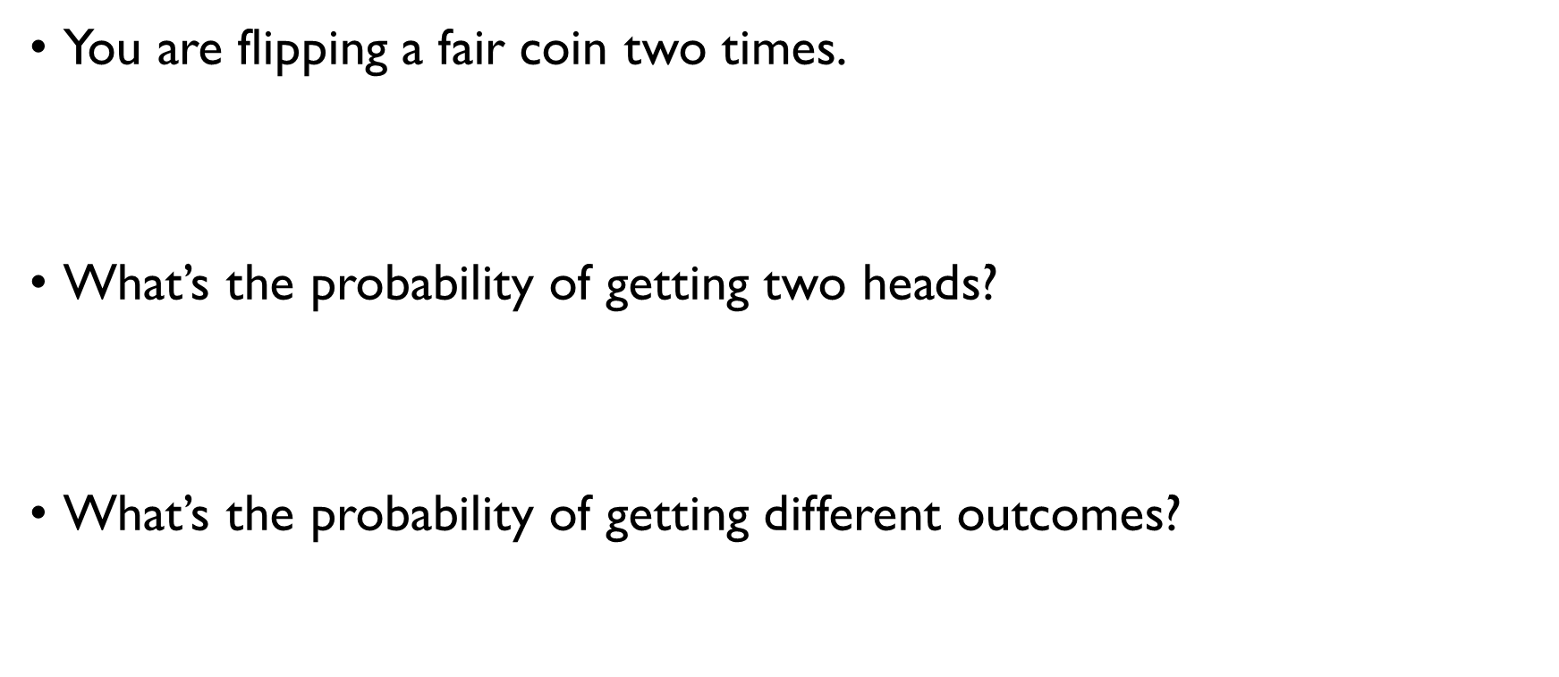
FLIPPING A COIN
You are flipping a fair coin two times.
$$S=\left\{HH, HT, TH,TT\right\}, \left|S\right|=4$$
What’s the probability of getting two heads?
$$E=\left\{HH\right\}, P\left(E\right)=1/4$$
What’s the probability of getting different outcomes?
$$E=\left\{HT,TH\right\}, P\left(E\right)=1/2$$

Slide 52
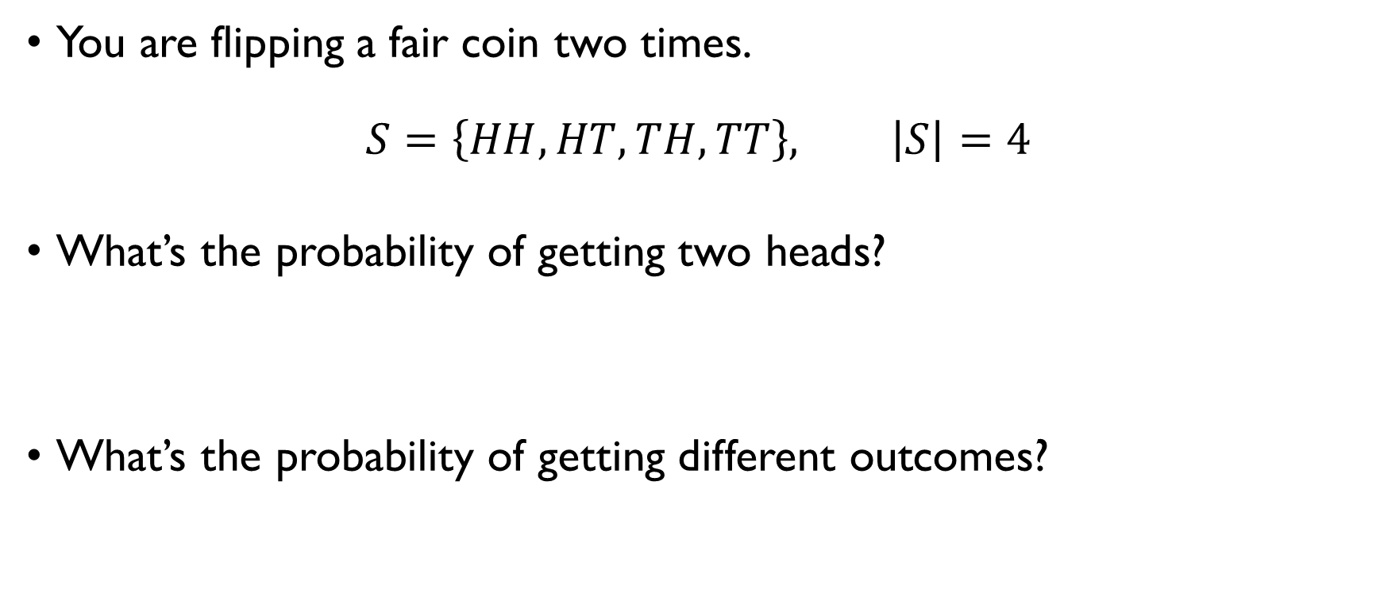
FLIPPING A COIN
You are flipping a fair coin two times.
$$S=\left\{HH, HT, TH,TT\right\}, \left|S\right|=4$$
What’s the probability of getting two heads?
$$E=\left\{HH\right\}, P\left(E\right)=1/4$$
What’s the probability of getting different outcomes?
$$E=\left\{HT,TH\right\}, P\left(E\right)=1/2$$

Slide 53
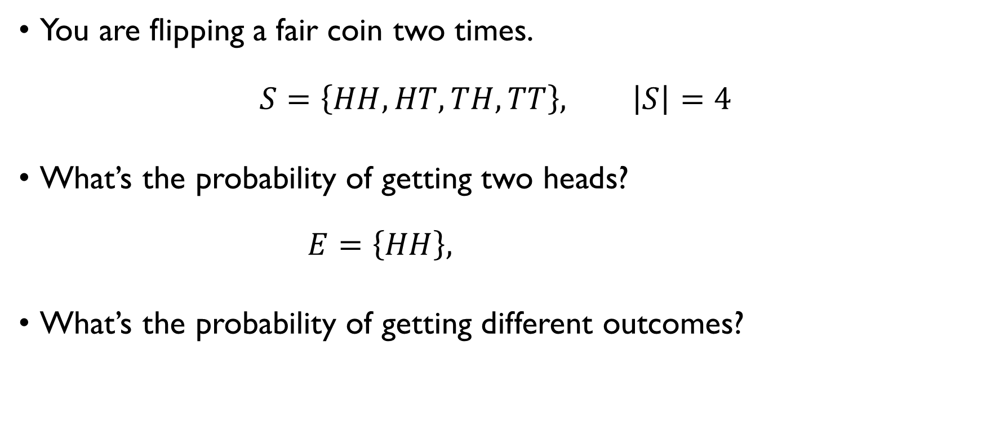
FLIPPING A COIN
You are flipping a fair coin two times.
$$S=\left\{HH, HT, TH,TT\right\}, \left|S\right|=4$$
What’s the probability of getting two heads?
$$E=\left\{HH\right\}, P\left(E\right)=1/4$$
What’s the probability of getting different outcomes?
$$E=\left\{HT,TH\right\}, P\left(E\right)=1/2$$

Slide 54
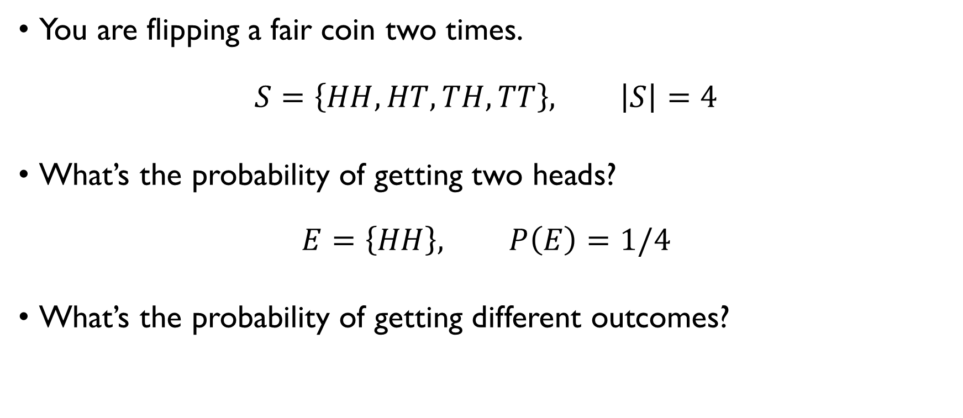
FLIPPING A COIN
You are flipping a fair coin two times.
$$S=\left\{HH, HT, TH,TT\right\}, \left|S\right|=4$$
What’s the probability of getting two heads?
$$E=\left\{HH\right\}, P\left(E\right)=1/4$$
What’s the probability of getting different outcomes?
$$E=\left\{HT,TH\right\}, P\left(E\right)=1/2$$

Slide 55
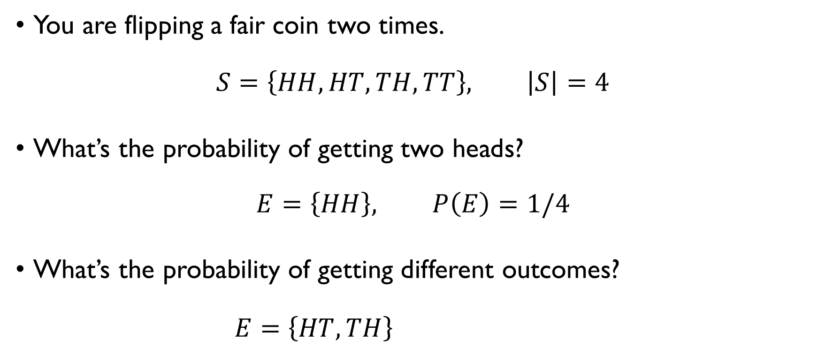
FLIPPING A COIN
You are flipping a fair coin two times.
$$S=\left\{HH, HT, TH,TT\right\}, \left|S\right|=4$$
What’s the probability of getting two heads?
$$E=\left\{HH\right\}, P\left(E\right)=1/4$$
What’s the probability of getting different outcomes?
$$E=\left\{HT,TH\right\}, P\left(E\right)=1/2$$

Slide 56
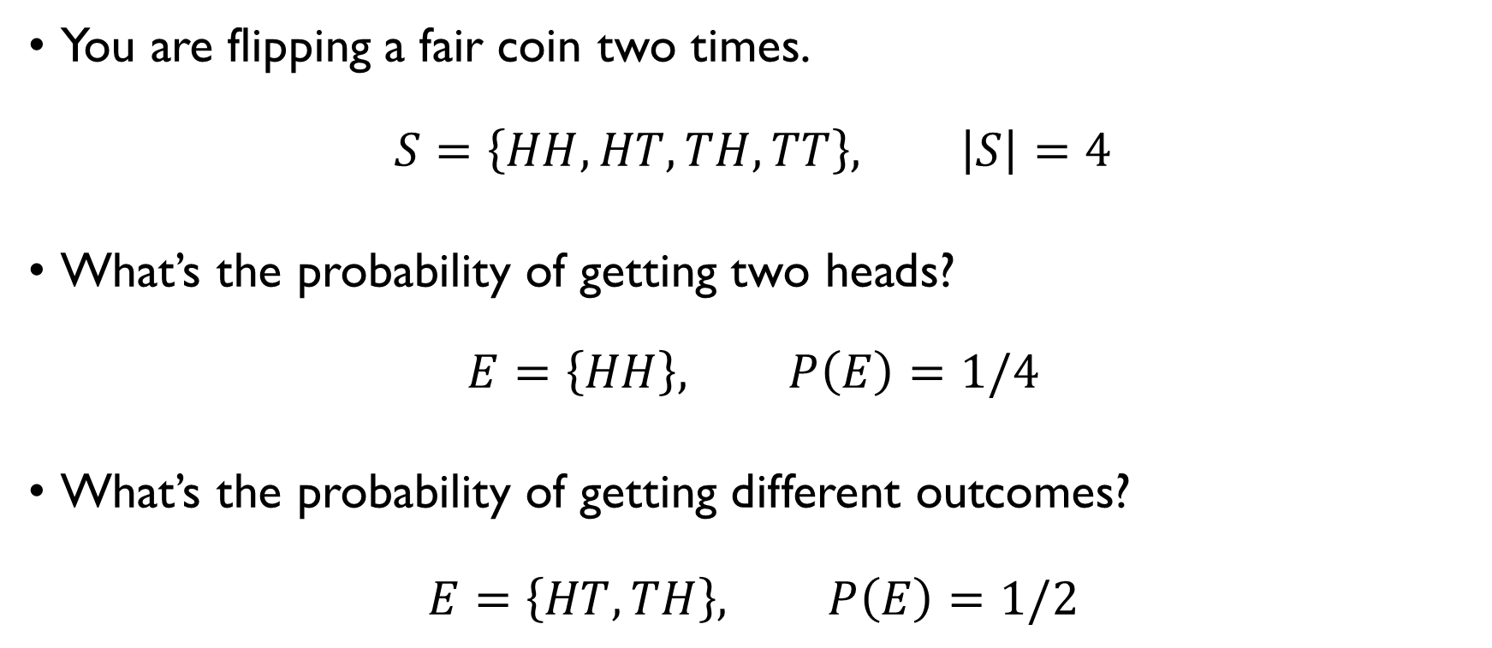
FLIPPING A COIN
You are flipping a fair coin two times.
$$S=\left\{HH, HT, TH,TT\right\}, \left|S\right|=4$$
What’s the probability of getting two heads?
$$E=\left\{HH\right\}, P\left(E\right)=1/4$$
What’s the probability of getting different outcomes?
$$E=\left\{HT,TH\right\}, P\left(E\right)=1/2$$

Slide 57

A bowl with balls - 1
A bowl contains 3 red, 2 blue and 1 green balls. You are picking 1 ball. What is the probability that it’s red? 6 balls in total $→\left|S\right|=6$ 3 red balls $→\left|E\right|=3$ Therefore,
$$P\left(E\right)=\frac{3}{6}=\frac{1}{2}$$

Slide 58

A bowl with balls - 1
A bowl contains 3 red, 2 blue and 1 green balls. You are picking 1 ball. What is the probability that it’s red? 6 balls in total $→\left|S\right|=6$ 3 red balls $→\left|E\right|=3$ Therefore,
$$P\left(E\right)=\frac{3}{6}=\frac{1}{2}$$

Slide 59
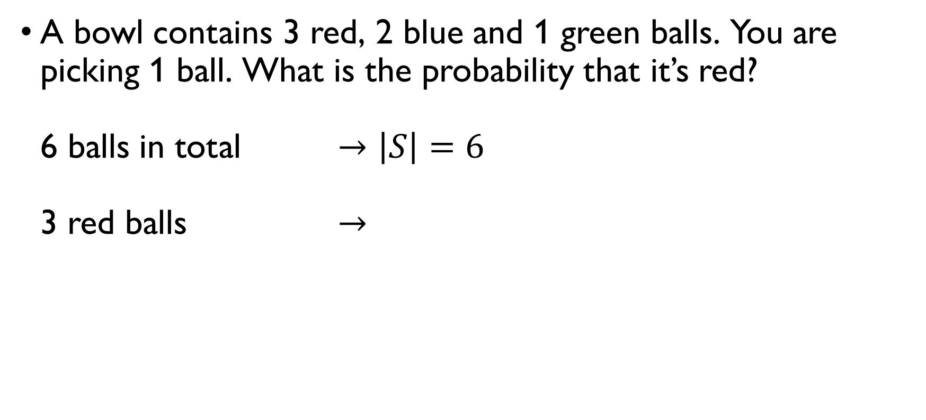
A bowl with balls - 1
A bowl contains 3 red, 2 blue and 1 green balls. You are picking 1 ball. What is the probability that it’s red? 6 balls in total $→\left|S\right|=6$ 3 red balls $→\left|E\right|=3$ Therefore,
$$P\left(E\right)=\frac{3}{6}=\frac{1}{2}$$

Slide 60
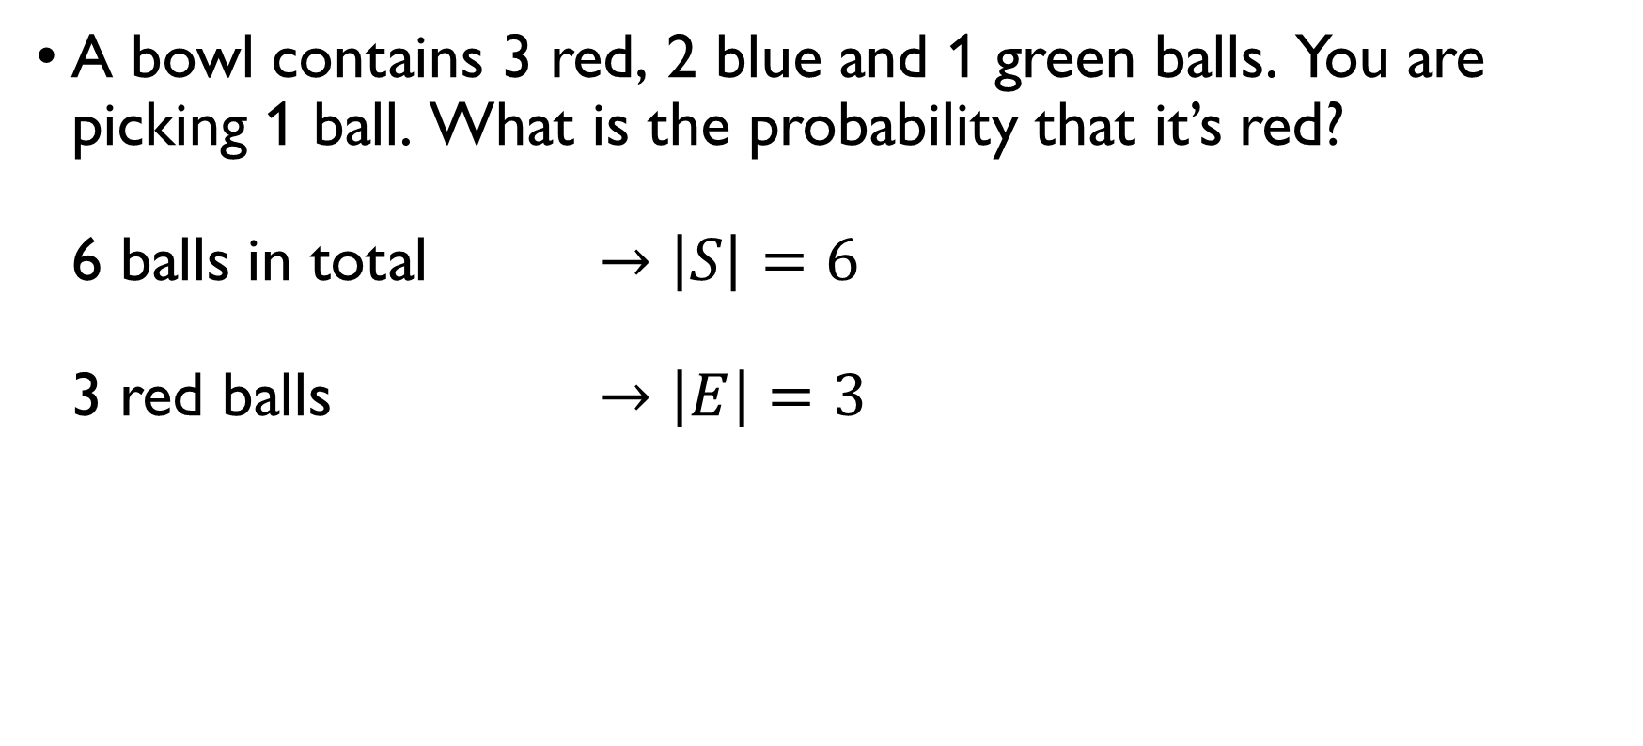
A bowl with balls - 1
A bowl contains 3 red, 2 blue and 1 green balls. You are picking 1 ball. What is the probability that it’s red? 6 balls in total $→\left|S\right|=6$ 3 red balls $→\left|E\right|=3$ Therefore,
$$P\left(E\right)=\frac{3}{6}=\frac{1}{2}$$

Slide 61
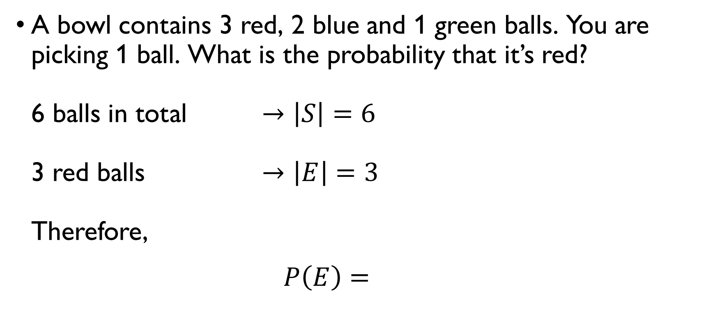
A bowl with balls - 1
A bowl contains 3 red, 2 blue and 1 green balls. You are picking 1 ball. What is the probability that it’s red? 6 balls in total $→\left|S\right|=6$ 3 red balls $→\left|E\right|=3$ Therefore,
$$P\left(E\right)=\frac{3}{6}=\frac{1}{2}$$

Slide 62
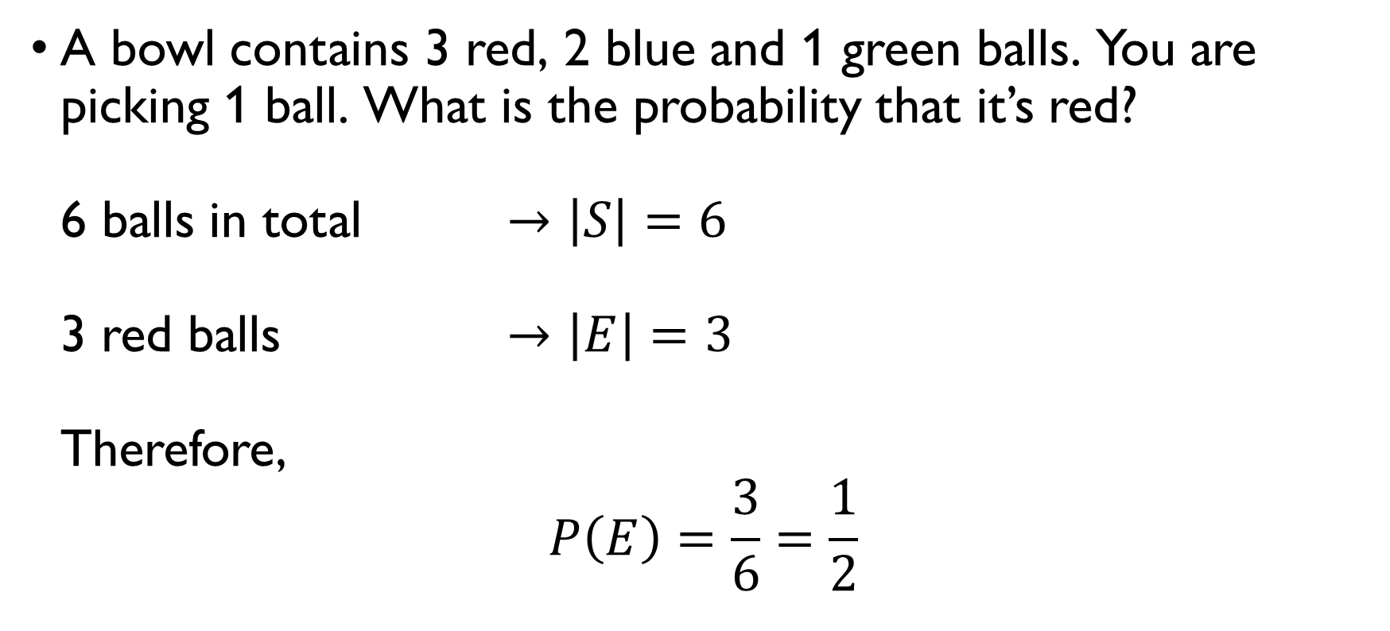
A bowl with balls - 1
A bowl contains 3 red, 2 blue and 1 green balls. You are picking 1 ball. What is the probability that it’s red? 6 balls in total $→\left|S\right|=6$ 3 red balls $→\left|E\right|=3$ Therefore,
$$P\left(E\right)=\frac{3}{6}=\frac{1}{2}$$

Slide 63

A bowl with balls - 2
A bowl contains 3 red, 2 blue and 1 green balls. You are picking 3 balls. What is the probability that they are all of different colors? 6 balls in total $→\left|S\right|=C\left(6, 3\right)=\frac{6!}{3!3!}=20$ pick 3 balls of different colors
$$→\left|E\right|=C\left(3,1\right)⋅C\left(2,1\right)⋅C\left(1,1\right)=3⋅2=6$$ Therefore,
$$P\left(E\right)=\frac{6}{20}=0.3$$

Slide 64

A bowl with balls - 2
A bowl contains 3 red, 2 blue and 1 green balls. You are picking 3 balls. What is the probability that they are all of different colors? 6 balls in total $→\left|S\right|=C\left(6, 3\right)=\frac{6!}{3!3!}=20$ pick 3 balls of different colors
$$→\left|E\right|=C\left(3,1\right)⋅C\left(2,1\right)⋅C\left(1,1\right)=3⋅2=6$$ Therefore,
$$P\left(E\right)=\frac{6}{20}=0.3$$

Slide 65

A bowl with balls - 2
A bowl contains 3 red, 2 blue and 1 green balls. You are picking 3 balls. What is the probability that they are all of different colors? 6 balls in total $→\left|S\right|=C\left(6, 3\right)=\frac{6!}{3!3!}=20$ pick 3 balls of different colors
$$→\left|E\right|=C\left(3,1\right)⋅C\left(2,1\right)⋅C\left(1,1\right)=3⋅2=6$$ Therefore,
$$P\left(E\right)=\frac{6}{20}=0.3$$

Slide 66
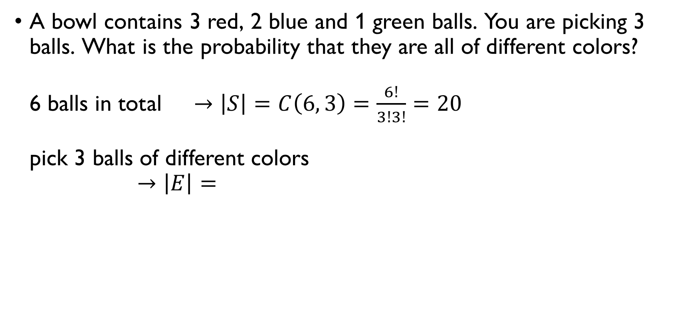
A bowl with balls - 2
A bowl contains 3 red, 2 blue and 1 green balls. You are picking 3 balls. What is the probability that they are all of different colors? 6 balls in total $→\left|S\right|=C\left(6, 3\right)=\frac{6!}{3!3!}=20$ pick 3 balls of different colors
$$→\left|E\right|=C\left(3,1\right)⋅C\left(2,1\right)⋅C\left(1,1\right)=3⋅2=6$$ Therefore,
$$P\left(E\right)=\frac{6}{20}=0.3$$

Slide 67
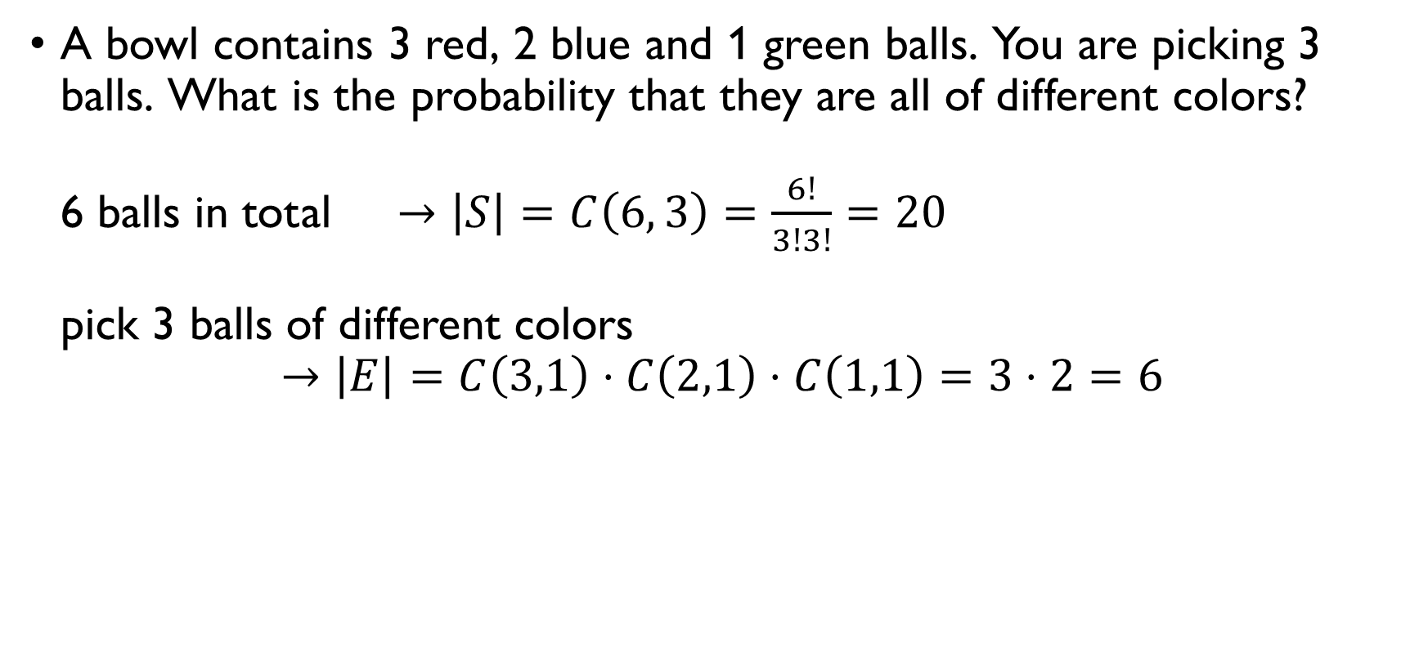
A bowl with balls - 2
A bowl contains 3 red, 2 blue and 1 green balls. You are picking 3 balls. What is the probability that they are all of different colors? 6 balls in total $→\left|S\right|=C\left(6, 3\right)=\frac{6!}{3!3!}=20$ pick 3 balls of different colors
$$→\left|E\right|=C\left(3,1\right)⋅C\left(2,1\right)⋅C\left(1,1\right)=3⋅2=6$$ Therefore,
$$P\left(E\right)=\frac{6}{20}=0.3$$

Slide 68
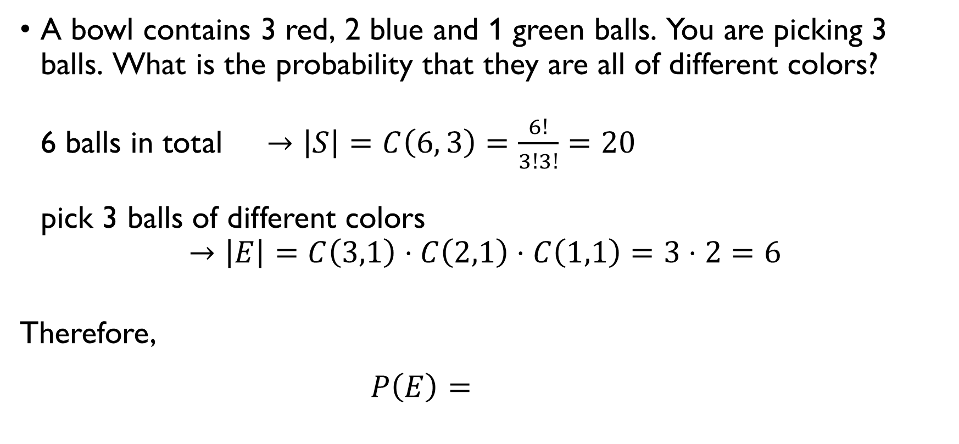
A bowl with balls - 2
A bowl contains 3 red, 2 blue and 1 green balls. You are picking 3 balls. What is the probability that they are all of different colors? 6 balls in total $→\left|S\right|=C\left(6, 3\right)=\frac{6!}{3!3!}=20$ pick 3 balls of different colors
$$→\left|E\right|=C\left(3,1\right)⋅C\left(2,1\right)⋅C\left(1,1\right)=3⋅2=6$$ Therefore,
$$P\left(E\right)=\frac{6}{20}=0.3$$

Slide 69
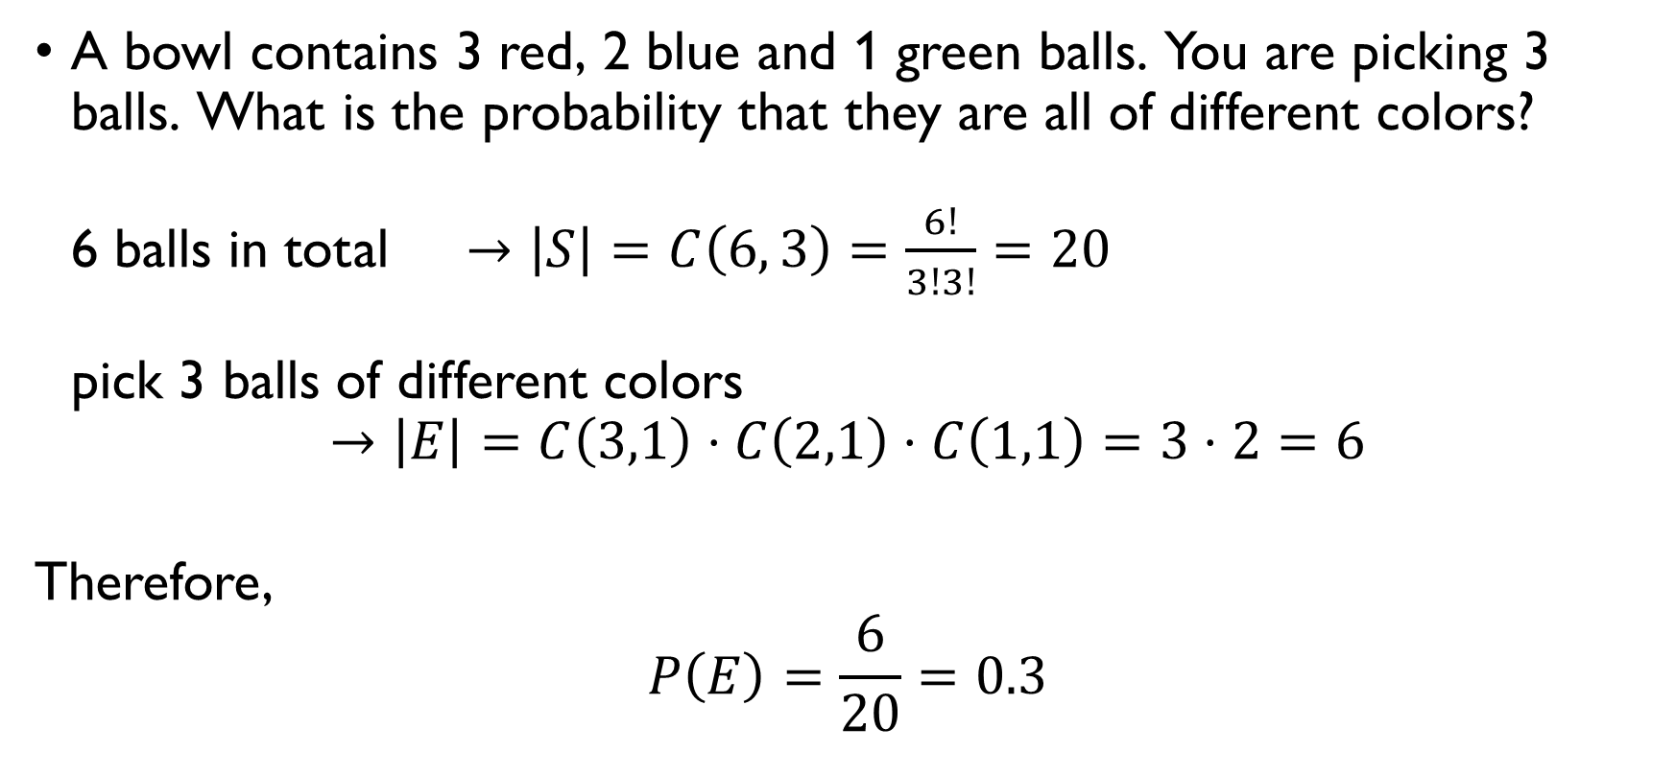
A bowl with balls - 2
A bowl contains 3 red, 2 blue and 1 green balls. You are picking 3 balls. What is the probability that they are all of different colors? 6 balls in total $→\left|S\right|=C\left(6, 3\right)=\frac{6!}{3!3!}=20$ pick 3 balls of different colors
$$→\left|E\right|=C\left(3,1\right)⋅C\left(2,1\right)⋅C\left(1,1\right)=3⋅2=6$$ Therefore,
$$P\left(E\right)=\frac{6}{20}=0.3$$

Slide 70
Playing A DICE GAME
https://youtu.be/Kgudt4PXs28

Slide 71

ROLLING DICE - 1
Two fair dice are rolled. Compute the probability that the sum of the faces is 7. $\left|S\right|=6⋅6=36$ possible combinations. $E=\left\{\left(1, 6\right), \left(2, 5\right), \left(3, 4\right), \left(4, 3\right), \left(5, 2\right), \left(6, 1\right)\right\}, \left|E\right|=6$
$$→P\left(E\right)=\frac{6}{36}=\frac{1}{6}$$

Slide 72

ROLLING DICE - 1
Two fair dice are rolled. Compute the probability that the sum of the faces is 7. $\left|S\right|=6⋅6=36$ possible combinations. $E=\left\{\left(1, 6\right), \left(2, 5\right), \left(3, 4\right), \left(4, 3\right), \left(5, 2\right), \left(6, 1\right)\right\}, \left|E\right|=6$
$$→P\left(E\right)=\frac{6}{36}=\frac{1}{6}$$

Slide 73
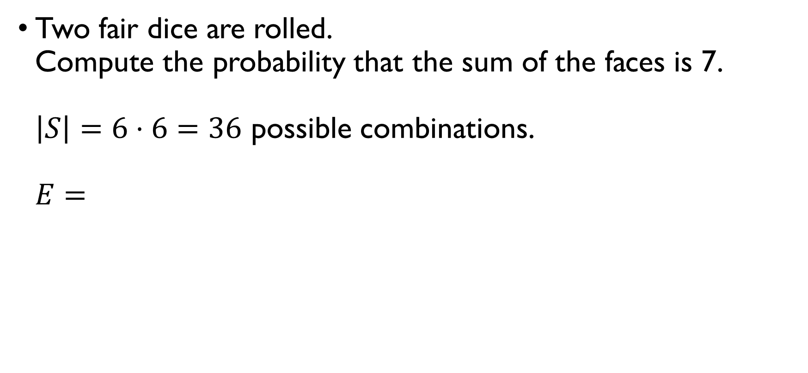
ROLLING DICE - 1
Two fair dice are rolled. Compute the probability that the sum of the faces is 7. $\left|S\right|=6⋅6=36$ possible combinations. $E=\left\{\left(1, 6\right), \left(2, 5\right), \left(3, 4\right), \left(4, 3\right), \left(5, 2\right), \left(6, 1\right)\right\}, \left|E\right|=6$
$$→P\left(E\right)=\frac{6}{36}=\frac{1}{6}$$

Slide 74
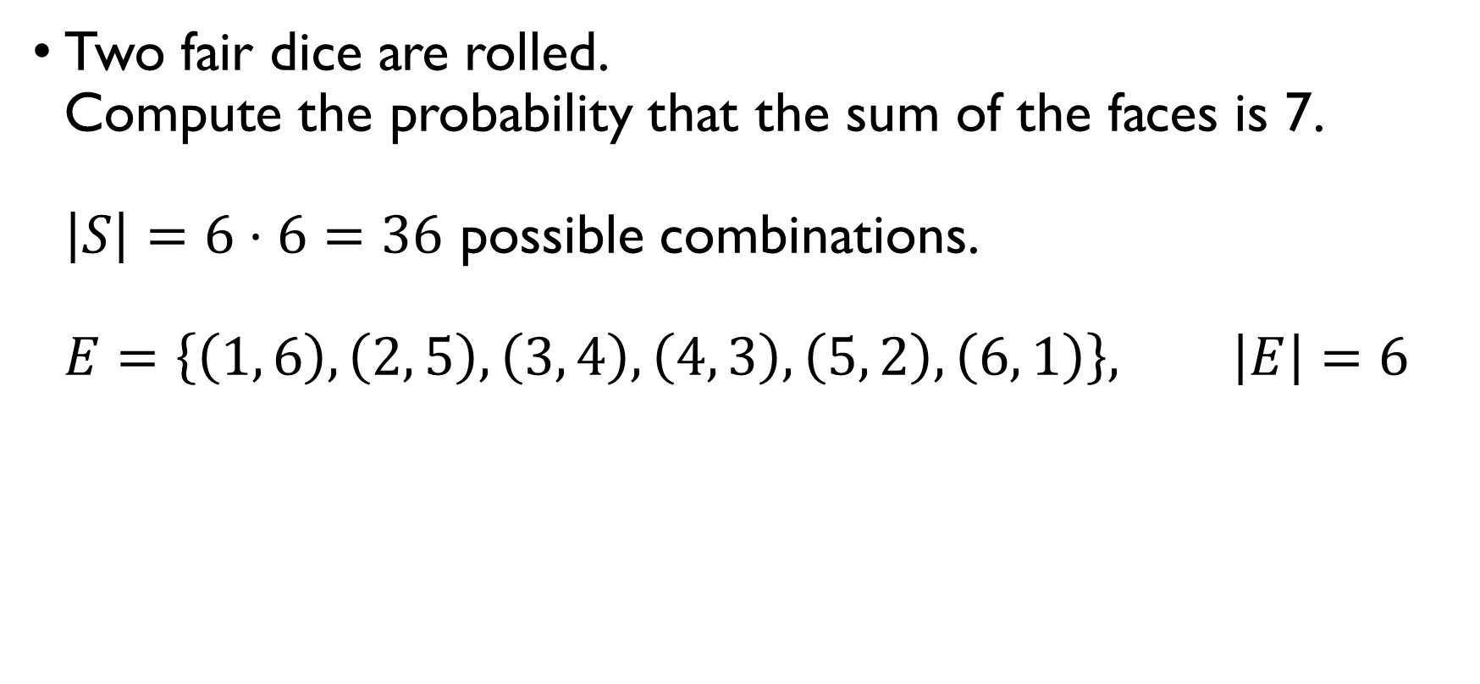
ROLLING DICE - 1
Two fair dice are rolled. Compute the probability that the sum of the faces is 7. $\left|S\right|=6⋅6=36$ possible combinations. $E=\left\{\left(1, 6\right), \left(2, 5\right), \left(3, 4\right), \left(4, 3\right), \left(5, 2\right), \left(6, 1\right)\right\}, \left|E\right|=6$
$$→P\left(E\right)=\frac{6}{36}=\frac{1}{6}$$

Slide 75
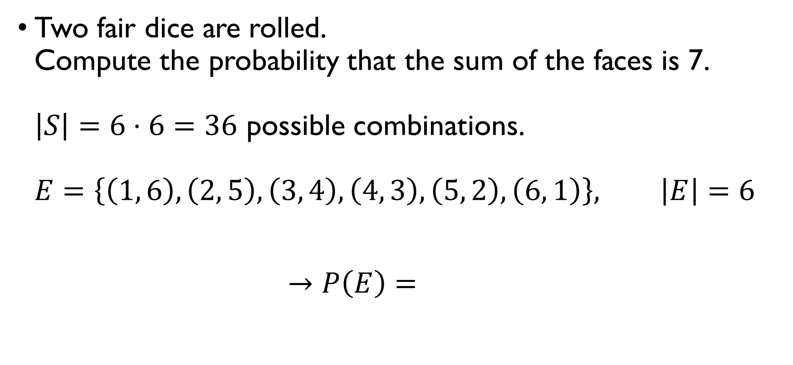
ROLLING DICE - 1
Two fair dice are rolled. Compute the probability that the sum of the faces is 7. $\left|S\right|=6⋅6=36$ possible combinations. $E=\left\{\left(1, 6\right), \left(2, 5\right), \left(3, 4\right), \left(4, 3\right), \left(5, 2\right), \left(6, 1\right)\right\}, \left|E\right|=6$
$$→P\left(E\right)=\frac{6}{36}=\frac{1}{6}$$

Slide 76
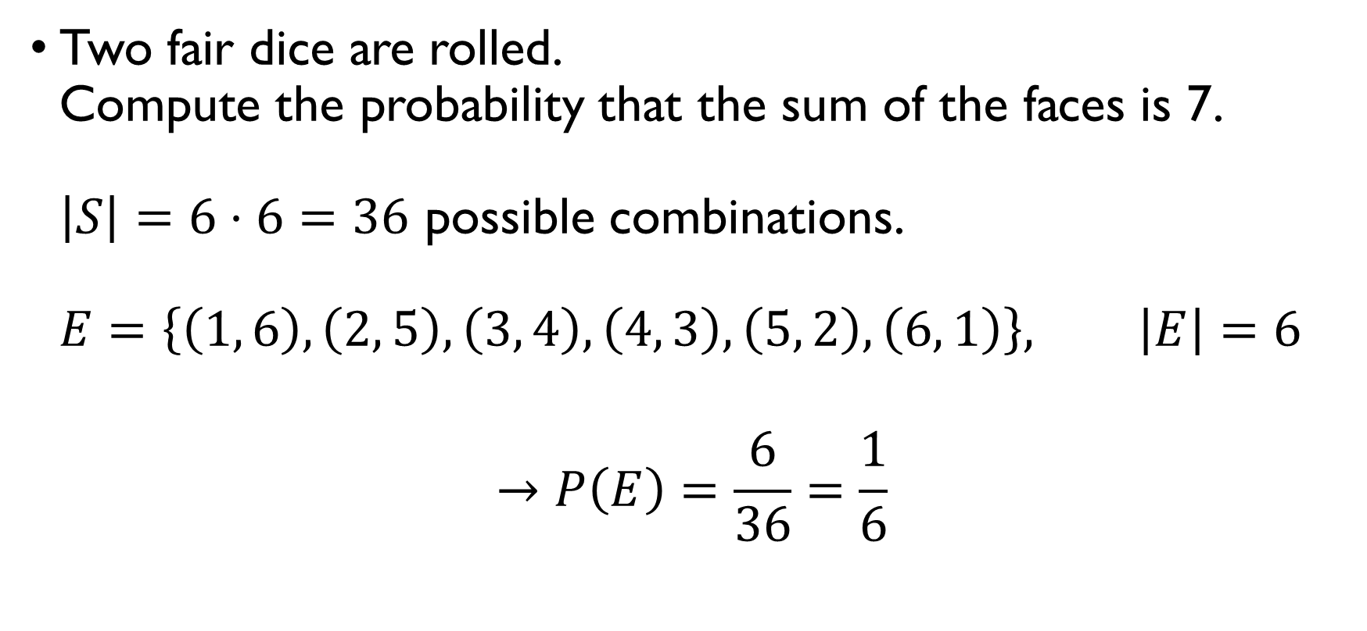
ROLLING DICE - 1
Two fair dice are rolled. Compute the probability that the sum of the faces is 7. $\left|S\right|=6⋅6=36$ possible combinations. $E=\left\{\left(1, 6\right), \left(2, 5\right), \left(3, 4\right), \left(4, 3\right), \left(5, 2\right), \left(6, 1\right)\right\}, \left|E\right|=6$
$$→P\left(E\right)=\frac{6}{36}=\frac{1}{6}$$

Slide 77

ROLLING DICE - 2
Two fair dice are rolled. Compute the probability that the sum of the faces is 11. $\left|S\right|=6⋅6=36$ possible combinations. $E=\left\{\left(5, 6\right), \left(6, 5\right)\right\}, \left|E\right|=2$
$$→P\left(E\right)=\frac{2}{36}=\frac{1}{18}$$

Slide 78

ROLLING DICE - 2
Two fair dice are rolled. Compute the probability that the sum of the faces is 11. $\left|S\right|=6⋅6=36$ possible combinations. $E=\left\{\left(5, 6\right), \left(6, 5\right)\right\}, \left|E\right|=2$
$$→P\left(E\right)=\frac{2}{36}=\frac{1}{18}$$

Slide 79

ROLLING DICE - 2
Two fair dice are rolled. Compute the probability that the sum of the faces is 11. $\left|S\right|=6⋅6=36$ possible combinations. $E=\left\{\left(5, 6\right), \left(6, 5\right)\right\}, \left|E\right|=2$
$$→P\left(E\right)=\frac{2}{36}=\frac{1}{18}$$

Slide 80

ROLLING DICE - 2
Two fair dice are rolled. Compute the probability that the sum of the faces is 11. $\left|S\right|=6⋅6=36$ possible combinations. $E=\left\{\left(5, 6\right), \left(6, 5\right)\right\}, \left|E\right|=2$
$$→P\left(E\right)=\frac{2}{36}=\frac{1}{18}$$

Slide 81

ROLLING DICE - 2
Two fair dice are rolled. Compute the probability that the sum of the faces is 11. $\left|S\right|=6⋅6=36$ possible combinations. $E=\left\{\left(5, 6\right), \left(6, 5\right)\right\}, \left|E\right|=2$
$$→P\left(E\right)=\frac{2}{36}=\frac{1}{18}$$

Slide 82

Rolling a dice - 3
A fair dice is rolled twice and two numbers are obtained, $X_{1}$ and $X_{2}$. Find the probability that $X_{1}≤3$ and $X_{2}≥4$. $\left|S\right|=6⋅6=36$ possible combinations $\left|E\right|=3⋅3=9$ combinations satisfy $X_{1}≤3$ and $X_{2}≥4$
$$→P\left(E\right)=\frac{9}{36}=\frac{1}{4}$$

Slide 83

Rolling a dice - 3
A fair dice is rolled twice and two numbers are obtained, $X_{1}$ and $X_{2}$. Find the probability that $X_{1}≤3$ and $X_{2}≥4$. $\left|S\right|=6⋅6=36$ possible combinations $\left|E\right|=3⋅3=9$ combinations satisfy $X_{1}≤3$ and $X_{2}≥4$
$$→P\left(E\right)=\frac{9}{36}=\frac{1}{4}$$

Slide 84

Rolling a dice - 3
A fair dice is rolled twice and two numbers are obtained, $X_{1}$ and $X_{2}$. Find the probability that $X_{1}≤3$ and $X_{2}≥4$. $\left|S\right|=6⋅6=36$ possible combinations $\left|E\right|=3⋅3=9$ combinations satisfy $X_{1}≤3$ and $X_{2}≥4$
$$→P\left(E\right)=\frac{9}{36}=\frac{1}{4}$$

Slide 85

Rolling a dice - 3
A fair dice is rolled twice and two numbers are obtained, $X_{1}$ and $X_{2}$. Find the probability that $X_{1}≤3$ and $X_{2}≥4$. $\left|S\right|=6⋅6=36$ possible combinations $\left|E\right|=3⋅3=9$ combinations satisfy $X_{1}≤3$ and $X_{2}≥4$
$$→P\left(E\right)=\frac{9}{36}=\frac{1}{4}$$

Slide 86

Rolling a dice - 3
A fair dice is rolled twice and two numbers are obtained, $X_{1}$ and $X_{2}$. Find the probability that $X_{1}≤3$ and $X_{2}≥4$. $\left|S\right|=6⋅6=36$ possible combinations $\left|E\right|=3⋅3=9$ combinations satisfy $X_{1}≤3$ and $X_{2}≥4$
$$→P\left(E\right)=\frac{9}{36}=\frac{1}{4}$$

Slide 87

Rolling a dice - 3
A fair dice is rolled twice and two numbers are obtained, $X_{1}$ and $X_{2}$. Find the probability that $X_{1}≤3$ and $X_{2}≥4$. $\left|S\right|=6⋅6=36$ possible combinations $\left|E\right|=3⋅3=9$ combinations satisfy $X_{1}≤3$ and $X_{2}≥4$
$$→P\left(E\right)=\frac{9}{36}=\frac{1}{4}$$

Slide 88
Axioms of probability

Slide 89

Axioms of probability
For any event $E$, $P\left(E\right)≥0$. Example: rolling a die $E_{1}:$ ‘get 1’ $P\left(E_{1}\right)=\frac{1}{6}$ $E_{2}:$ ‘get an even number’ $P\left(E_{2}\right)=\frac{1}{2}$ $E_{3}:$ ‘get 27’ $P\left(E_{3}\right)=0$

Slide 90

Axioms of probability
For any event $E$, $P\left(E\right)≥0$. Example: rolling a die $E_{1}:$ ‘get 1’ $P\left(E_{1}\right)=\frac{1}{6}$ $E_{2}:$ ‘get an even number’ $P\left(E_{2}\right)=\frac{1}{2}$ $E_{3}:$ ‘get 27’ $P\left(E_{3}\right)=0$

Slide 91

Axioms of probability
For any event $E$, $P\left(E\right)≥0$. Example: rolling a die $E_{1}:$ ‘get 1’ $P\left(E_{1}\right)=\frac{1}{6}$ $E_{2}:$ ‘get an even number’ $P\left(E_{2}\right)=\frac{1}{2}$ $E_{3}:$ ‘get 27’ $P\left(E_{3}\right)=0$

Slide 92

Axioms of probability
For any event $E$, $P\left(E\right)≥0$. Example: rolling a die $E_{1}:$ ‘get 1’ $P\left(E_{1}\right)=\frac{1}{6}$ $E_{2}:$ ‘get an even number’ $P\left(E_{2}\right)=\frac{1}{2}$ $E_{3}:$ ‘get 27’ $P\left(E_{3}\right)=0$

Slide 93

Axioms of probability
For any event $E$, $P\left(E\right)≥0$. Example: rolling a die $E_{1}:$ ‘get 1’ $P\left(E_{1}\right)=\frac{1}{6}$ $E_{2}:$ ‘get an even number’ $P\left(E_{2}\right)=\frac{1}{2}$ $E_{3}:$ ‘get 27’ $P\left(E_{3}\right)=0$

Slide 94

Axioms of probability
Probability of the sample space $S$ is $P\left(S\right)=1$. Example: getting a baby $S=\left\{boy, girl\right\}$ $E:$ ‘get boy or girl’ $P\left(E\right)=1$

Slide 95

Axioms of probability
Probability of the sample space $S$ is $P\left(S\right)=1$. Example: getting a baby $S=\left\{boy, girl\right\}$ $E:$ ‘get boy or girl’ $P\left(E\right)=1$

Slide 96

Axioms of probability
Probability of the sample space $S$ is $P\left(S\right)=1$. Example: getting a baby $S=\left\{boy, girl\right\}$ $E:$ ‘get boy or girl’ $P\left(E\right)=1$

Slide 97

Axioms of probability
If $E_{1},E_{2},E_{3},…$ are mutually exclusive events, then
$P\left(E_{1}∪E_{2}∪E_{3}…\right)=P\left(E_{1}\right)+P\left(E_{2}\right)+P\left(E_{3}\right)+…$
Example: Candidates A, B, C and D are participating in the elections. Based on the polls, A has a 20% chance of winning and B has a 40% chance of winning. What is the probability that A or B will win?
$$P\left(E_{A}∪E_{B}\right)=P\left(E_{A}\right)+P\left(E_{B}\right)=0.2+0.4=0.6$$

Slide 98

Axioms of probability
If $E_{1},E_{2},E_{3},…$ are mutually exclusive events, then
$P\left(E_{1}∪E_{2}∪E_{3}…\right)=P\left(E_{1}\right)+P\left(E_{2}\right)+P\left(E_{3}\right)+…$
Example: Candidates A, B, C and D are participating in the elections. Based on the polls, A has a 20% chance of winning and B has a 40% chance of winning. What is the probability that A or B will win?
$$P\left(E_{A}∪E_{B}\right)=P\left(E_{A}\right)+P\left(E_{B}\right)=0.2+0.4=0.6$$

Slide 99

Axioms of probability
If $E_{1},E_{2},E_{3},…$ are mutually exclusive events, then
$P\left(E_{1}∪E_{2}∪E_{3}…\right)=P\left(E_{1}\right)+P\left(E_{2}\right)+P\left(E_{3}\right)+…$
Example: Candidates A, B, C and D are participating in the elections. Based on the polls, A has a 20% chance of winning and B has a 40% chance of winning. What is the probability that A or B will win?
$$P\left(E_{A}∪E_{B}\right)=P\left(E_{A}\right)+P\left(E_{B}\right)=0.2+0.4=0.6$$

Slide 100

Axioms of probability
If $E_{1},E_{2},E_{3},…$ are mutually exclusive events, then
$P\left(E_{1}∪E_{2}∪E_{3}…\right)=P\left(E_{1}\right)+P\left(E_{2}\right)+P\left(E_{3}\right)+…$
Example: Candidates A, B, C and D are participating in the elections. Based on the polls, A has a 20% chance of winning and B has a 40% chance of winning. What is the probability that A or B will win?
$$P\left(E_{A}∪E_{B}\right)=P\left(E_{A}\right)+P\left(E_{B}\right)=0.2+0.4=0.6$$

Slide 101
Complementary events

Slide 102

Complement of an event
A complement $E^{C}=\overline{E}$ of an event $E$ is a set of all outcomes from the sample space $S$ that don’t belong to $E$. Example 1: flipping a coin $S=\left\{H, T\right\}$ $E=\left\{H\right\} \overline{E}=\left\{T\right\}$ Example 2: rolling a die $S=\left\{1, 2, 3, 4, 5, 6\right\}$ $E=\left\{1, 2, 3\right\} \overline{E}=\left\{4, 5, 6\right\}$

Slide 103

Complement of an event
A complement $E^{C}=\overline{E}$ of an event $E$ is a set of all outcomes from the sample space $S$ that don’t belong to $E$. Example 1: flipping a coin $S=\left\{H, T\right\}$ $E=\left\{H\right\} \overline{E}=\left\{T\right\}$ Example 2: rolling a die $S=\left\{1, 2, 3, 4, 5, 6\right\}$ $E=\left\{1, 2, 3\right\} \overline{E}=\left\{4, 5, 6\right\}$

Slide 104

Complement of an event
A complement $E^{C}=\overline{E}$ of an event $E$ is a set of all outcomes from the sample space $S$ that don’t belong to $E$. Example 1: flipping a coin $S=\left\{H, T\right\}$ $E=\left\{H\right\} \overline{E}=\left\{T\right\}$ Example 2: rolling a die $S=\left\{1, 2, 3, 4, 5, 6\right\}$ $E=\left\{1, 2, 3\right\} \overline{E}=\left\{4, 5, 6\right\}$

Slide 105

Complement of an event
A complement $E^{C}=\overline{E}$ of an event $E$ is a set of all outcomes from the sample space $S$ that don’t belong to $E$. Example 1: flipping a coin $S=\left\{H, T\right\}$ $E=\left\{H\right\} \overline{E}=\left\{T\right\}$ Example 2: rolling a die $S=\left\{1, 2, 3, 4, 5, 6\right\}$ $E=\left\{1, 2, 3\right\} \overline{E}=\left\{4, 5, 6\right\}$

Slide 106

Complement of an event
A complement $E^{C}=\overline{E}$ of an event $E$ is a set of all outcomes from the sample space $S$ that don’t belong to $E$. Example 1: flipping a coin $S=\left\{H, T\right\}$ $E=\left\{H\right\} \overline{E}=\left\{T\right\}$ Example 2: rolling a die $S=\left\{1, 2, 3, 4, 5, 6\right\}$ $E=\left\{1, 2, 3\right\} \overline{E}=\left\{4, 5, 6\right\}$

Slide 107

Probabilities of Complementary Events
If $E$ is an event and $E^{C}$ is its complement, then
$$P\left(E\right)=1−P\left(E^{C}\right)$$
Example: Rolling a fair die $S=\left\{1, 2, 3, 4, 5, 6\right\}$ $E = \left\{1, 2\right\}$ $P\left(E\right)=\frac{2}{6}=\frac{1}{3}$ $E^{C} = \{3, 4, 5, 6\}$ $P\left(E^{C}\right)=1−P\left(E\right)=1−\frac{1}{3}=\frac{2}{3}$

Slide 108

Probabilities of Complementary Events
If $E$ is an event and $E^{C}$ is its complement, then
$$P\left(E\right)=1−P\left(E^{C}\right)$$
Example: Rolling a fair die $S=\left\{1, 2, 3, 4, 5, 6\right\}$ $E = \left\{1, 2\right\}$ $P\left(E\right)=\frac{2}{6}=\frac{1}{3}$ $E^{C} = \{3, 4, 5, 6\}$ $P\left(E^{C}\right)=1−P\left(E\right)=1−\frac{1}{3}=\frac{2}{3}$

Slide 109

Probabilities of Complementary Events
If $E$ is an event and $E^{C}$ is its complement, then
$$P\left(E\right)=1−P\left(E^{C}\right)$$
Example: Rolling a fair die $S=\left\{1, 2, 3, 4, 5, 6\right\}$ $E = \left\{1, 2\right\}$ $P\left(E\right)=\frac{2}{6}=\frac{1}{3}$ $E^{C} = \{3, 4, 5, 6\}$ $P\left(E^{C}\right)=1−P\left(E\right)=1−\frac{1}{3}=\frac{2}{3}$

Slide 110

Probabilities of Complementary Events
If $E$ is an event and $E^{C}$ is its complement, then
$$P\left(E\right)=1−P\left(E^{C}\right)$$
Example: Rolling a fair die $S=\left\{1, 2, 3, 4, 5, 6\right\}$ $E = \left\{1, 2\right\}$ $P\left(E\right)=\frac{2}{6}=\frac{1}{3}$ $E^{C} = \{3, 4, 5, 6\}$ $P\left(E^{C}\right)=1−P\left(E\right)=1−\frac{1}{3}=\frac{2}{3}$

Slide 111

Probabilities of Complementary Events
If $E$ is an event and $E^{C}$ is its complement, then
$$P\left(E\right)=1−P\left(E^{C}\right)$$
Example: Rolling a fair die $S=\left\{1, 2, 3, 4, 5, 6\right\}$ $E = \left\{1, 2\right\}$ $P\left(E\right)=\frac{2}{6}=\frac{1}{3}$ $E^{C} = \{3, 4, 5, 6\}$ $P\left(E^{C}\right)=1−P\left(E\right)=1−\frac{1}{3}=\frac{2}{3}$

Slide 112

Probabilities of Complementary Events
If $E$ is an event and $E^{C}$ is its complement, then
$$P\left(E\right)=1−P\left(E^{C}\right)$$
Example: Rolling a fair die $S=\left\{1, 2, 3, 4, 5, 6\right\}$ $E = \left\{1, 2\right\}$ $P\left(E\right)=\frac{2}{6}=\frac{1}{3}$ $E^{C} = \{3, 4, 5, 6\}$ $P\left(E^{C}\right)=1−P\left(E\right)=1−\frac{1}{3}=\frac{2}{3}$

Slide 113

Probabilities of Complementary Events
If $E$ is an event and $E^{C}$ is its complement, then
$$P\left(E\right)=1−P\left(E^{C}\right)$$
Example: Rolling a fair die $S=\left\{1, 2, 3, 4, 5, 6\right\}$ $E = \left\{1, 2\right\}$ $P\left(E\right)=\frac{2}{6}=\frac{1}{3}$ $E^{C} = \{3, 4, 5, 6\}$ $P\left(E^{C}\right)=1−P\left(E\right)=1−\frac{1}{3}=\frac{2}{3}$

Slide 114

Example: bit strings
A sequence of 10 bits is randomly generated. What is the probability that at least one of these bits is 0? $S−$ all possible 10-bit strings. $\left|S\right|=2^{10}$ $E:$ ‘at least one of the bits is 0’ $P\left(E\right)=?$ $E^{C}:$ ‘none of the bits is 0’ $\left|E^{C}\right|=1$ $P\left(E^{C}\right)=\frac{1}{2^{10}}$
$$→P\left(E\right)=1−P\left(E^{C}\right)=1−1/2^{10}$$

Slide 115

Example: bit strings
A sequence of 10 bits is randomly generated. What is the probability that at least one of these bits is 0? $S−$ all possible 10-bit strings. $\left|S\right|=2^{10}$ $E:$ ‘at least one of the bits is 0’ $P\left(E\right)=?$ $E^{C}:$ ‘none of the bits is 0’ $\left|E^{C}\right|=1$ $P\left(E^{C}\right)=\frac{1}{2^{10}}$
$$→P\left(E\right)=1−P\left(E^{C}\right)=1−1/2^{10}$$

Slide 116

Example: bit strings
A sequence of 10 bits is randomly generated. What is the probability that at least one of these bits is 0? $S−$ all possible 10-bit strings. $\left|S\right|=2^{10}$ $E:$ ‘at least one of the bits is 0’ $P\left(E\right)=?$ $E^{C}:$ ‘none of the bits is 0’ $\left|E^{C}\right|=1$ $P\left(E^{C}\right)=\frac{1}{2^{10}}$
$$→P\left(E\right)=1−P\left(E^{C}\right)=1−1/2^{10}$$

Slide 117

Example: bit strings
A sequence of 10 bits is randomly generated. What is the probability that at least one of these bits is 0? $S−$ all possible 10-bit strings. $\left|S\right|=2^{10}$ $E:$ ‘at least one of the bits is 0’ $P\left(E\right)=?$ $E^{C}:$ ‘none of the bits is 0’ $\left|E^{C}\right|=1$ $P\left(E^{C}\right)=\frac{1}{2^{10}}$
$$→P\left(E\right)=1−P\left(E^{C}\right)=1−1/2^{10}$$

Slide 118

Example: bit strings
A sequence of 10 bits is randomly generated. What is the probability that at least one of these bits is 0? $S−$ all possible 10-bit strings. $\left|S\right|=2^{10}$ $E:$ ‘at least one of the bits is 0’ $P\left(E\right)=?$ $E^{C}:$ ‘none of the bits is 0’ $\left|E^{C}\right|=1$ $P\left(E^{C}\right)=\frac{1}{2^{10}}$
$$→P\left(E\right)=1−P\left(E^{C}\right)=1−1/2^{10}$$

Slide 119

Example: bit strings
A sequence of 10 bits is randomly generated. What is the probability that at least one of these bits is 0? $S−$ all possible 10-bit strings. $\left|S\right|=2^{10}$ $E:$ ‘at least one of the bits is 0’ $P\left(E\right)=?$ $E^{C}:$ ‘none of the bits is 0’ $\left|E^{C}\right|=1$ $P\left(E^{C}\right)=\frac{1}{2^{10}}$
$$→P\left(E\right)=1−P\left(E^{C}\right)=1−1/2^{10}$$

Slide 120

Example: bit strings
A sequence of 10 bits is randomly generated. What is the probability that at least one of these bits is 0? $S−$ all possible 10-bit strings. $\left|S\right|=2^{10}$ $E:$ ‘at least one of the bits is 0’ $P\left(E\right)=?$ $E^{C}:$ ‘none of the bits is 0’ $\left|E^{C}\right|=1$ $P\left(E^{C}\right)=\frac{1}{2^{10}}$
$$→P\left(E\right)=1−P\left(E^{C}\right)=1−1/2^{10}$$

Slide 121

Example: bit strings
A sequence of 10 bits is randomly generated. What is the probability that at least one of these bits is 0? $S−$ all possible 10-bit strings. $\left|S\right|=2^{10}$ $E:$ ‘at least one of the bits is 0’ $P\left(E\right)=?$ $E^{C}:$ ‘none of the bits is 0’ $\left|E^{C}\right|=1$ $P\left(E^{C}\right)=\frac{1}{2^{10}}$
$$→P\left(E\right)=1−P\left(E^{C}\right)=1−1/2^{10}$$

Slide 122

Example: bit strings
A sequence of 10 bits is randomly generated. What is the probability that at least one of these bits is 0? $S−$ all possible 10-bit strings. $\left|S\right|=2^{10}$ $E:$ ‘at least one of the bits is 0’ $P\left(E\right)=?$ $E^{C}:$ ‘none of the bits is 0’ $\left|E^{C}\right|=1$ $P\left(E^{C}\right)=\frac{1}{2^{10}}$
$$→P\left(E\right)=1−P\left(E^{C}\right)=1−1/2^{10}$$

Slide 123
Union of events

Slide 124

Probability of a union
Let $E_{1}$ and $E_{2}$ be some events in a sample space $S$. Then
$$P\left(E_{1}∪E_{2}\right)=\frac{\left|E_{1}∪E_{2}\right|}{\left|S\right|}=\frac{\left|E_{1}\right|+\left|E_{2}\right|−\left|E_{1}∩E_{2}\right|}{\left|S\right|}=$$
$$=\frac{\left|E_{1}\right|}{\left|S\right|}+\frac{\left|E_{2}\right|}{\left|S\right|}−\frac{\left|E_{1}∩E_{2}\right|}{\left|S\right|}=P\left(E_{1}\right)+P\left(E_{2}\right)−P\left(E_{1}∩E_{2}\right)$$

Slide 125

Probability of a union
Let $E_{1}$ and $E_{2}$ be some events in a sample space $S$. Then
$$P\left(E_{1}∪E_{2}\right)=\frac{\left|E_{1}∪E_{2}\right|}{\left|S\right|}=\frac{\left|E_{1}\right|+\left|E_{2}\right|−\left|E_{1}∩E_{2}\right|}{\left|S\right|}=$$
$$=\frac{\left|E_{1}\right|}{\left|S\right|}+\frac{\left|E_{2}\right|}{\left|S\right|}−\frac{\left|E_{1}∩E_{2}\right|}{\left|S\right|}=P\left(E_{1}\right)+P\left(E_{2}\right)−P\left(E_{1}∩E_{2}\right)$$

Slide 126

Probability of a union
Let $E_{1}$ and $E_{2}$ be some events in a sample space $S$. Then
$$P\left(E_{1}∪E_{2}\right)=\frac{\left|E_{1}∪E_{2}\right|}{\left|S\right|}=\frac{\left|E_{1}\right|+\left|E_{2}\right|−\left|E_{1}∩E_{2}\right|}{\left|S\right|}=$$
$$=\frac{\left|E_{1}\right|}{\left|S\right|}+\frac{\left|E_{2}\right|}{\left|S\right|}−\frac{\left|E_{1}∩E_{2}\right|}{\left|S\right|}=P\left(E_{1}\right)+P\left(E_{2}\right)−P\left(E_{1}∩E_{2}\right)$$

Slide 127

Probability of a union
Let $E_{1}$ and $E_{2}$ be some events in a sample space $S$. Then
$$P\left(E_{1}∪E_{2}\right)=\frac{\left|E_{1}∪E_{2}\right|}{\left|S\right|}=\frac{\left|E_{1}\right|+\left|E_{2}\right|−\left|E_{1}∩E_{2}\right|}{\left|S\right|}=$$
$$=\frac{\left|E_{1}\right|}{\left|S\right|}+\frac{\left|E_{2}\right|}{\left|S\right|}−\frac{\left|E_{1}∩E_{2}\right|}{\left|S\right|}=P\left(E_{1}\right)+P\left(E_{2}\right)−P\left(E_{1}∩E_{2}\right)$$

Slide 128

Probability of a union
Let $E_{1}$ and $E_{2}$ be some events in a sample space $S$. Then
$$P\left(E_{1}∪E_{2}\right)=\frac{\left|E_{1}∪E_{2}\right|}{\left|S\right|}=\frac{\left|E_{1}\right|+\left|E_{2}\right|−\left|E_{1}∩E_{2}\right|}{\left|S\right|}=$$
$$=\frac{\left|E_{1}\right|}{\left|S\right|}+\frac{\left|E_{2}\right|}{\left|S\right|}−\frac{\left|E_{1}∩E_{2}\right|}{\left|S\right|}=P\left(E_{1}\right)+P\left(E_{2}\right)−P\left(E_{1}∩E_{2}\right)$$

Slide 129

Drawing names
A total of 20 students participate in a drawing in which one name is chosen at random. There are 6 seniors (2 men and 4 women), 5 juniors (3 men and 2 women) and 9 freshmen (5 men and 4 women). What is the probability that the name that is drawn belongs to either a woman or to a junior? $$P\left(W∪J\right)=P\left(W\right)+P\left(J\right)−P\left(W∩J\right)= \\ =\frac{\left|W\right|}{\left|S\right|}+\frac{\left|J\right|}{\left|S\right|}−\frac{\left|W∩J\right|}{\left|S\right|}= \\ =\frac{4+2+4}{20}+\frac{5}{20}−\frac{2}{20}=0.5+0.2−0.1=0.6$$

Slide 130

Drawing names
A total of 20 students participate in a drawing in which one name is chosen at random. There are 6 seniors (2 men and 4 women), 5 juniors (3 men and 2 women) and 9 freshmen (5 men and 4 women). What is the probability that the name that is drawn belongs to either a woman or to a junior? $$P\left(W∪J\right)=P\left(W\right)+P\left(J\right)−P\left(W∩J\right)= \\ =\frac{\left|W\right|}{\left|S\right|}+\frac{\left|J\right|}{\left|S\right|}−\frac{\left|W∩J\right|}{\left|S\right|}= \\ =\frac{4+2+4}{20}+\frac{5}{20}−\frac{2}{20}=0.5+0.2−0.1=0.6$$

Slide 131

Drawing names
A total of 20 students participate in a drawing in which one name is chosen at random. There are 6 seniors (2 men and 4 women), 5 juniors (3 men and 2 women) and 9 freshmen (5 men and 4 women). What is the probability that the name that is drawn belongs to either a woman or to a junior? $$P\left(W∪J\right)=P\left(W\right)+P\left(J\right)−P\left(W∩J\right)= \\ =\frac{\left|W\right|}{\left|S\right|}+\frac{\left|J\right|}{\left|S\right|}−\frac{\left|W∩J\right|}{\left|S\right|}= \\ =\frac{4+2+4}{20}+\frac{5}{20}−\frac{2}{20}=0.5+0.2−0.1=0.6$$

Slide 132

Drawing names
A total of 20 students participate in a drawing in which one name is chosen at random. There are 6 seniors (2 men and 4 women), 5 juniors (3 men and 2 women) and 9 freshmen (5 men and 4 women). What is the probability that the name that is drawn belongs to either a woman or to a junior? $$P\left(W∪J\right)=P\left(W\right)+P\left(J\right)−P\left(W∩J\right)= \\ =\frac{\left|W\right|}{\left|S\right|}+\frac{\left|J\right|}{\left|S\right|}−\frac{\left|W∩J\right|}{\left|S\right|}= \\ =\frac{4+2+4}{20}+\frac{5}{20}−\frac{2}{20}=0.5+0.2−0.1=0.6$$

Slide 133

Drawing names
A total of 20 students participate in a drawing in which one name is chosen at random. There are 6 seniors (2 men and 4 women), 5 juniors (3 men and 2 women) and 9 freshmen (5 men and 4 women). What is the probability that the name that is drawn belongs to either a woman or to a junior? $$P\left(W∪J\right)=P\left(W\right)+P\left(J\right)−P\left(W∩J\right)= \\ =\frac{\left|W\right|}{\left|S\right|}+\frac{\left|J\right|}{\left|S\right|}−\frac{\left|W∩J\right|}{\left|S\right|}= \\ =\frac{4+2+4}{20}+\frac{5}{20}−\frac{2}{20}=0.5+0.25−0.1=0.65$$

Slide 134

numbers
What is the probability that a positive integer selected at random from the set of positive integers not exceeding 100 is divisible by either 2 or 5?
$$P\left(E_{2}∪E_{5}\right)=P\left(E_{2}\right)+P\left(E_{5}\right)−P\left(E_{2}∩E_{5}\right)= \\ =\frac{\left|E_{2}\right|}{\left|S\right|}+\frac{\left|E_{5}\right|}{\left|S\right|}−\frac{\left|E_{2}∩E_{5}\right|}{\left|S\right|}= \\ =\frac{50}{100}+\frac{20}{100}−\frac{10}{100}=0.6$$

Slide 135

numbers
What is the probability that a positive integer selected at random from the set of positive integers not exceeding 100 is divisible by either 2 or 5?
$$P\left(E_{2}∪E_{5}\right)=P\left(E_{2}\right)+P\left(E_{5}\right)−P\left(E_{2}∩E_{5}\right)= \\ =\frac{\left|E_{2}\right|}{\left|S\right|}+\frac{\left|E_{5}\right|}{\left|S\right|}−\frac{\left|E_{2}∩E_{5}\right|}{\left|S\right|}= \\ =\frac{50}{100}+\frac{20}{100}−\frac{10}{100}=0.6$$

Slide 136

numbers
What is the probability that a positive integer selected at random from the set of positive integers not exceeding 100 is divisible by either 2 or 5?
$$P\left(E_{2}∪E_{5}\right)=P\left(E_{2}\right)+P\left(E_{5}\right)−P\left(E_{2}∩E_{5}\right)= \\ =\frac{\left|E_{2}\right|}{\left|S\right|}+\frac{\left|E_{5}\right|}{\left|S\right|}−\frac{\left|E_{2}∩E_{5}\right|}{\left|S\right|}= \\ =\frac{50}{100}+\frac{20}{100}−\frac{10}{100}=0.6$$

Slide 137

numbers
What is the probability that a positive integer selected at random from the set of positive integers not exceeding 100 is divisible by either 2 or 5?
$$P\left(E_{2}∪E_{5}\right)=P\left(E_{2}\right)+P\left(E_{5}\right)−P\left(E_{2}∩E_{5}\right)= \\ =\frac{\left|E_{2}\right|}{\left|S\right|}+\frac{\left|E_{5}\right|}{\left|S\right|}−\frac{\left|E_{2}∩E_{5}\right|}{\left|S\right|}= \\ =\frac{50}{100}+\frac{20}{100}−\frac{10}{100}=0.6$$

Slide 138
Let’s practice!
https://docs.google.com/document/d/1RaSYs_32U0RHtzooHtjs7wJOrRGjCQBDLjR2kpvxg-s/edit?usp=sharing

