Slide 1
ELEMENTARY COMBINATORICS & PROBABILITY
Review week 2

Slide 2
LAST WEEK
Random experiments
outcome;
sample space;
events.
Probability of an event
Conditional probability
Independent events
The law of total probability
Bayes’ rule

Slide 3
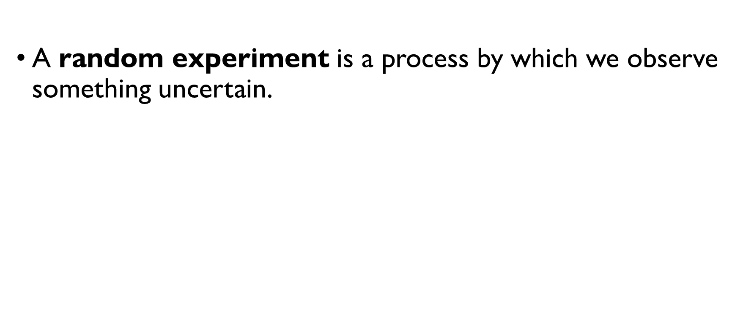
Random experiment
A random experiment is a process by which we observe something uncertain.
The result of a random experiment is called the outcome.
The set of all possible outcomes is called the sample space (denoted by $S$).

Slide 4
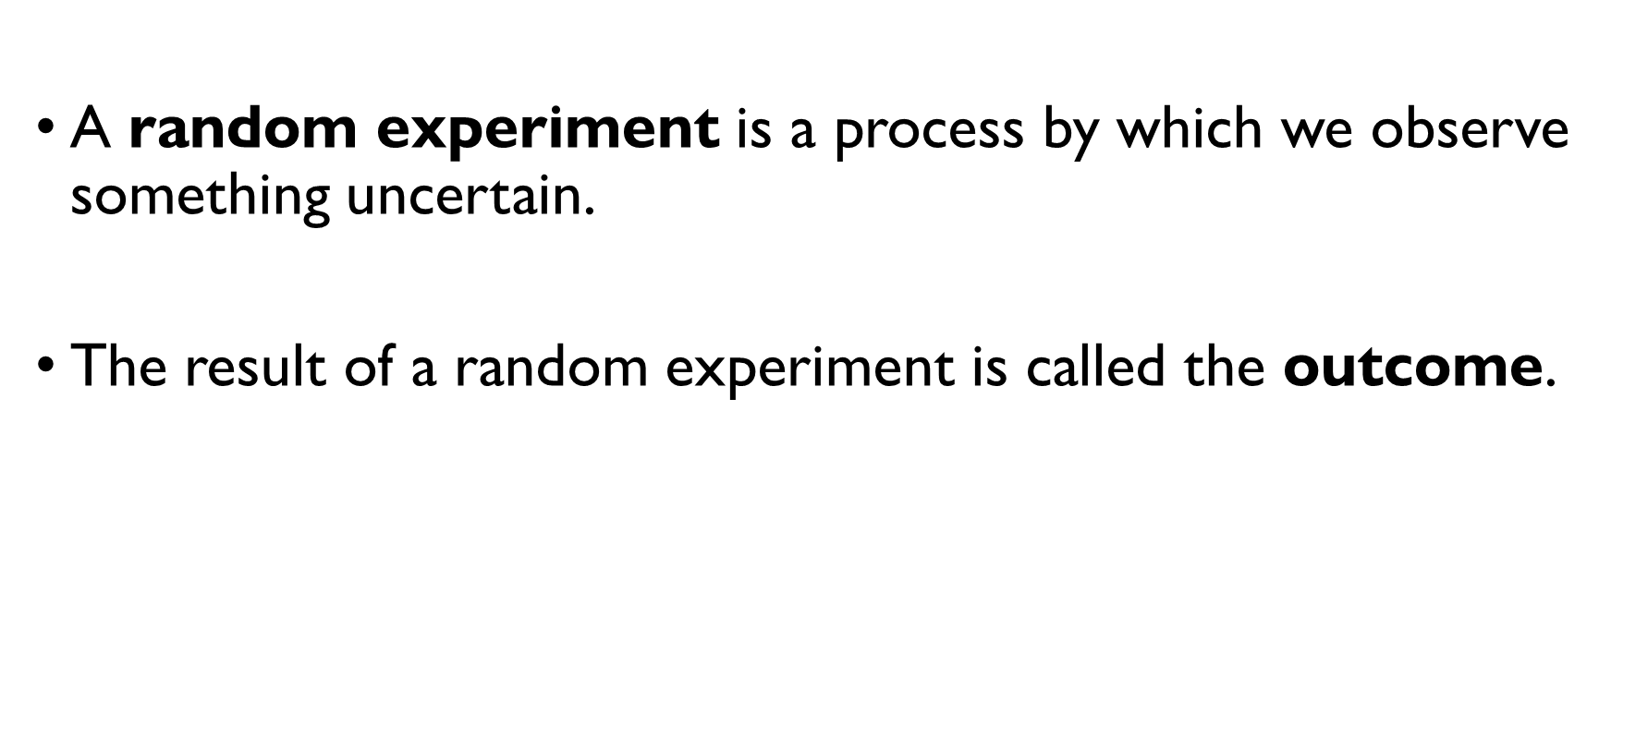
Random experiment
A random experiment is a process by which we observe something uncertain.
The result of a random experiment is called the outcome.
The set of all possible outcomes is called the sample space (denoted by $S$).

Slide 5
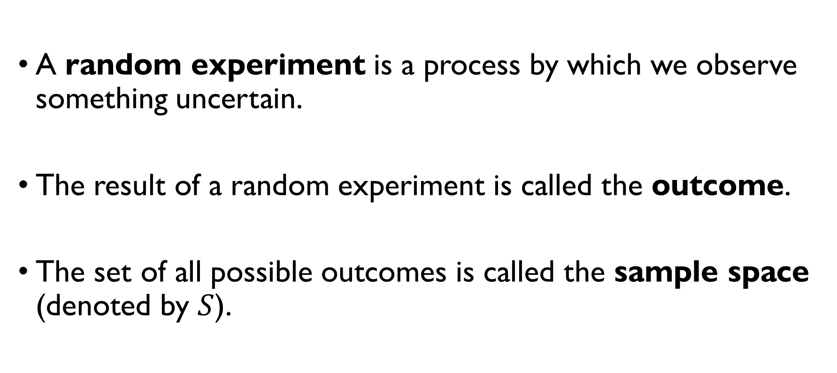
Random experiment
A random experiment is a process by which we observe something uncertain.
The result of a random experiment is called the outcome.
The set of all possible outcomes is called the sample space (denoted by $S$).

Slide 6

event
Each subset of a sampling space is called an event (denoted by $E$). Example: rolling a die $S = \left\{1, 2, 3, 4, 5, 6\right\}$ $E_{1}=\left\{1\right\}−$ we’ve got number 1. $E_{2}=\left\{2, 4, 6\right\}−$ we’ve got an even number. $E_{3}=\left\{3, 5\right\}−$ we’ve got $3$ or $5$.

Slide 7

event
Each subset of a sampling space is called an event (denoted by $E$). Example: rolling a die $S = \left\{1, 2, 3, 4, 5, 6\right\}$ $E_{1}=\left\{1\right\}−$ we’ve got number 1. $E_{2}=\left\{2, 4, 6\right\}−$ we’ve got an even number. $E_{3}=\left\{3, 5\right\}−$ we’ve got $3$ or $5$.

Slide 8
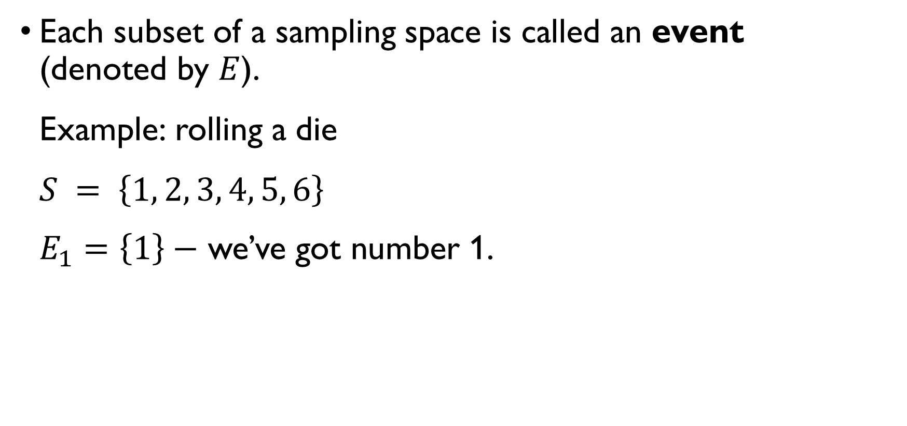
event
Each subset of a sampling space is called an event (denoted by $E$). Example: rolling a die $S = \left\{1, 2, 3, 4, 5, 6\right\}$ $E_{1}=\left\{1\right\}−$ we’ve got number 1. $E_{2}=\left\{2, 4, 6\right\}−$ we’ve got an even number. $E_{3}=\left\{3, 5\right\}−$ we’ve got $3$ or $5$.

Slide 9
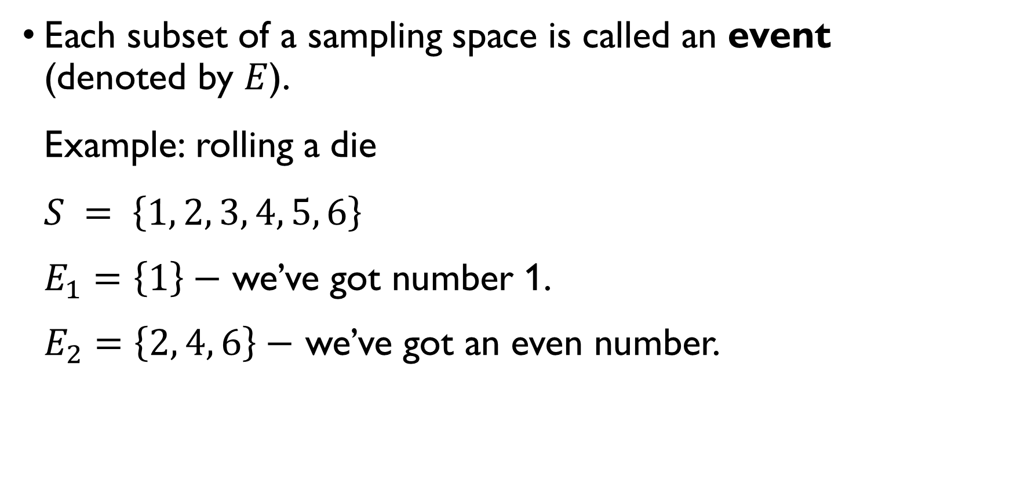
event
Each subset of a sampling space is called an event (denoted by $E$). Example: rolling a die $S = \left\{1, 2, 3, 4, 5, 6\right\}$ $E_{1}=\left\{1\right\}−$ we’ve got number 1. $E_{2}=\left\{2, 4, 6\right\}−$ we’ve got an even number. $E_{3}=\left\{3, 5\right\}−$ we’ve got $3$ or $5$.

Slide 10
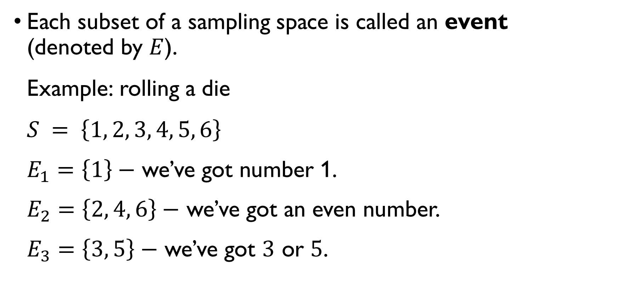
event
Each subset of a sampling space is called an event (denoted by $E$). Example: rolling a die $S = \left\{1, 2, 3, 4, 5, 6\right\}$ $E_{1}=\left\{1\right\}−$ we’ve got number 1. $E_{2}=\left\{2, 4, 6\right\}−$ we’ve got an even number. $E_{3}=\left\{3, 5\right\}−$ we’ve got $3$ or $5$.

Slide 11

Intersection of two events
Faculty board, consisting of 15 professors (10 men and 5 women) and 10 students (5 men and 5 women), is randomly choosing a candidate to represent the faculty at the visiting day. $E_{1}=\left\{a woman is selected\right\}, E_{2}=\left\{a student is selected\right\}$ $E_{1}∩E_{2}=\left\{a female student is selected\right\}, \left|E_{1}∩E_{2}\right|=5$ $F_{1}=\left\{a male prof. is selected\right\}, F_{2}=\left\{a female prof. is selected\right\}$ $F_{1}∩F_{2}=∅, \left|F_{1}∩F_{2}\right|=0$

Slide 12

Intersection of two events
Faculty board, consisting of 15 professors (10 men and 5 women) and 10 students (5 men and 5 women), is randomly choosing a candidate to represent the faculty at the visiting day. $E_{1}=\left\{a woman is selected\right\}, E_{2}=\left\{a student is selected\right\}$ $E_{1}∩E_{2}=\left\{a female student is selected\right\}, \left|E_{1}∩E_{2}\right|=5$ $F_{1}=\left\{a male prof. is selected\right\}, F_{2}=\left\{a female prof. is selected\right\}$ $F_{1}∩F_{2}=∅, \left|F_{1}∩F_{2}\right|=0$

Slide 13
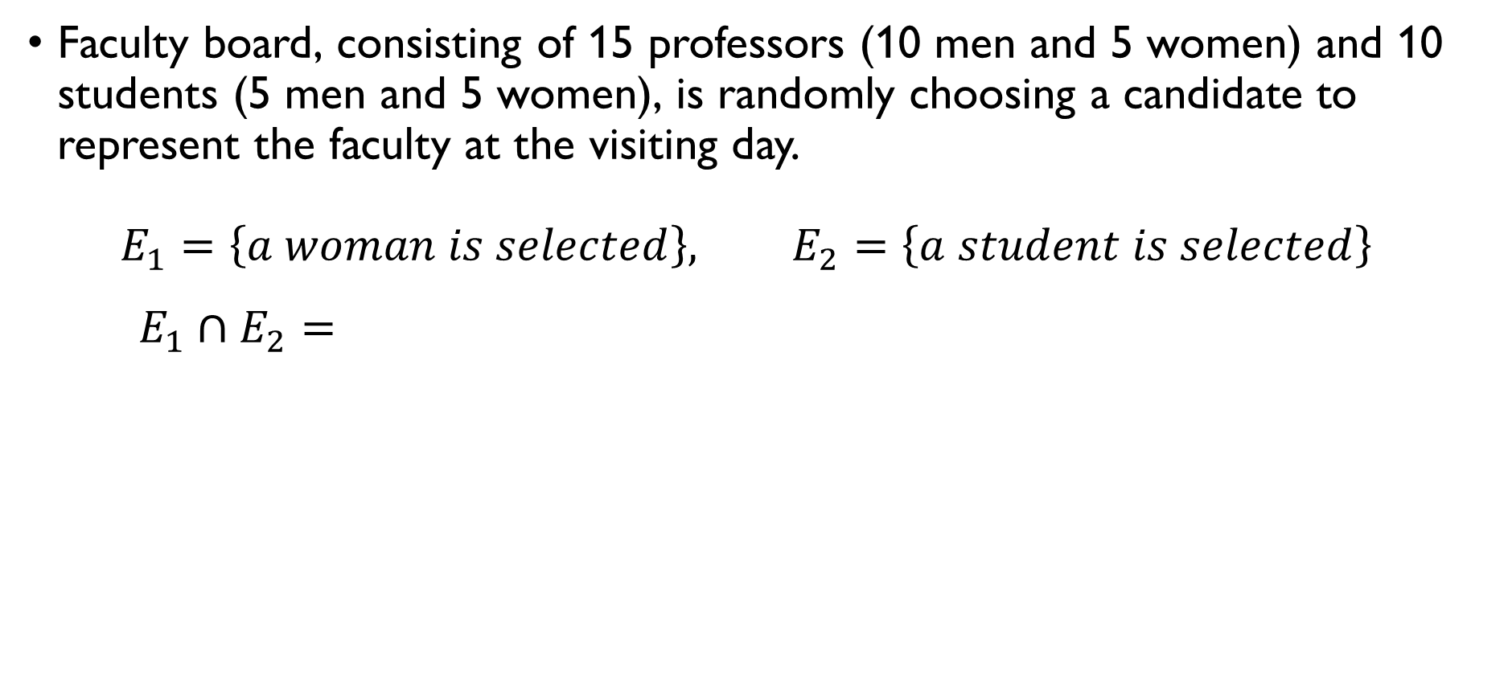
Intersection of two events
Faculty board, consisting of 15 professors (10 men and 5 women) and 10 students (5 men and 5 women), is randomly choosing a candidate to represent the faculty at the visiting day. $E_{1}=\left\{a woman is selected\right\}, E_{2}=\left\{a student is selected\right\}$ $E_{1}∩E_{2}=\left\{a female student is selected\right\}, \left|E_{1}∩E_{2}\right|=5$ $F_{1}=\left\{a male prof. is selected\right\}, F_{2}=\left\{a female prof. is selected\right\}$ $F_{1}∩F_{2}=∅, \left|F_{1}∩F_{2}\right|=0$

Slide 14
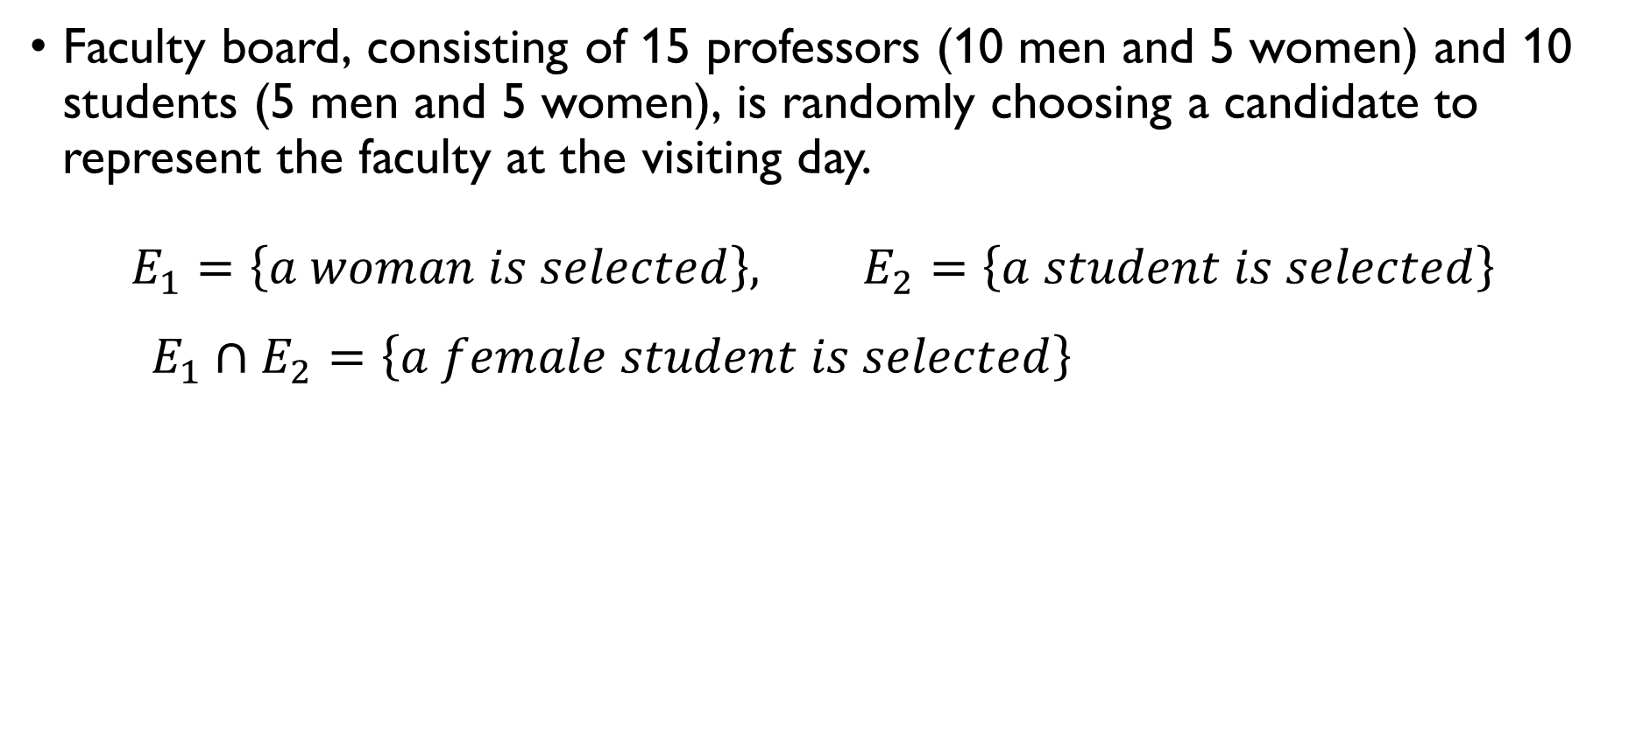
Intersection of two events
Faculty board, consisting of 15 professors (10 men and 5 women) and 10 students (5 men and 5 women), is randomly choosing a candidate to represent the faculty at the visiting day. $E_{1}=\left\{a woman is selected\right\}, E_{2}=\left\{a student is selected\right\}$ $E_{1}∩E_{2}=\left\{a female student is selected\right\}, \left|E_{1}∩E_{2}\right|=5$ $F_{1}=\left\{a male prof. is selected\right\}, F_{2}=\left\{a female prof. is selected\right\}$ $F_{1}∩F_{2}=∅, \left|F_{1}∩F_{2}\right|=0$

Slide 15
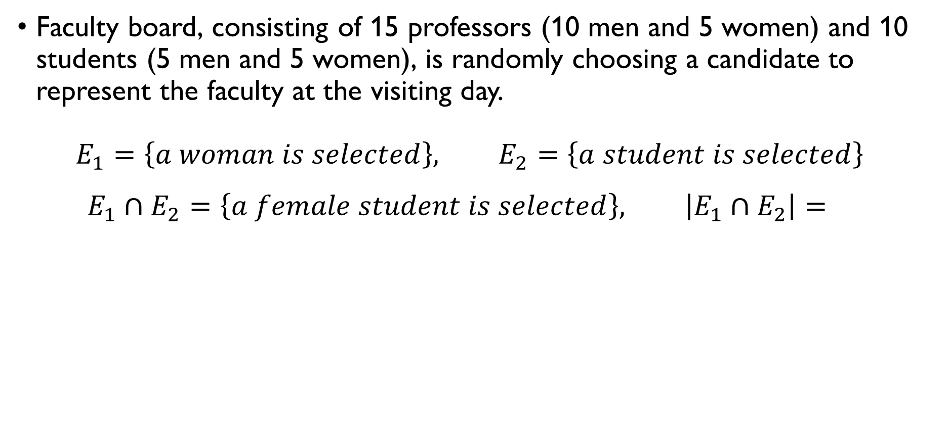
Intersection of two events
Faculty board, consisting of 15 professors (10 men and 5 women) and 10 students (5 men and 5 women), is randomly choosing a candidate to represent the faculty at the visiting day. $E_{1}=\left\{a woman is selected\right\}, E_{2}=\left\{a student is selected\right\}$ $E_{1}∩E_{2}=\left\{a female student is selected\right\}, \left|E_{1}∩E_{2}\right|=5$ $F_{1}=\left\{a male prof. is selected\right\}, F_{2}=\left\{a female prof. is selected\right\}$ $F_{1}∩F_{2}=∅, \left|F_{1}∩F_{2}\right|=0$

Slide 16
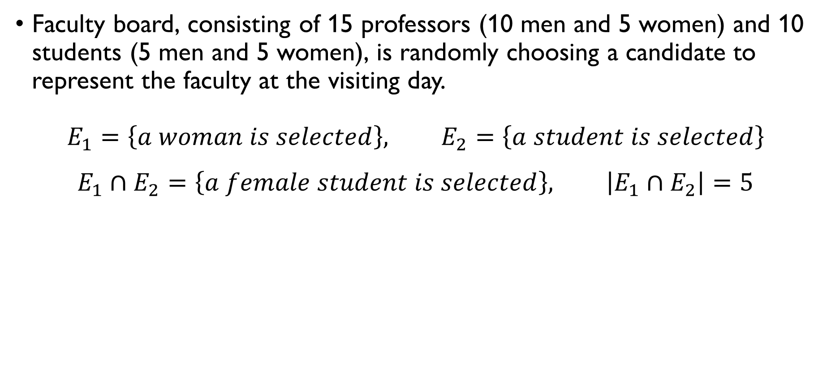
Intersection of two events
Faculty board, consisting of 15 professors (10 men and 5 women) and 10 students (5 men and 5 women), is randomly choosing a candidate to represent the faculty at the visiting day. $E_{1}=\left\{a woman is selected\right\}, E_{2}=\left\{a student is selected\right\}$ $E_{1}∩E_{2}=\left\{a female student is selected\right\}, \left|E_{1}∩E_{2}\right|=5$ $F_{1}=\left\{a male prof. is selected\right\}, F_{2}=\left\{a female prof. is selected\right\}$ $F_{1}∩F_{2}=∅, \left|F_{1}∩F_{2}\right|=0$

Slide 17
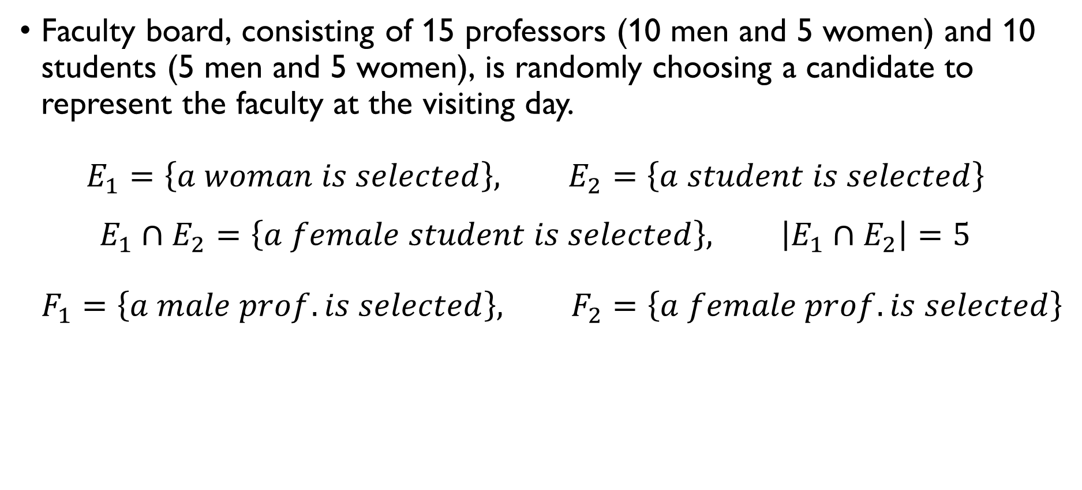
Intersection of two events
Faculty board, consisting of 15 professors (10 men and 5 women) and 10 students (5 men and 5 women), is randomly choosing a candidate to represent the faculty at the visiting day. $E_{1}=\left\{a woman is selected\right\}, E_{2}=\left\{a student is selected\right\}$ $E_{1}∩E_{2}=\left\{a female student is selected\right\}, \left|E_{1}∩E_{2}\right|=5$ $F_{1}=\left\{a male prof. is selected\right\}, F_{2}=\left\{a female prof. is selected\right\}$ $F_{1}∩F_{2}=∅, \left|F_{1}∩F_{2}\right|=0$

Slide 18
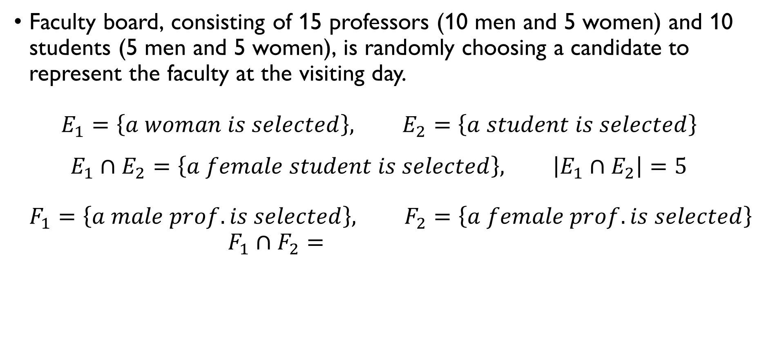
Intersection of two events
Faculty board, consisting of 15 professors (10 men and 5 women) and 10 students (5 men and 5 women), is randomly choosing a candidate to represent the faculty at the visiting day. $E_{1}=\left\{a woman is selected\right\}, E_{2}=\left\{a student is selected\right\}$ $E_{1}∩E_{2}=\left\{a female student is selected\right\}, \left|E_{1}∩E_{2}\right|=5$ $F_{1}=\left\{a male prof. is selected\right\}, F_{2}=\left\{a female prof. is selected\right\}$ $F_{1}∩F_{2}=∅, \left|F_{1}∩F_{2}\right|=0$

Slide 19

Intersection of two events
Faculty board, consisting of 15 professors (10 men and 5 women) and 10 students (5 men and 5 women), is randomly choosing a candidate to represent the faculty at the visiting day. $E_{1}=\left\{a woman is selected\right\}, E_{2}=\left\{a student is selected\right\}$ $E_{1}∩E_{2}=\left\{a female student is selected\right\}, \left|E_{1}∩E_{2}\right|=5$ $F_{1}=\left\{a male prof. is selected\right\}, F_{2}=\left\{a female prof. is selected\right\}$ $F_{1}∩F_{2}=∅, \left|F_{1}∩F_{2}\right|=0$

Slide 20
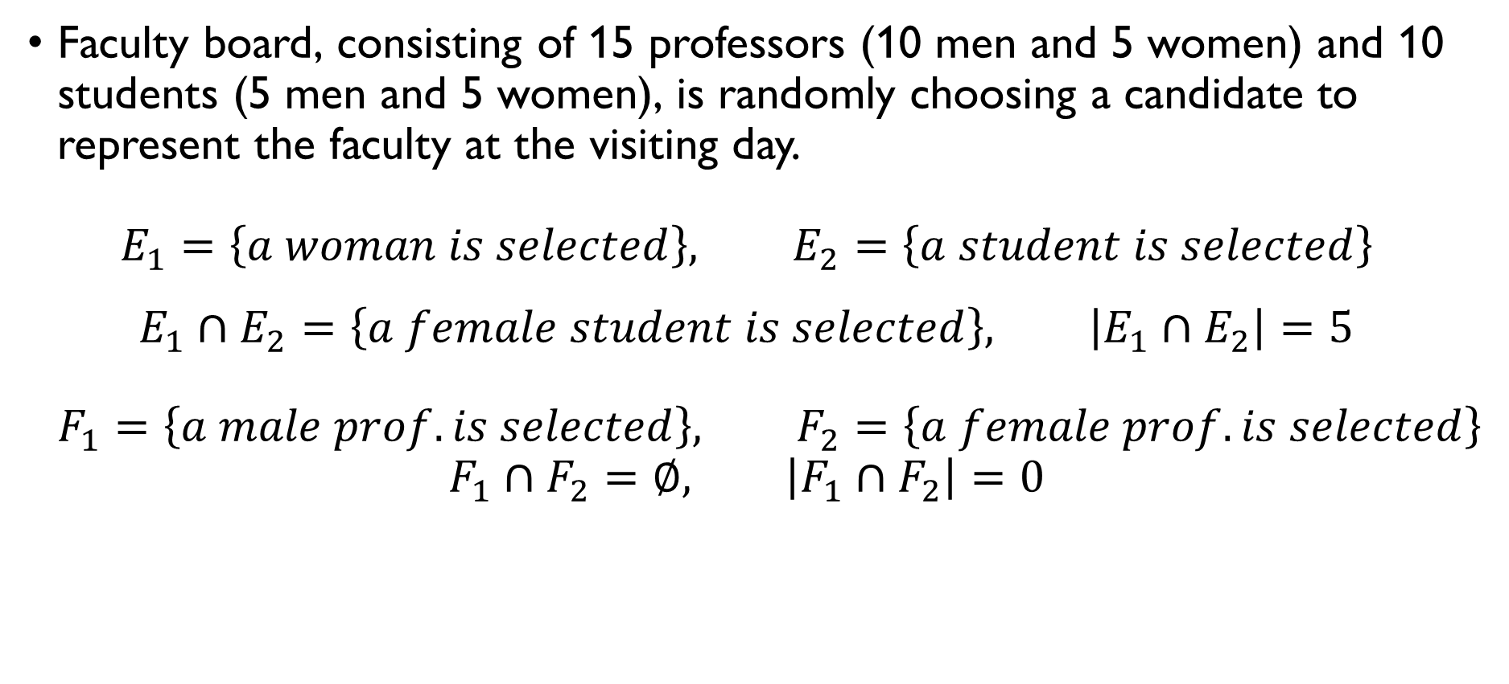
Intersection of two events
Faculty board, consisting of 15 professors (10 men and 5 women) and 10 students (5 men and 5 women), is randomly choosing a candidate to represent the faculty at the visiting day. $E_{1}=\left\{a woman is selected\right\}, E_{2}=\left\{a student is selected\right\}$ $E_{1}∩E_{2}=\left\{a female student is selected\right\}, \left|E_{1}∩E_{2}\right|=5$ $F_{1}=\left\{a male prof. is selected\right\}, F_{2}=\left\{a female prof. is selected\right\}$ $F_{1}∩F_{2}=∅, \left|F_{1}∩F_{2}\right|=0$

Slide 21

union of two events
Faculty board, consisting of 15 professors (10 men and 5 women) and 10 students (5 men and 5 women), is randomly choosing a candidate to represent the faculty at the visiting day. $E_{1}=\left\{a woman is selected\right\}, E_{2}=\left\{a student is selected\right\}$ $E_{1}∪E_{2}=\left\{a woman or a student is selected\right\}, \left|E_{1}∪E_{2}\right|=\left|E_{1}\right|+\left|E_{2}\right|−\left|E_{1}∩E_{2}\right|=5+5+10−5=15$ $F_{1}=\left\{a male prof. is selected\right\}, F_{2}=\left\{a female prof. is selected\right\}$ $F_{1}∪F_{2}=\left\{a professor is selected\right\},$ $\left|F_{1}∪F_{2}\right|=\left|F_{1}\right|+\left|F_{2}\right|−\left|F_{1}∩F_{2}\right|=10+5=15$

Slide 22
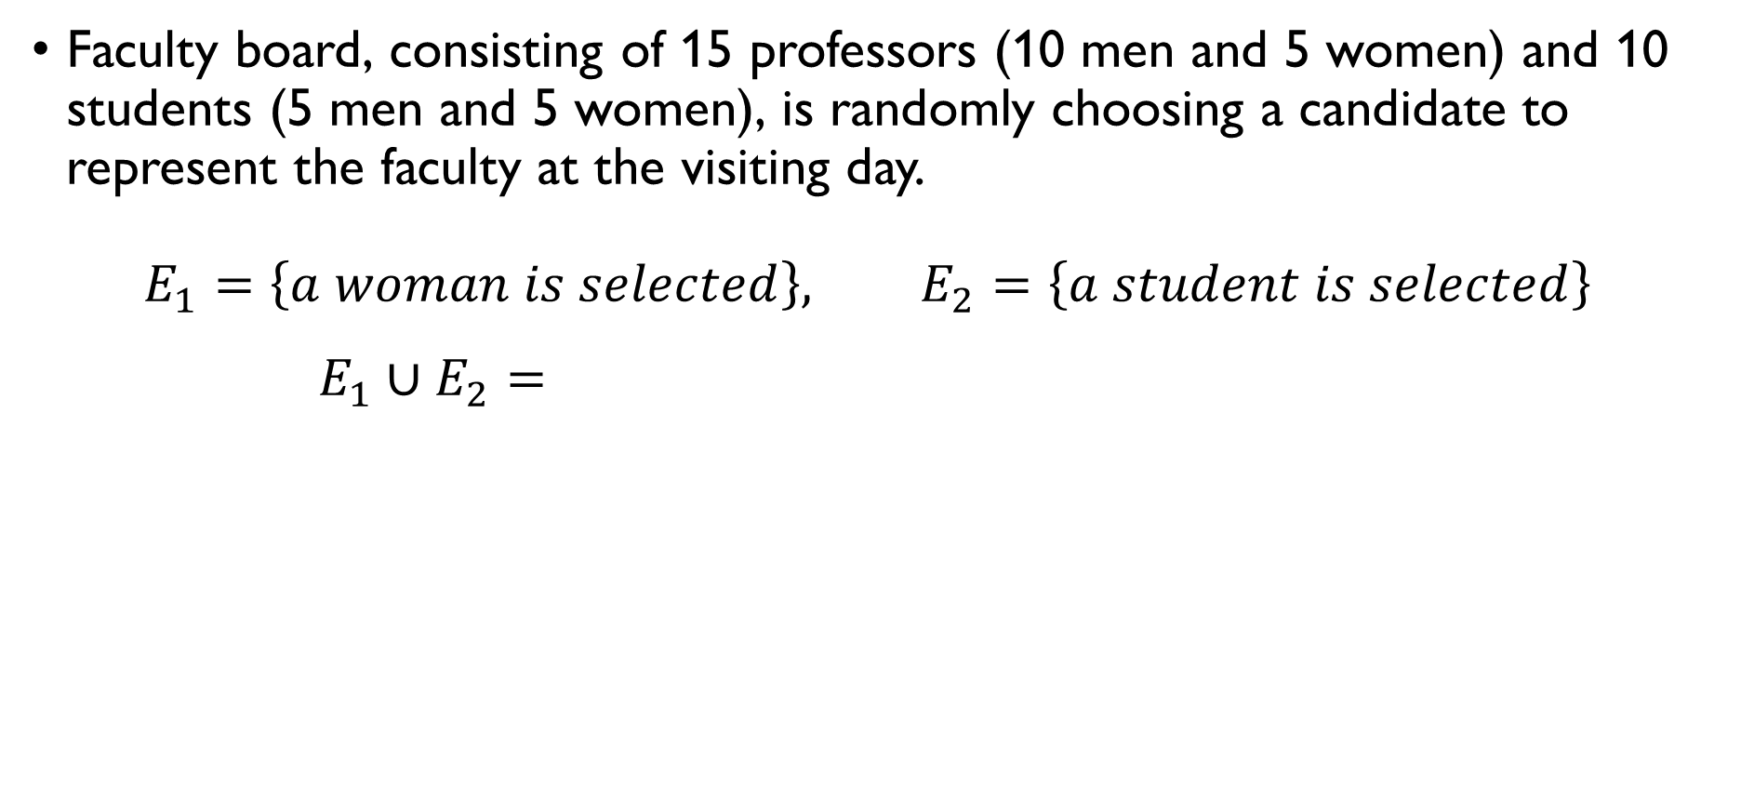
union of two events
Faculty board, consisting of 15 professors (10 men and 5 women) and 10 students (5 men and 5 women), is randomly choosing a candidate to represent the faculty at the visiting day. $E_{1}=\left\{a woman is selected\right\}, E_{2}=\left\{a student is selected\right\}$ $E_{1}∪E_{2}=\left\{a woman or a student is selected\right\}, \left|E_{1}∪E_{2}\right|=\left|E_{1}\right|+\left|E_{2}\right|−\left|E_{1}∩E_{2}\right|=5+5+10−5=15$ $F_{1}=\left\{a male prof. is selected\right\}, F_{2}=\left\{a female prof. is selected\right\}$ $F_{1}∪F_{2}=\left\{a professor is selected\right\},$ $\left|F_{1}∪F_{2}\right|=\left|F_{1}\right|+\left|F_{2}\right|−\left|F_{1}∩F_{2}\right|=10+5=15$

Slide 23
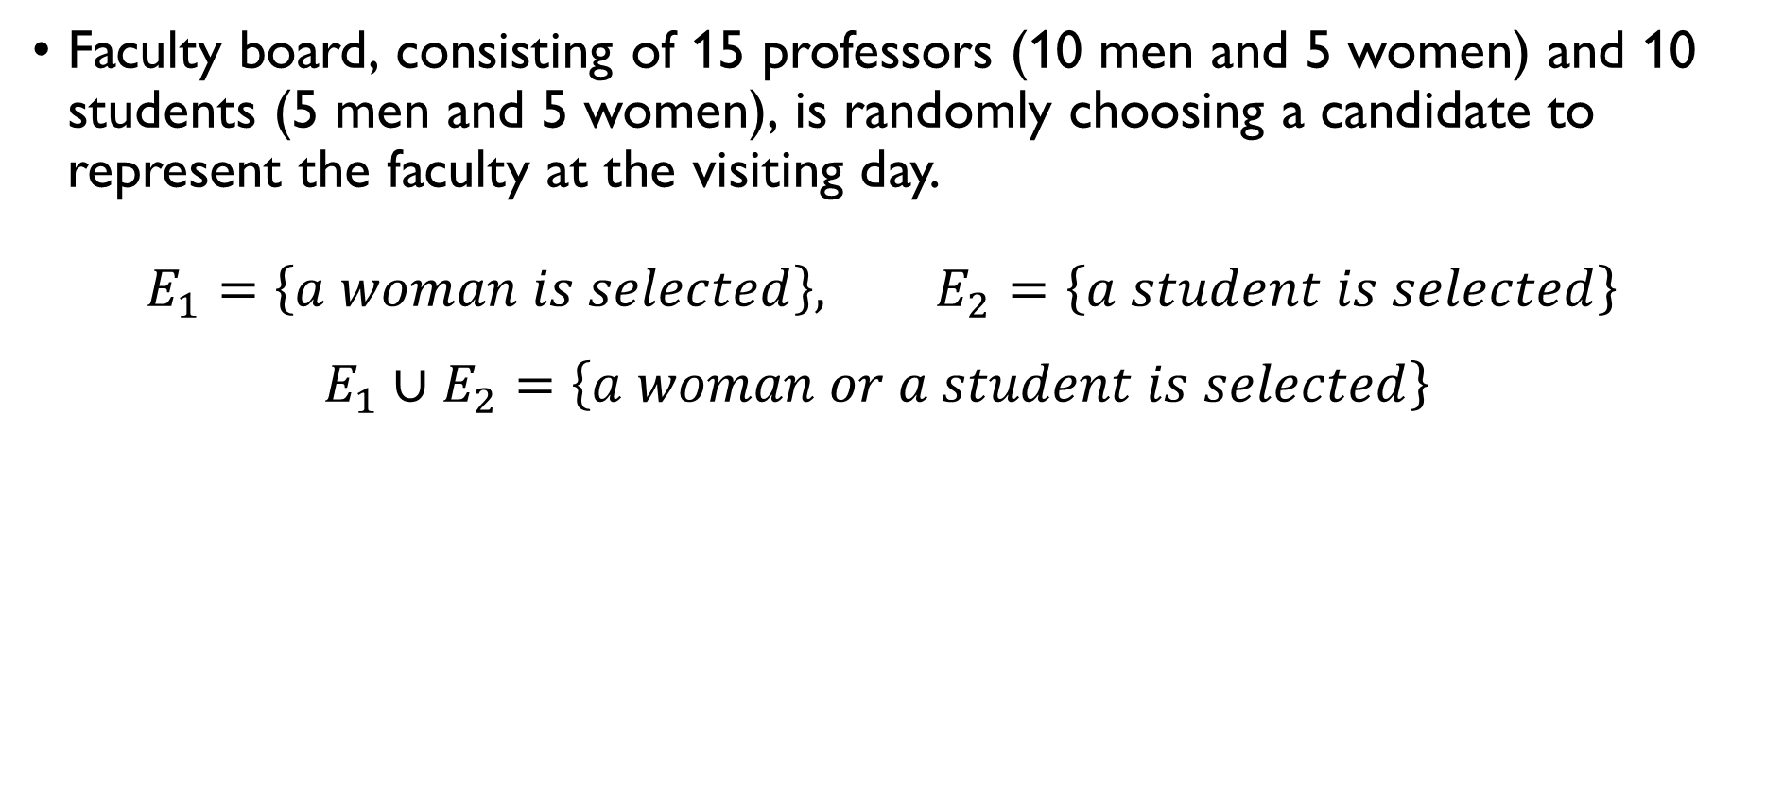
union of two events
Faculty board, consisting of 15 professors (10 men and 5 women) and 10 students (5 men and 5 women), is randomly choosing a candidate to represent the faculty at the visiting day. $E_{1}=\left\{a woman is selected\right\}, E_{2}=\left\{a student is selected\right\}$ $E_{1}∪E_{2}=\left\{a woman or a student is selected\right\}, \left|E_{1}∪E_{2}\right|=\left|E_{1}\right|+\left|E_{2}\right|−\left|E_{1}∩E_{2}\right|=5+5+10−5=15$ $F_{1}=\left\{a male prof. is selected\right\}, F_{2}=\left\{a female prof. is selected\right\}$ $F_{1}∪F_{2}=\left\{a professor is selected\right\},$ $\left|F_{1}∪F_{2}\right|=\left|F_{1}\right|+\left|F_{2}\right|−\left|F_{1}∩F_{2}\right|=10+5=15$

Slide 24
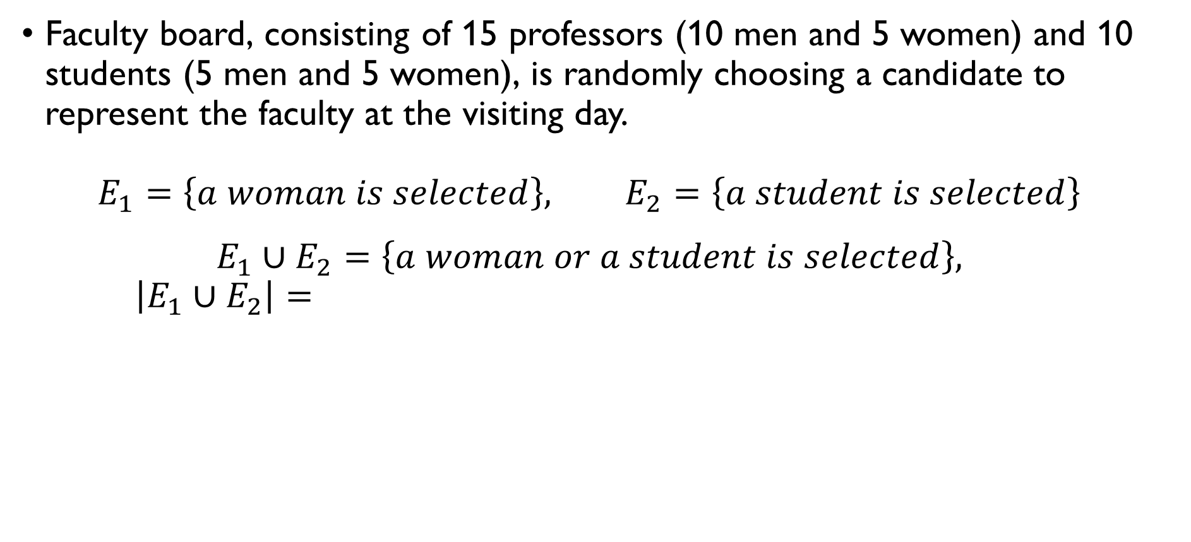
union of two events
Faculty board, consisting of 15 professors (10 men and 5 women) and 10 students (5 men and 5 women), is randomly choosing a candidate to represent the faculty at the visiting day. $E_{1}=\left\{a woman is selected\right\}, E_{2}=\left\{a student is selected\right\}$ $E_{1}∪E_{2}=\left\{a woman or a student is selected\right\}, \left|E_{1}∪E_{2}\right|=\left|E_{1}\right|+\left|E_{2}\right|−\left|E_{1}∩E_{2}\right|=5+5+10−5=15$ $F_{1}=\left\{a male prof. is selected\right\}, F_{2}=\left\{a female prof. is selected\right\}$ $F_{1}∪F_{2}=\left\{a professor is selected\right\},$ $\left|F_{1}∪F_{2}\right|=\left|F_{1}\right|+\left|F_{2}\right|−\left|F_{1}∩F_{2}\right|=10+5=15$

Slide 25
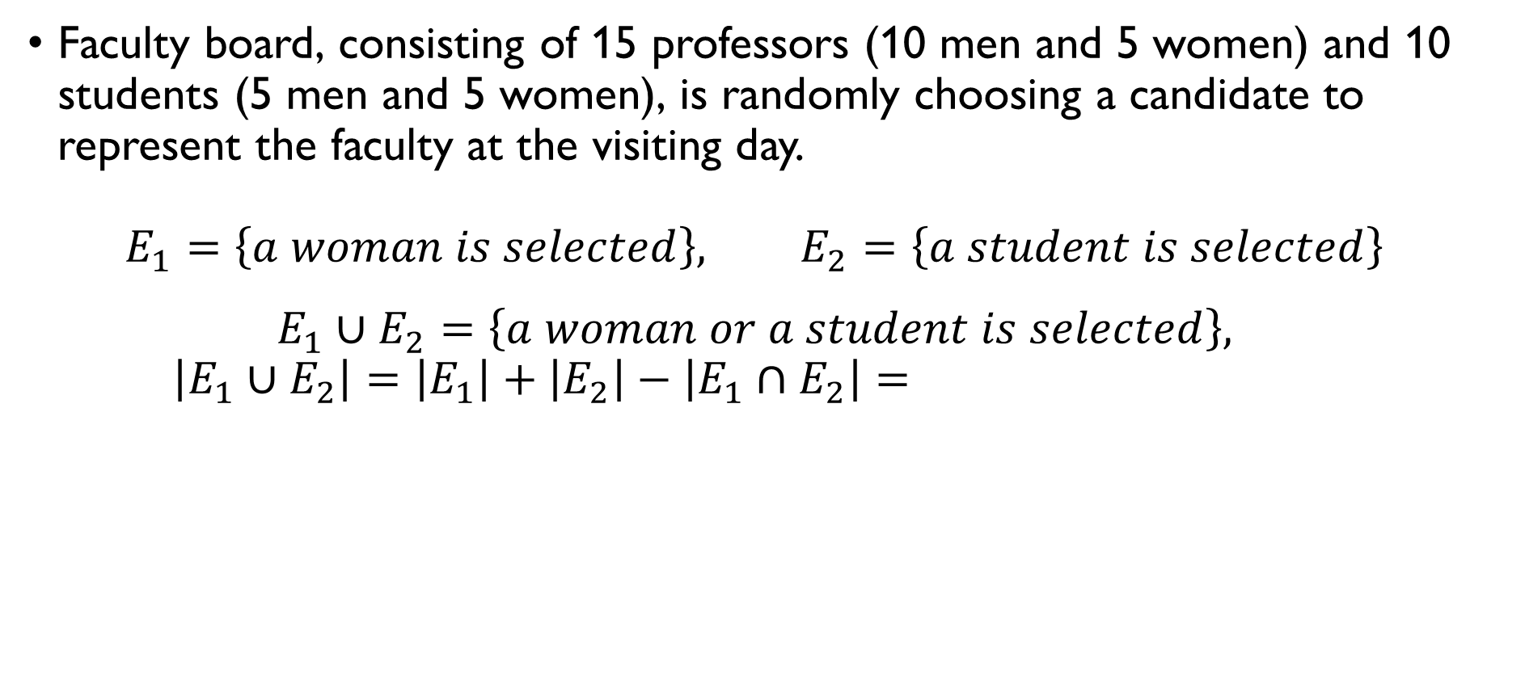
union of two events
Faculty board, consisting of 15 professors (10 men and 5 women) and 10 students (5 men and 5 women), is randomly choosing a candidate to represent the faculty at the visiting day. $E_{1}=\left\{a woman is selected\right\}, E_{2}=\left\{a student is selected\right\}$ $E_{1}∪E_{2}=\left\{a woman or a student is selected\right\}, \left|E_{1}∪E_{2}\right|=\left|E_{1}\right|+\left|E_{2}\right|−\left|E_{1}∩E_{2}\right|=5+5+10−5=15$ $F_{1}=\left\{a male prof. is selected\right\}, F_{2}=\left\{a female prof. is selected\right\}$ $F_{1}∪F_{2}=\left\{a professor is selected\right\},$ $\left|F_{1}∪F_{2}\right|=\left|F_{1}\right|+\left|F_{2}\right|−\left|F_{1}∩F_{2}\right|=10+5=15$

Slide 26
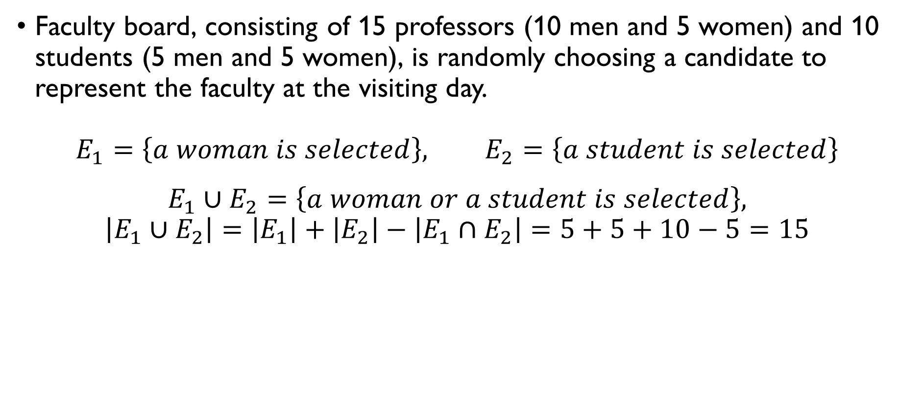
union of two events
Faculty board, consisting of 15 professors (10 men and 5 women) and 10 students (5 men and 5 women), is randomly choosing a candidate to represent the faculty at the visiting day. $E_{1}=\left\{a woman is selected\right\}, E_{2}=\left\{a student is selected\right\}$ $E_{1}∪E_{2}=\left\{a woman or a student is selected\right\}, \left|E_{1}∪E_{2}\right|=\left|E_{1}\right|+\left|E_{2}\right|−\left|E_{1}∩E_{2}\right|=5+5+10−5=15$ $F_{1}=\left\{a male prof. is selected\right\}, F_{2}=\left\{a female prof. is selected\right\}$ $F_{1}∪F_{2}=\left\{a professor is selected\right\},$ $\left|F_{1}∪F_{2}\right|=\left|F_{1}\right|+\left|F_{2}\right|−\left|F_{1}∩F_{2}\right|=10+5=15$

Slide 27
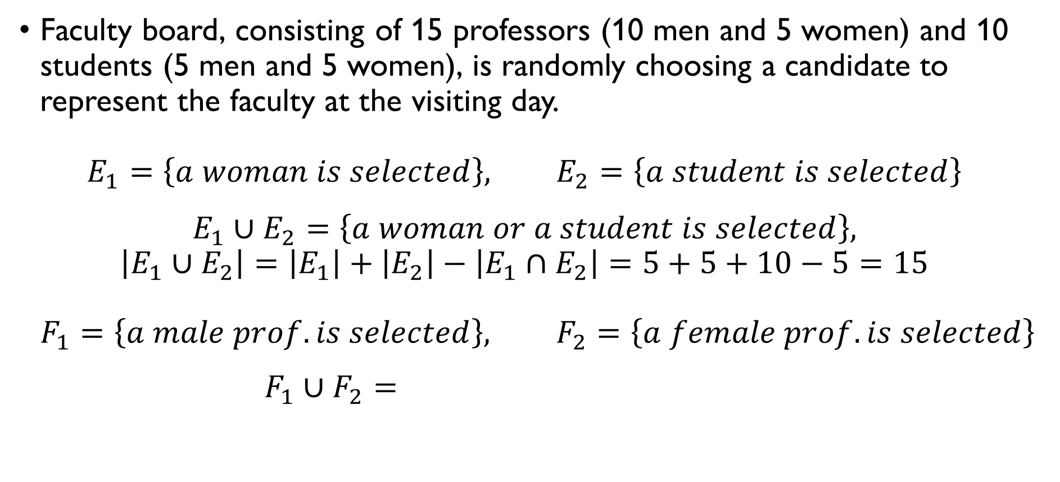
union of two events
Faculty board, consisting of 15 professors (10 men and 5 women) and 10 students (5 men and 5 women), is randomly choosing a candidate to represent the faculty at the visiting day. $E_{1}=\left\{a woman is selected\right\}, E_{2}=\left\{a student is selected\right\}$ $E_{1}∪E_{2}=\left\{a woman or a student is selected\right\}, \left|E_{1}∪E_{2}\right|=\left|E_{1}\right|+\left|E_{2}\right|−\left|E_{1}∩E_{2}\right|=5+5+10−5=15$ $F_{1}=\left\{a male prof. is selected\right\}, F_{2}=\left\{a female prof. is selected\right\}$ $F_{1}∪F_{2}=\left\{a professor is selected\right\},$ $\left|F_{1}∪F_{2}\right|=\left|F_{1}\right|+\left|F_{2}\right|−\left|F_{1}∩F_{2}\right|=10+5=15$

Slide 28
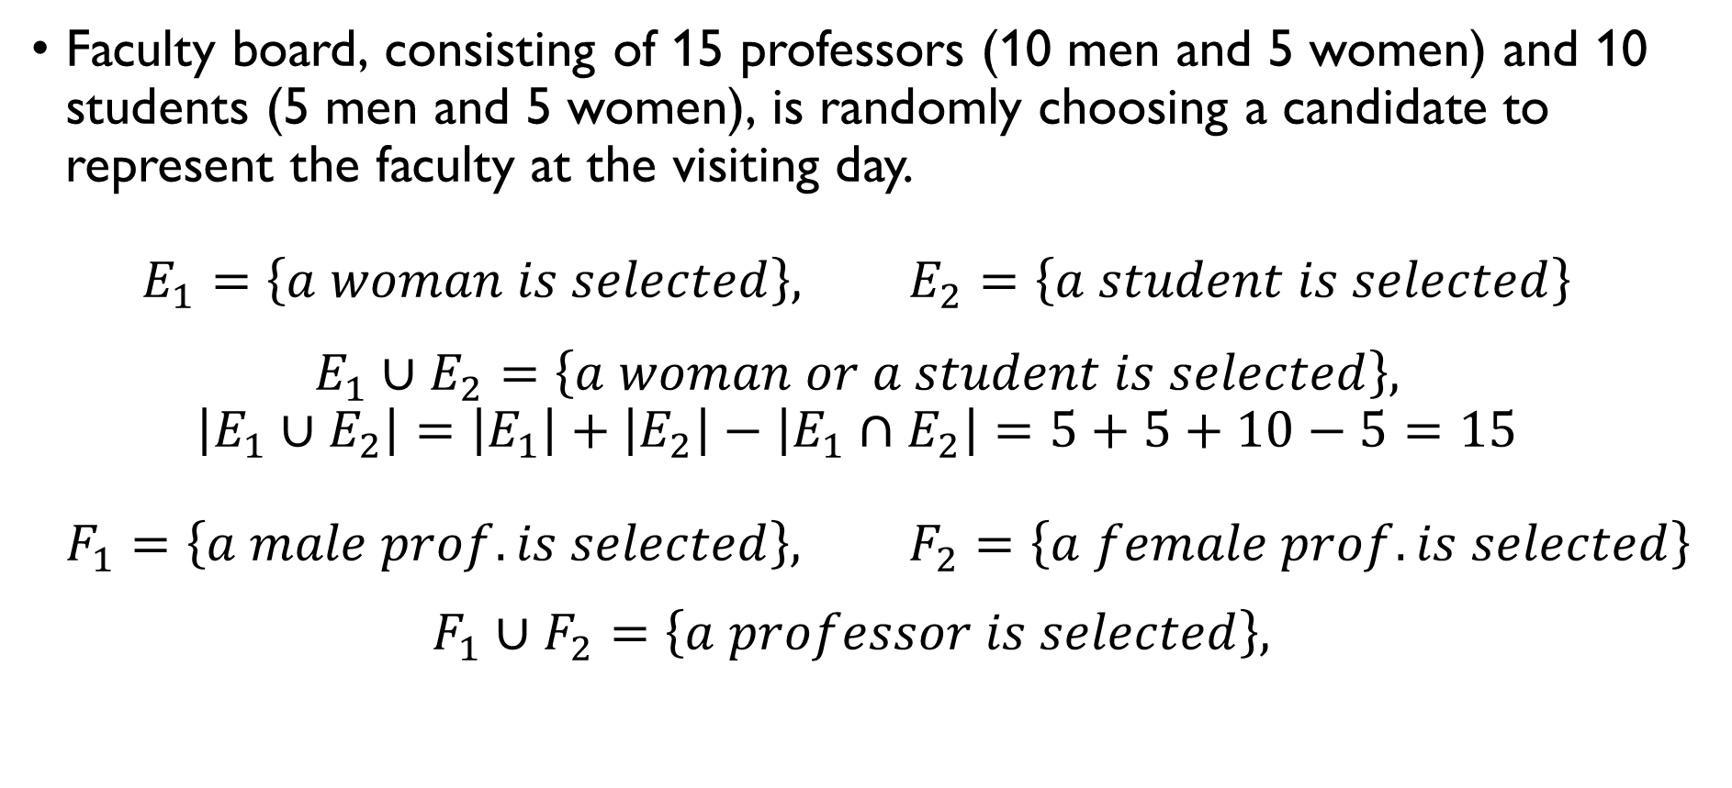
union of two events
Faculty board, consisting of 15 professors (10 men and 5 women) and 10 students (5 men and 5 women), is randomly choosing a candidate to represent the faculty at the visiting day. $E_{1}=\left\{a woman is selected\right\}, E_{2}=\left\{a student is selected\right\}$ $E_{1}∪E_{2}=\left\{a woman or a student is selected\right\}, \left|E_{1}∪E_{2}\right|=\left|E_{1}\right|+\left|E_{2}\right|−\left|E_{1}∩E_{2}\right|=5+5+10−5=15$ $F_{1}=\left\{a male prof. is selected\right\}, F_{2}=\left\{a female prof. is selected\right\}$ $F_{1}∪F_{2}=\left\{a professor is selected\right\},$ $\left|F_{1}∪F_{2}\right|=\left|F_{1}\right|+\left|F_{2}\right|−\left|F_{1}∩F_{2}\right|=10+5=15$

Slide 29
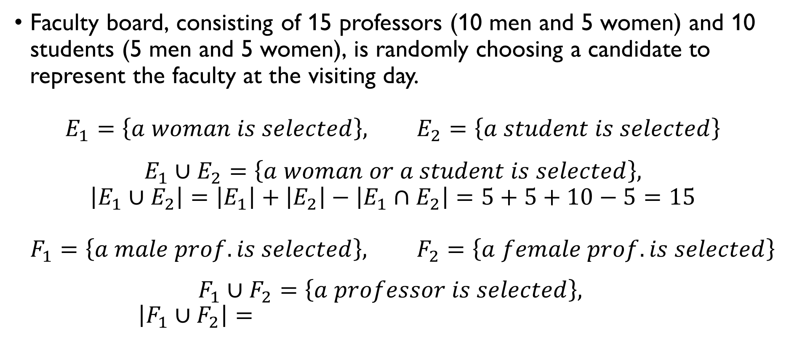
union of two events
Faculty board, consisting of 15 professors (10 men and 5 women) and 10 students (5 men and 5 women), is randomly choosing a candidate to represent the faculty at the visiting day. $E_{1}=\left\{a woman is selected\right\}, E_{2}=\left\{a student is selected\right\}$ $E_{1}∪E_{2}=\left\{a woman or a student is selected\right\}, \left|E_{1}∪E_{2}\right|=\left|E_{1}\right|+\left|E_{2}\right|−\left|E_{1}∩E_{2}\right|=5+5+10−5=15$ $F_{1}=\left\{a male prof. is selected\right\}, F_{2}=\left\{a female prof. is selected\right\}$ $F_{1}∪F_{2}=\left\{a professor is selected\right\},$ $\left|F_{1}∪F_{2}\right|=\left|F_{1}\right|+\left|F_{2}\right|−\left|F_{1}∩F_{2}\right|=10+5=15$

Slide 30
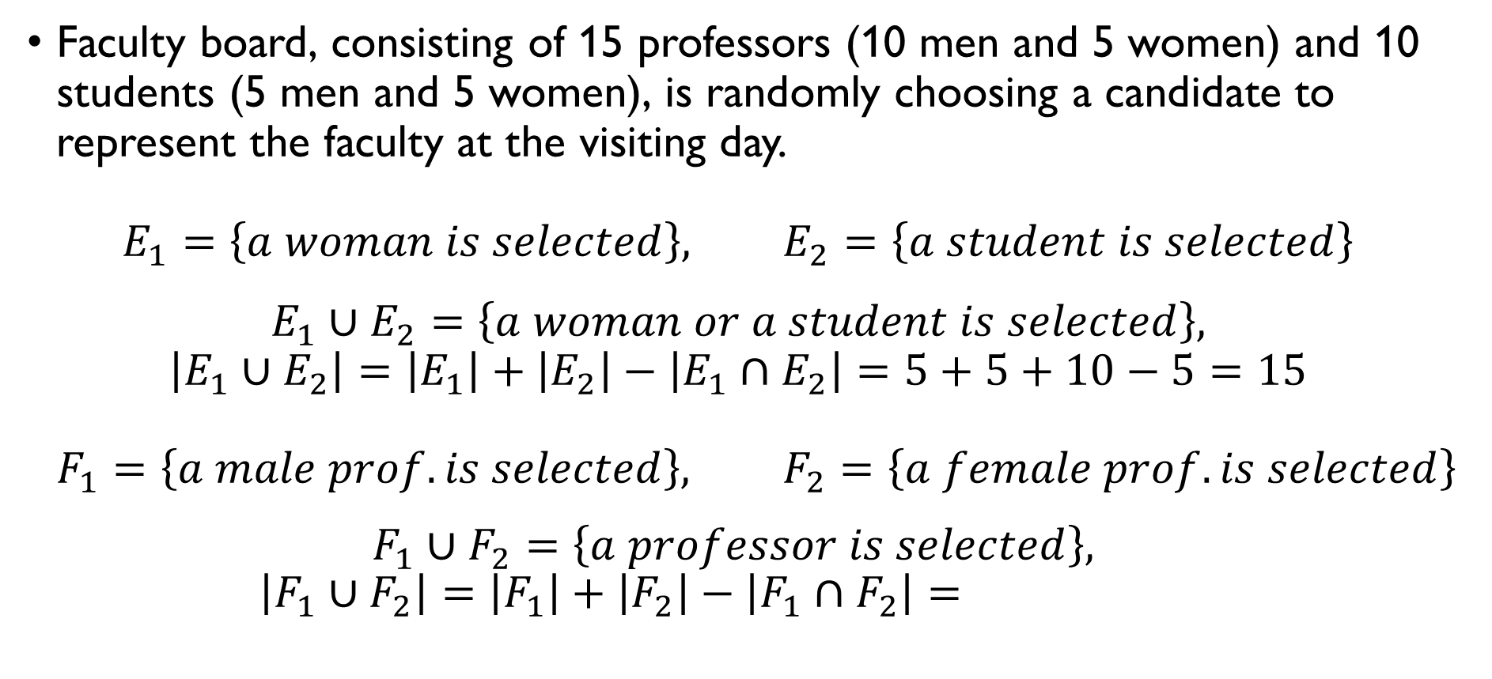
union of two events
Faculty board, consisting of 15 professors (10 men and 5 women) and 10 students (5 men and 5 women), is randomly choosing a candidate to represent the faculty at the visiting day. $E_{1}=\left\{a woman is selected\right\}, E_{2}=\left\{a student is selected\right\}$ $E_{1}∪E_{2}=\left\{a woman or a student is selected\right\}, \left|E_{1}∪E_{2}\right|=\left|E_{1}\right|+\left|E_{2}\right|−\left|E_{1}∩E_{2}\right|=5+5+10−5=15$ $F_{1}=\left\{a male prof. is selected\right\}, F_{2}=\left\{a female prof. is selected\right\}$ $F_{1}∪F_{2}=\left\{a professor is selected\right\},$ $\left|F_{1}∪F_{2}\right|=\left|F_{1}\right|+\left|F_{2}\right|−\left|F_{1}∩F_{2}\right|=10+5=15$

Slide 31
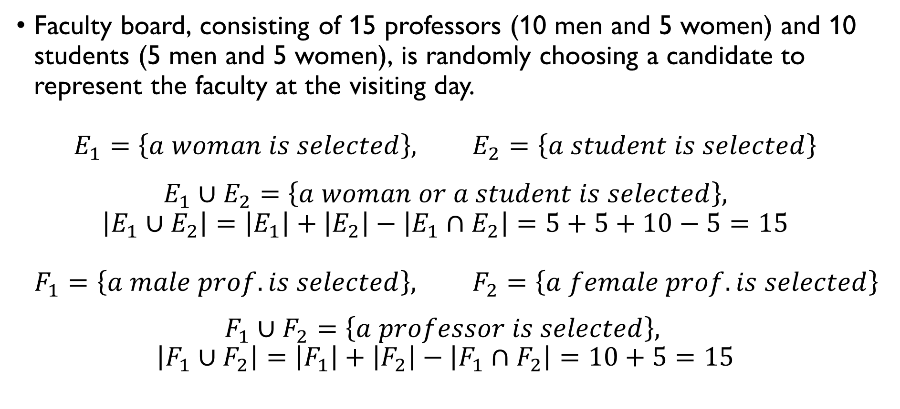
union of two events
Faculty board, consisting of 15 professors (10 men and 5 women) and 10 students (5 men and 5 women), is randomly choosing a candidate to represent the faculty at the visiting day. $E_{1}=\left\{a woman is selected\right\}, E_{2}=\left\{a student is selected\right\}$ $E_{1}∪E_{2}=\left\{a woman or a student is selected\right\}, \left|E_{1}∪E_{2}\right|=\left|E_{1}\right|+\left|E_{2}\right|−\left|E_{1}∩E_{2}\right|=5+5+10−5=15$ $F_{1}=\left\{a male prof. is selected\right\}, F_{2}=\left\{a female prof. is selected\right\}$ $F_{1}∪F_{2}=\left\{a professor is selected\right\},$ $\left|F_{1}∪F_{2}\right|=\left|F_{1}\right|+\left|F_{2}\right|−\left|F_{1}∩F_{2}\right|=10+5=15$

Slide 32

Complementary events
Faculty board, consisting of 15 professors (10 men and 5 women) and 10 students (5 men and 5 women), is randomly choosing a candidate to represent the faculty at the visiting day. $E=\left\{a professor is selected\right\}$ $E^{C}=\left\{a student is selected \right\}$ $F=\left\{a female student is selected\right\},$ $F^{C}=\left\{a male student or a professor is selected\right\}$

Slide 33
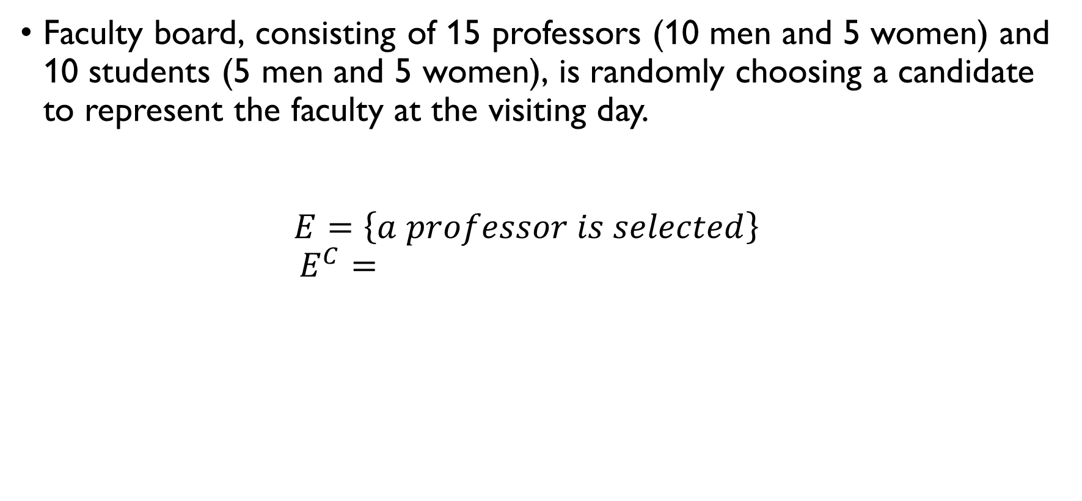
Complementary events
Faculty board, consisting of 15 professors (10 men and 5 women) and 10 students (5 men and 5 women), is randomly choosing a candidate to represent the faculty at the visiting day. $E=\left\{a professor is selected\right\}$ $E^{C}=\left\{a student is selected \right\}$ $F=\left\{a female student is selected\right\},$ $F^{C}=\left\{a male student or a professor is selected\right\}$

Slide 34
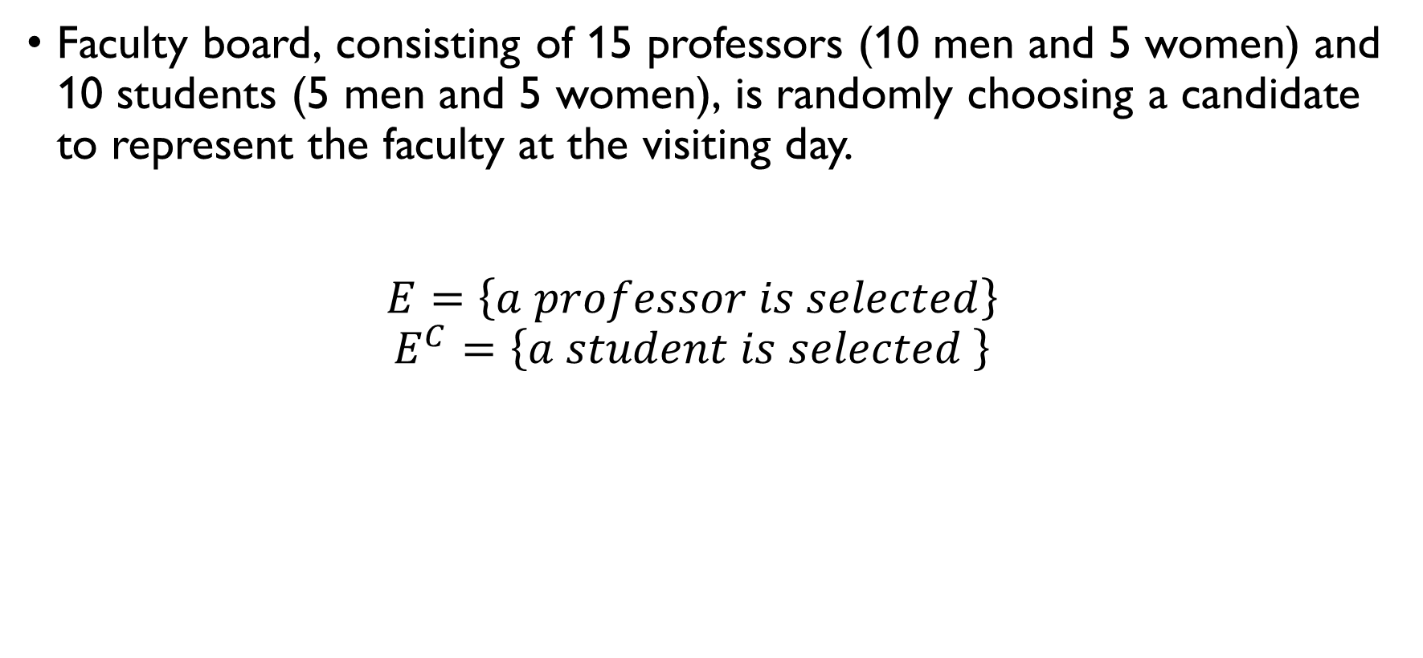
Complementary events
Faculty board, consisting of 15 professors (10 men and 5 women) and 10 students (5 men and 5 women), is randomly choosing a candidate to represent the faculty at the visiting day. $E=\left\{a professor is selected\right\}$ $E^{C}=\left\{a student is selected \right\}$ $F=\left\{a female student is selected\right\},$ $F^{C}=\left\{a male student or a professor is selected\right\}$

Slide 35
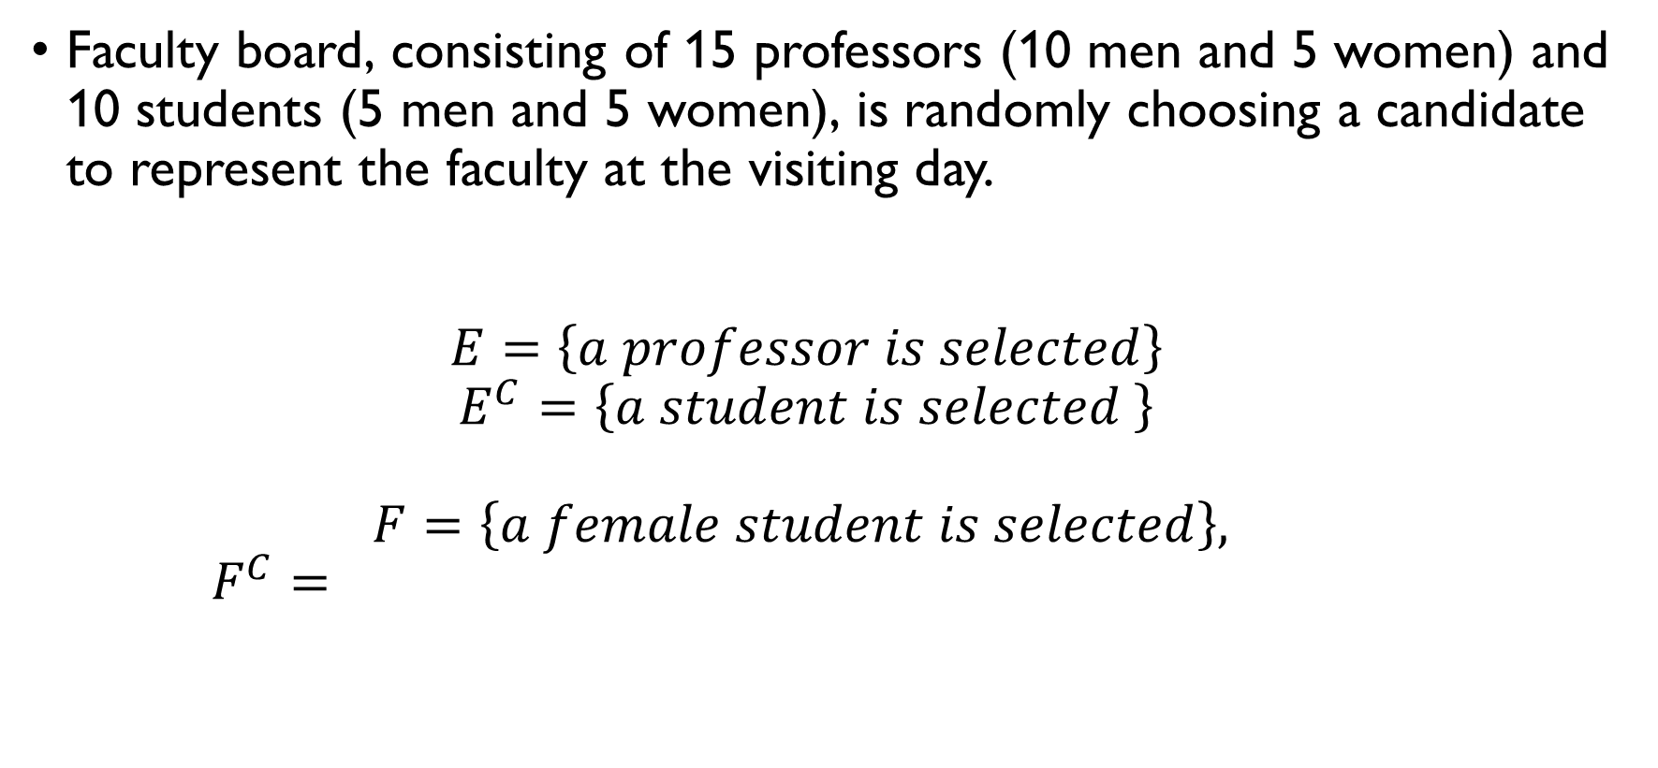
Complementary events
Faculty board, consisting of 15 professors (10 men and 5 women) and 10 students (5 men and 5 women), is randomly choosing a candidate to represent the faculty at the visiting day. $E=\left\{a professor is selected\right\}$ $E^{C}=\left\{a student is selected \right\}$ $F=\left\{a female student is selected\right\},$ $F^{C}=\left\{a male student or a professor is selected\right\}$

Slide 36
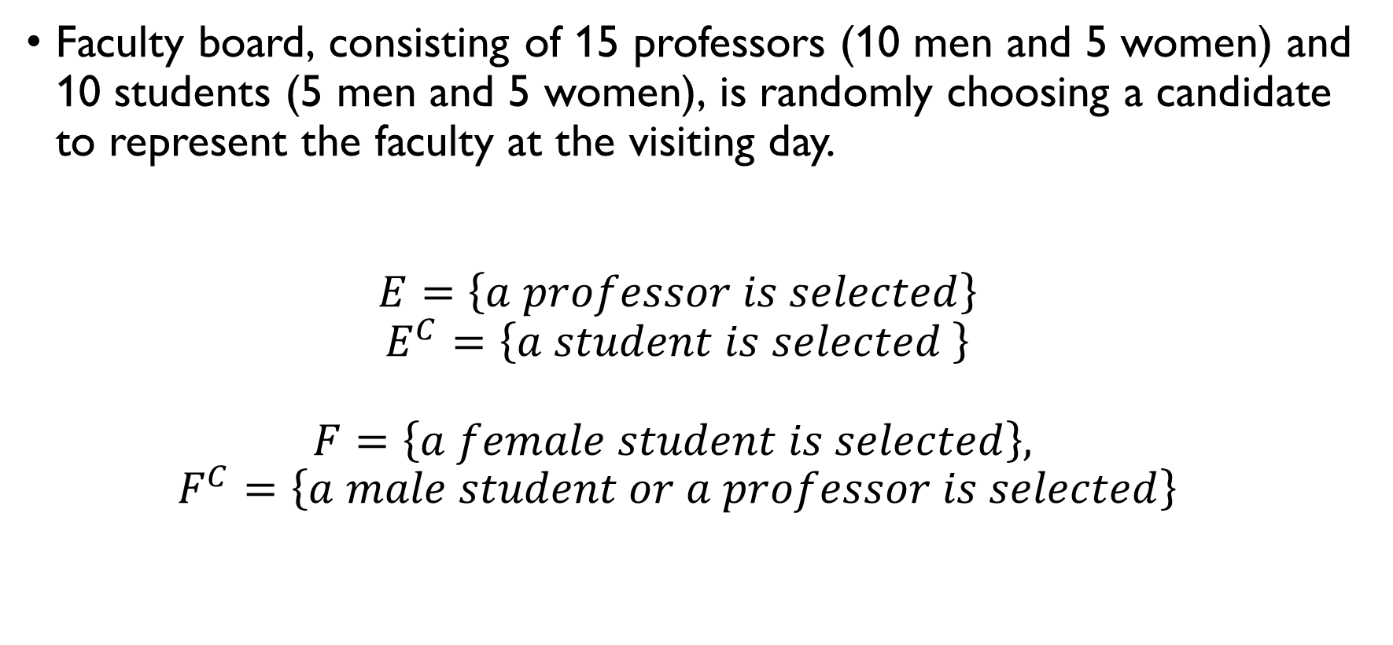
Complementary events
Faculty board, consisting of 15 professors (10 men and 5 women) and 10 students (5 men and 5 women), is randomly choosing a candidate to represent the faculty at the visiting day. $E=\left\{a professor is selected\right\}$ $E^{C}=\left\{a student is selected \right\}$ $F=\left\{a female student is selected\right\},$ $F^{C}=\left\{a male student or a professor is selected\right\}$

Slide 37

Computing probability
If a sample space $S$ is finite, and each outcome is equally likely, than probability of an event $E$ can be computed as
$$P\left(E\right)=\frac{\# ways E can occur}{\# possible outcomes}=\frac{\left|E\right|}{\left|S\right|}$$
Example: rolling a die $S=\left\{1, 2, 3, 4, 5, 6\right\}, \left|S\right|=6$ $E_{1}=\left\{1\right\}, \left|E_{1}\right|=1, P\left(E_{1}\right)=1/6$ $E_{2}=\left\{1, 3, 5\right\}, \left|E_{2}\right|=3, P\left(E_{2}\right)=1/2$

Slide 38

probability
Faculty board, consisting of 15 professors (10 men and 5 women) and 10 students (5 men and 5 women), is randomly choosing a candidate to represent the faculty at the visiting day. $P\left(professor\right)=\frac{15}{15+10}=\frac{15}{25}=\frac{3}{5}$ $P\left(student\right)=\frac{10}{15+10}=\frac{10}{25}=\frac{2}{5}$ $P\left(professor\right)+P\left(student\right)=1$

Slide 39
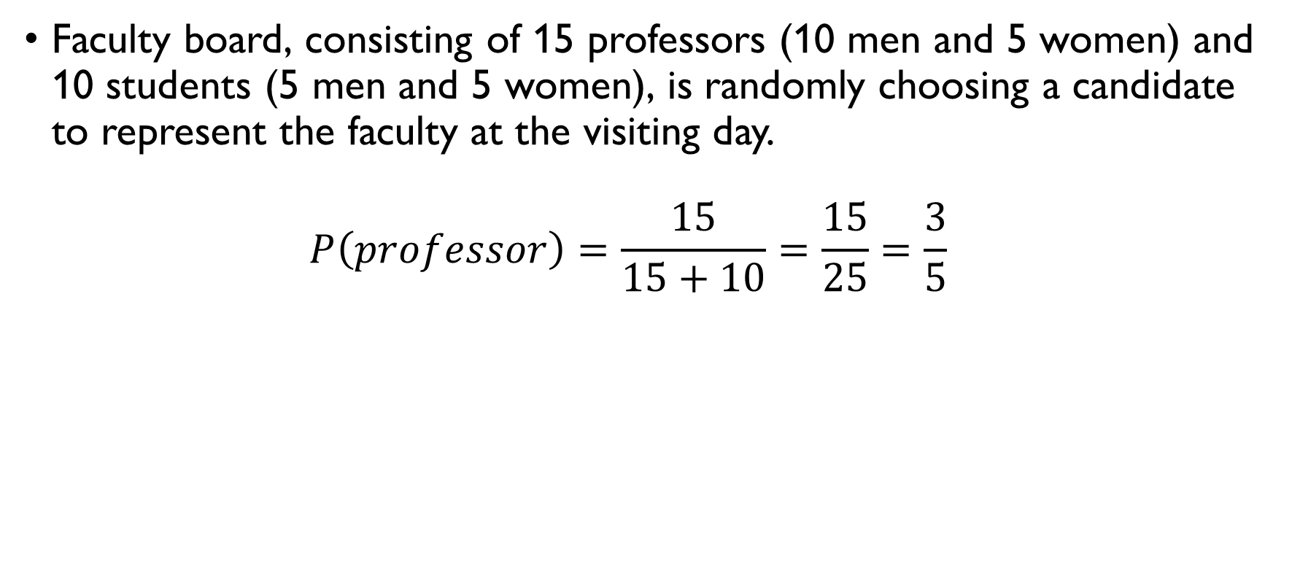
probability
Faculty board, consisting of 15 professors (10 men and 5 women) and 10 students (5 men and 5 women), is randomly choosing a candidate to represent the faculty at the visiting day. $P\left(professor\right)=\frac{15}{15+10}=\frac{15}{25}=\frac{3}{5}$ $P\left(student\right)=\frac{10}{15+10}=\frac{10}{25}=\frac{2}{5}$ $P\left(professor\right)+P\left(student\right)=1$

Slide 40
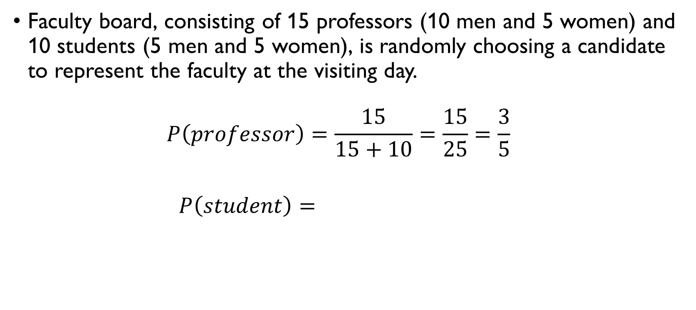
probability
Faculty board, consisting of 15 professors (10 men and 5 women) and 10 students (5 men and 5 women), is randomly choosing a candidate to represent the faculty at the visiting day. $P\left(professor\right)=\frac{15}{15+10}=\frac{15}{25}=\frac{3}{5}$ $P\left(student\right)=\frac{10}{15+10}=\frac{10}{25}=\frac{2}{5}$ $P\left(professor\right)+P\left(student\right)=1$

Slide 41
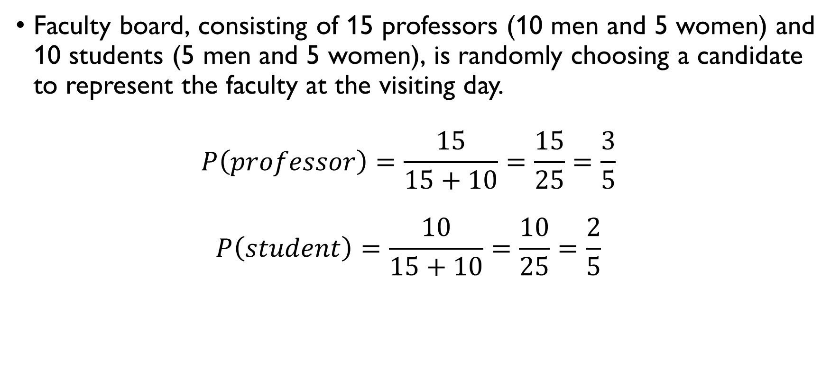
probability
Faculty board, consisting of 15 professors (10 men and 5 women) and 10 students (5 men and 5 women), is randomly choosing a candidate to represent the faculty at the visiting day. $P\left(professor\right)=\frac{15}{15+10}=\frac{15}{25}=\frac{3}{5}$ $P\left(student\right)=\frac{10}{15+10}=\frac{10}{25}=\frac{2}{5}$ $P\left(professor\right)+P\left(student\right)=1$

Slide 42
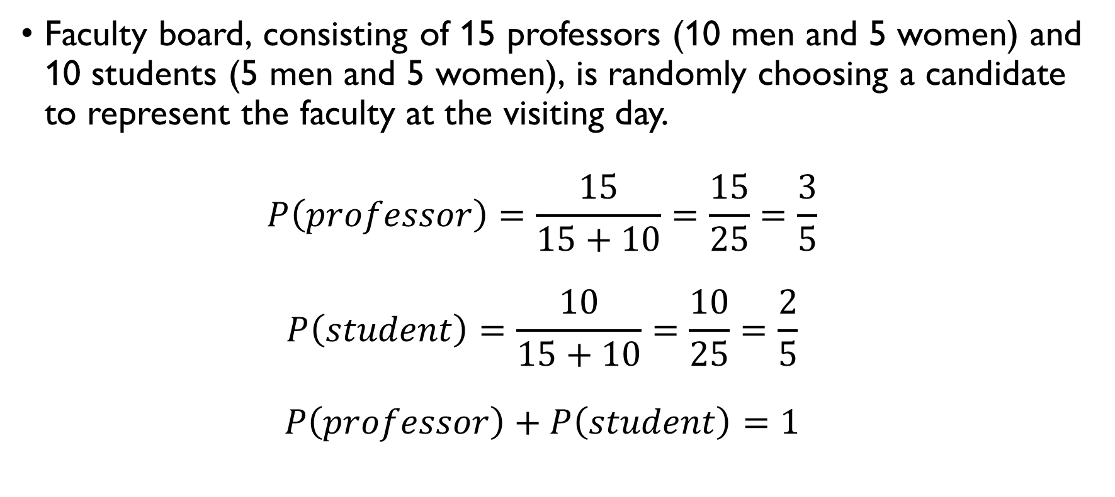
probability
Faculty board, consisting of 15 professors (10 men and 5 women) and 10 students (5 men and 5 women), is randomly choosing a candidate to represent the faculty at the visiting day. $P\left(professor\right)=\frac{15}{15+10}=\frac{15}{25}=\frac{3}{5}$ $P\left(student\right)=\frac{10}{15+10}=\frac{10}{25}=\frac{2}{5}$ $P\left(professor\right)+P\left(student\right)=1$

Slide 43

Conditional probability
Let $A$ and $B$ be events in a sample space $S$ with $P(B) > 0$.
Then the conditional probability of the event $A$ given that event $B$ has occurred is
$$P\left(A|B\right)=\frac{P\left(A∩B\right)}{P\left(B\right)}=\frac{P\left(AB\right)}{P(B)}=\frac{P\left(A \& B\right)}{P(B)}$$

Slide 44
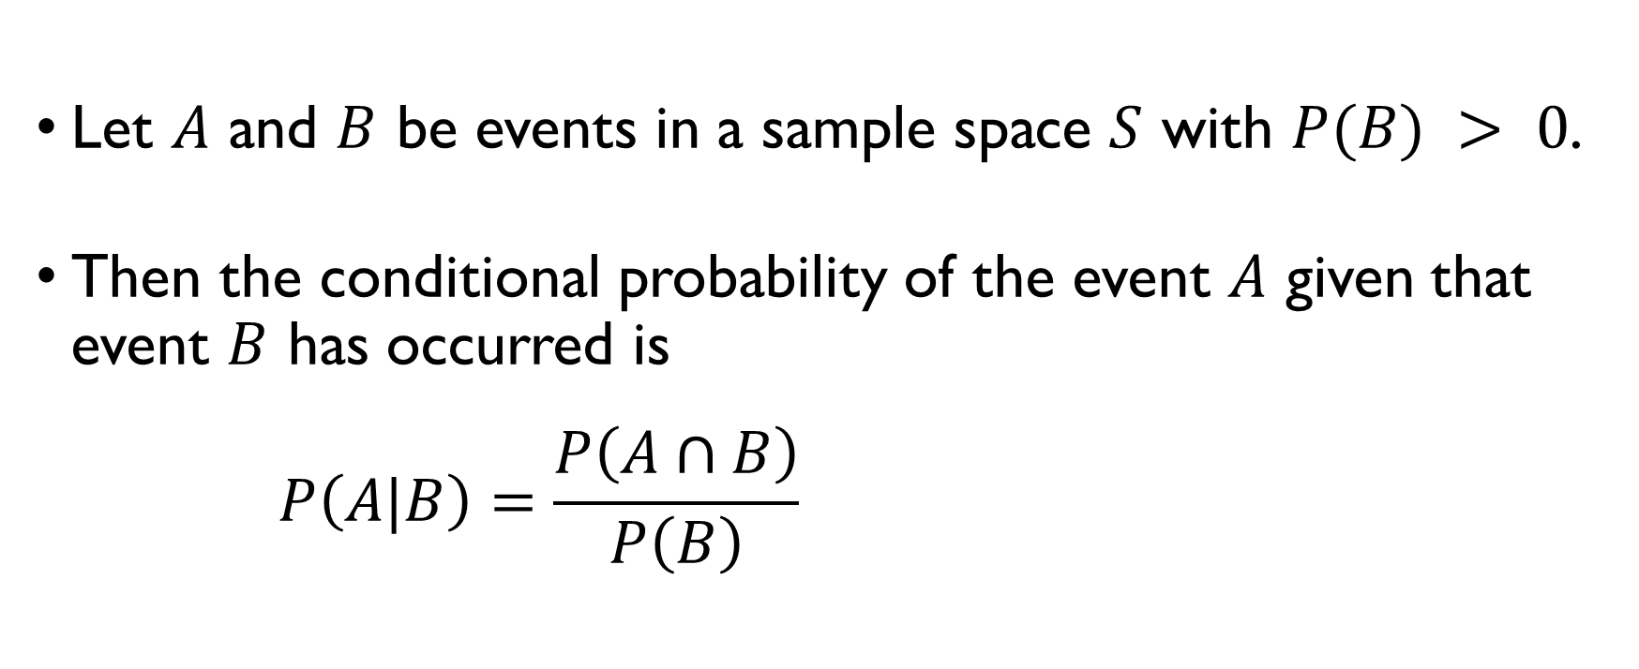
Conditional probability
Let $A$ and $B$ be events in a sample space $S$ with $P(B) > 0$.
Then the conditional probability of the event $A$ given that event $B$ has occurred is
$$P\left(A|B\right)=\frac{P\left(A∩B\right)}{P\left(B\right)}=\frac{P\left(AB\right)}{P(B)}=\frac{P\left(A \& B\right)}{P(B)}$$

Slide 45
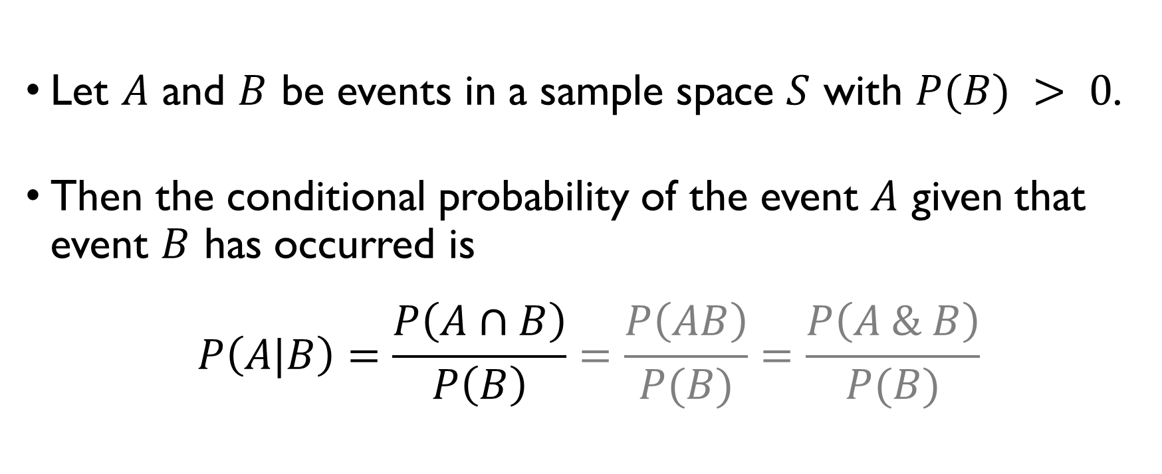
Conditional probability
Let $A$ and $B$ be events in a sample space $S$ with $P(B) > 0$.
Then the conditional probability of the event $A$ given that event $B$ has occurred is
$$P\left(A|B\right)=\frac{P\left(A∩B\right)}{P\left(B\right)}=\frac{P\left(AB\right)}{P(B)}=\frac{P\left(A \& B\right)}{P(B)}$$

Slide 46

Conditional probability
Faculty board, consisting of 15 professors (10 men and 5 women) and 10 students (5 men and 5 women), is randomly choosing a candidate to represent the faculty at the visiting day. $P\left(man|professor\right)=\frac{10}{15}=\frac{2}{3}$ $P\left(woman|student\right)=\frac{5}{10}=\frac{1}{2}$

Slide 47
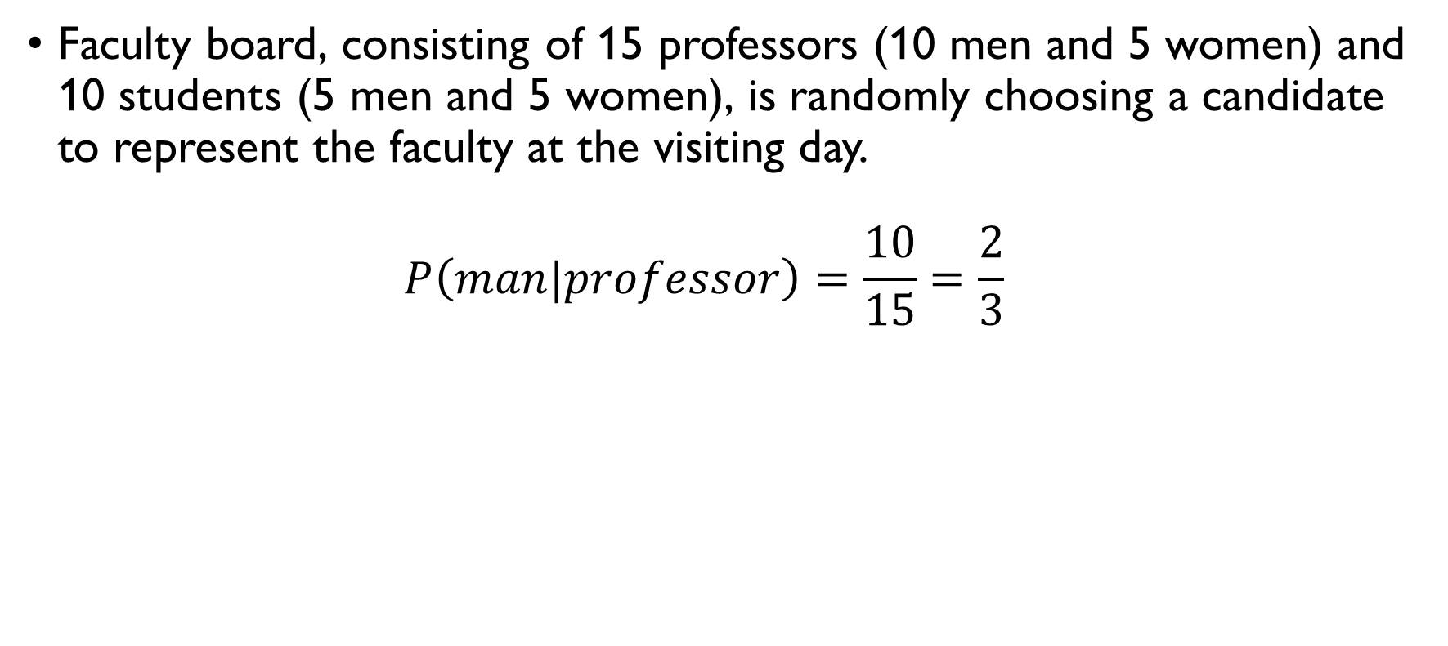
Conditional probability
Faculty board, consisting of 15 professors (10 men and 5 women) and 10 students (5 men and 5 women), is randomly choosing a candidate to represent the faculty at the visiting day. $P\left(man|professor\right)=\frac{10}{15}=\frac{2}{3}$ $P\left(woman|student\right)=\frac{5}{10}=\frac{1}{2}$

Slide 48
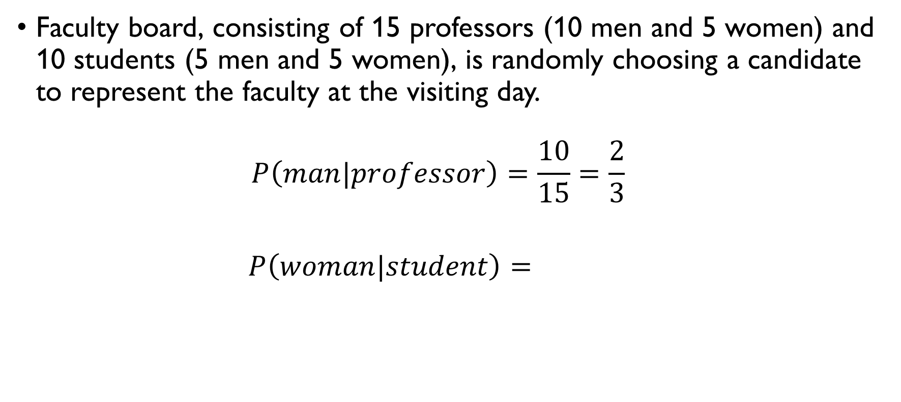
Conditional probability
Faculty board, consisting of 15 professors (10 men and 5 women) and 10 students (5 men and 5 women), is randomly choosing a candidate to represent the faculty at the visiting day. $P\left(man|professor\right)=\frac{10}{15}=\frac{2}{3}$ $P\left(woman|student\right)=\frac{5}{10}=\frac{1}{2}$

Slide 49
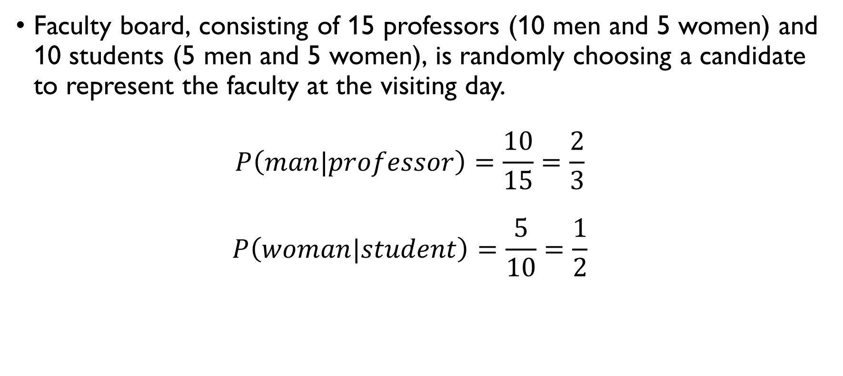
Conditional probability
Faculty board, consisting of 15 professors (10 men and 5 women) and 10 students (5 men and 5 women), is randomly choosing a candidate to represent the faculty at the visiting day. $P\left(man|professor\right)=\frac{10}{15}=\frac{2}{3}$ $P\left(woman|student\right)=\frac{5}{10}=\frac{1}{2}$

Slide 50




The law of total probability
Suppose that the sample space $S$ is split into $n$ disjoint events:
$$S=E_{1}∪E_{2}∪…∪E_{n}, E_{1}∩E_{2}∩…∩E_{n}=∅$$
Then $P\left(A\right)$ can be computed as follows:
$$P\left(A\right)=P\left(A,E_{1}\right)+P\left(A,E_{2}\right)+…+P\left(A,E_{n}\right)=$$
$$=P\left(A|E_{1}\right)⋅P\left(E_{1}\right)+P\left(A|E_{2}\right)⋅P\left(E_{2}\right)+$$
$$+…+P\left(A|E_{n}\right)⋅P\left(E_{n}\right)$$
$$E_{1}$$
$$E_{2}$$
$$E_{3}$$

Slide 51


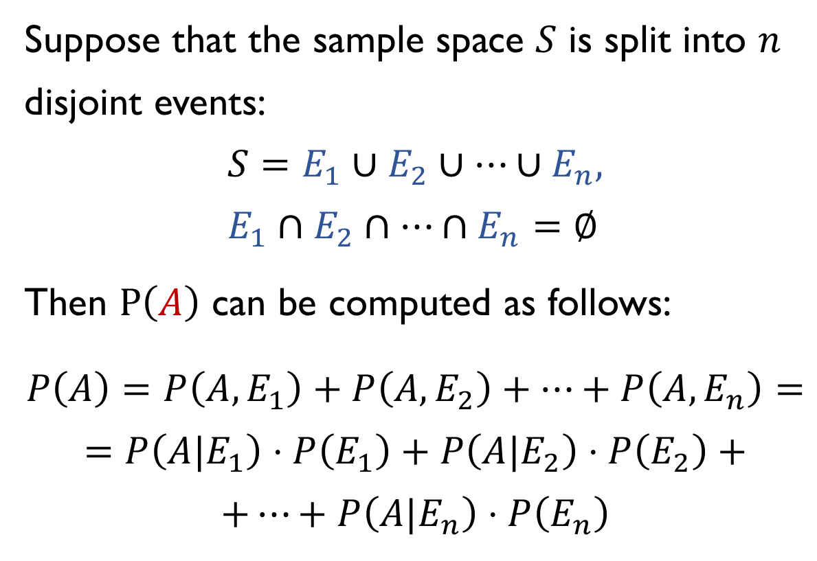

The law of total probability
Suppose that the sample space $S$ is split into $n$ disjoint events:
$$S=E_{1}∪E_{2}∪…∪E_{n}, E_{1}∩E_{2}∩…∩E_{n}=∅$$
Then $P\left(A\right)$ can be computed as follows:
$$P\left(A\right)=P\left(A,E_{1}\right)+P\left(A,E_{2}\right)+…+P\left(A,E_{n}\right)=$$
$$=P\left(A|E_{1}\right)⋅P\left(E_{1}\right)+P\left(A|E_{2}\right)⋅P\left(E_{2}\right)+$$
$$+…+P\left(A|E_{n}\right)⋅P\left(E_{n}\right)$$
$$E_{1}$$
$$E_{2}$$
$$E_{3}$$
$$A∩E_{1}$$
$$A∩E_{2}$$
$$A∩E_{3}$$

Slide 52

total probability
Faculty board, consisting of 15 professors (10 men and 5 women) and 10 students (5 men and 5 women), is randomly choosing a candidate to represent the faculty at the visiting day. $P\left(man\right)=$
$$=P\left(man|student\right)⋅P\left(student\right)+P\left(man|professor\right)⋅P\left(professor\right)= \\ =\frac{5}{10}⋅\frac{10}{25}+\frac{10}{15}⋅\frac{15}{25}=\frac{5}{25}+\frac{10}{25}=\frac{15}{25}=\frac{3}{5}$$

Slide 53
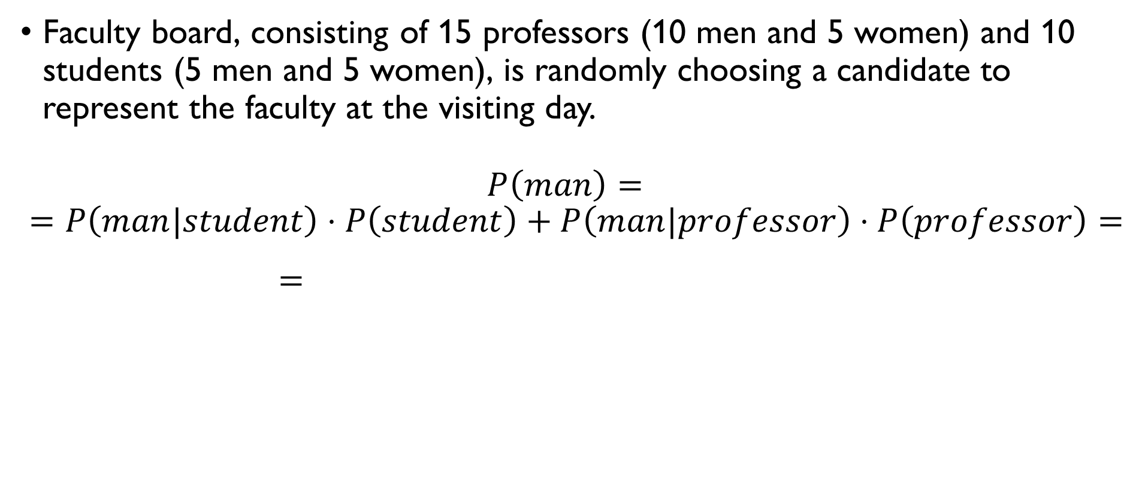
total probability
Faculty board, consisting of 15 professors (10 men and 5 women) and 10 students (5 men and 5 women), is randomly choosing a candidate to represent the faculty at the visiting day. $P\left(man\right)=$
$$=P\left(man|student\right)⋅P\left(student\right)+P\left(man|professor\right)⋅P\left(professor\right)= \\ =\frac{5}{10}⋅\frac{10}{25}+\frac{10}{15}⋅\frac{15}{25}=\frac{5}{25}+\frac{10}{25}=\frac{15}{25}=\frac{3}{5}$$

Slide 54

total probability
Faculty board, consisting of 15 professors (10 men and 5 women) and 10 students (5 men and 5 women), is randomly choosing a candidate to represent the faculty at the visiting day. $P\left(man\right)=$
$$=P\left(man|student\right)⋅P\left(student\right)+P\left(man|professor\right)⋅P\left(professor\right)= \\ =\frac{5}{10}⋅\frac{10}{25}+\frac{10}{15}⋅\frac{15}{25}=\frac{5}{25}+\frac{10}{25}=\frac{15}{25}=\frac{3}{5}$$

Slide 55

Bayes’ rule
$$P\left(A|B\right)=\frac{P\left(AB\right)}{P\left(B\right)}=\frac{P\left(B|A\right)}{P\left(B\right)}⋅P\left(A\right)$$

Slide 56

Bayes’ rule
Faculty board, consisting of 15 professors (10 men and 5 women) and 10 students (5 men and 5 women), is randomly choosing a candidate to represent the faculty at the visiting day. $P\left(professor|man\right)=\frac{P\left(man|professor\right)⋅P\left(professor\right)}{P\left(man\right)}=$ $=\frac{\frac{10}{15}⋅\frac{15}{25}}{\frac{10}{15}⋅\frac{15}{25}+\frac{5}{10}⋅\frac{10}{25}}=\frac{2}{5}⋅\frac{5}{3}=\frac{2}{3}$

Slide 57

Bayes’ rule
Faculty board, consisting of 15 professors (10 men and 5 women) and 10 students (5 men and 5 women), is randomly choosing a candidate to represent the faculty at the visiting day. $P\left(professor|man\right)=\frac{P\left(man|professor\right)⋅P\left(professor\right)}{P\left(man\right)}=$ $=\frac{\frac{10}{15}⋅\frac{15}{25}}{\frac{10}{15}⋅\frac{15}{25}+\frac{5}{10}⋅\frac{10}{25}}=\frac{2}{5}⋅\frac{5}{3}=\frac{2}{3}$

Slide 58

Bayes’ rule
Faculty board, consisting of 15 professors (10 men and 5 women) and 10 students (5 men and 5 women), is randomly choosing a candidate to represent the faculty at the visiting day. $P\left(professor|man\right)=\frac{P\left(man|professor\right)⋅P\left(professor\right)}{P\left(man\right)}=$ $=\frac{\frac{10}{15}⋅\frac{15}{25}}{\frac{10}{15}⋅\frac{15}{25}+\frac{5}{10}⋅\frac{10}{25}}=\frac{2}{5}⋅\frac{5}{3}=\frac{2}{3}$

Slide 59

Bayes’ rule
Faculty board, consisting of 15 professors (10 men and 5 women) and 10 students (5 men and 5 women), is randomly choosing a candidate to represent the faculty at the visiting day. $P\left(professor|man\right)=\frac{P\left(man|professor\right)⋅P\left(professor\right)}{P\left(man\right)}=$ $=\frac{\frac{10}{15}⋅\frac{15}{25}}{\frac{10}{15}⋅\frac{15}{25}+\frac{5}{10}⋅\frac{10}{25}}=\frac{2}{5}⋅\frac{5}{3}=\frac{2}{3}$

Slide 60

Independent events
Two events $A$ and $B$ from the same sample space S are independent if
$$P\left(AB\right)=P\left(A\right)⋅P\left(B\right)$$
Note that this means that
$$P\left(A|B\right)=\frac{P\left(AB\right)}{P\left(B\right)}=\frac{P\left(A\right)⋅P\left(B\right)}{P\left(B\right)}=P\left(A\right)$$
$$P\left(B|A\right)=\frac{P\left(AB\right)}{P\left(A\right)}=\frac{P\left(A\right)⋅P\left(B\right)}{P\left(A\right)}=P\left(B\right)$$

Slide 61

Independent events
Two events $A$ and $B$ from the same sample space S are independent if
$$P\left(AB\right)=P\left(A\right)⋅P\left(B\right)$$
Note that this means that
$$P\left(A|B\right)=\frac{P\left(AB\right)}{P\left(B\right)}=\frac{P\left(A\right)⋅P\left(B\right)}{P\left(B\right)}=P\left(A\right)$$
$$P\left(B|A\right)=\frac{P\left(AB\right)}{P\left(A\right)}=\frac{P\left(A\right)⋅P\left(B\right)}{P\left(A\right)}=P\left(B\right)$$

Slide 62

Independent events
Two events $A$ and $B$ from the same sample space S are independent if
$$P\left(AB\right)=P\left(A\right)⋅P\left(B\right)$$
Note that this means that
$$P\left(A|B\right)=\frac{P\left(AB\right)}{P\left(B\right)}=\frac{P\left(A\right)⋅P\left(B\right)}{P\left(B\right)}=P\left(A\right)$$
$$P\left(B|A\right)=\frac{P\left(AB\right)}{P\left(A\right)}=\frac{P\left(A\right)⋅P\left(B\right)}{P\left(A\right)}=P\left(B\right)$$

Slide 63

Independent events
Faculty board, consisting of 15 professors (10 men and 5 women) and 10 students (5 men and 5 women), is randomly choosing a candidate to represent the faculty at the visiting day. Are the following events independent? $E_{1}=\left\{man\right\}, E_{2}=\left\{professor\right\}$
$$P\left(E_{1}\right)=\frac{15}{25}=\frac{3}{5}, P\left(E_{2}\right)=\frac{15}{25}=\frac{3}{5}, P\left(E_{1}∩E_{2}\right)=\frac{10}{25}=\frac{2}{5}$$ $$P\left(E_{1}∩E_{2}\right)≠P\left(E_{1}\right)⋅P\left(E_{2}\right)→$$
the events are not independent

Slide 64

Independent events
Faculty board, consisting of 15 professors (10 men and 5 women) and 10 students (5 men and 5 women), is randomly choosing a candidate to represent the faculty at the visiting day. Are the following events independent? $E_{1}=\left\{man\right\}, E_{2}=\left\{professor\right\}$
$$P\left(E_{1}\right)=\frac{15}{25}=\frac{3}{5}, P\left(E_{2}\right)=\frac{15}{25}=\frac{3}{5}, P\left(E_{1}∩E_{2}\right)=\frac{10}{25}=\frac{2}{5}$$ $$P\left(E_{1}∩E_{2}\right)≠P\left(E_{1}\right)⋅P\left(E_{2}\right)→$$
the events are not independent

Slide 65

Independent events
Faculty board, consisting of 15 professors (10 men and 5 women) and 10 students (5 men and 5 women), is randomly choosing a candidate to represent the faculty at the visiting day. Are the following events independent? $E_{1}=\left\{man\right\}, E_{2}=\left\{professor\right\}$
$$P\left(E_{1}\right)=\frac{15}{25}=\frac{3}{5}, P\left(E_{2}\right)=\frac{15}{25}=\frac{3}{5}, P\left(E_{1}∩E_{2}\right)=\frac{10}{25}=\frac{2}{5}$$ $$P\left(E_{1}∩E_{2}\right)≠P\left(E_{1}\right)⋅P\left(E_{2}\right)→$$
the events are not independent

Slide 66

Independent events
Faculty board, consisting of 15 professors (10 men and 5 women) and 10 students (5 men and 5 women), is randomly choosing a candidate to represent the faculty at the visiting day. Are the following events independent? $E_{1}=\left\{man\right\}, E_{2}=\left\{professor\right\}$
$$P\left(E_{1}\right)=\frac{15}{25}=\frac{3}{5}, P\left(E_{2}\right)=\frac{15}{25}=\frac{3}{5}, P\left(E_{1}∩E_{2}\right)=\frac{10}{25}=\frac{2}{5}$$ $$P\left(E_{1}∩E_{2}\right)≠P\left(E_{1}\right)⋅P\left(E_{2}\right)→$$
the events are not independent

Slide 67

Independent events
Faculty board, consisting of 15 professors (10 men and 5 women) and 10 students (5 men and 5 women), is randomly choosing a candidate to represent the faculty at the visiting day. Are the following events independent? $E_{1}=\left\{man\right\}, E_{2}=\left\{professor\right\}$
$$P\left(E_{1}\right)=\frac{15}{25}=\frac{3}{5}, P\left(E_{2}\right)=\frac{15}{25}=\frac{3}{5}, P\left(E_{1}∩E_{2}\right)=\frac{10}{25}=\frac{2}{5}$$ $$P\left(E_{1}∩E_{2}\right)≠P\left(E_{1}\right)⋅P\left(E_{2}\right)→$$
the events are not independent

Slide 68

Independent events
Faculty board, consisting of 15 professors (10 men and 5 women) and 10 students (5 men and 5 women), is randomly choosing a candidate to represent the faculty at the visiting day. Are the following events independent? $E_{1}=\left\{man\right\}, E_{2}=\left\{professor\right\}$
$$P\left(E_{1}\right)=\frac{15}{25}=\frac{3}{5}, P\left(E_{2}\right)=\frac{15}{25}=\frac{3}{5}, P\left(E_{1}∩E_{2}\right)=\frac{10}{25}=\frac{2}{5}$$ $$P\left(E_{1}∩E_{2}\right)≠P\left(E_{1}\right)⋅P\left(E_{2}\right)→$$
the events are not independent

Slide 69

Independent events
Faculty board, consisting of 15 professors (10 men and 5 women) and 10 students (5 men and 5 women), is randomly choosing a candidate to represent the faculty at the visiting day. Are the following events independent? $E_{1}=\left\{man\right\}, E_{2}=\left\{professor\right\}$
$$P\left(E_{1}\right)=\frac{15}{25}=\frac{3}{5}, P\left(E_{2}\right)=\frac{15}{25}=\frac{3}{5}, P\left(E_{1}∩E_{2}\right)=\frac{10}{25}=\frac{2}{5}$$ $$P\left(E_{1}∩E_{2}\right)≠P\left(E_{1}\right)⋅P\left(E_{2}\right)→$$
the events are not independent

Slide 70

Independent events
Faculty board, consisting of 15 professors (10 men and 5 women) and 10 students (5 men and 5 women), is randomly choosing a candidate to represent the faculty at the visiting day. Are the following events independent? $E_{1}=\left\{man\right\}, E_{2}=\left\{professor\right\}$
$$P\left(E_{1}\right)=\frac{15}{25}=\frac{3}{5}, P\left(E_{2}\right)=\frac{15}{25}=\frac{3}{5}, P\left(E_{1}∩E_{2}\right)=\frac{10}{25}=\frac{2}{5}$$ $$P\left(E_{1}∩E_{2}\right)≠P\left(E_{1}\right)⋅P\left(E_{2}\right)→$$
the events are not independent

Slide 71

Independent events
Faculty board, consisting of 15 professors (10 men and 5 women) and 10 students (5 men and 5 women), is randomly choosing a candidate to represent the faculty at the visiting day. Are the following events independent? $E_{1}=\left\{man\right\}, E_{2}=\left\{professor\right\}$
$$P\left(E_{1}\right)=\frac{15}{25}=\frac{3}{5}, P\left(E_{2}\right)=\frac{15}{25}=\frac{3}{5}, P\left(E_{1}∩E_{2}\right)=\frac{10}{25}=\frac{2}{5}$$ $$P\left(E_{1}∩E_{2}\right)≠P\left(E_{1}\right)⋅P\left(E_{2}\right)→$$
the events are not independent

Slide 72

Independent events
Faculty board, consisting of 15 professors (10 men and 5 women) and 10 students (5 men and 5 women), is randomly choosing a candidate to represent the faculty at the visiting day. Are the following events independent? $E_{1}=\left\{man\right\}, E_{2}=\left\{professor\right\}$
$$P\left(E_{1}\right)=\frac{15}{25}=\frac{3}{5}, P\left(E_{2}\right)=\frac{15}{25}=\frac{3}{5}, P\left(E_{1}∩E_{2}\right)=\frac{10}{25}=\frac{2}{5}$$ $$P\left(E_{1}∩E_{2}\right)≠P\left(E_{1}\right)⋅P\left(E_{2}\right)→$$
the events are not independent

Slide 73

Weather forecast
There is a 50% chance of rain on Saturday and a 50%chance of rain on Sunday. If having rain on Saturday and having rain on Sunday are independent events, then what is the probability of having no rain over the weekend?
$$P\left(Sat \& Sun\right)=P\left(Sat\right)⋅P\left(Sun\right)=\frac{1}{4}$$

Slide 74

Weather forecast
There is a 50% chance of rain on Saturday and a 50%chance of rain on Sunday. If having rain on Saturday and having rain on Sunday are independent events, then what is the probability of having no rain over the weekend?
$$P\left(Sat \& Sun\right)=P\left(Sat\right)⋅P\left(Sun\right)=\frac{1}{4}$$

Slide 75

Weather forecast
There is a 50% chance of rain on Saturday and a 50%chance of rain on Sunday. If having rain on Saturday and having rain on Sunday are independent events, then what is the probability of having no rain over the weekend?
$$P\left(Sat \& Sun\right)=P\left(Sat\right)⋅P\left(Sun\right)=\frac{1}{4}$$

Slide 76

Weather forecast
There is a 50% chance of rain on Saturday and a 50%chance of rain on Sunday. If having rain on Saturday and having rain on Sunday are independent events, then what is the probability of having no rain over the weekend?
$$P\left(Sat \& Sun\right)=P\left(Sat\right)⋅P\left(Sun\right)=\frac{1}{4}$$

Slide 77

boxes
Box A contains 1 white ball, and box B contains 14 white and 15 black balls. A person randomly picks a box and then picks a random ball. What is the probability to choose a white ball?
$$P\left(white\right)=P\left(white|A\right)⋅P\left(A\right)+P\left(white|B\right)⋅P\left(B\right)=$$ $$=\frac{1}{2}⋅1+\frac{14}{29}⋅\frac{1}{2}=\frac{1}{2}+\frac{7}{29}=\frac{43}{58}$$

Slide 78

boxes
Box A contains 1 white ball, and box B contains 14 white and 15 black balls. A person randomly picks a box and then picks a random ball. What is the probability to choose a white ball?
$$P\left(white\right)=P\left(white|A\right)⋅P\left(A\right)+P\left(white|B\right)⋅P\left(B\right)=$$ $$=\frac{1}{2}⋅1+\frac{14}{29}⋅\frac{1}{2}=\frac{1}{2}+\frac{7}{29}=\frac{43}{58}$$

Slide 79

boxes
Box A contains 1 white ball, and box B contains 14 white and 15 black balls. A person randomly picks a box and then picks a random ball. What is the probability to choose a white ball?
$$P\left(white\right)=P\left(white|A\right)⋅P\left(A\right)+P\left(white|B\right)⋅P\left(B\right)=$$ $$=\frac{1}{2}⋅1+\frac{14}{29}⋅\frac{1}{2}=\frac{1}{2}+\frac{7}{29}=\frac{43}{58}$$

Slide 80

boxes
Box A contains 1 white ball, and box B contains 14 white and 15 black balls. A person randomly picks a box and then picks a random ball. What is the probability that box B was chosen given that the chosen ball was white?
$$P\left(B|white\right)=\frac{P\left(white|B\right)⋅P\left(B\right)}{P\left(white\right)}=\frac{\frac{14}{29}⋅\frac{1}{2}}{\frac{14}{29}⋅\frac{1}{2}+1⋅\frac{1}{2}}=\frac{14}{43}$$

Slide 81

boxes
Box A contains 1 white ball, and box B contains 14 white and 15 black balls. A person randomly picks a box and then picks a random ball. What is the probability that box B was chosen given that the chosen ball was white?
$$P\left(B|white\right)=\frac{P\left(white|B\right)⋅P\left(B\right)}{P\left(white\right)}=\frac{\frac{14}{29}⋅\frac{1}{2}}{\frac{14}{29}⋅\frac{1}{2}+1⋅\frac{1}{2}}=\frac{14}{43}$$

Slide 82

boxes
Box A contains 1 white ball, and box B contains 14 white and 15 black balls. A person randomly picks a box and then picks a random ball. What is the probability that box B was chosen given that the chosen ball was white?
$$P\left(B|white\right)=\frac{P\left(white|B\right)⋅P\left(B\right)}{P\left(white\right)}=\frac{\frac{14}{29}⋅\frac{1}{2}}{\frac{14}{29}⋅\frac{1}{2}+1⋅\frac{1}{2}}=\frac{14}{43}$$

Slide 83

queue
Six people form a queue, including A and B. Assume that all 6! orderings are equiprobable. What is the probability that B is before A given that A is not the first? $P\left(B<A|A≠1\right)=\frac{P\left(B<A, A≠1\right)}{P\left(A≠1\right)}=$
$$=\frac{1⋅4!+2⋅4!+3⋅4!+4⋅4!+5⋅4!}{5⋅5!}=\frac{15⋅4!}{5⋅5!}=\frac{15}{25}=\frac{3}{5}$$

Slide 84

queue
Six people form a queue, including A and B. Assume that all 6! orderings are equiprobable. What is the probability that B is before A given that A is not the first? $P\left(B<A|A≠1\right)=\frac{P\left(B<A, A≠1\right)}{P\left(A≠1\right)}=$
$$=\frac{1⋅4!+2⋅4!+3⋅4!+4⋅4!+5⋅4!}{5⋅5!}=\frac{15⋅4!}{5⋅5!}=\frac{15}{25}=\frac{3}{5}$$

Slide 85

queue
Six people form a queue, including A and B. Assume that all 6! orderings are equiprobable. What is the probability that B is before A given that A is not the first? $P\left(B<A|A≠1\right)=\frac{P\left(B<A, A≠1\right)}{P\left(A≠1\right)}=$
$$=\frac{1⋅4!+2⋅4!+3⋅4!+4⋅4!+5⋅4!}{5⋅5!}=\frac{15⋅4!}{5⋅5!}=\frac{15}{25}=\frac{3}{5}$$

Slide 86

queue
Six people form a queue, including A and B. Assume that all 6! orderings are equiprobable. What is the probability that B is before A given that A is not the first? $P\left(B<A|A≠1\right)=\frac{P\left(B<A, A≠1\right)}{P\left(A≠1\right)}=$
$$=\frac{1⋅4!+2⋅4!+3⋅4!+4⋅4!+5⋅4!}{5⋅5!}=\frac{15⋅4!}{5⋅5!}=\frac{15}{25}=\frac{3}{5}$$

Slide 87
Monty hall

Slide 88
Interim exam
Exam available on Google classroom as of 10:20
Open book
15 questions
5 one-point questions;
10 two-point questions.
Solutions must be written in the file
typed or pictures;
should contain explanations.
Deadline: 12:30 Barcelona time
GOOD LUCK!

Slide 89

Monty hall

Slide 90
Monty hall

