Slide 1
INTRODUCTION TO STATISTICS
LECTURE 1

Slide 2

ABOUT ME
evgeniakorneva@gmail.com
EVGENIYA Korneva
Education:
2015 - Bachelor of Applied Mathematics (Moscow, Russia)
2016 - Master of Artificial Intelligence (Leuven, Belgium)
2016 - … Doctoral researcher at KU Leuven
Prague, Czech Republic

Slide 3


ABOUT ME
evgeniakorneva@gmail.com
EVGENIYA Korneva
Education:
2015 - Bachelor of Applied Mathematics (Moscow, Russia)
2016 - Master of Artificial Intelligence (Leuven, Belgium)
2016 - … Doctoral researcher at KU Leuven
Prague, Czech Republic

Slide 4

ABOUT ME
evgeniakorneva@gmail.com
EVGENIYA Korneva
Education:
2015 - Bachelor of Applied Mathematics (Moscow, Russia)
2016 - Master of Artificial Intelligence (Leuven, Belgium)
2016 - … Doctoral researcher at KU Leuven
Prague, Czech Republic

Slide 5

ABOUT ME
evgeniakorneva@gmail.com
EVGENIYA Korneva
Education:
2015 - Bachelor of Applied Mathematics (Moscow, Russia)
2016 - Master of Artificial Intelligence (Leuven, Belgium)
2016 - … Doctoral researcher at KU Leuven
Prague, Czech Republic

Slide 6
ABOUT THE COURSE
Class: 09:00 – 12.20
two 10-minute break
Office hours: 13.00 – 14.00
Want to talk? Send me an email first!
Materials will be posted after class.

Slide 7
ABOUT THE COURSE
Class: 09:00 – 12.20
two 10-minute break
Office hours: 13.00 – 14.00
Want to talk? Send me an email first!
Materials will be posted after class.
Final grade:
5 graded assignments (20 pts each)
mid-term exam (? December 11 or 12)
final exam (? December 17 or 18)
First graded assignment out today. Deadline: this Thursday.
Please complete the ENTRY TEST by tomorrow evening!

Slide 8

LET’S STRAT!

Slide 9
WHAT IS STATISTICS?
How do you imagine Statistics?
Can you think of any example of Statistics?
Where is it used?
Why do we need Statistics?

Slide 10
WHAT IS STATISTICS?
How do you imagine Statistics?
Can you think of any example of Statistics?
Where is it used?
Why do we need Statistics?

Slide 11
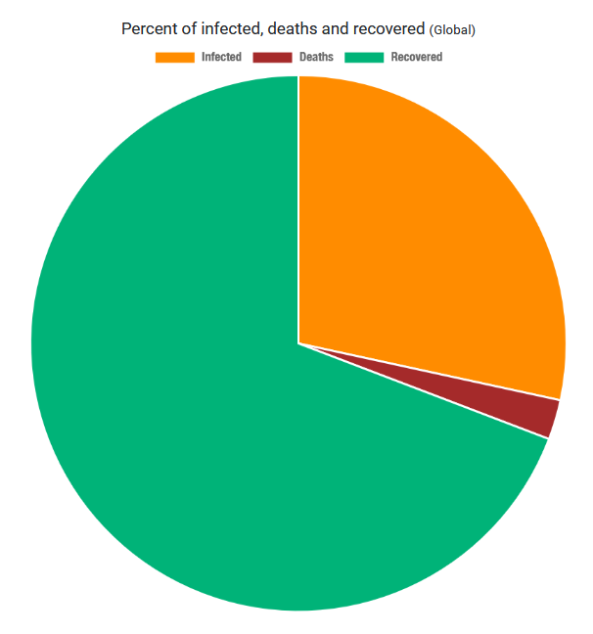
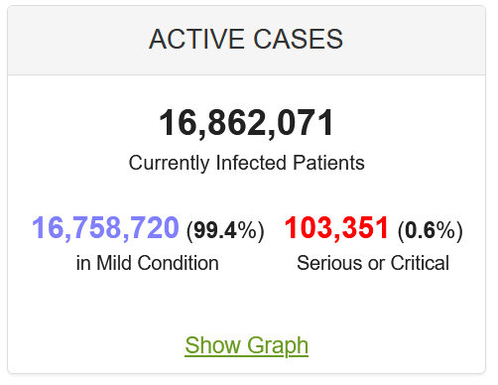
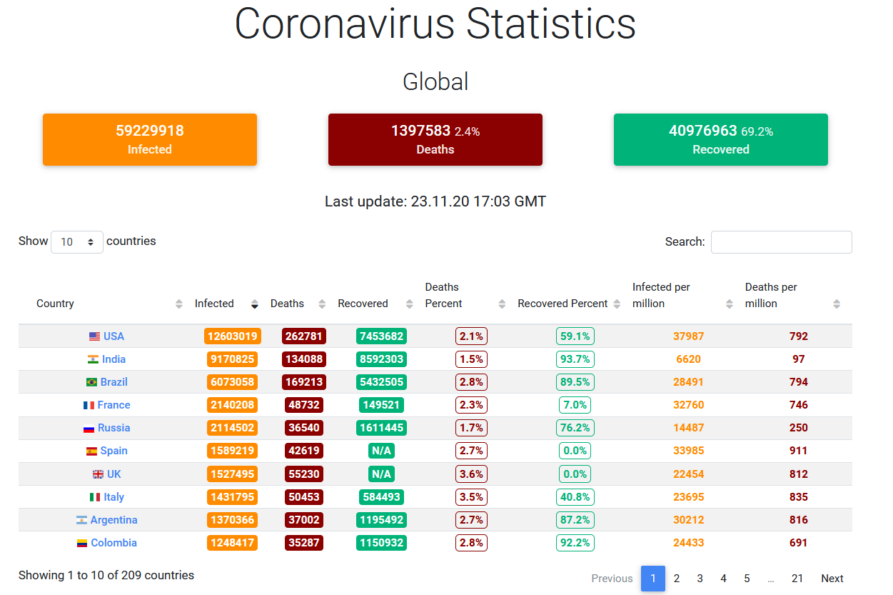
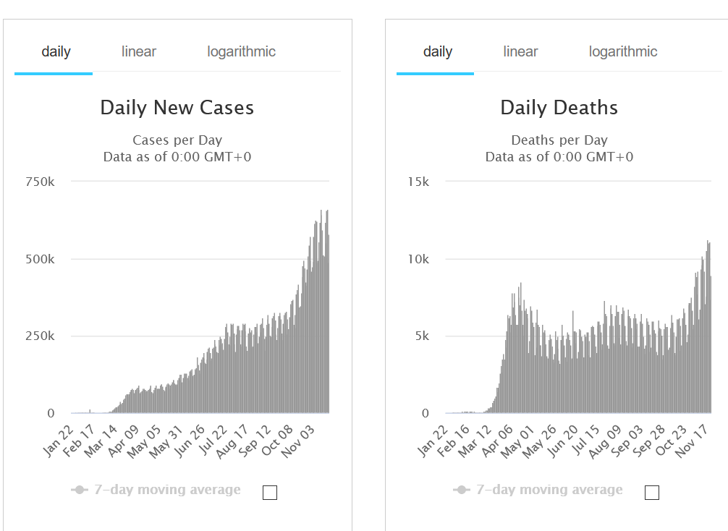
WE’RE ALL FOLLOWING THESE STATISTICS…

Slide 12
WHAT IS STATISTICS?
How do you imagine Statistics?
Can you think of any example of Statistics?
What is it?
Why do we need Statistics?

Slide 13
WHAT IS STATISTICS?
How do you imagine Statistics?
Can you think of any example of Statistics?
What is it?
Why do we need it?

Slide 14
WHAT IS STATISTICS?
Statistics is a collection of methods which help us to describe, summarize, interpret and analyse data.
Vital in research, politics, management, business…
There are different kinds of Statistics…

Slide 15
WHAT IS STATISTICS?
Statistics is a collection of methods which help us to describe, summarize, interpret and analyse data.
Vital in research, politics, management, business…
There are different kinds of Statistics…

Slide 16
WHAT IS STATISTICS?
Statistics is a collection of methods which help us to describe, summarize, interpret and analyse data.
Vital in research, politics, management, business…
There are different kinds of Statistics…

Slide 17
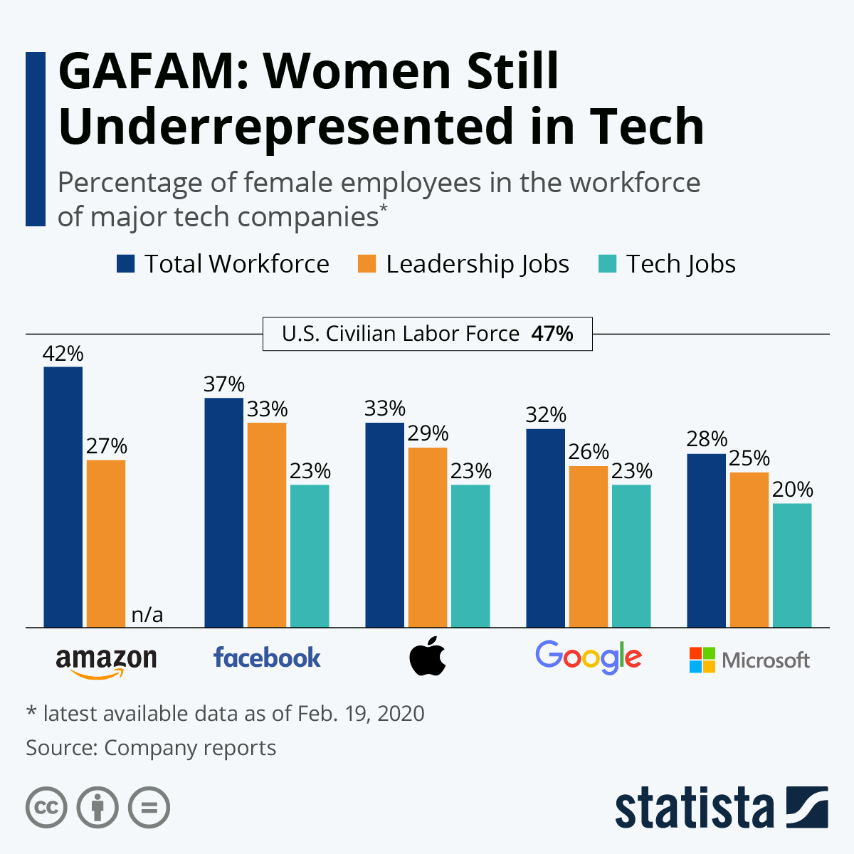
STATISTICS: EXAMPLE 1
Source: https://www.statista.com/chart/4467/female-employees-at-tech-companies/

Slide 18
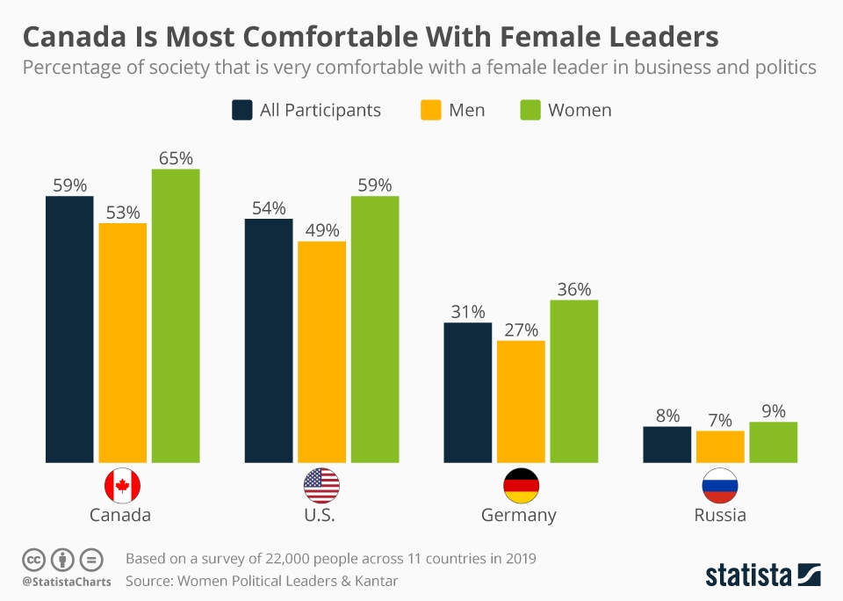
STATISTICS: EXAMPLE 2
Source: https://www.statista.com/chart/20018/canada-most-comfortable-with-female-leaders/

Slide 19
WHAT’S THE DIFFERENCE BETWEEN THE TWO?
EXAMPLE 1
EXAMPLE 2
Source: https://www.statista.com/chart/4467/female-employees-at-tech-companies/
Source: https://www.statista.com/chart/20018/canada-most-comfortable-with-female-leaders/

Slide 20
WATCH THE VIDEO:
https://bit.ly/3fy8nzd

Slide 21
WHAT’S THE DIFFERENCE BETWEEN THE TWO?
EXAMPLE 1
EXAMPLE 2
Source: https://www.statista.com/chart/4467/female-employees-at-tech-companies/
Source: https://www.statista.com/chart/20018/canada-most-comfortable-with-female-leaders/

Slide 22
WHAT’S THE DIFFERENCE BETWEEN THE TWO?
DESCRIPTIVE STATISTICS
INFERENTIAL STATISTICS
Source: https://www.statista.com/chart/4467/female-employees-at-tech-companies/
Source: https://www.statista.com/chart/20018/canada-most-comfortable-with-female-leaders/

Slide 23
DESCRIPTIVE VS INFERENTIAL STATISTICS
DESCRIPTIVE STATISTICS
INFERENTIAL STATISTICS
Describe the data at hand.
From the data at hand, make conclusions about a larger group.

Slide 24
DESCRIPTIVE STATISTICS
Describing the data at hand

Slide 25
DATA
Statistic is all about data.
But what kinds of data are there?
Important to know: different methods are applicable to different kinds of data.

Slide 26
DATA
Statistic is all about data.
But what kinds of data are there?
Important to know: different methods are applicable to different kinds of data.

Slide 27
Quantitative vs Qualitative Variables
QUANTITATIVE measurable quantities can be ordered
QUALITATIVE can’t be ordered

Slide 28
Quantitative vs Qualitative Variables
QUANTITATIVE measurable quantities can be ordered
QUALITATIVE can’t be ordered
Air temperature (-1, 15, 21.5, …)
Shoe size (38, 39, 40, …)
Score for the final exam (100, 0, 85, …)

Slide 29
Quantitative vs Qualitative Variables
QUANTITATIVE measurable quantities can be ordered
QUALITATIVE can’t be ordered
Air temperature (-1, 15, 21.5, …)
Shoe size (38, 39, 40, …)
Score for the final exam (100, 0, 85, …)
Eye colour (blue, brown, grey, …)
Political party you support (Republicans, Democrats, …)
Type of transport you use to commute (metro, bus, bike, …)

Slide 30
Quantitative vs Qualitative Variables
Consider variable SEX that takes two values: ‘male’ or ‘female’.
In a dataset
‘male’ is represented as 0
‘female’ is represented as 1.
Is gender a qualitative or a quantitative variable?
NAME | SEX
Ann | Female
Bob | Male
Kate | Female
Nick | Male

Slide 31
Quantitative vs Qualitative Variables
Consider variable SEX that takes two values: ‘male’ or ‘female’.
In a dataset
‘male’ is represented as 0
‘female’ is represented as 1.
Is gender a qualitative or a quantitative variable?
NAME | SEX
Ann | Female
Bob | Male
Kate | Female
Nick | Male
NAME | SEX
Ann | 1
Bob | 0
Kate | 1
Nick | 0

Slide 32
Quantitative vs Qualitative Variables
Consider variable SEX that takes two values: ‘male’ or ‘female’.
In a dataset
‘male’ is represented as 0
‘female’ is represented as 1.
Is SEX a qualitative or a quantitative variable now?
NAME | SEX
Ann | Female
Bob | Male
Kate | Female
Nick | Male
NAME | SEX
Ann | 1
Bob | 0
Kate | 1
Nick | 0

Slide 33
Quantitative vs Qualitative Variables
QUANTITATIVE measurable quantities can be ordered
QUALITATIVE can’t be ordered
Air temperature (-1, 15, 21.5, …)
Shoe size (38, 39, 40, …)
Score for the final exam (100, 0, 85, …)
Eye colour (blue, brown, grey, …)
Political party you support (Republicans, Democrats, …)
Type of transport you use to commute (metro, bus, bike, …)

Slide 34
Discrete vs Continuous Variables
CONTINIOUS take infinite number of values
DISCRETE take finite number of values

Slide 35
Discrete vs Continuous Variables
CONTINIOUS take infinite number of values
DISCRETE take finite number of values

Slide 36
Discrete vs Continuous Variables
CONTINIOUS take infinite number of values
DISCRETE take finite number of values
Some quantitative variables:
height;
time to travel to work;
etc.

Slide 37
Discrete vs Continuous Variables
CONTINIOUS take infinite number of values
DISCRETE take finite number of values
Some quantitative variables:
height;
time to travel to work;
etc.
All qualitative variables.
Some quantitative variables:
shoe size;
etc.

Slide 38
NOW, LET’S ANALYZE SOME DATA!

Slide 39
OUR DATASET
 | NAME | SEX | AGE | POSITION | SALARY (in $1000)
1 | Ann | F | 30 | Manager | 3
2 | Bob | M | 30 | Manager | 4
3 | Kate | F | 20 | Secretary | 1
4 | Nick | M | 45 | CEO | 50
5 | John | M | 25 | HR | 2
6 | Alice | F | 30 | Manager | 3
7 | Joe | M | 25 | Manager | 4
8 | Dan | M | 40 | PR | 1
9 | Laura | F | 35 | HR | 2
10 | Jack | M | 20 | PR | 1
You are considering joining a company.
What could you learn from the data available?

Slide 40

OUR DATASET
 | NAME | SEX | AGE | POSITION | SALARY (in $1000)
1 | Ann | F | 30 | Manager | 3
2 | Bob | M | 30 | Manager | 4
3 | Kate | F | 20 | Secretary | 1
4 | Nick | M | 45 | CEO | 50
5 | John | M | 25 | HR | 2
6 | Alice | F | 30 | Manager | 3
7 | Joe | M | 25 | Manager | 4
8 | Dan | M | 40 | PR | 1
9 | Laura | F | 35 | HR | 2
10 | Jack | M | 20 | PR | 1
You are considering joining a company.
What could you learn from the data available?

Slide 41
How old are the employees there? How much do they make?
Measures of center: mean and median

Slide 42

MEAN
 | NAME | SEX | AGE | POSITION | SALARY (in $1000)
1 | Ann | F | 30 | Manager | 3
2 | Bob | M | 30 | Manager | 4
3 | Kate | F | 20 | Secretary | 1
4 | Nick | M | 45 | CEO | 50
5 | John | M | 25 | HR | 2
6 | Alice | F | 30 | Manager | 3
7 | Joe | M | 25 | Manager | 4
8 | Dan | M | 40 | PR | 1
9 | Laura | F | 35 | HR | 2
10 | Jack | M | 20 | PR | 1
Sample mean: $\overline{X}=\frac{1}{n}\sum_{i=1}^{n}{X_{i}}$
What is the mean age?
$$\frac{30+30+20+45+25+30+25+40+35+20}{10}=$$
What is the mean salary?
$$\frac{3+4+1+50+2+3+4+1+2+1}{10}=$$
30
7.2

Slide 43
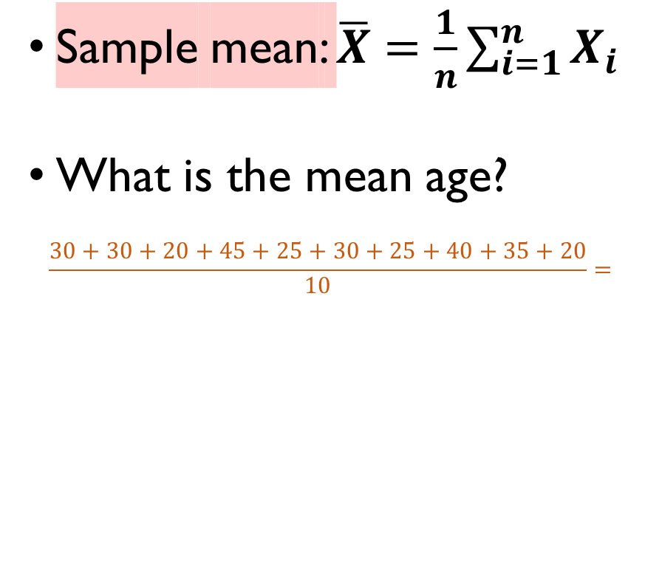
MEAN
 | NAME | SEX | AGE | POSITION | SALARY (in $1000)
1 | Ann | F | 30 | Manager | 3
2 | Bob | M | 30 | Manager | 4
3 | Kate | F | 20 | Secretary | 1
4 | Nick | M | 45 | CEO | 50
5 | John | M | 25 | HR | 2
6 | Alice | F | 30 | Manager | 3
7 | Joe | M | 25 | Manager | 4
8 | Dan | M | 40 | PR | 1
9 | Laura | F | 35 | HR | 2
10 | Jack | M | 20 | PR | 1
Sample mean: $\overline{X}=\frac{1}{n}\sum_{i=1}^{n}{X_{i}}$
What is the mean age?
$$\frac{30+30+20+45+25+30+25+40+35+20}{10}=$$
What is the mean salary?
$$\frac{3+4+1+50+2+3+4+1+2+1}{10}=$$
30
7.2

Slide 44
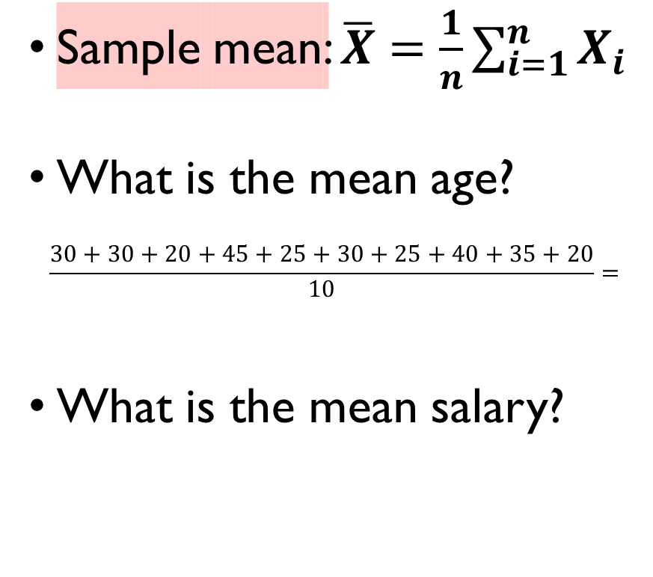
MEAN
 | NAME | SEX | AGE | POSITION | SALARY (in $1000)
1 | Ann | F | 30 | Manager | 3
2 | Bob | M | 30 | Manager | 4
3 | Kate | F | 20 | Secretary | 1
4 | Nick | M | 45 | CEO | 50
5 | John | M | 25 | HR | 2
6 | Alice | F | 30 | Manager | 3
7 | Joe | M | 25 | Manager | 4
8 | Dan | M | 40 | PR | 1
9 | Laura | F | 35 | HR | 2
10 | Jack | M | 20 | PR | 1
Sample mean: $\overline{X}=\frac{1}{n}\sum_{i=1}^{n}{X_{i}}$
What is the mean age?
$$\frac{30+30+20+45+25+30+25+40+35+20}{10}=$$
What is the mean salary?
$$\frac{3+4+1+50+2+3+4+1+2+1}{10}=$$
30
7.2

Slide 45
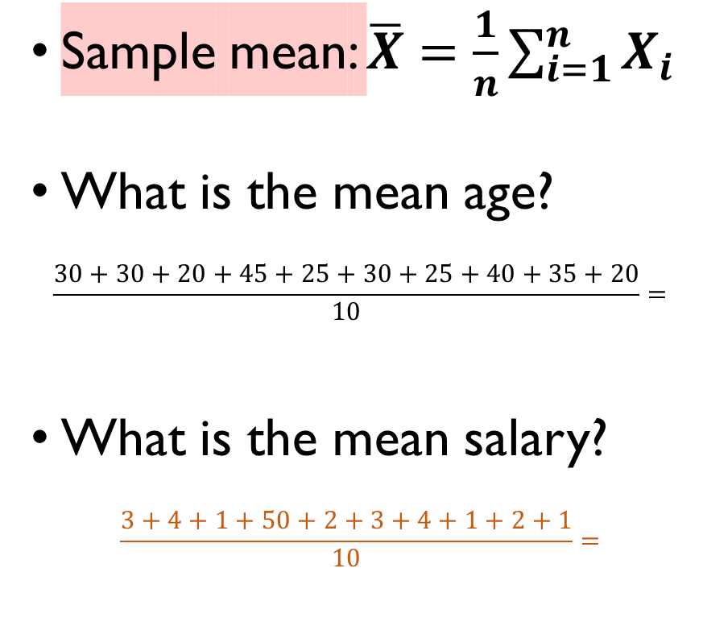
MEAN
 | NAME | SEX | AGE | POSITION | SALARY (in $1000)
1 | Ann | F | 30 | Manager | 3
2 | Bob | M | 30 | Manager | 4
3 | Kate | F | 20 | Secretary | 1
4 | Nick | M | 45 | CEO | 50
5 | John | M | 25 | HR | 2
6 | Alice | F | 30 | Manager | 3
7 | Joe | M | 25 | Manager | 4
8 | Dan | M | 40 | PR | 1
9 | Laura | F | 35 | HR | 2
10 | Jack | M | 20 | PR | 1
Sample mean: $\overline{X}=\frac{1}{n}\sum_{i=1}^{n}{X_{i}}$
What is the mean age?
$$\frac{30+30+20+45+25+30+25+40+35+20}{10}=$$
What is the mean salary?
$$\frac{3+4+1+50+2+3+4+1+2+1}{10}=$$
30
7.2

Slide 46
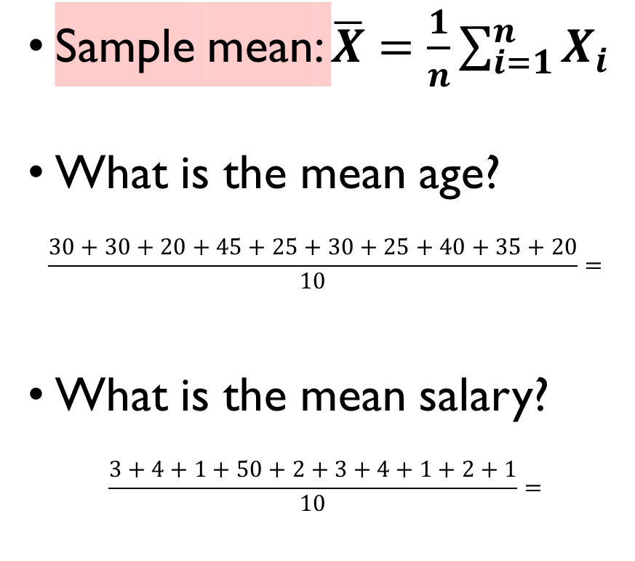
MEAN
 | NAME | SEX | AGE | POSITION | SALARY (in $1000)
1 | Ann | F | 30 | Manager | 3
2 | Bob | M | 30 | Manager | 4
3 | Kate | F | 20 | Secretary | 1
4 | Nick | M | 45 | CEO | 50
5 | John | M | 25 | HR | 2
6 | Alice | F | 30 | Manager | 3
7 | Joe | M | 25 | Manager | 4
8 | Dan | M | 40 | PR | 1
9 | Laura | F | 35 | HR | 2
10 | Jack | M | 20 | PR | 1
Sample mean: $\overline{X}=\frac{1}{n}\sum_{i=1}^{n}{X_{i}}$
What is the mean age?
$$\frac{30+30+20+45+25+30+25+40+35+20}{10}=$$
What is the mean salary?
$$\frac{3+4+1+50+2+3+4+1+2+1}{10}=$$
30
7.2

Slide 47
MEAN
 | NAME | SEX | AGE | POSITION | SALARY (in $1000)
1 | Ann | F | 30 | Manager | 3
2 | Bob | M | 30 | Manager | 4
3 | Kate | F | 20 | Secretary | 1
4 | Nick | M | 45 | CEO | 50
5 | John | M | 25 | HR | 2
6 | Alice | F | 30 | Manager | 3
7 | Joe | M | 25 | Manager | 4
8 | Dan | M | 40 | PR | 1
9 | Laura | F | 35 | HR | 2
10 | Jack | M | 20 | PR | 1
Sample mean: $\overline{X}=\frac{1}{n}\sum_{i=1}^{n}{X_{i}}$
What is the mean age?
$$\frac{30+30+20+45+25+30+25+40+35+20}{10}=$$
What is the mean salary?
$$\frac{3+4+1+50+2+3+4+1+2+1}{10}=$$
outlier
30
7.2

Slide 48
MEAN
SENSITIVE TO OUTLIERS ☹
 | NAME | SEX | AGE | POSITION | SALARY (in $1000)
1 | Ann | F | 30 | Manager | 3
2 | Bob | M | 30 | Manager | 4
3 | Kate | F | 20 | Secretary | 1
4 | Nick | M | 45 | CEO | 50
5 | John | M | 25 | HR | 2
6 | Alice | F | 30 | Manager | 3
7 | Joe | M | 25 | Manager | 4
8 | Dan | M | 40 | PR | 1
9 | Laura | F | 35 | HR | 2
10 | Jack | M | 20 | PR | 1
Sample mean: $\overline{X}=\frac{1}{n}\sum_{i=1}^{n}{X_{i}}$
What is the mean age?
$$\frac{30+30+20+45+25+30+25+40+35+20}{10}=$$
What is the mean salary?
$$\frac{3+4+1+50+2+3+4+1+2+1}{10}=$$
outlier
30
7.1

Slide 49
MEDIAN
 | NAME | SEX | AGE | POSITION | SALARY (in $1000)
1 | Ann | F | 30 | Manager | 3
2 | Bob | M | 30 | Manager | 4
3 | Kate | F | 20 | Secretary | 1
4 | Nick | M | 45 | CEO | 50
5 | John | M | 25 | HR | 2
6 | Alice | F | 30 | Manager | 3
7 | Joe | M | 25 | Manager | 4
8 | Dan | M | 40 | PR | 1
9 | Laura | F | 35 | HR | 2
10 | Jack | M | 20 | PR | 1
A value such that 50% of the data is lower than it, and 50% is higher.
What is the median salary?

Slide 50
MEDIAN
 | NAME | SEX | AGE | POSITION | SALARY (in $1000)
1 | Ann | F | 30 | Manager | 3
2 | Bob | M | 30 | Manager | 4
3 | Kate | F | 20 | Secretary | 1
4 | Nick | M | 45 | CEO | 50
5 | John | M | 25 | HR | 2
6 | Alice | F | 30 | Manager | 3
7 | Joe | M | 25 | Manager | 4
8 | Dan | M | 40 | PR | 1
9 | Laura | F | 35 | HR | 2
10 | Jack | M | 20 | PR | 1
A value such that 50% of the data is lower than it, and 50% is higher.
What is the median salary?
3 | 4 | 1 | 50 | 2 | 3 | 4 | 1 | 2 | 1

Slide 51
MEDIAN
 | NAME | SEX | AGE | POSITION | SALARY (in $1000)
1 | Ann | F | 30 | Manager | 3
2 | Bob | M | 30 | Manager | 4
3 | Kate | F | 20 | Secretary | 1
4 | Nick | M | 45 | CEO | 50
5 | John | M | 25 | HR | 2
6 | Alice | F | 30 | Manager | 3
7 | Joe | M | 25 | Manager | 4
8 | Dan | M | 40 | PR | 1
9 | Laura | F | 35 | HR | 2
10 | Jack | M | 20 | PR | 1
A value such that 50% of the data is lower than it, and 50% is higher.
What is the median salary?
sort from min to max
1 | 1 | 1 | 2 | 2 | 3 | 3 | 4 | 4 | 50

Slide 52
MEDIAN
 | NAME | SEX | AGE | POSITION | SALARY (in $1000)
1 | Ann | F | 30 | Manager | 3
2 | Bob | M | 30 | Manager | 4
3 | Kate | F | 20 | Secretary | 1
4 | Nick | M | 45 | CEO | 50
5 | John | M | 25 | HR | 2
6 | Alice | F | 30 | Manager | 3
7 | Joe | M | 25 | Manager | 4
8 | Dan | M | 40 | PR | 1
9 | Laura | F | 35 | HR | 2
10 | Jack | M | 20 | PR | 1
A value such that 50% of the data is lower than it, and 50% is higher.
What is the median salary?
sort from min to max
1 | 1 | 1 | 2 | 2 | 3 | 3 | 4 | 4 | 50
take the value(s) in the middle

Slide 53
MEDIAN
 | NAME | SEX | AGE | POSITION | SALARY (in $1000)
1 | Ann | F | 30 | Manager | 3
2 | Bob | M | 30 | Manager | 4
3 | Kate | F | 20 | Secretary | 1
4 | Nick | M | 45 | CEO | 50
5 | John | M | 25 | HR | 2
6 | Alice | F | 30 | Manager | 3
7 | Joe | M | 25 | Manager | 4
8 | Dan | M | 40 | PR | 1
9 | Laura | F | 35 | HR | 2
10 | Jack | M | 20 | PR | 1
A value such that 50% of the data is lower than it, and 50% is higher.
What is the median salary?
sort from min to max
1 | 1 | 1 | 2 | 2 | 3 | 3 | 4 | 4 | 50
The median is (2 + 3)/2 = 2.5

Slide 54
MEDIAN
LESS SENSITIVE TO OUTLIERS ☺
 | NAME | SEX | AGE | POSITION | SALARY (in $1000)
1 | Ann | F | 30 | Manager | 3
2 | Bob | M | 30 | Manager | 4
3 | Kate | F | 20 | Secretary | 1
4 | Nick | M | 45 | CEO | 50
5 | John | M | 25 | HR | 2
6 | Alice | F | 30 | Manager | 3
7 | Joe | M | 25 | Manager | 4
8 | Dan | M | 40 | PR | 1
9 | Laura | F | 35 | HR | 2
10 | Jack | M | 20 | PR | 1
A value such that 50% of the data is lower than it, and 50% is higher.
What is the median salary?
sort from min to max
1 | 1 | 1 | 2 | 2 | 3 | 3 | 4 | 4 | 50
The median is (2 + 3)/2 = 2.5
Mean salary: 7.1
Median salary: 2.5

Slide 55
MEDIAN
LESS SENSITIVE TO OUTLIERS ☺
 | NAME | SEX | AGE | POSITION | SALARY (in $1000)
1 | Ann | F | 30 | Manager | 3
2 | Bob | M | 30 | Manager | 4
3 | Kate | F | 20 | Secretary | 1
4 | Nick | M | 45 | CEO | 50
5 | John | M | 25 | HR | 2
6 | Alice | F | 30 | Manager | 3
7 | Joe | M | 25 | Manager | 4
8 | Dan | M | 40 | PR | 1
9 | Laura | F | 35 | HR | 2
10 | Jack | M | 20 | PR | 1
A value such that 50% of the data is lower than it, and 50% is higher.
What is the median salary?
What is the median age?
sort from min to max
1 | 1 | 1 | 2 | 2 | 3 | 3 | 4 | 4 | 50
The median is (2 + 3)/2 = 2.5

Slide 56
MEDIAN
LESS SENSITIVE TO OUTLIERS ☺
 | NAME | SEX | AGE | POSITION | SALARY (in $1000)
1 | Ann | F | 30 | Manager | 3
2 | Bob | M | 30 | Manager | 4
3 | Kate | F | 20 | Secretary | 1
4 | Nick | M | 45 | CEO | 50
5 | John | M | 25 | HR | 2
6 | Alice | F | 30 | Manager | 3
7 | Joe | M | 25 | Manager | 4
8 | Dan | M | 40 | PR | 1
9 | Laura | F | 35 | HR | 2
10 | Jack | M | 20 | PR | 1
A value such that 50% of the data is lower than it, and 50% is higher.
What is the median salary?
What is the median age?
1 | 1 | 1 | 2 | 2 | 3 | 3 | 4 | 4 | 50
The median is (2 + 3)/2 = 2.5
sort from min to max
20 | 20 | 25 | 25 | 30 | 30 | 30 | 35 | 40 | 45

Slide 57
MEDIAN
LESS SENSITIVE TO OUTLIERS ☺
 | NAME | SEX | AGE | POSITION | SALARY (in $1000)
1 | Ann | F | 30 | Manager | 3
2 | Bob | M | 30 | Manager | 4
3 | Kate | F | 20 | Secretary | 1
4 | Nick | M | 45 | CEO | 50
5 | John | M | 25 | HR | 2
6 | Alice | F | 30 | Manager | 3
7 | Joe | M | 25 | Manager | 4
8 | Dan | M | 40 | PR | 1
9 | Laura | F | 35 | HR | 2
10 | Jack | M | 20 | PR | 1
A value such that 50% of the data is lower than it, and 50% is higher.
What is the median salary?
What is the median age?
1 | 1 | 1 | 2 | 2 | 3 | 3 | 4 | 4 | 50
The median is (2 + 3)/2 = 2.5
sort from min to max
20 | 20 | 25 | 25 | 30 | 30 | 30 | 35 | 40 | 45
30

Slide 58
How different are the salaries? How different are the ages?
Measures of spread: variance and standard deviation,
percentiles

Slide 59




SAMPLE VARIANCE
 | NAME | SEX | AGE | POSITION | SALARY (in $1000)
1 | Ann | F | 30 | Manager | 3
2 | Bob | M | 30 | Manager | 4
3 | Kate | F | 20 | Secretary | 1
4 | Nick | M | 45 | CEO | 50
5 | John | M | 25 | HR | 2
6 | Alice | F | 30 | Manager | 3
7 | Joe | M | 25 | Manager | 4
8 | Dan | M | 40 | PR | 1
9 | Laura | F | 35 | HR | 2
10 | Jack | M | 20 | PR | 1
Sample variance: average squared distance from all the points to the mean:
$$Var\left(X\right)=\frac{1}{n}\sum_{i=1}^{n}{{\left(X_{i}−\overline{X}\right)}^{2}}$$
What could you learn from the data available?
$${\left(\overline{X}−X_{i}\right)}^{2}$$
$$\overline{X}$$
$$X_{i}$$

Slide 60
SAMPLE VARIANCE
Sometimes, (n-1) instead of n.
We’ll discuss the reasons for that later
 | NAME | SEX | AGE | POSITION | SALARY (in $1000)
1 | Ann | F | 30 | Manager | 3
2 | Bob | M | 30 | Manager | 4
3 | Kate | F | 20 | Secretary | 1
4 | Nick | M | 45 | CEO | 50
5 | John | M | 25 | HR | 2
6 | Alice | F | 30 | Manager | 3
7 | Joe | M | 25 | Manager | 4
8 | Dan | M | 40 | PR | 1
9 | Laura | F | 35 | HR | 2
10 | Jack | M | 20 | PR | 1
Sample variance: average squared distance from all the points to the mean:
$$Var\left(X\right)=\frac{1}{n}\sum_{i=1}^{n}{{\left(X_{i}−\overline{X}\right)}^{2}}$$
What could you learn from the data available?
$${\left(\overline{X}−X_{i}\right)}^{2}$$
$$\overline{X}$$
$$X_{i}$$

Slide 61
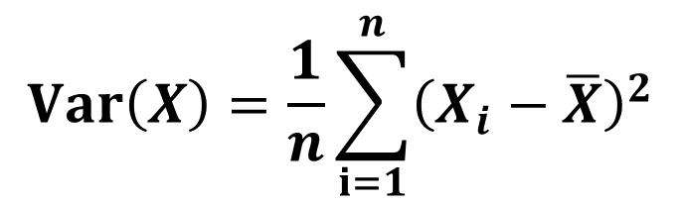
SAMPLE VARIANCE
$$Var\left(X\right)=\frac{1}{n}\sum_{i=1}^{n}{{\left(X_{i}−\overline{X}\right)}^{2}}$$
 | NAME | SEX | AGE | POSITION | SALARY (in $1000)
1 | Ann | F | 30 | Manager | 3
2 | Bob | M | 30 | Manager | 4
3 | Kate | F | 20 | Secretary | 1
4 | Nick | M | 45 | CEO | 50
5 | John | M | 25 | HR | 2
6 | Alice | F | 30 | Manager | 3
7 | Joe | M | 25 | Manager | 4
8 | Dan | M | 40 | PR | 1
9 | Laura | F | 35 | HR | 2
10 | Jack | M | 20 | PR | 1
What is the variance of age?
[(30-30)² +
(30-30)² +
(20-30)² +
(45-30)² +
(25-30)² +
(30-30)² +
(25-30)² +
(40-30)² +
(35-30)² +
(20-30)² ]/10 = ?

Slide 62
SAMPLE VARIANCE
$$Var\left(X\right)=\frac{1}{n}\sum_{i=1}^{n}{{\left(X_{i}−\overline{X}\right)}^{2}}$$
 | NAME | SEX | AGE | POSITION | SALARY (in $1000)
1 | Ann | F | 30 | Manager | 3
2 | Bob | M | 30 | Manager | 4
3 | Kate | F | 20 | Secretary | 1
4 | Nick | M | 45 | CEO | 50
5 | John | M | 25 | HR | 2
6 | Alice | F | 30 | Manager | 3
7 | Joe | M | 25 | Manager | 4
8 | Dan | M | 40 | PR | 1
9 | Laura | F | 35 | HR | 2
10 | Jack | M | 20 | PR | 1
What is the variance of age?
[(30-30)² +
(30-30)² +
(20-30)² +
(45-30)² +
(25-30)² +
(30-30)² +
(25-30)² +
(40-30)² +
(35-30)² +
(20-30)² ]/10 = 60

Slide 63
SAMPLE VARIANCE
$$Var\left(X\right)=\frac{1}{n}\sum_{i=1}^{n}{{\left(X_{i}−\overline{X}\right)}^{2}}$$
 | NAME | SEX | AGE | POSITION | SALARY (in $1000)
1 | Ann | F | 30 | Manager | 3
2 | Bob | M | 30 | Manager | 4
3 | Kate | F | 20 | Secretary | 1
4 | Nick | M | 45 | CEO | 50
5 | John | M | 25 | HR | 2
6 | Alice | F | 30 | Manager | 3
7 | Joe | M | 25 | Manager | 4
8 | Dan | M | 40 | PR | 1
9 | Laura | F | 35 | HR | 2
10 | Jack | M | 20 | PR | 1
What is the variance of age?
[(30-30)² +
(30-30)² +
(20-30)² +
(45-30)² +
(25-30)² +
(30-30)² +
(25-30)² +
(40-30)² +
(35-30)² +
(20-30)² ]/10 = 60 YEARS²

Slide 64
SAMPLE VARIANCE
$$Var\left(X\right)=\frac{1}{n}\sum_{i=1}^{n}{{\left(X_{i}−\overline{X}\right)}^{2}}$$
 | NAME | SEX | AGE | POSITION | SALARY (in $1000)
1 | Ann | F | 30 | Manager | 3
2 | Bob | M | 30 | Manager | 4
3 | Kate | F | 20 | Secretary | 1
4 | Nick | M | 45 | CEO | 50
5 | John | M | 25 | HR | 2
6 | Alice | F | 30 | Manager | 3
7 | Joe | M | 25 | Manager | 4
8 | Dan | M | 40 | PR | 1
9 | Laura | F | 35 | HR | 2
10 | Jack | M | 20 | PR | 1
What is the variance of age?
[(30-30)² +
(30-30)² +
(20-30)² +
(45-30)² +
(25-30)² +
(30-30)² +
(25-30)² +
(40-30)² +
(35-30)² +
(20-30)² ]/10 = 60 YEARS²
HARD TO INTERPRET ☹

Slide 65
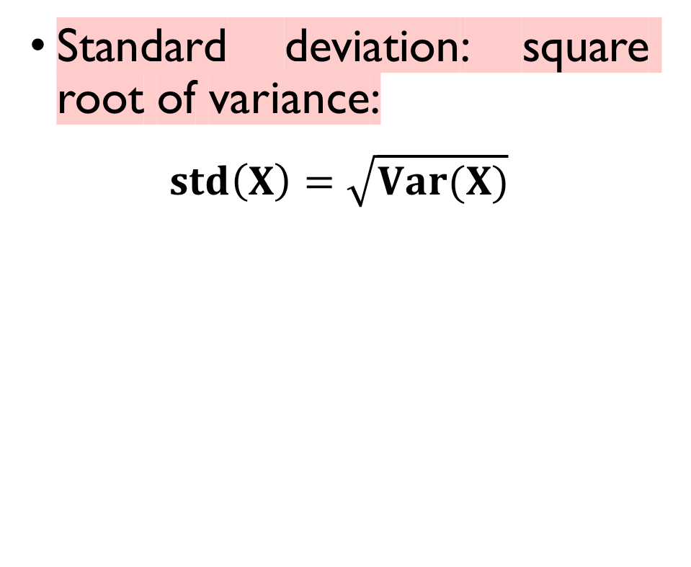
SAMPLE VARIANCE
 | NAME | SEX | AGE | POSITION | SALARY (in $1000)
1 | Ann | F | 30 | Manager | 3
2 | Bob | M | 30 | Manager | 4
3 | Kate | F | 20 | Secretary | 1
4 | Nick | M | 45 | CEO | 50
5 | John | M | 25 | HR | 2
6 | Alice | F | 30 | Manager | 3
7 | Joe | M | 25 | Manager | 4
8 | Dan | M | 40 | PR | 1
9 | Laura | F | 35 | HR | 2
10 | Jack | M | 20 | PR | 1
Standard deviation: square root of variance:
$$std\left(X\right)=\sqrt{Var(X)}$$
What is the standard deviation of age?
std(AGE) = $\sqrt{60}$ ~ 7.8

Slide 66
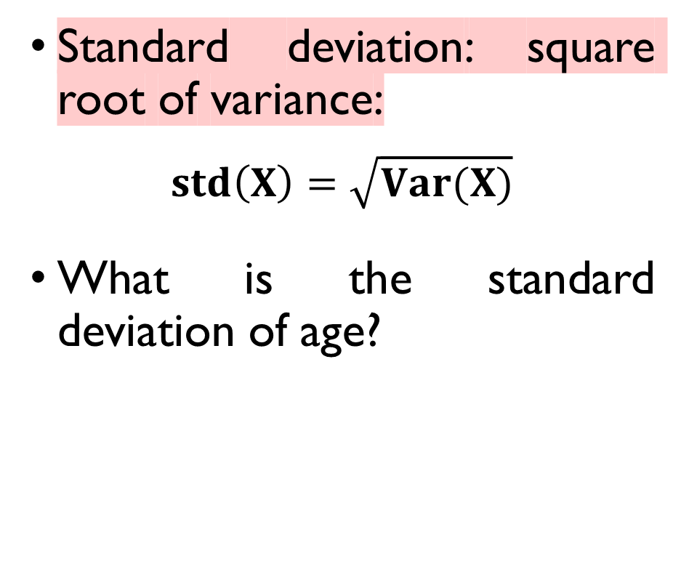
SAMPLE VARIANCE
 | NAME | SEX | AGE | POSITION | SALARY (in $1000)
1 | Ann | F | 30 | Manager | 3
2 | Bob | M | 30 | Manager | 4
3 | Kate | F | 20 | Secretary | 1
4 | Nick | M | 45 | CEO | 50
5 | John | M | 25 | HR | 2
6 | Alice | F | 30 | Manager | 3
7 | Joe | M | 25 | Manager | 4
8 | Dan | M | 40 | PR | 1
9 | Laura | F | 35 | HR | 2
10 | Jack | M | 20 | PR | 1
Standard deviation: square root of variance:
$$std\left(X\right)=\sqrt{Var(X)}$$
What is the standard deviation of age?
std(AGE) = $\sqrt{60}$ ~ 7.8

Slide 67
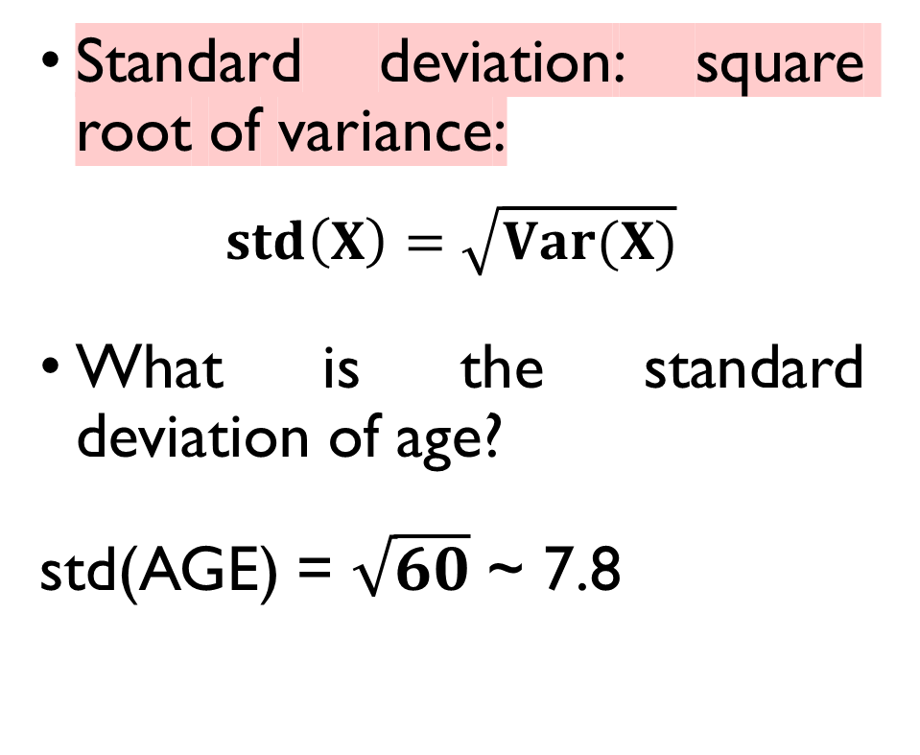
SAMPLE VARIANCE
 | NAME | SEX | AGE | POSITION | SALARY (in $1000)
1 | Ann | F | 30 | Manager | 3
2 | Bob | M | 30 | Manager | 4
3 | Kate | F | 20 | Secretary | 1
4 | Nick | M | 45 | CEO | 50
5 | John | M | 25 | HR | 2
6 | Alice | F | 30 | Manager | 3
7 | Joe | M | 25 | Manager | 4
8 | Dan | M | 40 | PR | 1
9 | Laura | F | 35 | HR | 2
10 | Jack | M | 20 | PR | 1
Standard deviation: square root of variance:
$$std\left(X\right)=\sqrt{Var(X)}$$
What is the standard deviation of age?
std(AGE) = $\sqrt{60}$ ~ 7.8

Slide 68
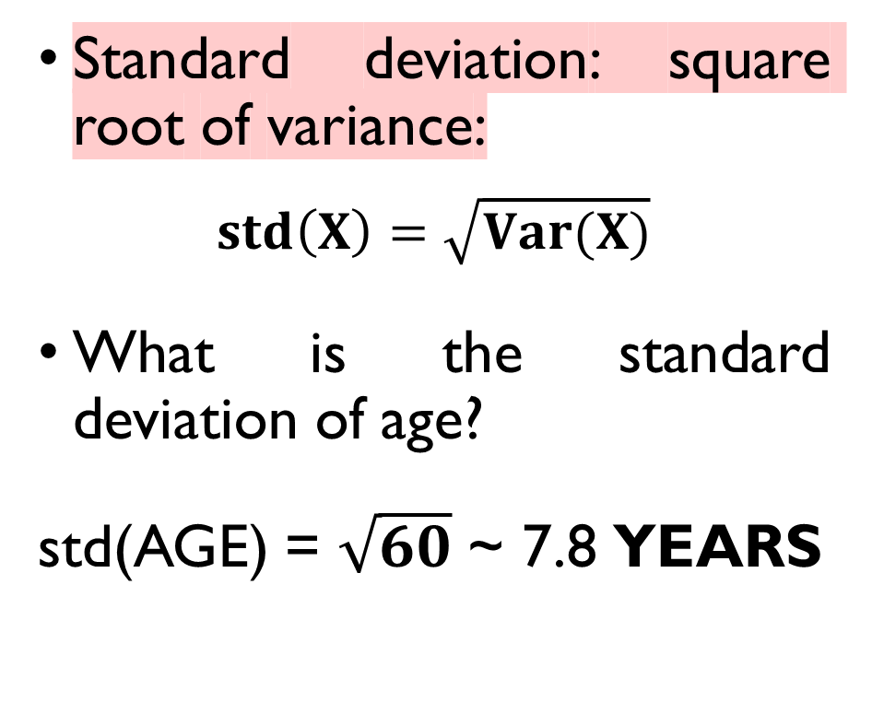
SAMPLE VARIANCE
EASY TO INTERPRET ☺
 | NAME | SEX | AGE | POSITION | SALARY (in $1000)
1 | Ann | F | 30 | Manager | 3
2 | Bob | M | 30 | Manager | 4
3 | Kate | F | 20 | Secretary | 1
4 | Nick | M | 45 | CEO | 50
5 | John | M | 25 | HR | 2
6 | Alice | F | 30 | Manager | 3
7 | Joe | M | 25 | Manager | 4
8 | Dan | M | 40 | PR | 1
9 | Laura | F | 35 | HR | 2
10 | Jack | M | 20 | PR | 1
Standard deviation: square root of variance:
$$std\left(X\right)=\sqrt{Var(X)}$$
What is the standard deviation of age?
std(AGE) = $\sqrt{60}$ ~ 7.8 YEARS

Slide 69
What positions are the most common there?
Measures of center: mode

Slide 70
MODE
 | NAME | SEX | AGE | POSITION | SALARY (in $1000)
1 | Ann | F | 30 | Manager | 3
2 | Bob | M | 30 | Manager | 4
3 | Kate | F | 20 | Secretary | 1
4 | Nick | M | 45 | CEO | 50
5 | John | M | 25 | HR | 2
6 | Alice | F | 30 | Manager | 3
7 | Joe | M | 25 | Manager | 4
8 | Dan | M | 40 | PR | 1
9 | Laura | F | 35 | HR | 2
10 | Jack | M | 20 | PR | 1
Mode: the most common value of a variable.
What’s the mode of POSITION?
‘Manager’
What’s the mode of SEX?
30
7.2

Slide 71
MODE
 | NAME | SEX | AGE | POSITION | SALARY (in $1000)
1 | Ann | F | 30 | Manager | 3
2 | Bob | M | 30 | Manager | 4
3 | Kate | F | 20 | Secretary | 1
4 | Nick | M | 45 | CEO | 50
5 | John | M | 25 | HR | 2
6 | Alice | F | 30 | Manager | 3
7 | Joe | M | 25 | Manager | 4
8 | Dan | M | 40 | PR | 1
9 | Laura | F | 35 | HR | 2
10 | Jack | M | 20 | PR | 1
Mode: the most common value of a variable.
What’s the mode of POSITION?
‘Manager’
What’s the mode of SEX?
30
7.2

Slide 72
MODE
 | NAME | SEX | AGE | POSITION | SALARY (in $1000)
1 | Ann | F | 30 | Manager | 3
2 | Bob | M | 30 | Manager | 4
3 | Kate | F | 20 | Secretary | 1
4 | Nick | M | 45 | CEO | 50
5 | John | M | 25 | HR | 2
6 | Alice | F | 30 | Manager | 3
7 | Joe | M | 25 | Manager | 4
8 | Dan | M | 40 | PR | 1
9 | Laura | F | 35 | HR | 2
10 | Jack | M | 20 | PR | 1
Mode: the most common value of a variable.
What’s the mode of POSITION?
‘Manager’
What’s the mode of SEX?
30
7.2

Slide 73
MODE
 | NAME | SEX | AGE | POSITION | SALARY (in $1000)
1 | Ann | F | 30 | Manager | 3
2 | Bob | M | 30 | Manager | 4
3 | Kate | F | 20 | Secretary | 1
4 | Nick | M | 45 | CEO | 50
5 | John | M | 25 | HR | 2
6 | Alice | F | 30 | Manager | 3
7 | Joe | M | 25 | Manager | 4
8 | Dan | M | 40 | PR | 1
9 | Laura | F | 35 | HR | 2
10 | Jack | M | 20 | PR | 1
Mode: the most common value of a variable.
What’s the mode of POSITION?
‘Manager’
What’s the mode of SEX?
‘M’
30
7.2

Slide 74
Are men and women equally represented at each position?
Contingency tables

Slide 75
CONTIGENCY TABLE
CATEGORICAL x CATEGORICAL
VARIABLE
 | NAME | SEX | AGE | POSITION | SALARY (in $1000)
1 | Ann | F | 30 | Manager | 3
2 | Bob | M | 30 | Manager | 4
3 | Kate | F | 20 | Secretary | 1
4 | Nick | M | 45 | CEO | 50
5 | John | M | 25 | HR | 2
6 | Alice | F | 30 | Manager | 3
7 | Joe | M | 25 | Manager | 4
8 | Dan | M | 40 | PR | 1
9 | Laura | F | 35 | HR | 2
10 | Jack | M | 20 | PR | 1
Position / Sex | M | F | TOTAL
CEO | 1 | 0 | 1
Manager | 2 | 2 | 4
HR
PR
Secretary
TOTAL

Slide 76
CONTIGENCY TABLE
CATEGORICAL x CATEGORICAL
VARIABLE
 | NAME | SEX | AGE | POSITION | SALARY (in $1000)
1 | Ann | F | 30 | Manager | 3
2 | Bob | M | 30 | Manager | 4
3 | Kate | F | 20 | Secretary | 1
4 | Nick | M | 45 | CEO | 50
5 | John | M | 25 | HR | 2
6 | Alice | F | 30 | Manager | 3
7 | Joe | M | 25 | Manager | 4
8 | Dan | M | 40 | PR | 1
9 | Laura | F | 35 | HR | 2
10 | Jack | M | 20 | PR | 1
Position / Sex | M | F | TOTAL
CEO | 1 | 0 | 1
Manager | 2 | 2 | 4
HR | 1 | 1 | 2
PR
Secretary
TOTAL

Slide 77
CONTIGENCY TABLE
CATEGORICAL x CATEGORICAL
VARIABLE
 | NAME | SEX | AGE | POSITION | SALARY (in $1000)
1 | Ann | F | 30 | Manager | 3
2 | Bob | M | 30 | Manager | 4
3 | Kate | F | 20 | Secretary | 1
4 | Nick | M | 45 | CEO | 50
5 | John | M | 25 | HR | 2
6 | Alice | F | 30 | Manager | 3
7 | Joe | M | 25 | Manager | 4
8 | Dan | M | 40 | PR | 1
9 | Laura | F | 35 | HR | 2
10 | Jack | M | 20 | PR | 1
Position / Sex | M | F | TOTAL
CEO | 1 | 0 | 1
Manager | 2 | 2 | 4
HR | 1 | 1 | 2
PR | 2 | 0 | 2
Secretary
TOTAL

Slide 78
CONTIGENCY TABLE
CATEGORICAL x CATEGORICAL
VARIABLE
 | NAME | SEX | AGE | POSITION | SALARY (in $1000)
1 | Ann | F | 30 | Manager | 3
2 | Bob | M | 30 | Manager | 4
3 | Kate | F | 20 | Secretary | 1
4 | Nick | M | 45 | CEO | 50
5 | John | M | 25 | HR | 2
6 | Alice | F | 30 | Manager | 3
7 | Joe | M | 25 | Manager | 4
8 | Dan | M | 40 | PR | 1
9 | Laura | F | 35 | HR | 2
10 | Jack | M | 20 | PR | 1
Position / Sex | M | F | TOTAL
CEO | 1 | 0 | 1
Manager | 2 | 2 | 4
HR | 1 | 1 | 2
PR | 2 | 0 | 2
Secretary | 0 | 1 | 1
TOTAL

Slide 79
CONTIGENCY TABLE
CATEGORICAL x CATEGORICAL
VARIABLE
 | NAME | SEX | AGE | POSITION | SALARY (in $1000)
1 | Ann | F | 30 | Manager | 3
2 | Bob | M | 30 | Manager | 4
3 | Kate | F | 20 | Secretary | 1
4 | Nick | M | 45 | CEO | 50
5 | John | M | 25 | HR | 2
6 | Alice | F | 30 | Manager | 3
7 | Joe | M | 25 | Manager | 4
8 | Dan | M | 40 | PR | 1
9 | Laura | F | 35 | HR | 2
10 | Jack | M | 20 | PR | 1
Position / Sex | M | F | TOTAL
CEO | 1 | 0 | 1
Manager | 2 | 2 | 4
HR | 1 | 1 | 2
PR | 2 | 0 | 2
Secretary | 0 | 1 | 1
TOTAL | 6 | 4 | 10

Slide 80
Are men and women paid equally?
Pivot tables

Slide 81
PIVOT TABLE
CATEGORICAL x NUMERIC
VARIABLE
 | NAME | SEX | AGE | POSITION | SALARY (in $1000)
1 | Ann | F | 30 | Manager | 3
2 | Bob | M | 30 | Manager | 4
3 | Kate | F | 20 | Secretary | 1
4 | Nick | M | 45 | CEO | 50
5 | John | M | 25 | HR | 2
6 | Alice | F | 30 | Manager | 3
7 | Joe | M | 25 | Manager | 4
8 | Dan | M | 40 | PR | 1
9 | Laura | F | 35 | HR | 2
10 | Jack | M | 20 | PR | 1
SEX x SALARY
Sex | Mean salary (in $1000)
F | (3 + 1 + 3 + 2)/4 = 2.25
M | (4 + 50 + 2 + 4 + 1 + 1)/6 = 10.3

Slide 82
PIVOT TABLE
CATEGORICAL x NUMERIC
VARIABLE
 | NAME | SEX | AGE | POSITION | SALARY (in $1000)
1 | Ann | F | 30 | Manager | 3
2 | Bob | M | 30 | Manager | 4
3 | Kate | F | 20 | Secretary | 1
4 | Nick | M | 45 | CEO | 50
5 | John | M | 25 | HR | 2
6 | Alice | F | 30 | Manager | 3
7 | Joe | M | 25 | Manager | 4
8 | Dan | M | 40 | PR | 1
9 | Laura | F | 35 | HR | 2
10 | Jack | M | 20 | PR | 1
SEX x SALARY
Sex | Mean salary (in $1000)
F | (3 + 1 + 3 + 2)/4 = 2.25
M | (4 + 50 + 2 + 4 + 1 + 1)/6 = 10.3

Slide 83
NOW, LET’S PRACTICE WITH SOME REAL DATA!
Summary statistics + basic plots in Python

Slide 84
TO SUM UP…
Two branches of Statistics.
Data types
numerical vs categorical;
continuous vs discrete.
Descriptive Statistics
summary statistics;
tables;
plots.

Slide 85
TO SUM UP…
Two branches of Statistics.
Data types
numerical vs categorical;
continuous vs discrete.
Descriptive Statistics
summary statistics;
tables;
plots.
Please complete the ENTRY TEST!
Assignment 1 is online
20 points
Deadline: Thursday 23:59.

