Slide 1
INTRODUCTION TO STATISTICS
LECTURE 12

Slide 2
LAST TIME
Hypothesis testing
P-values
Overview of some statistical tests
One-sample tests
t-test
One sample t-test
Two-sample tests
Two sample t-test
Welch’s test
Pair samples t-test

Slide 3
TODAY
Wrap-up hypothesis testing
Non-parametric tests: an overview
Practice
Two random variables
Covariance
Correlation

Slide 4
QUICK QUIZ

Slide 5
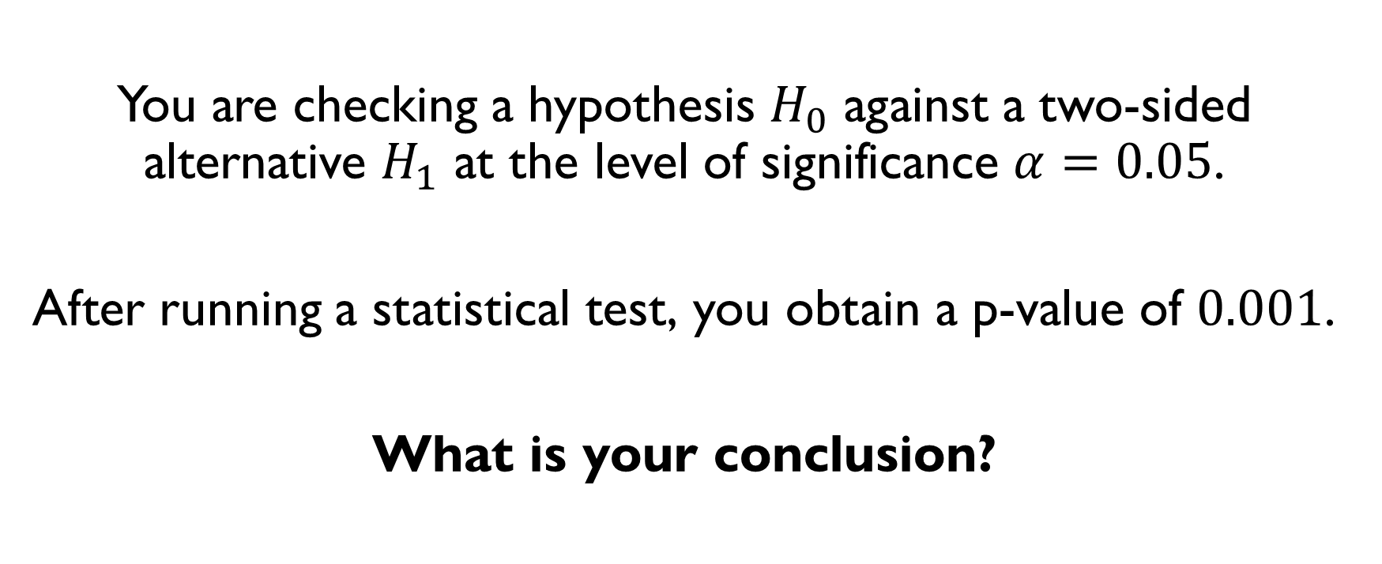
You are checking a hypothesis $H_{0}$ against a two-sided alternative $H_{1}$ at the level of significance $α=0.05$.
After running a statistical test, you obtain a p-value of $0.001$.
What is your conclusion?

Slide 6
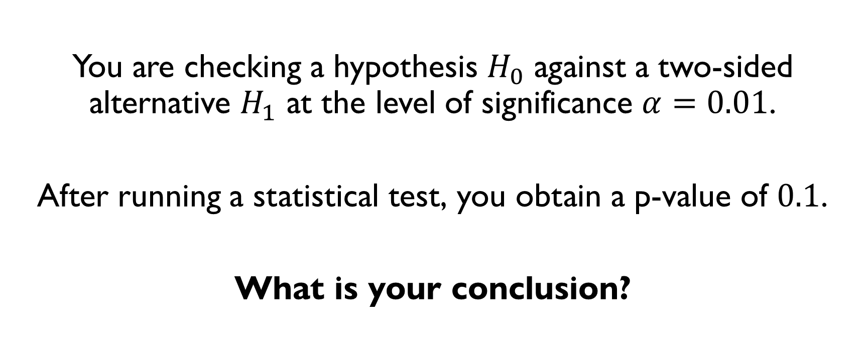
You are checking a hypothesis $H_{0}$ against a two-sided alternative $H_{1}$ at the level of significance $α=0.01$.
After running a statistical test, you obtain a p-value of $0.1$.
What is your conclusion?

Slide 7
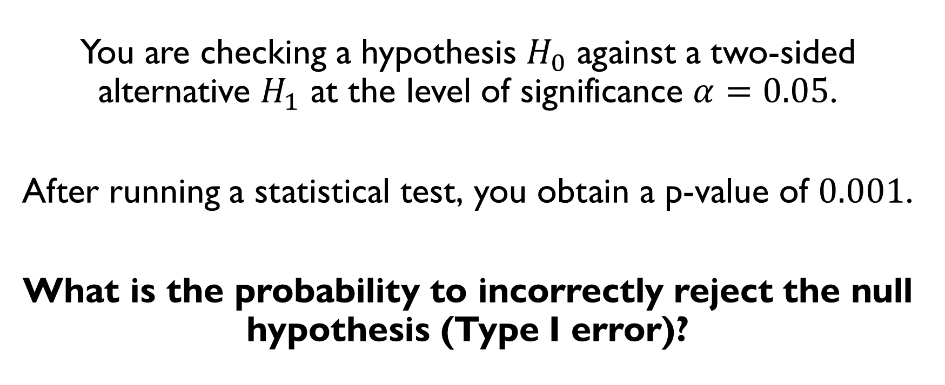
You are checking a hypothesis $H_{0}$ against a two-sided alternative $H_{1}$ at the level of significance $α=0.05$.
After running a statistical test, you obtain a p-value of $0.001$.
What is the probability to incorrectly reject the null hypothesis (Type I error)?

Slide 8
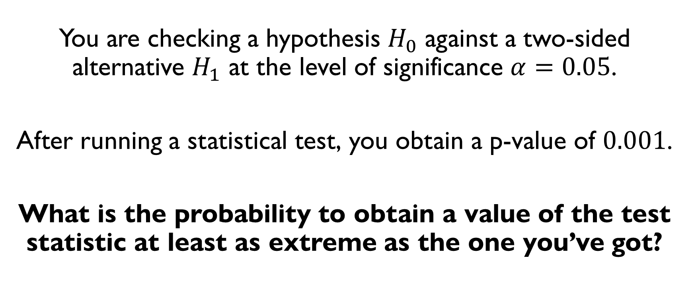
You are checking a hypothesis $H_{0}$ against a two-sided alternative $H_{1}$ at the level of significance $α=0.05$.
After running a statistical test, you obtain a p-value of $0.001$.
What is the probability to obtain a value of the test statistic at least as extreme as the one you’ve got?

Slide 9
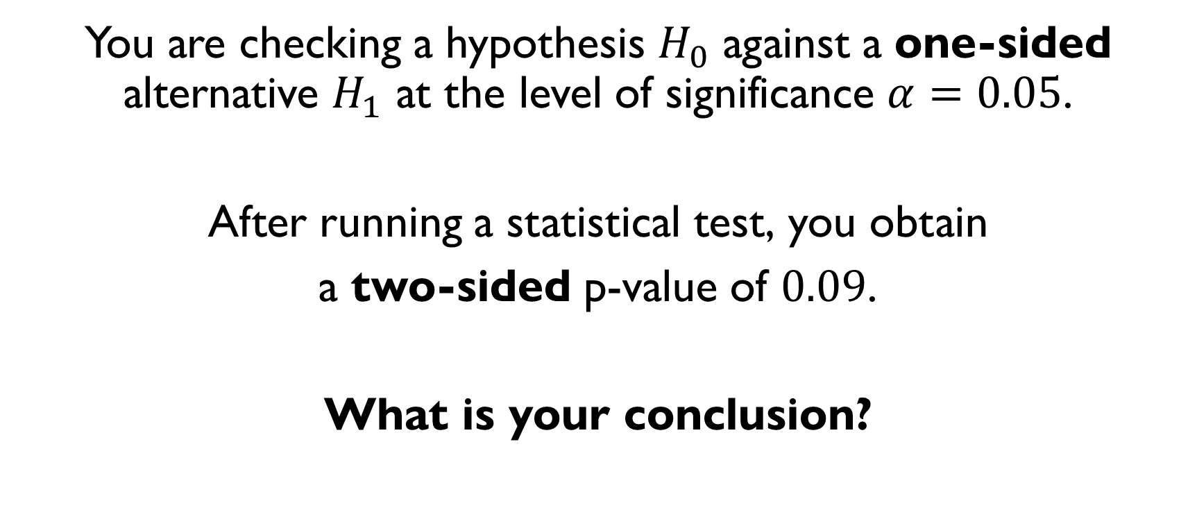
You are checking a hypothesis $H_{0}$ against a one-sided alternative $H_{1}$ at the level of significance $α=0.05$.
After running a statistical test, you obtain
a two-sided p-value of $0.09$.
What is your conclusion?

Slide 10

ONCE AGAIN ABOUT ONE- AND TWO-SIDED TESTS
Example: one-sample test for population mean $μ$
$$H_{0}: μ=μ_{0}$$
Two-sided alternative:
$$H_{1}:μ≠μ_{0}$$
One-sided alternatives:
$$H_{1}:μ<μ_{0} { H}_{1}:μ>μ_{0}$$
Pay attention: the null hypothesis is still just $μ=μ_{0}$.
Never use a one-sided alternative unless absolutely sure that the opposite of it isn’t possible.

Slide 11

ONCE AGAIN ABOUT ONE- AND TWO-SIDED TESTS
Example: one-sample test for population mean $μ$
$$H_{0}: μ=μ_{0}$$
Two-sided alternative:
$$H_{1}:μ≠μ_{0}$$
One-sided alternatives:
$$H_{1}:μ<μ_{0} { H}_{1}:μ>μ_{0}$$
Pay attention: the null hypothesis is still just $μ=μ_{0}$.
Never use a one-sided alternative unless absolutely sure that the opposite of it isn’t possible.

Slide 12

ONCE AGAIN ABOUT ONE- AND TWO-SIDED TESTS
Example: one-sample test for population mean $μ$
$$H_{0}: μ=μ_{0}$$
Two-sided alternative:
$$H_{1}:μ≠μ_{0}$$
One-sided alternatives:
$$H_{1}:μ<μ_{0} { H}_{1}:μ>μ_{0}$$
Pay attention: the null hypothesis is still just $μ=μ_{0}$.
Never use a one-sided alternative unless absolutely sure that the opposite of it isn’t possible.

Slide 13
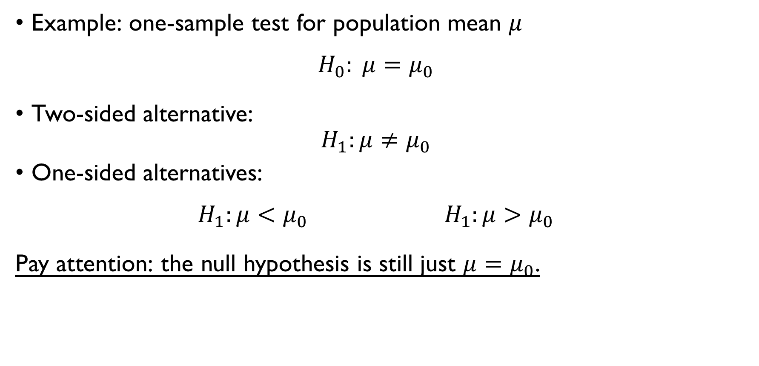
ONCE AGAIN ABOUT ONE- AND TWO-SIDED TESTS
Example: one-sample test for population mean $μ$
$$H_{0}: μ=μ_{0}$$
Two-sided alternative:
$$H_{1}:μ≠μ_{0}$$
One-sided alternatives:
$$H_{1}:μ<μ_{0} { H}_{1}:μ>μ_{0}$$
Pay attention: the null hypothesis is still just $μ=μ_{0}$.
Never use a one-sided alternative unless absolutely sure that the opposite of it isn’t possible.

Slide 14
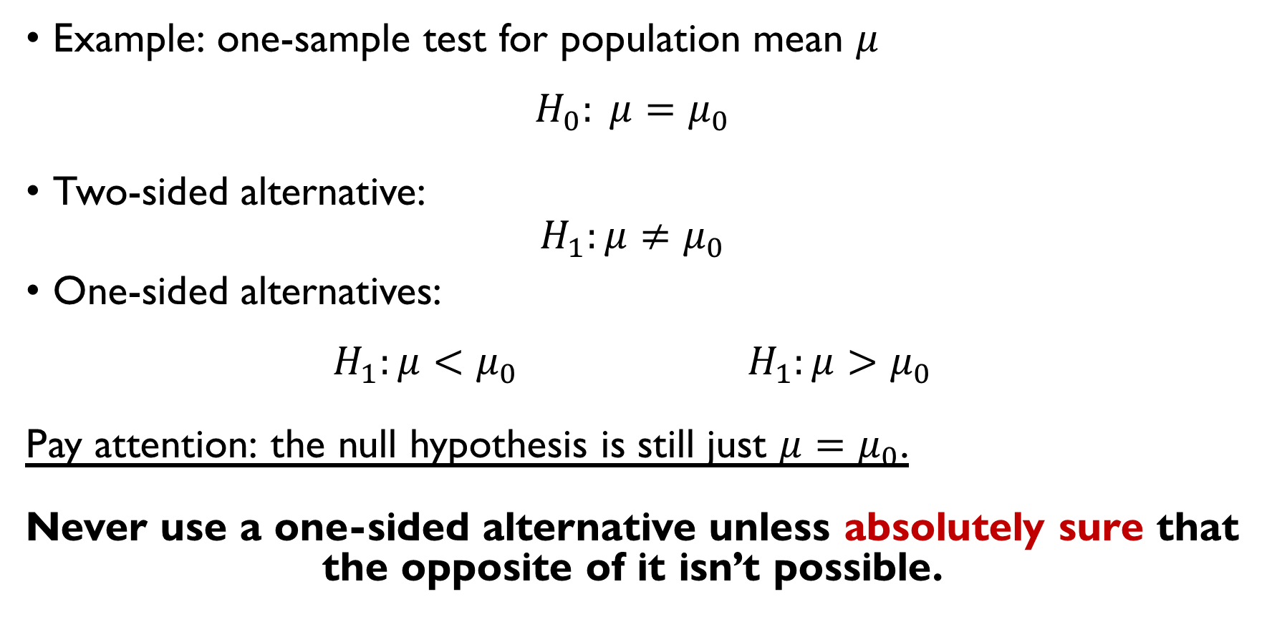
ONCE AGAIN ABOUT ONE- AND TWO-SIDED TESTS
Example: one-sample test for population mean $μ$
$$H_{0}: μ=μ_{0}$$
Two-sided alternative:
$$H_{1}:μ≠μ_{0}$$
One-sided alternatives:
$$H_{1}:μ<μ_{0} { H}_{1}:μ>μ_{0}$$
Pay attention: the null hypothesis is still just $μ=μ_{0}$.
Never use a one-sided alternative unless absolutely sure that the opposite of it isn’t possible.

Slide 15
NON-PARAMETRIC TESTS

Slide 16

NON-PARAMETRIC TESTS
Up till now: parametric models
Example: mean $μ$ and variance $σ^{2}$
Non-parametric statistics doesn’t rely on data belonging to any parametric family of probability distributions:
distribution-free or
having a specified distribution but with the distribution's parameters unspecified.

Slide 17
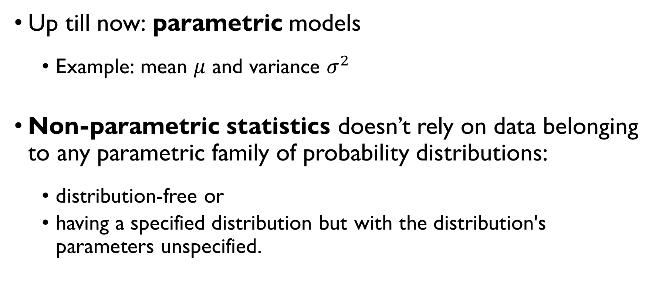
NON-PARAMETRIC TESTS
Up till now: parametric models
Example: mean $μ$ and variance $σ^{2}$
Non-parametric statistics doesn’t rely on data belonging to any parametric family of probability distributions:
distribution-free or
having a specified distribution but with the distribution's parameters unspecified.

Slide 18
NON-PARAMETRIC TESTS
PARAMETRIC HYPOTHESES
NON-PARAMETRIC HYPOTHESES
Data comes from the normal distribution with specified mean and variance.
Data comes from the normal distribution with specified mean and unspecified variance.
Data comes from a normal distribution form with both mean and variance unspecified.
Two unspecified continuous distributions are identical.

Slide 19
NON-PARAMETRIC TESTS
PARAMETRIC HYPOTHESES
NON-PARAMETRIC HYPOTHESES
Data comes from the normal distribution with specified mean and variance.
Data comes from the normal distribution with specified mean and unspecified variance.
Data comes from a normal distribution form with both mean and variance unspecified.
Two unspecified continuous distributions are identical.

Slide 20
MANN-WHITNEY U TEST
An alternative to the two-sample t-test when the distribution of the data cannot be assumed to be normal

Slide 21

MANN-WHITNEY U TEST
Two independent i.i.d. sets of data:
$$X_{1},X_{2},…,X_{n}$$
$$Y_{1},Y_{2},…,Y_{m}$$
Null hypothesis:
$H_{0}:$ For randomly selected values X and Y from two populations,
$$P\left(X>Y\right)=P\left(X<Y\right)$$
Alternatives
Two-sided: $P\left(X>Y\right)≠P\left(X<Y\right)$
One-sided: $P\left(X>Y\right)>P\left(X<Y\right), P\left(X>Y\right)<P\left(X<Y\right)$

Slide 22

MANN-WHITNEY U TEST
Two independent i.i.d. sets of data:
$$X_{1},X_{2},…,X_{n}$$
$$Y_{1},Y_{2},…,Y_{m}$$
Null hypothesis:
$H_{0}:$ For randomly selected values X and Y from two populations,
$$P\left(X>Y\right)=P\left(X<Y\right)$$
Alternatives
Two-sided: $P\left(X>Y\right)≠P\left(X<Y\right)$
One-sided: $P\left(X>Y\right)>P\left(X<Y\right), P\left(X>Y\right)<P\left(X<Y\right)$

Slide 23
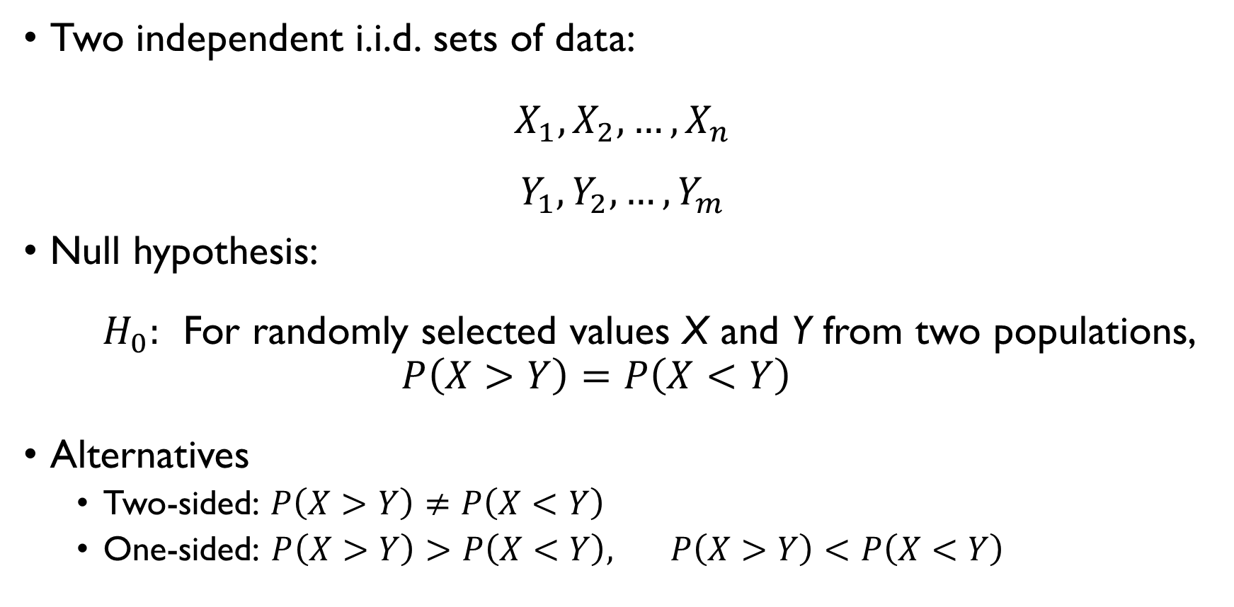
MANN-WHITNEY U TEST
Two independent i.i.d. sets of data:
$$X_{1},X_{2},…,X_{n}$$
$$Y_{1},Y_{2},…,Y_{m}$$
Null hypothesis:
$H_{0}:$ For randomly selected values X and Y from two populations,
$$P\left(X>Y\right)=P\left(X<Y\right)$$
Alternatives
Two-sided: $P\left(X>Y\right)≠P\left(X<Y\right)$
One-sided: $P\left(X>Y\right)>P\left(X<Y\right), P\left(X>Y\right)<P\left(X<Y\right)$

Slide 24

MANN-WHITNEY U TEST
Test statistic:
$$U=\sum_{i=1}^{n}{\sum_{j=1}^{m}{S\left(X_{i}, Y_{j}\right)}}$$
where $S\left(X,Y\right)=\left\{\begin{aligned}1, Y<X \\ 1/2, Y=X \\ 0, Y>X\end{aligned}\right.$
Null distribution:
For small $n$, tabulated
For large $n, \left(n≥30\right) U \sim normal$

Slide 25
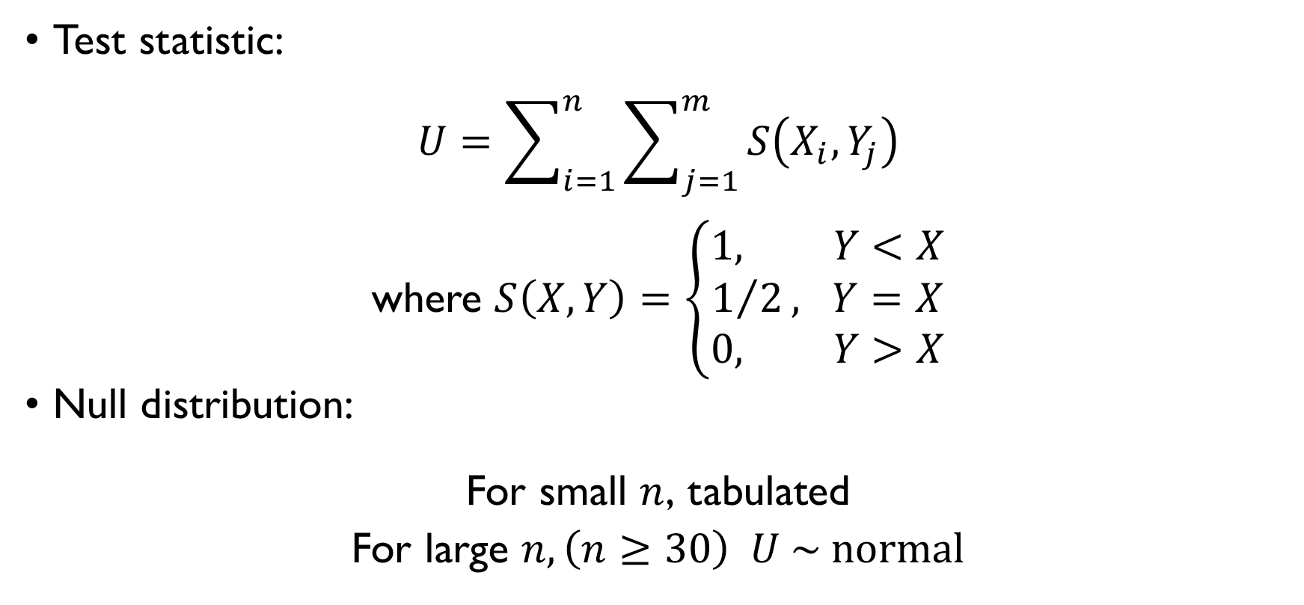
MANN-WHITNEY U TEST
Test statistic:
$$U=\sum_{i=1}^{n}{\sum_{j=1}^{m}{S\left(X_{i}, Y_{j}\right)}}$$
where $S\left(X,Y\right)=\left\{\begin{aligned}1, Y<X \\ 1/2, Y=X \\ 0, Y>X\end{aligned}\right.$
Null distribution:
For small $n$, tabulated
For large $n, \left(n≥30\right) U \sim normal$

Slide 26
WILCOXON SIGNED RANK TEST
An alternative to the paired t-test when the distribution of the differences cannot be assumed to be normal

Slide 27

WILCOXON SIGNED RANK TEST
Two paired i.i.d. sets of data:
$$X_{1},X_{2},…,X_{n}$$
$$Y_{1},Y_{2},…,Y_{m}$$
Null hypothesis:
$H_{0}:$ difference between the pairs follows a symmetric distribution around zero
Alternatives
Two-sided: difference between the pairs doesn’t follow a symmetric distribution around zero
One-sided: distribution is skewed to one particular side

Slide 28

WILCOXON SIGNED RANK TEST
Two paired i.i.d. sets of data:
$$X_{1},X_{2},…,X_{n}$$
$$Y_{1},Y_{2},…,Y_{m}$$
Null hypothesis:
$H_{0}:$ difference between the pairs follows a symmetric distribution around zero
Alternatives
Two-sided: difference between the pairs doesn’t follow a symmetric distribution around zero
One-sided: distribution is skewed to one particular side

Slide 29
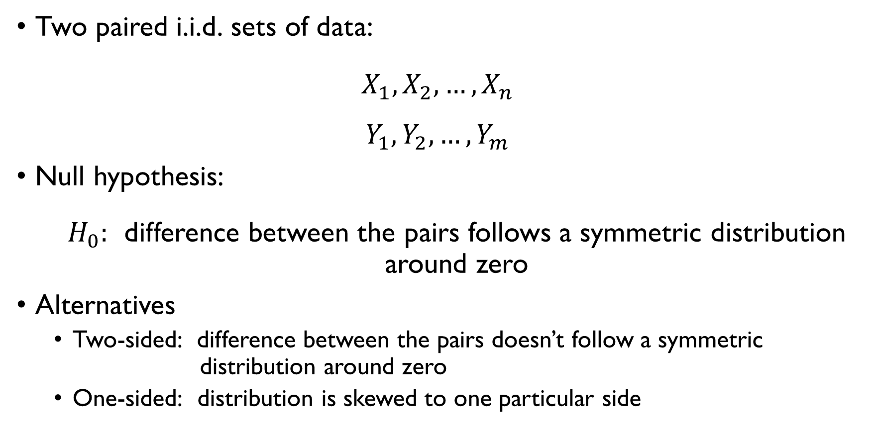
WILCOXON SIGNED RANK TEST
Two paired i.i.d. sets of data:
$$X_{1},X_{2},…,X_{n}$$
$$Y_{1},Y_{2},…,Y_{m}$$
Null hypothesis:
$H_{0}:$ difference between the pairs follows a symmetric distribution around zero
Alternatives
Two-sided: difference between the pairs doesn’t follow a symmetric distribution around zero
One-sided: distribution is skewed to one particular side

Slide 30

WILCOXON SIGNED RANK TEST
Test statistic:
Compute $\left|X_{i}−Y_{i}\right|$and $\operatorname{sgn}\left(X_{i}−Y_{i}\right)$
Exclude pairs $\left(X_{i},Y_{i}\right)$ where$\left|X_{i}−Y_{i}\right|=0$
Rank the remaining pairs from smallest to largest $\left|X_{i}−Y_{i}\right|→R_{i}$
$$W=\sum_{i=1}^{n}{R_{i}\operatorname{sgn}\left(X_{i}−Y_{i}\right)}$$
Null distributions:
some specific tabulated distribution.

Slide 31

WILCOXON SIGNED RANK TEST
Test statistic:
Compute $\left|X_{i}−Y_{i}\right|$and $\operatorname{sgn}\left(X_{i}−Y_{i}\right)$
Exclude pairs $\left(X_{i},Y_{i}\right)$ where$\left|X_{i}−Y_{i}\right|=0$
Rank the remaining pairs from smallest to largest $\left|X_{i}−Y_{i}\right|→R_{i}$
$$W=\sum_{i=1}^{n}{R_{i}\operatorname{sgn}\left(X_{i}−Y_{i}\right)}$$
Null distributions:
some specific tabulated distribution.

Slide 32

WILCOXON SIGNED RANK TEST
Test statistic:
Compute $\left|X_{i}−Y_{i}\right|$and $\operatorname{sgn}\left(X_{i}−Y_{i}\right)$
Exclude pairs $\left(X_{i},Y_{i}\right)$ where$\left|X_{i}−Y_{i}\right|=0$
Rank the remaining pairs from smallest to largest $\left|X_{i}−Y_{i}\right|→R_{i}$
$$W=\sum_{i=1}^{n}{R_{i}\operatorname{sgn}\left(X_{i}−Y_{i}\right)}$$
Null distributions:
some specific tabulated distribution.

Slide 33

WILCOXON SIGNED RANK TEST
Test statistic:
Compute $\left|X_{i}−Y_{i}\right|$and $\operatorname{sgn}\left(X_{i}−Y_{i}\right)$
Exclude pairs $\left(X_{i},Y_{i}\right)$ where$\left|X_{i}−Y_{i}\right|=0$
Rank the remaining pairs from smallest to largest $\left|X_{i}−Y_{i}\right|→R_{i}$
$$W=\sum_{i=1}^{n}{R_{i}\operatorname{sgn}\left(X_{i}−Y_{i}\right)}$$
Null distributions:
some specific tabulated distribution.

Slide 34
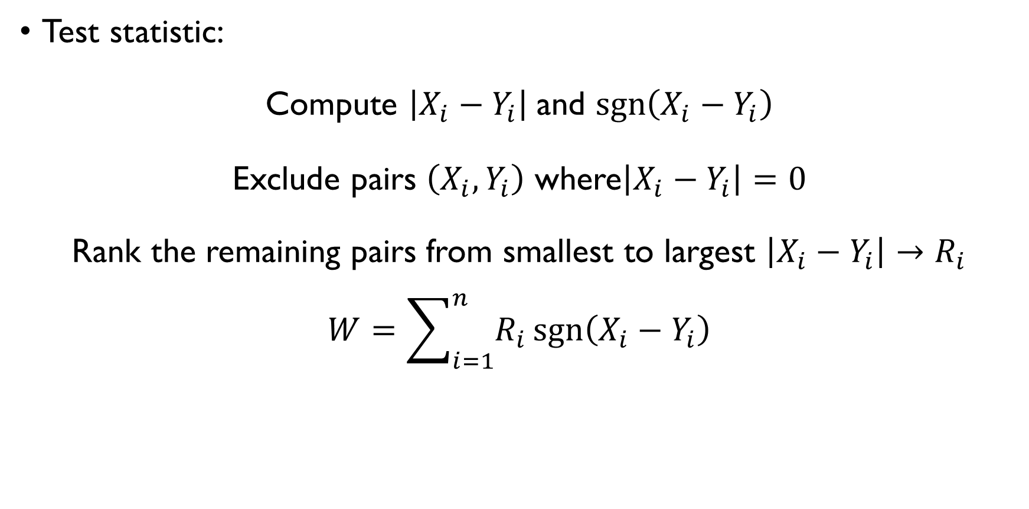
WILCOXON SIGNED RANK TEST
Test statistic:
Compute $\left|X_{i}−Y_{i}\right|$and $\operatorname{sgn}\left(X_{i}−Y_{i}\right)$
Exclude pairs $\left(X_{i},Y_{i}\right)$ where$\left|X_{i}−Y_{i}\right|=0$
Rank the remaining pairs from smallest to largest $\left|X_{i}−Y_{i}\right|→R_{i}$
$$W=\sum_{i=1}^{n}{R_{i}\operatorname{sgn}\left(X_{i}−Y_{i}\right)}$$
Null distributions:
some specific tabulated distribution.

Slide 35
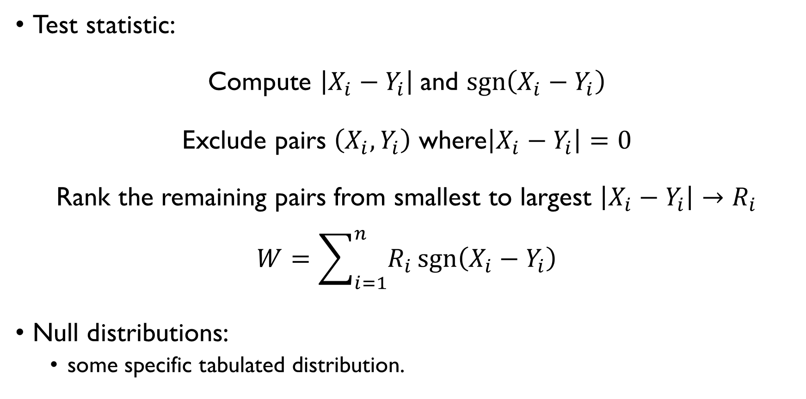
WILCOXON SIGNED RANK TEST
Test statistic:
Compute $\left|X_{i}−Y_{i}\right|$and $\operatorname{sgn}\left(X_{i}−Y_{i}\right)$
Exclude pairs $\left(X_{i},Y_{i}\right)$ where$\left|X_{i}−Y_{i}\right|=0$
Rank the remaining pairs from smallest to largest $\left|X_{i}−Y_{i}\right|→R_{i}$
$$W=\sum_{i=1}^{n}{R_{i}\operatorname{sgn}\left(X_{i}−Y_{i}\right)}$$
Null distributions:
some specific tabulated distribution.

Slide 36

$χ^{2}$-TEST
Independence of two categorical variables based on contingency table

Slide 37
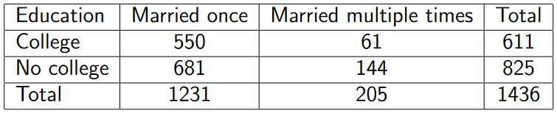
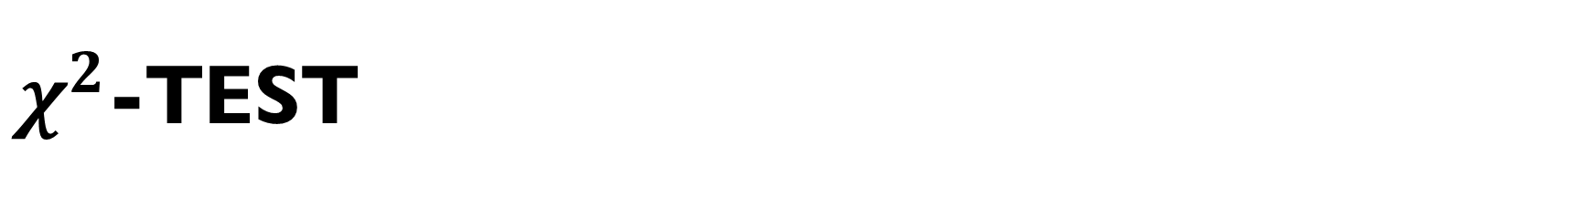
$χ^{2}$-TEST
Motivating example: consider the following contingency table:
Are education levels and number of marriages (one / many) independent?

Slide 38
$χ^{2}$-TEST
Motivating example: consider the following contingency table:
Are education levels and number of marriages (one / many) independent?

Slide 39
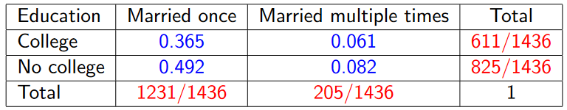
$χ^{2}$-TEST
Are education levels and number of marriages (one / many) independent?
If so, cell probabilities are the product of the marginal ones:

Slide 40
$χ^{2}$-TEST
Are education levels and number of marriages (one / many) independent?
If so, cell probabilities are the product of the marginal ones:

Slide 41
$χ^{2}$-TEST
Are education levels and number of marriages (one / many) independent?
If so, cell probabilities are the product of the marginal ones:

Slide 42
$χ^{2}$-TEST
Are education levels and number of marriages (one / many) independent?
If so, cell probabilities are the product of the marginal ones:

Slide 43
$χ^{2}$-TEST
Are education levels and number of marriages (one / many) independent?
If so, cell probabilities are the product of the marginal ones:

Slide 44
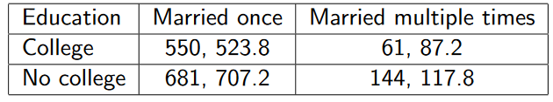
$χ^{2}$-TEST
From this, we can get expected counts (multiplying cell probabilities by the total number of women surveyed):

Slide 45
$χ^{2}$-TEST
From this, we can get expected counts (multiplying cell probabilities by the total number of women surveyed):

Slide 46
$χ^{2}$-TEST
From this, we can get expected counts (multiplying cell probabilities by the total number of women surveyed):

Slide 47
$χ^{2}$-TEST
From this, we can get expected counts (multiplying cell probabilities by the total number of women surveyed):

Slide 48

$χ^{2}$-TEST
Null hypothesis:
$H_{0}:$ cell probabilities are the product of the marginal ones, the difference, so the difference between them should be small
$H_{1}:$ the difference between observed and expected counts is large (!!! one-sided)

Slide 49
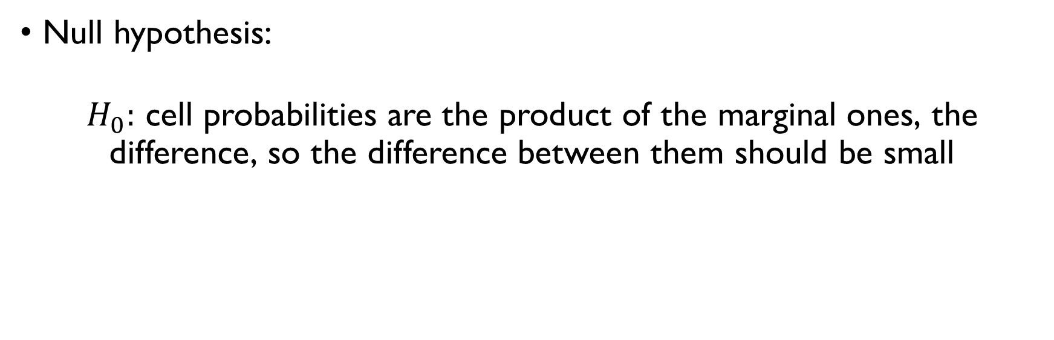
$χ^{2}$-TEST
Null hypothesis:
$H_{0}:$ cell probabilities are the product of the marginal ones, the difference, so the difference between them should be small
$H_{1}:$ the difference between observed and expected counts is large (!!! one-sided)

Slide 50
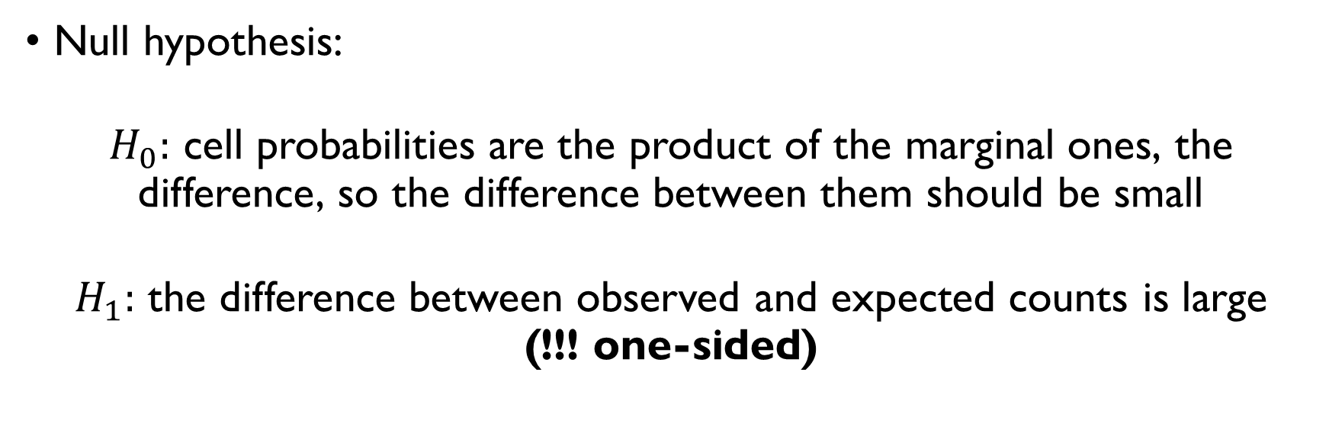
$χ^{2}$-TEST
Null hypothesis:
$H_{0}:$ cell probabilities are the product of the marginal ones, the difference, so the difference between them should be small
$H_{1}:$ the difference between observed and expected counts is large (!!! one-sided)

Slide 51
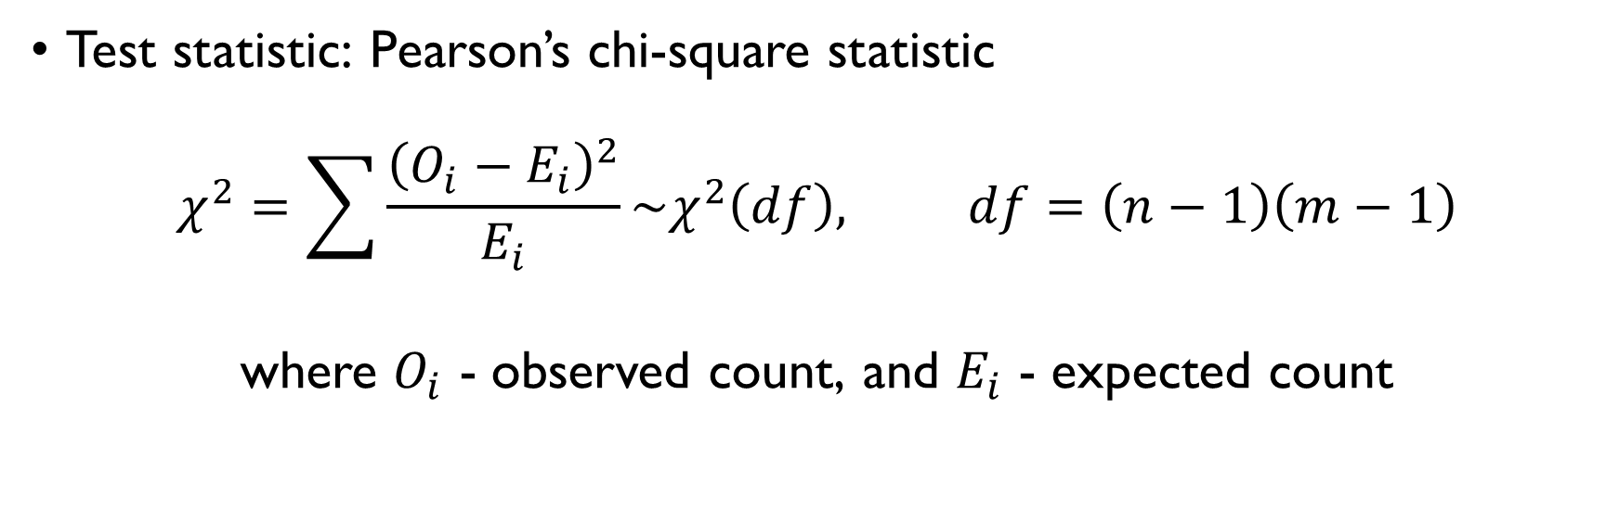
$χ^{2}$-TEST
Test statistic: Pearson’s chi-square statistic
$$χ^{2}=\sum{\frac{{\left(O_{i}−E_{i}\right)}^{2}}{E_{i}}}\sim χ^{2}\left(df\right), df=\left(n−1\right)\left(m−1\right)$$
where $O_{i}$ - observed count, and $E_{i}$ - expected count

Slide 52

$χ^{2}$-TEST
In this case
$χ^{2}=16.01$, $df =1$
$$χ_{1−α}^{2}\left(1\right)=χ_{0.95}^{2}\left(1\right)=7.879$$
$16.01>7.879⟹$ reject $H_{0}$

Slide 53

$χ^{2}$-TEST
In this case
$χ^{2}=16.01$, $df =1$
$$χ_{1−α}^{2}\left(1\right)=χ_{0.95}^{2}\left(1\right)=7.879$$
$16.01>7.879⟹$ reject $H_{0}$

Slide 54

$χ^{2}$-TEST
In this case
$χ^{2}=16.01$, $df =1$
$$χ_{1−α}^{2}\left(1\right)=χ_{0.95}^{2}\left(1\right)=7.879$$
$16.01>7.879⟹$ reject $H_{0}$

Slide 55
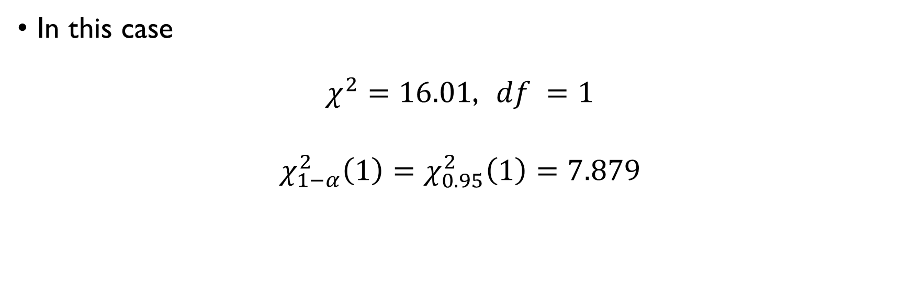
$χ^{2}$-TEST
In this case
$χ^{2}=16.01$, $df =1$
$$χ_{1−α}^{2}\left(1\right)=χ_{0.95}^{2}\left(1\right)=7.879$$
$16.01>7.879⟹$ reject $H_{0}$

Slide 56
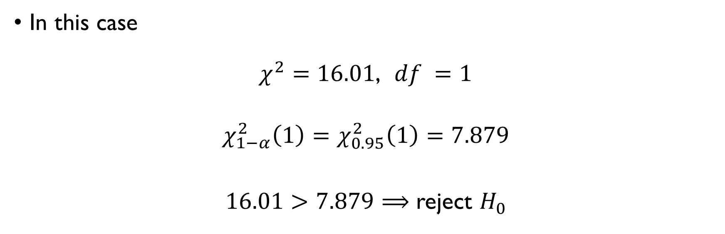
$χ^{2}$-TEST
In this case
$χ^{2}=16.01$, $df =1$
$$χ_{1−α}^{2}\left(1\right)=χ_{0.95}^{2}\left(1\right)=7.879$$
$16.01>7.879⟹$ reject $H_{0}$

Slide 57
NON-PARAMETRIC TESTS
Fewer assumptions, wider applicability.
This comes with the cost: when parametric tests are applicable, non-parametric ones have less power
a larger sample size can be required to draw conclusions with the same degree of confidence.

Slide 58
NON-PARAMETRIC TESTS
Fewer assumptions, wider applicability.
This comes with the cost: when parametric tests are applicable, non-parametric ones have less power
a larger sample size can be required to draw conclusions with the same degree of confidence.

Slide 59
PRACTICE!
Google Classroom -> Lecture 11 -> Two-sample tests

Slide 60
TWO RANDOM VARIABLES
Covariance and correlation

Slide 61

REMINDER: INDEPENDENCE
Random variables $X$ and $Y$ are independent if and only if
Discrete case:
$$P\left(X=x, Y=y\right)=P\left(X\right)P\left(Y\right)$$
Continuous case:
$$p_{xy}\left(x,y\right)=p_{x}\left(x\right)p_{y}\left(y\right)$$

Slide 62

REMINDER: INDEPENDENCE
Random variables $X$ and $Y$ are independent if and only if
Discrete case:
$$P\left(X=x, Y=y\right)=P\left(X\right)P\left(Y\right)$$
Continuous case:
$$p_{xy}\left(x,y\right)=p_{x}\left(x\right)p_{y}\left(y\right)$$

Slide 63
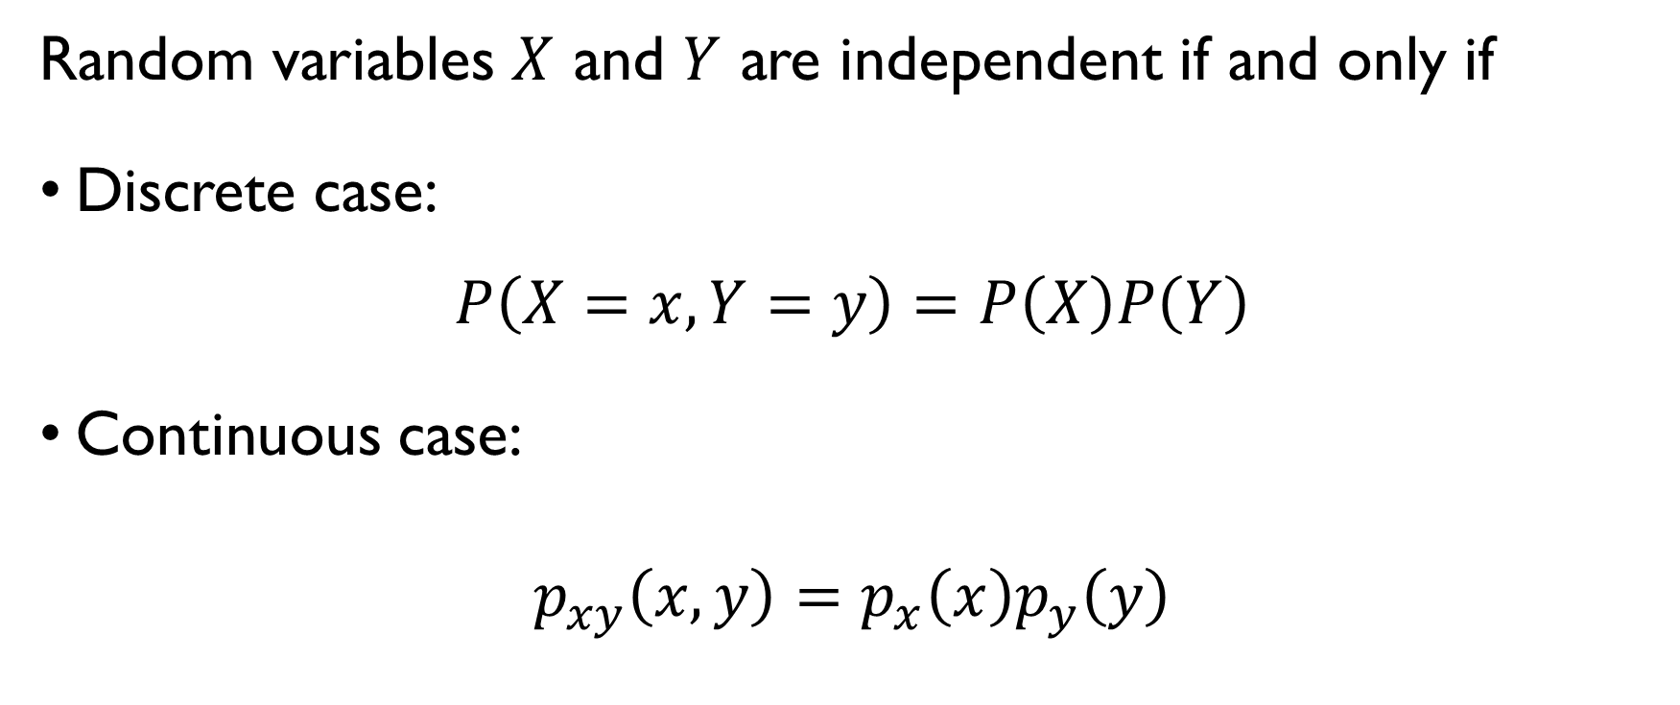
REMINDER: INDEPENDENCE
Random variables $X$ and $Y$ are independent if and only if
Discrete case:
$$P\left(X=x, Y=y\right)=P\left(X\right)P\left(Y\right)$$
Continuous case:
$$p_{xy}\left(x,y\right)=p_{x}\left(x\right)p_{y}\left(y\right)$$

Slide 64

REMINDER: INDEPENDENCE
If $X$ and $Y$ are independent, then
$$var\left(aX+bY\right)=a^{2}var\left(X\right)+b^{2}var\left(Y\right)$$
But what if $X$ and $Y$ are dependent?

Slide 65
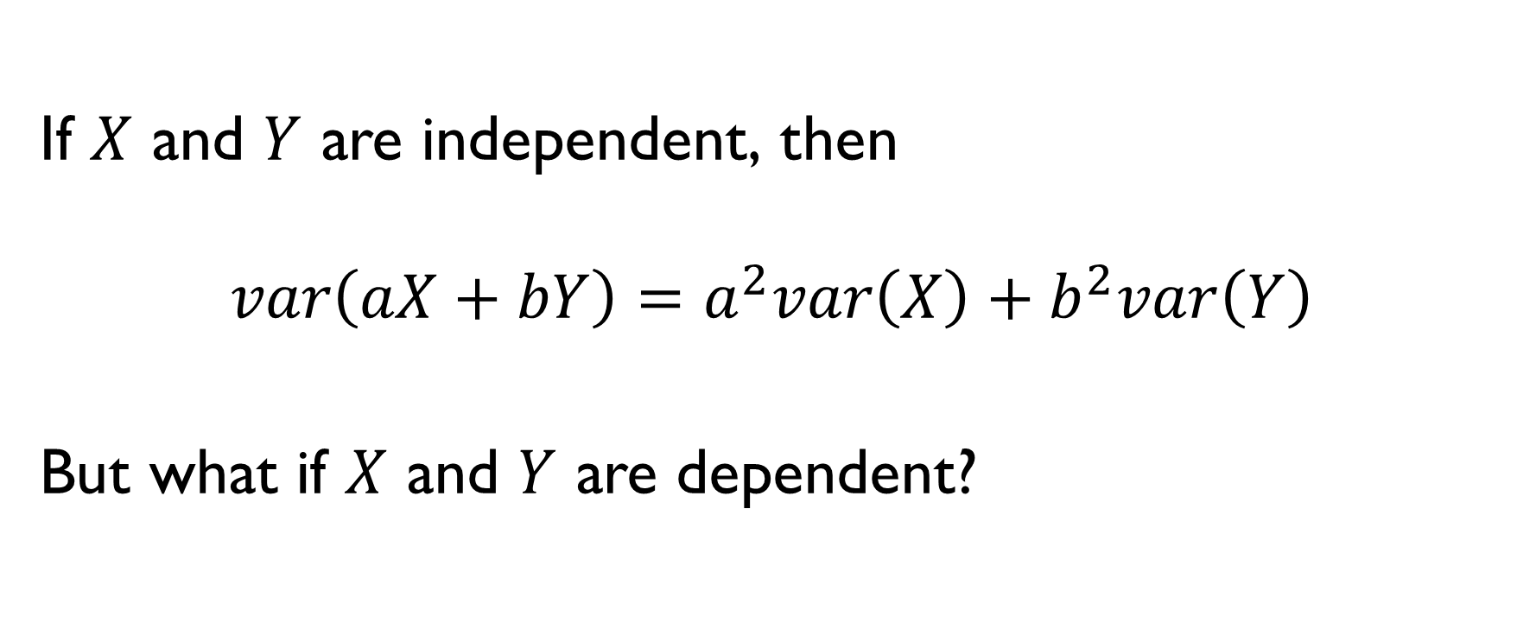
REMINDER: INDEPENDENCE
If $X$ and $Y$ are independent, then
$$var\left(aX+bY\right)=a^{2}var\left(X\right)+b^{2}var\left(Y\right)$$
But what if $X$ and $Y$ are dependent?

Slide 66

COVARIANCE
$$var\left(aX+bY\right)=a^{2}var\left(X\right)+b^{2}var\left(Y\right)−ab∙cov\left(X,Y\right)$$

Slide 67

COVARIANCE
Covariance $σ_{XY}^{2}$ is a measure of the joint variability of two random variables $X$ and $Y$:
$$σ_{XY}^{2}=E\left[\left(X−\overline{X}\right)\left(Y−\overline{Y}\right)\right]=E\left(XY\right)−\overline{X}\overline{Y}$$
Example:
Height and weight of a giraffe have a positive covariance: when one is large, the other also tends to be large.

Slide 68
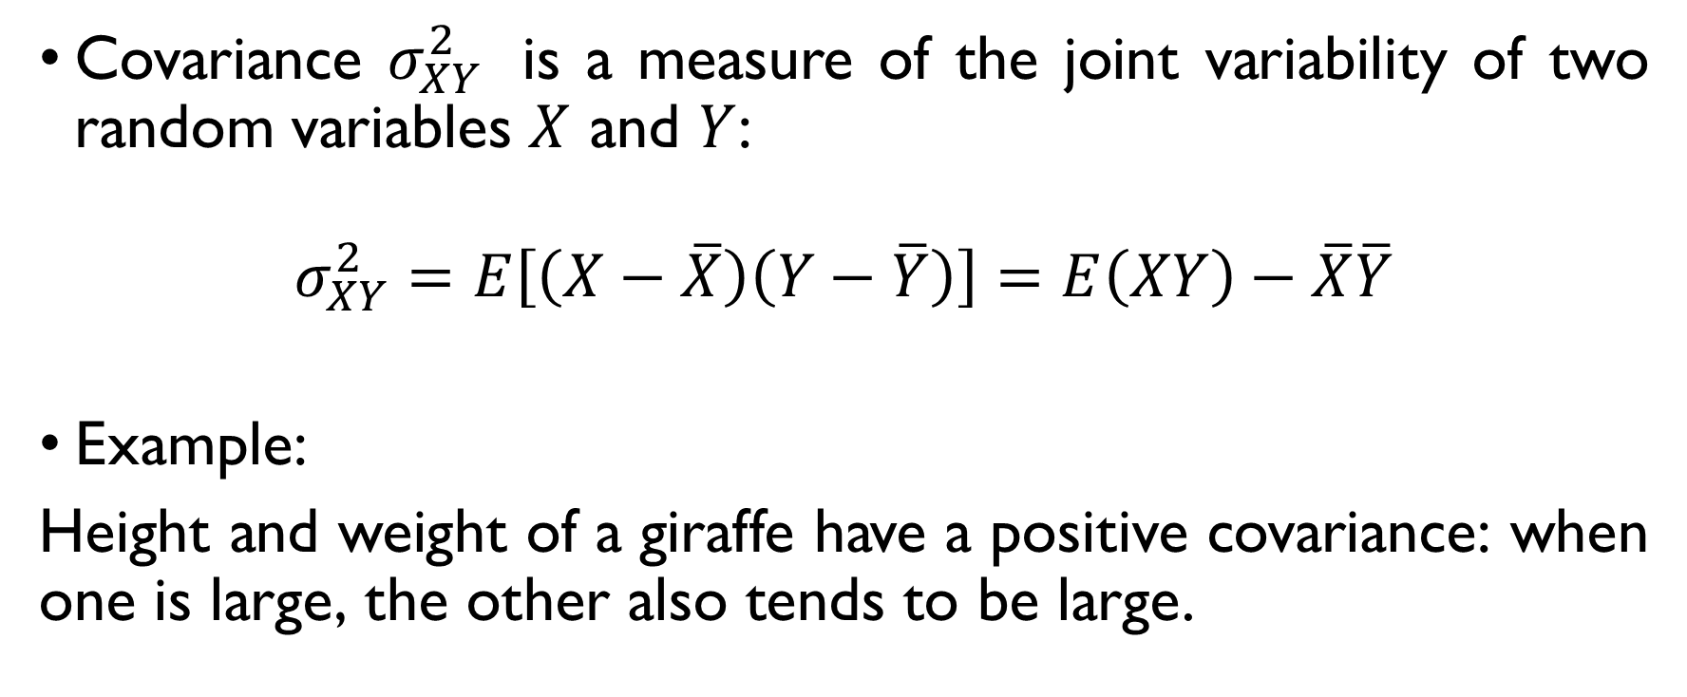
COVARIANCE
Covariance $σ_{XY}^{2}$ is a measure of the joint variability of two random variables $X$ and $Y$:
$$σ_{XY}^{2}=E\left[\left(X−\overline{X}\right)\left(Y−\overline{Y}\right)\right]=E\left(XY\right)−\overline{X}\overline{Y}$$
Example:
Height and weight of a giraffe have a positive covariance: when one is large, the other also tends to be large.

Slide 69
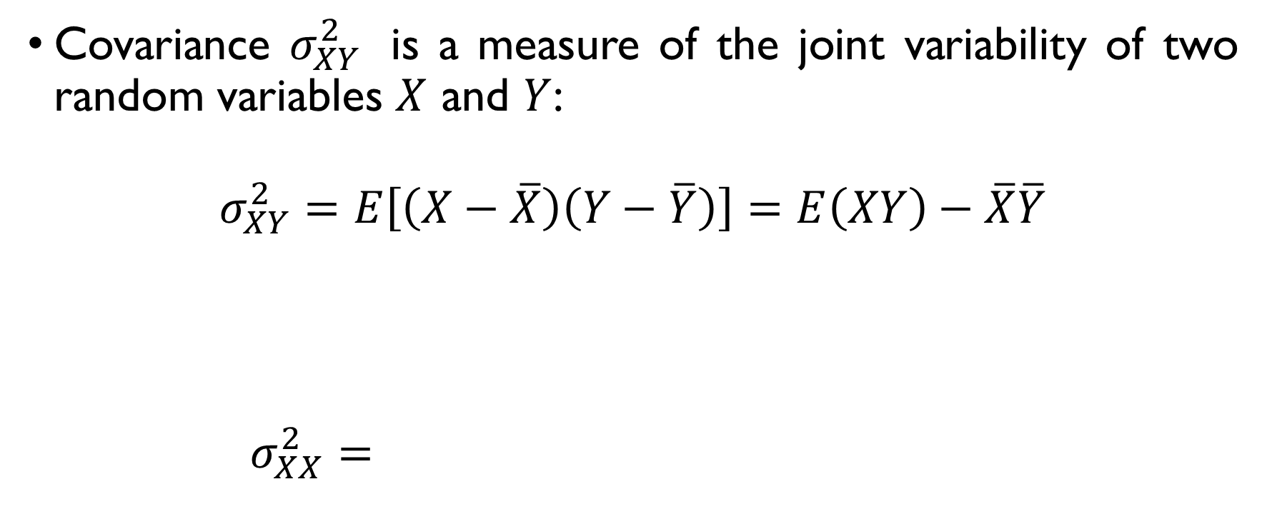
COVARIANCE
Covariance $σ_{XY}^{2}$ is a measure of the joint variability of two random variables $X$ and $Y$:
$$σ_{XY}^{2}=E\left[\left(X−\overline{X}\right)\left(Y−\overline{Y}\right)\right]=E\left(XY\right)−\overline{X}\overline{Y}$$
Note that covariance of a variable with itself is its variance:
$$σ_{XX}^{2}=E{\left(X−\overline{X}\right)}^{2}=E\left(X^{2}\right)−{\overline{X}}^{2}=σ_{X}^{2}$$

Slide 70
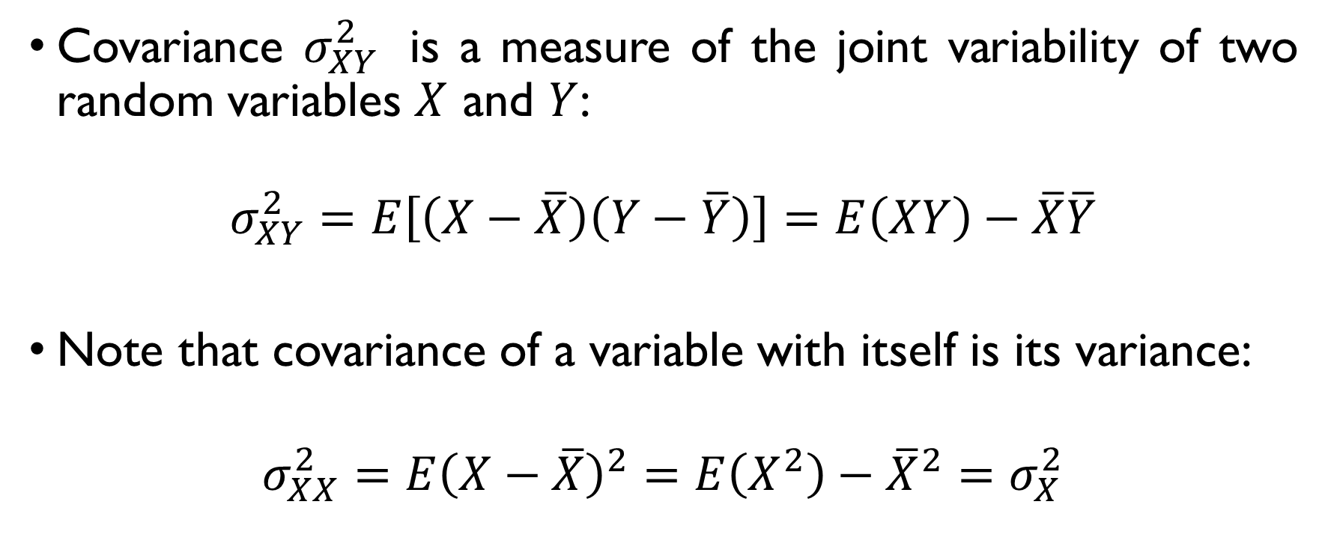
COVARIANCE
Covariance $σ_{XY}^{2}$ is a measure of the joint variability of two random variables $X$ and $Y$:
$$σ_{XY}^{2}=E\left[\left(X−\overline{X}\right)\left(Y−\overline{Y}\right)\right]=E\left(XY\right)−\overline{X}\overline{Y}$$
Note that covariance of a variable with itself is its variance:
$$σ_{XX}^{2}=E{\left(X−\overline{X}\right)}^{2}=E\left(X^{2}\right)−{\overline{X}}^{2}=σ_{X}^{2}$$

Slide 71

COVARIANCE & INDEPENDENCE
$$σ_{XY}^{2}=E\left[\left(X−\overline{X}\right)\left(Y−\overline{Y}\right)\right]=E\left(XY\right)−\overline{X}\overline{Y}$$
If $X$ and $Y$ are independent, the covariance $σ_{XY}=0$.
Is the opposite true?

Slide 72

COVARIANCE & INDEPENDENCE
$$σ_{XY}^{2}=E\left[\left(X−\overline{X}\right)\left(Y−\overline{Y}\right)\right]=E\left(XY\right)−\overline{X}\overline{Y}$$
If $X$ and $Y$ are independent, the covariance $σ_{XY}=0$.
Is the opposite true?

Slide 73
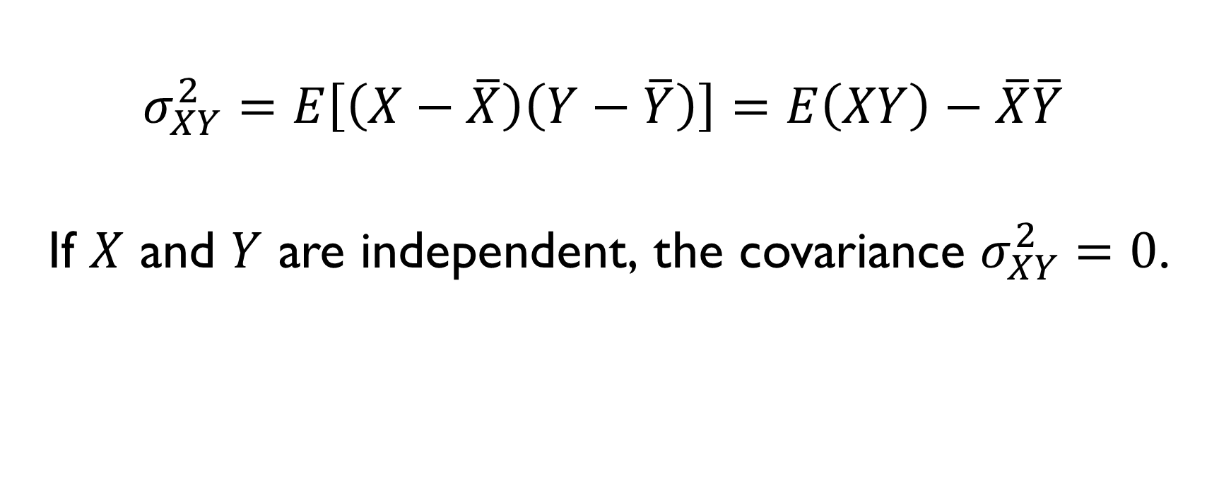
COVARIANCE & INDEPENDENCE
$$σ_{XY}^{2}=E\left[\left(X−\overline{X}\right)\left(Y−\overline{Y}\right)\right]=E\left(XY\right)−\overline{X}\overline{Y}$$
If $X$ and $Y$ are independent, the covariance $σ_{XY}^{2}=0$.
Is the opposite true?

Slide 74
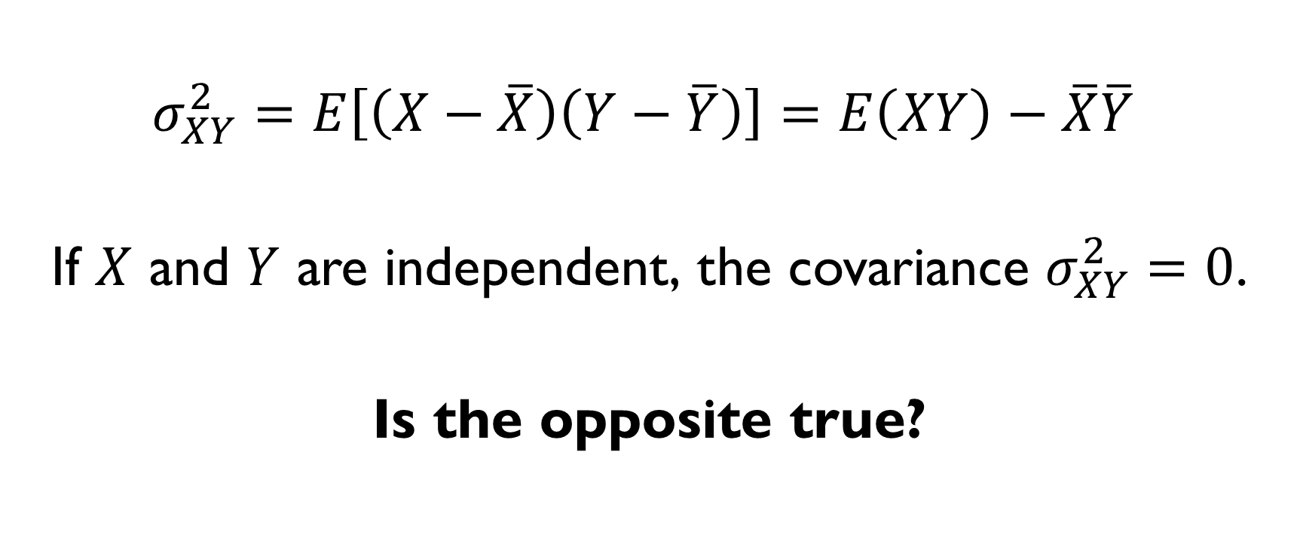
COVARIANCE & INDEPENDENCE
$$σ_{XY}^{2}=E\left[\left(X−\overline{X}\right)\left(Y−\overline{Y}\right)\right]=E\left(XY\right)−\overline{X}\overline{Y}$$
If $X$ and $Y$ are independent, the covariance $σ_{XY}^{2}=0$.
Is the opposite true?

Slide 75
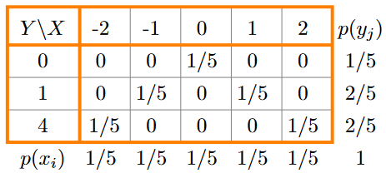

COVARIANCE: EXAMPLE
Let $X$ take values $−2, −1, 0, 1$and $2$ with equal probabilities. Compute covariance between $X$ and ${Y=X}^{2}$

Slide 76
COVARIANCE: EXAMPLE
Let $X$ take values $−2, −1, 0, 1$and $2$ with equal probabilities. Compute covariance between $X$ and ${Y=X}^{2}$

Slide 77
COVARIANCE: EXAMPLE
Let $X$ take values $−2, −1, 0, 1$and $2$ with equal probabilities. Compute covariance between $X$ and ${Y=X}^{2}$

Slide 78
COVARIANCE: EXAMPLE
Let $X$ take values $−2, −1, 0, 1$and $2$ with equal probabilities. Compute covariance between $X$ and ${Y=X}^{2}$

Slide 79

COVARIANCE: EXAMPLE
Let $X$ take values $−2, −1, 0, 1$and $2$ with equal probabilities. Compute covariance between $X$ and ${Y=X}^{2}$.
$$σ_{XY}=E\left(XY\right)−\overline{X} \overline{Y}=\frac{1}{5}\left(0−1+1−2+2\right)−0∙2=0$$

Slide 80

COVARIANCE: EXAMPLE
Let $X$ take values $−2, −1, 0, 1$and $2$ with equal probabilities. Compute covariance between $X$ and ${Y=X}^{2}$.
$$σ_{XY}^{2}=E\left(XY\right)−\overline{X} \overline{Y}=\frac{1}{5}\left(0−1+1−2+2\right)−0∙2=0$$

Slide 81

COVARIANCE: EXAMPLE
Let $X$ take values $−2, −1, 0, 1$and $2$ with equal probabilities. Compute covariance between $X$ and ${Y=X}^{2}$.
$$σ_{XY}^{2}=E\left(XY\right)−\overline{X} \overline{Y}=\frac{1}{5}\left(0−1+1−2+2\right)−0∙2=0$$

Slide 82

COVARIANCE & INDEPENDENCE
$$σ_{XY}^{2}=E\left[\left(X−\overline{X}\right)\left(Y−\overline{Y}\right)\right]=E\left(XY\right)−\overline{X}\overline{Y}$$
If $X$ and $Y$ are independent, the covariance $σ_{XY}^{2}=0$.
The inverse is not true: $σ_{XY}=0$ does not imply that If $X$ and $Y$ are independent.

Slide 83

CORRELATION
Covariance: $σ_{XY}^{2}=E\left(XY\right)−\overline{X} \overline{Y}$
What are the measurement units of it?
‘units of X times units of Y’
Hard to compare covariances.
Correlation removes scale from covariance:
$$ρ=\frac{E\left(X−\overline{X}\right)\left(Y−\overline{Y}\right)}{E{\left(X−\overline{X}\right)}^{2}E{\left(Y−\overline{Y}\right)}^{2}}=\frac{σ_{XY}}{σ_{X}σ_{Y}}$$

Slide 84

CORRELATION
Covariance: $σ_{XY}^{2}=E\left(XY\right)−\overline{X} \overline{Y}$
What are the measurement units of it?
‘units of X times units of Y’
Hard to compare covariances.
Correlation removes scale from covariance:
$$ρ=\frac{E\left(X−\overline{X}\right)\left(Y−\overline{Y}\right)}{E{\left(X−\overline{X}\right)}^{2}E{\left(Y−\overline{Y}\right)}^{2}}=\frac{σ_{XY}}{σ_{X}σ_{Y}}$$

Slide 85

CORRELATION
Covariance: $σ_{XY}^{2}=E\left(XY\right)−\overline{X} \overline{Y}$
What are the measurement units of it?
‘units of X times units of Y’
Hard to compare covariances.
Correlation removes scale from covariance:
$$ρ=\frac{E\left(X−\overline{X}\right)\left(Y−\overline{Y}\right)}{E{\left(X−\overline{X}\right)}^{2}E{\left(Y−\overline{Y}\right)}^{2}}=\frac{σ_{XY}}{σ_{X}σ_{Y}}$$

Slide 86

CORRELATION
Covariance: $σ_{XY}^{2}=E\left(XY\right)−\overline{X} \overline{Y}$
What are the measurement units of it?
‘units of X times units of Y’
Hard to compare covariances.
Correlation removes scale from covariance:
$$ρ=\frac{E\left(X−\overline{X}\right)\left(Y−\overline{Y}\right)}{E{\left(X−\overline{X}\right)}^{2}E{\left(Y−\overline{Y}\right)}^{2}}=\frac{σ_{XY}}{σ_{X}σ_{Y}}$$

Slide 87

CORRELATION
Covariance: $σ_{XY}^{2}=E\left(XY\right)−\overline{X} \overline{Y}$
What are the measurement units of it?
‘units of X times units of Y’
Hard to compare covariances.
Correlation removes scale from covariance:
$$ρ=\frac{σ_{XY}^{2}}{σ_{X}σ_{Y}}=\frac{E\left(X−\overline{X}\right)\left(Y−\overline{Y}\right)}{\sqrt{E{\left(X−\overline{X}\right)}^{2}E{\left(Y−\overline{Y}\right)}^{2}}}$$

Slide 88

PROPERTIES OF CORRELATION
$$ρ=\frac{σ_{XY}^{2}}{σ_{X}σ_{Y}}=\frac{E\left(X−\overline{X}\right)\left(Y−\overline{Y}\right)}{\sqrt{E{\left(X−\overline{X}\right)}^{2}E{\left(Y−\overline{Y}\right)}^{2}}}$$
Correlation is dimensionless (it’s a ratio!)
2. $-1≤ρ≤1$

Slide 89

PROPERTIES OF CORRELATION
$$ρ=\frac{σ_{XY}^{2}}{σ_{X}σ_{Y}}=\frac{E\left(X−\overline{X}\right)\left(Y−\overline{Y}\right)}{\sqrt{E{\left(X−\overline{X}\right)}^{2}E{\left(Y−\overline{Y}\right)}^{2}}}$$
Correlation is dimensionless (it’s a ratio!)
2. $-1≤ρ≤1$

Slide 90

PROPERTIES OF CORRELATION
$$ρ=\frac{σ_{XY}^{2}}{σ_{X}σ_{Y}}=\frac{E\left(X−\overline{X}\right)\left(Y−\overline{Y}\right)}{\sqrt{E{\left(X−\overline{X}\right)}^{2}E{\left(Y−\overline{Y}\right)}^{2}}}$$
Correlation is dimensionless (it’s a ratio!)
2. $-1≤ρ≤1$

Slide 91

WHAT IS CORRELATION
Degree to which a pair of variables are linearly related.
The higher $\left|ρ\right|$ is, the greater the degree of linear dependency is.
Sign:
$ρ\left(X,Y\right)>0$
“The larger $X$ is, the larger $Y$ tends to be”
$ρ\left(X,Y\right)<0$
“The larger $X$ is, the smaller $Y$ tends to be”

Slide 92

WHAT IS CORRELATION NOT

Slide 93
WHAT IS CORRELATION NOT

Slide 94
WATCH THE VIDEO
https://youtu.be/6RzDMEW5omc

Slide 95
SPURIOUS CORRELATIONS
More:
http://www.tylervigen.com/spurious-correlations

Slide 96

WHAT IS CORRELATION NOT

