Slide 1
INTRODUCTION TO STATISTICS
LECTURE 2

Slide 2
LAST TIME
DESCRIPTIVE STATISTICS
Data about the whole population is available.
Summarize it with
summary statistics;
tables;
plots.
INFERENTIAL STATISTICS
Data about a sample of the whole population is available.
Reason about the whole populations.

Slide 3
LAST TIME
DESCRIPTIVE STATISTICS
Data about the whole population is available.
Summarize it with
summary statistics;
tables;
plots.
INFERENTIAL STATISTICS
Data about a sample of the whole population is available.
Reason about the whole population.

Slide 4
LAST TIME
DESCRIPTIVE STATISTICS
Data about the whole population is available.
Summarize it with
summary statistics;
tables;
plots.
INFERENTIAL STATISTICS
Data about a sample of the whole population is available.
Reason about the whole population.

Slide 5
MEN AND WOMEN
If we take a random person X, what’s the probability that it’s a man?
If we take 100 random people X₁…X₁₀₀, how many man do we expect to see?
N_{men} = X₁ + … + X₁₀₀ ~ Bi(100, p)
E(N_{man}) = 100 * p = 500
How many men and women are there in the world?
There is precise data! ☺
p = 0.5

Slide 6
MEN AND WOMEN
If we take a random person X, what’s the probability that it’s a man?
If we take 100 random people X₁…X₁₀₀, how many man do we expect to see?
N_{men} = X₁ + … + X₁₀₀ ~ Bi(100, p)
E(N_{man}) = 100 * p = 500
How many men and women are there in the world?
There is precise data! ☺
p = 0.5
X | 1 | 0
P(X) | p | 1-p

Slide 7
MEN AND WOMEN
If we take a random person X, what’s the probability that it’s a man?
If we take 100 random people X₁…X₁₀₀, how many man do we expect to see?
N_{men} = X₁ + … + X₁₀₀ ~ Bi(100, p)
E(N_{man}) = 100 * p = 500
How many men and women are there in the world?
There is precise data! ☺
p = 0.5
X | 1 | 0
P(X) | p | 1-p

Slide 8
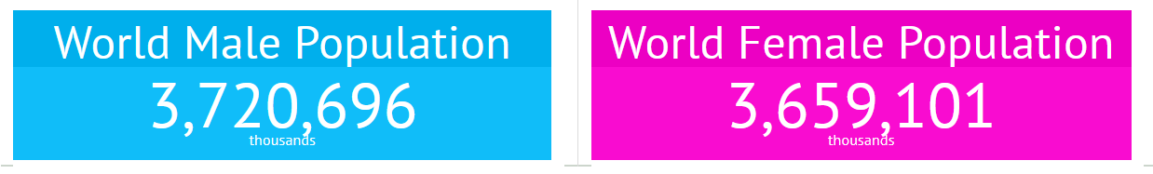
MEN AND WOMEN
If we take a random person X, what’s the probability that it’s a man?
If we take 100 random people X₁…X₁₀₀, how many man do we expect to see?
N_{men} = X₁ + … + X₁₀₀ ~ Bi(100, p)
E(N_{man}) = 100 * p = 500
How many men and women are there in the world?
There is precise data! ☺
p = 0.5
X | 1 | 0
P(X) | p | 1-p
https://knoema.com/gndibag/sex-ratio-around-the-world-men-per-100-women-1950-2100

Slide 9
MEN AND WOMEN
If we take a random person X, what’s the probability that it’s a man?
If we take 100 random people X₁…X₁₀₀, how many man do we expect to see?
N_{men} = X₁ + … + X₁₀₀ ~ Bi(100, p)
E(N_{man}) = 100 * p = 500
How many men and women are there in the world?
There is precise data! ☺
p = 0.5
X | 1 | 0
P(X) | p = 0.5 | 1-p = 0.5
https://knoema.com/gndibag/sex-ratio-around-the-world-men-per-100-women-1950-2100

Slide 10
MEN AND WOMEN
If we take a random person X, what’s the probability that it’s a man?
If we take 100 random people X₁…X₁₀₀, how many men do we expect to see?
N_{men} = X₁ + … + X₁₀₀ ~ Bi(100, p)
E(N_{man}) = 100 * p = 500
How many men and women are there in the world?
There is precise data! ☺
p = 0.5
X | 1 | 0
P(X) | p = 0.5 | 1-p = 0.5
https://knoema.com/gndibag/sex-ratio-around-the-world-men-per-100-women-1950-2100

Slide 11
MEN AND WOMEN
If we take a random person X, what’s the probability that it’s a man?
If we take 100 random people X₁…X₁₀₀, how many men do we expect to see?
N_{men} = X₁ + … + X₁₀₀ ~ Bi(100, p)
E(N_{man}) = 100 * p = 500
How many men and women are there in the world?
There is precise data! ☺
p = 0.5
X | 1 | 0
P(X) | p = 0.5 | 1-p = 0.5
https://knoema.com/gndibag/sex-ratio-around-the-world-men-per-100-women-1950-2100

Slide 12
MEN AND WOMEN
If we take a random person X, what’s the probability that it’s a man?
If we take 100 random people X₁…X₁₀₀, how many men do we expect to see?
N_{men} = X₁ + … + X₁₀₀ ~ Bi(100, p)
E(N_{men}) = 100 * p = 50
How many men and women are there in the world?
There is precise data! ☺
p = 0.5
X | 1 | 0
P(X) | p = 0.5 | 1-p = 0.5
https://knoema.com/gndibag/sex-ratio-around-the-world-men-per-100-women-1950-2100

Slide 13

(NON-)VEGETARIANS
If we take a random person X, what’s the probability that it’s a vegetarian?
X ~ Bernoulli(p) P(X = 1) = p = ?
What is a good guess for the value of p?
$\hat{p}$ = 13 / 100 = 0.13
How many vegetarians are there in the world?
No precise data! ☹
What would you do?
Survey:
100 people: X₁…X₁₀₀
13 are vegetarians

Slide 14

(NON-)VEGETARIANS
If we take a random person X, what’s the probability that it’s a vegetarian?
X ~ Bernoulli(p) P(X = 1) = p = ?
What is a good guess for the value of p?
$\hat{p}$ = 13 / 100 = 0.13
How many vegetarians are there in the world?
No precise data! ☹
What would you do?
Survey:
100 people: X₁…X₁₀₀
13 are vegetarians

Slide 15
(NON-)VEGETARIANS
If we take a random person X, what’s the probability that it’s a vegetarian?
X ~ Bernoulli(p) P(X = 1) = p = ?
What is a good guess for the value of p?
$\hat{p}$ = 13 / 100 = 0.13
How many vegetarians are there in the world?
No precise data! ☹
What would you do?
Survey:
100 people: X₁…X₁₀₀
13 are vegetarians

Slide 16
(NON-)VEGETARIANS
If we take a random person X, what’s the probability that it’s a vegetarian?
X ~ Bernoulli(p) P(X = 1) = p = ?
What is a good guess for the value of p?
$\hat{p}$ = 13 / 100 = 0.13
How many vegetarians are there in the world?
No precise data! ☹
What would you do?
Survey:
100 people: X₁…X₁₀₀
13 are vegetarians

Slide 17
(NON-)VEGETARIANS
If we take a random person X, what’s the probability that it’s a vegetarian?
X ~ Bernoulli(p) P(X = 1) = p = ?
What is a good guess for the value of p?
$\hat{p}$ = 13 / 100 = 0.13
How many vegetarians are there in the world?
No precise data! ☹
What would you do?
Survey:
100 people: X₁…X₁₀₀
13 are vegetarians

Slide 18
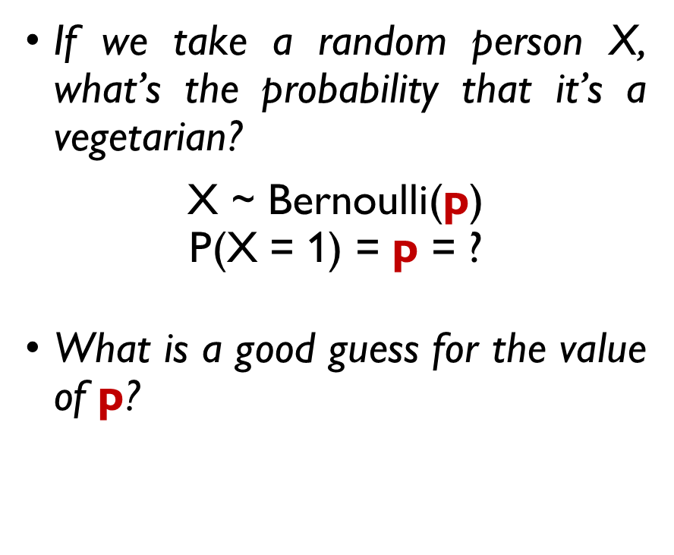
(NON-)VEGETARIANS
If we take a random person X, what’s the probability that it’s a vegetarian?
X ~ Bernoulli(p) P(X = 1) = p = ?
What is a good guess for the value of p?
$\hat{p}$ = 13 / 100 = 0.13
How many vegetarians are there in the world?
No precise data! ☹
What would you do?
Survey:
100 people: X₁…X₁₀₀
13 are vegetarians

Slide 19
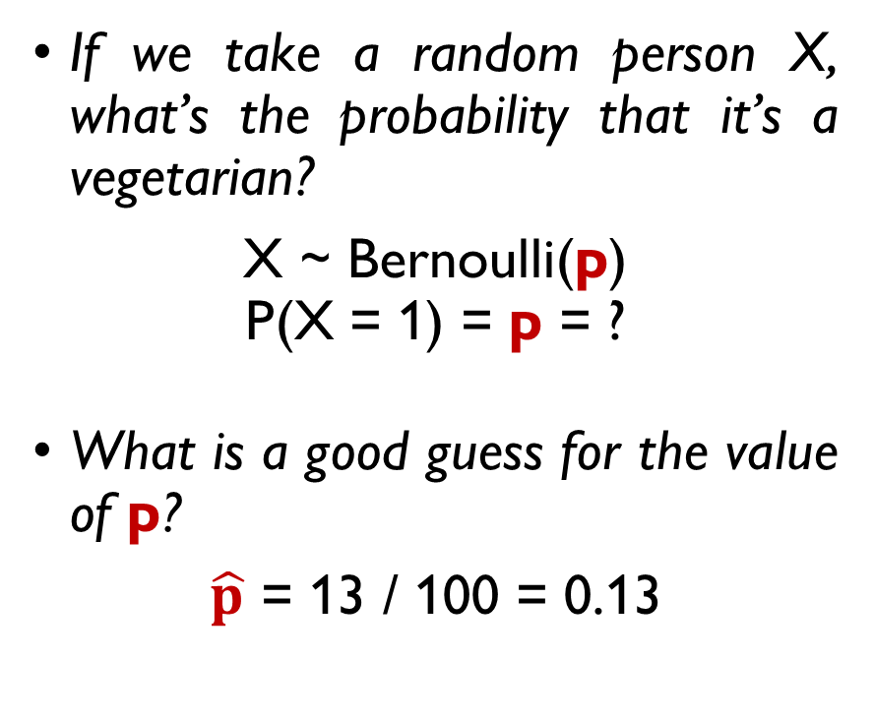
(NON-)VEGETARIANS
If we take a random person X, what’s the probability that it’s a vegetarian?
X ~ Bernoulli(p) P(X = 1) = p = ?
What is a good guess for the value of p?
$\hat{p}$ = 13 / 100 = 0.13
How many vegetarians are there in the world?
No precise data! ☹
What would you do?
Survey:
100 people: X₁…X₁₀₀
13 are vegetarians

Slide 20
(NON-)VEGETARIANS
INFERENTIAL STATISTICS
If we take a random person X, what’s the probability that it’s a vegetarian?
X ~ Bernoulli(p) P(X = 1) = p = ?
What is a good guess for the value of p?
$\hat{p}$ = 13 / 100 = 0.13
How many vegetarians are there in the world?
No precise data! ☹
What would you do?
Survey:
100 people: X₁…X₁₀₀
13 are vegetarians
…get the parameter estimate
From the data…

Slide 21
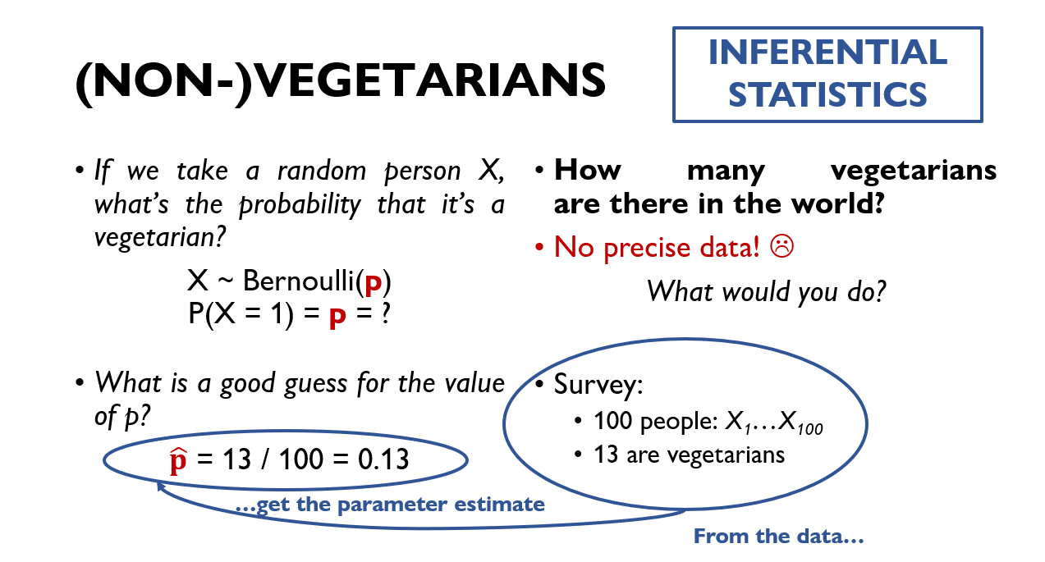
SOME QUESTIONS TO ASK OURSELVES
Was it a good way to obtain an estimate?
How precise is our estimate?
Would it be better if there were more people in the survey?

Slide 22
SOME QUESTIONS TO ASK OURSELVES
Was it a good way to obtain an estimate?
How precise is our estimate?
Would it be better if there were more people in the survey?

Slide 23
SOME QUESTIONS TO ASK OURSELVES
Was it a good way to obtain an estimate?
How precise is our estimate?
Would it be better if there were more people in the survey?

Slide 24
SOME QUESTIONS TO ASK OURSELVES
Was it a good way to obtain an estimate?
How precise is our estimate?
Would it be better if there were more people in the survey?

Slide 25
THE METHOD OF MAXIMUM LIKELIHOOD
A general framework for parameter estimation

Slide 26
THE METHOD OF MAXIMUM LIKELIHOOD
A general framework for parameter estimation

Slide 27
LIKELIHOOD FUNCTION
X ~ Bernoulli(p) – whether a person is a vegetarian (1) or not (0).
p - the true proportion of the vegetarians.
Survey results: 13 out of 100 participants are vegetarians:
X₁ = 1, …, X₁₃ = 1, X₁₄ = 0, …, X₁₀₀ = 0
What is the probability to obtain such results given p? Likelihood:
L (X₁,…,X₁₀₀ , p) = P(X₁ = 1, …, X₁₃ = 1, X₁₄ = 0, …, X₁₀₀ = 0 | p) =
{X₁, …, X₁₀₀ are independent}
= P(X₁ = 1 | p) *…* P(X₁₃ = 1 | p) * P(X₁₄ = 0 | p) *…* P(X₁₀₀ = 0 | p) =
= p¹³(1-p)⁸⁷

Slide 28
LIKELIHOOD FUNCTION
X ~ Bernoulli(p) – whether a person is a vegetarian (1) or not (0).
p - the true proportion of the vegetarians.
Survey results: 13 out of 100 participants are vegetarians:
X₁ = 1, …, X₁₃ = 1, X₁₄ = 0, …, X₁₀₀ = 0
What is the probability to obtain such results given p? Likelihood:
L (X₁,…,X₁₀₀ , p) = P(X₁ = 1, …, X₁₃ = 1, X₁₄ = 0, …, X₁₀₀ = 0 | p) =
{X₁, …, X₁₀₀ are independent}
= P(X₁ = 1 | p) *…* P(X₁₃ = 1 | p) * P(X₁₄ = 0 | p) *…* P(X₁₀₀ = 0 | p) =
= p¹³(1-p)⁸⁷

Slide 29
LIKELIHOOD FUNCTION
X ~ Bernoulli(p) – whether a person is a vegetarian (1) or not (0).
p - the true proportion of the vegetarians.
Survey results: 13 out of 100 participants are vegetarians:
X₁ = 1, …, X₁₃ = 1, X₁₄ = 0, …, X₁₀₀ = 0
What is the probability to obtain such results given p? Likelihood:
L (X₁,…,X₁₀₀ , p) = P(X₁ = 1, …, X₁₃ = 1, X₁₄ = 0, …, X₁₀₀ = 0 | p) =
{X₁, …, X₁₀₀ are independent}
= P(X₁ = 1 | p) *…* P(X₁₃ = 1 | p) * P(X₁₄ = 0 | p) *…* P(X₁₀₀ = 0 | p) =
= p¹³(1-p)⁸⁷

Slide 30
LIKELIHOOD FUNCTION
X ~ Bernoulli(p) – whether a person is a vegetarian (1) or not (0).
p - the true proportion of the vegetarians.
Survey results: 13 out of 100 participants are vegetarians:
X₁ = 1, …, X₁₃ = 1, X₁₄ = 0, …, X₁₀₀ = 0
What is the probability to obtain such results given p? Likelihood:
L (p) = P(X₁ = 1, …, X₁₃ = 1, X₁₄ = 0, …, X₁₀₀ = 0 | p) =
{X₁, …, X₁₀₀ are independent}
= P(X₁ = 1 | p) *…* P(X₁₃ = 1 | p) * P(X₁₄ = 0 | p) *…* P(X₁₀₀ = 0 | p) =
= p¹³(1-p)⁸⁷

Slide 31
LIKELIHOOD FUNCTION
X ~ Bernoulli(p) – whether a person is a vegetarian (1) or not (0).
p - the true proportion of the vegetarians.
Survey results: 13 out of 100 participants are vegetarians:
X₁ = 1, …, X₁₃ = 1, X₁₄ = 0, …, X₁₀₀ = 0
What is the probability to obtain such results given p? Likelihood:
L (p) = P(X₁ = 1, …, X₁₃ = 1, X₁₄ = 0, …, X₁₀₀ = 0 | p) =
{X₁, …, X₁₀₀ are independent}
= P(X₁ = 1 | p) *…* P(X₁₃ = 1 | p) * P(X₁₄ = 0 | p) *…* P(X₁₀₀ = 0 | p) =
= p¹³(1-p)⁸⁷

Slide 32
LIKELIHOOD FUNCTION
X ~ Bernoulli(p) – whether a person is a vegetarian (1) or not (0).
p - the true proportion of the vegetarians.
Survey results: 13 out of 100 participants are vegetarians:
X₁ = 1, …, X₁₃ = 1, X₁₄ = 0, …, X₁₀₀ = 0
What is the probability to obtain such results given p? Likelihood:
L (p) = P(X₁ = 1, …, X₁₃ = 1, X₁₄ = 0, …, X₁₀₀ = 0 | p) =
{X₁, …, X₁₀₀ are independent}
= P(X₁ = 1 | p) *…* P(X₁₃ = 1 | p) * P(X₁₄ = 0 | p) *…* P(X₁₀₀ = 0 | p) =
= p¹³(1-p)⁸⁷

Slide 33
LIKELIHOOD FUNCTION
X ~ Bernoulli(p) – whether a person is a vegetarian (1) or not (0).
p - the true proportion of the vegetarians.
Survey results: 13 out of 100 participants are vegetarians:
X₁ = 1, …, X₁₃ = 1, X₁₄ = 0, …, X₁₀₀ = 0
What is the probability to obtain such results given p? Likelihood:
L (p) = P(X₁ = 1, …, X₁₃ = 1, X₁₄ = 0, …, X₁₀₀ = 0 | p) =
{X₁, …, X₁₀₀ are independent}
= P(X₁ = 1 | p) *…* P(X₁₃ = 1 | p) * P(X₁₄ = 0 | p) *…* P(X₁₀₀ = 0 | p) =
= p¹³(1-p)⁸⁷

Slide 34
LIKELIHOOD FUNCTION
X ~ Bernoulli(p) – whether a person is a vegetarian (1) or not (0).
p - the true proportion of the vegetarians.
Survey results: 13 out of 100 participants are vegetarians:
X₁ = 1, …, X₁₃ = 1, X₁₄ = 0, …, X₁₀₀ = 0
What is the probability to obtain such results given p? Likelihood:
L (p) = P(X₁ = 1, …, X₁₃ = 1, X₁₄ = 0, …, X₁₀₀ = 0 | p) =
{X₁, …, X₁₀₀ are independent}
= P(X₁ = 1 | p) *…* P(X₁₃ = 1 | p) * P(X₁₄ = 0 | p) *…* P(X₁₀₀ = 0 | p) =
= p¹³(1-p)⁸⁷

Slide 35
Likelihood function is the joint probability of realized sample given the parameters.

Slide 36
MAXIMUM LIKELIHOOD
The probability to observe such data given p is:
L (p) = p¹³(1-p)⁸⁷
How to chose the best p?
We want the data that we obtained to be the most likely one.
Maximize L(X, p) w.r.t. p!

Slide 37
MAXIMUM LIKELIHOOD
The probability to observe such data given p is:
L (p) = p¹³(1-p)⁸⁷
How to chose the best p?
We want the data that we obtained to be the most likely one.
Maximize L(X, p) w.r.t. p!

Slide 38
MAXIMUM LIKELIHOOD
The probability to observe such data given p is:
L (p) = p¹³(1-p)⁸⁷
How to chose the best p?
We want the data that we obtained to be the most likely one.
Maximize L(X, p) w.r.t. p!

Slide 39
MAXIMUM LIKELIHOOD
The probability to observe such data given p is:
L (p) = p¹³(1-p)⁸⁷
How to chose the best p?
We want the data that we obtained to be the most likely one.
Maximize L(p) w.r.t. p!

Slide 40

CALCULUS 101
How to optimize a function?
Compute its derivative.
Set it to zero.
Get the critical point(s).
Chose the point of maximum.
$$f\left(x\right)=\log{x}+\log\left(1−x\right)$$
$$\frac{d}{dx}f\left(x\right)=\frac{1}{x}−\frac{1}{1−x}=0$$
Critical points:
$$x=0, x=1, x=\frac{1}{2}$$

Slide 41
CALCULUS 101
How to optimize a function?
Compute its derivative.
Set it to zero.
Get the critical point(s).
Chose the point of maximum.
$$f\left(x\right)=\log{x}+\log\left(1−x\right)$$
$$\frac{d}{dx}f\left(x\right)=\frac{1}{x}−\frac{1}{1−x}=0$$
Critical points:
$$x=0, x=1, x=\frac{1}{2}$$

Slide 42

CALCULUS 101
How to optimize a function?
Compute its derivative.
Set it to zero.
Get the critical point(s).
Chose the point of maximum.
$$f\left(x\right)=\log{x}+\log\left(1−x\right)$$
$$\frac{d}{dx}f\left(x\right)=\frac{1}{x}−\frac{1}{1−x}=0$$
Critical points:
$$x=0, x=1, x=\frac{1}{2}$$

Slide 43

CALCULUS 101
How to optimize a function?
Compute its derivative.
Set it to zero.
Get the critical point(s).
Chose the point of maximum.
$$f\left(x\right)=\log{x}+\log\left(1−x\right)$$
$$\frac{d}{dx}f\left(x\right)=\frac{1}{x}−\frac{1}{1−x}=0$$
Critical points:
$$x=0, x=1, x=\frac{1}{2}$$

Slide 44

CALCULUS 101
How to optimize a function?
Compute its derivative.
Set it to zero.
Get the critical point(s).
Chose the point of maximum.
$$f\left(x\right)=\log{x}+\log\left(1−x\right)$$
$$\frac{d}{dx}f\left(x\right)=\frac{1}{x}−\frac{1}{1−x}=0$$
Critical points:
$$x=0, x=1, x=\frac{1}{2}$$

Slide 45
CALCULUS 101
How to optimize a function?
Compute its derivative.
Set it to zero.
Get the critical point(s).
Chose the point of maximum.
$$f\left(x\right)=\log{x}+\log\left(1−x\right)$$
$$\frac{d}{dx}f\left(x\right)=\frac{1}{x}−\frac{1}{1−x}=0$$
Critical points:
$$x=0, x=1, x=\frac{1}{2}$$
f’(x)
+
-
0
0.5
1

Slide 46

MAXIMUM LIKELIHOOD
maximize L (p) = p¹³(1-p)⁸⁷ w.r.t. p
USEFUL TRICK: MAXIMIZE LOG-LIKELIHOOD INSTEAD
maximize log L (p) = 13 log(p) + 87 log (1-p)⁸⁷ w.r.t. p
$$\frac{d}{dp}\log{L\left(p\right)}=\frac{13}{p}−\frac{87}{1−p}=0$$
$$\hat{p}=\frac{13}{100}$$

Slide 47

MAXIMUM LIKELIHOOD
maximize L (p) = p¹³(1-p)⁸⁷ w.r.t. p
USEFUL TRICK: MAXIMIZE LOG-LIKELIHOOD INSTEAD
maximize log L (p) = 13 log(p) + 87 log (1-p)⁸⁷ w.r.t. p
$$\frac{d}{dp}\log{L\left(p\right)}=\frac{13}{p}−\frac{87}{1−p}=0$$
$$\hat{p}=\frac{13}{100}$$

Slide 48
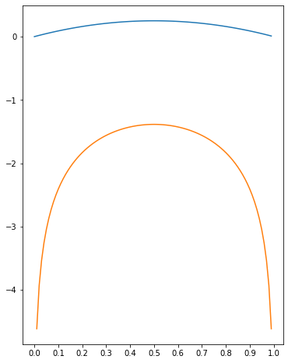
f(x) = x*(1-x)
log f(x)

Slide 49

MAXIMUM LIKELIHOOD
maximize L (p) = p¹³(1-p)⁸⁷ w.r.t. p
USEFUL TRICK: MAXIMIZE LOG-LIKELIHOOD INSTEAD
maximize log L (p) = 13 log(p) + 87 log (1-p) w.r.t. p
$$\frac{d}{dp}\log{L\left(p\right)}=\frac{13}{p}−\frac{87}{1−p}=0$$
$$\hat{p}=\frac{13}{100}$$

Slide 50
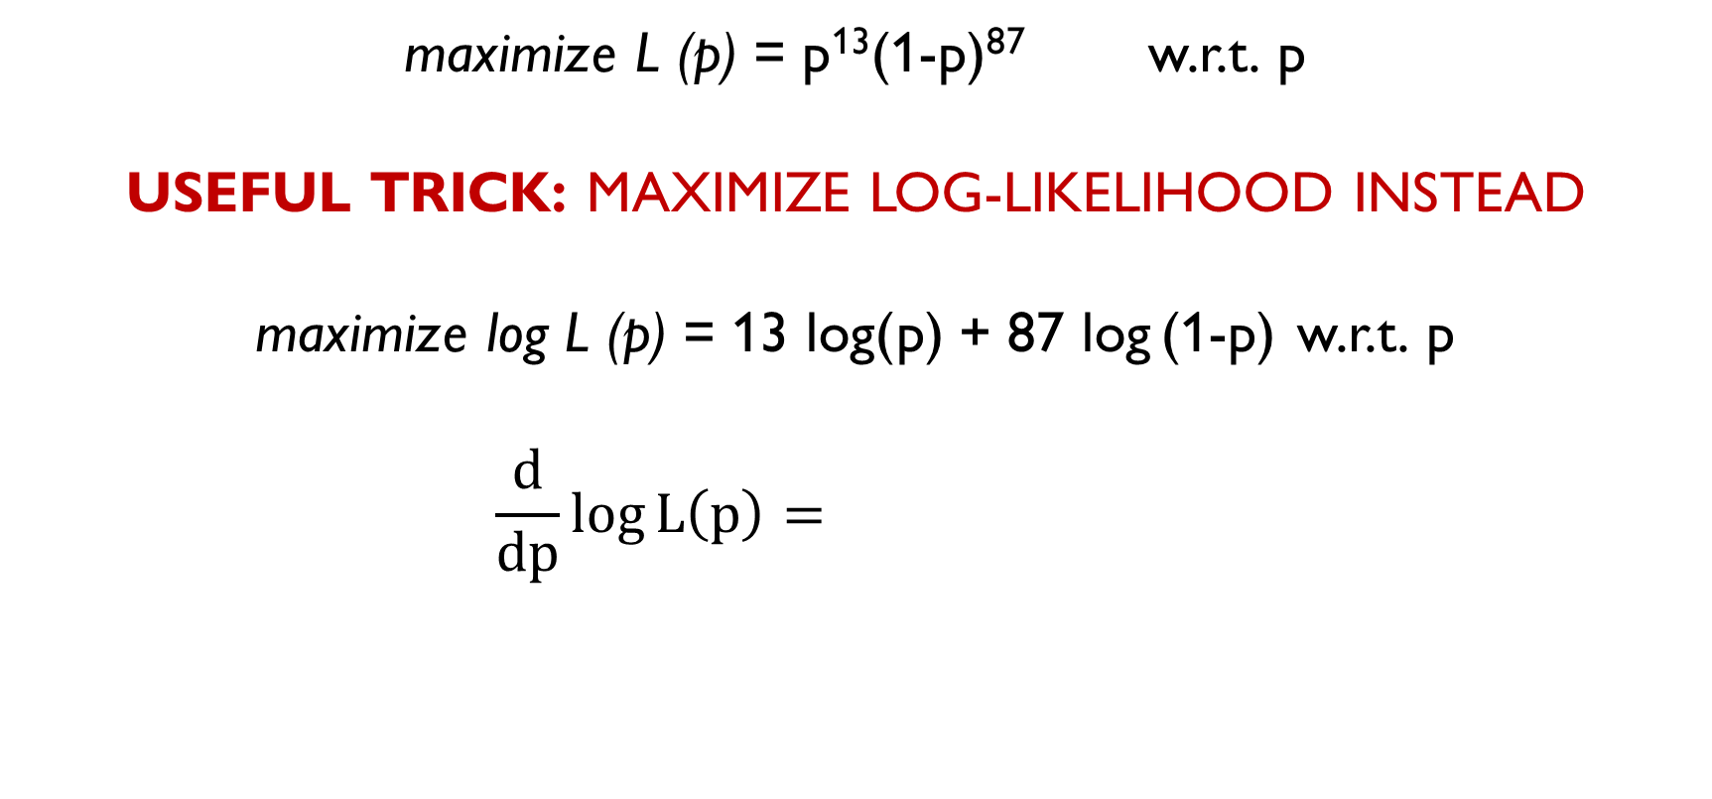
MAXIMUM LIKELIHOOD
maximize L (p) = p¹³(1-p)⁸⁷ w.r.t. p
USEFUL TRICK: MAXIMIZE LOG-LIKELIHOOD INSTEAD
maximize log L (p) = 13 log(p) + 87 log (1-p) w.r.t. p
$$\frac{d}{dp}\log{L\left(p\right)}=\frac{13}{p}−\frac{87}{1−p}=0$$
$$\hat{p}=\frac{13}{100}$$

Slide 51
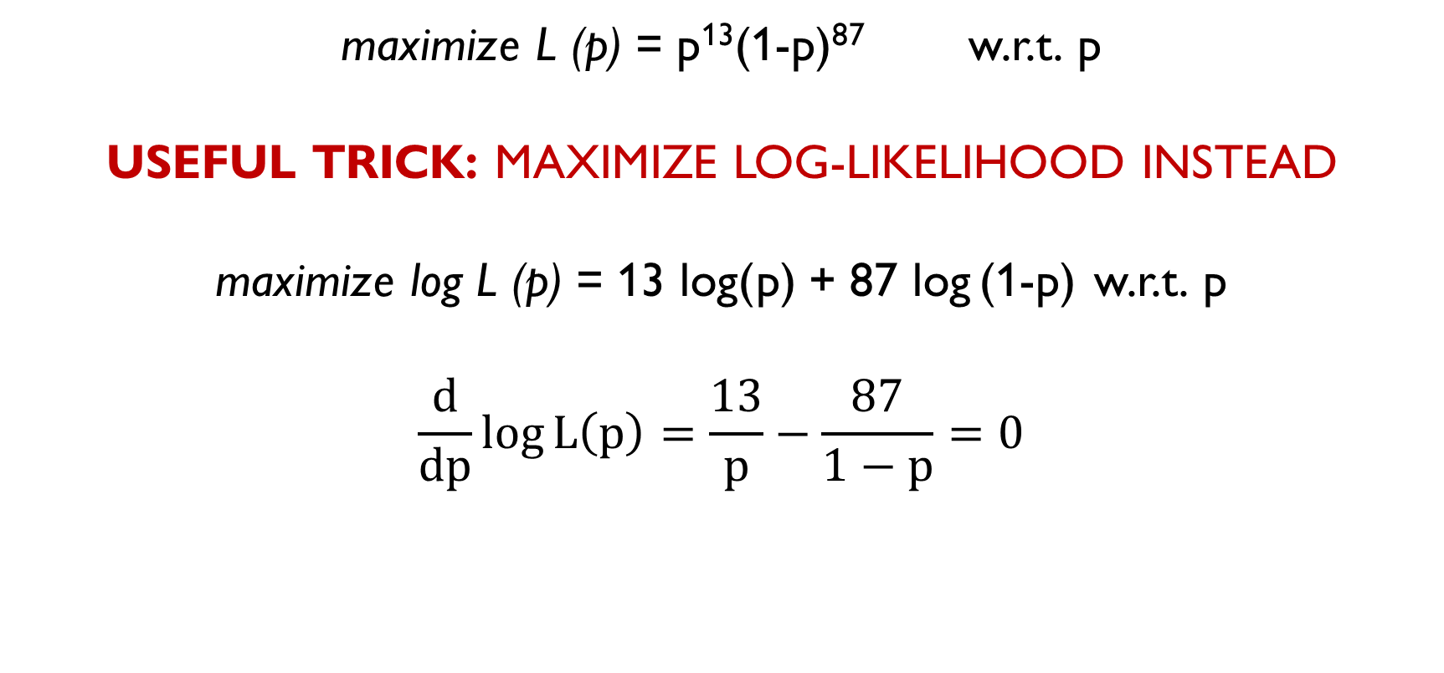
MAXIMUM LIKELIHOOD
maximize L (p) = p¹³(1-p)⁸⁷ w.r.t. p
USEFUL TRICK: MAXIMIZE LOG-LIKELIHOOD INSTEAD
maximize log L (p) = 13 log(p) + 87 log (1-p) w.r.t. p
$$\frac{d}{dp}\log{L\left(p\right)}=\frac{13}{p}−\frac{87}{1−p}=0$$
$$\hat{p}=\frac{13}{100}$$

Slide 52
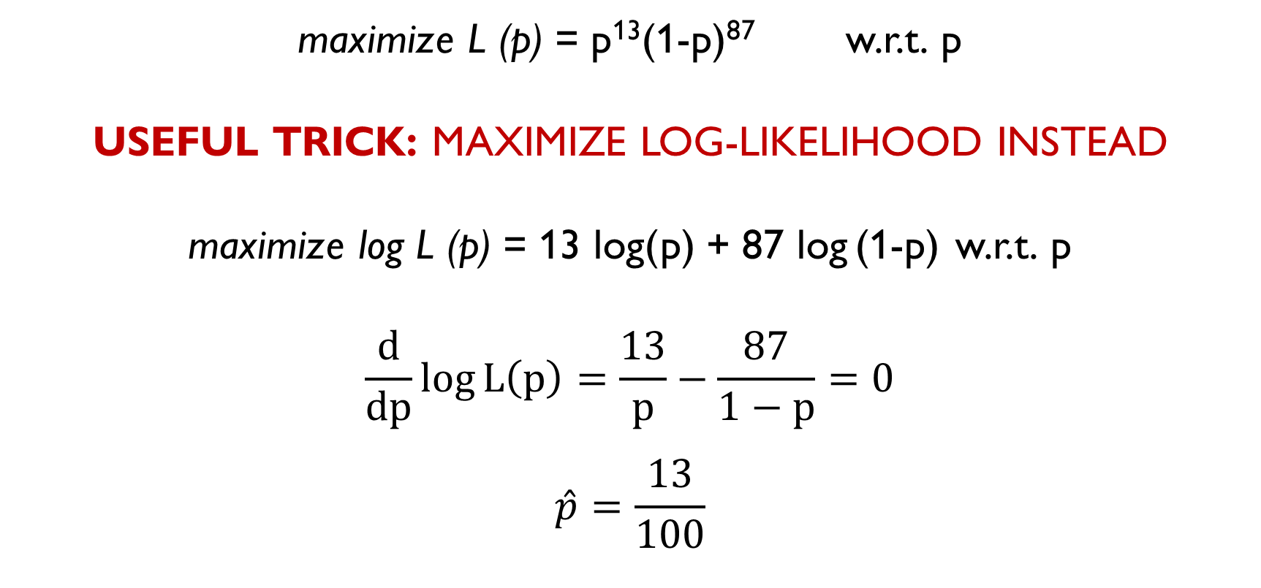
MAXIMUM LIKELIHOOD
maximize L (p) = p¹³(1-p)⁸⁷ w.r.t. p
USEFUL TRICK: MAXIMIZE LOG-LIKELIHOOD INSTEAD
maximize log L (p) = 13 log(p) + 87 log (1-p) w.r.t. p
$$\frac{d}{dp}\log{L\left(p\right)}=\frac{13}{p}−\frac{87}{1−p}=0$$
$$\hat{p}=\frac{13}{100}$$

Slide 53

MAXIMUM LIKELIHOOD ESTIMATE
1. Write down the likelihood function:
L($θ$) = P(X₁, …, X_{n} | $θ$) = $\prod_{i=1}^{n}{\text{P}\text{(}\text{Xi}\text{ | }θ\text{)}}$
2. Find its maximum w.r.t. the unknown parameter $θ$:
$\hat{Θ}$ = argmax L($θ$) w.r.t. $θ$
(!) In many cases, it’s easier to maximize log-likelihood:
log L($θ$) = log $\prod_{i=1}^{n}{\text{P}\text{(}\text{Xi}\text{ | }θ\text{)}}$ = $\sum_{i=1}^{n}{\text{log} \text{P}\text{(}\text{Xi}\text{ | }θ\text{)}}$
$\hat{Θ}$= argmax log L($θ$)

Slide 54
Maximum Likelihood Estimate (MLE) is the value which …

Slide 55
Maximum Likelihood Estimate (MLE) is the value which maximizes the probability of observing the realized sample.

Slide 56
BREAK

Slide 57
MLE FOR SOME DISCRETE DISTRIBUTIONS

Slide 58
BERNOULLI DISTRIBUTION
X ~ Bernoulli(p)
E(X) = p
Var(X) = p(p-1)
Models the probability of success in an experiment with two outcomes.

Slide 59
BERNOULLI DISTRIBUTION
X ~ Bernoulli(p)
E(X) = p
Var(X) = p(p-1)
Models the probability of success in an experiment with two outcomes.
(General case of the previous example)
You want to estimate the proportion of the vegetarians.
Survey: you ask N people whether they are vegetarians and get responses
X₁, X₂,… X_{N}
What’s the MLE of p?

Slide 60
BERNOULLI DISTRIBUTION
X ~ Bernoulli(p)
E(X) = p
Var(X) = p(p-1)
Models the probability of success in an experiment with two outcomes.
(General case of the previous example)
You want to estimate the proportion of the vegetarians.
Survey: you ask N people whether they are vegetarians and get responses
X₁, X₂,… X_{N}
What’s the MLE of p?

Slide 61
BERNOULLI DISTRIBUTION
X ~ Bernoulli(p)
E(X) = p
Var(X) = p(p-1)
Models the probability of success in an experiment with two outcomes.
(General case of the previous example)
You want to estimate the proportion of the vegetarians.
Survey: you ask N people whether they are vegetarians and get responses
X₁, X₂,… X_{N}
What’s the MLE of p?

Slide 62

MLE FOR BERNOULLI DISTRIBUTION
$$L\left(p\right)=\prod_{i=1}^{N}{p^{X_{i}}{\left(1−p\right)}^{1−X_{i}}}$$
$$\log{L\left(p\right)=\sum_{i=1}^{N}{X_{i}\log{p}+\left(1−X_{i}\right)}}\log\left(1−p\right)$$
$$\frac{d}{dp}\log{L\left(p\right)}=\frac{\sum_{i=1}^{N}{X_{i}}}{p}−\frac{N−\sum_{i=1}^{N}{X_{i}}}{1−p}=0$$
$$\hat{p}=\frac{1}{N}\sum_{i=1}^{N}{X_{i}}$$

Slide 63

MLE FOR BERNOULLI DISTRIBUTION
$$L\left(p\right)=\prod_{i=1}^{N}{p^{X_{i}}{\left(1−p\right)}^{1−X_{i}}}$$
$$\log{L\left(p\right)=\sum_{i=1}^{N}{X_{i}\log{p}+\left(1−X_{i}\right)}}\log\left(1−p\right)$$
$$\frac{d}{dp}\log{L\left(p\right)}=\frac{\sum_{i=1}^{N}{X_{i}}}{p}−\frac{N−\sum_{i=1}^{N}{X_{i}}}{1−p}=0$$
$$\hat{p}=\frac{1}{N}\sum_{i=1}^{N}{X_{i}}$$

Slide 64

MLE FOR BERNOULLI DISTRIBUTION
$$L\left(p\right)=\prod_{i=1}^{N}{p^{X_{i}}{\left(1−p\right)}^{1−X_{i}}}$$
$$\log{L\left(p\right)=\sum_{i=1}^{N}{X_{i}\log{p}+\left(1−X_{i}\right)}}\log\left(1−p\right)$$
$$\frac{d}{dp}\log{L\left(p\right)}=\frac{\sum_{i=1}^{N}{X_{i}}}{p}−\frac{N−\sum_{i=1}^{N}{X_{i}}}{1−p}=0$$
$$\hat{p}=\frac{1}{N}\sum_{i=1}^{N}{X_{i}}$$

Slide 65

MLE FOR BERNOULLI DISTRIBUTION
$$L\left(p\right)=\prod_{i=1}^{N}{p^{X_{i}}{\left(1−p\right)}^{1−X_{i}}}$$
$$\log{L\left(p\right)=\sum_{i=1}^{N}{X_{i}\log{p}+\left(1−X_{i}\right)}}\log\left(1−p\right)$$
$$\frac{d}{dp}\log{L\left(p\right)}=\frac{\sum_{i=1}^{N}{X_{i}}}{p}−\frac{N−\sum_{i=1}^{N}{X_{i}}}{1−p}=0$$
$$\hat{p}=\frac{1}{N}\sum_{i=1}^{N}{X_{i}}$$

Slide 66

MLE FOR BERNOULLI DISTRIBUTION
$$L\left(p\right)=\prod_{i=1}^{N}{p^{X_{i}}{\left(1−p\right)}^{1−X_{i}}}$$
$$\log{L\left(p\right)=\sum_{i=1}^{N}{X_{i}\log{p}+\left(1−X_{i}\right)}}\log\left(1−p\right)$$
$$\frac{d}{dp}\log{L\left(p\right)}=\frac{\sum_{i=1}^{N}{X_{i}}}{p}−\frac{N−\sum_{i=1}^{N}{X_{i}}}{1−p}=0$$
$$\hat{p}=\frac{1}{N}\sum_{i=1}^{N}{X_{i}}$$

Slide 67

MLE FOR BERNOULLI DISTRIBUTION
$$L\left(p\right)=\prod_{i=1}^{N}{p^{X_{i}}{\left(1−p\right)}^{1−X_{i}}}$$
$$\log{L\left(p\right)=\sum_{i=1}^{N}{X_{i}\log{p}+\left(1−X_{i}\right)}}\log\left(1−p\right)$$
$$\frac{d}{dp}\log{L\left(p\right)}=\frac{\sum_{i=1}^{N}{X_{i}}}{p}−\frac{N−\sum_{i=1}^{N}{X_{i}}}{1−p}=0$$
$$\hat{p}=\frac{1}{N}\sum_{i=1}^{N}{X_{i}}$$

Slide 68

MLE FOR BERNOULLI DISTRIBUTION
$$L\left(p\right)=\prod_{i=1}^{N}{p^{X_{i}}{\left(1−p\right)}^{1−X_{i}}}$$
$$\log{L\left(p\right)=\sum_{i=1}^{N}{X_{i}\log{p}+\left(1−X_{i}\right)}}\log\left(1−p\right)$$
$$\frac{d}{dp}\log{L\left(p\right)}=\frac{\sum_{i=1}^{N}{X_{i}}}{p}−\frac{N−\sum_{i=1}^{N}{X_{i}}}{1−p}=0$$
$$\hat{p}=\frac{1}{N}\sum_{i=1}^{N}{X_{i}}$$

Slide 69
MLE FOR BERNOULLI DISTRIBUTION
$$L\left(p\right)=\prod_{i=1}^{N}{p^{X_{i}}{\left(1−p\right)}^{1−X_{i}}}$$
$$\log{L\left(p\right)=\sum_{i=1}^{N}{X_{i}\log{p}+\left(1−X_{i}\right)}}\log\left(1−p\right)$$
$$\frac{d}{dp}\log{L\left(p\right)}=\frac{\sum_{i=1}^{N}{X_{i}}}{p}−\frac{N−\sum_{i=1}^{N}{X_{i}}}{1−p}=0$$
$$\hat{p}=\frac{1}{N}\sum_{i=1}^{N}{X_{i}}$$

Slide 70
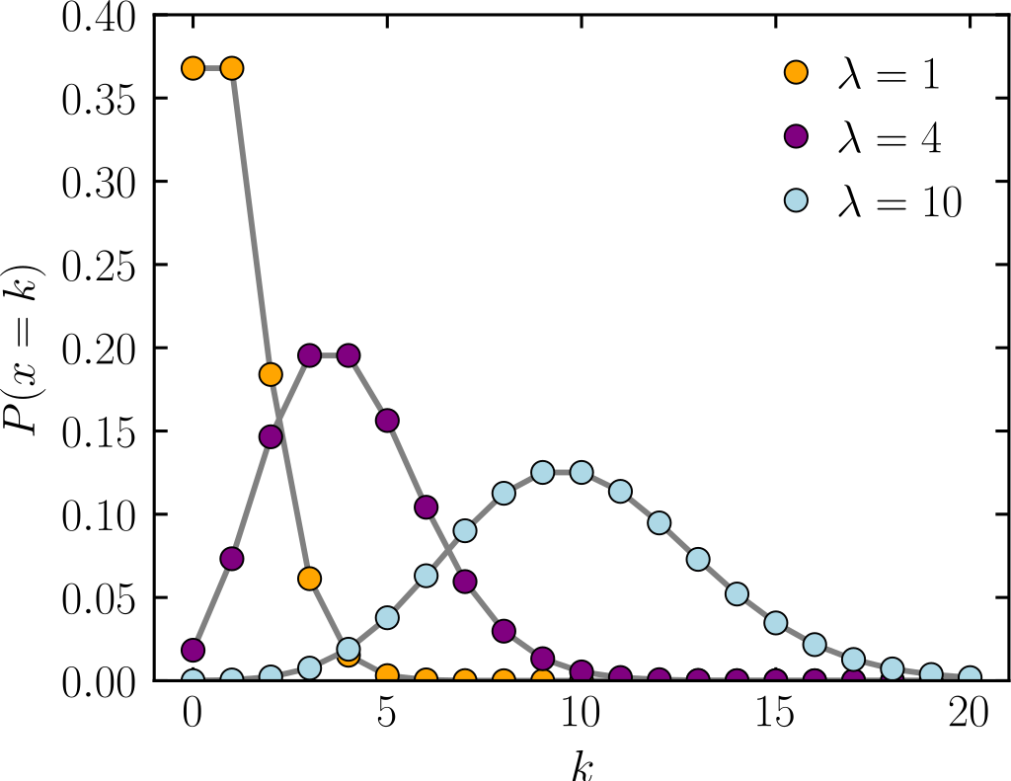
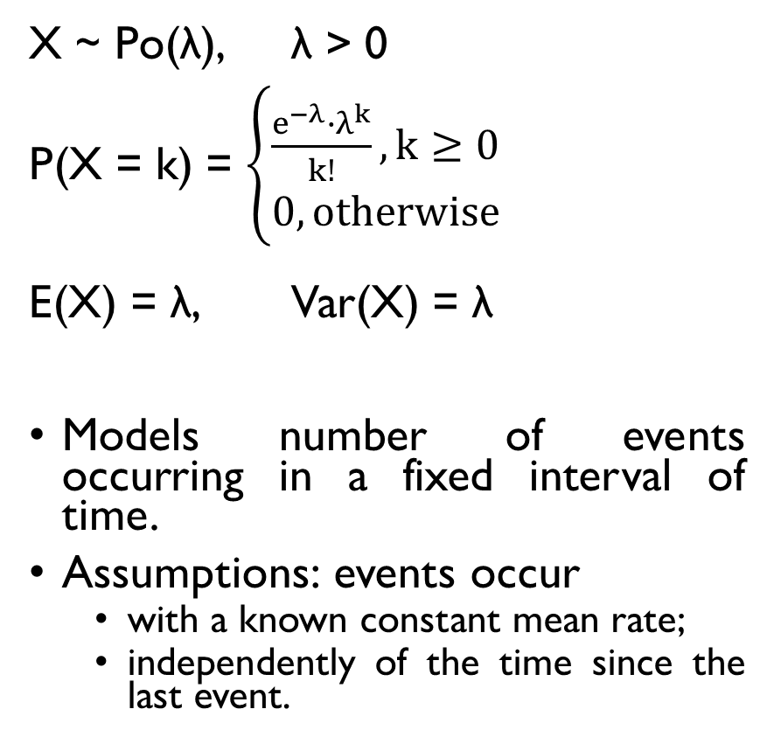
POISSON DISTRIBUTION
X ~ Po(λ), λ > 0
P(X = k) = $\left\{\begin{aligned}\frac{e^{−λ}∙λ^{k}}{k!}, k≥0 \\ 0, otherwise\end{aligned}\right.$
E(X) = λ, Var(X) = λ
Models number of events occurring in a fixed interval of time.
Assumptions: events occur
with a known constant mean rate;
independently of the time since the last event.

Slide 71
POISSON DISTRIBUTION
X ~ Po(λ), λ > 0
P(X = k) = $\left\{\begin{aligned}\frac{e^{−λ}∙λ^{k}}{k!}, k≥0 \\ 0, otherwise\end{aligned}\right.$
E(X) = λ, Var(X) = λ
Models number of events occurring in a fixed interval of time.
Assumptions: events occur
with a known constant mean rate;
independently of the time since the last event.
Suppose you want to model the number of phone calls a call center receives in an hour.
You’ve been recording it for the past n hours:
X1, X2, …, Xn
What’s the MLE of λ?

Slide 72
POISSON DISTRIBUTION
X ~ Po(λ), λ > 0
P(X = k) = $\left\{\begin{aligned}\frac{e^{−λ}∙λ^{k}}{k!}, k≥0 \\ 0, otherwise\end{aligned}\right.$
E(X) = λ, Var(X) = λ
Models number of events occurring in a fixed interval of time.
Assumptions: events occur
with a known constant mean rate;
independently of the time since the last event.
Suppose you want to model the number of phone calls a call center receives in an hour.
You’ve been recording it for the past n hours:
X1, X2, …, Xn
What’s the MLE of λ?

Slide 73
POISSON DISTRIBUTION
X ~ Po(λ), λ > 0
P(X = k) = $\left\{\begin{aligned}\frac{e^{−λ}∙λ^{k}}{k!}, k≥0 \\ 0, otherwise\end{aligned}\right.$
E(X) = λ, Var(X) = λ
Models number of events occurring in a fixed interval of time.
Assumptions: events occur
with a known constant mean rate;
independently of the time since the last event.
Suppose you want to model the number of phone calls a call center receives in an hour.
You’ve been recording it for the past n hours:
X1, X2, …, Xn
What’s the MLE of λ?

Slide 74
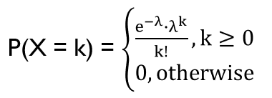

MLE FOR POISSON DISTRIBUTION
$$L\left(λ\right)=P\left(X_{1},…,X_{n}|λ\right)=\prod_{i=1}^{n}{\frac{e^{−λ}λ^{X_{i}}}{X_{i}!}}$$
$$log L\left(λ\right)=\sum_{i=1}^{n}{\left[−λ\log{e}+X_{1}\log{λ}−\log{X_{i}!}\right]}$$
$=−nλ+\log{λ}\sum_{i=1}^{n}{X_{i}}−\sum_{i=1}^{n}{\log{X_{i}!}}$
$$\frac{d}{dλ}L\left(λ\right)=−n+\frac{\sum_{i=1}^{n}{X_{i}}}{λ}=0, \hat{λ}=\frac{1}{n}\sum_{i=1}^{n}{X_{i}}$$

Slide 75

MLE FOR POISSON DISTRIBUTION
$$L\left(λ\right)=P\left(X_{1},…,X_{n}|λ\right)=\prod_{i=1}^{n}{\frac{e^{−λ}λ^{X_{i}}}{X_{i}!}}$$
$$log L\left(λ\right)=\sum_{i=1}^{n}{\left[−λ\log{e}+X_{1}\log{λ}−\log{X_{i}!}\right]}$$
$=−nλ+\log{λ}\sum_{i=1}^{n}{X_{i}}−\sum_{i=1}^{n}{\log{X_{i}!}}$
$$\frac{d}{dλ}L\left(λ\right)=−n+\frac{\sum_{i=1}^{n}{X_{i}}}{λ}=0, \hat{λ}=\frac{1}{n}\sum_{i=1}^{n}{X_{i}}$$

Slide 76

MLE FOR POISSON DISTRIBUTION
$$L\left(λ\right)=P\left(X_{1},…,X_{n}|λ\right)=\prod_{i=1}^{n}{\frac{e^{−λ}λ^{X_{i}}}{X_{i}!}}$$
$$log L\left(λ\right)=\sum_{i=1}^{n}{\left[−λ\log{e}+X_{1}\log{λ}−\log{X_{i}!}\right]}$$
$=−nλ+\log{λ}\sum_{i=1}^{n}{X_{i}}−\sum_{i=1}^{n}{\log{X_{i}!}}$
$$\frac{d}{dλ}L\left(λ\right)=−n+\frac{\sum_{i=1}^{n}{X_{i}}}{λ}=0, \hat{λ}=\frac{1}{n}\sum_{i=1}^{n}{X_{i}}$$

Slide 77

MLE FOR POISSON DISTRIBUTION
$$L\left(λ\right)=P\left(X_{1},…,X_{n}|λ\right)=\prod_{i=1}^{n}{\frac{e^{−λ}λ^{X_{i}}}{X_{i}!}}$$
$$log L\left(λ\right)=\sum_{i=1}^{n}{\left[−λ\log{e}+X_{i}\log{λ}−\log{X_{i}!}\right]}$$
$=−nλ+\log{λ}\sum_{i=1}^{n}{X_{i}}−\sum_{i=1}^{n}{\log{X_{i}!}}$
$$\frac{d}{dλ}L\left(λ\right)=−n+\frac{\sum_{i=1}^{n}{X_{i}}}{λ}=0, \hat{λ}=\frac{1}{n}\sum_{i=1}^{n}{X_{i}}$$

Slide 78

MLE FOR POISSON DISTRIBUTION
$$L\left(λ\right)=P\left(X_{1},…,X_{n}|λ\right)=\prod_{i=1}^{n}{\frac{e^{−λ}λ^{X_{i}}}{X_{i}!}}$$
$$log L\left(λ\right)=\sum_{i=1}^{n}{\left[−λ\log{e}+X_{i}\log{λ}−\log{X_{i}!}\right]}$$
$=−nλ+\log{λ}\sum_{i=1}^{n}{X_{i}}−\sum_{i=1}^{n}{\log{X_{i}!}}$
$$\frac{d}{dλ}L\left(λ\right)=−n+\frac{\sum_{i=1}^{n}{X_{i}}}{λ}=0, \hat{λ}=\frac{1}{n}\sum_{i=1}^{n}{X_{i}}$$

Slide 79
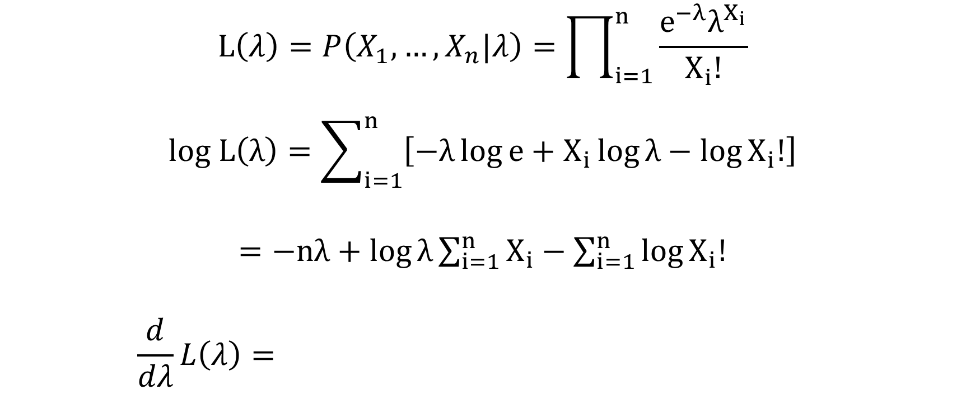
MLE FOR POISSON DISTRIBUTION
$$L\left(λ\right)=P\left(X_{1},…,X_{n}|λ\right)=\prod_{i=1}^{n}{\frac{e^{−λ}λ^{X_{i}}}{X_{i}!}}$$
$$log L\left(λ\right)=\sum_{i=1}^{n}{\left[−λ\log{e}+X_{i}\log{λ}−\log{X_{i}!}\right]}$$
$=−nλ+\log{λ}\sum_{i=1}^{n}{X_{i}}−\sum_{i=1}^{n}{\log{X_{i}!}}$
$$\frac{d}{dλ}L\left(λ\right)=−n+\frac{\sum_{i=1}^{n}{X_{i}}}{λ}=0, \hat{λ}=\frac{1}{n}\sum_{i=1}^{n}{X_{i}}$$

Slide 80
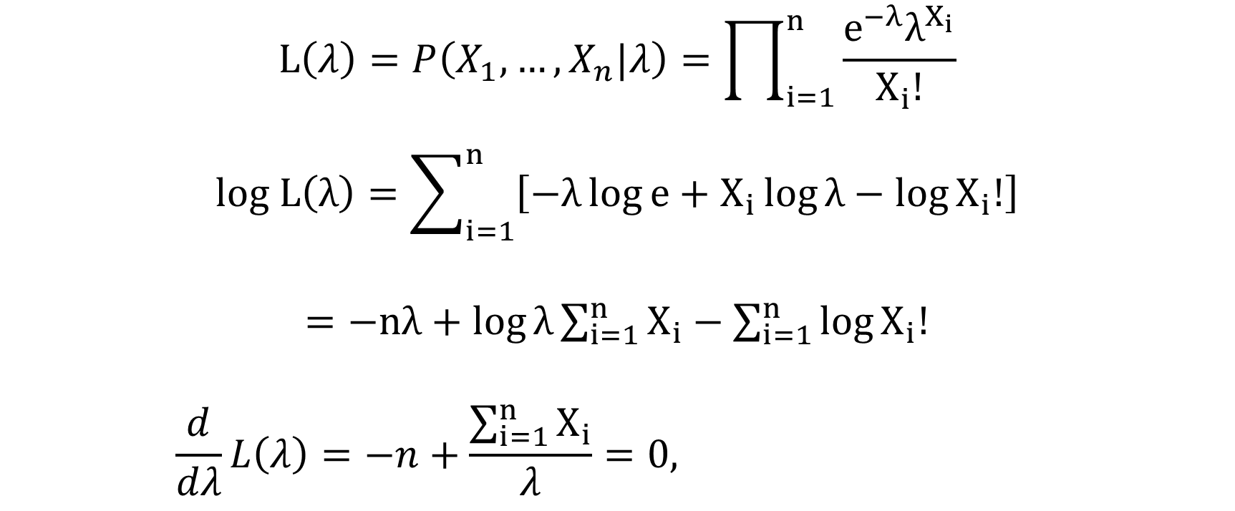
MLE FOR POISSON DISTRIBUTION
$$L\left(λ\right)=P\left(X_{1},…,X_{n}|λ\right)=\prod_{i=1}^{n}{\frac{e^{−λ}λ^{X_{i}}}{X_{i}!}}$$
$$log L\left(λ\right)=\sum_{i=1}^{n}{\left[−λ\log{e}+X_{i}\log{λ}−\log{X_{i}!}\right]}$$
$=−nλ+\log{λ}\sum_{i=1}^{n}{X_{i}}−\sum_{i=1}^{n}{\log{X_{i}!}}$
$$\frac{d}{dλ}L\left(λ\right)=−n+\frac{\sum_{i=1}^{n}{X_{i}}}{λ}=0, \hat{λ}=\frac{1}{n}\sum_{i=1}^{n}{X_{i}}$$

Slide 81
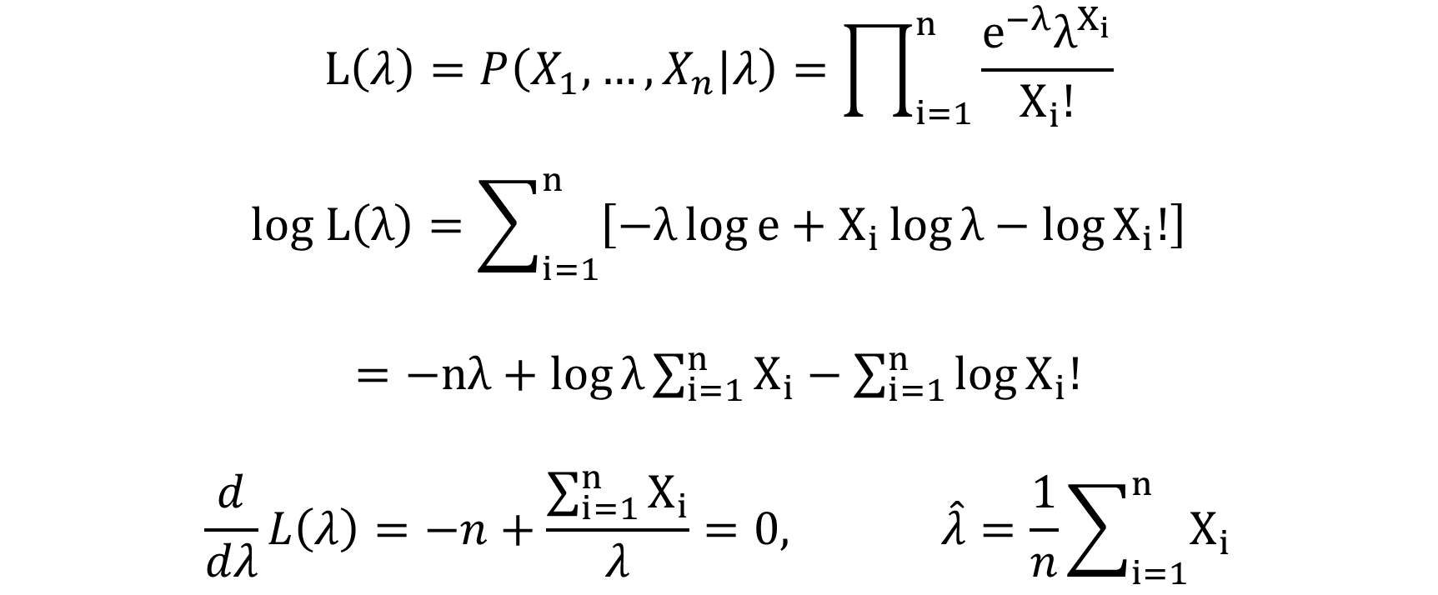
MLE FOR POISSON DISTRIBUTION
$$L\left(λ\right)=P\left(X_{1},…,X_{n}|λ\right)=\prod_{i=1}^{n}{\frac{e^{−λ}λ^{X_{i}}}{X_{i}!}}$$
$$log L\left(λ\right)=\sum_{i=1}^{n}{\left[−λ\log{e}+X_{i}\log{λ}−\log{X_{i}!}\right]}$$
$=−nλ+\log{λ}\sum_{i=1}^{n}{X_{i}}−\sum_{i=1}^{n}{\log{X_{i}!}}$
$$\frac{d}{dλ}L\left(λ\right)=−n+\frac{\sum_{i=1}^{n}{X_{i}}}{λ}=0, \hat{λ}=\frac{1}{n}\sum_{i=1}^{n}{X_{i}}$$

Slide 82
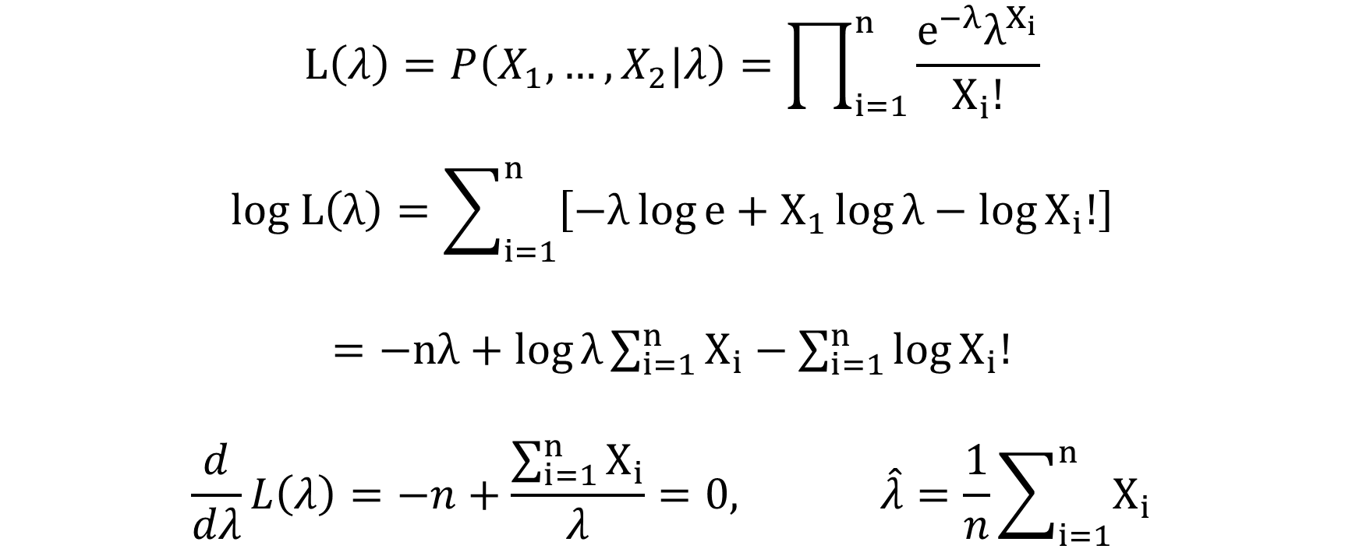
MLE FOR POISSON DISTRIBUTION
$$L\left(λ\right)=P\left(X_{1},…,X_{2}|λ\right)=\prod_{i=1}^{n}{\frac{e^{−λ}λ^{X_{i}}}{X_{i}!}}$$
$$log L\left(λ\right)=\sum_{i=1}^{n}{\left[−λ\log{e}+X_{1}\log{λ}−\log{X_{i}!}\right]}$$
$=−nλ+\log{λ}\sum_{i=1}^{n}{X_{i}}−\sum_{i=1}^{n}{\log{X_{i}!}}$
$$\frac{d}{dλ}L\left(λ\right)=−n+\frac{\sum_{i=1}^{n}{X_{i}}}{λ}=0, \hat{λ}=\frac{1}{n}\sum_{i=1}^{n}{X_{i}}$$

Slide 83
MLE: YET ANOTHER EXAMPLE
Random variable X takes three values with unknown probabilities:
How many parameters does such a distribution have?
X | 1 | 2 | 3
P(X) | ? | ? | ?

Slide 84
MLE: YET ANOTHER EXAMPLE
Random variable X takes three values with unknown probabilities:
How many parameters does such a distribution have?
X | 1 | 2 | 3
P(X) | ? | ? | ?

Slide 85
MLE: YET ANOTHER EXAMPLE
Random variable X takes three values with unknown probabilities:
How many parameters does such a distribution have?
X | 1 | 2 | 3
P(X) | p | q | 1-p-q

Slide 86
MLE: YET ANOTHER EXAMPLE
Random variable X takes three values with unknown probabilities:
How many parameters does such a distribution have?
We observed it N times:
What is the MLE of the parameters?
X | 1 | 2 | 3
P(X) | p | q | 1-p-q
X | 1 | 2 | 3
# | n₁ | n₂ | n₃

Slide 87
MLE: YET ANOTHER EXAMPLE
Random variable X takes three values with unknown probabilities:
How many parameters does such a distribution have?
We observed it N times:
What is the MLE of the parameters?
X | 1 | 2 | 3
P(X) | p | q | 1-p-q
X | 1 | 2 | 3
# | n₁ | n₂ | n₃

Slide 88

CALCULUS 101
How to optimize a function of several variables?
Compute partial derivatives.
Set them to zero.
Solve the equations and get the critical points.
$$f\left(x,y\right)=x^{2}+2xy−2x−4y$$
$$\frac{d}{dx}f\left(x,y\right)=2x+2y−2=0$$
$$\frac{d}{dy}f\left(x,y\right)=2x−4=0$$
$$x^{∗}=2, y^{∗}=1$$

Slide 89
CALCULUS 101
How to optimize a function of several variables?
Compute partial derivatives.
Set them to zero.
Solve the equations and get the critical points.
$$f\left(x,y\right)=x^{2}+2xy−2x−4y$$
$$\frac{d}{dx}f\left(x,y\right)=2x+2y−2=0$$
$$\frac{d}{dy}f\left(x,y\right)=2x−4=0$$
$$x^{∗}=2, y^{∗}=1$$

Slide 90

CALCULUS 101
How to optimize a function of several variables?
Compute partial derivatives.
Set them to zero.
Solve the equations and get the critical points.
$$f\left(x,y\right)=x^{2}+2xy−2x−4y$$
$$\frac{d}{dx}f\left(x,y\right)=2x+2y−2=0$$
$$\frac{d}{dy}f\left(x,y\right)=2x−4=0$$
$$x^{∗}=2, y^{∗}=1$$

Slide 91

MLE: YET ANOTHER EXAMPLE
X | 1 | 2 | 3
P(X) | p | q | 1-p-q
Value | 1 | 2 | 3
# | n₁ | n₂ | n₃
What’s the probability of observing such data? Likelihood:
L(p, q) = $p^{n_{1}}∙q^{n_{2}}∙{\left(1−p−q\right)}^{n_{3}}$
maximize L(p, q) w.r.t. p, q
⬄
log L(p, q) = $n_{1}log{p}+n_{2}\log{q}+n_{3}\log\left(1−p−q\right)$
maximize log L(p, q) w.r.t. p, q

Slide 92
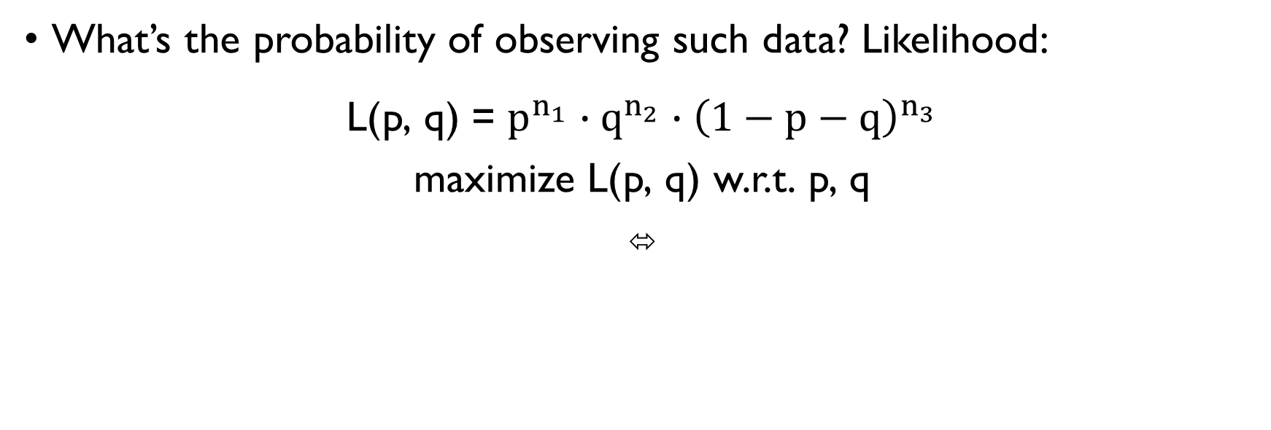
MLE: YET ANOTHER EXAMPLE
X | 1 | 2 | 3
P(X) | p | q | 1-p-q
Value | 1 | 2 | 3
# | n₁ | n₂ | n₃
What’s the probability of observing such data? Likelihood:
L(p, q) = $p^{n_{1}}∙q^{n_{2}}∙{\left(1−p−q\right)}^{n_{3}}$
maximize L(p, q) w.r.t. p, q
⬄
log L(p, q) = $n_{1}log{p}+n_{2}\log{q}+n_{3}\log\left(1−p−q\right)$
maximize log L(p, q) w.r.t. p, q

Slide 93
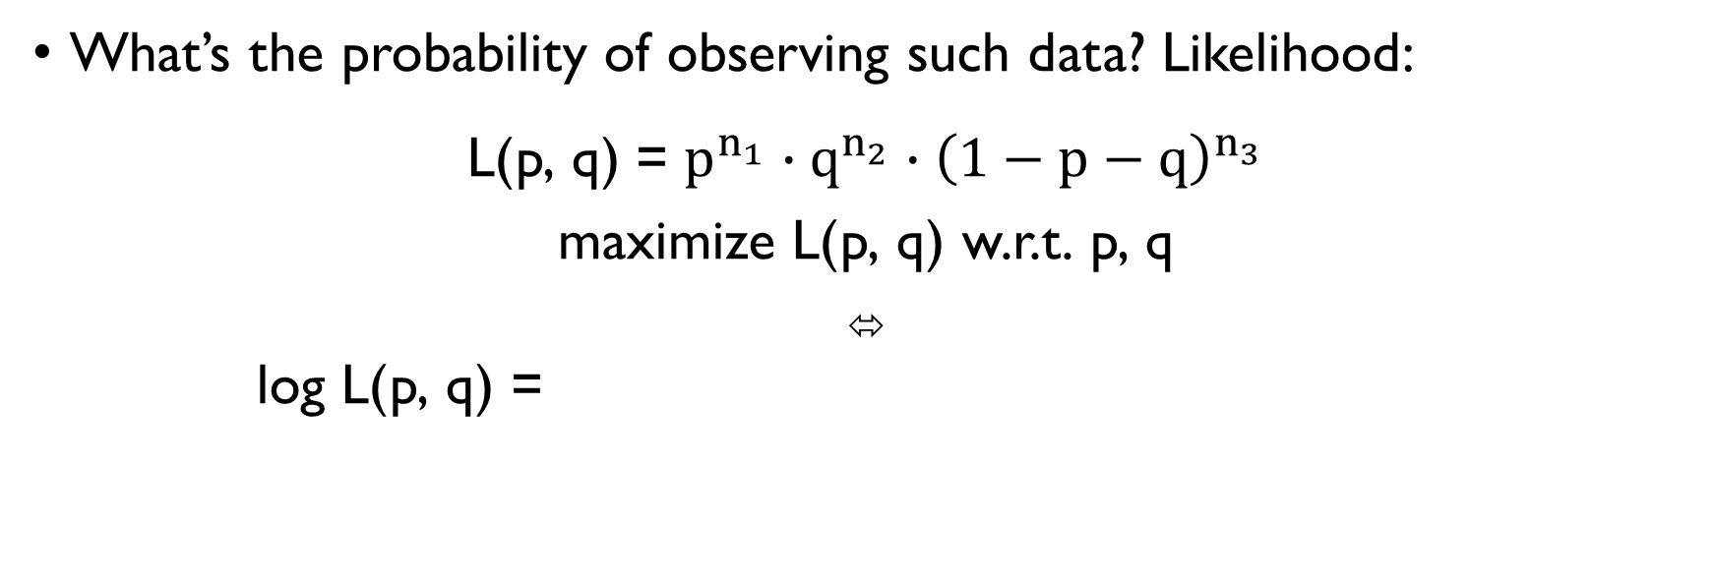
MLE: YET ANOTHER EXAMPLE
X | 1 | 2 | 3
P(X) | p | q | 1-p-q
Value | 1 | 2 | 3
# | n₁ | n₂ | n₃
What’s the probability of observing such data? Likelihood:
L(p, q) = $p^{n_{1}}∙q^{n_{2}}∙{\left(1−p−q\right)}^{n_{3}}$
maximize L(p, q) w.r.t. p, q
⬄
log L(p, q) = $n_{1}log{p}+n_{2}\log{q}+n_{3}\log\left(1−p−q\right)$
maximize log L(p, q) w.r.t. p, q

Slide 94
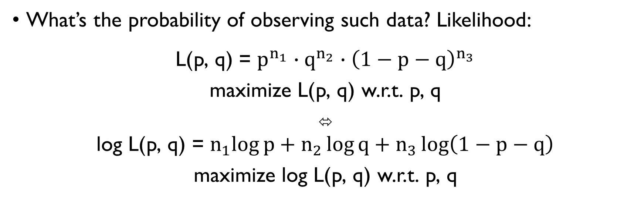
MLE: YET ANOTHER EXAMPLE
X | 1 | 2 | 3
P(X) | p | q | 1-p-q
Value | 1 | 2 | 3
# | n₁ | n₂ | n₃
What’s the probability of observing such data? Likelihood:
L(p, q) = $p^{n_{1}}∙q^{n_{2}}∙{\left(1−p−q\right)}^{n_{3}}$
maximize L(p, q) w.r.t. p, q
⬄
log L(p, q) = $n_{1}log{p}+n_{2}\log{q}+n_{3}\log\left(1−p−q\right)$
maximize log L(p, q) w.r.t. p, q

Slide 95
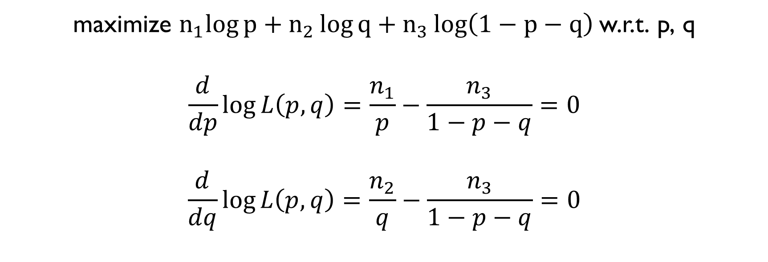
MLE: EXAMPLE 2
X | 1 | 2 | 3
P(X) | p | q | 1-p-q
Value | 1 | 2 | 3
# | n₁ | n₂ | n₃
maximize $n_{1}log{p}+n_{2}\log{q}+n_{3}\log\left(1−p−q\right)$w.r.t. p, q
$$\frac{d}{dp}\log{L\left(p,q\right)=\frac{n_{1}}{p}−\frac{n_{3}}{1−p−q}=0}$$
$$\frac{d}{dq}\log{L\left(p,q\right)=\frac{n_{2}}{q}−\frac{n_{3}}{1−p−q}=0}$$

Slide 96

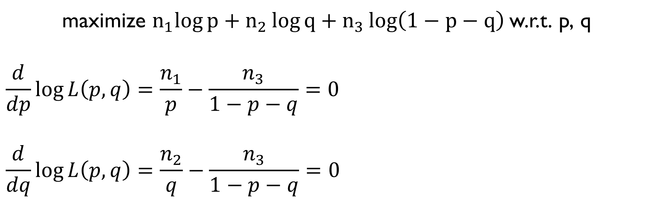
MLE: EXAMPLE 2
X | 1 | 2 | 3
P(X) | p | q | 1-p-q
Value | 1 | 2 | 3
# | n₁ | n₂ | n₃
maximize $n_{1}log{p}+n_{2}\log{q}+n_{3}\log\left(1−p−q\right)$w.r.t. p, q
$$\frac{d}{dp}\log{L\left(p,q\right)=\frac{n_{1}}{p}−\frac{n_{3}}{1−p−q}=0}$$
$$\frac{d}{dq}\log{L\left(p,q\right)=\frac{n_{2}}{q}−\frac{n_{3}}{1−p−q}=0}$$
$$\hat{p}=\frac{n_{1}}{N}$$
$$\hat{q}=\frac{n_{2}}{N}$$

Slide 97
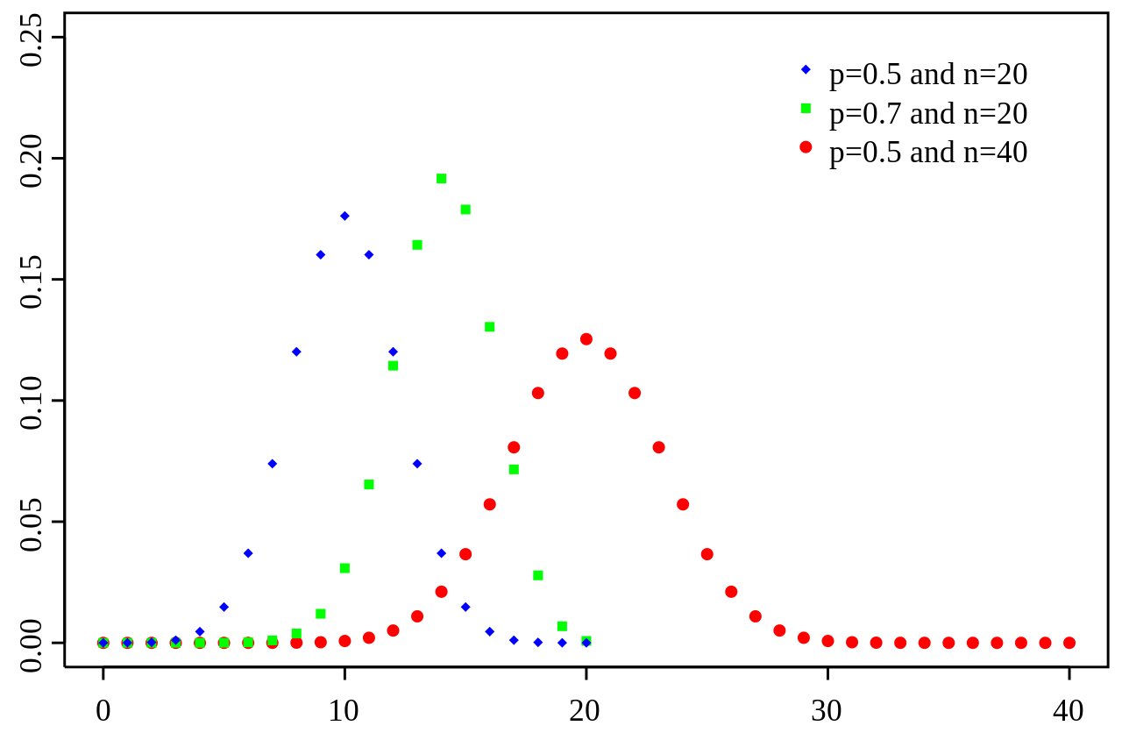
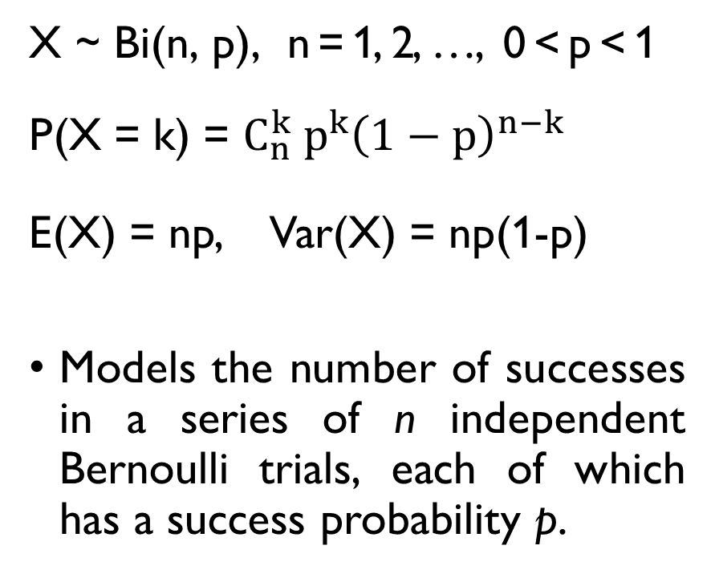
BINOMIAL DISTRIBUTION
X ~ Bi(n, p), n = 1, 2, …, 0 < p < 1
P(X = k) = $C_{n}^{k} p^{k}{\left(1−p\right)}^{n−k}$
E(X) = np, Var(X) = np(1-p)
Models the number of successes in a series of n independent Bernoulli trials, each of which has a success probability p.

Slide 98
BINOMIAL DISTRIBUTION
X ~ Bi(n, p), n = 1, 2, …, 0 < p < 1
P(X = k) = $C_{n}^{k} p^{k}{\left(1−p\right)}^{n−k}$
E(X) = np, Var(X) = np(1-p)
Models the number of successes in a series of n independent Bernoulli trials, each of which has a success probability p.
You sell two types of sandwiches: chicken and vegetarian. Which one people like more?
For the past N days, you were selling n=100 sandwiches every day and recorded the number of the chicken ones:
X₁, X₂, …, X_{N}
What is the MLE of the p parameter?

Slide 99

MLE FOR BINOMIAL DISTRIBUTION
$$L\left(p\right)= \prod_{i=1}^{N}{C_{n}^{X_{i}}p^{X_{i}}{\left(1−p \right)}^{100−X_{i}}}$$
$$\log{L\left(p\right)=\sum_{i=1}^{N}{\left[\log{C_{n}^{X_{i}}+X_{i}\log{p}+\left(100−X_{i}\right)\log\left(1−p\right)}\right]}}$$
$$\frac{d}{dp}L\left(p\right)=\sum_{i=1}^{N}{\frac{X_{i}}{p} −\frac{100−X_{i}}{1−p}=\frac{\sum_{i=1}^{N}{X_{i}}}{p}−\frac{100N −\sum_{i=1}^{N}{X_{i}}}{1−p}=0}$$
$$\hat{p}=\frac{\sum_{i=1}^{N}{X_{i}}}{100N}$$

Slide 100

MLE FOR BINOMIAL DISTRIBUTION
$$L\left(p\right)= \prod_{i=1}^{N}{C_{n}^{X_{i}}p^{X_{i}}{\left(1−p \right)}^{100−X_{i}}}$$
$$\log{L\left(p\right)=\sum_{i=1}^{N}{\left[\log{C_{n}^{X_{i}}+X_{i}\log{p}+\left(100−X_{i}\right)\log\left(1−p\right)}\right]}}$$
$$\frac{d}{dp}L\left(p\right)=\sum_{i=1}^{N}{\frac{X_{i}}{p} −\frac{100−X_{i}}{1−p}=\frac{\sum_{i=1}^{N}{X_{i}}}{p}−\frac{100N −\sum_{i=1}^{N}{X_{i}}}{1−p}=0}$$
$$\hat{p}=\frac{\sum_{i=1}^{N}{X_{i}}}{100N}$$

Slide 101

MLE FOR BINOMIAL DISTRIBUTION
$$L\left(p\right)= \prod_{i=1}^{N}{C_{n}^{X_{i}}p^{X_{i}}{\left(1−p \right)}^{100−X_{i}}}$$
$$\log{L\left(p\right)=\sum_{i=1}^{N}{\left[\log{C_{n}^{X_{i}}+X_{i}\log{p}+\left(100−X_{i}\right)\log\left(1−p\right)}\right]}}$$
$$\frac{d}{dp}L\left(p\right)=\sum_{i=1}^{N}{\frac{X_{i}}{p} −\frac{100−X_{i}}{1−p}=\frac{\sum_{i=1}^{N}{X_{i}}}{p}−\frac{100N −\sum_{i=1}^{N}{X_{i}}}{1−p}=0}$$
$$\hat{p}=\frac{\sum_{i=1}^{N}{X_{i}}}{100N}$$

Slide 102

MLE FOR BINOMIAL DISTRIBUTION
$$L\left(p\right)= \prod_{i=1}^{N}{C_{n}^{X_{i}}p^{X_{i}}{\left(1−p \right)}^{100−X_{i}}}$$
$$\log{L\left(p\right)=\sum_{i=1}^{N}{\left[\log{C_{n}^{X_{i}}+X_{i}\log{p}+\left(100−X_{i}\right)\log\left(1−p\right)}\right]}}$$
$$\frac{d}{dp}L\left(p\right)=\sum_{i=1}^{N}{\frac{X_{i}}{p} −\frac{100−X_{i}}{1−p}=\frac{\sum_{i=1}^{N}{X_{i}}}{p}−\frac{100N −\sum_{i=1}^{N}{X_{i}}}{1−p}=0}$$
$$\hat{p}=\frac{\sum_{i=1}^{N}{X_{i}}}{100N}$$

Slide 103

MLE FOR BINOMIAL DISTRIBUTION
$$L\left(p\right)= \prod_{i=1}^{N}{C_{n}^{X_{i}}p^{X_{i}}{\left(1−p \right)}^{100−X_{i}}}$$
$$\log{L\left(p\right)=\sum_{i=1}^{N}{\left[\log{C_{n}^{X_{i}}+X_{i}\log{p}+\left(100−X_{i}\right)\log\left(1−p\right)}\right]}}$$
$$\frac{d}{dp}L\left(p\right)=\sum_{i=1}^{N}{\frac{X_{i}}{p} −\frac{100−X_{i}}{1−p}=\frac{\sum_{i=1}^{N}{X_{i}}}{p}−\frac{100N −\sum_{i=1}^{N}{X_{i}}}{1−p}=0}$$
$$\hat{p}=\frac{\sum_{i=1}^{N}{X_{i}}}{100N}$$

Slide 104

MLE FOR BINOMIAL DISTRIBUTION
$$L\left(p\right)= \prod_{i=1}^{N}{C_{n}^{X_{i}}p^{X_{i}}{\left(1−p \right)}^{100−X_{i}}}$$
$$\log{L\left(p\right)=\sum_{i=1}^{N}{\left[\log{C_{n}^{X_{i}}+X_{i}\log{p}+\left(100−X_{i}\right)\log\left(1−p\right)}\right]}}$$
$$\frac{d}{dp}L\left(p\right)=\sum_{i=1}^{N}{\frac{X_{i}}{p} −\frac{100−X_{i}}{1−p}=\frac{\sum_{i=1}^{N}{X_{i}}}{p}−\frac{100N −\sum_{i=1}^{N}{X_{i}}}{1−p}=0}$$
$$\hat{p}=\frac{\sum_{i=1}^{N}{X_{i}}}{100N}$$

Slide 105

MLE FOR BINOMIAL DISTRIBUTION
$$L\left(p\right)= \prod_{i=1}^{N}{C_{n}^{X_{i}}p^{X_{i}}{\left(1−p \right)}^{100−X_{i}}}$$
$$\log{L\left(p\right)=\sum_{i=1}^{N}{\left[\log{C_{n}^{X_{i}}+X_{i}\log{p}+\left(100−X_{i}\right)\log\left(1−p\right)}\right]}}$$
$$\frac{d}{dp}L\left(p\right)=\sum_{i=1}^{N}{\frac{X_{i}}{p} −\frac{100−X_{i}}{1−p}=\frac{\sum_{i=1}^{N}{X_{i}}}{p}−\frac{100N −\sum_{i=1}^{N}{X_{i}}}{1−p}=0}$$
$$\hat{p}=\frac{\sum_{i=1}^{N}{X_{i}}}{100N}$$

Slide 106

MLE FOR BINOMIAL DISTRIBUTION
$$L\left(p\right)= \prod_{i=1}^{N}{C_{n}^{X_{i}}p^{X_{i}}{\left(1−p \right)}^{100−X_{i}}}$$
$$\log{L\left(p\right)=\sum_{i=1}^{N}{\left[\log{C_{n}^{X_{i}}+X_{i}\log{p}+\left(100−X_{i}\right)\log\left(1−p\right)}\right]}}$$
$$\frac{d}{dp}L\left(p\right)=\sum_{i=1}^{N}{\frac{X_{i}}{p} −\frac{100−X_{i}}{1−p}=\frac{\sum_{i=1}^{N}{X_{i}}}{p}−\frac{100N −\sum_{i=1}^{N}{X_{i}}}{1−p}=0}$$
$$\hat{p}=\frac{\sum_{i=1}^{N}{X_{i}}}{100N}$$

Slide 107

MLE FOR BINOMIAL DISTRIBUTION
$$L\left(p\right)= \prod_{i=1}^{N}{C_{n}^{X_{i}}p^{X_{i}}{\left(1−p \right)}^{100−X_{i}}}$$
$$\log{L\left(p\right)=\sum_{i=1}^{N}{\left[\log{C_{n}^{X_{i}}+X_{i}\log{p}+\left(100−X_{i}\right)\log\left(1−p\right)}\right]}}$$
$$\frac{d}{dp}L\left(p\right)=\sum_{i=1}^{N}{\frac{X_{i}}{p} −\frac{100−X_{i}}{1−p}=\frac{\sum_{i=1}^{N}{X_{i}}}{p}−\frac{100N −\sum_{i=1}^{N}{X_{i}}}{1−p}=0}$$
$$\hat{p}=\frac{\sum_{i=1}^{N}{X_{i}}}{100N}$$

Slide 108
MLE FOR BINOMIAL DISTRIBUTION
$$L\left(p\right)= \prod_{i=1}^{N}{C_{n}^{X_{i}}p^{X_{i}}{\left(1−p \right)}^{100−X_{i}}}$$
$$\log{L\left(p\right)=\sum_{i=1}^{N}{\left[\log{C_{n}^{X_{i}}+X_{i}\log{p}+\left(100−X_{i}\right)\log\left(1−p\right)}\right]}}$$
$$\frac{d}{dp}L\left(p\right)=\sum_{i=1}^{N}{\frac{X_{i}}{p} −\frac{100−X_{i}}{1−p}=\frac{\sum_{i=1}^{N}{X_{i}}}{p}−\frac{100N −\sum_{i=1}^{N}{X_{i}}}{1−p}=0}$$
$$\hat{p}=\frac{\sum_{i=1}^{N}{X_{i}}}{100N}$$

Slide 109
BREAK
Task: find a coin ☺

Slide 110
RANDOMIZED RESPONSE
Asking embarrassing questions

Slide 111
MOTIVATION
BEFORE:
How many vegetarians are in the world?
Survey: ask “are you a vegetarian?”, estimate the true proportion.
BUT WHAT IF the question is very sensitive?
People won’t tell the truth.
EXAMPLE: Do you find this course boring?
How do I find out what my students actually think?

Slide 112
MOTIVATION
BEFORE:
How many vegetarians are in the world?
Survey: ask “are you a vegetarian?”, estimate the true proportion.
BUT WHAT IF the question is very sensitive?
People won’t tell the truth.
EXAMPLE: Do you find this course boring?
How do I find out what my students actually think?

Slide 113
MOTIVATION
BEFORE:
How many vegetarians are in the world?
Survey: ask “are you a vegetarian?”, estimate the true proportion.
BUT WHAT IF the question is very sensitive?
People won’t tell the truth.
EXAMPLE: Do you find this course boring?
How do I find out what my students actually think?

Slide 114
STRATEGY: RANDOMIZED RESPONSE
Watch the video about the randomized response strategy.
In groups, discuss the strategy and complete the assignment.
See Google Classroom.

Slide 115
LET’S TRY THIS OUT!
Toss a coin…
Now, answer one of the following questions:
If you got HEADS: Do you find this class boring?
If you got TAILS: Are you at the Statistics class right now?

Slide 116
LET’S TRY THIS OUT!
Toss a coin…
Now, answer one of the following questions:
If you got HEADS: Do you find this class boring?
If you got TAILS: Are you at the Statistics class right now?

Slide 117
LET’S TRY THIS OUT!
Toss a coin…
Now, answer one of the following questions:
If you got HEADS: DO YOU FIND THIS CLASS BORING?
If you got TAILS: ARE YOU AT THE STATISTICS CLASS RIGHT NOW?

Slide 118
TO SUM UP
Likelihood function is the joint probability of realized sample given the parameters.
Maximum Likelihood Estimate (MLE) is the value which maximizes the probability of observing the realized sample.

