Slide 1
INTRODUCTION TO STATISTICS
LECTURE 3

Slide 2
LAST TIME
Parameter estimation
Maximum Likelihood
Discrete distributions
Randomized response

Slide 3
TODAY
Wrap-up randomized response exercise
Overview of the distributions we’ve seen so far
More MLE
Continuous distributions

Slide 4
A bit more on randomized response
Constrained optimization

Slide 5
REMARKS ON RANDOMIZED RESPONSE
Ask people two questions:
50% of the cases: Q1 (embarrassing)
50% of the cases: Q2 (regular, answer is always YES)
Record responses X₁, …, X₁₀₀ , X_{i} = 1 (YES) or 0 (NO)
X_{i} ~ Bernoulli(q)
q = P(X_{i} = 1) = P(YES) = P(YES|Q1)*P(Q1) + P(YES|Q2)*P(Q2) =
= P(YES|Q1)*0.5 + 0.5*1 = p + 0.5

Slide 6
REMARKS ON RANDOMIZED RESPONSE
Ask people two questions:
50% of the cases: Q1 (embarrassing)
50% of the cases: Q2 (regular, answer is always YES)
Record responses X₁, …, X₁₀₀ , X_{i} = 1 (YES) or 0 (NO)
X_{i} ~ Bernoulli(q)
q = P(X_{i} = 1) = P(YES) = P(YES|Q1)*P(Q1) + P(YES|Q2)*P(Q2) =
= P(YES|Q1)*0.5 + 0.5*1 = p + 0.5

Slide 7
REMARKS ON RANDOMIZED RESPONSE
Ask people two questions:
50% of the cases: Q1 (embarrassing)
50% of the cases: Q2 (regular, answer is always YES)
Record responses X₁, …, X₁₀₀ , X_{i} = 1 (YES) or 0 (NO)
X_{i} ~ Bernoulli(q)
q = P(X_{i} = 1) = P(YES) = P(YES|Q1)*P(Q1) + P(YES|Q2)*P(Q2) =
= P(YES|Q1)*0.5 + 0.5*1 = p + 0.5

Slide 8
REMARKS ON RANDOMIZED RESPONSE
Ask people two questions:
50% of the cases: Q1 (embarrassing)
50% of the cases: Q2 (regular, answer is always YES)
Record responses X₁, …, X₁₀₀ , X_{i} = 1 (YES) or 0 (NO)
X_{i} ~ Bernoulli(q)
q = P(X_{i} = 1) = P(YES) = P(YES|Q1)*P(Q1) + P(YES|Q2)*P(Q2) =
= P(YES|Q1)*0.5 + 0.5*1 = p + 0.5

Slide 9
REMARKS ON RANDOMIZED RESPONSE
Ask people two questions:
50% of the cases: Q1 (embarrassing)
50% of the cases: Q2 (regular, answer is always YES)
Record responses X₁, …, X₁₀₀ , X_{i} = 1 (YES) or 0 (NO)
X_{i} ~ Bernoulli(q)
q = P(X_{i} = 1) = P(YES) = P(YES|Q1)*P(Q1) + P(YES|Q2)*P(Q2) =
= P(YES|Q1)*0.5 + 0.5*1 = p + 0.5

Slide 10
REMARKS ON RANDOMIZED RESPONSE
Ask people two questions:
50% of the cases: Q1 (embarrassing)
50% of the cases: Q2 (regular, answer is always YES)
Record responses X₁, …, X₁₀₀ , X_{i} = 1 (YES) or 0 (NO)
X_{i} ~ Bernoulli(q)
q = P(X_{i} = 1) = P(YES) = P(YES|Q1)*P(Q1) + P(YES|Q2)*P(Q2) =
= P(YES|Q1)*0.5 + 0.5*1 = p*0.5 + 0.5

Slide 11

REMARKS ON RANDOMIZED RESPONSE
Responses X₁, …, X₁₀₀ , X_{i} ~ Bernoulli(q)
q = 0.5*p + 0.5
MLE: $\hat{q}$ = {We got 60 YES out of 100} = 0.6 $⇒\hat{p}$ = 2$\hat{q}$ - 1 = 0.2
Imagine that we got 40 YES out of 100. Then:
$\hat{q}$ = 0.4 $⇒\hat{p}$ = 2$\hat{q}$ - 1 = -0.2

Slide 12

REMARKS ON RANDOMIZED RESPONSE
Responses X₁, …, X₁₀₀ , X_{i} ~ Bernoulli(q)
q = 0.5*p + 0.5
MLE: $\hat{q}$ = {We got 60 YES out of 100} = 0.6 $⇒\hat{p}$ = 2$\hat{q}$ - 1 = 0.2
Imagine that we got 40 YES out of 100. Then:
$\hat{q}$ = 0.4 $⇒\hat{p}$ = 2$\hat{q}$ - 1 = -0.2

Slide 13

REMARKS ON RANDOMIZED RESPONSE
Responses X₁, …, X₁₀₀ , X_{i} ~ Bernoulli(q)
q = 0.5*p + 0.5
MLE: $\hat{q}$ = {We got 60 YES out of 100} = 0.6 $⇒\hat{p}$ = 2$\hat{q}$ - 1 = 0.2
Imagine that we got 40 YES out of 100. Then:
$\hat{q}$ = 0.4 $⇒\hat{p}$ = 2$\hat{q}$ - 1 = -0.2

Slide 14
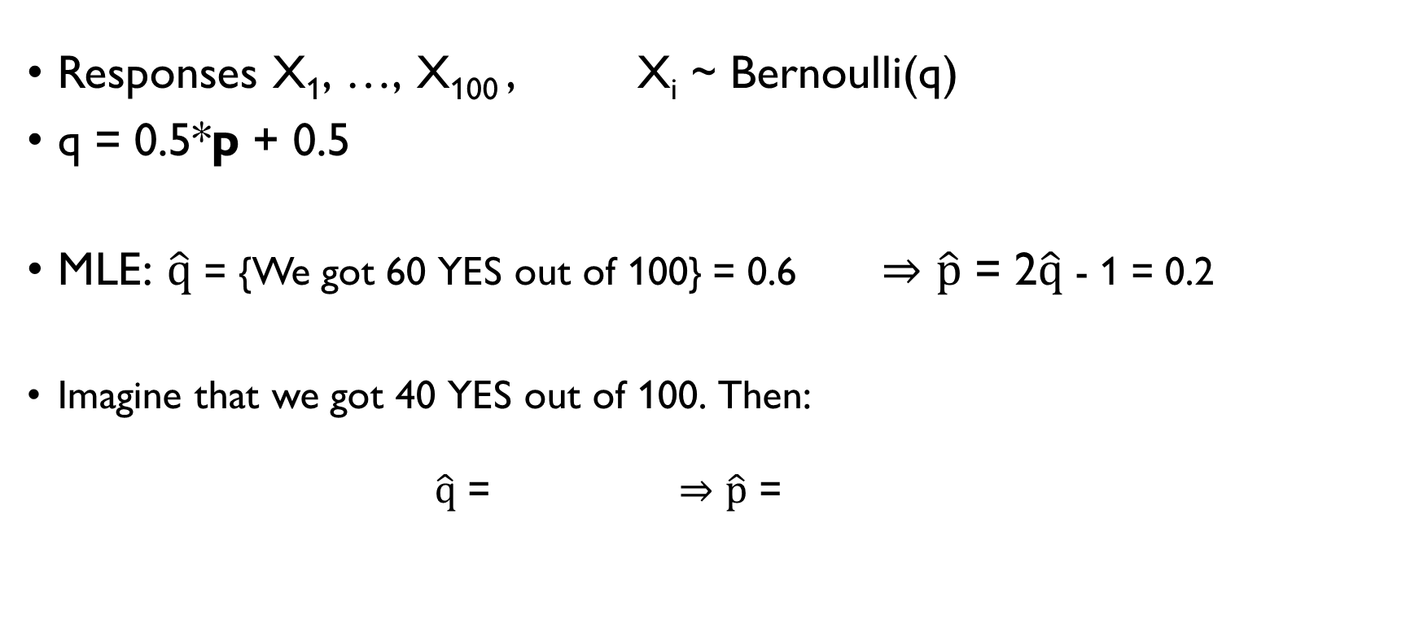
REMARKS ON RANDOMIZED RESPONSE
Responses X₁, …, X₁₀₀ , X_{i} ~ Bernoulli(q)
q = 0.5*p + 0.5
MLE: $\hat{q}$ = {We got 60 YES out of 100} = 0.6 $⇒\hat{p}$ = 2$\hat{q}$ - 1 = 0.2
Imagine that we got 40 YES out of 100. Then:
$\hat{q}$ = 0.4 $⇒\hat{p}$ = 2$\hat{q}$ - 1 = -0.2

Slide 15

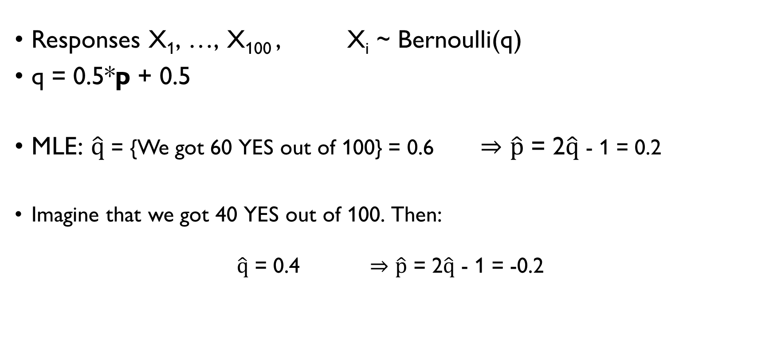
REMARKS ON RANDOMIZED RESPONSE
Responses X₁, …, X₁₀₀ , X_{i} ~ Bernoulli(q)
q = 0.5*p + 0.5
MLE: $\hat{q}$ = {We got 60 YES out of 100} = 0.6 $⇒\hat{p}$ = 2$\hat{q}$ - 1 = 0.2
Imagine that we got 40 YES out of 100. Then:
$\hat{q}$ = 0.4 $⇒\hat{p}$ = 2$\hat{q}$ - 1 = -0.2

Slide 16
REMARKS ON RANDOMIZED RESPONSE
Responses X₁, …, X₁₀₀ , X_{i} ~ Bernoulli(q)
q = 0.5*p + 0.5
MLE: $\hat{q}$ = {We got 60 YES out of 100} = 0.6 $⇒\hat{p}$ = 2$\hat{q}$ - 1 = 0.2
Imagine that we got 40 YES out of 100. Then:
$\hat{q}$ = 0.4 $⇒\hat{p}$ = 2$\hat{q}$ - 1 = -0.2

Slide 17

REMARKS ON RANDOMIZED RESPONSE
Responses X₁, …, X₁₀₀ , X_{i} ~ Bernoulli(q)
q = 0.5*p + 0.5
Constraints: 0 $≤$ $\hat{q}$ $≤$ 1,
0 $≤$ $\hat{p}$ $≤$ 1
When maximizing a function with constraints: check the borders.
40 out of 100 YES. MLE:
0.4 gives the highest L(q), but out of reach
L(0.5) > L(1) = 0 $⇒\hat{q}=0.5, \hat{p}=0$

Slide 18

REMARKS ON RANDOMIZED RESPONSE
Responses X₁, …, X₁₀₀ , X_{i} ~ Bernoulli(q)
q = 0.5*p + 0.5
Constraints: 0 $≤$ $\hat{q}$ $≤$ 1,
0 $≤$ $\hat{p}$ $≤$ 1
When maximizing a function with constraints: check the borders.
40 out of 100 YES. MLE:
0.4 gives the highest L(q), but out of reach
L(0.5) > L(1) = 0 $⇒\hat{q}=0.5, \hat{p}=0$

Slide 19

REMARKS ON RANDOMIZED RESPONSE
Responses X₁, …, X₁₀₀ , X_{i} ~ Bernoulli(q)
q = 0.5*p + 0.5
Constraints: 0 $≤$ $\hat{q}$ $≤$ 1,
0 $≤$ $\hat{p}$ $≤$ 1
When maximizing a function with constraints: check the borders.
40 out of 100 YES. MLE:
0.4 gives the highest L(q), but out of reach
L(0.5) > L(1) = 0 $⇒\hat{q}=0.5, \hat{p}=0$
$$⇒0.5≤\hat{q}≤1$$

Slide 20
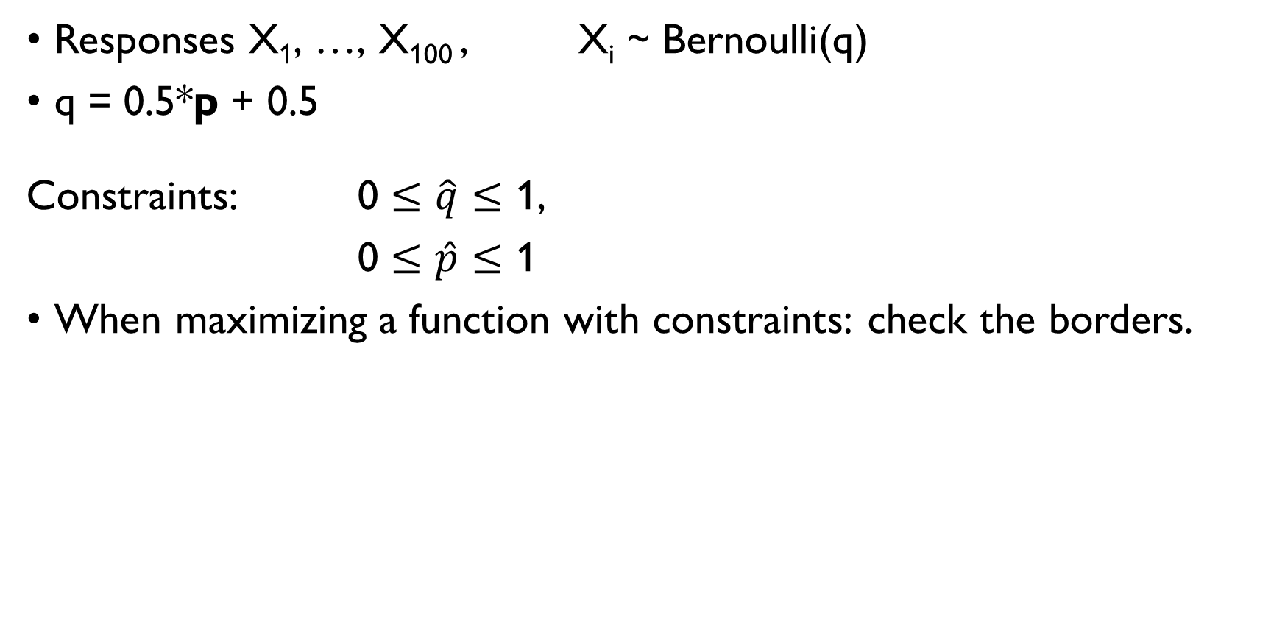
REMARKS ON RANDOMIZED RESPONSE
Responses X₁, …, X₁₀₀ , X_{i} ~ Bernoulli(q)
q = 0.5*p + 0.5
Constraints: 0 $≤$ $\hat{q}$ $≤$ 1,
0 $≤$ $\hat{p}$ $≤$ 1
When maximizing a function with constraints: check the borders.
40 out of 100 YES. MLE:
0.4 gives the highest L(q), but out of reach
L(0.5) > L(1) = 0 $⇒\hat{q}=0.5, \hat{p}=0$
$$⇒0.5≤\hat{q}≤1$$

Slide 21
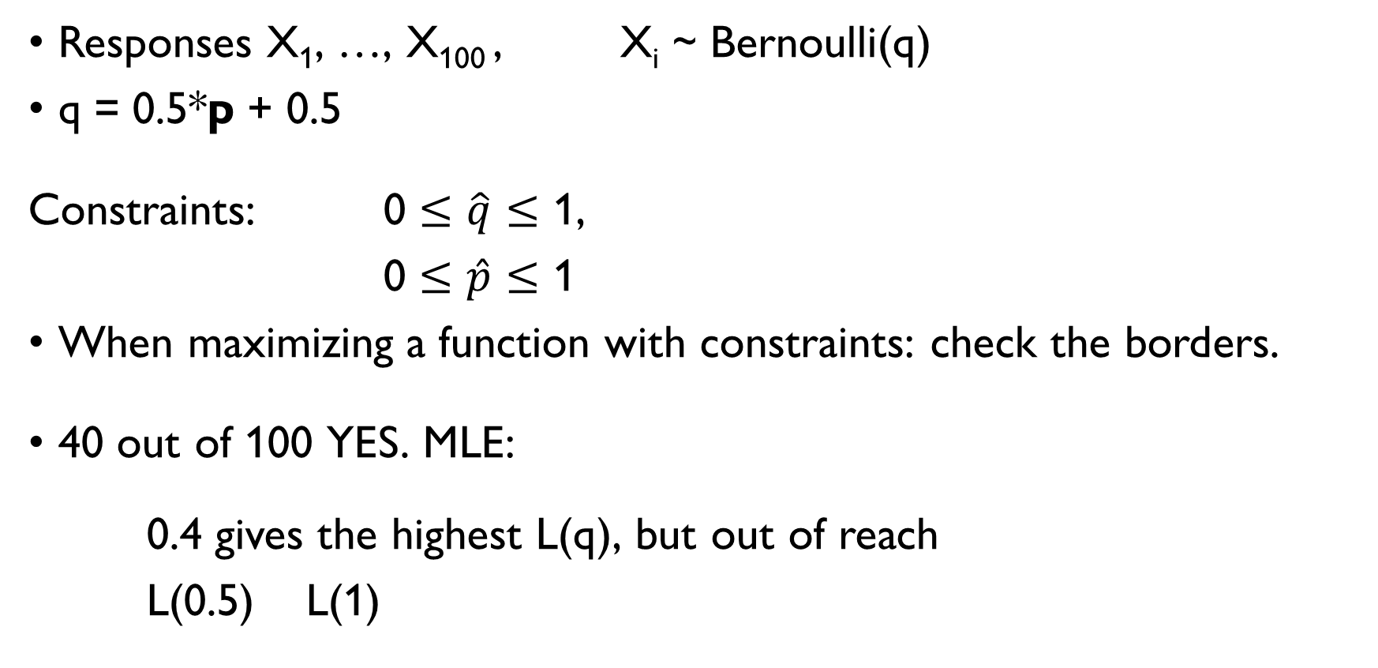
REMARKS ON RANDOMIZED RESPONSE
Responses X₁, …, X₁₀₀ , X_{i} ~ Bernoulli(q)
q = 0.5*p + 0.5
Constraints: 0 $≤$ $\hat{q}$ $≤$ 1,
0 $≤$ $\hat{p}$ $≤$ 1
When maximizing a function with constraints: check the borders.
40 out of 100 YES. MLE:
0.4 gives the highest L(q), but out of reach
L(0.5) > L(1) = 0 $⇒\hat{q}=0.5, \hat{p}=0$
$$⇒0.5≤\hat{q}≤1$$

Slide 22
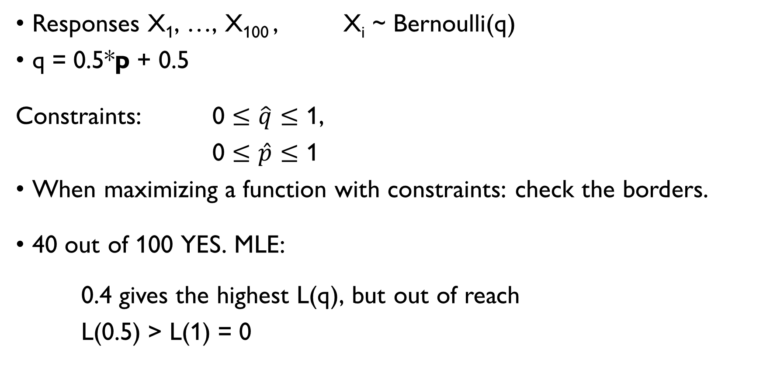
REMARKS ON RANDOMIZED RESPONSE
Responses X₁, …, X₁₀₀ , X_{i} ~ Bernoulli(q)
q = 0.5*p + 0.5
Constraints: 0 $≤$ $\hat{q}$ $≤$ 1,
0 $≤$ $\hat{p}$ $≤$ 1
When maximizing a function with constraints: check the borders.
40 out of 100 YES. MLE:
0.4 gives the highest L(q), but out of reach
L(0.5) > L(1) = 0 $⇒\hat{q}=0.5, \hat{p}=0$
$$⇒0.5≤\hat{q}≤1$$

Slide 23
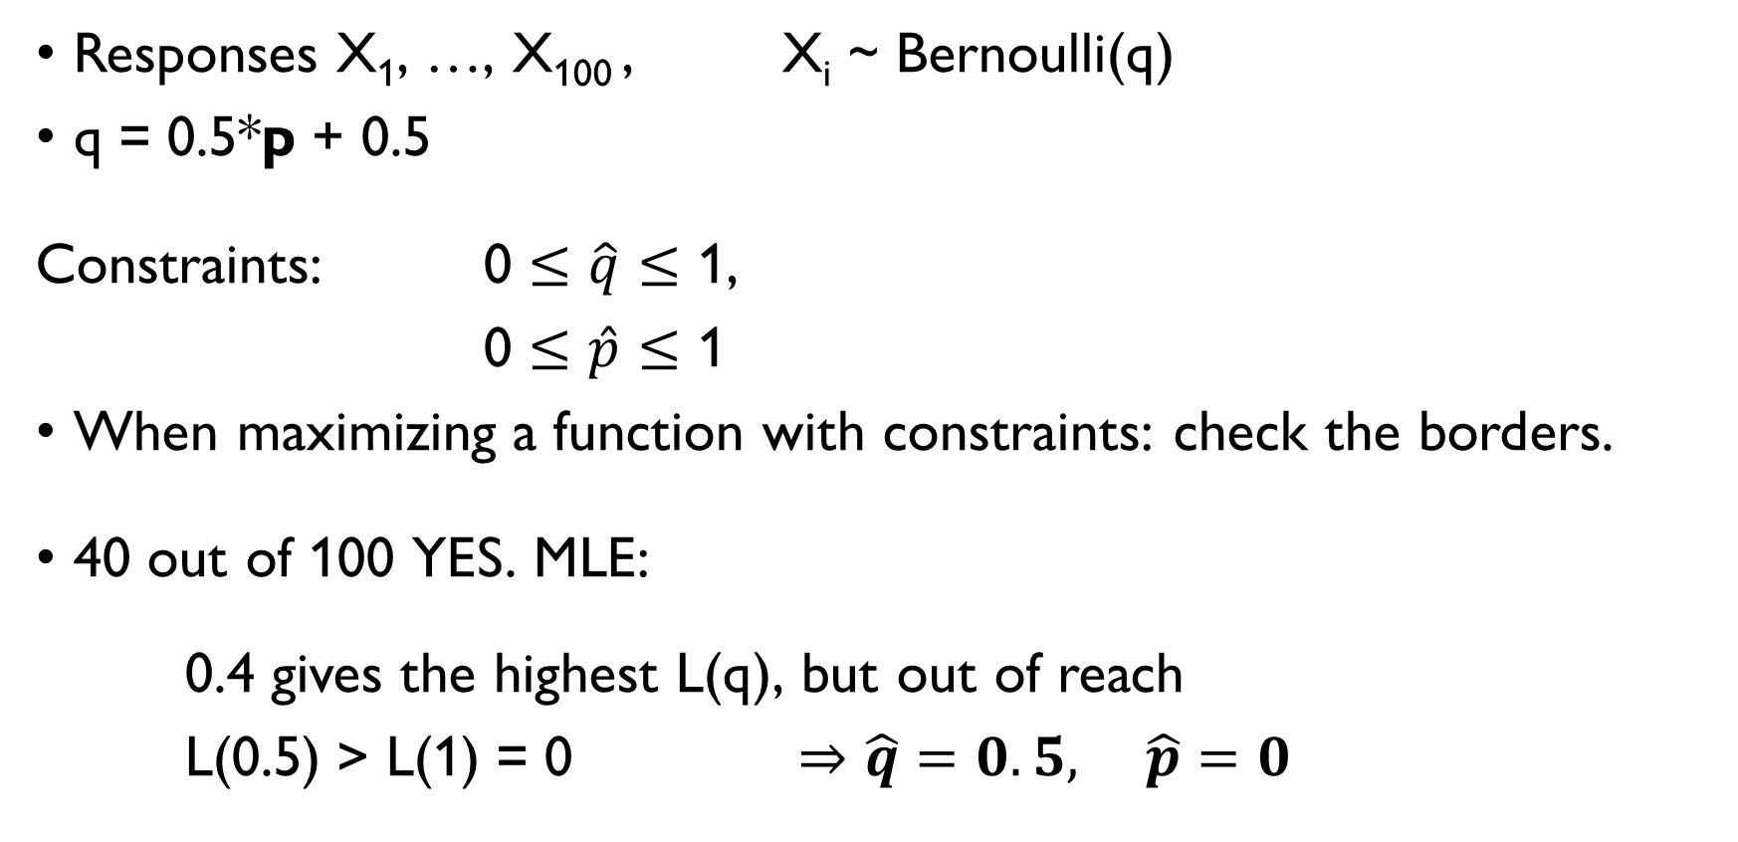
REMARKS ON RANDOMIZED RESPONSE
Responses X₁, …, X₁₀₀ , X_{i} ~ Bernoulli(q)
q = 0.5*p + 0.5
Constraints: 0 $≤$ $\hat{q}$ $≤$ 1,
0 $≤$ $\hat{p}$ $≤$ 1
When maximizing a function with constraints: check the borders.
40 out of 100 YES. MLE:
0.4 gives the highest L(q), but out of reach
L(0.5) > L(1) = 0 $⇒\hat{q}=0.5, \hat{p}=0$
$$⇒0.5≤\hat{q}≤1$$

Slide 24
OVERVIEW OF SOME DISTRIBUTIONS WE WORKED WITH

Slide 25

DISTRIBUTIONS WE’VE SEEN SO FAR
Bernoulli
X ~ Bernoulli(p) $P\left(X=1\right)=p, P\left(X=0\right)=1−p$
E(X) = p Chance of success in a single trial with two outcomes
Binomial
X ~ Bi(n, p), $P\left(X=k\right)=C_{n}^{k}p^{k}{\left(1−p\right)}^{n−k}, 0≤k≤1$
E(X) = np # of successes in a series of n Bernoulli trials
Poisson
X ~ Po(λ), $P\left(X=k\right)=\frac{e^{−λ}∙λ^{k}}{k!}, k≥0$
E(X) = λ # events that occur within a fixed amount of time

Slide 26

DISTRIBUTIONS WE’VE SEEN SO FAR
Bernoulli
X ~ Bernoulli(p) $P\left(X=1\right)=p, P\left(X=0\right)=1−p$
E(X) = p Chance of success in a single trial with two outcomes
Binomial
X ~ Bi(n, p), $P\left(X=k\right)=C_{n}^{k}p^{k}{\left(1−p\right)}^{n−k}, 0≤k≤1$
E(X) = np # of successes in a series of n Bernoulli trials
Poisson
X ~ Po(λ), $P\left(X=k\right)=\frac{e^{−λ}∙λ^{k}}{k!}, k≥0$
E(X) = λ # events that occur within a fixed amount of time

Slide 27

DISTRIBUTIONS WE’VE SEEN SO FAR
Bernoulli
X ~ Bernoulli(p) $P\left(X=1\right)=p, P\left(X=0\right)=1−p$
E(X) = p Chance of success in a single trial with two outcomes
Binomial
X ~ Bi(n, p), $P\left(X=k\right)=C_{n}^{k}p^{k}{\left(1−p\right)}^{n−k}, 0≤k≤1$
E(X) = np # of successes in a series of n Bernoulli trials
Poisson
X ~ Po(λ), $P\left(X=k\right)=\frac{e^{−λ}∙λ^{k}}{k!}, k≥0$
E(X) = λ # events that occur within a fixed amount of time

Slide 28
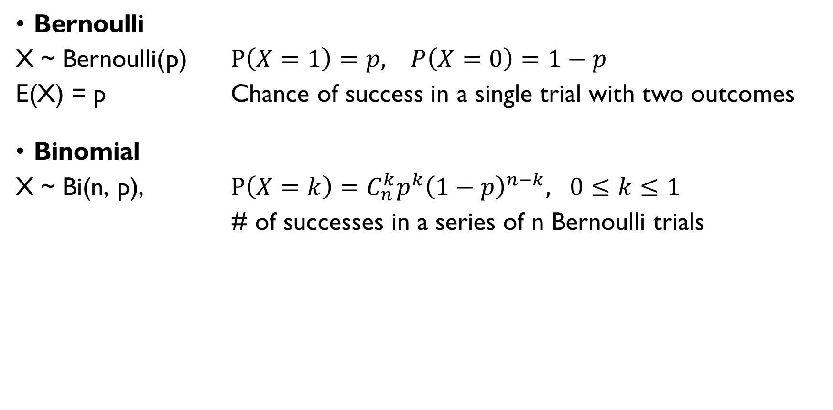
DISTRIBUTIONS WE’VE SEEN SO FAR
Bernoulli
X ~ Bernoulli(p) $P\left(X=1\right)=p, P\left(X=0\right)=1−p$
E(X) = p Chance of success in a single trial with two outcomes
Binomial
X ~ Bi(n, p), $P\left(X=k\right)=C_{n}^{k}p^{k}{\left(1−p\right)}^{n−k}, 0≤k≤1$
E(X) = np # of successes in a series of n Bernoulli trials
Poisson
X ~ Po(λ), $P\left(X=k\right)=\frac{e^{−λ}∙λ^{k}}{k!}, k≥0$
E(X) = λ # events that occur within a fixed amount of time

Slide 29
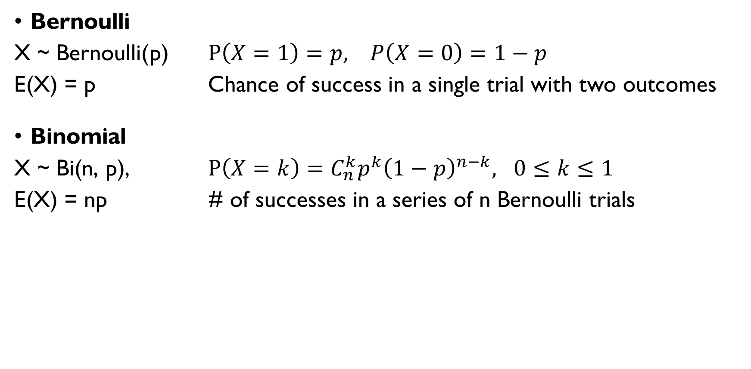
DISTRIBUTIONS WE’VE SEEN SO FAR
Bernoulli
X ~ Bernoulli(p) $P\left(X=1\right)=p, P\left(X=0\right)=1−p$
E(X) = p Chance of success in a single trial with two outcomes
Binomial
X ~ Bi(n, p), $P\left(X=k\right)=C_{n}^{k}p^{k}{\left(1−p\right)}^{n−k}, 0≤k≤1$
E(X) = np # of successes in a series of n Bernoulli trials
Poisson
X ~ Po(λ), $P\left(X=k\right)=\frac{e^{−λ}∙λ^{k}}{k!}, k≥0$
E(X) = λ # events that occur within a fixed amount of time

Slide 30
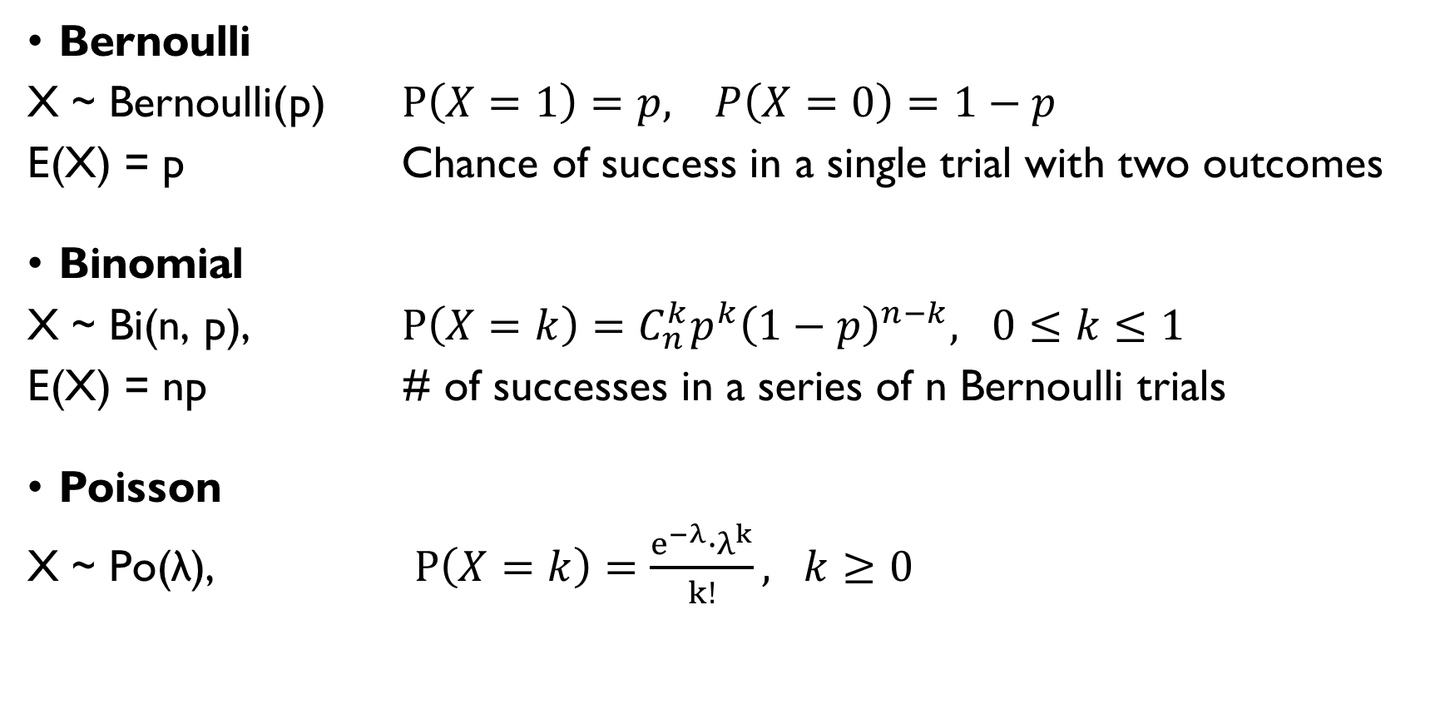
DISTRIBUTIONS WE’VE SEEN SO FAR
Bernoulli
X ~ Bernoulli(p) $P\left(X=1\right)=p, P\left(X=0\right)=1−p$
E(X) = p Chance of success in a single trial with two outcomes
Binomial
X ~ Bi(n, p), $P\left(X=k\right)=C_{n}^{k}p^{k}{\left(1−p\right)}^{n−k}, 0≤k≤1$
E(X) = np # of successes in a series of n Bernoulli trials
Poisson
X ~ Po(λ), $P\left(X=k\right)=\frac{e^{−λ}∙λ^{k}}{k!}, k≥0$
E(X) = λ # events that occur within a fixed amount of time

Slide 31
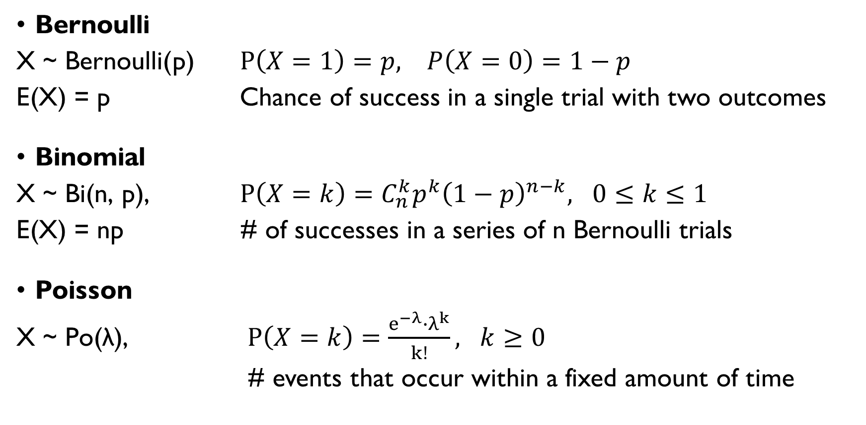
DISTRIBUTIONS WE’VE SEEN SO FAR
Bernoulli
X ~ Bernoulli(p) $P\left(X=1\right)=p, P\left(X=0\right)=1−p$
E(X) = p Chance of success in a single trial with two outcomes
Binomial
X ~ Bi(n, p), $P\left(X=k\right)=C_{n}^{k}p^{k}{\left(1−p\right)}^{n−k}, 0≤k≤1$
E(X) = np # of successes in a series of n Bernoulli trials
Poisson
X ~ Po(λ), $P\left(X=k\right)=\frac{e^{−λ}∙λ^{k}}{k!}, k≥0$
E(X) = λ # events that occur within a fixed amount of time

Slide 32
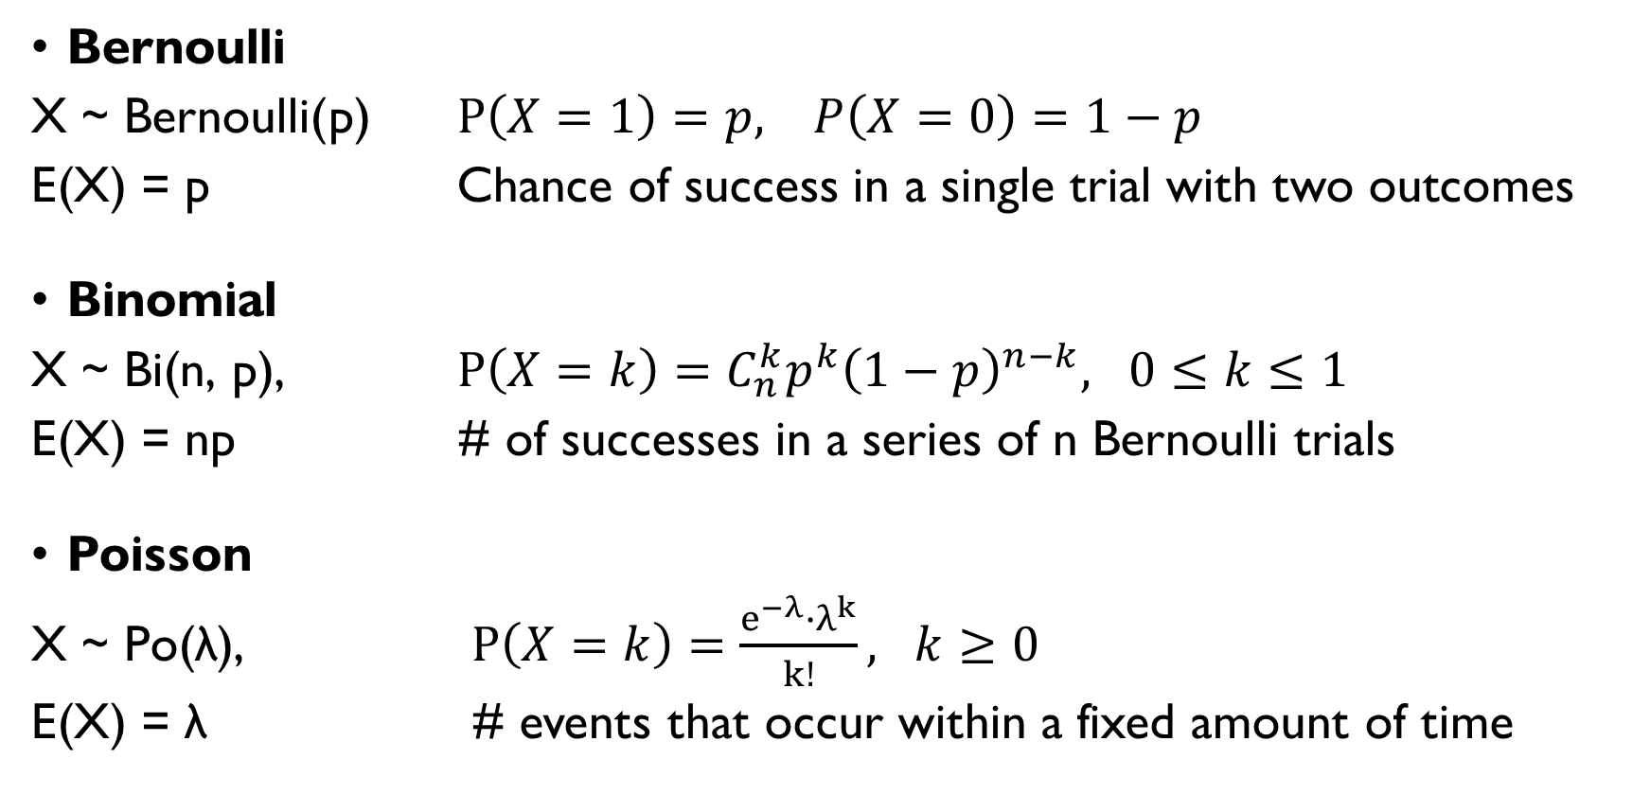
DISTRIBUTIONS WE’VE SEEN SO FAR
Bernoulli
X ~ Bernoulli(p) $P\left(X=1\right)=p, P\left(X=0\right)=1−p$
E(X) = p Chance of success in a single trial with two outcomes
Binomial
X ~ Bi(n, p), $P\left(X=k\right)=C_{n}^{k}p^{k}{\left(1−p\right)}^{n−k}, 0≤k≤1$
E(X) = np # of successes in a series of n Bernoulli trials
Poisson
X ~ Po(λ), $P\left(X=k\right)=\frac{e^{−λ}∙λ^{k}}{k!}, k≥0$
E(X) = λ # events that occur within a fixed amount of time

Slide 33
MLE ONCE AGAIN
+ one more discrete distribution

Slide 34
WAITING FOR A METRO
You are waiting for a train in the metro.
Trains go every t minutes (no delays).
How long may you have to wait?
Anything between 0 and t minutes.
You ask N of your friends how long have they waited:
T₁, T₂, …, T_{N}
How often do the trains go? And how much will you need to wait?

Slide 35
WAITING FOR A METRO
You are waiting for a train in the metro.
Trains go every t minutes (no delays).
How long may you have to wait?
Anything between 0 and t minutes.
You ask N of your friends how long have they waited:
T₁, T₂, …, T_{N}
How often do the trains go? And how much will you need to wait?

Slide 36
WAITING FOR A METRO
You are waiting for a train in the metro.
Trains go every t minutes (no delays).
How long may you have to wait?
Anything between 0 and t minutes.
You ask N of your friends how long have they waited:
T₁, T₂, …, T_{N}
How often do the trains go? And how much will you need to wait?

Slide 37
WAITING FOR A METRO
You are waiting for a train in the metro.
Trains go every t minutes (no delays).
How long may you have to wait?
Anything between 0 and t minutes.
You ask N of your friends how long have they waited:
T₁, T₂, …, T_{N}
How often do the trains go? And how much will you need to wait?

Slide 38
WAITING FOR A METRO
You are waiting for a train in the metro.
Trains go every t minutes (no delays).
How long may you have to wait?
Anything between 0 and t minutes.
You ask N of your friends how long have they waited:
T₁, T₂, …, T_{N}
How often do the trains go? And how much will you need to wait?

Slide 39
WAITING FOR A METRO
Let’s start with estimating the value of parameter t (train come every t minutes).
Assume a very simple model: X – one’s waiting time.
You know how long N of your friends waited: T₁, T₂, …, T_{N} How to estimate the parameter t? -> Maximum likelihood ☺

Slide 40
WAITING FOR A METRO
Let’s start with estimating the value of parameter t (train come every t minutes).
Assume a very simple model: X – one’s waiting time.
You know how long N of your friends waited: T₁, T₂, …, T_{N} How to estimate the parameter t? -> Maximum likelihood ☺

Slide 41
WAITING FOR A METRO
Let’s start with estimating the value of parameter t (train come every t minutes).
Assume a very simple model: X – one’s waiting time.
You know how long N of your friends waited: T₁, T₂, …, T_{N} How to estimate the parameter t? -> Maximum likelihood ☺
X | 0 | 1 | … | t
P(X) | 1/(t+1) | 1/(t+1) | … | 1/(t+1)

Slide 42
WAITING FOR A METRO
Let’s start with estimating the value of parameter t (train come every t minutes).
Assume a very simple model: X – one’s waiting time.
You know how long N of your friends waited: T₁, T₂, …, T_{N} How to estimate the parameter t? -> Maximum likelihood ☺
X | 0 | 1 | … | t
P(X) | 1/(t+1) | 1/(t+1) | … | 1/(t+1)

Slide 43
WAITING FOR A METRO
Let’s start with estimating the value of parameter t (train come every t minutes).
Assume a very simple model: X – one’s waiting time.
You know how long N of your friends waited: T₁, T₂, …, T_{N} How to estimate the parameter t? -> Maximum likelihood ☺
X | 0 | 1 | … | t
P(X) | 1/(t+1) | 1/(t+1) | … | 1/(t+1)
… and 0 otherwise

Slide 44
WAITING FOR A METRO
Let’s start with estimating the value of parameter t (train come every t minutes).
Assume a very simple model: X – one’s waiting time.
You know how long N of your friends waited: T₁, T₂, …, T_{N} How to estimate the parameter t? -> Maximum likelihood ☺
X | 0 | 1 | … | t
P(X) | 1/(t+1) | 1/(t+1) | … | 1/(t+1)
… and 0 otherwise

Slide 45
WAITING FOR A METRO
Let’s start with estimating the value of parameter t (train come every t minutes).
Assume a very simple model: X – one’s waiting time.
You know how long N of your friends waited: T₁, T₂, …, T_{N} How to estimate the parameter t? -> Maximum likelihood ☺
X | 0 | 1 | … | t
P(X) | 1/(t+1) | 1/(t+1) | … | 1/(t+1)
… and 0 otherwise

Slide 46

WAITING FOR A METRO
X | 0 | 1 | … | t
P(X) | 1/(t+1) | 1/(t+1) | … | 1/(t+1)
Your friends waited for T₁, T₂, …, T_{N}
maximize $L\left(t\right)=\prod_{i=1}^{N}{\frac{1}{t+1}∙I\left(T_{i}≤t\right)}$ w.r.t. $t$
$$I\left(T_{i}≤t\right)≠0⇒t≥\max\left(T_{1},…,T_{N}\right)=T$$
$\log{L\left(t\right)}=\sum_{i=1}^{N}{\log{\frac{1}{t+1}}}=−N\log\left(t+1\right)$
decreasing function, need the smallest t possible $⇒\hat{t}=T=max\left(T_{1},…,T_{N} \right)$
… and 0 otherwise

Slide 47

WAITING FOR A METRO
X | 0 | 1 | … | t
P(X) | 1/(t+1) | 1/(t+1) | … | 1/(t+1)
Your friends waited for T₁, T₂, …, T_{N}
maximize $L\left(t\right)=\prod_{i=1}^{N}{\frac{1}{t+1}∙I\left(T_{i}≤t\right)}$ w.r.t. $t$
$$I\left(T_{i}≤t\right)≠0⇒t≥\max\left(T_{1},…,T_{N}\right)=T$$
$\log{L\left(t\right)}=\sum_{i=1}^{N}{\log{\frac{1}{t+1}}}=−N\log\left(t+1\right)$
decreasing function, need the smallest t possible $⇒\hat{t}=T=max\left(T_{1},…,T_{N} \right)$
… and 0 otherwise

Slide 48

WAITING FOR A METRO
X | 0 | 1 | … | t
P(X) | 1/(t+1) | 1/(t+1) | … | 1/(t+1)
Your friends waited for T₁, T₂, …, T_{N}
maximize $L\left(t\right)=\prod_{i=1}^{N}{\frac{1}{t+1}∙I\left(T_{i}≤t\right)}$ w.r.t. $t$
$$I\left(T_{i}≤t\right)≠0⇒t≥\max\left(T_{1},…,T_{N}\right)=T$$
$\log{L\left(t\right)}=\sum_{i=1}^{N}{\log{\frac{1}{t+1}}}=−N\log\left(t+1\right)$
decreasing function, need the smallest t possible $⇒\hat{t}=T=max\left(T_{1},…,T_{N} \right)$
… and 0 otherwise

Slide 49

WAITING FOR A METRO
X | 0 | 1 | … | t
P(X) | 1/(t+1) | 1/(t+1) | … | 1/(t+1)
Your friends waited for T₁, T₂, …, T_{N}
maximize $L\left(t\right)=\prod_{i=1}^{N}{\frac{1}{t+1}∙I\left(T_{i}≤t\right)}$ w.r.t. $t$
$$I\left(T_{i}≤t\right)≠0⇒t≥\max\left(T_{1},…,T_{N}\right)=T$$
$\log{L\left(t\right)}=\sum_{i=1}^{N}{\log{\frac{1}{t+1}}}=−N\log\left(t+1\right)$
decreasing function, need the smallest t possible $⇒\hat{t}=T=max\left(T_{1},…,T_{N} \right)$
… and 0 otherwise

Slide 50

WAITING FOR A METRO
X | 0 | 1 | … | t
P(X) | 1/(t+1) | 1/(t+1) | … | 1/(t+1)
Your friends waited for T₁, T₂, …, T_{N}
maximize $L\left(t\right)=\prod_{i=1}^{N}{\frac{1}{t+1}∙I\left(T_{i}≤t\right)}$ w.r.t. $t$
$$I\left(T_{i}≤t\right)≠0⇒t≥\max\left(T_{1},…,T_{N}\right)=T$$
$\log{L\left(t\right)}=\sum_{i=1}^{N}{\log{\frac{1}{t+1}}}=−N\log\left(t+1\right)$
decreasing function, need the smallest t possible $⇒\hat{t}=T=max\left(T_{1},…,T_{N} \right)$
… and 0 otherwise

Slide 51
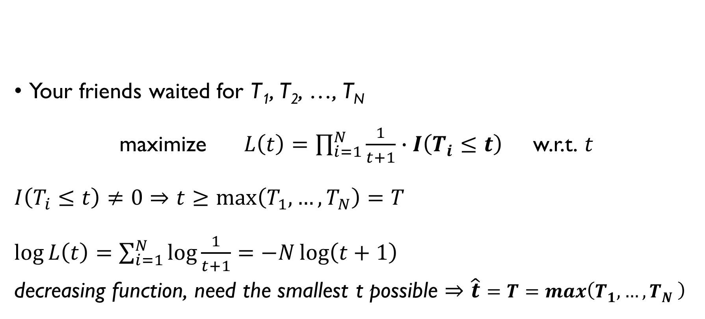
WAITING FOR A METRO
X | 0 | 1 | … | t
P(X) | 1/(t+1) | 1/(t+1) | … | 1/(t+1)
Your friends waited for T₁, T₂, …, T_{N}
maximize $L\left(t\right)=\prod_{i=1}^{N}{\frac{1}{t+1}∙I\left(T_{i}≤t\right)}$ w.r.t. $t$
$$I\left(T_{i}≤t\right)≠0⇒t≥\max\left(T_{1},…,T_{N}\right)=T$$
$\log{L\left(t\right)}=\sum_{i=1}^{N}{\log{\frac{1}{t+1}}}=−N\log\left(t+1\right)$
decreasing function, need the smallest t possible $⇒\hat{t}=T=max\left(T_{1},…,T_{N} \right)$
… and 0 otherwise

Slide 52

WAITING FOR A METRO
X | 0 | 1 | … | t
P(X) | 1/(t+1) | 1/(t+1) | … | 1/(t+1)
… and 0 otherwise
Your friends waited for T₁, T₂, …, T_{N}
MLE: $\hat{t}=T=max\left(T_{1},…,T_{N} \right)$
How long will you need to wait on average?
$$E\left(X\right)=\sum_{k=0}^{\hat{t}}{k∙\frac{1}{\hat{t}+1}}=\frac{\hat{t}}{2}$$
Example: your friends waited for 0, 2, 4, 5, 10, 0, 2, 1, 3, 1 minutes.
MLE: trains every 10 minutes
Your friends waited on average 2.8 minutes
You’ll have to wait 5 minutes

Slide 53
WAITING FOR A METRO
X | 0 | 1 | … | t
P(X) | 1/(t+1) | 1/(t+1) | … | 1/(t+1)
… and 0 otherwise
Your friends waited for T₁, T₂, …, T_{N}
MLE: $\hat{t}=T=max\left(T_{1},…,T_{N} \right)$
How long will you need to wait on average?
$$E\left(X\right)=\sum_{k=0}^{\hat{t}}{k∙\frac{1}{\hat{t}+1}}=\frac{\hat{t}}{2}$$
Example: your friends waited for 0, 2, 4, 5, 10, 0, 2, 1, 3, 1 minutes.
MLE: trains every 10 minutes
Your friends waited on average 2.8 minutes
You’ll have to wait 5 minutes

Slide 54
WAITING FOR A METRO
X | 0 | 1 | … | t
P(X) | 1/(t+1) | 1/(t+1) | … | 1/(t+1)
… and 0 otherwise
Your friends waited for T₁, T₂, …, T_{N}
MLE: $\hat{t}=T=max\left(T_{1},…,T_{N} \right)$
How long will you need to wait on average?
$$E\left(X\right)=\sum_{k=0}^{\hat{t}}{k∙\frac{1}{\hat{t}+1}}=\frac{\hat{t}}{2}$$
Example: your friends waited for 0, 2, 4, 5, 10, 0, 2, 1, 3, 1 minutes.
MLE: trains every 10 minutes
Your friends waited on average 2.8 minutes
You’ll have to wait 5 minutes

Slide 55
WAITING FOR A METRO
X | 0 | 1 | … | t
P(X) | 1/(t+1) | 1/(t+1) | … | 1/(t+1)
… and 0 otherwise
Your friends waited for T₁, T₂, …, T_{N}
MLE: $\hat{t}=T=max\left(T_{1},…,T_{N} \right)$
How long will you need to wait on average?
$$E\left(X\right)=\sum_{k=0}^{\hat{t}}{k∙\frac{1}{\hat{t}+1}}=\frac{\hat{t}}{2}$$
Example: your friends waited for 0, 2, 4, 5, 10, 0, 2, 1, 3, 1 minutes.
MLE: trains every 10 minutes
Your friends waited on average 2.8 minutes
You’ll have to wait 5 minutes

Slide 56
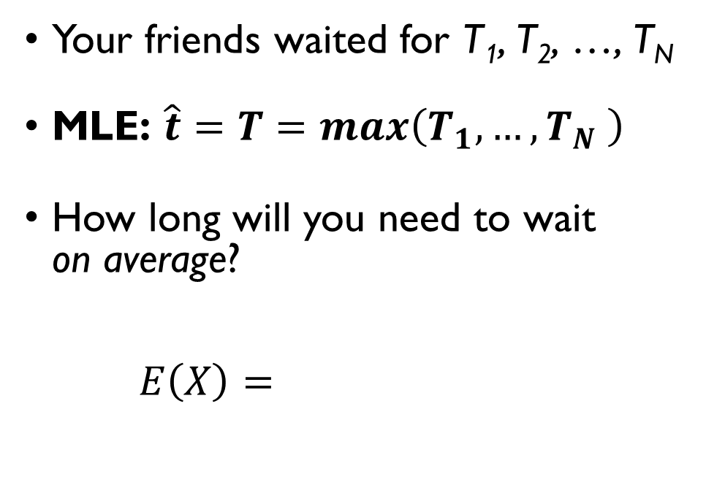
WAITING FOR A METRO
X | 0 | 1 | … | t
P(X) | 1/(t+1) | 1/(t+1) | … | 1/(t+1)
… and 0 otherwise
Your friends waited for T₁, T₂, …, T_{N}
MLE: $\hat{t}=T=max\left(T_{1},…,T_{N} \right)$
How long will you need to wait on average?
$$E\left(X\right)=\sum_{k=0}^{\hat{t}}{k∙\frac{1}{\hat{t}+1}}=\frac{\hat{t}}{2}$$
Example: your friends waited for 0, 2, 4, 5, 10, 0, 2, 1, 3, 1 minutes.
MLE: trains every 10 minutes
Your friends waited on average 2.8 minutes
You’ll have to wait 5 minutes

Slide 57
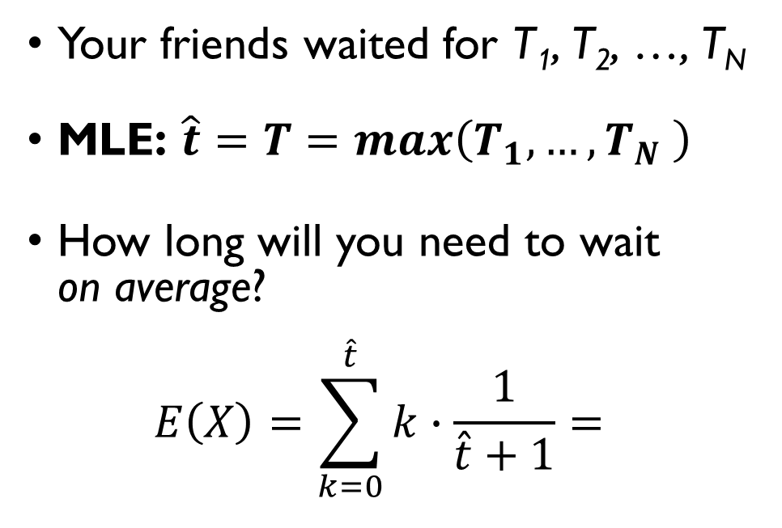
WAITING FOR A METRO
X | 0 | 1 | … | t
P(X) | 1/(t+1) | 1/(t+1) | … | 1/(t+1)
… and 0 otherwise
Your friends waited for T₁, T₂, …, T_{N}
MLE: $\hat{t}=T=max\left(T_{1},…,T_{N} \right)$
How long will you need to wait on average?
$$E\left(X\right)=\sum_{k=0}^{\hat{t}}{k∙\frac{1}{\hat{t}+1}}=\frac{\hat{t}}{2}$$
Example: your friends waited for 0, 2, 4, 5, 10, 0, 2, 1, 3, 1 minutes.
MLE: trains every 10 minutes
Your friends waited on average 2.8 minutes
You’ll have to wait 5 minutes

Slide 58
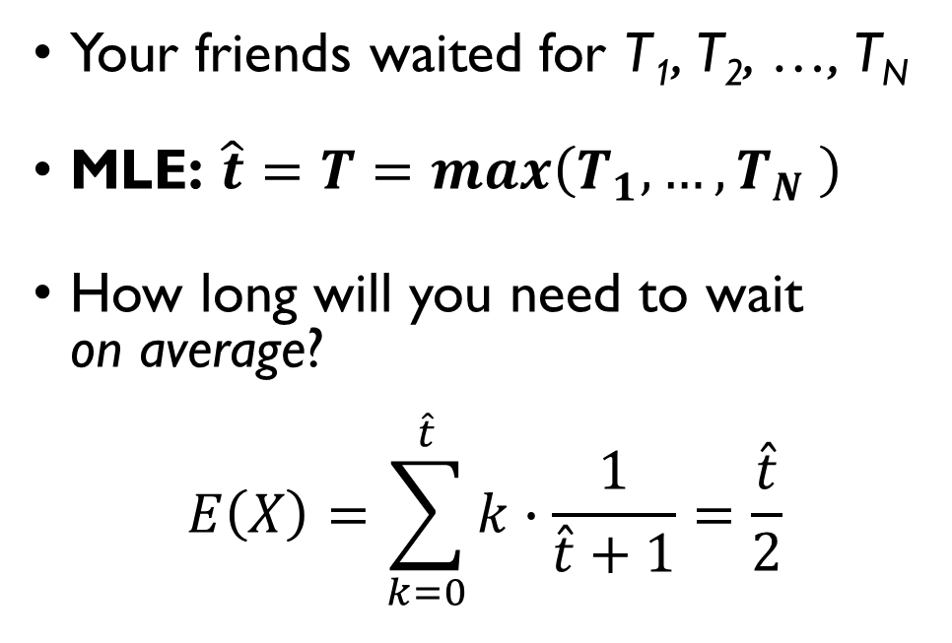
WAITING FOR A METRO
X | 0 | 1 | … | t
P(X) | 1/(t+1) | 1/(t+1) | … | 1/(t+1)
… and 0 otherwise
Your friends waited for T₁, T₂, …, T_{N}
MLE: $\hat{t}=T=max\left(T_{1},…,T_{N} \right)$
How long will you need to wait on average?
$$E\left(X\right)=\sum_{k=0}^{\hat{t}}{k∙\frac{1}{\hat{t}+1}}=\frac{\hat{t}}{2}$$
Example: your friends waited for 0, 2, 4, 5, 10, 0, 2, 1, 3, 1 minutes.
MLE: trains every 10 minutes
Your friends waited on average 2.8 minutes
You’ll have to wait 5 minutes

Slide 59
WAITING FOR A METRO
X | 0 | 1 | … | t
P(X) | 1/(t+1) | 1/(t+1) | … | 1/(t+1)
… and 0 otherwise
Your friends waited for T₁, T₂, …, T_{N}
MLE: $\hat{t}=T=max\left(T_{1},…,T_{N} \right)$
How long will you need to wait on average?
$$E\left(X\right)=\sum_{k=0}^{\hat{t}}{k∙\frac{1}{\hat{t}+1}}=\frac{\hat{t}}{2}$$
Example: your friends waited for 0, 2, 4, 5, 10, 0, 2, 1, 3, 1 minutes.
MLE: trains every 10 minutes
Your friends waited on average 2.8 minutes
You’ll have to wait 5 minutes

Slide 60

DISCRETE UNIFORM DISTRIBUTION
Takes values from 1 to n with equal probabilities:
$$P\left(X=k\right)=\left\{\begin{aligned}\frac{1}{n}, 1≤k≤n \\ 0, otherwise\end{aligned}\right.$$
$$E\left(X\right)=\sum_{k=1}^{n}{\frac{k}{n}}=\frac{1}{n}∙\frac{n\left(n+1\right)}{2}=\frac{n+1}{2}$$
Typical example: rolling a fair die
And if we roll two dice and consider a sum of the values we get?

Slide 61
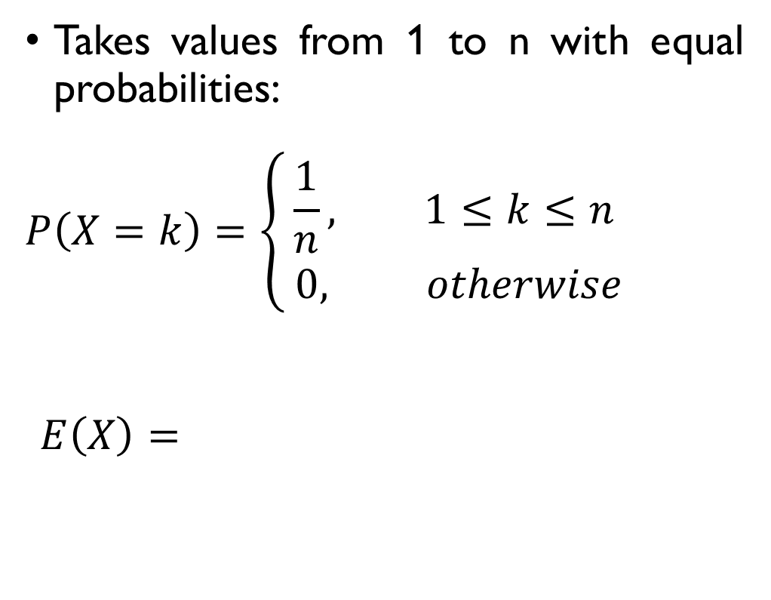
DISCRETE UNIFORM DISTRIBUTION
Takes values from 1 to n with equal probabilities:
$$P\left(X=k\right)=\left\{\begin{aligned}\frac{1}{n}, 1≤k≤n \\ 0, otherwise\end{aligned}\right.$$
$$E\left(X\right)=\sum_{k=1}^{n}{\frac{k}{n}}=\frac{1}{n}∙\frac{n\left(n+1\right)}{2}=\frac{n+1}{2}$$
Typical example: rolling a fair die
And if we roll two dice and consider a sum of the values we get?

Slide 62
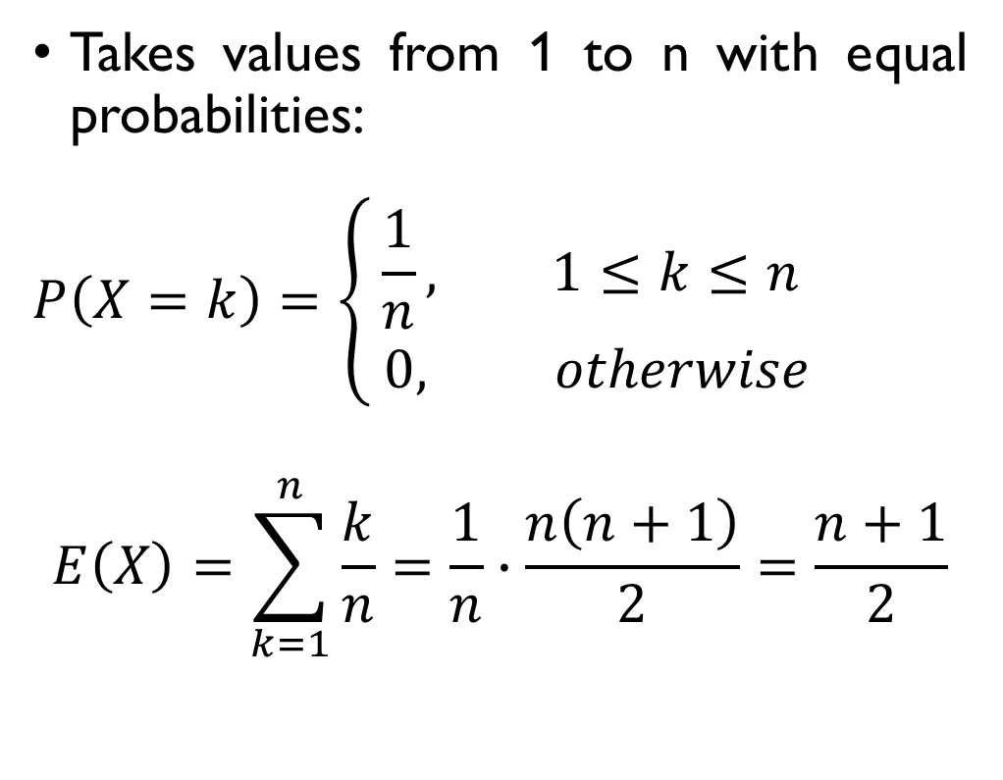
DISCRETE UNIFORM DISTRIBUTION
Takes values from 1 to n with equal probabilities:
$$P\left(X=k\right)=\left\{\begin{aligned}\frac{1}{n}, 1≤k≤n \\ 0, otherwise\end{aligned}\right.$$
$$E\left(X\right)=\sum_{k=1}^{n}{\frac{k}{n}}=\frac{1}{n}∙\frac{n\left(n+1\right)}{2}=\frac{n+1}{2}$$
Typical example: rolling a fair die
And if we roll two dice and consider a sum of the values we get?

Slide 63
DISCRETE UNIFORM DISTRIBUTION
Takes values from 1 to n with equal probabilities:
$$P\left(X=k\right)=\left\{\begin{aligned}\frac{1}{n}, 1≤k≤n \\ 0, otherwise\end{aligned}\right.$$
$$E\left(X\right)=\sum_{k=1}^{n}{\frac{k}{n}}=\frac{1}{n}∙\frac{n\left(n+1\right)}{2}=\frac{n+1}{2}$$
Typical example: rolling a fair die
And if we roll two dice and consider a sum of the values we get?

Slide 64
LOOKING FOR A BETTER MODEL

Slide 65
WE NEED A BETTER MODEL
A model used in the previous example was too simple: waiting time can be not just 0, 1, 2, … t minutes.
We need a distribution that takes more values.
In fact, we need out random variable to take infinite number of values…

Slide 66
WE NEED A BETTER MODEL
A model used in the previous example was too simple: waiting time can be not just 0, 1, 2, … t minutes.
We need a distribution that takes more values.
In fact, we need out random variable to take infinite number of values…

Slide 67
DIFFERENT KINDS OF ‘INFINITE’
FINITE SET OF VALUES
INFINITE SET OF VALUES
X ~ Bernoulli(p)
2 values
X ~ Bi(n, p)
n+1 values
X ~ Uniform discrete (k)
k (or k+1 as in our example) values
X ~ Po(λ)
0, 1, 2, 3, …
countable set of values
?
uncountably many values

Slide 68
DIFFERENT KINDS OF ‘INFINITE’
FINITE SET OF VALUES
INFINITE SET OF VALUES
X ~ Bernoulli(p)
2 values
X ~ Bi(n, p)
n+1 values
X ~ Uniform discrete (k)
k (or k+1 as in our example) values
X ~ Po(λ)
0, 1, 2, 3, …
countable set of values
?
uncountably many values

Slide 69
DIFFERENT KINDS OF ‘INFINITE’
FINITE SET OF VALUES
INFINITE SET OF VALUES
X ~ Bernoulli(p)
2 values
X ~ Bi(n, p)
n+1 values
X ~ Uniform discrete (k)
k (or k+1 as in our example) values
X ~ Po(λ)
0, 1, 2, 3, …
countable set of values
?
uncountably many values

Slide 70
DIFFERENT KINDS OF ‘INFINITE’
FINITE SET OF VALUES
INFINITE SET OF VALUES
X ~ Bernoulli(p)
2 values
X ~ Bi(n, p)
n+1 values
X ~ Uniform discrete (k)
k (or k+1 as in our example) values
X ~ Po(λ)
0, 1, 2, 3, …
countable set of values
?
uncountably many values

Slide 71
DIFFERENT KINDS OF ‘INFINITE’
FINITE SET OF VALUES
INFINITE SET OF VALUES
X ~ Bernoulli(p)
2 values
X ~ Bi(n, p)
n+1 values
X ~ Uniform discrete (k)
k (or k+1 as in our example) values
X ~ Po(λ)
0, 1, 2, 3, …
countable set of values
Continuous distributions
uncountably many values

Slide 72
CONTINUOUS UNIFORM DISTRIBUTION

Slide 73
UNIFORM DISTRIBUTION
We want to model a random variable X that takes any value between a and b with equal probability.
For example, let a = 0 and b = 10:
What’s the expected value of such a variable? E(X) = (10 - 0)/2 = 5

Slide 74
UNIFORM DISTRIBUTION
We want to model a random variable X that takes any value between a and b with equal probability.
For example, let a = 0 and b = 10:
What’s the expected value of such a variable? E(X) = (10 - 0)/2 = 5
0
10

Slide 75
UNIFORM DISTRIBUTION
We want to model a random variable X that takes any value between a and b with equal probability.
For example, let a = 0 and b = 10:
What’s the expected value of such a variable? E(X) = (10 - 0)/2 = 5
0
10

Slide 76
UNIFORM DISTRIBUTION
We want to model a random variable X that takes any value between a and b with equal probability.
For example, let a = 0 and b = 10:
What’s the expected value of such a variable? E(X) = (10 - 0)/2 = 5
0
5
10

Slide 77

UNIFORM DISTRIBUTION
What’s the probability P(X $≤$ 5)?
P(X $≤$ 5) = (5 - 0) / (10 - 0) =
= 0.5
0
5
10

Slide 78
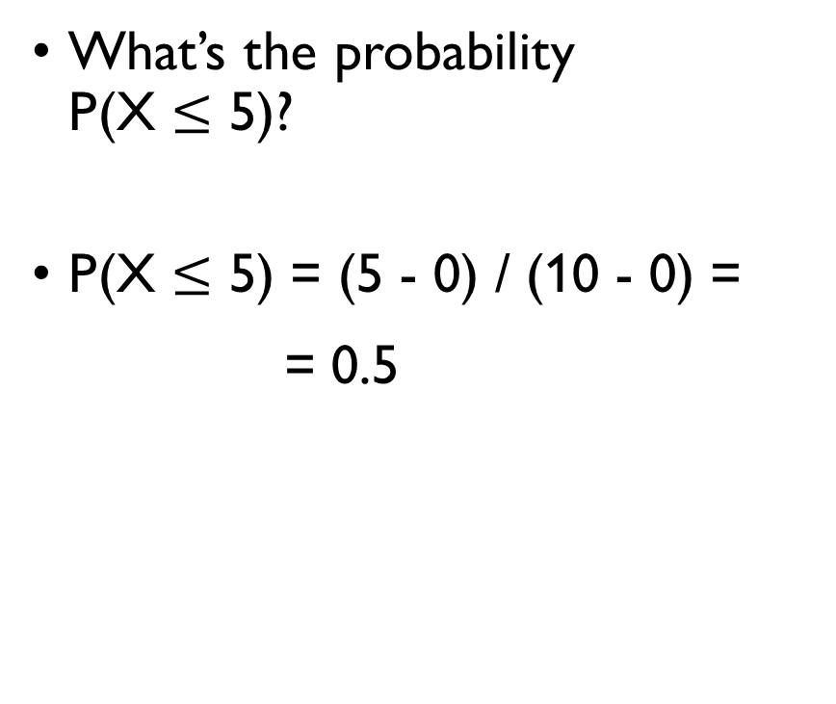
UNIFORM DISTRIBUTION
What’s the probability P(X $≤$ 5)?
P(X $≤$ 5) = (5 - 0) / (10 - 0) =
= 0.5
0
5
10

Slide 79

UNIFORM DISTRIBUTION
What’s the probability P(X $≤$ 3)?
P(X $≤$ 3) = (3 - 0) / (10 - 0) =
= 0.3
0
3
10

Slide 80
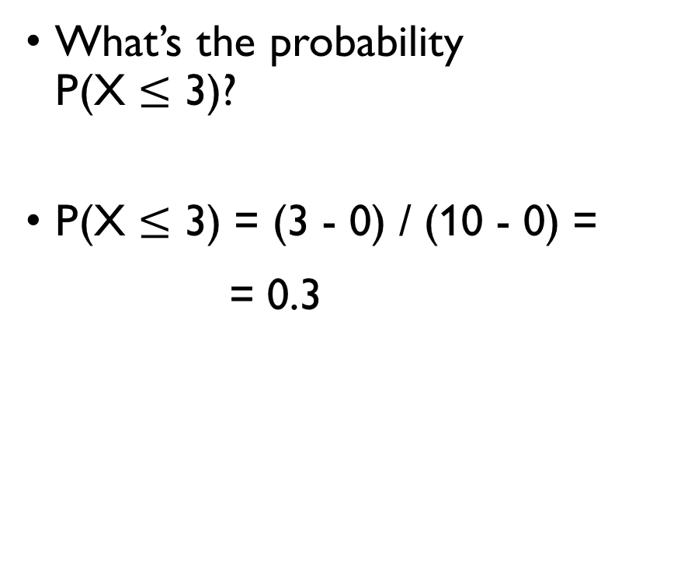
UNIFORM DISTRIBUTION
What’s the probability P(X $≤$ 3)?
P(X $≤$ 3) = (3 - 0) / (10 - 0) =
= 0.3
0
3
10

Slide 81

UNIFORM DISTRIBUTION
What’s the probability P(X $≤$ -1)?
P(X $≤$ -1) = 0
0
10

Slide 82

UNIFORM DISTRIBUTION
What’s the probability P(X $≤$ -1)?
P(X $≤$ -1) = 0
0
10

Slide 83

UNIFORM DISTRIBUTION
What’s the probability P(X $≤$ 15)?
P(X $≤$ 15) = 1
0
10

Slide 84

UNIFORM DISTRIBUTION
What’s the probability P(X $≤$ 15)?
P(X $≤$ 15) = 1
0
10

Slide 85

UNIFORM DISTRIBUTION
CUMULATIVE DISTRIBUTION FUNCTION (CDF):
F(x) = P(X $≤$ x)
Uniform distribution:
$$F\left(x\right)=\left\{\begin{aligned}0, x<a \\ \frac{x−a}{b−a}, a≤x≤b \\ 1, x>b\end{aligned}\right.$$

Slide 86
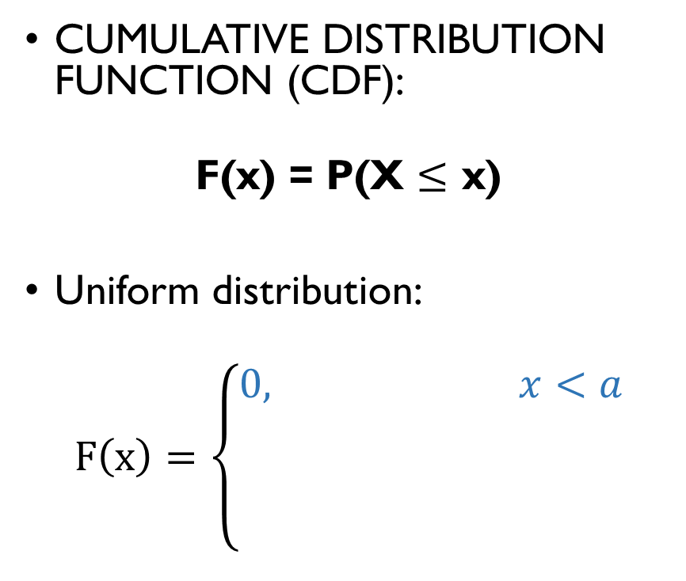
UNIFORM DISTRIBUTION
CUMULATIVE DISTRIBUTION FUNCTION (CDF):
F(x) = P(X $≤$ x)
Uniform distribution:
$$F\left(x\right)=\left\{\begin{aligned}0, x<a \\ \frac{x−a}{b−a}, a≤x≤b \\ 1, x>b\end{aligned}\right.$$
x
a
b

Slide 87
UNIFORM DISTRIBUTION
CUMULATIVE DISTRIBUTION FUNCTION (CDF):
F(x) = P(X $≤$ x)
Uniform distribution:
$$F\left(x\right)=\left\{\begin{aligned}0, x<a \\ \frac{x−a}{b−a}, a≤x≤b \\ 1, x>b\end{aligned}\right.$$
x
a
b
a
x
b

Slide 88
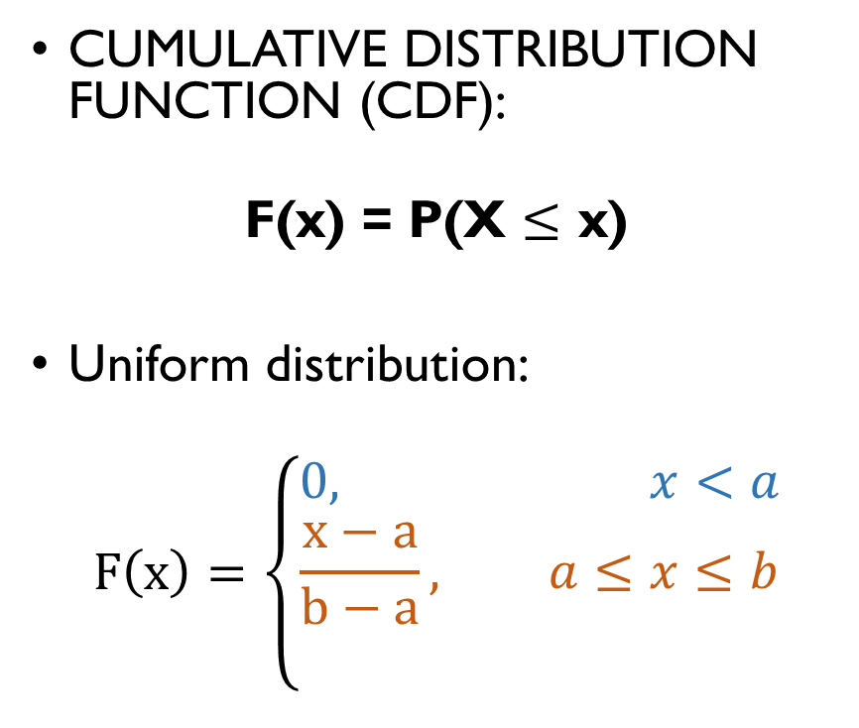
UNIFORM DISTRIBUTION
CUMULATIVE DISTRIBUTION FUNCTION (CDF):
F(x) = P(X $≤$ x)
Uniform distribution:
$$F\left(x\right)=\left\{\begin{aligned}0, x<a \\ \frac{x−a}{b−a}, a≤x≤b \\ 1, x>b\end{aligned}\right.$$
x
a
b
a
x
b

Slide 89
UNIFORM DISTRIBUTION
CUMULATIVE DISTRIBUTION FUNCTION (CDF):
F(x) = P(X $≤$ x)
Uniform distribution:
$$F\left(x\right)=\left\{\begin{aligned}0, x<a \\ \frac{x−a}{b−a}, a≤x≤b \\ 1, x>b\end{aligned}\right.$$
x
a
b
a
x
b
a
b
x

Slide 90
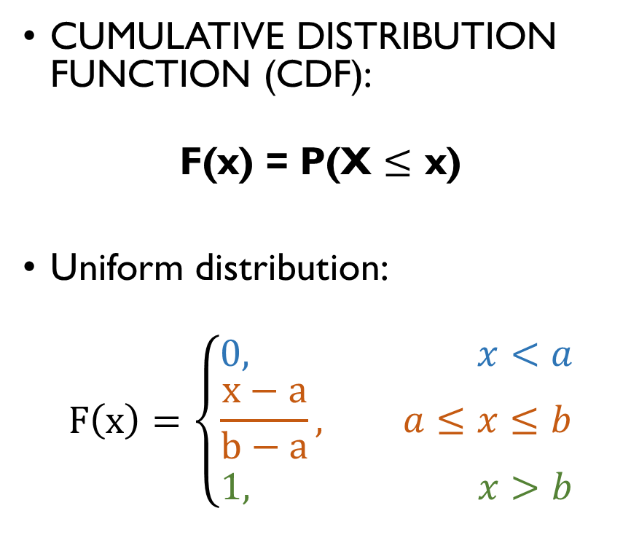
UNIFORM DISTRIBUTION
CUMULATIVE DISTRIBUTION FUNCTION (CDF):
F(x) = P(X $≤$ x)
Uniform distribution:
$$F\left(x\right)=\left\{\begin{aligned}0, x<a \\ \frac{x−a}{b−a}, a≤x≤b \\ 1, x>b\end{aligned}\right.$$
x
a
b
a
x
b
a
b
x

Slide 91

CDF
Cumulative Distribution Function:
F(x) = P(X $≤$ x)
Which basic properties such a function has?
0 $≤$ F(x) $≤$ 1
F(x) is non-decreasing
CDF defines a continuous distribution!

Slide 92
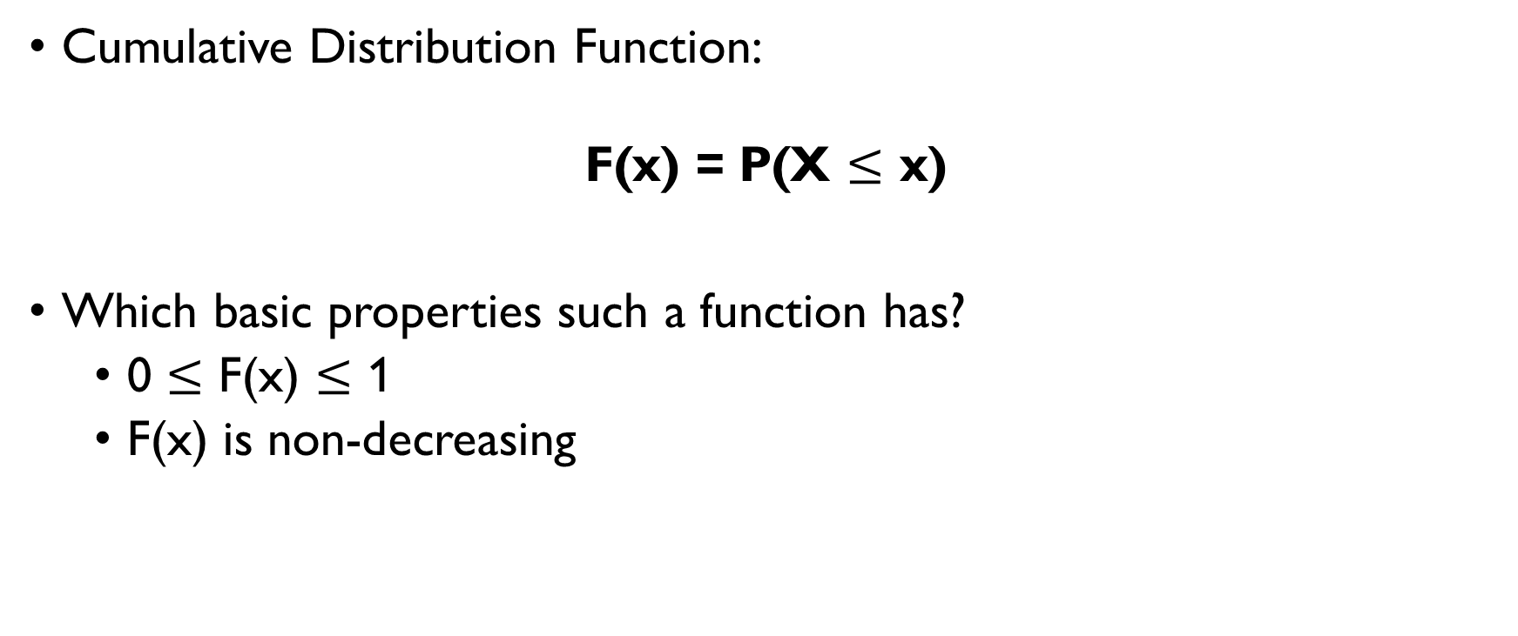
CDF
Cumulative Distribution Function:
F(x) = P(X $≤$ x)
Which basic properties such a function has?
0 $≤$ F(x) $≤$ 1
F(x) is non-decreasing
CDF defines a continuous distribution!

Slide 93
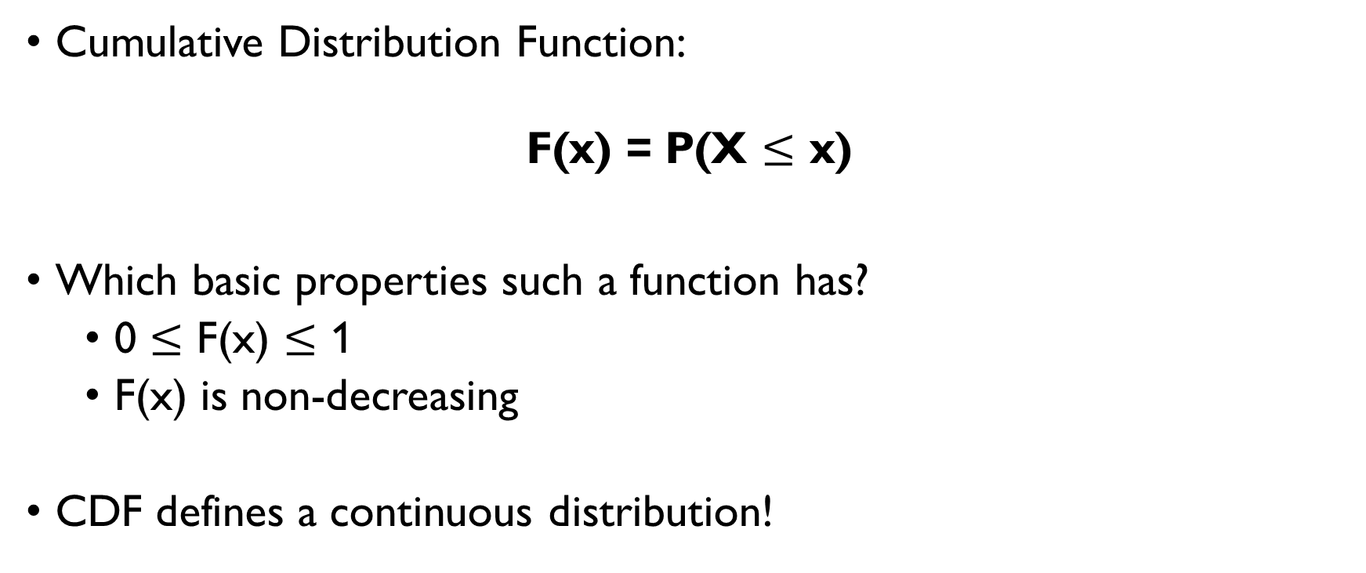
CDF
Cumulative Distribution Function:
F(x) = P(X $≤$ x)
Which basic properties such a function has?
0 $≤$ F(x) $≤$ 1
F(x) is non-decreasing
CDF defines a continuous distribution!

Slide 94

UNIFORM DISTRIBUTION
What’s the probability P(X > 7)?
P(X > 7) = 1 – P(X $≤$ 7) =
= 1 – F(7) =
= 1 – (7 - 0)/(10 - 0) =
= 1 – 0.7 = 0.3

Slide 95

UNIFORM DISTRIBUTION
What’s the probability P(X > 7)?
P(X > 7) = 1 – P(X $≤$ 7) =
= 1 – F(7) =
= 1 – (7 - 0)/(10 - 0) =
= 1 – 0.7 = 0.3
0
7
10

Slide 96
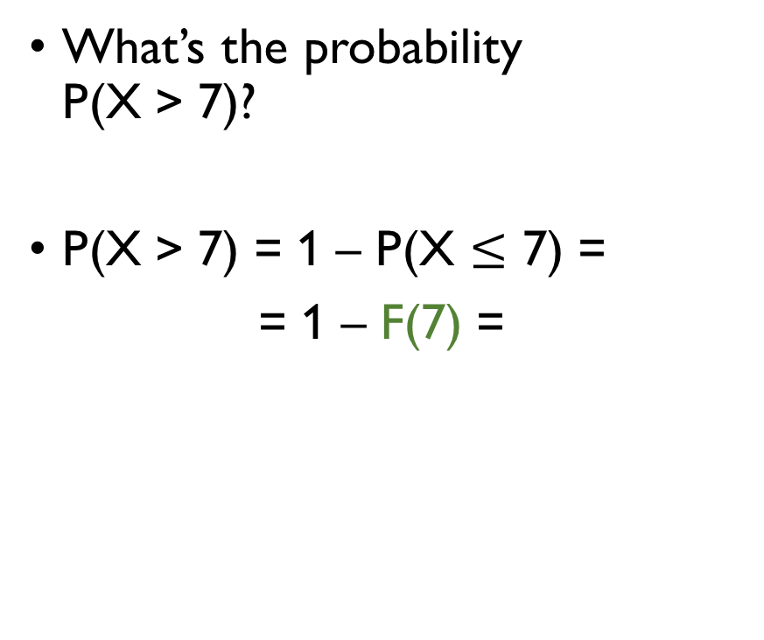
UNIFORM DISTRIBUTION
What’s the probability P(X > 7)?
P(X > 7) = 1 – P(X $≤$ 7) =
= 1 – F(7) =
= 1 – (7 - 0)/(10 - 0) =
= 1 – 0.7 = 0.3
0
7
10

Slide 97
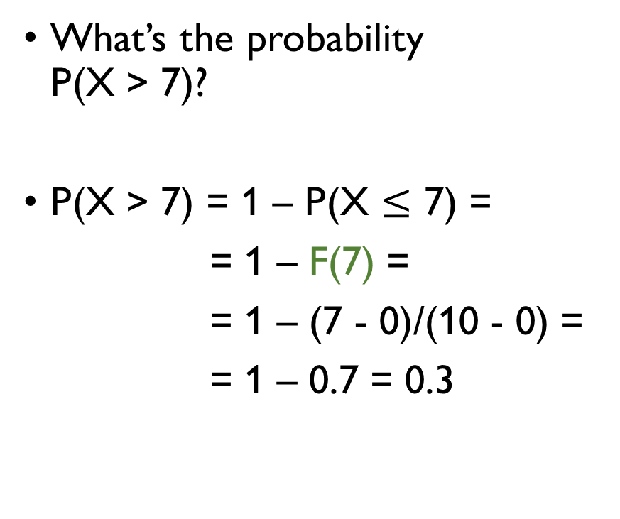
UNIFORM DISTRIBUTION
What’s the probability P(X > 7)?
P(X > 7) = 1 – P(X $≤$ 7) =
= 1 – F(7) =
= 1 – (7 - 0)/(10 - 0) =
= 1 – 0.7 = 0.3
0
7
10

Slide 98
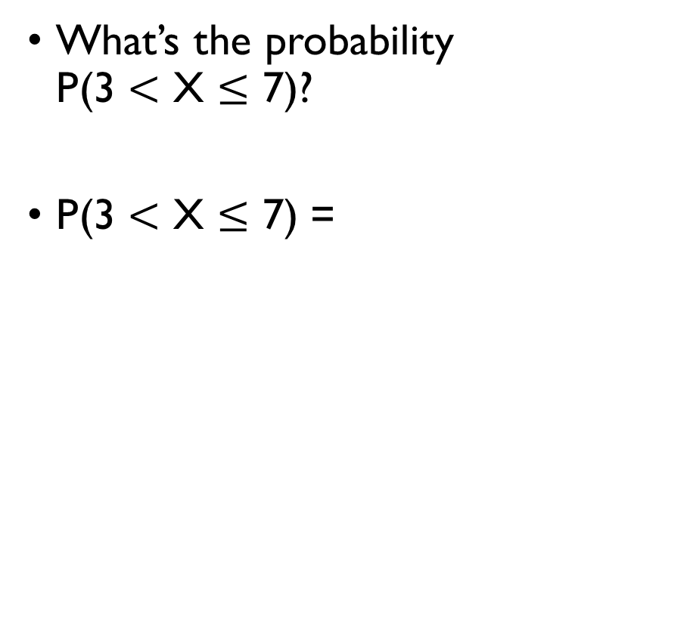
UNIFORM DISTRIBUTION
What’s the probability P(3 $<$ X $≤$ 7)?
P(3 $<$ X $≤$ 7) = (7 – 3)/(10 - 0) =
= 0.4
In terms of CDF:
P(3 $≤$ X $≤$ 7) =
= P(X $≤$ 7) – P(X $≤$ 3)=
= F(7) – F(3)
0
3
7
10

Slide 99

UNIFORM DISTRIBUTION
What’s the probability P(3 $<$ X $≤$ 7)?
P(3 $<$ X $≤$ 7) = (7 – 3)/(10 - 0) =
= 0.4
In terms of CDF:
P(3 $≤$ X $≤$ 7) =
= P(X $≤$ 7) – P(X $≤$ 3)=
= F(7) – F(3)
0
3
7
10

Slide 100

UNIFORM DISTRIBUTION
What’s the probability P(3 $<$ X $≤$ 7)?
P(3 $<$ X $≤$ 7) = (7 – 3)/(10 - 0) =
= 0.4
In terms of CDF:
P(3 $≤$ X $≤$ 7) =
= P(X $≤$ 7) – P(X $≤$ 3)=
= F(7) – F(3)
0
3
7
10

Slide 101

UNIFORM DISTRIBUTION
What’s the probability P(3 $<$ X $≤$ 7)?
P(3 $<$ X $≤$ 7) = (7 – 3)/(10 - 0) =
= 0.4
In terms of CDF:
P(3 $≤$ X $≤$ 7) =
= P(X $≤$ 7) – P(X $≤$ 3)=
= F(7) – F(3)
0
3
7
10

Slide 102

UNIFORM DISTRIBUTION
What’s the probability P(3 $<$ X $≤$ 7)?
P(3 $<$ X $≤$ 7) = (7 – 3)/(10 - 0) =
= 0.4
In terms of CDF:
P(3 $≤$ X $≤$ 7) =
= P(X $≤$ 7) – P(X $≤$ 3)=
= F(7) – F(3)
0
3
7
10

Slide 103

UNIFORM DISTRIBUTION
What’s the probability P(1 $<$ X $≤$ 2 or 7 $<$ X $≤$ 9)?
P(1 $<$ X $≤$ 2 or 7 $<$ X $≤$ 9) =
= F(2) – F(1) +
+ F(9) – F(7) =
= 0.2 – 0.1 + 0.9 – 0.7 =
= 0.3
0
1
2
7
9
10

Slide 104

UNIFORM DISTRIBUTION
What’s the probability P(1 $<$ X $≤$ 2 or 7 $<$ X $≤$ 9)?
P(1 $<$ X $≤$ 2 or 7 $<$ X $≤$ 9) =
= F(2) – F(1) +
+ F(9) – F(7) =
= 0.2 – 0.1 + 0.9 – 0.7 =
= 0.3
0
1
2
7
9
10

Slide 105

UNIFORM DISTRIBUTION
What’s the probability P(1 $<$ X $≤$ 2 or 7 $<$ X $≤$ 9)?
P(1 $<$ X $≤$ 2 or 7 $<$ X $≤$ 9) =
= F(2) – F(1) +
+ F(9) – F(7) =
= 0.2 – 0.1 + 0.9 – 0.7 =
= 0.3
0
1
2
7
9
10

Slide 106

CDF
We’ve figured out so far that
P(X $≤$ x) = F(x)
P(X $>$ x) = 1 – F(x)
P(x1 $<$ X $≤$ x2) = F(x2) – F(x1)
But what’s, for example, P(X = 5)?

Slide 107

CDF
We’ve figured out so far that
P(X $≤$ x) = F(x)
P(X $>$ x) = 1 – F(x)
P(x1 $<$ X $≤$ x2) = F(x2) – F(x1)
But what’s, for example, P(X = 5)?

Slide 108

CDF
We’ve figured out so far that
P(X $≤$ x) = F(x)
P(X $>$ x) = 1 – F(x)
P(x1 $<$ X $≤$ x2) = F(x2) – F(x1)
But what’s, for example, P(X = 5)?

Slide 109

CDF
We’ve figured out so far that
P(X $≤$ x) = F(x)
P(X $>$ x) = 1 – F(x)
P(x1 $<$ X $≤$ x2) = F(x2) – F(x1)
But what’s, for example, P(X = 5)?

Slide 110

CDF
We’ve figured out so far that
P(X $≤$ x) = F(x)
P(X $>$ x) = 1 – F(x)
P(x1 $<$ X $≤$ x2) = F(x2) – F(x1)
But what’s, for example, P(X = 5)?

Slide 111

CDF
We’ve figured out so far that
P(X $≤$ x) = F(x)
P(X $>$ x) = 1 – F(x)
P(x1 $<$ X $≤$ x2) = F(x2) – F(x1)
But what’s, for example, P(X = 5)?

Slide 112

UNIFORM DISTRIBUTION
P(4 < X $≤$ 6) =
= (6 – 4)/(10 - 0) = 0.2
P(4.5 < X $≤$ 5.5) =
= (4.5 – 5.5)/(10 – 0) = 0.1
P(4.9 < X $≤$ 5.1) =
= (4.9 – 5.1)/(10 – 0) = 0.02
P(X = 5) = … ?

Slide 113

UNIFORM DISTRIBUTION
P(4 < X $≤$ 6) =
= (6 – 4)/(10 - 0) = 0.2
P(4.5 < X $≤$ 5.5) =
= (4.5 – 5.5)/(10 – 0) = 0.1
P(4.9 < X $≤$ 5.1) =
= (4.9 – 5.1)/(10 – 0) = 0.02
P(X = 5) = … ?
0
4
6
10

Slide 114

UNIFORM DISTRIBUTION
P(4 < X $≤$ 6) =
= (6 – 4)/(10 - 0) = 0.2
P(4.5 < X $≤$ 5.5) =
= (4.5 – 5.5)/(10 – 0) = 0.1
P(4.9 < X $≤$ 5.1) =
= (4.9 – 5.1)/(10 – 0) = 0.02
P(X = 5) = … ?
0
4
6
10

Slide 115

UNIFORM DISTRIBUTION
P(4 < X $≤$ 6) =
= (6 – 4)/(10 - 0) = 0.2
P(4.5 < X $≤$ 5.5) =
= (4.5 – 5.5)/(10 – 0) = 0.1
P(4.9 < X $≤$ 5.1) =
= (4.9 – 5.1)/(10 – 0) = 0.02
P(X = 5) = … ?
0
4
6
10
0
4.5
5.5
10

Slide 116

UNIFORM DISTRIBUTION
P(4 < X $≤$ 6) =
= (6 – 4)/(10 - 0) = 0.2
P(4.5 < X $≤$ 5.5) =
= (4.5 – 5.5)/(10 – 0) = 0.1
P(4.9 < X $≤$ 5.1) =
= (4.9 – 5.1)/(10 – 0) = 0.02
P(X = 5) = … ?
0
4
6
10
0
4.5
5.5
10

Slide 117

UNIFORM DISTRIBUTION
P(4 < X $≤$ 6) =
= (6 – 4)/(10 - 0) = 0.2
P(4.5 < X $≤$ 5.5) =
= (4.5 – 5.5)/(10 – 0) = 0.1
P(4.9 < X $≤$ 5.1) =
= (4.9 – 5.1)/(10 – 0) = 0.02
P(X = 5) = … ?
0
4
6
10
0
4.5
5.5
10
0
4.9
5.1
10

Slide 118
UNIFORM DISTRIBUTION
We want to model a random variable X that takes any value between 0 and 10 with equal probability.
But what’s, for example, P(X = 5)?
Let’s start with the discrete uniform distribution between 0 and 10: X takes n values between 0 and 10 with probability p = 1/n:

Slide 119
UNIFORM DISTRIBUTION
We want to model a random variable X that takes any value between 0 and 10 with equal probability.
But what’s, for example, P(X = 5)?
Let’s start with the discrete uniform distribution between 0 and 10: X takes n values between 0 and 10 with probability p = 1/n:
n | 2 | 3 | 10 | 1000 | 100000 | … | ∞
1/p | 0.5 | 0.33 | 0.1 | 0.001 | 0.00001 | … | 0

Slide 120
UNIFORM DISTRIBUTION
We want to model a random variable X that takes any value between 0 and 10 with equal probability.
But what’s, for example, P(X = 5)?
Let’s start with the discrete uniform distribution between 0 and 10: X takes n values between 0 and 10 with probability p = 1/n:
n | 2 | 3 | 10 | 1000 | 100000 | … | ∞
1/p | 0.5 | 0.33 | 0.1 | 0.001 | 0.00001 | … | 0

Slide 121
UNIFORM DISTRIBUTION
We want to model a random variable X that takes any value between 0 and 10 with equal probability.
But what’s, for example, P(X = 5)?
Let’s start with the discrete uniform distribution between 0 and 10: X takes n values between 0 and 10 with probability p = 1/n:
n | 2 | 3 | 10 | 1000 | 100000 | … | ∞
1/p | 0.5 | 0.33 | 0.1 | 0.001 | 0.00001 | … | 0

Slide 122
Continuous random variables can take uncountably many values, but…
The probability that a continuous random variable is equal to a particular value is 0!

Slide 123
So far, we’ve learned that:
Continuous random variables take uncountably many values.
If X is a continuous random variable, P(X = x) = 0.
Continuous distribution can be defined with a CDF.

Slide 124

CDFs FOR DISCRETE DISTRIBUTIONS
Actually, CDF can be defined also for a discrete random variable.
X – discrete, takes values x₁, x₂, … x_{n}
$$F\left(x\right)=P\left(X<x\right)=\sum_{i=1}^{n}{I\left(x_{i}<x\right)∙P\left(X=x_{i}\right)}$$
What’s CDF for Bernoulli distribution?
$$F\left(x\right)=P(X≤x) \left\{\begin{aligned}0, x<0 \\ 1−p, 0≤x<1 \\ 1, x≥1\end{aligned}\right.$$

Slide 125

CDFs FOR DISCRETE DISTRIBUTIONS
Actually, CDF can be defined also for a discrete random variable.
X – discrete, takes values x₁, x₂, … x_{n}
$$F\left(x\right)=P\left(X≤x\right)=\sum_{i=1}^{n}{I\left(x_{i}≤x\right)∙P\left(X=x_{i}\right)}$$
What’s CDF for Bernoulli distribution?
$$F\left(x\right)=P(X≤x) \left\{\begin{aligned}0, x<0 \\ 1−p, 0≤x<1 \\ 1, x≥1\end{aligned}\right.$$

Slide 126

CDFs FOR DISCRETE DISTRIBUTIONS
Actually, CDF can be defined also for a discrete random variable.
X – discrete, takes values x₁, x₂, … x_{n}
$$F\left(x\right)=P\left(X≤x\right)=\sum_{i=1}^{n}{I\left(x_{i}≤x\right)∙P\left(X=x_{i}\right)}$$
What’s CDF for Bernoulli distribution?
$$F\left(x\right)=P(X≤x) \left\{\begin{aligned}0, x<0 \\ 1−p, 0≤x<1 \\ 1, x≥1\end{aligned}\right.$$

Slide 127

CDFs FOR DISCRETE DISTRIBUTIONS
Actually, CDF can be defined also for a discrete random variable.
X – discrete, takes values x₁, x₂, … x_{n}
$$F\left(x\right)=P\left(X≤x\right)=\sum_{i=1}^{n}{I\left(x_{i}≤x\right)∙P\left(X=x_{i}\right)}$$
What’s CDF for Bernoulli distribution?
$$F\left(x\right)=P\left(X≤x\right)= \left\{\begin{aligned}0, x<0 \\ 1−p, 0≤x<1 \\ 1, x≥1\end{aligned}\right.$$

Slide 128

CDFs FOR DISCRETE DISTRIBUTIONS
Actually, CDF can be defined also for a discrete random variable.
X – discrete, takes values x₁, x₂, … x_{n}
$$F\left(x\right)=P\left(X≤x\right)=\sum_{i=1}^{n}{I\left(x_{i}≤x\right)∙P\left(X=x_{i}\right)}$$
What’s CDF for Bernoulli distribution?
$$F\left(x\right)=P\left(X≤x\right)=\left\{\begin{aligned}0, x<0 \\ 1−p, 0≤x<1 \\ 1, x≥1\end{aligned}\right.$$

Slide 129

CDFs FOR DISCRETE DISTRIBUTIONS
Actually, CDF can be defined also for a discrete random variable.
X – discrete, takes values x₁, x₂, … x_{n}
$$F\left(x\right)=P\left(X<x\right)=\sum_{i=1}^{n}{I\left(x_{i}<x\right)∙P\left(X=x_{i}\right)}$$
What’s CDF for Bernoulli distribution?
$$F\left(x\right)=P\left(X≤x\right)= \left\{\begin{aligned}0, x<0 \\ 1−p, 0≤x<1 \\ 1, x≥1\end{aligned}\right.$$

Slide 130

CDFs FOR DISCRETE DISTRIBUTIONS
Actually, CDF can be defined also for a discrete random variable.
X – discrete, takes values x₁, x₂, … x_{n}
$$F\left(x\right)=P\left(X<x\right)=\sum_{i=1}^{n}{I\left(x_{i}<x\right)∙P\left(X=x_{i}\right)}$$
What’s CDF for Bernoulli distribution?
$$F\left(x\right)=P\left(X≤x\right)= \left\{\begin{aligned}0, x<0 \\ 1−p, 0≤x<1 \\ 1, x≥1\end{aligned}\right.$$

Slide 131

CDFs FOR DISCRETE DISTRIBUTIONS
Actually, CDF can be defined also for a discrete random variable.
X – discrete, takes values x₁, x₂, … x_{n}
$$F\left(x\right)=P\left(X<x\right)=\sum_{i=1}^{n}{I\left(x_{i}<x\right)∙P\left(X=x_{i}\right)}$$
What’s CDF for Bernoulli distribution?
$$F\left(x\right)=P\left(X≤x\right)= \left\{\begin{aligned}0, x<0 \\ 1−p, 0≤x<1 \\ 1, x≥1\end{aligned}\right.$$

Slide 132
EXPERIMENT WITH CDFs IN PYTHON
Google Classroom -> Probability mass functions and CDFs

Slide 133
TO SUM UP
MLE for discrete uniform distribution
Discrete vs continuous random variables
CDF
for discrete
for continuous

