Slide 1
INTRODUCTION TO STATISTICS
LECTURE 5

Slide 2
LAST TIME
Understanding probability density functions (PDFs)
PDF and CDF
Uniform distribution
Exponential distribution

Slide 3
TODAY
Finish the uniform distribution exercise
Review density
Maximum Likelihood for continuous distributions
Normal distribution
“Strange” distributions

Slide 4
MEAN, MEDIAN AND MODE
ON PDFs

Slide 5
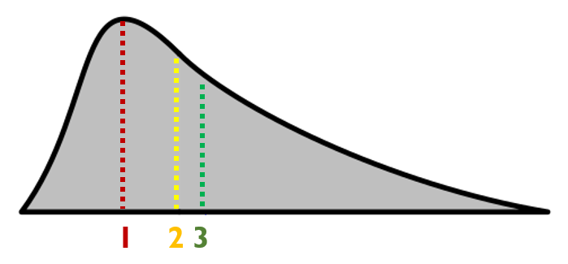
MEAN, MEDIAN AND MODE

Slide 6
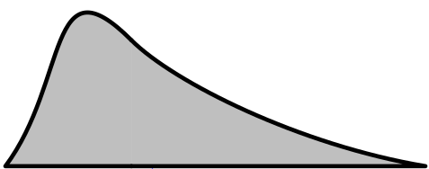
MEAN, MEDIAN AND MODE
mode

Slide 7
MEAN, MEDIAN AND MODE

Slide 8
MEAN, MEDIAN AND MODE
50%
50%
median

Slide 9
MEAN, MEDIAN AND MODE
mean

Slide 10
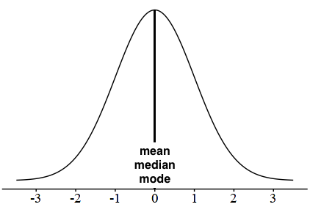
MEAN, MEDIAN AND MODE

Slide 11
MEAN, MEDIAN AND MODE

Slide 12

REMINDER: EXPONENTIAL DISTRIBUTION
Models waiting times
X ~ $Exp\left(λ\right)$, $λ>0$ – rate parameter.
$F\left(x\right)=\left\{\begin{aligned}1 − e^{−λx}, x≥0 \\ 0, x<0\end{aligned}\right. p\left(x\right)=\left\{\begin{aligned}λ∙e^{−λx}, x≥0 \\ 0, otherwise\end{aligned}\right.$
$E\left(X\right)=\frac{1}{λ} Var\left(X\right)=\frac{1}{λ^{2}}$

Slide 13

REMINDER: EXPONENTIAL DISTRIBUTION
Models waiting times
X ~ $Exp\left(λ\right)$, $λ>0$ – rate parameter.
$F\left(x\right)=\left\{\begin{aligned}1 − e^{−λx}, x≥0 \\ 0, x<0\end{aligned}\right. p\left(x\right)=\left\{\begin{aligned}λ∙e^{−λx}, x≥0 \\ 0, otherwise\end{aligned}\right.$
$E\left(X\right)=\frac{1}{λ} Var\left(X\right)=\frac{1}{λ^{2}}$

Slide 14

REMINDER: EXPONENTIAL DISTRIBUTION
Models waiting times
X ~ $Exp\left(λ\right)$, $λ>0$ – rate parameter.
$F\left(x\right)=\left\{\begin{aligned}1 − e^{−λx}, x≥0 \\ 0, x<0\end{aligned}\right. p\left(x\right)=\left\{\begin{aligned}λ∙e^{−λx}, x≥0 \\ 0, otherwise\end{aligned}\right.$
$E\left(X\right)=\frac{1}{λ} Var\left(X\right)=\frac{1}{λ^{2}}$

Slide 15
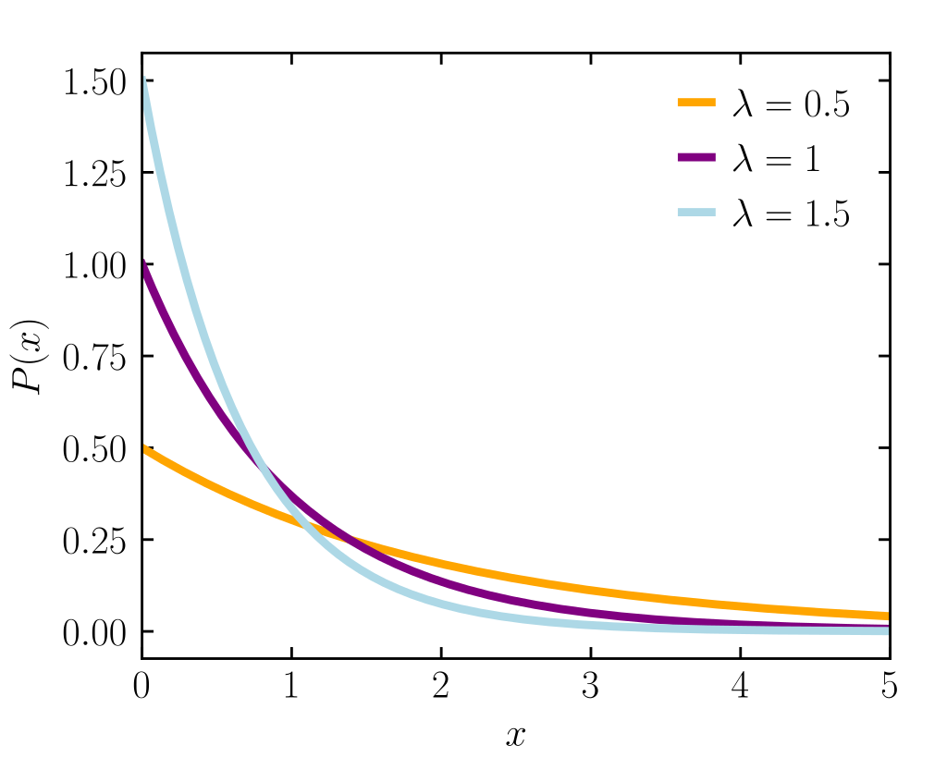

REMINDER: EXPONENTIAL DISTRIBUTION
Models waiting times
X ~ $Exp\left(λ\right)$, $λ>0$ – rate parameter.
$F\left(x\right)=\left\{\begin{aligned}1 − e^{−λx}, x≥0 \\ 0, x<0\end{aligned}\right. p\left(x\right)=\left\{\begin{aligned}λ∙e^{−λx}, x≥0 \\ 0, otherwise\end{aligned}\right.$
$E\left(X\right)=\frac{1}{λ} Var\left(X\right)=\frac{1}{λ^{2}}$

Slide 16

REMINDER: EXPONENTIAL DISTRIBUTION
Models waiting times
X ~ $Exp\left(λ\right)$, $λ>0$ – rate parameter.
$F\left(x\right)=\left\{\begin{aligned}1 − e^{−λx}, x≥0 \\ 0, x<0\end{aligned}\right. p\left(x\right)=\left\{\begin{aligned}λ∙e^{−λx}, x≥0 \\ 0, otherwise\end{aligned}\right.$
$E\left(X\right)=\frac{1}{λ} Var\left(X\right)=\frac{1}{λ^{2}}$

Slide 17
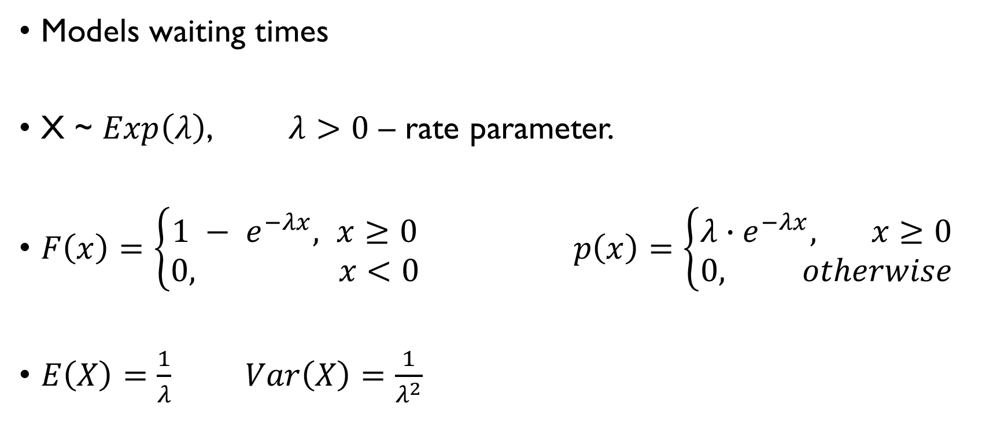
REMINDER: EXPONENTIAL DISTRIBUTION
Models waiting times
X ~ $Exp\left(λ\right)$, $λ>0$ – rate parameter.
$F\left(x\right)=\left\{\begin{aligned}1 − e^{−λx}, x≥0 \\ 0, x<0\end{aligned}\right. p\left(x\right)=\left\{\begin{aligned}λ∙e^{−λx}, x≥0 \\ 0, otherwise\end{aligned}\right.$
$E\left(X\right)=\frac{1}{λ} Var\left(X\right)=\frac{1}{λ^{2}}$

Slide 18

EXPONENTIAL DISTRIBUTION
On the average, a certain computer part lasts ten years.
$X$ - the length of time the computer part lasts.
Let’s model it with an exponential distribution:
$$X\sim Exp\left(0.1\right)$$
What is the probability that a computer part lasts more than 7 years?
$$P\left(X>7\right)=1−P\left(X≤7\right)=1−F\left(7\right)=e^{−0.1∙7}≈\text{0.4966}$$

Slide 19

EXPONENTIAL DISTRIBUTION
On the average, a certain computer part lasts ten years.
$X$ - the length of time the computer part lasts.
Let’s model it with an exponential distribution:
$$X\sim Exp\left(0.1\right)$$
What is the probability that a computer part lasts more than 7 years?
$$P\left(X>7\right)=1−P\left(X≤7\right)=1−F\left(7\right)=e^{−0.1∙7}≈\text{0.4966}$$

Slide 20
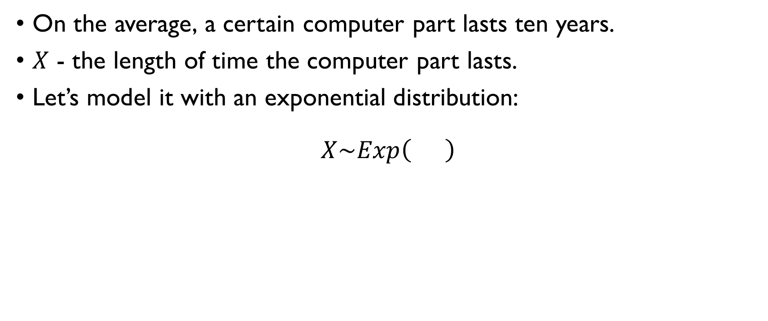
EXPONENTIAL DISTRIBUTION
On the average, a certain computer part lasts ten years.
$X$ - the length of time the computer part lasts.
Let’s model it with an exponential distribution:
$$X\sim Exp\left(0.1\right)$$
What is the probability that a computer part lasts more than 7 years?
$$P\left(X>7\right)=1−P\left(X≤7\right)=1−F\left(7\right)=e^{−0.1∙7}≈\text{0.4966}$$

Slide 21
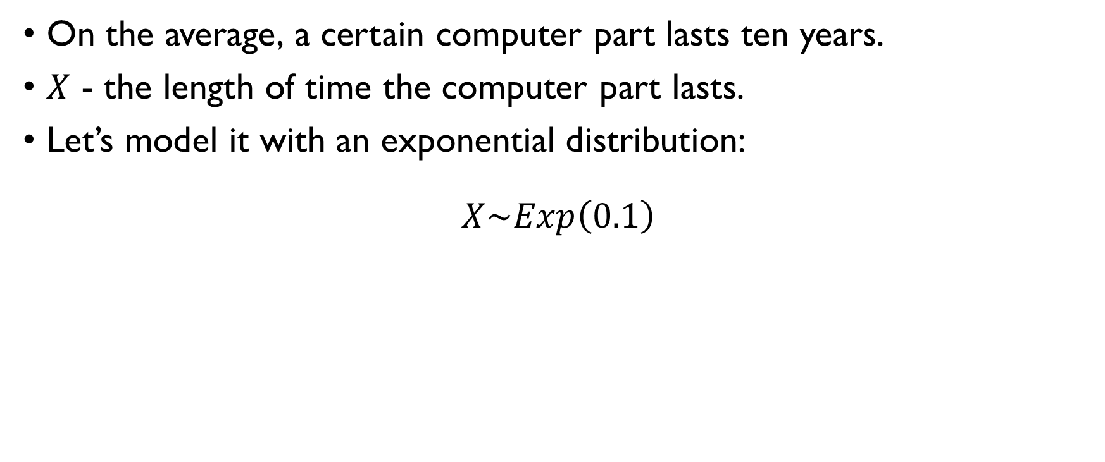
EXPONENTIAL DISTRIBUTION
On the average, a certain computer part lasts ten years.
$X$ - the length of time the computer part lasts.
Let’s model it with an exponential distribution:
$$X\sim Exp\left(0.1\right)$$
What is the probability that a computer part lasts more than 7 years?
$$P\left(X>7\right)=1−P\left(X≤7\right)=1−F\left(7\right)=e^{−0.1∙7}≈\text{0.4966}$$

Slide 22
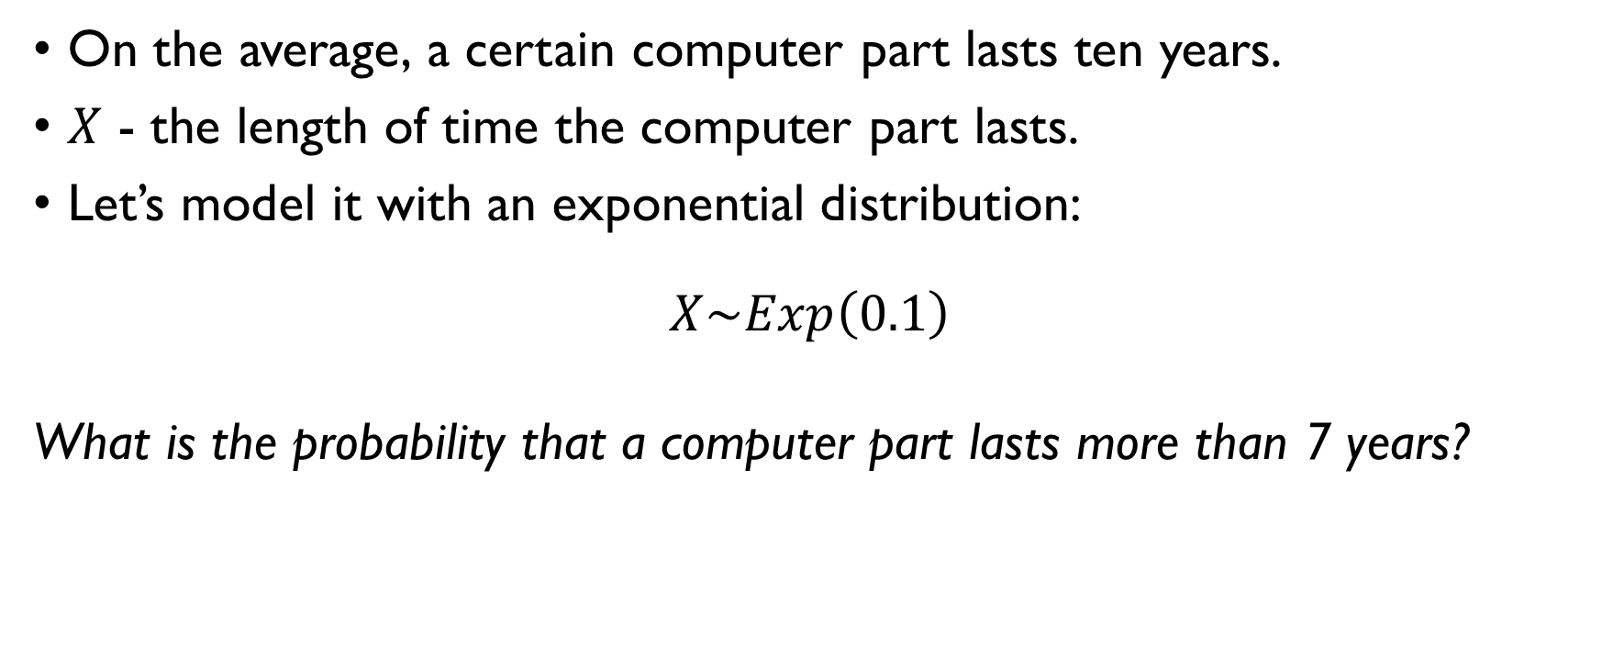
EXPONENTIAL DISTRIBUTION
On the average, a certain computer part lasts ten years.
$X$ - the length of time the computer part lasts.
Let’s model it with an exponential distribution:
$$X\sim Exp\left(0.1\right)$$
What is the probability that a computer part lasts more than 7 years?
$$P\left(X>7\right)=1−P\left(X≤7\right)=1−F\left(7\right)=e^{−0.1∙7}≈\text{0.4966}$$

Slide 23
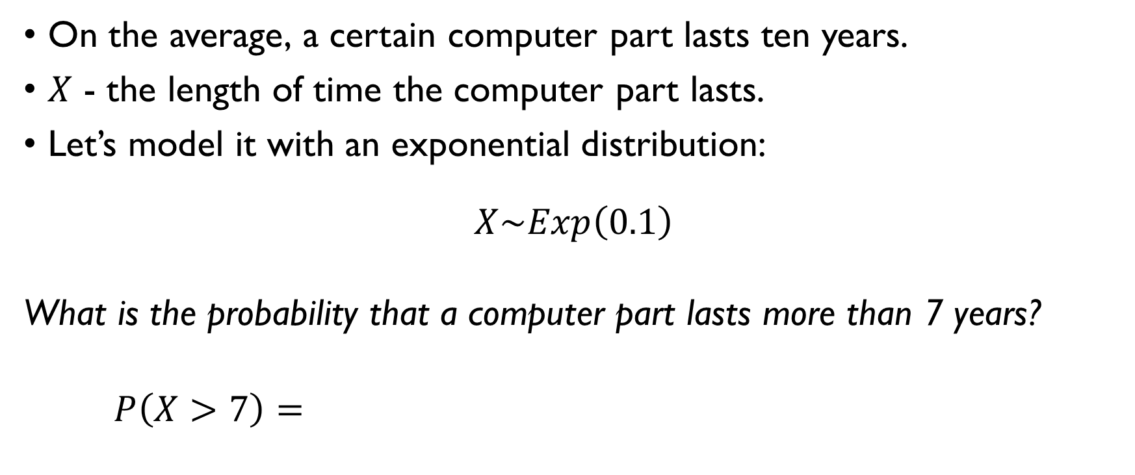
EXPONENTIAL DISTRIBUTION
On the average, a certain computer part lasts ten years.
$X$ - the length of time the computer part lasts.
Let’s model it with an exponential distribution:
$$X\sim Exp\left(0.1\right)$$
What is the probability that a computer part lasts more than 7 years?
$$P\left(X>7\right)=1−P\left(X≤7\right)=1−F\left(7\right)=e^{−0.1∙7}≈\text{0.4966}$$

Slide 24
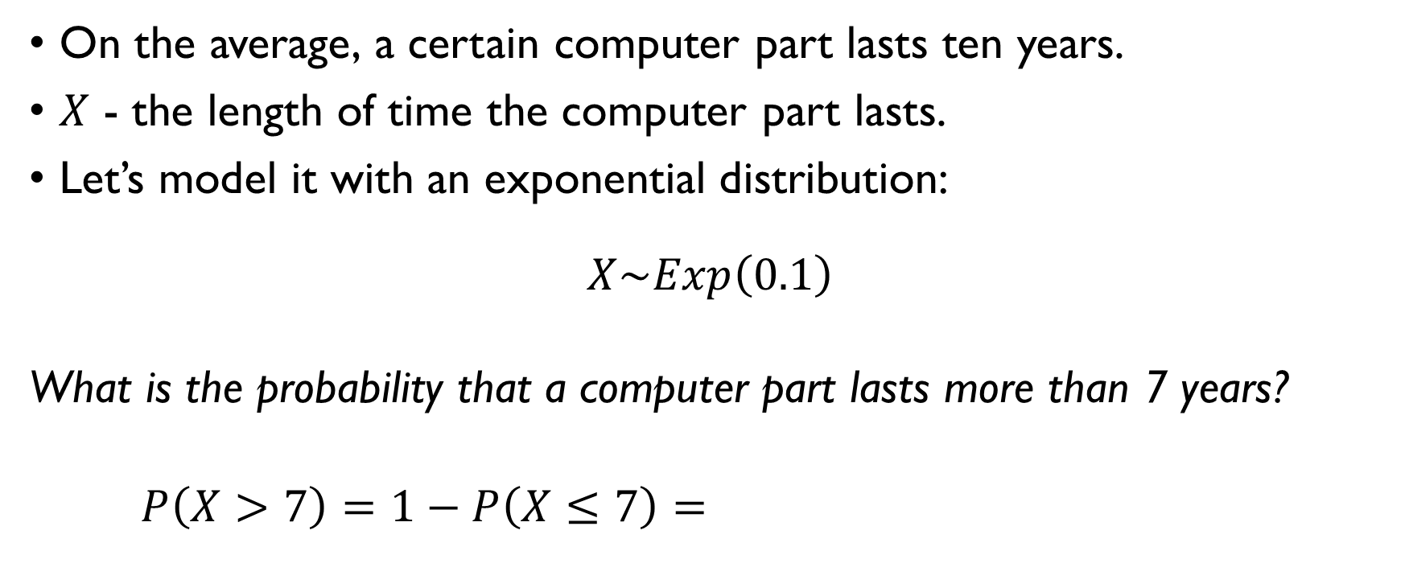
EXPONENTIAL DISTRIBUTION
On the average, a certain computer part lasts ten years.
$X$ - the length of time the computer part lasts.
Let’s model it with an exponential distribution:
$$X\sim Exp\left(0.1\right)$$
What is the probability that a computer part lasts more than 7 years?
$$P\left(X>7\right)=1−P\left(X≤7\right)=1−F\left(7\right)=e^{−0.1∙7}≈\text{0.4966}$$

Slide 25
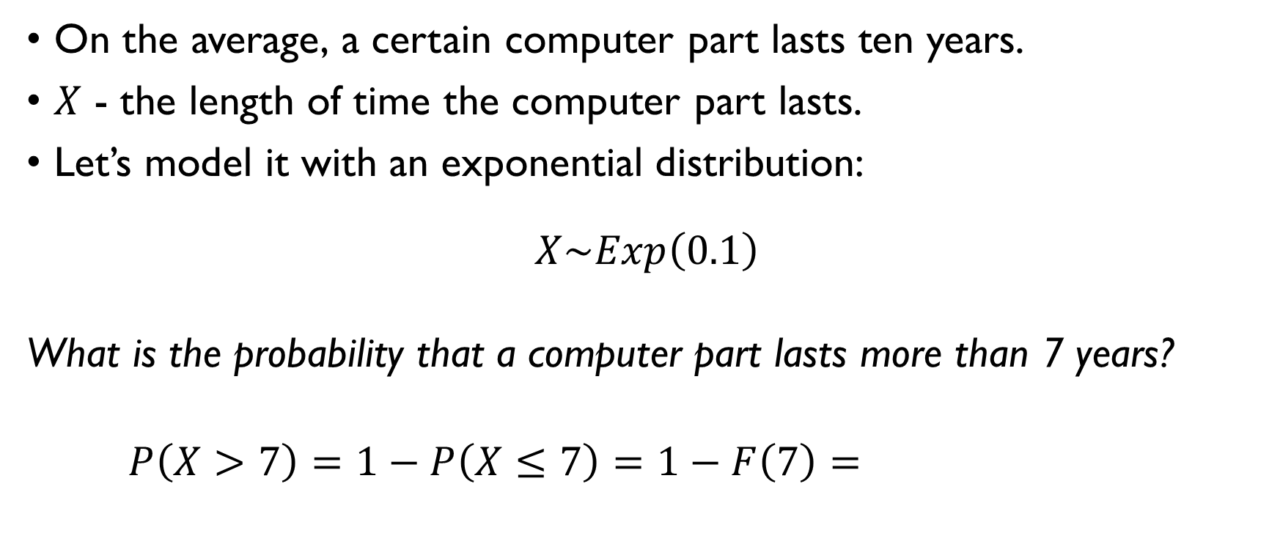
EXPONENTIAL DISTRIBUTION
On the average, a certain computer part lasts ten years.
$X$ - the length of time the computer part lasts.
Let’s model it with an exponential distribution:
$$X\sim Exp\left(0.1\right)$$
What is the probability that a computer part lasts more than 7 years?
$$P\left(X>7\right)=1−P\left(X≤7\right)=1−F\left(7\right)=e^{−0.1∙7}≈\text{0.4966}$$

Slide 26
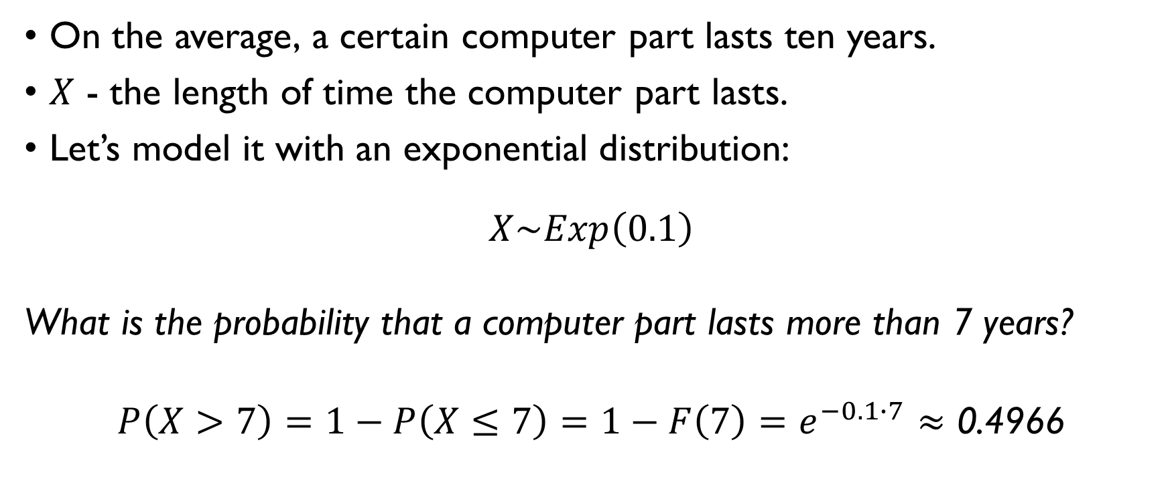
EXPONENTIAL DISTRIBUTION
On the average, a certain computer part lasts ten years.
$X$ - the length of time the computer part lasts.
Let’s model it with an exponential distribution:
$$X\sim Exp\left(0.1\right)$$
What is the probability that a computer part lasts more than 7 years?
$$P\left(X>7\right)=1−P\left(X≤7\right)=1−F\left(7\right)=e^{−0.1∙7}≈\text{0.4966}$$

Slide 27

EXPONENTIAL DISTRIBUTION
X – an amount of money customers spent on their purchase.
Can be modelled as $Exp\left(λ\right)$.
Shop records costs of purchases of the last N customers:
X₁, X₂, …, X_{N}
How to estimate $λ$?

Slide 28

EXPONENTIAL DISTRIBUTION
X – an amount of money customers spent on their purchase.
Can be modelled as $Exp\left(λ\right)$.
Shop records costs of purchases of the last N customers:
X₁, X₂, …, X_{N}
How to estimate $λ$?

Slide 29
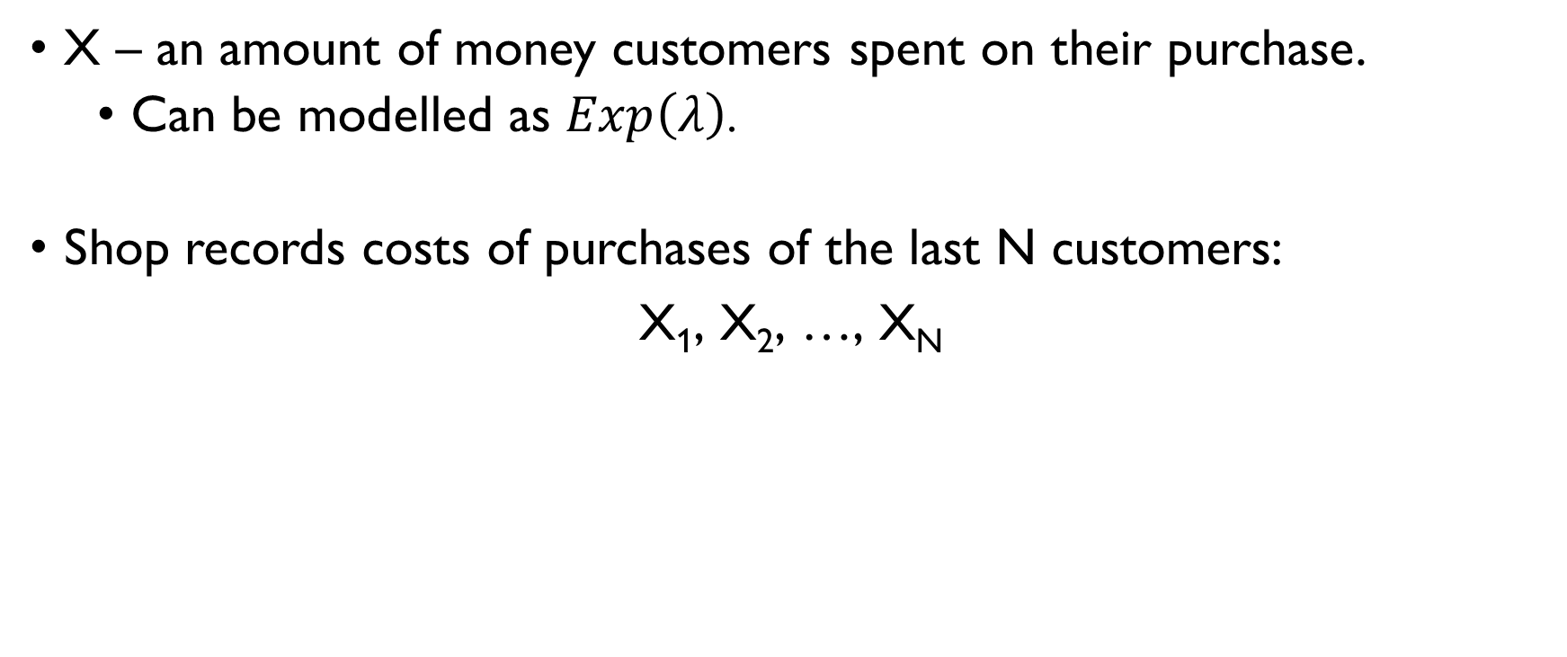
EXPONENTIAL DISTRIBUTION
X – an amount of money customers spent on their purchase.
Can be modelled as $Exp\left(λ\right)$.
Shop records costs of purchases of the last N customers:
X₁, X₂, …, X_{N}
How to estimate $λ$?

Slide 30
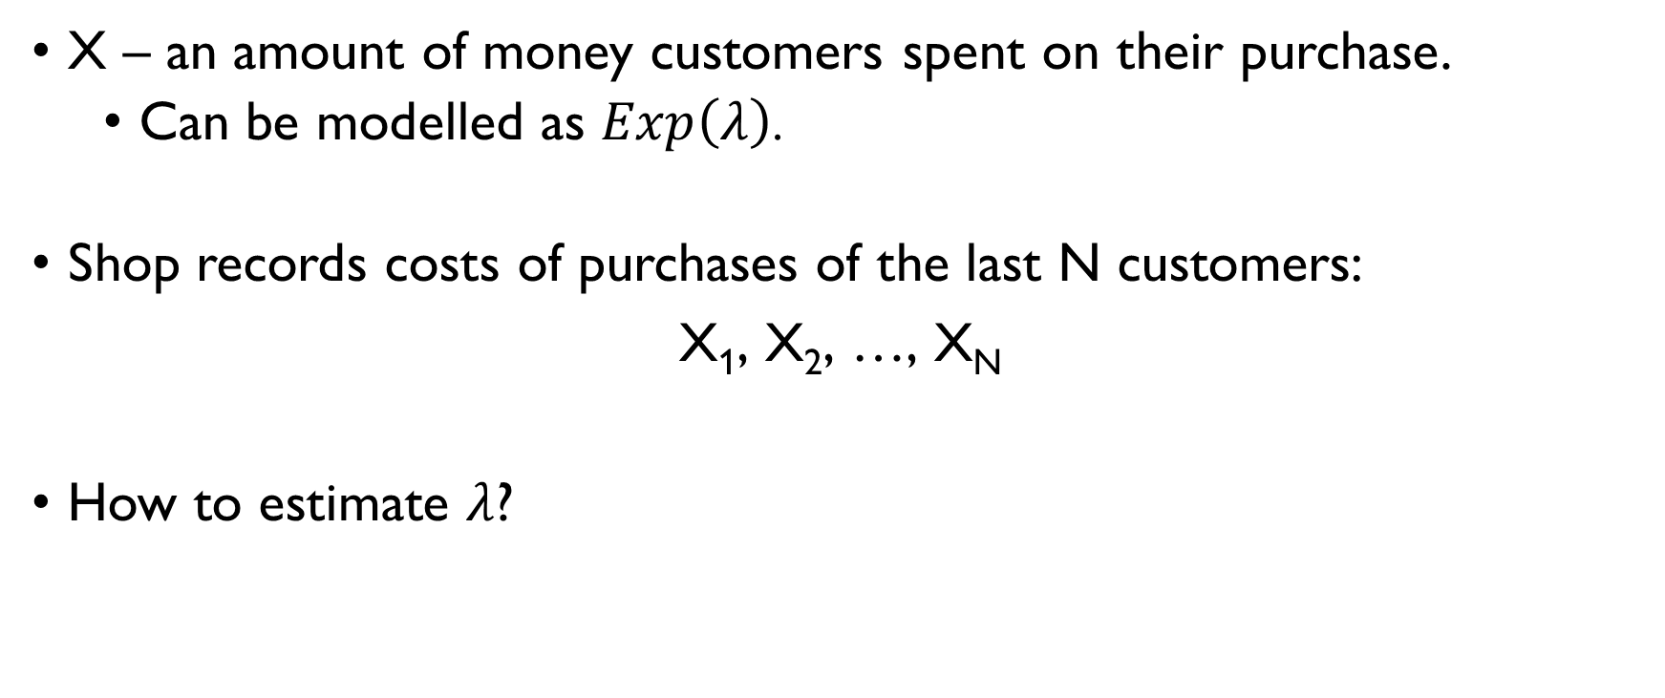
EXPONENTIAL DISTRIBUTION
X – an amount of money customers spent on their purchase.
Can be modelled as $Exp\left(λ\right)$.
Shop records costs of purchases of the last N customers:
X₁, X₂, …, X_{N}
How to estimate $λ$?

Slide 31
MAXIMUM LIKELIHOOD ESTIMATE
FOR PARAMETERS OF CONTINUOUS DISTRIBUTIONS

Slide 32

LIKELIHOOD FUNCTION
Given samples from a distribution: $X_{1},X_{2},…,X_{N}$ Obtain estimate of the parameter(s) $θ$
Likelihood function: joint density function of the obtained data given the model parameters
$$L\left(θ\right)=p\left(X_{1},X_{2},…,X_{n}|θ\right)$$
Assuming the independence of the samples:
$$L\left(θ\right)=\prod_{i=1}^{n}{p\left(X_{i}|θ\right)}$$

Slide 33

LIKELIHOOD FUNCTION
Given samples from a distribution: $X_{1},X_{2},…,X_{N}$ Obtain estimate of the parameter(s) $θ$
Likelihood function: joint density function of the obtained data given the model parameters
$$L\left(θ\right)=p\left(X_{1},X_{2},…,X_{n}|θ\right)$$
Assuming the independence of the samples:
$$L\left(θ\right)=\prod_{i=1}^{n}{p\left(X_{i}|θ\right)}$$

Slide 34
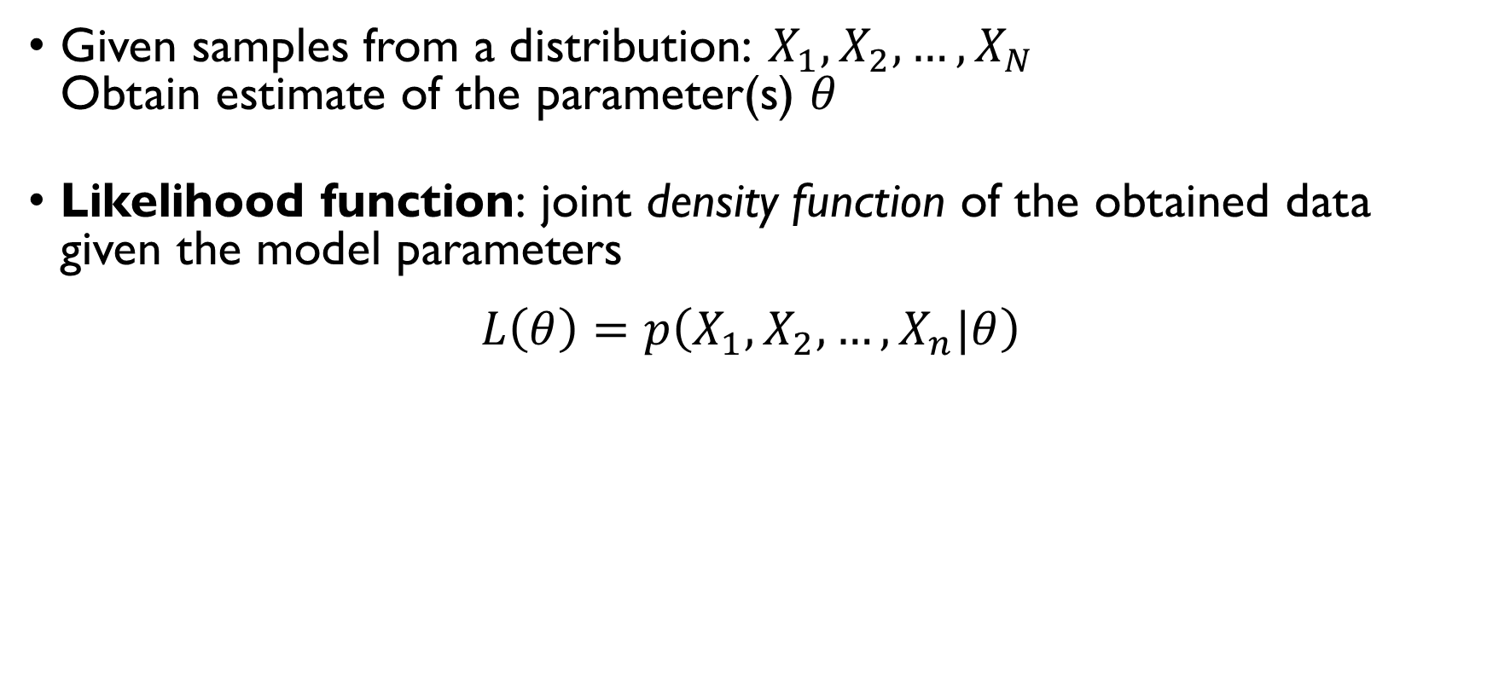
LIKELIHOOD FUNCTION
Given samples from a distribution: $X_{1},X_{2},…,X_{N}$ Obtain estimate of the parameter(s) $θ$
Likelihood function: joint density function of the obtained data given the model parameters
$$L\left(θ\right)=p\left(X_{1},X_{2},…,X_{n}|θ\right)$$
Assuming the independence of the samples:
$$L\left(θ\right)=\prod_{i=1}^{n}{p\left(X_{i}|θ\right)}$$

Slide 35
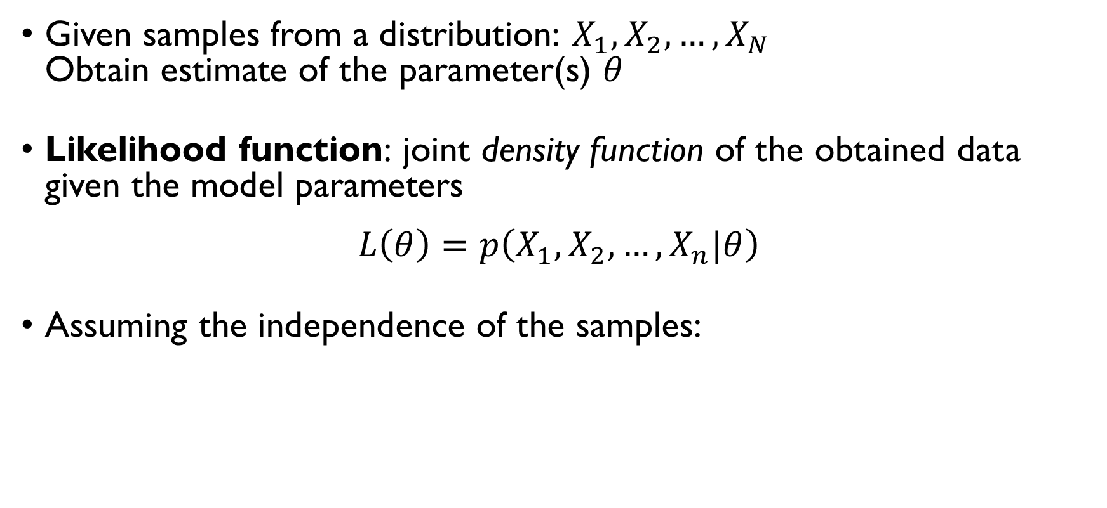
LIKELIHOOD FUNCTION
Given samples from a distribution: $X_{1},X_{2},…,X_{N}$ Obtain estimate of the parameter(s) $θ$
Likelihood function: joint density function of the obtained data given the model parameters
$$L\left(θ\right)=p\left(X_{1},X_{2},…,X_{n}|θ\right)$$
Assuming the independence of the samples:
$$L\left(θ\right)=\prod_{i=1}^{n}{p\left(X_{i}|θ\right)}$$

Slide 36
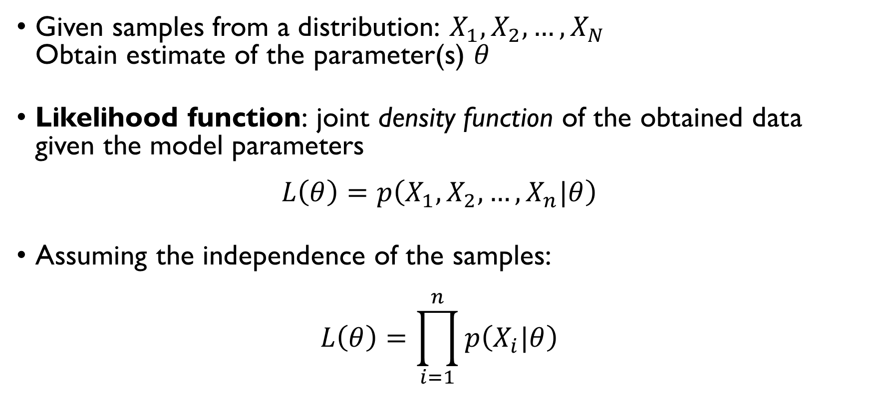
LIKELIHOOD FUNCTION
Given samples from a distribution: $X_{1},X_{2},…,X_{N}$ Obtain estimate of the parameter(s) $θ$
Likelihood function: joint density function of the obtained data given the model parameters
$$L\left(θ\right)=p\left(X_{1},X_{2},…,X_{n}|θ\right)$$
Assuming the independence of the samples:
$$L\left(θ\right)=\prod_{i=1}^{n}{p\left(X_{i}|θ\right)}$$

Slide 37

ML EXAMPLE: EXPONENTIAL DISTRIBUTION
Observed data: $X_{1},X_{2},…,X_{N}$
Likelihood:
$$L\left(λ\right)=p\left(X_{1},…,X_{N}|λ\right)=\prod_{i=1}^{N}{λ∙e^{−λX_{i}}=λ^{n}∙\prod_{i=1}^{N}{e^{−λX_{i}}}}$$
maximize $L\left(λ\right)$ w.r.t. $λ$
$$\log{L\left(λ\right)=n∙\log{λ}−λ\sum_{i=1}^{N}{X_{i}}}$$
$$\frac{d}{dλ}\log{L\left(λ\right)}=\frac{n}{λ}−\sum_{i=1}^{N}{X_{i}}=0 ⇒ \hat{λ}=\frac{1}{\frac{1}{N}\sum_{i=1}^{N}{X_{i}}}$$

Slide 38

ML EXAMPLE: EXPONENTIAL DISTRIBUTION
Observed data: $X_{1},X_{2},…,X_{N}$
Likelihood:
$$L\left(λ\right)=p\left(X_{1},…,X_{N}|λ\right)=\prod_{i=1}^{N}{λ∙e^{−λX_{i}}=λ^{n}∙\prod_{i=1}^{N}{e^{−λX_{i}}}}$$
maximize $L\left(λ\right)$ w.r.t. $λ$
$$\log{L\left(λ\right)=n∙\log{λ}−λ\sum_{i=1}^{N}{X_{i}}}$$
$$\frac{d}{dλ}\log{L\left(λ\right)}=\frac{n}{λ}−\sum_{i=1}^{N}{X_{i}}=0 ⇒ \hat{λ}=\frac{1}{\frac{1}{N}\sum_{i=1}^{N}{X_{i}}}$$

Slide 39


ML EXAMPLE: EXPONENTIAL DISTRIBUTION
Observed data: $X_{1},X_{2},…,X_{N}$
Likelihood:
$$L\left(λ\right)=p\left(X_{1},…,X_{N}|λ\right)=\prod_{i=1}^{N}{λ∙e^{−λX_{i}}=λ^{n}∙\prod_{i=1}^{N}{e^{−λX_{i}}}}$$
maximize $L\left(λ\right)$ w.r.t. $λ$
$$\log{L\left(λ\right)=n∙\log{λ}−λ\sum_{i=1}^{N}{X_{i}}}$$
$$\frac{d}{dλ}\log{L\left(λ\right)}=\frac{n}{λ}−\sum_{i=1}^{N}{X_{i}}=0 ⇒ \hat{λ}=\frac{1}{\frac{1}{N}\sum_{i=1}^{N}{X_{i}}}$$
$p\left(x\right)=\left\{\begin{aligned}λ∙e^{−λx}, x≥0 \\ 0, otherwise\end{aligned}\right.$

Slide 40

ML EXAMPLE: EXPONENTIAL DISTRIBUTION
Observed data: $X_{1},X_{2},…,X_{N}$
Likelihood:
$$L\left(λ\right)=p\left(X_{1},…,X_{N}|λ\right)=\prod_{i=1}^{N}{λ∙e^{−λX_{i}}=λ^{n}∙\prod_{i=1}^{N}{e^{−λX_{i}}}}$$
maximize $L\left(λ\right)$ w.r.t. $λ$
$$\log{L\left(λ\right)=n∙\log{λ}−λ\sum_{i=1}^{N}{X_{i}}}$$
$$\frac{d}{dλ}\log{L\left(λ\right)}=\frac{n}{λ}−\sum_{i=1}^{N}{X_{i}}=0 ⇒ \hat{λ}=\frac{1}{\frac{1}{N}\sum_{i=1}^{N}{X_{i}}}$$
$p\left(x\right)=\left\{\begin{aligned}λ∙e^{−λx}, x≥0 \\ 0, otherwise\end{aligned}\right.$

Slide 41

ML EXAMPLE: EXPONENTIAL DISTRIBUTION
Observed data: $X_{1},X_{2},…,X_{N}$
Likelihood:
$$L\left(λ\right)=p\left(X_{1},…,X_{N}|λ\right)=\prod_{i=1}^{N}{λ∙e^{−λX_{i}}=λ^{n}∙\prod_{i=1}^{N}{e^{−λX_{i}}}}$$
maximize $L\left(λ\right)$ w.r.t. $λ$
$$\log{L\left(λ\right)=n∙\log{λ}−λ\sum_{i=1}^{N}{X_{i}}}$$
$$\frac{d}{dλ}\log{L\left(λ\right)}=\frac{n}{λ}−\sum_{i=1}^{N}{X_{i}}=0 ⇒ \hat{λ}=\frac{1}{\frac{1}{N}\sum_{i=1}^{N}{X_{i}}}$$

Slide 42

ML EXAMPLE: EXPONENTIAL DISTRIBUTION
Observed data: $X_{1},X_{2},…,X_{N}$
Likelihood:
$$L\left(λ\right)=p\left(X_{1},…,X_{N}|λ\right)=\prod_{i=1}^{N}{λ∙e^{−λX_{i}}=λ^{n}∙\prod_{i=1}^{N}{e^{−λX_{i}}}}$$
maximize $L\left(λ\right)$ w.r.t. $λ$
$$\log{L\left(λ\right)=n∙\log{λ}−λ\sum_{i=1}^{N}{X_{i}}}$$
$$\frac{d}{dλ}\log{L\left(λ\right)}=\frac{n}{λ}−\sum_{i=1}^{N}{X_{i}}=0 ⇒ \hat{λ}=\frac{1}{\frac{1}{N}\sum_{i=1}^{N}{X_{i}}}$$

Slide 43

ML EXAMPLE: EXPONENTIAL DISTRIBUTION
Observed data: $X_{1},X_{2},…,X_{N}$
Likelihood:
$$L\left(λ\right)=p\left(X_{1},…,X_{N}|λ\right)=\prod_{i=1}^{N}{λ∙e^{−λX_{i}}=λ^{n}∙\prod_{i=1}^{N}{e^{−λX_{i}}}}$$
maximize $L\left(λ\right)$ w.r.t. $λ$
$$\log{L\left(λ\right)=n∙\log{λ}−λ\sum_{i=1}^{N}{X_{i}}}$$
$$\frac{d}{dλ}\log{L\left(λ\right)}=\frac{n}{λ}−\sum_{i=1}^{N}{X_{i}}=0 ⇒ \hat{λ}=\frac{1}{\frac{1}{N}\sum_{i=1}^{N}{X_{i}}}$$

Slide 44

ML EXAMPLE: EXPONENTIAL DISTRIBUTION
Observed data: $X_{1},X_{2},…,X_{N}$
Likelihood:
$$L\left(λ\right)=p\left(X_{1},…,X_{N}|λ\right)=\prod_{i=1}^{N}{λ∙e^{−λX_{i}}=λ^{n}∙\prod_{i=1}^{N}{e^{−λX_{i}}}}$$
maximize $L\left(λ\right)$ w.r.t. $λ$
$$\log{L\left(λ\right)=n∙\log{λ}−λ\sum_{i=1}^{N}{X_{i}}}$$
$$\frac{d}{dλ}\log{L\left(λ\right)}=\frac{n}{λ}−\sum_{i=1}^{N}{X_{i}}=0 ⇒ \hat{λ}=\frac{1}{\frac{1}{N}\sum_{i=1}^{N}{X_{i}}}$$

Slide 45

ML EXAMPLE: EXPONENTIAL DISTRIBUTION
Observed data: $X_{1},X_{2},…,X_{N}$
Likelihood:
$$L\left(λ\right)=p\left(X_{1},…,X_{N}|λ\right)=\prod_{i=1}^{N}{λ∙e^{−λX_{i}}=λ^{n}∙\prod_{i=1}^{N}{e^{−λX_{i}}}}$$
maximize $L\left(λ\right)$ w.r.t. $λ$
$$\log{L\left(λ\right)=n∙\log{λ}−λ\sum_{i=1}^{N}{X_{i}}}$$
$$\frac{d}{dλ}\log{L\left(λ\right)}=\frac{n}{λ}−\sum_{i=1}^{N}{X_{i}}=0 ⇒ \hat{λ}=\frac{1}{\frac{1}{N}\sum_{i=1}^{N}{X_{i}}}$$

Slide 46
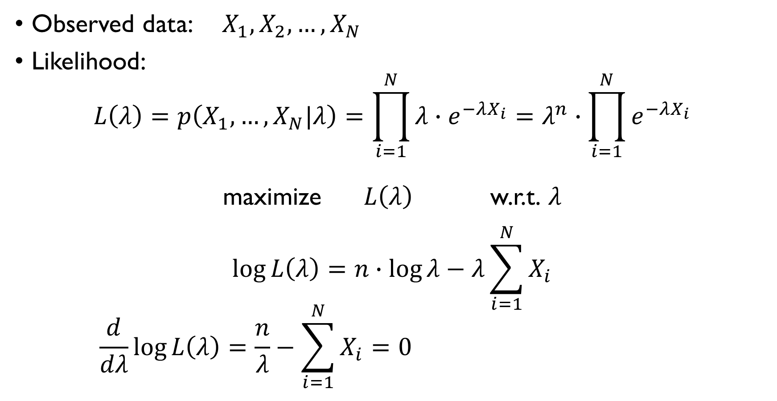
ML EXAMPLE: EXPONENTIAL DISTRIBUTION
Observed data: $X_{1},X_{2},…,X_{N}$
Likelihood:
$$L\left(λ\right)=p\left(X_{1},…,X_{N}|λ\right)=\prod_{i=1}^{N}{λ∙e^{−λX_{i}}=λ^{n}∙\prod_{i=1}^{N}{e^{−λX_{i}}}}$$
maximize $L\left(λ\right)$ w.r.t. $λ$
$$\log{L\left(λ\right)=n∙\log{λ}−λ\sum_{i=1}^{N}{X_{i}}}$$
$$\frac{d}{dλ}\log{L\left(λ\right)}=\frac{n}{λ}−\sum_{i=1}^{N}{X_{i}}=0 ⇒ \hat{λ}=\frac{1}{\frac{1}{N}\sum_{i=1}^{N}{X_{i}}}$$

Slide 47
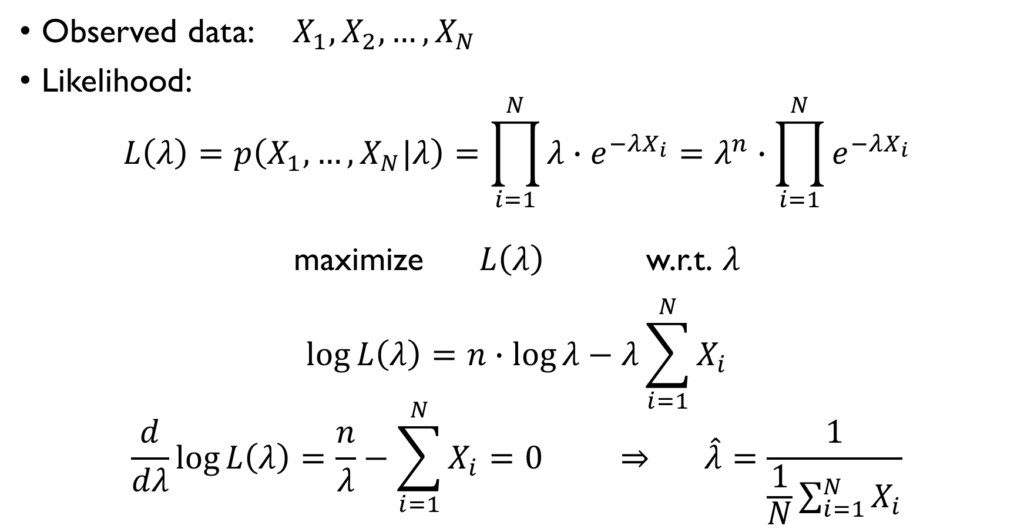
ML EXAMPLE: EXPONENTIAL DISTRIBUTION
Observed data: $X_{1},X_{2},…,X_{N}$
Likelihood:
$$L\left(λ\right)=p\left(X_{1},…,X_{N}|λ\right)=\prod_{i=1}^{N}{λ∙e^{−λX_{i}}=λ^{n}∙\prod_{i=1}^{N}{e^{−λX_{i}}}}$$
maximize $L\left(λ\right)$ w.r.t. $λ$
$$\log{L\left(λ\right)=n∙\log{λ}−λ\sum_{i=1}^{N}{X_{i}}}$$
$$\frac{d}{dλ}\log{L\left(λ\right)}=\frac{n}{λ}−\sum_{i=1}^{N}{X_{i}}=0 ⇒ \hat{λ}=\frac{1}{\frac{1}{N}\sum_{i=1}^{N}{X_{i}}}$$

Slide 48
BREAK

Slide 49
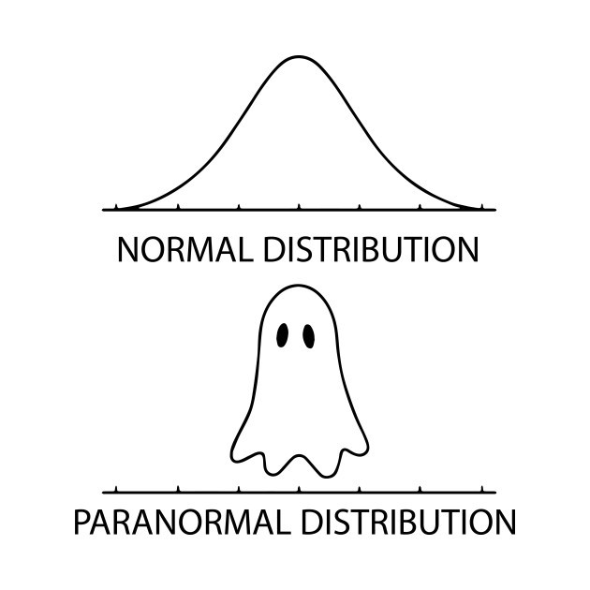
NORMAL DISTRIBUTION

Slide 50

NORMAL DISTRIBUTION
$$X\sim N\left(μ,σ^{2}\right)$$
$μ$ – mean, $σ$ – standard deviation
$$p\left(x\right)=\frac{1}{σ\sqrt{2π}}e^{−\frac{1}{2}{\left(\frac{x−μ}{σ}\right)}^{2}}$$

Slide 51

NORMAL DISTRIBUTION
$$X\sim N\left(μ,σ^{2}\right)$$
$μ$ – mean, $σ$ – standard deviation
$$p\left(x\right)=\frac{1}{σ\sqrt{2π}}e^{−\frac{1}{2}{\left(\frac{x−μ}{σ}\right)}^{2}}$$

Slide 52
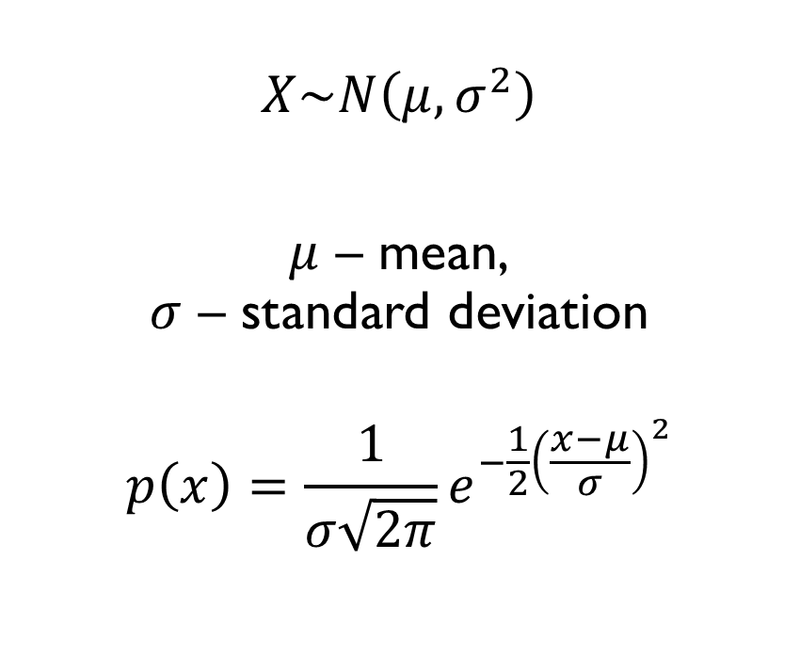
NORMAL DISTRIBUTION
$$X\sim N\left(μ,σ^{2}\right)$$
$μ$ – mean, $σ$ – standard deviation
$$p\left(x\right)=\frac{1}{σ\sqrt{2π}}e^{−\frac{1}{2}{\left(\frac{x−μ}{σ}\right)}^{2}}$$

Slide 53
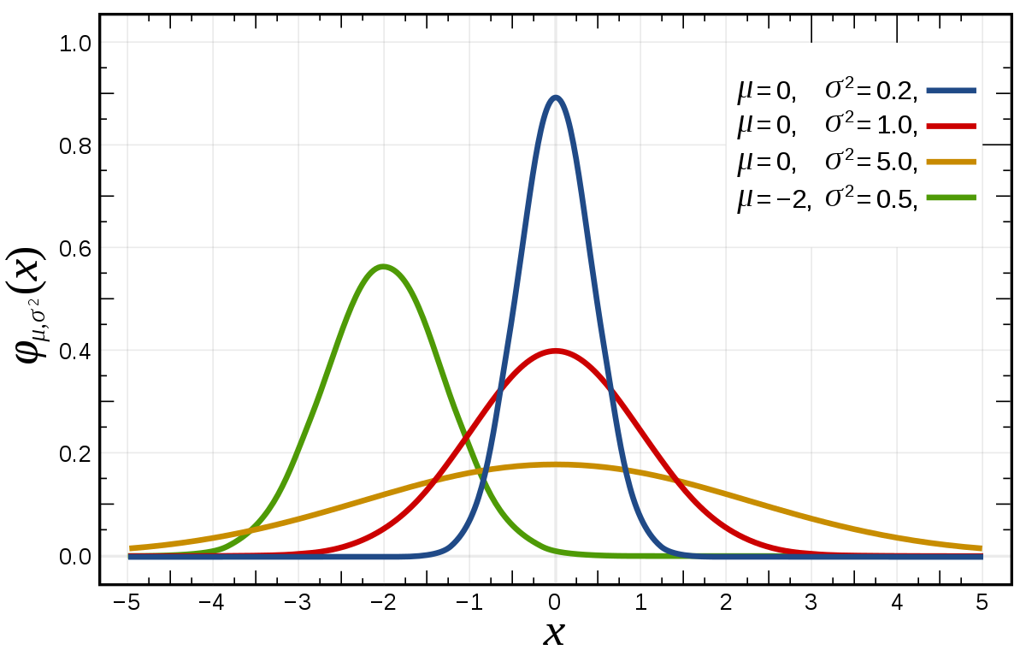

NORMAL DISTRIBUTION
$$X\sim N\left(μ,σ^{2}\right)$$
$μ$ – mean, $σ$ – standard deviation
$$p\left(x\right)=\frac{1}{σ\sqrt{2π}}e^{−\frac{1}{2}{\left(\frac{x−μ}{σ}\right)}^{2}}$$

Slide 54
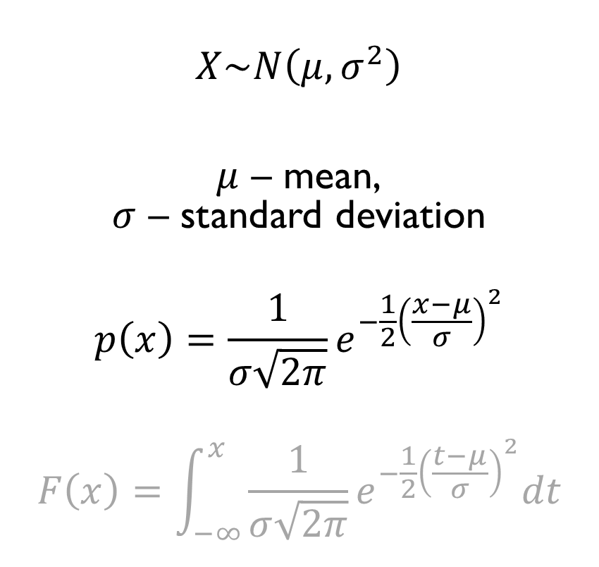
NORMAL DISTRIBUTION
$$X\sim N\left(μ,σ^{2}\right)$$
$μ$ – mean, $σ$ – standard deviation
$$p\left(x\right)=\frac{1}{σ\sqrt{2π}}e^{−\frac{1}{2}{\left(\frac{x−μ}{σ}\right)}^{2}}$$
$$F\left(x\right)=\int_{−∞}^{x}{\frac{1}{σ\sqrt{2π}}e^{−\frac{1}{2}{\left(\frac{t−μ}{σ}\right)}^{2}}dt}$$

Slide 55
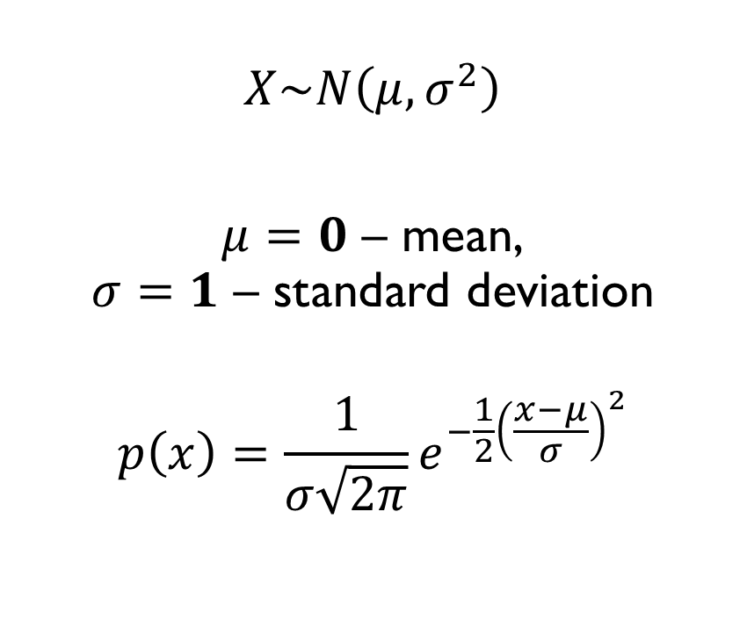
STANDARD NORMAL DISTRIBUTION
$$X\sim N\left(μ,σ^{2}\right)$$
$μ=0$ – mean, $σ=1$ – standard deviation
$$p\left(x\right)=\frac{1}{σ\sqrt{2π}}e^{−\frac{1}{2}{\left(\frac{x−μ}{σ}\right)}^{2}}$$

Slide 56
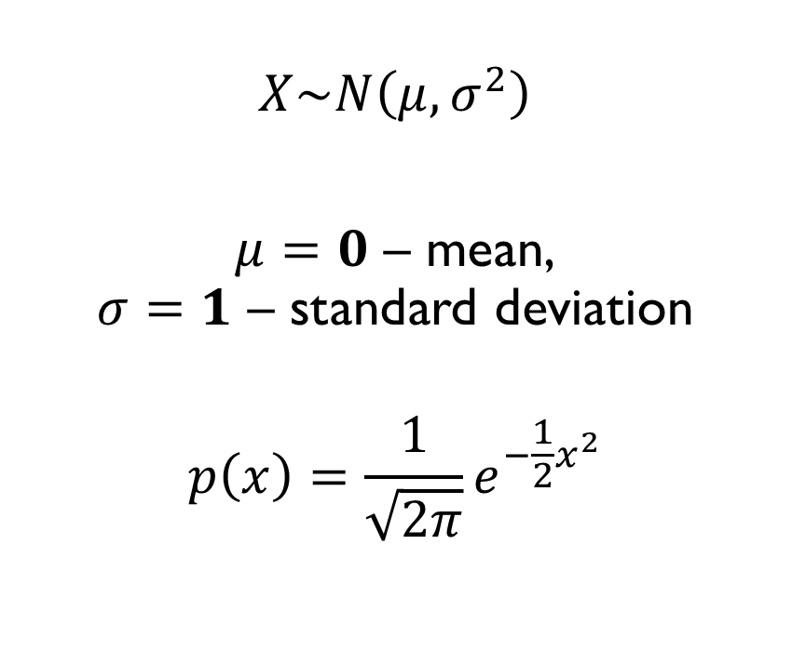
STANDARD NORMAL DISTRIBUTION
$$X\sim N\left(μ,σ^{2}\right)$$
$μ=0$ – mean, $σ=1$ – standard deviation
$$p\left(x\right)=\frac{1}{\sqrt{2π}}e^{−\frac{1}{2}x^{2}}$$

Slide 57
LET’S GET TO KNOW THE NORMAL DISTRIBUTION BETTER!
Google Classroom -> Lecture 5 -> Normal Distribution Basics

Slide 58
PARAMETER ESTIMATION FOR THE NORMAL DISTRIBUTION

Slide 59

MLE FOR THE MEAN OF THE NORMAL
You are modelling something that follows a normal distribution:
$$X\sim N\left(μ, σ^{2}\right)$$
Suppose that you know the true $σ$ parameter of the distribution but want to estimate the $μ$ from the data:
$$X_{1},…,X_{n}$$
What is the MLE $\hat{μ}=?$

Slide 60
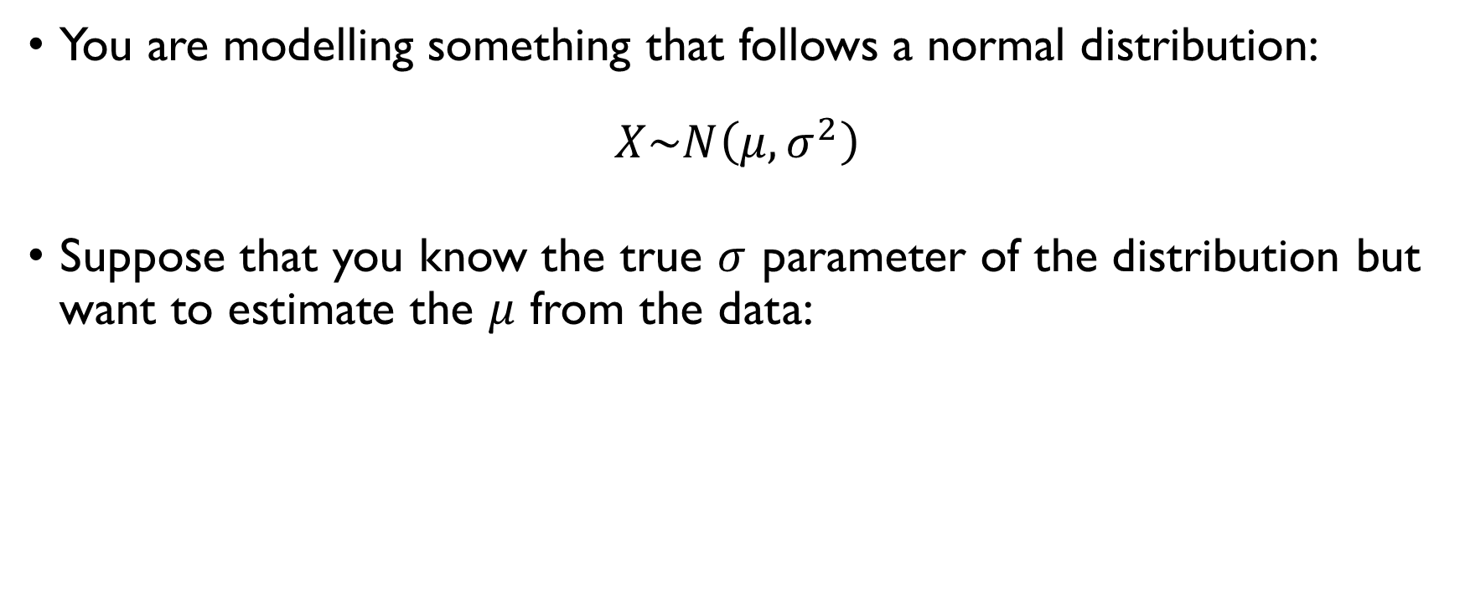
MLE FOR THE MEAN OF THE NORMAL
You are modelling something that follows a normal distribution:
$$X\sim N\left(μ, σ^{2}\right)$$
Suppose that you know the true $σ$ parameter of the distribution but want to estimate the $μ$ from the data:
$$X_{1},…,X_{n}$$
What is the MLE $\hat{μ}=?$

Slide 61

MLE FOR THE MEAN OF THE NORMAL
You are modelling something that follows a normal distribution:
$$X\sim N\left(μ, σ^{2}\right)$$
Suppose that you know the true $σ$ parameter of the distribution but want to estimate the $μ$ from the data:
$$X_{1},…,X_{n}$$
What is the MLE $\hat{μ}=?$

Slide 62

MLE FOR THE MEAN OF THE NORMAL
You are modelling something that follows a normal distribution:
$$X\sim N\left(μ, σ^{2}\right)$$
Suppose that you know the true $σ$ parameter of the distribution but want to estimate the $μ$ from the data:
$$X_{1},…,X_{n}$$
What is the MLE $\hat{μ}=?$

Slide 63

MLE FOR THE MEAN OF THE NORMAL
$$L\left(μ\right)=\prod_{i=1}^{N}{\frac{1}{σ\sqrt{2π}}e^{−\frac{1}{2}{\left(\frac{X_{i}−μ}{σ}\right)}^{2}}}$$
$$maximize \log{L\left(μ\right)}=\sum_{i=1}^{N}{\log{\frac{1}{σ\sqrt{2π}}}}−\frac{1}{2}\sum_{i=1}^{N}{{\left(\frac{X_{i}−μ}{σ}\right)}^{2}}w.r.t. μ$$
$$\frac{d}{dμ}\log{L\left(μ\right)}=\sum_{i=1}^{N}{\left(\frac{X_{i}−μ}{σ^{2}}\right)}=0 ⇒ \sum_{i=1}^{N}{X_{i}}−Nμ=0 ⇒μ=\frac{1}{n}\sum_{i=1}^{N}{X_{i}}$$

Slide 64

MLE FOR THE MEAN OF THE NORMAL
$$L\left(μ\right)=\prod_{i=1}^{N}{\frac{1}{σ\sqrt{2π}}e^{−\frac{1}{2}{\left(\frac{X_{i}−μ}{σ}\right)}^{2}}}$$
$$maximize \log{L\left(μ\right)}=\sum_{i=1}^{N}{\log{\frac{1}{σ\sqrt{2π}}}}−\frac{1}{2}\sum_{i=1}^{N}{{\left(\frac{X_{i}−μ}{σ}\right)}^{2}}w.r.t. μ$$
$$\frac{d}{dμ}\log{L\left(μ\right)}=\sum_{i=1}^{N}{\left(\frac{X_{i}−μ}{σ^{2}}\right)}=0 ⇒ \sum_{i=1}^{N}{X_{i}}−Nμ=0 ⇒μ=\frac{1}{n}\sum_{i=1}^{N}{X_{i}}$$

Slide 65

MLE FOR THE MEAN OF THE NORMAL
$$L\left(μ\right)=\prod_{i=1}^{N}{\frac{1}{σ\sqrt{2π}}e^{−\frac{1}{2}{\left(\frac{X_{i}−μ}{σ}\right)}^{2}}}$$
$$maximize \log{L\left(μ\right)}=\sum_{i=1}^{N}{\log{\frac{1}{σ\sqrt{2π}}}}−\frac{1}{2}\sum_{i=1}^{N}{{\left(\frac{X_{i}−μ}{σ}\right)}^{2}}w.r.t. μ$$
$$\frac{d}{dμ}\log{L\left(μ\right)}=\sum_{i=1}^{N}{\left(\frac{X_{i}−μ}{σ^{2}}\right)}=0 ⇒ \sum_{i=1}^{N}{X_{i}}−Nμ=0 ⇒μ=\frac{1}{n}\sum_{i=1}^{N}{X_{i}}$$

Slide 66

MLE FOR THE MEAN OF THE NORMAL
$$L\left(μ\right)=\prod_{i=1}^{N}{\frac{1}{σ\sqrt{2π}}e^{−\frac{1}{2}{\left(\frac{X_{i}−μ}{σ}\right)}^{2}}}$$
$$maximize \log{L\left(μ\right)}=\sum_{i=1}^{N}{\log{\frac{1}{σ\sqrt{2π}}}}−\frac{1}{2}\sum_{i=1}^{N}{{\left(\frac{X_{i}−μ}{σ}\right)}^{2}}w.r.t. μ$$
$$\frac{d}{dμ}\log{L\left(μ\right)}=\sum_{i=1}^{N}{\left(\frac{X_{i}−μ}{σ^{2}}\right)}=0 ⇒ \sum_{i=1}^{N}{X_{i}}−Nμ=0 ⇒μ=\frac{1}{n}\sum_{i=1}^{N}{X_{i}}$$

Slide 67

MLE FOR THE MEAN OF THE NORMAL
$$L\left(μ\right)=\prod_{i=1}^{N}{\frac{1}{σ\sqrt{2π}}e^{−\frac{1}{2}{\left(\frac{X_{i}−μ}{σ}\right)}^{2}}}$$
$$maximize \log{L\left(μ\right)}=\sum_{i=1}^{N}{\log{\frac{1}{σ\sqrt{2π}}}}−\frac{1}{2}\sum_{i=1}^{N}{{\left(\frac{X_{i}−μ}{σ}\right)}^{2}}w.r.t. μ$$
$$\frac{d}{dμ}\log{L\left(μ\right)}=\sum_{i=1}^{N}{\left(\frac{X_{i}−μ}{σ^{2}}\right)}=0 ⇒ \sum_{i=1}^{N}{X_{i}}−Nμ=0 ⇒μ=\frac{1}{n}\sum_{i=1}^{N}{X_{i}}$$

Slide 68

MLE FOR THE MEAN OF THE NORMAL
$$L\left(μ\right)=\prod_{i=1}^{N}{\frac{1}{σ\sqrt{2π}}e^{−\frac{1}{2}{\left(\frac{X_{i}−μ}{σ}\right)}^{2}}}$$
$$maximize \log{L\left(μ\right)}=\sum_{i=1}^{N}{\log{\frac{1}{σ\sqrt{2π}}}}−\frac{1}{2}\sum_{i=1}^{N}{{\left(\frac{X_{i}−μ}{σ}\right)}^{2}}w.r.t. μ$$
$$\frac{d}{dμ}\log{L\left(μ\right)}=\sum_{i=1}^{N}{\left(\frac{X_{i}−μ}{σ^{2}}\right)}=0 ⇒ \sum_{i=1}^{N}{X_{i}}−Nμ=0 ⇒μ=\frac{1}{n}\sum_{i=1}^{N}{X_{i}}$$

Slide 69

MLE FOR THE MEAN OF THE NORMAL
$$L\left(μ\right)=\prod_{i=1}^{N}{\frac{1}{σ\sqrt{2π}}e^{−\frac{1}{2}{\left(\frac{X_{i}−μ}{σ}\right)}^{2}}}$$
$$maximize \log{L\left(μ\right)}=\sum_{i=1}^{N}{\log{\frac{1}{σ\sqrt{2π}}}}−\frac{1}{2}\sum_{i=1}^{N}{{\left(\frac{X_{i}−μ}{σ}\right)}^{2}}w.r.t. μ$$
$$\frac{d}{dμ}\log{L\left(μ\right)}=\sum_{i=1}^{N}{\left(\frac{X_{i}−μ}{σ^{2}}\right)}=0 ⇒ \sum_{i=1}^{N}{X_{i}}−Nμ=0 ⇒μ=\frac{1}{n}\sum_{i=1}^{N}{X_{i}}$$

Slide 70

MLE FOR THE MEAN OF THE NORMAL
$$L\left(μ\right)=\prod_{i=1}^{N}{\frac{1}{σ\sqrt{2π}}e^{−\frac{1}{2}{\left(\frac{X_{i}−μ}{σ}\right)}^{2}}}$$
$$maximize \log{L\left(μ\right)}=\sum_{i=1}^{N}{\log{\frac{1}{σ\sqrt{2π}}}}−\frac{1}{2}\sum_{i=1}^{N}{{\left(\frac{X_{i}−μ}{σ}\right)}^{2}}w.r.t. μ$$
$$\frac{d}{dμ}\log{L\left(μ\right)}=\sum_{i=1}^{N}{\left(\frac{X_{i}−μ}{σ^{2}}\right)}=0 ⇒ \sum_{i=1}^{N}{X_{i}}−Nμ=0 ⇒μ=\frac{1}{n}\sum_{i=1}^{N}{X_{i}}$$

Slide 71

MLE FOR THE MEAN OF THE NORMAL
$$L\left(μ\right)=\prod_{i=1}^{N}{\frac{1}{σ\sqrt{2π}}e^{−\frac{1}{2}{\left(\frac{X_{i}−μ}{σ}\right)}^{2}}}$$
$$maximize \log{L\left(μ\right)}=\sum_{i=1}^{N}{\log{\frac{1}{σ\sqrt{2π}}}}−\frac{1}{2}\sum_{i=1}^{N}{{\left(\frac{X_{i}−μ}{σ}\right)}^{2}}w.r.t. μ$$
$$\frac{d}{dμ}\log{L\left(μ\right)}=\sum_{i=1}^{N}{\left(\frac{X_{i}−μ}{σ^{2}}\right)}=0 ⇒ \sum_{i=1}^{N}{X_{i}}−Nμ=0 ⇒μ=\frac{1}{n}\sum_{i=1}^{N}{X_{i}}$$

Slide 72
BREAK

Slide 73
LONG-TAIL DISTRIBUTIONS

Slide 74

EXPECTED VALUE
$$E\left(X\right)=\int_{−∞}^{+∞}{x∙p\left(x\right)dx}$$

Slide 75


PARETO DISTRIBUTION
$$p\left(x\right)=\left\{\begin{aligned}\frac{α}{x^{α+1}}, x≥0 \\ 0, x<0\end{aligned}\right.$$
$$α>0$$

Slide 76

PARETO DISTRIBUTION

Slide 77


PARETO DISTRIBUTION

Slide 78


PARETO DISTRIBUTION
$$p\left(x\right)=\left\{\begin{aligned}\frac{1}{x^{2}}, x≥0 \\ 0, x<0\end{aligned}\right.$$
$$α=1$$

Slide 79

PARETO DISTRIBUTION
$$p\left(x\right)=\left\{\begin{aligned}\frac{1}{x^{2}}, x≥0 \\ 0, x<0\end{aligned}\right.$$
$$α=1$$
$$E\left(X\right)=?$$

Slide 80

EXPECTED VALUE FOR PARETO
$$\int_{0}^{+∞}{\frac{x}{x^{2}}dx}=\int_{0}^{1}{\frac{1}{x}dx}+\int_{1}^{+∞}{\frac{1}{x}dx}=$$
$$={\left.\log\left(x\right)\right|}_{0}^{1}+{\left.\log\left(x\right)\right|}_{1}^{+∞}=$$
$$=∞+∞$$

Slide 81

EXPECTED VALUE FOR PARETO
$$\int_{0}^{+∞}{\frac{x}{x^{2}}dx}=\int_{0}^{1}{\frac{1}{x}dx}+\int_{1}^{+∞}{\frac{1}{x}dx}=$$
$$={\left.\log\left(x\right)\right|}_{0}^{1}+{\left.\log\left(x\right)\right|}_{1}^{+∞}=$$
$$=∞+∞$$

Slide 82

EXPECTED VALUE FOR PARETO
$$\int_{0}^{+∞}{\frac{x}{x^{2}}dx}=\int_{0}^{1}{\frac{1}{x}dx}+\int_{1}^{+∞}{\frac{1}{x}dx}=$$
$$={\left.\log\left(x\right)\right|}_{0}^{1}+{\left.\log\left(x\right)\right|}_{1}^{+∞}=$$
$$=∞+∞$$

Slide 83

EXPECTED VALUE FOR PARETO
$$\int_{0}^{+∞}{\frac{x}{x^{2}}dx}=\int_{0}^{1}{\frac{1}{x}dx}+\int_{1}^{+∞}{\frac{1}{x}dx}=$$
$$={\left.\log\left(x\right)\right|}_{0}^{1}+{\left.\log\left(x\right)\right|}_{1}^{+∞}=$$
$$=∞+∞$$

Slide 84


CAUCHY DISTRIBUTION
$$p\left(x\right)=\frac{1}{πγ\left[1+{\left(\frac{x−x_{o}}{γ}\right)}^{2}\right]}$$

Slide 85

CAUCHY DISTRIBUTION

Slide 86


CAUCHY DISTRIBUTION
$$p\left(x\right)=\frac{1}{π\left(1+x^{2}\right)}$$
$$x_{0}=0, γ=1$$

Slide 87
CAUCHY DISTRIBUTION
$$p\left(x\right)=\frac{1}{π\left(1+x^{2}\right)}$$
$$x_{0}=0, γ=1$$
$$E\left(X\right)=?$$

Slide 88

EXPECTED VALUES FOR CAUCHY
$$\int_{−∞}^{+∞}{\frac{x}{π\left(1+x^{2}\right)}dx}=\int_{−∞}^{0}{\frac{x}{π\left(1+x^{2}\right)}dx}+\int_{0}^{+∞}{\frac{x}{π\left(1+x^{2}\right)}dx}=$$
$$=\int_{−∞}^{0}{\frac{dx^{2}}{2π\left(1+x^{2}\right)}}+\int_{0}^{+∞}{\frac{dx^{2}}{2π\left(1+x^{2}\right)}}=$$
$$= {\left.\frac{1}{2π}\log\left(1+x^{2}\right)\right|}_{−∞}^{0}+{\left.\frac{1}{2π}\log\left(1+x^{2}\right)\right|}_{0}^{+∞}=∞−∞$$

Slide 89

EXPECTED VALUES FOR CAUCHY
$$\int_{−∞}^{+∞}{\frac{x}{π\left(1+x^{2}\right)}dx}=\int_{−∞}^{0}{\frac{x}{π\left(1+x^{2}\right)}dx}+\int_{0}^{+∞}{\frac{x}{π\left(1+x^{2}\right)}dx}=$$
$$=\int_{−∞}^{0}{\frac{dx^{2}}{2π\left(1+x^{2}\right)}}+\int_{0}^{+∞}{\frac{dx^{2}}{2π\left(1+x^{2}\right)}}=$$
$$= {\left.\frac{1}{2π}\log\left(1+x^{2}\right)\right|}_{−∞}^{0}+{\left.\frac{1}{2π}\log\left(1+x^{2}\right)\right|}_{0}^{+∞}=∞−∞$$

Slide 90

EXPECTED VALUES FOR CAUCHY
$$\int_{−∞}^{+∞}{\frac{x}{π\left(1+x^{2}\right)}dx}=\int_{−∞}^{0}{\frac{x}{π\left(1+x^{2}\right)}dx}+\int_{0}^{+∞}{\frac{x}{π\left(1+x^{2}\right)}dx}=$$
$$=\int_{−∞}^{0}{\frac{dx^{2}}{2π\left(1+x^{2}\right)}}+\int_{0}^{+∞}{\frac{dx^{2}}{2π\left(1+x^{2}\right)}}=$$
$$= {\left.\frac{1}{2π}\log\left(1+x^{2}\right)\right|}_{−∞}^{0}+{\left.\frac{1}{2π}\log\left(1+x^{2}\right)\right|}_{0}^{+∞}=∞−∞$$

Slide 91

EXPECTED VALUES FOR CAUCHY
$$\int_{−∞}^{+∞}{\frac{x}{π\left(1+x^{2}\right)}dx}=\int_{−∞}^{0}{\frac{x}{π\left(1+x^{2}\right)}dx}+\int_{0}^{+∞}{\frac{x}{π\left(1+x^{2}\right)}dx}=$$
$$=\int_{−∞}^{0}{\frac{dx^{2}}{2π\left(1+x^{2}\right)}}+\int_{0}^{+∞}{\frac{dx^{2}}{2π\left(1+x^{2}\right)}}=$$
$$= {\left.\frac{1}{2π}\log\left(1+x^{2}\right)\right|}_{−∞}^{0}+{\left.\frac{1}{2π}\log\left(1+x^{2}\right)\right|}_{0}^{+∞}=∞−∞$$

Slide 92

EXPECTED VALUES FOR CAUCHY
$$\int_{−∞}^{+∞}{\frac{x}{π\left(1+x^{2}\right)}dx}=\int_{−∞}^{0}{\frac{x}{π\left(1+x^{2}\right)}dx}+\int_{0}^{+∞}{\frac{x}{π\left(1+x^{2}\right)}dx}=$$
$$=\int_{−∞}^{0}{\frac{dx^{2}}{2π\left(1+x^{2}\right)}}+\int_{0}^{+∞}{\frac{dx^{2}}{2π\left(1+x^{2}\right)}}=$$
$$= {\left.\frac{1}{2π}\log\left(1+x^{2}\right)\right|}_{−∞}^{0}+{\left.\frac{1}{2π}\log\left(1+x^{2}\right)\right|}_{0}^{+∞}=∞−∞$$

Slide 93
BUT WHAT DOES IT MEAN?
Google Classroom -> Lecture 5 -> Long-tailed distributions

Slide 94


DETECTING HEAVY TAILS: LOG-LOG SCALE
POWER LAW
EXPONENTIAL
$$y=x^{a}$$
$$\log{y}=a\log{x}$$
LINEAR in a log-log plot
$$y=e^{ax}$$
$$\log{y}=ax=e^{\log{ax}}$$
EXPONENTIAL in a log-log plot

Slide 95
TO SUM UP EVERYTHING…
https://youtu.be/iA0xRUNvLV8

Slide 96
SUMMARY OF WEEK 1
Descriptive statistics
Summary statistics, tables and plots
Continuous random variables:
CDFs and PDFs
Standard distributions (uniform, exponential, normal)
Long-tailed distributions (Pareto, Cauchy)
Parameter estimation:
Maximum Likelihood;
discrete and continuous variants.

Slide 97
SUMMARY OF WEEK 1
Descriptive statistics
Summary statistics, tables and plots
Continuous random variables:
CDFs and PDFs
Standard distributions (uniform, exponential, normal)
Long-tailed distributions (Pareto, Cauchy)
Parameter estimation:
Maximum Likelihood;
discrete and continuous variants.
You can still submit Assignment 1 (-10% of the score each late day)
Graded assignment 2 due Monday evening.
New assignment on Monday.

