Slide 1
INTRODUCTION TO STATISTICS
LECTURE 8

Slide 2

TODAY
Confidence intervals based on normal data
for $μ$ when $σ$ is known;
for $μ$ when $σ$ is unknown;
for $σ$.
Large sample CI
Bernoulli data and polling

Slide 3

TODAY
Confidence intervals based on normal data
for $μ$ when $σ$ is known;
for $μ$ when $σ$ is unknown;
for $σ$.
Large sample CI
Bernoulli data and polling

Slide 4
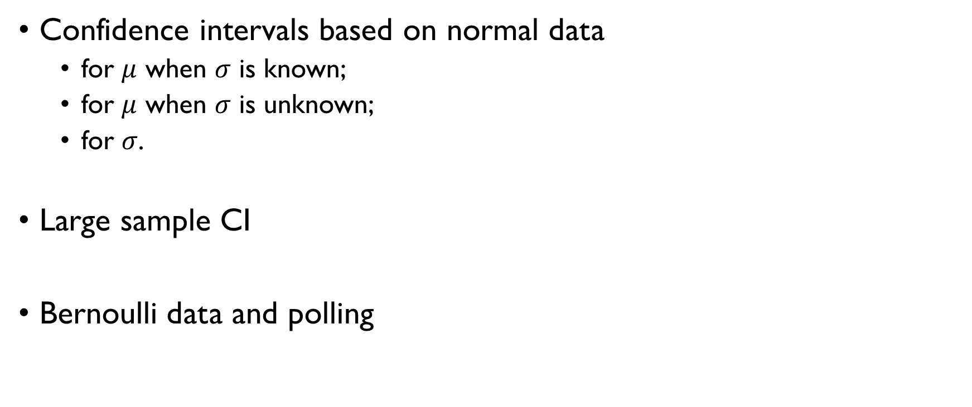
TODAY
Confidence intervals based on normal data
for $μ$ when $σ$ is known;
for $μ$ when $σ$ is unknown;
for $σ$.
Large sample CI
Bernoulli data and polling

Slide 5
A QUICK REMINDER
What we saw last time

Slide 6

CI: DEFINITION
A $1−α$ confidence interval for a parameter $θ$ is an interval $C_{n}=\left(T_{1},T_{2}\right)$ such that $T_{1}=t_{1}\left(X_{1},…,X_{n}\right), T_{2}=t_{2}\left(X_{1},…,X_{n}\right)$ and
$P\left(T_{1}<θ<T_{2}\right)≥1−α$
Random intervals: $T_{1}$ and $T_{2}$ are functions of random samples.
$θ$ is unknown, but fixed $T_{1}$ and $T_{2}$ are random

Slide 7
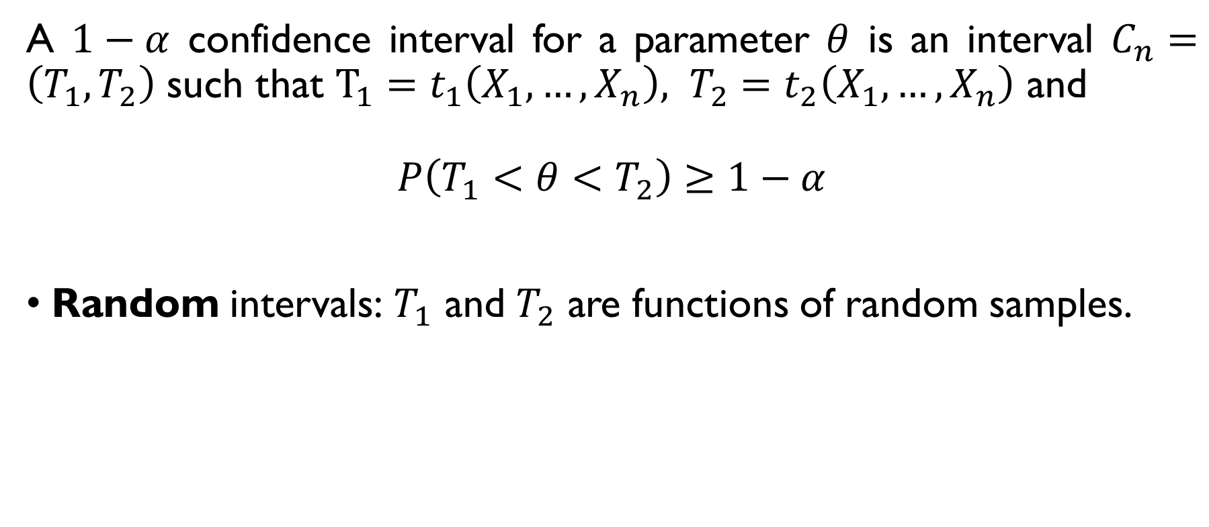
CI: DEFINITION
A $1−α$ confidence interval for a parameter $θ$ is an interval $C_{n}=\left(T_{1},T_{2}\right)$ such that $T_{1}=t_{1}\left(X_{1},…,X_{n}\right), T_{2}=t_{2}\left(X_{1},…,X_{n}\right)$ and
$P\left(T_{1}<θ<T_{2}\right)≥1−α$
Random intervals: $T_{1}$ and $T_{2}$ are functions of random samples.
$θ$ is unknown, but fixed $T_{1}$ and $T_{2}$ are random

Slide 8
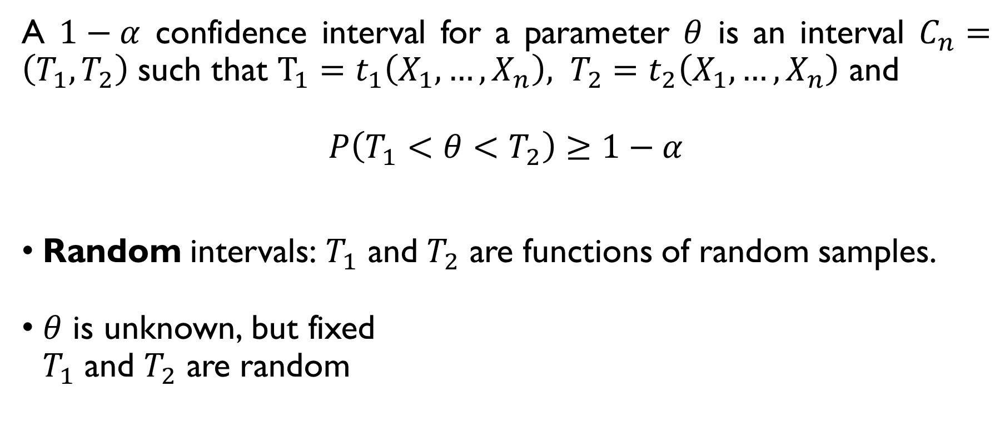
CI: DEFINITION
A $1−α$ confidence interval for a parameter $θ$ is an interval $C_{n}=\left(T_{1},T_{2}\right)$ such that $T_{1}=t_{1}\left(X_{1},…,X_{n}\right), T_{2}=t_{2}\left(X_{1},…,X_{n}\right)$ and
$P\left(T_{1}<θ<T_{2}\right)≥1−α$
Random intervals: $T_{1}$ and $T_{2}$ are functions of random samples.
$θ$ is unknown, but fixed $T_{1}$ and $T_{2}$ are random

Slide 9
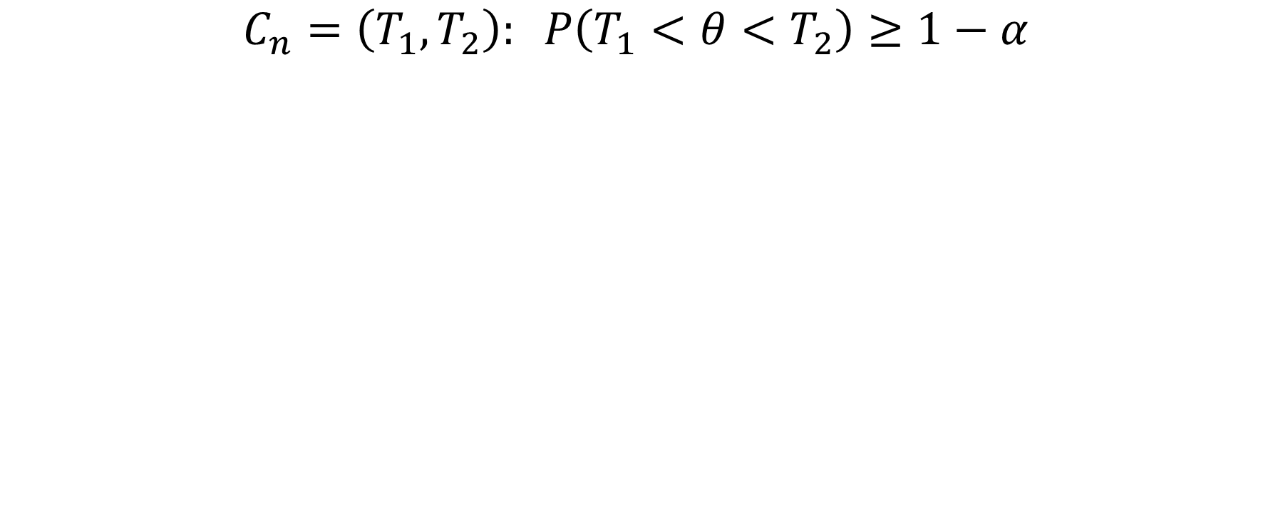
CI: INTERPRETATION
$C_{n}=\left(T_{1},T_{2}\right): P\left(T_{1}<θ<T_{2}\right)≥1−α$
Not a probability statement about $θ$ since it’s fixed.
Common interpretation:
If I repeat the experiment many times, the interval will contain the true value of $θ$ 95% of the time ($α$=0.05).

Slide 10
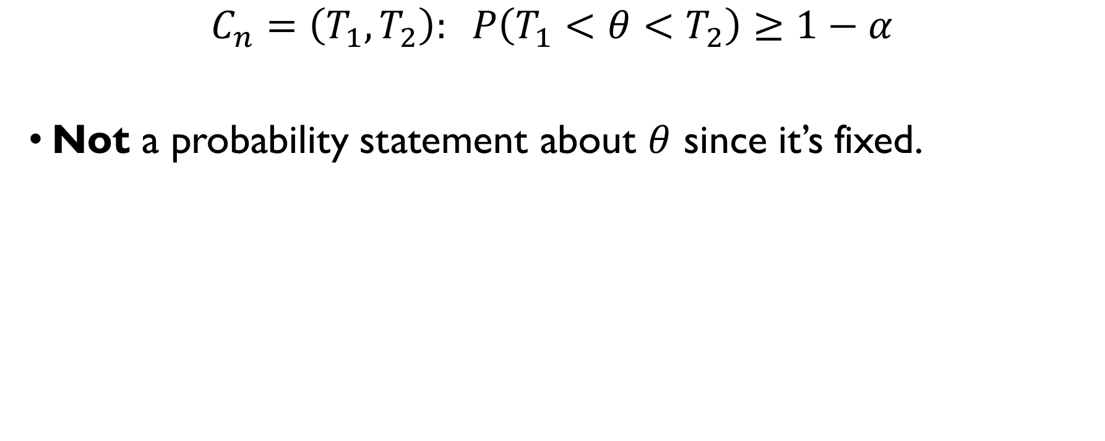
CI: INTERPRETATION
$C_{n}=\left(T_{1},T_{2}\right): P\left(T_{1}<θ<T_{2}\right)≥1−α$
Not a probability statement about $θ$ since it’s fixed.
Common interpretation:
If I repeat the experiment many times, the interval will contain the true value of $θ$ 95% of the time ($α$=0.05).

Slide 11
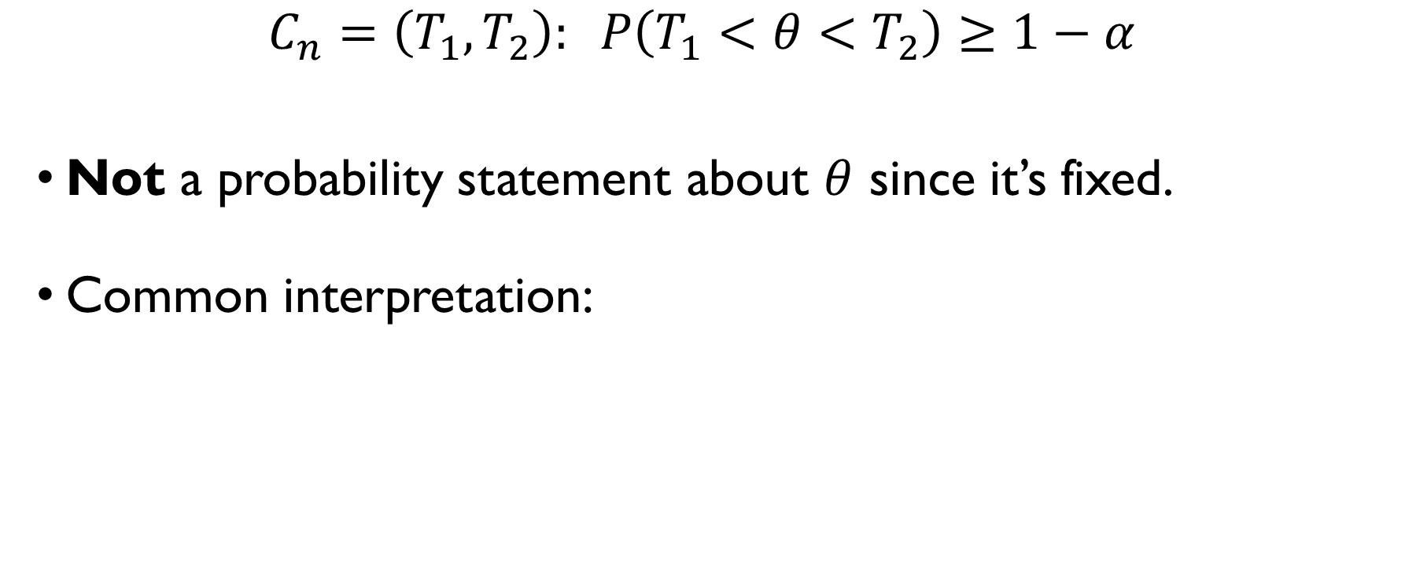
CI: INTERPRETATION
$C_{n}=\left(T_{1},T_{2}\right): P\left(T_{1}<θ<T_{2}\right)≥1−α$
Not a probability statement about $θ$ since it’s fixed.
Common interpretation:
If I repeat the experiment many times, the interval will contain the true value of $θ$ 95% of the time ($α$=0.05).

Slide 12
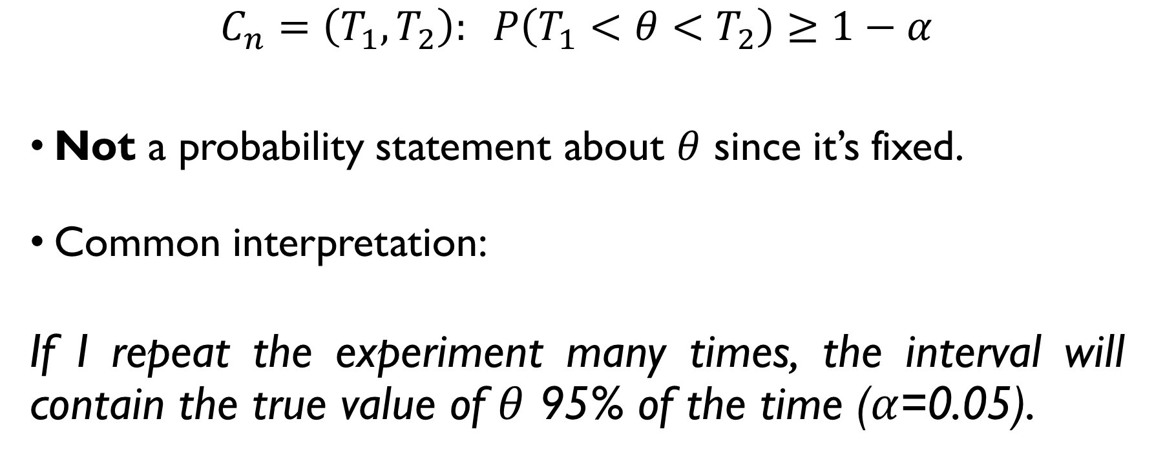
CI: INTERPRETATION
$C_{n}=\left(T_{1},T_{2}\right): P\left(T_{1}<θ<T_{2}\right)≥1−α$
Not a probability statement about $θ$ since it’s fixed.
Common interpretation:
If I repeat the experiment many times, the interval will contain the true value of $θ$ 95% of the time ($α$=0.05).

Slide 13

CI FOR NORMAL DATA
CI for $μ$, known $σ$

Slide 14


CI FOR $μ$, KNOWN $σ$
$X_{1},X_{2},…,X_{n}−$ samples from $N\left(μ,σ^{2}\right)$, $σ$ is known.
How to construct a CI for $μ$? Consider $\overline{X}$:
$$\overline{X}=\frac{1}{n}\sum_{i=1}^{n}{X_{i}} \sim N\left(μ,σ^{2}/n\right) ⇒ \frac{\left(\overline{X}−μ\right)\sqrt{n}}{σ}\sim N\left(0,1\right)$$
$$P\left(−z_{1−\frac{α}{2}}<\frac{\left(\overline{X}−μ\right)\sqrt{n}}{σ}<z_{1−\frac{α}{2}}\right)=1−α$$
$$P\left(\overline{X}−\frac{σ}{\sqrt{n}}z_{1−\frac{α}{2}}<μ<\overline{X}+\frac{σ}{\sqrt{n}}z_{1−\frac{α}{2}}\right)=1−α$$

Slide 15

CI FOR $μ$, KNOWN $σ$
$X_{1},X_{2},…,X_{n}−$ samples from $N\left(μ,σ^{2}\right)$, $σ$ is known.
How to construct a CI for $μ$? Consider $\overline{X}$:
$$\overline{X}=\frac{1}{n}\sum_{i=1}^{n}{X_{i}} \sim N\left(μ,σ^{2}/n\right) ⇒ \frac{\left(\overline{X}−μ\right)\sqrt{n}}{σ}\sim N\left(0,1\right)$$
$$P\left(−z_{1−\frac{α}{2}}<\frac{\left(\overline{X}−μ\right)\sqrt{n}}{σ}<z_{1−\frac{α}{2}}\right)=1−α$$
$$P\left(\overline{X}−\frac{σ}{\sqrt{n}}z_{1−\frac{α}{2}}<μ<\overline{X}+\frac{σ}{\sqrt{n}}z_{1−\frac{α}{2}}\right)=1−α$$

Slide 16

CI FOR $μ$, KNOWN $σ$
$X_{1},X_{2},…,X_{n}−$ samples from $N\left(μ,σ^{2}\right)$, $σ$ is known.
How to construct a CI for $μ$? Consider $\overline{X}$:
$$\overline{X}=\frac{1}{n}\sum_{i=1}^{n}{X_{i}} \sim N\left(μ,σ^{2}/n\right) ⇒ \frac{\left(\overline{X}−μ\right)\sqrt{n}}{σ}\sim N\left(0,1\right)$$
$$P\left(−z_{1−\frac{α}{2}}<\frac{\left(\overline{X}−μ\right)\sqrt{n}}{σ}<z_{1−\frac{α}{2}}\right)=1−α$$
$$P\left(\overline{X}−\frac{σ}{\sqrt{n}}z_{1−\frac{α}{2}}<μ<\overline{X}+\frac{σ}{\sqrt{n}}z_{1−\frac{α}{2}}\right)=1−α$$

Slide 17

CI FOR $μ$, KNOWN $σ$
$X_{1},X_{2},…,X_{n}−$ samples from $N\left(μ,σ^{2}\right)$, $σ$ is known.
How to construct a CI for $μ$? Consider $\overline{X}$:
$$\overline{X}=\frac{1}{n}\sum_{i=1}^{n}{X_{i}} \sim N\left(μ,σ^{2}/n\right) ⇒ \frac{\left(\overline{X}−μ\right)\sqrt{n}}{σ}\sim N\left(0,1\right)$$
$$P\left(−z_{1−\frac{α}{2}}<\frac{\left(\overline{X}−μ\right)\sqrt{n}}{σ}<z_{1−\frac{α}{2}}\right)=1−α$$
$$P\left(\overline{X}−\frac{σ}{\sqrt{n}}z_{1−\frac{α}{2}}<μ<\overline{X}+\frac{σ}{\sqrt{n}}z_{1−\frac{α}{2}}\right)=1−α$$

Slide 18

CI FOR $μ$, KNOWN $σ$
$X_{1},X_{2},…,X_{n}−$ samples from $N\left(μ,σ^{2}\right)$, $σ$ is known.
How to construct a CI for $μ$? Consider $\overline{X}$:
$$\overline{X}=\frac{1}{n}\sum_{i=1}^{n}{X_{i}} \sim N\left(μ,σ^{2}/n\right) ⇒ \frac{\left(\overline{X}−μ\right)\sqrt{n}}{σ}\sim N\left(0,1\right)$$
$$P\left(−z_{1−\frac{α}{2}}<\frac{\left(\overline{X}−μ\right)\sqrt{n}}{σ}<z_{1−\frac{α}{2}}\right)=1−α$$
$$P\left(\overline{X}−\frac{σ}{\sqrt{n}}z_{1−\frac{α}{2}}<μ<\overline{X}+\frac{σ}{\sqrt{n}}z_{1−\frac{α}{2}}\right)=1−α$$

Slide 19

CI FOR $μ$, KNOWN $σ$
$X_{1},X_{2},…,X_{n}−$ samples from $N\left(μ,σ^{2}\right)$, $σ$ is known.
How to construct a CI for $μ$? Consider $\overline{X}$:
$$\overline{X}=\frac{1}{n}\sum_{i=1}^{n}{X_{i}} \sim N\left(μ,σ^{2}/n\right) ⇒ \frac{\left(\overline{X}−μ\right)\sqrt{n}}{σ}\sim N\left(0,1\right)$$
$$P\left(−z_{1−\frac{α}{2}}<\frac{\left(\overline{X}−μ\right)\sqrt{n}}{σ}<z_{1−\frac{α}{2}}\right)=1−α$$
$$P\left(\overline{X}−\frac{σ}{\sqrt{n}}z_{1−\frac{α}{2}}<μ<\overline{X}+\frac{σ}{\sqrt{n}}z_{1−\frac{α}{2}}\right)=1−α$$

Slide 20

CI FOR $μ$, KNOWN $σ$
$X_{1},X_{2},…,X_{n}−$ samples from $N\left(μ,σ^{2}\right)$, $σ$ is known.
How to construct a CI for $μ$? Consider $\overline{X}$:
$$\overline{X}=\frac{1}{n}\sum_{i=1}^{n}{X_{i}} \sim N\left(μ,σ^{2}/n\right) ⇒ \frac{\left(\overline{X}−μ\right)\sqrt{n}}{σ}\sim N\left(0,1\right)$$
$$P\left(−z_{1−\frac{α}{2}}<\frac{\left(\overline{X}−μ\right)\sqrt{n}}{σ}<z_{1−\frac{α}{2}}\right)=1−α$$
$$P\left(\overline{X}−\frac{σ}{\sqrt{n}}z_{1−\frac{α}{2}}<μ<\overline{X}+\frac{σ}{\sqrt{n}}z_{1−\frac{α}{2}}\right)=1−α$$

Slide 21

CI FOR $μ$, KNOWN $σ$
$X_{1},X_{2},…,X_{n}−$ samples from $N\left(μ,σ^{2}\right)$, $σ$ is known.
How to construct a CI for $μ$? Consider $\overline{X}$:
$$\overline{X}=\frac{1}{n}\sum_{i=1}^{n}{X_{i}} \sim N\left(μ,σ^{2}/n\right) ⇒ \frac{\left(\overline{X}−μ\right)\sqrt{n}}{σ}\sim N\left(0,1\right)$$
$$P\left(−z_{1−\frac{α}{2}}<\frac{\left(\overline{X}−μ\right)\sqrt{n}}{σ}<z_{1−\frac{α}{2}}\right)=1−α$$
$$P\left(\overline{X}−\frac{σ}{\sqrt{n}}z_{1−\frac{α}{2}}<μ<\overline{X}+\frac{σ}{\sqrt{n}}z_{1−\frac{α}{2}}\right)=1−α$$

Slide 22

CI FOR $μ$, KNOWN $σ$
$X_{1},X_{2},…,X_{n}−$ samples from $N\left(μ,σ^{2}\right)$, $σ$ is known.
How to construct a CI for $μ$? Consider $\overline{X}$:
$$\overline{X}=\frac{1}{n}\sum_{i=1}^{n}{X_{i}} \sim N\left(μ,σ^{2}/n\right) ⇒ \frac{\left(\overline{X}−μ\right)\sqrt{n}}{σ}\sim N\left(0,1\right)$$
$$P\left(−z_{1−\frac{α}{2}}<\frac{\left(\overline{X}−μ\right)\sqrt{n}}{σ}<z_{1−\frac{α}{2}}\right)=1−α$$
$$P\left(\overline{X}−\frac{σ}{\sqrt{n}}z_{1−\frac{α}{2}}<μ<\overline{X}+\frac{σ}{\sqrt{n}}z_{1−\frac{α}{2}}\right)=1−α$$

Slide 23
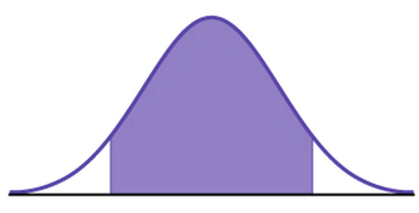





CI FOR $μ$, KNOWN $σ$
$$1−α$$
$$α/2$$
$$α/2$$
$$z_{α/2}=−z_{1−α/2}$$
$$z_{1−α/2}$$

Slide 24

CI FOR $μ$, KNOWN $σ$
$$1−α$$
$$α/2$$
$$α/2$$
$$z_{α/2}=−z_{1−α/2}$$
$$z_{1−α/2}$$

Slide 25

CI FOR $μ$, KNOWN $σ$
$$1−α$$
$$α/2$$
$$α/2$$
$$z_{α/2}=−z_{1−α/2}$$
$$z_{1−α/2}$$

Slide 26

CI FOR $μ$, KNOWN $σ$
$$1−α$$
$$α/2$$
$$α/2$$
$$z_{α/2}=−z_{1−α/2}$$
$$z_{1−α/2}$$

Slide 27

CI FOR $μ$, KNOWN $σ$
$$1−α$$
$$α/2$$
$$α/2$$
$$z_{α/2}=−z_{1−α/2}$$
$$z_{1−α/2}$$

Slide 28
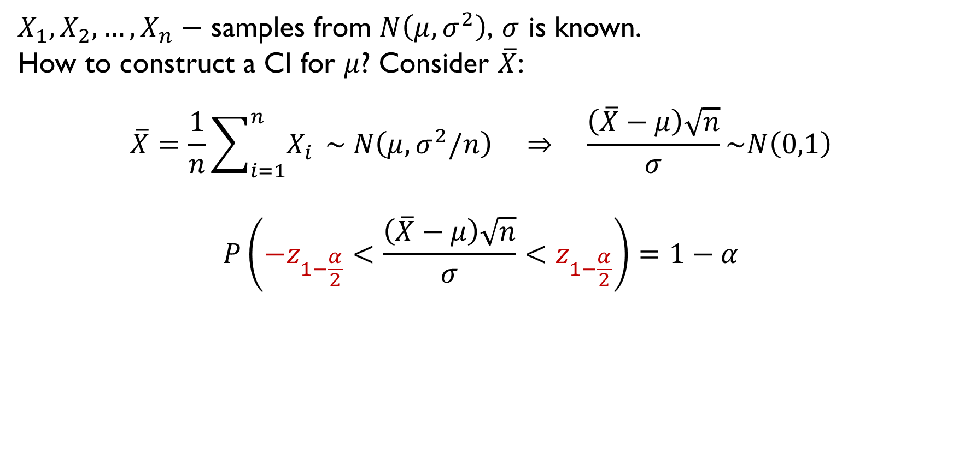
CI FOR $μ$, KNOWN $σ$
$X_{1},X_{2},…,X_{n}−$ samples from $N\left(μ,σ^{2}\right)$, $σ$ is known.
How to construct a CI for $μ$? Consider $\overline{X}$:
$$\overline{X}=\frac{1}{n}\sum_{i=1}^{n}{X_{i}} \sim N\left(μ,σ^{2}/n\right) ⇒ \frac{\left(\overline{X}−μ\right)\sqrt{n}}{σ}\sim N\left(0,1\right)$$
$$P\left(−z_{1−\frac{α}{2}}<\frac{\left(\overline{X}−μ\right)\sqrt{n}}{σ}<z_{1−\frac{α}{2}}\right)=1−α$$
$$P\left(\overline{X}−\frac{σ}{\sqrt{n}}z_{1−\frac{α}{2}}<μ<\overline{X}+\frac{σ}{\sqrt{n}}z_{1−\frac{α}{2}}\right)=1−α$$

Slide 29
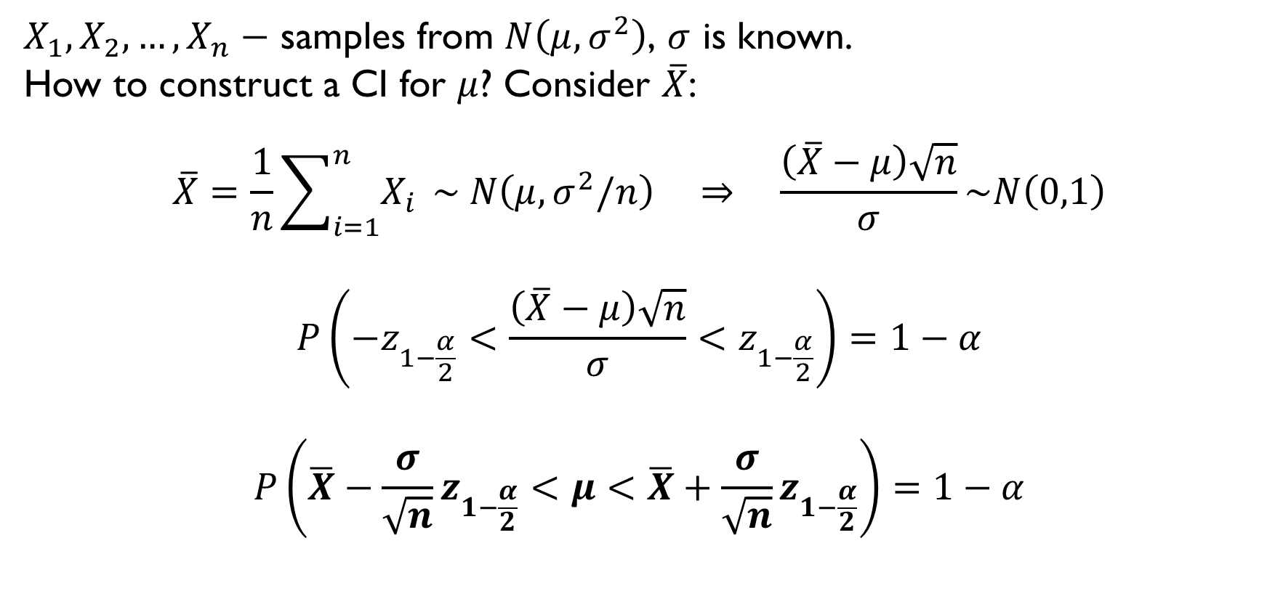
CI FOR $μ$, KNOWN $σ$
$X_{1},X_{2},…,X_{n}−$ samples from $N\left(μ,σ^{2}\right)$, $σ$ is known.
How to construct a CI for $μ$? Consider $\overline{X}$:
$$\overline{X}=\frac{1}{n}\sum_{i=1}^{n}{X_{i}} \sim N\left(μ,σ^{2}/n\right) ⇒ \frac{\left(\overline{X}−μ\right)\sqrt{n}}{σ}\sim N\left(0,1\right)$$
$$P\left(−z_{1−\frac{α}{2}}<\frac{\left(\overline{X}−μ\right)\sqrt{n}}{σ}<z_{1−\frac{α}{2}}\right)=1−α$$
$$P\left(\overline{X}−\frac{σ}{\sqrt{n}}z_{1−\frac{α}{2}}<μ<\overline{X}+\frac{σ}{\sqrt{n}}z_{1−\frac{α}{2}}\right)=1−α$$

Slide 30


CI FOR $μ$, KNOWN $σ$: EXAMPLE 1
$X_{1},X_{2},…,X_{100} −$samples from $N\left(μ, 3^{2}\right), \overline{X}=12$.
Give the 95%-CI for $μ$.
Interval:
$$\overline{X}±\frac{σ}{\sqrt{n}}∙z_{1−α/2}$$
$$1−α=0.95⇒α=0.05, z_{1−0.025}=1.96$$
$$12±\frac{3}{\sqrt{100}}∙1.96$$

Slide 31

CI FOR $μ$, KNOWN $σ$: EXAMPLE 1
$X_{1},X_{2},…,X_{100} −$samples from $N\left(μ, 3^{2}\right), \overline{X}=12$.
Give the 95%-CI for $μ$.
Interval:
$$\overline{X}±\frac{σ}{\sqrt{n}}∙z_{1−α/2}$$
$$1−α=0.95⇒α=0.05, z_{1−0.025}=1.96$$
$$12±\frac{3}{\sqrt{100}}∙1.96$$

Slide 32

CI FOR $μ$, KNOWN $σ$: EXAMPLE 1
$X_{1},X_{2},…,X_{100} −$samples from $N\left(μ, 3^{2}\right), \overline{X}=12$.
Give the 95%-CI for $μ$.
Interval:
$$\overline{X}±\frac{σ}{\sqrt{n}}∙z_{1−α/2}$$
$$1−α=0.95⇒α=0.05, z_{1−0.025}=1.96$$
$$12±\frac{3}{\sqrt{100}}∙1.96$$

Slide 33
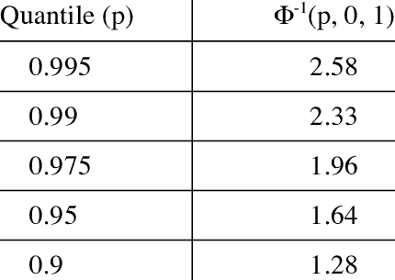

CI FOR $μ$, KNOWN $σ$: EXAMPLE 1
$X_{1},X_{2},…,X_{100} −$samples from $N\left(μ, 3^{2}\right), \overline{X}=12$.
Give the 95%-CI for $μ$.
Interval:
$$\overline{X}±\frac{σ}{\sqrt{n}}∙z_{1−α/2}$$
$$1−α=0.95⇒α=0.05, z_{1−0.025}=1.96$$
$$12±\frac{3}{\sqrt{100}}∙1.96$$

Slide 34
CI FOR $μ$, KNOWN $σ$: EXAMPLE 1
$X_{1},X_{2},…,X_{100} −$samples from $N\left(μ, 3^{2}\right), \overline{X}=12$.
Give the 95%-CI for $μ$.
Interval:
$$\overline{X}±\frac{σ}{\sqrt{n}}∙z_{1−α/2}$$
$$1−α=0.95⇒α=0.05, z_{1−0.025}=1.96$$
$$12±\frac{3}{\sqrt{100}}∙1.96$$

Slide 35

CI FOR $μ$, KNOWN $σ$: EXAMPLE 1
$X_{1},X_{2},…,X_{100} −$samples from $N\left(μ, 3^{2}\right), \overline{X}=12$.
Give the 95%-CI for $μ$.
Interval:
$$\overline{X}±\frac{σ}{\sqrt{n}}∙z_{1−α/2}$$
$$1−α=0.95⇒α=0.05, z_{1−0.025}=1.96$$
$$12±\frac{3}{\sqrt{100}}∙1.96$$

Slide 36

CI FOR $μ$, KNOWN $σ$: EXAMPLE 1
$X_{1},X_{2},…,X_{100} −$samples from $N\left(μ, 3^{2}\right), \overline{X}=12$.
Give the 95%-CI for $μ$.
Interval:
$$\overline{X}±\frac{σ}{\sqrt{n}}∙z_{1−α/2}$$
$$1−α=0.95⇒α=0.05, z_{1−0.025}=1.96$$
$$12±\frac{3}{\sqrt{100}}∙1.96$$

Slide 37


CI FOR $μ$, KNOWN $σ$: EXAMPLE 2
$X_{1},X_{2},…,X_{100} −$samples from $N\left(μ, 1^{2}\right), \overline{X}=5$.
Give the 90%-CI for $μ$.
Interval:
$$\overline{X}±\frac{σ}{\sqrt{n}}∙z_{1−α/2}$$
$$1−α=0.90⇒α=0.1, z_{1−0.05}=1.64$$
$$5±\frac{1}{\sqrt{100}}∙1.64$$

Slide 38

CI FOR $μ$, KNOWN $σ$: EXAMPLE 2
$X_{1},X_{2},…,X_{100} −$samples from $N\left(μ, 1^{2}\right), \overline{X}=5$.
Give the 90%-CI for $μ$.
Interval:
$$\overline{X}±\frac{σ}{\sqrt{n}}∙z_{1−α/2}$$
$$1−α=0.90⇒α=0.1, z_{1−0.05}=1.64$$
$$5±\frac{1}{\sqrt{100}}∙1.64$$

Slide 39
CI FOR $μ$, KNOWN $σ$: EXAMPLE 2
$X_{1},X_{2},…,X_{100} −$samples from $N\left(μ, 1^{2}\right), \overline{X}=5$.
Give the 90%-CI for $μ$.
Interval:
$$\overline{X}±\frac{σ}{\sqrt{n}}∙z_{1−α/2}$$
$$1−α=0.90⇒α=0.1, z_{1−0.05}=1.64$$
$$5±\frac{1}{\sqrt{100}}∙1.64$$

Slide 40

CI FOR $μ$, KNOWN $σ$: EXAMPLE 2
$X_{1},X_{2},…,X_{100} −$samples from $N\left(μ, 1^{2}\right), \overline{X}=5$.
Give the 90%-CI for $μ$.
Interval:
$$\overline{X}±\frac{σ}{\sqrt{n}}∙z_{1−α/2}$$
$$1−α=0.90⇒α=0.1, z_{1−0.05}=1.64$$
$$5±\frac{1}{\sqrt{100}}∙1.64$$

Slide 41

CI FOR $μ$, KNOWN $σ$: EXAMPLE 2
$X_{1},X_{2},…,X_{100} −$samples from $N\left(μ, 1^{2}\right), \overline{X}=5$.
Give the 90%-CI for $μ$.
Interval:
$$\overline{X}±\frac{σ}{\sqrt{n}}∙z_{1−α/2}$$
$$1−α=0.90⇒α=0.1, z_{1−0.05}=1.64$$
$$5±\frac{1}{\sqrt{100}}∙1.64$$

Slide 42
PRACTICE!
Google Classroom -> Lecture 8 -> z-intervals

Slide 43

CI FOR NORMAL DATA
CI for $μ$, unknown $σ$

Slide 44


CI FOR $μ$, UNKNOWN $σ$
$X_{1},X_{2},…,X_{n}−$ samples from $N\left(μ,σ^{2}\right)$, $σ$ is unknown.
How to construct a CI for $μ$? Consider $\overline{X}$:
$$\overline{X}=\frac{1}{n}\sum_{i=1}^{n}{X_{i}} \sim N\left(μ,σ^{2}/n\right) ⇒ \frac{\left(\overline{X}−μ\right)\sqrt{n}}{σ}\sim N\left(0,1\right)$$
Approximate with sample variance $s^{2}=\frac{1}{n−1}\sum_{i=1}^{n}{{\left(X_{i}−\overline{X}\right)}^{2}}$:
$\frac{\left(\overline{X}−μ\right)\sqrt{n}}{s}\sim t\left(n−1\right)−$ Student distribution

Slide 45

CI FOR $μ$, UNKNOWN $σ$
$X_{1},X_{2},…,X_{n}−$ samples from $N\left(μ,σ^{2}\right)$, $σ$ is unknown.
How to construct a CI for $μ$? Consider $\overline{X}$:
$$\overline{X}=\frac{1}{n}\sum_{i=1}^{n}{X_{i}} \sim N\left(μ,σ^{2}/n\right) ⇒ \frac{\left(\overline{X}−μ\right)\sqrt{n}}{σ}\sim N\left(0,1\right)$$
Approximate with sample variance $s^{2}=\frac{1}{n−1}\sum_{i=1}^{n}{{\left(X_{i}−\overline{X}\right)}^{2}}$:
$\frac{\left(\overline{X}−μ\right)\sqrt{n}}{s}\sim t\left(n−1\right)−$ Student distribution

Slide 46

CI FOR $μ$, UNKNOWN $σ$
$X_{1},X_{2},…,X_{n}−$ samples from $N\left(μ,σ^{2}\right)$, $σ$ is unknown.
How to construct a CI for $μ$? Consider $\overline{X}$:
$$\overline{X}=\frac{1}{n}\sum_{i=1}^{n}{X_{i}} \sim N\left(μ,σ^{2}/n\right) ⇒ \frac{\left(\overline{X}−μ\right)\sqrt{n}}{σ}\sim N\left(0,1\right)$$
Approximate with sample variance $s^{2}=\frac{1}{n−1}\sum_{i=1}^{n}{{\left(X_{i}−\overline{X}\right)}^{2}}$:
$\frac{\left(\overline{X}−μ\right)\sqrt{n}}{s}\sim t\left(n−1\right)−$ Student distribution

Slide 47

CI FOR $μ$, UNKNOWN $σ$
$X_{1},X_{2},…,X_{n}−$ samples from $N\left(μ,σ^{2}\right)$, $σ$ is unknown.
How to construct a CI for $μ$? Consider $\overline{X}$:
$$\overline{X}=\frac{1}{n}\sum_{i=1}^{n}{X_{i}} \sim N\left(μ,σ^{2}/n\right) ⇒ \frac{\left(\overline{X}−μ\right)\sqrt{n}}{σ}\sim N\left(0,1\right)$$
Approximate with sample variance $s^{2}=\frac{1}{n−1}\sum_{i=1}^{n}{{\left(X_{i}−\overline{X}\right)}^{2}}$:
$\frac{\left(\overline{X}−μ\right)\sqrt{n}}{s}\sim t\left(n−1\right)−$ Student distribution

Slide 48

CI FOR $μ$, UNKNOWN $σ$
$X_{1},X_{2},…,X_{n}−$ samples from $N\left(μ,σ^{2}\right)$, $σ$ is unknown.
How to construct a CI for $μ$? Consider $\overline{X}$:
$$\overline{X}=\frac{1}{n}\sum_{i=1}^{n}{X_{i}} \sim N\left(μ,σ^{2}/n\right) ⇒ \frac{\left(\overline{X}−μ\right)\sqrt{n}}{σ}\sim N\left(0,1\right)$$
Approximate with sample variance $s^{2}=\frac{1}{n−1}\sum_{i=1}^{n}{{\left(X_{i}−\overline{X}\right)}^{2}}$:
$\frac{\left(\overline{X}−μ\right)\sqrt{n}}{s}\sim t\left(n−1\right)−$ Student distribution

Slide 49
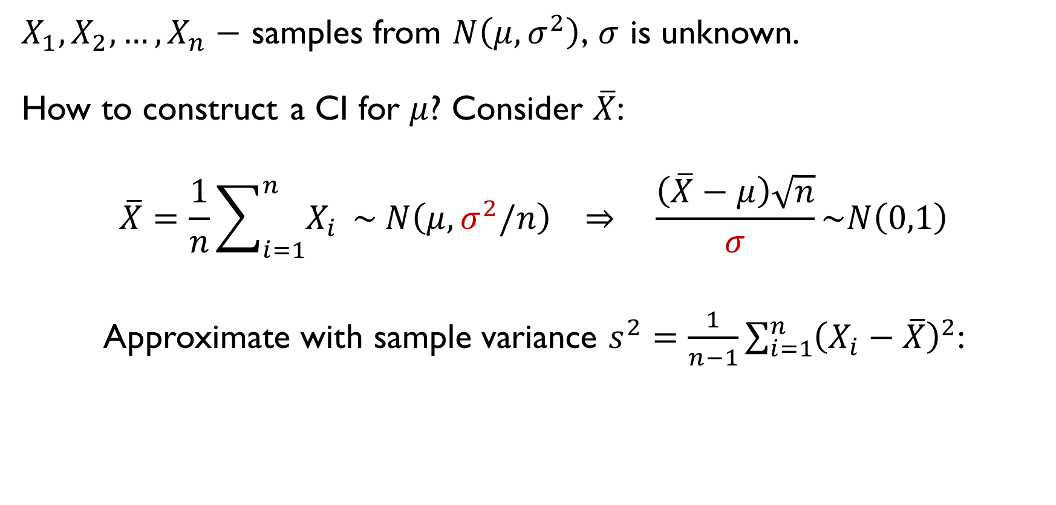
CI FOR $μ$, UNKNOWN $σ$
$X_{1},X_{2},…,X_{n}−$ samples from $N\left(μ,σ^{2}\right)$, $σ$ is unknown.
How to construct a CI for $μ$? Consider $\overline{X}$:
$$\overline{X}=\frac{1}{n}\sum_{i=1}^{n}{X_{i}} \sim N\left(μ,σ^{2}/n\right) ⇒ \frac{\left(\overline{X}−μ\right)\sqrt{n}}{σ}\sim N\left(0,1\right)$$
Approximate with sample variance $s^{2}=\frac{1}{n−1}\sum_{i=1}^{n}{{\left(X_{i}−\overline{X}\right)}^{2}}$:
$\frac{\left(\overline{X}−μ\right)\sqrt{n}}{s}\sim t\left(n−1\right)−$ Student distribution

Slide 50
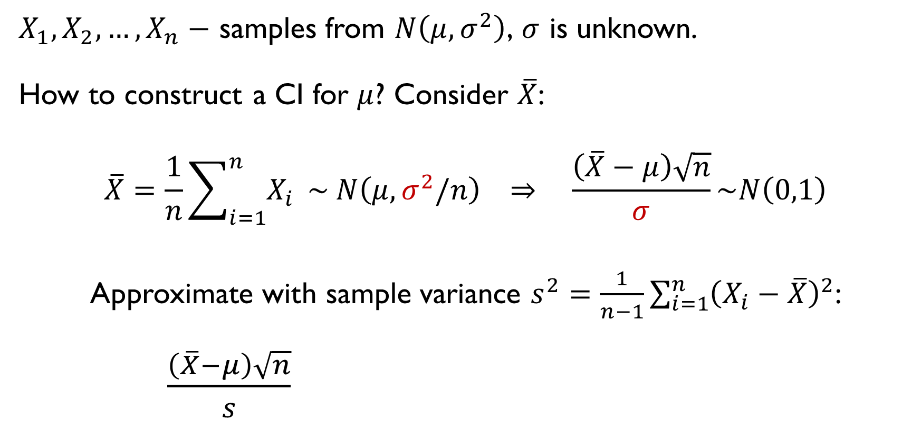
CI FOR $μ$, UNKNOWN $σ$
$X_{1},X_{2},…,X_{n}−$ samples from $N\left(μ,σ^{2}\right)$, $σ$ is unknown.
How to construct a CI for $μ$? Consider $\overline{X}$:
$$\overline{X}=\frac{1}{n}\sum_{i=1}^{n}{X_{i}} \sim N\left(μ,σ^{2}/n\right) ⇒ \frac{\left(\overline{X}−μ\right)\sqrt{n}}{σ}\sim N\left(0,1\right)$$
Approximate with sample variance $s^{2}=\frac{1}{n−1}\sum_{i=1}^{n}{{\left(X_{i}−\overline{X}\right)}^{2}}$:
$\frac{\left(\overline{X}−μ\right)\sqrt{n}}{s}\sim t\left(n−1\right)−$ Student distribution

Slide 51
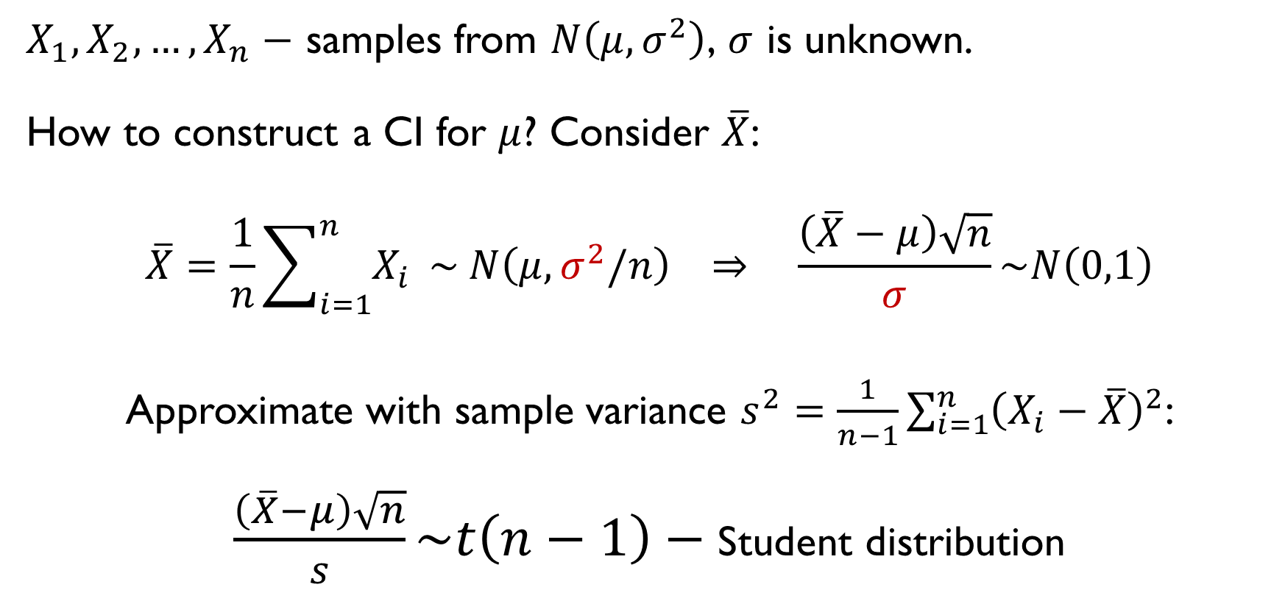
CI FOR $μ$, UNKNOWN $σ$
$X_{1},X_{2},…,X_{n}−$ samples from $N\left(μ,σ^{2}\right)$, $σ$ is unknown.
How to construct a CI for $μ$? Consider $\overline{X}$:
$$\overline{X}=\frac{1}{n}\sum_{i=1}^{n}{X_{i}} \sim N\left(μ,σ^{2}/n\right) ⇒ \frac{\left(\overline{X}−μ\right)\sqrt{n}}{σ}\sim N\left(0,1\right)$$
Approximate with sample variance $s^{2}=\frac{1}{n−1}\sum_{i=1}^{n}{{\left(X_{i}−\overline{X}\right)}^{2}}$:
$\frac{\left(\overline{X}−μ\right)\sqrt{n}}{s}\sim t\left(n−1\right)−$ Student distribution

Slide 52
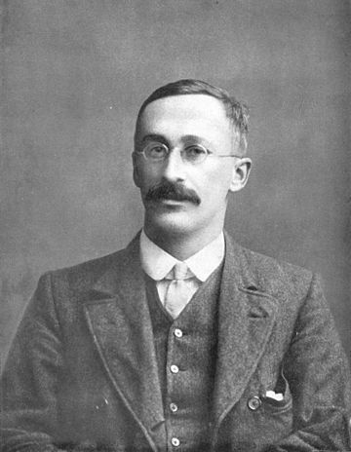

STUDENT DISTRIBUTION
$$\frac{\left({\overline{X}}_{n}−μ\right)\sqrt{n}}{s}\sim t\left(n−1\right)$$
William Sealy Gosset

Slide 53

STUDENT DISTRIBUTION
$$\frac{\left({\overline{X}}_{n}−μ\right)\sqrt{n}}{s}\sim t\left(n−1\right)$$
William Sealy Gosset

Slide 54
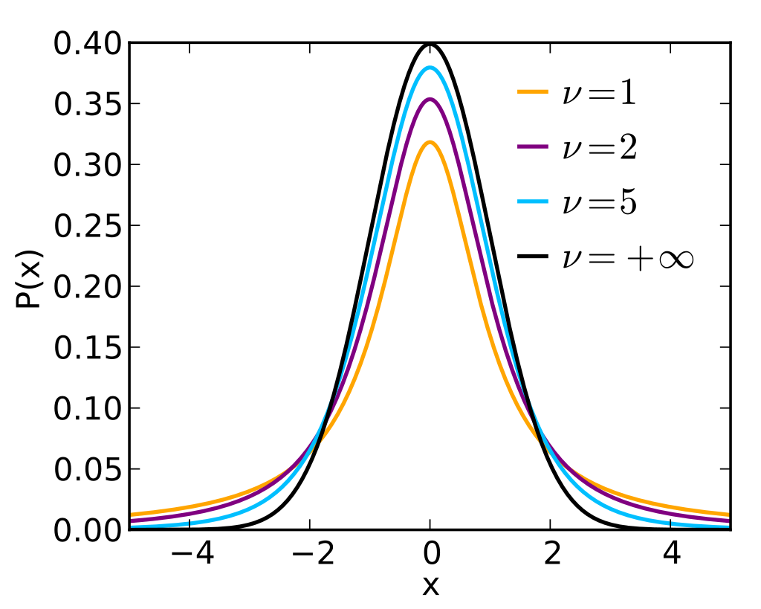
STUDENT DISTRIBUTION
$$\frac{\left({\overline{X}}_{n}−μ\right)\sqrt{n}}{s}\sim t\left(n−1\right)$$
William Sealy Gosset

Slide 55

CI FOR $μ$, UNKNOWN $σ$
$X_{1},X_{2},…,X_{n}−$ samples from $N\left(μ,σ^{2}\right)$, $σ$ is unknown.
How to construct a CI for $μ$? Consider $\overline{X}$:
$\frac{\left(\overline{X}−μ\right)\sqrt{n}}{s}\sim t\left(n−1\right)−$ Student distribution
Before: $P\left(−z_{1−α/2}<\frac{\left(\overline{X}−μ\right)\sqrt{n}}{σ}<z_{1−α/2}\right)=1−α$
Now: same logic, replace $z_{1−a/2}$ with $t_{1−a/2}$:
$$P\left(−t_{1−α/2}<\frac{\left(\overline{X}−μ\right)\sqrt{n}}{s}<t_{1−α/2}\right)=1−α$$

Slide 56
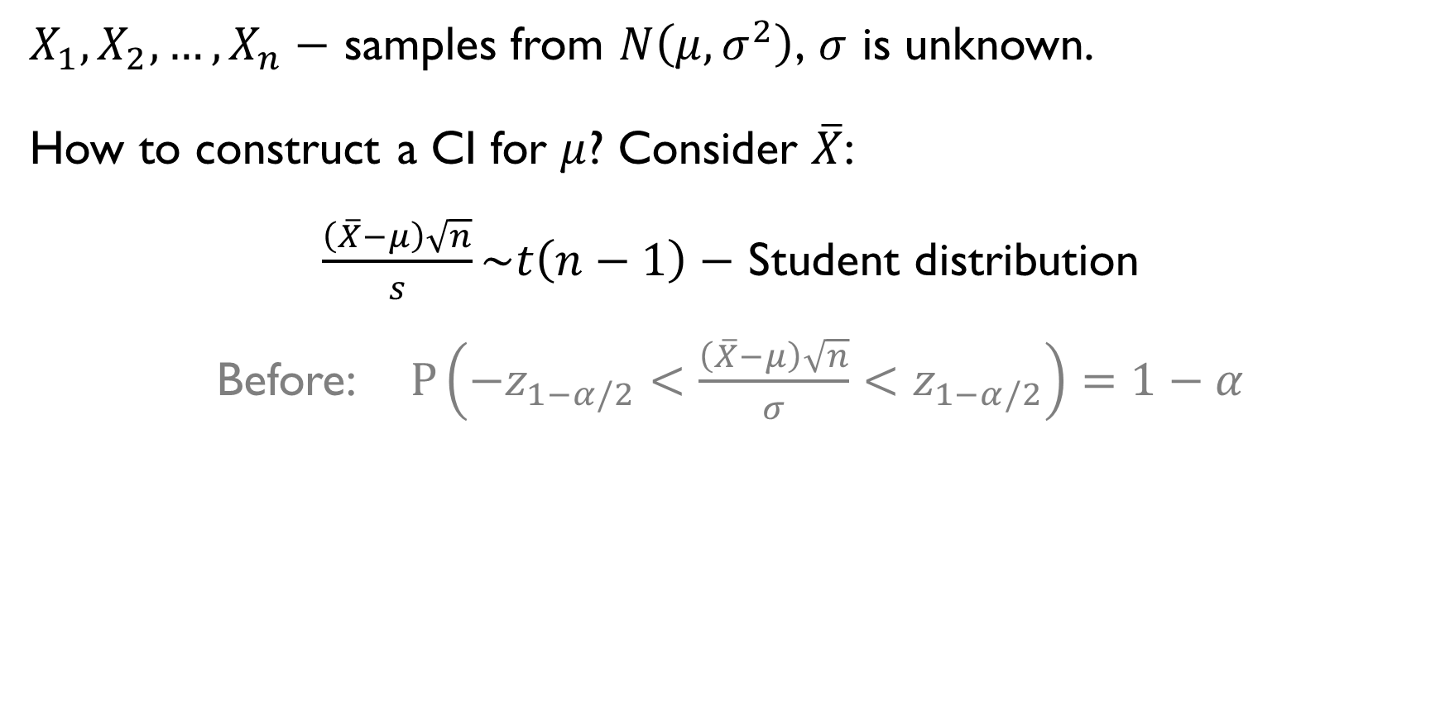
CI FOR $μ$, UNKNOWN $σ$
$X_{1},X_{2},…,X_{n}−$ samples from $N\left(μ,σ^{2}\right)$, $σ$ is unknown.
How to construct a CI for $μ$? Consider $\overline{X}$:
$\frac{\left(\overline{X}−μ\right)\sqrt{n}}{s}\sim t\left(n−1\right)−$ Student distribution
Before: $P\left(−z_{1−α/2}<\frac{\left(\overline{X}−μ\right)\sqrt{n}}{σ}<z_{1−α/2}\right)=1−α$
Now: same logic, replace $z_{1−a/2}$ with $t_{1−a/2}$:
$$P\left(−t_{1−α/2}<\frac{\left(\overline{X}−μ\right)\sqrt{n}}{s}<t_{1−α/2}\right)=1−α$$

Slide 57
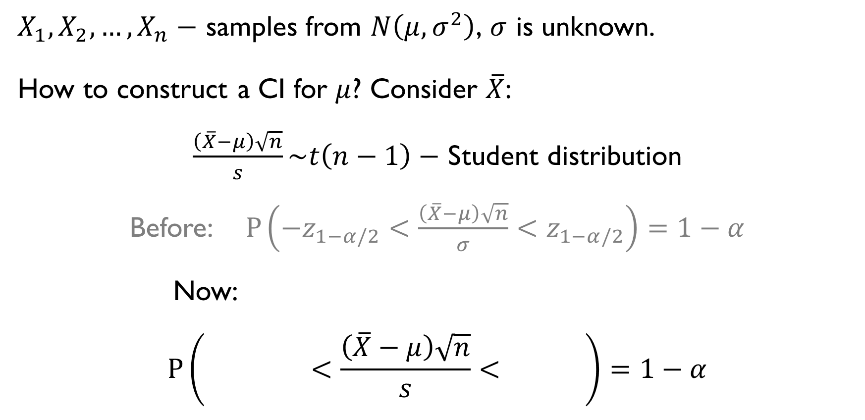
CI FOR $μ$, UNKNOWN $σ$
$X_{1},X_{2},…,X_{n}−$ samples from $N\left(μ,σ^{2}\right)$, $σ$ is unknown.
How to construct a CI for $μ$? Consider $\overline{X}$:
$\frac{\left(\overline{X}−μ\right)\sqrt{n}}{s}\sim t\left(n−1\right)−$ Student distribution
Before: $P\left(−z_{1−α/2}<\frac{\left(\overline{X}−μ\right)\sqrt{n}}{σ}<z_{1−α/2}\right)=1−α$
Now: same logic, replace $z_{1−a/2}$ with $t_{1−a/2}$:
$$P\left(−t_{1−α/2}<\frac{\left(\overline{X}−μ\right)\sqrt{n}}{s}<t_{1−α/2}\right)=1−α$$

Slide 58
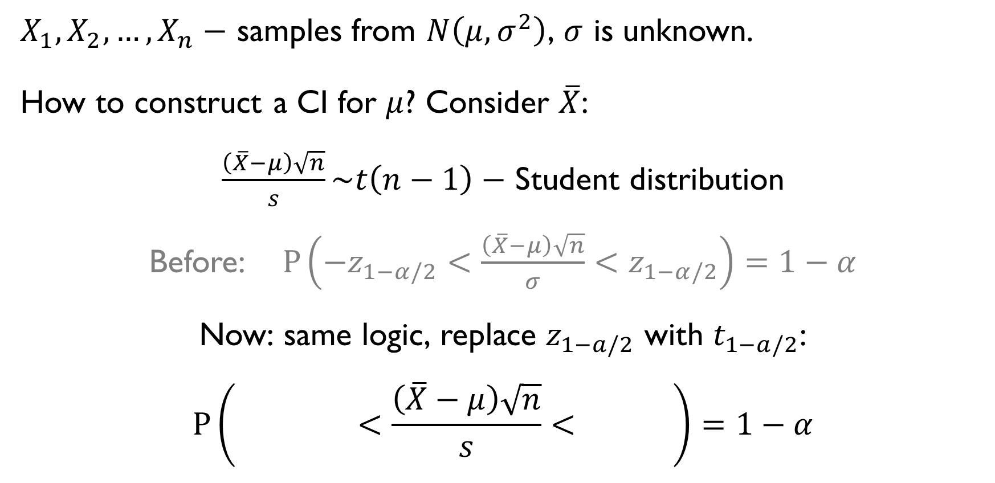
CI FOR $μ$, UNKNOWN $σ$
$X_{1},X_{2},…,X_{n}−$ samples from $N\left(μ,σ^{2}\right)$, $σ$ is unknown.
How to construct a CI for $μ$? Consider $\overline{X}$:
$\frac{\left(\overline{X}−μ\right)\sqrt{n}}{s}\sim t\left(n−1\right)−$ Student distribution
Before: $P\left(−z_{1−α/2}<\frac{\left(\overline{X}−μ\right)\sqrt{n}}{σ}<z_{1−α/2}\right)=1−α$
Now: same logic, replace $z_{1−a/2}$ with $t_{1−a/2}$:
$$P\left(−t_{1−α/2}<\frac{\left(\overline{X}−μ\right)\sqrt{n}}{s}<t_{1−α/2}\right)=1−α$$

Slide 59
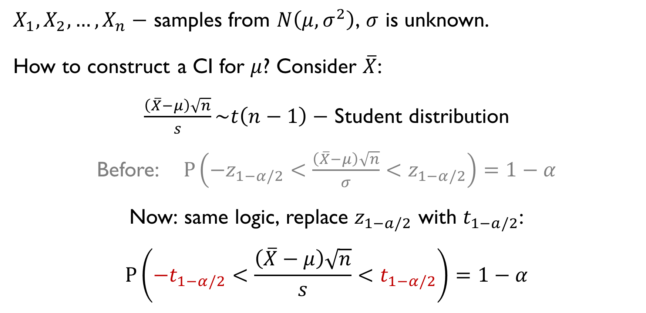
CI FOR $μ$, UNKNOWN $σ$
$X_{1},X_{2},…,X_{n}−$ samples from $N\left(μ,σ^{2}\right)$, $σ$ is unknown.
How to construct a CI for $μ$? Consider $\overline{X}$:
$\frac{\left(\overline{X}−μ\right)\sqrt{n}}{s}\sim t\left(n−1\right)−$ Student distribution
Before: $P\left(−z_{1−α/2}<\frac{\left(\overline{X}−μ\right)\sqrt{n}}{σ}<z_{1−α/2}\right)=1−α$
Now: same logic, replace $z_{1−a/2}$ with $t_{1−a/2}$:
$$P\left(−t_{1−α/2}<\frac{\left(\overline{X}−μ\right)\sqrt{n}}{s}<t_{1−α/2}\right)=1−α$$

Slide 60
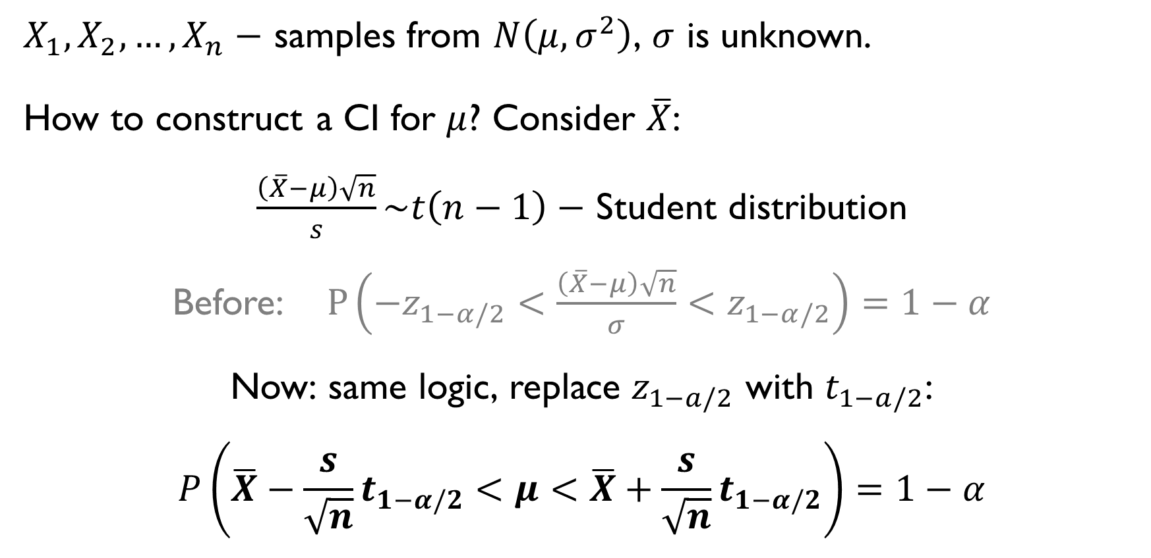
CI FOR $μ$, UNKNOWN $σ$
$X_{1},X_{2},…,X_{n}−$ samples from $N\left(μ,σ^{2}\right)$, $σ$ is unknown.
How to construct a CI for $μ$? Consider $\overline{X}$:
$\frac{\left(\overline{X}−μ\right)\sqrt{n}}{s}\sim t\left(n−1\right)−$ Student distribution
Before: $P\left(−z_{1−α/2}<\frac{\left(\overline{X}−μ\right)\sqrt{n}}{σ}<z_{1−α/2}\right)=1−α$
Now: same logic, replace $z_{1−a/2}$ with $t_{1−a/2}$:
$$P\left(\overline{X}−\frac{s}{\sqrt{n}}t_{1−α/2}<μ<\overline{X}+\frac{s}{\sqrt{n}}t_{1−α/2}\right)=1−α$$

Slide 61


CI FOR $μ$, UNKNOWN $σ$: EXAMPLE
$X_{1},X_{2},…,X_{20}−$ samples from $N\left(μ,σ^{2}\right)$, $σ$ is unknown.
$\overline{X}=42, s^{2}=36$
Give the 95%-CI for $μ$.
$$μ=\overline{X}±\frac{s}{\sqrt{n}}t_{1−α/2}$$
$$1−α=0.95⇒α=0.05, t_{1−0.025}=2.093$$
$$μ=42±\frac{6}{\sqrt{20}}∙2.093$$

Slide 62

CI FOR $μ$, UNKNOWN $σ$: EXAMPLE
$X_{1},X_{2},…,X_{20}−$ samples from $N\left(μ,σ^{2}\right)$, $σ$ is unknown.
$\overline{X}=42, s^{2}=36$
Give the 95%-CI for $μ$.
$$μ=\overline{X}±\frac{s}{\sqrt{n}}t_{1−α/2}$$
$$1−α=0.95⇒α=0.05, t_{1−0.025}=2.093$$
$$μ=42±\frac{6}{\sqrt{20}}∙2.093$$

Slide 63

CI FOR $μ$, UNKNOWN $σ$: EXAMPLE
$X_{1},X_{2},…,X_{20}−$ samples from $N\left(μ,σ^{2}\right)$, $σ$ is unknown.
$\overline{X}=42, s^{2}=36$
Give the 95%-CI for $μ$.
$$μ=\overline{X}±\frac{s}{\sqrt{n}}t_{1−α/2}$$
$$1−α=0.95⇒α=0.05, t_{1−0.025}=2.093$$
$$μ=42±\frac{6}{\sqrt{20}}∙2.093$$

Slide 64

CI FOR $μ$, UNKNOWN $σ$: EXAMPLE
$X_{1},X_{2},…,X_{20}−$ samples from $N\left(μ,σ^{2}\right)$, $σ$ is unknown.
$\overline{X}=42, s^{2}=36$
Give the 95%-CI for $μ$.
$$μ=\overline{X}±\frac{s}{\sqrt{n}}t_{1−α/2}$$
$$1−α=0.95⇒α=0.05, t_{1−0.025}=2.093$$
$$μ=42±\frac{6}{\sqrt{20}}∙2.093$$

Slide 65

CI FOR $μ$, UNKNOWN $σ$: EXAMPLE
$X_{1},X_{2},…,X_{20}−$ samples from $N\left(μ,σ^{2}\right)$, $σ$ is unknown.
$\overline{X}=42, s^{2}=36$
Give the 95%-CI for $μ$.
$$μ=\overline{X}±\frac{s}{\sqrt{n}}t_{1−α/2}$$
$$1−α=0.95⇒α=0.05, t_{1−0.025}=2.093$$
$$μ=42±\frac{6}{\sqrt{20}}∙2.093$$

Slide 66

CI FOR $μ$, UNKNOWN $σ$: EXAMPLE
$X_{1},X_{2},…,X_{20}−$ samples from $N\left(μ,σ^{2}\right)$, $σ$ is unknown.
$\overline{X}=42, s^{2}=36$
Give the 95%-CI for $μ$.
$$μ=\overline{X}±\frac{s}{\sqrt{n}}t_{1−α/2}$$
$$1−α=0.95⇒α=0.05, t_{1−0.025}=2.093$$
$$μ=42±\frac{6}{\sqrt{20}}∙2.093$$

Slide 67
PRACTICE!
Google Classroom -> Lecture 8 -> t-intervals

Slide 68

CI FOR NORMAL DATA
CI for $σ$, unknown $μ$, $σ$

Slide 69


CI FOR $σ$, UNKNOWN $μ, σ$
$X_{1},X_{2},…,X_{100} −$samples from $N\left(μ, σ^{2}\right)$, $σ$ is unknown.
How to construct a CI for $σ$? Consider $S^{2}$:
$$s^{2}=\frac{1}{n−1}\sum_{i=1}^{n}{{\left(X_{i}−\overline{X}\right)}^{2}}$$
$$\frac{\left(n−1\right)s^{2}}{σ^{2}}\sim χ^{2}\left(n−1\right)−$$
Chi-squared distribution

Slide 70

CI FOR $σ$, UNKNOWN $μ, σ$
$X_{1},X_{2},…,X_{100} −$samples from $N\left(μ, σ^{2}\right)$, $σ$ is unknown.
How to construct a CI for$σ$? Consider $S^{2}$:
$$s^{2}=\frac{1}{n−1}\sum_{i=1}^{n}{{\left(X_{i}−\overline{X}\right)}^{2}}$$
$$\frac{\left(n−1\right)s^{2}}{σ^{2}}\sim χ^{2}\left(n−1\right)−$$
Chi-squared distribution

Slide 71

CI FOR $σ$, UNKNOWN $μ, σ$
$X_{1},X_{2},…,X_{100} −$samples from $N\left(μ, σ^{2}\right)$, $σ$ is unknown.
How to construct a CI for $σ$? Consider $S^{2}$:
$$s^{2}=\frac{1}{n−1}\sum_{i=1}^{n}{{\left(X_{i}−\overline{X}\right)}^{2}}$$
$$\frac{\left(n−1\right)s^{2}}{σ^{2}}\sim χ^{2}\left(n−1\right)−$$
Chi-squared distribution

Slide 72

CI FOR $σ$, UNKNOWN $μ, σ$
$X_{1},X_{2},…,X_{100} −$samples from $N\left(μ, σ^{2}\right)$, $σ$ is unknown.
How to construct a CI for $μ$? Consider $S^{2}$:
$$s^{2}=\frac{1}{n−1}\sum_{i=1}^{n}{{\left(X_{i}−\overline{X}\right)}^{2}}$$
$$\frac{\left(n−1\right)s^{2}}{σ^{2}}\sim χ^{2}\left(n−1\right)−$$
Chi-squared distribution

Slide 73

CI FOR $σ$, UNKNOWN $μ, σ$
$X_{1},X_{2},…,X_{100} −$samples from $N\left(μ, σ^{2}\right)$, $σ$ is unknown.
How to construct a CI for $μ$? Consider $S^{2}$:
$$s^{2}=\frac{1}{n−1}\sum_{i=1}^{n}{{\left(X_{i}−\overline{X}\right)}^{2}}$$
$$\frac{\left(n−1\right)s^{2}}{σ^{2}}\sim χ^{2}\left(n−1\right)−$$
Chi-squared distribution

Slide 74

CHI-SQUARED DISTRIBUTION
$$Z_{1},Z_{2},…,Z_{n} −i.i.d. N\left(0,1\right)$$
$$⇒$$
$$Q=Z_{1}^{2}+…+Z_{n}^{2} \sim χ^{2}\left(n−1\right)$$

Slide 75

CHI-SQUARED DISTRIBUTION
$$Z_{1},Z_{2},…,Z_{n} −i.i.d. N\left(0,1\right)$$
$$⇒$$
$$Q=Z_{1}^{2}+…+Z_{n}^{2} \sim χ^{2}\left(n−1\right)$$

Slide 76

CHI-SQUARED DISTRIBUTION
$$Z_{1},Z_{2},…,Z_{n} −i.i.d. N\left(0,1\right)$$
$$⇒$$
$$Q=Z_{1}^{2}+…+Z_{n}^{2} \sim χ^{2}\left(n−1\right)$$

Slide 77

CI FOR $σ$, UNKNOWN $μ, σ$
$X_{1},X_{2},…,X_{100} −$samples from $N\left(μ, σ^{2}\right)$, $σ$ is unknown.
How to construct a CI for$σ$? Consider $S^{2}$:
$$\frac{\left(n−1\right)s^{2}}{σ^{2}}\sim χ^{2}\left(n−1\right)$$
$$P\left(c_{α/2}<\frac{\left(n−1\right)s^{2}}{σ^{2}}<c_{1−α/2}\right)=1−α$$
$$P\left(\frac{\left(n−1\right)s^{2}}{c_{1−α/2}}<σ^{2}<\frac{\left(n−1\right)s^{2}}{c_{α/2}}\right)=1−α$$

Slide 78

CI FOR $σ$, UNKNOWN $μ, σ$
$X_{1},X_{2},…,X_{100} −$samples from $N\left(μ, σ^{2}\right)$, $σ$ is unknown.
How to construct a CI for $σ$? Consider $S^{2}$:
$$\frac{\left(n−1\right)s^{2}}{σ^{2}}\sim χ^{2}\left(n−1\right)$$
$$P\left(c_{α/2}<\frac{\left(n−1\right)s^{2}}{σ^{2}}<c_{1−α/2}\right)=1−α$$
$$P\left(\frac{\left(n−1\right)s^{2}}{c_{1−α/2}}<σ^{2}<\frac{\left(n−1\right)s^{2}}{c_{α/2}}\right)=1−α$$

Slide 79

CI FOR $σ$, UNKNOWN $μ, σ$

Slide 80

CI FOR $σ$, UNKNOWN $μ, σ$
$X_{1},X_{2},…,X_{100} −$samples from $N\left(μ, σ^{2}\right)$, $σ$ is unknown.
How to construct a CI for $σ$? Consider $S^{2}$:
$$\frac{\left(n−1\right)s^{2}}{σ^{2}}\sim χ^{2}\left(n−1\right)$$
$$P\left(c_{α/2}<\frac{\left(n−1\right)s^{2}}{σ^{2}}<c_{1−α/2}\right)=1−α$$
$$P\left(\frac{\left(n−1\right)s^{2}}{c_{1−α/2}}<σ^{2}<\frac{\left(n−1\right)s^{2}}{c_{α/2}}\right)=1−α$$

Slide 81

CI FOR $σ$, UNKNOWN $μ, σ$
$X_{1},X_{2},…,X_{100} −$samples from $N\left(μ, σ^{2}\right)$, $σ$ is unknown.
How to construct a CI for $σ$? Consider $S^{2}$:
$$\frac{\left(n−1\right)s^{2}}{σ^{2}}\sim χ^{2}\left(n−1\right)$$
$$P\left(c_{α/2}<\frac{\left(n−1\right)s^{2}}{σ^{2}}<c_{1−α/2}\right)=1−α$$
$$P\left(\frac{\left(n−1\right)s^{2}}{c_{1−α/2}}<σ^{2}<\frac{\left(n−1\right)s^{2}}{c_{α/2}}\right)=1−α$$

Slide 82


CI FOR $σ$, UNKNOWN $μ, σ$: EXAMPLE
$X_{1},X_{2},…,X_{20}−$ samples from $N\left(μ,σ^{2}\right)$, $σ$ is unknown.
$\overline{X}=42, s^{2}=36$
Give the 95%-CI for $σ$.
$$\left[\frac{\left(n−1\right)s^{2}}{c_{1−α/2}};\frac{\left(n−1\right)s^{2}}{c_{α/2}}\right]$$
$$\left[\frac{20∙36}{32.85};\frac{20∙36}{8.91}\right]$$

Slide 83

CI FOR $σ$, UNKNOWN $μ, σ$: EXAMPLE
$X_{1},X_{2},…,X_{20}−$ samples from $N\left(μ,σ^{2}\right)$, $σ$ is unknown.
$\overline{X}=42, s^{2}=36$
Give the 95%-CI for $σ$.
$$\left[\frac{\left(n−1\right)s^{2}}{c_{1−α/2}};\frac{\left(n−1\right)s^{2}}{c_{α/2}}\right]$$
$$\left[\frac{20∙36}{32.85};\frac{20∙36}{8.91}\right]$$

Slide 84

CI FOR $σ$, UNKNOWN $μ, σ$: EXAMPLE
$X_{1},X_{2},…,X_{20}−$ samples from $N\left(μ,σ^{2}\right)$, $σ$ is unknown.
$\overline{X}=42, s^{2}=36$
Give the 95%-CI for $σ$.
$$\left[\frac{\left(n−1\right)s^{2}}{c_{1−α/2}};\frac{\left(n−1\right)s^{2}}{c_{α/2}}\right]$$
$$\left[\frac{20∙36}{32.85};\frac{20∙36}{8.91}\right]$$

Slide 85

CI FOR $σ$, UNKNOWN $μ, σ$: EXAMPLE
$X_{1},X_{2},…,X_{20}−$ samples from $N\left(μ,σ^{2}\right)$, $σ$ is unknown.
$\overline{X}=42, s^{2}=36$
Give the 95%-CI for $σ$.
$$\left[\frac{\left(n−1\right)s^{2}}{c_{1−α/2}};\frac{\left(n−1\right)s^{2}}{c_{α/2}}\right]$$
$$\left[\frac{19∙36}{32.85};\frac{19∙36}{8.91}\right]$$

Slide 86
LARGE SAMPLES
Using Central Limit Theorem

Slide 87

CI FOR LARGE SAMPLES
Typical task: estimating the mean of a distribution.
Suppose $X_{1},…X_{n}$is drawn from an unknown distribution.
How to construct a CI?
CLT:
If $μ,σ^{2}<∞$and if $n$ is sufficiently large, then:
$$\frac{\left(\overline{X}−μ\right)\sqrt{n}}{s}≈N\left(0,1\right)$$

Slide 88

CI FOR LARGE SAMPLES
Typical task: estimating the mean of a distribution.
Suppose $X_{1},…X_{n}$is drawn from an unknown distribution.
How to construct a CI?
CLT:
If $μ,σ^{2}<∞$and if $n$ is sufficiently large, then:
$$\frac{\left(\overline{X}−μ\right)\sqrt{n}}{s}≈N\left(0,1\right) ⇒ μ≈\overline{X}±\frac{s}{\sqrt{n}}z_{1−α/2}$$

Slide 89

CI FOR LARGE SAMPLES
Typical task: estimating the mean of a distribution.
Suppose $X_{1},…X_{n}$is drawn from an unknown distribution.
How to construct a CI?
CLT:
If $μ,σ^{2}<∞$and if $n$ is sufficiently large, then:
$$\frac{\left(\overline{X}−μ\right)\sqrt{n}}{s}≈N\left(0,1\right) ⇒ μ≈\overline{X}±\frac{s}{\sqrt{n}}z_{1−α/2}$$

Slide 90
PRACTICE!
Google Classroom -> Lecture 8 -> Large sample CI

