Slide 1




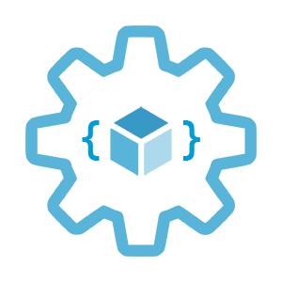

Monitoring options in AKS
Infrastructure as Code User Group Oslo
17.02.2022
with Evgeny Borzenin

Slide 2
Infrastructure as Code User Group roadmap
AKS workshops roadmap:
[x] AKS and Kubernetes 101
[x] Advanced AKS configuration
[x] Implement Immutable AKS Infrastructure on Azure with Bicep
[x] GitOps in AKS with Flux
[x] Scaling options for applications and clusters in AKS
[ ] Monitoring options in AKS
[ ] Landing Zones 101 (???)
[ ] Service mesh in AKS with linkerd
[ ] Security in AKS
+ “regular” events (work in progress)

Slide 3
Infrastructure as Code User Group roadmap
AKS workshops roadmap:
[x] AKS and Kubernetes 101
[x] Advanced AKS configuration
[x] Implement Immutable AKS Infrastructure on Azure with Bicep
[x] GitOps in AKS with Flux
[x] Scaling options for applications and clusters in AKS
[ ] Monitoring options in AKS
[ ] Landing Zones 101 (???)
[ ] Service mesh in AKS with linkerd
[ ] Security in AKS
+ “regular” events (work in progress)

Slide 4
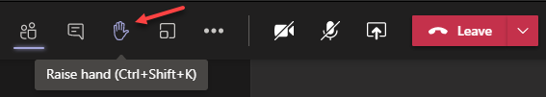
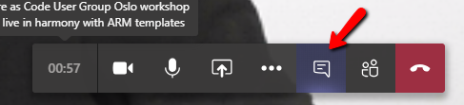

Microsoft Teams 101
Mute your mic (but don’t forget to unmute when you speak)
Feel free to use video
«Rise your hand» if you need some attention
Conversation/chat
Share screen

Slide 5
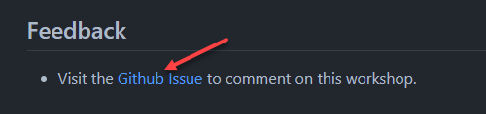
Practical information
Each lab is time-boxed (ish…)
When you done with lab, post to the Conversation channel
lab-01 (lab-02, lab-03 etc…)
Feel free to contribute to the labs content by fixing gramma, typos, wrong commands etc..
Feel free to comment on workshop main page

Slide 6
Monitoring in general

Slide 7
Monitoring
Infrastructure
Applications
Notes:
If you ask different people in your org what Monitoring means for them, you will get different perspective deneding who do you ask.
Ops, SRE guys will start talking about infra monitoring, CPU, RAM, DISK IO, Networking, Servers crashes,
Devs will talk about applications, exceptions, memory leaks,
DBA will start blame developers, that they write SQL without checking with them and that causes a table scan leading to the bad DB performance
Security will talk about firewal rules,
And Business will talk about business KPI, like number of purchases, number of new customers and new

Slide 8
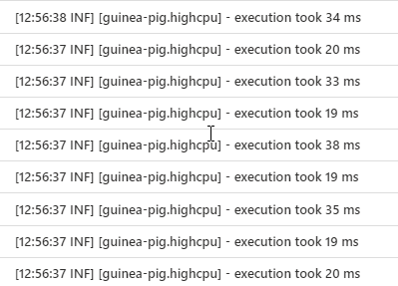
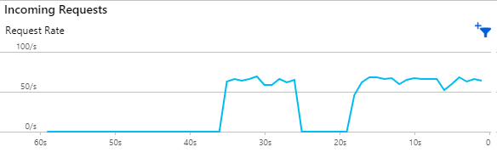
Monitoring
Logs
Metrics
Notes:
A log message is a system generated set of data when an event has happened to describe the event. In a log message is the log data. Log data are the details about the event such as a resource that was accessed, who accessed it, and the time. Each event in a system is going to have different sets of data in the message.
While logs are about a specific event, metrics are a measurement at a point in time for the system.
This unit of measure can have the value, timestamp, and identifier of what that value applies to (like a source or a tag).
Logs may be collected any time an event takes place, but metrics are typically collected at fixed-time intervals.
Sometimes metrics are implemented as logs with numeric values

Slide 9
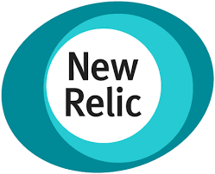



Monitoring
Logs
Metrics
Notes:
Quite often it’s different systems used to collect, vizualize and analyze logs and metrics

Slide 10
Monitoring
Monitoring platform
Monitors infra and apps 24/7
Alerts during outages
Reports for analysis

Slide 11
Monitoring options in AKS

Slide 12
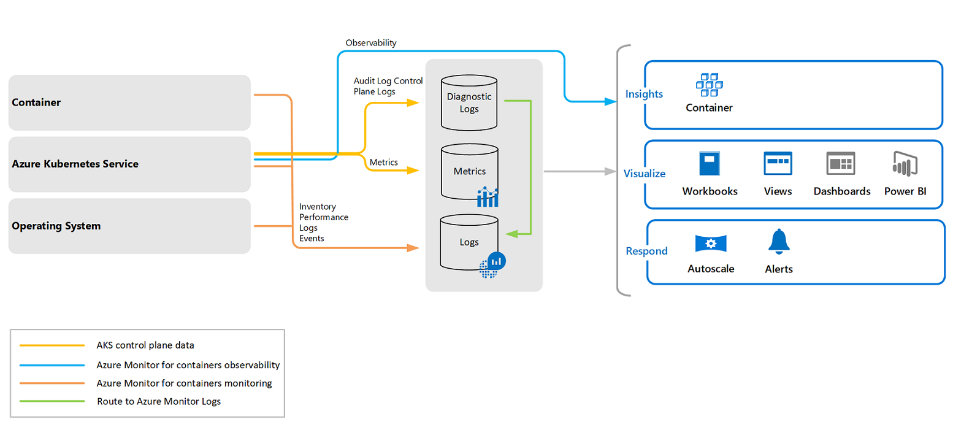
Container insights overview
Image is taken from: https://docs.microsoft.com/en-us/azure/azure-monitor/containers/container-insights-overview?WT.mc_id=AZ-MVP-5003837
Notes:
Container insights is a feature designed to monitor the performance of container workloads deployed to AKS:
Container insights supports clusters running the Linux and Windows Server 2019 operating system.
By default, Container insights is disabled and you need to enable it (portal, cli, powershell, ARM, Bicep etc)
Container insights gives you performance visibility by collecting memory and processor metrics from controllers, nodes, and containers.
Container logs are also collected.
Metrics and logs are automatically collected for you through a containerized version of the Log Analytics agent for Linux aka omsagent.
Metrics are written to the metrics store and log data is written to the logs store associated with your Log Analytics workspace.

Slide 13
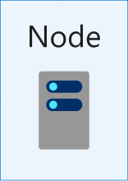
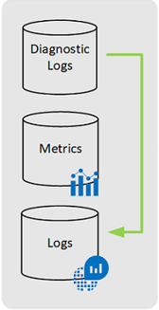
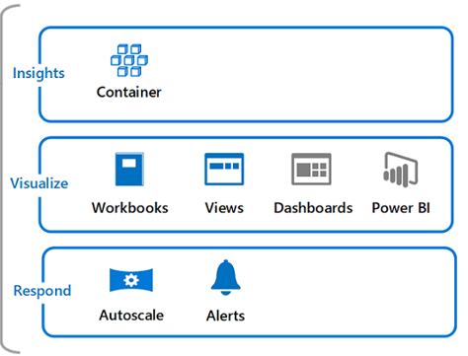
Container insights overview
omsagent
ConfigMap
omsagent
Image is taken from: https://docs.microsoft.com/en-us/azure/azure-monitor/containers/container-insights-overview?WT.mc_id=AZ-MVP-5003837
Notes:
Container insights is a feature designed to monitor the performance of container workloads deployed to AKS:
Container insights gives you performance visibility by collecting memory and processor metrics from controllers, nodes, and containers.
Container logs are also collected.
Container insights supports clusters running the Linux and Windows Server 2019 operating system.
By default, Container insights is disabled and you need to enable it (portal, cli, powershell, ARM, Bicep etc)
When CI enabled, Metrics and logs are automatically collected for you through a containerized version of the Log Analytics agent aka omsagent.
Metrics are written to the metrics store and log data is written to the logs store associated with your Log Analytics workspace.

Slide 14
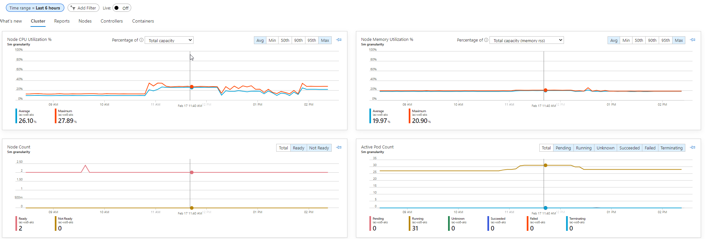
Container insights overview

Slide 15
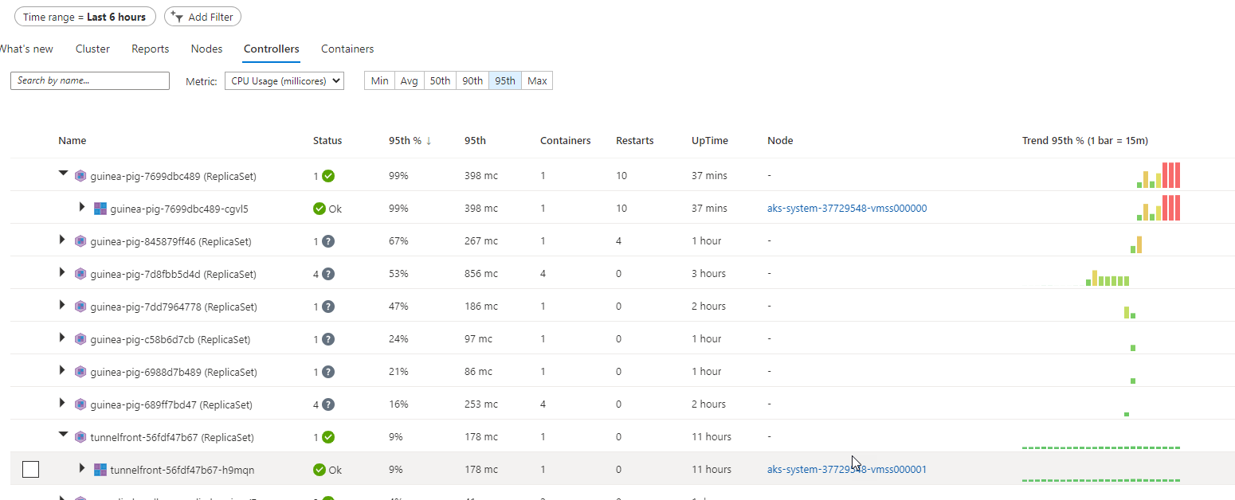
Container insights overview

Slide 16
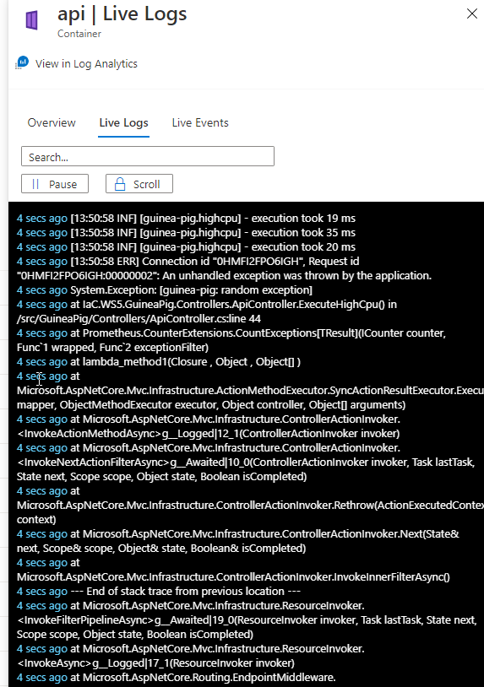
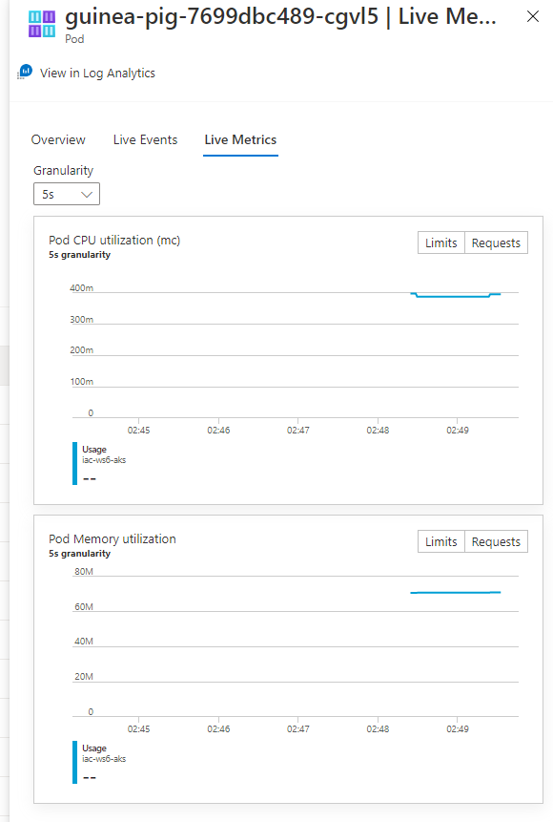
Container insights overview

Slide 17

What if monitoring platform already exists?

Slide 18
Splunk
hec
hec

Slide 19
Dynatrace
agent
dtagent

Slide 20
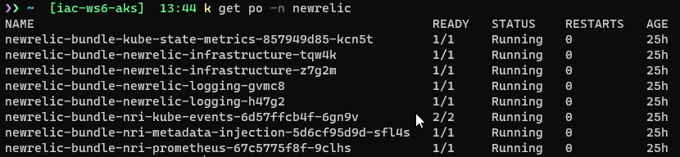
NewRelic
agent
dtagent

Slide 21
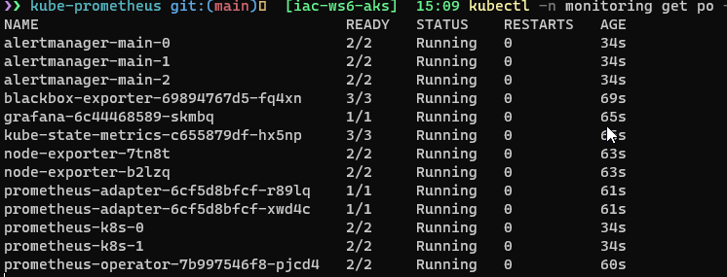
Prometheus + Grafana – in cluster
prometehus
grafana
alertmanager
Use port-forward

Slide 22




Securely expose Grafana with AGW + AAD
AAD
https://grafana.iac-labs.no/
AKS
AGW
Grafana service
or via ingress controler
grafana
backend
Http Listener

Slide 23
Prometheus in cluster + Grafana in cloud
Securely expose Thanos query endpoint with mTLS via Azure Application Gateway
https://foobar.grafana.net
Signup with SAML
AAD
https://prometheus.foobar.no/
AKS
AGW
Grafana cloud
Http Listener
Prometheus Data Source
with TLS client auth
prometheus
prometheus
backend
SSL policy
Dashboards
Client cert
Self-signed client certificate
CN= prometheus.foobar.no

Slide 24
Lab-01, 02, 03

Slide 25


