Slide 1
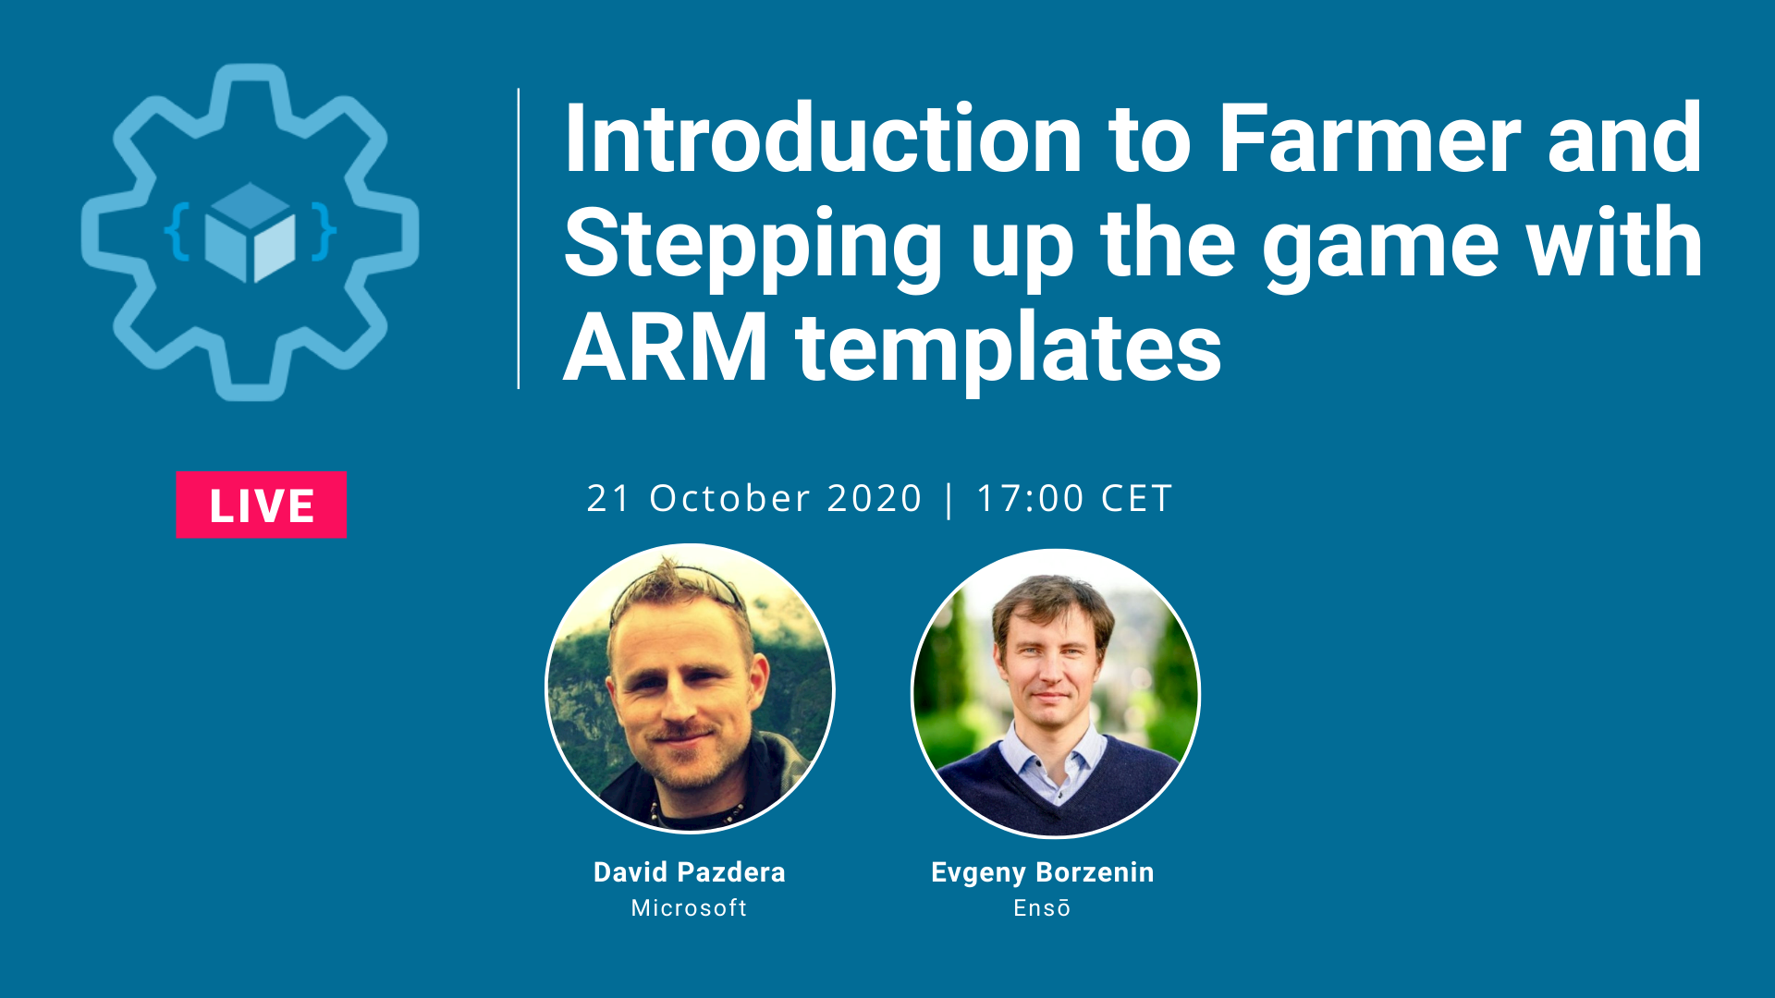

Slide 2


About Infrastructure as Code Oslo
Started at 2019
All about infrastructure
Infrastructure as Code
If you want to talk, contact me
https://www.meetup.com/Infrastructure-As-Code-User-Group-Oslo

Slide 3
2020
3 workshops – 2 ARM templates and Pulumi introduction
27.10.2020 - Workshop #4: Implement immutable infrastructure on Azure with Pulumi - Part II
November – Terraform 101
December – Implement immutable infrastructure on Azure with Terraform
Want to talk, contact me ☺
https://www.meetup.com/Infrastructure-As-Code-User-Group-Oslo

Slide 4
Practicalities
Write comments to the YouTube
If doesn’t work, write them to the Meetup Event comment

Slide 5



Learn how to create your first Azure Application https://aka.ms/learn-azure-dev
Get a Learner digital badge of Azure Heroes program https://aka.ms/digital-badge
Winner of “The best tech question” competition will receive a swagpack from Microsoft to your home address!
Don’t forget to add Microsoft Azure skill to your LinkedIn account to stay connected with a developer community
+ Microsoft Azure
We post the latest announces about free events for the developers in Norway on our official Twitter account
@MSDevNo
Notes:
All attendees of today's workshop are eligible to participate in the Azure Heroes program by Microsoft.
To claim your Azure Heroes Builder badge, please follow the instructions on this page:
https://beam.enjin.io/claim/4b8c0644ace62654ec57f96c2b106501
To learn more about IaC on Azure, please visit this page: https://aka.ms/AA8j7kg

