Slide 1





Automate
workload provisioning with Azure DevOps
Infrastructure as Code User Group Oslo
25.01.2023
with Evgeny Borzenin

Slide 2

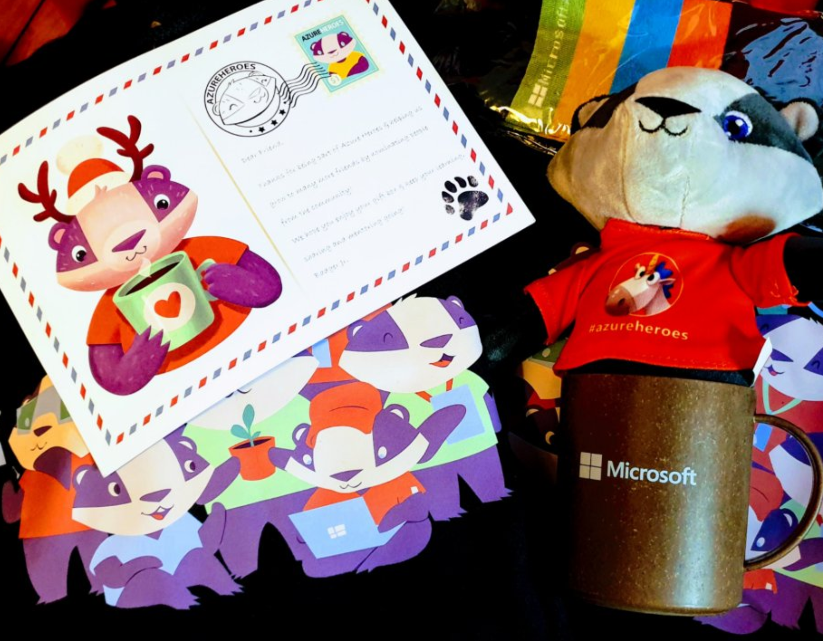
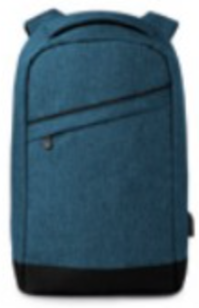


Guide on monitoring AKS using Azure Monitor: https://aka.ms/azure-aks
Get your next Learner digital badge of Azure Heroes program https://aka.ms/azure-heroes-badge
Win a cool Microsoft backpack!
Don’t forget to add Microsoft Azure skill to your LinkedIn account to stay connected with a developer community
+ Microsoft Azure
We post the latest announces about free events for the developers in Norway on our official Twitter account
@MSDevNo
Notes:
Our usergroup partners with Microsoft Norway
On this slide you’ll find a link to the documentation about AKS monitoring, and a link to claim your digital badge of the Azure Heroes program.
Also, Microsoft Norway has a tech twitter account where they announce their own and community-driven events for the developers – please follow @MSDevNo to stay updated.
Follow https://twitter.com/msdevno to not miss the events for the developers – to learn about Azure and to gather more Azure Heroes badges!

Slide 3
Infrastructure as Code User Group roadmap
AKS workshops roadmap:
[x] AKS and Kubernetes 101
[x] Advanced AKS configuration
[x] Implement Immutable AKS Infrastructure on Azure with Bicep
[x] GitOps in AKS with Flux
[x] Scaling options for applications and clusters in AKS
[ ] Monitoring options in AKS
[ ] Azure Landing Zones 101 (Not 100% decided yet)
[ ] Service mesh in AKS with linkerd
[ ] Security in AKS
“regular” events (work in progress)

Slide 4
Workshops in your organization
Infrastructure as Code (Bicep, ARM)
AKS workshops
Azure Cloud Adaptation Framework
Workshops can be adapted for your organization use-case
List of past workshops: https://borzenin.com/workshops/
Commercial offer from Enso AS
Contact me at evgeny@enso.no if any interest

Slide 5
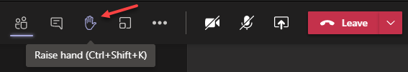
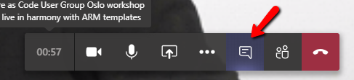

Microsoft Teams 101
Mute your mic (but don’t forget to unmute when you speak)
Feel free to use video
«Rise your hand» if you need some attention
Conversation/chat
Share screen

Slide 6
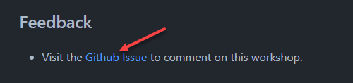
Practical information
Each lab is time-boxed (ish…)
When you done with lab, post to the Conversation channel
lab-01 (lab-02, lab-03 etc…)
Feel free to contribute to the labs content by fixing gramma, typos, wrong commands etc..
Feel free to comment on workshop main page

Slide 7


