Slide 1






Load-Balancing Options on Azure
Infrastructure as Code User Group Oslo
28.02.2023
with Evgeny Borzenin

Slide 2
Infrastructure as Code User Group roadmap
AKS workshops roadmap:
[x] 2021-2022 - AKS workshops 6 out of 8
[x] Automate workload provisioning with Azure DevOps
[ ] Load-balancing options on Azure
[ ] Automate Domains and SSL certificates management on Azure
[ ] Working with Azure Landing Zones
[ ] Working with Azure Container Apps
[ ] Azure API Management 101
[ ] Security in AKS
“regular” events - very unlikely ☺, but ping me if you have interesting topic to present

Slide 3
Workshops in your organization
Infrastructure as Code (Bicep, ARM, Automation with Azure DevOps and GitHub Actions)
AKS workshops
Workshops can be adapted for your organization use-case
List of past workshops: https://borzenin.com/workshops/
Commercial offer from Enso AS
Contact me at evgeny@enso.no if any interest

Slide 4
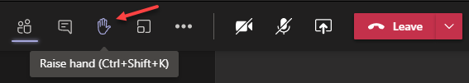
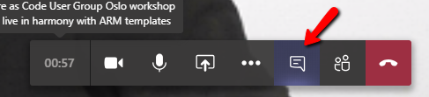

Microsoft Teams 101
Mute your mic (but don’t forget to unmute when you speak)
Feel free to use video
«Rise your hand» if you need some attention
Conversation/chat
Share screen

Slide 5

Practical information
Use the same naming conventions
When you done working with lab, post to the Conversation channel
lab-01 (lab-02, lab-03 etc…)
Feel free to contribute to the labs content
Feel free to left your comments on workshop main page

Slide 6
Load-Balancing Options on Azure

Slide 7

What is and why load balancing
Resource
Load
Balancer
Resource
Resource
Distibute workloads across multiple compute resources
Optimize resource use
Maximize throughput and minimize response time
Improve availability
Notes:
The term load balancing refers to the distribution of workloads across multiple computing resources.
Load balancing aims to optimize resource use, maximize throughput, minimize response time, and avoid overloading any single resource.
It can also improve availability by sharing a workload across redundant computing resources.
Central endpoint they can share

Slide 8
Load Load Balancing Options
Azure Load Balancer
Azure Application Gateway
Azure Traffic Manager
Azure Front Door
Notes:
Azure provides various load balancing services that you can use to distribute your workloads across multiple computing resources –
Load Balancer,
Application Gateway,
Front Door,
Traffic Manager.

Slide 9
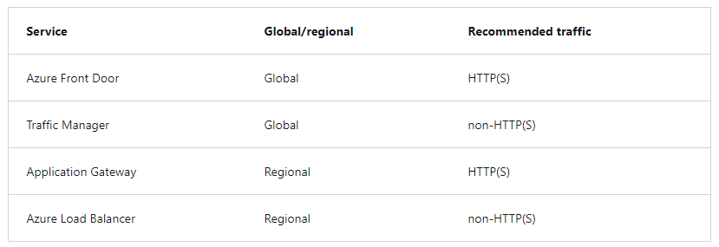
Service categorizations
Global versus regional
HTTP(S) versus non-HTTP(S)l
Notes:
Global
load-balancing services distribute traffic across regional backends, clouds, or hybrid on-premises services. These services route end-user traffic to the closest available backend. They also react to changes in service reliability or performance, in order to maximize availability and performance. You can think of them as systems that load balance between application stamps, endpoints, or scale-units hosted across different regions/geographies.
Regional
load-balancing services distribute traffic within virtual networks across virtual machines (VMs) or zonal and zone-redundant service endpoints within a region. You can think of them as systems that load balance between VMs, containers, or clusters within a region in a virtual network.
HTTP(S)
load-balancing services are Layer 7 load balancers that only accept HTTP(S) traffic. They are intended for web applications or other HTTP(S) endpoints. They include features such as SSL offload, web application firewall, path-based load balancing, and session affinity.
Non-HTTP/S load-balancing (Level 4), services can handle non-HTTP(S) traffic and are recommended for non-web workloads.

Slide 10
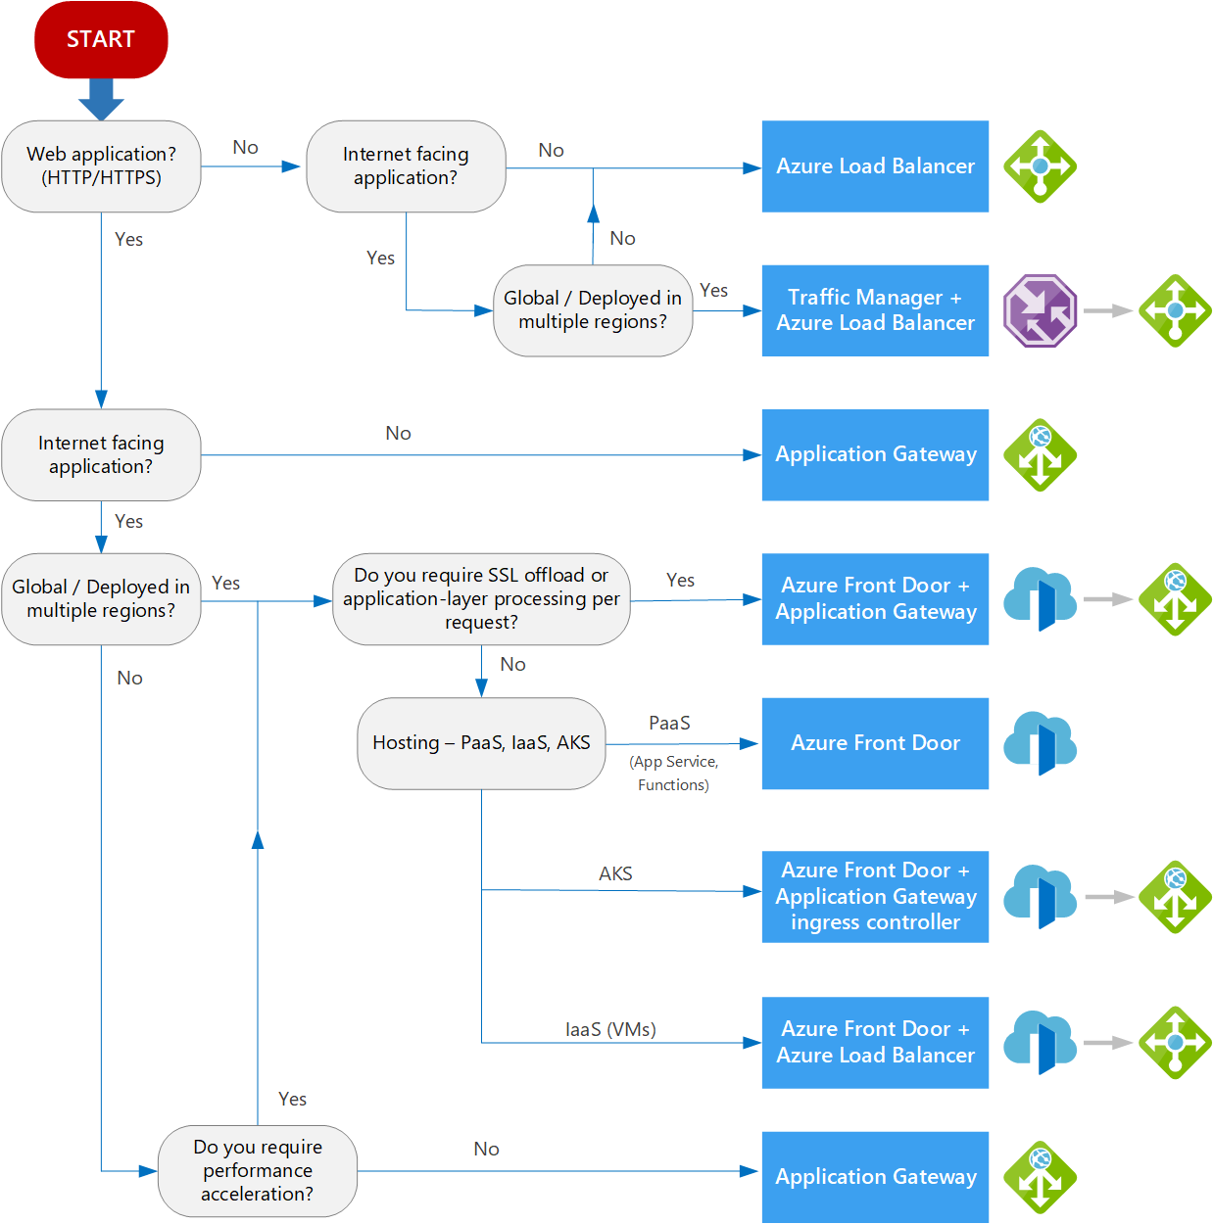
Decision tree

Slide 11
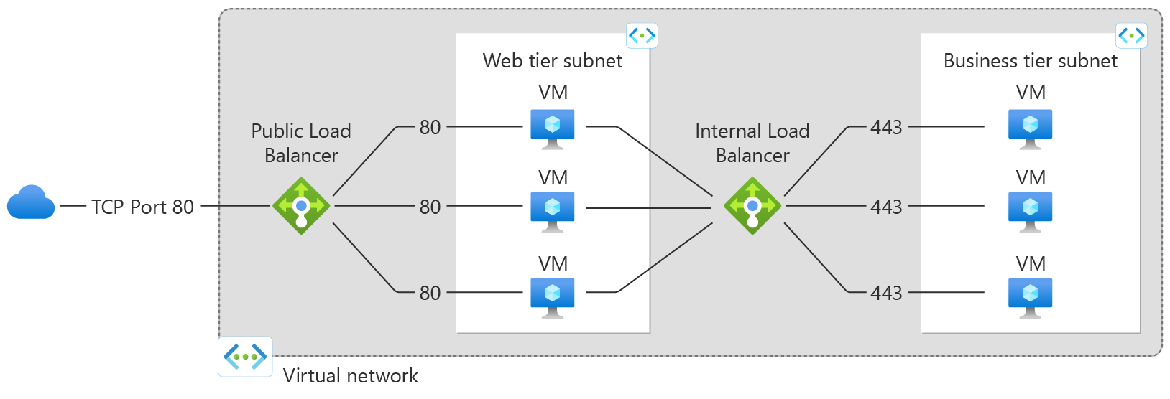
Azure Load Balancer
Regional, Level 4 (non HTTP(s))
Public and Private
Notes:
A public load balancer can provide outbound connections for virtual machines (VMs) inside your virtual network. These connections are accomplished by translating their private IP addresses to public IP addresses. Public Load Balancers are used to load balance internet traffic to your VMs.
An private load balancer
is used where private IPs are needed at the frontend only. Internal load balancers are used to load balance traffic inside a virtual network. A load balancer frontend can be accessed from an on-premises network in a hybrid scenario.

Slide 12
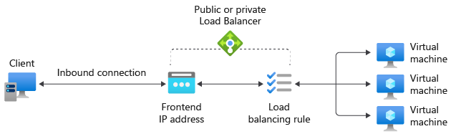
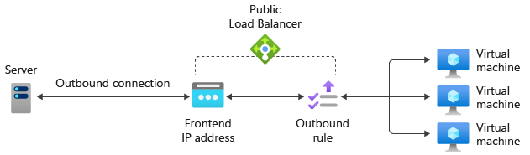
Azure Load Balancer components
Frontend IP Configuration
Backend pool
Health probes
Load Balancer Rules
Outbound rules
Images are from: https://learn.microsoft.com/en-us/azure/load-balancer/components
Notes:
Frontend IP configuration
The IP address of your Azure Load Balancer. It's the point of contact for clients. These IP addresses can be either:
Public IP Address
Private IP Address
Backend pool
The group of virtual machines or instances in a virtual machine scale set that is serving the incoming request.
Health probes
A health probe is used to determine the health status of the instances in the backend pool.
Load Balancer rules
A load balancer rule is used to define how incoming traffic is distributed to all the instances within the backend pool. A load-balancing rule maps a given frontend IP configuration and port to multiple backend IP addresses and ports. Load Balancer rules are for inbound traffic only.

Slide 13
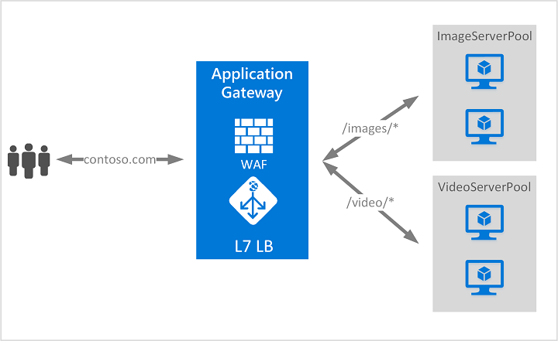
Azure Application Gateway
Regional, Level 7 - HTTP(s)
URL-based routing
Rewrite HTTP headers and URL
Autoscaling
Redirection
SSL offload + mTLS
Web Application Firewall
Ingress Controller for AKS
Session affinity
Multiple-site hosting
Connection draining
Notes:
Azure Application Gateway is a web traffic load balancer that enables you to manage traffic to your web applications. Application Gateway can make routing decisions based on additional attributes of an HTTP request, for example URI path or host headers.
For example, you can route traffic based on the incoming URL. So if /images is in the incoming URL, you can route traffic to a specific set of servers (known as a pool) configured for images. If /video is in the URL, that traffic is routed to another pool that's optimized for videos.
URL-based routing
URL Path Based Routing allows you to route traffic to backend server pools based on URL Paths of the request. One of the scenarios is to route requests for different content types to different pool.
For example, requests for http://contoso.com/videos/* are routed to VideoServerPool, and http://contoso.com/images/* are routed to ImageServerPool. DefaultServerPool is selected if none of the path patterns match.
Rewrite HTTP headers and URL
HTTP headers allow the client and server to pass additional information with the request or the response. Rewriting these HTTP headers helps you accomplish several important scenarios, such as:
Adding security-related header fields like HSTS/ X-XSS-Protection.
Removing response header fields that can reveal sensitive information.
Stripping port information from X-Forwarded-For headers.
Application Gateway and WAF v2 SKU supports the capability to add, remove, or update HTTP request and response headers, while the request and response packets move between the client and backend pools. You can also rewrite URLs, query string parameters and host name. With URL rewrite and URL path-based routing, you can choose to either route requests to one of the backend pools based on the original path or the rewritten path, using the re-evaluate path map option.
It also provides you with the capability to add conditions to ensure the specified headers or URL are rewritten only when certain conditions are met. These conditions are based on the request and response information.
Web Application Firewall
Web Application Firewall (WAF) is a service that provides centralized protection of your web applications from common exploits and vulnerabilities. WAF is based on rules from the OWASP (Open Web Application Security Project) core rule sets 3.1 (WAF_v2 only), 3.0, and 2.2.9.
Connection draining
Connection draining helps you achieve graceful removal of backend pool members during planned service updates. This setting is enabled via the backend http setting and can be applied to all members of a backend pool during rule creation. Once enabled, Application Gateway ensures all deregistering instances of a backend pool don't receive any new request while allowing existing requests to complete within a configured time limit. This applies to both backend instances that are explicitly removed from the backend pool by a user configuration change, and backend instances that are reported as unhealthy as determined by the health probes. The only exception to this are requests bound for deregistering instances, which have been deregistered explicitly, because of gateway-managed session affinity and continues to be proxied to the deregistering instances.

Slide 14
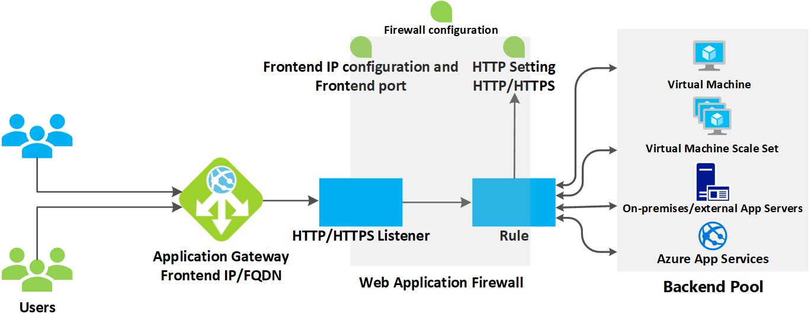
Azure Application Gateway components
Frontend IP addresses
Public
private
Listeners
Basic
Multi-site
Request routing rules
Basic
Path-based
HTTP settings
Backend pools
Notes:
Frontend IP addresses
A frontend IP address is the IP address associated with an application gateway. You can configure an application gateway to have a public IP address, a private IP address, or both. An application gateway supports one public or one private IP address. Your virtual network and public IP address must be in the same location as your application gateway. After it's created, a frontend IP address is associated with a listener.
Listeners
A listener is a logical entity that checks for incoming connection requests. A listener accepts a request if the protocol, port, hostname, and IP address associated with the request match the same elements associated with the listener configuration.
Before you use an application gateway, you must add at least one listener. There can be multiple listeners attached to an application gateway, and they can be used for the same protocol.
After a listener detects incoming requests from clients, the application gateway routes these requests to members in the backend pool configured in the rule.
Basic. This type of listener listens to a single domain site, where it has a single DNS mapping to the IP address of the application gateway. This listener configuration is required when you host a single site behind an application gateway.
Multi-site. This listener configuration is required when you want to configure routing based on host name or domain name for more than one web application on the same application gateway. It allows you to configure a more efficient topology for your deployments by adding up to 100+ websites to one application gateway. Each website can be directed to its own backend pool. For example, three domains, contoso.com, fabrikam.com, and adatum.com, point to the IP address of the application gateway. You'd create three multi-site listeners and configure each listener for the respective port and protocol setting.
Backend pools
A backend pool routes request to backend servers, which serve the request. Backend pools can contain:
NICs
Virtual machine scale sets
Public IP addresses
Internal IP addresses
FQDN
App Service
Application Gateway backend pool members aren't tied to an availability set. An application gateway can communicate with instances outside of the virtual network that it's in. As a result, the members of the backend pools can be across clusters, across datacenters, or outside Azure, as long as there's IP connectivity.
An application gateway can also communicate with on-premises servers when they're connected by Azure ExpressRoute or VPN tunnels if traffic is allowed.
You can create different backend pools for different types of requests. For example, create one backend pool for general requests, and then another backend pool for requests to the microservices for your application.
Request routing rules
A request routing rule is a key component of an application gateway because it determines how to route traffic on the listener. The rule binds the listener, the backend server pool, and the backend HTTP settings.
When a listener accepts a request, the request routing rule forwards the request to the backend or redirects it elsewhere. If the request is forwarded to the backend, the request routing rule defines which backend server pool to forward it to. The request routing rule also determines if the headers in the request are to be rewritten. One listener can be attached to one rule.
There are two types of request routing rules:
Basic. All requests on the associated listener (for example, blog.contoso.com/*) are forwarded to the associated backend pool by using the associated HTTP setting.
Path-based. This routing rule lets you route the requests on the associated listener to a specific backend pool, based on the URL in the request. If the path of the URL in a request matches the path pattern in a path-based rule, the rule routes that request. It applies the path pattern only to the URL path, not to its query parameters. If the URL path on a listener request doesn't match any of the path-based rules, it routes the request to the default backend pool and HTTP settings.
HTTP settings
An application gateway routes traffic to the backend servers (specified in the request routing rule that include HTTP settings) by using the port number, protocol, and other settings detailed in this component.
The port and protocol used in the HTTP settings determine whether the traffic between the application gateway and backend servers is encrypted (providing end-to-end TLS) or unencrypted.
Health probes
By default, an application gateway monitors the health of all resources in its backend pool and automatically removes unhealthy ones. It then monitors unhealthy instances and adds them back to the healthy backend pool when they become available and respond to health probes.
In addition to using default health probe monitoring, you can also customize the health probe to suit your application's requirements. Custom probes allow more granular control over the health monitoring. When using custom probes, you can configure a custom hostname, URL path, probe interval, and how many failed responses to accept before marking the backend pool instance as unhealthy, custom status codes and response body match, etc. We recommend that you configure custom probes to monitor the health of each backend pool.

Slide 15
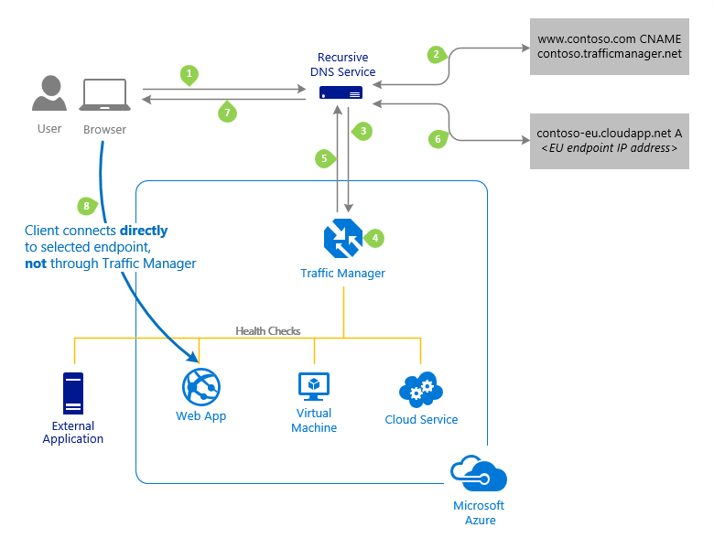
Azure Traffic Manager
Global, non-HTTP(S)
DNS-based traffic load balancer
Increase application availability
Improve application performance
Combine hybrid applications
Service maintenance without downtime
Distribute traffic for complex deployments
Notes:
Azure Traffic Manager is a DNS-based traffic load balancer. This service allows you to distribute traffic to your public facing applications across the global Azure regions. Traffic Manager also provides your public endpoints with high availability and quick responsiveness.
Traffic Manager uses DNS to direct client requests to the appropriate service endpoint based on a traffic-routing method. Traffic manager also provides health monitoring for every endpoint. The endpoint can be any Internet-facing service hosted inside or outside of Azure.
Traffic Manager provides a range of traffic-routing methods and endpoint monitoring options to suit different application needs and automatic failover models.
Traffic Manager is resilient to failure, including the failure of an entire Azure region.

Slide 16
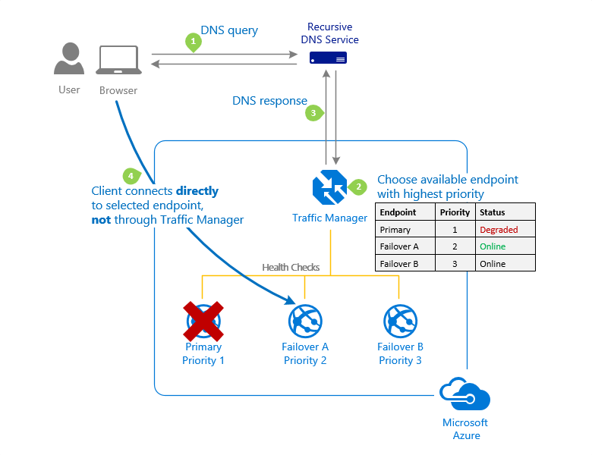
Priority traffic-routing method
Use-cases:
DR Failover
Notes:
Often an organization wants to provide reliability for their services. To do so, they deploy one or more backup services in case their primary goes down.
The 'Priority' traffic-routing method allows Azure customers to easily implement this failover pattern.
The Traffic Manager profile contains a prioritized list of service endpoints. By default, Traffic Manager sends all traffic to the primary (highest-priority) endpoint. If the primary endpoint isn't available, Traffic Manager routes the traffic to the second endpoint. In a situation where the primary and secondary endpoints aren't available, the traffic goes to the third, and so on. Availability of the endpoint is based on the configured status (enabled or disabled) and the ongoing endpoint monitoring.

Slide 17
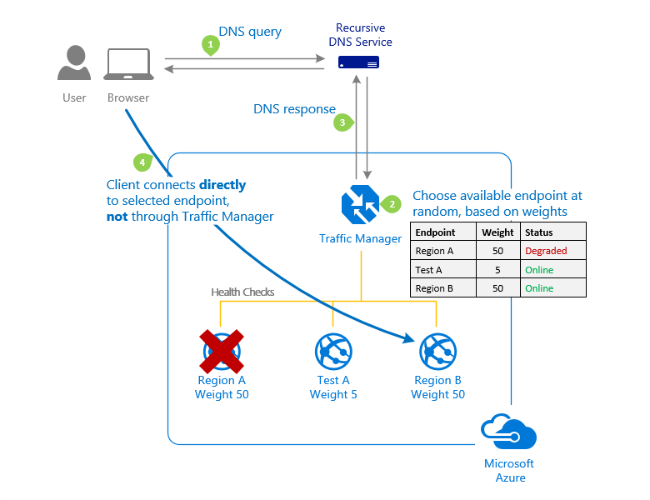
Weighted traffic-routing method
Use-cases:
Gradual application upgrade
Migration to Azure
Cloud-bursting for more capacity
Notes:
The 'Weighted' traffic-routing method allows you to distribute traffic evenly or to use a pre-defined weighting.
In the Weighted traffic-routing method, you assign a weight to each endpoint in the Traffic Manager profile configuration. The weight is an integer from 1 to 1000. This parameter is optional. If omitted, Traffic Managers uses a default weight of '1'. The higher weight, the higher the priority.
For each DNS query received, Traffic Manager randomly chooses an available endpoint. The probability of choosing an endpoint is based on the weights assigned to all available endpoints. Using the same weight across all endpoints results in an even traffic distribution. Using higher or lower weights on specific endpoints causes those endpoints to be returned more or less frequently in the DNS responses.
The weighted method enables some useful scenarios:
Gradual application upgrade: Given a percentage of traffic to route to a new endpoint, and gradually increase the traffic over time to 100%.
Application migration to Azure: Create a profile with both Azure and external endpoints. Adjust the weight of the endpoints to prefer the new endpoints.
Cloud-bursting for more capacity: Quickly expand an on-premises deployment into the cloud by putting it behind a Traffic Manager profile. When you need extra capacity in the cloud, you can add or enable more endpoints and specify what portion of traffic goes to each endpoint.

Slide 18
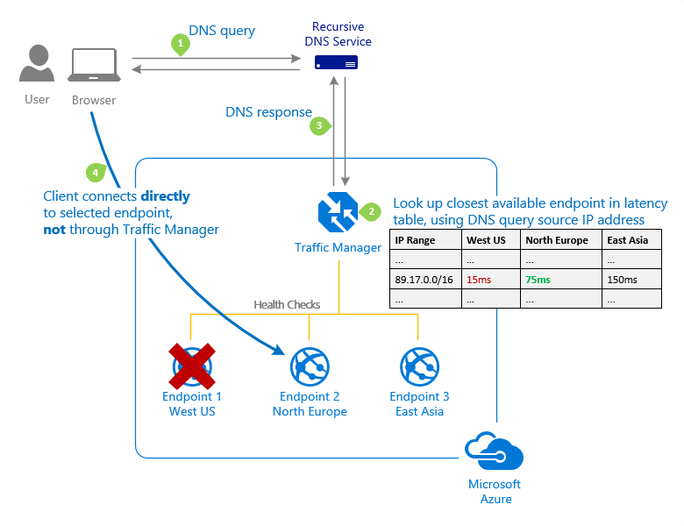
Performance traffic-routing method
Use-cases:
Improve application performance
Notes:
Deploying endpoints in two or more locations across the globe can improve the responsiveness of your applications. With the 'Performance' traffic-routing method, you can route traffic to the location that is 'closest' to you.
The 'closest' endpoint isn't necessarily closest as measured by geographic distance. Instead, the 'Performance' traffic-routing method determines the closest endpoint by measuring network latency. Traffic Manager maintains an Internet Latency Table to track the round-trip time between IP address ranges and each Azure datacenter.
Traffic Manager looks up the source IP address of the incoming DNS request in the Internet Latency Table. Traffic Manager then chooses an available endpoint in the Azure datacenter that has the lowest latency for that IP address range. Then Traffic Manager returns that endpoint in the DNS response.
Traffic Manager doesn't receive DNS queries directly from clients. Instead, DNS queries come from the recursive DNS service that the clients are configured to use. As such, the IP address used to determine the 'closest' endpoint isn't the client's IP address, but it's the IP address of the recursive DNS service. This IP address is a good proxy for the client.
Traffic Manager regularly updates the Internet Latency Table to account for changes in the global Internet and new Azure regions. However, application performance varies based on real-time variations in load across the Internet. Performance traffic-routing doesn't monitor load on a given service endpoint. If an endpoint becomes unavailable, Traffic Manager won't include it in the DNS query responses.

Slide 19

Nested Traffic Manager profiles
Priority
1
2
Weighted
Weighted
10
90
100
Norway
East
West
Europe
vNext
Active
Active
Notes:
Each Traffic Manager profile specifies a single traffic-routing method. However, there are scenarios that require more sophisticated traffic routing than the routing provided by a single Traffic Manager profile. You can nest Traffic Manager profiles to combine the benefits of more than one traffic-routing method. Nested profiles allow you to override the default Traffic Manager behavior to support larger and more complex application deployments.

Slide 20
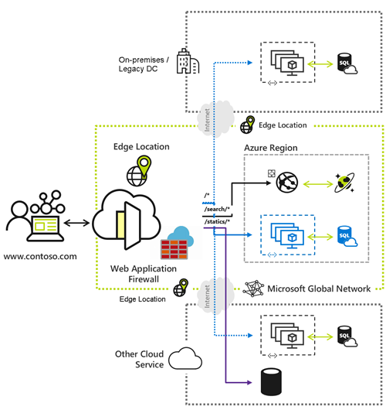
Azure Front Door
Global, HTTP(S)
Deliver your app and content globally
Accelerate application performance
Terminate SSL offload
Integrated certificate management
Custom domains
Security
WAF
Private Link
Notes:
Azure Front Door is Microsoft’s modern cloud Content Delivery Network (CDN) that provides fast, reliable, and secure access between your users and your applications’ static and dynamic web content across the globe.
Azure Front Door delivers your content using the Microsoft’s global edge network with hundreds of global and local points of presence (PoPs) distributed around the world close to both your enterprise and consumer end users.

Slide 21
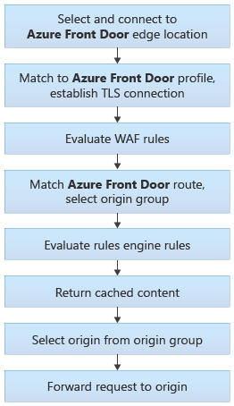
Azure Front Door components
Endpoints
Origins and origin groups
Routing
Rules
Notes:
endpoints
an endpoint is a logical grouping of one or more routes that are associated with domain names. Each endpoint is assigned a domain name by Front Door, and you can associate your own custom domains by using routes.
Origin
An origin refers to the application deployment that Azure Front Door will retrieve contents from when caching isn't enabled or when a cache gets missed.
Azure Front Door supports origins hosted in Azure as well as applications hosted in your on-premises datacenter or with another cloud provider.
The origin should be viewed as the endpoint for your application backend.
Origin group
A set of origins that receives similar traffic for their application. You can define the origin group as a logical grouping of your application instances across the world that receives the same traffic and responds with an expected behavior.
Routing
Front Door traffic routing takes place over multiple stages. First, traffic is routed from the client to Front Door. Then, Front Door uses your configuration to determine the origin to send the traffic to. The Front Door web application firewall, routing rules, rules engine, and caching configuration all affect the routing process.
Rules
A Rule set is a customized rules engine that groups a combination of rules into a single set. You can associate a Rule Set with multiple routes. The Rule set allows you to customize how requests get processed at the edge, and how Azure Front Door handles those requests.
Common supported scenarios
Implementing security headers to prevent browser-based vulnerabilities like HTTP Strict-Transport-Security (HSTS), X-XSS-Protection, Content-Security-Policy, X-Frame-Options, and Access-Control-Allow-Origin headers for Cross-Origin Resource Sharing (CORS) scenarios. Security-based attributes can also be defined with cookies.
Route requests to mobile or desktop versions of your application based on the client device type.
Rewrite the request URL path and forwards the request to the appropriate origin in your configured origin group.
Add, modify, or remove request/response header to hide sensitive information or capture important information through headers.

Slide 22
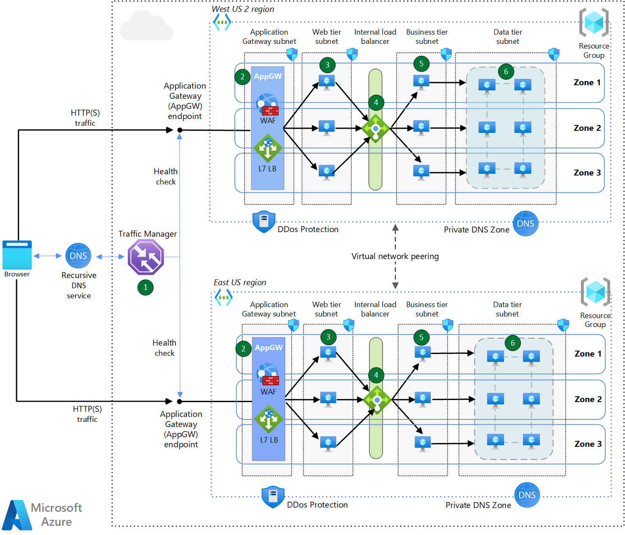
Combile Load Balancers
Multi-region load balancing with Traffic Manager and Application Gateway

Slide 23
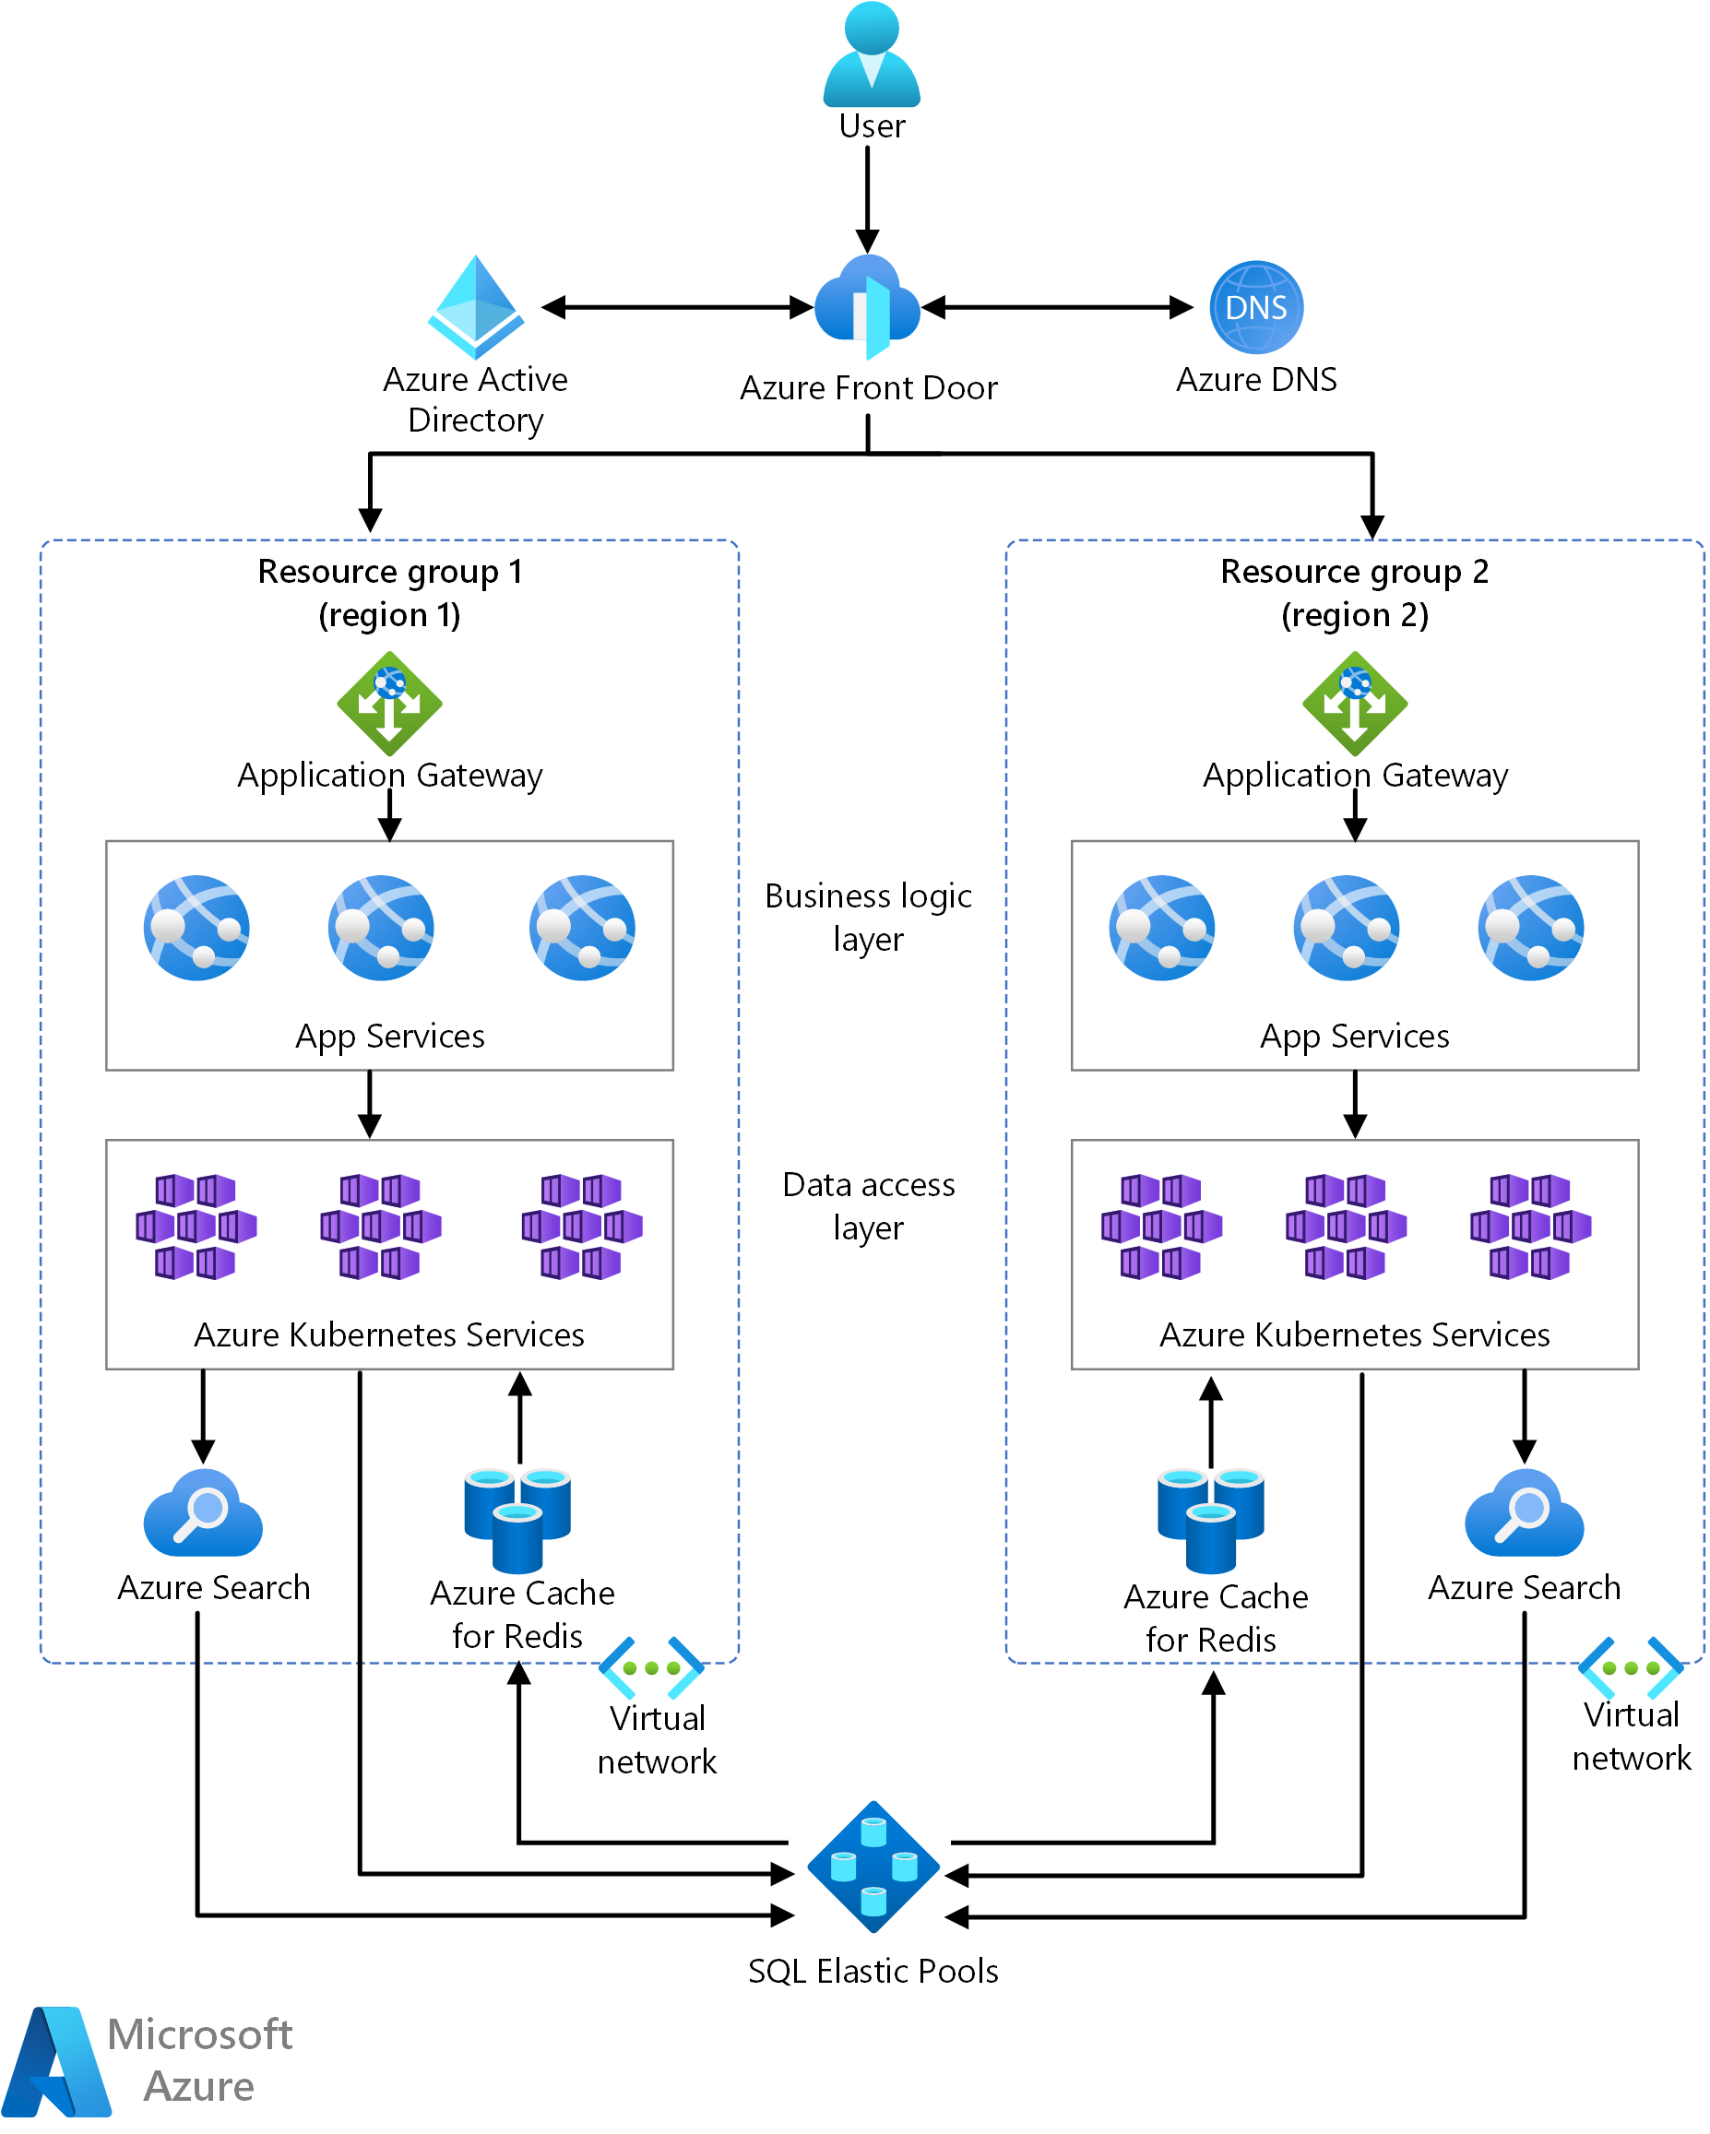
Combile Load Balancers
Multitenant SaaS on Azure

Slide 24
Questions?

Slide 25
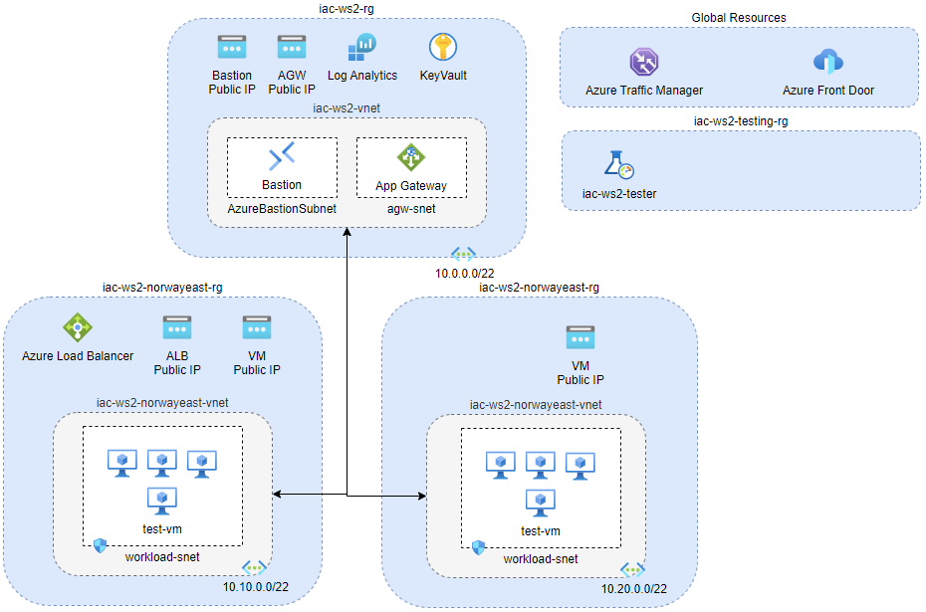
Lab-01: preprovision labs infratsructure

Slide 26
Lab-01: preprovision labs infratsructure
3 peered Virtual networks
Bastion to securely remote into VMs
KeyVault to keep VM admin password
2 regions
4 VMs used at lab-02 - ALB
4 VMs used at lab-03 - AGW
2 public VMs used at lab-04 and lab-05
Azure Lad Testing to generate some load

Slide 27

Lab-01: preprovision labs infratsructure
Virtual Machine configuration
All workload VMs have IIS installed using
iac/lab-01/scripts/iis-eastus.ps1
iac/lab-01/scripts/ iis-norwayeast.ps1
scripts

Slide 28


