Slide 1
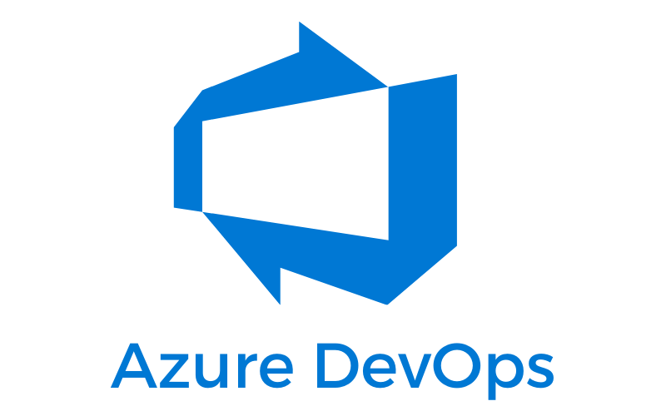




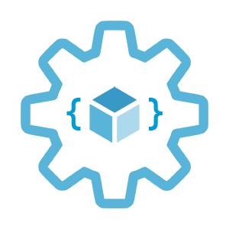

Automate DNS
and Certificate management on Azure
with Azure DevOps
Infrastructure as Code User Group Oslo
30.03.2023
with Evgeny Borzenin

Slide 2
Infrastructure as Code User Group roadmap
IaC workshops roadmap:
[x] 2021-2022 - AKS workshops 6 out of 8
[x] Automate workload provisioning with Azure DevOps
[x] Load-balancing options on Azure
[ ] Automate DNS and certificates management on Azure
[ ] Azure Landing Zones 101
[ ] Working with Azure Container Apps
[ ] Azure API Management 101
[ ] Security in AKS
“regular” events - very unlikely ☺, but ping me if you have interesting topic to present

Slide 3
Workshops in your organization
Infrastructure as Code (Bicep, ARM, Azure Landing Zones, Automation with Azure DevOps or GitHub Actions)
AKS workshops
Workshops can be adapted for your organization use-case
List of past workshops: https://borzenin.com/workshops/
Commercial offer from Enso AS
Contact me at evgeny@enso.no if any interest

Slide 4
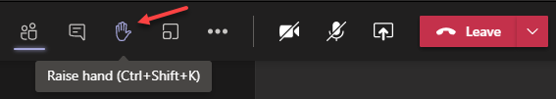
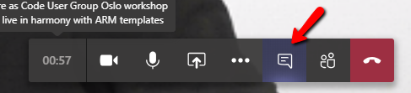

Microsoft Teams 101
Mute your mic (but don’t forget to unmute when you speak)
Feel free to use video
«Rise your hand» if you need some attention
Conversation/chat
Share screen

Slide 5
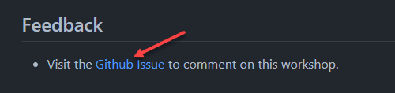
Practical information
Use the same naming conventions
When you done working with lab, post to the Conversation channel
lab-01 (lab-02, lab-03 etc…)
Feel free to contribute to the labs content
Feel free to left your comments on workshop main page

Slide 6
DNS
and Certificate options on Azure

Slide 7
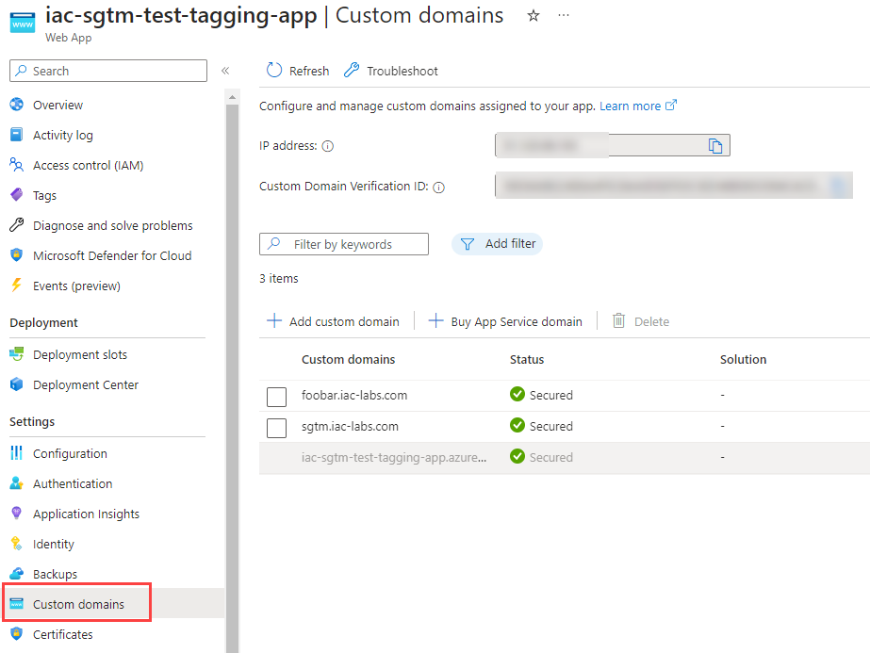
Domains and SSL certificates
Azure Publicly faced resource
capp.wittyriver-af3c9fa9.norwayeast.azurecontainerapps.io
azure-func.azurewebsites.net
web-app.azurewebsites.net
Custom domains
Bring your own Domain name
SSL certificate
Managed by App Service
Bring your own

Slide 8
Domain names 101
Domain Name System (DNS) is a hierarchy of domains
Root (.) -> top-level (.com, .uk) -> second-level (org.uk)
Globally distributed and hosted by DNS name servers
Domain name registrar (GoDaddy)
host the domain in its own name servers (NS)
allows you to specify alternative NS
DNS records (bar.com)
Record name
foo -> foo.bar.com
Record type
A - IPv4: 10.10.0.1 -> nslookup foo.bar.com -> 10.10.0.1
CNAME – domain: www.foobar.com -> nslookup foo.bar.com -> www.foobar.com
TXT
Notes:
The Domain Name System is a hierarchy of domains. The hierarchy starts from the 'root' domain, whose name is simply '.'. Below this come top-level domains, such as 'com', 'net', 'org', 'uk' or 'jp'. Below the top-level domains are second-level domains, such as 'org.uk' or 'co.jp'. The domains in the DNS hierarchy are globally distributed, hosted by DNS name servers around the world.
A domain name registrar is an organization that allows you to purchase a domain name, such as contoso.com. Purchasing a domain name gives you the right to control the DNS hierarchy under that name, for example allowing you to direct the name www.contoso.com to your company web site. The registrar may host the domain in its own name servers on your behalf or allow you to specify alternative name servers.
TXT records are used to map domain names to arbitrary text strings.

Slide 9
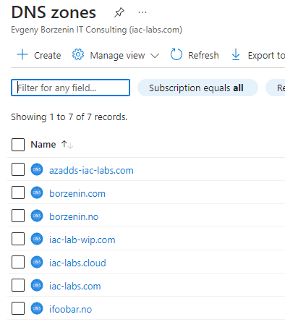
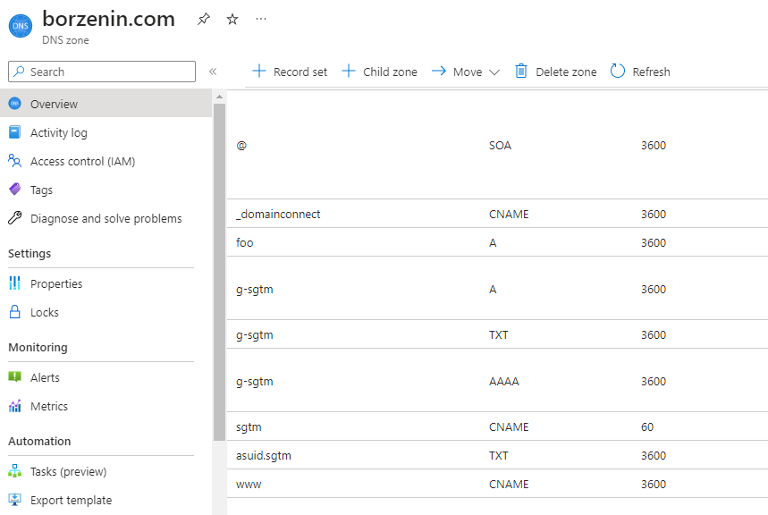
Azure DNS Zone
Azure DNS globally distributed name server infrastructure
Azure DNS is not registrar
Purchase DNS from registrar
Delegate Domain to Azure DNS
used to host the DNS records for a particular domain
Notes:
Azure DNS provides a globally distributed and high-availability name server infrastructure that you can use to host your domain.
By hosting your domains in Azure DNS, you can manage your DNS records with the same credentials, APIs, tools, billing, and support as your other Azure services.
Azure DNS currently doesn't support purchasing of domain names.
If you want to purchase a domain name, you need to use a third-party domain name registrar. The registrar typically charges a small annual fee. The domains can then be hosted in Azure DNS for management of DNS records. See Delegate a Domain to Azure DNS for details.

Slide 10
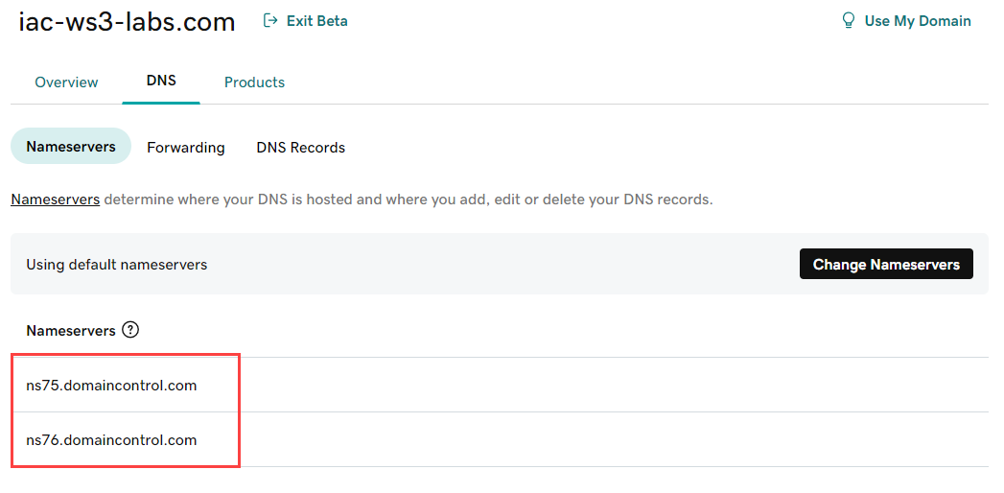
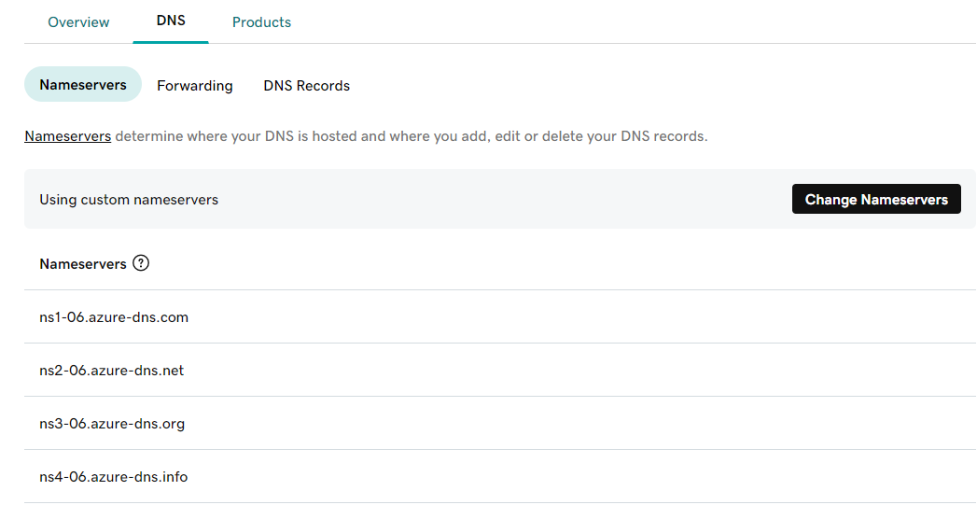
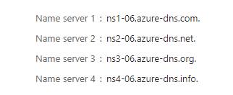
Delegation of DNS zones with Azure DNS
Purchase domain from registrar -> iac-ws3-labs.com
Create new DNS Zone -> iac-ws3-labs.com
Change Name Servers at registrar with DNS Zone Name Servers

Slide 11
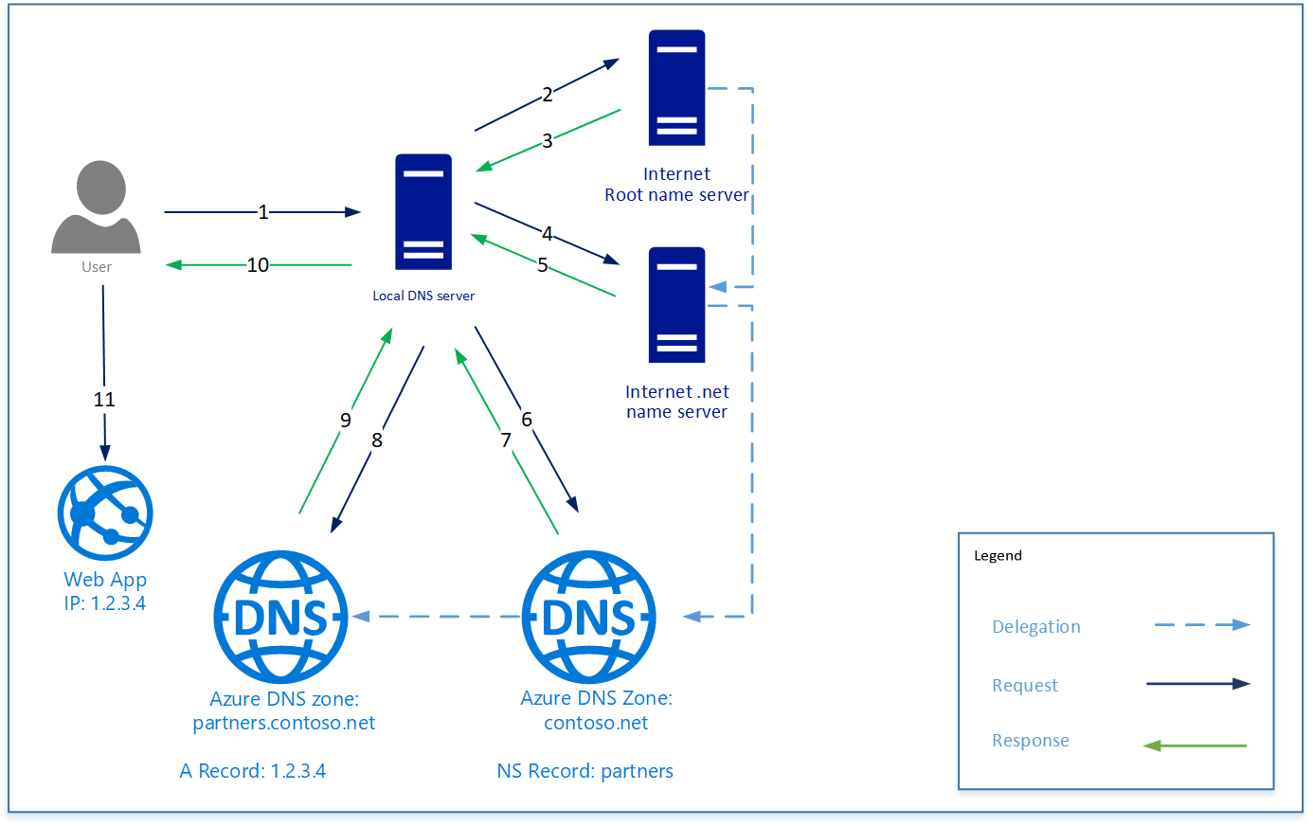
Resolution and delegation
www.partners.contoso.net
Notes:
The client requests www.partners.contoso.net from their local DNS server.
The local DNS server doesn't have the record so it makes a request to their root name server.
The root name server doesn't have the record, but knows the address of the .net name server, it provides that address to the DNS server
The local DNS server sends the request to the .net name server.
The .net name server doesn't have the record but does know the address of the contoso.net name server. In this case, it responds with the address of the name server for the DNS zone hosted in Azure DNS.
The local DNS server sends the request to the name server for the contoso.net zone hosted in Azure DNS.
The zone contoso.net doesn't have the record but knows the name server for partners.contoso.net and responds with the address. In this case, it's a DNS zone hosted in Azure DNS.
The local DNS server sends the request to the name server for the partners.contoso.net zone.
The partners.contoso.net zone has the A record and responds with the IP address.
The local DNS server provides the IP address to the client
The client connects to the website www.partners.contoso.net.

Slide 12
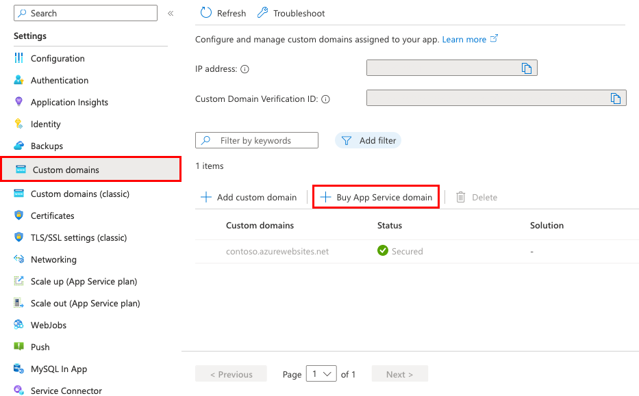
Buy App Service Domains on Azure
use GoDaddy for domain registration
Support top-level domains com, net, co.uk, org, nl, in, biz, org.uk, and co.in

Slide 13
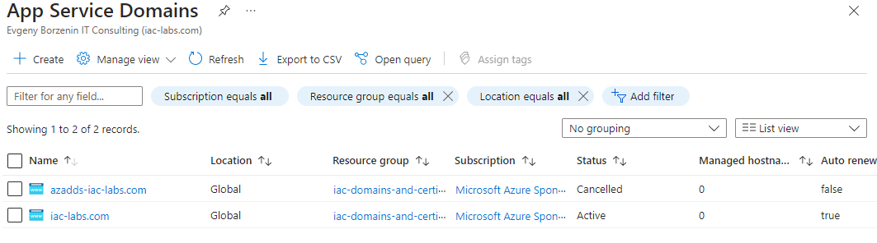
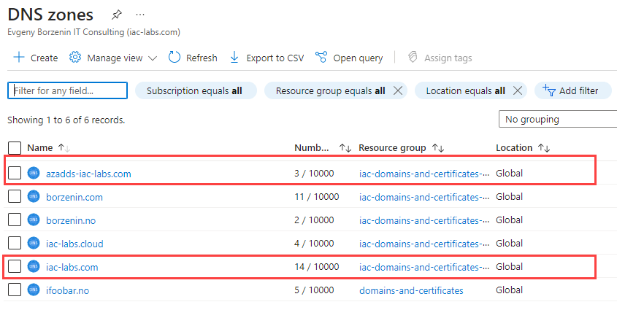
Buy App Service Domains on Azure

Slide 14
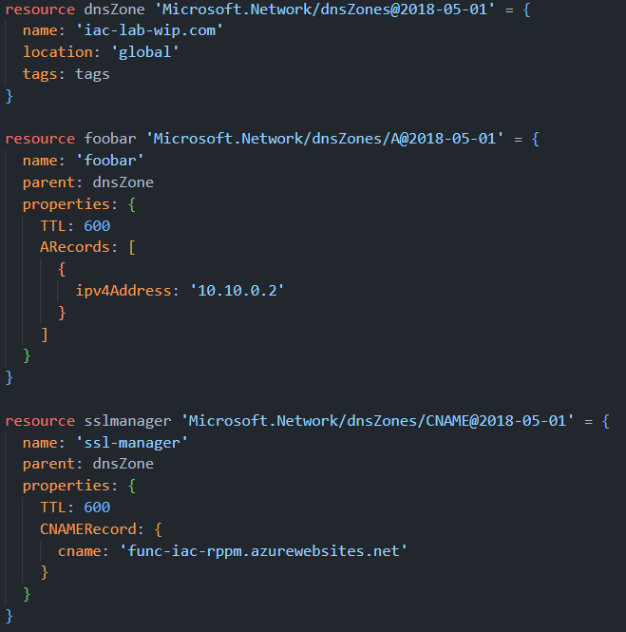
Automate DNS records management on Azure
DNS Zone
Azure resource
Bicep, Terraform, Pulumi etc...
DNS Record is a resource

Slide 15
Automate DNS records management on Azure
Dev team needs new DNS record
PR into DNS Zone fine
Platform team review and approve PR
CI/CD deploys changes to the DNS Zone
Use Tags to assosiate deployment with PR
Audit and trasability
Easy to rollback changes
Bicep: can’t delete records

Slide 16
TLS/SSL options available on Azure
Create a free managed certificate
Buy and import App Service certificate
Upload a private certificate

Slide 17
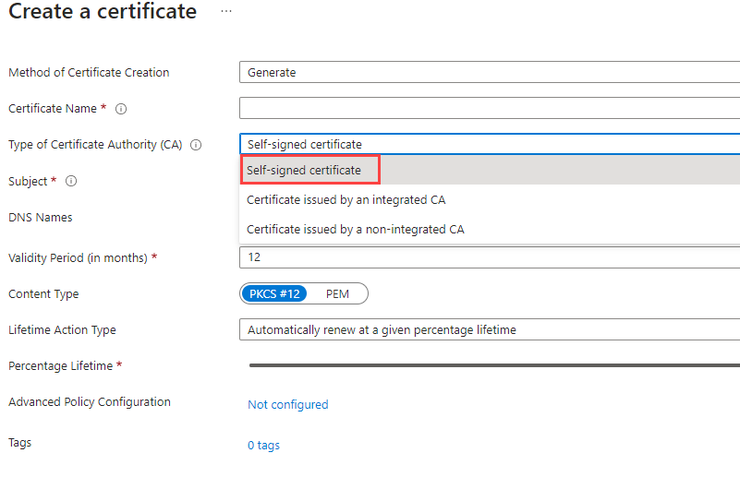
Certificates in Key Vault – self signed

Slide 18
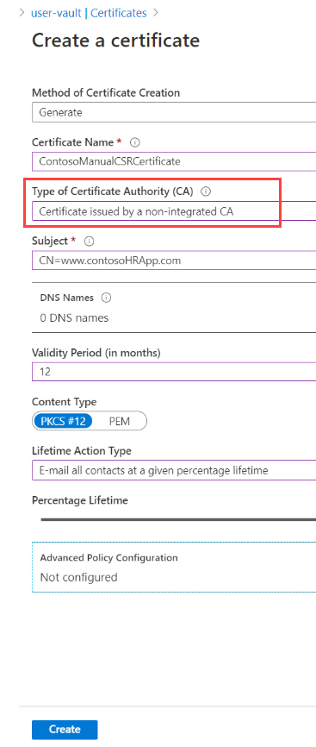
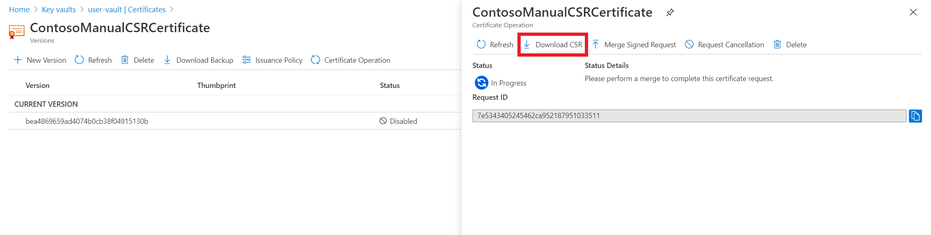
Certificates in Key Vault – non-integrated CA
Create Certificate Sign Request (SCR) from the Keyvault
Download CSR
Send it to your CA
Receive signed CSR
Merge Signed Request

Slide 19
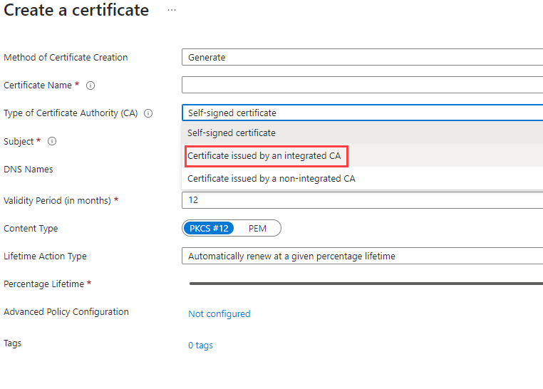
Certificates in Key Vault – integrated CA
DigiCert
GlobalSign
https://learn.microsoft.com/en-us/azure/key-vault/certificates/create-certificate-signing-request?tabs=azure-portal#add-certificates-in-key-vault-issued-by-partnered-cas

Slide 20
Monitor SSL Certificates with Azure Monitor
https://www.techielass.com/monitor-ssl-certificates-with-azure-monitor/
https://learn.microsoft.com/en-us/azure/azure-monitor/app/availability-standard-tests

Slide 21
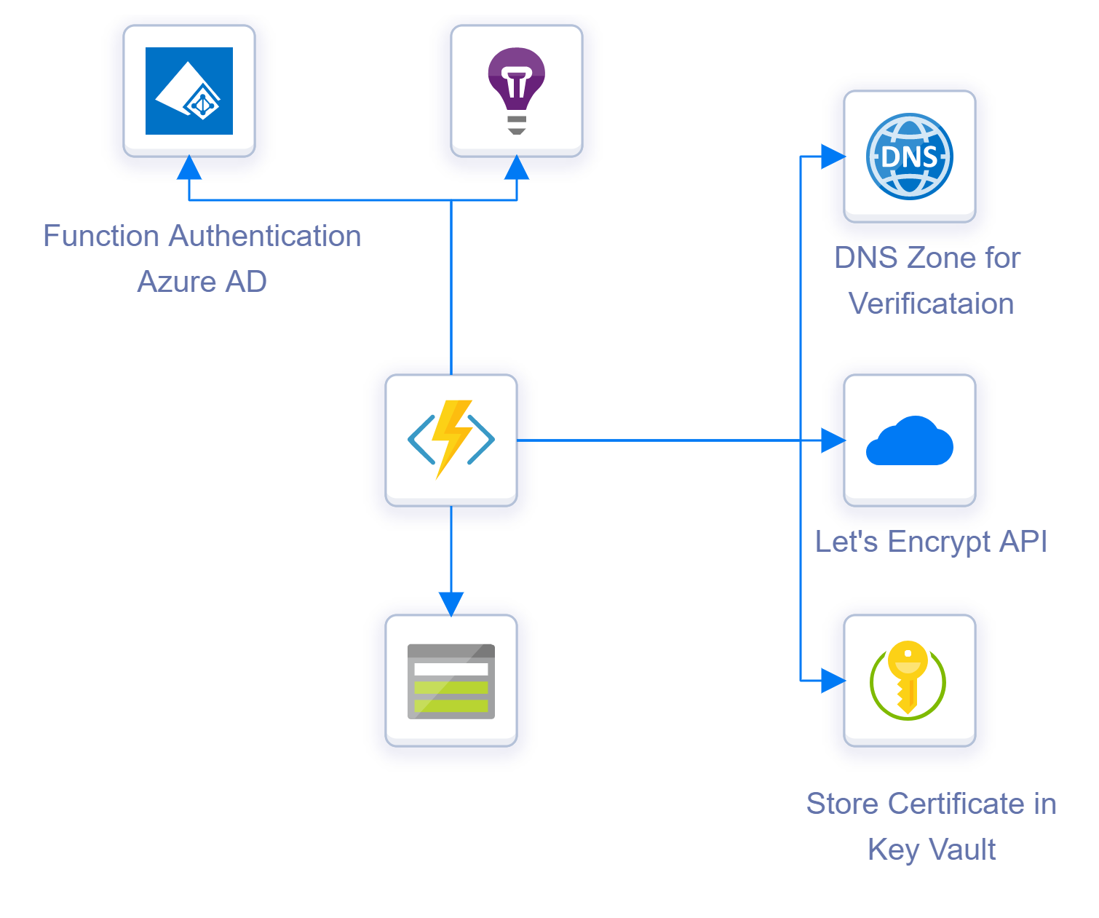
keyvault-acmebot
Azure function
Auth with AAD
Supports Several DNS providers
Azure DNS *
GoDaddy
Custom DNS Providers
Support ACME v2 compliant CA
Let’s encrypt *
Bypass
ZeroSSL
https://samcogan.com/lets-encrypt-certificates-in-azure-with-acmebotot/
Notes:
ACMEBot is a reasonably simple solution. It runs as an Azure Function using the consumption plan, so you only pay for when it is used (and get hefty free allowance). Alongside the function, a storage account and app insights instance are also created. A Key Vault is required to store the secrets, you can either have the application create one for you (and set up the permissions for you), or you can use an existing one. Finally, you want to set up authentication on the application, so this can use Azure AD or one of the other options offered by App Service Auth.
How the solution works is that when you hit the Azure Functions “add-certificate” function, it presents a UI for you to enter the certificate you want to create. Once you submit this, several other functions are used to call out and undertake the issuing process. These hit the following resources:
Azure DNS - ACMEBot uses the DNS validation process to verify ownership of the domain you want to issue the certificate to, to Let’s Encrypt. To do this, the function needs to be able to create and delete records in the Azure DNS zone that hosts your domain. At present, there is not a way to use another DNS provider
Let’s Encrypt - Once the DNS record is set up, calls are made to the Let’s encrypt API to create the Certificate Signing Request (CSR) and generate and download the certificate
Azure KeyVault - once the certificate is created it is stored in Azure Key Vault
This process runs when you create a new certificate. What ACMEBot also does is handle certificate renewals. It will detect certificates that are reaching expiry and call out to Let’s Encrypt to renew them and place the new certificate into Key Vault.

Slide 22
keyvault-acmebot
Issue certificate steps:
DNS validation process (DNS Zone)
Create TXT record under DNS Zone
Check TXT record
Delete TXT record
Let’s Encrypt
create the Certificate Signing Request (CSR)
Generate certificate
Download certificate
KeyVault
Store LE certificate as keyvault certificate
https://samcogan.com/lets-encrypt-certificates-in-azure-with-acmebotot/
Notes:
ACMEBot is a reasonably simple solution. It runs as an Azure Function using the consumption plan, so you only pay for when it is used (and get hefty free allowance). Alongside the function, a storage account and app insights instance are also created. A Key Vault is required to store the secrets, you can either have the application create one for you (and set up the permissions for you), or you can use an existing one. Finally, you want to set up authentication on the application, so this can use Azure AD or one of the other options offered by App Service Auth.
How the solution works is that when you hit the Azure Functions “add-certificate” function, it presents a UI for you to enter the certificate you want to create. Once you submit this, several other functions are used to call out and undertake the issuing process. These hit the following resources:
Azure DNS - ACMEBot uses the DNS validation process to verify ownership of the domain you want to issue the certificate to, to Let’s Encrypt. To do this, the function needs to be able to create and delete records in the Azure DNS zone that hosts your domain. At present, there is not a way to use another DNS provider
Let’s Encrypt - Once the DNS record is set up, calls are made to the Let’s encrypt API to create the Certificate Signing Request (CSR) and generate and download the certificate
Azure KeyVault - once the certificate is created it is stored in Azure Key Vault
This process runs when you create a new certificate. What ACMEBot also does is handle certificate renewals. It will detect certificates that are reaching expiry and call out to Let’s Encrypt to renew them and place the new certificate into Key Vault.

Slide 23
labs
Lab-01 - provision workshop infrastructure
Lab-02 - create Azure DNS Zone and Azure Keyvault for SSL certificates
Lab-03 - delegate your domain to Azure DNS Zone
Lab-04 - deploy keyvault-acmebot
Lab-05 - configure custom domain for keyvault-acmebot
Lab-06 - cleaning up resources!!!

Slide 24
Resources

Slide 25


