Slide 1
Ta1|< D^t^2Me
Model Selection 4 the Ad Placement

Slide 2
Steps:
1. Clean the data
2. Fit models:
Logistic Regression
Gradient Boosting
4. Features

Slide 3
Clean the data
Patsy.dmatrix categorical fields
Keep continues as they are
478 Features to choose from

Slide 4
Gradient Boosting
precision: [ 0.96210015 0.7558209 ]
recall: [ 0.99125844 0.40931135]
fscore: [ 0.97646167 0.53104027]
support: [93576 6186]
Accuracy: 0.955173312484

Slide 5
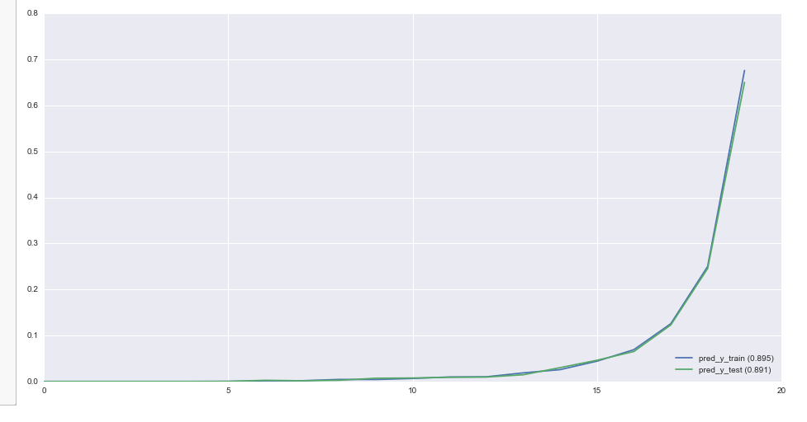
SomersD and Lift Chart

Slide 6
Feature Importance

Slide 7
Features not shown to be important:
Mother and Father country of birth
Migration Status
Household status
State of residence
Tax filer status
Veteran status

