Slide 1
FPGA design for PMSM control

Slide 2
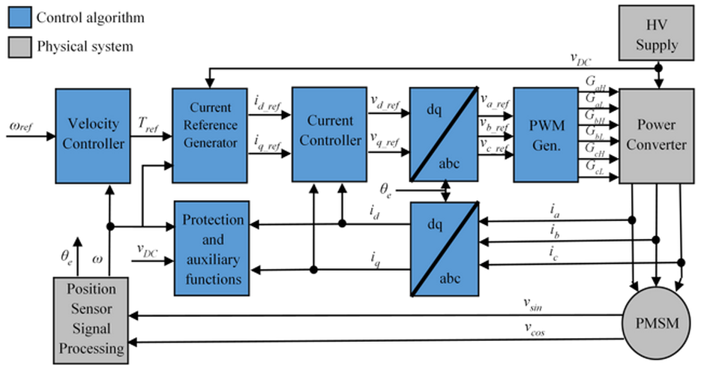
Typical control structure

Slide 3
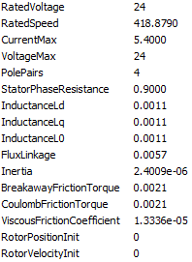
System parameters
PMSM: BLY171D-24V-4000
Velocity controller
SampleTime = 1e-3
Pgain = 0.2785
Igain = 2.6778
DQ controller
SampleTime = 4e-6
DPgain = 5.1349
DIgain = 8.662e3
QPgain = 4.5899
QIgain = 200

Slide 4
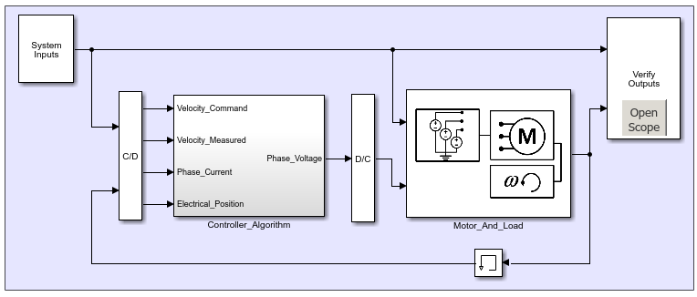
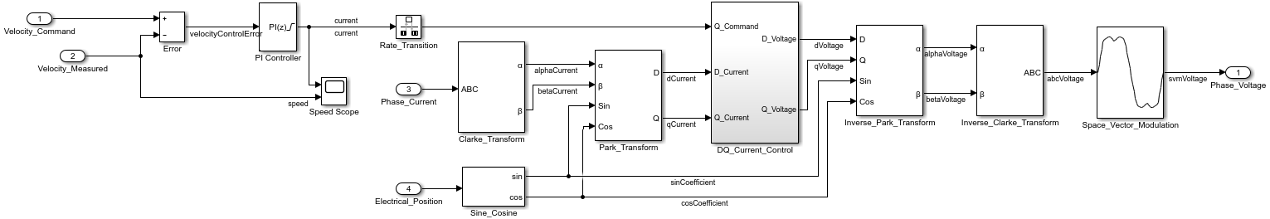
MATLAB: Basic control structure
*design from Matlab docs

Slide 5
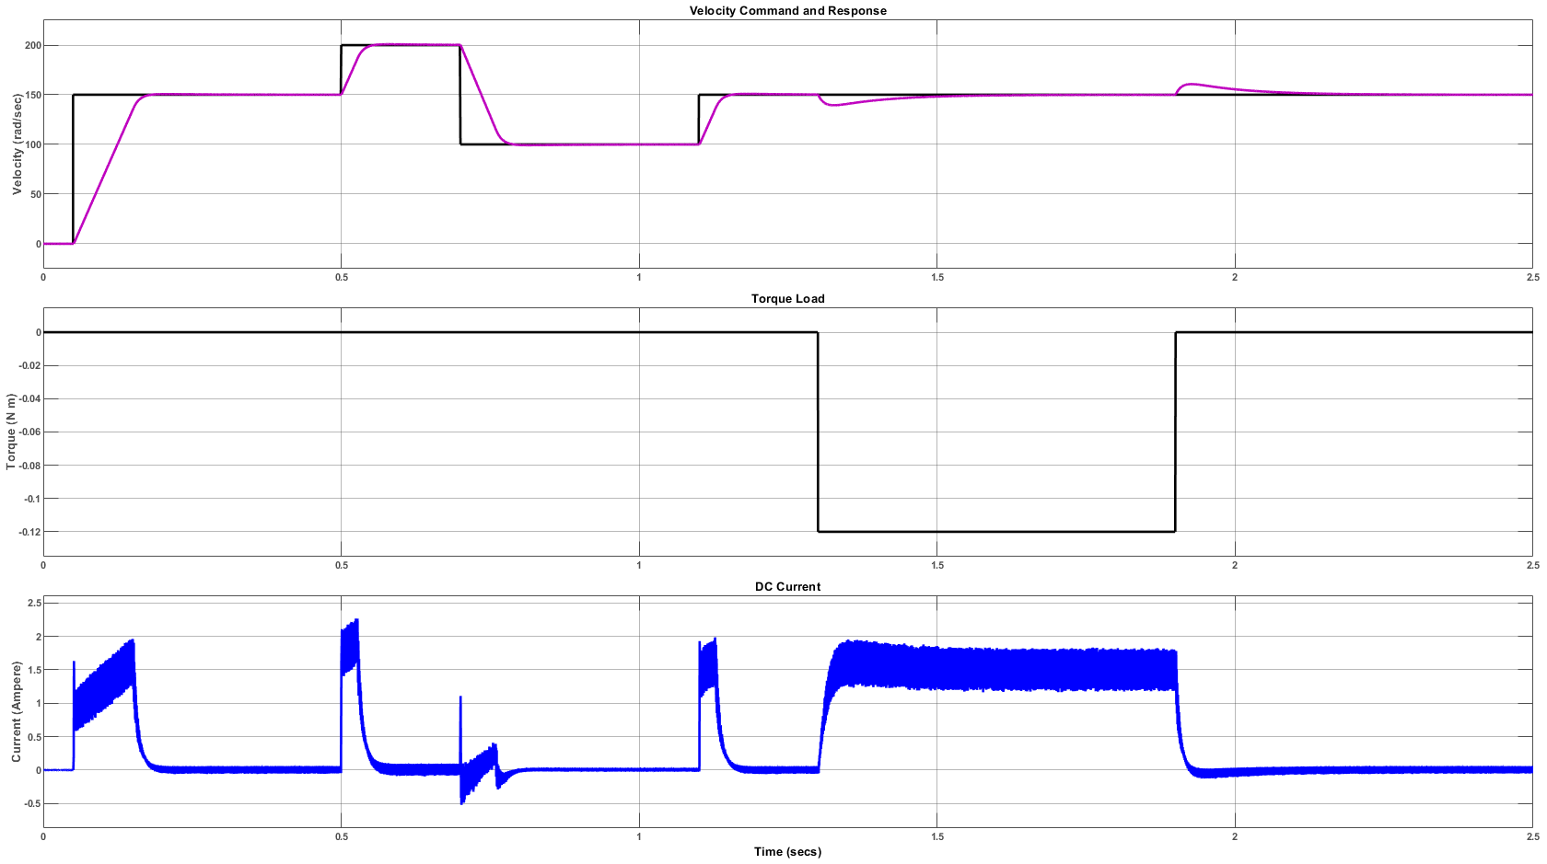
MATLAB: System command and response

Slide 6
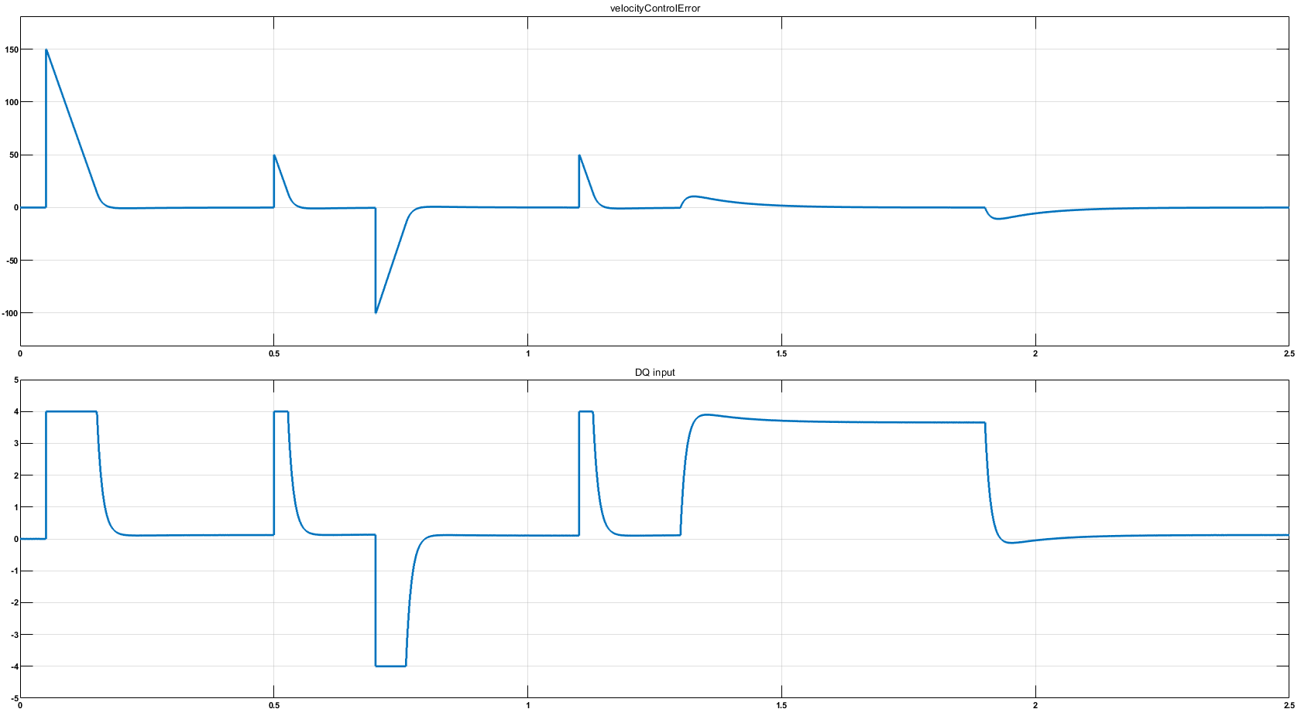
MATLAB: Velocity PI controller error/output

Slide 7
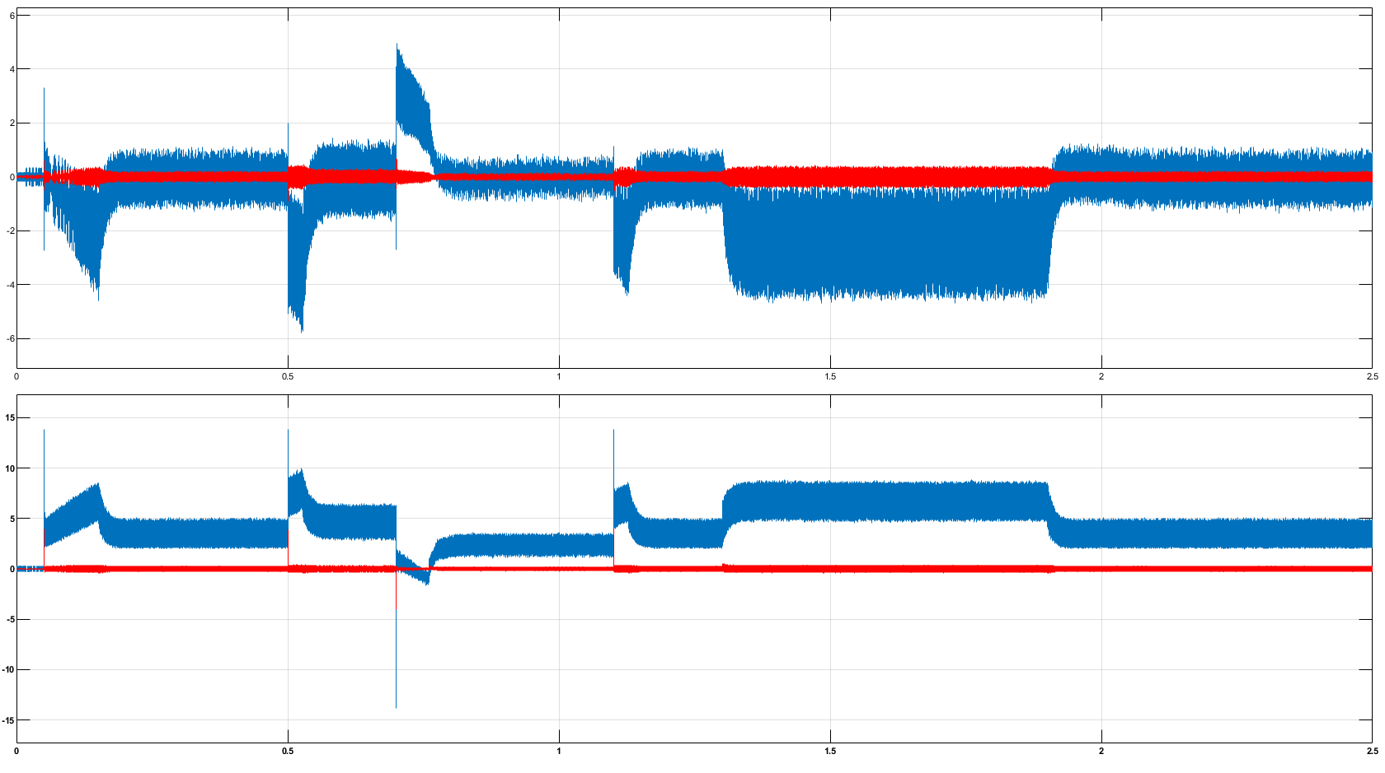
MATLAB: DQ PI controller error/output

Slide 8
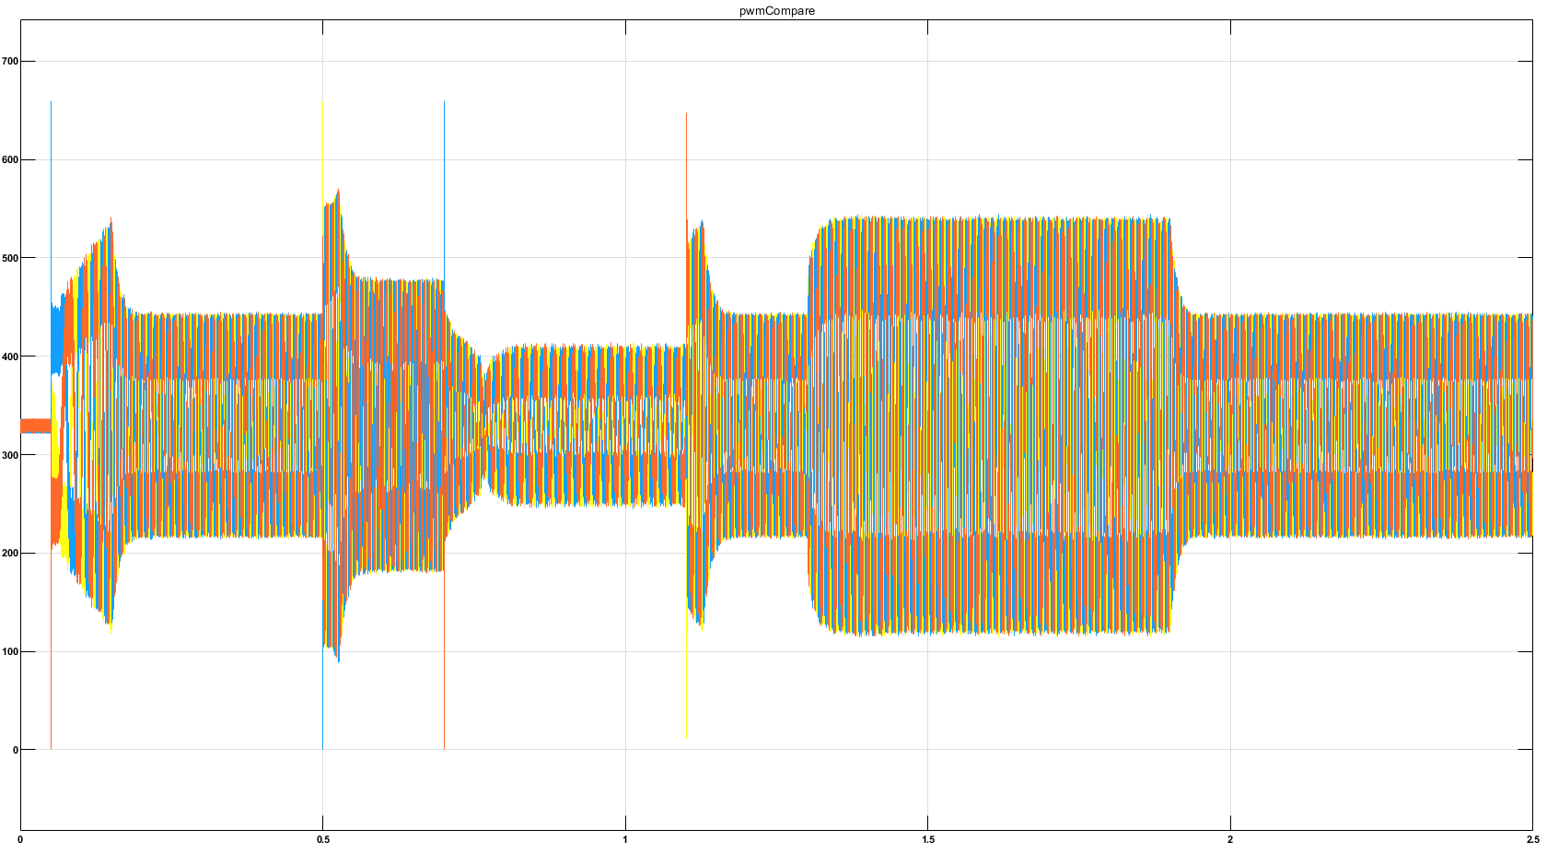
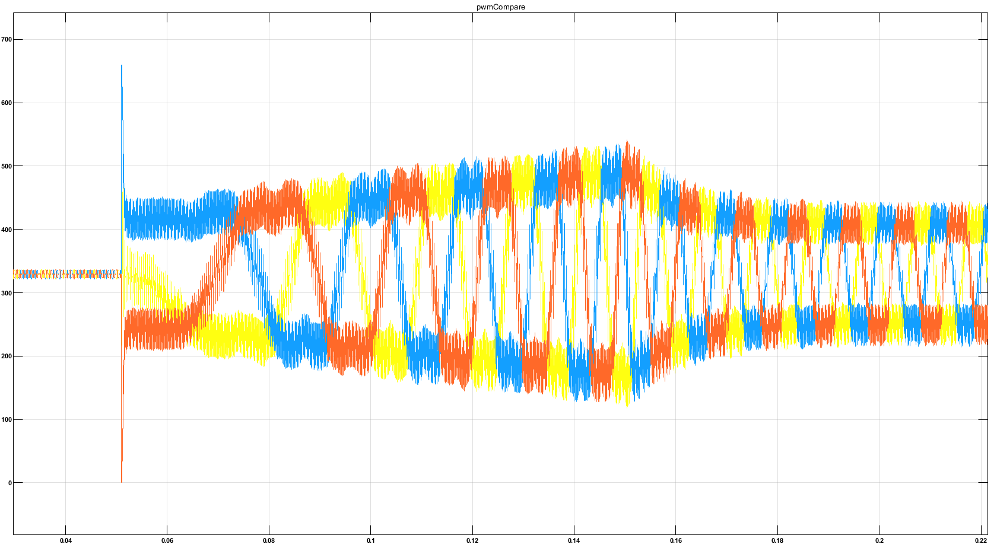
MATLAB: SVPWM compare signal

Slide 9
System testing environment
DE0-Nano board
Hall sensors
A/B channels
Rotary encoder
External commands
SPI
CTRL
PWM
Drv8320 board
(gate driver)
SPI
ADC128s022
8-channel 12bit ADC
phase current
Matlab simulation data

Slide 10
FPGA structure (Altera Cyclone IV EP4CE22F17)
sys_ctrl
SPI
SPI slave
regs_routine
dbg_ram
main_fsm
adc_ctrl
ADC model
slpf
ADC SPI
FOC
cordic
clark/park
Speed Control Loop
DQ Control Loop
Inv clark/park
svpwm
drv8320 interface
ready
need to debug
Not ready

Slide 11
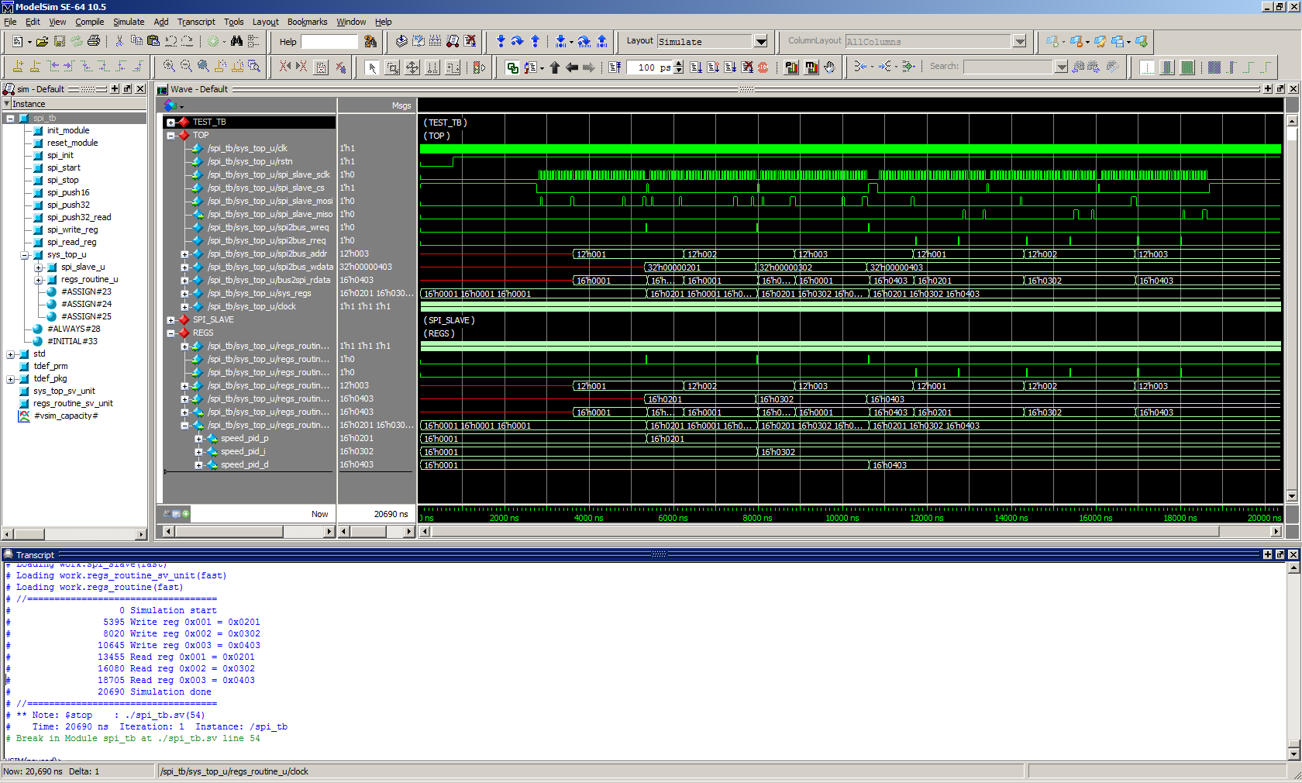
Modelsim: External commands SPI write/read operation
Write registers at 0x1, 0x2, 0x3, then read back

Slide 12
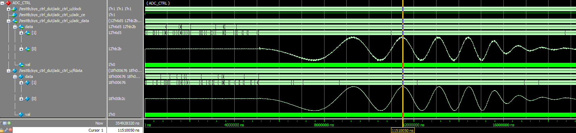
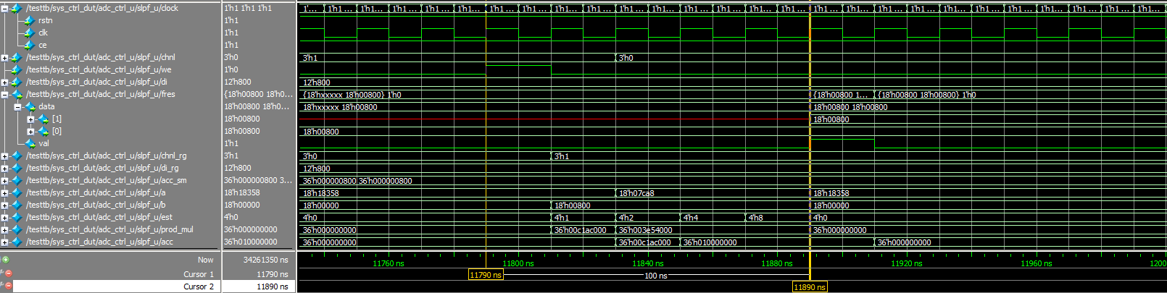
Modelsim: Phase current / ADC filter / Exponent smoothing
ADC: adc128s022 (200kSPS) 2Channels @0.9MSPS
minimal phase lag
5clk for output (100ns @50MHz)

Slide 13
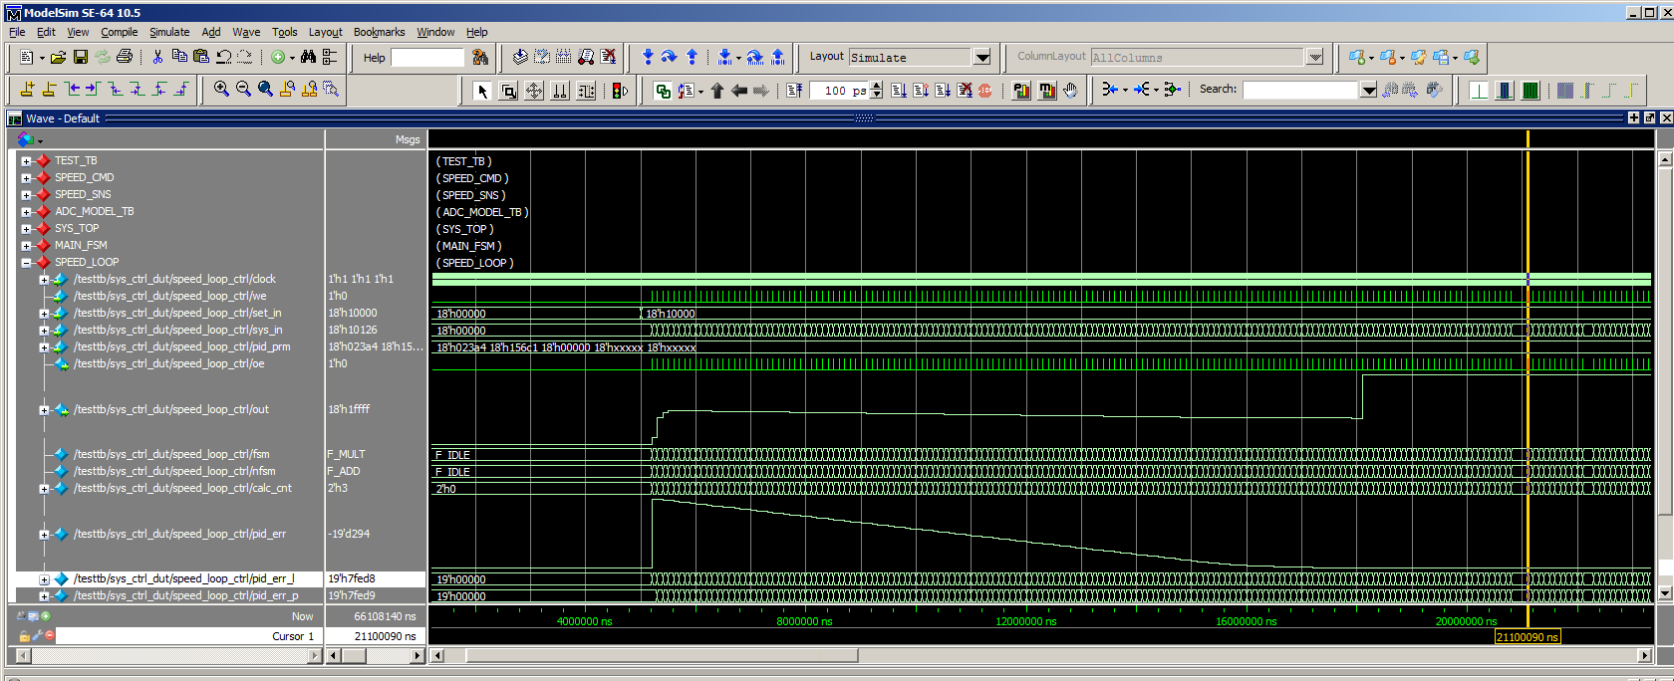
Modelsim: Velocity PI controller
ERROR: Scale mismatching
9clk for output (180ns @50MHz)

Slide 14
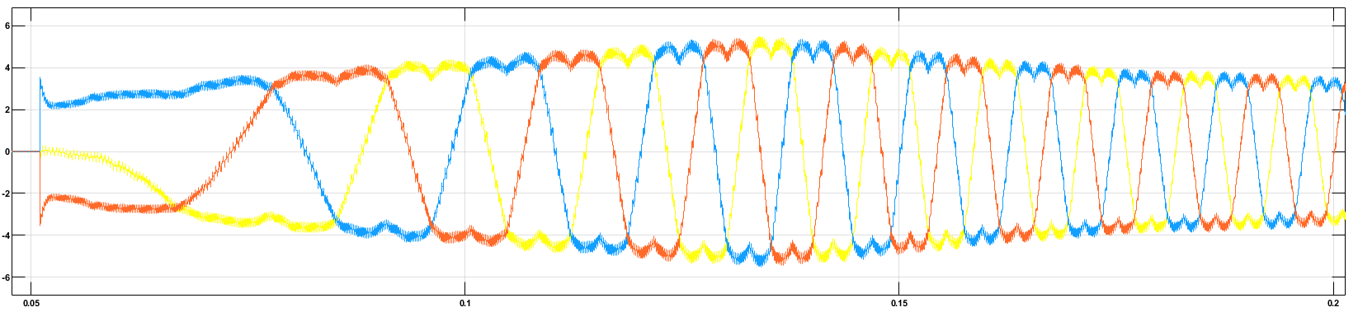
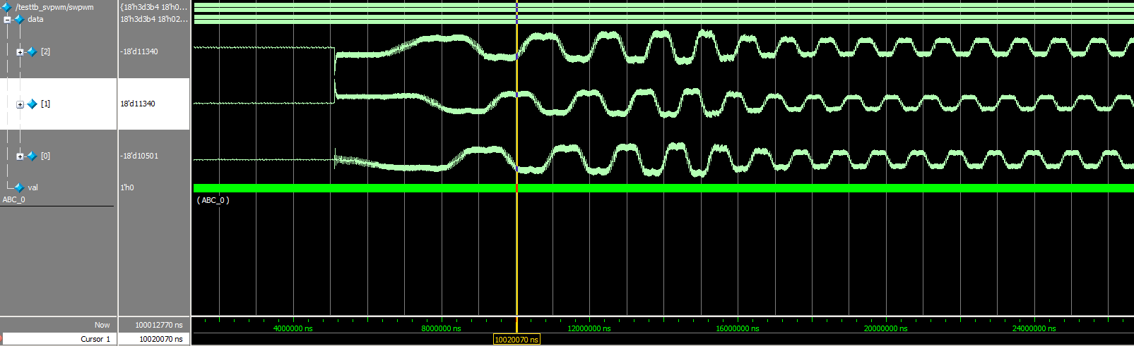
Modelsim: Space Vector Modulation

Slide 15
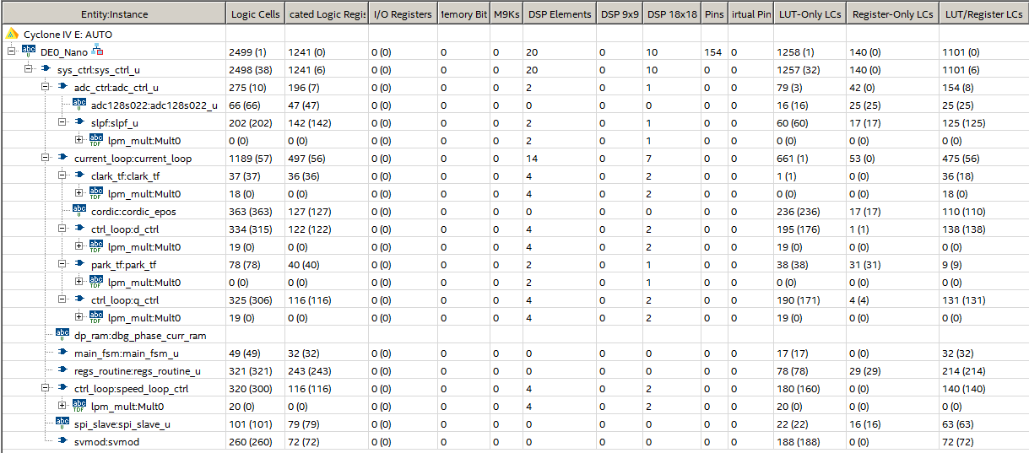
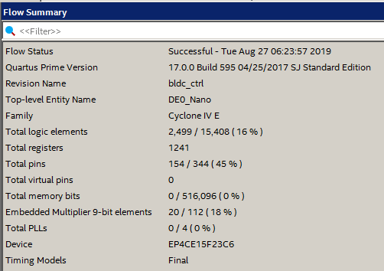
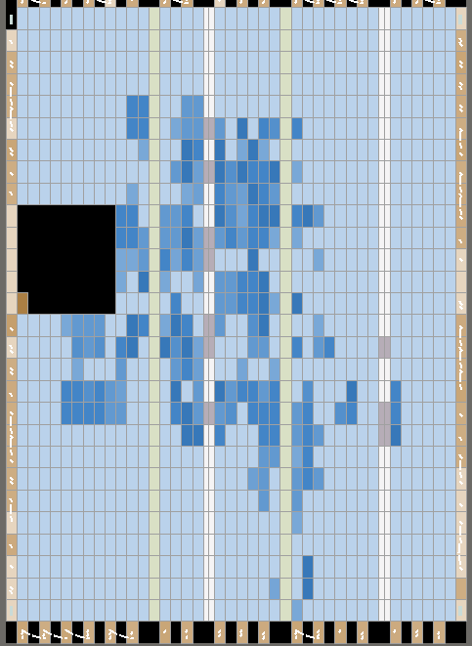
Quartus: Fitter results
Chip resource utilization
Report Fmax = 64.59MHz @ 50MHz,
pid module can be optimazed

