Slide 1

Game by Evgeny, Jason and Mason

Slide 2
Idea
Game that simulates blindness
- No visual queues
- Reliance on audio only
Benefits:
- Game suitable for visually impaired individuals
- Allows people to feel how it is like to be visually impaired

Slide 3
The plot
You wake up in the bedroom unable to see
You have to go through the day
relying only your tactile and audio abilities
Even ordinary tasks require a lot of time and patience in this condition

Slide 4

Result
An actual screenshot

Slide 5
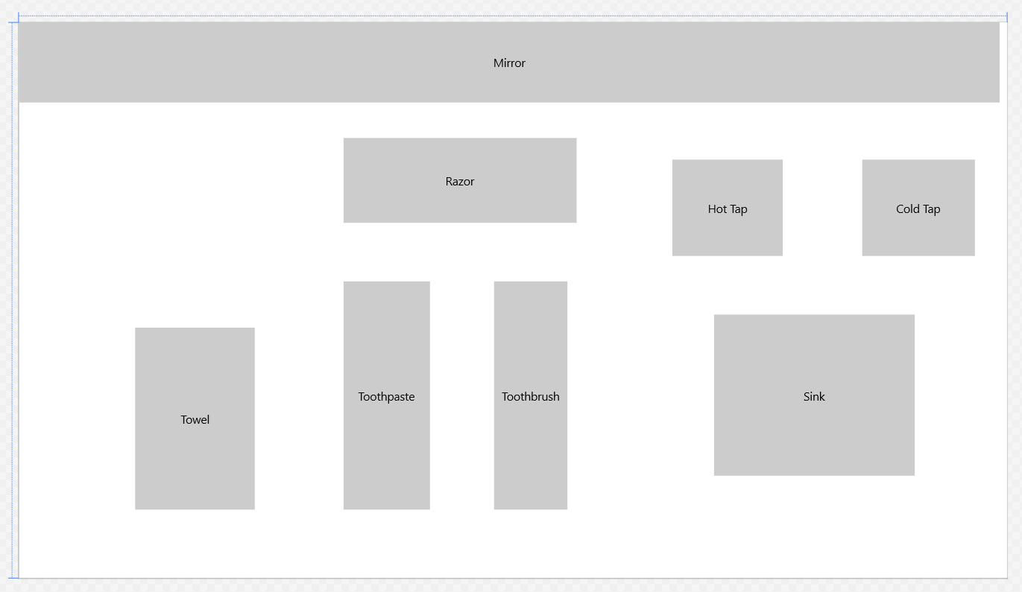
Behind the scenes
Invisible controls!!!

Slide 6
Features
Three stages
- Waking up, getting dressed
- bathroom, brushing teeth
- making breakfast
Soundtrack!
Difficult gameplay!

