Slide 1

Hip hop library
Grass-roots initiative–
Establishing a free hip hop and street art library

Slide 2



Who are we?
DA EXIT NGO (ДА ВЫХОД)
Great experience in project realization
Great team of specialists

Slide 3
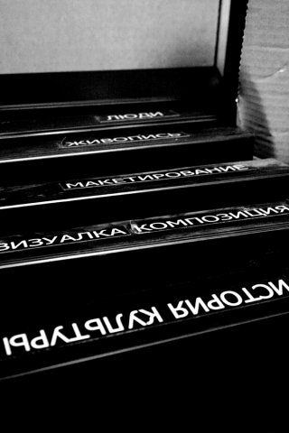
Main goals
To attract youth to the process of forming of the educative environment
- Lobbing of the ideas of tolerance, cross cultural communications and support
- Systematization and storing the hip hop and street culture texts, books and media
- Methodological supply for the youth in the sphere of subcultures and hip hop
- Broadening the communities channels of communication

Slide 4

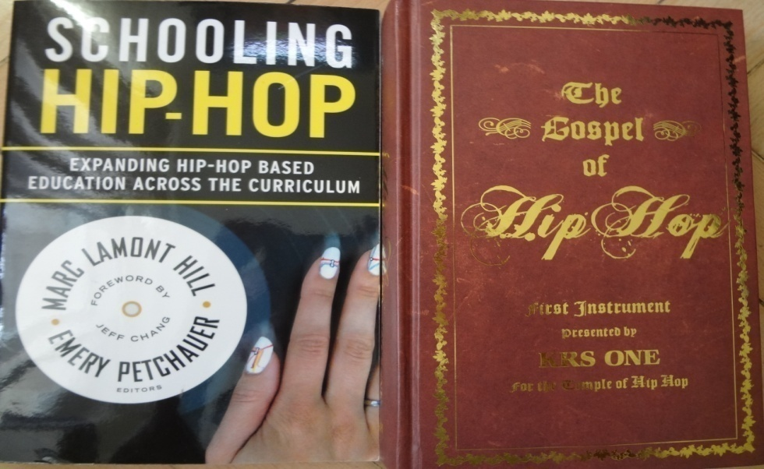
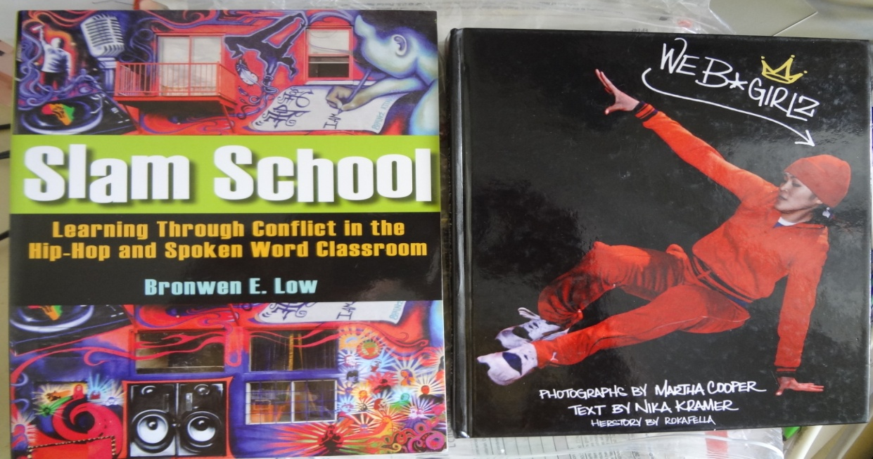
Material
Systematization and storing

Slide 5
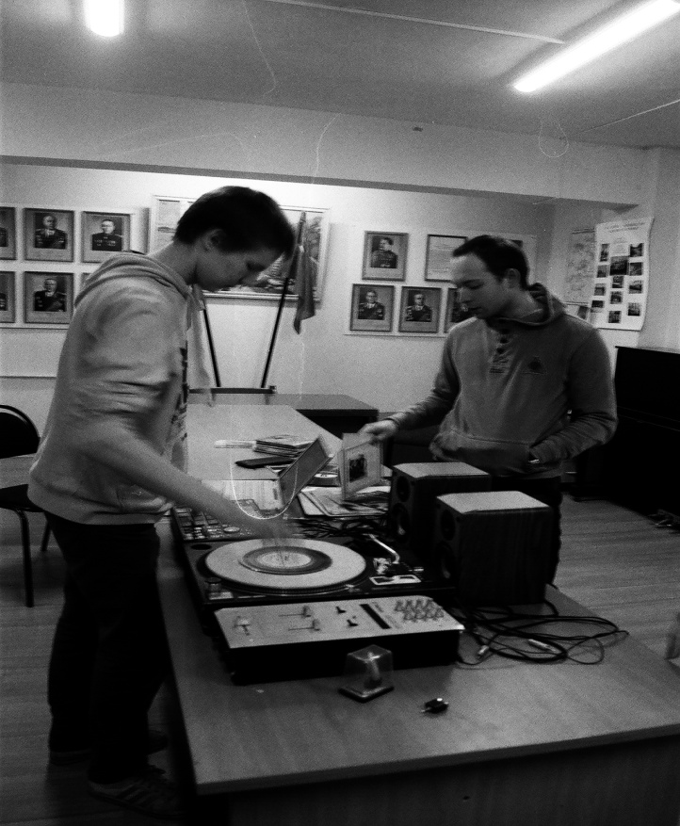
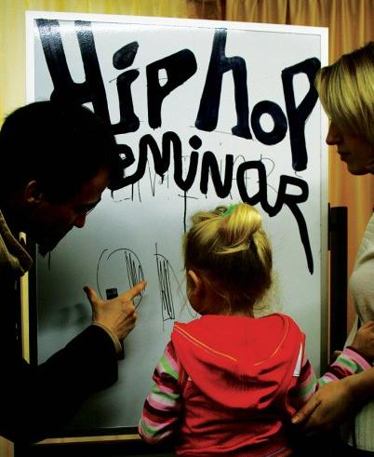
Additional education
Helping teachers to use new materials and technologies

Slide 6
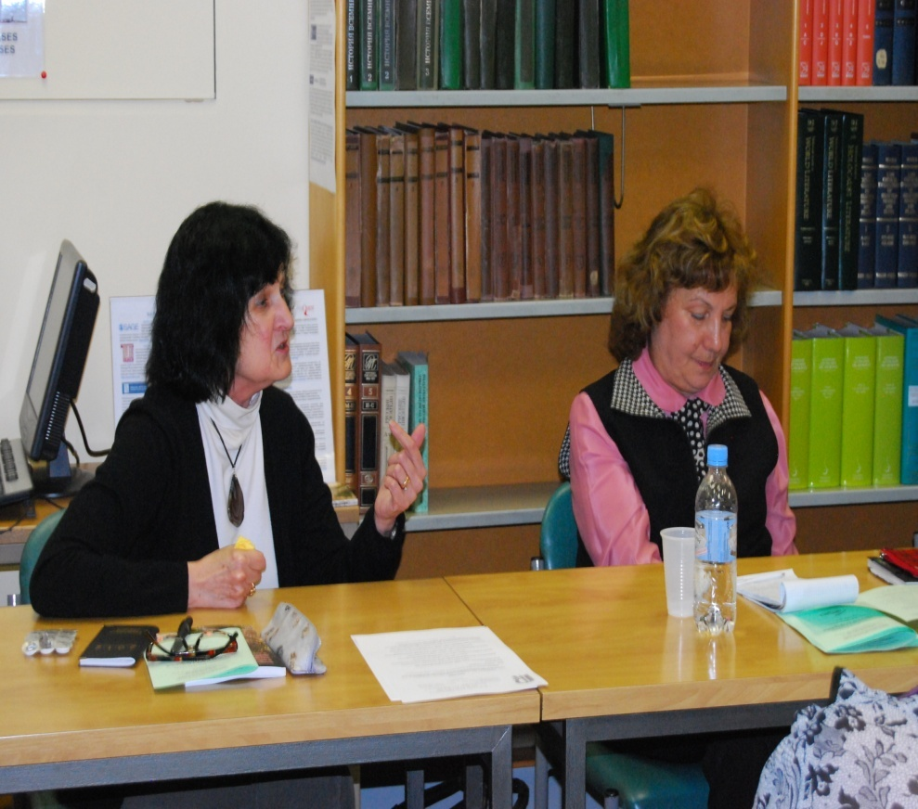
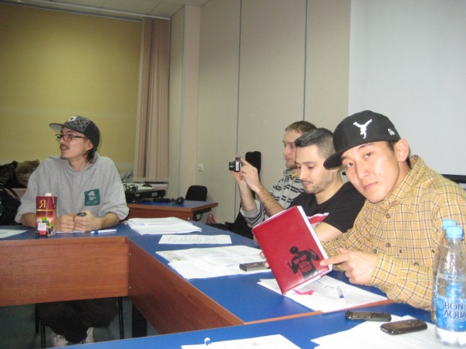
Science
Support of the scientific work

Slide 7
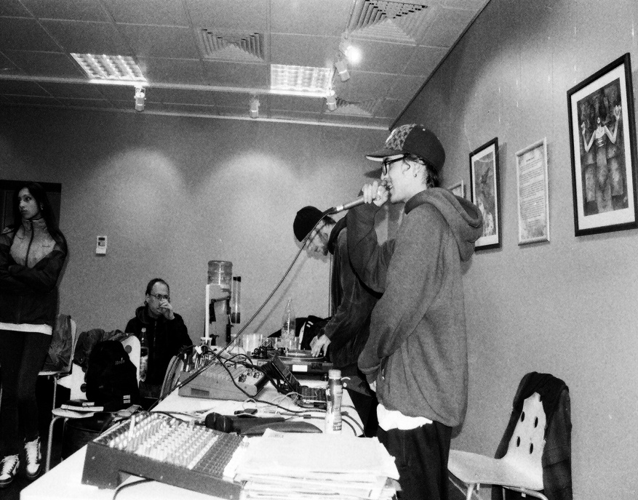
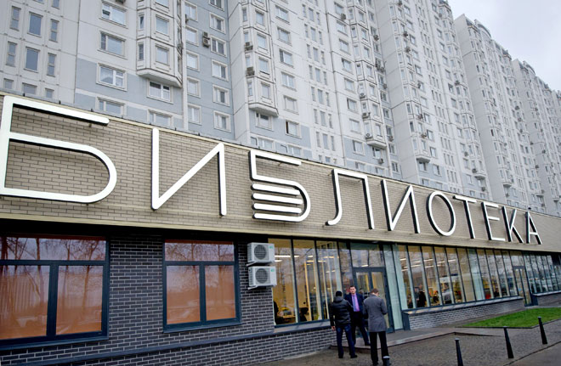
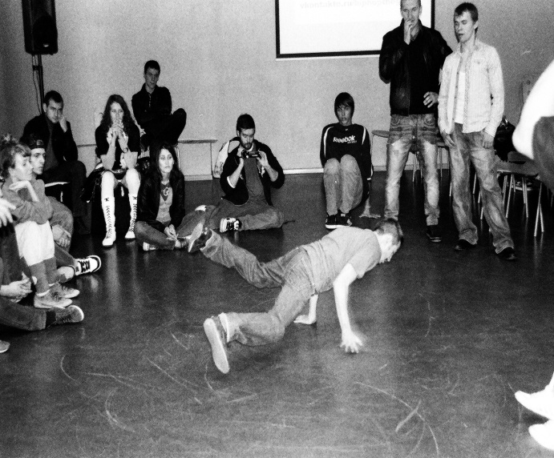
Collaboration with the libraries (state)
Making masterclasses

Slide 8
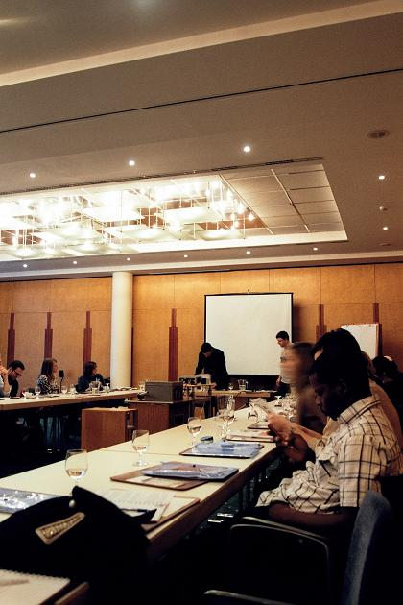
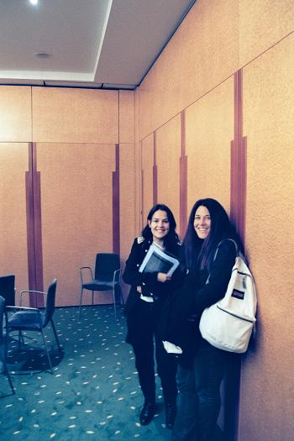
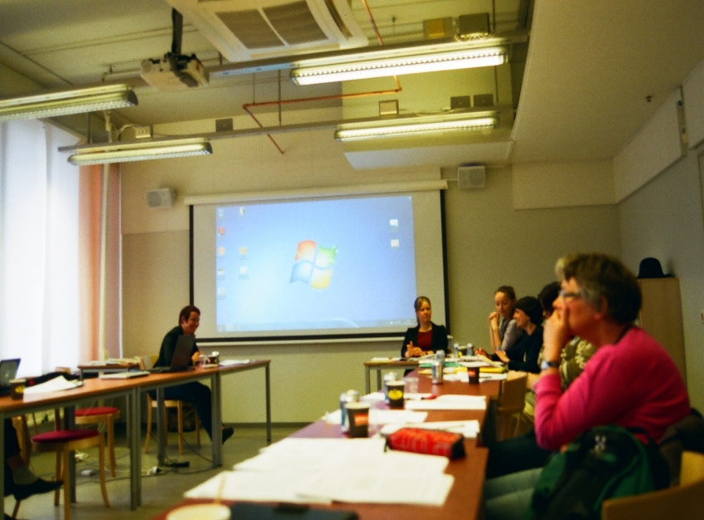
International connection
Working with foreign parthners

Slide 9

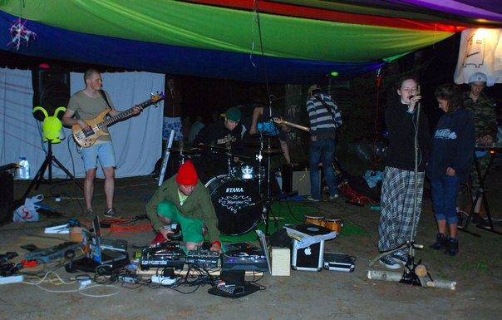
Other projects
From concerts to education

Slide 10
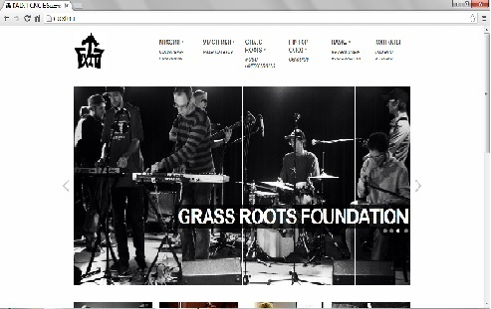
Implementation of the project
Development of the web site

