Slide 1
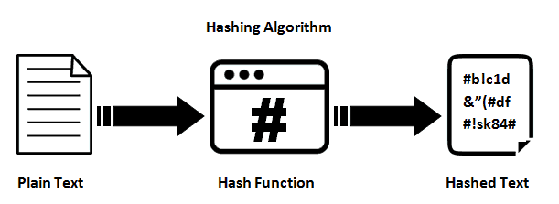
Hash-function

Slide 2
Field of application
Hash tables
Checksums
Digital signature
Password encryption

Slide 3
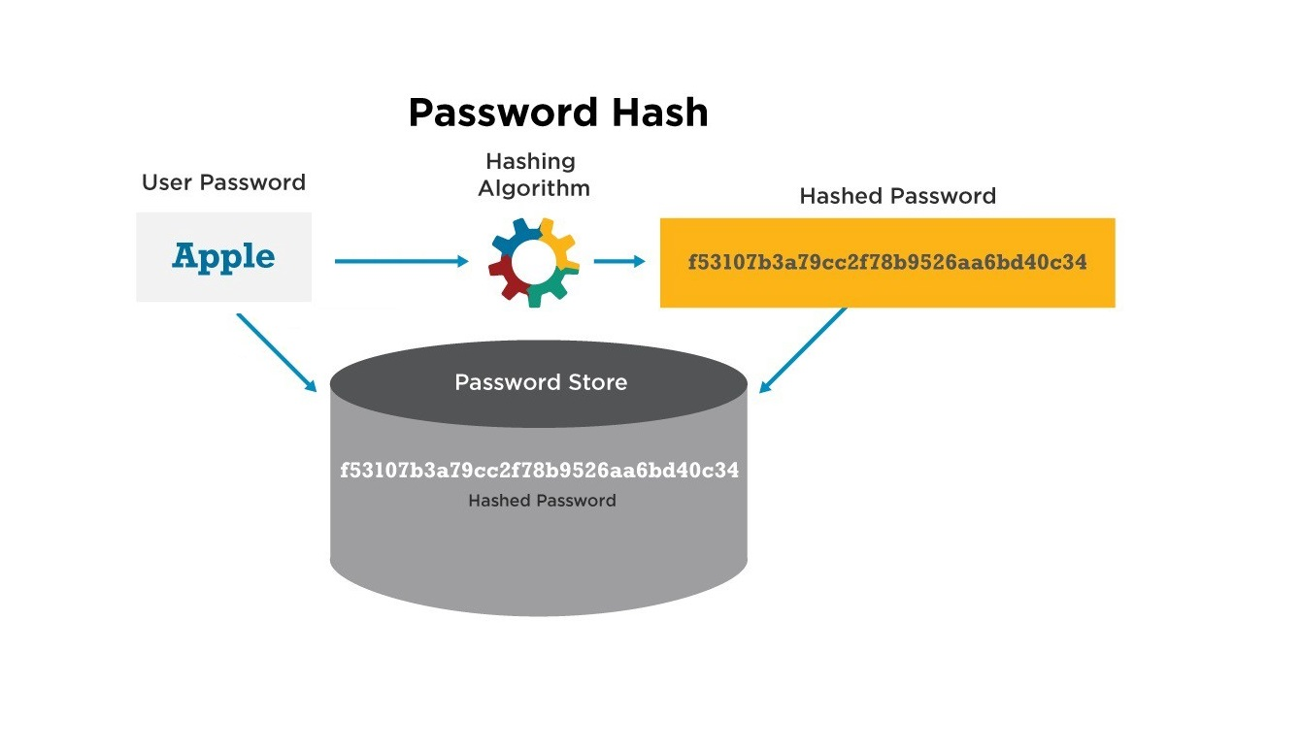

Slide 4
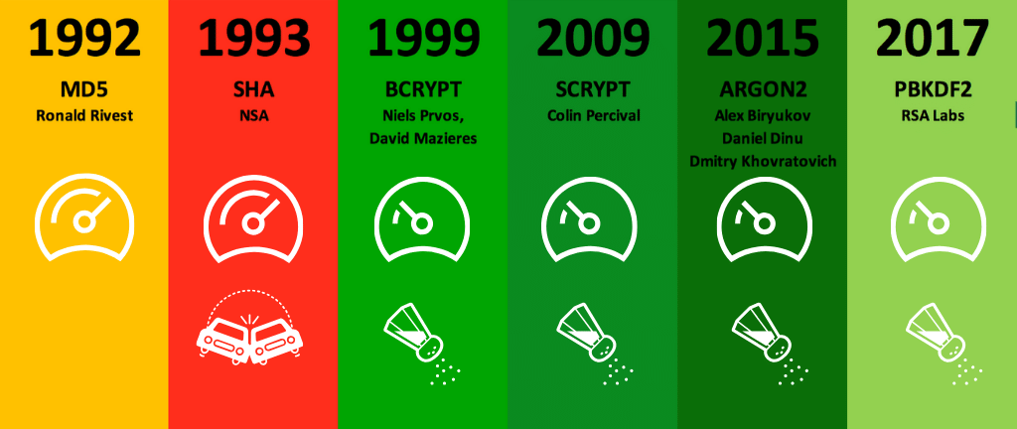
TYPES OF HASH FUNCTIONS
NOT RECOMMENDED:
MD5
SHA
RECOMMENDED: - PBKDF2
- BCrypt
- SCrypt

Slide 5
PASSWORD HASH SALTING
salt + “password” + salt

Slide 6
EXAMPLE
“12345pass”
a11b7f3acb5aea7e3a63e3bba98f3ef11da5774a7729e70a88f6eb470b3708b8
“12345pass” + “ABC”
2280856a33b2e005b997f040573dbc89cb4907af0dac4cc6e389693772eda66b
https://crackstation.net/

Slide 7
SECURE RANDOM GENERATORS
PHP: mcrypt_create_iv, openssl_random_pseudo_bytes
Java: java.security.SecureRandom
Dot NET (C#, VB): System.Security.Cryptography.RNGCryptoServiceProvider
Ruby: SecureRandom
Python: os.urandom
Perl: Math::Random::Secure
C/C++ (Windows API): CryptGenRandom

Slide 8
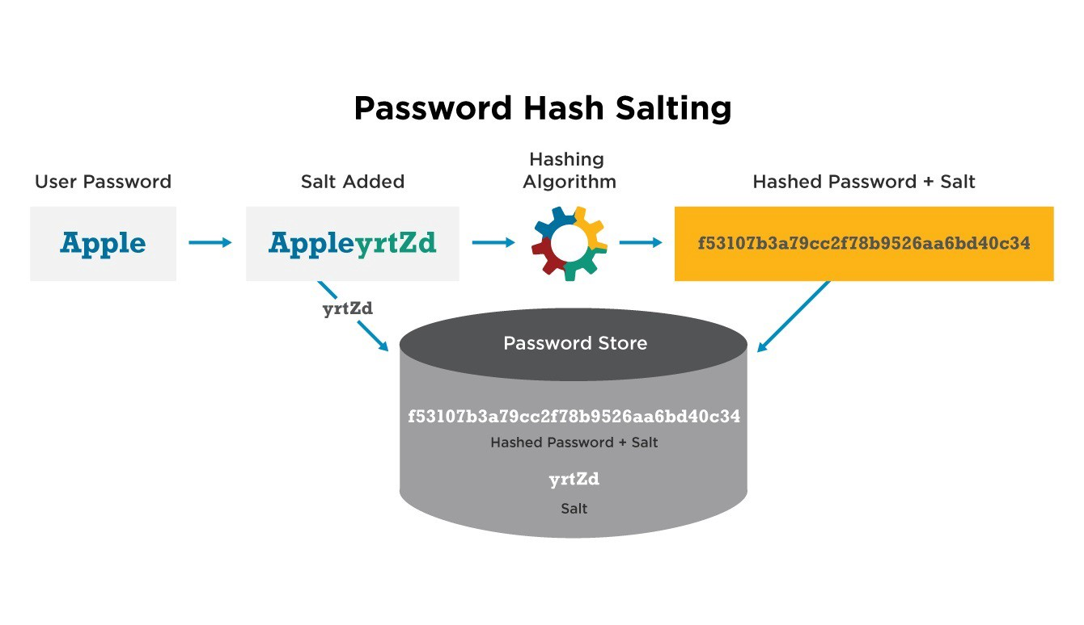

Slide 9
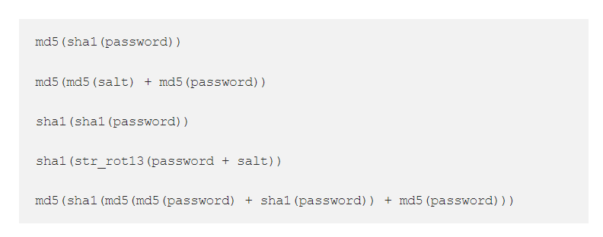
ANTI-EXAMPLE

Slide 10
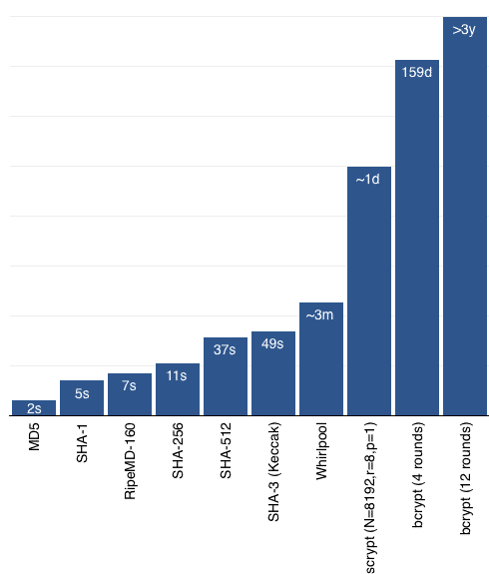
SLOW
HASH
FUNCTIONS

Slide 11
BIBLIOGRAPHY
https://medium.com/@balovbohdan/%D1%83%D0%BF%D1%80%D0%B0%D0%B2%D0%BB%D0%B5%D0%BD%D0%B8%D0%B5-%D0%BF%D0%B0%D1%80%D0%BE%D0%BB%D1%8F%D0%BC%D0%B8-82d99005207
https://habr.com/ru/post/210760/
https://ru.wikipedia.org/wiki/%D0%A5%D0%B5%D1%88-%D1%84%D1%83%D0%BD%D0%BA%D1%86%D0%B8%D1%8F
https://en.wikipedia.org/wiki/Hash_function
https://www.baeldung.com/java-password-hashing
https://habr.com/ru/sandbox/26876/
https://crackstation.net/

