Slide 1
SOLID with examples
SOLID
The Single responsibility principle(SRP)
The Open\Close principle(OCP)
The Liskov substitution principle(LSP)
The Interface segregation principle(ISG)
The Dependency Inversion principle(DIP)

Slide 2
So what is SOLID ?
SOLID is a mnemonic acronym for 5 design principles intended to make software design more understandable, flexible and maintainable. The principles are a subset of many principles promoted by Robert C. Martin.
S - The Single responsibility principle(SRP)
O - The Open\Close principle(OCP)
L - The Liskov substitution principle(LSP)
I - The Interface segregation principle(ISG)
D - The Dependency Inversion principle(DIP)

Slide 3

Let`s have a look closer…

Slide 4
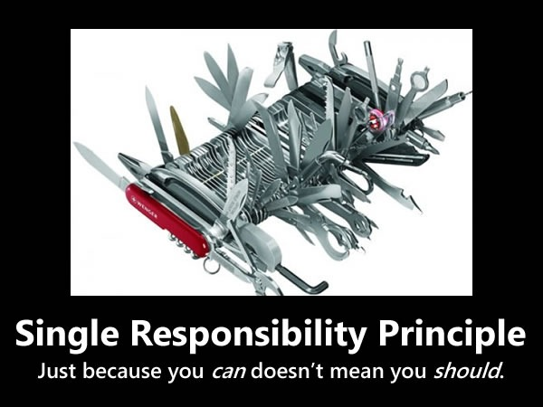
Single responsibility principle (SRP).
SRP: A class should have one and only one reason to change ,meaning that class should have only one job.

Slide 5


Slide 6
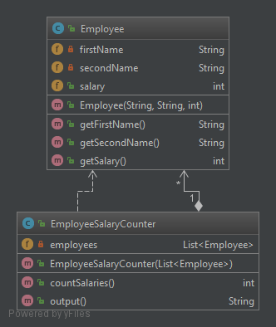
UML:
©Employee
©EmployeeSalaryCounter

Slide 7

Did you spot SOLID violation?

Slide 8
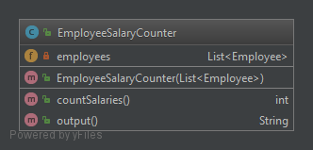
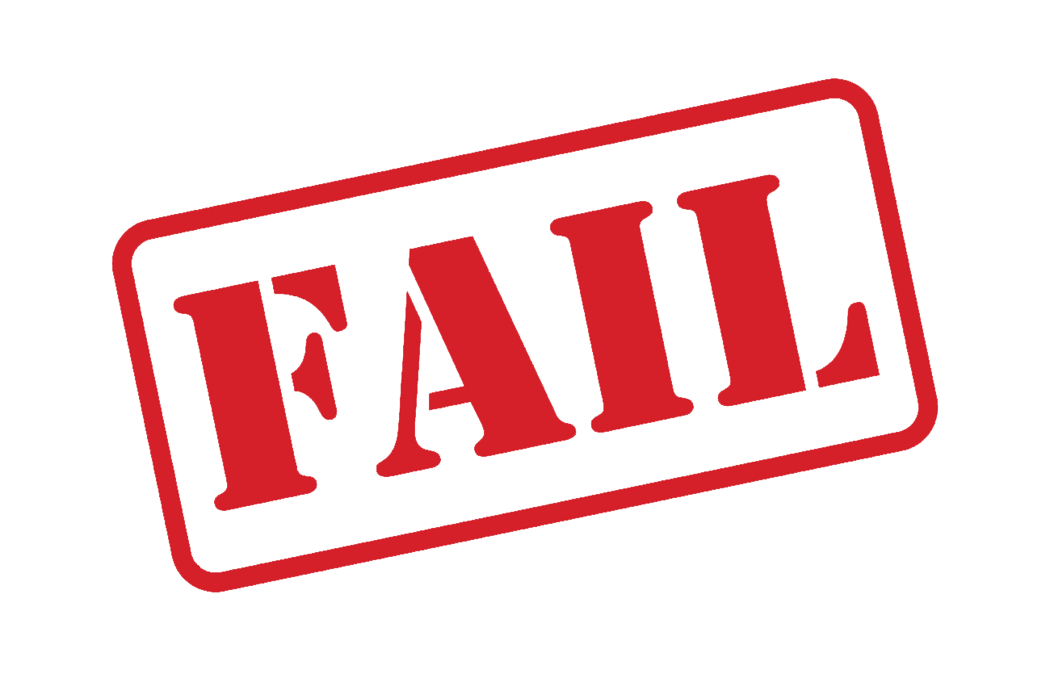
Single Responsibility Principle

Slide 9
EmployeeSalaryCounter have multiple responsibilities.

Slide 10
What disadvantages of this design?
1)Big class to cover those two responsibilities.
2)Huge amount if unit tests for both responsibilities.

Slide 11
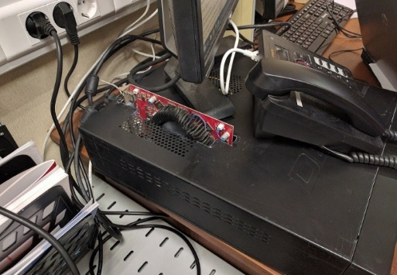
How to fix that ?

Slide 12
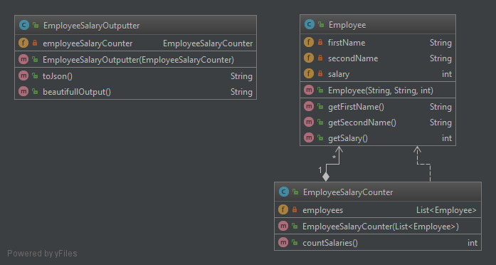
Solution
Notes:
CHECKPOINT

Slide 13
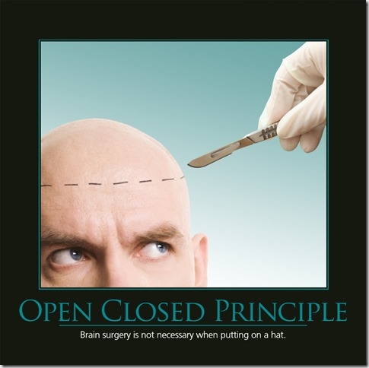
Open\Close principle (OCP)
OCP: Class should be open for extension ,but closed for modification.

Slide 15
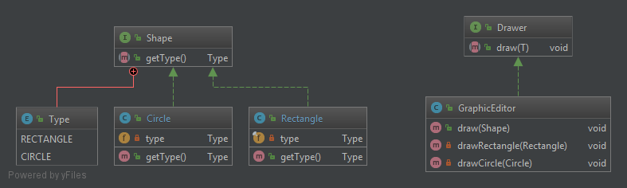
UML:
1) (I)Shape ,(E)Type ,©Circle ,©Rectangle
2) (I)Drawer ,©GraphicEditor

Slide 16
Did you spot SOLID violation?

Slide 17
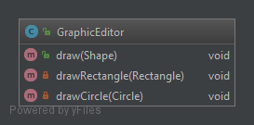
Open
Close
Principle

Slide 18
GraphicEditor class has to be modified every time when we create new Shape implementation.

Slide 19
What disadvantages of this design?
1)For each new shape added unit tests for GraphicEditor should be redone.
2) High time consuming for adjusting draw() method with new Shape object.

Slide 20
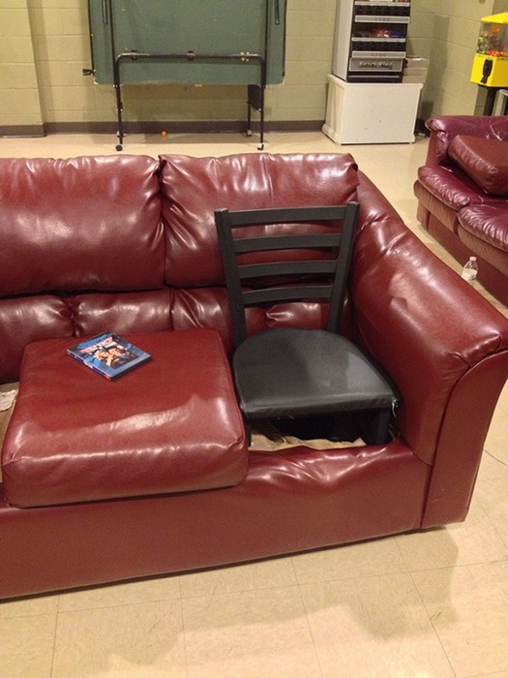
How to fix that ?

Slide 21
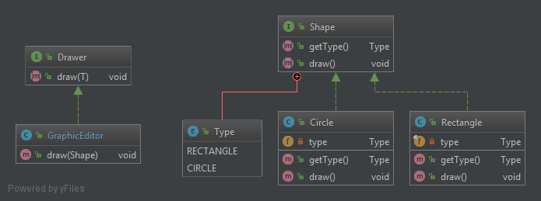
Solution
Notes:
CHECKPOINT

Slide 22
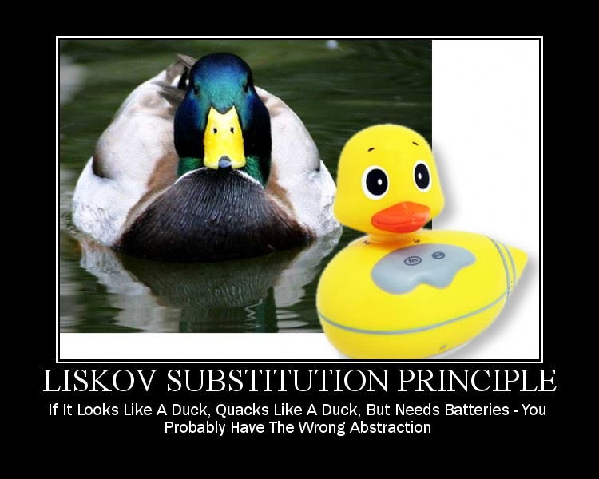
The Liskov substitution principle(LSP)
LSP: if a program module is using a Base class, then the reference to the Base class can be replaced with a Derived class without affecting the functionality of the program module.

Slide 24
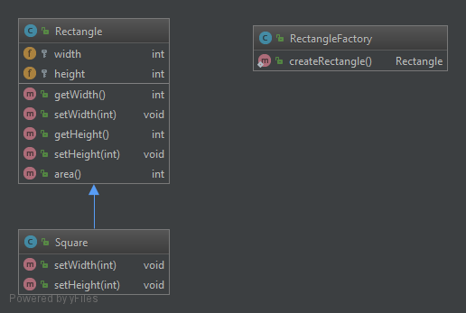
UML:
1)©Rectangle,
©Square
2)©RectangleFactory

Slide 25
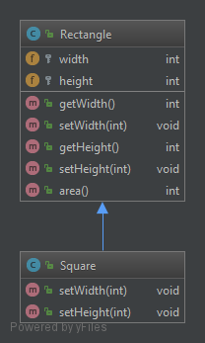
Liskov
Substitution
Principle

Slide 26
Unexpected behavior of Square class.

Slide 27
What disadvantages of this design?
1)Misleading object behavior.
2)Take huge amount of time for debug and find this problem.

Slide 28
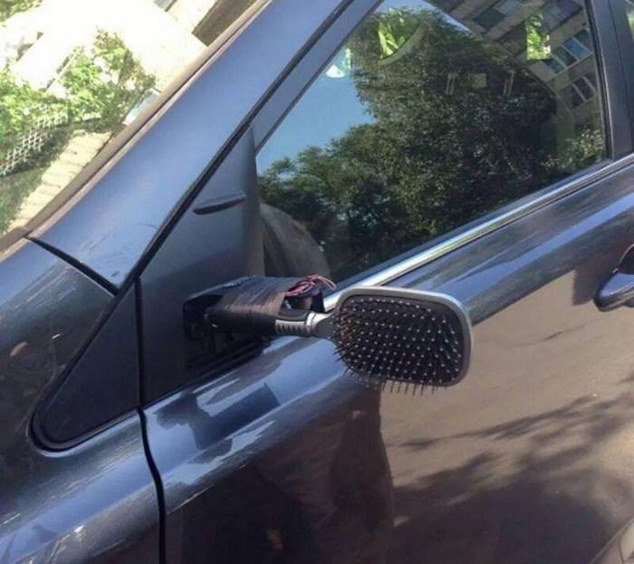
How to fix that ?

Slide 29
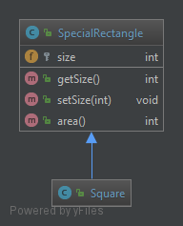
Solution
Notes:
CHECKPOINT

Slide 30
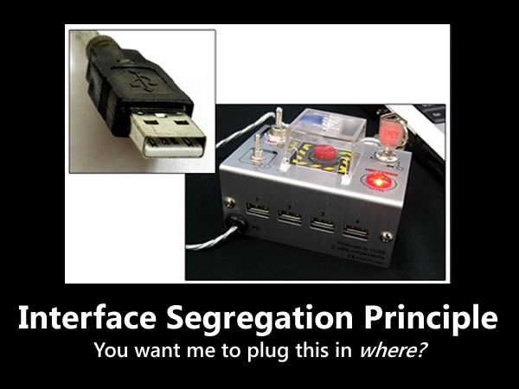
The Interface segregation principle(ISG)
ISG: clients should not be forced to implement interfaces they don't use. Instead of one fat interface many small interfaces are preferred based on groups of methods, each one serving one submodule.

Slide 32
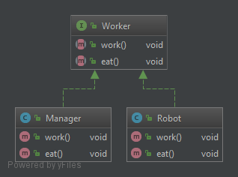
UML:
(I) Worker
©Manager
©Robot

Slide 33
Did you spot SOLID violation?

Slide 34
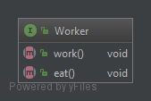
Interface
Segregation
Principle

Slide 35
Some implementations don’t use all methods provided by base interface.

Slide 36
What disadvantages of this design?
1)Dirty code.
2)Make others nervous.

Slide 37
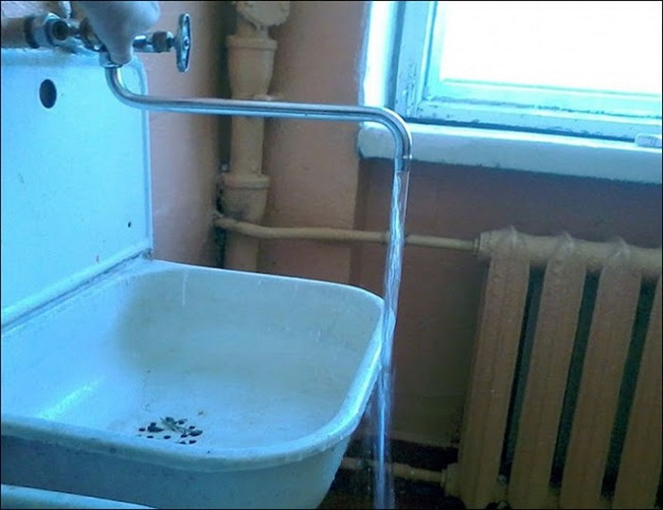
How to fix that ?

Slide 38
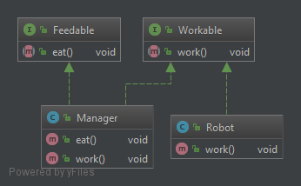
Solution
Notes:
CHECKPOINT

Slide 39
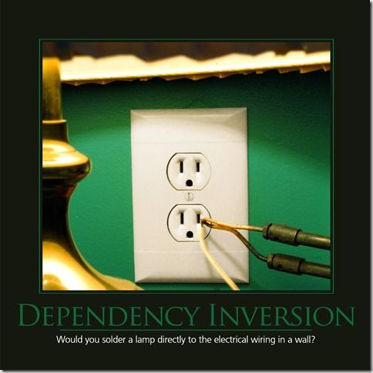
The Dependency Inversion principle(DIP).
DIP: High level modules should not depend upon low-level modules. Both should depend upon abstractions.

Slide 41
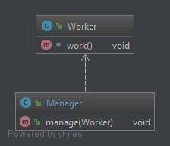
UML:
©Worker
©Manager

Slide 42
Did you spot SOLID violation?

Slide 43

Dependency
Inversion
Principle

Slide 44
Manager class is high coupled with Worker class.

Slide 45
What disadvantages of this design?
1)Frequent class changes.
2)Frequent unit test changes.

Slide 46
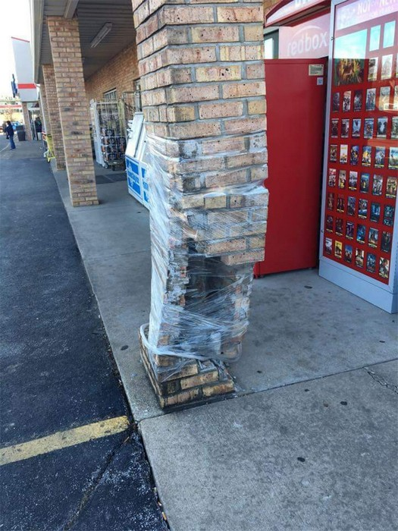
How to fix that ?

Slide 47
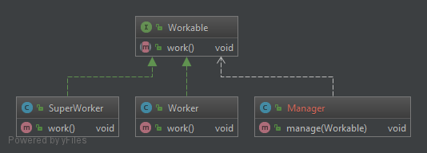
Solution
Notes:
CHECKPOINT

Slide 48
THANK YOU.

