Slide 1
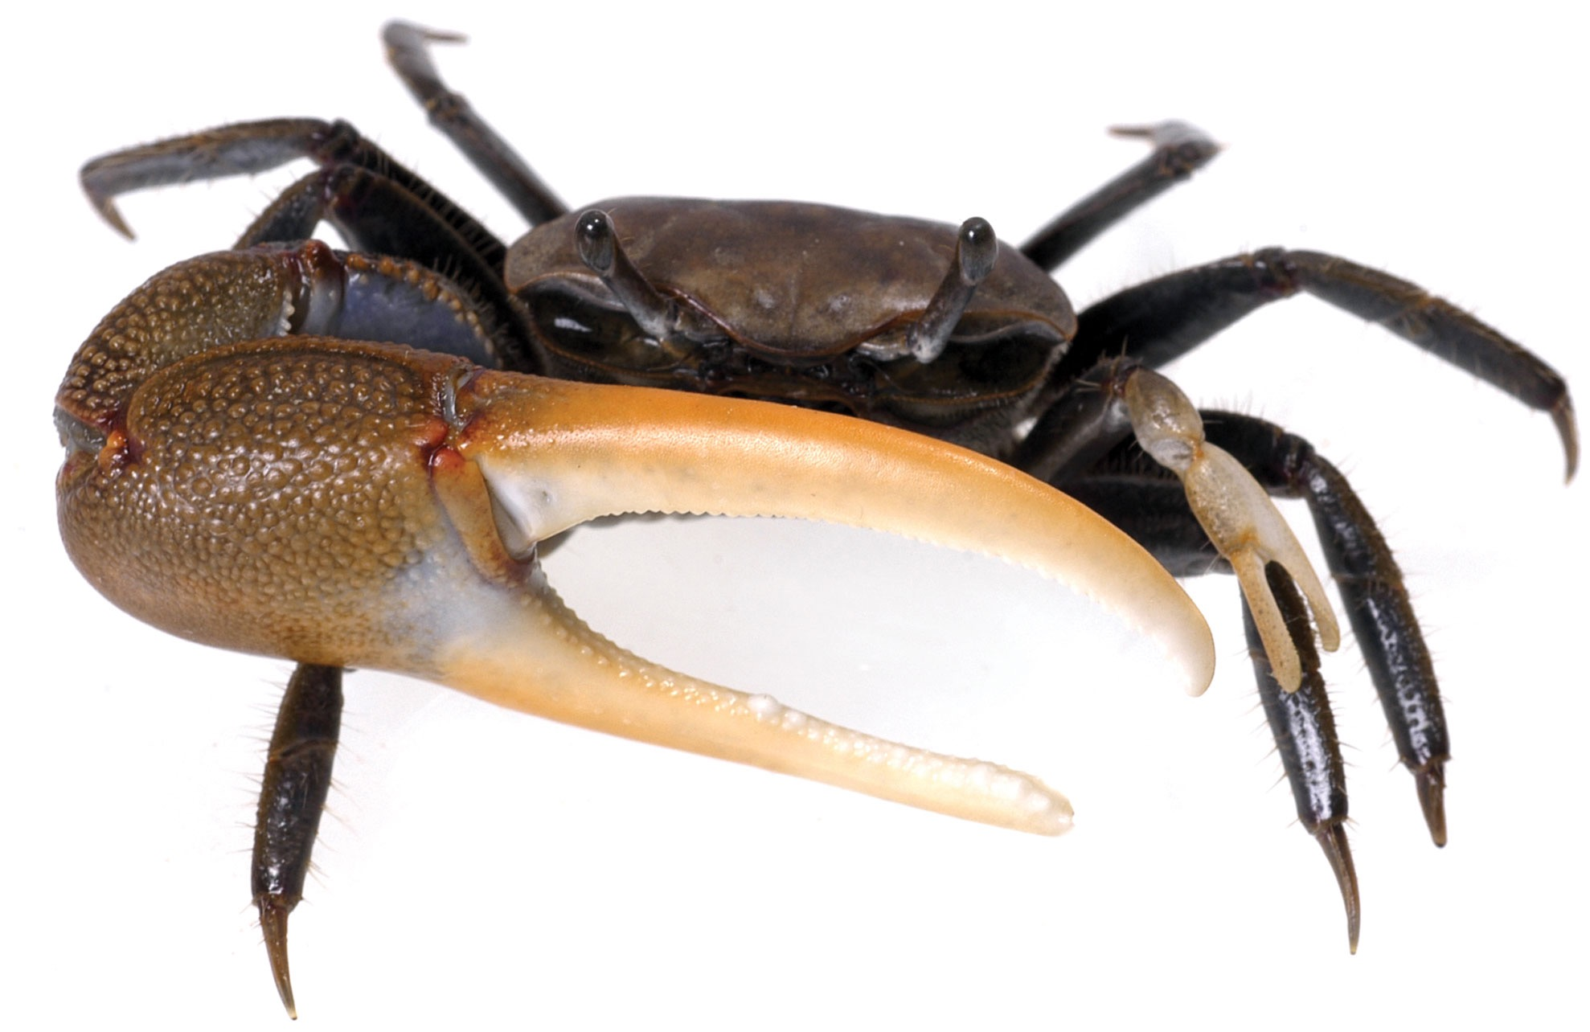
Robocrab: Data-driven adaptation of the evasion behavior in fiddler crabs
Evripidis Gkanias
Supervisor: prof. Barbara Webb

Slide 2
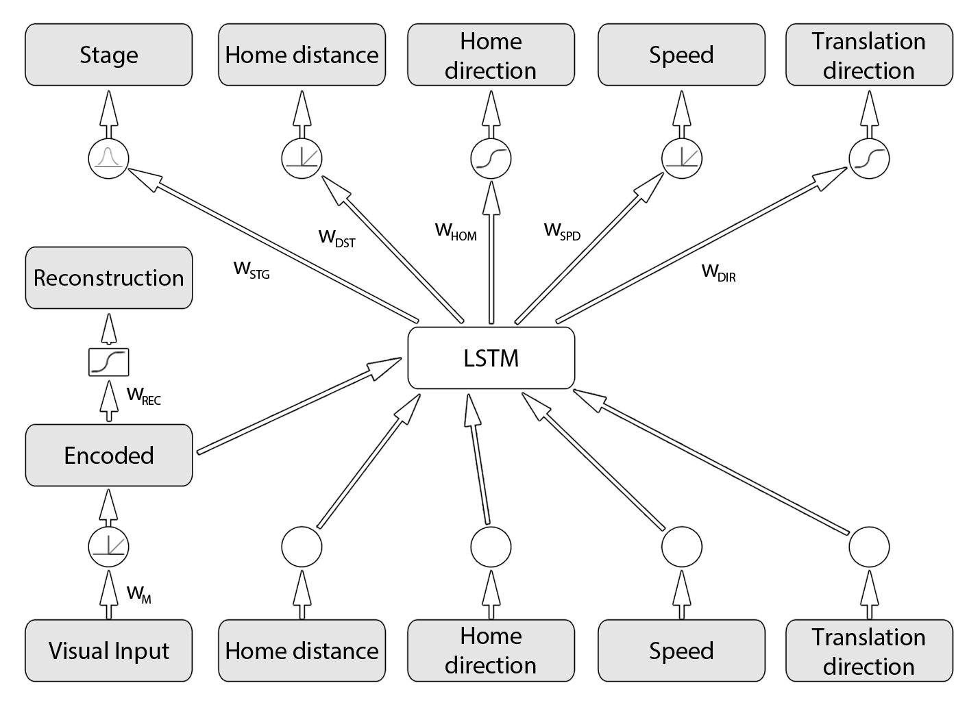
The model architecture

Slide 3

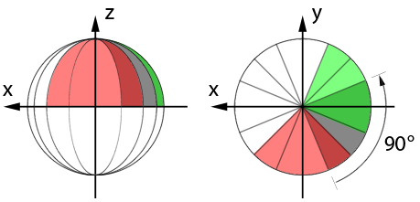
Optical encoder
Lateral inhibition
ZCA whitening
M1 & M2 neurons
Non-linear
localization
Reconstruction
Learn to

Slide 4
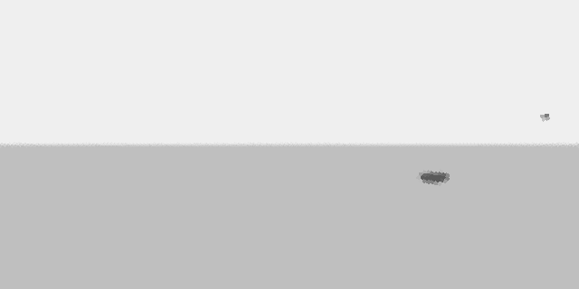
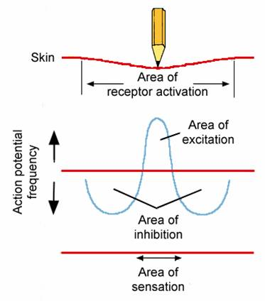
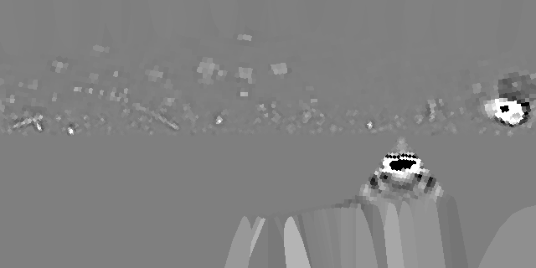
Lateral inhibition

Slide 5
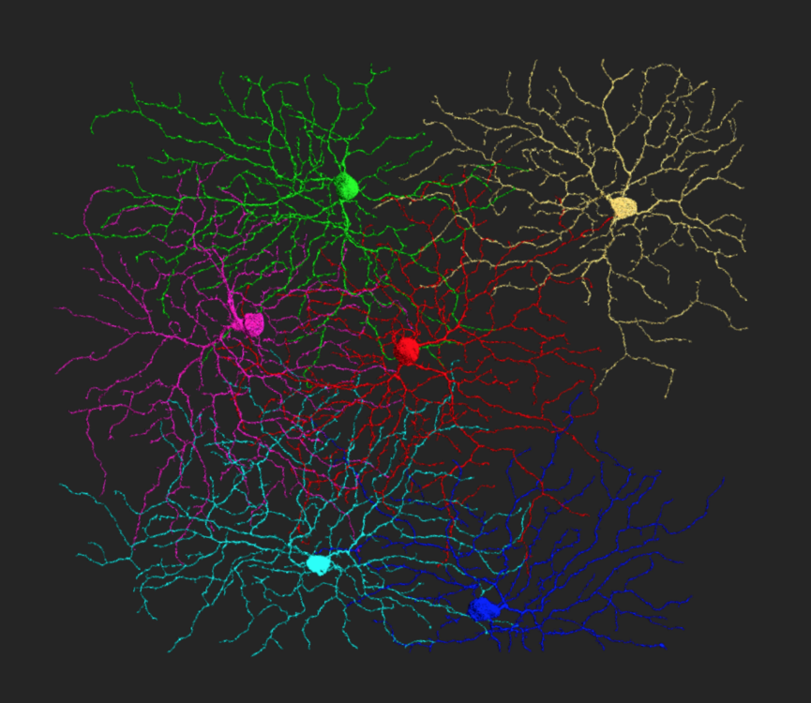
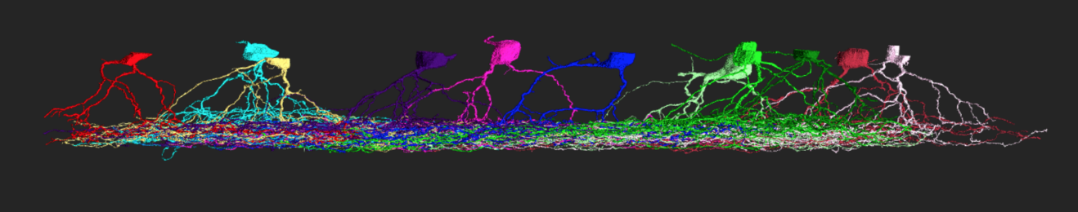
Monostratified neurons
M1 neurons
Restricted receptive field
M2 neurons
Cover the entire panoramic view
http://blog.eyewire.org/the-seung-detector-aka-museum-eyewire-org/

Slide 6
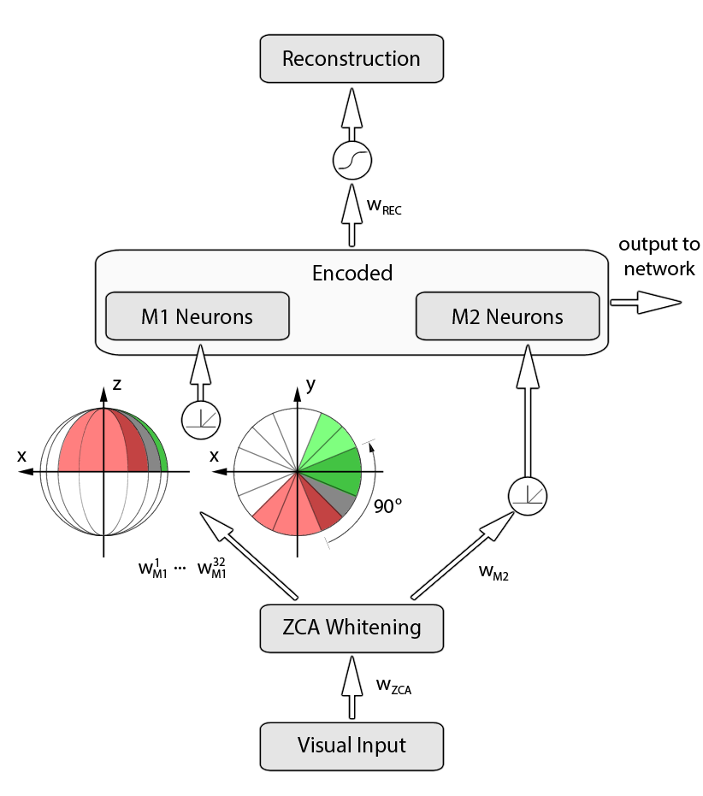
The optical auto-encoder

Slide 7
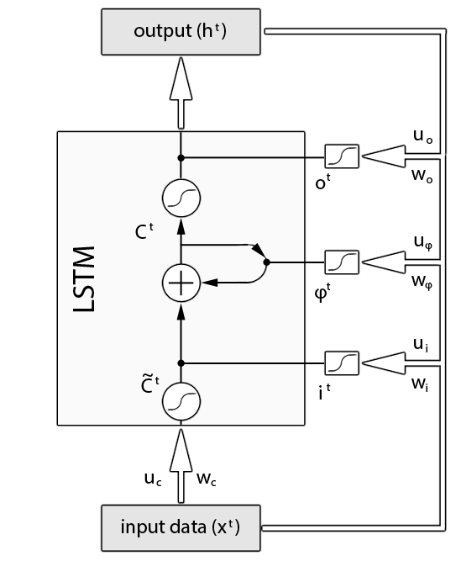
The behavioural decoder
Integrate the past
Remember to forget
Make decisions about the future

Slide 8
The data-set
527 runs
Short trials
Simple and clear reactions
254 runs
Long trials
Multiple reactions in every experiment
Extract features that crabs use in order to make decisions
Home vector
Self translation
Visual information
Stage detection

Slide 9
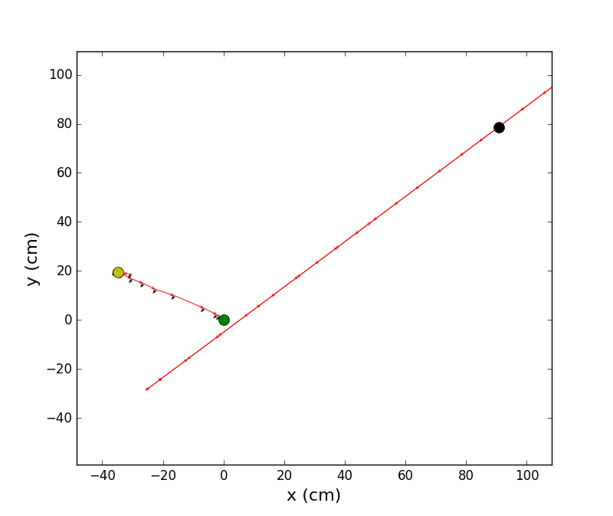
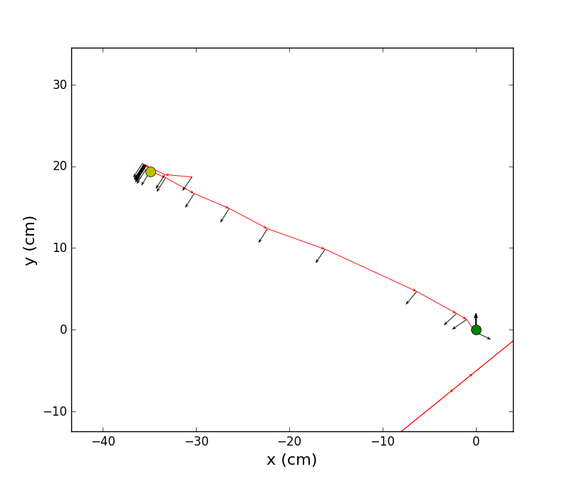
Home vector & translation

Slide 10
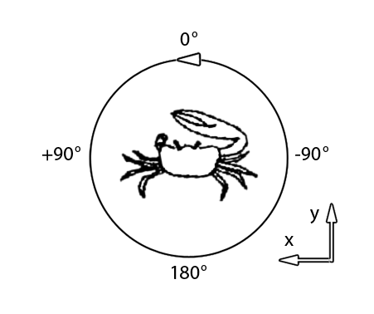
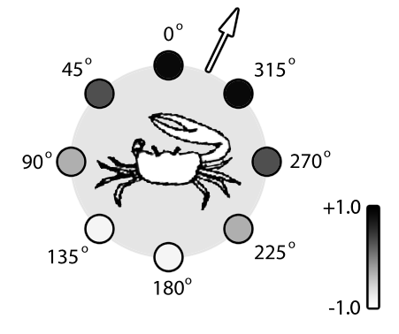
Coordinate system & compass encoding

Slide 11
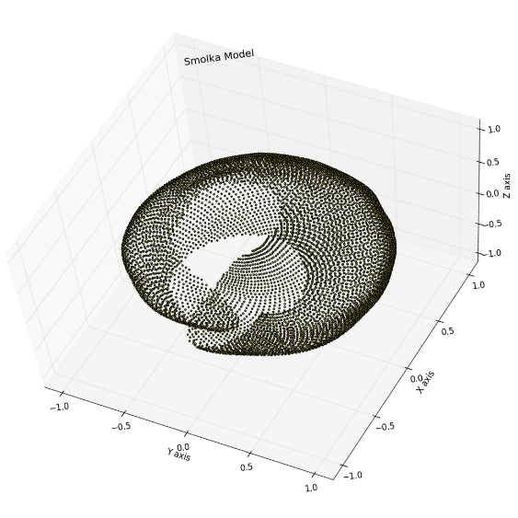
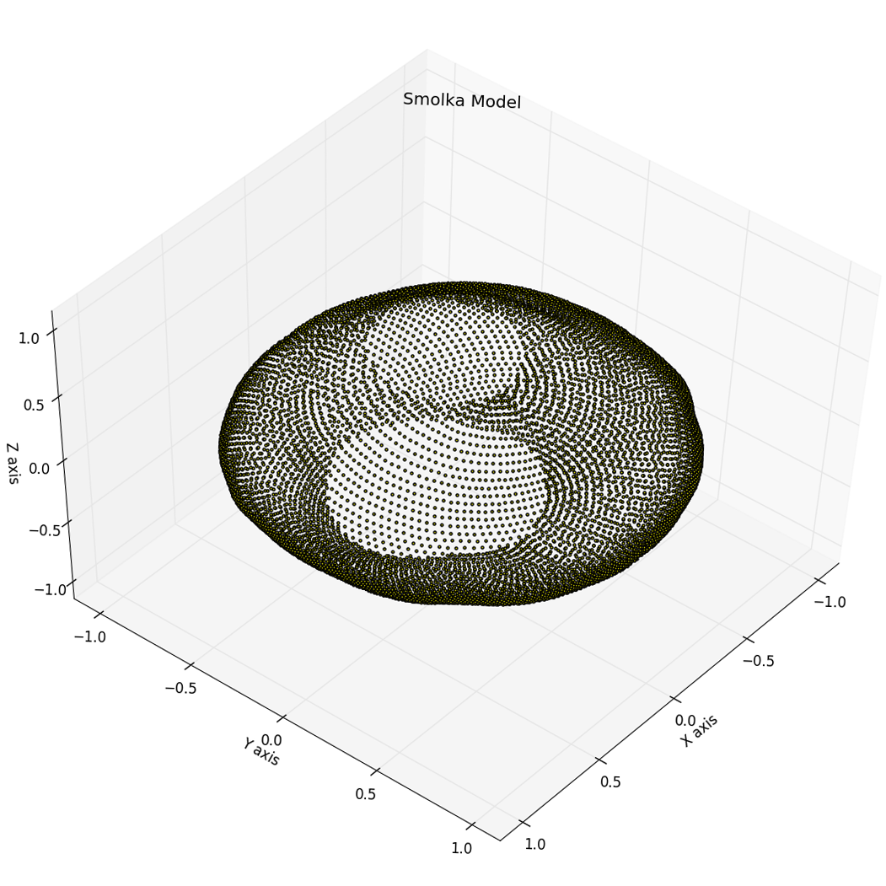
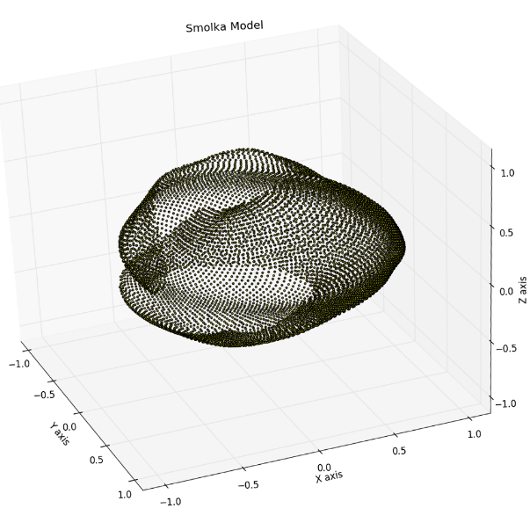
Visual information

Slide 12
Visual information

Slide 13
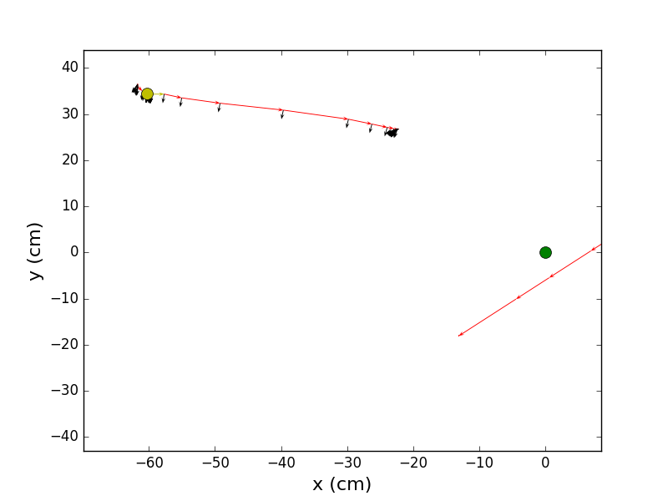
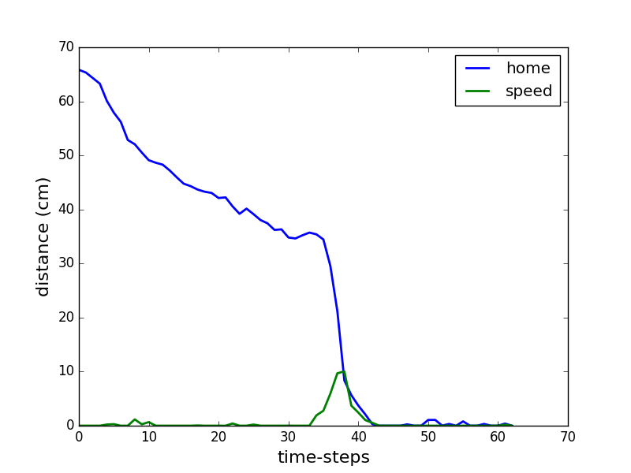
Experimental results: trial 1
Notes:
The crab stops far from his burrow but consume the whole burrow distance. He wrongly decreased his burrow distance at the beginning because he was in home-run stage. It seems that, despite the speed and direction of the crabs, there is also a correlation in the burrow-distance value and the stage.

Slide 14
Experimental results: trial 1

Slide 15
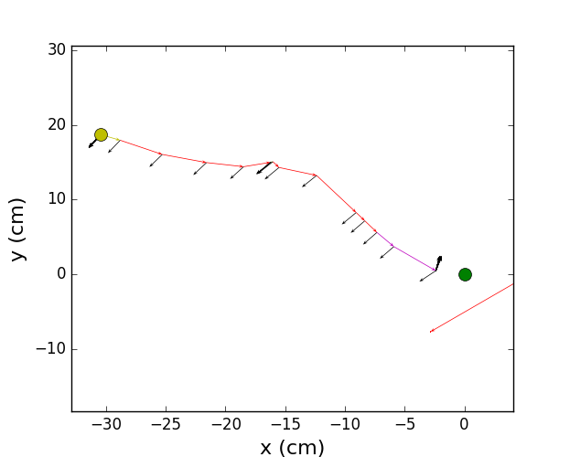
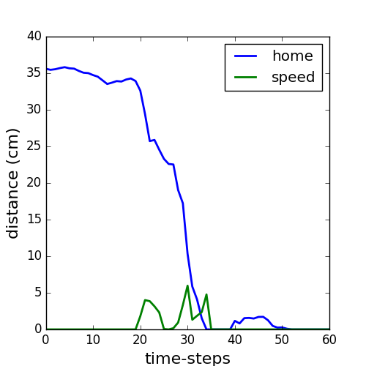
Experimental results: trial 2
Notes:
Here the crab goes close enough to the burrow consuming correctly his burrow-distance using his speed. Notice the change of the stages from foraging to home-run and then burrow descent.

Slide 16
Experimental results: trial 2

Slide 17
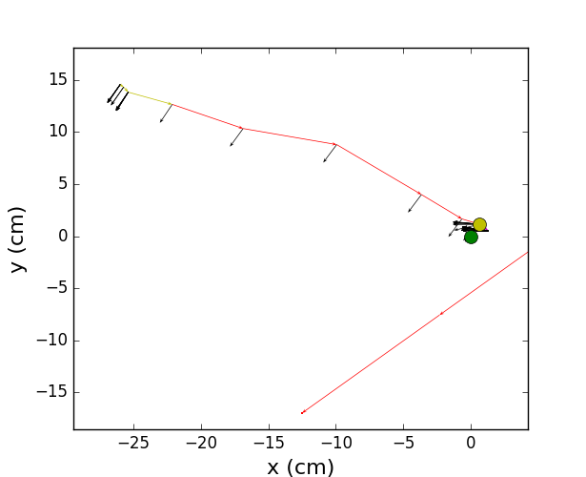
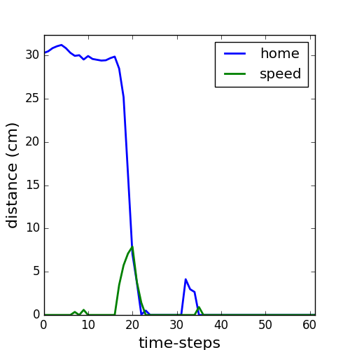
Experimental results: trial 3
Notes:
Notice that he starts doing some small steps closer to his burrow using foraging rather than freezing. Nice motion and then try to align himself with his burrow.

Slide 18
Experimental results: trial 3

Slide 19
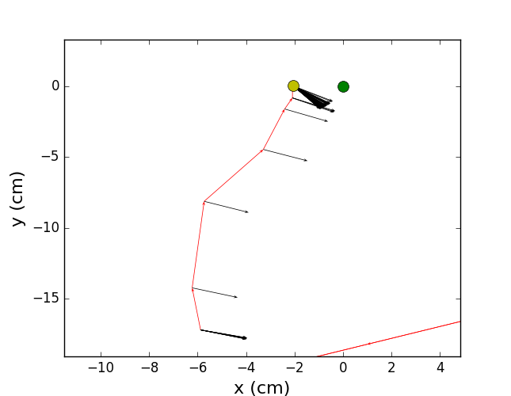
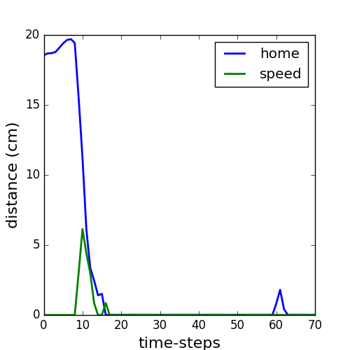
Experimental results: trial 4
Notes:
The crab runs towards his burrow but not in a straight line. When he stops, he tries to align himself with the burrow. It seems like he recognise the distinct tasks he has to perform and he prioritize them, giving a greater priority to the home-run rather than the alignment to the burrow. This is not what we know about the biological crabs.

Slide 20
Experimental results: trial 4

Slide 21
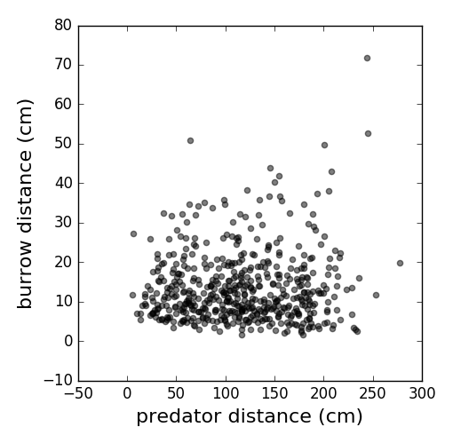
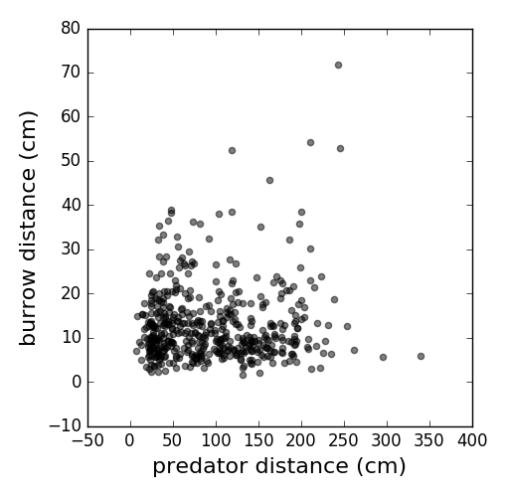
Experiments
Normal conditions
Without translation feedback
Notes:
The crab waits the predator to come closer in order to proceed in home-run. This shows a clear relationship between his translation and response time.

Slide 22
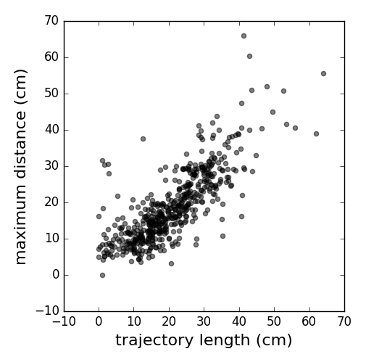
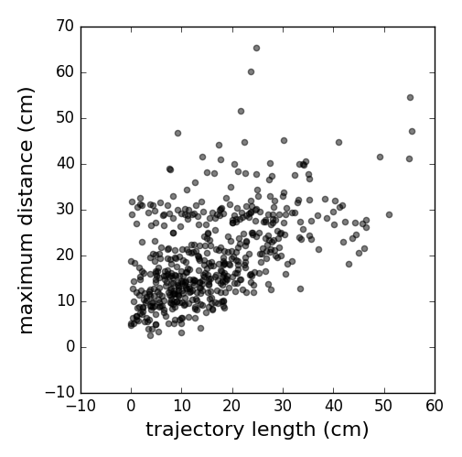
Experiments
Normal conditions
Without translation feedback
Notes:
In normal conditions there is a correlation between the crabs initial position and his trajectory length. Cutting the translation feedback this correlation becomes weak.

