Slide 1
Lesson 2. Basic terms
Detailed presentation of Lesson2 with pictures and links based on style and template of Lesson1

Slide 2
Table of contents
UML notations
Java basic data types
Java access modifiers
Java non access modifiers
Java constructors
Using the “this” keyword in Java
Using “void” keyword in Java
Using “return” keyword in Java
Creating an Object
Source file declaration rules

Slide 3
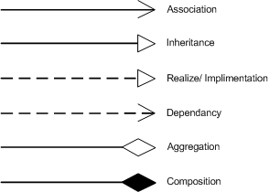
UML notations
Class diagrams are widely used to describe the types of objects in a system and their relationships. Class diagrams model class structure and contents using design elements such as classes, packages and objects. Class diagrams describe three different perspectives when designing a system, conceptual, specification, and implementation.
http://www.codeproject.com/Articles/22769/Introduction-to-Object-Oriented-Programming-Concep#Class_Diagram

Slide 4
Java basic data types
There are two data types available in Java:
Primitive Data Types (byte, short, int, long, float, double, boolean, char).
Reference/Object Data Types - reference variables are created using defined constructors of the classes. They are used to access objects. These variables are declared to be of a specific type that cannot be changed.
http://www.tutorialspoint.com/java/java_basic_datatypes.htm

Slide 5
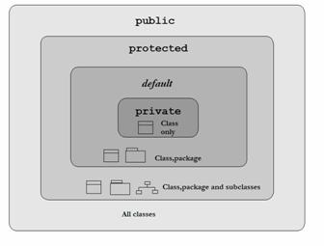
Java access modifiers
Java provides a number of access modifiers to set access levels for classes, variables, methods and constructors. The four access levels are:
Visible to the package. No modifiers are needed (default).
Visible to the class only (private).
Visible to the world (public).
Visible to the package and all
subclasses (protected).
http://www.tutorialspoint.com/java/java_access_modifiers.htm

Slide 6
Java non access modifiers
Java provides a number of non-access modifiers to achieve many other functionality.
The static modifier for creating class methods and variables
The final modifier for finalizing the implementations of classes, methods, and variables.
The abstract modifier for creating abstract classes and methods.
The synchronized and volatile modifiers, which are used for threads.
http://www.tutorialspoint.com/java/java_nonaccess_modifiers.htm

Slide 7
Java constructors
A java constructor has the same name as the name of the class to which it belongs.
Constructors never return a value.
Constructors may include parameters of various types.
When the constructor is invoked using the new operator, the types must match those that are specified in the constructor definition.
Java provides a default constructor which takes no arguments and performs no special actions or initializations, when no explicit constructors are provided.
http://www.wideskills.com/java-tutorial/java-constructors

Slide 8
Using the “this” keyword in Java
Within an instance method or a constructor, this is a reference to the current object — the object whose method or constructor is being called. You can refer to any member of the current object from within an instance method or a constructor by using this.
The most common reason for using the this keyword is because a field is shadowed by a method or constructor parameter.
From within a constructor, you can also use the this keyword to call another constructor in the same class. Doing so is called an explicit constructor invocation.
https://docs.oracle.com/javase/tutorial/java/javaOO/thiskey.html

Slide 9
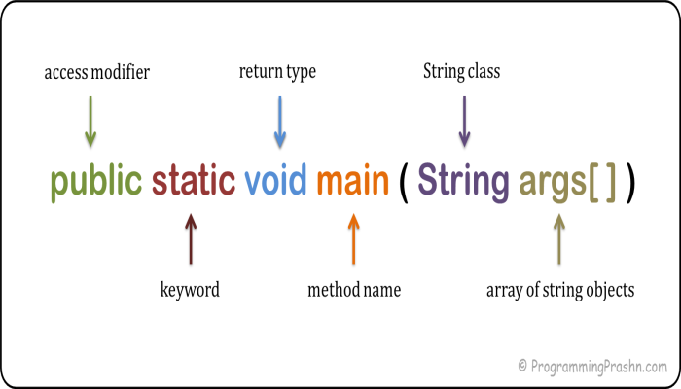
Using “void” keyword in Java
Used at method declaration and definition to specify that the method does not return any type, the method returns void.
https://en.wikibooks.org/wiki/Java_Programming/Keywords/void

Slide 10


Using “return” keyword in Java
The return statement is used to explicitly return from a method. That is, it causes program control to transfer back to the caller of the method.
The return statement immediately terminates the method in which it is executed.
http://www.java-samples.com/showtutorial.php?tutorialid=280

Slide 11
Creating an Object
There are three steps when creating an object from a class:
Declaration: A variable declaration with a variable name with an object type.
Instantiation: The 'new' key word is used to create the object.
Initialization: The 'new' keyword is followed by a call to a constructor. This call initializes the new object.

Slide 12
Source file declaration rules
There can be only one public class per source file.
A source file can have multiple non public classes.
The public class name should be the name of the source file as well which should be appended by .java at the end.
If the class is defined inside a package, then the package statement should be the first statement in the source file.
If import statements are present then they must be written between the package statement and the class declaration. If there are no package statements then the import statement should be the first line in the source file.
Import and package statements will imply to all the classes present in the source file. It is not possible to declare different import and/or package statements to different classes in the source file.

Slide 13
Thank you for attention! ☺

