Slide 1
Twillio Sendgrid Inbound Email Parsing
A look at how to set up and some example use cases

Slide 2
What is Inbound Email Parsing?

Slide 3







What is Inbound Email Parsing?
Email Server
Email
Processing App

Slide 4

How to set it up?
DNS changes
Domain authentication
MX record change to mx.sendgrid.net
Endpoint configuration
Build a simple POST endpoint
Deploy your application somewhere
Configure the endpoint URL in SendGrid Backoffice
Notes:
Domain authentication can be archived in multiple different ways, you need to go case by case, the simplest way imo is setting some TXT reccords in your DNS rules.

Slide 5
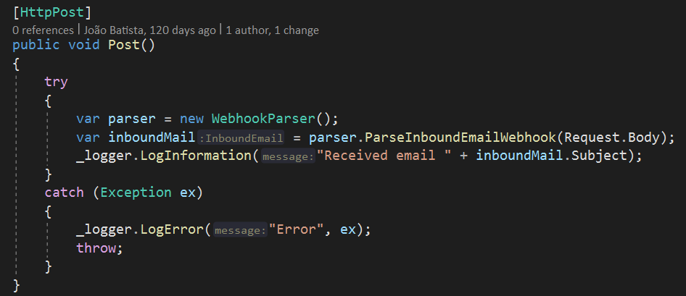
Endpoint code example
Notes:
The code to parse the email is super simple as you can see, you can use the nugget package StrongGrid, which does the parsing for you and returns an object with all the information that you might need.

Slide 6
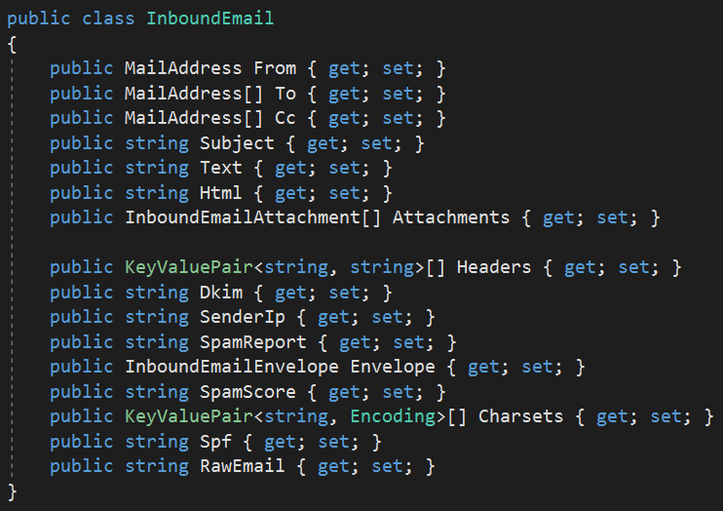
What information do you get?

Slide 7
That's it!

Slide 8
That's it! Sort of...
Notes:
With these steps you have working inbound parsing, if you send an email to the configured domain, you'll receive a post request in your application, with the entire information of the email, including attachments.
With this you would use that information and build your software solution for your use case, however, there's a few problems with this solution.

Slide 9
Problems with this solution
Unpredictability of the load
Dificulty managing downtime/maintenance
Dificult error management
Easy to have data-loss

Slide 10
A better way of implementing it..

Slide 11


A better way of implementing it..
Email
Email Server
Azure Functions
Azure Service Bus Queue
Processing App
Notes:
Azure functions have very High SLAs, so it helps a lot with unpredictable loads and also with downtime and maintenance.
Azure service bus provides error control, you can use the deadletter queue to control the errors, and also you only consume the messages when your service is actually available, so you can do maintenance on your service however you want.

Slide 12
What can you build using this?

Slide 13
What can you build using this?
Carlsberg Example Use Case
Easy ordering integration for smaller clients
Notes:
Carlsberg has smaller clients, with small or inexistent development capacity, so integrating automatic ordering systems based on API's might be very challenging for them.
With Sendgrid income parsing, we can provide an email adress and a format, and parse all incoming emails and place orders for those customers.
Implementing automatic emails on customers ERP's it's very often an easy task that they can do themselves.

Slide 14
Some more examples
Submit support requests via email
Post blog articles via email
Process email replies and update your mailing list or database
Allow users to upload pictures to their profile via email
Your imagination is the limit...

Slide 15
Hope you liked it!
Any Questions?

