Slide 1
CSE7000 - INTERNSHIP A Presentation on SmartTrip AI: Best tourist recommendation guide
Student Details
Name | E Vidya
Roll No | 20241CSE1084
Section | 5CSE01
Under the Supervision of,
Mr. Aadil Firooz
Presidency School of Computer Science and Engineering
Presidency University
Name of the Program: B. Tech (CSE)
Name of the HoD: Dr. Nagaraja S R
Name of the Program Internship Coordinator: Ms. Vidhya Rengasamy
Name of the School Internship Coordinators: Dr. Bhuvaneshwari Patil

Slide 2
About Company or Organization
AI GPU Summer Internship Program (Summer 2026) at Presidency University.
This elite training track is organized by the Presidency School of Artificial Intelligence and Advanced Computing
It is directly collaborated with NVIDIA Accelerated AI Centre of Excellence
Focuses on Machine Learning, Deep Learning, LLMs & Generative AI

Slide 3
Working domain or the technology
Domain: Artificial Intelligence & GPU Computing
Key Features
High-performance GPU acceleration
Real-time AI model training and inference
Hands-on coding with PyTorch & Hugging Face

Slide 4
Objectives of the work
Developed an AI-powered tourism planning and recommendation system.
To reduce the time and effort involved in planning trips
To recommend tourist attractions based on users interests
It includes destination, hotel, and budget planning into a single application
To generate efficient day-wise travel

Slide 5
Methodology Used / Course Description
Collected and integrated tourism and hotel dataset
Datasets used are places.csv, Top Indian Places to Visit.csv, Top Indian Places to Visit.csv, hotel_details_clean.csv
Performed data cleaning and preprocessing
Generated text embeddings using the all-MiniLM-L6-v2 Transformer model
Built an interactive web application using Streamlit

Slide 6
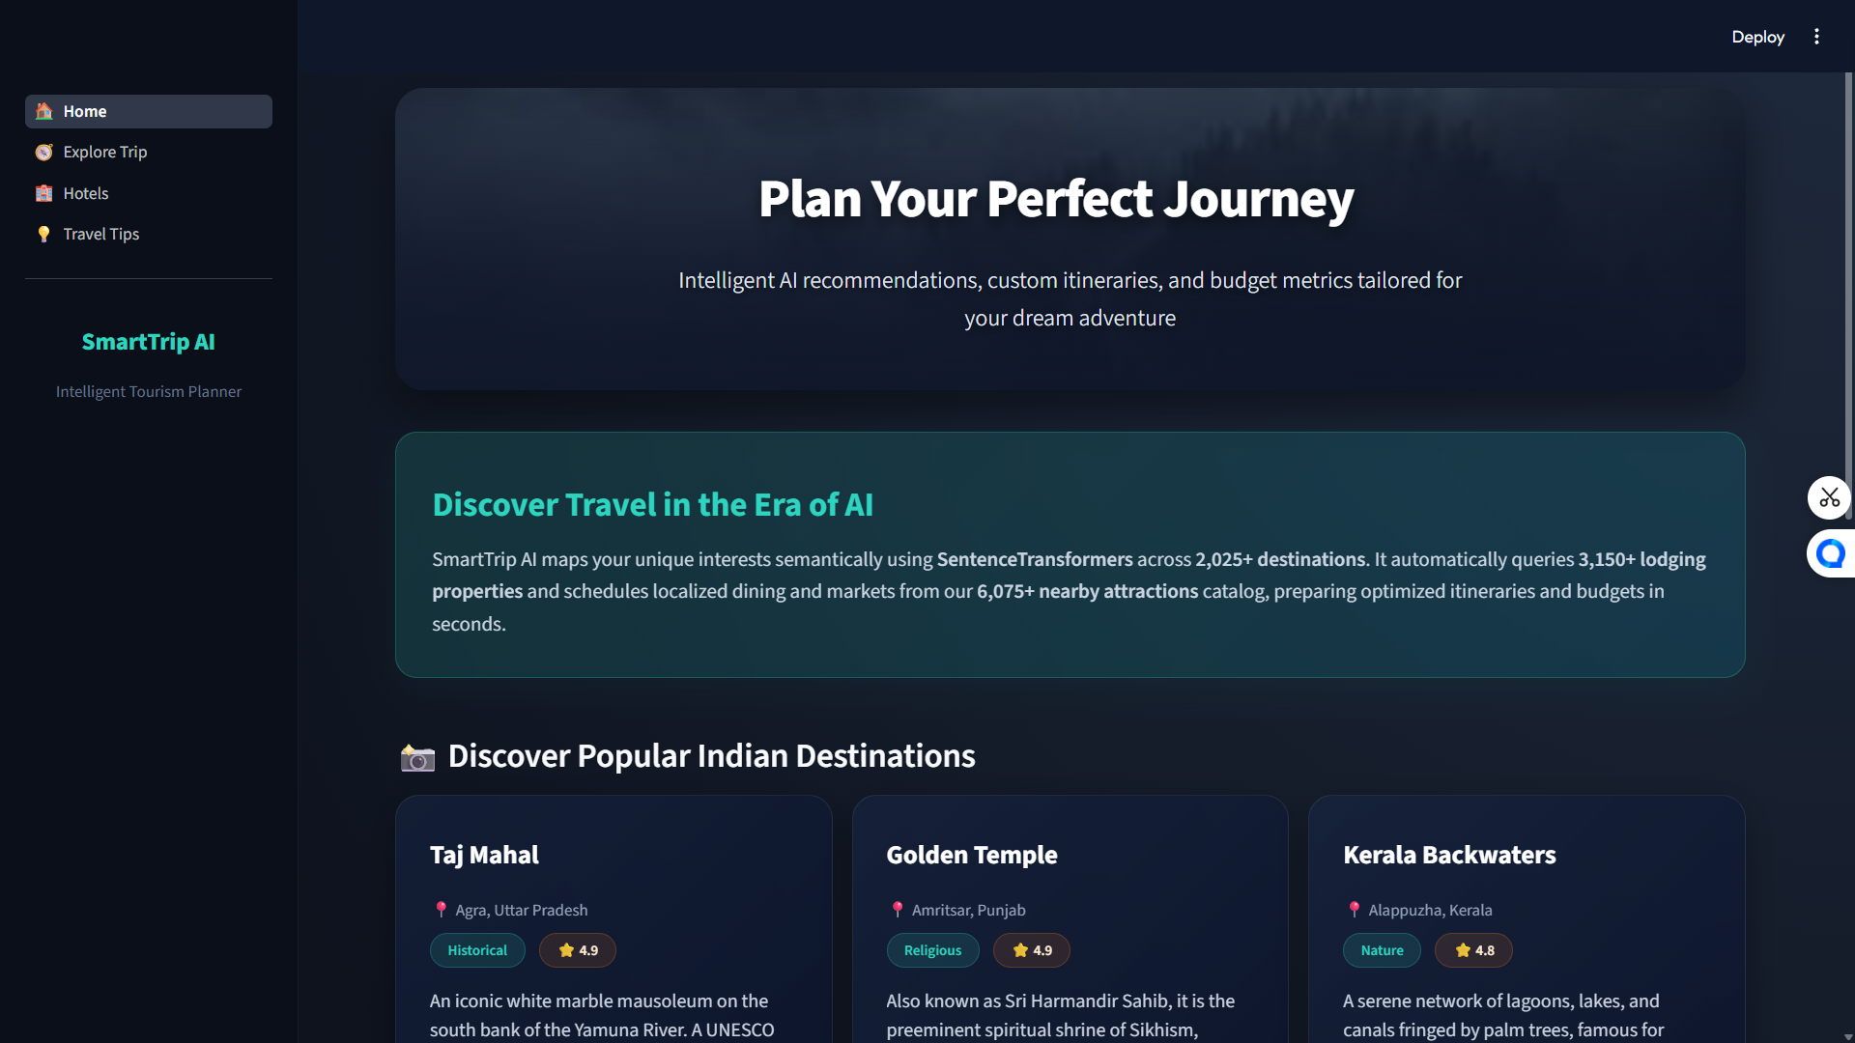
Results

Slide 7
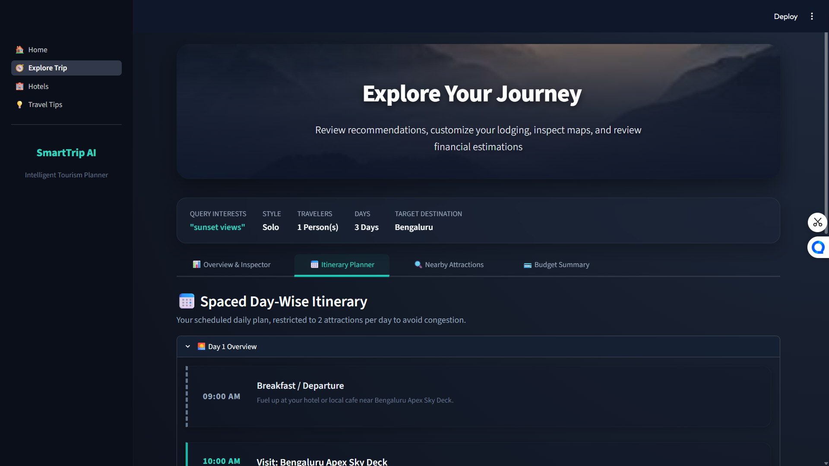
Results

Slide 8
Conclusion
Developed a user-friendly AI-based tourism planning application
The project highlights the practical application of AI in solving real-world travel planning challenges
This project demonstrates how technology can make tourism more accessible, efficient, and user-centric.
This project has the potential to enhance tourism experiences and can be further expanded into a real-world travel assistant.

Slide 9
Q&A

Slide 10
Thank you !!

