Slide 1

A Census Analysis: What Determines Earnings Above and Below $50,000 in the US?
Evie Mills

Slide 2
Problem Statement
Goal: to identify characteristics associated with US citizens that earn more or less than $50,000 per year based off data collected in the census.
Why? Identifying such characteristics can help inform policies around social welfare, job training, education, etc.

Slide 3
Data Source
A stratified sample of approximately 300,000 individuals from the US Census, ensuring a representative distribution of key variables.
Key Variables: The dataset includes a range of demographic and economic features, such as age, education, occupation, and income, among others.
Files Included:
census_income_learn.csv
census_income_test.csv
census_income_metadata.txt
census_income_additional_info.pdf

Slide 4
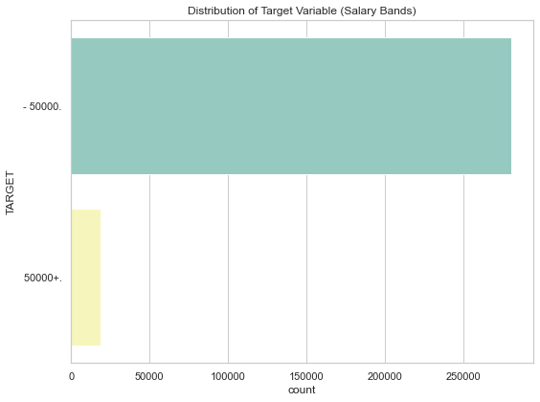
Imbalanced Dataset
Class Distribution (Counts):
< $50,000 280,717 (93.8%)
>$50,000 18,568 (6.2%)

Slide 5
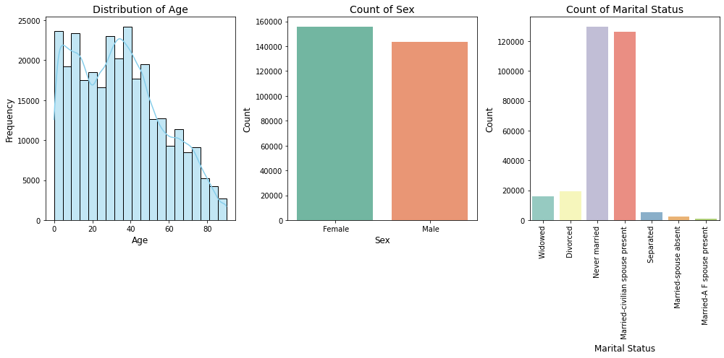
Age, Gender and Marital Status

Slide 6
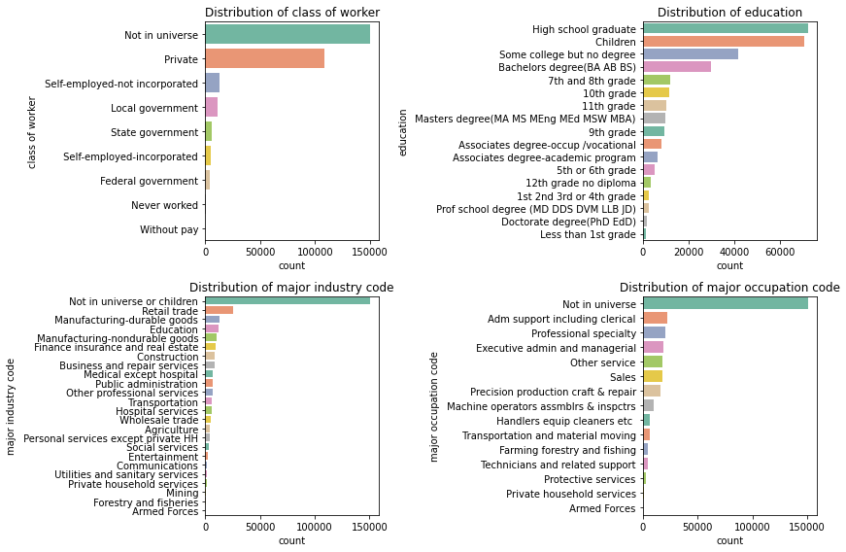
Education and employment variables

Slide 7
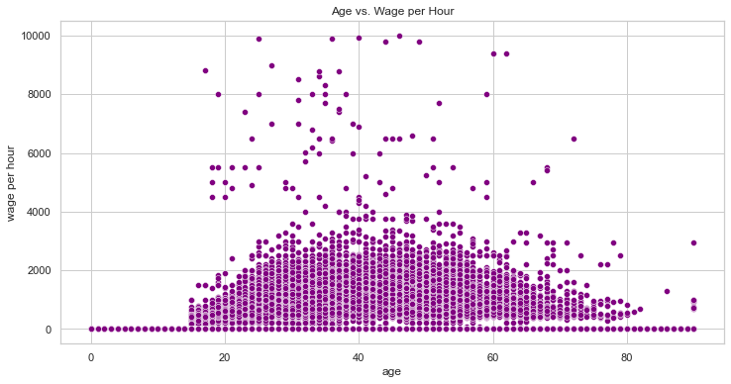
Age vs Wage per Hour

Slide 8
Data Preparation
The dataset was divided into two-thirds for training and one-third for testing.
Categorical variables (such as education, marital status, and occupation) were encoded using label encoding, converting the categorical values into numerical representations suitable for model training.

Slide 9
Modelling
Model 2 – XGBoost with SMOTE
Model 1 -XGBoost
Feature Set - Models were trained using all 38 features,
Model Selection - Two powerful models were fit to the data:
XGBoost Classifier
Random Forest Classifier
Handling Class Imbalance Due to the class imbalance in the target variable (more individuals earning <$50,000 than >$50,000), oversampling was used to balance the dataset.
Model Evaluation
Accuracy: Overall correctness of the model's predictions.
Precision: The proportion of true positive predictions among all positive predictions made by the model.
Recall: The proportion of true positive predictions among all actual positive instances in the dataset.
Gradient boosting methodology
Gradient boosting methodology + addressing class imbalance
Model 4 – Random Forest with SMOTE
Model 3 – Random Forest
Decision tree methodology + addressing class imbalance
Decision tree methodology

Slide 10
Introduction to XGBoost & Random Forest
XGBoost:
An advanced machine learning algorithm that builds multiple trees to make predictions.
It learns from its mistakes by correcting errors in each new tree.
Highly accurate
Great for complex data but may take longer to train.
Random Forest:
A more simple and effective algorithm that builds many decision trees in parallel.
Each tree makes a prediction, and the final answer is based on the average of all trees.
Easy to use and works well for most problems with minimal tuning.
Fast to train and can handle large datasets efficiently.

Slide 11
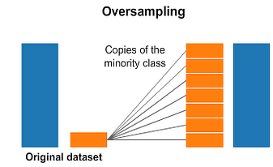
Oversampling
Oversampling is used to fix class imbalance in datasets, where one class (like the minority class) has fewer samples than the other.
We used SMOTE (Synthetic Minority Over-sampling Technique), which creates new examples for the minority class by combining existing samples, instead of just copying them.
Purpose: Oversampling helps balance the classes, so the model can better learn the patterns of the minority class, improving predictions.
However, if too many synthetic samples are created, it could lead to overfitting, where the model becomes too tailored to the training data and performs poorly on new data.

Slide 12
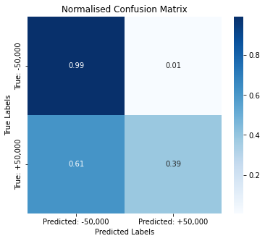
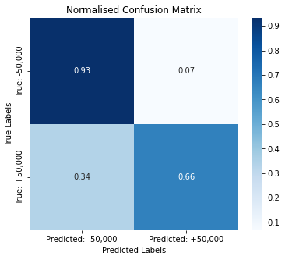
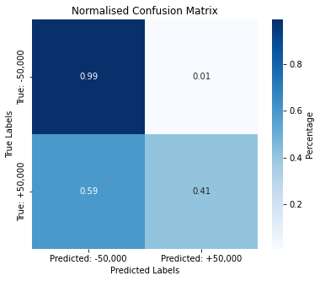
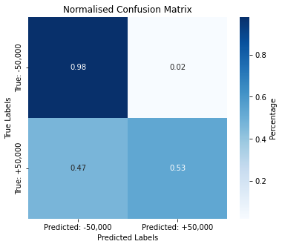
Model 1 XGBoost
Model 2
XGBoost + SMOTE
Model 3
RF
Model 4
RF + SMOTE

Slide 13
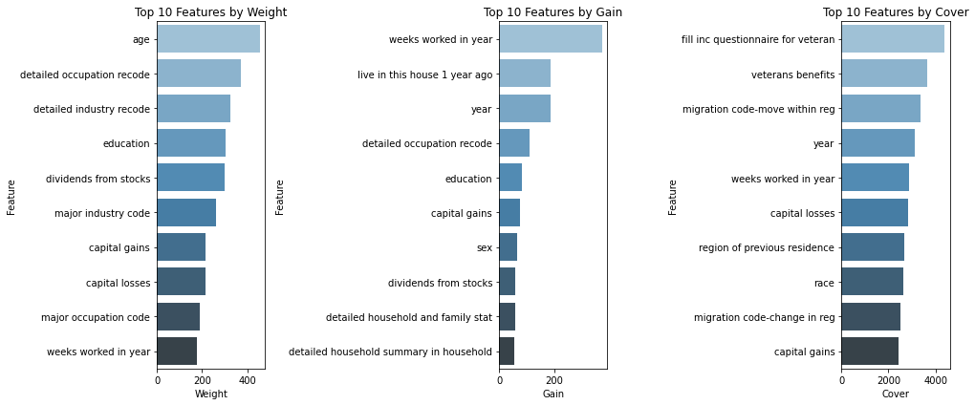
Model 2: XGBoost with SMOTE is the best performing
What features are the most influential on the model decisions?
Notes:
Weight = most influential
Gain = most crucial
Cover = effecting the most samples

Slide 14
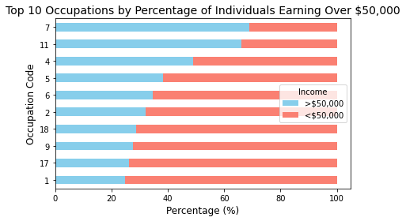
Occupation Insights
7: Financial Specialists
11: Surveyors, Cartographers, and Photogrammetrists
4: Business and Financial Operations Occupations Agents and Business Managers of Artists, Performers, and Athletes
9: Actuaries, Mathematicians, Operations Research Analysts, Statisticians, Misc. Mathematical Science Occupations

Slide 15
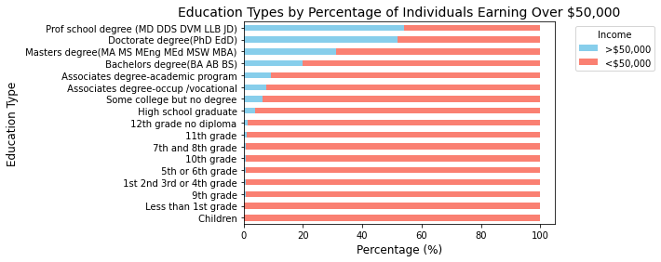
Education
Higher proportion of our sample with a professional school degree earning greater than $50,000 compared to doctorate degree

Slide 16
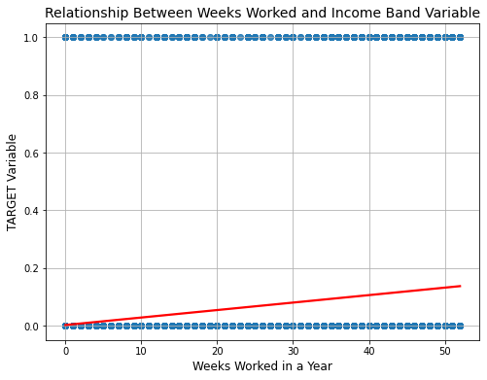
Numeric Variables
Top 5 Strongest Relationships with Income Group:
Weeks worked in year: 0.2622
Capital gains: 0.2404
Number persons worked for employer: 0.2241
Dividends from stocks: 0.1785
Capital losses: 0.1474

Slide 17
Limitations and Future Improvements
Feature engineering e.g. scaling numerical features
Hyperparameter Tuning & Cross-Validation
Limited Granularity of Occupation Data
Absence of Economic Factors
Geographical Deprivation Factors

Slide 18

Any Questions?

