Slide 1

Design and implementation of an ai system for personalized learning and academic progress tracking
PRESENTED BY
NAME OF STUDENT
MATRICULATION NUMBER
DEPARTMENT OF COMPUTER SCIENCE
FACULTY OF SCIENCE
EDO STATE UNIVERSITY IYAMHO
SUPERVISOR: ______________

Slide 2
BACKGROUND OF THE STUDY
- Universities increasingly use digital platforms for learning and student support.
- Students need personalized help with weak topics, study planning, and mock tests.
- Lecturers need timely insight into course performance and intervention needs.
- Generic AI tools are not designed around ESUI data, privacy, or role-based access.
- Eve was developed as an AI academic companion for Edo State University Iyamho.

Slide 3
STATEMENT OF THE PROBLEM
- Academic guidance is spread across portals, offices, websites, and course materials.
- Students may know their scores but lack continuous improvement guidance.
- Lecturers may not easily connect student practice activity to teaching intervention.
- Generic chatbots can hallucinate or expose private data if poorly governed.
- A role-aware AI system is needed for personalized learning and progress tracking.

Slide 4
AIM AND OBJECTIVES
- Aim: To design and implement an ai system for personalized learning and academic progress tracking.
- Design a responsive academic-support interface.
- Implement personalized student learning progress tracking.
- Identify weak topics and recommend learning sessions.
- Implement guided sessions with quiz scoring, feedback, and SQLite history.
- Support upload-assisted learning questions and moderated peer notes.
- Provide lecturer assigned-course analytics with guardrails and RAG.

Slide 5
SIGNIFICANCE OF THE STUDY
- Students receive personalized academic guidance and weak-topic support.
- Lecturers receive course-level evidence for teaching intervention.
- Prospective candidates receive admission-readiness and public guidance.
- The university gains a prototype for a future institutional AI platform.
- The system improves support while enforcing privacy and cybersecurity controls.

Slide 6
LITERATURE REVIEW
- RAG improves factual grounding by combining retrieval with generation.
- LLMs can support explanation, tutoring, and summarization when constrained.
- AI risk frameworks emphasize governance, privacy, safety, and accountability.
- Universities such as ASU, University of Michigan, Georgia State, and University of Houston show growing AI adoption.
- Identified gap: an ESUI-focused system for personalized learning and progress tracking.

Slide 7
ANALYSIS OF THE EXISTING SYSTEM
- Students rely on separate sources for guidance and course support.
- Public information, course materials, and academic records are not unified.
- Existing support may not provide continuous personalized recommendations.
- Lecturer intervention can depend on delayed or fragmented data.
- Generic AI tools lack ESUI-specific governance and privacy controls.

Slide 8
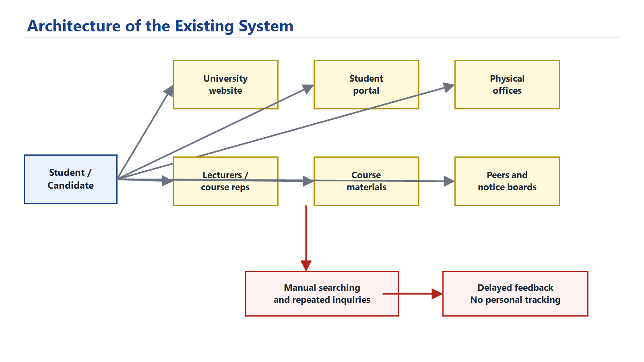
ARCHITECTURE OF THE EXISTING SYSTEM
- Information is scattered across website, portal, offices, lecturers, course materials, and peers.
- The student must manually search across several sources.
- There is limited personalization, delayed feedback, and no continuous progress tracking.

Slide 9
ANALYSIS OF THE PROPOSED SYSTEM
- Proposed system: Eve.
- Guest mode for public and admission guidance.
- Student mode for personalized learning and progress tracking.
- Lecturer mode for assigned-course analytics.
- Upload-assisted Ask Eve support for student notes.
- Moderated peer notes and admin knowledge governance.
- RAG for verified ESUI knowledge and guardrails for privacy protection.
- SQLite persistence and optional OpenAI mode for natural responses.

Slide 10
DESIGN METHODOLOGY
- Design and implementation research approach.
- Iterative prototyping model.
- Requirement analysis from project description and ESUI context.
- Backend implemented with Python FastAPI.
- Client implemented with Flutter.
- Testing through API checks, Flutter analysis, widget tests, and security scenarios.

Slide 11
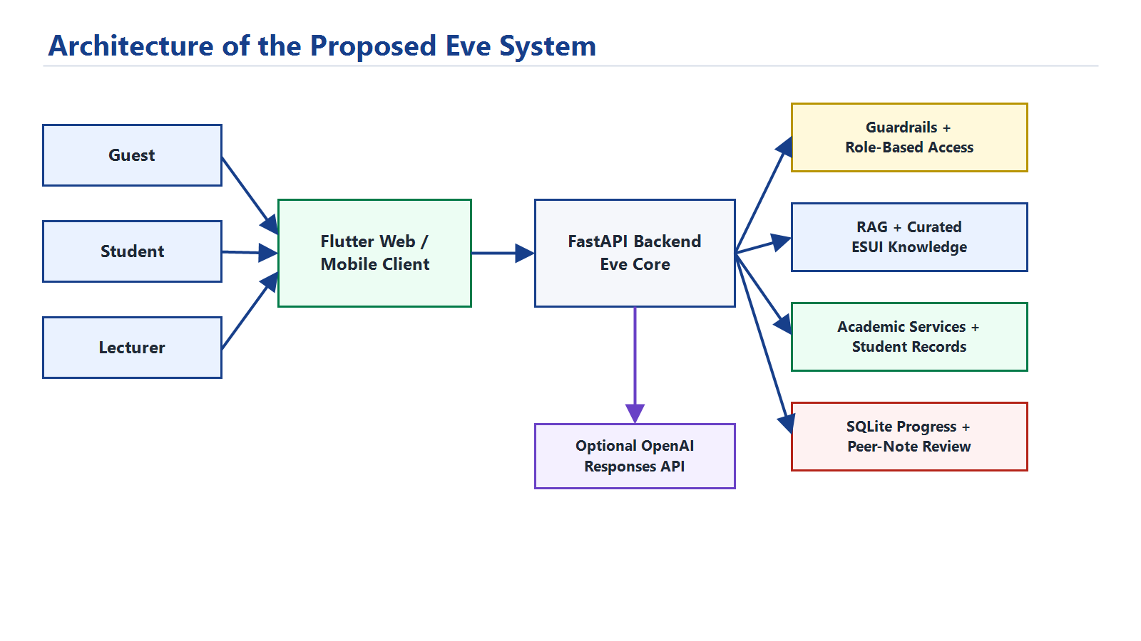
ARCHITECTURE OF THE PROPOSED SYSTEM
- Flutter connects guest, student, and lecturer users to a FastAPI backend.
- Guardrails and role-based access control protect private academic data.
- RAG, academic services, SQLite, peer-note review, and OpenAI mode work together.

Slide 12
SYSTEM REQUIREMENTS
- Hardware: laptop or desktop computer with internet for OpenAI mode.
- Software: Windows, Flutter SDK, Python, FastAPI, Uvicorn, SQLite, browser.
- Backend URL: http://127.0.0.1:8010.
- Flutter web URL: http://127.0.0.1:8011.
- API key is stored privately in .env and never hard-coded.

Slide 13
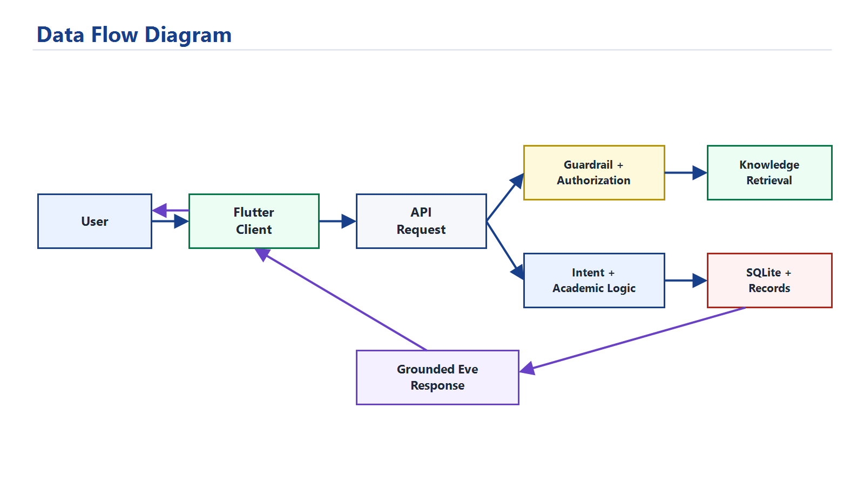
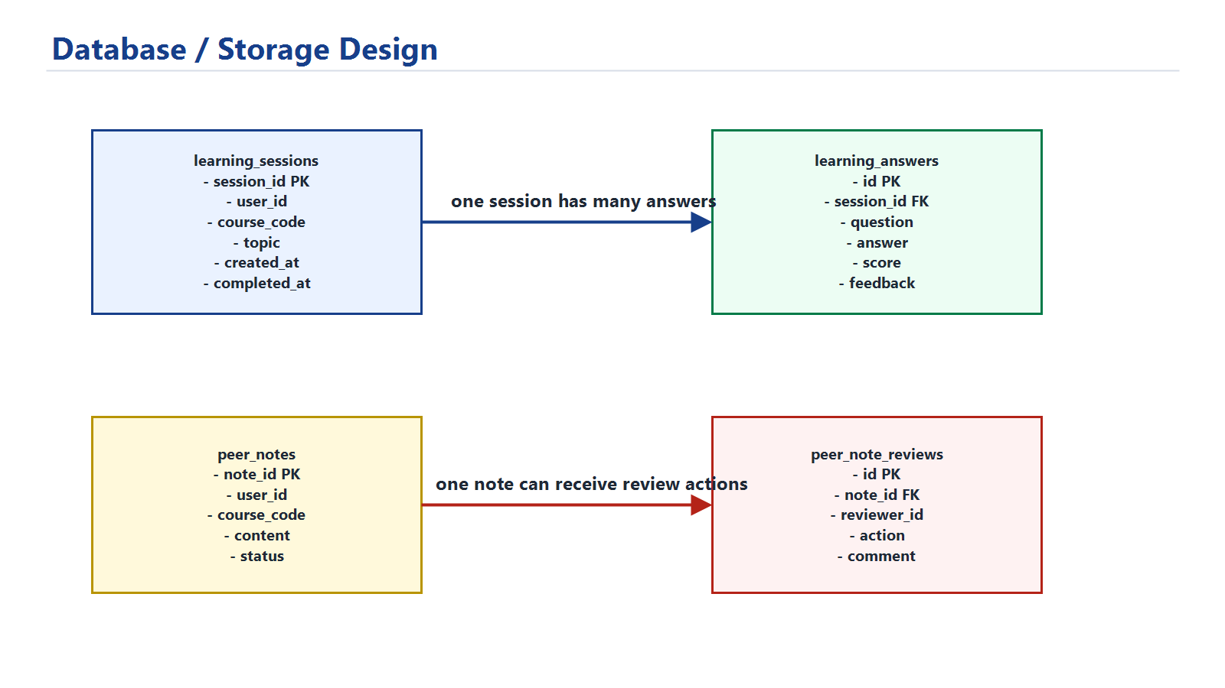
SYSTEM DIAGRAMS
- Data flow shows how a request becomes a grounded Eve response.
- Storage design separates learning progress from moderated peer-note review.
- Use case, sequence, and ERD details are documented in Chapter Three.

Slide 14
OVERVIEW OF IMPLEMENTATION
- Entry and role selection screen.
- AI chat interface.
- Admission readiness estimator.
- Student learning progress dashboard.
- Guided learning session mode with feedback history.
- Upload-assisted Ask Eve questions.
- Moderated peer-note contribution and lecturer review.
- Lecturer teaching workbench, admin governance, and OpenAI response layer.

Slide 15
IMPLEMENTATION PROCEDURES
- Created curated ESUI knowledge and sample academic records.
- Built FastAPI backend routes and Flutter screens.
- Implemented role-based access and prompt-injection checks.
- Added RAG retrieval and OpenAI response mode.
- Added learning profile, guided sessions, quiz scoring, and SQLite persistence.
- Added upload-assisted questions and moderated peer notes.
- Added lecturer saved-session analytics and tested the system.

Slide 16
PROGRAMMING LANGUAGE AND TOOLS USED
- Flutter and Dart: responsive client and future Android deployment.
- Python: backend and AI orchestration.
- FastAPI: REST API server.
- SQLite: persistent progress tracking.
- JSON: prototype knowledge and academic records.
- OpenAI Responses API: optional natural language generation.
- Render: public deployment for user review.

Slide 17
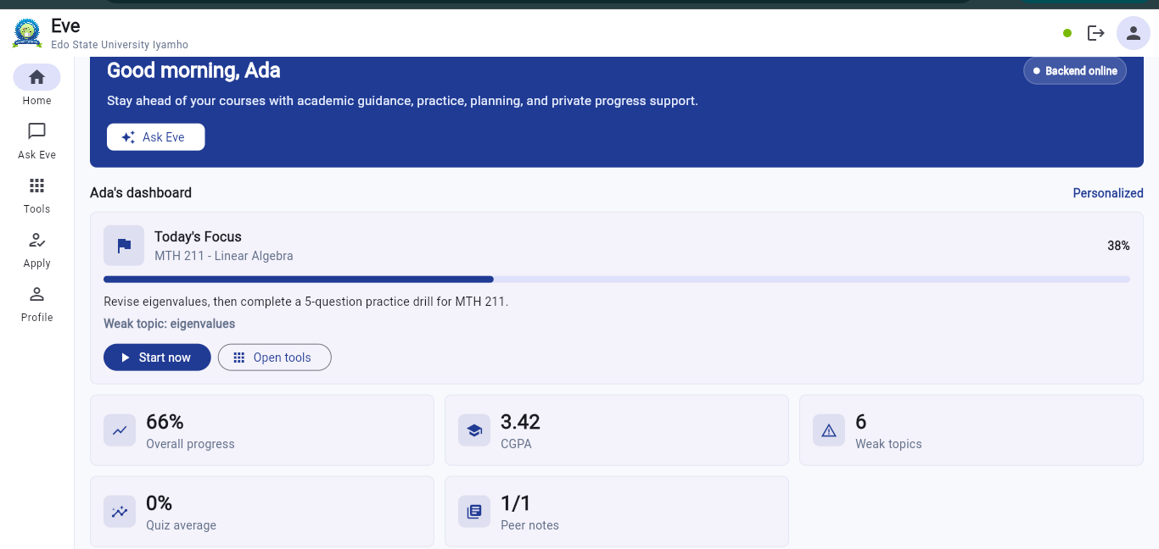
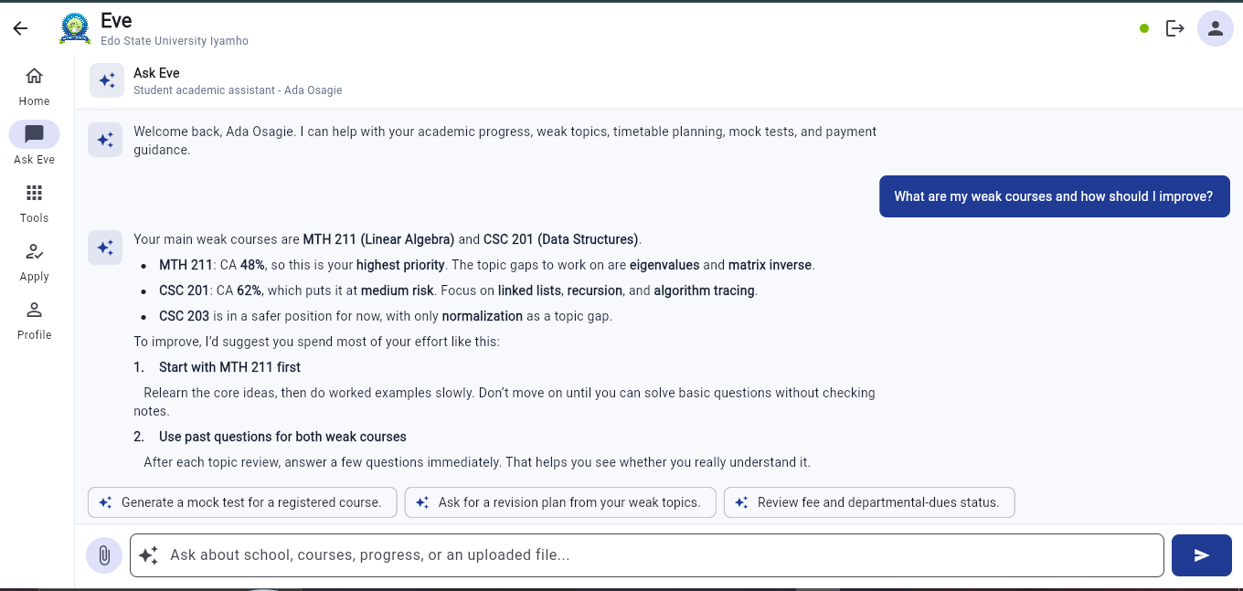
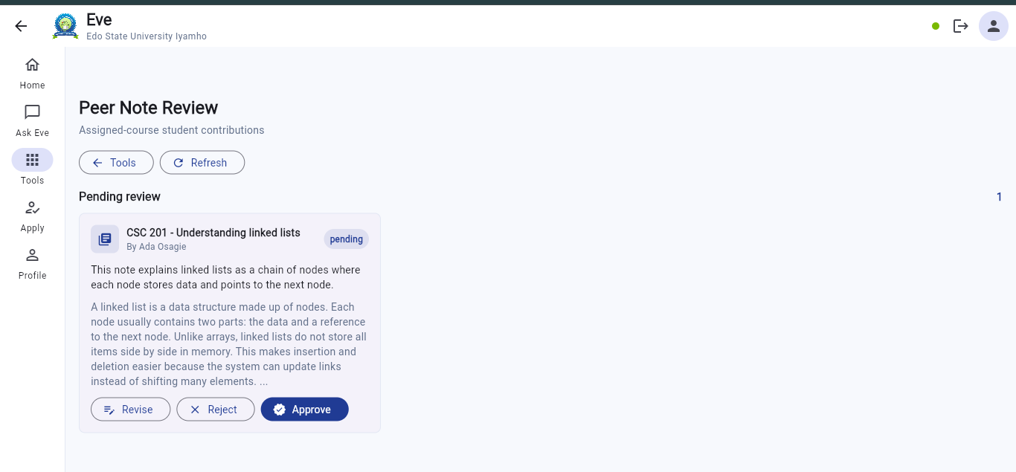
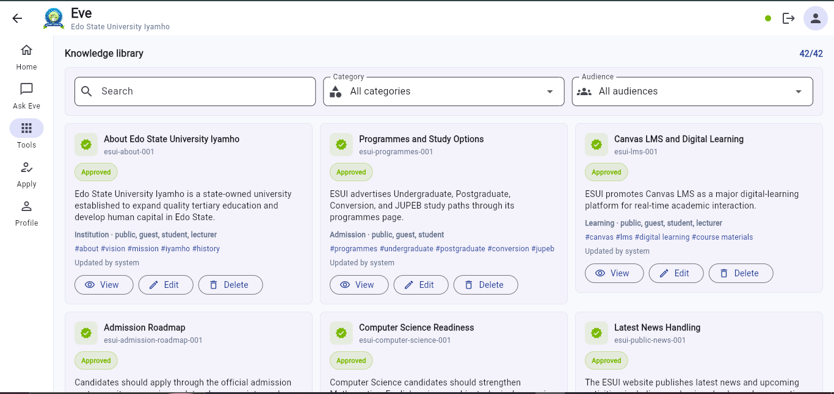
SYSTEM INTERFACE / SCREENSHOTS
- Personalized dashboard, Ask Eve conversation, lecturer review, and knowledge governance are shown below.

Slide 18
DISCUSSION OF RESULTS / EVALUATION
- python -m compileall -q api: passed.
- flutter analyze: no issues found.
- flutter test: all tests passed.
- Backend health endpoint returned ok.
- Student progress and progress-history endpoints returned saved data.
- Lecturer endpoint returned assigned-course learning trends.
- Upload-assisted Ask Eve used a CSC note as private context.
- Peer-note workflow kept student submissions pending until review.
- Guardrails blocked unsafe requests.

Slide 19
CONCLUSION AND RECOMMENDATIONS
- The project successfully implemented an AI system for personalized learning and academic progress tracking.
- Eve supports guest, student, and lecturer modes.
- The system demonstrates RAG, guardrails, guided learning, saved progress, uploads, moderated peer notes, knowledge governance, and lecturer analytics.
- Recommendations: integrate official ESUI records, Canvas LMS, managed database storage, official lecturer accounts, and admin content approval.

Slide 20
SELECTED REFERENCES
- Lewis et al. (2020) - Retrieval-Augmented Generation.
- NIST (2023) - AI Risk Management Framework.
- ISO/IEC (2023) - AI Management System.
- Zhao et al. (2023) - Survey of Large Language Models.
- Gao et al. (2024) - RAG Survey.
- OWASP (2025) - Top 10 for LLM Applications.

Slide 21
THANK YOU
Thank you.
Questions and contributions are welcome.

