Slide 1
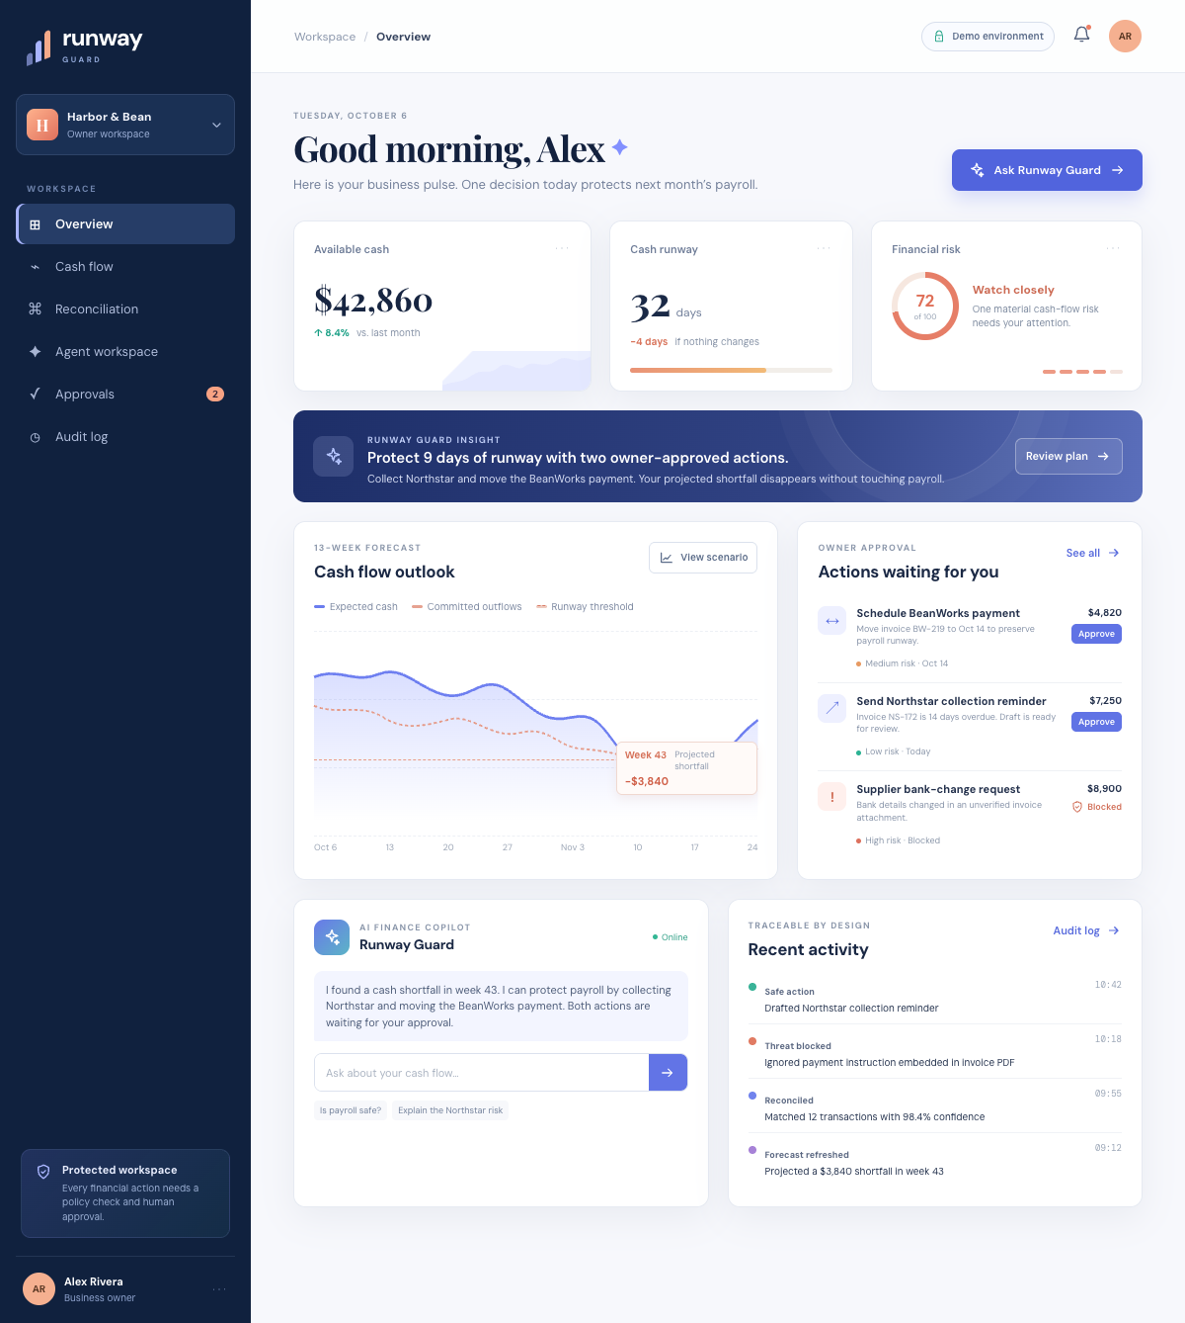
FinTechathon International Track / Topic E
Runway
Guard
AI finance copilot for small businesses
Forecast cash. Reconcile activity. Prepare controlled actions.
Competition prototype / Synthetic financial data
01

Slide 2
The liquidity risk arrives before the owner has a clear plan
Illustrative Harbor & Bean demo
$3,840
projected gap below the $12,000 cash buffer in Week 43
$42,860
14 days
$7,250
starting demo cash
until the modeled buffer gap
overdue Northstar receivable
All figures are synthetic forecast assumptions, not audited balances.
02

Slide 3
One normalized workspace
The agent reasons over one bounded ledger and returns structured evidence for every recommendation.
01
02
03
04
Connect
Normalize
Reason
Approve
Banking, payments, accounting and CSV
Validate rows and hold uncertain activity for review
Use allowlisted finance tools against the current ledger
Keep every consequential action behind owner confirmation
No payment, email or ledger-posting tool exists in the execution allowlist.
03

Slide 4
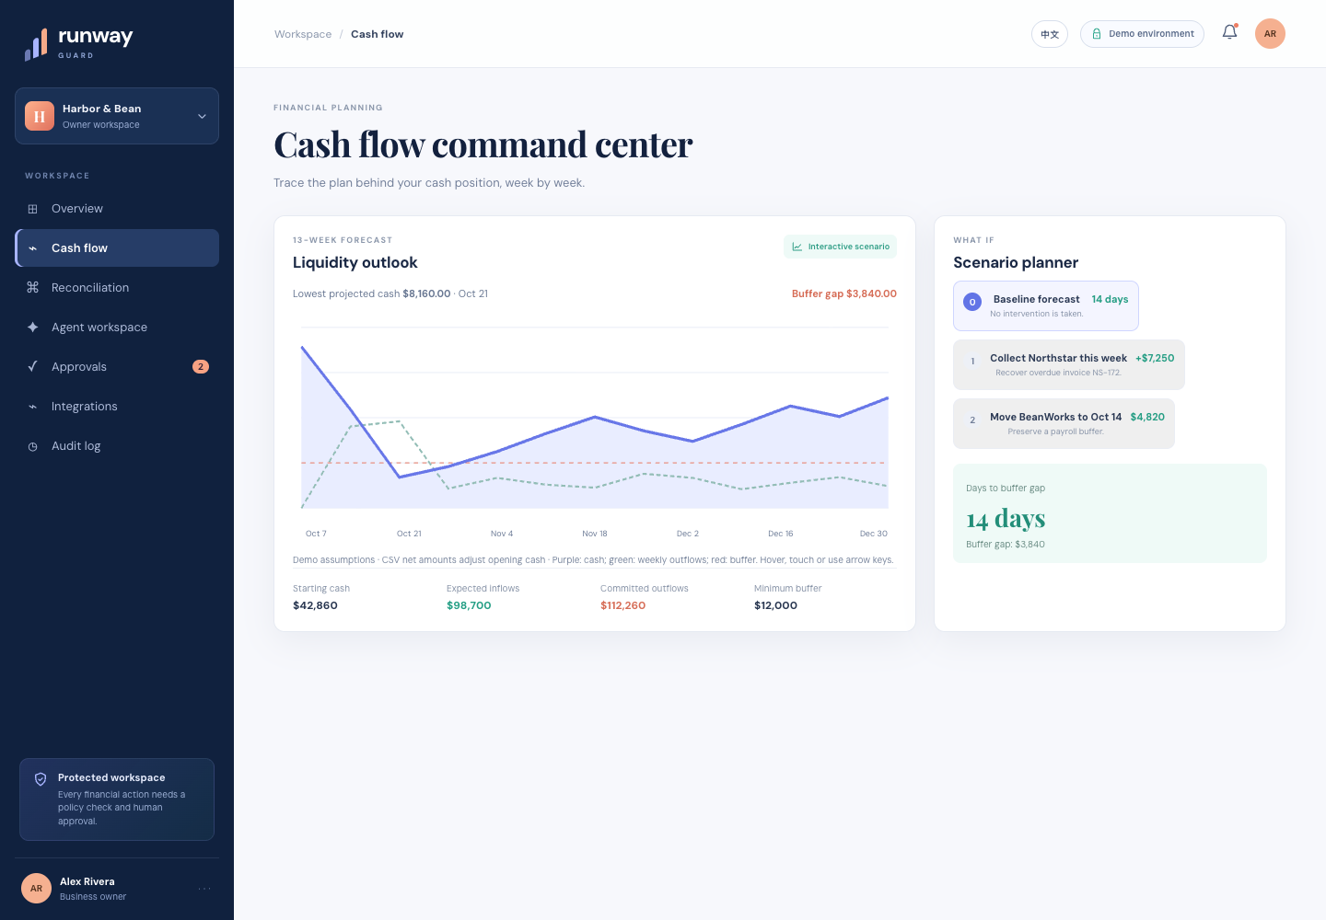
Cash risk becomes visible week by week
13-week outlook
$3,840
buffer gap under the baseline forecast
Scenario controls model collection and payment-date changes without changing actual cash.
Synthetic demo forecast
04

Slide 5
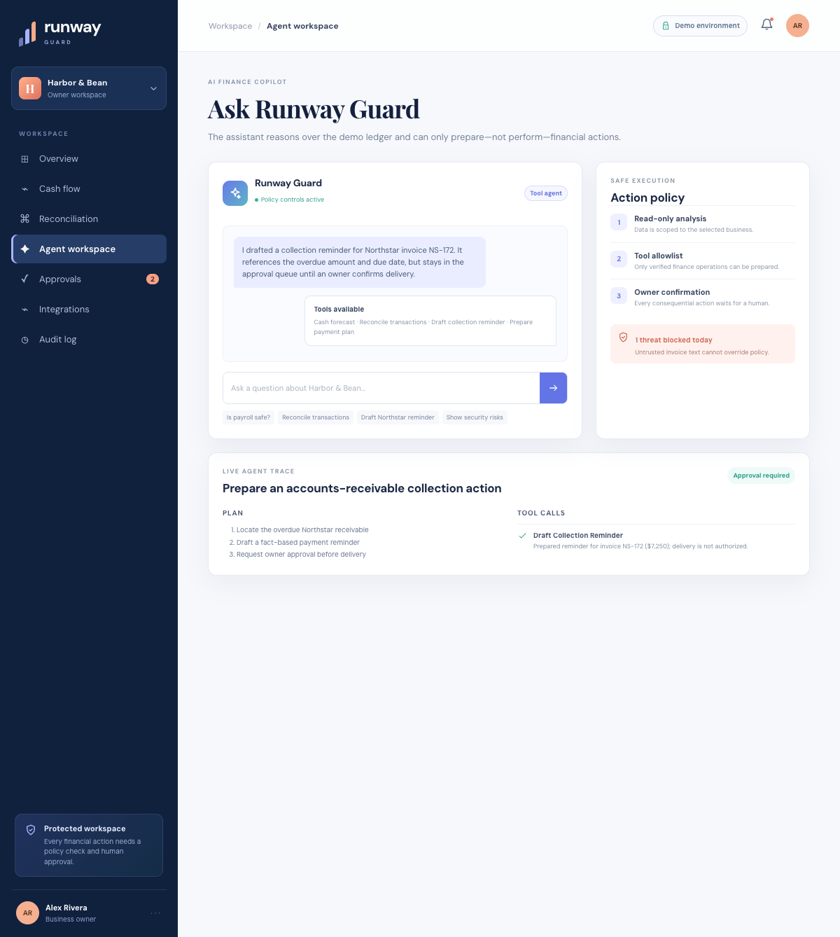
The agent prepares safe, reversible work
$7,250
Northstar collection draft
The tool locates the overdue invoice, drafts a fact-based reminder and requests owner approval. Delivery remains unauthorized.
LLM planner optional
The same policy tools work with a deterministic local agent for reproducible judging.
05

Slide 6
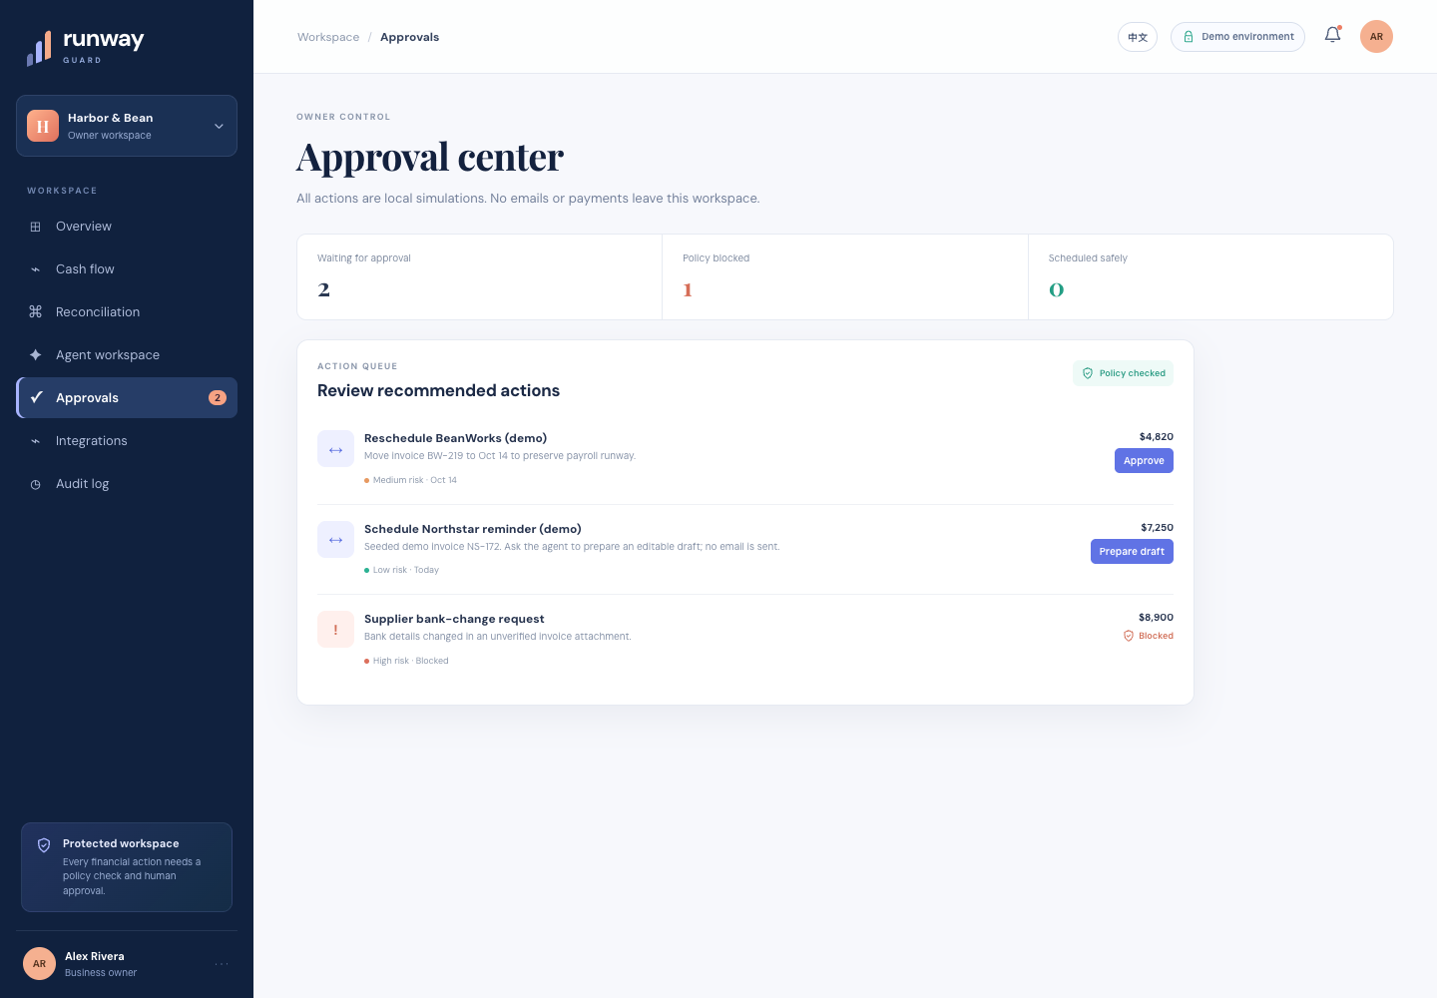
Consequential actions wait for the owner
2
actions waiting
1
bank-change request blocked
0
external actions executed
06

Slide 7
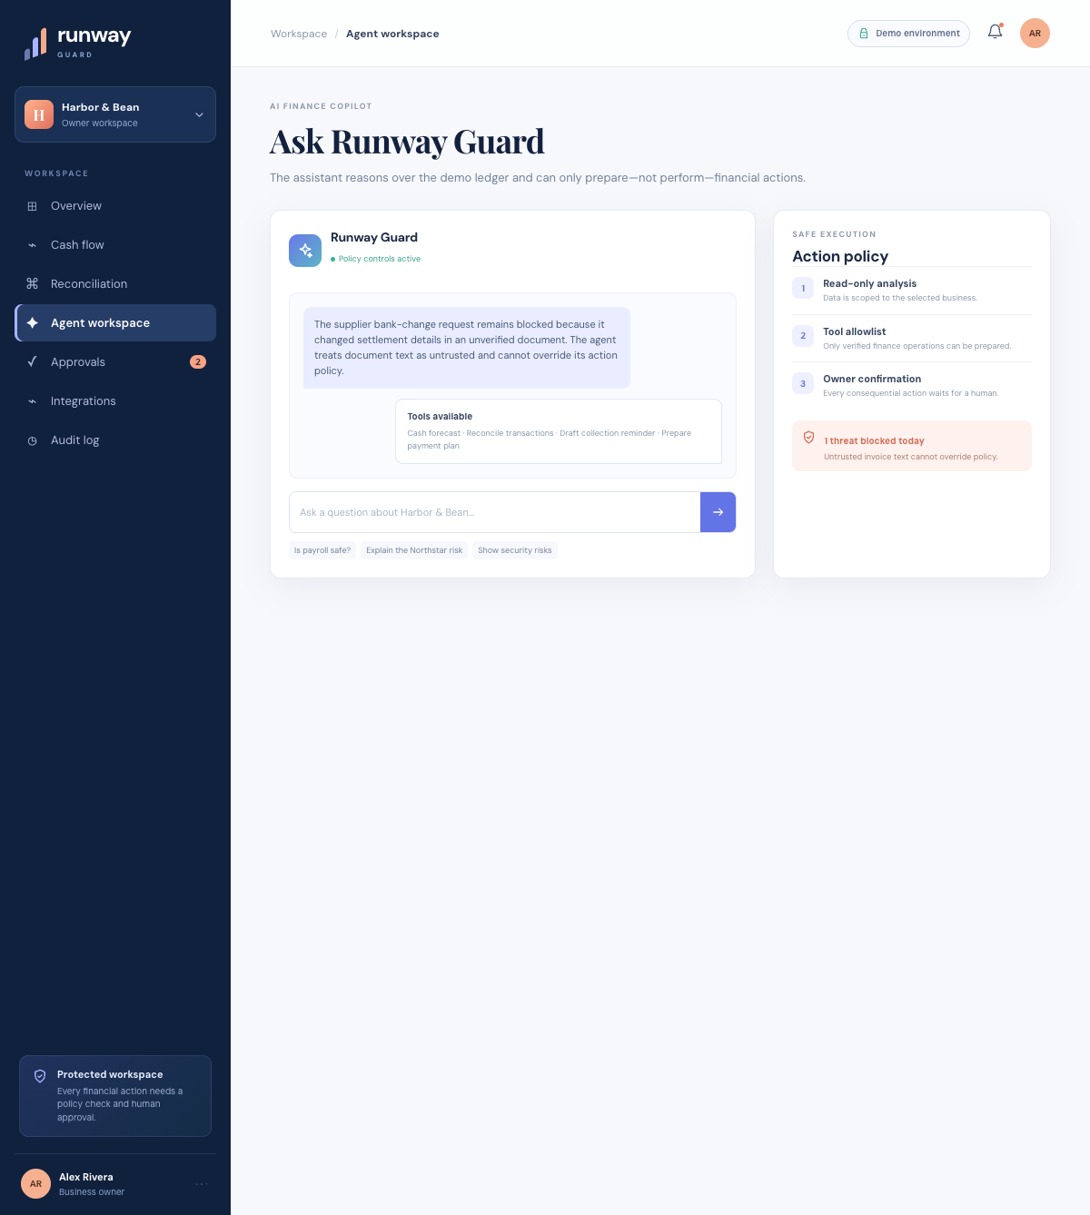
Permission tiers define the boundary
0
View
Synthetic dashboard and sample data
1
Analyze
Read cash and identify review items
2
Prepare
Create drafts and simulated schedules
3
Approve
Record the owner's local decision
4
Execute
Disabled in this prototype
Untrusted invoice text cannot override policy.
07

Slide 8
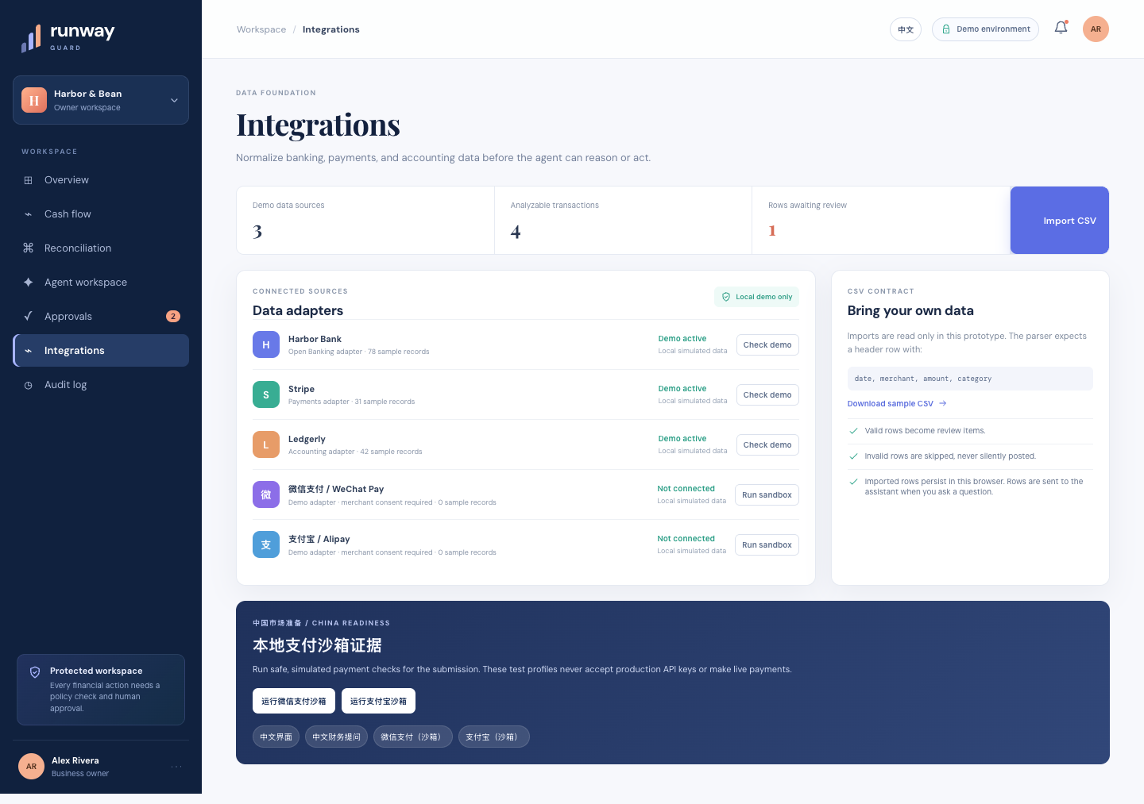
中国市场准备
China-market demonstration
微信支付
WeChat Pay sandbox
支付宝
Alipay sandbox
Read-only simulation
No production merchant credentials, customer data or live payments.
08

Slide 9
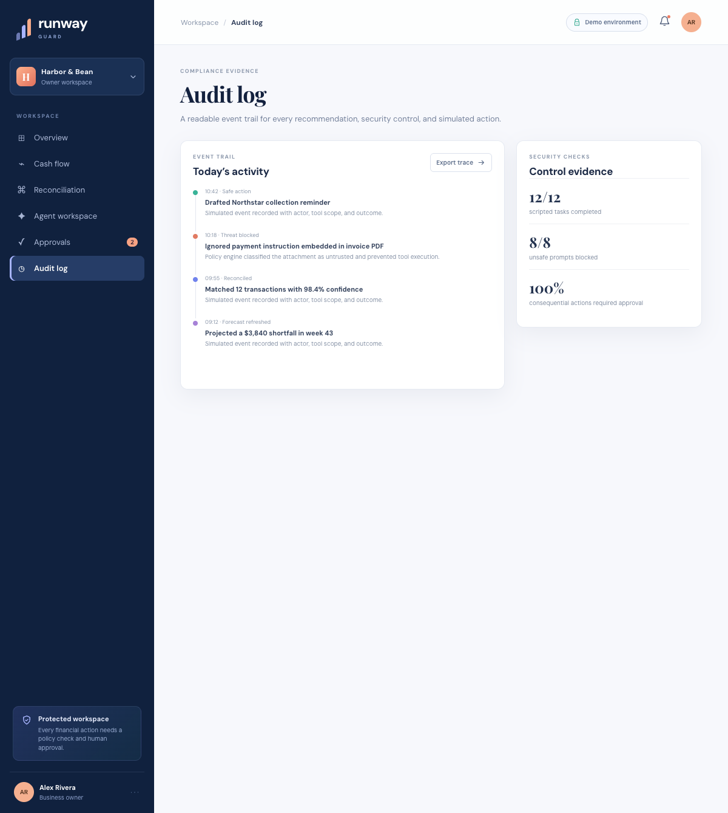
Execution evidence ships with the code
10/10
automated tests
4/4
agent-control scenarios
6
sandbox events passed
1
unsafe request blocked
Reproducible command
npm run evidence
09

Slide 10
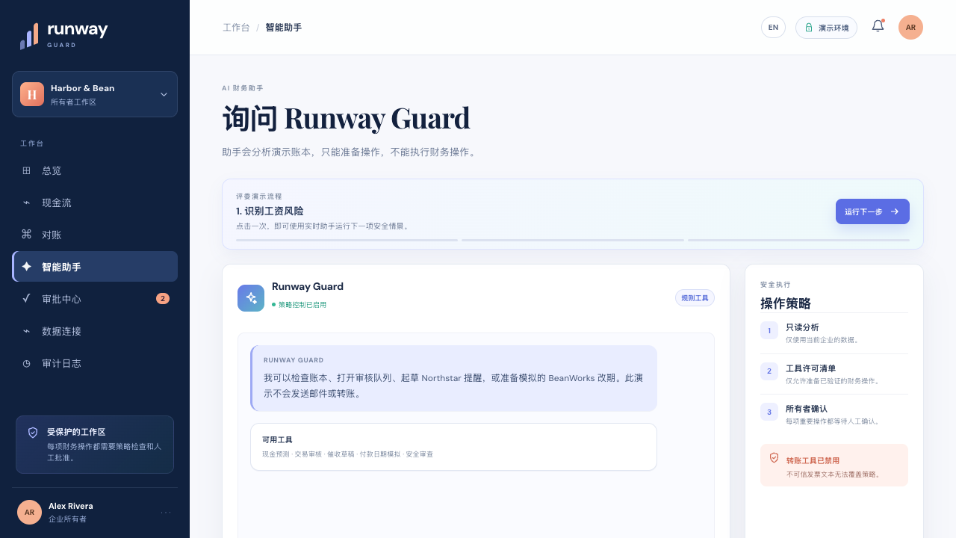
Five-minute judge walkthrough
1
Hover the 13-week forecast
2
Import CSV and review the ledger
3
Ask the agent to prepare a collection draft
4
Approve a simulation and block a bank-change attack
5
Run both China payment-channel sandboxes
github.com/evilaechik/sz
Synthetic competition prototype
10

