Slide 1
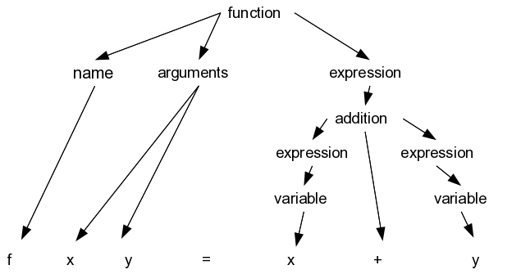
function
name
arguments
expression
addition
expression
expression
variable
variable
f x y = x + y

