Slide 1
<script> λ </script>
JSHC
JavaScript Haskell Compiler

Slide 2

Vad är det?
En kompilator, som kompilerar
Haskell
till
JavaScript
<script>
foo x = f x 1
foo = function(x) {
return f(x)(1)
};

Slide 3
Vad är det?
En kompilator, som kompilerar
Haskell
till
JavaScript
<script>
foo x = f x 1
foo = function(x) {
return f(x)(1)
};
Skriven i JavaScript

Slide 4
Varför JavaScript?

Slide 5
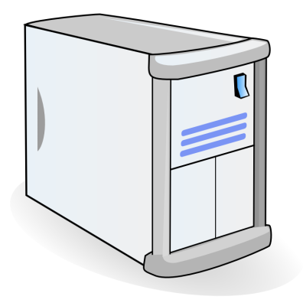
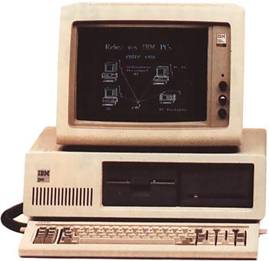
Script
Response

Slide 6
JavaScript är de facto standard för klientbaserad skriptning

Slide 7
Vad är JavaScript?

Slide 8
Ett exempel på JavaScript-kod
ur verkliga livet:
Autocomplete i ett textfält
var suggestions = new Array("Boris", "Bäcker", "Peter", "Test","Bums");
var outp;
var oldins;
var posi = -1;
var words = new Array();
var input;
var key;
function setVisible(visi){
var x = document.getElementById("shadow");
var t = document.getElementsByName("text")[0];
x.style.position = 'absolute';
x.style.top = (findPosY(t)+3)+"px";
x.style.left = (findPosX(t)+2)+"px";
x.style.visibility = visi;
}
function init(){
outp = document.getElementById("output");
window.setInterval("lookAt()", 100);
setVisible("hidden");
document.onkeydown = keygetter; //needed for Opera...
document.onkeyup = keyHandler;
}
function findPosY(obj)
{
var curtop = 0;
if (obj.offsetParent){
curtop += obj.offsetHeight;
while (obj.offsetParent){
curtop += obj.offsetTop;
obj = obj.offsetParent;
}
}
else if (obj.y){
curtop += obj.y;
curtop += obj.height;
}
return curtop;
}
oldins = this.firstChild.nodeValue;
}
function lookAt(){
var ins = document.getElementsByName("text")[0].value;
if (oldins == ins) return;
else if (posi > -1);
else if (ins.length > 0){
words = getWord(ins);
if (words.length > 0){
clearOutput();
for (var i=0;i < words.length; ++i) addWord (words[i]);
setVisible("visible");
input = document.getElementsByName("text")[0].value;
}
else{
setVisible("hidden");
posi = -1;
}
}
else{
setVisible("hidden");
posi = -1;
}
oldins = ins;
}
function findPosX(obj)
{
var curleft = 0;
if (obj.offsetParent){
while (obj.offsetParent){
curleft += obj.offsetLeft;
obj = obj.offsetParent;
}
}
else if (obj.x)
curleft += obj.x;
return curleft;
}
function addWord(word){
var sp = document.createElement("div");
sp.appendChild(document.createTextNode(word));
sp.onmouseover = mouseHandler;
sp.onmouseout = mouseHandlerOut;
sp.onclick = mouseClick;
outp.appendChild(sp);
}
function clearOutput(){
while (outp.hasChildNodes()){
noten=outp.firstChild;
outp.removeChild(noten);
}
posi = -1;
}
function getWord(beginning){
var words = new Array();
for (var i=0;i < suggestions.length; ++i){
var j = -1;
var correct = 1;
while (correct == 1 && ++j < beginning.length){
if (suggestions[i].charAt(j) != beginning.charAt(j)) correct = 0;
}
if (correct == 1) words[words.length] = suggestions[i];
}
return words;
}
function setColor (_posi, _color, _forg){
outp.childNodes[_posi].style.background = _color;
outp.childNodes[_posi].style.color = _forg;
}
function keygetter(event){
if (!event && window.event) event = window.event;
if (event) key = event.keyCode;
else key = event.which;
}
function keyHandler(event){
if (document.getElementById("shadow").style.visibility == "visible"){
var textfield = document.getElementsByName("text")[0];
if (key == 40){ //Key down
//alert (words);
if (words.length > 0 && posi words.length-1){
if (posi >=0) setColor(posi, "#fff", "black");
else input = textfield.value;
setColor(++posi, "blue", "white");
textfield.value = outp.childNodes[posi].firstChild.nodeValue;
}
}
else if (key == 38){ //Key up
if (words.length > 0 && posi >= 0){
if (posi >=1){
setColor(posi, "#fff", "black");
setColor(--posi, "blue", "white");
textfield.value = outp.childNodes[posi].firstChild.nodeValue;
}
else{
setColor(posi, "#fff", "black");
textfield.value = input;
textfield.focus();
posi--;
}
}
}
else if (key == 27){ // Esc
textfield.value = input;
setVisible("hidden");
posi = -1;
oldins = input;
}
else if (key == 8){ // Backspace
posi = -1;
oldins=-1;
}
}
}
var mouseHandler=function(){
for (var i=0; i < words.length; ++i)
setColor (i, "white", "black");
this.style.background = "blue";
this.style.color= "white";
}
var mouseHandlerOut=function(){
this.style.background = "white";
this.style.color= "black";
}
var mouseClick=function(){
document.getElementsByName("text")[0].value = this.firstChild.nodeValue;
setVisible("hidden");
Posi = -1;
oldins = this.firstChild.nodeValue;
}

