Slide 1

5.2 Final Project
Sarah Hinojosa – Ty Adams – David Crouch – Jeffrey Reigel – Steven Woods

Slide 2
1
Table of Contents
2
Problem Statement
Business Model Canvas
Value Proposition Analysis
High Fidelity
Materials Design Figma
React Shopping Cart Project
Inserting React Components
Peer Review
GitHub
Conclusion
3
4
5
6
7
8
9
10

Slide 3
Problem Statement
The project we decided to redesign is craigslist. The changes we decided to make were to fix have the search bar float at bottom, have two columns of buttons for ease of use, and to simplify the color scheme.
The problem statement was:
“The craigslist website is very dull and outdated which leaves it overshadowed by better looking and organized websites like Ebay.”

Slide 4
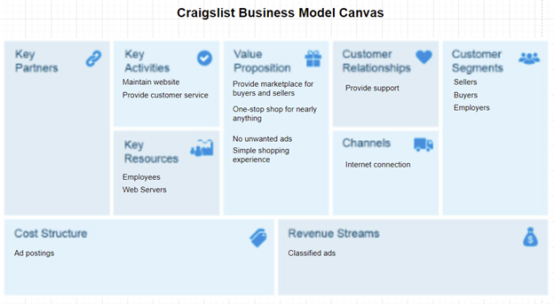
Business Model Canvas

Slide 5
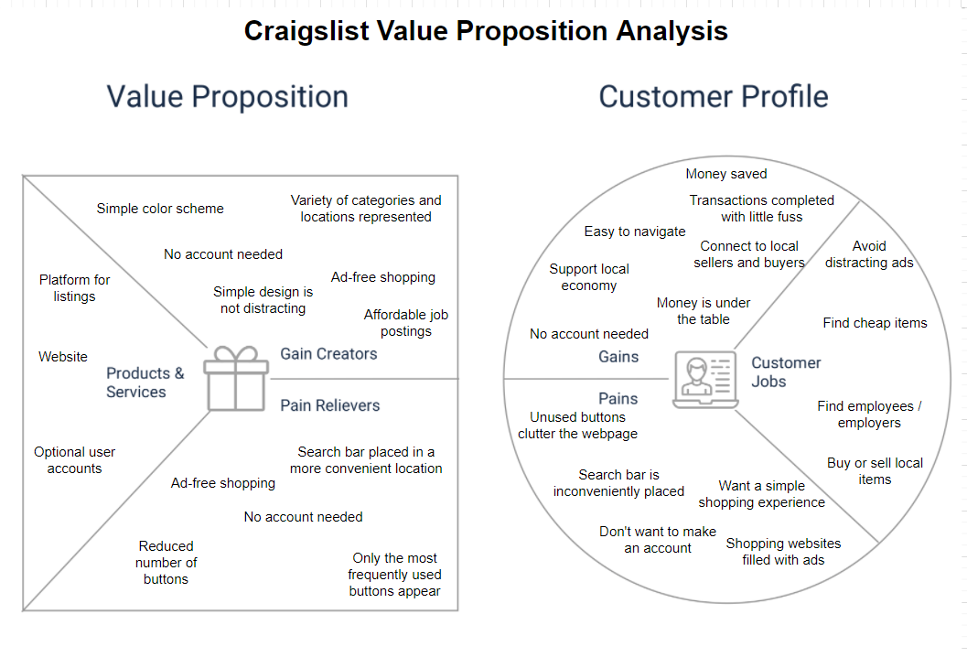
Value Proposition Analysis

Slide 6
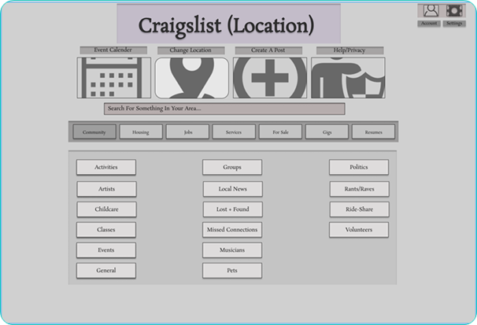
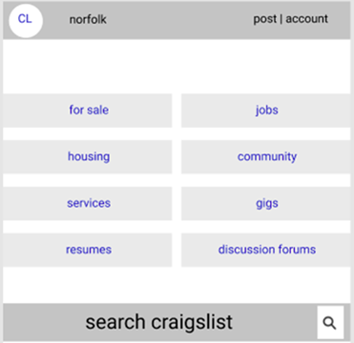
High Fidelity

Slide 7
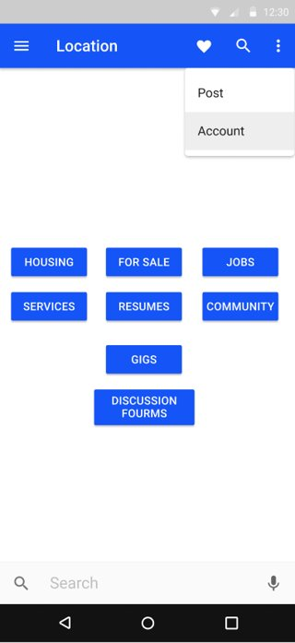
Materials Design Figma

Slide 8
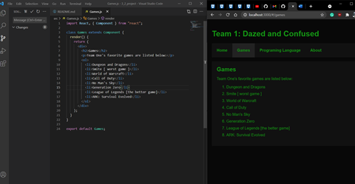
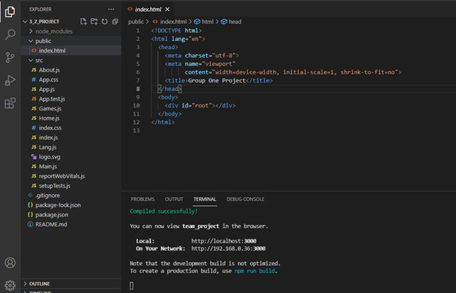
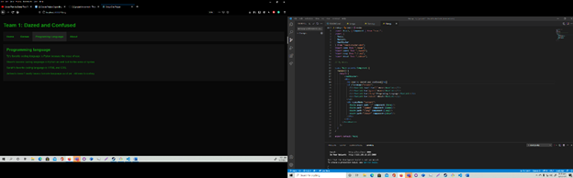
React Shopping Cart Project
For the shopping cart project, we made a react website that used components and JSX

Slide 9
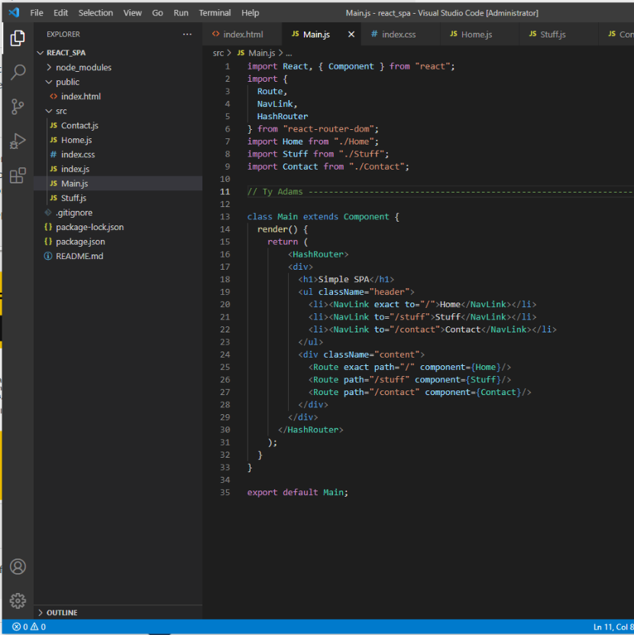
Inserting React Components
React is a JavaScript framework, that allows you to import libraries or components they are premade code that does something the way you import them is to import at the top of your code like another library.

Slide 10
Peer Review
Steven Woods - The team worked well together because we all let each team member speak their ideas without making them feel safe enough to do it without fear. This was great thing that allowed us all to get an equal say in the work and giving us all the feeling of being respected.
Ty Adams - I liked how well the group worked together, and how quick we were to just work. The thing we could improve on is sleep our group was tired a lot.
David Crouch - Overall we were efficient and delegated work well to team members. My greatest concern was how quickly we could get off topic and then remain off topic for quite a while.
Sarah Hinojosa - Together as a team, I was confident enough to know that we will get everything submitted on time and with excellence. Everyone was willing to aid each other, and overall be a familiar friend. Projects were a breeze with this team since everyone was open to working on something or help with a task at hand.
Jeffrey Reigel - I liked how are our team worked together overall. We were efficent in our completion of the projects. We worked well together and helped each other when needed. Everyone performed well and was respectful.

Slide 11
Github
https://github.com/Thoecles44/5_2_Final_Project - Ty
https://github.com/ZaraxShade/CIS453L_Final_Project - Steve
https://github.com/eviljesta81/CIS453L_Final_Project - Jeffrey

Slide 12
Conclusion
Holy balls we are awesome
Like, seriously

