Slide 1

Running a Truly Open Source Android Stack
By eviljoel
eviljoel@linux.com
A2BE 2D12 24D1 67CA 8830 DDE7 DFB3 676B 196D 6430

Slide 2

About Me
15 Year Linux User
10 Year Chicago GLUG Member
Open Source and Privacy Advocate
Work at a Chicago Security Company
eviljoel@linux.com
A2BE 2D12 24D1 67CA 8830 DDE7 DFB3 676B 196D 6430

Slide 3

Hold Your Questions
Have a lot to cover.
If you are confused, those questions are OK.

Slide 4
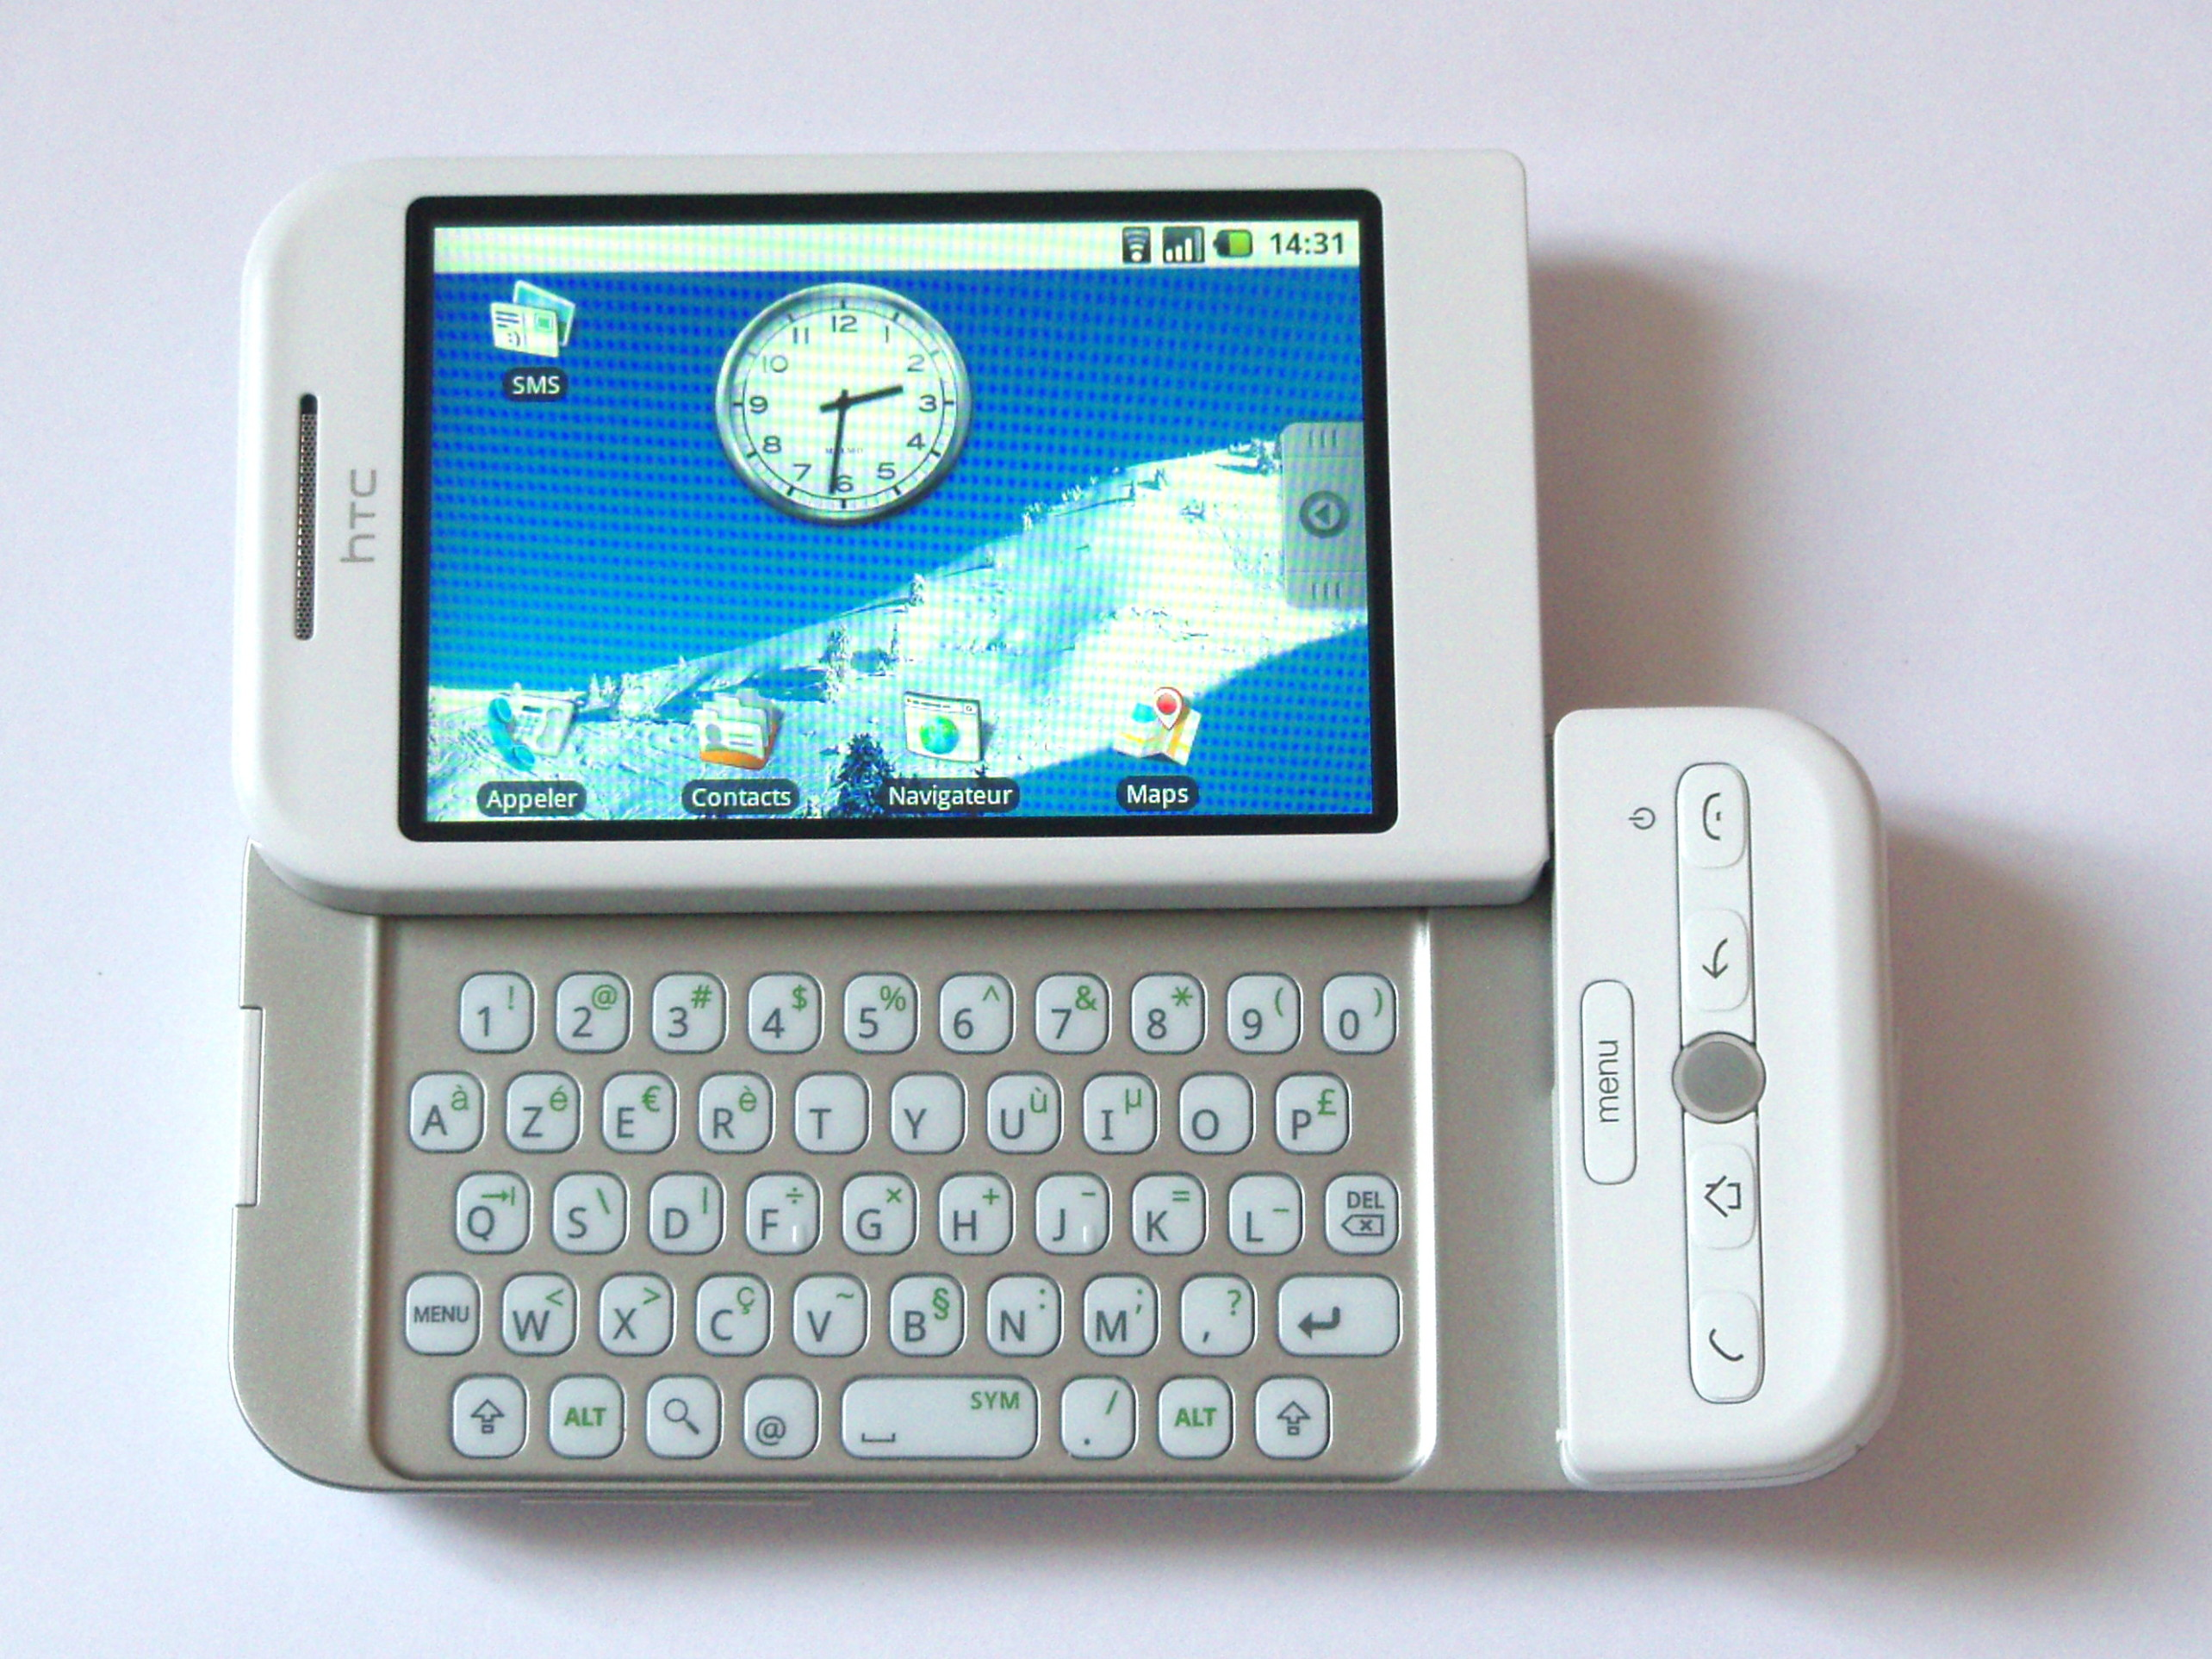

History of Android
Released on September of 2008
Linux Kernel
Open Source!
Over the years, components were re-licensed as proprietary
Google maintains control via copyright assignment
Photo Credit: Akela NDE

Slide 5
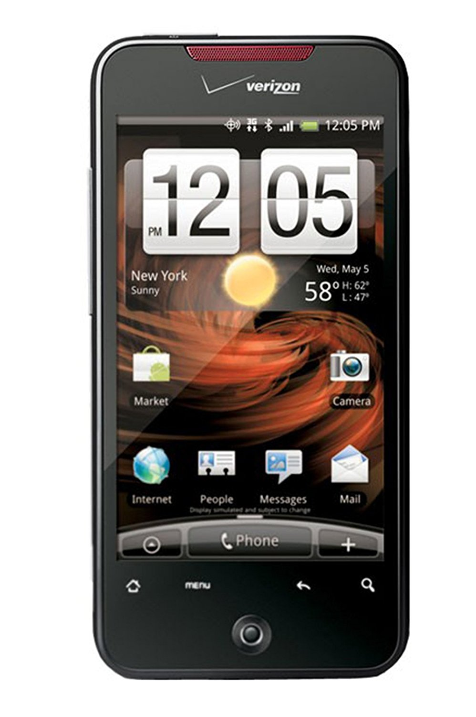
My Android Experience
Ran Stock on an HTC Incredible
Tight Google Integration
Forced Contact Sync (Android 4.0)
Secret Data Collection (Carrier IQ)
Almost No Marketplace Vetting
Updated Infrequently And Quickly Unsupported

Slide 6
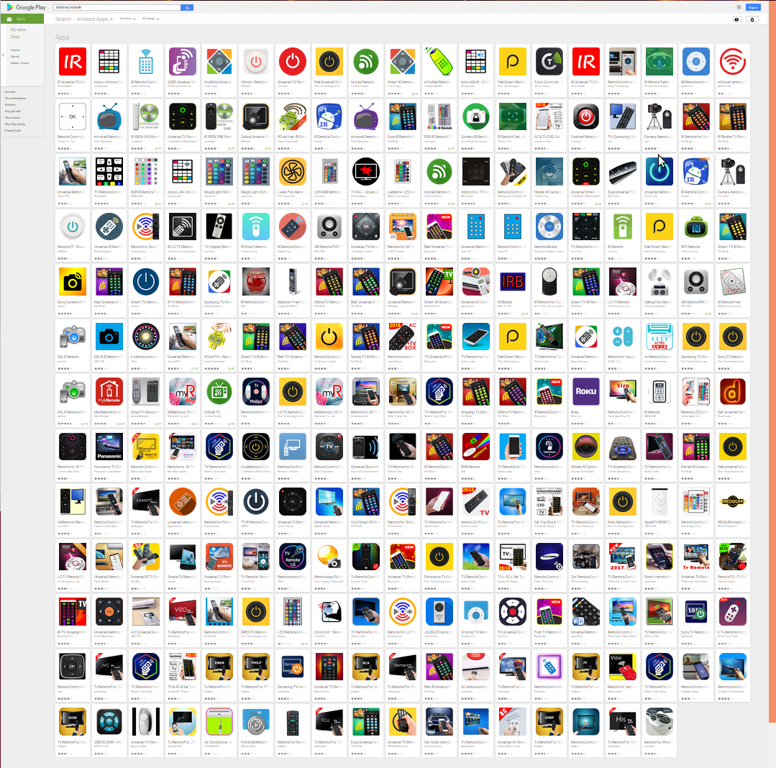
Play Store
Searched for “IR Remote”
All Had Unnecessary Permissions!

Slide 7

Google Data Collection
Transparent Backups (Including Passwords)
Photos and Videos
Contacts
Location Information
Every App You Open
Records “OK Google”
Device Configuration

Slide 8






CyanogenMod w/ GApps
3rd Party “ROM” (Customized Android)
Community Developed
Additional Privacy Features
No Bloatware
Still Tied into Google with Gapps
  Remove App Installation
CyanogenMod Became LineageOS

Slide 9
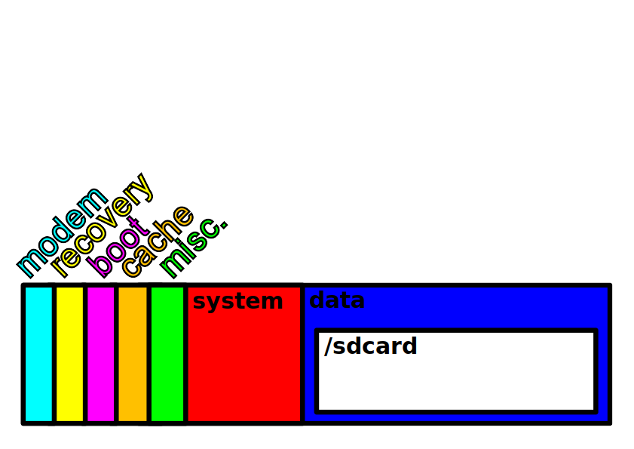
Phone Flash Memory

Slide 10

CyanogenMod Without GApps
F-Droid Replaced Play Store
No Real Google Maps Replacement
Had OS Updates Up to Android 6
Android 5 had 4G Issues on Galaxy Nexus
Worked OK for Years
Couldn’t Get Signal Working
SVG Credit: Amitie 10g

Slide 11

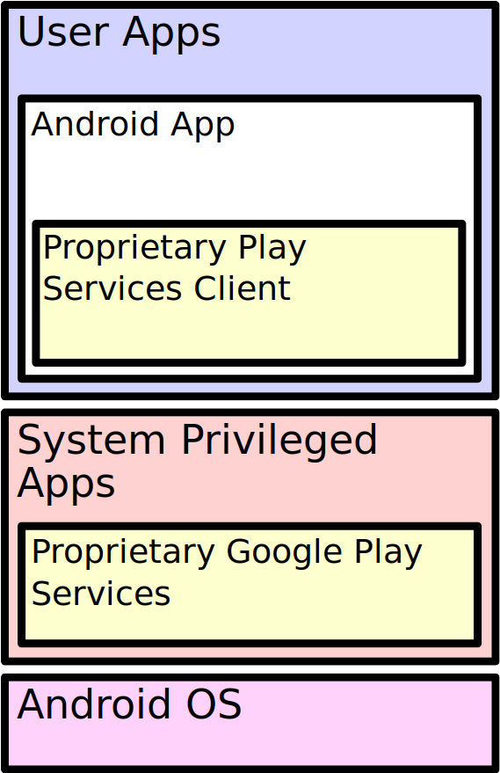
Google Play Services
Proprietary API Extension
Required by Many if Not Most Apps
Updates Automatically
Required for Many New Features
Applications Verify Play Services Signature
Caused Me Big Problems!

Slide 12
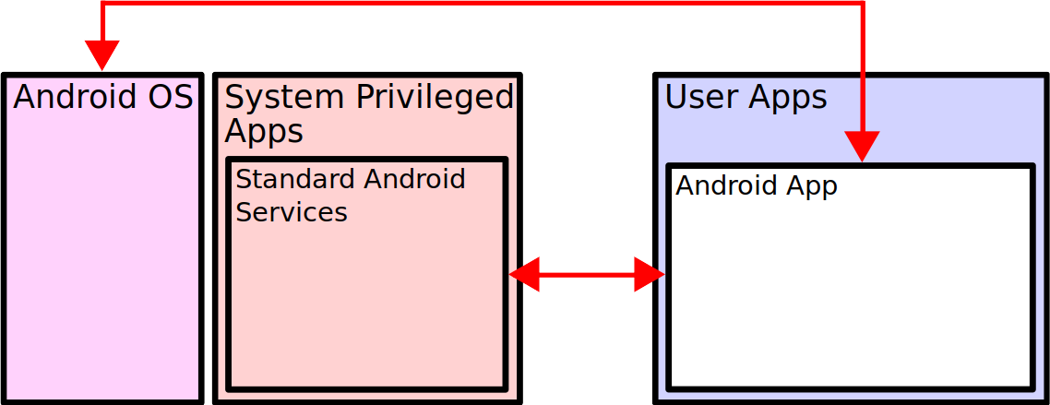
Before Google Play Services

Slide 13
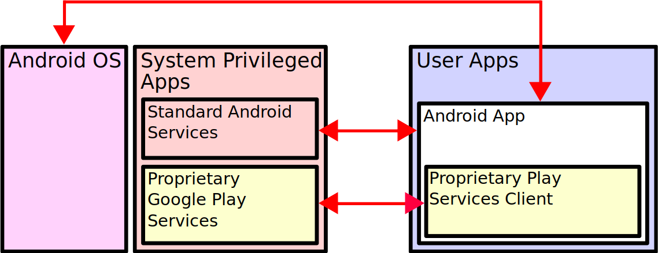
With Google Play Services

Slide 14
Privileged System Apps
Runs with System Privileges
Stored on ‘system’ Partition
  Not ‘data’ Partition Like Most Apps
  Stays Present After Factory Reset
Cannot Install Directly From Play Store
  Unless App is Signed by Trusted Certificate
  Installed via ‘Recovery’ or App w/ Root Privileges

Slide 15

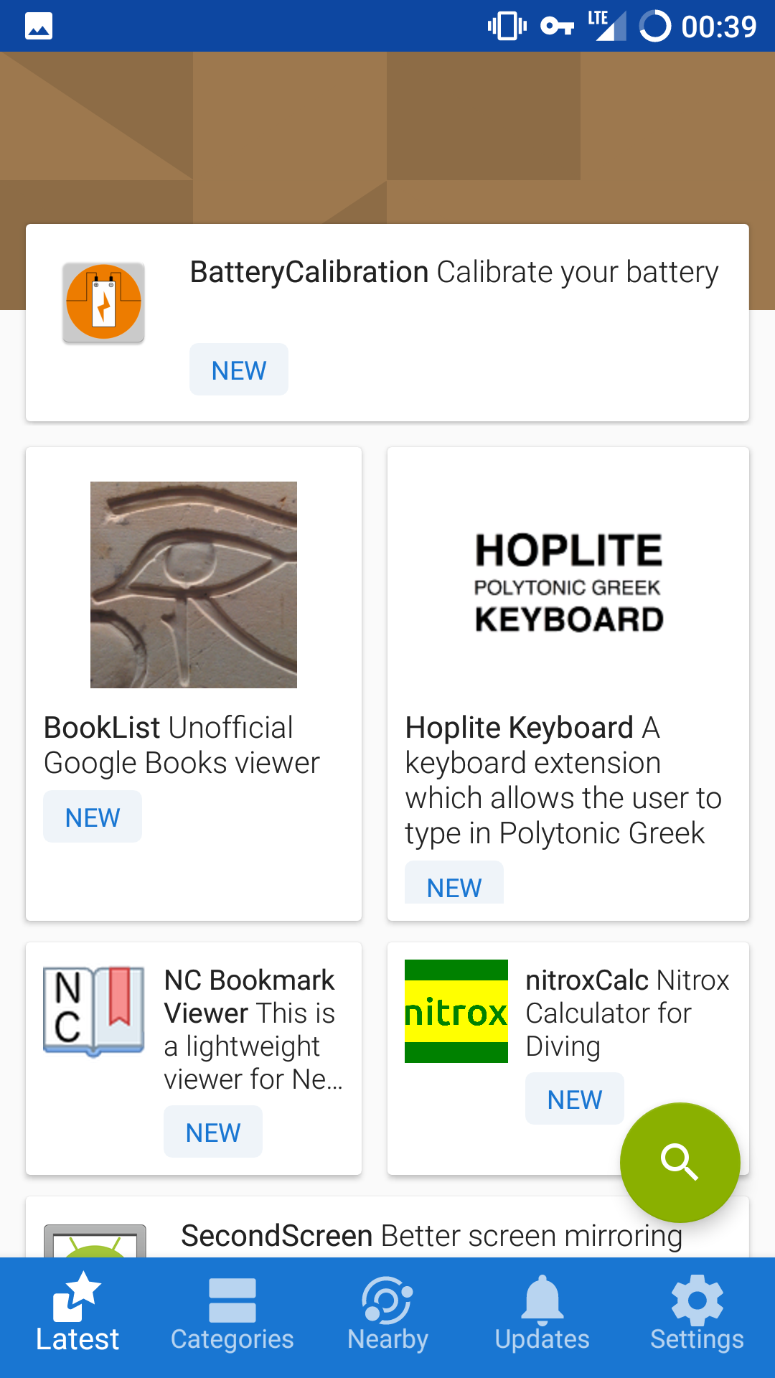
F-Droid
Play Store Alternative
100% Open Source
Vets for Anti-features
Thousands of Apps

Slide 16

How Do I Fix This?!?
Can’t Run Popular Apps
Terrible Support For Galaxy Nexus
  No 4G!
  Frequent Crashes
F-Droid Installing Apps via “Unknown Sources”
Compiling Signal From Source
OS Updates Required Full Reinstall

Slide 17

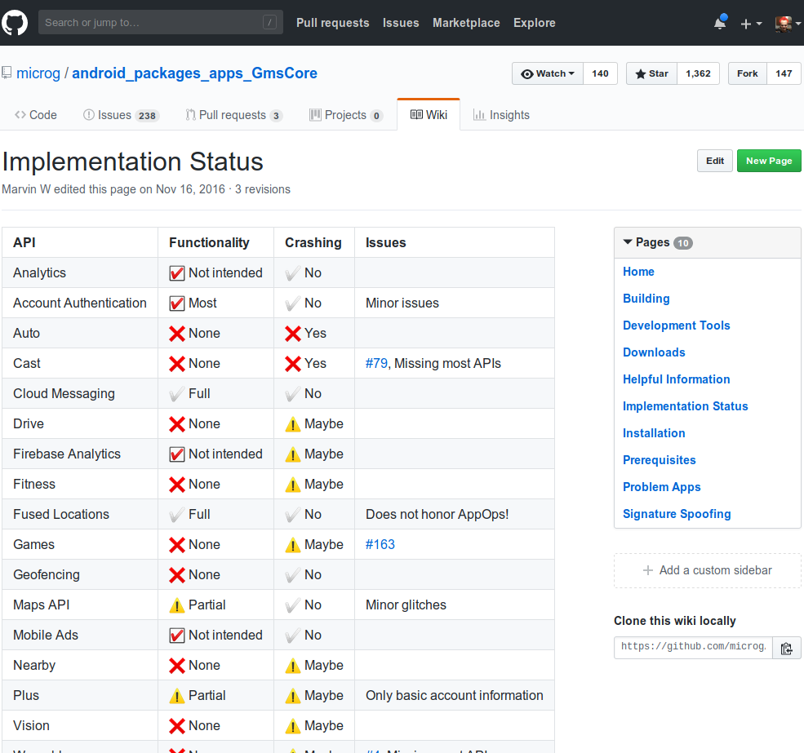
Open Source Implementation of Play Services
  Partial Implementation
  Has Good Location Support
Required “Signature
Spoofing” Patch
Hard to Update and
Maintain
Too Scary for Me

Slide 18
A Year Later (2018)
Fed Up with No 4G!
LineageOS 13 Updates Stopped in February
Needed a “New” Phone
  Wanted a Small Screen
  Replaceable Battery
Restarted My Search from Last Year

Slide 19

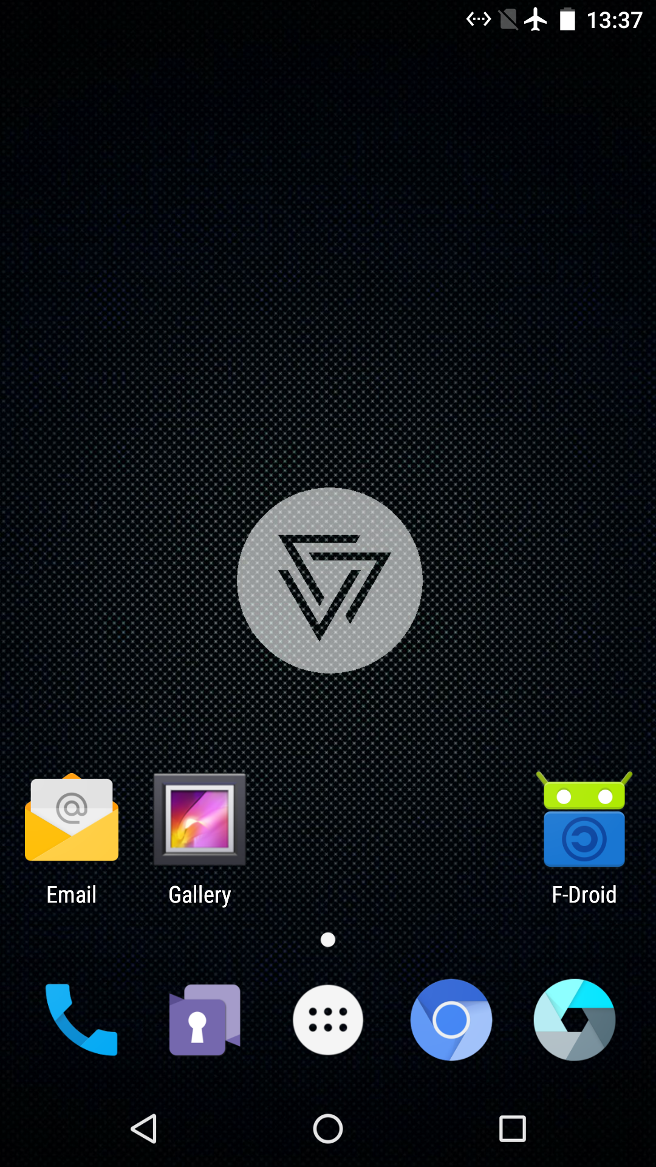
CopperheadOS
Only Supports Nexus and Pixel Devices
Support is Limited to Two Years
No Official 3rd Party ROMs for Pixel/Pixel 2 Yet
No Longer Have Install Downloads
  Must Compile from Source!
  OTA Updates are Supported.

Slide 20
What a Difference a Year Makes
MicroG is a Reputable Project
Signature Spoofing Included in 3rd Party ROMs
Explanations of Signature Spoofing Available
  https://blogs.fsfe.org/larma/2016/microg-signature-spoofing-security/
Figured Out F-Droid App Install Problem
LineageOS with MicroG
  Fork of LineageOS
  Lineage + Signature Spoofing + MicroG + F-Droid

Slide 21

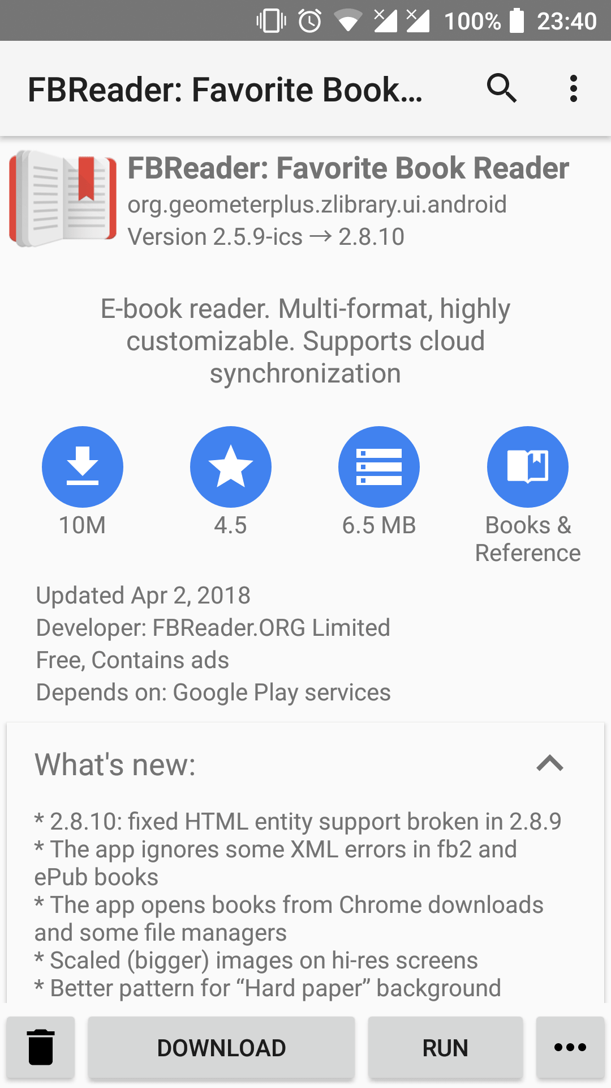
Yalp Store
Yalp is ‘Play’ Spelled Backwards
Download Apps from Google Play
Uses a Default Account Built Into the App
Install Apps Not Available in F-Droid
  Signal
Can Be Installed as System Application

Slide 22
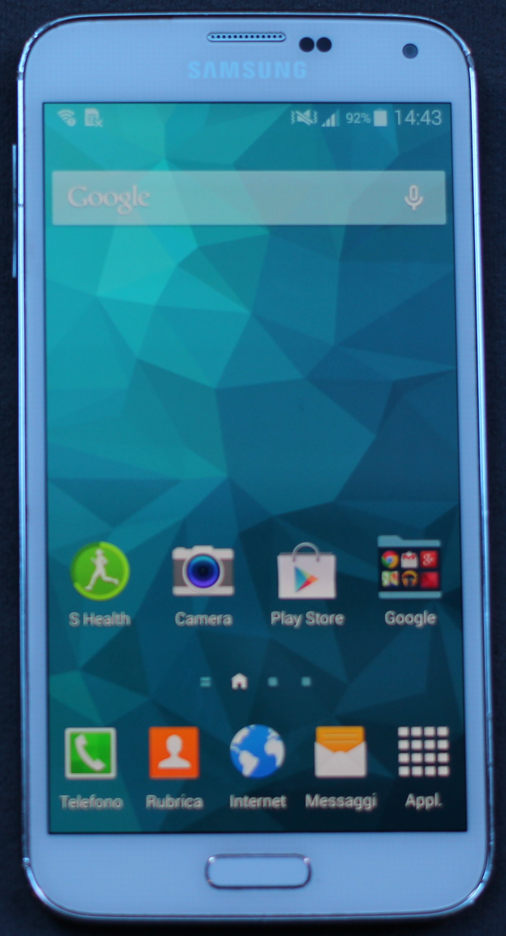

Samsung Galaxy S5
2014 Phone
Better Than Some Newer Phones
Little Larger than Galaxy Nexus by Volume
Replaceable Battery
Very Popular Phone
  Great 3rd Party ROM Support
  LineageOS 14.1 (Android 7.1)
Photo Credit: Maurizio Pesce

Slide 23
App Security Model
Google Does Not Sign Play Store Apps*
APKs are Downloaded Over HTTPS from Google
You PGP Sign Your APKs
Your PGP Public Key is Included With APK
APK Updates are Verified Against Existing Public PGP Key
  Nobody Else Can Update Your App
* Google Now Provides an App Signing Service

Slide 24
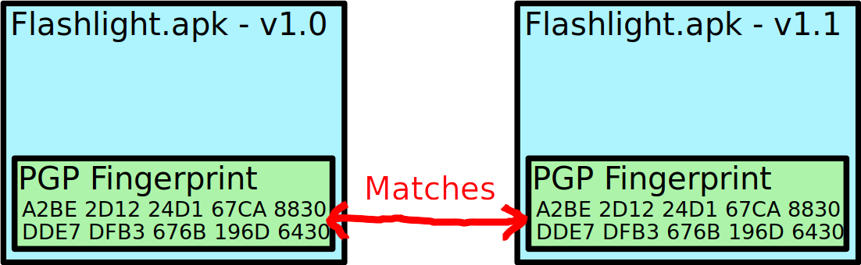
App Security Model
Original Install
Upgrade Install

Slide 25
Signature Spoofing
Signature Spoofing Fakes the Signature of Apps Reported to Other Apps
  Update Verification is Unaffected
Spoofed App Must Have FAKE_PACKAGE_SIGNATURE Permission
Play Services Client API Asks Android OS for Play Services Public Key
  Android OS Replies With Hard Coded Play Services Public Key

Slide 26
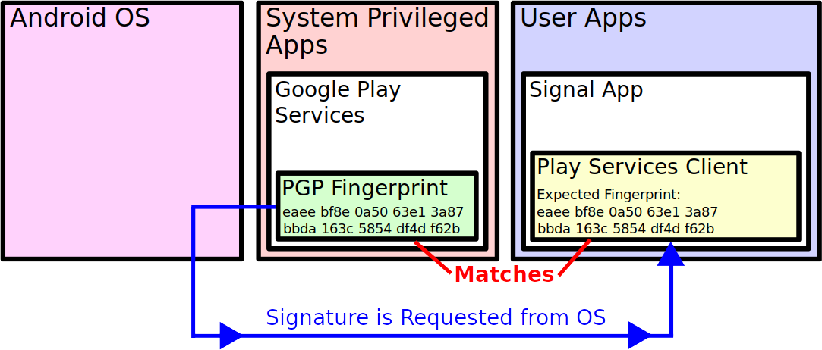
Without Signature Spoofing

Slide 27
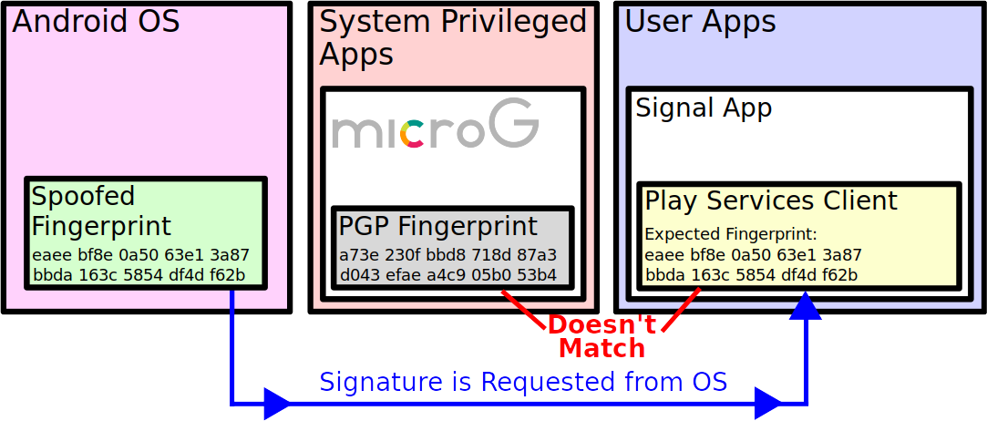
With Signature Spoofing

Slide 28
Signature Spoofing
Limited to System Apps
Can Only Be Used with Trusted Apps
  Apps Included with Android ROM
  Apps Installed as System Apps
No Legitimate Security Concern
  Any App that Can Install As System App Can Do Anything Anyway
LineageOS Rejected Signature Spoofing Patch to Ensure SafetyNet Attestation

Slide 29
SafetyNet
Provides Assurance to Apps That the Phone is Not Compromised
Some Apps Require Passing Attestation
  Banking Apps
  Video Streaming Apps (For DRM)
  Pokémon Go
Collects and Sends Data to Google
  Server Evaluates Data and Signs a Response
Can be Sandboxed w/ DroidGuard Helper

Slide 30
SafetyNet Data Collection
Rooted Status
Android Debugging (ADB) Enabled.
Lock Screen Configuration (Not the Password)
Apps Installed Via “Unknown Sources”
Device Locale (Roughly Your Country)
Select Strings from Log Files
Various Details About ‘System’ Partition

Slide 31
Phone Flash Memory

Slide 32
Unlocking vs. Rooting
SIM Unlocking
  Use Phone on Any Network (If Hardware Allows)
Bootloader Unlocking
  Allow Flashing Images to Flash Memory
  Sometimes Need Vulnerability to Unlock
Rooting
  Apps Have Access to Superuser (Root User)
  Obtained by Exploiting Privileged Apps
  Or by Flashing Superuser App Via Recovery

Slide 33
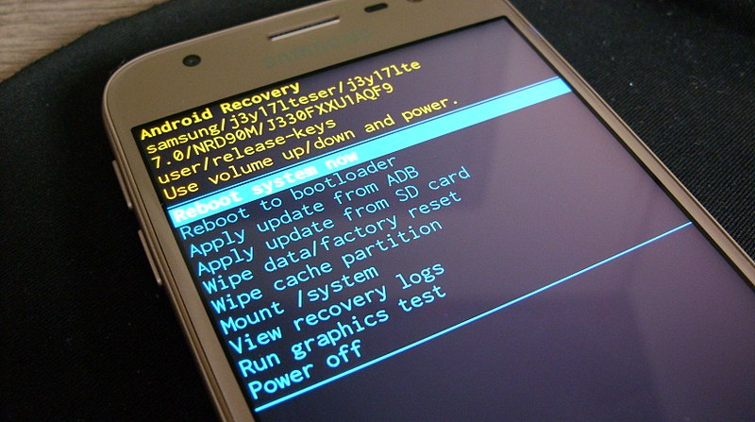
Recovery Partition
Performs Over the Air (OTA) Updates
Manually Applies Updates from Storage
Wipes ‘Data’ Partition
Clear Cache Partitions
Third Party Recoveries Provide More Features
Photo Credit: VampishBowl

Slide 34
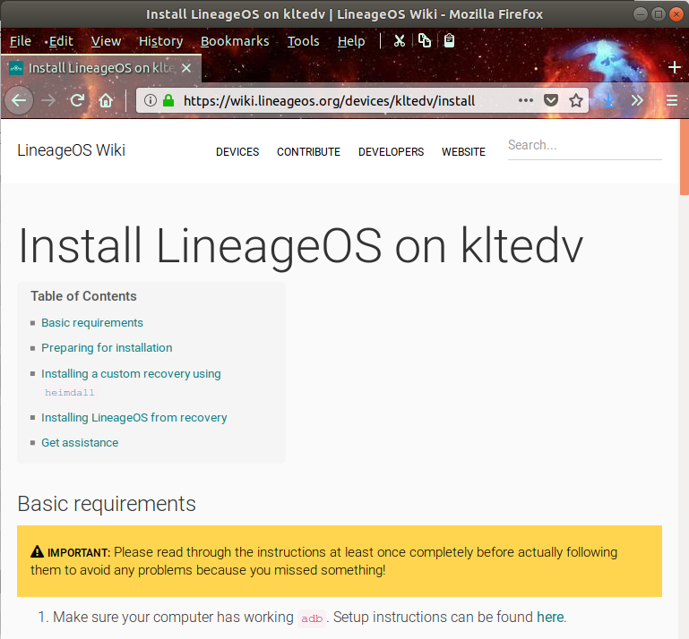
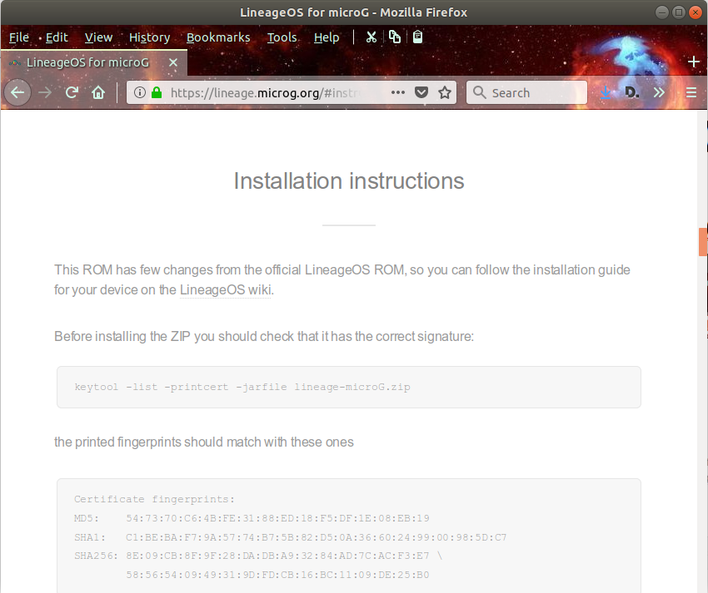
Install Instructions
https://wiki.lineageos.org/devices/
https://lineage.microg.org/#instructions

Slide 35
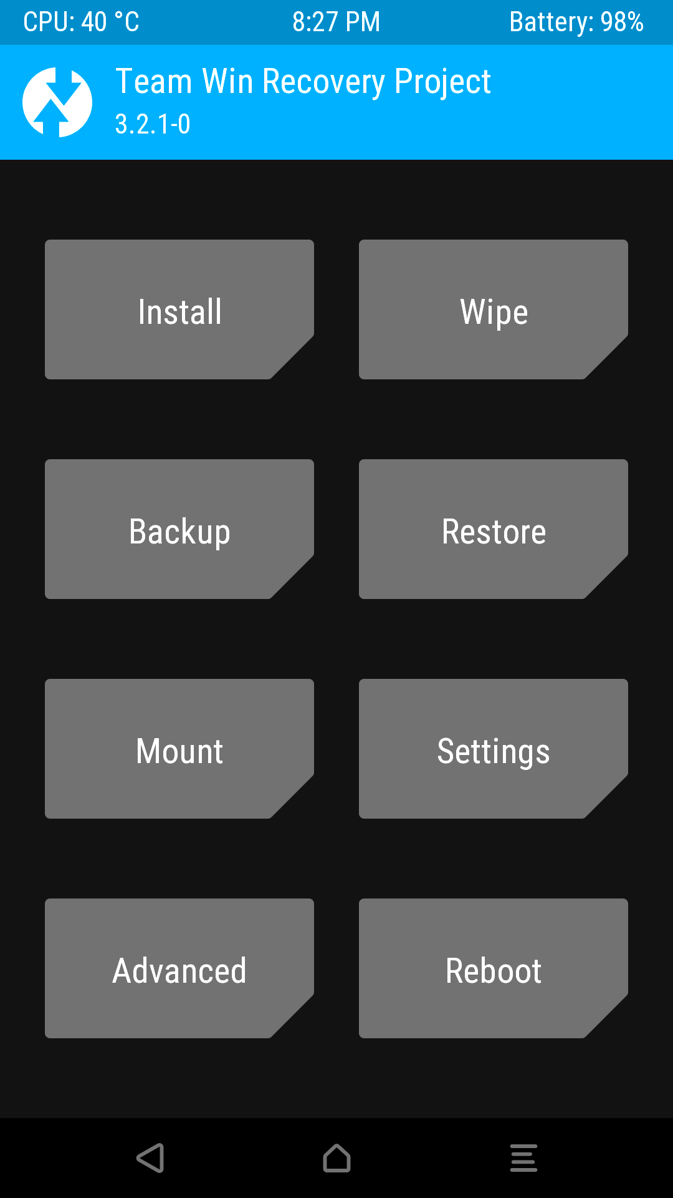
TWRP
Graphical Recovery w/ Touch Support
Install Custom ROMs
Install System Apps
Backups
ADB Access

Slide 36
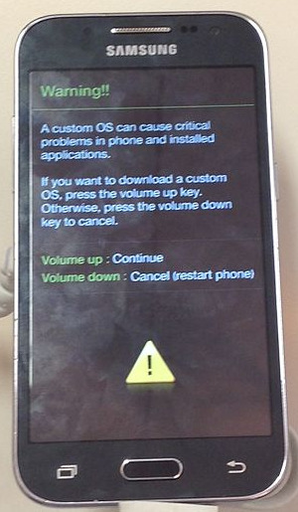
Heimdall
Samsung Specific Partition
Flasher
Similar to Google’s Fastboot
Use Key Combination to Enter
Download Mode
heimdall flash --RECOVERY \
twrp.img
Photo Credit: LeonardoIannelliCOMPUTE

Slide 37

Fastboot
Google’s Fastboot Used to
Unlock Bootloader
fastboot flashing unlock
  May Wipe Data
fastboot flash recovery twrp.img
Photo Credit: Google

Slide 38
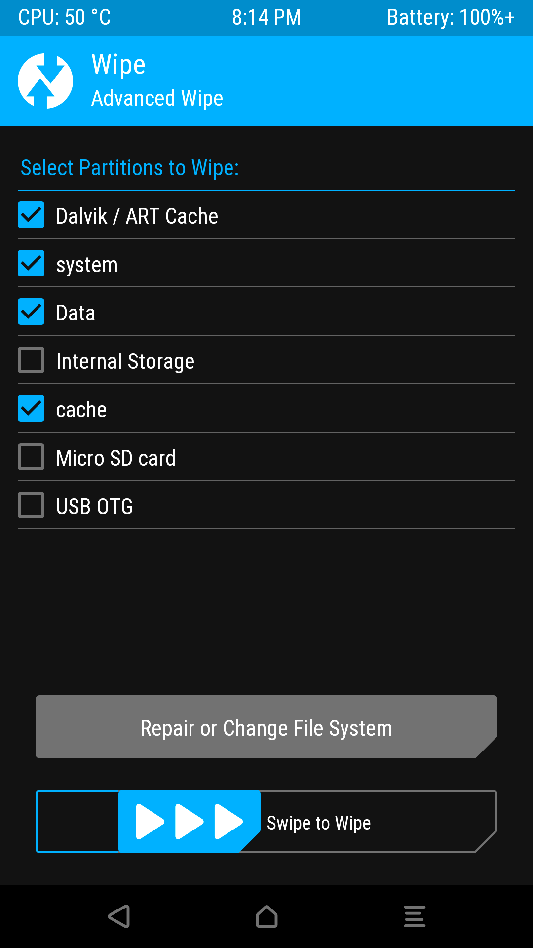
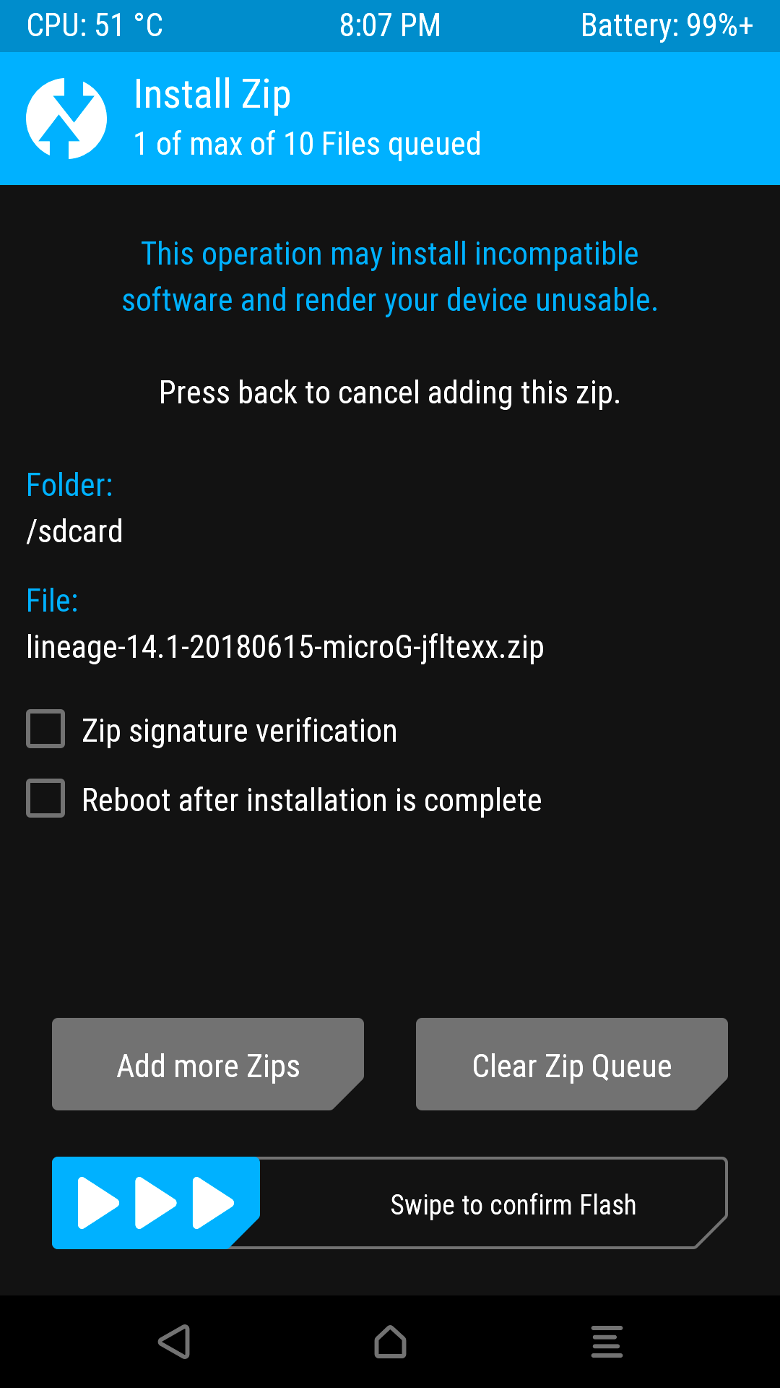
Install Lineage w/ MicroG
Download ROM ZIP to Phone
Boot to Recovery
  Special Button
  Combination
Wipe Cache, System,
and Data
Install Lineage ZIP

Slide 39
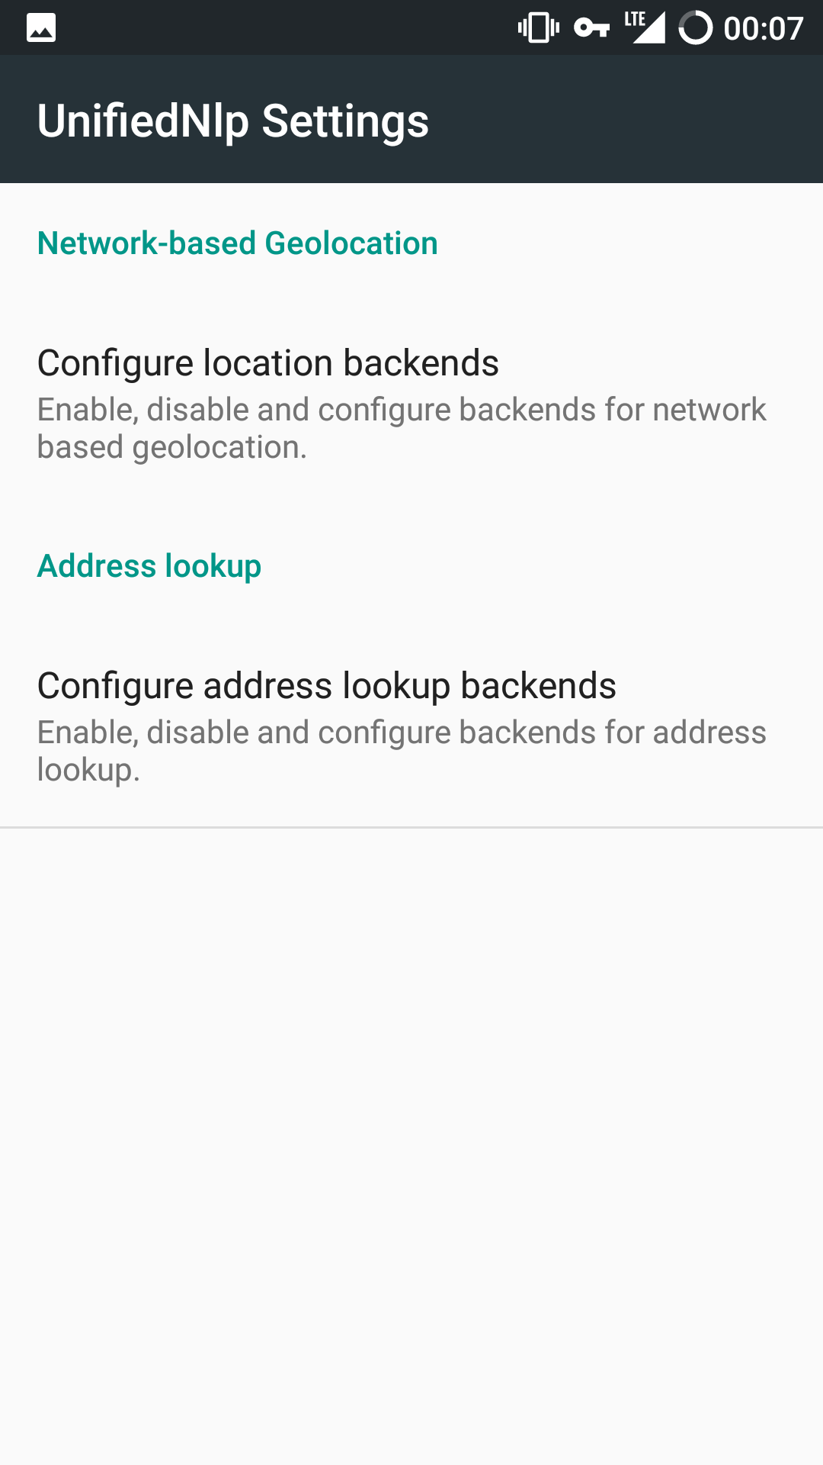
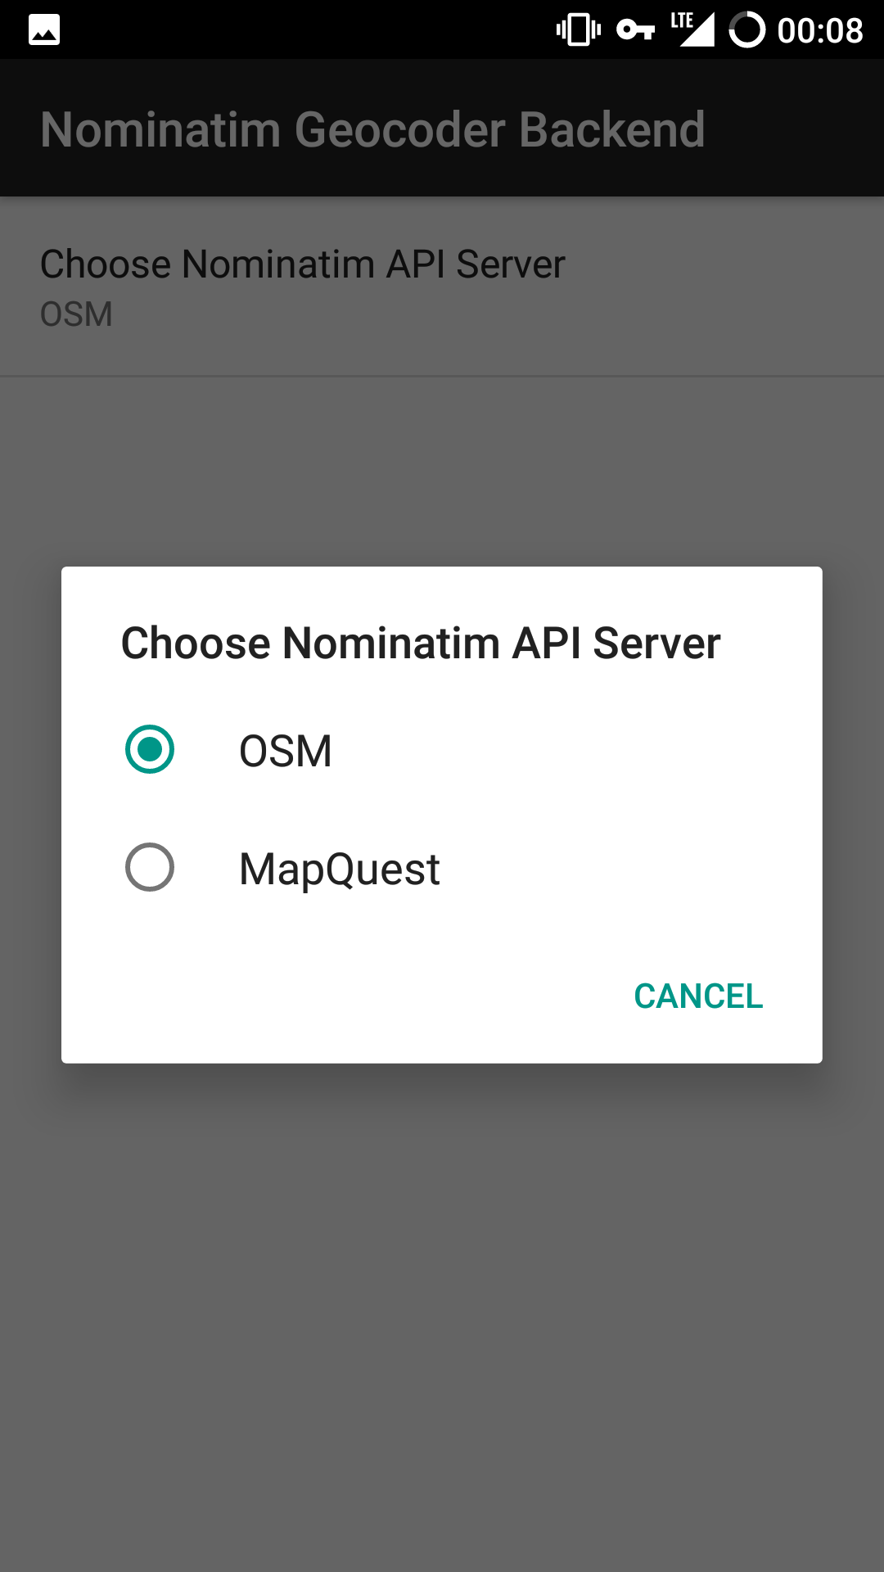
MicroG Setup - NLP Backend
Network Location Provider
Open Street Map or MapQuest Available by Default
More Available from
F-Droid

Slide 40
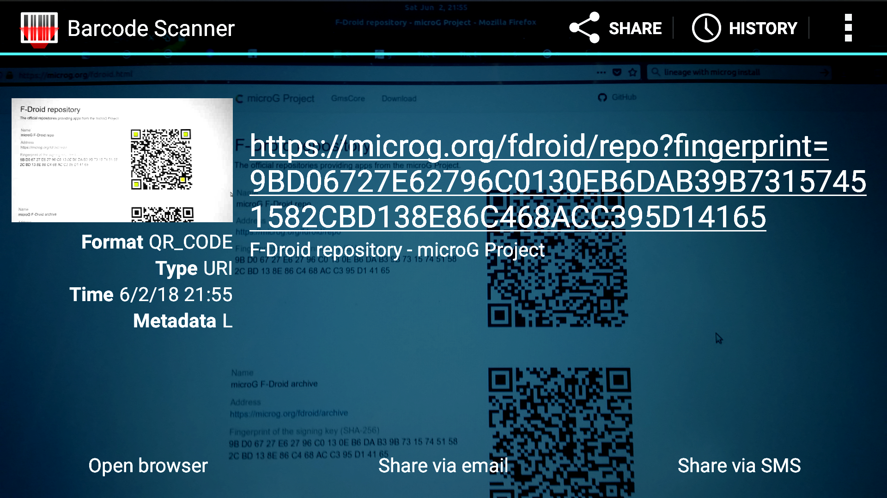
MicroG Setup – MicroG Repo
Open F-Droid
Install Barcode Scanner
Scan Barcodes at https://microg.org/fdroid.html

Slide 41
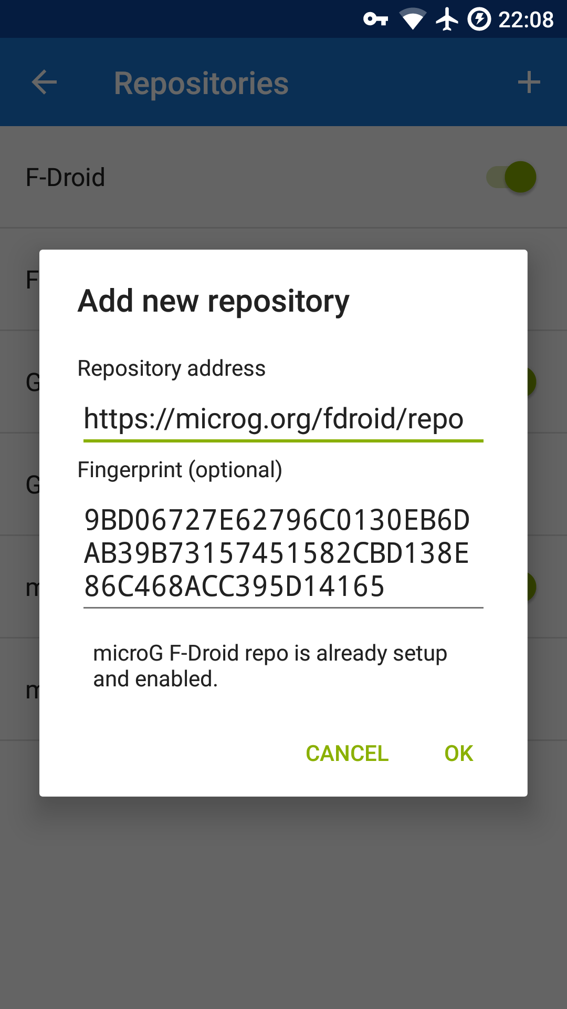
MicroG Setup – MicroG Repo
Return to F-Droid → Settings →
Repositories → + (Add)
Enable Auto Updates

Slide 42
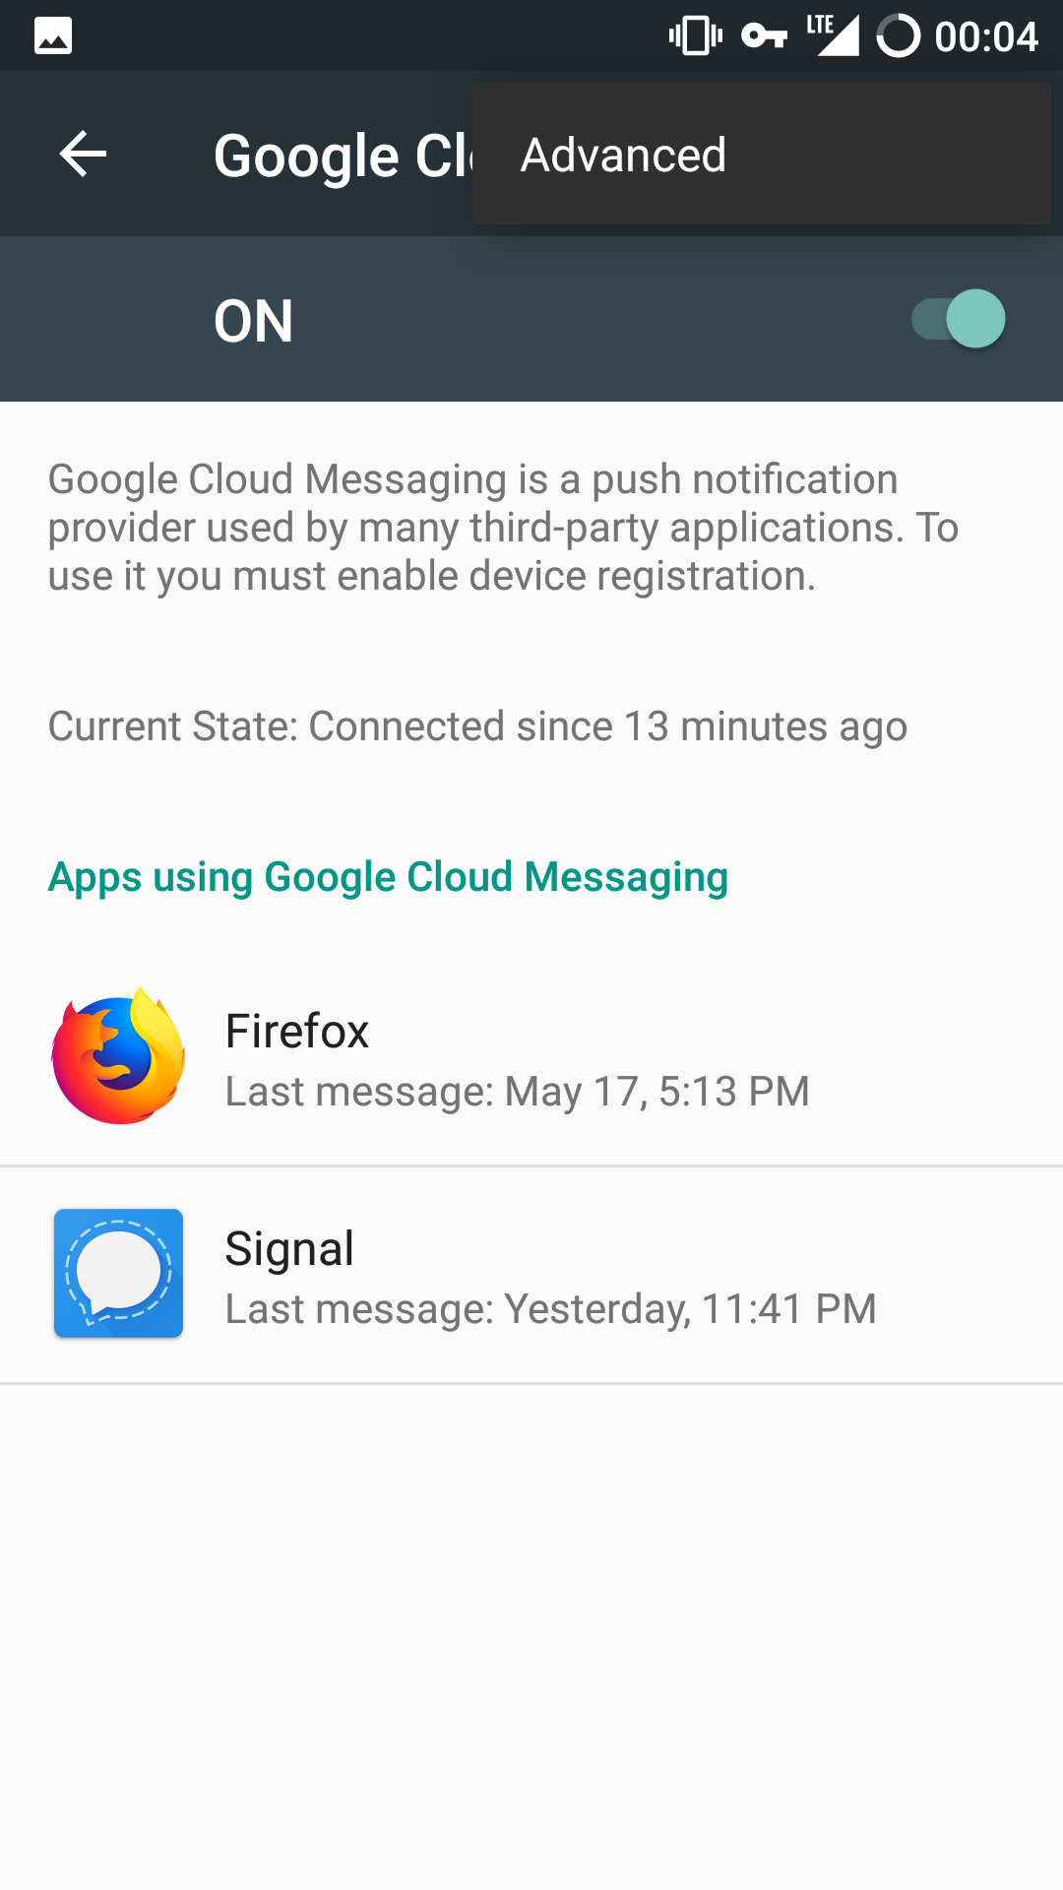
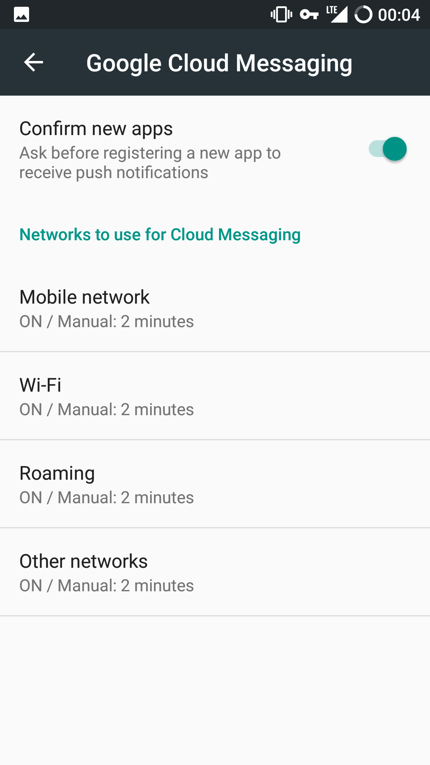
MicroG Setup – Cloud Messaging
Provides Push
Notifications
Doesn’t Require a
Google Account
Disabled by Default
Adjust Poll Interval

Slide 43
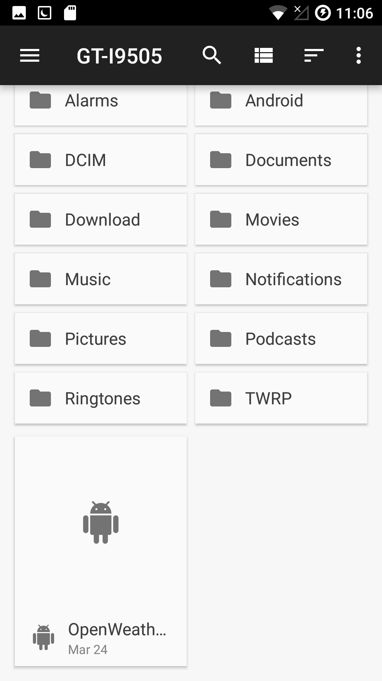
MicroG Setup – Weather Provider
Download Providers to Phone from https://download.lineageos.org/extras
Enable Installation from Unknown
Sources
  Signature Verification Can Be Done
  from PC
Install Weather Provider APKs
Disable Installation from Unknown
Sources

Slide 44
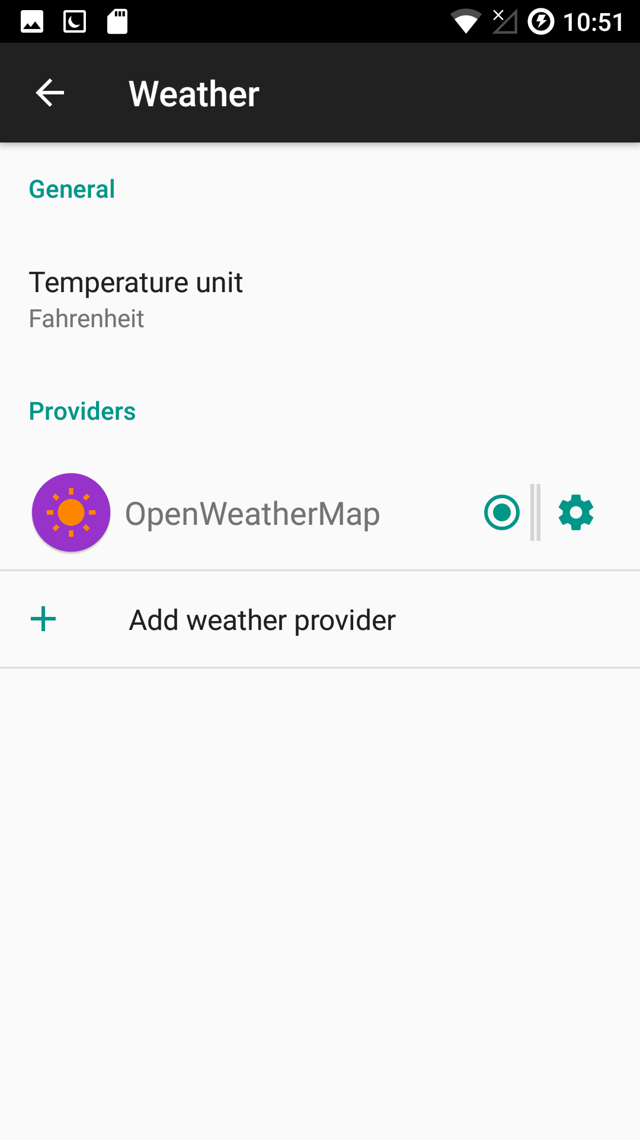
MicroG Setup – Weather Provider
Select Weather Provider
  Settings → Apps → ⚙ → Weather →
  Select Provider
Add API If Necessary
Configure cLock Widget in Clock App
  Enable “Display weather”

Slide 45
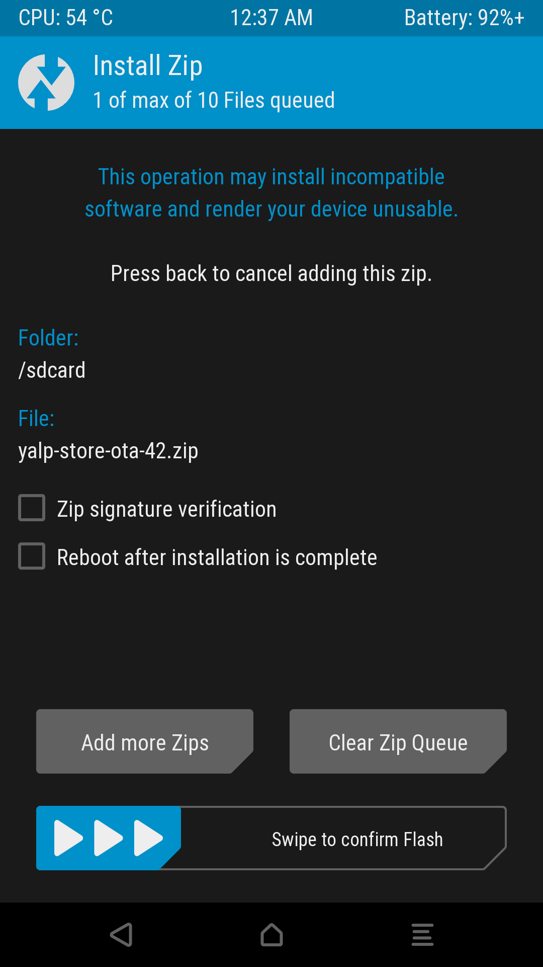
Yalp Installation
Download Zip from GitHub
  https://github.com/yeriomin/YalpStore/releases
  Don’t Install Via F-Droid
Install Zip Via Recovery

Slide 46
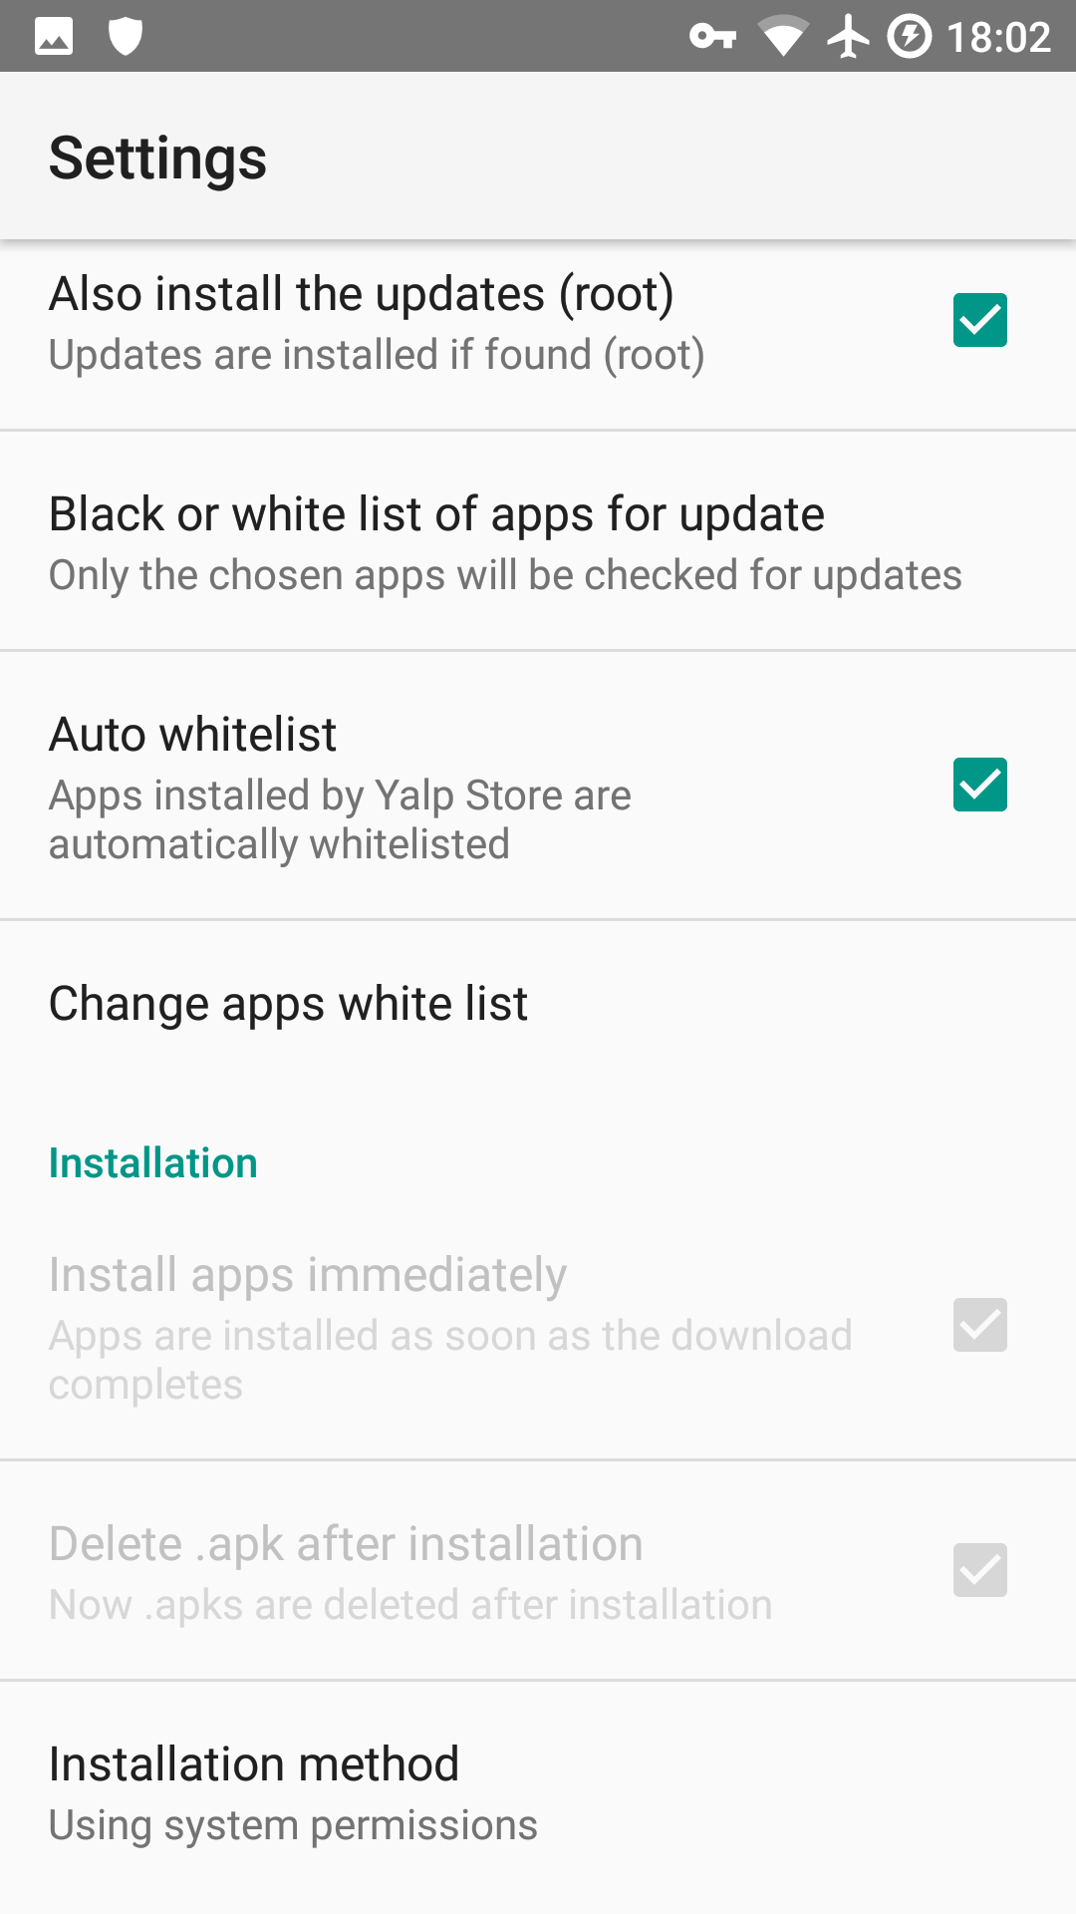
Yalp Installation
Open Yalp
  Change Installation Method to Using System Permissions
  Reboot
  Whitelist Managed Apps
  Enable Auto Updates
  Download to Internal Storage*
    Does Not Work at the Moment

Slide 47
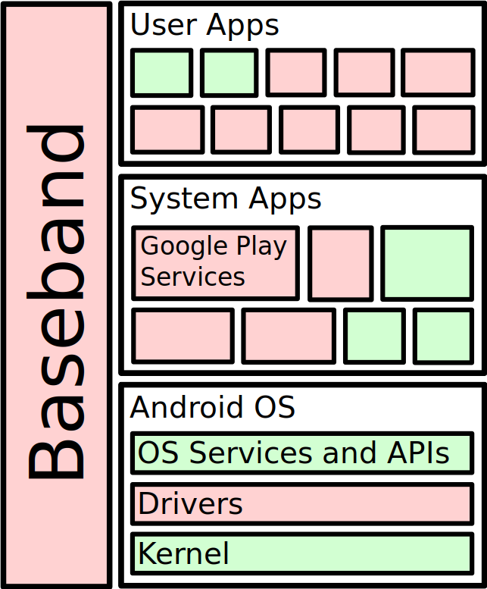
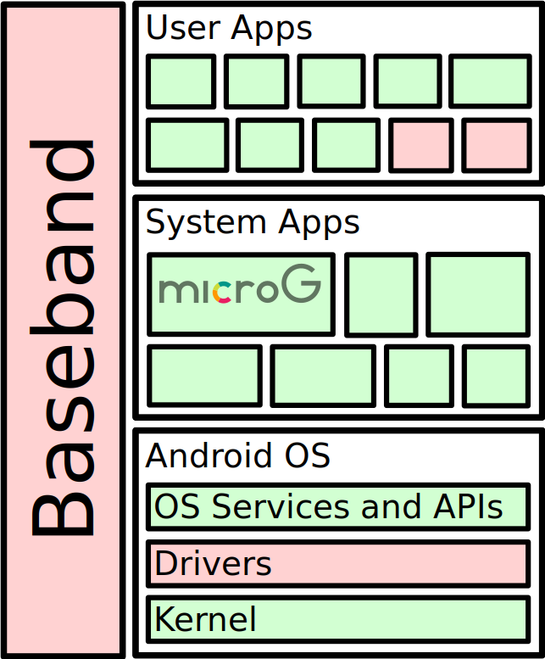
What’s Open Source?

Slide 48
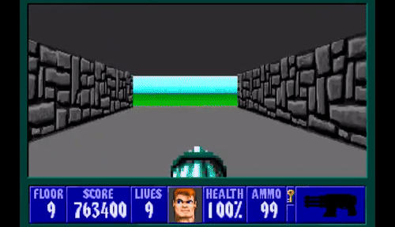
Is it Worth It?
More Control Over Personal Data
Longer Device Support
Open Source
Some Apps Will Not Run
Installation Takes Some Time
Break Free!

Slide 49

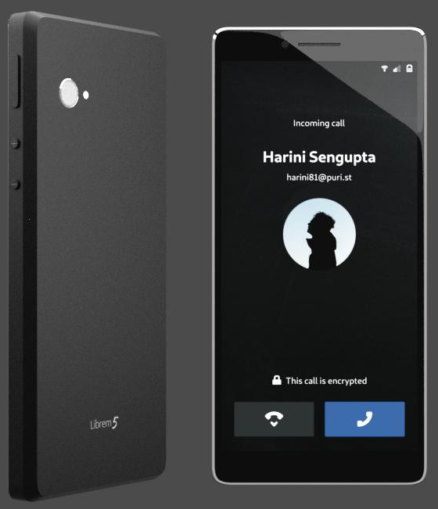
Purism 5 Phone Expected in January 2019
Runs GNU/Linux! Not Android
100% Open Source (Except
Baseband)
Hardware Kill Switches for Bluetooth/Wifi/Baseband and Camera/Mic
https://puri.sm/shop/librem-5/

Slide 50

Questions?
Extra Topics:
  F-Droid Apps
  ADB (Android Debugger)
  Migrating Signal Data
  Bit for Bit Phone Backups
Image Credit: ShockerPaintz
eviljoel@linux.com
https://eviljoel.github.io/presentations
A2BE 2D12 24D1 67CA 8830 DDE7 DFB3 676B 196D 6430

Slide 51
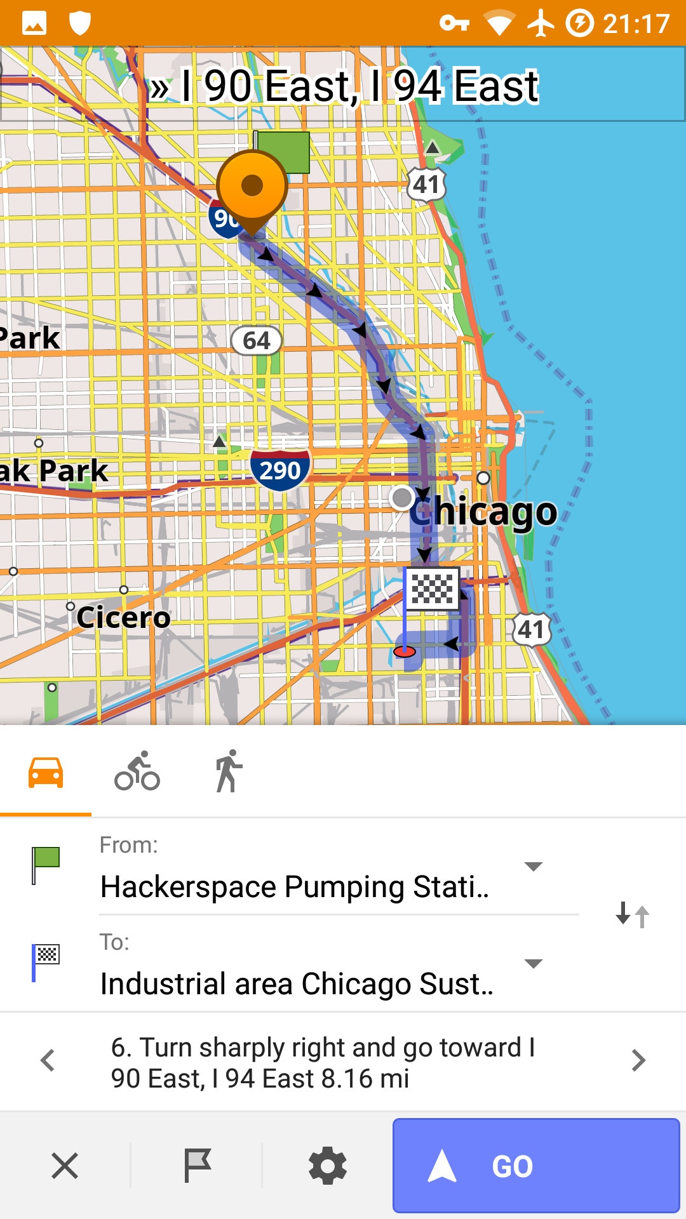
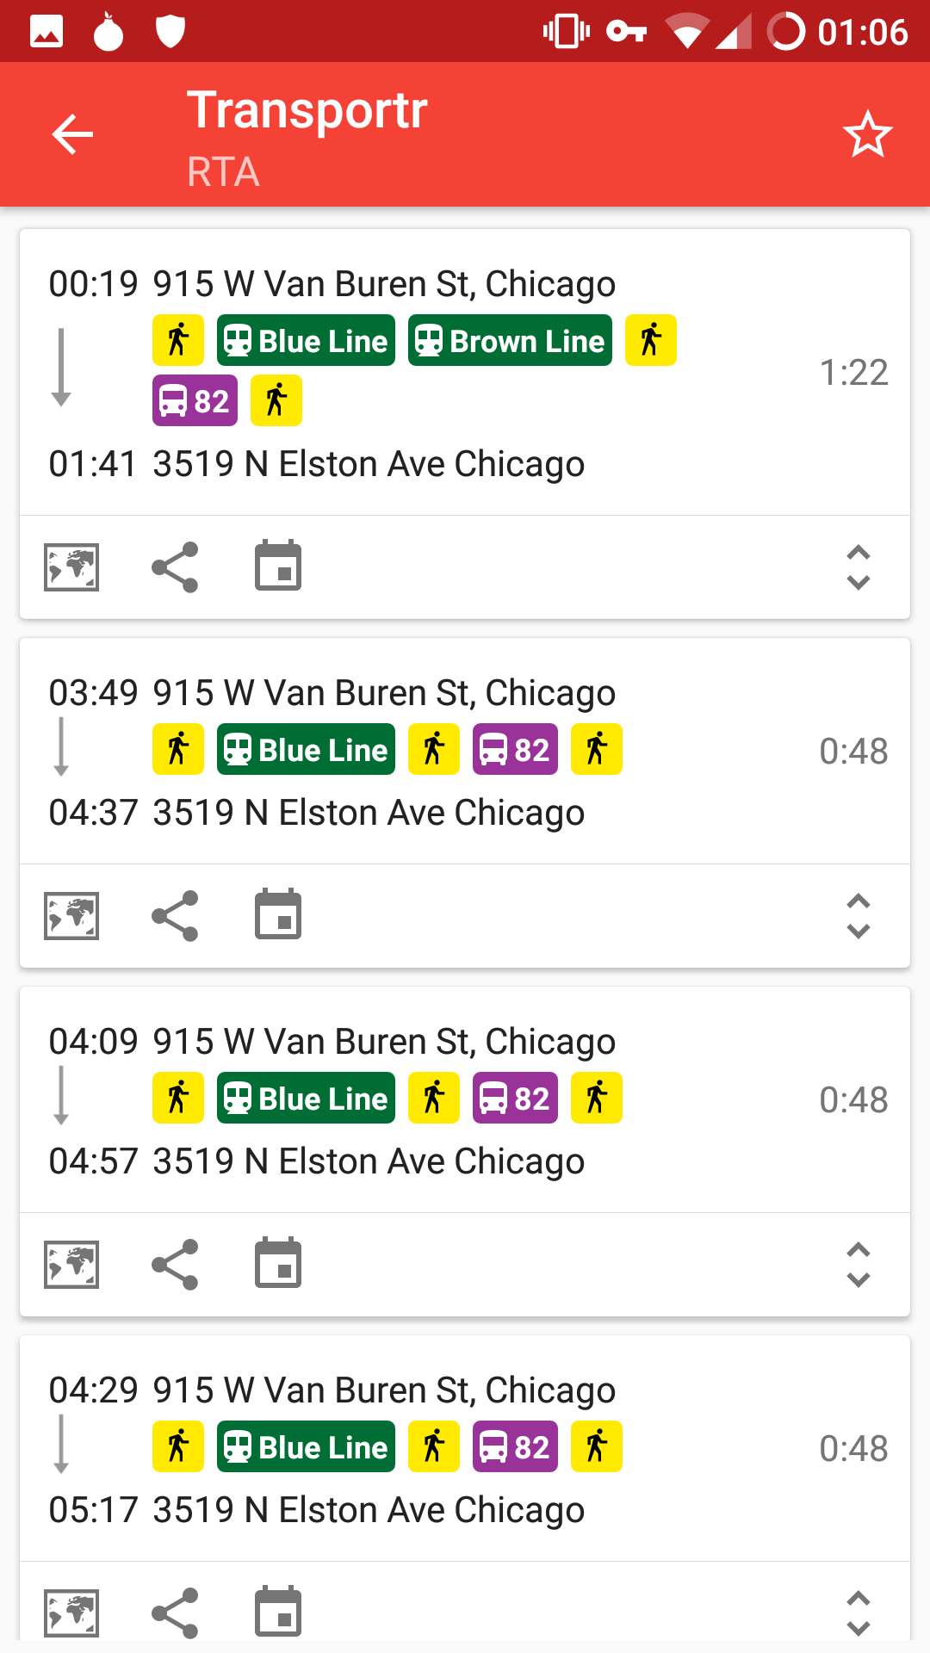
F-Droid Apps
OsmAnd+
Maps & GPS
Transportr
Public Transit

Slide 52
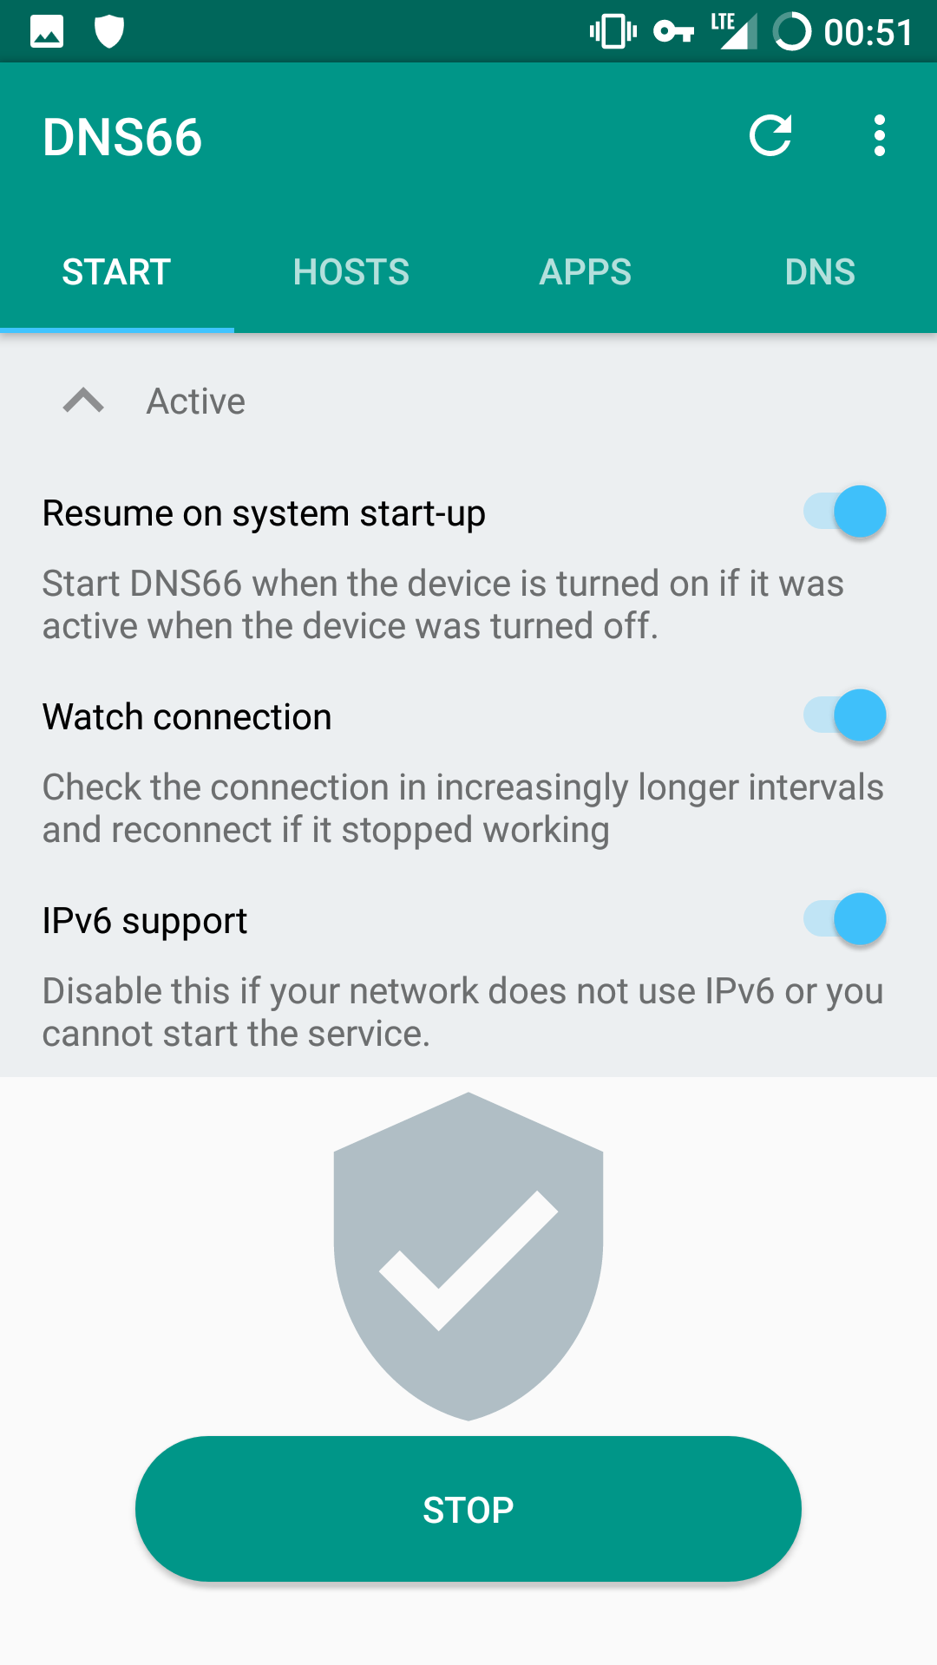
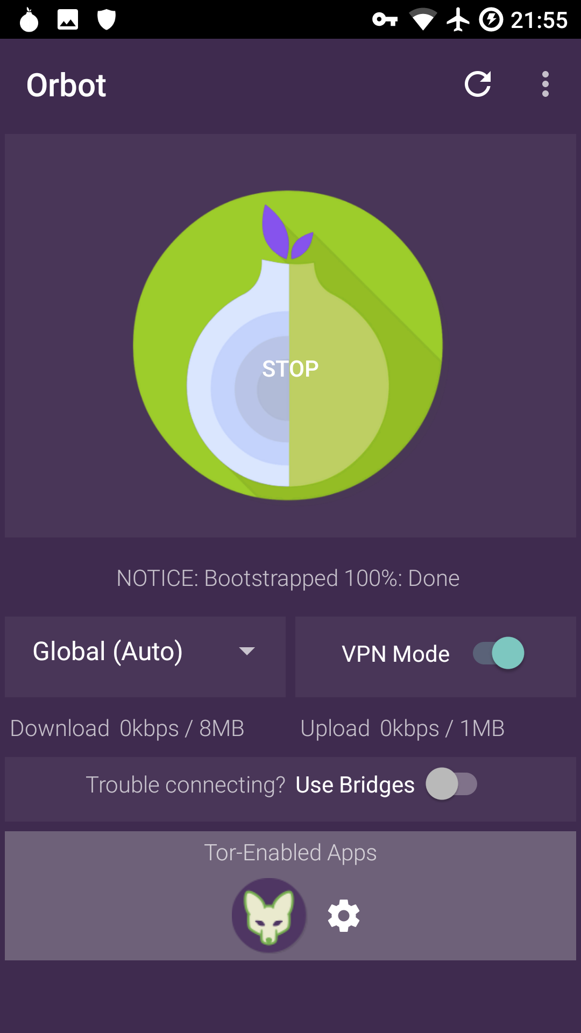
F-Droid Apps
DNS66
“VPN” Add Blocker
Orbot & Orfox
Tor Client & Tor
Browser

Slide 53
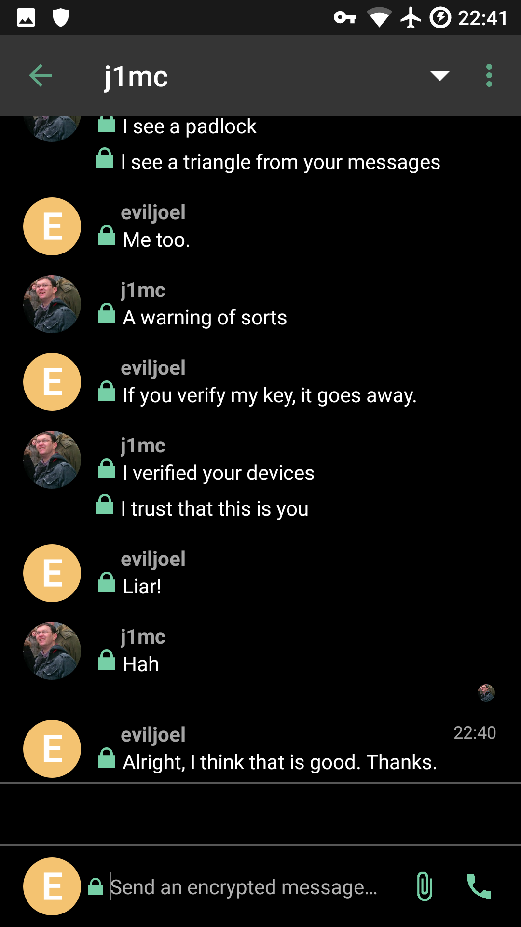
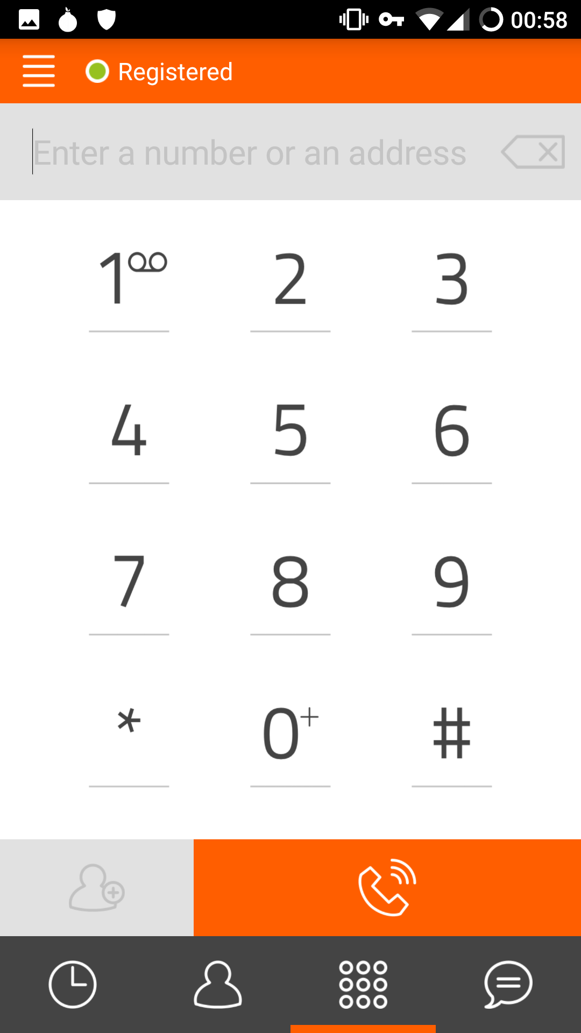
F-Droid Apps
Riot.im
Matrix Client
(Encrypted IM)
Linphone
VOIP Client

Slide 54
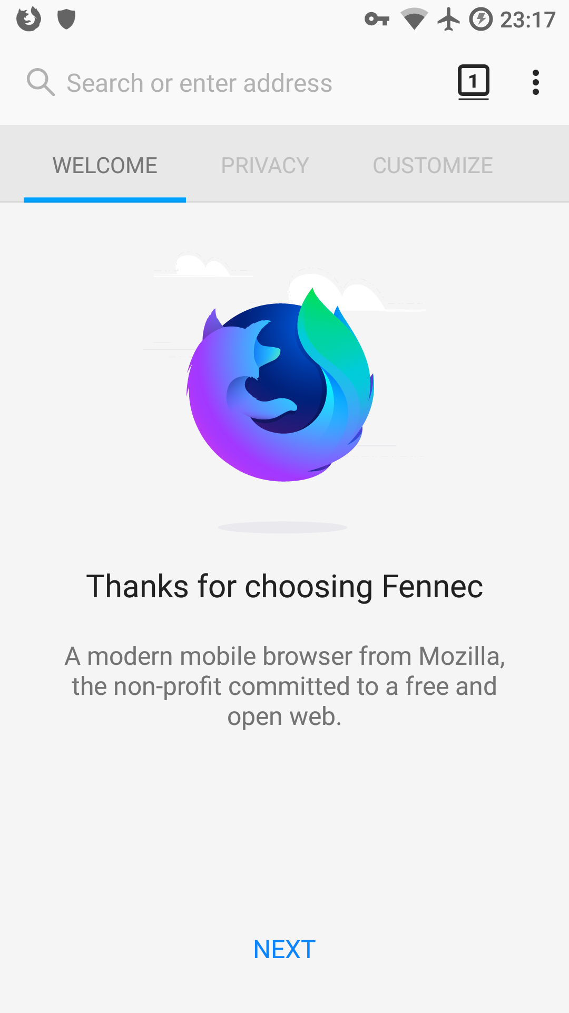

F-Droid Apps
Fennec
Firefox Without DRM
SlimSocial
Facebook Client

Slide 55
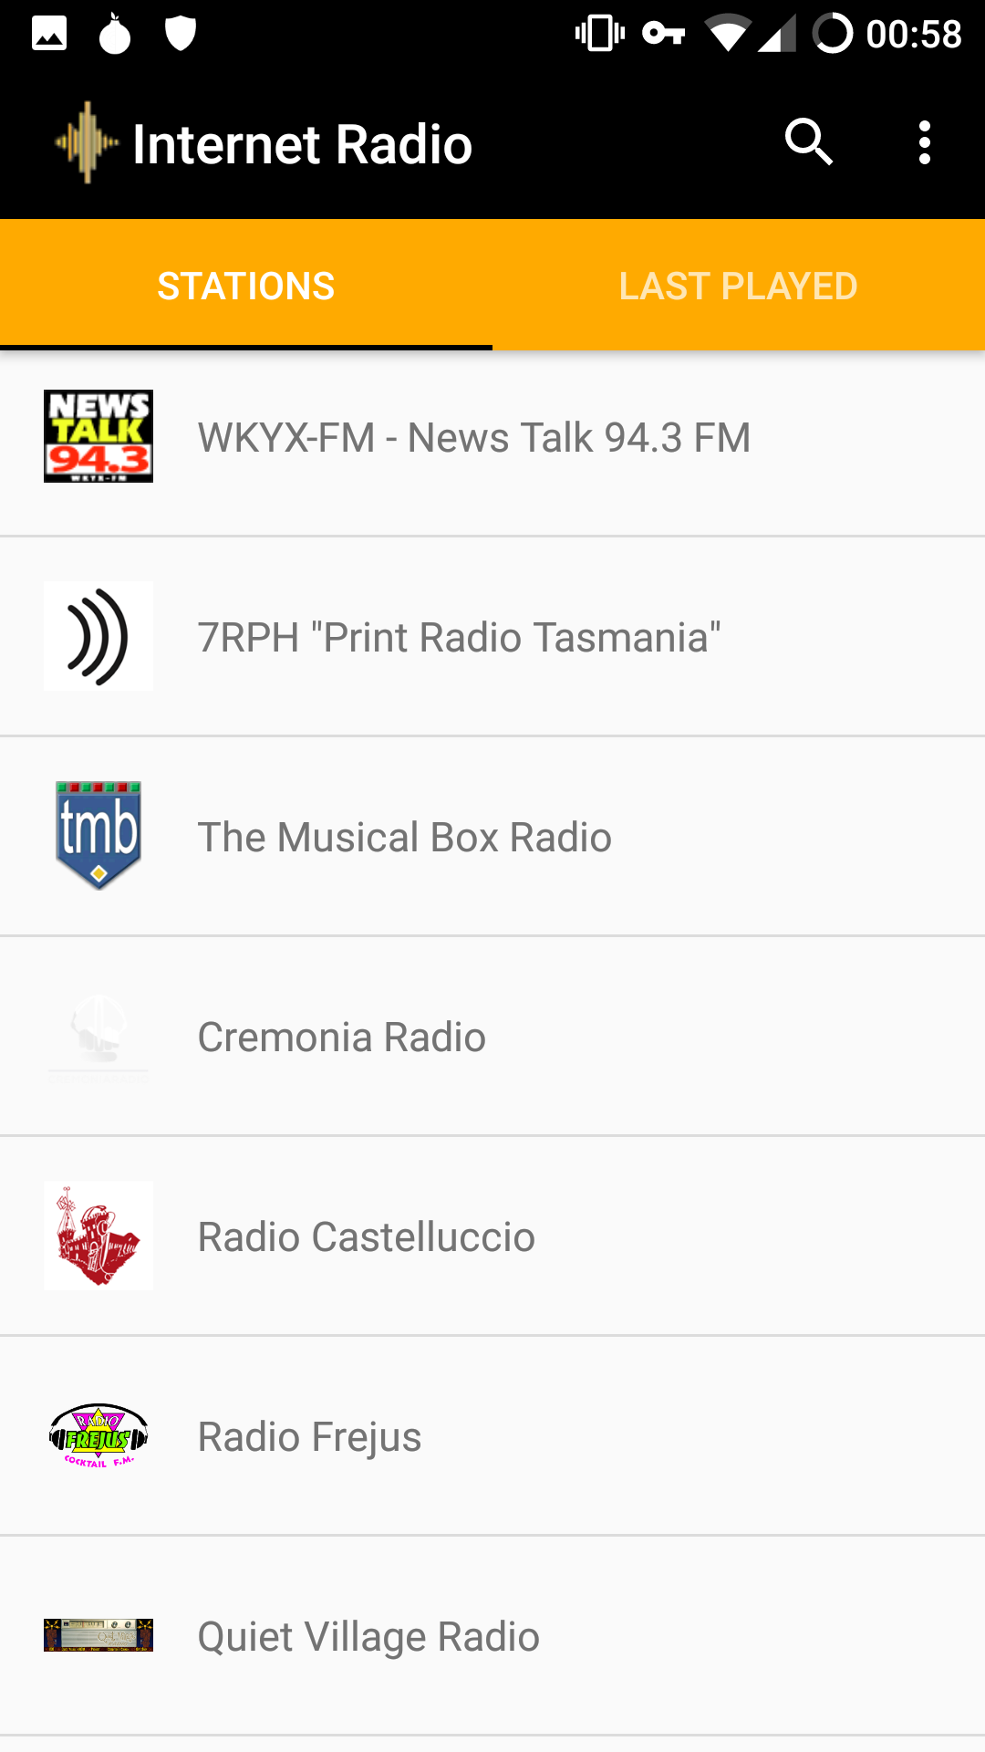
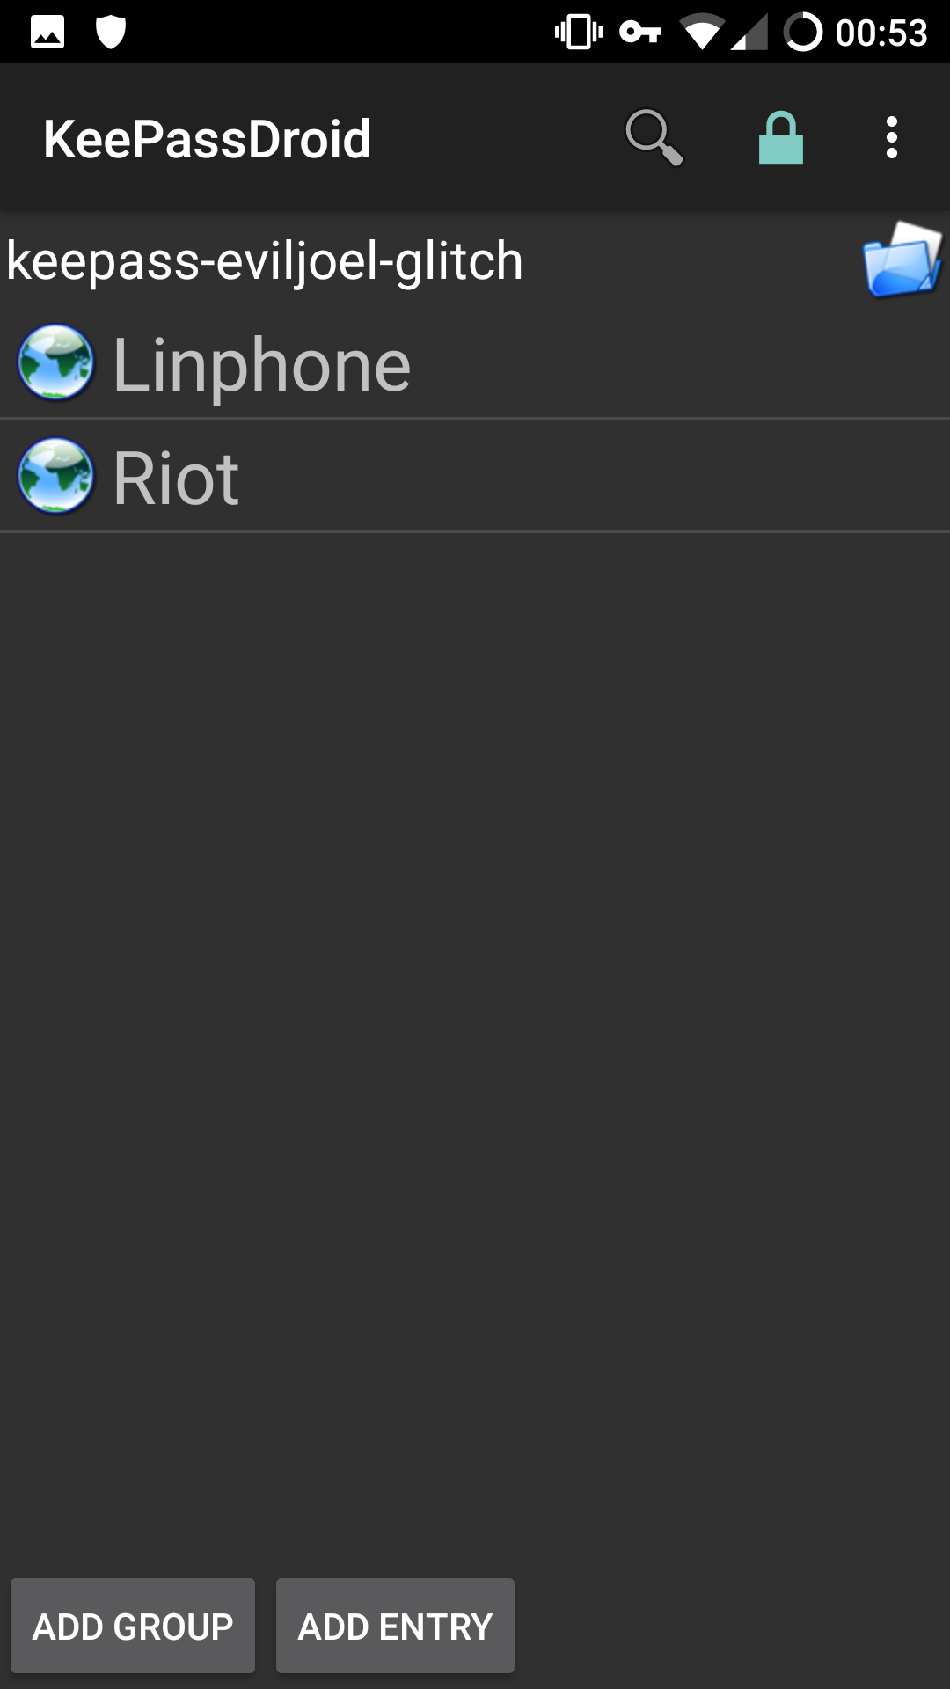
F-Droid Apps
Internet Radio
Internet Radio
KeePassDroid
Password Manager

Slide 56
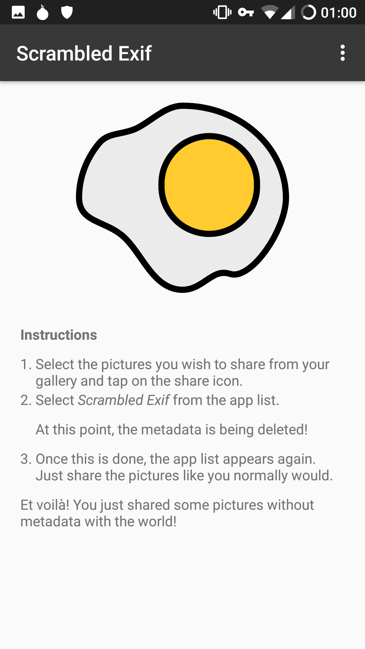
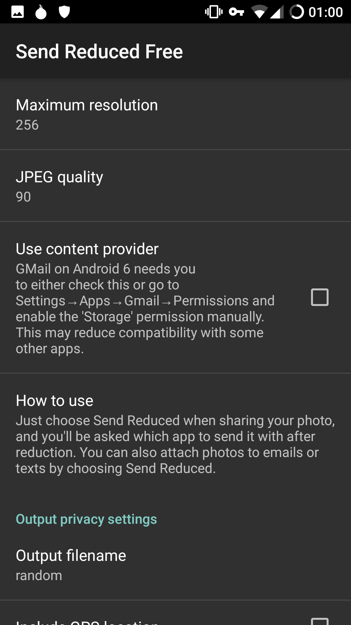
F-Droid Apps
Scrambled Exif
Removes Image Metadata Via Share Menu
Send Reduce Free
Resizes Images Via Share Menu

Slide 57

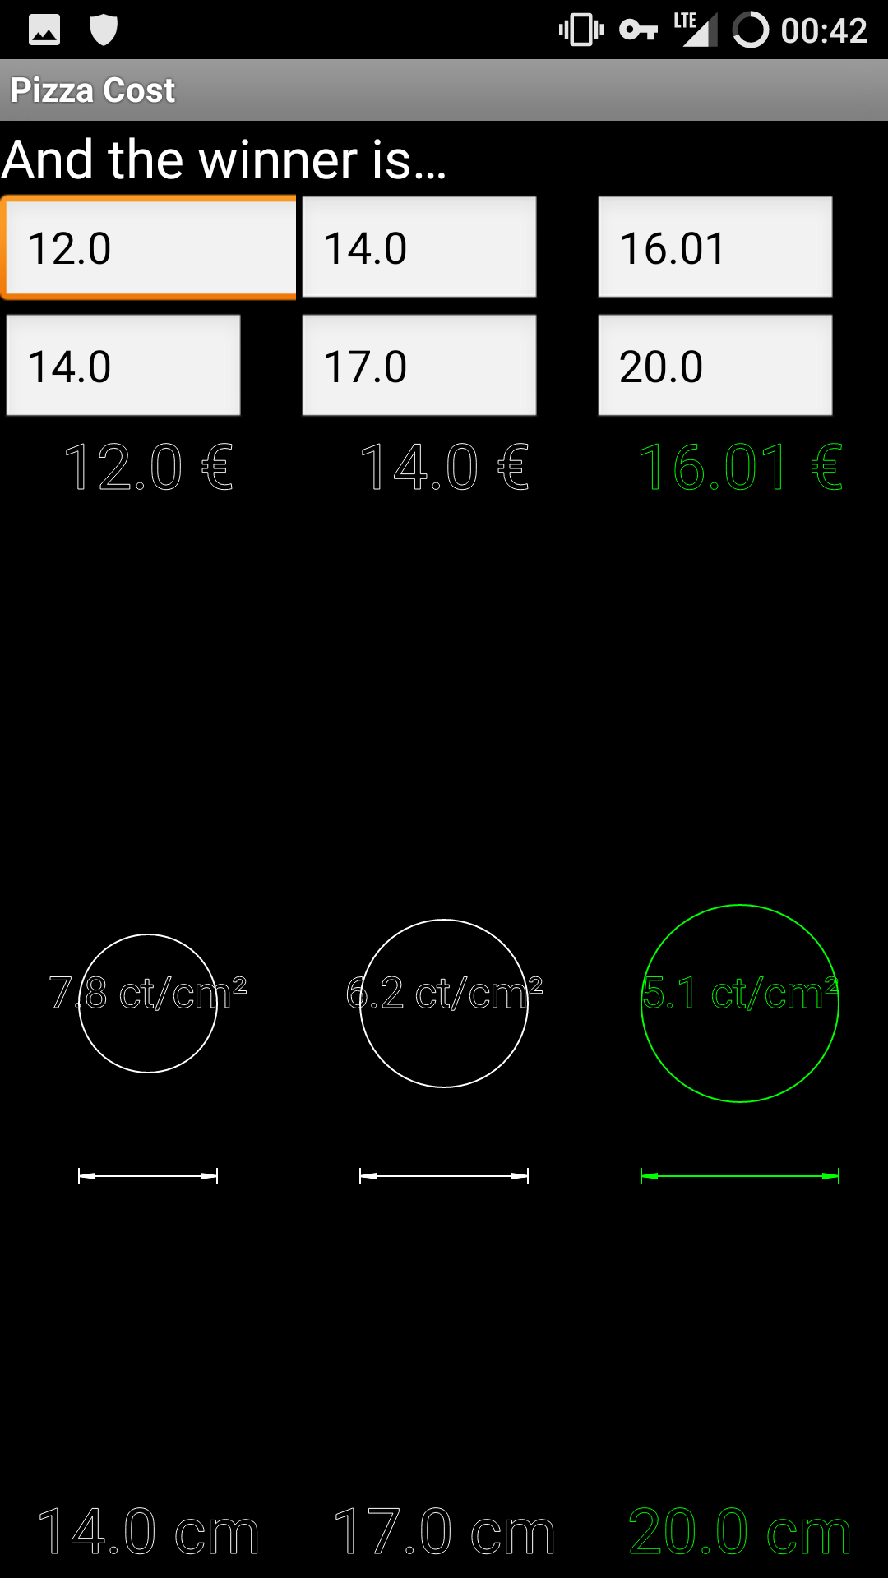
F-Droid Apps
Asciicam
Take & Render Photos as Characters
Pizza Calculator
Find the Best Price/Inch²

Slide 58
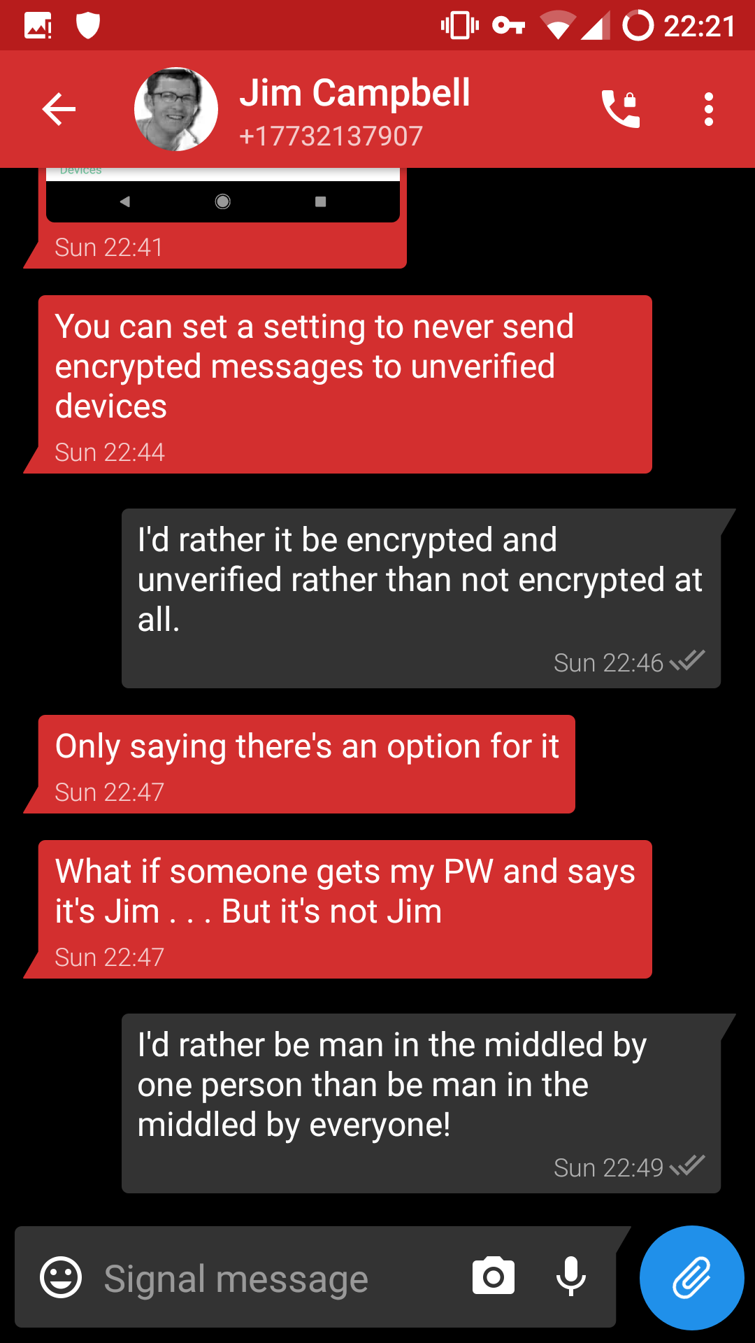
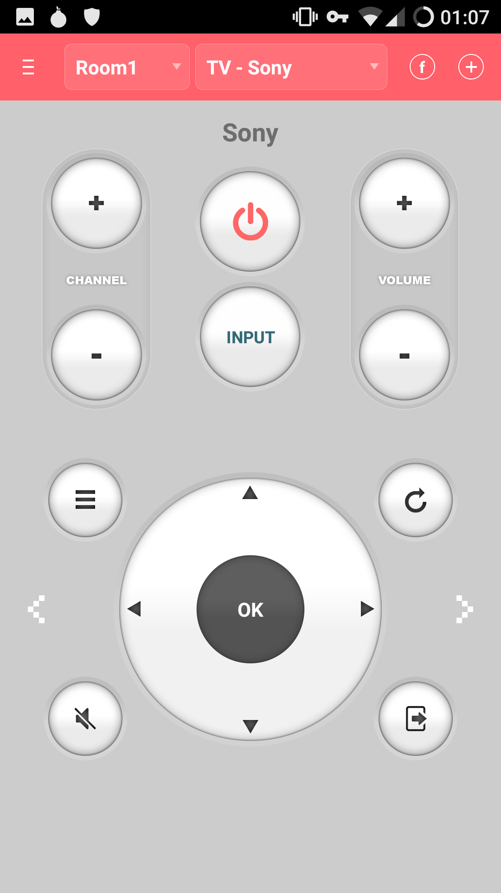

Yalp Apps
Signal
ASmart Remote
Firefox

Slide 59

App Alternatives
https://m.lyft.com
https://m.uber.com

Slide 60

Rooting LineageOS
Root Phone
  Download addonsu from https://download.lineageos.org/extras
  Boot to Recovery
  Flash ZIP

Slide 61


Rooting LineageOS
Enable Root
  Open Settings → About
  Device →Build Number
  Tap Build Number 7 Times
  Open Developer Options
  For Enable Root, select
  “Apps only”
Remove Root with
addonsu-remove Zip

Slide 62


Android Debugger (ADB)
sudo apt install android-tools-adb
Obtain a Root Shell:
  adb root
  adb shell
Push and Pull Files:
  adb push IMG_0139.jpg /sdcard
  adb pull /sdcard/IMG_0139.jpg .
View System Logs:
  adb logcat

Slide 63
Migrating Signal Data
tar -cvf signalData.tar \ /data/data/org.thoughtcrime.securesms
Install Signal on New Device
ls -ld /data/data/org.thoughtcrome.securesms
  drwxr-x--x u0_a89 u0_a89 org.thoughtcrime.securesms
tar -xvf signalData.tar
chown -R u0_a89:u0_a89 \ org.thoughtcrime.securesms

Slide 64

Migrating Signal Data
Signal Crashed

Slide 65
Migrating Signal Data
adb logcat
Copy /data/misc/keystore/user_0/
10089_USRSKEY_SignalSecret to new device.
AndroidRuntime: Shutting down VM
AndroidRuntime: FATAL EXCEPTION: main
AndroidRuntime: Process: org.thoughtcrime.securesms, PID: 4284
AndroidRuntime: java.lang.RuntimeException: Unable to create application
org.thoughtcrime.securesms.ApplicationContext: java.lang.NullPointerException: Attempt
to invoke virtual method 'javax.crypto.SecretKey
java.security.KeyStore$SecretKeyEntry.getSecretKey()' on a null object reference
AndroidRuntime: at android.app.ActivityThread.handleBindApplication(ActivityThread.java:5451)
AndroidRuntime: at android.app.ActivityThread.-wrap2(ActivityThread.java)
AndroidRuntime: at android.app.ActivityThread$H.handleMessage(ActivityThread.java:1564)
AndroidRuntime: at android.os.Handler.dispatchMessage(Handler.java:102)
…
ActivityManager: Force finishing activity org.thoughtcrime.securesms/.RoutingActivity

Slide 66
Bit for Bit Partition Backups
Needed to Move from One Galaxy S5 Phone to Another Galaxy S5
In OS Backup Tools Wasn’t Exact Enough
TWRP Backup Tools Wasn’t Quite Right

Slide 67
Bit for Bit Partition Backups
Boot to Recovery
Looked at Mounts
  adb shell "mount”
rootfs on / type rootfs (rw,seclabel)
tmpfs on /dev type tmpfs (rw,seclabel,nosuid,relatime,size=850964k,nr_inodes=
devpts on /dev/pts type devpts (rw,seclabel,relatime,mode=600)
proc on /proc type proc (rw,relatime)
sysfs on /sys type sysfs (rw,seclabel,relatime)
selinuxfs on /sys/fs/selinux type selinuxfs (rw,relatime)
tmpfs on /tmp type tmpfs (rw,seclabel,relatime,size=850964k,nr_inodes=129291)
/dev/block/mmcblk0p24 on /cache type ext4 (rw,seclabel,relatime,data=ordered)
/dev/block/dm-0 on /data type ext4 (rw,seclabel,relatime,data=ordered)
/dev/block/dm-1 on /external_sd type f2fs (rw,seclabel,relatime,background_gc=on
/dev/block/dm-1 on /sdcard type f2fs (rw,seclabel,relatime,background_gc=on,user

Slide 68
Bit for Bit Partition Backups
Looked at Partition Table
  adb shell \
  "ls -l /dev/block/platform/msm_sdcc.1/by-name/*"
lrwxrwxrwx root root aboot -> /dev/block/mmcblk0p6
lrwxrwxrwx root root apnhlos -> /dev/block/mmcblk0p1
lrwxrwxrwx root root backup -> /dev/block/mmcblk0p18
lrwxrwxrwx root root boot -> /dev/block/mmcblk0p15
lrwxrwxrwx root root cache -> /dev/block/mmcblk0p24
lrwxrwxrwx root root carrier -> /dev/block/mmcblk0p25
lrwxrwxrwx root root dbi -> /dev/block/mmcblk0p4
lrwxrwxrwx root root ddr -> /dev/block/mmcblk0p5
lrwxrwxrwx root root efs -> /dev/block/mmcblk0p12
lrwxrwxrwx root root fsg -> /dev/block/mmcblk0p9
lrwxrwxrwx root root modem -> /dev/block/mmcblk0p2
lrwxrwxrwx root root recovery -> /dev/block/mmcblk0p16
lrwxrwxrwx root root system -> /dev/block/mmcblk0p23
lrwxrwxrwx root root userdata -> /dev/block/mmcblk0p26

Slide 69
Bit for Bit Partition Backups
Unmounted All Partitions (Except ‘Data’)
Tried ‘dd’ing from ADB
  adb shell "dd if=/dev/block/mmcblk0p23" > system.img
  adb shell "sha256sum /dev/block/mmcblk0p23"
  c5d7125c...8a8819bd /dev/block/mmcblk0p23
  sha256sum system.img
  d76ab8bd...484eb6b2 system.img
SHA Hashes Didn’t Match! Something Changed

Slide 70
Bit for Bit Partition Backups
Tried SHA Hashing on Phone with a Pipe
  adb shell "sha256sum /dev/block/mmcblk0p23"
  c5d7125c...8a8819bd /dev/block/mmcblk0p23
  adb shell "cat /dev/block/mmcblk0p23 | sha256sum"
  c5d7125c...8a8819bd -
Same Result! Something Was Changing in the Stream as It Left the Phone!

Slide 71
Bit for Bit Partition Backups
Tried Piping a Base64 Converted Output
Turns:
“�Sv�]�,4�E.;,��0&!���&K� ����� ;oO�n���bi�T�yhmI”
Into Human Readable:
“AdhoD8L2MwGc/GEYCRyVsi7HwAi5/H/9BMj1Z+Uho6epbg2oECfe16U4hAhGXOfV6wAiddTdWGp==”

Slide 72
Bit for Bit Partition Backups
Base64 Piping Result:
  adb shell "cat /dev/block/mmcblk0p23 | base64" > \ system64.img
  cat system64.img | base64 -d > system.img
  base64: invalid input

Slide 73

Bit for Bit Partition Backups

Slide 74
Bit for Bit Partition Backups
Solution:
  adb shell "cat /dev/block/mmcblk0p23 | base64" > \ system64.img
  cat system64.img | base64 -di > system.img
  sha256sum system.img
  c5d7125c...8a8819bd system.img
  adb shell "sha256sum /dev/block/mmcblk0p23"
  c5d7125c...8a8819bd /dev/block/mmcblk0p23

Slide 75

Bit for Bit Partition Backups
Encrypted Data Partition Was
Mounted
  Don’t Know the Command to Unmount
  adb Service Won’t Run if Data is Not
  Decrypted
Start Sideload and Cancel to Start
adb Service

Slide 76
Bit for Bit Partition Backups
ADB Didn’t Support STDIN
From adb shell:
  nc -lp 5555 | base64 -d | dd \ of=/dev/block/mmcblk0p23
From Linux:
  adb forward tcp:4444 tcp:5555
  cat system.img | base64 | pv | nc 127.0.0.1 4444

