Slide 1

Running a Truly Open Source Android Stack
By eviljoel
eviljoel@linux.com
A2BE 2D12 24D1 67CA 8830 DDE7 DFB3 676B 196D 6430
Notes:
- Intro
- Talking about using a real open source Android stack.
- Why I care about open source Android
- What I used to do.
- What I settled on.
- How to install it.
- Extra interesting information.

Slide 2

About Me
15 Year Linux User
10 Year Chicago GLUG Member
Open Source and Privacy Advocate
Work at a Chicago Security Company
eviljoel@linux.com
A2BE 2D12 24D1 67CA 8830 DDE7 DFB3 676B 196D 6430
Notes:
- Myself
- Name
- Joel Luellwitz
- eviljoel
- 15 year Linux user
- 10 year Chicago LUG member.
- open source enthusiast
- privacy advocate
- Work at Security Company.
- View are my own and not my employers
- PGP Key

Slide 3

Hold Your Questions
Have a lot to cover.
If you are confused, those questions are OK.
Notes:
- Questions.
- How to keep this talk engaging.
- Problem deciding what to leave out.
- Original outline was 8 pages.
- I have a lot to get through.
- Limit questions to what you are confused about.
- Person who like to share what they know
- That's great.
- I'm sure someone know more than me.
- Write your own talk
- This is my time. :)

Slide 4
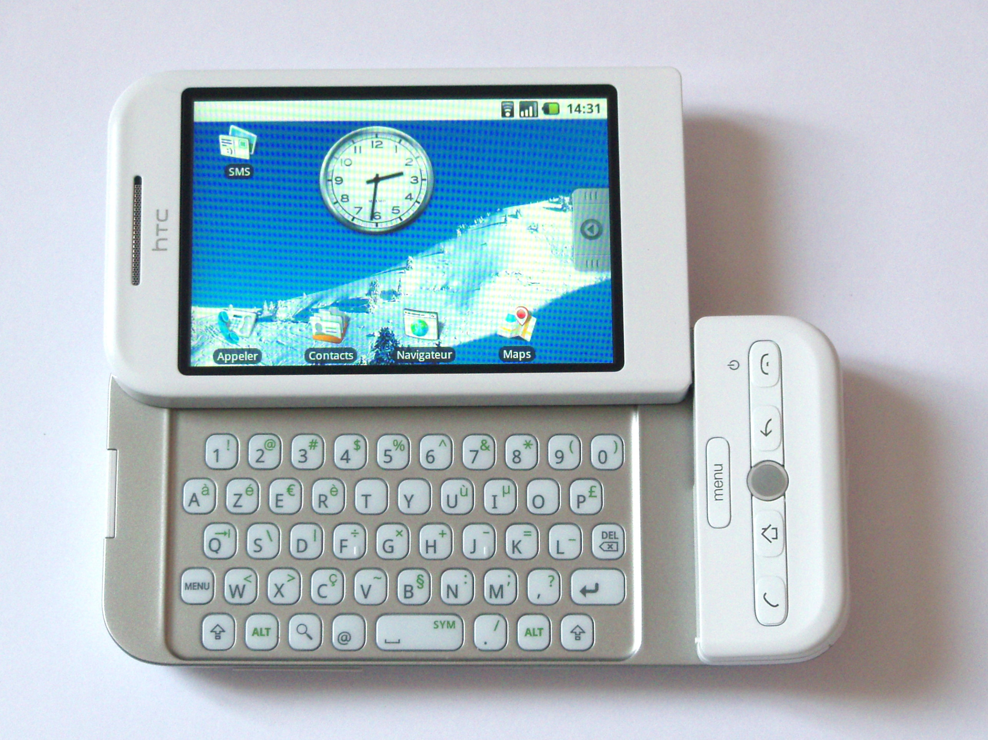

History of Android
Released on September of 2008
Linux Kernel
Open Source!
Over the years, components were re-licensed as proprietary
Google maintains control via copyright assignment
Photo Credit: Akela NDE
Notes:
- Android History
- We were pretty excited when Android was released in 2008!
- Ran on Linux
- Open source except for drivers.
- In 2018, core Android is still open source.
- More and more applications have been re-released under proprietary licenses.
- Due to copyright assignment, Google still maintains creative control over Android.
- Look but don't touch type of open source.
- Google Play Services
- Proprietary API extension.
- Under Google, there isn't a way to 100% control what data Google collects.
- I particularly don't like my location being recorded.
- I dislike the sites I visit being recorded.
- I like full control of my computers.
- You might have other sensitivities.
- It is important that you have a choice about which data is collected and who you give it to.
- I'll show you how to take back some of that control from Google.

Slide 5
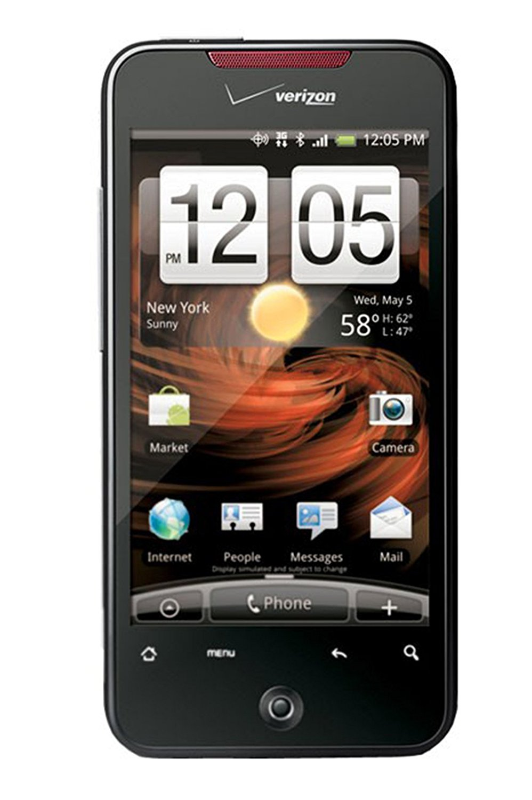
My Android Experience
Ran Stock on an HTC Incredible
Tight Google Integration
Forced Contact Sync (Android 4.0)
Secret Data Collection (Carrier IQ)
Almost No Marketplace Vetting
Updated Infrequently And Quickly Unsupported
Notes:
- My stock experience
- What is stock
- Phone as you get it from your carrier/store/Google.
- Tied into Google
- Required for play store.
- Disassociating your account sometimes requires a data wipe
- Or at least used to.
- At one point forced an irreversible sync of your contacts.
- Have a speaker from a conference I helped run 2008 in my contacts.
- Someone I don't expect to speak to again.
- Carrier IQ
- Google Play Services data collection.
- Can't turn it off. Don't really control your phone.
- Lack of security updates
- Last official Galaxy Nexus update in on Jan 16, 2013
- Android 4.2.1 (Jellybean)
- Purchased in August of 2012
- Released November of 2011 (less than two years of support).

Slide 6
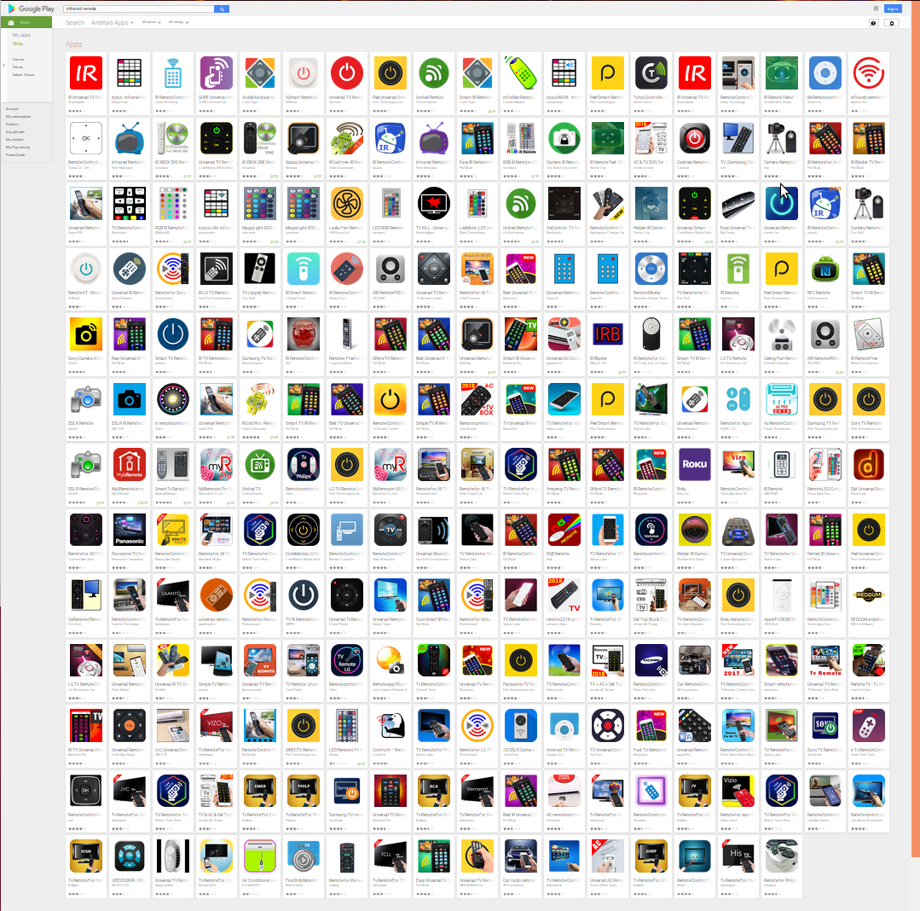
Play Store
Searched for “IR Remote”
All Had Unnecessary Permissions!
Notes:
- Play store
- Massive quantities of crap with anti-features.
- Have to sift through 50 to 100 apps to find the privacy conscious ones.

Slide 7

Google Data Collection
Transparent Backups (Including Passwords)
Photos and Videos
Contacts
Location Information
Every App You Open
Records “OK Google”
Device Configuration
Notes:
- What data does Google Collect
- Google backs up your WiFi password.
- Logins for some applications.
- Google was accidentally grabbing your location data even if you disabled location services.
- All your contacts.
- Not just your data but the data of your friends.
- All your photos and videos.
- All the apps you have installed.
- According to http://bgr.com/2018/01/24/android-location-history-tracking-google/
- What mode of transportation you are using.
- Barometric pressure.
- Whether you are connected to WiFi.
- MAC address.
- Nearby Bluetooth beacons.
- Battery and charge status.
- According to https://www.teenvogue.com/story/all-the-data-google-has-on-you
- Every app you open
- OK Google recordings, even accidental ones.
- Device configuration via SafteyNet.

Slide 8






CyanogenMod w/ GApps
3rd Party “ROM” (Customized Android)
Community Developed
Additional Privacy Features
No Bloatware
Still Tied into Google with Gapps
  Remove App Installation
CyanogenMod Became LineageOS
Notes:
- CyanogenMod with Gapps
- What is CyanogenMod
- More pure version of Android
- Open source
- Additional features.
- Themed differently.
- Don't know why I did it.
- Ability to disable permission for each app.
- But only worked after application install.
- Less bloatware.
- Noticed I could remotely install app from my desktop.
- This went too far for me.
- Should have some on-device confirmation.
- Wasn't in control of my own phone (computer).
- Project eventually became lineage.

Slide 9
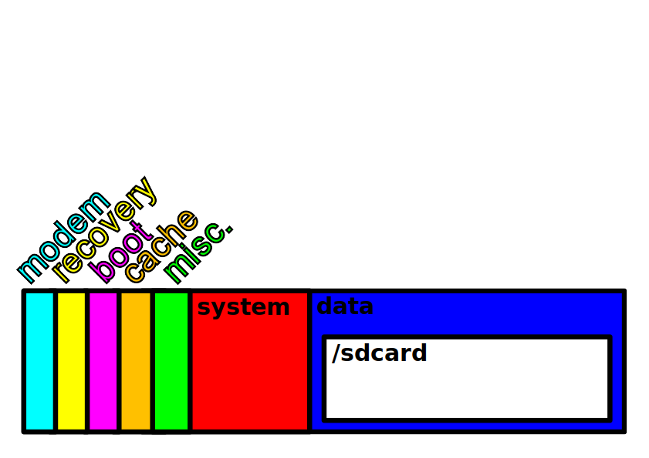
Phone Flash Memory
Notes:
- Diagram of phone storage
- Boot
- Kernel and initramfs together.
- Linux binary and ramdisk.
- Preserved on data wipe.
- recovery
- Helps you out if you're having problems booting Android.
- data
- Read/write
- Store applications/app data
- /sdcard
- G1 exclusively used this for accessible storage, hence the name.
- Photos, movies, downloads, stuff you care about.
- There regardless of an actual SD card.
- Now shares the partition with /data.
- This is the partition that gets encrypted.
- Wiped out on system reset
- system
- Read only, contains operating system
- Preserved on data wipe.
- modem
- Baseband
- cache
- other
- Parts that are replaced.

Slide 10

CyanogenMod Without GApps
F-Droid Replaced Play Store
No Real Google Maps Replacement
Had OS Updates Up to Android 6
Android 5 had 4G Issues on Galaxy Nexus
Worked OK for Years
Couldn’t Get Signal Working
SVG Credit: Amitie 10g
Notes:
- CyanogenMod without Gapps.
- Fdroid was store.
- Couldn't figure out how to install as system app.
- Installed apps with Installation from Unknown Sources.
- No Google Maps.
- That's OK, I never really used the GPS anyway.
- Navit seemed pretty terrible.
- Still had security updates.
- Up to Android 6 for Galaxy Nexus.
- My particular phone stopped working with 4G.
- Worked OK for a while.
- Signal required Google play services.
- Other apps started requiring play services too.
- Youtube
- Uber & lyft
- Tinder

Slide 11

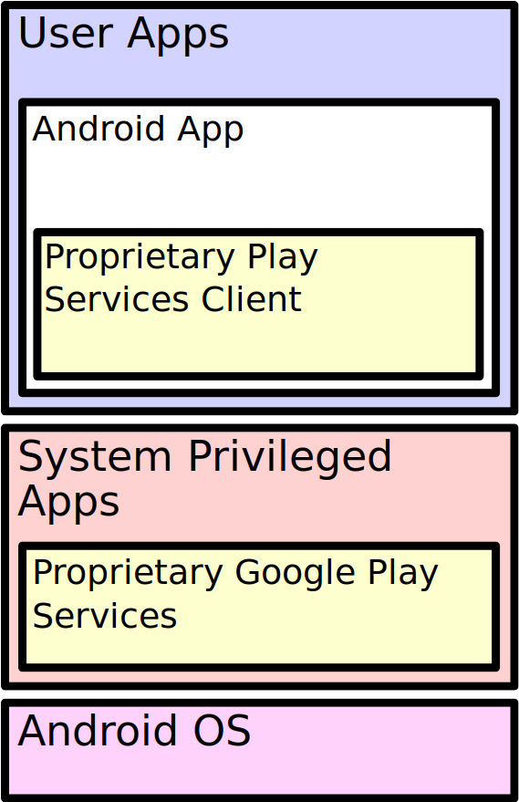
Google Play Services
Proprietary API Extension
Required by Many if Not Most Apps
Updates Automatically
Required for Many New Features
Applications Verify Play Services Signature
Caused Me Big Problems!
Notes:
- Google Play Services
- Introduced in Ice Cream Sandwich (Android 4.0)
- Prior to this, apps linked against Android Open Source project.
- An abstraction layer between your operating system and your application.
- Silently updates in the background.
- 93% of Android users are on the latest Google Play Services version.
- Great for security.
- Generally, new features are added to Google Play Services and not ASOP. (Actually, I'm not 100% sure about this.)
- Android applications ask the operating system if an authentic Google Play Services is installed.
- Prevents 3rd parties from creating their own Google play services.
- Uses a lot of system resources and is a huge drain on battery.

Slide 12
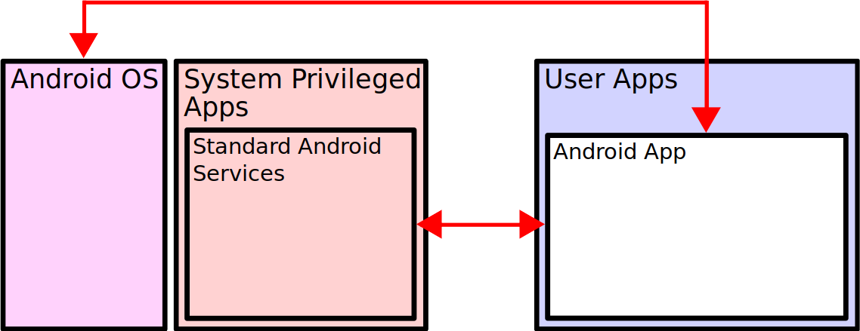
Before Google Play Services

Slide 13
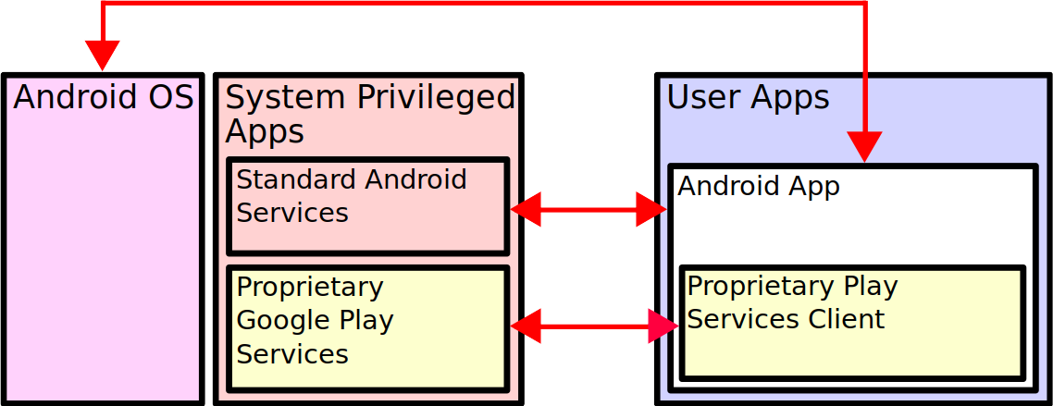
With Google Play Services

Slide 14
Privileged System Apps
Runs with System Privileges
Stored on ‘system’ Partition
  Not ‘data’ Partition Like Most Apps
  Stays Present After Factory Reset
Cannot Install Directly From Play Store
  Unless App is Signed by Trusted Certificate
  Installed via ‘Recovery’ or App w/ Root Privileges
Notes:
- System applications
- Runs with system privileges.
- Stored on System partition
- Not on data partition
- Stays after system reset.
- Cannot be installed via the app store.
- Unless you have platform key.
- Need to be installed from recovery or with root access

Slide 15

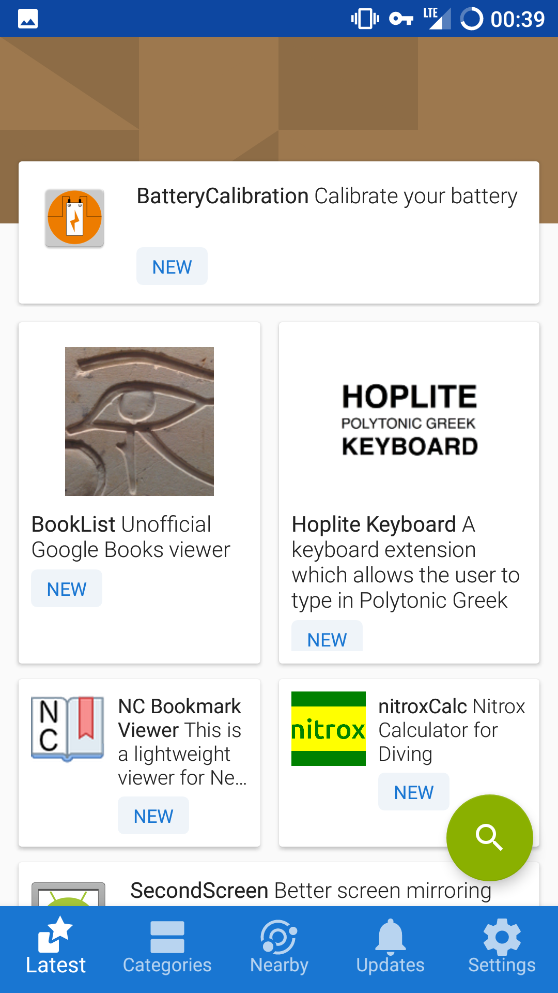
F-Droid
Play Store Alternative
100% Open Source
Vets for Anti-features
Thousands of Apps
Notes:
- Fdroid
- Free alternative to play store.
- All open source
- Firefox doesn't even qualify.
- Better vetting for anti-features.
- Has thousands of apps
- Play store has millions

Slide 16

How Do I Fix This?!?
Can’t Run Popular Apps
Terrible Support For Galaxy Nexus
  No 4G!
  Frequent Crashes
F-Droid Installing Apps via “Unknown Sources”
Compiling Signal From Source
OS Updates Required Full Reinstall
Notes:
- 2017 Attempt
- On a Galaxy Nexus.
- CyanogenMod then LineageOS.
- Support was terrible.
- At one point I had to compile my own Android for security updates.
- Stock security updates had stopped years ago.
- 4G stopped working with Android 5 or 6.
- Frequent crashes.
- Couldn't do more than a 6 minute phone call.
- Compiling my own Signal.
- Installing apps from Fdroid with Allow Installation from Unknown Sources.
- Weekly builds were available.
- Couldn't OTA update.
- Couldn't install it form recovery either.
- Until the latest release TWRP.
- Because the /data could not be decrypted.
- Had to do a fresh installation for every OS update.
- Wasn't upgrading my OS or Signal very much.
- Harder to upgrade other apps without 4G.
- Bad for security.
- This was a mess!

Slide 17

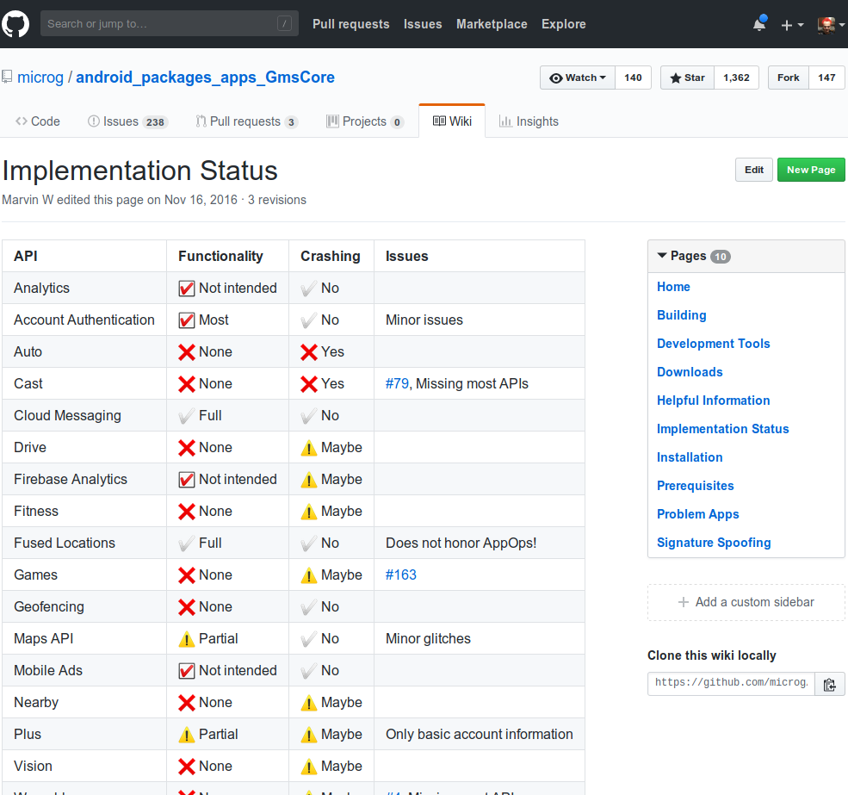
Open Source Implementation of Play Services
  Partial Implementation
  Has Good Location Support
Required “Signature
Spoofing” Patch
Hard to Update and
Maintain
Too Scary for Me
Notes:
- MicroG
- Open source implementation of Google Play Services
- Partial implementation
- The most used parts of it are implemented
- Location stuff.
- Requires signature spoofing.
- Sounded kind scary.
- Steps.
- Install your ROM.
- Install signature spoofing system app.
- Install MicroG.
- Software was too new for me to trust.

Slide 18
A Year Later (2018)
Fed Up with No 4G!
LineageOS 13 Updates Stopped in February
Needed a “New” Phone
  Wanted a Small Screen
  Replaceable Battery
Restarted My Search from Last Year
Notes:
- Galaxy S5
- Got sick of not having 4G.
- Worried about using Lyft with such a bad connection.
- And getting stranded somewhere.
- Couldn't figure out why 4G didn't work.
- Lineage Android 6.0 updates stopped in January 2018.
- Looked into getting a "new" phone.
- Largely started with OS and moved backwards to the phone.
- Wanted removable battery and small screen.

Slide 19

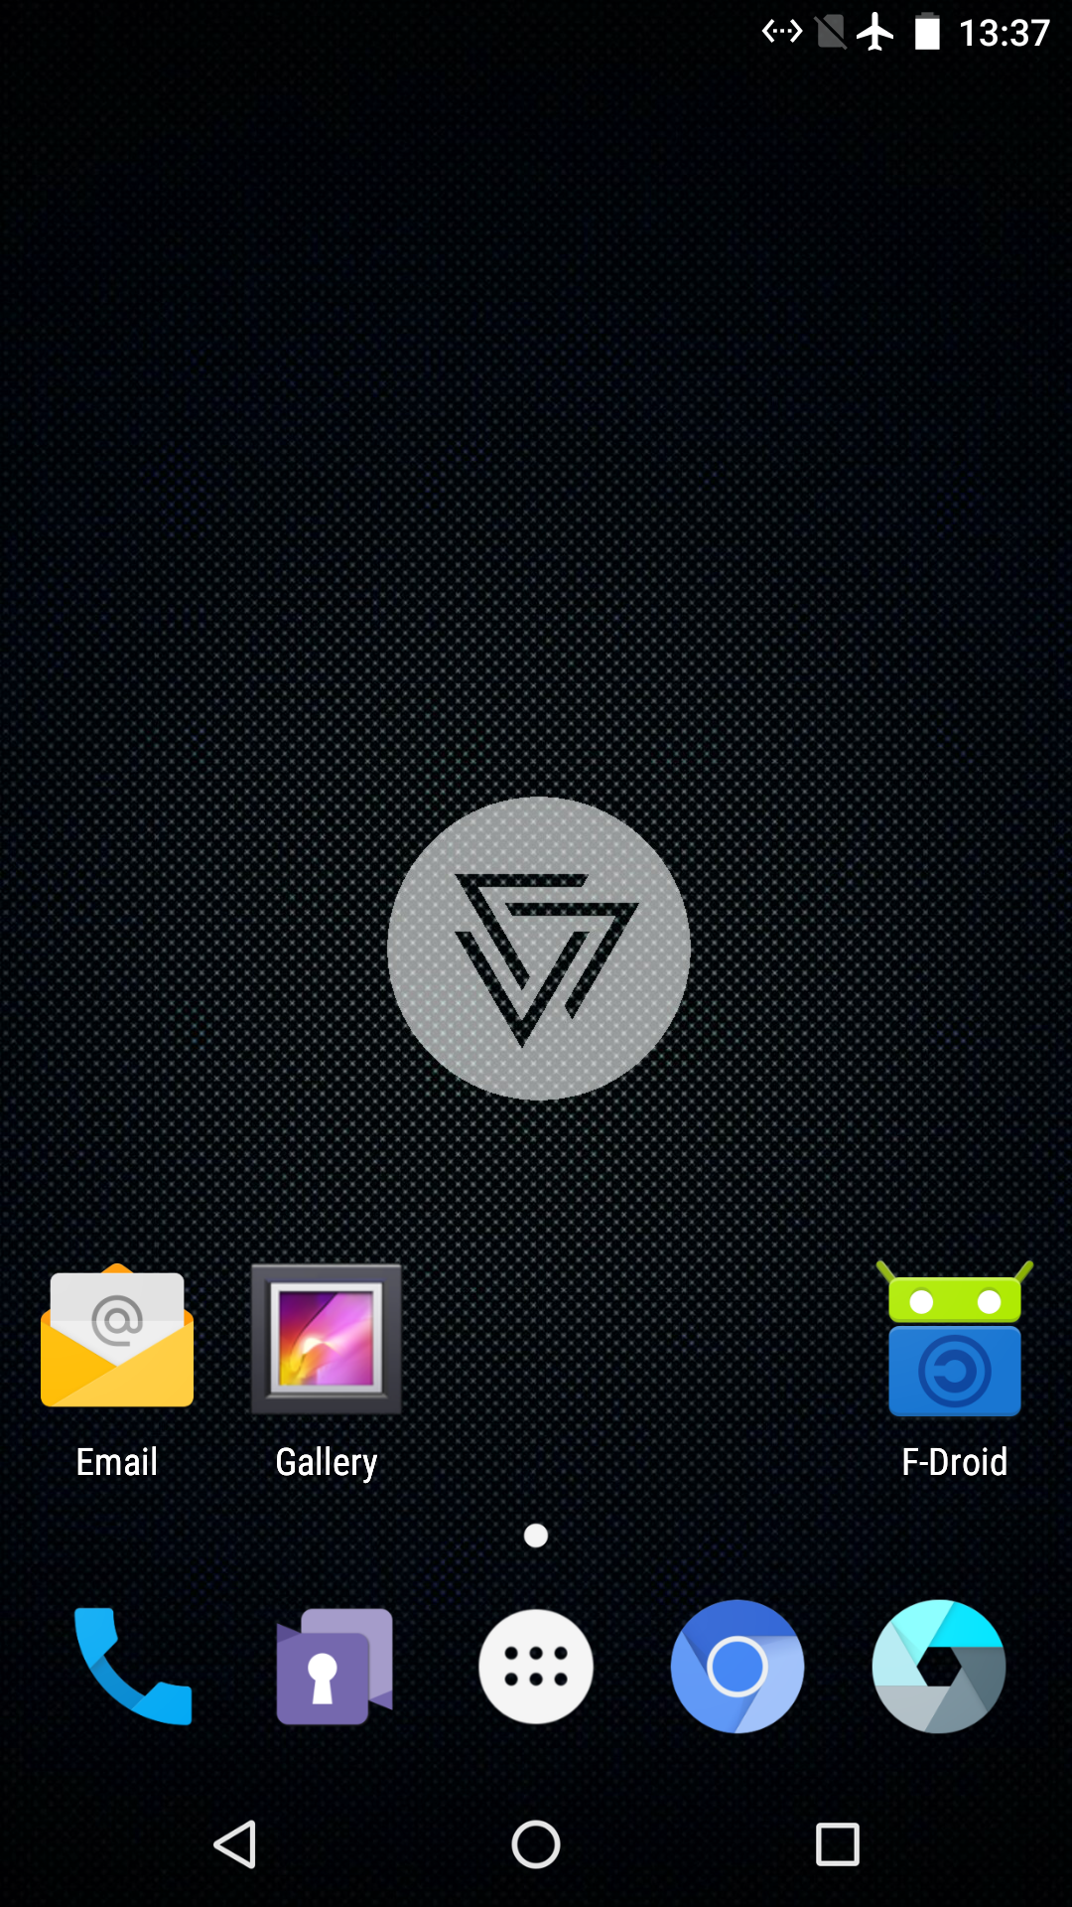
CopperheadOS
Only Supports Nexus and Pixel Devices
Support is Limited to Two Years
No Official 3rd Party ROMs for Pixel/Pixel 2 Yet
No Longer Have Install Downloads
  Must Compile from Source!
  OTA Updates are Supported.
Notes:
- CopperheadOS
- Only for expensive nexus devices.
- Only supported for 2 years.
- No official Lineage release for Pixel.
- Now have to compile it from source.
- According to Jim, the future of this project is uncertain.

Slide 20
What a Difference a Year Makes
MicroG is a Reputable Project
Signature Spoofing Included in 3rd Party ROMs
Explanations of Signature Spoofing Available
  https://blogs.fsfe.org/larma/2016/microg-signature-spoofing-security/
Figured Out F-Droid App Install Problem
LineageOS with MicroG
  Fork of LineageOS
  Lineage + Signature Spoofing + MicroG + F-Droid
Notes:
- Situation improved since 2017.
- Lots of people seemed to be happy with MicroG.
- A more established project.
- Technical explanations of signature spoofing is now available.
- Scope of signature spoofing has been reduced to system applications.
- Many distros have signature spoofing built in.
- LineageOS refused to do so
- Most popular 3rd party ROM.
- Worried about Google locking down Android.
- Particularly worried about loosing SafteyNet approval.
- Fdroid
- Figured out LineageOS no longer rooted by default.
- Couldn't install itself as system application.
- LineageOS with MicroG
- Combines LineageOS, Signature Spoofing, MicroG, and Fdroid

Slide 21

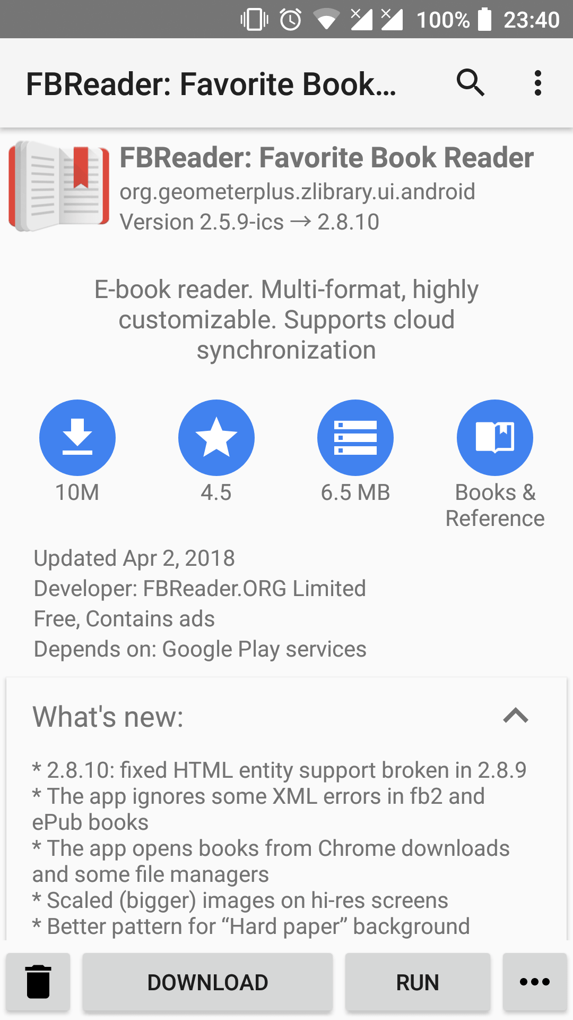
Yalp Store
Yalp is ‘Play’ Spelled Backwards
Download Apps from Google Play
Uses a Default Account Built Into the App
Install Apps Not Available in F-Droid
  Signal
Can Be Installed as System Application
Notes:
- Yalp
- Play spelled backwards
- Shares one Google play account.
- Install everything not in the Fdroid store.
- Signal
- A IR remote application.
- Firefox
- Can be Installed as system app.

Slide 22
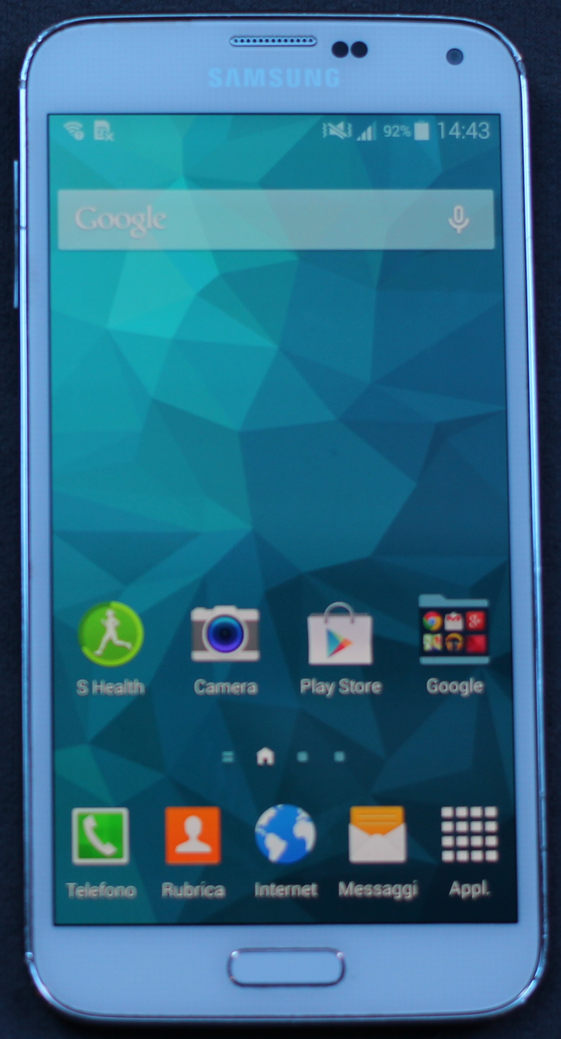

Samsung Galaxy S5
2014 Phone
Better Than Some Newer Phones
Little Larger than Galaxy Nexus by Volume
Replaceable Battery
Very Popular Phone
  Great 3rd Party ROM Support
  LineageOS 14.1 (Android 7.1)
Photo Credit: Maurizio Pesce
Notes:
- Settled on a Galaxy S5.
- Removable battery.
- Overall less volume than my Galaxy Nexus.
- A very popular phone.
- Great community support.
- Sprint support and could keep Sprint's Google Voice integration.
- Basically allows all called and text to appear from one Google number.
- Access to voicemail and texts from computer.
- Unfortunately, Sprint's Google Voice integration was decommissioned on June 1st.
- Lineage OS support for Android 7. (Lineage 14.1)
- Lineage support Android 8 on some phones. (Lineage 15.1)
- Have weekly OTA updates.
- Googles monthly security updates.
- Stock updates stopped in April 2017.

Slide 23
App Security Model
Google Does Not Sign Play Store Apps*
APKs are Downloaded Over HTTPS from Google
You PGP Sign Your APKs
Your PGP Public Key is Included With APK
APK Updates are Verified Against Existing Public PGP Key
  Nobody Else Can Update Your App
* Google Now Provides an App Signing Service
Notes:
- Signature Spoofing
- Scary name.
- App security model
- Apparently Google does not digitally sign APK files.
- The developer signs their own APK file.
- The app developer distributes his/her public key with the app.
- The public key is checked during upgrades.
- This way only the developer can upgrade apps.
- The Lineage with MicroG's signature spoofing does not affect this.

Slide 24
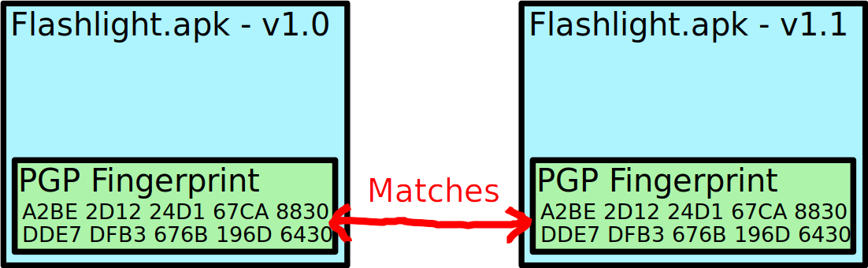
App Security Model
Original Install
Upgrade Install

Slide 25
Signature Spoofing
Signature Spoofing Fakes the Signature of Apps Reported to Other Apps
  Update Verification is Unaffected
Spoofed App Must Have FAKE_PACKAGE_SIGNATURE Permission
Play Services Client API Asks Android OS for Play Services Public Key
  Android OS Replies With Hard Coded Play Services Public Key
Notes:
- Signature spoofing fakes the signature of an app reported to another app.
- Operating system returns hard coded signature.
- Limited to apps listed in a special configuration file.

Slide 26
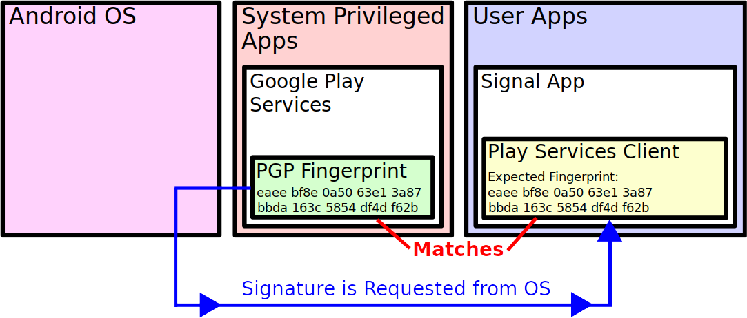
Without Signature Spoofing

Slide 27
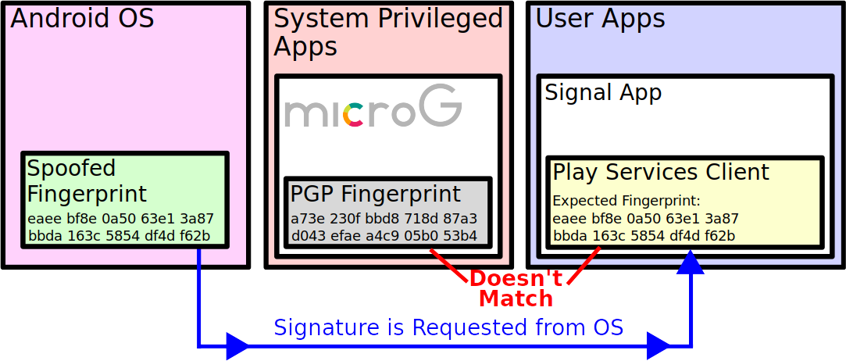
With Signature Spoofing

Slide 28
Signature Spoofing
Limited to System Apps
Can Only Be Used with Trusted Apps
  Apps Included with Android ROM
  Apps Installed as System Apps
No Legitimate Security Concern
  Any App that Can Install As System App Can Do Anything Anyway
LineageOS Rejected Signature Spoofing Patch to Ensure SafetyNet Attestation
Notes:
- Limited to system apps.
- The only reason for an application to check the signature of a system app to for DRM.
- And that is exactly what Google Play Services is in this case.

Slide 29
SafetyNet
Provides Assurance to Apps That the Phone is Not Compromised
Some Apps Require Passing Attestation
  Banking Apps
  Video Streaming Apps (For DRM)
  Pokémon Go
Collects and Sends Data to Google
  Server Evaluates Data and Signs a Response
Can be Sandboxed w/ DroidGuard Helper
Notes:
- Used to provide some assurance that your phone has not been hacked.
- Must pass SafetyNet to use some apps.
- Banking apps.
- Video streaming apps might not work due to DRM protections.
- Pokemon Go
- Sent to Google's servers.
- Google signs the result on their servers.
- Apps checks the signature from Google.
- Can be sandboxed with DroidGuard Helper
- Downloadable from MicroG F-Droid repository.
- Samsung has a Pay app that checks a program called Knox built into Samsung phones.

Slide 30
SafetyNet Data Collection
Rooted Status
Android Debugging (ADB) Enabled.
Lock Screen Configuration (Not the Password)
Apps Installed Via “Unknown Sources”
Device Locale (Roughly Your Country)
Select Strings from Log Files
Various Details About ‘System’ Partition
Notes:
- Collects information from your phone and sends to Google:
- Is your device rooted.
- Looks for known malware.
- Emulators
- Hooked APIs.
- Default apps.
- Android debugger enabled.
- Lock screen details (not the password).
- Enabled
- Type
- Timeout.
- Installed apps via unknown sources.
- Device locale. (Your country.)
- Verifies TLS connections can be established.
- Detects SSL downgrades
- Hostname lookups are correct.
- SELinux is enabled.
- Select strings from log files.
- Files that have setuid permissions.

Slide 31
Phone Flash Memory
Notes:
- Phone layout
- Show diagram of phone.
- Explain partitions.
- recovery
- boot
- system
- data
- sdcard
- modem
- Baseband
- Proprietary.
- Sometimes encrypted.
- Sometimes protected with a digital signature.
- Always closed source.
- Almost no open source implementations on any device.
- caches
- other device specific partitions

Slide 32
Unlocking vs. Rooting
SIM Unlocking
  Use Phone on Any Network (If Hardware Allows)
Bootloader Unlocking
  Allow Flashing Images to Flash Memory
  Sometimes Need Vulnerability to Unlock
Rooting
  Apps Have Access to Superuser (Root User)
  Obtained by Exploiting Privileged Apps
  Or by Flashing Superuser App Via Recovery
Notes:
- Unlocking and Rooting
- SIM unlocking
- Can use any carrier sim card in your phone.
- Given your hardware supports the frequencies.
- I don't know anything about this.
- Bootloader unlocking
- Can use a partition flashing tool.
- Might wipe data on some phones.
- Prevents access to protected data.
- Rooting.
- Allows you to give apps permission to be superuser.
- Superuser can access the /system partition.

Slide 33
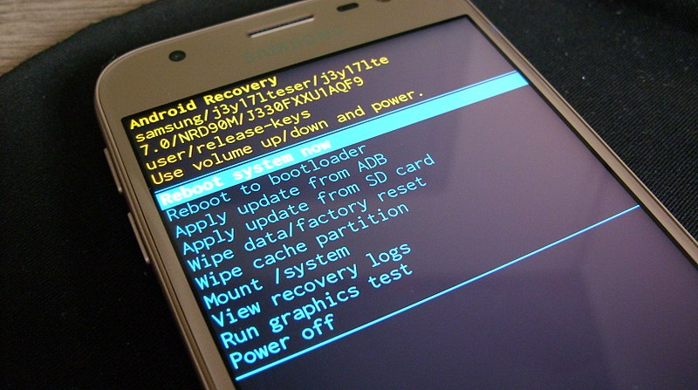
Recovery Partition
Performs Over the Air (OTA) Updates
Manually Applies Updates from Storage
Wipes ‘Data’ Partition
Clear Cache Partitions
Third Party Recoveries Provide More Features
Photo Credit: VampishBowl
Notes:
- What is recovery?
- Similar to Windows restore partition.
- Doesn't include install image.
- Typically just
- Manages OTA updates
- Clears cache.
- Clears user data.
- Third party ROMs:
- Ability to install custom ROMs
- Ability to use ADB
- Backups and other features

Slide 34
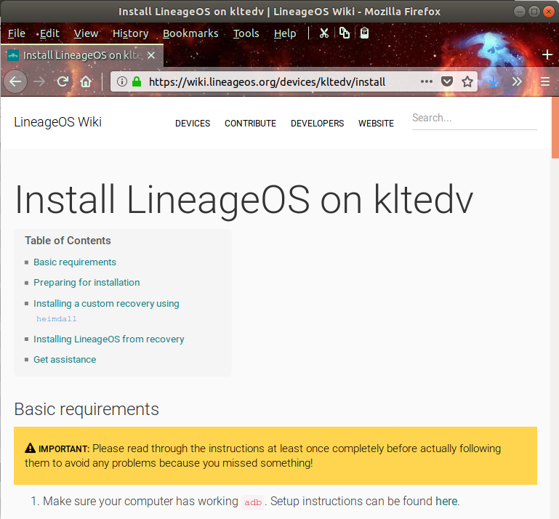
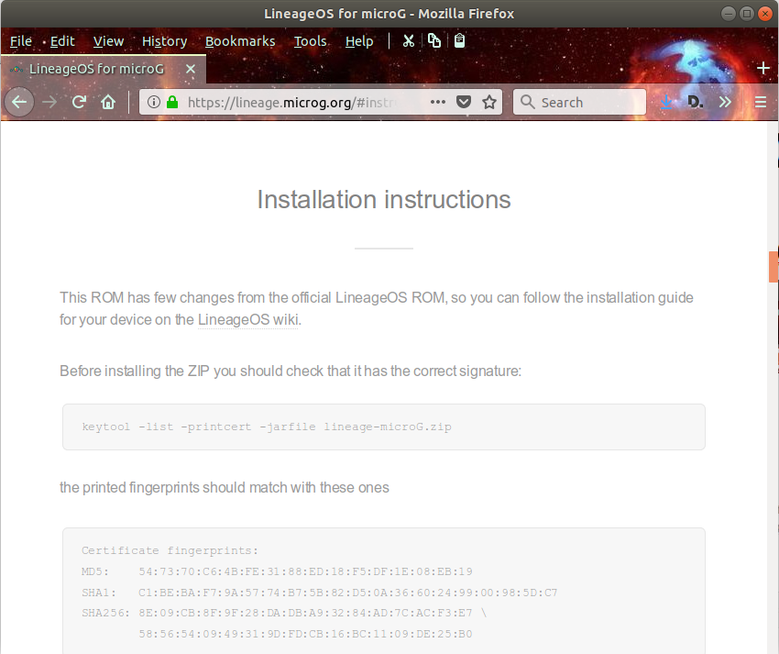
Install Instructions
https://wiki.lineageos.org/devices/
https://lineage.microg.org/#instructions
Notes:
- Installation process
- Instructions on LineageOS website off of the download page.
- I skipped important verification steps.

Slide 35
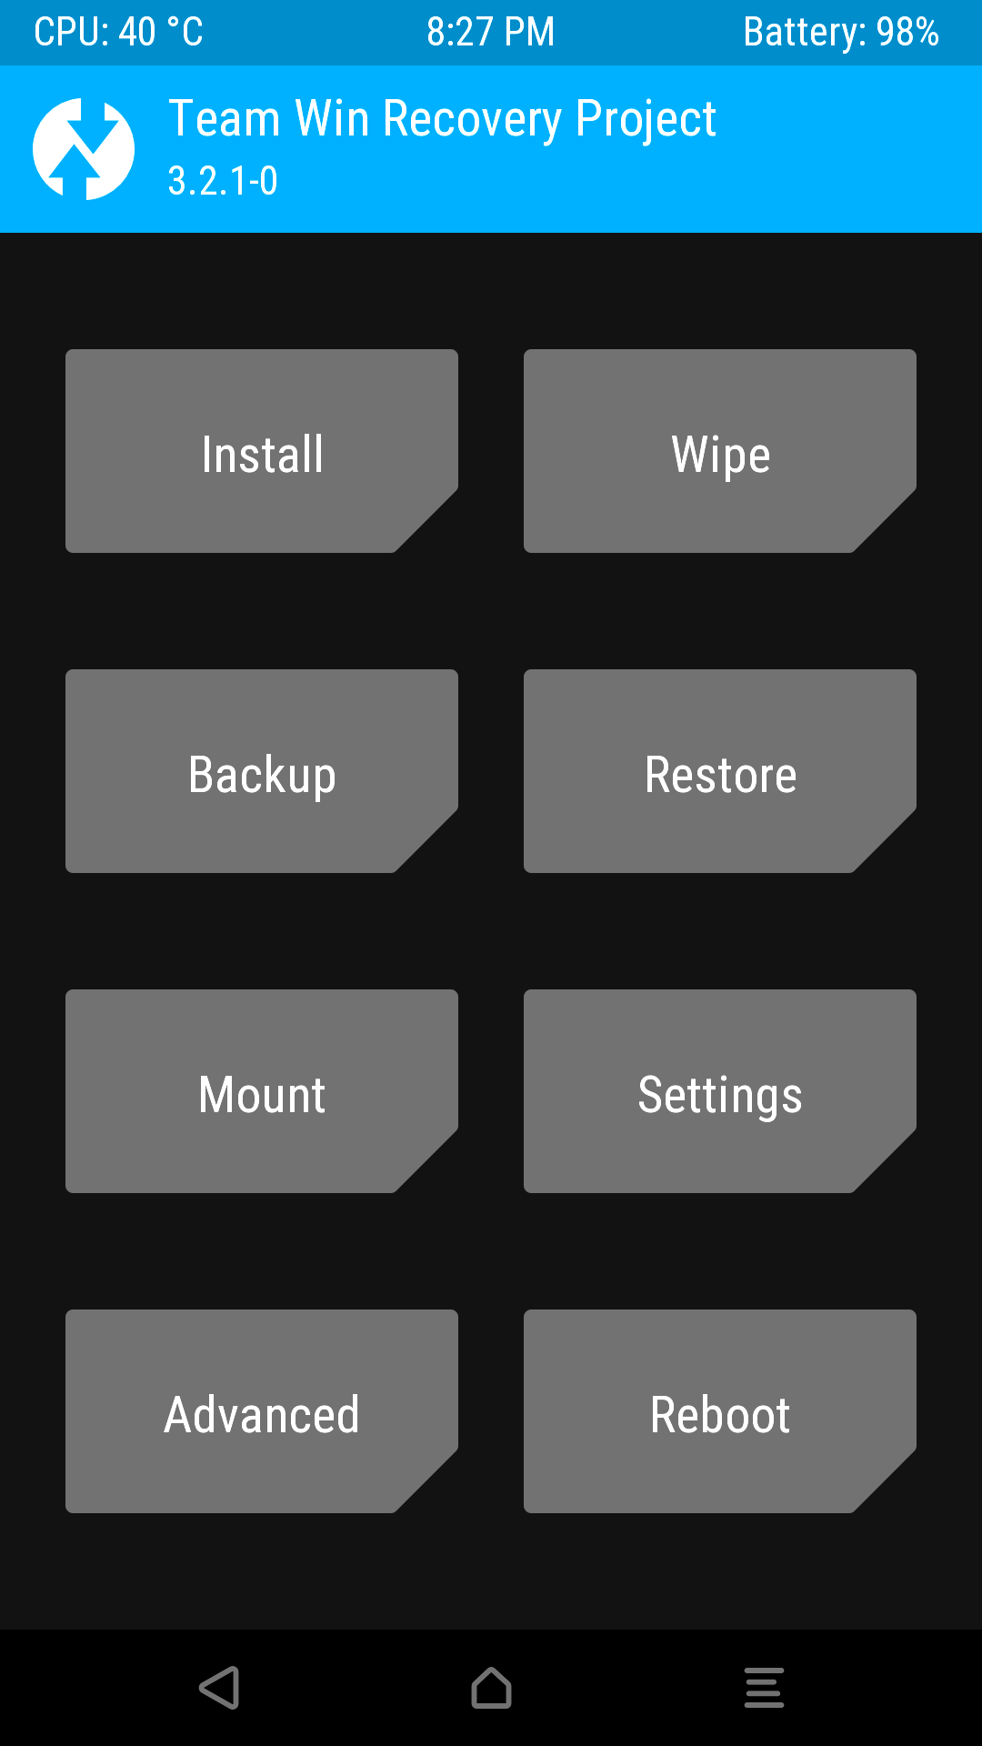
TWRP
Graphical Recovery w/ Touch Support
Install Custom ROMs
Install System Apps
Backups
ADB Access
Notes:
- Install custom recovery.
- TWRP (Team Win Recovery Project)
- Graphical recovery.
- Install ROMs via ZIP files.
- Install system apps via ZIP files.
- Backups
- Wipe data/Clear caches.
- Android Debugger access.
- Download the image for your device to your computer.

Slide 36
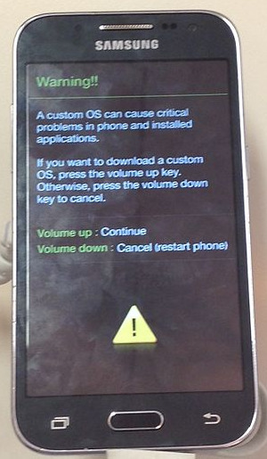
Heimdall
Samsung Specific Partition
Flasher
Similar to Google’s Fastboot
Use Key Combination to Enter
Download Mode
heimdall flash --RECOVERY \
twrp.img
Photo Credit: LeonardoIannelliCOMPUTE
Notes:
- Heimdall
- Works on Windows and Mac too.
- Odin on Windows
- Like Fastboot
- Used to flash bit for bit copies of phone partitions
- Used to install recovery
- Ubuntu version didn't work.
- Had to compile the latest version from source.
- heimdall flash --RECOVERY twrp-x.x.x-x-klte.img --no-reboot

Slide 37

Fastboot
Google’s Fastboot Used to
Unlock Bootloader
fastboot flashing unlock
  May Wipe Data
fastboot flash recovery twrp.img
Photo Credit: Google
Notes:
- Fastboot can be used for unlocking.

Slide 38
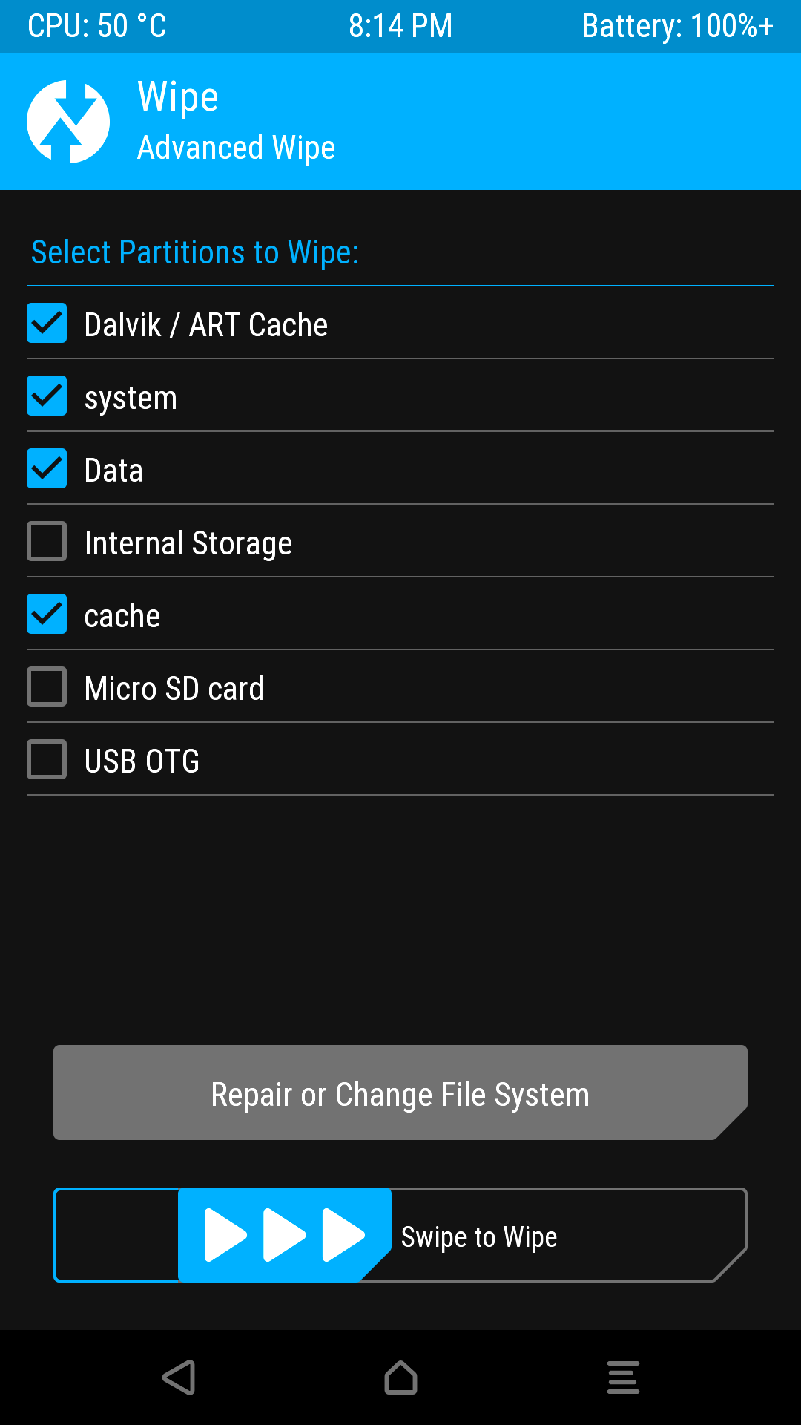
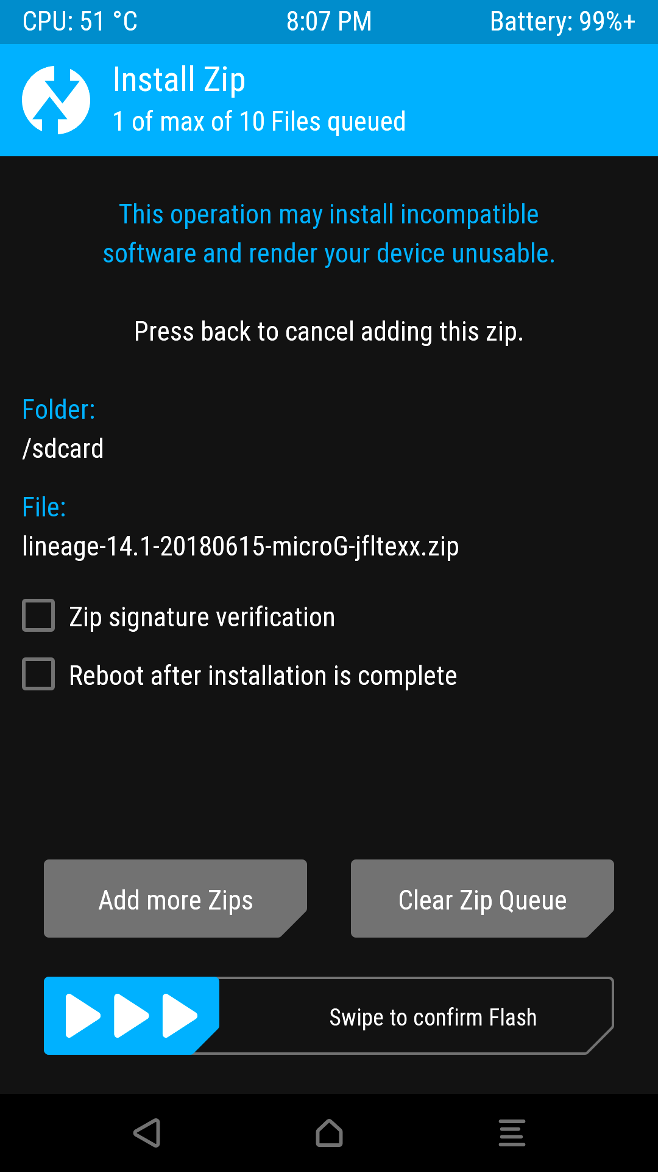
Install Lineage w/ MicroG
Download ROM ZIP to Phone
Boot to Recovery
  Special Button
  Combination
Wipe Cache, System,
and Data
Install Lineage ZIP
Notes:
- Flash system
- Download lineage Zip.
- Boot to recovery
- Wipe Cache, System and Data
- Install ZIP
- Leave signature verification unchecked.
- Apparently works for stock images.
- Nobody explains it online. They just say to uncheck it.
- Installs to system and boot.
- From what I can tell, code in system initializes /data.

Slide 39
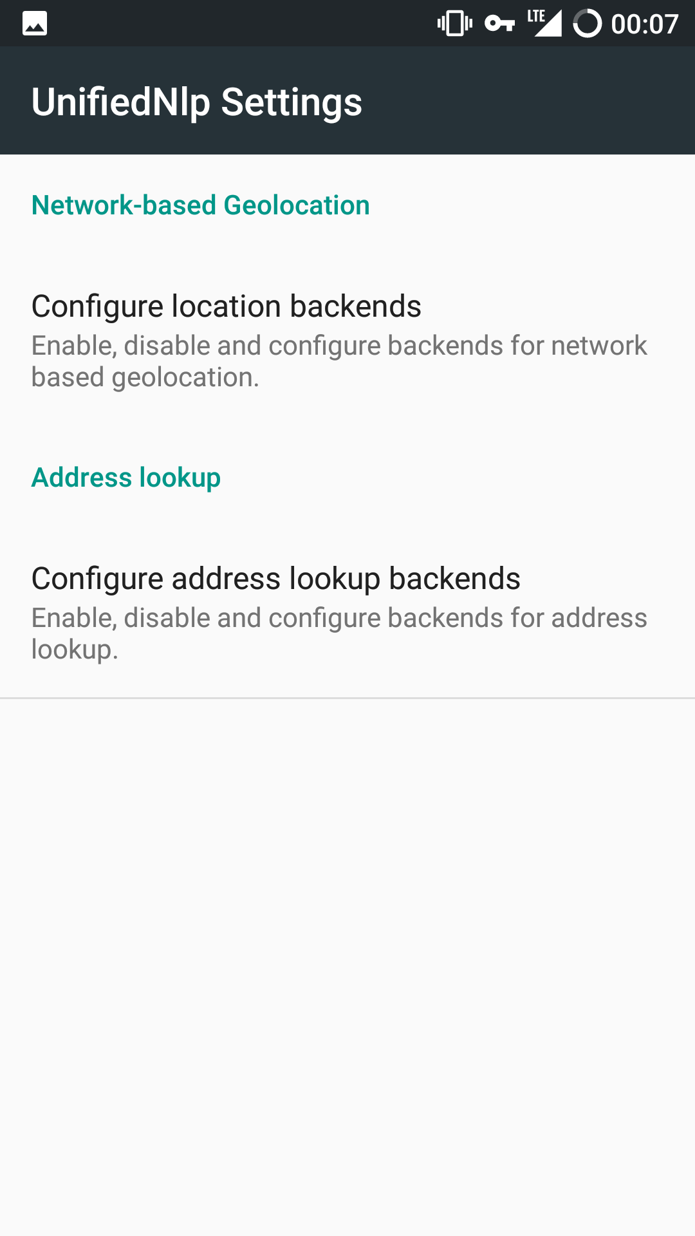
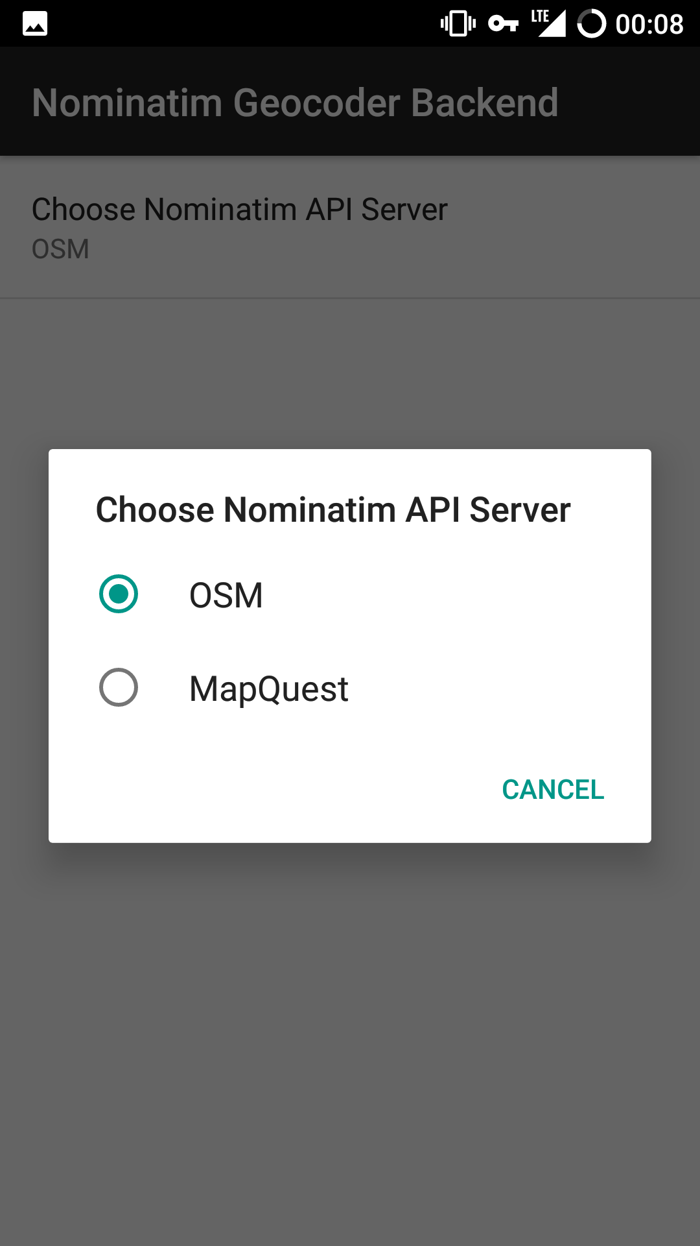
MicroG Setup - NLP Backend
Network Location Provider
Open Street Map or MapQuest Available by Default
More Available from
F-Droid
Notes:
- MicroG setup
- NLP backend

Slide 40
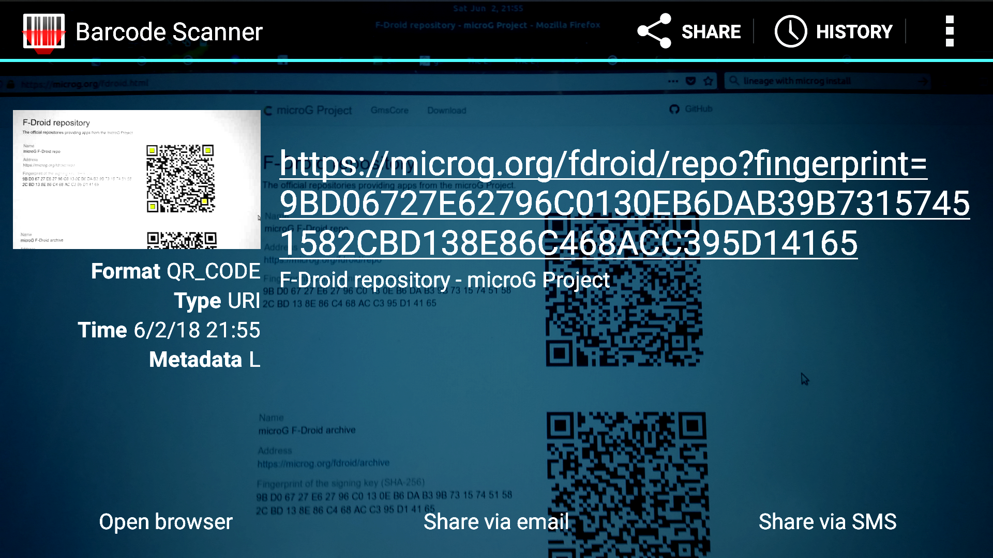
MicroG Setup – MicroG Repo
Open F-Droid
Install Barcode Scanner
Scan Barcodes at https://microg.org/fdroid.html
Notes:
- Add MicroG F-Droid repository
- Install Barcode Scanner.
- Scan QR code from MicroG website.

Slide 41
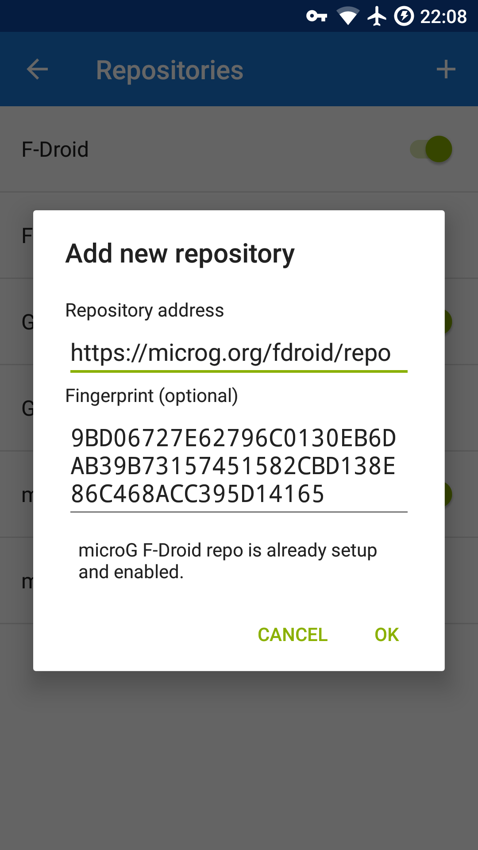
MicroG Setup – MicroG Repo
Return to F-Droid → Settings →
Repositories → + (Add)
Enable Auto Updates

Slide 42
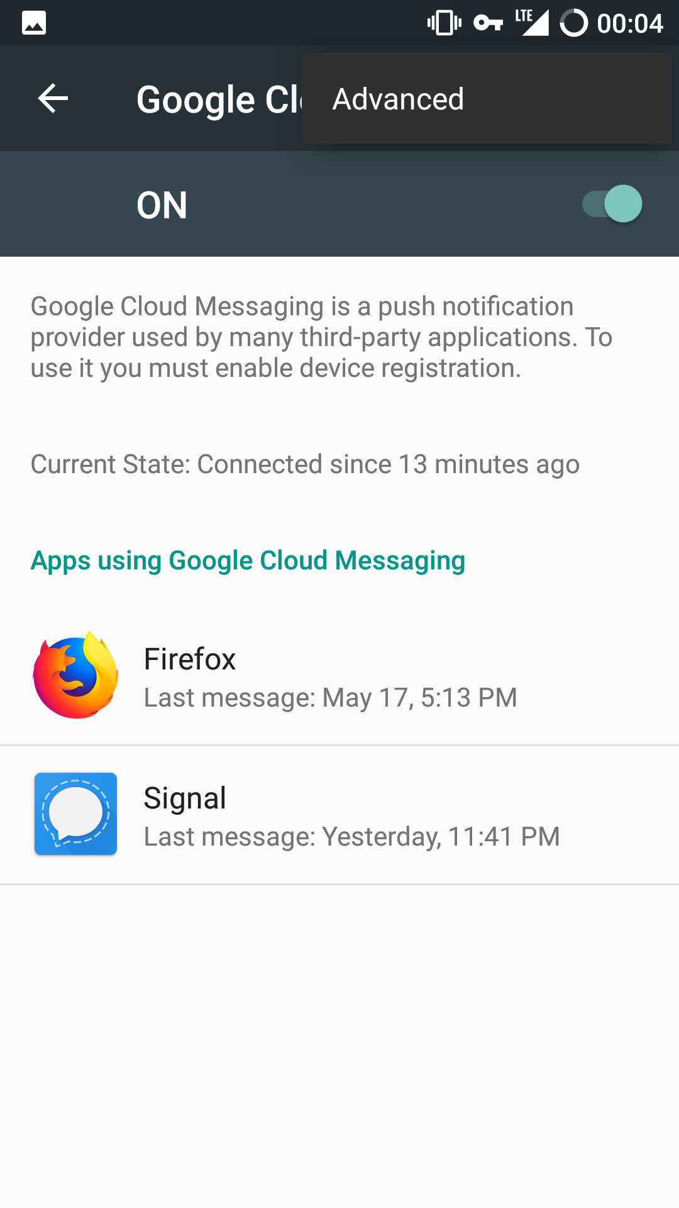
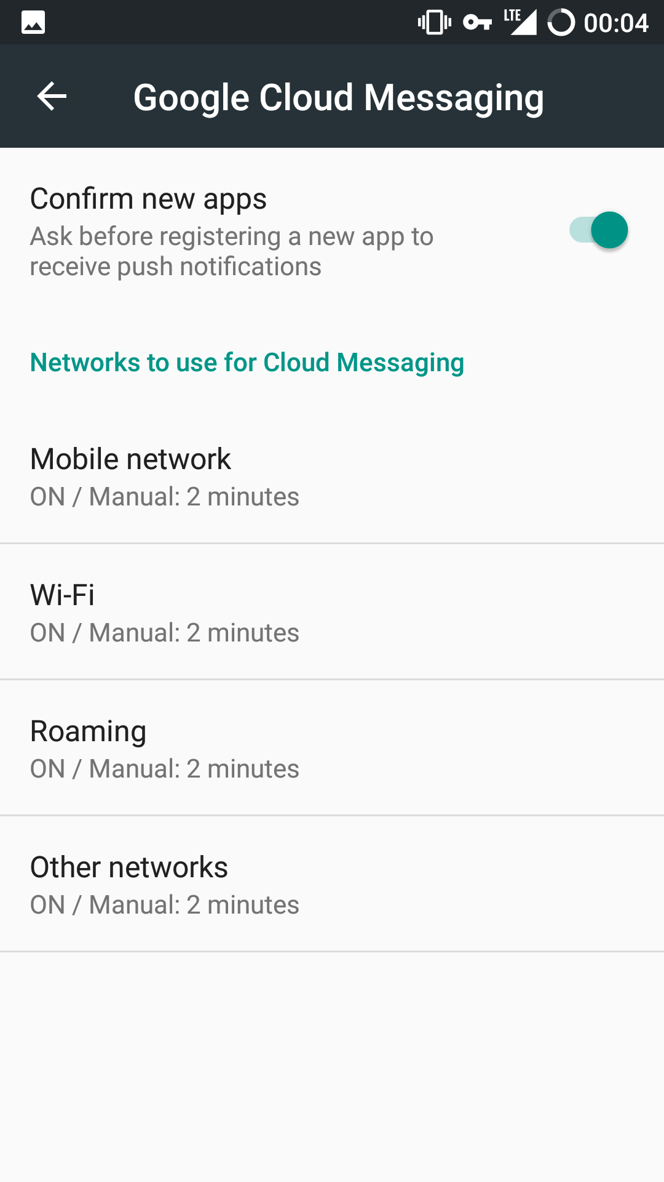
MicroG Setup – Cloud Messaging
Provides Push
Notifications
Doesn’t Require a
Google Account
Disabled by Default
Adjust Poll Interval
Notes:
- Register phone on Google
- Enable push notifications.
- Adjust polling interval.

Slide 43
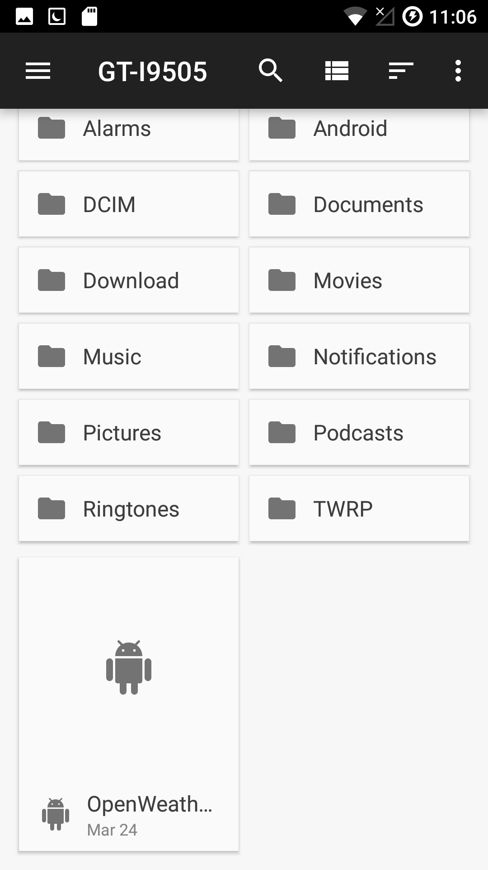
MicroG Setup – Weather Provider
Download Providers to Phone from https://download.lineageos.org/extras
Enable Installation from Unknown
Sources
  Signature Verification Can Be Done
  from PC
Install Weather Provider APKs
Disable Installation from Unknown
Sources
Notes:
- Weather providers
- Install via APK.
- Have to enable install via Unknown Source
- Can verify package signature from desktop.

Slide 44
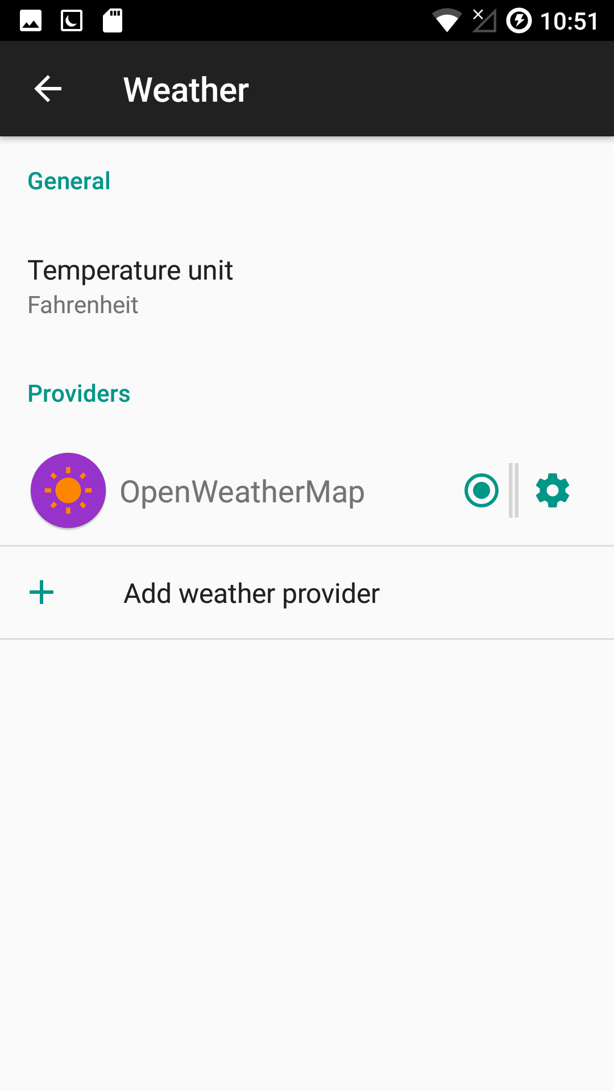
MicroG Setup – Weather Provider
Select Weather Provider
  Settings → Apps → ⚙ → Weather →
  Select Provider
Add API If Necessary
Configure cLock Widget in Clock App
  Enable “Display weather”
Notes:
- Select in provider under Settings -> Apps -> Gear Icon -> Weather.
- Configure cLock to display weather using the settings in the Clock app.
- Or install weather apps.

Slide 45
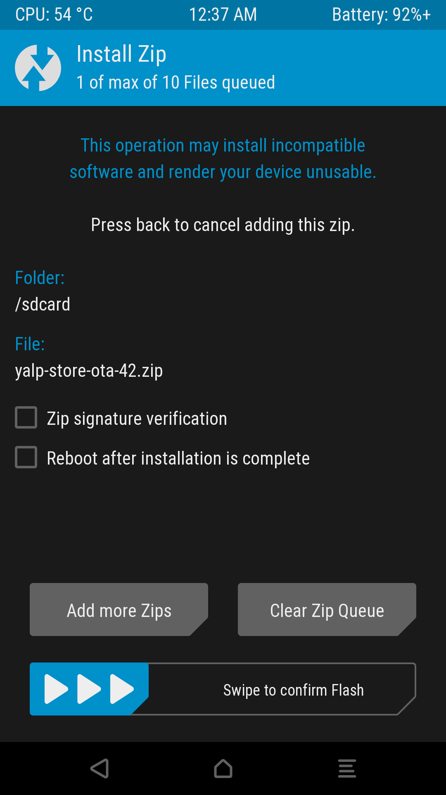
Yalp Installation
Download Zip from GitHub
  https://github.com/yeriomin/YalpStore/releases
  Don’t Install Via F-Droid
Install Zip Via Recovery
Notes:
- Yalp
- Install method that didn't work:
- This one is fun.
- Install Yalp via Fdroid.
- Root device.
- Download su zip (and uninstall) from Lineage.
- Not from the MicroG site.
- Boot to recovery.
- Flash the zip.
- Tap developer options 7 times.
- Enable root setting in developer options.
- Change the Yalp installation method.
- Remove root in developer options.
- Unroot via ADB.
- Disable installing apps installed from Fdroid.
- Wasn't that simple?
- Yalp kept disappearing.
- Can alternatively install as system app by downloading zip from Yalp GitHub.
- Install via recovery.

Slide 46
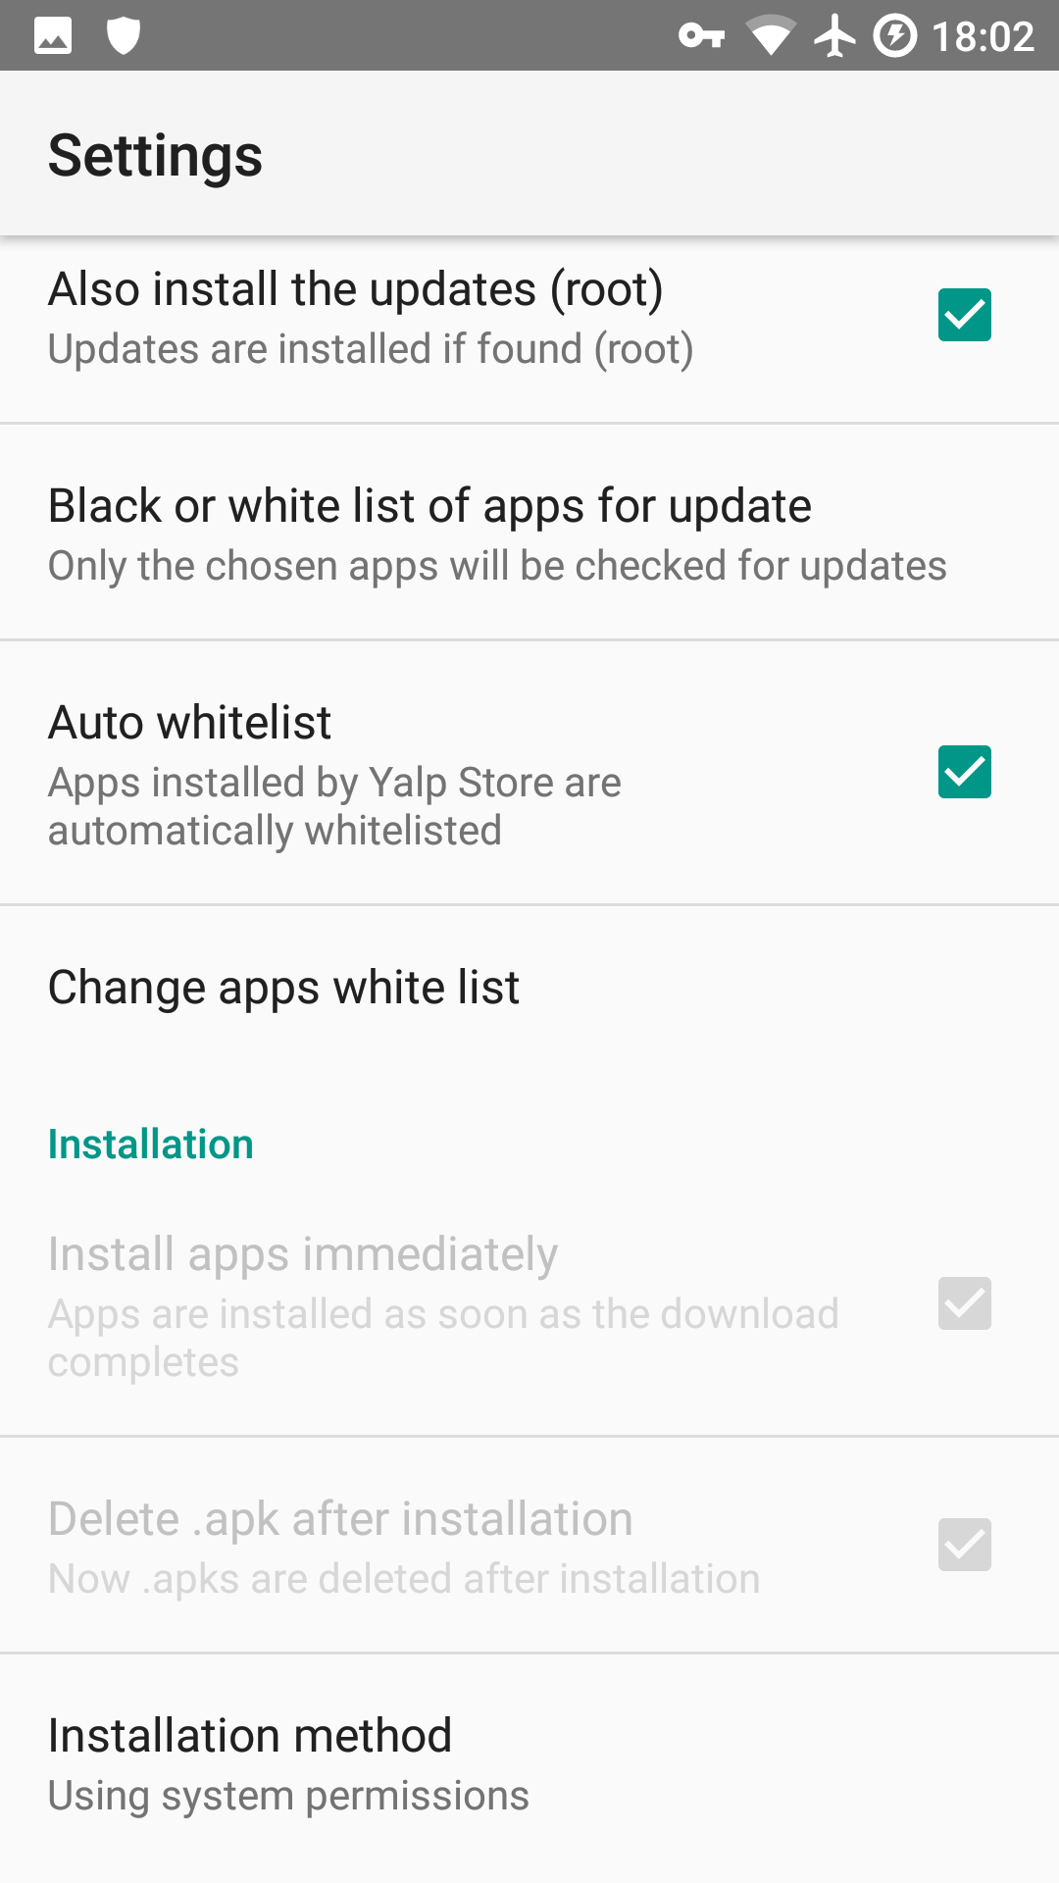
Yalp Installation
Open Yalp
  Whitelist Managed Apps
  Enable Auto Updates
  Download to Internal Storage*
    Does Not Work at the Moment

Slide 47
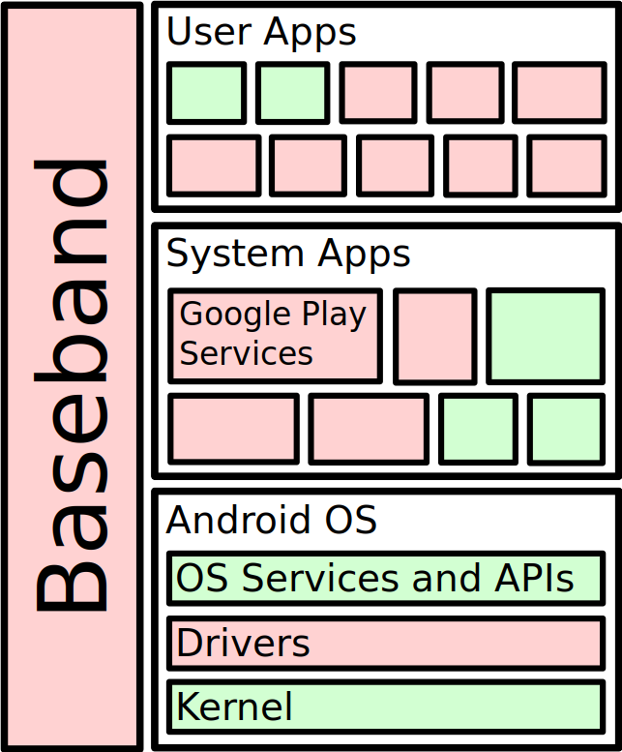
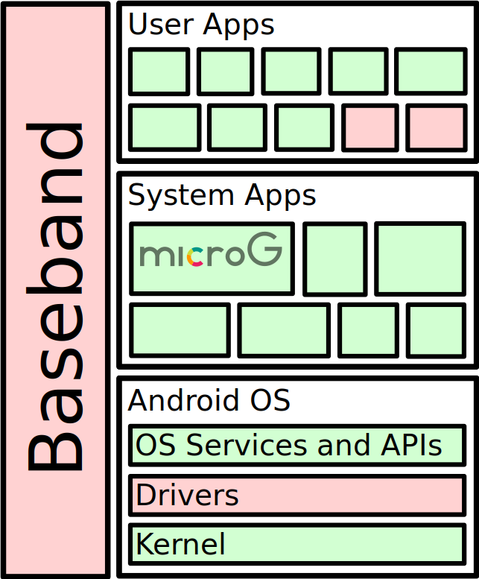
What’s Open Source?
Notes:
Red is closed source.
Green is Open Source.

Slide 48

Is it Worth It?
More Control Over Personal Data
Longer Device Support
Open Source
Some Apps Will Not Run
Installation Takes Some Time
Break Free!
Notes:
- Summary and Conclusion
- More control.
- Much more private.
- Automatic updates.
- More open source.
- Some limitations.
- Some apps won't run.
- Takes a while to install right.
- Signal Doesn't got push notifications all the time.
- Enable Websocket polling instead.
- Signal has hidden configuration file under /data/data/org.thoughtcrime.securesms/???/???.ini
- Push notification tester works fine.
- Yalp keeps uninstalling.
- Yalp is a new app.

Slide 49

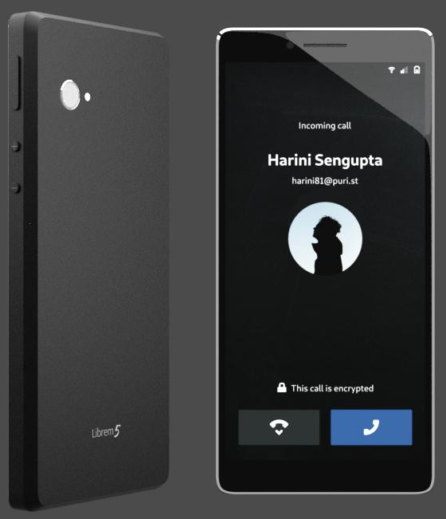
Purism 5 Phone Expected in January 2019
Runs GNU/Linux! Not Android
100% Open Source (Except
Baseband)
Hardware Kill Switches for Bluetooth/Wifi/Baseband and Camera/Mic
https://puri.sm/shop/librem-5/

Slide 50

Questions?
Extra Topics:
  F-Droid Apps
  ADB (Android Debugger)
  Migrating Signal Data
  Bit for Bit Phone Backups
Image Credit: ShockerPaintz
eviljoel@linux.com
https://eviljoel.github.io/presentations
A2BE 2D12 24D1 67CA 8830 DDE7 DFB3 676B 196D 6430
Notes:
- Questions?
- Slides are available online.
- PGP key.
- Have extras information I can share later.
- The apps I installed
- ADB
- Moving Signal Data
- Bit for bit partition backups

Slide 51
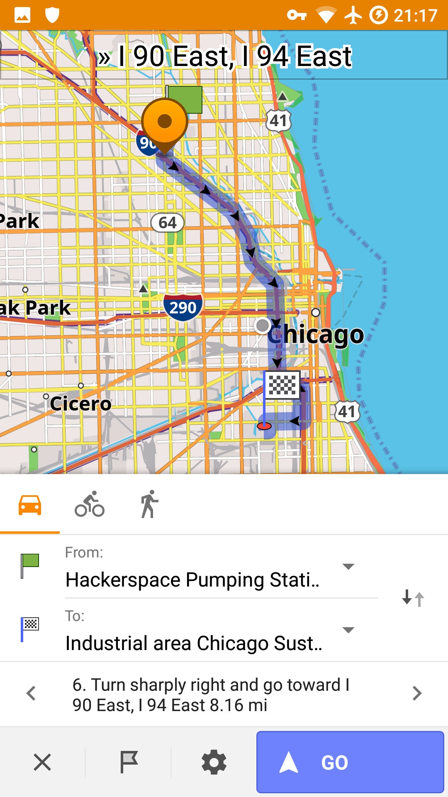
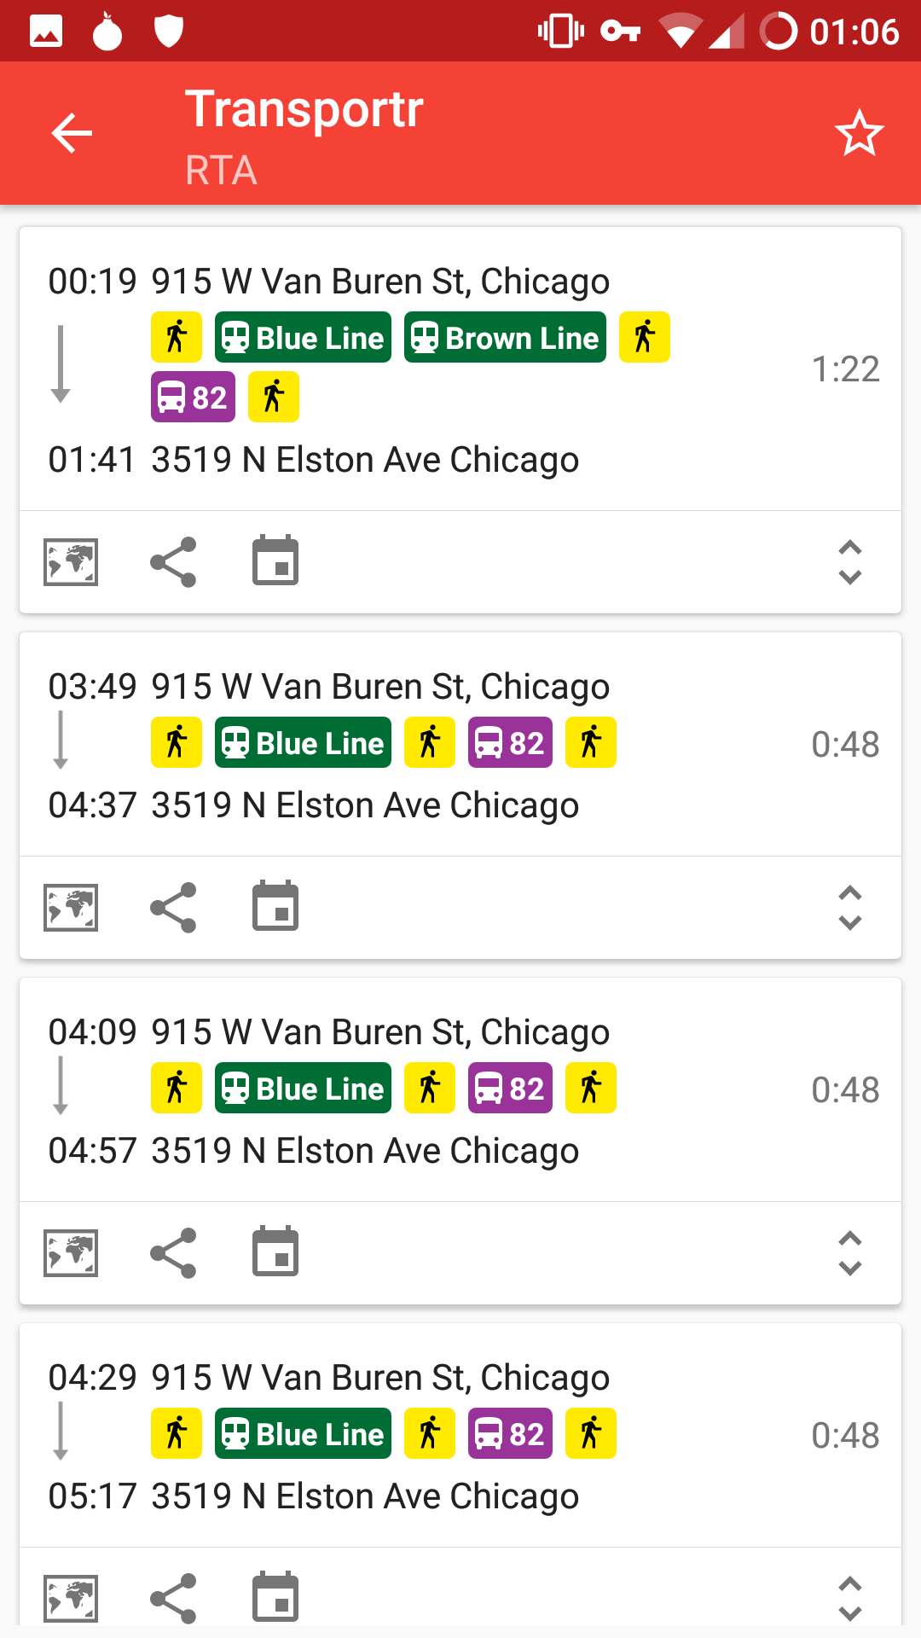
F-Droid Apps
OsmAnd+
Maps & GPS
Transportr
Public Transit

Slide 52
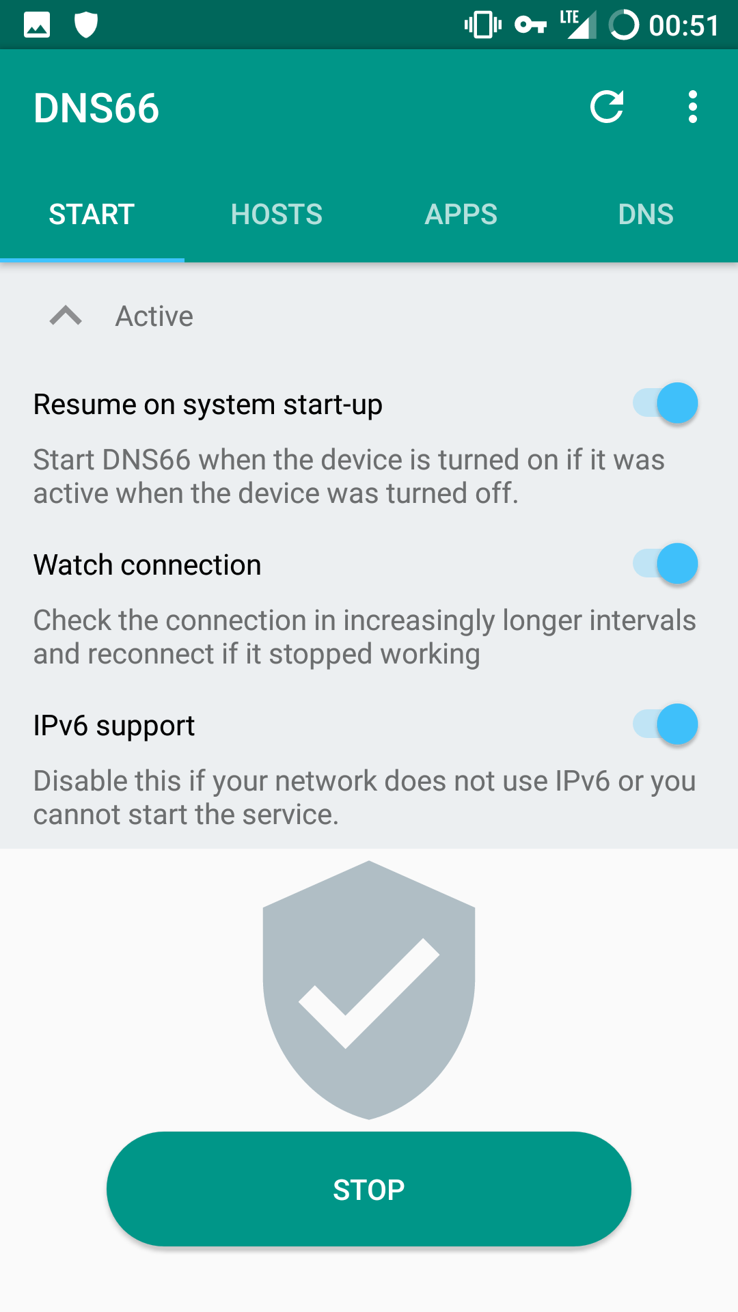
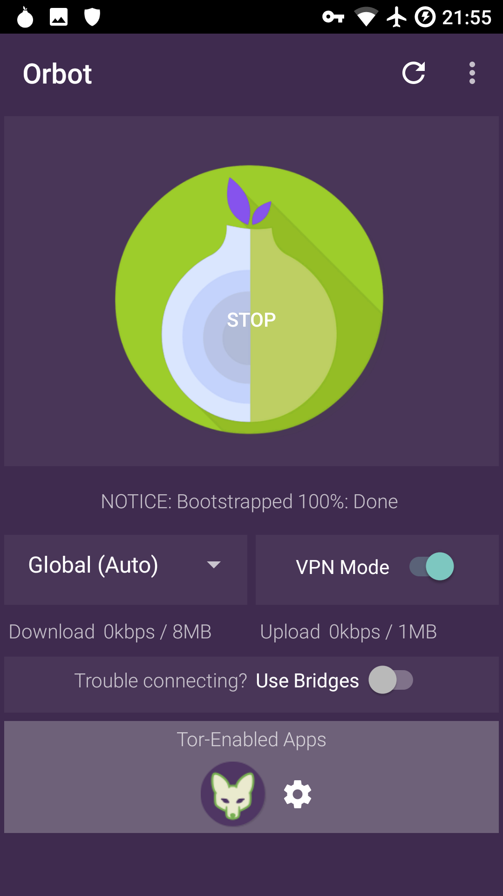
F-Droid Apps
DNS66
“VPN” Add Blocker
Orbot & Orfox
Tor Client & Tor
Browser

Slide 53
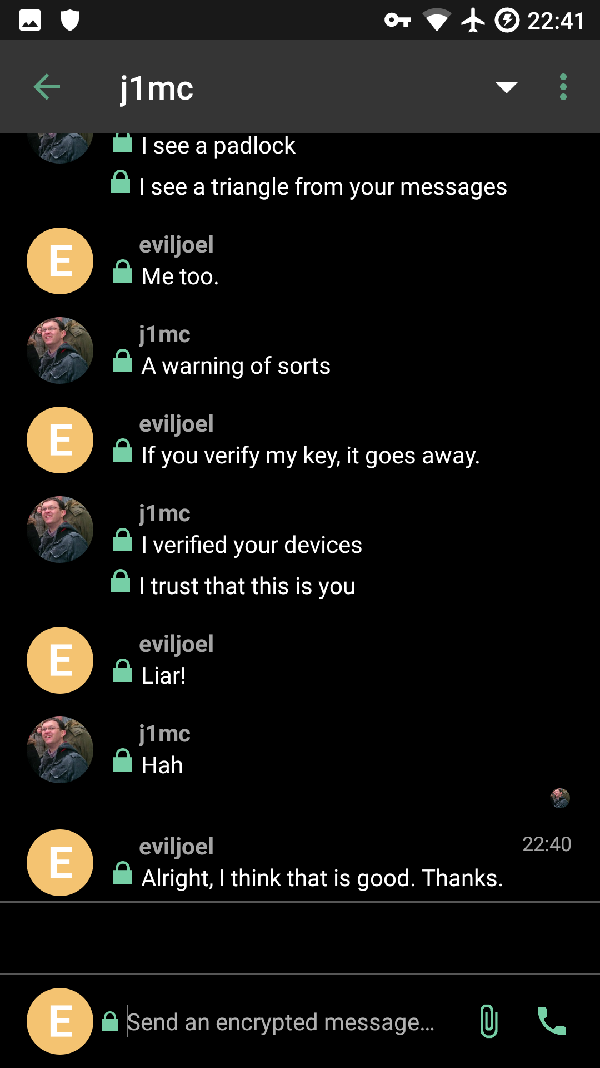
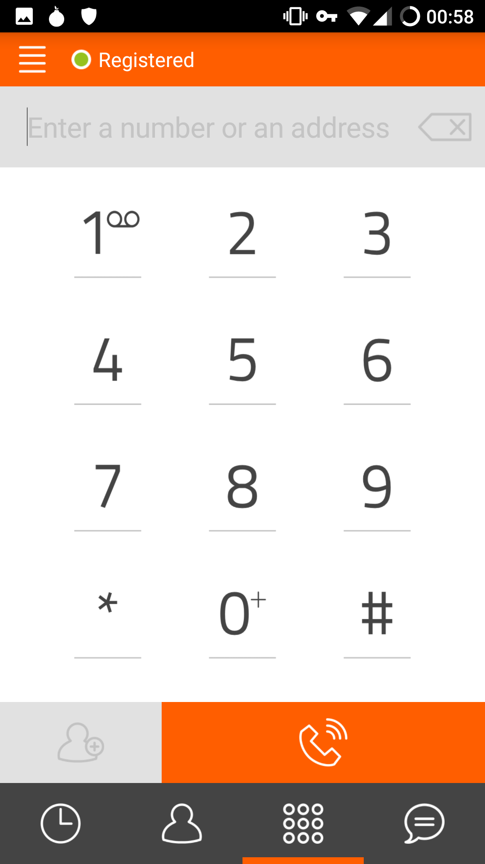
F-Droid Apps
Riot.im
Matrix Client
(Encrypted IM)
Linphone
VOIP Client

Slide 54
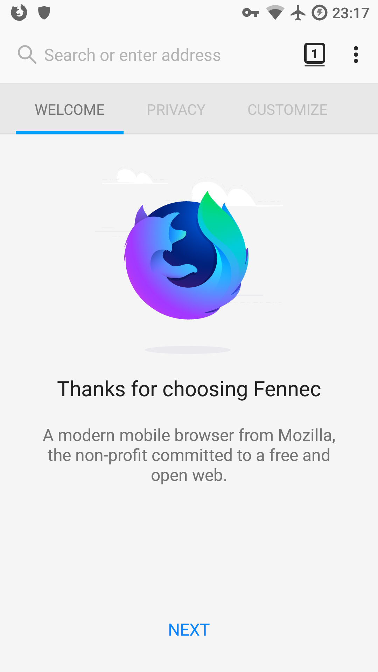
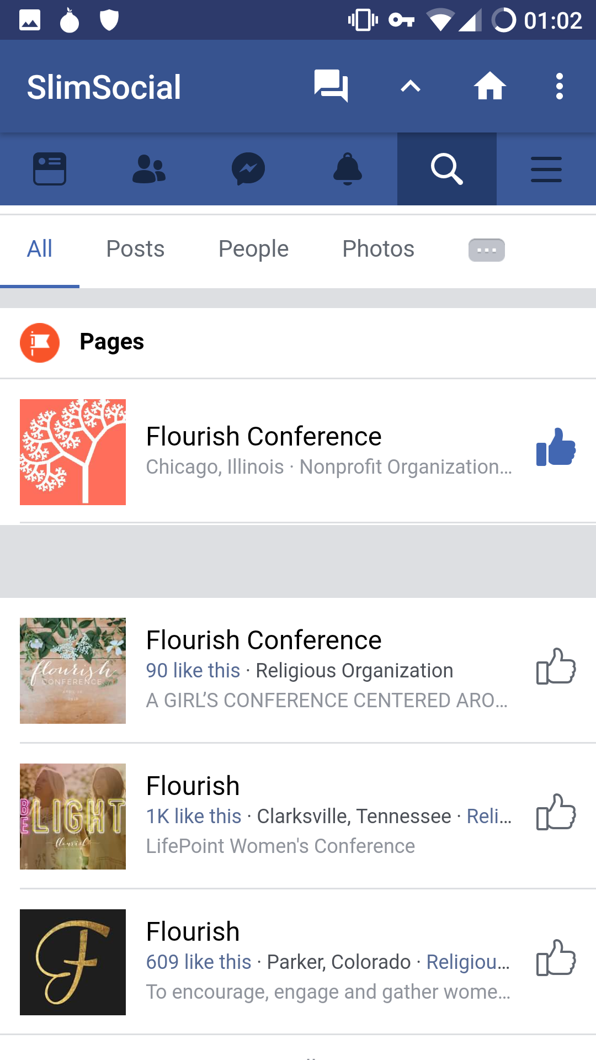
F-Droid Apps
Fennec
Firefox Without DRM
SlimSocial
Facebook Client

Slide 55
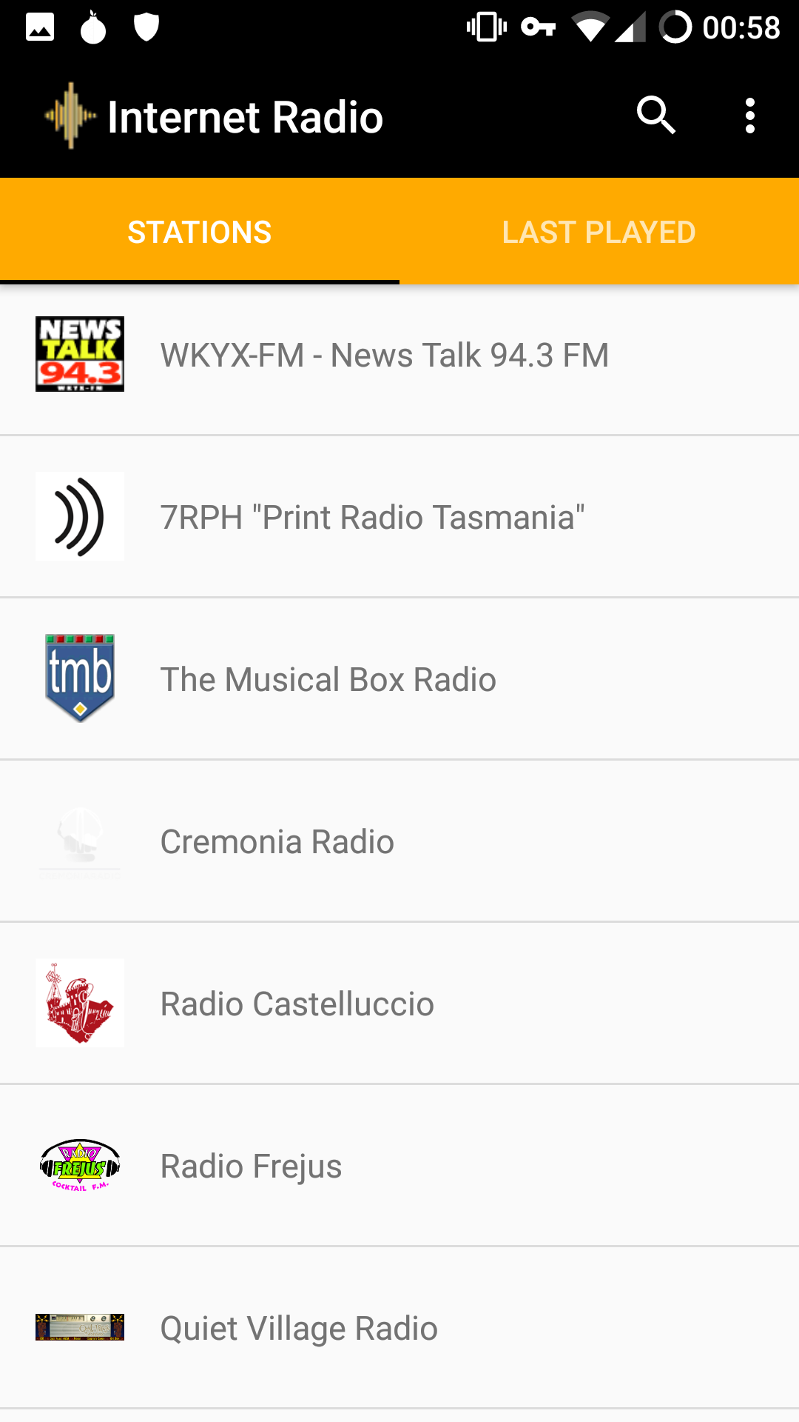
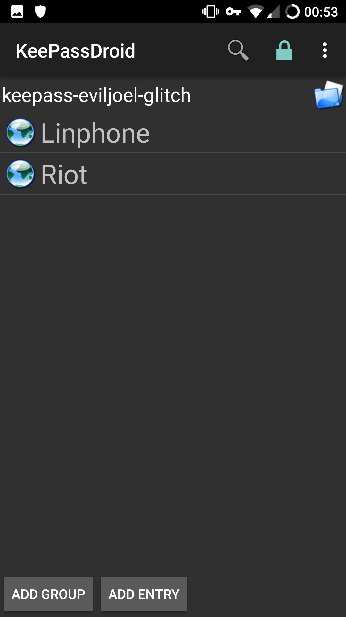
F-Droid Apps
Internet Radio
Internet Radio
KeePassDroid
Password Manager

Slide 56
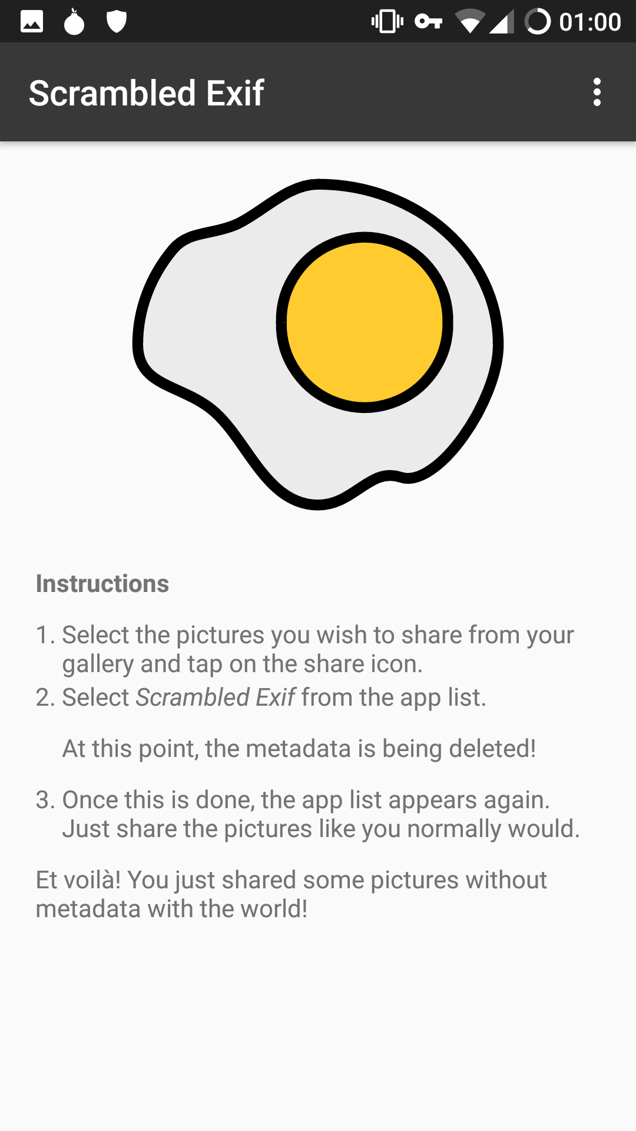
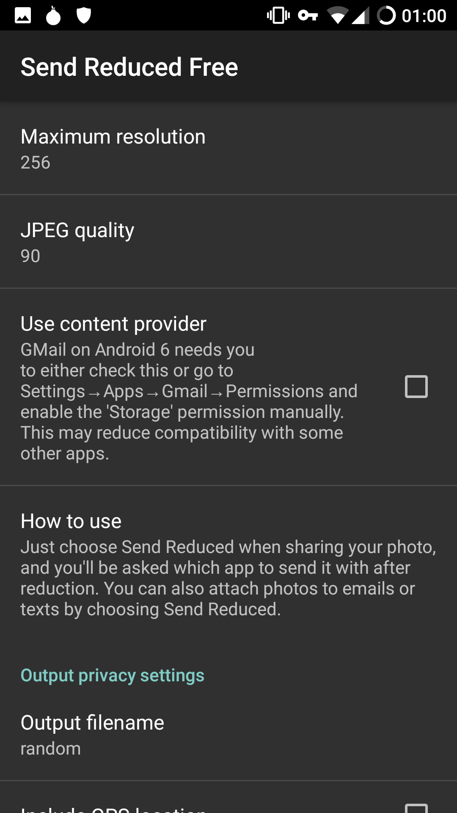
F-Droid Apps
Scrambled Exif
Removes Image Metadata Via Share Menu
Send Reduce Free
Resizes Images Via Share Menu

Slide 57

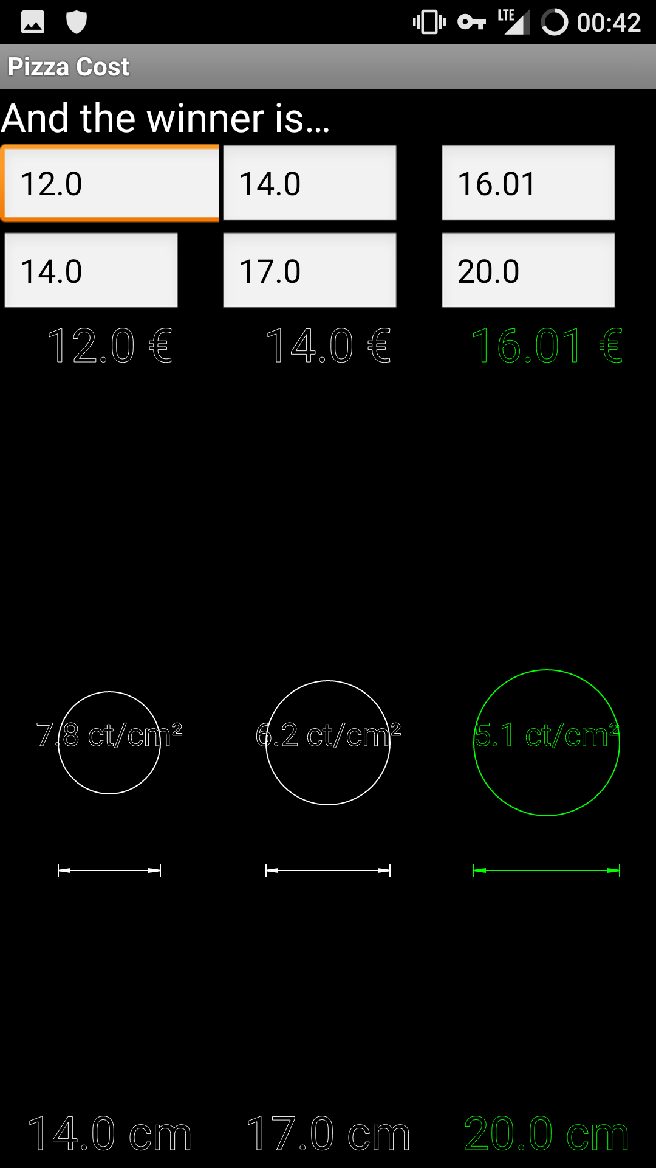
F-Droid Apps
Asciicam
Take & Render Photos as Characters
Pizza Calculator
Find the Best Price/Inch²

Slide 58
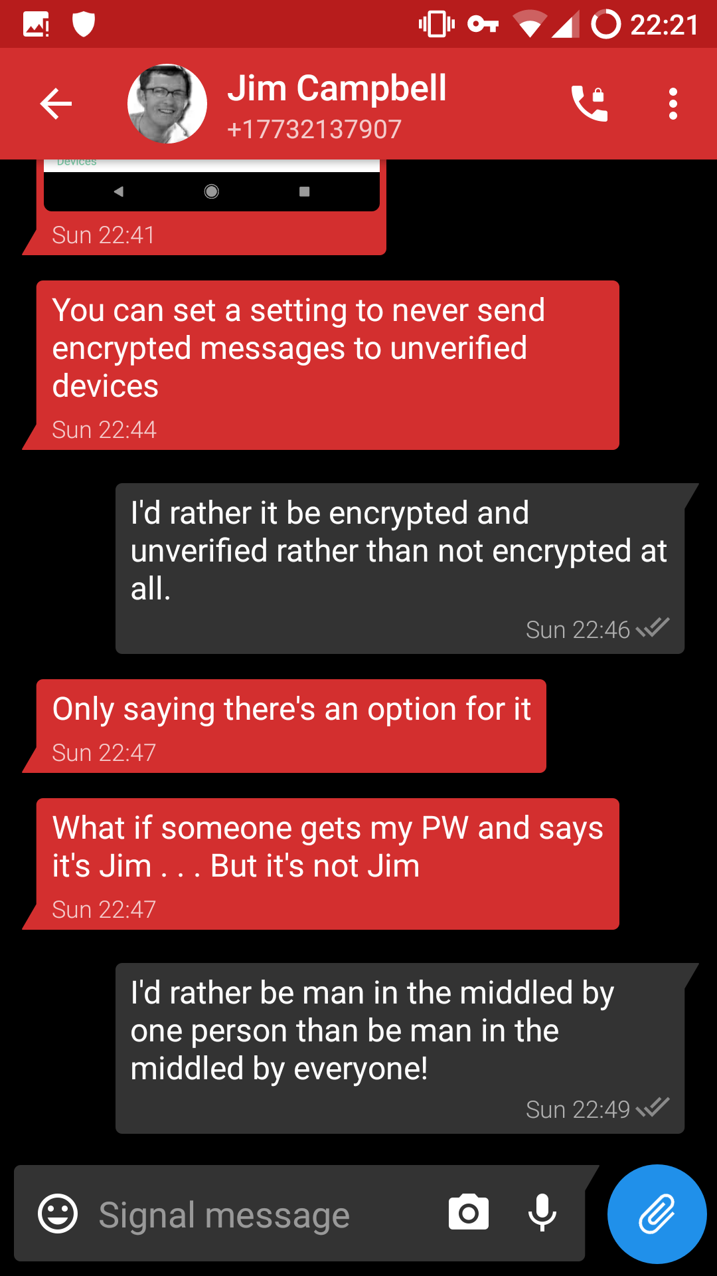
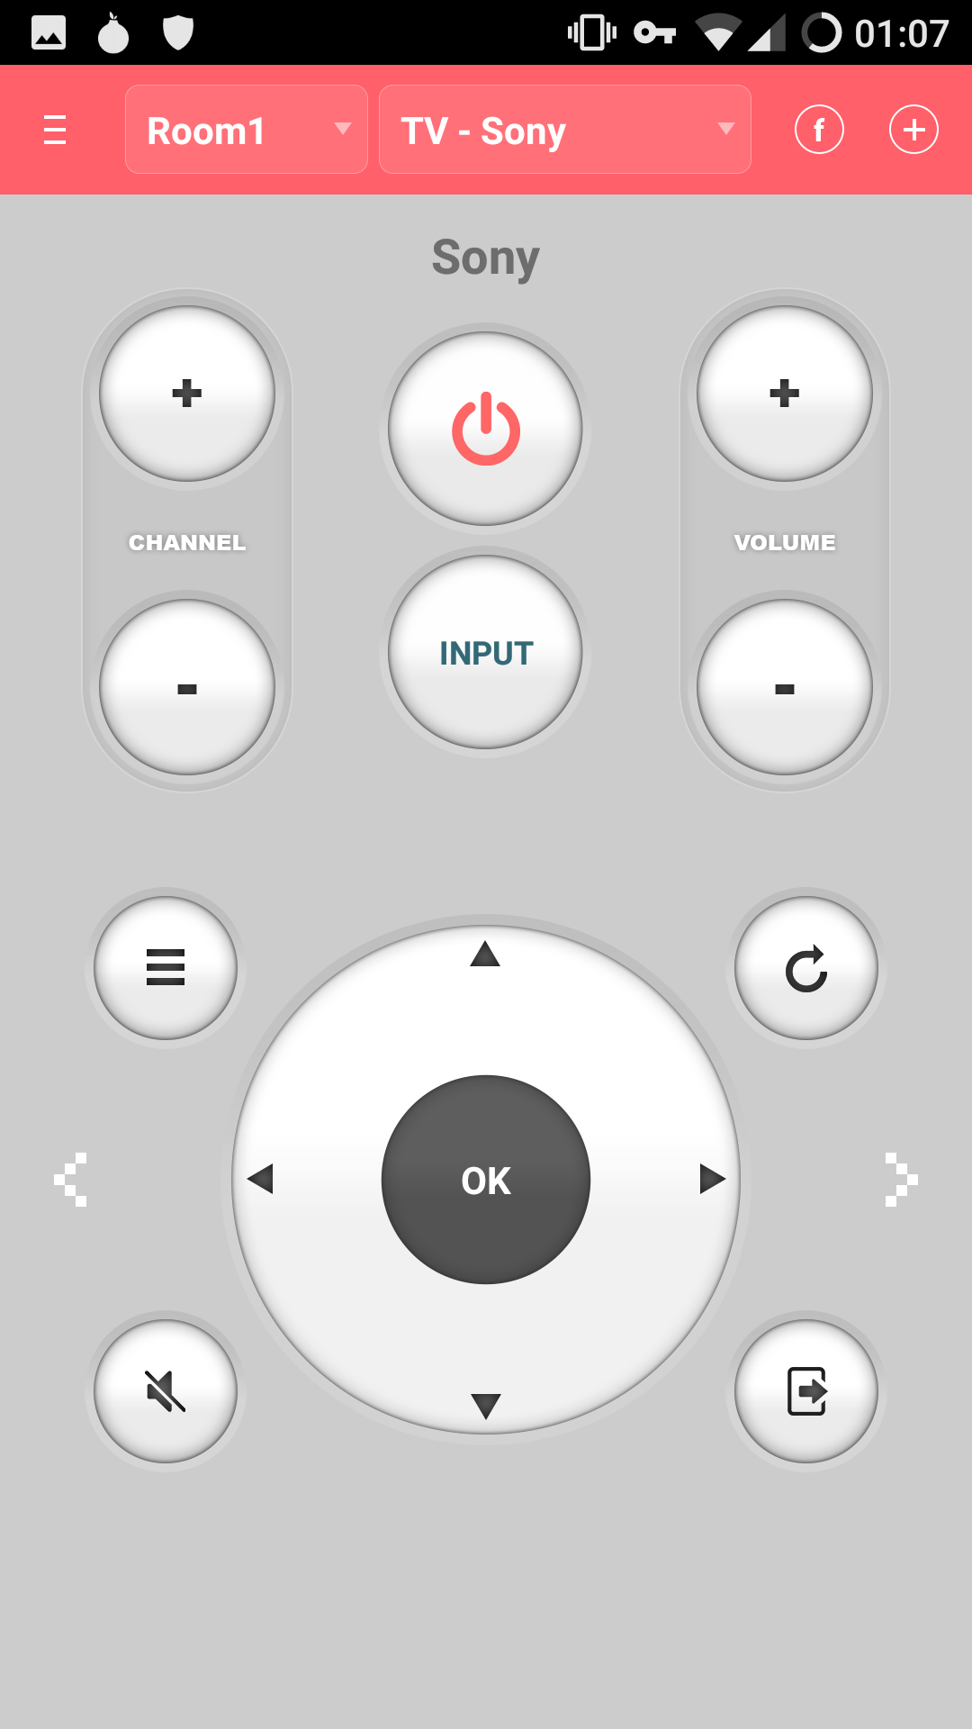

Yalp Apps
Signal
ASmart Remote
Firefox

Slide 59

App Alternatives
https://m.lyft.com
https://m.uber.com

Slide 60

Rooting LineageOS
Root Phone
  Download addonsu from https://download.lineageos.org/extras
  Boot to Recovery
  Flash ZIP

Slide 61


Rooting LineageOS
Enable Root
  Open Settings → About
  Device →Build Number
  Tap Build Number 7 Times
  Open Developer Options
  For Enable Root, select
  “Apps only”
Remove Root with
addonsu-remove Zip

Slide 62


Android Debugger (ADB)
sudo apt install android-tools-adb
Obtain a Root Shell:
  adb root
  adb shell
Push and Pull Files:
  adb push IMG_0139.jpg /sdcard
  adb pull /sdcard/IMG_0139.jpg .
View System Logs:
  adb logcat
Notes:
- What is ADB?
- Install via Linux package manager.
- Windows and Mac users can download from Google's website.
- Android Debugger.
- Get a shell.
- Root shell if enabled in developer mode.
- Copy files to and from device.
- View system log information.
- Root access via TWRP

Slide 63
Migrating Signal Data
tar -cvf signalData.tar \ /data/data/org.thoughtcrime.securesms
Install Signal on New Device
ls -ld /data/data/org.thoughtcrome.securesms
  drwxr-x--x u0_a89 u0_a89 org.thoughtcrime.securesms
tar -xvf signalData.tar
chown -R u0_a89:u0_a89 \ org.thoughtcrime.securesms
Notes:
- Moving Signal Data
- Install Signal
- Note the installed username and group name.
- Copy data under /data/data/org.thoughtcrime.securesms
- Recursively change username and group name.
- chown -r u0_89:u0_89 org.thoughtcrime.securesms

Slide 64

Migrating Signal Data
Signal Crashed

Slide 65
Migrating Signal Data
adb logcat
Copy /data/misc/keystore/user_0/
10089_USRSKEY_SignalSecret to new device.
AndroidRuntime: Shutting down VM
AndroidRuntime: FATAL EXCEPTION: main
AndroidRuntime: Process: org.thoughtcrime.securesms, PID: 4284
AndroidRuntime: java.lang.RuntimeException: Unable to create application
org.thoughtcrime.securesms.ApplicationContext: java.lang.NullPointerException: Attempt
to invoke virtual method 'javax.crypto.SecretKey
java.security.KeyStore$SecretKeyEntry.getSecretKey()' on a null object reference
AndroidRuntime: at android.app.ActivityThread.handleBindApplication(ActivityThread.java:5451)
AndroidRuntime: at android.app.ActivityThread.-wrap2(ActivityThread.java)
AndroidRuntime: at android.app.ActivityThread$H.handleMessage(ActivityThread.java:1564)
AndroidRuntime: at android.os.Handler.dispatchMessage(Handler.java:102)
…
ActivityManager: Force finishing activity org.thoughtcrime.securesms/.RoutingActivity
Notes:
- Keys are stored under /data/misc/keystore/user_0/
- Hidden settings file.

Slide 66
Bit for Bit Partition Backups
Needed to Move from One Galaxy S5 Phone to Another Galaxy S5
In OS Backup Tools Wasn’t Exact Enough
TWRP Backup Tools Wasn’t Quite Right

Slide 67
Bit for Bit Partition Backups
Boot to Recovery
Looked at Mounts
  adb shell "mount”
rootfs on / type rootfs (rw,seclabel)
tmpfs on /dev type tmpfs (rw,seclabel,nosuid,relatime,size=850964k,nr_inodes=
devpts on /dev/pts type devpts (rw,seclabel,relatime,mode=600)
proc on /proc type proc (rw,relatime)
sysfs on /sys type sysfs (rw,seclabel,relatime)
selinuxfs on /sys/fs/selinux type selinuxfs (rw,relatime)
tmpfs on /tmp type tmpfs (rw,seclabel,relatime,size=850964k,nr_inodes=129291)
/dev/block/mmcblk0p24 on /cache type ext4 (rw,seclabel,relatime,data=ordered)
/dev/block/dm-0 on /data type ext4 (rw,seclabel,relatime,data=ordered)
/dev/block/dm-1 on /external_sd type f2fs (rw,seclabel,relatime,background_gc=on
/dev/block/dm-1 on /sdcard type f2fs (rw,seclabel,relatime,background_gc=on,user
Notes:
Note mmcblk0p24 in output.

Slide 68
Bit for Bit Partition Backups
Looked at Partition Table
  adb shell \
  "ls -l /dev/block/platform/msm_sdcc.1/by-name/*"
lrwxrwxrwx root root aboot -> /dev/block/mmcblk0p6
lrwxrwxrwx root root apnhlos -> /dev/block/mmcblk0p1
lrwxrwxrwx root root backup -> /dev/block/mmcblk0p18
lrwxrwxrwx root root boot -> /dev/block/mmcblk0p15
lrwxrwxrwx root root cache -> /dev/block/mmcblk0p24
lrwxrwxrwx root root carrier -> /dev/block/mmcblk0p25
lrwxrwxrwx root root dbi -> /dev/block/mmcblk0p4
lrwxrwxrwx root root ddr -> /dev/block/mmcblk0p5
lrwxrwxrwx root root efs -> /dev/block/mmcblk0p12
lrwxrwxrwx root root fsg -> /dev/block/mmcblk0p9
lrwxrwxrwx root root modem -> /dev/block/mmcblk0p2
lrwxrwxrwx root root recovery -> /dev/block/mmcblk0p16
lrwxrwxrwx root root system -> /dev/block/mmcblk0p23
lrwxrwxrwx root root userdata -> /dev/block/mmcblk0p26
Notes:
Find the names of important partitions.

Slide 69
Bit for Bit Partition Backups
Unmounted All Partitions (Except ‘Data’)
Tried ‘dd’ing from ADB
  adb shell "dd if=/dev/block/mmcblk0p23" > system.img
  adb shell "sha256sum /dev/block/mmcblk0p23"
  c5d7125c...8a8819bd /dev/block/mmcblk0p23
  sha256sum system.img
  d76ab8bd...484eb6b2 system.img
SHA Hashes Didn’t Match! Something Changed
Notes:
- Unmount partitions you want to backup.
- We’ll cover data partition later.
- Basically data is changing as it is piped out.

Slide 70
Bit for Bit Partition Backups
Tried SHA Hashing on Phone with a Pipe
  adb shell "sha256sum /dev/block/mmcblk0p23"
  c5d7125c...8a8819bd /dev/block/mmcblk0p23
  adb shell "cat /dev/block/mmcblk0p23 | sha256sum"
  c5d7125c...8a8819bd -
Same Result! Something Was Changing in the Stream as It Left the Phone!
Notes:
Basically proving the data was changing when piped out.

Slide 71
Bit for Bit Partition Backups
Tried Piping a Base64 Converted Output
Turns:
“�Sv�]�,4�E.;,��0&!���&K� ����� ;oO�n���bi�T�yhmI”
Into Human Readable:
“AdhoD8L2MwGc/GEYCRyVsi7HwAi5/H/9BMj1Z+Uho6epbg2oECfe16U4hAhGXOfV6wAiddTdWGp==”
Notes:
Showing what encoding binary data in base64 looks like.

Slide 72
Bit for Bit Partition Backups
Base64 Piping Result:
  adb shell "cat /dev/block/mmcblk0p23 | base64" > \ system64.img
  cat system64.img | base64 -d > system.img
  base64: invalid input
Notes:
Piping data as base64 still resulted in corrupt output. Base64 decoding failed.

Slide 73

Bit for Bit Partition Backups
Notes:
I was angry.

Slide 74
Bit for Bit Partition Backups
Solution:
  adb shell "cat /dev/block/mmcblk0p23 | base64" > \ system64.img
  cat system64.img | base64 -di > system.img
  sha256sum system.img
  c5d7125c...8a8819bd system.img
  adb shell "sha256sum /dev/block/mmcblk0p23"
  c5d7125c...8a8819bd /dev/block/mmcblk0p23
Notes:
Adding base64’s -i option ignores invalid characters. That did the trick! The hashes now match!

Slide 75

Bit for Bit Partition Backups
Encrypted Data Partition Was
Mounted
  Don’t Know the Command to Unmount
  adb Service Won’t Run if Data is Not
  Decrypted
Start Sideload and Cancel to Start
adb Service
Notes:
Didn’t know how to “unmount” the encrypted data parition, so I just didn’t put in the password when TWRP started. However, this causes the adb service to not start. You can get around this by starting a “sideload” which starts the adb service.

Slide 76
Bit for Bit Partition Backups
ADB Didn’t Support STDIN
From adb shell:
  nc -lp 5555 | base64 -d | dd \ of=/dev/block/mmcblk0p23
From Linux:
  adb forward tcp:4444 tcp:5555
  cat system.img | base64 | pv | nc 127.0.0.1 4444
Notes:
While adb supports standard out, (at least order versions of) adb does not support standard in. I use a combination of netcat and port forwarding to get around this limitation.

